Slide 1
PROMISE, PROgrammable MIxed Signal ASIC Electronics Electrical Characterisation
BARAMILIS, Dimitrios (ISD); MAKRIS, Kostas (ISD); VASILIADIS, Nikolaos (ISD); DOKIANAKI, Olga (ISD); PAPADAS, Constantin (ISD); AYZAC, Philippe (TAS)
AMICSA JUNE 16 -18, 2025

Slide 2
OUTLINE
Architecture and features
Design overview
Electrical validation results
Conclusions

Slide 3
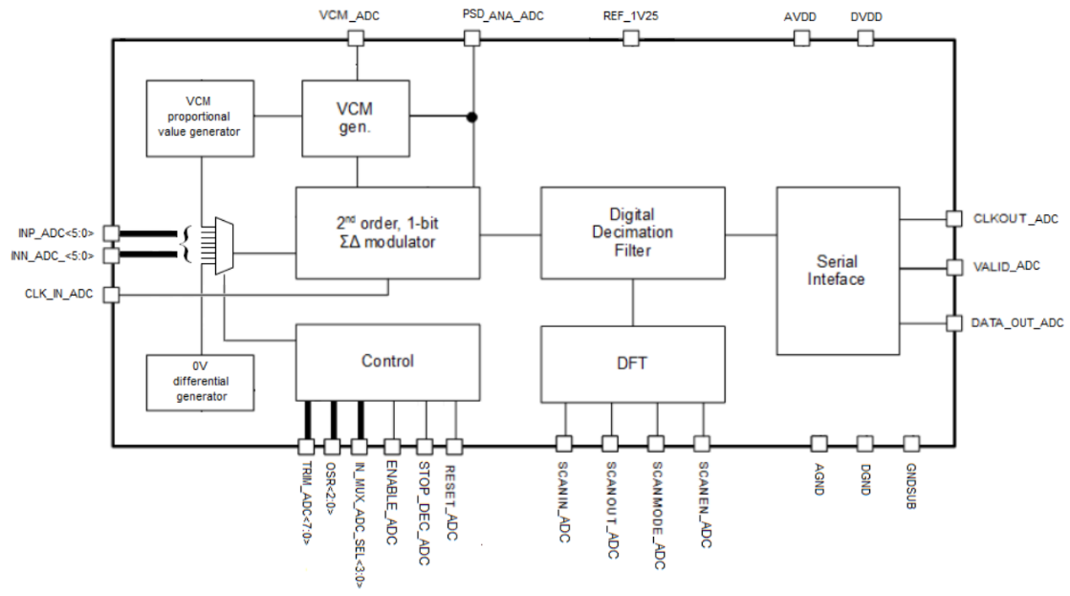
Architecture and features
1 bit ΣΔ modulator
Single clock domain
Six (6) differential or single ended voltage inputs
Simple serial output interface
Selectable over-sampling ratios (OSR) allowing sampling rates up to 156 kSps
Analogue input bandwidth from DC to 40 kHz
Implemented in XFAB’s XH018 technology with 4 thin metals and two thick top metals

Slide 4
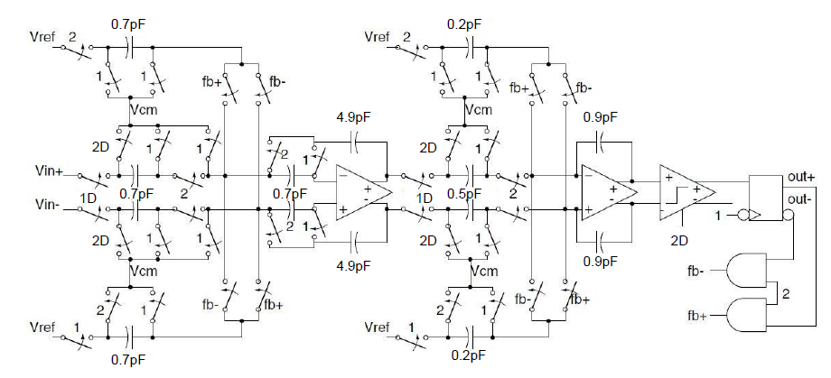
Design Overview
ADC model ΣΔ modulator
1 bit quantizer
Single clock domain
1 bit feedback DAC
ADC model ΣΔ modulator

Slide 5
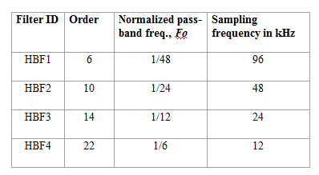
Design Overview
SINC CIC Decimator
4th order
Very efficient implementation

Slide 6
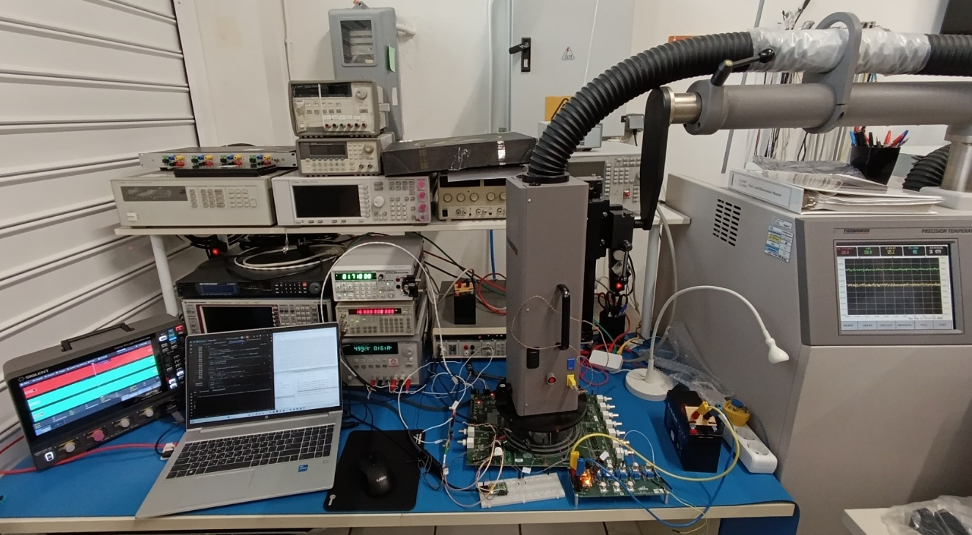
Design Overview
Pilot Circuit Test Board
Pilot Circuit is the outcome of a European union’s Horizon 2020 research and innovation program PROMISE (grant agreement No 870358)
Pilot Circuit Test Board under temperature forcing system

Slide 7
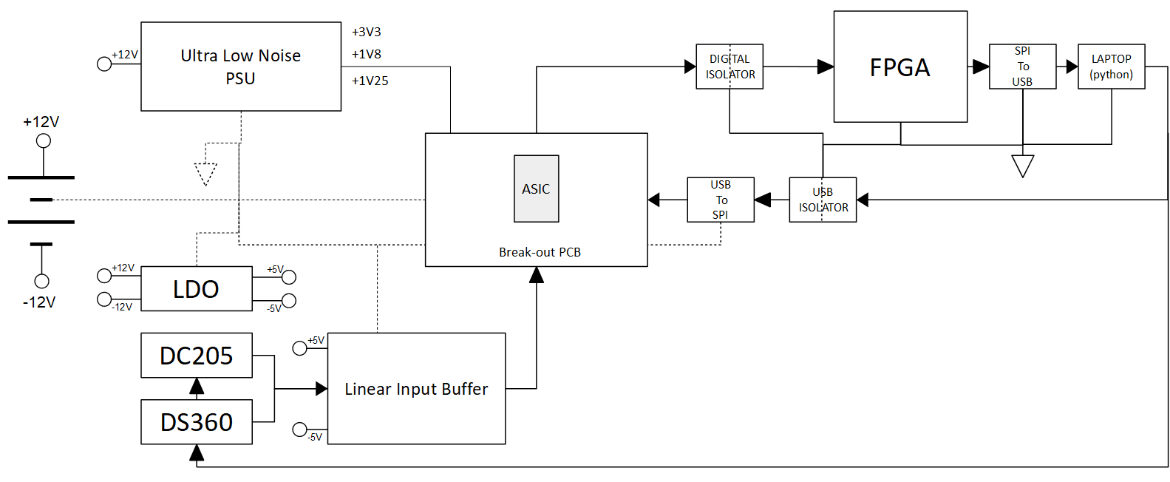
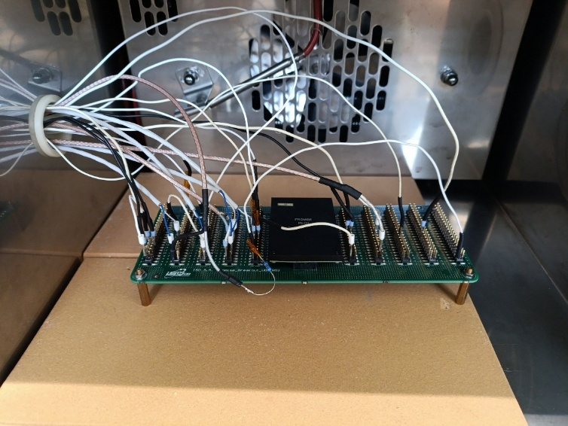
Design Overview
Dedicated ADC Test Board
Test bench with isolated DUT board

Slide 8
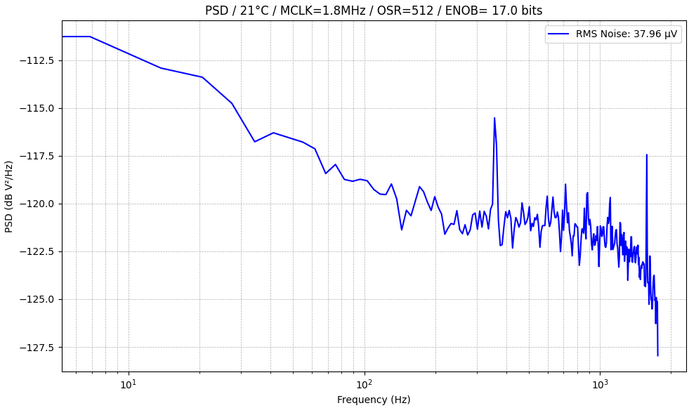
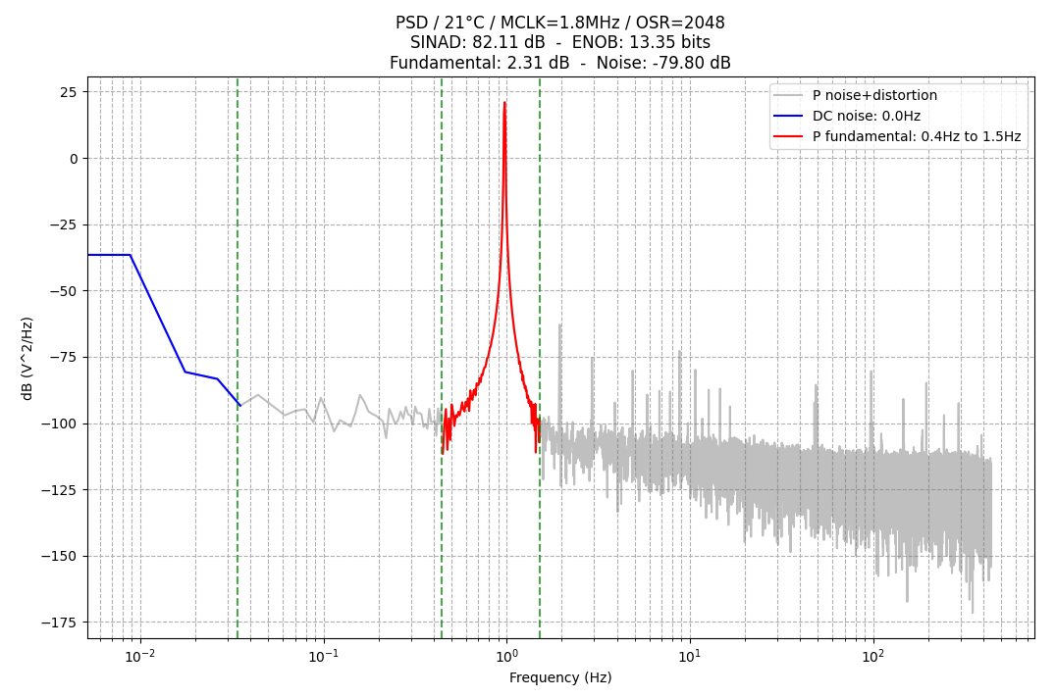
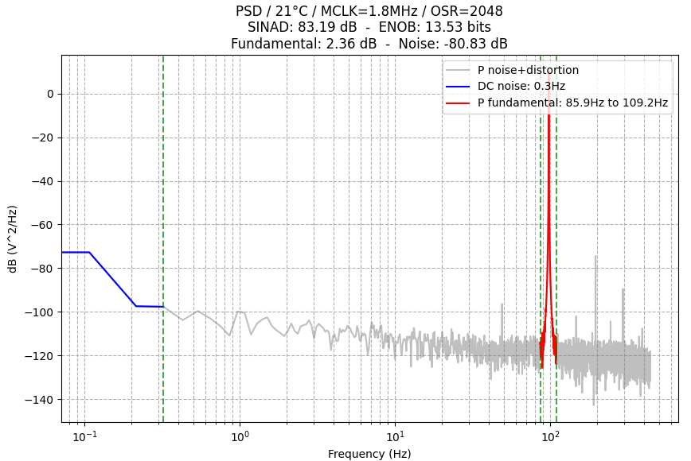
Performance
PSD for input sine wave 1Hz clock frequency 1.8 MHz, OSR = 2048
PSD for clock frequency 1.8 MHz, OSR = 512, V_{in} = 1.025 V
PSD for input sine wave 100Hz clock frequency 1.8 MHz, OSR = 2048

Slide 9
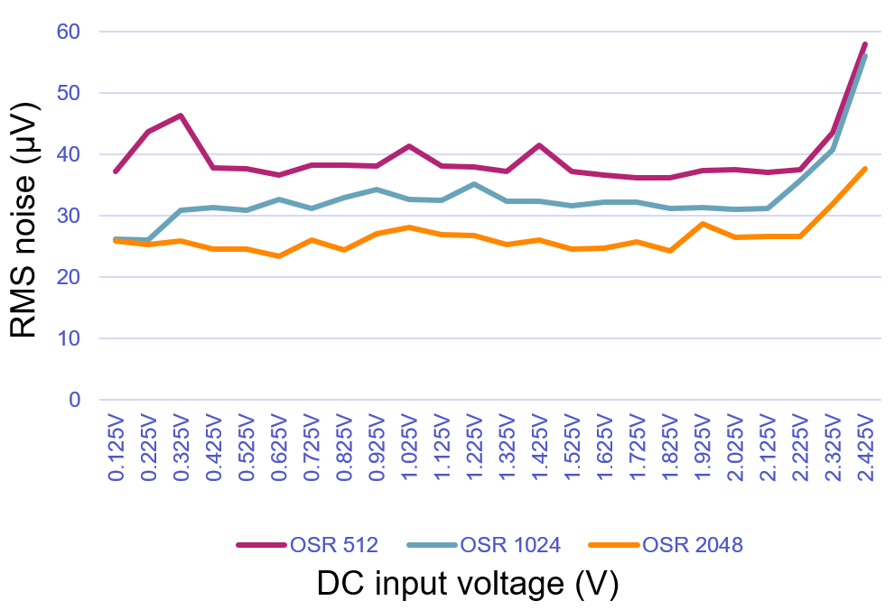
Performance
 | MCLK 1.8MHz OSR 512 | MCLK 1.8MHz OSR 1024 | MCLK 3.28MHz OSR 2048
DC input | RMS noise (μV) | RMS noise (μV) | RMS noise (μV)
0.125V | 37.24 | 26.24 | 25.87
0.225V | 43.77 | 26.12 | 25.29
0.325V | 46.29 | 30.85 | 25.86
0.425V | 37.8 | 31.37 | 24.62
0.525V | 37.61 | 30.98 | 24.66
0.625V | 36.62 | 32.63 | 23.41
0.725V | 38.31 | 31.16 | 26.11
0.825V | 38.26 | 33.03 | 24.51
0.925V | 38.13 | 34.34 | 27.12
1.025V | 41.34 | 32.62 | 28.13
1.125V | 38.08 | 32.48 | 27.01
1.225V | 38 | 35.22 | 26.73
1.325V | 37.26 | 32.37 | 25.25
1.425V | 41.47 | 32.36 | 26.13
1.525V | 37.27 | 31.62 | 24.52
1.625V | 36.58 | 32.26 | 24.78
1.725V | 36.22 | 32.23 | 25.76
1.825V | 36.2 | 31.25 | 24.24
1.925V | 37.44 | 31.39 | 28.67
2.025V | 37.52 | 30.99 | 26.53
2.125V | 37.12 | 31.26 | 26.63
2.225V | 37.46 | 35.73 | 26.6
2.325V | 43.52 | 40.75 | 31.91
2.425V | 58 | 56.04 | 37.73
RMS noise for differential configuration

Slide 10
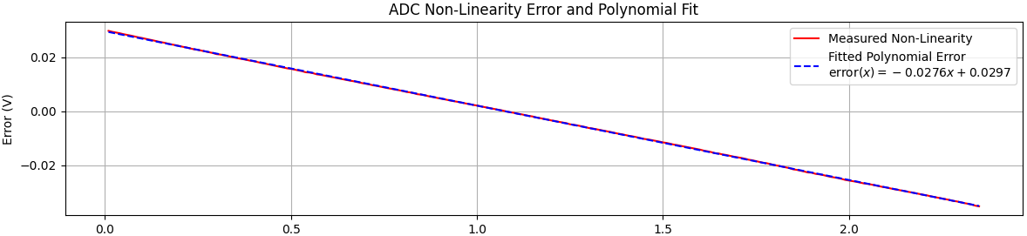
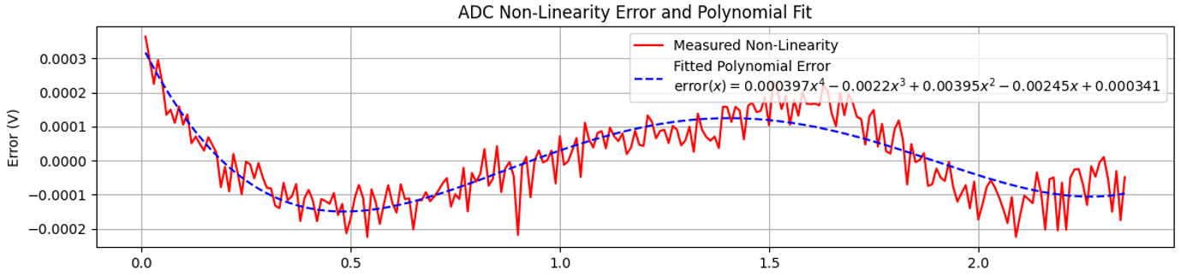
Performance

Slide 11
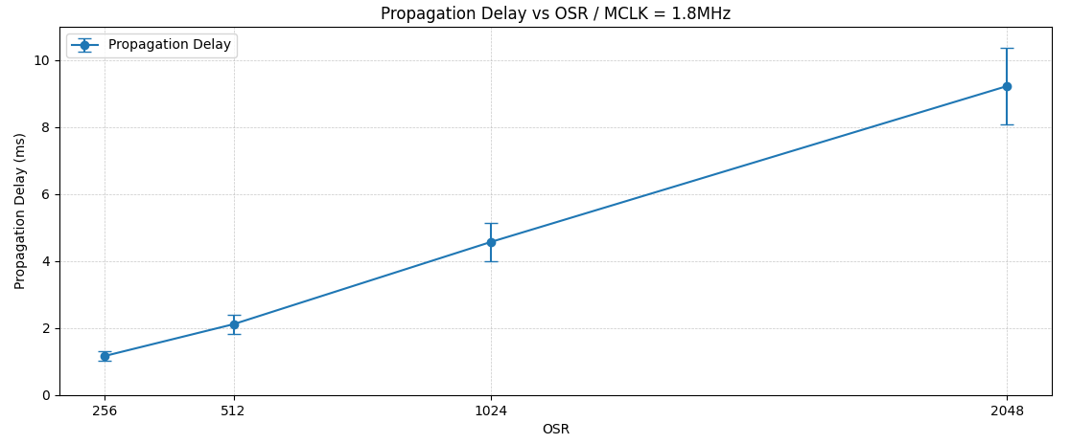
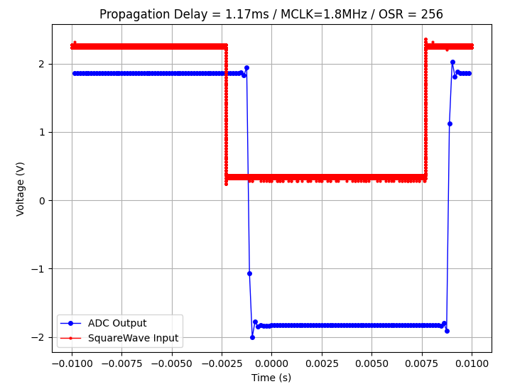
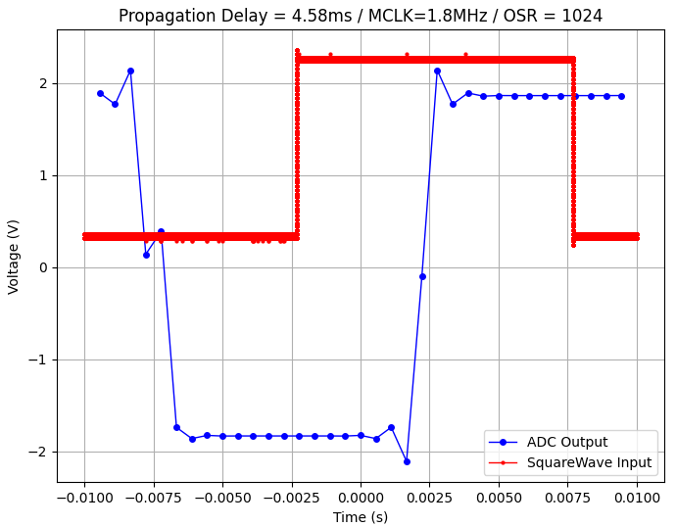
Performance
Propagation delay with 1.8 MHz master clock vs different OSR configuration
OSR = 256
OSR = 512
OSR = 1024

Slide 12
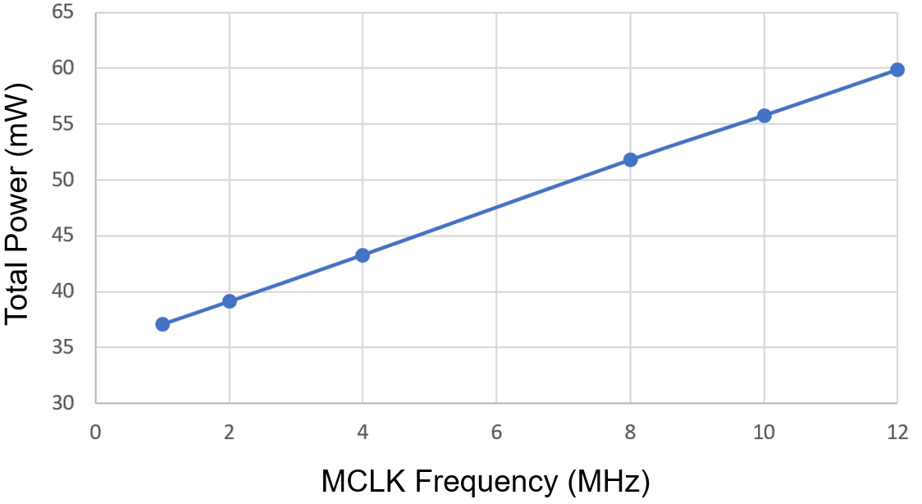
Performance
Total power dissipation

Slide 13
Conclusions
Performance is within expectation
Target applications where interleaved operation with low frequency input signals is needed:
  High accuracy instrumentation and measurement
  Process control

Slide 14

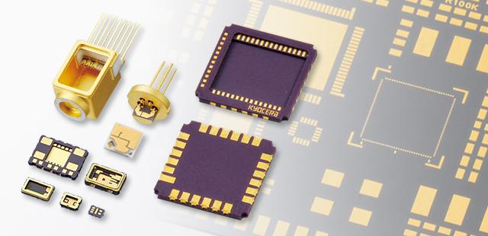
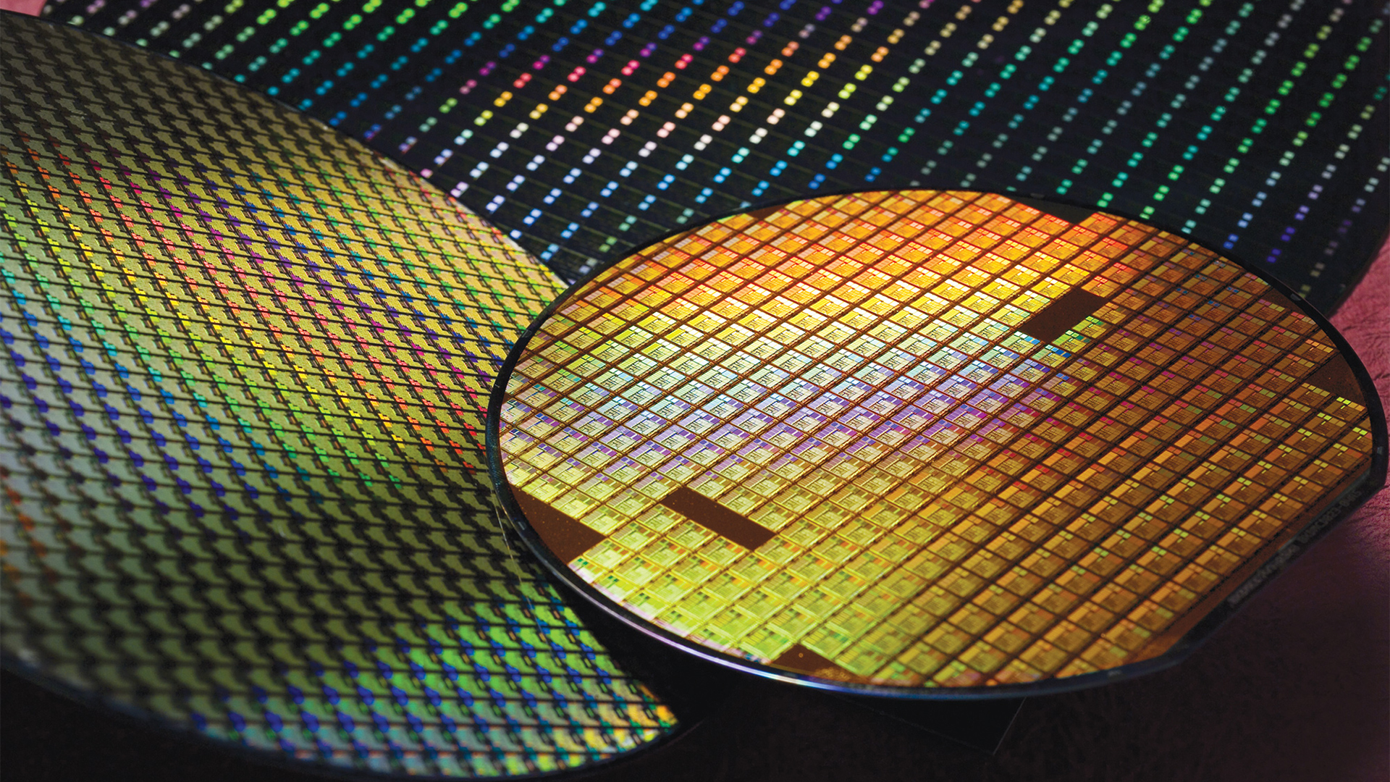
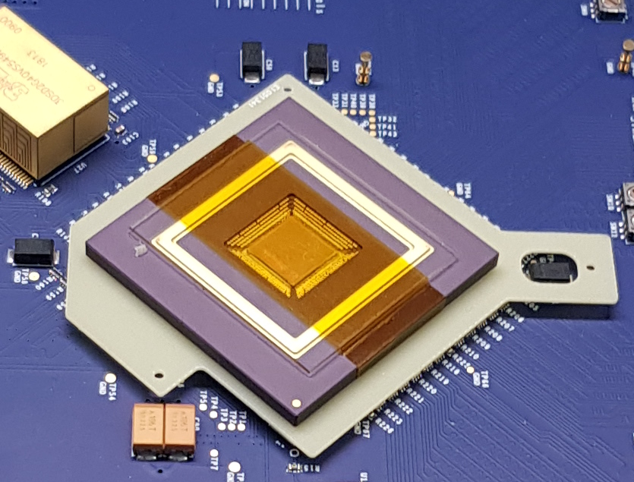
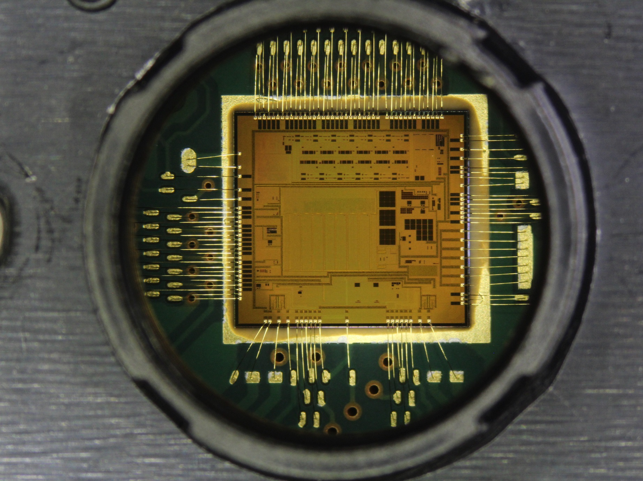
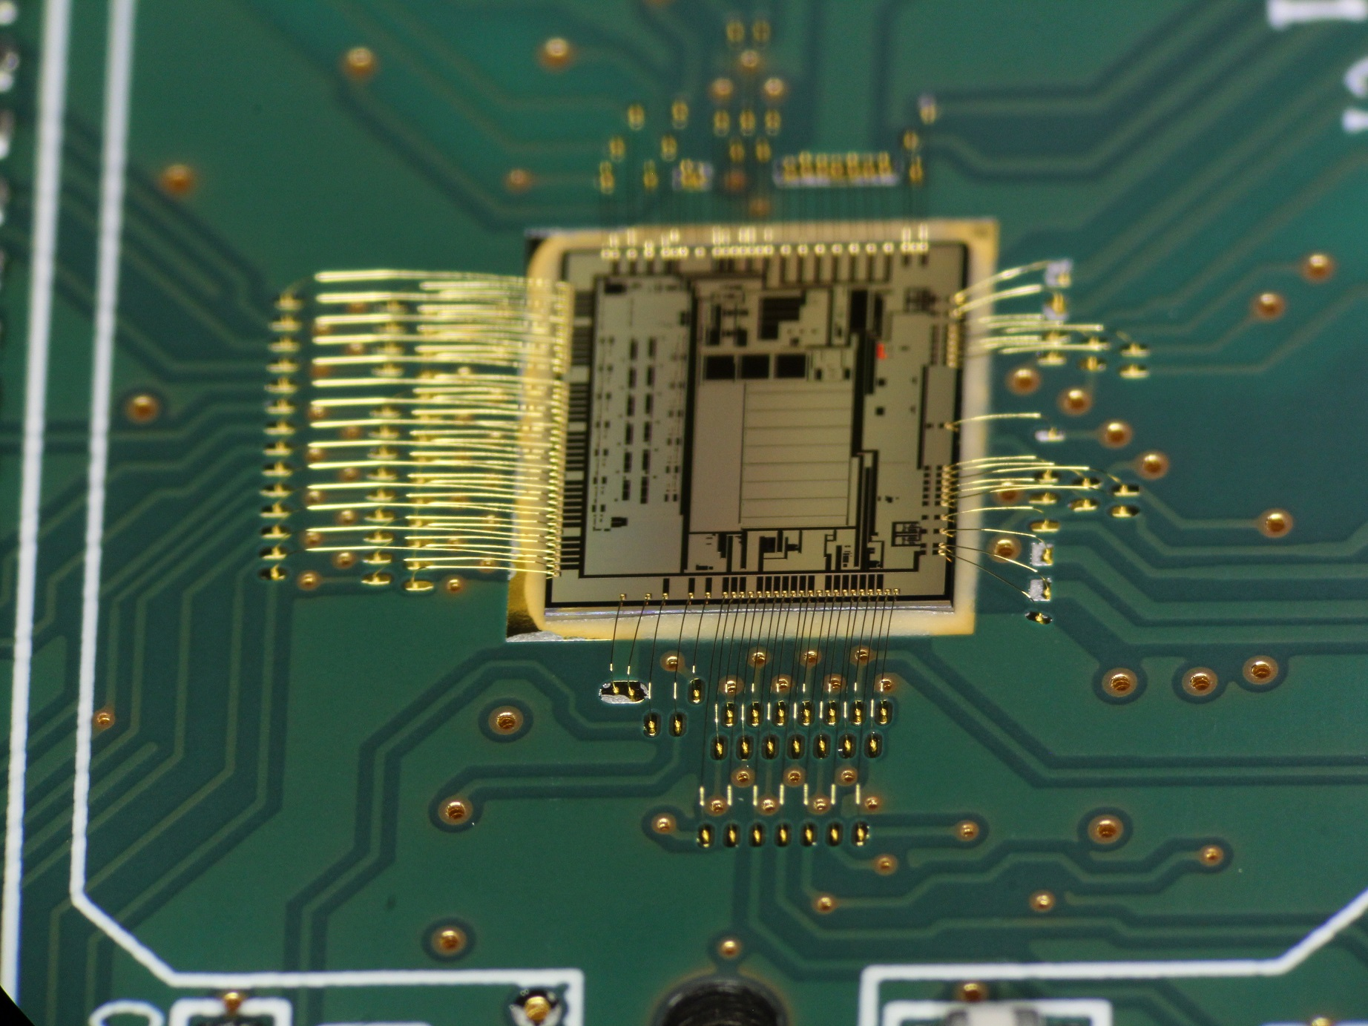
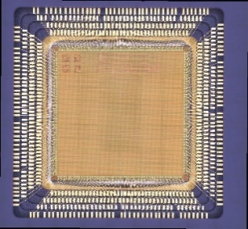
Thank you

