Slide 1
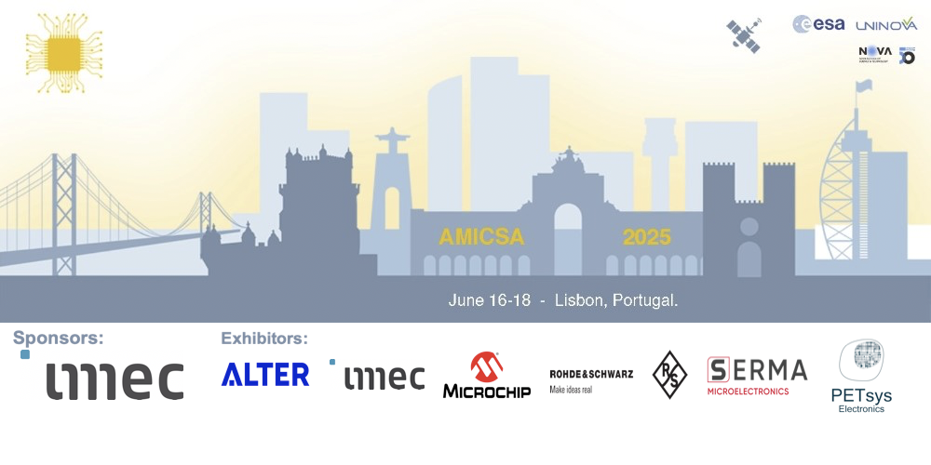
AMICSA 2022
Boris Glass
31/05/2022

Slide 2


Linha 1 do
Noordwijk
Gothenburg
Leuven
Geneva
Cascais / Sintra
Xanthi
×1
DSP
You are here
Lisbon
Stuttgart
Madrid
Virtual

Slide 3
AMICSA 2025 – Organising Commitee
Chairs
  João Goes, Uninova, Portugal
  Boris Glass, ESA, The Netherlands
Members
  Luis Oliveira, Uninova, Portugal
  Maria Pilar Garde, ESA, The Netherlands

Slide 4
Technical Programme – Tracks
Needs and Requirements for Future Missions
Radiation-Hardened Technologies
Methodologies for Radiation Hardening
Intellectual Property and Re-usability
Radiation Effects
Radiation Test Results
Qualification
Space Applications
In-Orbit Experiences and Flight Heritage

Slide 5
Oral Presentations
Talk: 20’
Questions: 5’
Buffer: up to 5’
Talk – 20’
Q: 5’
?: 5’

Slide 6
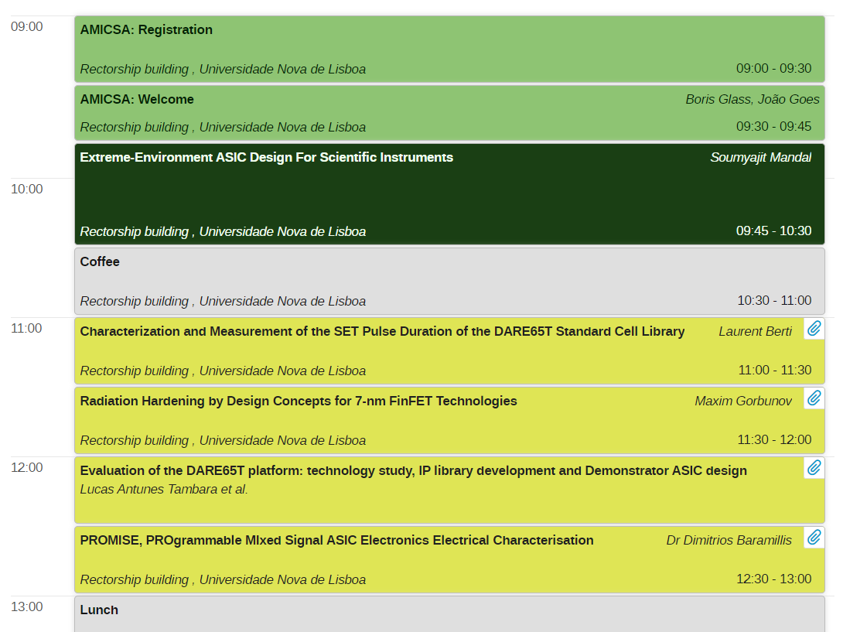


AMICSA 2025 – Day 1 – June 16 – Morning

Slide 7
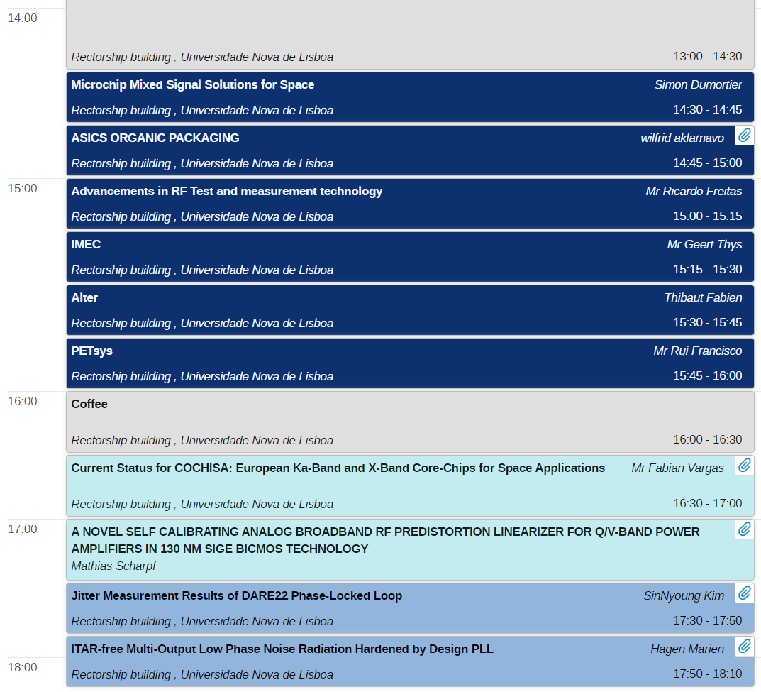


AMICSA 2025 – Day 1 – June 16 – Afternoon

Slide 8
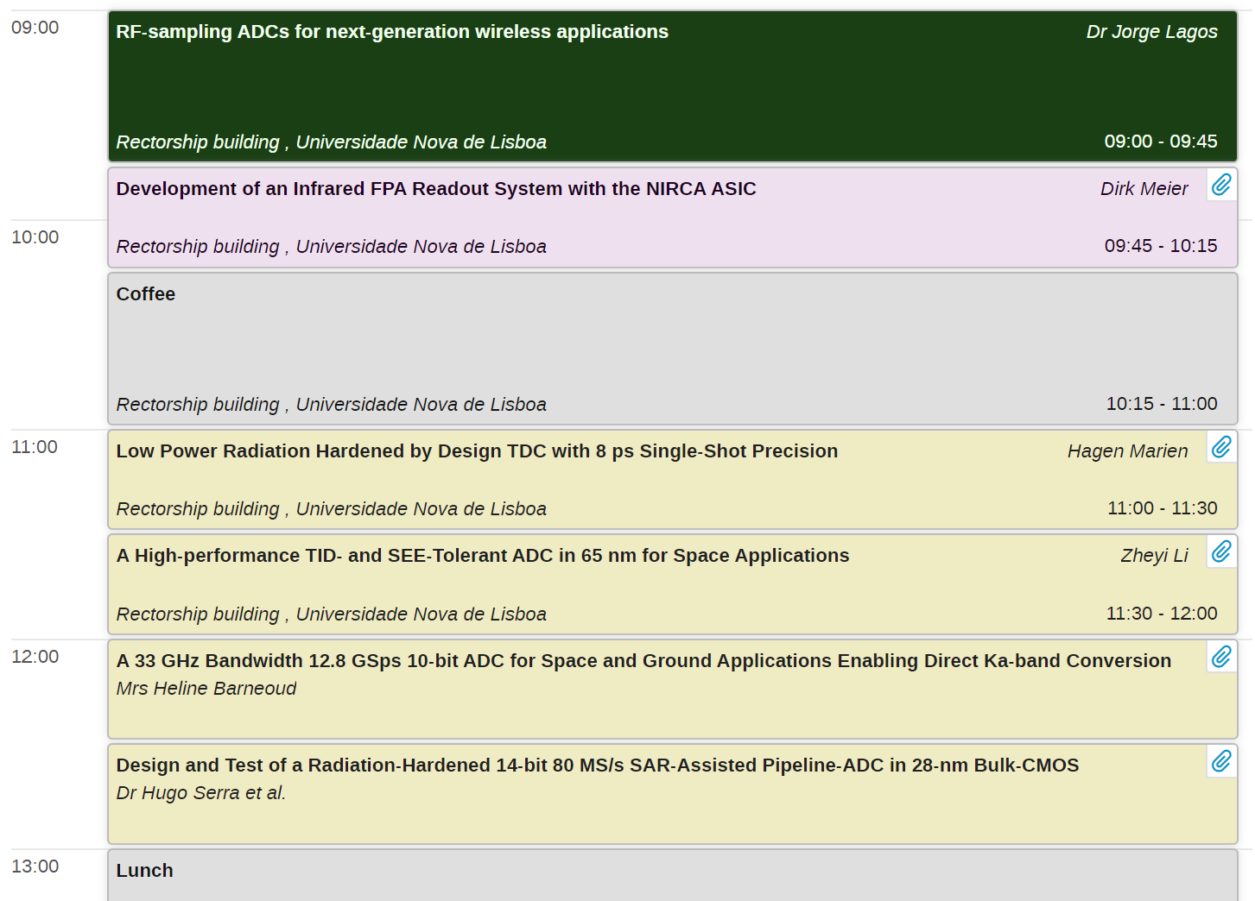


AMICSA 2025 – Day 2 – June 17 – Morning

Slide 9
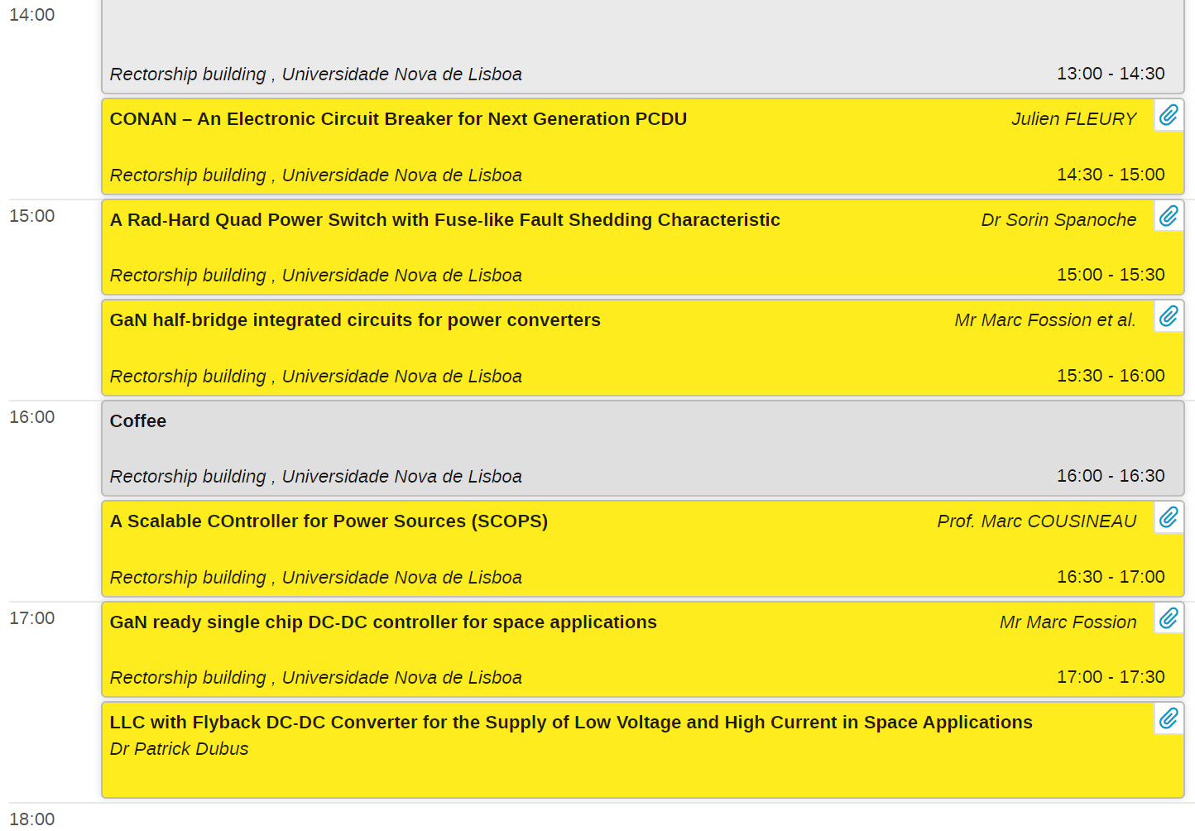

AMICSA 2025 – Day 2 – June 17 – Afternoon
Gala Dinner

Slide 10
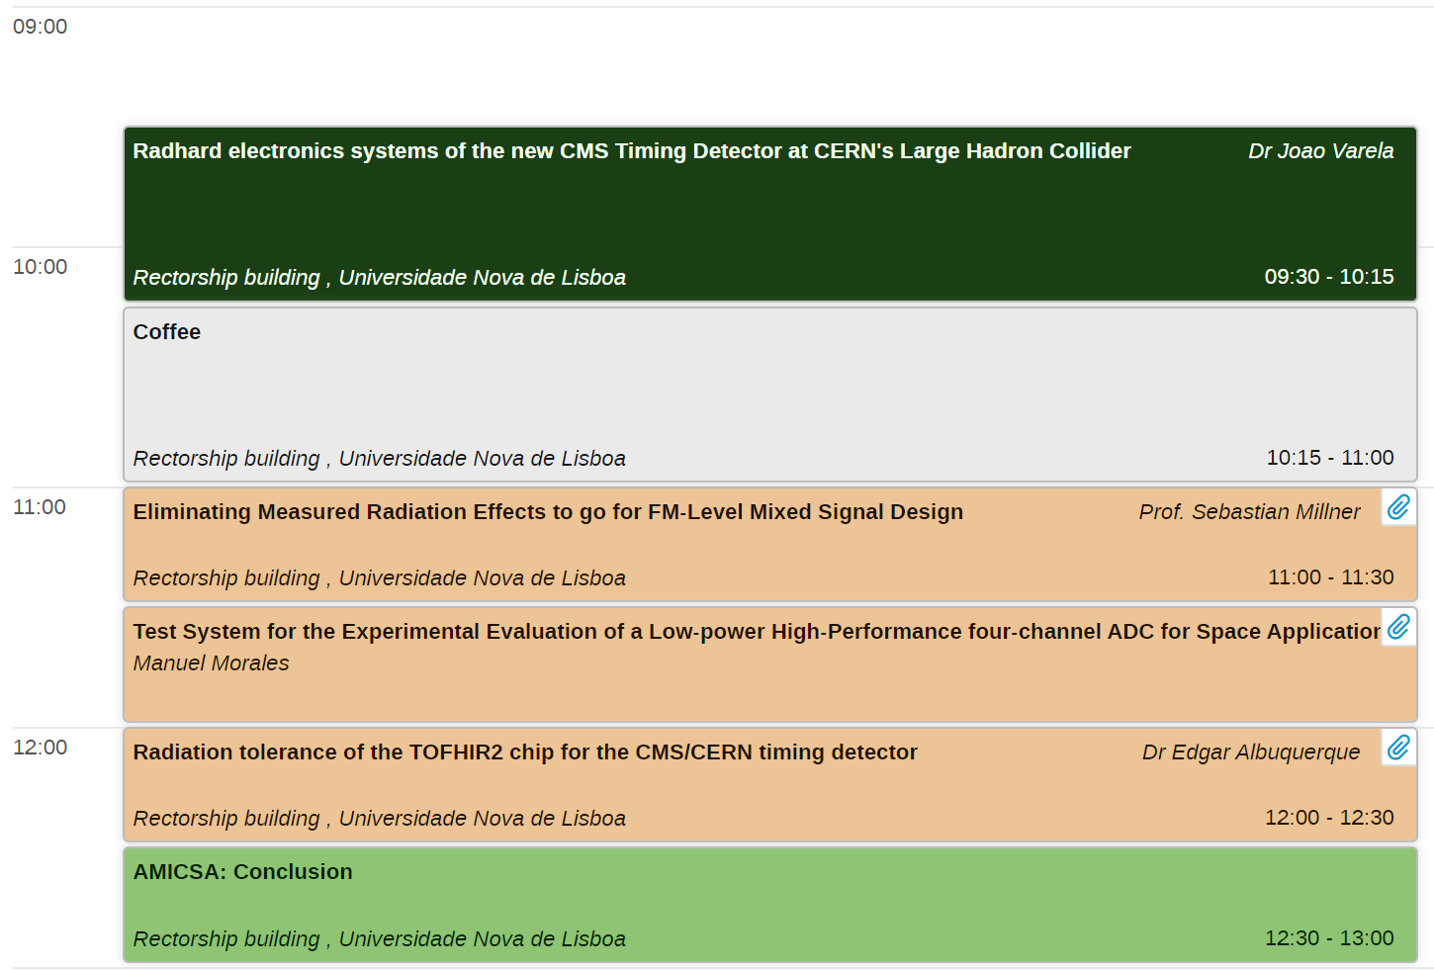

AMICSA 2025 – Day 3 – June 18 – Morning

