Slide 1

AMICSA 2022
Boris Glass
31/05/2022

Slide 2
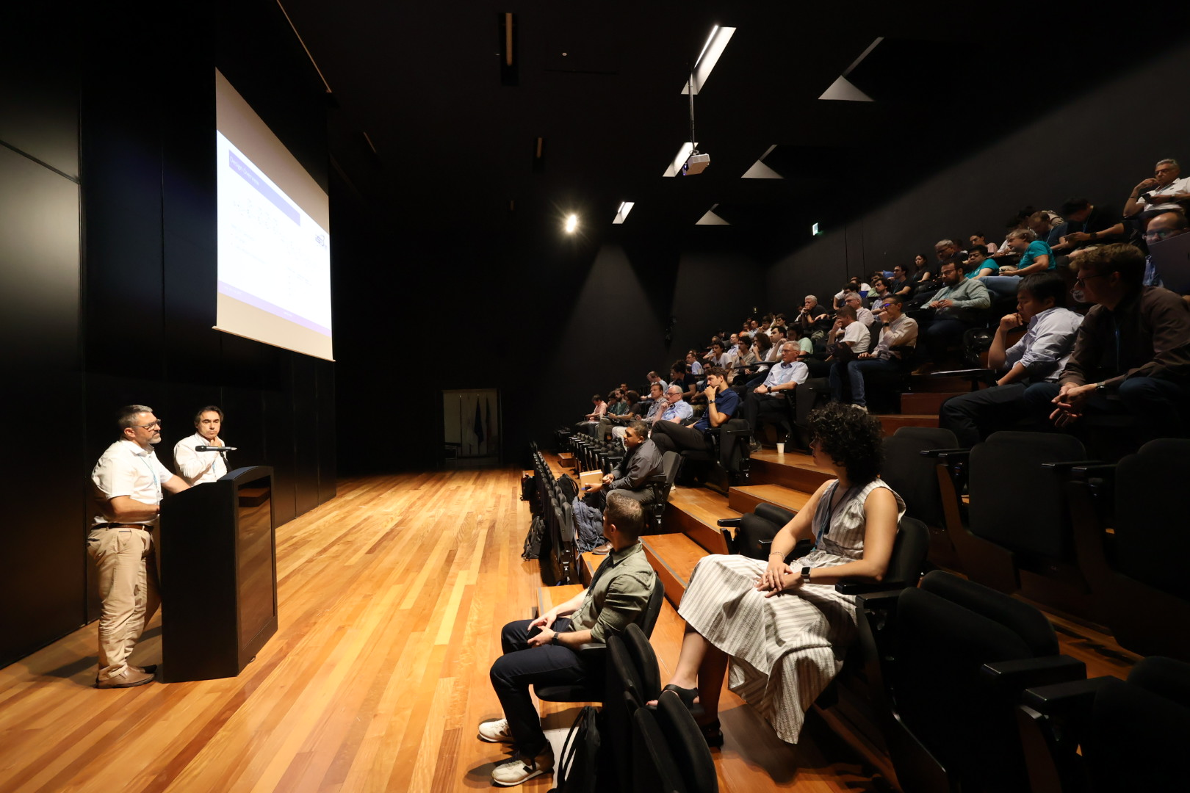
Thank you

Slide 3
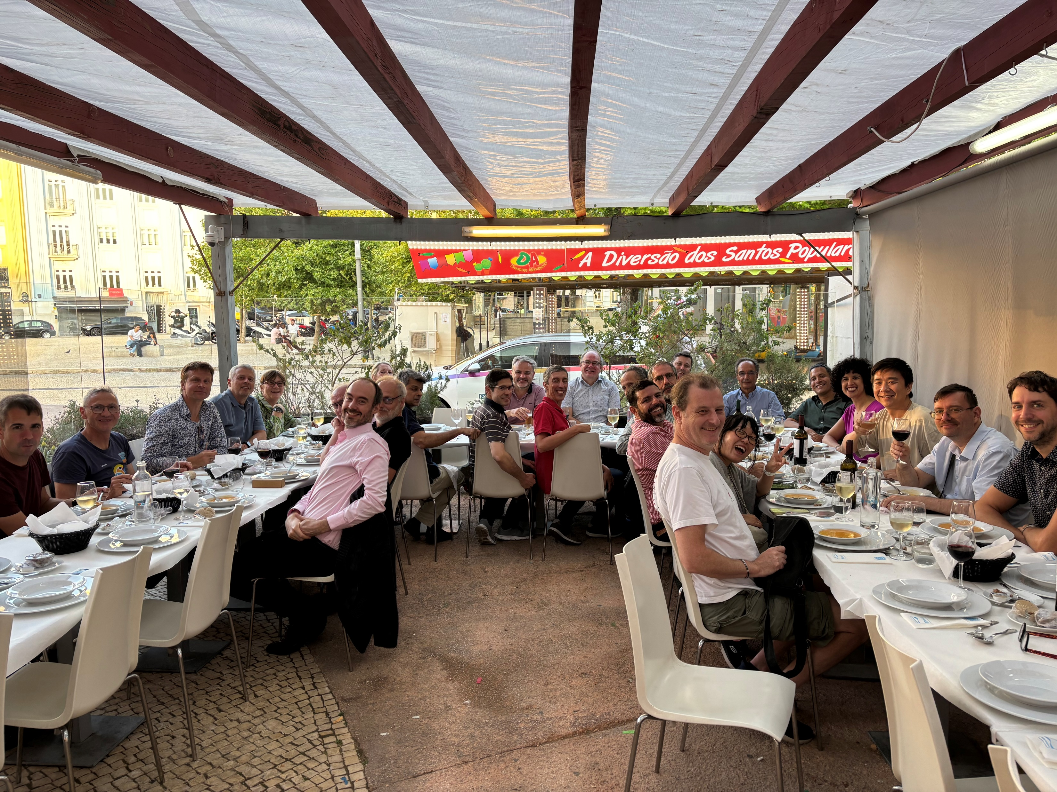
Thank you!

Slide 4
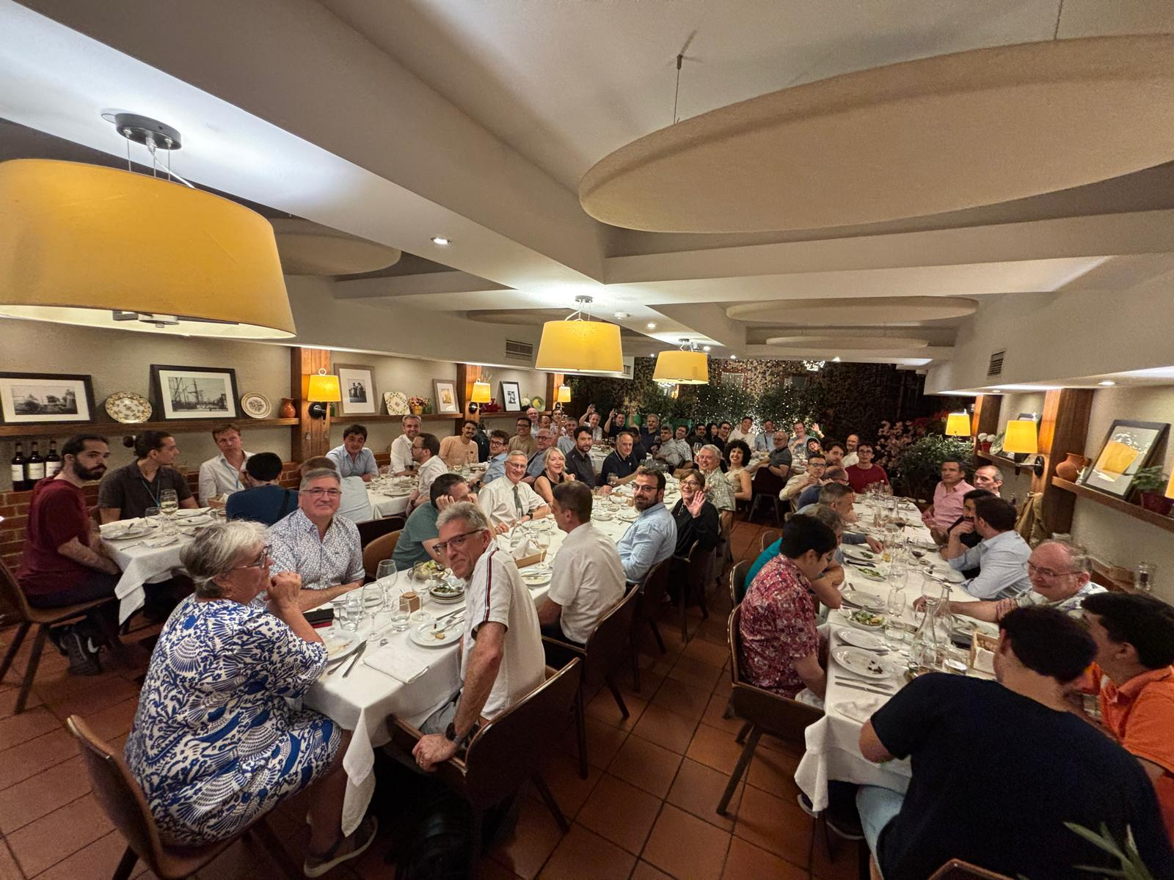
Thank you!

Slide 5
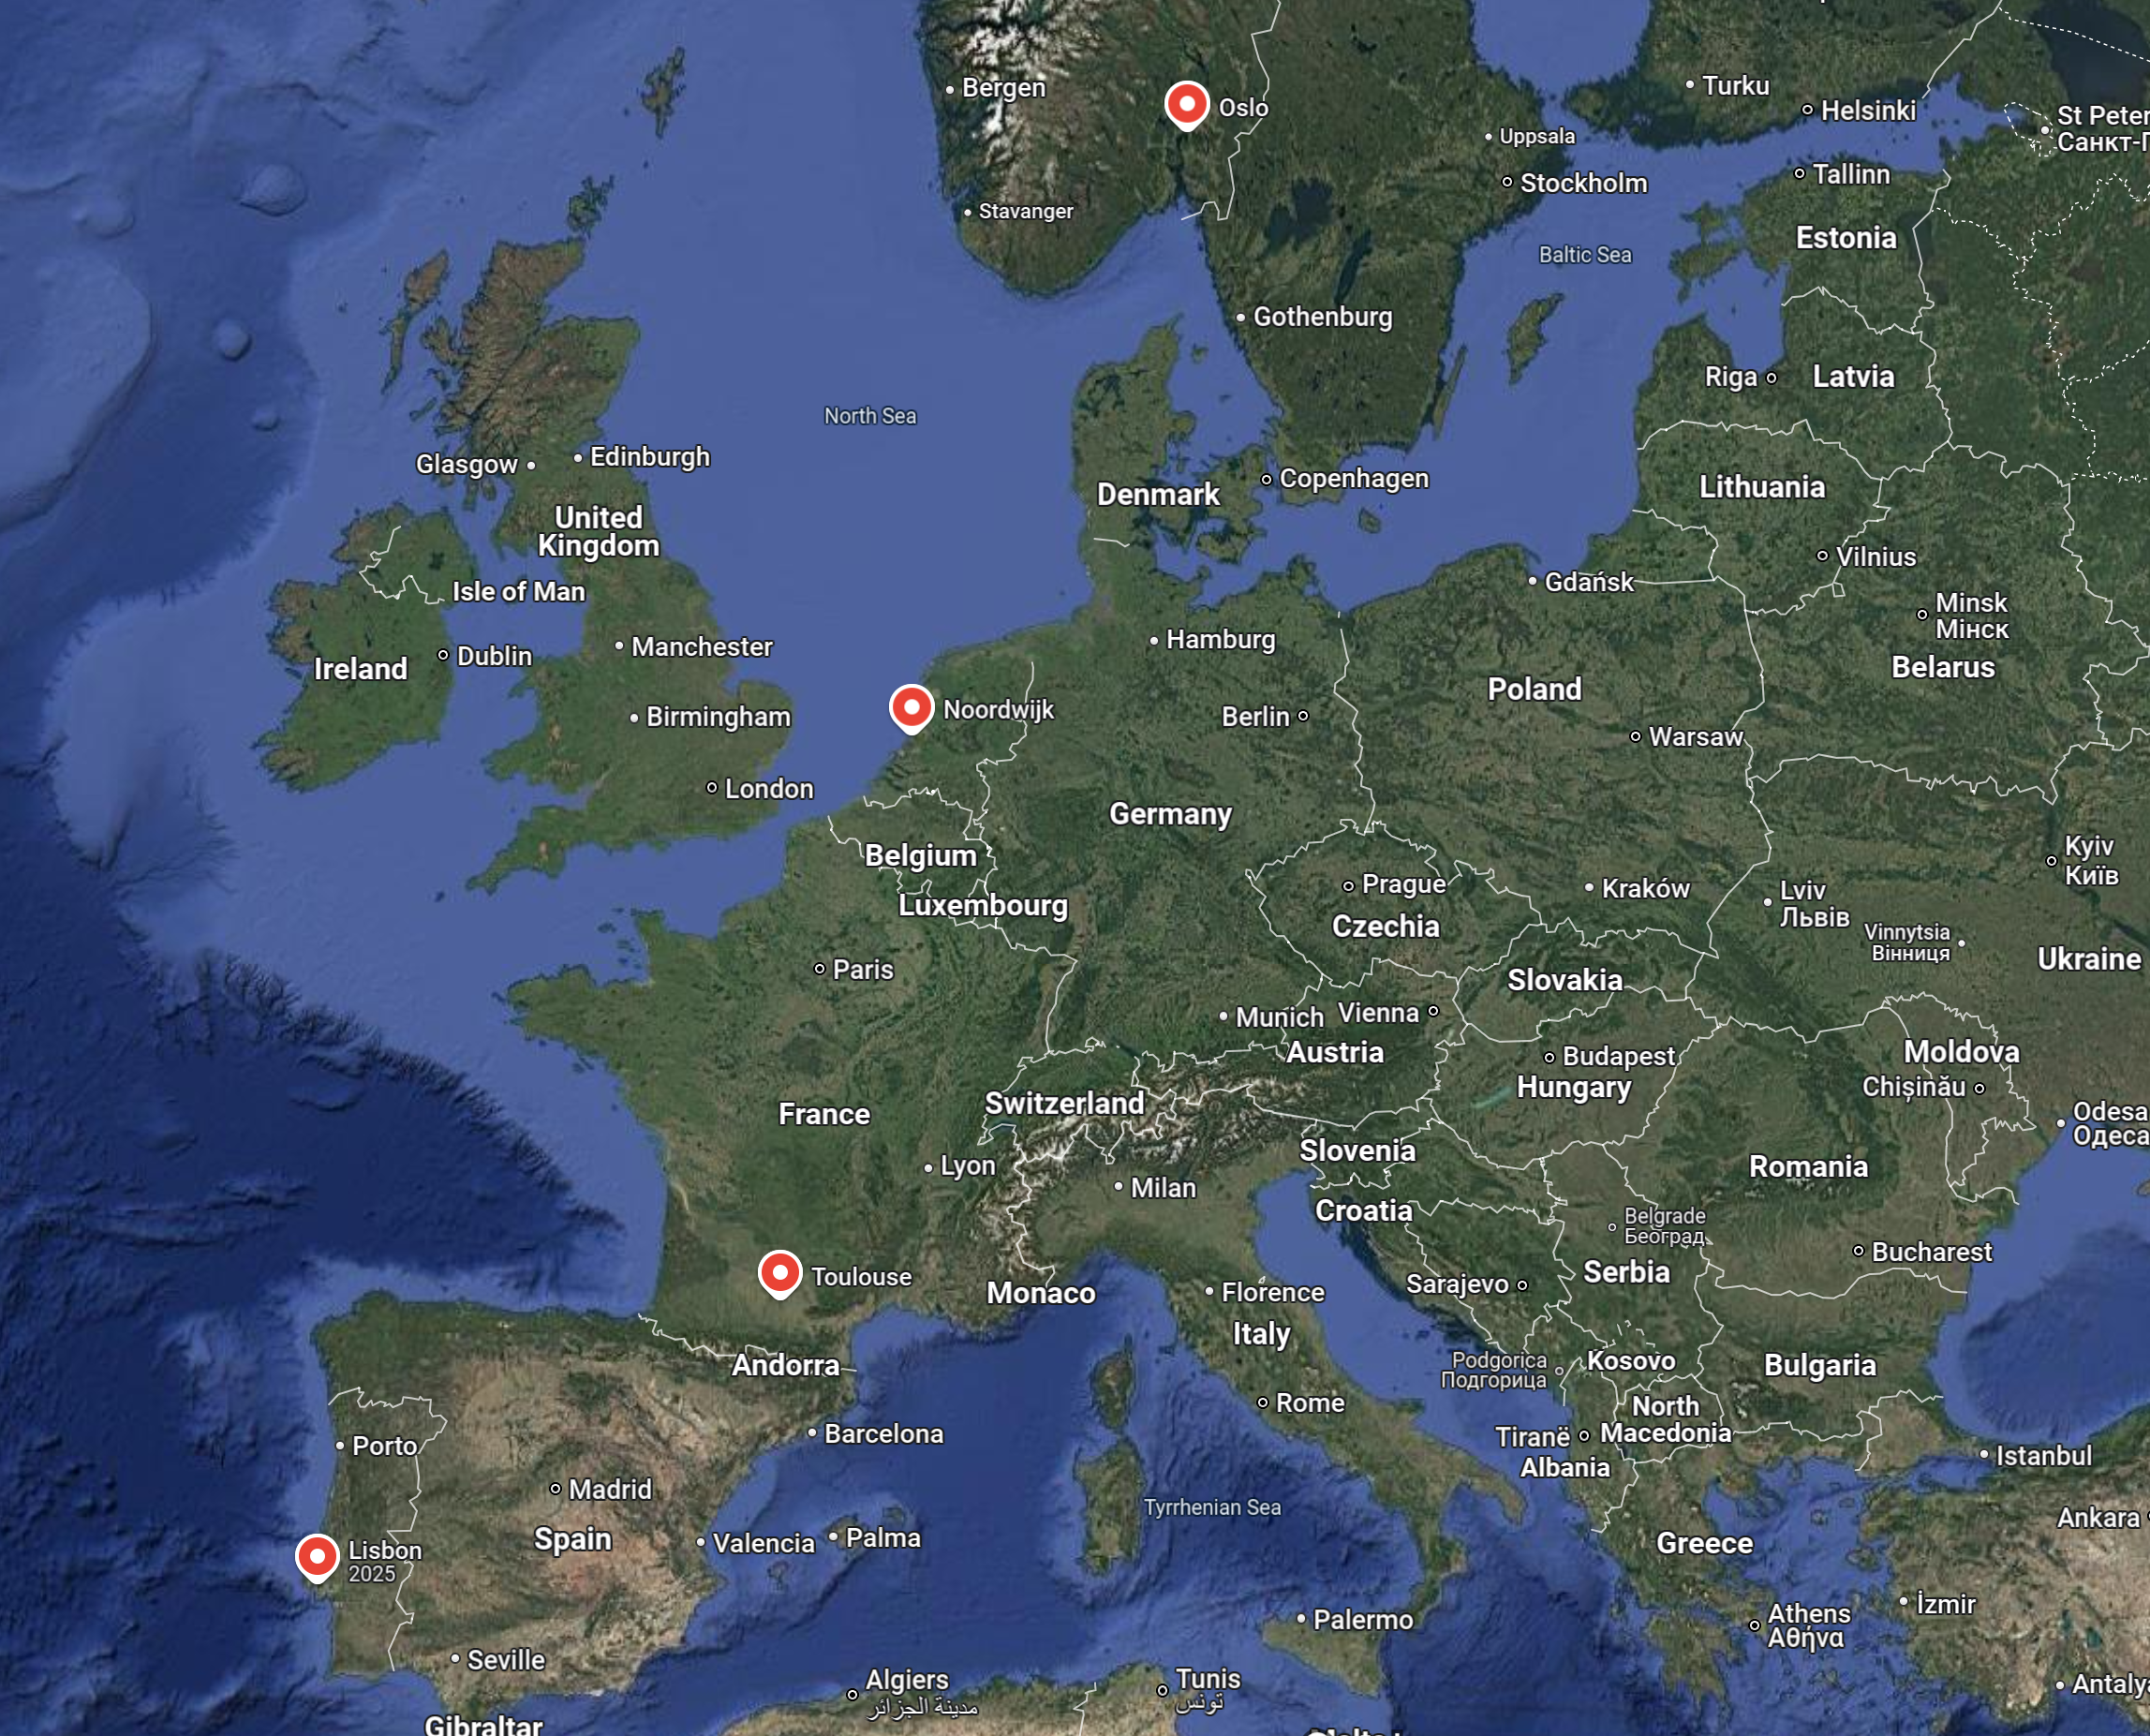
AMICSA 2027

Slide 6
OslO, June, 2027
Welcome to AMICSA 2027
in Oslo, Norway

Slide 7
Midsummer
in Oslo

Slide 8
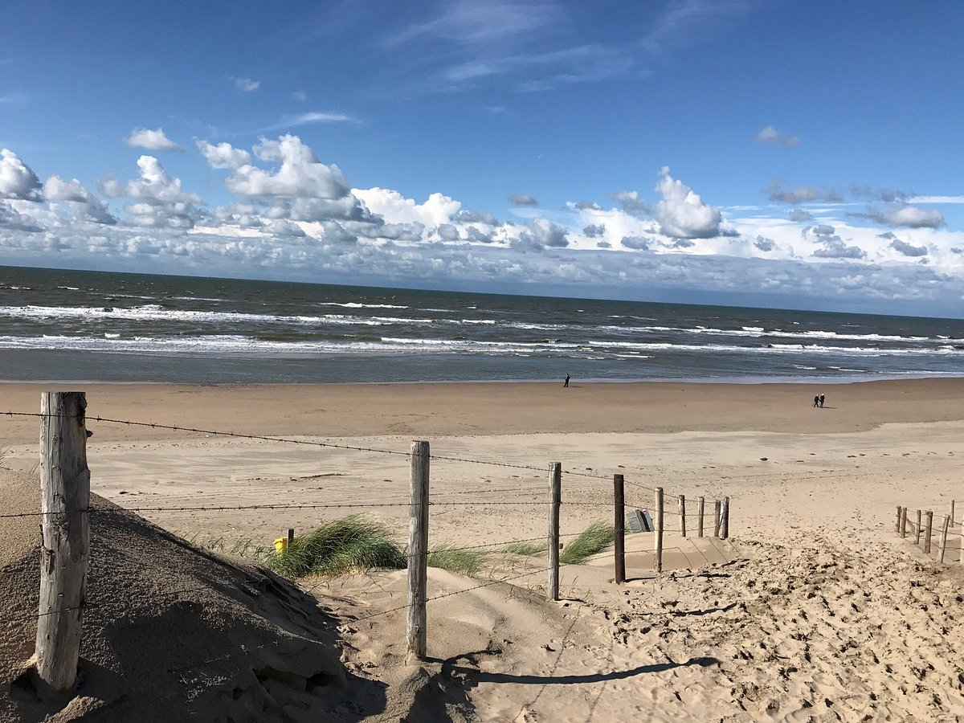
Noordwijk Beach

Slide 9
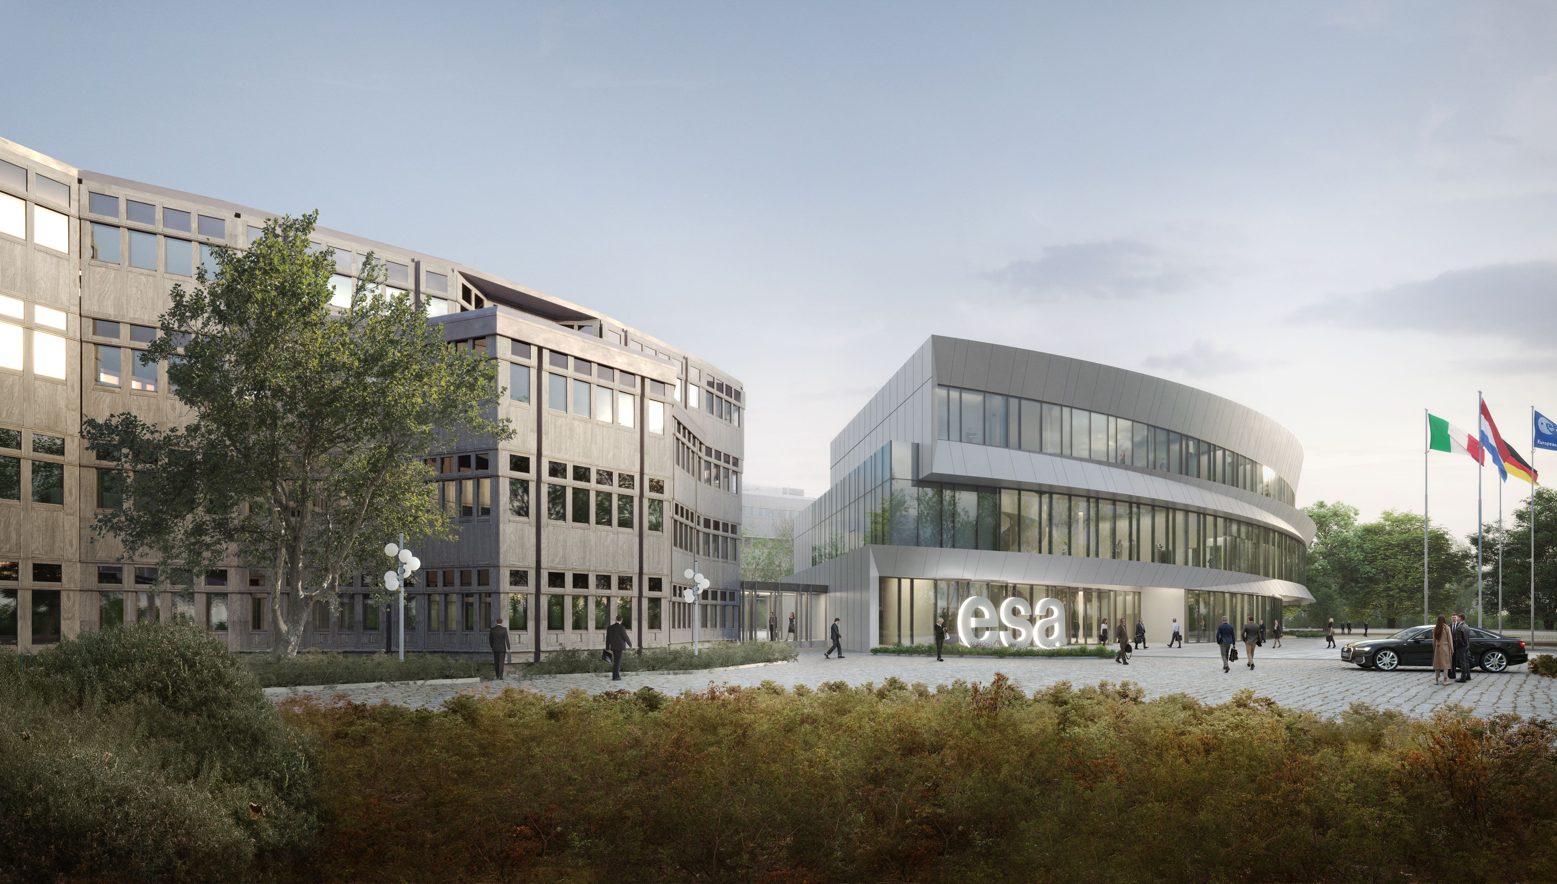
ESTEC – New Conference Center “IMF”

Slide 10
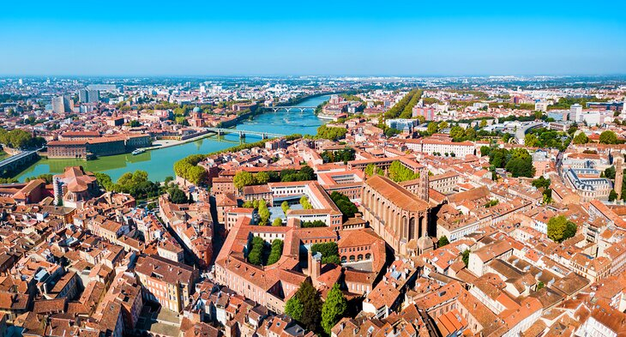
Toulouse

Slide 11
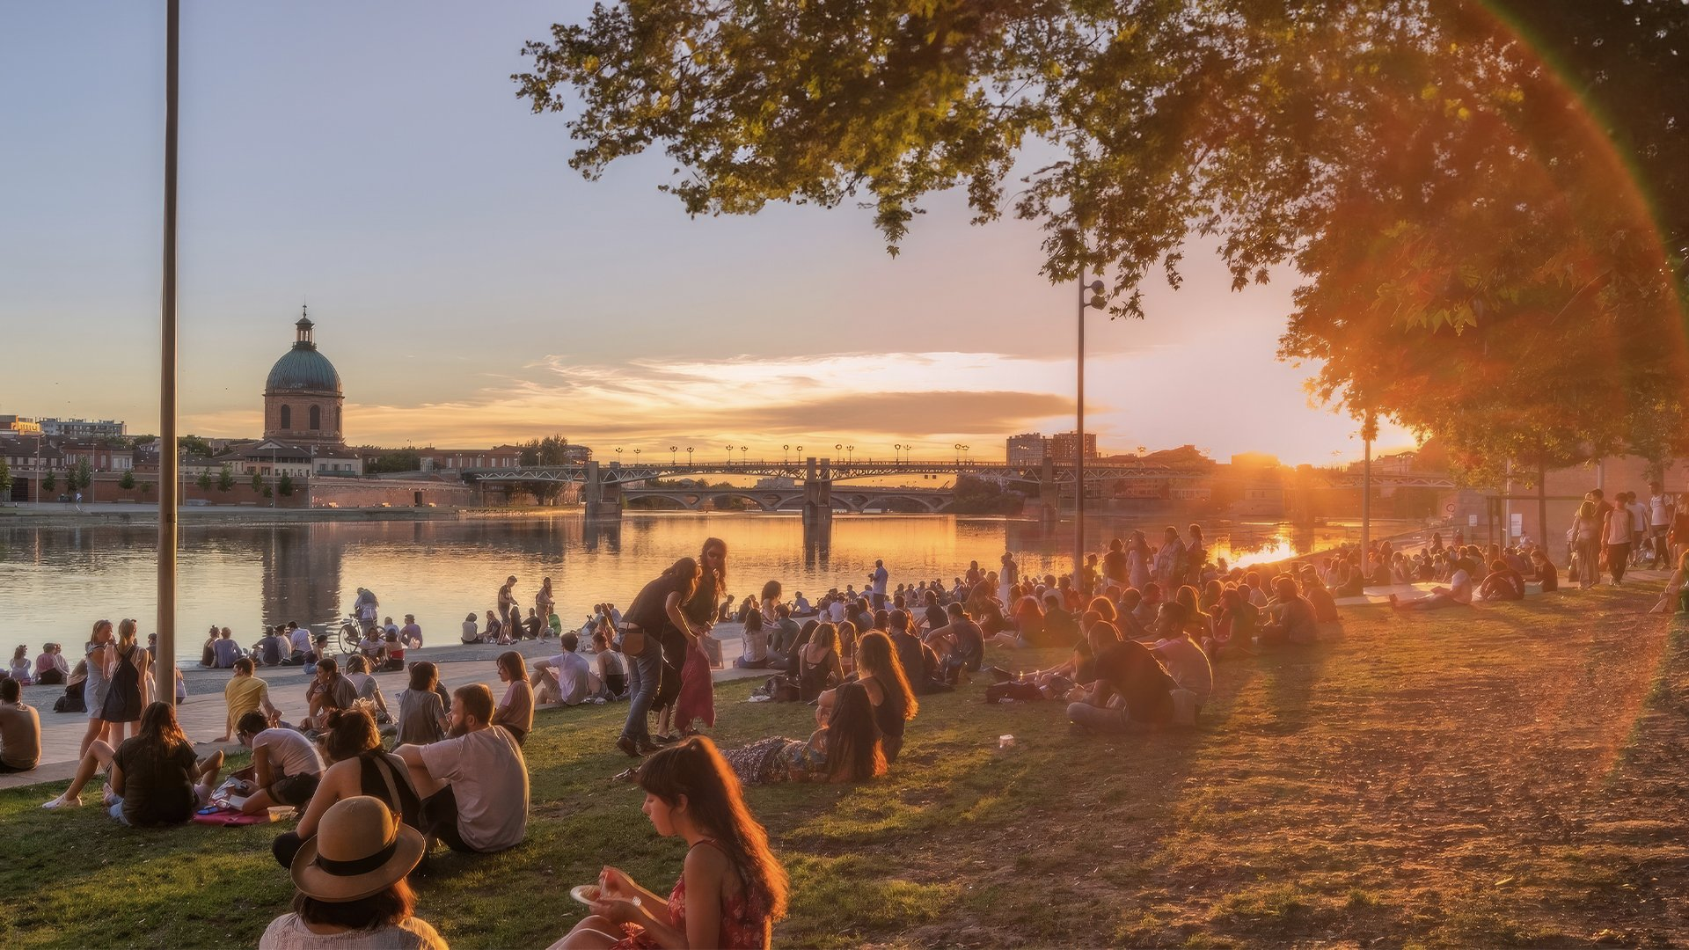
Toulouse

Slide 12
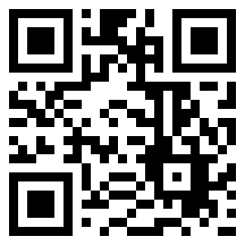
Questionaire
https://128.pl/OUyan

Slide 13
Take care on your way home, looking forward to next time!

Slide 14
AMICSA 2022
Boris Glass
31/05/2022

Slide 15
Statistics
Participants
Countries
Organizations
Contributions

