Slide 1
Jitter Measurement Results of DARE22G Phase-Locked Loop
SinNyoung Kim

Slide 2
Outline
Overview of DARE22 PLL
Performance of DARE22 PLL
Design Challenge: Low jitter Radiation-Hardened VCO
Test Structure, Test Board, and Test Setup
Jitter Measurement Results
Conclusion

Slide 3
Overview of DARE22G PLL
Conventional PLL topology of the sub-block in the loop
Two output dividers & one input divider
Extra functions with two MUXs
Low-Pass Filter (LPF) | 2nd order RC filter
Feedback Divider (FDIV) | Division factor = /20 - /128 in steps of /1
Input Divider (IDIV) | Division factor = /1 - /8 in steps of /1
Output Divider 1 (ODIV1) | Division factor = /1 - /8 in steps of /1
Output Divider 2 (ODIV2) | Division factor = /1 - /128 in steps of power of 2

Slide 4

Performance of DARE22G PLL
Technology | 22nm FD-SOI CMOS
Supply voltage | 0.8V
Input frequency for loop | 20MHz to 100MHz
VCO frequency | 2GHz to 3GHz
Output frequency at CLK_PLL_OUT | 1.953MHz to 3000MHz
Period jitter (rms) | < 1ps at 3GHz PLL clock output
Current consumption | 18mA @ typical condition
*SET timing error @ 60 MeV.cm²/mg | < 15ps @ 2GHz PLL clock output < 5ps @ 3GHz PLL clock output
TID mitigation level | > 100krad
SEL threshold | 70 MeV.cm²/mg
Phase-locked ‘Loop’
Today’s topic
Irradiation campaigns are cancelled twice due to budget issue
➔ Not today’s topic

Slide 5
Design Challenge: Low Jitter Radiation-Hardened VCO
DARE22G PLL should be compatible with digital chip implementation for user-friendly
  DARE22G PLL provides a clock to a digital system (not for RF communications)
  DARE22G PLL is an IP of DARE design platform
  Need to avoid special layers, such as inductors (L) & MIM capacitors (C)
Ring Oscillator (RO)-based Voltage-Controlled Oscillator (VCO) used for DARE22G PLL

Slide 6
Design Challenge: Low Jitter Radiation-Hardened VCO
VCO jitter (=noise) is the dominant for PLL jitter
RO-based VCOs have higher jitter values than LC-VCOs
  More transistors, higher thermal noise
  LC-VCOs enables to filter out noises more efficiently
LC oscillator
Ring oscillator
Ring Oscillator
LC Oscillator
Frequency Characteristics

Slide 7
Design Challenge: Low Jitter Radiation-Hardened VCO
Design less than 1 ps jitter RO-based VCO at 3GHz
  Use current consumption as large as possible
    Transistor current is only one design parameter regarding to thermal noise
  No special & additional circuitry to improve VCO jitter
    Risk to be radiation vulnerability
Triple Modular Redundancy RO-based VCO
Differential RO
  To suppress supply noise
90% of the total PLL current is VCO current consumption

Slide 8
Test Structure
Clock buffer & Schmitt trigger to ensure a glitch-free input clock
SPI register & controller for setting configuration bits
  PLL_IDIV[2:0], PLL_FDIV[7:0], PLL_ODIV1,2[2:0], Power-Down & Digital Reset

Slide 9
Test Structure
Test frequency divider /128 for quick functionality test
Test buffer + decoupling capacitor + three pads to jitter measurement
  Test buffer is an inverter with high driving strength
    To drive 3GHz clock
  Decoupling capacitor
    To suppress the supply noise of the test buffer that can corrupt jitter performance
  Three pads
    To reduce the inductance of bond wire by factor of 3

Slide 10
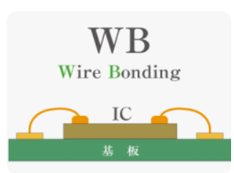
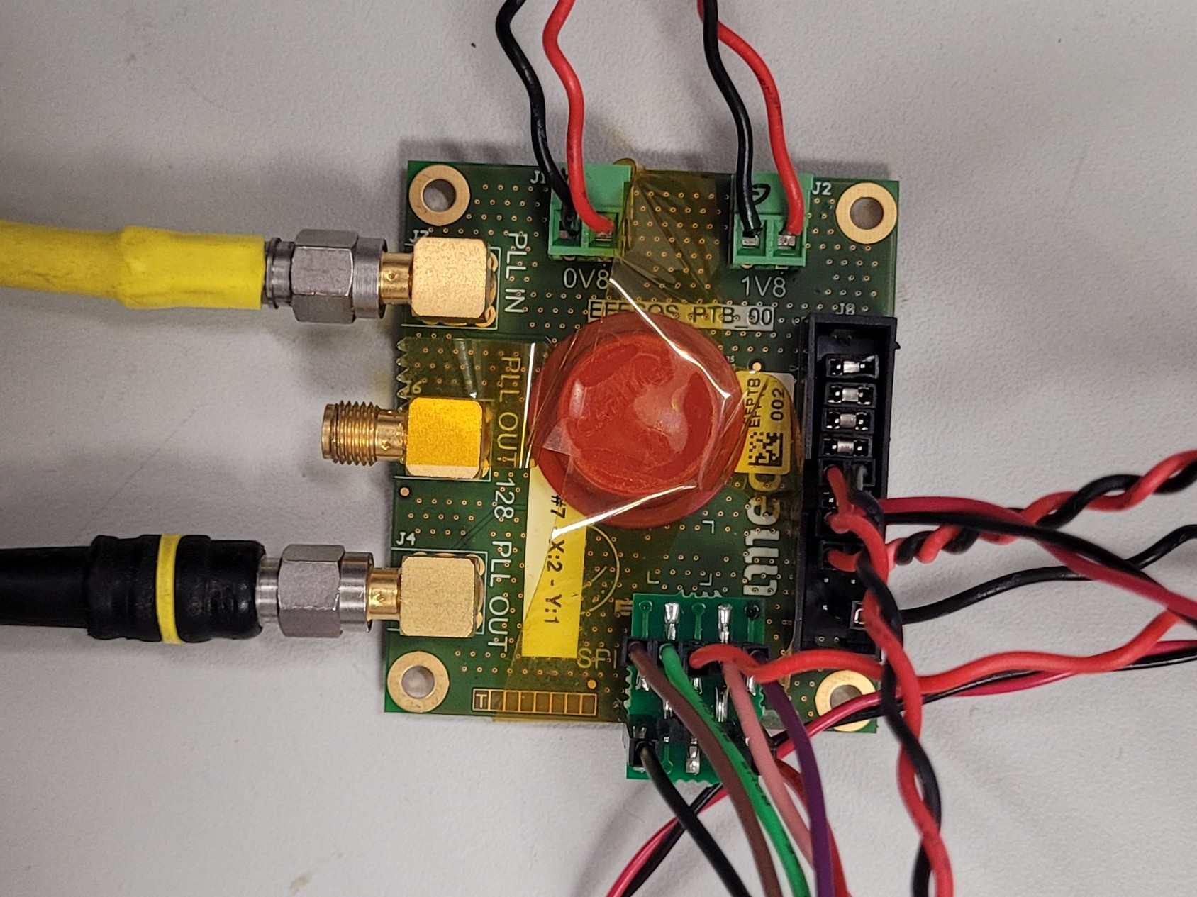
Test Board
Direct bonding from the die to the test board
  To remove an impact of package’s inductance
The three pads are merged to one on the test board
PLL input
(TI_PLL_CLKIN)
Power supplies
PLL_OUT_DIV128
Die
Back-gate biases
(VNW_x, VPW_x)
PLL output
(TO_PLL_CLKOUT)
SPI control pins

Slide 11
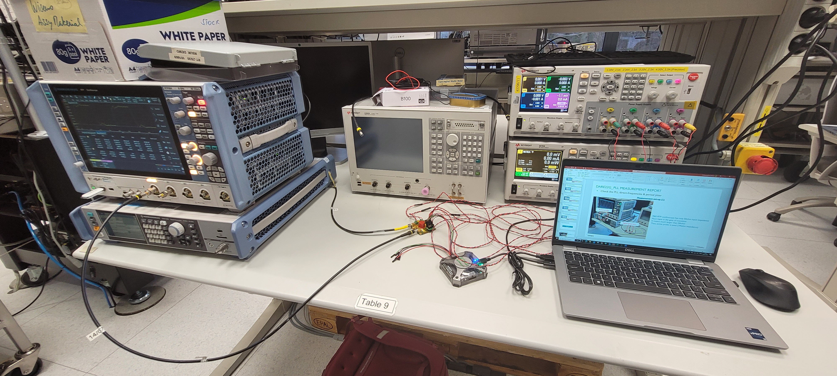
Test Setup
Test instrument list is in the paper
Power supply 1:
CH1=VNW_N_VCO, CH2=VNW_x,
CH3=VPW_x, CH4=SPI reset
Power supply 2:
CH1=VDD0V8 (PLL), CH2=VDD1V8 (IO)
Oscilloscope:
Probe TO_PLL_CLKOUT
Pattern generator
(Digital Discovery)
Signal generator:
Supply TI_PLL_CLKIN

Slide 12
Jitter Measurement: Configurations & Conditions
Measured the period jitter across 30 configurations of the PLL
  In theory, these configurations should have no impact on the period jitter
  If design is incorrect, the period jitter values will vary across the configurations
Room temperature & nominal VDD
* TI_PLL_CLKIN X FDIV division factor = VCO output
 | Configuration bit
 | VCO output | TI_PLL_ CLKIN | FDIV | ODIV1 | ODIV2 | IDIV
A-1 | 3GHz | 23.4375MHz | /128 | /1 | /1, /2, … /128 | /1
A-2 | 3GHz | 23.4375MHz | /128 | /2 | /1, /2, … /64 | /1
B-1 | 3GHz | 100MHz | /30 | /1 | /1, /2, … /128 | /1
B-2 | 3GHz | 100MHz | /30 | /2 | /1, /2, … /64 | /1
Min. input frequency & FDIV division factor
to create 3GHz VCO output
Max. input frequency & FDIV division factor
to create 3GHz VCO output
Notes:
If the design is something wrong, we can see that the period jitter depends on the configurations

Slide 13

Jitter Measurement Results: Configuration A-1
Measured jitter accumulates proportionally with the ODIV1, 2 division factor
  Need to normalize the measured jitter to its equivalent value at the 3GHz clock
Normalized jitter values are almost constant across ODIV1, 2 configurations
* TO_PLL_CLKOUT freq. = VCO out freq. / (ODIV1&2 division factor)
TO_PLL_CLKOUT frequency [MHz] | Period jitter (rms)
 | Measured jitter [ps] | Normalized jitter [ps]
3000 (=3000/1) | 1.4 | 1.4
1500 (=3000/2) | 1.8 | 1.3
750 (=3000/4) | 2.0 | 1.0
375 (=3000/8) | 2.2 | 0.8
187.5(=3000/16) | 2.3 | 0.6
93.75(=3000/32) | 2.9 | 0.5
46.875(=3000/64) | 4.4 | 0.6
23.4375(=3000/128) | 7.5 | 0.7
$$\text{Normalized} \text{jitter}\text{ (}\text{rms}\text{)}=\frac{\text{Measured} \text{jitter}\text{ (}\text{rms}\text{)}}{\sqrt{\text{ODIV}\text{1+}\text{ODIV}\text{2}}}$$
Average 0.6 ps period jitter

Slide 14
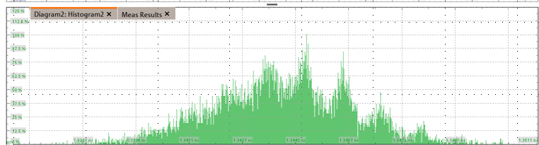
Jitter Measurement Results: Configuration A-1
Three values more than 1ps is due to supply noise of the test divider /128
  VDD of test divider /128 is shared with PLL
    # of chip pads are limited
  The jitter histogram shows periodic components, considered supply noise components
TO_PLL_CLKOUT frequency [MHz] | Normalized jitter [ps]
3000 (=3000/1) | 1.4
1500 (=3000/2) | 1.3
750 (=3000/4) | 1.0
375 (=3000/8) | 0.8
187.5(=3000/16) | 0.6
93.75(=3000/32) | 0.5
46.875(=3000/64) | 0.6
23.4375(=3000/128) | 0.7
VDD0V8_PLL
VDD0V8_BUF
TO_PLL_CLKOUT
=3000/4 MHz
Periodic components

Slide 15

Jitter Measurement Results: Configuration A-1
Supply noise has a stronger influence when ODIV1, 2 division factors are small
  Due to the ratio between jitter induced by supply noise and the intrinsic jitter of the PLL
  In normalized values, the amount of jitter induced by supply noise is ignorable
Jitter induced by supply noise
$$\text{Normalized} \text{jitter}\text{ (}\text{rms}\text{)}=\frac{\text{Measured} \text{jitter}\text{ (}\text{rms}\text{)}}{\sqrt{\text{ODIV}\text{1+}\text{ODIV}\text{2}}}$$
PLL intrinsic jitter
TO_PLL_CLKOUT = 3000 [MHz]
TO_PLL_CLKOUT = 23.4375 [MHz]
/ √1
/ √128
Measure period jitter
Normalized period jitter
Measure period jitter
Normalized period jitter

Slide 16
Jitter Measurement Results: Configuration A-1, A-2, B-1, B-2
Period jitter values for Configuration A-1, A-2, B-1, B-2 are similar (=around 0.6 ps)
  This PLL is correctly designed and reach the target period jitter (<1 ps)
TO_PLL_CLKOUT frequency [MHz] | Normalized period jitter (rms)
 | A-1 [ps] | A-2 [ps] | B-1 [ps] | B-2 [ps]
3000 (=3000/1) | 1.4 | - | 1.6 | -
1500 (=3000/2) | 1.3 | 1.3 | 1.3 | 1.3
750 (=3000/4) | 1.0 | 1.0 | 1.0 | 1.0
375 (=3000/8) | 0.8 | 0.8 | 0.8 | 0.8
187.5(=3000/16) | 0.6 | 0.6 | 0.6 | 0.6
93.75(=3000/32) | 0.5 | 0.5 | 0.5 | 0.5
46.875(=3000/64) | 0.6 | 0.5 | 0.5 | 0.5
23.4375(=3000/128) | 0.7 | 0.6 | 0.6 | 0.6

Slide 17
Conclusion
The DARE22G PLL has demonstrated in term of low jitter
Jitter measurement results across various configurations have consistently shown values around 0.6 ps
The PLL is correctly designed and meets the target jitter requirement of less than 1ps

