Slide 1
Mixed-Signal Solutions for Space
Aerospace & Defense

Slide 2
Mixed-Signal Solutions for Space
Microchip in Europe: Products and Competencies for Space
Scalable Solutions for Space Applications
Mixed Signals Microcontroller Overview
Typical Mixed Signal Applications

Slide 3
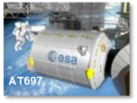
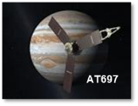
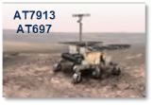
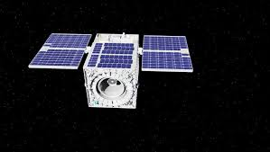
Processing: An Unrivalled Flight Heritage
Sentinels & Alphasat
2013
Colombus
2008
Proba2
2009
JUNO (Nasa)
2011
SPOT6
2012
SVOM/Eclair
2013
TSC695
ATmegaS128
MMS (Nasa)
2014
Exomars
2016
Solar Obiter
2017
Bepi-Colombo
2018
Mega Constellation
LEO Sat -2019
Perseverance 2021
SAMV71Q21RT
SAM3X8ERT
SAMRH71
Thousands of flight models delivered worldwide
ASBM 2024
Capella Sequoia
Earth Obs 2020
ANGELS Nanosat 2020
IRIDE 2025

Slide 4
A&D Product Lines in Europe
Nantes, France
Rousset, France
ADG France
Processors and Microcontrollers
Com Interfaces and Memories
ASIC Mixed Signals
DPG France
Power Modules
DPG Ireland
Hi-Reliability Discrete
Power Modules
Vectron Germany
Oscillators
RF SAW Filters
RF Microwave UK
Amplifiers
Advanced Packaging UK
Size, Power and Reliability
Rousset, France
Belfast
Ennis
Caldicot
Teltow
Ennis, Ireland
ESCC certified Supply Chain
Neckarbischofsheim
Nantes
Bordeaux
Rousset
Teltow & Neckarbischofsheim, Germany
Belfast, UK

Slide 5
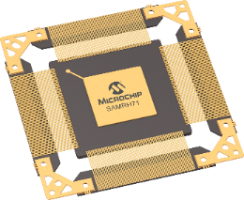
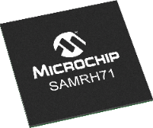
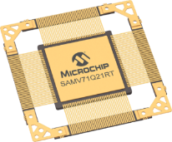
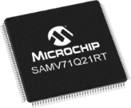
From COTS to Space-Qualified Solutions
Quality
Grade
Plastic and Hermetic
(pin distribution compatible)
RHBD
Radiation Hardened by Design
TID > 100 krad
No SEE mitigations
RT
Radiation Tolerant
Singe Event Latch-up Immune
Auto
COTS
Temperature performances
Radiation performances

Slide 6
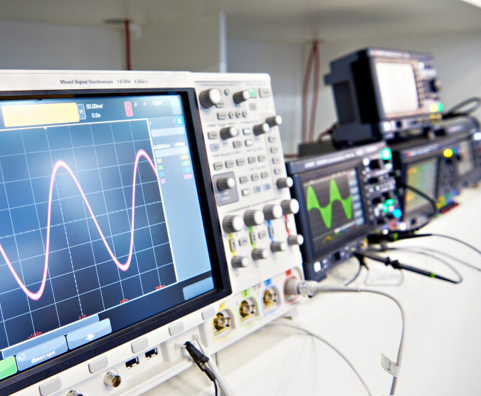
Mixed-Signal Microcontrollers (MCUs)
Mixed-signal microcontrollers advantages in space applications:
Integration of analog and digital functions
Reduced power consumption
Enhanced signal processing
Simplified design and development
Improved reliability
Cost efficiency
Notes:
Integration of Analog and Digital Functions: Mixed-signal MCUs combine analog and digital components on a single chip, reducing the need for additional discrete components and saving space and weight—critical factors in space applications.
Reduced Power Consumption: By integrating multiple functions into a single chip, mixed-signal MCUs can optimize power usage, which is essential for space missions where power resources are limited.
Enhanced Signal Processing: These MCUs can handle both analog and digital signals, allowing for efficient processing of sensor data, which is vital for navigation, communication, and scientific measurements in space.
Improved Reliability: Fewer components and interconnections reduce potential points of failure, enhancing the overall reliability of the system—a key requirement for space missions.
Cost Efficiency: The integration of multiple functions into a single MCU can lower the overall system cost by reducing the number of components and simplifying the design.
Flexibility and Versatility: Mixed-signal MCUs can be programmed to perform a wide range of tasks, from data acquisition to control functions, making them adaptable to various mission requirements.
Simplified Design and Development: With integrated analog and digital capabilities, mixed-signal MCUs simplify the design process, reducing development time and complexity.

Slide 7
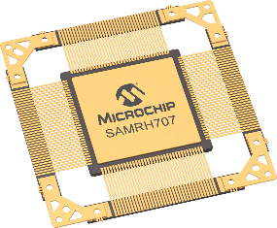
SAMRH707 Rad-Hard MCU
SEL immune up to 78Mev.cm2/mg
TID >100 krad, Embedded Flash at 40 krad
SEU LET >30Mev.cm2/mg, Xsection <10⁻⁹ cm2/word
No SEFI, No Flash SBU nor MBU
ES Available
FM Available
128KB Flash
320KB SRAM
(192KB TCM)
Int/Ext Mem
CQFP 164
BGA 484
-55°C / +125°C
>100 DMIPS
TCM / MPU / ICM
FPU / DSP
Dual CAN FD
SpaceWire 200Mb x2
Mil Std 1553 BC/RT
Analog integration
ADC and DAC 12-bit
ECC
SAMRH707
ECC
Memory
Cortex®-M7
50 MHz
System
ECC
128KB Embedded Flash
with ECC
2 Independent Watchdog
POR
Voltage Regulator Monitor
192KB SRAM for TCM
with ECC
TCM
50 MHz
ETM
ECC
128KB Multi-Port SRAM
with ECC
MPU
DSP / FPU
2 PLL, RTC, RTT
Hardened External Memory Controller w/ ECC
PROM – SRAM – FLASH
2x 16 KB L1 Cache
with ECC
3-20MHz Xtal OSC input
4/8/10/12MHz RC OSC
32,768KHz Xtal OSC input
32KHz RC OSC
Dual port 32ch-DMA Controller
Connectivity
50MHz
Matrix
Control
4 UART, 4 USART,
4 SPI, 4 TWI
88 IOs
Dual CAN-FD
2x 32-bit Timers/Counters
2x 16-bit PWM (4 ch)
2x SpaceWire with RMAP
LVDS Transceiver
16 ch 12-bit ADC
4 ch 12-bit DAC
MIL-STD-1553B
Integrity Check Monitor
(SHA)
*Integrity Check Monitor

Slide 8
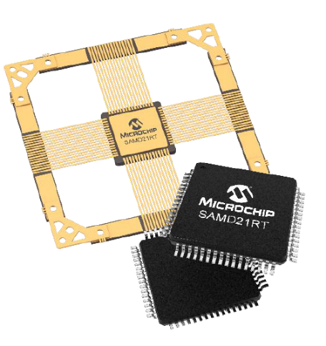
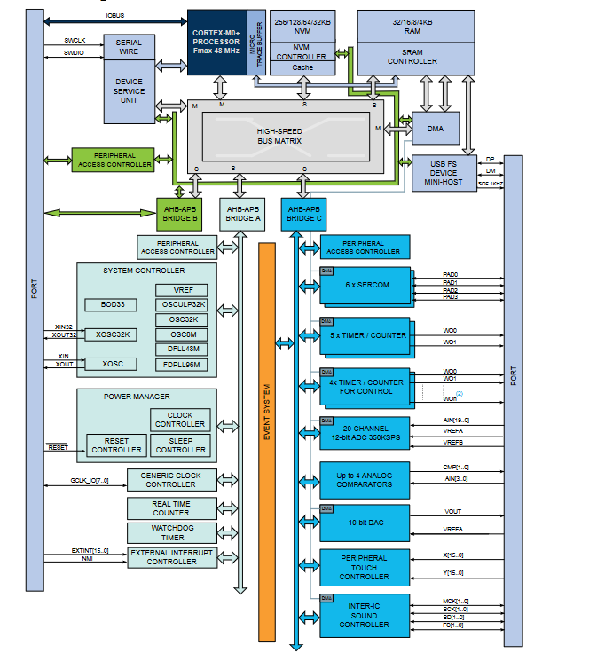
SAMD21J17RT Radiation-Tolerant MCU
Arm® Cortex®-M0+ MCU
128 kB Flash
16 kB SRAM
52 GPIOs
Small package
QFP64
-40°C/125°C
3V to 3.6V
Samples and Flight Models Available
~50 DMIPS
Hmatrix with DMA
350 ksps ADC, 12-bit
10-bit DAC
14 PWM motor control
Analog comparator
SERCOM
6 UART/SPI/TWI
Radiation
TID >50 krad SEL immune up to 78MeV

Slide 9
Differential and Single-Ended Embedded ADC
Advantage of having both differential and single-ended embedded Analog-to-Digital Converters (ADCs) in a microcontroller
Single-End
🟢Occupies only one analog microcontroller pin per input
🟢In most cases conceptually simple and easy to use
🔴Sensitive to noise along the analog signal path and common-mode noise
🔴The signal path should be as short as possible to minimize noise
Differential
🟢Rejects noise along the signal path and common-mode noise
🟢Double dynamic range compared to single-ended operation
🔴 Occupies two analog microcontroller pins per input
🔴 Somewhat more complex to connect and use
Notes:
Differential ADCs: These are ideal for measuring signals where noise rejection is critical. They measure the voltage difference between two inputs, which helps cancel out common-mode noise and interference, making them suitable for applications with long signal paths or noisy environments.
Single-Ended ADCs: These measure the voltage relative to a common ground, which is simpler and often sufficient for short signal paths or less noisy environments. They are typically used for straightforward applications where noise is not a significant concern.

Slide 10
Embedded Analog Comparators
Analog comparators are not common peripherals on microcontrollers and can be of great value in digital power applications
Analog comparators can quickly detect overcurrent or overvoltage conditions
In AC power applications, analog comparators are used to detect the zero-crossing points of the AC waveform
Comparators can be used to implement fault detection and diagnostic features
Key advantages
Analog comparators offer fast response times, which are essential for real-time monitoring and control in power applications
By integrating analog comparators within the MCU, designers can reduce the need for external components
Notes:
Analog comparators in microcontrollers (MCUs) play a crucial role in digital power applications by providing fast and efficient signal processing capabilities. These comparators are used to compare two voltage levels and output a digital signal based on the comparison, which is essential for various control and monitoring functions in power electronics. Here are some key uses of MCU analog comparators in digital power applications:
Overcurrent and Overvoltage Protection:
Analog comparators can quickly detect overcurrent or overvoltage conditions by comparing the sensed voltage or current against predefined threshold levels. When the threshold is exceeded, the comparator triggers protective actions, such as shutting down the power stage or activating a fault indicator, to prevent damage to the system.
Zero-Crossing Detection:
In AC power applications, analog comparators are used to detect the zero-crossing points of the AC waveform. This information is critical for synchronizing switching actions in power converters, such as inverters and rectifiers, to minimize switching losses and improve efficiency.
Pulse Width Modulation (PWM) Control:
Comparators can be used in conjunction with PWM controllers to regulate the duty cycle of power switches. By comparing the feedback signal (e.g., output voltage or current) with a reference signal, the comparator helps adjust the PWM signal to maintain the desired output level, ensuring stable and efficient power delivery.
Current Sensing and Control:
In applications like motor control and power supplies, analog comparators are used for current sensing and control. They compare the sensed current with a reference to implement current limiting or to provide feedback for closed-loop control systems, enhancing the precision and safety of the power system.
Voltage Level Detection:
Comparators can monitor voltage levels to ensure they remain within specified limits. This is particularly useful in battery management systems, where maintaining the correct charge and discharge levels is crucial for battery health and longevity.
Fast Response Time:
Analog comparators offer fast response times, which are essential for real-time monitoring and control in power applications. This speed allows for immediate corrective actions, improving the overall reliability and performance of the power system.
Simplified Circuit Design:
By integrating analog comparators within the MCU, designers can reduce the need for external components, simplifying the circuit design and reducing the overall system cost and size.
Fault Detection and Diagnostics:
Comparators can be used to implement fault detection and diagnostic features, such as identifying short circuits or open circuits, which are critical for maintaining system integrity and safety.
In summary, MCU analog comparators are vital components in digital power applications, providing essential functions for protection, control, and monitoring. Their ability to quickly and accurately compare voltage levels makes them indispensable for ensuring the efficiency, reliability, and safety of power electronic systems.

Slide 11
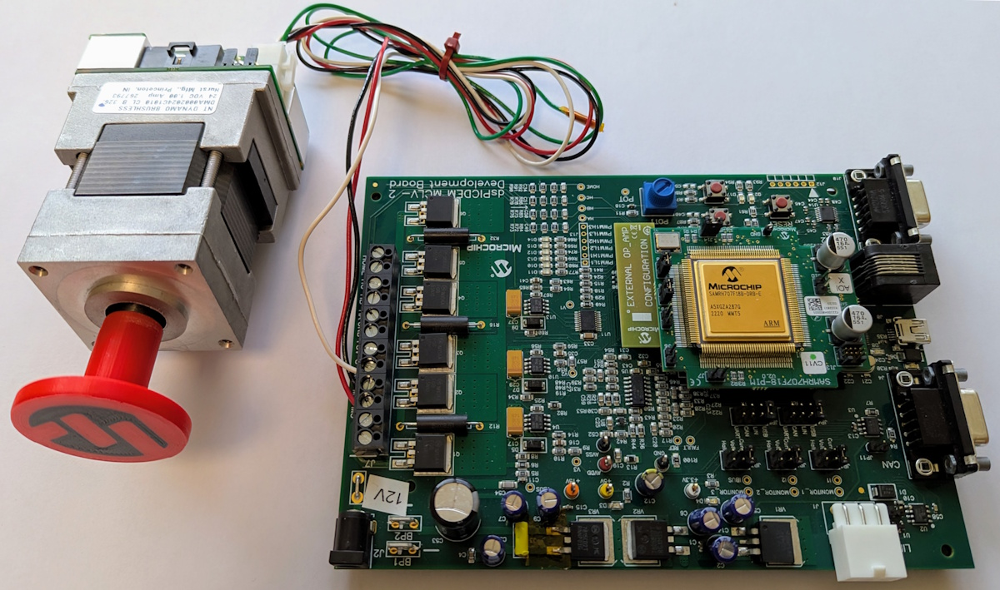
Motor Control
Electric motors, mostly PMSM (Permanent Magnet Synchronous Motor) and stepper motors are widely used in space. Mixed signal microcontrollers are ideal to control such motors
Where stepper motors could be simple to use, PMSM motors require more complex driving algorithms like Field Oriented Control (FOC).
FOC is a sophisticated and highly efficient method for controlling the torque and speed of electric motors, enabling independent control of torque and flux
Visit Microchip at booth 1
FOC requires powerful microcontrollers such as Microchip Arm® Cortex®-M
Notes:
Feature PLL Estimator Sliding Mode Observer (SMO)
Operating Principle Tracks back-EMF phase with PLL Nonlinear observer reconstructs back-EMF using sliding mode control
Low-Speed Performance Poor (weak back-EMF) Good (robust to weak back-EMF)
High-Speed Performance Excellent Good
Robustness to Parameters Moderate High
Noise Immunity Moderate High (with proper filtering)
Implementation Complexity Simple to moderate Moderate to high
Chattering No Possible (requires filtering)
Typical Applications Industrial drives, EVs Servo drives, robotics, automotive

Slide 12
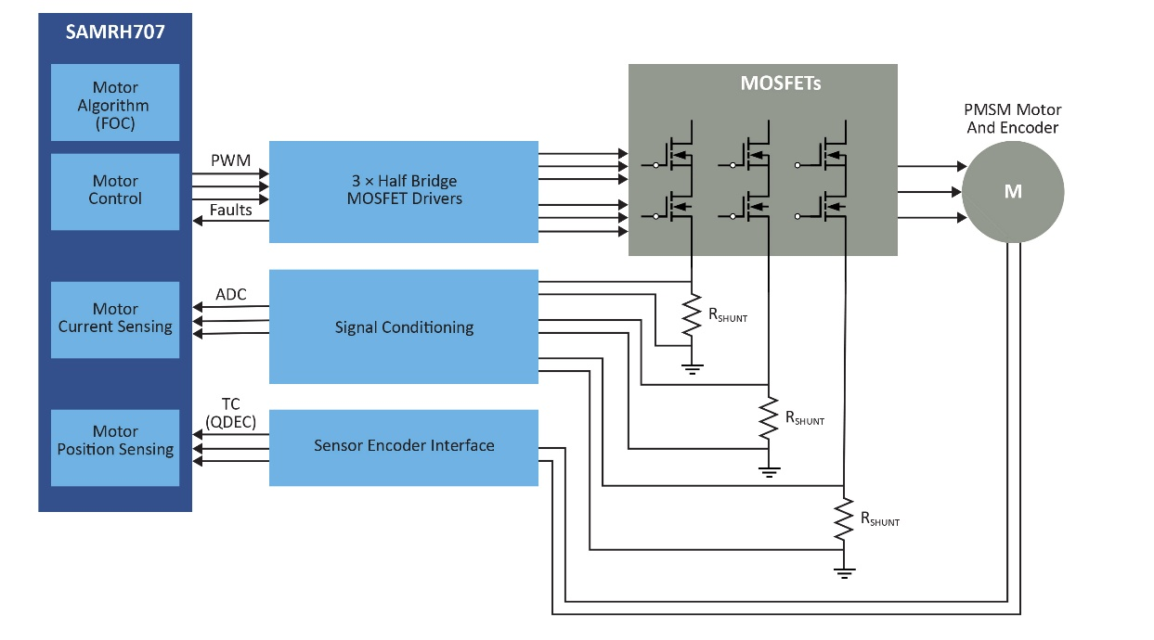
Field Oriented Control (FOC)
There are several types of FOC algorithms, each with its own approach to achieving precise motor control
Sensored
A position sensor is required, which can be a quadrature encoder or a resolver
🟢Less computer intensive
🔴Require extra hardware
Sensorless
No need for a position sensor, rotor position is computed based on the back EMF currents.
🟢Reduces cost and complexity by eliminating sensors
🔴Requires sophisticated algorithms to accurately estimate rotor position and speed

Slide 13
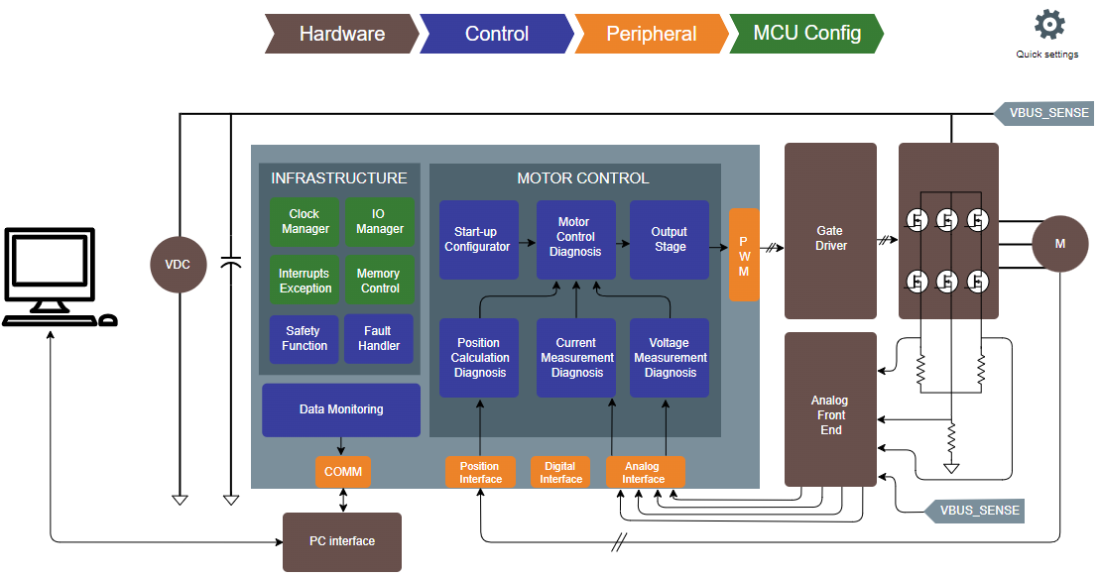
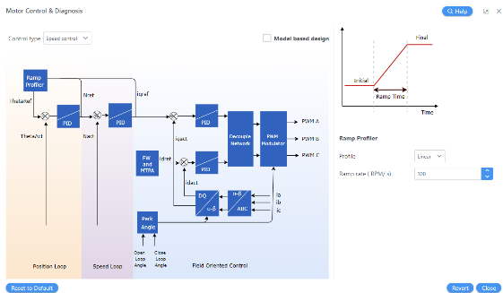
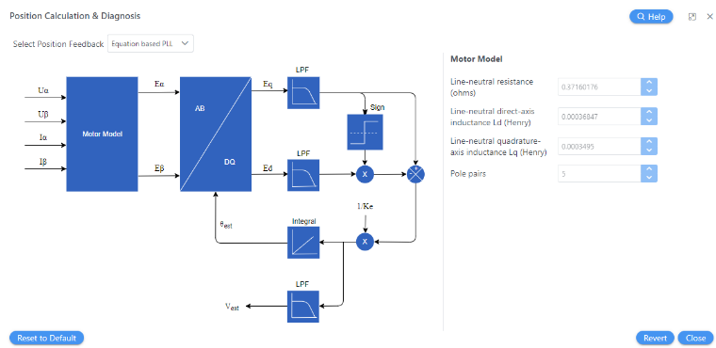
MPLAB®Harmony QuickSpin PMSM FOC Configurator
MPLAB® Harmony QuickSpin is a software library within Microchip’s MPLAB Harmony framework that provides motor control algorithms and tools specifically designed for sensorless and sensored control of PMSM motors
QuickSpin simplifies the development of efficient, real-time motor control applications on Microchip microcontrollers by offering pre-implemented algorithms, configuration tools, and integration with MPLAB X IDE
Works with the SAMRH707

Slide 14
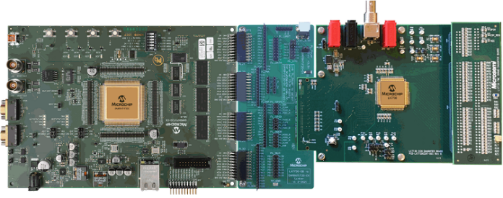
Telemetry
Telemetry in space applications is the process of automatically measuring and collecting data from spacecraft systems, instruments or payloads
Mixed-signals microcontroller are well suited for compact telemetry applications where the MCU can collect and process the data.
SAMRH71
LX7730
SAMD21RT

Slide 15
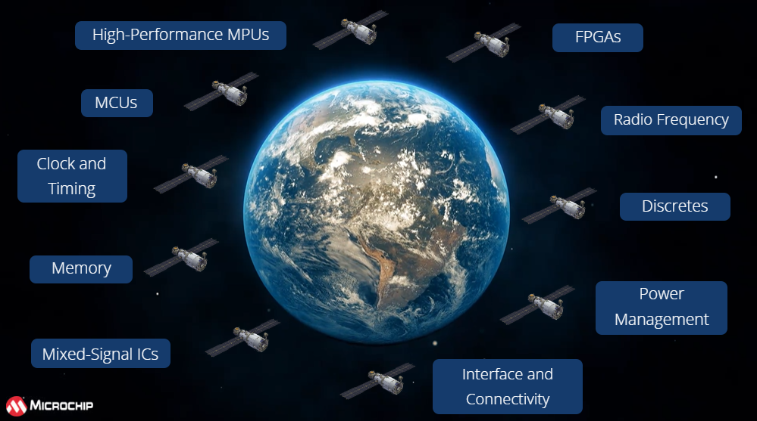
Where to Learn More
Web pages to access link
Products, applications
Reference designs on product pages
Webinars and video, blogs
Newsletters

Slide 16
Thank You
https://www.microchip.com/en-us/solutions/aerospace-and-defense

