Slide 1
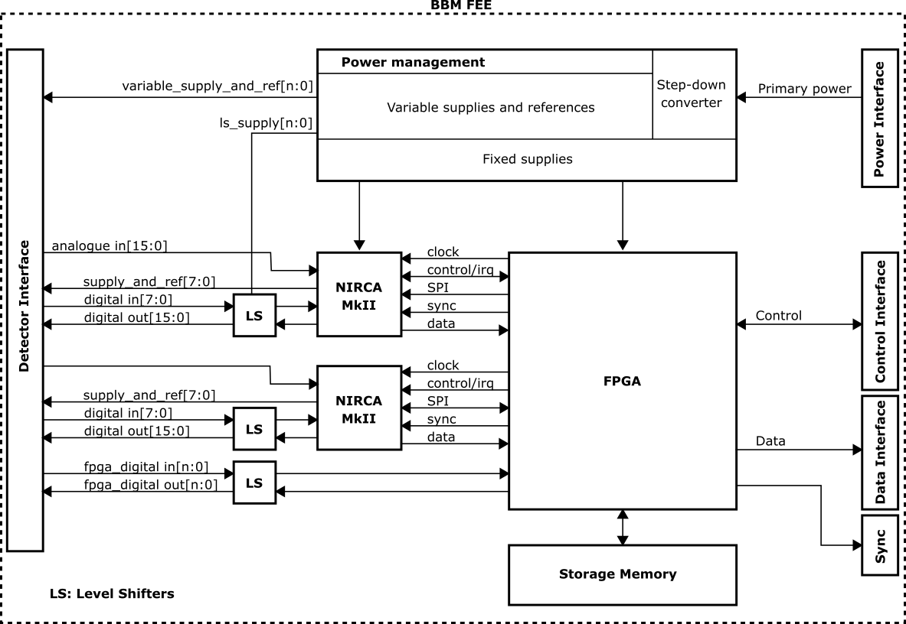
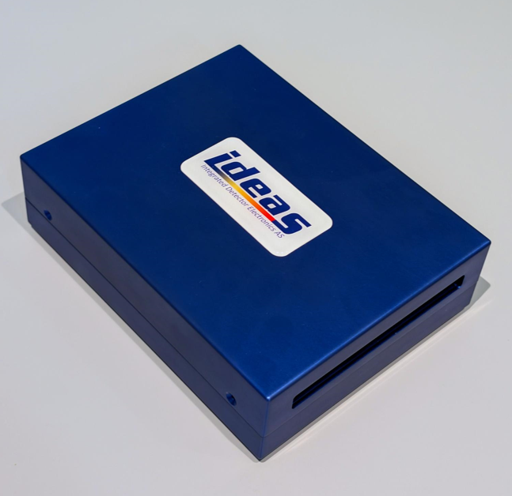
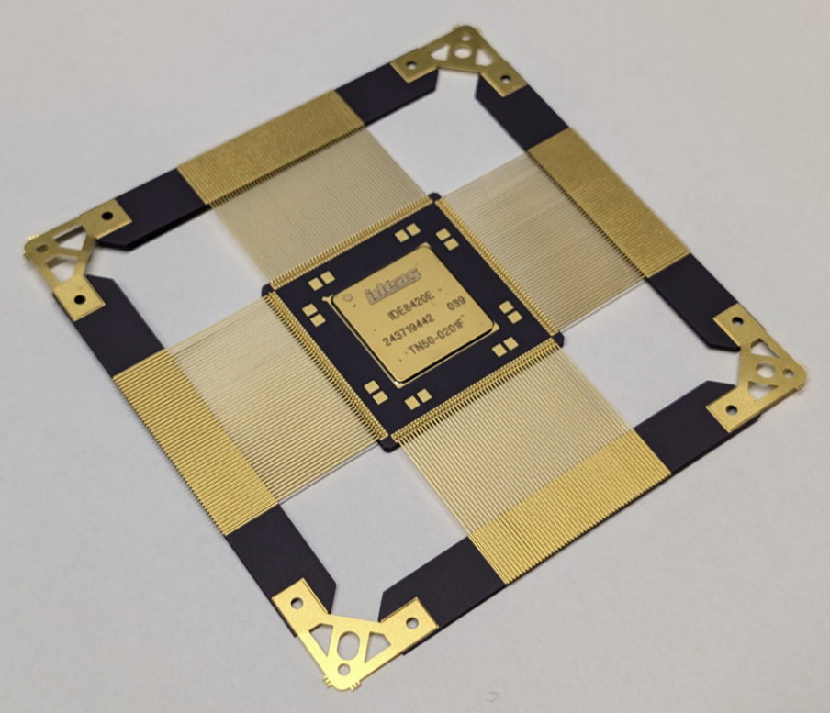
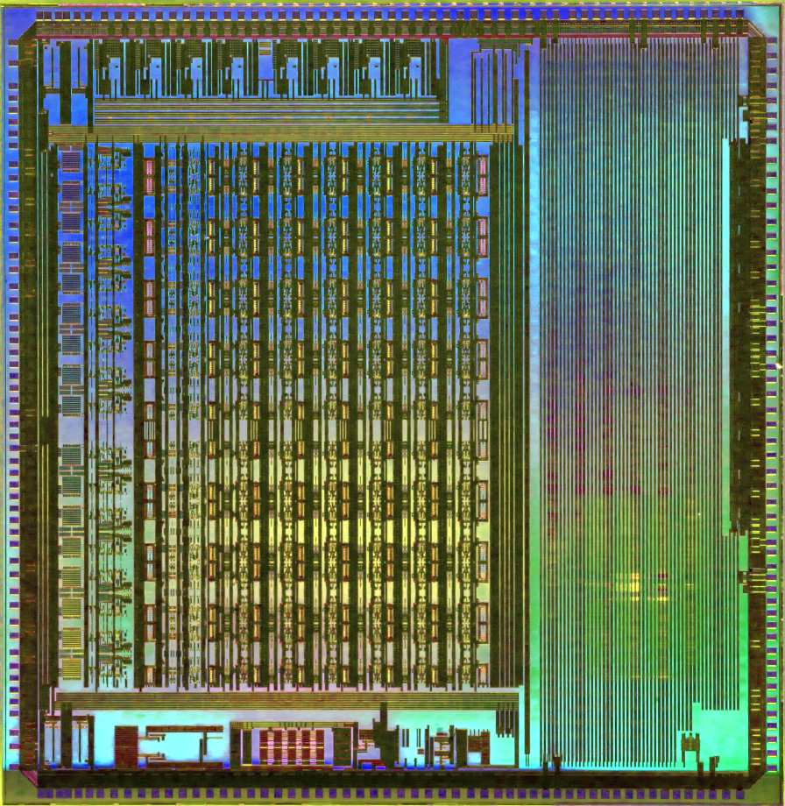
Infrared FPA Detector Readout with the NIRCA MkII ASIC
A. Hasanbegovic, T. Ostmoe, A.Fagerland Haavik, D. Meier, B. Samadpoor Rikan, T. Nesjo, HK. Otnes Berge, A. Dadashi, S. Azman, J. Talebi, JE. Holter, P. Oya, G. Maehlum – IDEAS, Oslo, Norway –
AMICSA 2025, 16 – 18 June 2025, Lisbon, Portugal
Dirk.meier@ideas.no
On behalf of IDEAS team

Slide 2
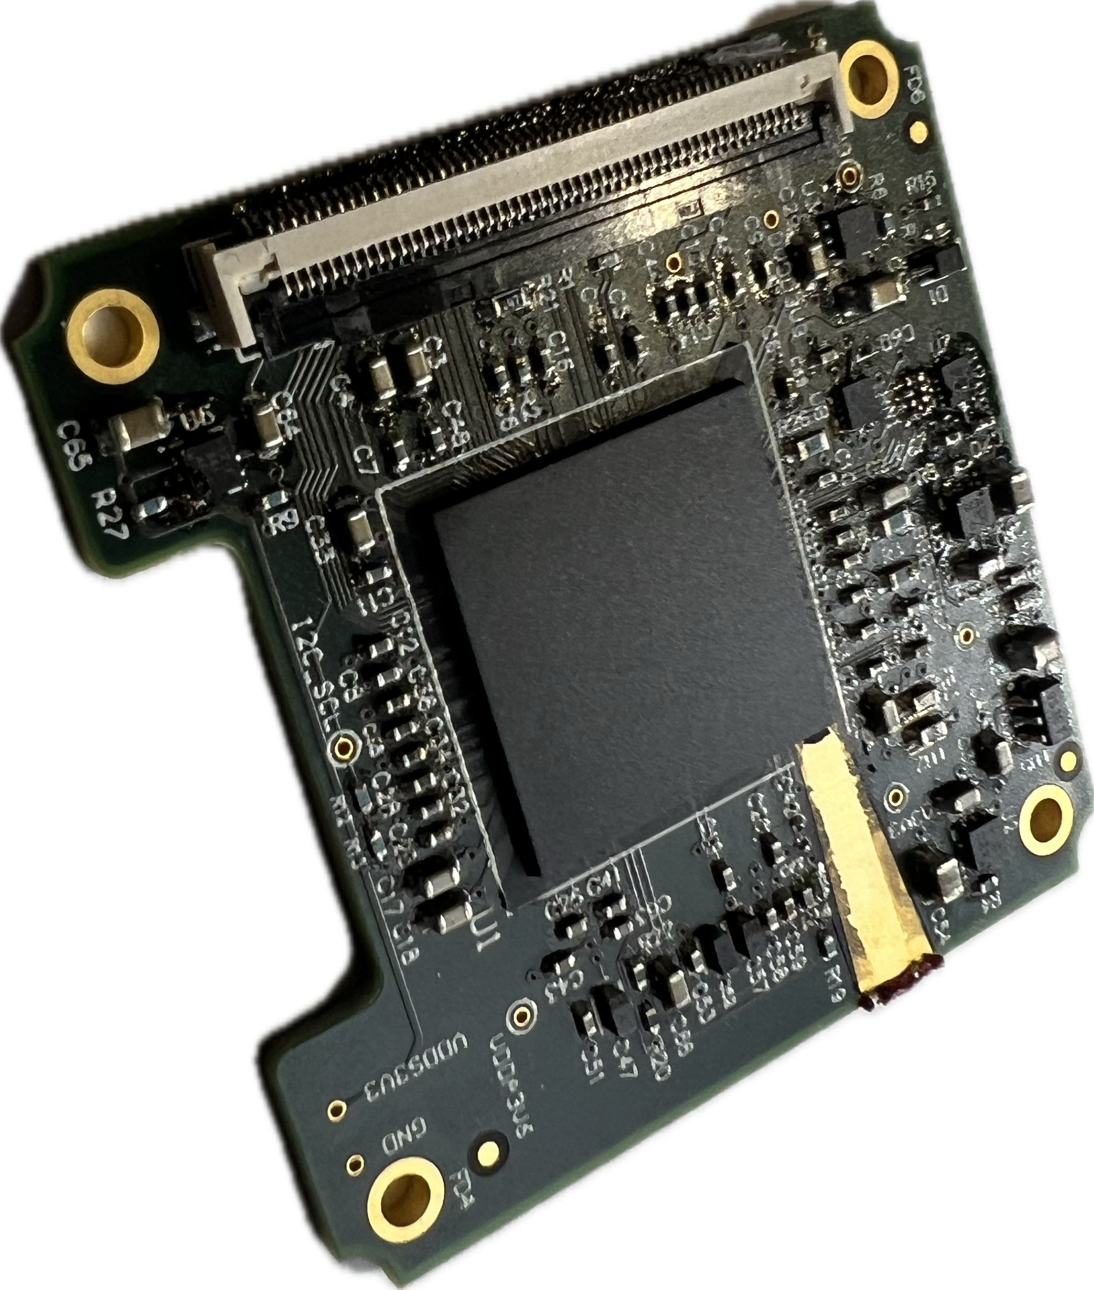
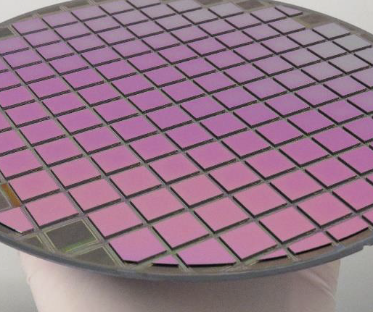
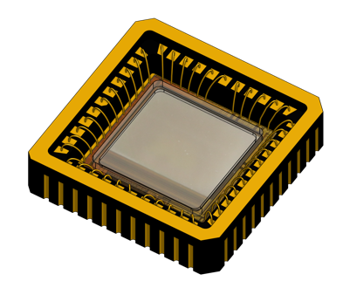
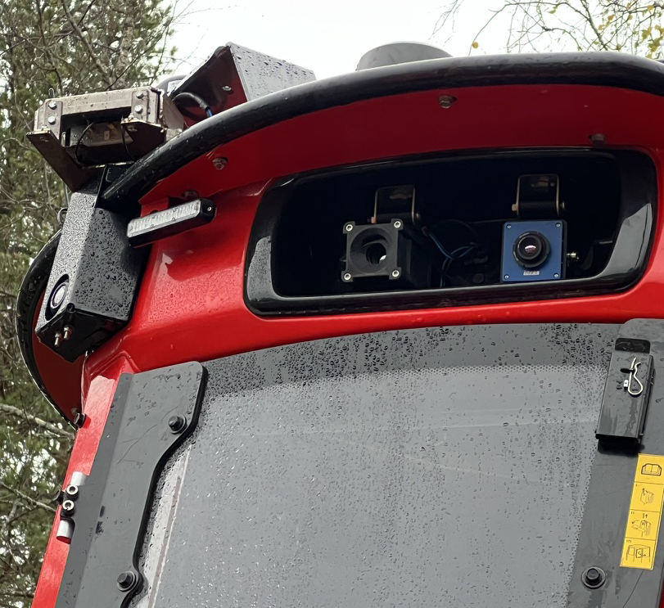
IR FPA Detectors, FEE, Camera Core and Applications in Space and on Earth
Detector
I/F
Space Science, Earth Observation
Cryogenic
Camera
I/F
Cold
Power
Power
MCT, T2SL on ROIC
Control
Control
Industries, Automation, Safety
Digital
Video
Output
Analog
Video
Output
Warm
Microbolometers, QD on ROIC

Slide 3
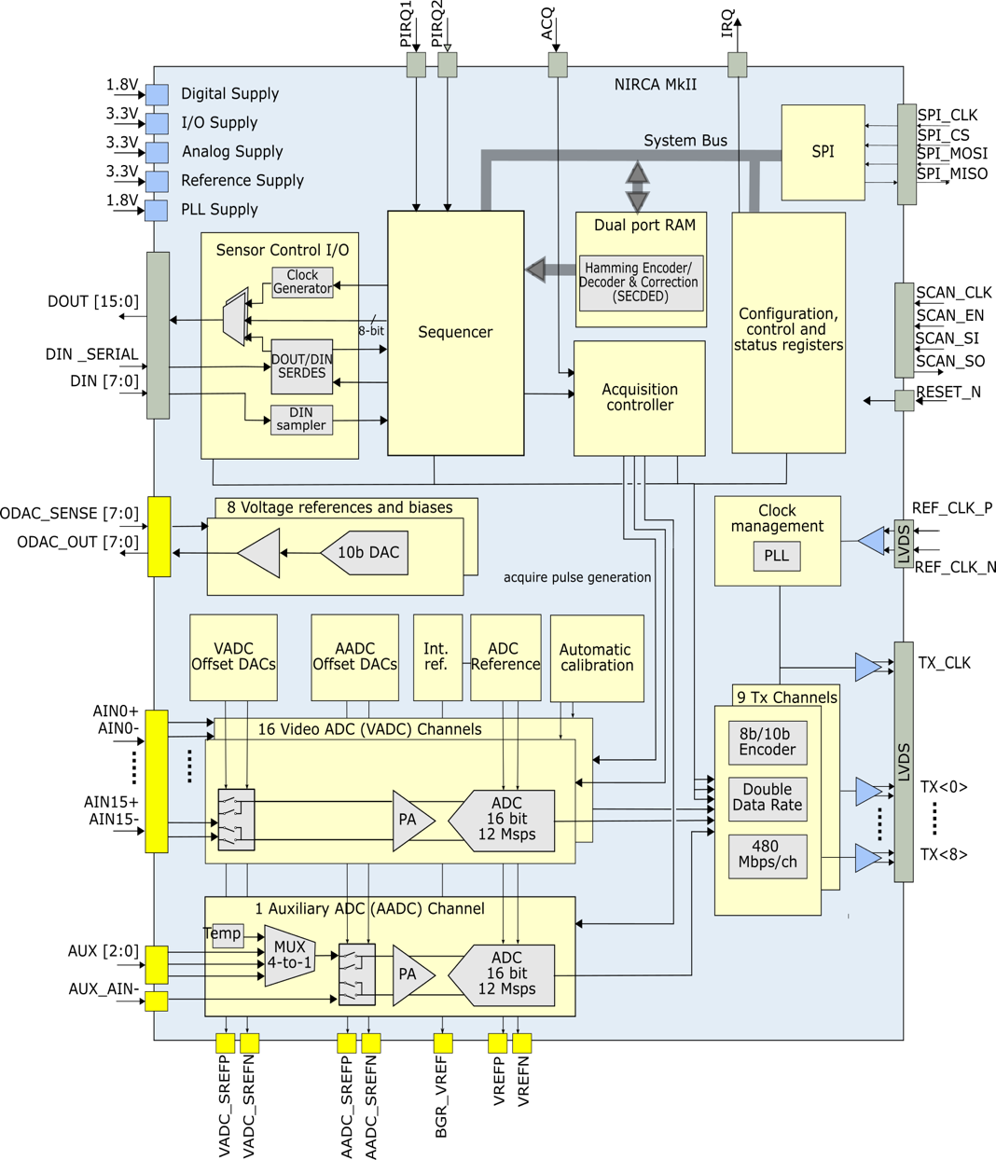
NIRCA MkII Infrared FPA Controller Readout ASIC
A single-chip solution to bias, read out and control a focal plane array (FPA).
Control and clocking
IR FPA with analog video out
Biasing and supplies
Analog readout and digitization

Slide 4
NIRCA MkII Infrared FPA Controller Readout ASIC
A single-chip solution to bias, read out and control a focal plane array (FPA).
Programmable Sequencer Custom instruction set 16× Digital outputs 8× Digital inputs 2048 instructions (ECC-RAM) 8 nested loops, +++ Interfaces SPI serial peripheral interface 9×480 Mbps upstream LVDS (8b/10b) IRQ for exception, sequencer messages Analog Acquisition 16× 16-bit, 12 Msps ADCs Programmable gain - x1, x1.14, x1.33, x1.6, x2, x2.67, x4, x8 Analog input configurations: - Fully differential, - Pseudo differential, - Single ended Sample point adjustment (4+ ns steps) | Analog monitoring 1× 16-bit, 12 Msps ADC 3× analog inputs (muxed), Internal temperature sensor Bias and supply outputs 8× Ext. V_{bias} (w. 10-bit DACs) Output and ground sensing Environment SEL LET_{th} > 118 MeV cm²/mg Good SEU tolerance -40°C to +85°C Power Less than 2W (flexible power- down scheme) Applications Earth observation missions Hybrid image sensors, IRFPA Astronomical science Space instrumentation

Slide 5
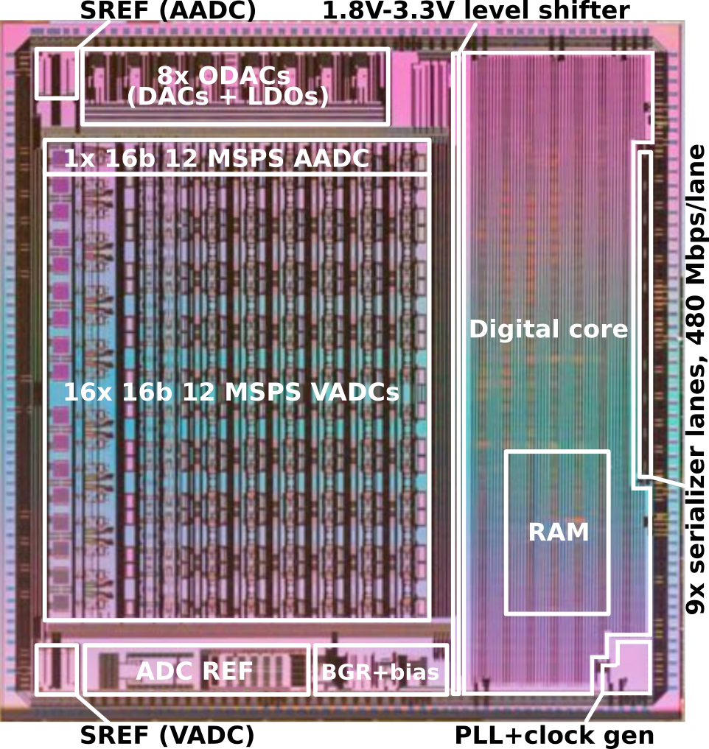
NIRCA MkII Process, IP and Floorplan (WS CIS 2022, ESTEC)
Fabricated in the UMC180
Using DARE 180U PLL, RAM (non-protected), CORE and IO library by IMEC
Otherwise, design IP by IDEAS

Slide 6
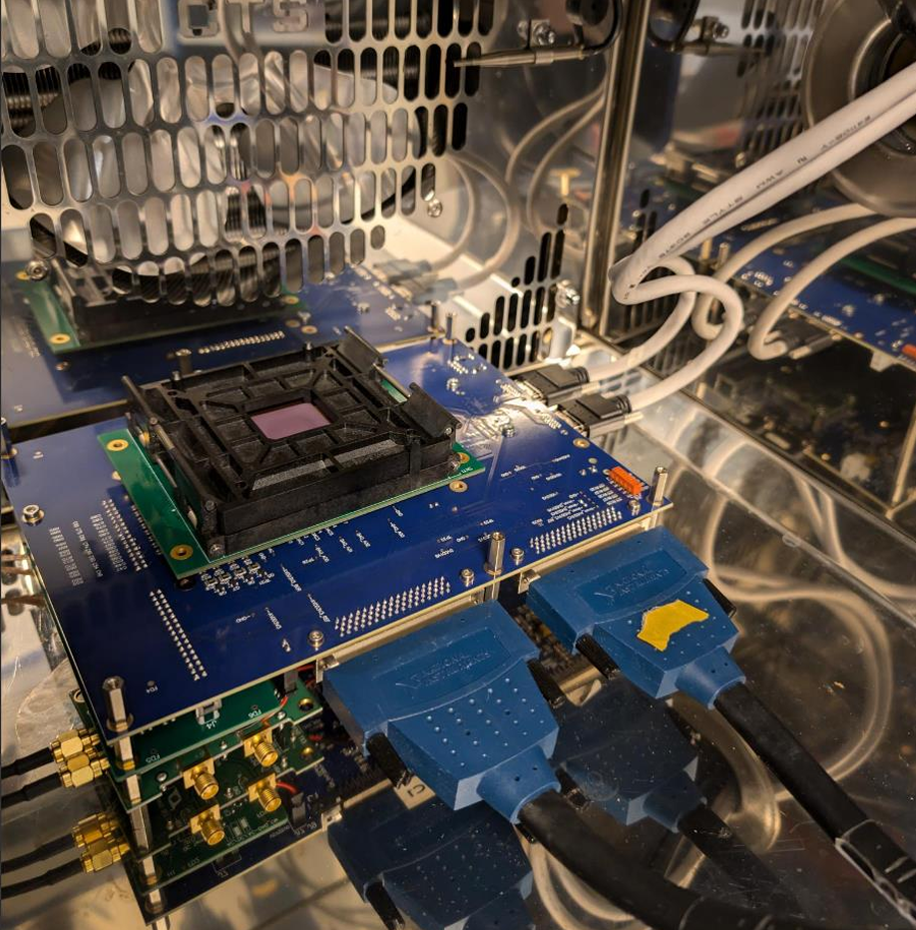
Qualification – Electrical Tests (WS CIS 2024, Toulouse)
Environmental test conditions:
[V_{TYP} -10%, V_{TYP}, V_{TYP} +10%], [-40°C, 25°C, 85°C]
Test parameters:
Input range, DNL, INL, Gain, Digital functionality, IO-tests, References, Current consumption, Rates ….
Data collection
Test result database, PDF report generation
Channel offset and gain tuning parameters
Tuning for target applications
E.g., temperature range, input range, gain, offset

Slide 7
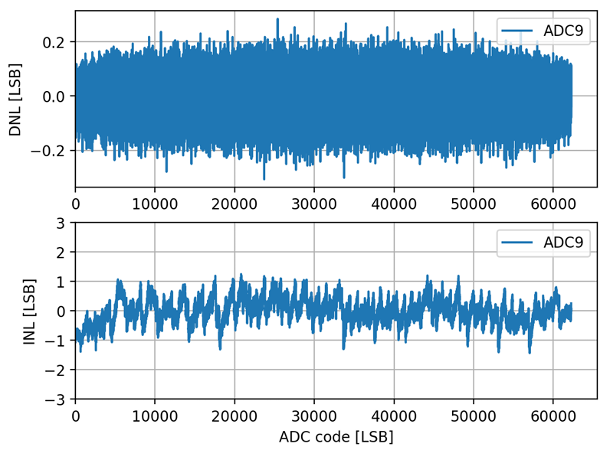
Test Results – Flight Package (WS CIS 2024, Toulouse)
Package design and assembly successful
ADC input noise 2.9 LSB_{RMS} – 3.2 LSB_{RMS}
DNL < ± 0.3 LSB , INL < ± 1.5 LSB
Max sampling frequency: 12 Msps
Reference output noise: 10 µV_{RMS} – 30 µV_{RMS}
Power 2W (16 ADCs @ 12 Msps)

Slide 8
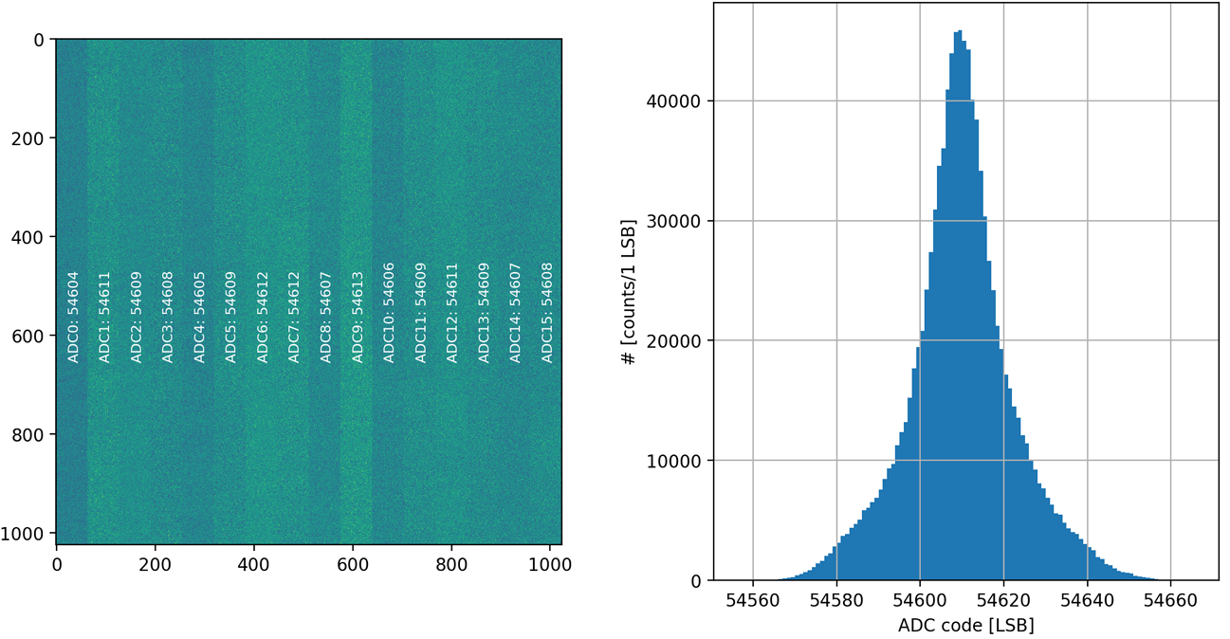
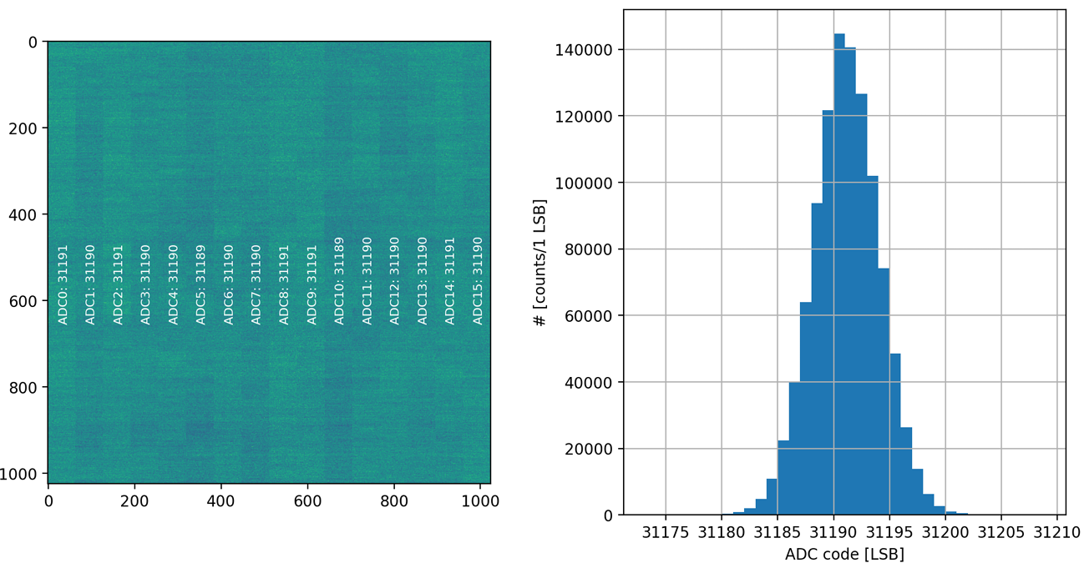
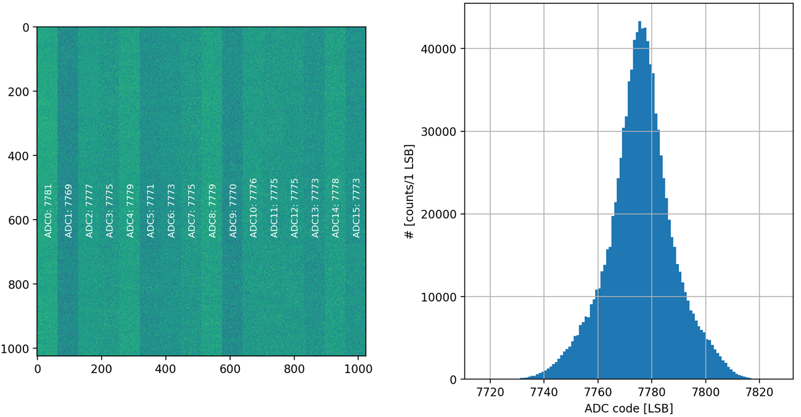
Test Results – ADC Channel Equalization (WS CIS 2024, Toulouse)
Vin = +1.5 V
Preliminary channel equalizations using on-chip offset- and gain calibration
±1 LSB offset mismatch
±10 LSB gain mismatch
Ongoing work to further improve gain mismatch
Target is ±1 LSB gain mismatch
Vin = -1.5 V

Slide 9
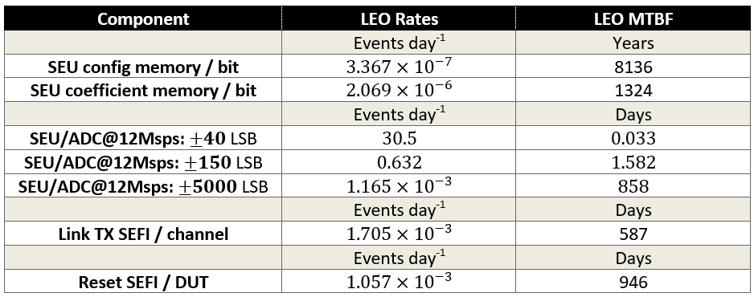
Radiation Tolerance of NIRCA MkII ASIC
SEE
Heavy ions, UCL:
3.3 and 72.17 MeVcm2/mg
3 devices
=> SEE rates =============>
=> No SEL detected
TID
Co-60, ESTEC
LDR to 76 krad (Si)
5 biased, 5 unbiased, 1 reference
=> 5% drift in current consumption
=> No performance parameter drift
Shielding: 1 mm Al equivalent,
CREME96 (peak 5-minutes) solar particles (H – U) AP-8 MIN trapped protons
1 SEU with ±40 LSB error every 32000 frames for 1k x 1k @ 180 fps.
1 SEU with 1 ±150 LSB error every 1536000 frames for 1k x 1k @ 180 fps.

Slide 10
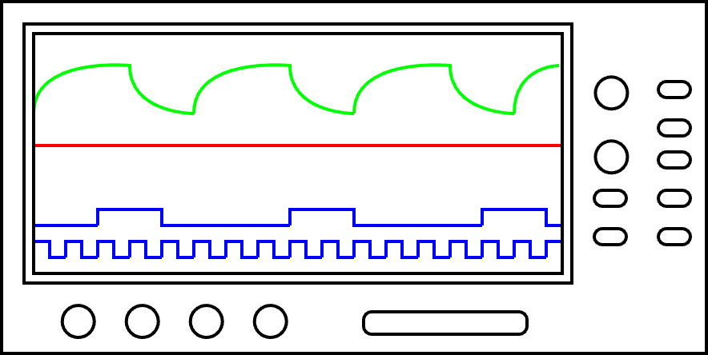
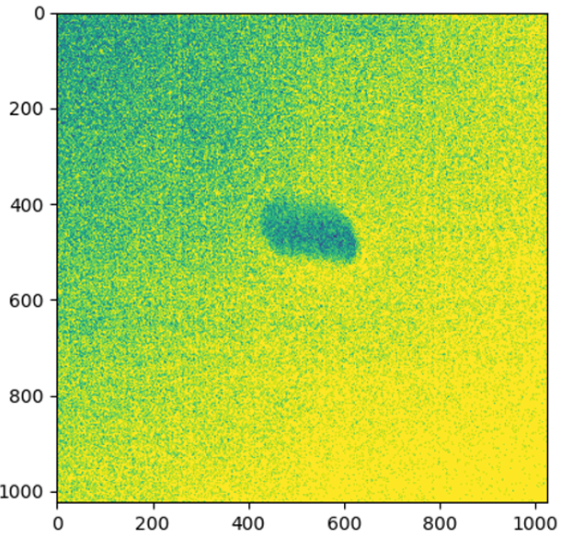
IR FPA Detector Readout System DevKit
Step 1 (A): Make a harness to interface to the sensor
Step 1 (B): Make a proximity electronics board to interface to the sensor
Step 2: Use one of the provided examples as baseline for
sensor power and bias sequencing
control
readout
frame size, frame segmentation, number of frames
Step 3: Connect your monitoring devices to observe response
Step 4: Perform the image acquisition
IR ROIC readout wo. MCT. Laser pointer on die.

Slide 11
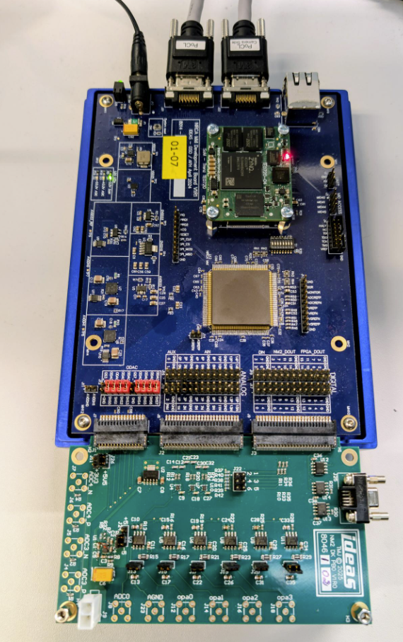
IR FPA Detector Readout Emulation
Cooled IR FPA Detectors are expensive and non-trivial to operate. Detector interface details are under NDA.
Goal: Demonstrate NIRCA MkII and FEE performance with electronics only (no detector)
Settling accuracy
Crosstalk
Dynamic range (def. signal/noise_{RMS})
How: Proximity board used for generating fast switching levels (i.e., detector output emulation)
Voltage levels between 0V – 3.3V
Fully differential
Pseudo differential
Single ended

Slide 12
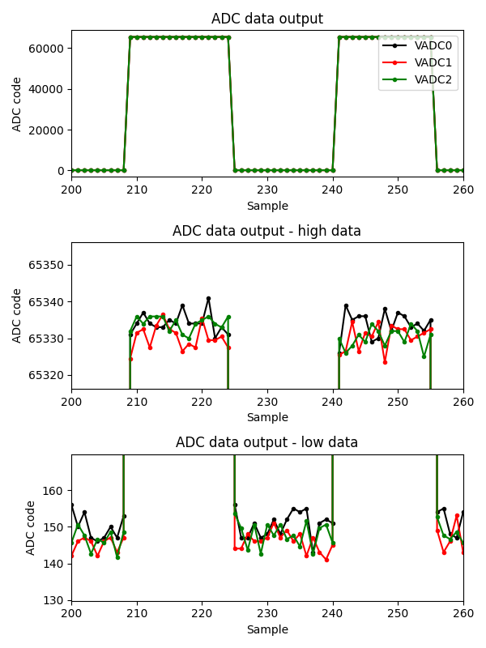
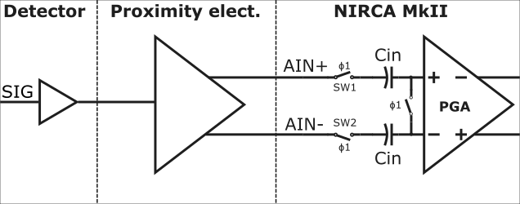
Fully Differential Input – Settling
Fully differential (FDIFF)
Key parameters
Gain | x1
Internal offset | Internal VCM
AIN+ | 0.6V - 2.25V
AIN- | 2.25V – 0.6V
Full-scale input | 3.3 Vpp, i.e.,2x1.65 Vpp
Sampling frequency | 12 Msps
Results
High data noise | 3.48 LSB_{RMS}
Low data noise | 3.52 LSB_{RMS}
Dynamic range | 18561:1, 85.3 dB
Observations
Excellent settling at 12 Msps
Dynamic range can be > 20000:1 (> 86 dB) when full-scale input is above 4 Vpp
Activating multiple simultaneously sampling ADCs of identical signals does not impact settling accuracy

Slide 13
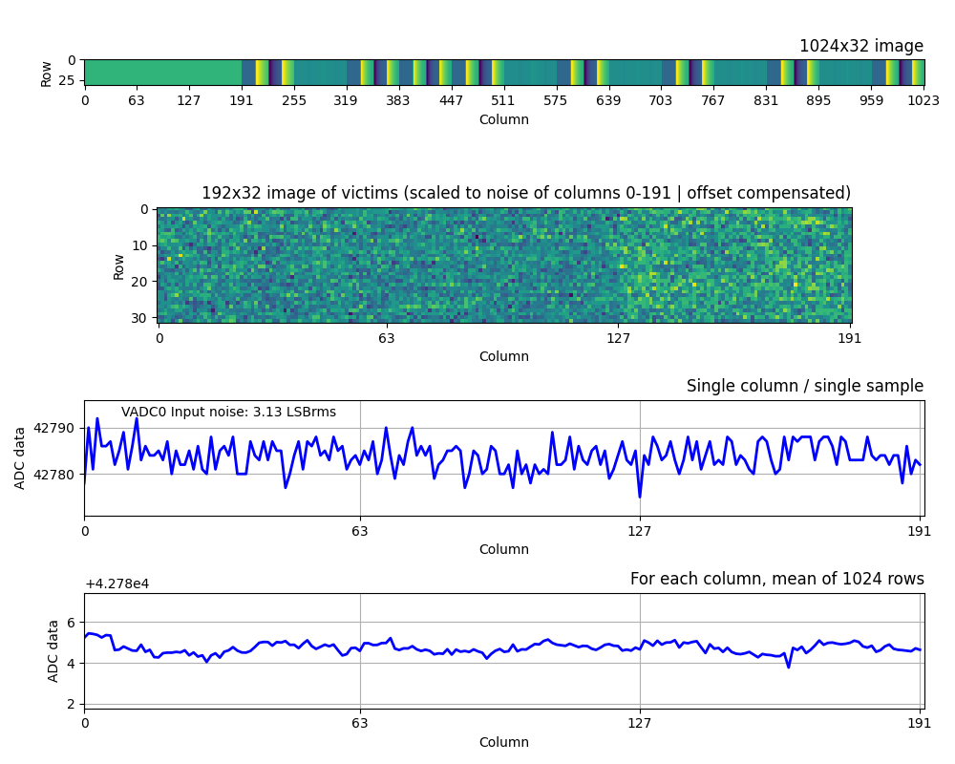
Fully Differential Input – Crosstalk
Driven input victims
Floating input victims
Key parameters
Gain | x1
Internal offset | Internal VCM
AIN+ | 0.6V - 2.25V
AIN- | 2.25V – 0.6V
Full-scale input | 3.3 Vpp
Sampling frequency | 12 Msps
Driven input victims | 3
Floating input victims | 5
Aggressors | 8
Aggressor full-scale input | 0-100%, with some taper
Visualizing only a part of the 1024x1024 frame
Aggressors
Observe driven input victims only, non-driven are non-relevant
Readout direction
VADC0
VADC1
VADC2
Average to “look into” the noise for crosstalk patterns
Observations
Noise not impacted by 8 aggressors
Averaging 1024 samples shows < 2 LSB impact, but no evident crosstalk pattern
VADC0
VADC1
VADC2
Notes:
8 aggressors acting on 8 victims

Slide 14
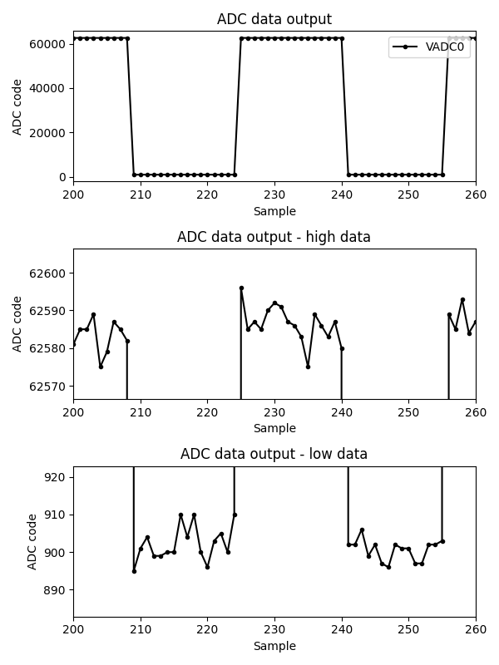
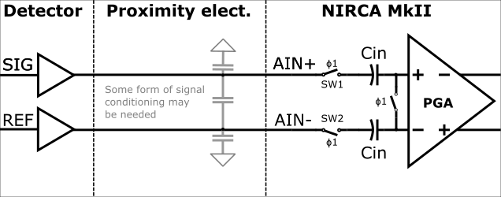
Pseudo Differential Input – Settling
Pseudo differential (PDIFF)
Key parameters
Gain | x1.6
Internal offset | srefp= 255, srefn = 85
AIN+ | 1V - 3.3V
AIN- | 1V
Full-scale input | 2.3 Vpp
Sampling frequency | 12 Msps
Results
High data noise | 5.5 LSB_{RMS}
Low data noise | 4.5 LSB_{RMS}
Dynamic range | 11214:1, 81 dB
Observations
Excellent settling at 12 Msps
Larger full-scale input gives higher dynamic range
Above results are with 7 aggressors active

Slide 15
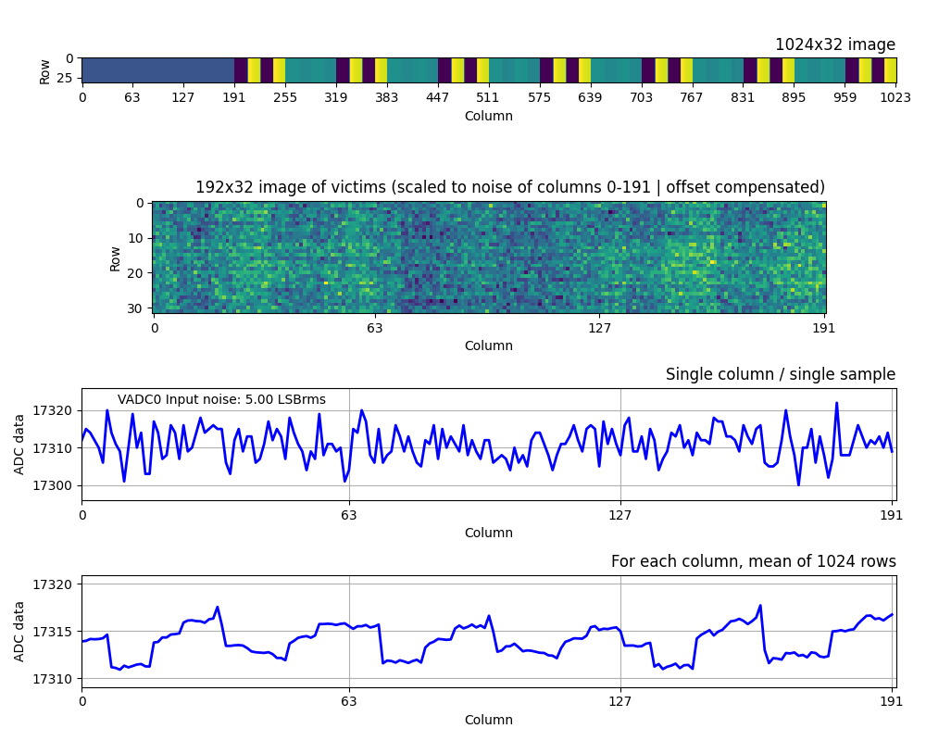
Pseudo Differential Input – Crosstalk
Key parameters
Gain | x1.6
Internal offset | srefp= 255, srefn = 85
AIN+ | 1V - 3.3V
AIN- | 1V
Full-scale input | 2.3 Vpp
Sampling frequency | 12 Msps
Driven input victims | 3
Floating input victims | 6
Aggressors | 7
Aggressor full-scale input | 0-100%
Observations
Noise (single sample) slightly impacted by 7 aggressors
Averaging 1024 samples shows ~ 8 LSB crosstalk patterns
Signal conditioning and sample rate affects crosstalk.
Notes:
8 aggressors acting on 8 victims

Slide 16
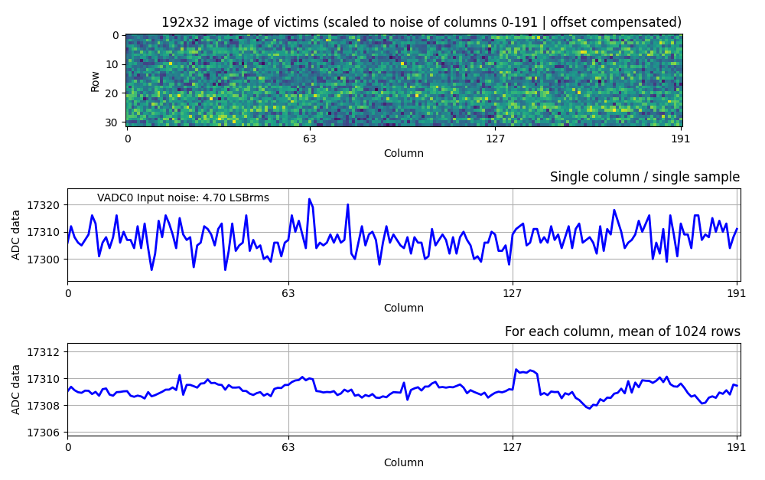
Pseudo Differential Input – Crosstalk
Key parameters
Gain | x1.6
Internal offset | srefp= 255, srefn = 85
AIN+ | 1V - 3.3V
AIN- | 1V
Full-scale input | 2.3 Vpp
Sampling frequency | 10 Msps
Driven input victims | 3
Floating input victims | 6
Aggressors | 7
Aggressor full-scale input | 0-100%
Observations
Noise (single sample) not impacted by 7 aggressors
Averaging 1024 samples shows ~ 8 LSB crosstalk patterns
Signal conditioning and sample rate affects crosstalk. E.g., at 10 Msps, < 3 LSB crosstalk patterns are observed
Notes:
8 aggressors acting on 8 victims

Slide 17
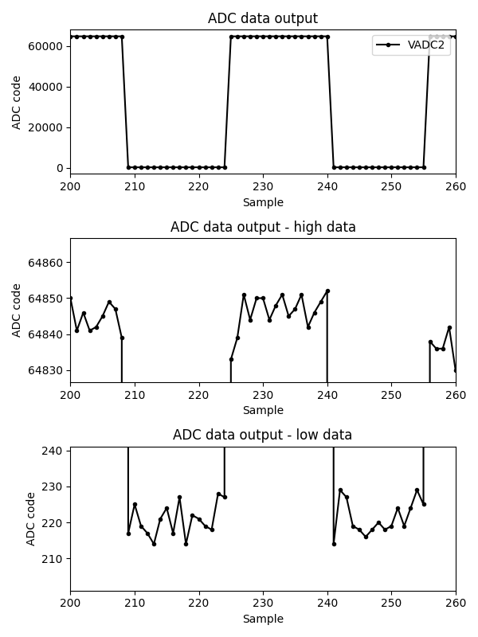
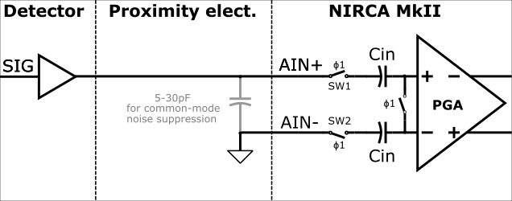
Single Ended Input – Settling
Single ended (SE)
Key parameters
Gain | x1.33
Internal offset | srefp= 255, srefn = 32
AIN+ | 0V - 3V
AIN- | GND
Full-scale input | 3 Vpp
Sampling frequency | 12 Msps
Results
High data noise | 4.6 LSB_{RMS}
Low data noise | 6.3 LSB_{RMS}
Dynamic range | 10518:1, 80.4 dB
Observations
Good settling at 12 Msps, better at lower sampling rates
Above results are with 7 aggressors active
Single ended settling is sensitive to local ground shifts, therefore signal conditioning is beneficial (e.g., small cap between ADC inputs)

Slide 18
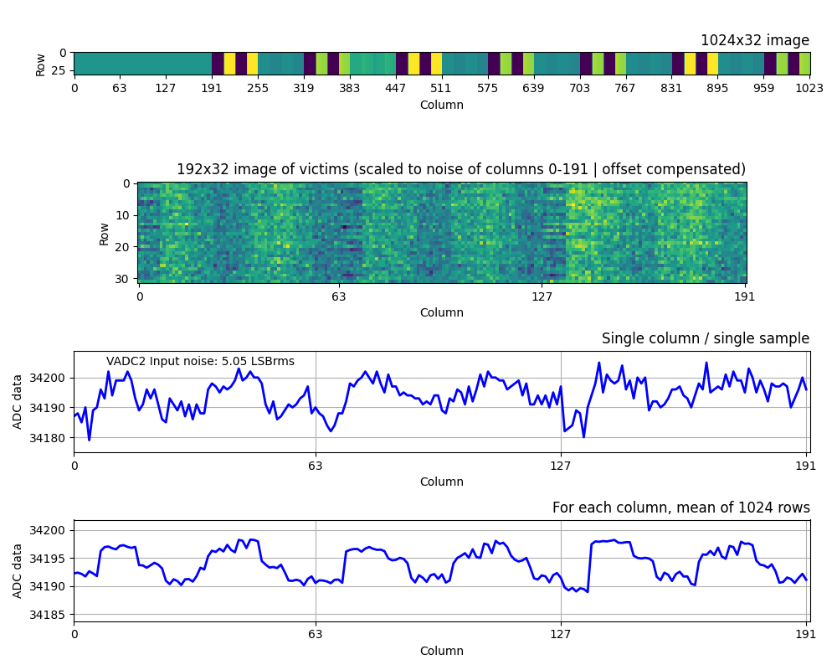
Single Ended Input – Crosstalk
Key parameters
Gain | x1.33
Internal offset | srefp= 255, srefn = 32
AIN+ | 0V - 3V
AIN- | GND
Full-scale input | 3 Vpp
Sampling frequency | 12 Msps
Driven input victims | 3
Floating input victims | 6
Aggressors | 7
Aggressor full-scale input | 3x 0-100%, 4x 0-80%
Observations
Noise (single sample) impacted by 7 aggressors – crosstalk pattern visible
Averaging 1024 samples shows ~ 8 LSB crosstalk patterns
Signal conditioning and sample rate affects crosstalk and care must be taken to avoid noise coupling to the input
Notes:
8 aggressors acting on 8 victims

Slide 19
Front-End Electronics with NIRCA MkII
Front-End Electronics Breadboard
32-channel readout
Space-grade power management
SpaceWire TM/TC
Detector SEL protection
Detector Emulator
8-channel emulation
14-bit DACs
Configurable output signal conditioning
Front-End Electronics EM
In development, available in H1 2026
Detector Emulator
Front-End Electronics Breadboard

Slide 20
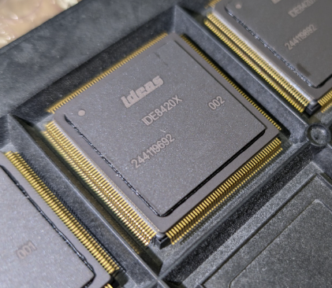
Packaging and Qualification of NIRCA MkII
IDE8420X
Ceramic package for terrestrial applications
IDE8420E/S
Ceramic package for space applications
IDE8420, Chip-on-board
Aluminum lid, or molded
Radiation test
Wafer lot acceptance
Early EMs
Evaluation
Qualification ESCC9000 Q1 2026
FMs Q1 2026
completed
Planned and Ongoing

Slide 21
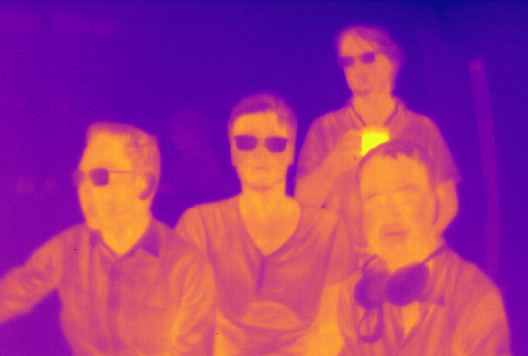
Thank you
And thank you
… to ESA for supporting the NIRCA MkII related activities
… to industry partners for the collaboration

