Slide 1
TEC-EPS Final Presentation Days
TEC-EPS
09/06/2024

Slide 2
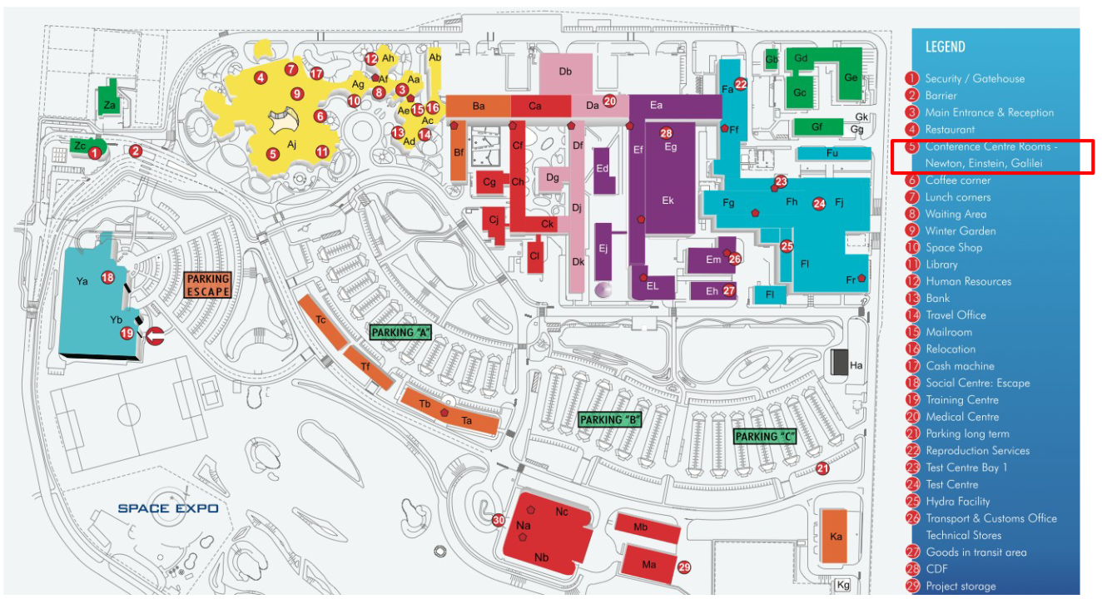
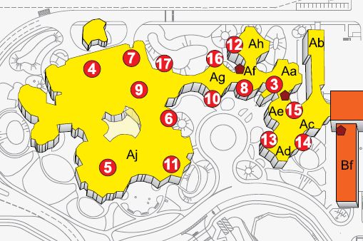
ESTEC info
Visitors can move in Zone 1 (approx. yellow part + ESCAPE). In Zone 2+, visitors must be accompanied. Please wear your personal access badge visibly at all times.
Emergency number +31 71 565 3333
Emergencies evacuation: assembly area near building Ya (ESCAPE sports centre).
Lunch (at own cost) in main ESTEC Restaurant (#4)
Coffee will be available in this room
ATM: across from the Coffee Corner.
For shuttles or taxies: info and booking at Reception (#3)
ESTEC is a smoke free facility. Smoking is only allowed (outside the buildings) in designated areas.

Slide 3
Event rules
The use of photo and video cameras is strictly forbidden while visiting the ESTEC premises. This is also applicable for the slides of this event
Presenters: The presentations will be projected from the room computer.
Please upload your material to Indico in advance of your talk.
Set the material to “Protected” when uploading.
Please stay within the allocated time, including ~5 minutes for questions.

Slide 4
RADSHIELD 2024
Registration and programme:
https://indico.esa.int/e/radshield2024
Conference room: ESCAPE Tennis Hall

Slide 5
Final remarks
Slides distribution
The slides uploaded are made available
to ESA colleagues,
and to the “TEC-EPS Final Presentation Days group”
Attendees of this event have been added to that group
In case you prefer some details in the slides to be removed or changed
please upload a new presentation suitable for distribution as mentioned above
For those attending RADSHIELD, see you tomorrow from 9:00 for coffee in the ESCAPE Tennis Hall
Thank you, and see you next time!

