Slide 1
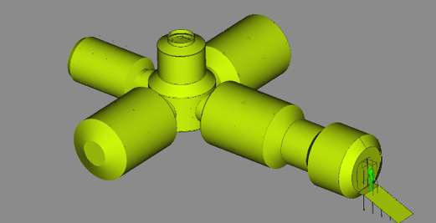
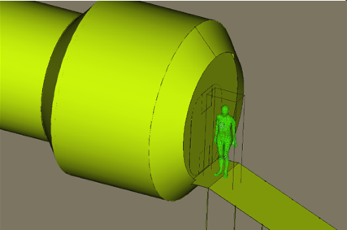
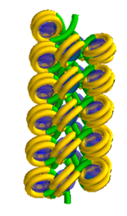
BioRad III
« Multi-scale open source radiation effect platform for space radiation protection »
Space habitat
Human phantom
DNA fiber
TEC-EPS Final Presentation Days
2024-06-11, ESA/ESTEC, The Netherlands Sébastien Incerti, CNRS / IN2P3, France

Slide 2
Context
1. Cucinotta and Durante, 2006
2. Zeitlin et al., 2013
Space radiation is considered one of the greatest and most uncertain risks for long-term space missions¹,
before microgravity & psychological stress
  Doses in space are ~100 times higher than on earth: 0.5-2 mSv/day (space) versus 2-3 mSv/year (earth)²
  Cancer risk from space radiation is the limiting factor for long duration manned-missions
To better understand the induction of adverse biological effects, since 2007 we have been developing and providing the community with a mechanistic extension to the Geant4 particle-matter simulation toolkit – called “Geant4-DNA” (http://geant4-dna.org) following a bottom-up approach* “from DNA to macroscopic effects”
  Initiated by P. Nieminen at ESTEC/ESA in 2001
  Many efforts over the years to add new functionalities in Geant4: physics, chemistry, biology… : first time in open access
  But not yet mature for space environment multi-scale use cases (complex radiation field & planet environment,
  space habitats not considered…), focusing only on DNA scale (single cell), complex simulations for novice users…
2001
Initiated at the
European Space Agency/ESTEC
by Petteri Nieminen
2007
First prototypes of TS physics models
for liquid water
added to Geant4 release 9.1
2008
New development areas:
physics, chemistry, geometries
2014
Chemistry stage extension
ready for end users in Geant4 10.1
2017-21
New TS models,
combination radiolysis (SBS, IRTs)
with geometries,
10.2 – 11
2022-2023
Integral simulation chains for DNA damage prediction
& repair
11.1 – 11.2
* « A major challenge lies in providing a sound mechanistic understanding of low-dose radiation carcinogenesis »
L. Mullenders et al. (2009)

Slide 3
BioRad III at a glance
Objective
  An « open », mechanistic & multi-scale radiation effects platform for radiation protection in space
    Simulate the effects of ionizing radiation on biological matter combining
      Radiation physics: particle-matter interactions in « discrete » mode
      Radiation chemistry: production of molecular species, diffusion, chemical reactions
      Radiation biology: early DNA damage induction (direct, non-direct) and repair
    In a multi-scale environment, easy to use
      From space habitats to realistic human phantoms and down to biological cells
  No equivalent software currently accessible to the scientific community
    PARTRAC, RI(E)TRACKS, KURBUC, MC4V*, TRAX, TOPASnBio… - see recent review in Cancers 14 (2022) 35 (link)
  Open source approach
    Based on the open-source particle – matter Monte Carlo simulation tools Geant4/Geant4-DNA and GRAS,
    strongly supported by ESA over the years
    Core components to be fully included in Geant4

Slide 4
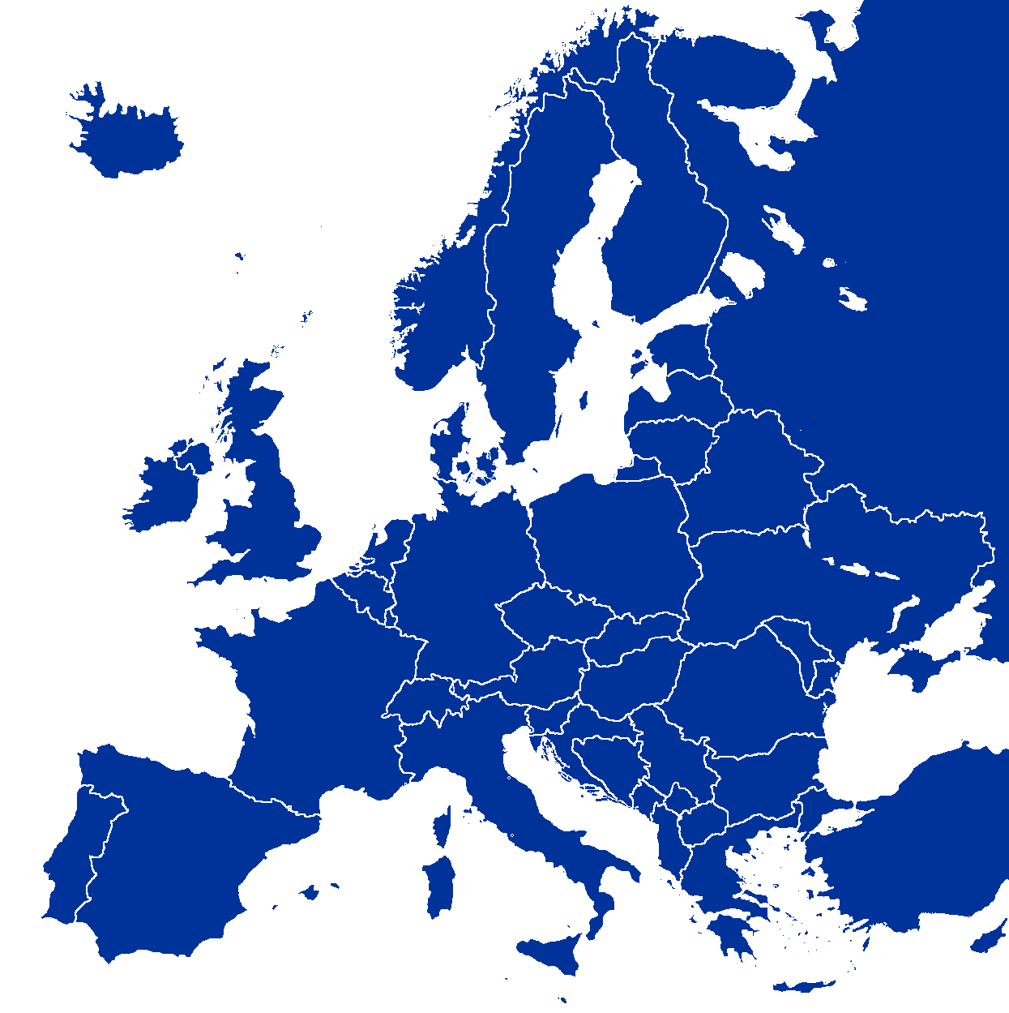
BioRad III at a glance (2)
A consortium of 9 EU partners
  Main contract ESA/ESTEC with Centre National de la Recherche Scientifique (CNRS, FR)
    2 years (mid 2021- mid 2023), 400 k€
  Sub-contact CNRS with subcontractors
    Centre National de la Recherche Scientifique (France): Geant4-DNA development & coordination
    Centre Hospitalier Universitaire Vaudois (Switzerland): radiation chemistry, dosimetry in phantoms
    Commissariat à l’Énergie Atomique et aux énergies alternatives (France): radiation chemistry
    G4AI Ltd (UK): particle-matter physical interactions, Geant4 & GRAS
    National Institute for Nuclear Physics (Italy): radiobiology
    Institut de Radioprotection et de Sûreté Nucléaire (France): radiobiology
    SWHARD SRL (Italy): computing, Geant4 & GRAS
    University of Ioannina (Greece): particle-matter physical interactions
    University of Sevilla (Spain): particle-matter physical interactions
  Including external collaborators: Belgrade U., Serbia; JINR, Russia; Osaka U., Japan; Wollongong U., Australia
Areas of expertise
 | Physics | Chemistry | Biology | Software | Exp. validation
CNRS | X | X | X
CHUV |  | X | X
CEA |  | X |  |  | X
G4AI Ltd. | X |  |  | X
INFN |  |  | X |  | X
IRSN |  |  | X
SWHARD SRL |  |  |  | X
Ioannina U. | X
Sevilla U. | X

Slide 5
BioRad III at a glance (3)
An interdisciplinary project gathering a wide variety of expertise:
  From track-structure physics / radiation chemistry /
  radiobiology mechanistic simulation using open source
  software to validation experiments in radiation chemistry and radiobiology
Work carried out in five activities (with dedicated working groups)
  Development of nanoscale physics models and optimized software (coord. Ioannina U., Greece)
  Modeling and experiments in water radiolysis (CEA, France)
  Modeling of biological repair after irradiation at the cell scale (IRSN, France)
  Multi-scale simulation platform (SWHARD SRL, Italy)
  Radiobiology experiments (INFN, Italy)
  under CNRS, France, coordination

Slide 6
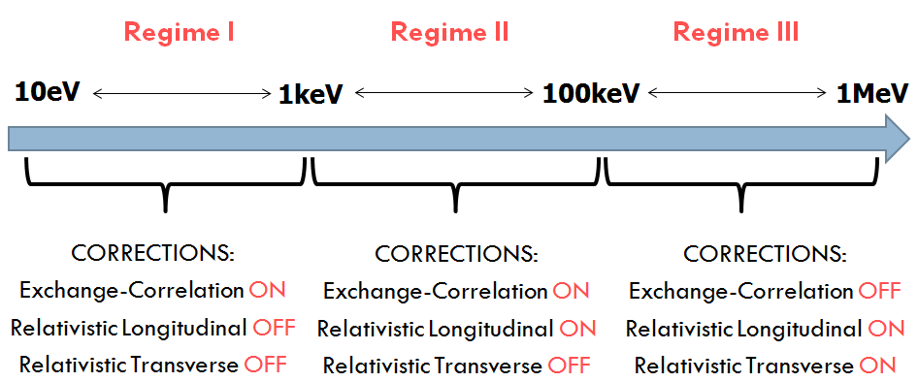
1) Nanoscale physics & software
Geant4 11.3 BETA
July 2024
Significant improvement and extension the physics of electrons and protons in the Geant4-DNA extension of Geant4
  A requirement for accurate step-by-step modeling of radiation-induced biological damage
  In liquid water medium (main component of the biological medium)
For electrons, a refined and extended physics model ("Opt4Rel") allows for the first time the simulation of inelastic electron interactions up to 10 MeV in liquid water beyond the current limit of 10 keV (existing Geant4-DNA "option 4" model)
  Plane wave Born approximation (PWBA) for the calculation of inelastic cross sections and energy-loss function (ELF) formalism to describe the material’s response
  ELF includes a modified set of parameters and the PWBA cross sections include exchange-correlation corrections, as well as relativistic longitudinal and transverse corrections
  A 3% agreement is obtained with the ICRU90 SP reference data
Stopping power of electrons in liquid water for the entire energy range of the applicability of Opt4Rel. The ICRU-90 data are available down to 1 keV.
Computational regimes for the application of PWBA corrections in the new Geant4 DNA relativistic Option 4 (Opt4Rel) model.

Slide 7
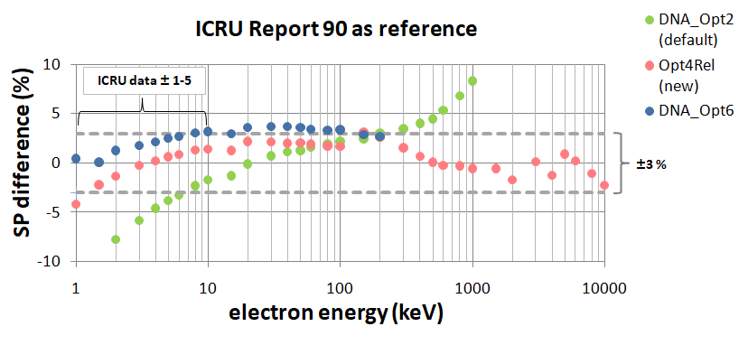
1) Nanoscale physics & software
Geant4 11.3 BETA
July 2024
Significant improvement and extension the physics of electrons and protons in the Geant4-DNA extension of Geant4
  A requirement for accurate step-by-step modeling of radiation-induced biological damage
  In liquid water medium (main component of the biological medium)
For electrons, a refined and extended physics model ("Opt4Rel") allows for the first time the simulation of inelastic electron interactions up to 10 MeV in liquid water beyond the current limit of 10 keV (existing Geant4-DNA "option 4" model)
  Plane wave Born approximation (PWBA) for the calculation of inelastic cross sections and energy-loss function (ELF) formalism to describe the material’s response
  ELF includes a modified set of parameters and the PWBA cross sections include exchange-correlation corrections, as well as relativistic longitudinal and transverse corrections
  A 3% agreement is obtained with the ICRU90 SP reference data
Difference in electron stopping power in liquid water for the whole energy range of the "Opt4Rel" model obtained from Geant4 simulations, compared to the ICRU90 reference data and the existing Geant4-DNA "Option 2" and "Option 6" models.
Computational regimes for the application of PWBA corrections in the new Geant4 DNA relativistic Option 4 (Opt4Rel) model.

Slide 8
1) Nanoscale physics & software (2)
Geant4 11.1
December 2022
For protons, a new model has been developed for Geant4-DNA describing the inelastic interactions of protons and that extends for the first time the upper energy limit of 100 MeV
Similar approach : Relativistic Plane Wave Born Approximation (RPWBA), describing the target response using the ELF and considering density effect correction
  The new upper limit for protons is now established at 300 MeV
  Corresponds to a maximum energy transferred to a secondary electron below 10 MeV, compatible with the "Opt4Rel" model
Comparison with the ICRU 90 reference data
  stopping power: very good agreement (< %)
  range: an approximately constant relative error of about 1%
Mass stopping power calculated for protons in liquid water as function of the incident energy E.
Range calculated for protons in liquid water as function of the incident energy E.
https://doi.org/10.1016/j.radphyschem.2022.110363

Slide 9
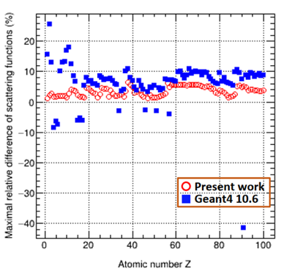
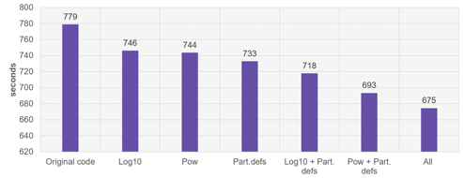
1) Nanoscale physics & software (3)
Geant4 11.1
December 2022
Geant4 and Geant4-DNA user interfaces have been improved
  Consistent combination of physics models
  (different energy ranges & particles : e⁻, H^{(n+)}, He^{(n+)}, ions)
    Ensures the transport of secondary particles beyond the energy limits of the Geant4-DNA models, using Geant4 EM Physics models
    Combination of physics models is automatically handled by the
    new G4EmDNABuilder interface
  Allows the use of the recent EPICS2017 data for the Livermore models (interactions of photons)
  Computational performance of the Geant4-DNA physical models has been significantly improved, showing a gain of about 10% to 75%, depending on the user application
    Optimized access to particle definitions
    Replacement of standard “pow” and “log” functions with Geant4 implementations
    Intel® VTune™ Profiler
Improvement of Compton scattering cross sections : maximal relative difference of fitted scattering functions as a function of atomic number
(Z: 1–100).
https://doi.org/10.1016/j.ejmp.2022.01.008
Time consumption of the “dnaphysics” example reported for the unmodified example, and with the introduction of G4Log, G4Pow, the modification of particle definition handling, and a combination of them.

Slide 10
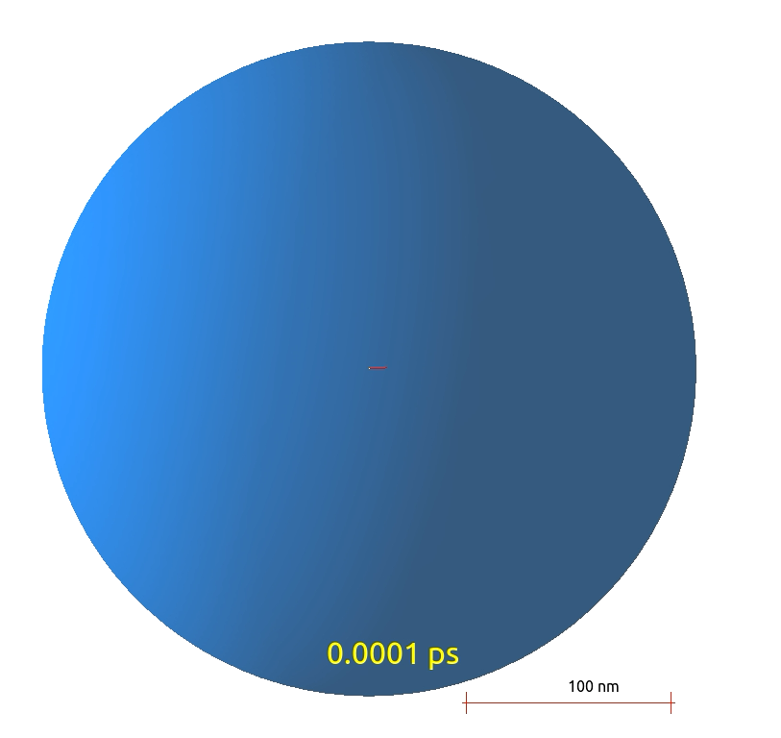
2) Modeling and measurements of water radiolysis
Geant4 11.1
December 2022
The multi-scale platform is able to simulate water radiolysis:
  Requirement for the computation of early indirect biological damage induced by radiolysis products
Review of Geant4-DNA approaches for radiolysis modeling
  Step-by-step (SBS) approach
  Independent Reaction Time (IRT) approach
    - Including a « synchronized » version (IRT-syn)
  Compartment based (SBS-RDME) approach
Addition of new functionnalities
  Scavenging of molecular species
    New « scavenger » example, in collaboration with « MAGIC »
  Possibility to consider temperature dependence
Radiolysis movie for a 1 keV electron from the “chem3” example

Slide 11
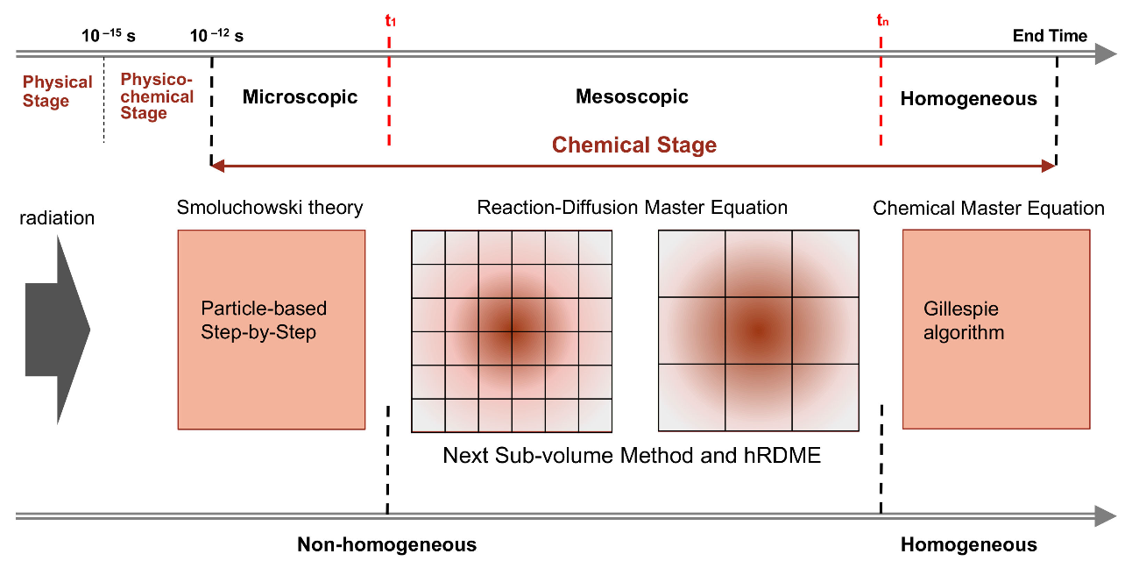
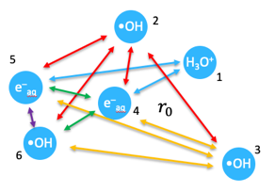
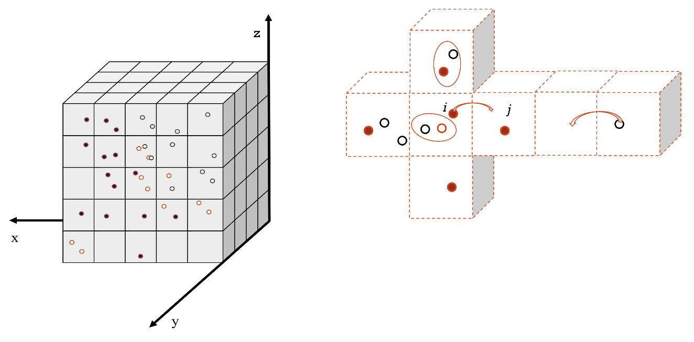
2) Modeling and measurements of water radiolysis (2)
+: Tracking of species
-: Very slow, < μs
+: Very fast
-: NO tracking of species , < μs
+: Large nb of species & long times > μs
-: Tracking of species
SBS model
Brownian transport of molecules from the Smoluchowski model. Chemical species are represented by point objects which diffuse in the liquid medium (continuum).
At each stime step (larger than a Minimum Time Step) the separation distance “d" of all pairs of reactants is checked.
Two species react with each other when d is below a given threshold “R”, called reaction radius.
The Brownian bridge technique compensates for possible missed reactions.
IRT model
An event table is constructed with the initial chemical species positions and reaction times (calculated with probability functions) for each reactant pair of interest.
Table’s entries are sorted in ascending reaction time order and then processed.
Reaction product positions are randomly sampled within a sphere centred at the reaction site.
SBS-RDME model
Combination of microscopic / mesoscopic / homogeneous states
SBS model
Compartment-based model using the Reaction-Diffusion Master Equation
Clifford et al. (1986)
B
R
A
Karamitros, M. et al. (2020) Implementing the Independent Reaction Time method in Geant4 for radiation chemistry simulations. https://doi.org/10.48550/arXiv.2006.14225
Ramos-Méndez, J. et al. (2020) Independent reaction times method in Geant4-DNA: Implementation and performance.
https://doi.org/10.1002/mp.14490
Karamitros, M. et al. (2014) Diffusion-controlled reactions modeling in Geant4-DNA. Journal of Computational Physics, 274, 841-882. https://doi.org/10.1016/j.jcp.2014.06.011
Tran, H. N. et al. (2021) Geant4-DNA Modeling of Water Radiolysis beyond the Microsecond: An On-Lattice Stochastic Approach. International Journal of Molecular Sciences, 22(11), 6023. https://doi.org/10.3390/ijms22116023
Courtesy of S. Fattori (INFN – LNS)

Slide 12
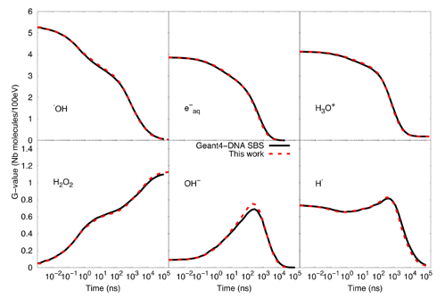
2) Modeling and measurements of water radiolysis (2)
Review accepted in Med. Phys. (2024)
+: Tracking of species
-: Very slow, < μs
+: Very fast
-: NO tracking of species , < μs
+: Large nb of species & long times > μs
-: Tracking of species
SBS model
Brownian transport of molecules from the Smoluchowski model. Chemical species are represented by point objects which diffuse in the liquid medium (continuum).
At each stime step (larger than a Minimum Time Step) the separation distance “d" of all pairs of reactants is checked.
Two species react with each other when d is below a given threshold “R”, called reaction radius.
The Brownian bridge technique compensates for possible missed reactions.
IRT model
An event table is constructed with the initial chemical species positions and reaction times (calculated with probability functions) for each reactant pair of interest.
Table’s entries are sorted in ascending reaction time order and then processed.
Reaction product positions are randomly sampled within a sphere centred at the reaction site.
SBS-RDME model
Combination of microscopic / mesoscopic / homogeneous states
SBS model
Compartment-based model using the Reaction-Diffusion Master Equation
Clifford et al. (1986)
B
Comparison of time-dependent G-values as computed with the particle-based SBS model and the SBS-RDME model (this work) from 1 ns until 100 µs.
R
A
Karamitros, M. et al. (2020) Implementing the Independent Reaction Time method in Geant4 for radiation chemistry simulations. https://doi.org/10.48550/arXiv.2006.14225
Ramos-Méndez, J. et al. (2020) Independent reaction times method in Geant4-DNA: Implementation and performance.
https://doi.org/10.1002/mp.14490
Karamitros, M. et al. (2014) Diffusion-controlled reactions modeling in Geant4-DNA. Journal of Computational Physics, 274, 841-882. https://doi.org/10.1016/j.jcp.2014.06.011
Tran, H. N. et al. (2021) Geant4-DNA Modeling of Water Radiolysis beyond the Microsecond: An On-Lattice Stochastic Approach. International Journal of Molecular Sciences, 22(11), 6023. https://doi.org/10.3390/ijms22116023
Courtesy of S. Fattori (INFN – LNS)

Slide 13
2) Modeling and measurements of water radiolysis (3)
Experimental plan established to validate Geant4-DNA simulations of water radiolysis
  chemical yield of e─_{aq}, ●OH and H₂O₂ measured by fluorescence spectroscopy, under different scavenging conditions
  Fricke dosimetry (Fe³⁺) was used to determine the yield of H●
Original optical setup installed on the beam lines
  detection of the fluorescence intensity or absorbance of a solution during its irradiation and along the track of the incident beam, allowing observation of the processes at the end of the tracks (Bragg peak)
  Experiments at 3 PF : GANIL, CAL, CEMHTI – in France
Definition of experimental chemistry protocols
Experimental radiolysis plan
Ion | Machine | Date | Experiments
30 MeV p+ | CEMHTI / CNRS Orléans | Jun & Nov 2021 | e-aq, ●OH, Fricke
25 & 62 MeV p+ | MEDICYC / CAL Nice | 1st Dec 2021 | e-aq, ●OH, Fricke
95 MeV/A C6+ | GANIL / CEA-CNRS Caen | 1st of April 2022 | e-aq, ●OH, Fricke
25 MeV p+ | MEDICYC / CAL Nice | 20th of Jun 2022 | H₂O₂ and e-aq and ●OH with lower currents
25 MeV p+ | MEDICYC / CAL Nice | 28th of Nov 2022 | Fricke, e-aq and ●OH with absorption spectroscopy
95 MeV/A C6+ | GANIL / CEA-CNRS Caen | 8th of May 2023 | e-aq, ●OH, Fricke

Slide 14
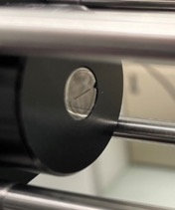
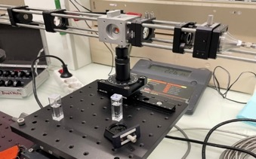
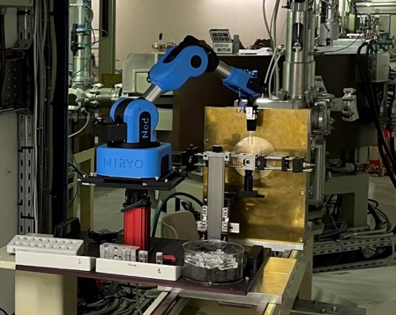
2) Modeling and measurements of water radiolysis (3)
14
Experimental plan established to validate Geant4-DNA simulations of water radiolysis
  chemical yield of e─_{aq}, ●OH and H₂O₂ measured by fluorescence spectroscopy, under different scavenging conditions
  Fricke dosimetry (Fe³⁺) was used to determine the yield of H●
Original optical setup installed on the beam lines
  detection of the fluorescence intensity or absorbance of a solution during its irradiation and along the track of the incident beam, allowing observation of the processes at the end of the tracks (Bragg peak)
  Experiments at 3 PF : GANIL, CAL, CEMHTI – in France
p⁺ beam
20 fiber bundle
Photograph of the optical setup of the in-line spectrophotometry rail. The detail of the entrance of the fiber bundle is on the left.
Experimental radiolysis plan
Ion | Machine | Date | Experiments
30 MeV p+ | CEMHTI / CNRS Orléans | Jun & Nov 2021 | e-aq, ●OH, Fricke
25 & 62 MeV p+ | MEDICYC / CAL Nice | 1st Dec 2021 | e-aq, ●OH, Fricke
95 MeV/A C6+ | GANIL / CEA-CNRS Caen | 1st of April 2022 | e-aq, ●OH, Fricke
25 MeV p+ | MEDICYC / CAL Nice | 20th of Jun 2022 | H₂O₂ and e-aq and ●OH with lower currents
25 MeV p+ | MEDICYC / CAL Nice | 28th of Nov 2022 | Fricke, e-aq and ●OH with absorption spectroscopy
95 MeV/A C6+ | GANIL / CEA-CNRS Caen | 8th of May 2023 | e-aq, ●OH, Fricke
Full installation in line with the proton beam at CAL (Nice Proton therapy center).

Slide 15
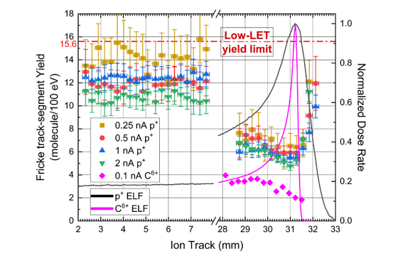
2) Modeling and measurements of water radiolysis (4)
Fricke response along the track of 62-MeV protons
and 550 MeV carbon ions
Original experimental investigation of track-segment yields along the propagation axis of proton and carbon beams
First evaluation of the Fricke yield in the distal part of Bragg peak
Protons
1) yield minima of Fricke dosimeter (extreme LET region, scavenging reactions of H₂O₂ and HO₂⋅)
2) recovery in the post Bragg peak region, could be assigned to the increase of protons energy spread combined with numerous low energy protons (« lower LET-like » effect)
Carbon: recovery not visible in track ends (too low resolution?)
Geant4-DNA simulations
Calculated yields along the track of protons reflect the expected values of independent tracks, for very low dose rates/low doses
Convincing yields, compared to the literature yields for similar radiation type and energy
G(Fe³⁺)
https://doi.org/10.1038/s41598-023-42639-4

Slide 16
3) Modeling biological repair
Modeling biological repair at the cellular level allows one to go beyond the early induction of damage
(at the microsecond scale) by physical (direct) and chemical (indirect) interactions
Three repair models were provided for the platform, including experimental data for the validation of simulations
  The Local Effect Model (LEM) version IV was proposed to reproduce non-rejoined DSB.
  Good agreement with experimental data was found for DSB rejoining after irradiation at low LET and high LET.
  A surviving fraction model is proposed from the Two Lesion Kinetic (TLK) model. Studies from the literature show that the TLK provides a satisfactory formalism to link the DSB repair mechanisms to cell killing, and supports the hypothesis of fast and slow repair mechanisms.
  Belov’s model provides a quantitative approach for the simulation of DSB repair that takes into account the main repair pathways in mammalian cells. The model was able to reproduce experimental data on the temporal evolution of γ-H2AX foci in different types of cells. It was suggested that the model is suitable for both low and high LET radiation and ions up to iron.
Characteristics of the repair models proposed in the BioRad III project
Model | Biological endpoint | Reference | Input data | Benchmark
Local Effect Model | Non rejoined DSB | Tommasino et al. (2013) Rad. Res. 180, 524-538 | Simple and complex DSB in 2 Mbp chromatin loops | Fibroblast α 40 keV/µm
Two Lesion Kinetic Model | Surviving fraction | Stewart (2001) Rad. Res. 156, 365-378 | Simple and complex DSB | Fibroblast p 7.7 keV/µm
Belov’s Model | DSB repair | Belov et al. (2015) J. theo. Biol. 366, 115-130 | Simple and complex DSB | Fibroblast P 28.5 keV/µm

Slide 17
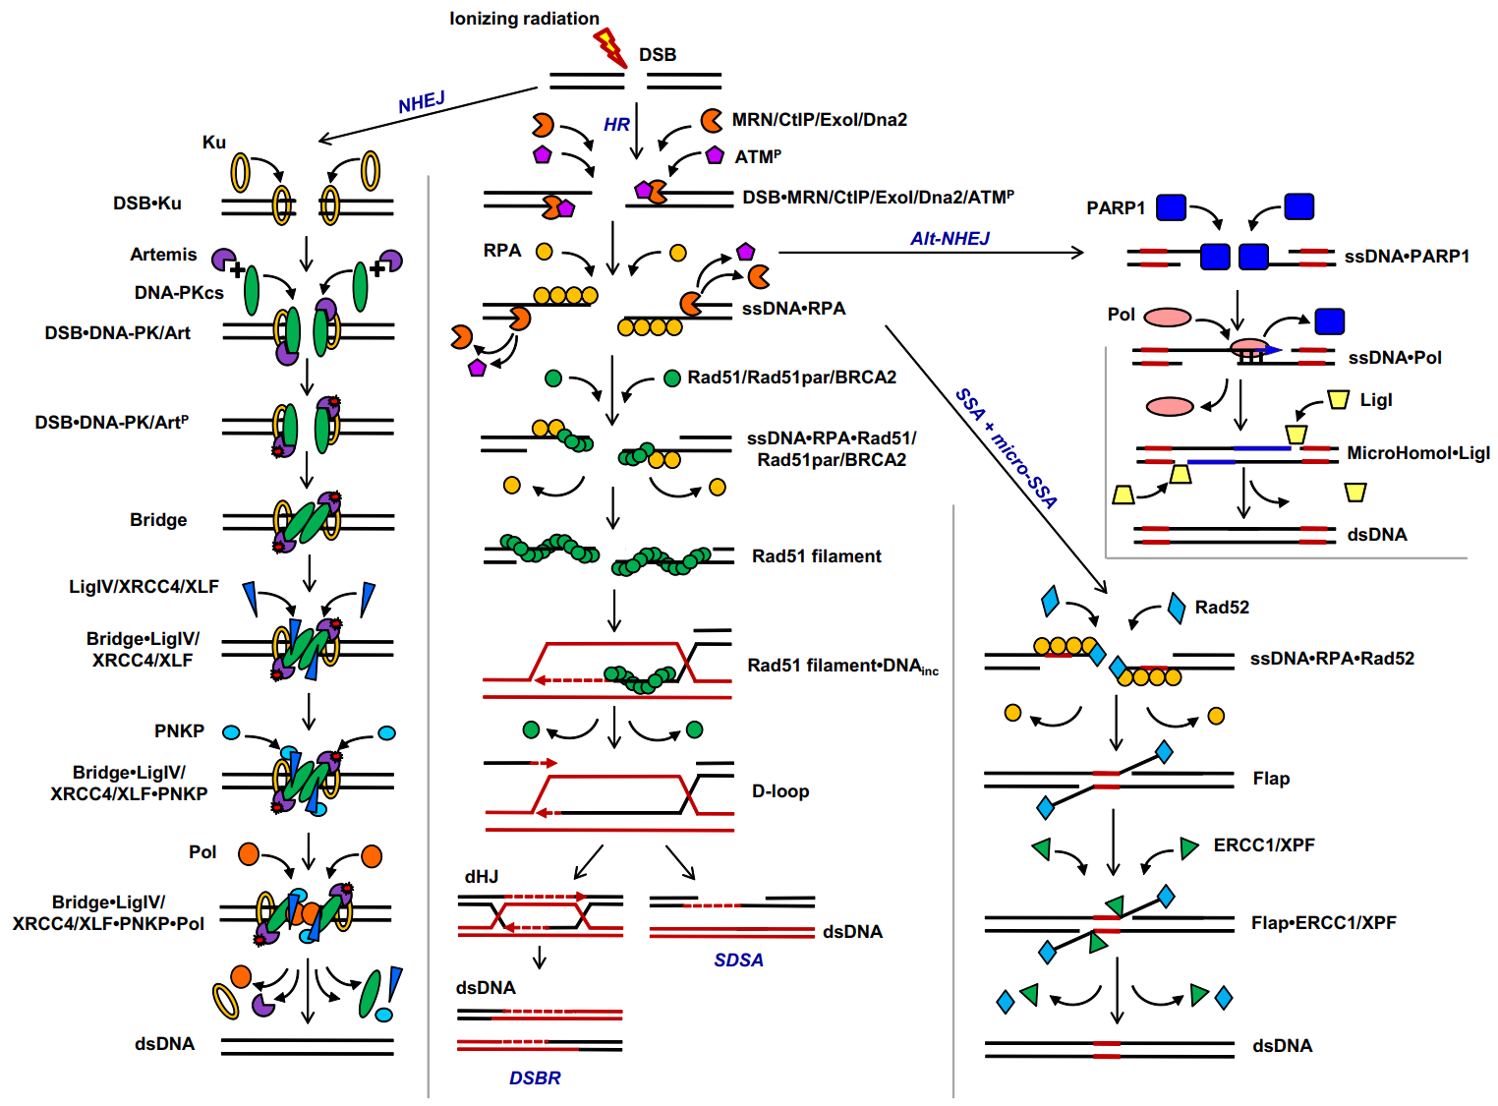
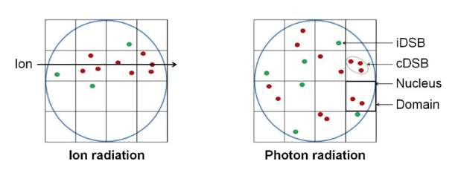

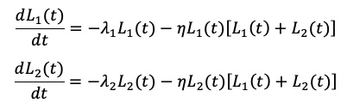




3) Modeling biological repair (2)
Comparison with experimental data of 3 types of biological end-effects predictions
(fraction of unrejoined DSB, surviving fraction, γ-H2AX foci) for the LEM IV, TLK, and Belov models.
https://doi.org/10.1016/j.jtbi.2014.09.024
LEM IV model
TLK model
Belov’s model
The time-dependent accumulation of lethal DNA damage (thus cell survival) in a cell is modelled by:
Four repair pathways of DSBs are considered
non-homologous end-joining (NHEJ)
homologous recombination (HR)
single-strand annealing (SSA)
alternative end-joining mechanism (Alt-NHEJ)
The total number of DSBs is given by:
The number of unrejoined DSBs is two-phase exponential decay with components F_{fast} and F_{slow}, characterized by half-lives τ_{fast} and τ_{slow}:
L₁(t) : number of simple DSBs at time t
L₂(t) : number of complex DSBs at time t
λ₁ : probability of repair of simple DSBs
λ₂ : probability of repair of complex DSBs
η : probability of interaction between two DSBs to form lethal lesions
β₁ : probability of lethal misrepair for single DSBs
β₂ : probability of lethal mis-repair for complex DSBs
N_{ncDSB} : number of non-clustered DSBs
N_{cDSB} : number of complex DSBs (DSBs with additional SSBs or DSBs within 10 bp separation and with inclusion of base damage)
N₀ = N_{ncDSB}+N_{cDSB}
V_{NHEJ}, V_{HR}, V_{SSA}, V_{microSSA}, V_{Alt-NHEJ} : elimination terms of DSBs by the different pathways
D : absorbed dose
α(L) : DSB induction per unit dose and per cell
n_{DSB} = n_{i} + n_{c}λ_{c}
n_{i} : number of domains containing an iDSB
n_{c} : number of domains containing a cDSB
λ_{c} : mean number of DSBs in a cDSB
F_{unrej} : fraction of residual DSBs, i.e. the fraction of DSBs that are not repaired even for late times (> 24 h)

Slide 18
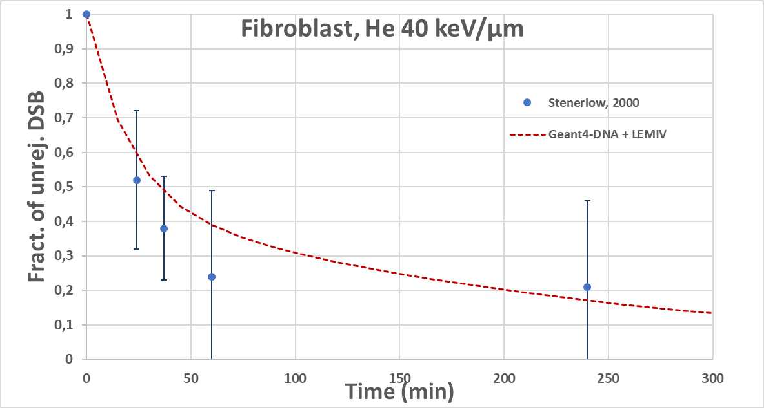
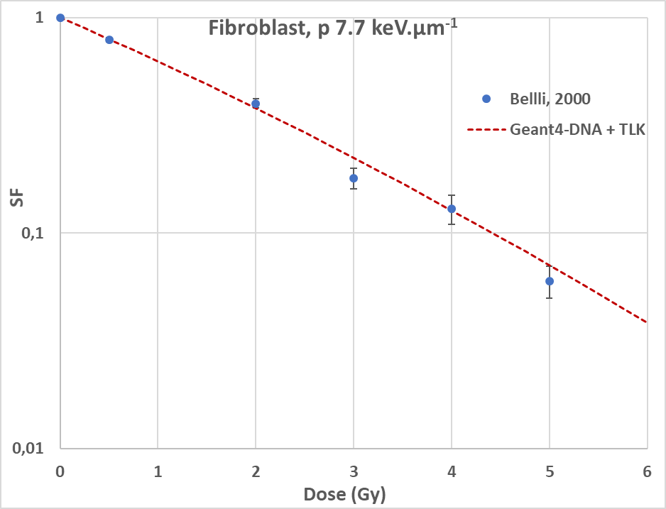
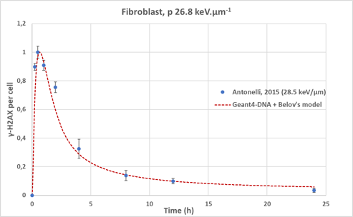
3) Modeling biological repair (3)
Comparison with experimental data of 3 types of biological end-effects predictions
(fraction of unrejoined DSB, surviving fraction, γ-H2AX foci) for the LEM IV, TLK, and Belov models.
Unrejoinded DSBs
Survival fraction
LEM IV model
TLK model
γ-H2AX foci
Belov’s model
C++ codes provided, taking as input DNA damage map
(SDD format: https://doi.org/10.1667/RR15209.1)

Slide 19
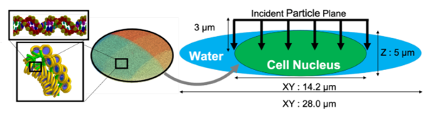
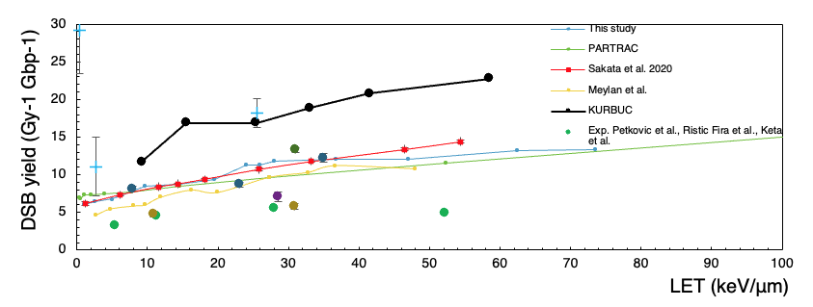
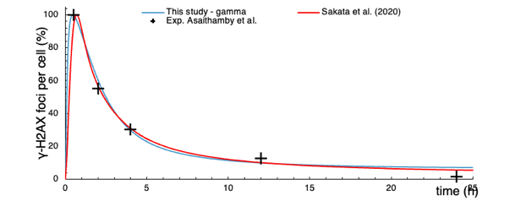
4) Multi-scale platform: single cell scale
Geant4 11.2
December 2023
« molecularDNA »: the first Geant4-DNA full integral chain example combining in a single application
  Physics + chemistry (IRT-syn) + geometries of biological targets + early and late DNA damage & SF
  Library of geometries: chromatin – phage – bacterium (E. coli ) – single cell
    Via the open source FractalDNA python toolkit by Lampe et al.: https://github.com/natl/fractaldna
  Full UI control (no C++ coding required)
A dedicated web site : https://geant4-dna.github.io/molecular-docs
DSB yield for incident protons as a function of LET, for the "human cell" geometry.
Both simulation and experimental data are included.
Damage kinetics presented as γ-H2AX yield as a function of repair time, using Belov’s model differential equations for the NHEJ repair pathway.

Slide 20
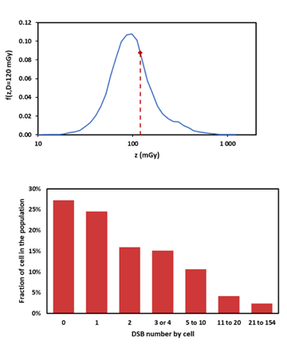
4) Multi-scale platform: cell population scale
Geant4 11.2
December 2023
« dsbandrepair »: development of an alternative chain (sequential approach)
  Physics + geometry, then chemistry (IRT syn) + geometry, then analysis of DNA damage
    Geometries are built from the DNAFabric toolkit by Meylan et al.: https://bitbucket.org/sylMeylan/opendnafabric/src/master/
  Based on the existing « dnadamage1 » Geant4-DNA example
    Induction of DNA damage in a chromatine fiber
Computations times with such chains are too large to simulate the irradiation of a cell population
  The « MINAS TIRITH » (MIcrodosimetry and NAnodosimetry to simulate the initial radiation-induced damage topology's heterogeneity) tool has been developed
  during the PhD thesis of Y. Thibaut (other funding)
  Combination and sampling of precomputed spectra (using « dsbandrepair »)
    Distribution of tracks per cell
    Determination of the number of damage assigned to each track
Top: f(z) distribution within an endothelial cell population for a given absorbed dose.
Bottom: distribution of DSB inside the population for an irradiation with monoenergetic neutrons of 15 MeV at a given absorbed dose of 120 mGy.

Slide 21
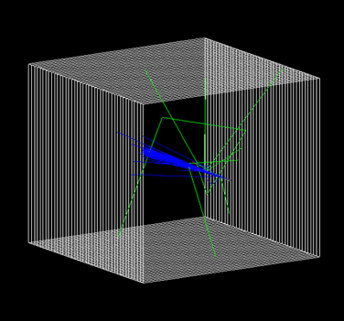
4) Multi-scale platform: radiobiology example
Geant4 11.2
December 2023
A new Geant4 example « radiobiology » has been developed for fast dosimetric and radiobiological applications for proton and ion beams
  Primaries and secondaries energy spectra
  LET (Linear Energy Transfer) – dose or track-averaged
  Survival Fraction from averaged alpha and beta values
  in slices based on prec-calc. LUT (Linear-Quadratic survival model)
  RBE (Relative Biological Effectiveness)
  Physical and biological doses
Macroscopic approach
  Only Geant4 physics (EM + hadronic) – much faster
  For large scale volumes (mm – cm water tank)
  UI control
The default geometry of the “radiobiology” example : 4 x 4 x 4 cm and was sectioned into 0.2 x 40 x 40 mm slices

Slide 22
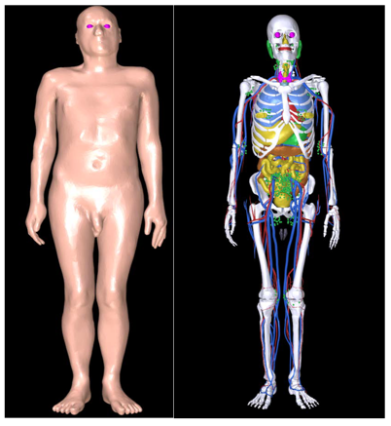
4) Multi-scale platform: human phantoms
Geant4 11.1
December 2022
Two new Geant4 advanced examples implementing ICRP phantoms
  « ICRU110_human_phantom »
    Individual voxels
    Human male phantom, from a whole-body clinical CT image: 38yr old, 176 cm, 70 kg
    Human female phantom: 43yr old, 163 cm, 60 kg
    Fully scalable, scoring information at the voxel level
  « ICRU145_humanPhantom »
    Mesh style (more realistic)
    Also available in GRAS 6.1
ICRU145 phantom visualisation:
left – skin, right – organs

Slide 23
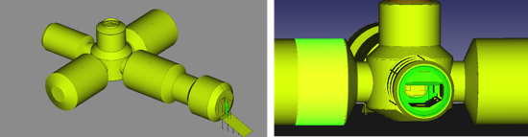
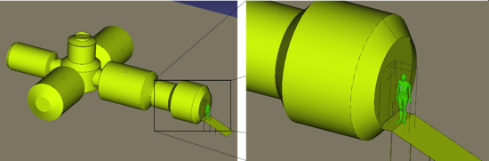
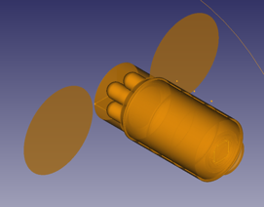
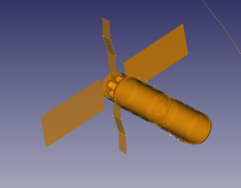
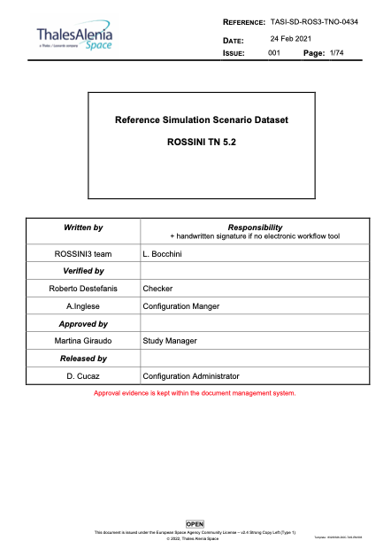
4) Multi-scale platform: space habitats
Examples of space habitats
Space habitats
  Provided by ESA
    From the Reference Simulation Scenario Dataset (RSSD) in the framework of the ROSSINI3 study, provided in GDML format
      See Reference Simulation Scenario Dataset ROSSINI TN 5.2
    Include incident particle spectra (GRAS format)
  Four habitats can be imported in the PF
    Moon
    Mars
    Transfer
    Station
  Human phantom can be placed inside the setup (ICRU110)
  Incident spectrum of particles can be shot on the setup
Moon
Mars
Transfer
Station

Slide 24
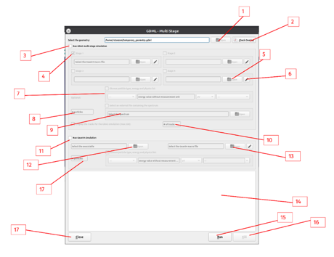
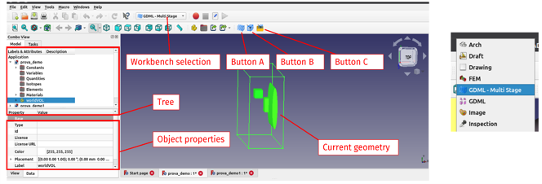
4) Multi-scale platform: overview
In FreeCAD
We developed a dedicated framework based on FreeCAD called “GDML - Multi Stage”
  Simplify the launch of multi-scale simulations, the scoring in virtual volumes and the use radiation phase space files, allowing the design of space habitats with specific radiation environments and supporting the use of the scaled human phantom to calculate the dosimetry
  The simulation is split into two or more stages
    The splitting is obtained by defining some interfaces (bounding surfaces) and saving the phase space whenever a particle reaches them. These are used as the source for the next simulation stage.
    Can combine GRAS multi-stage with Geant4/Geant4-DNA applications
    or Geant4/Geant4-DNA standalone applications
    New dedicated classes for GRAS PSF reading in Geant4/Geant4-DNA examples
  Directly accessible from the dropdown menu in FreeCAD
Left: The main interface for the plugin developed on FreeCAD.
Right: detail on the dropdown menu for the workbench selection.
Interface elements for the simulation launch

Slide 25
4) Multi-scale platform: macro to micro
Example of « MACRO to MICRO » use case:
« quantify the impact of particles at the DNA scale in a human’s liver cell (micro) from a spectrum impacting on a space habitat (macro) »
  Open FreeCAD and select the “GDML - Multistage” workbench
  Import the geometry of the Space Habitat
  Import the ICRP human phantom and place it inside the habitat.
  The user can simulate the impact of the radiation at the DNA level by running a DNA-scale example (e.g., dnaphysics) into a portion of the human phantom.
      For the use of molecularDNA, the user has to modify the original example’s geometry placement, moving it in the desired position inside the world, e.g., inside an organ of the human phantom.
  Associate the Stage information to each volume by using the customized interface.
  Select the simulation macro files and parameters (e.g., number of particles, physics list or an external spectrum file) from the interface.
  Launch the simulation. The framework will run the several simulation stages, automatically passing the phase space from one stage to the next one. All the phase space files are saved in .csv format
  The simulation standard output is displayed inside the FreeCAD GUI with additional messages about the multistage procedure.

Slide 26
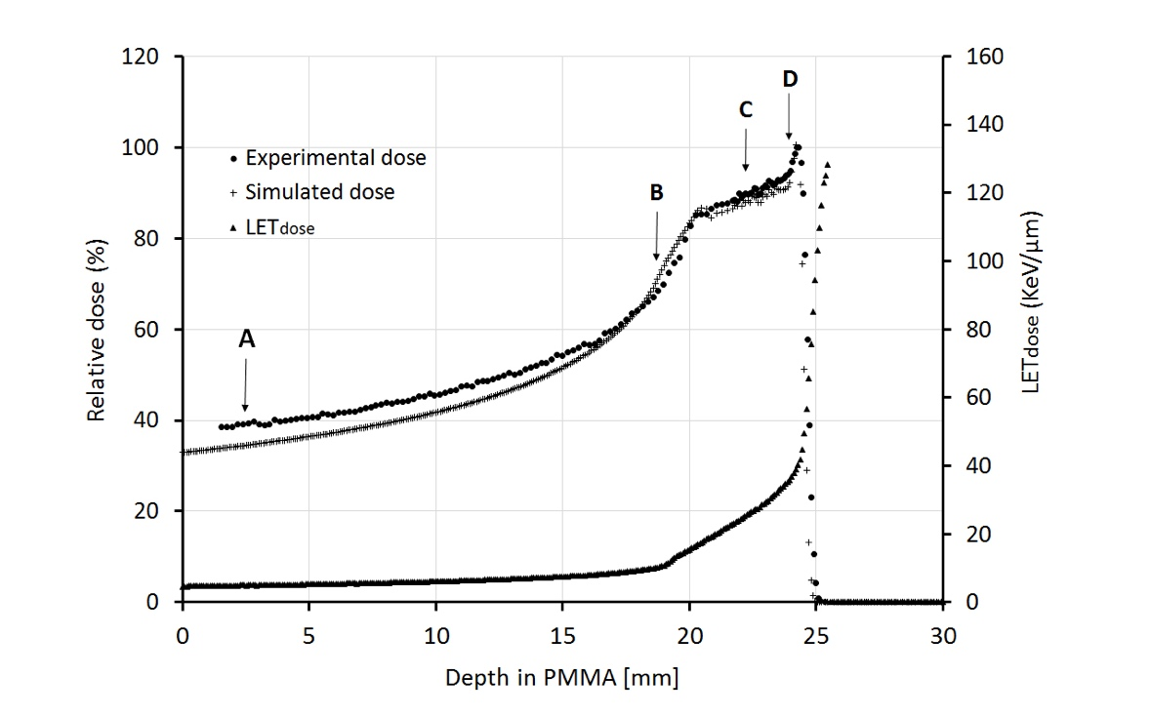
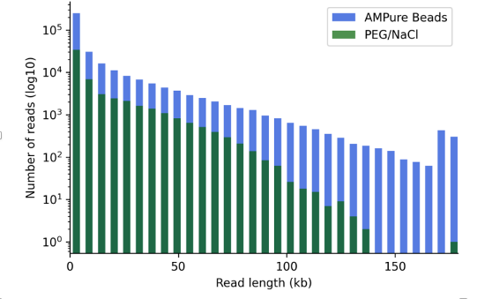
5) Radiobiology experiments
Two series of irradiation experiments for the validation of simulations
  Irradiation of radioresistant 3 human malignant cells (human HTB140 melanoma, MCF-7 breast adenocarcinoma and HTB177 non-small lung cancer) with helium ions as a function of LET
    INFN-LNS, Italy, and Vinca Institute, Belgrade, Serbia
    Reference irradiations with gamma rays from a ⁶⁰Co source were also performed at the Vinca Institute.
  Methodology to study fragmentation of T4 phage DNA under 2.5 MeV proton irradiation
    LP2iB in France
LNS : Measured depth dose distribution in Perspex (Polymethyl methacrylate - PMMA) of the broadened Bragg peak, for the ⁴He ion beam with an initial energy of 62 MeV/u, including four selected irradiation positions.
Comparison of plasmid fragment length distribution of Bacteriophage T4 genome sequencing runs on R.10.3 MinION flow cells for different DNA purification methods with PEG/NaCl precipitation and against AMPure Beads from the original protocol.

Slide 27
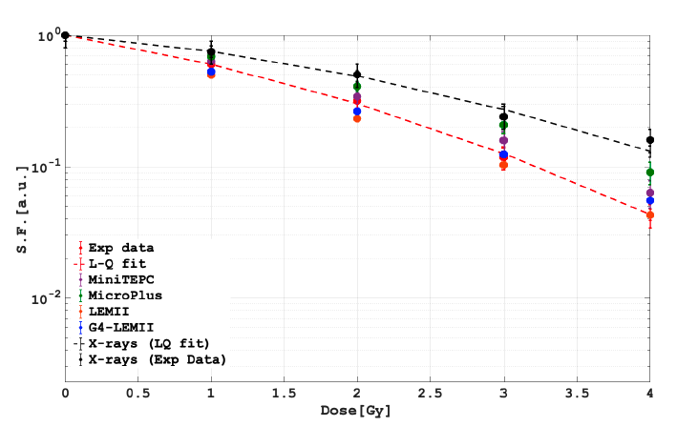
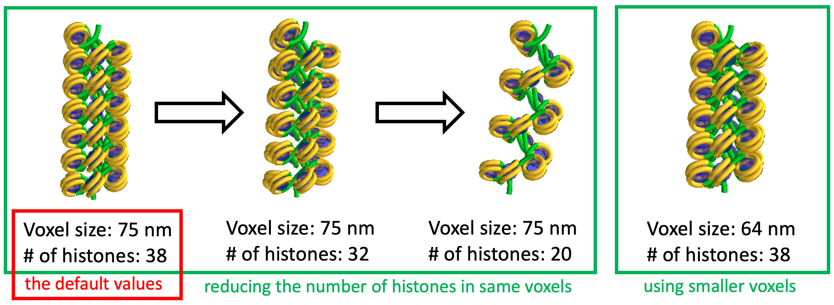
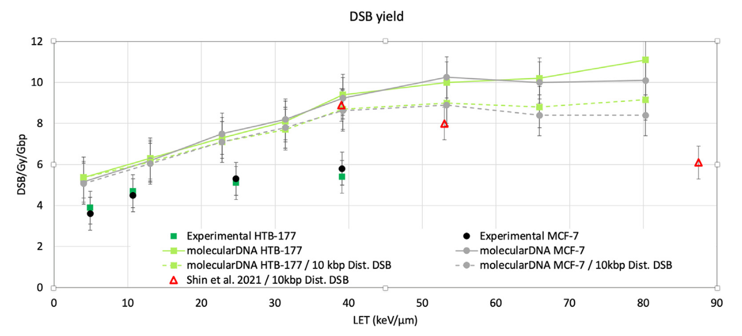
5) Radiobiology: experiments VS simulations
Simulation of irradiation experiments with Geant4 and Geant4-DNA were performed both at macroscopic and microscopic scale
At macroscopic scale
  Survival fraction for two cells lines (human 92.1 uveal melanoma cell line and human normal retinal pigment epithelial ARPE-19 cell line, with protons)
    experimental measurements of microdosimetric spectra (mini-TEPC and MicroPlus)
    calculated by coupling the Geant4 with the LEM-II model
  The proposed approaches were compared with experimental data. In almost all the cases studied, all approaches are able to reproduce the experimental data.
  Release of the Geant4 “radiobiology” example for the simulation of LET, physical and biological doses, alpha and beta parameters for RBE calculation for different facilities (LNS, Trento, CNAO).
At microscopic scale, several Geant4-DNA components have been developed, included in “molecularDNA”
  Geant4-DNA cellular geometries for human cells irradiated at INFN-LNS and Vinca
  Geant4-DNA phage geometries for irradiations at LP2iB
Survival fractions for 92.1 human uveal melanoma cell line using the “radiobiology” example.
Chromatin fiber geometry in “molecularDNA”.
Measured and simulated DSB yields using the “molecularDNA” simulation chain.

Slide 28
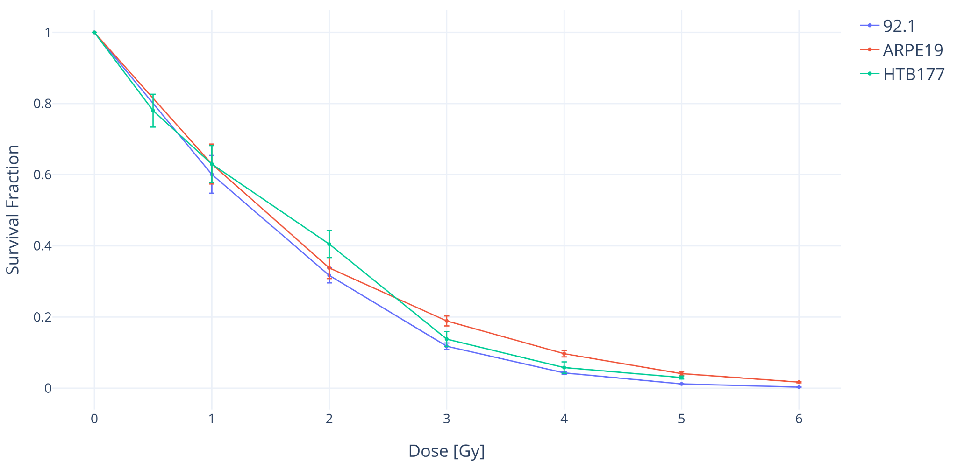
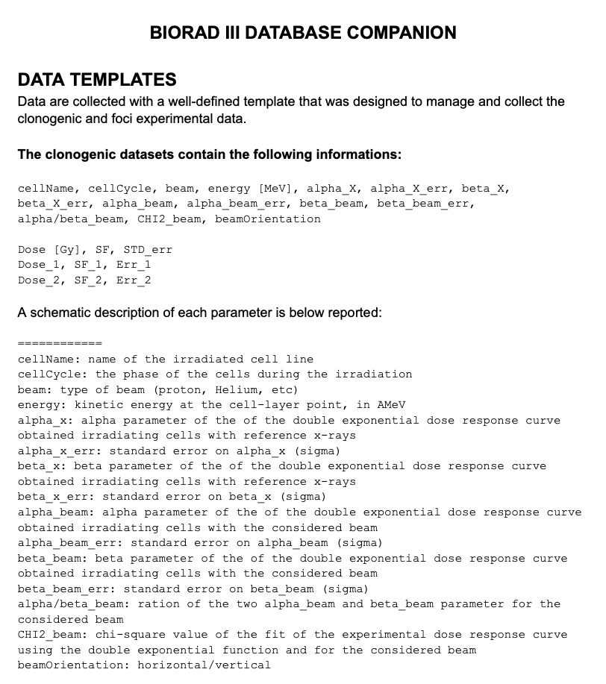
5) Radiobiology: experimental database
BioRad III has developed an online database dedicated to the storage of radiobiological data
  Provide easy access to data for the experimental validation of simulations
Data are collected using a well-defined template that has been designed to manage and collect
  Clonogenic data
  Foci experimental data
Currently, this database contains 14 collections of data
  Institute that conducted the experiment, cell line, type of measured biological endpoint, irradiation source – photons, protons and ions
  Cell types include both healthy and cancer cells:
  92.1 (human uveal melanoma cell line),
  ARPE19 (human retinal pigment epithelial cell line),
  HTB177 (non-small human lung cancer cell line),
  U-87 (human glioblastoma cell line),
  MCF10A (human breast epithelial cell line),
  HUVEC (primary human umbilical vein endothelial cells),
  U2OS (human bone osteosarcoma)
Accessible to the community
INFN hosted
Clonogenic cell survival data extracted from the online database showing the difference in radioresistance for different cell lines, the irradiation process shown in the image is a 62 MeV proton irradiation performed by the Vinca institute.
BioRad III database companion

Slide 29
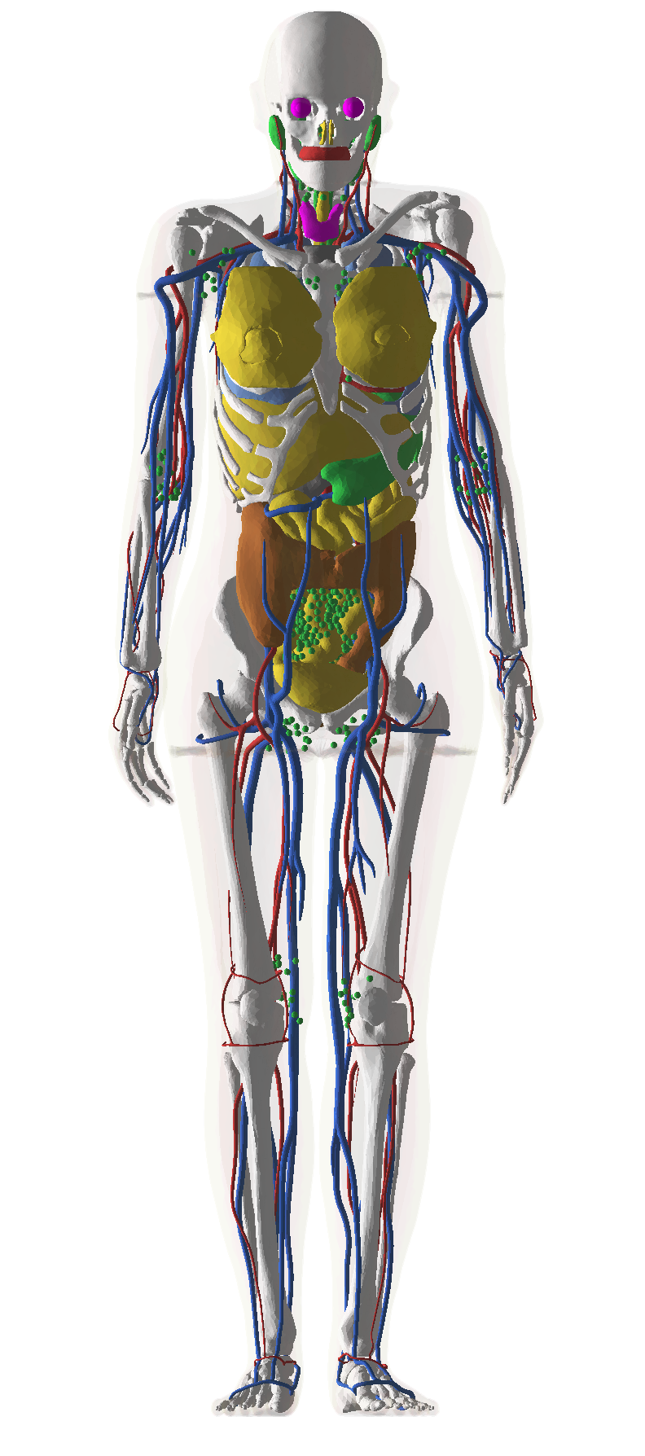
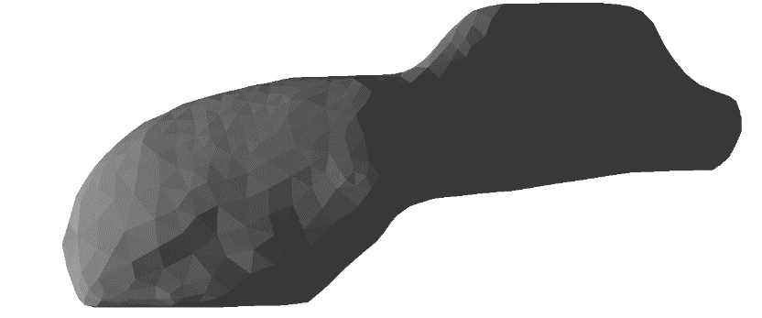
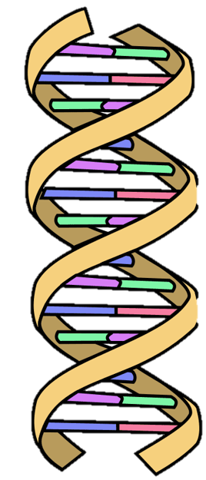
Ex. of application: a first nanodosimetric study of lunar radiation in the organs of astronauts
Courtesy of J. W. Archer et al.
Under revision with Life Sciences in Space Research
By J. W. Archer^{1*}, M. J. Large¹, D. Bolst¹, D. Sakata³, H. N. Tran⁴, V. Ivantchenko^{5,6}, K. P. Chatzipapas⁴, A. B. Rosenfeld¹,
S. Incerti⁴, J. M. C. Brown^{2,1} and S. Guatelli¹
  ¹ Centre for Medical Radiation Physics, University of Wollongong, Northfields Ave, Wollongong, NSW 2522, Australia
  ² Optical Sciences Centre, Department of Physics and Astronomy, Swinburne University of Technology, Hawthorn, VIC 3122, Australia
  ³ Graduate School of Medicine, Osaka University, Osaka, Japan
  ⁴ University of Bordeaux, CNRS, LP2I Bordeaux, UMR 5797, F-33170 Gradignan, France
  ⁵ CERN, Geneva, Switzerland
  ⁶ Princeton University, USA
  BioRad III contributors
Solar Energetic Particles (SEP)
Radiation in Space
Galactic Cosmic Radiation (GCR)

Slide 30
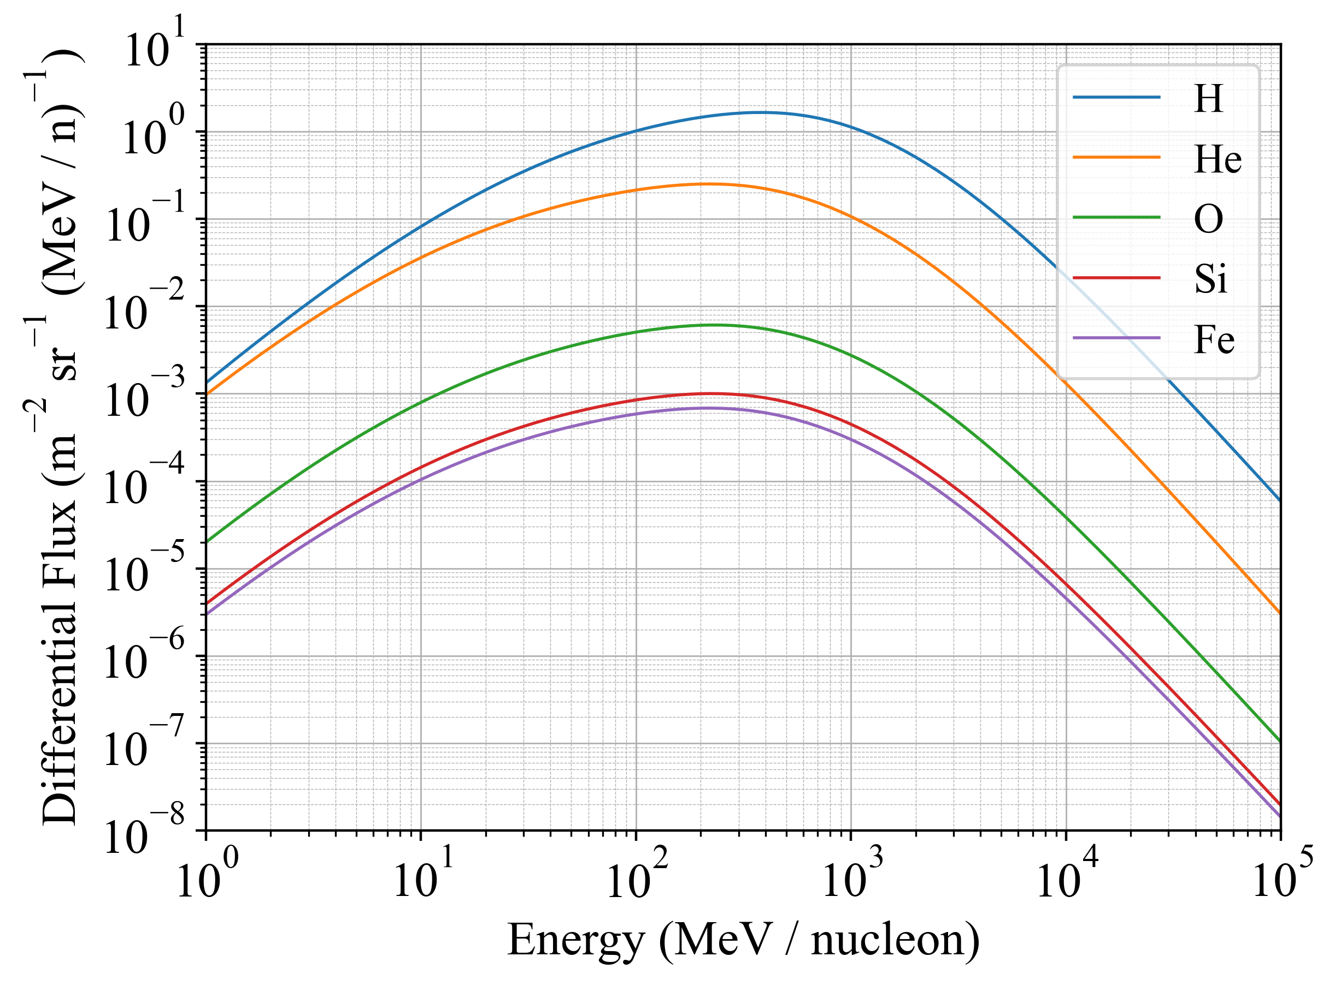
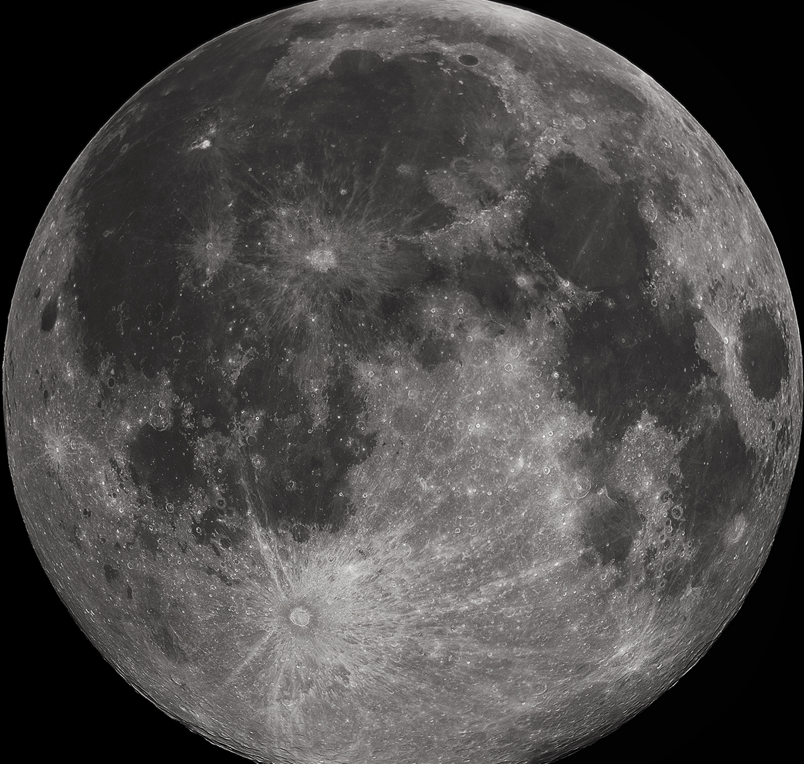

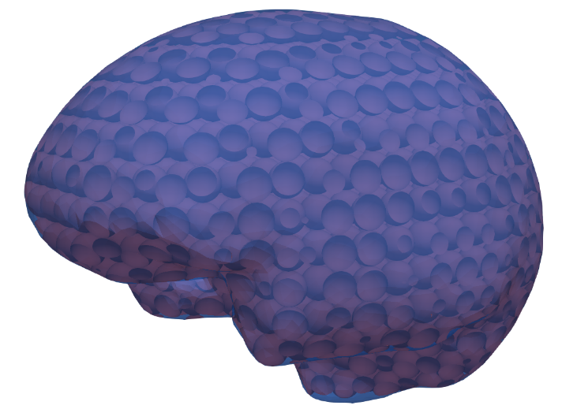
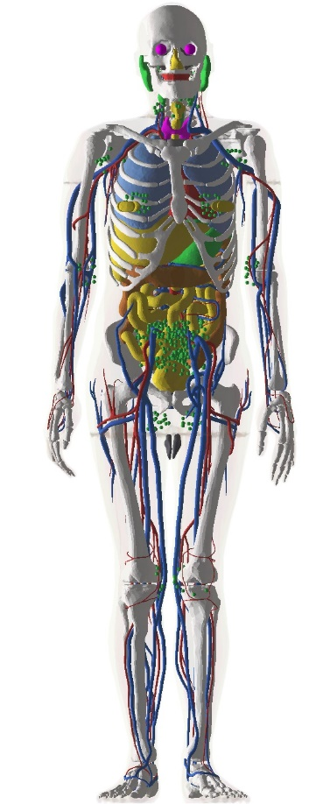

Ex. of application: methodology
Modelling of backscattered radiation from the moon
  GCR protons at solar minimum (SPENVIS model ISO-15390) only
  Geometrical model of the moon (sphere, 4 layers from borehole data, tracking of particles down to 10 m)
Radiation environment at the cellular scale
  Male and female ICRP145 tetrahedral mesh phantoms
  Particles were scored inside different organs by considering
  a spherical lattice of 10 um spheres
  A virtual scoring approach used to limit steps only inside organs of interest
  GCR & BLR with biasing considered
Early DNA damage prediction
  Physics (CH & TS) + chemistry combined with geometrical model of human fibroblast using « molecularDNA »
Consist of ~8.4 million tetrahedra
Courtesy of J. W. Archer et al.

Slide 31


Ex. of application: selected results
Sources of DNA damage in the female phantom
due to GCR and BLR
Backscattered radiation spectra from incident GCR protons
Simulated DSB yields are similar to that of high energy protons (low-LET ≲ 25 keV/μm).
Hayatsu et al. 2008, Biological Sciences in Space 22, 59– 66
Zhao et al. 2020, Biomedical Phys. Eng. Express, 6
Meylan et al., 2017. Scientific Reports, 7(1)

Slide 32
BioRad III publications
Described software is/will be included in Geant4 and/or GRAS.
GENERAL REVIEW: Review of the Geant4-DNA simulation toolkit for radiobiological applications at the cellular and DNA level,
I. Kyriakou, D. Sakata, H. N. Tran, Y. Perrot, W. G. Shin, N. Lampe, S. Zein, M. C. Bordage, S. Guatelli, C. Villagrasa, D. Emfietzoglou, S. Incerti,
Cancers 14 (2022) 35 (link)
PHYSICS: Sub-keV corrections to binary encounter cross section models for electron ionization of liquid water with application to the Geant4-DNA Monte Carlo code,
S. Margis, I. Kyriakou, S. Incerti, M.-C. Bordage, D. Emfietzoglou,
Appl. Radiat. Isot. 194 (2023) 110693 (link)
PHYSICS : A model for Geant4-DNA to simulate ionization and excitation of liquid water by protons travelling above 100 MeV,
A. D. Dominguez-Munoz, M. I. Gallardo, M. C. Bordage, Z. Francis, S. Incerti, M. A. Cortes-Giraldo,
Radiat. Phys. Chem. 199 (2022) 110363 (link)
CHEMISTRY: Review of chemical models and applications in Geant4-DNA: Report from the ESA BioRad III Project,
H. N. Tran, J. Archer, G. Baldacchino, J. M. C. Brown, F. Chappuis, G. A. P. Cirrone, L. Desorgher, N. Dominguez, S. Fattori, S. Guatelli, V. Ivantchenko, J.-R. Méndez, P. Nieminen, Y. Perrot, D. Sakata, G. Santin, W.-G. Shin, C. Villagrasa, S. Zein, S. Incerti, accepted in Med. Phys. (2024)
BIOLOGY: Simulation of DNA damage using Geant4-DNA: an overview of the “molecularDNA” example application,
K. P. Chatzipapas, N. H. Tran, M. Dordevic, S. Zivkovic, S. Zein, W.-G. Shin, D. Sakata, N. Lampe, J. M. C. Brown, A. Ristic-Fira, I. Petrovic, I. Kyriakou, D. Emfietzoglou, S. Guatelli, S. Incerti,
Prec. Radiat. Oncol. (2023) 1-11(link)
BIOLOGY: Experimental validation in a neutron exposure frame of the MINAS TIRITH for cell damage simulation,
Y. Thibaut, G. Gonon, J. S. Martinez, M. Petit, R. Babut, A. Vaurijoux, G. Gruel, C. Villagrasa, S. Incerti, Y. Perrot,
Phys. Med. Biol. 68 (2023) 225008 (link)
BIOLOGY: MINAS TIRITH: A new tool for simulating radiation-induced DNA damage at the cell population level,
Y. Thibaut, G. Gonon, J. Martinez-Guerrero, M. Petit, A. Vaurijoux, G. Gruel, C. Villagrasa, S. Incerti, Y. Perrot,
Phys. Med. Biol. 68 (2023) 034002 (2023) (link)
BIOLOGY: Prediction of DNA rejoining kinetics and cell survival for V79 cells using Geant4-DNA,
D. Sakata, R. Hirayama, W.-G. Shin, M. Belli, M. A. Tabocchini, O. Belov, M. A. Bernal, M.-C. Bordage, J. M. C. Brown, F. Chappuis, L. Desorgher, D. Emfietzoglou, Z. Francis, S. Guatelli, T. Inaniwa, V. Ivanchenko, M. Karamitros, I. Kyriakou, Z. Li, S. Meylan, C. Michelet, N. Lampe, K. Murakami, S. Okada, Y. Perrot, I. Petrovic, J. Ramos-Mendez, A. Ristic-Fira, G. Santin, T. Sasaki, J. Schuemann, H. N. Tran, C. Villagrasa, S. Incerti,
Phys. Med. (2023) 102508 (link)
RISK: Microdosimetry study of proton quality factor using analytic model calculations,
A. Papadopoulos, I. Kyriakou, Y. Matsuya, S. Incerti, I. Daglis, D. Emfietzoglou,
Appl. Sci. 12 (2022) 8950 (link)
RISK : Space radiation quality factor for Galactic Cosmic Rays and typical space mission scenarios using a microdosimetric approach,
A. Papadopoulos, I. Kyriakou, S. Incerti, G. Santin, P. Nieminen, I. A. Daglis, W. Li, D. Emfietzoglou,
Radiat. Environ. Biophys. 62 (2023) 221-234 (link)
+2 currently under review:
BIOLOGY: nanodosimetry in organs from lunar radiation
RISK: analytical RP quality factor

Slide 33


BioRad III publications: 2 highlights
CHEMISTRY: Review of chemical models and applications in Geant4-DNA:
Report from the ESA BioRad III Project,
H. N. Tran, J. Archer, G. Baldacchino, J. M. C. Brown, F. Chappuis, G. A. P. Cirrone,
L. Desorgher, N. Dominguez, S. Fattori, S. Guatelli, V. Ivantchenko, J.-R. Méndez,
P. Nieminen, Y. Perrot, D. Sakata, G. Santin, W.-G. Shin, C. Villagrasa, S. Zein, S. Incerti,
accepted in Med. Phys. (2024)
First and global review of all Geant4-DNA developments in chemistry since 2010:
13 years of development, the 5th Geant4-DNA “collaboration” paper
BIOLOGY: Prediction of DNA rejoining kinetics and cell survival for V79 cells using Geant4-DNA,
D. Sakata, R. Hirayama, W.-G. Shin, M. Belli, M. A. Tabocchini, O. Belov, M. A. Bernal,
M.-C. Bordage, J. M. C. Brown, F. Chappuis, L. Desorgher, D. Emfietzoglou, Z. Francis,
S. Guatelli, T. Inaniwa, V. Ivanchenko, M. Karamitros, I. Kyriakou, Z. Li, S. Meylan,
C. Michelet, N. Lampe, K. Murakami, S. Okada, Y. Perrot, I. Petrovic, J. Ramos-Mendez,
A. Ristic-Fira, G. Santin, T. Sasaki, J. Schuemann, H. N. Tran, C. Villagrasa, S. Incerti,
Phys. Med. (2023) 102508 (link)
Galileo Galilei Award 2023
European Journal of Medical Physics / Physica Medica
Ceremony on Sept. 14th, 2024 in Munich during ECMP2024
https://www.physicamedica.com/galileo_galilei_award

Slide 34
BioRad III: main perspectives
Radiation physics
  Improve the accuracy of ion physical interaction models down to the DNA scale, including charge exchange processes & multiple-ionization, as well as resulting physico-chemistry processes
  Towards risk estimation: a new model for radiation protection Q-factor (see Ioannina U. team)
Radiation chemistry
  Experimental validation of radiolysis simulation for such primary particles, including dose rate effects
Radiation biology
  Towards more advanced geometrical & repair models
  Simulation of radioinduced biological damage in bacteria (Sengupta et al., 2024) and in 3D assemblies of cells:
  AI the way to go?
  Further populate the reference radiobiological database (extension to other quantities such as G-yields)
  Experiments with various (GCR) beam qualities including dose rates / biological models / @ dedicated facilities
Outreach: international tutorials showcasing the platform, during Geant4-DNA tutorials
Other application domains: environmental studies (ex. ecosystems), ionizing radiation in medical physics
(ex. novel irradiation modalities such as Flash RT) …

Slide 35
In summary
BioRad III has allowed the development of key functionalities in the Geant4, Geant4-DNA and GRAS tools
  Allowing in particular the development of a prototype multi-scale simulation platform based on the FreeCAD framework
  Key components : DNA-scale chains & geometries, phantoms, space habitats
Such a platform can be used in the context of space missions, combining detailed geometries of space habitats and realistic human phantoms, down to the cellular scale
  Also paving the way to new semi-analytical Q-model for risk estimation during space missions
Dedicated experiments have been performed to verify/validate recently released software for radiolysis simulations, and for radiobiological simulations based on the Geant4 and Geant4-DNA tools
Described software is being/will be included in Geant4 and/or GRAS
The creation of a common radiobiological database, in particular for the validation of radiobiology simulations, will probably be useful for the scientific community
Thank you !

