Slide 1
Project Report NORM
Norwegian Radiation Monitor for a long-term mission in highly-elliptical orbit
ESA Contract: 4000128542/19/NL/AS
2024-06-11 TEC-EPS Final Presentation Days

Slide 2

Why NORM?
The need for more radiation data
Norwegian interest in research
Flight opportunity: Space Norway's Arctic Satellite Broadband Mission
At IDEAS, gain experience with designing and testing of space electronics in order to support our customers including ESA better
Advance the capabilities of this technology

Slide 3
Project Objectives
To develop the Norwegian Radiation Monitor.
It produces data from which differential and integral flux data for energetic protons and electrons with low cross species contamination can be derived, as well as optional LET spectra.
Shall be suitable for use on many satellites, but in particular the ASBM mission with its unique TAP orbit.
At IDEAS, we planned to
reuse frontend readout electronics that were developed for the RADEM instrument on JUICE,
Make improvements in cost and detector noise thresholds,
Gain knowledge to support future customers better, by understanding the issues in the design of space electronics ans systems in more depth.

Slide 4

At IDEAS, we develop and manufacture electronics for radiation detection
Radiation Imaging Systems
Frontend ICs for Radiation Detectors
Custom Mixed-Signal ASIC Development
For use in Industry, Scientific Research
Founded in 1992, we are based in Oslo, Norway.

Slide 5

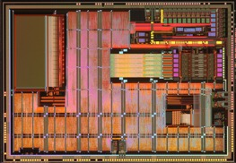
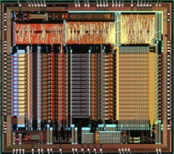
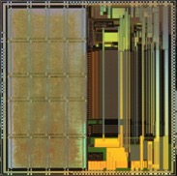
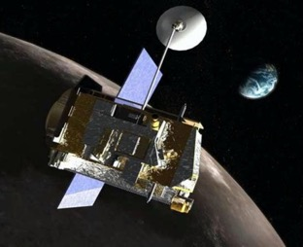
Integrated Detector Electronics AS
SWIFT | NASA | 2004 | BAT gamma-ray telescope and spectrometer
CREAM | NASA | 2004-2010 | High energy particle spectrometer onboard several balloon flights
AMS/AMS02 | NASA | 1997 / 2011 | Charged particle tracker
PAMELA | INFN | 2006 | Charged particle tracker
STEREO | NASA | 2006 | PLASTIC, Particle and ion Spectrometer
Super AGILE | INAF-IASF INFN | 2007 | Gamma-ray spectrometer
Chandrayaan-1 | ISRO | 2008 | HEX, High Energy gamma and X-ray spectrometer
FOXSI | NASA | 2014 | X-ray telescope/spectrometer
CALET | JAXA | 2015 | CALorimetric Electron Telescope
DAMPE | CAS | 2015 | DArk Matter Particle Explorer. High energy calorimeter and tracker.
ASTRO-H | JAXA | 2016 | SDG Soft Gamma-ray Imager HXI Hard X-ray Imager
Tiangong 2 | CAS | 2016 | POLAR gamma-ray spectrometer/polarimeter
ARASE/ERG | JAXA | 2016 | Electron spectrometer
ISS-CREAM | NASA | 2017 | High energy particle spectrometer attached to the International Space Station
ASIM | DNSC | 2018 | MXGS, Miniature X- and Gamma-Ray Sensor.
BepiColombo | ESA/JAXA | 2018 | MPPE instrument on MMO, BERM radiation monitor ELENA instrument
EDRS-C | ESA | 2019 | NGRM, Next Generation Radiation Monitor, electron and proton spectrometer.
SRG | SRI/VNIIEF/NASA | 2019 | ART-XC – Astronomical Roentgen Telescope – X-ray Concentrator.
JUICE | ESA | 2023 | RADEM Electron and proton spectrometer.
ASBM | Space Norway | 2024 | NORM Norwegian Radiation Monitor
IDEAS SME in operation since 1992.
integrated circuits for image sensors (x-rays, gamma rays, charged particles, IR, thermal).
Systems for radiation imaging in space and on earth.
Applications:
Radiation monitoring.
Particle and cosmic ray detection.
Gamma and x-ray astronomy.
Infrared astronomy.
Planetary science.
SWIFT Chandrayaan-1 AMS BepiColombo JUICE

Slide 6




Project Partners

Slide 7
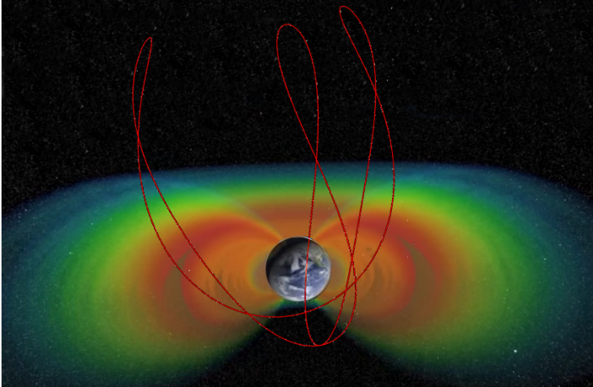
NORM Specifications
Application Measuring kinetic energy for energetic charged particle radiation
Energy range Electrons: 0.5 - 7 MeV, 9 log bins
Protons: 7 - 200 MeV, 9 log bins
Power consumption < 3W (target)
Weight 3 kg
Data interfaces MIL-STD-1553B, (CAN, others)
Radiation hardness 100 krad TID, 60+ MeV cm²/mg SEL
In orbit lifetime 5+ years in HEO
Input voltage range 25V – 37V (adaptable)
Credit for radiation belt: NASA Goddard
Credit for radiation belt: NASA Goddard

Slide 8
Electronics Unit
DHU + PSU
Detector Unit
DGU / Sensor
Model
Test and Verification
Kick-Off Summer 2019
Detector Diodes +
7085 FrontEnd Board
SAMV71-Evalboard +
ASIC shield + Lab-PSU,
SAMV71RH Eng. Board + 1553 Test HW
breadboard
Development on Breadboard Prototypes
Phase B
PDR Jan 2020
EM Detector stack + Readout PCB (ASIC) +
EM housing
SAMV71RH, PSU, 1553 Bus on Design PCB,
Eng. Components,
Housing to Flight Design
EM
Electronics Testing, MIL-STD-1553-BUS Testing
Sensor Functional Test
Mechanics (Vibration/Shock) and Noise-Testing
Calibration (“Beam-Test”)
Phase C1
CDR July 2020
FM Detector stack
+ FM housing
EM with FM footprint RH components, non-certified, FM housing
EQM
Thermal Vacuum, Vibration Testing, EMC/EMI
Environment and Mechanics Design Verification
Calibration (“Beam-Test”)
Phase C2
QAR Jan 2021
FM Detector stack
+ FM housing
As EQM with certified components, FM housing
FM
Flight Model Functional Testing
Environment and Mechanics Acceptance Testing
Phase D
Delivery May 2021

Slide 9
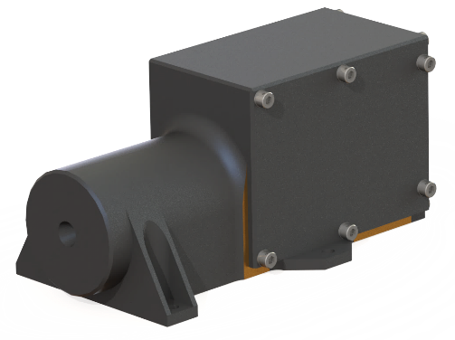
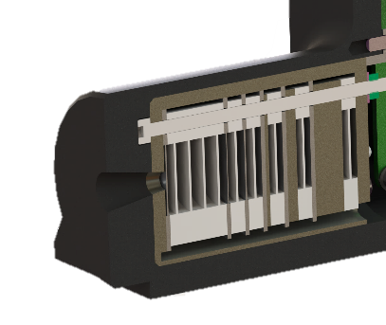
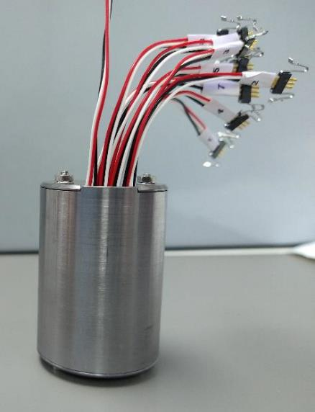
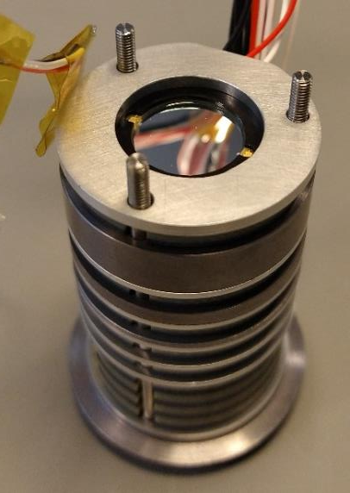
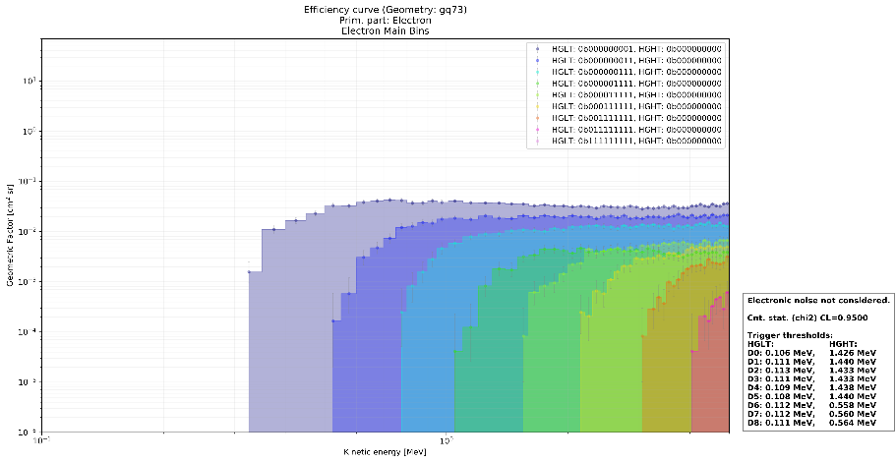
Detector Unit
9x 500um Si detector diodes with 2 different
active area diameters (8 and 12 mm)
Aluminum and tantulum absorbers.
Stack design based on simulation with
GRAS/GEANT4

Slide 10
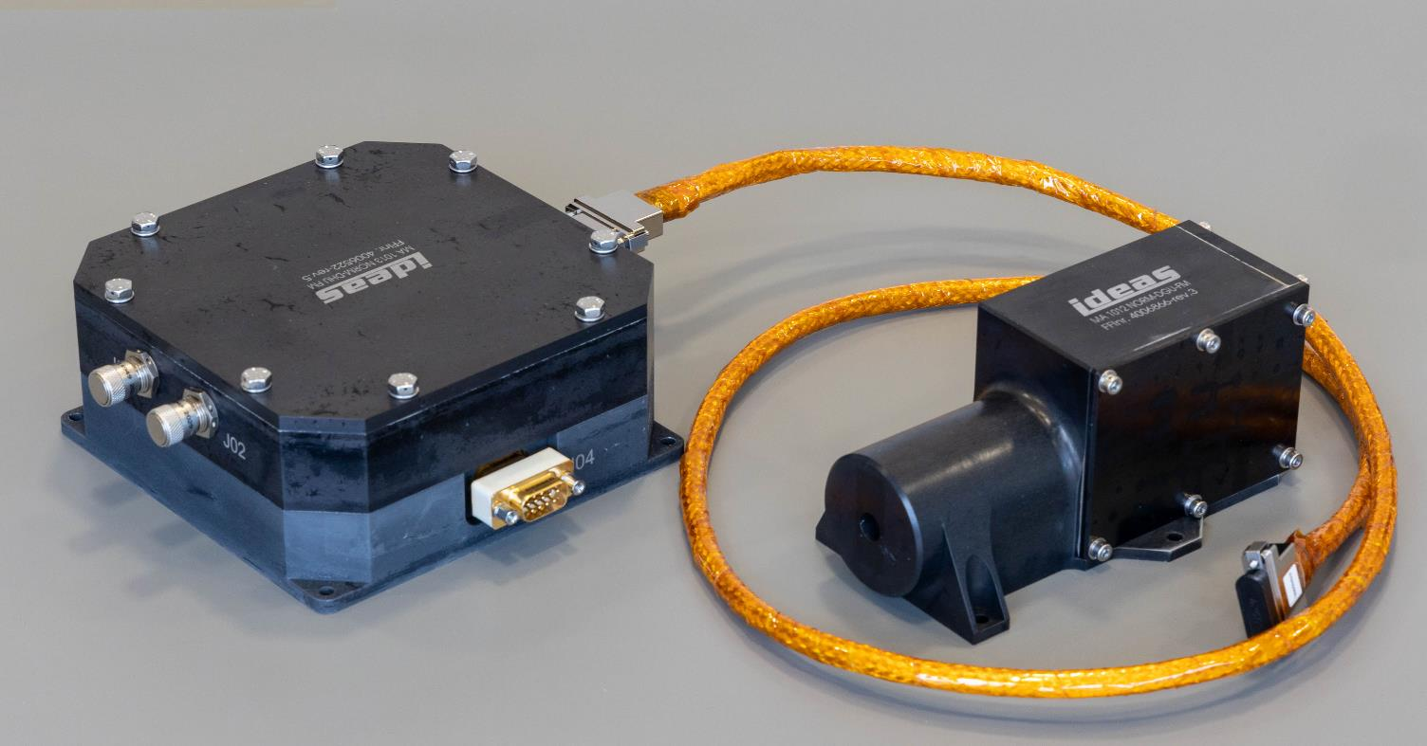
NORM instrument hardware
Data Handling Unit
Detector Unit
Image credit: IDEAS
Front face, detector stack

Slide 11
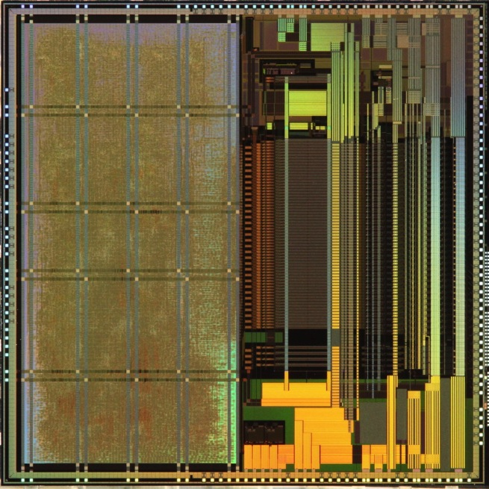
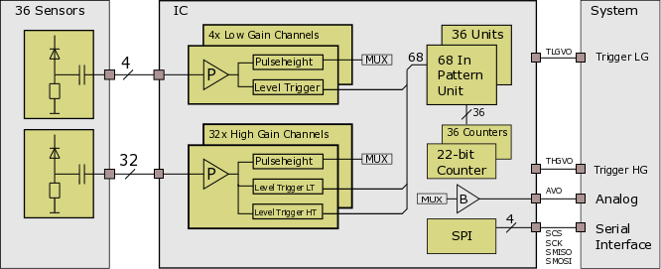
Detector Readout ASIC
IDEAS IDE3466 chip.
IDE3466 ASIC [1]
Features:
  Radiation-hard 16 x 16 mm² chip
  36 input channels (for Si detectors)
  Energy spectroscopy capability
  Pattern unit (coincidence)
  High-speed counters
  On-board calibration circuit
  SPI interface
IDE3466 block diagram.
Image credit: IDEAS
Image credit: IDEAS
[1] T. A. Stein, et al.,
“Front-end readout ASIC for charged particle counting with the RADEM instrument on the ESA JUICE mission,” Proc. SPIE 9905, Space Telescopes and Instrumentation 2016: Ultraviolet to Gamma Ray, 990546 (19 July 2016). DOI: 10.1117/12.2231901

Slide 12
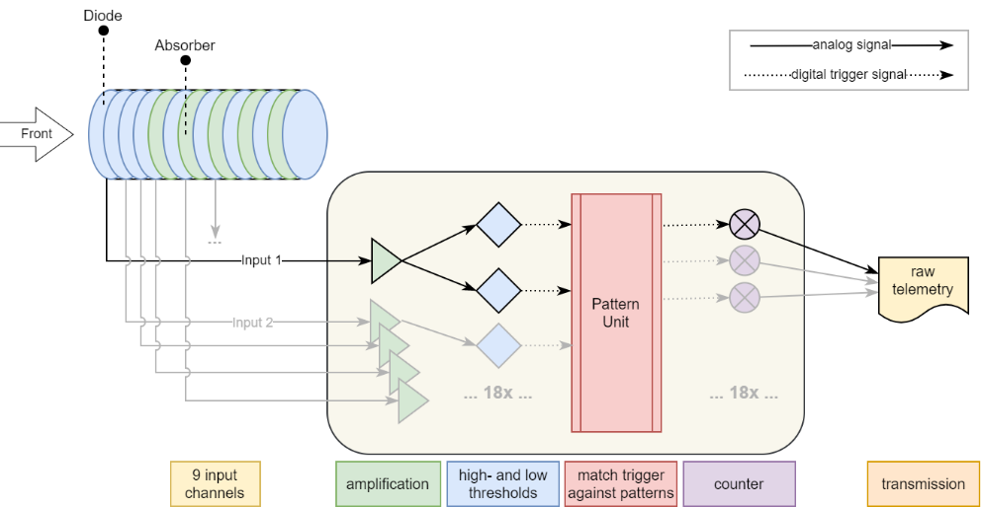
Detection Scheme
Read out Electronics using the IDE3466 ASIC (as used in RADEM)
Discriminator with two threshold settings
Electron detection uses low threshold trigger in the coincidence patterns.
Proton detection uses both high and low threshold trigger in the coincidence patterns.
Counter sampled every 60 seconds.
Histogram for 9 electron and 9 proton bins.
Event rate 100k events/s per channel

Slide 13
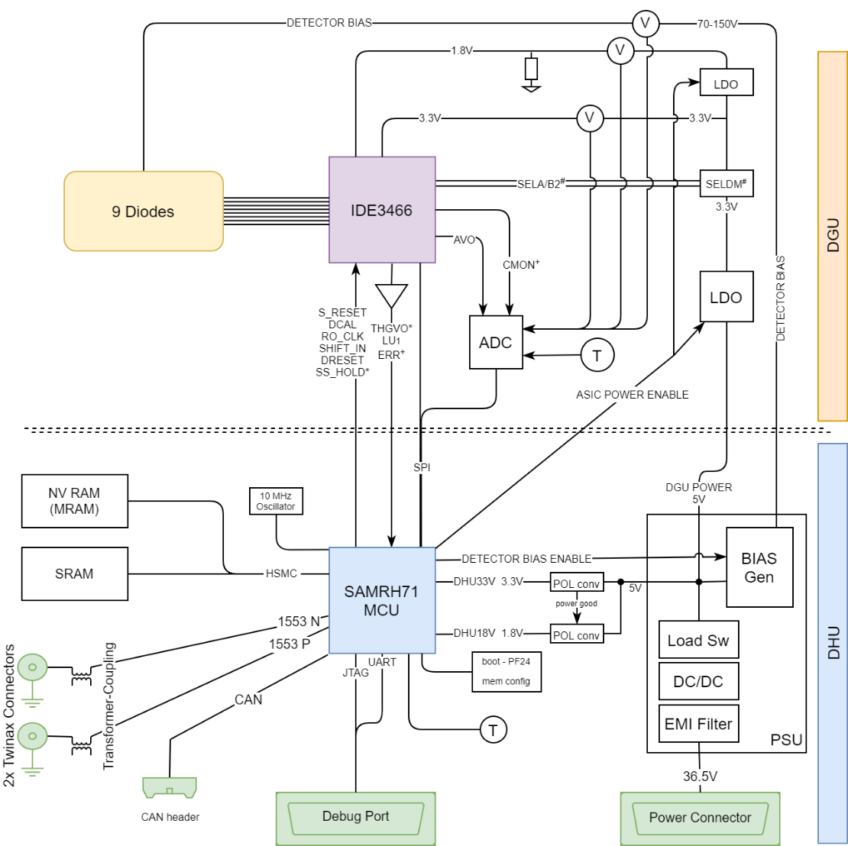
Readout
Counter Readout through the IDE3466 ASIC SPI interface
We also use an analog output for pulse-height spectroscopy and for calibration.
Notes:
This uses the ADC to read the data
It is triggered by low thresholds

Slide 14
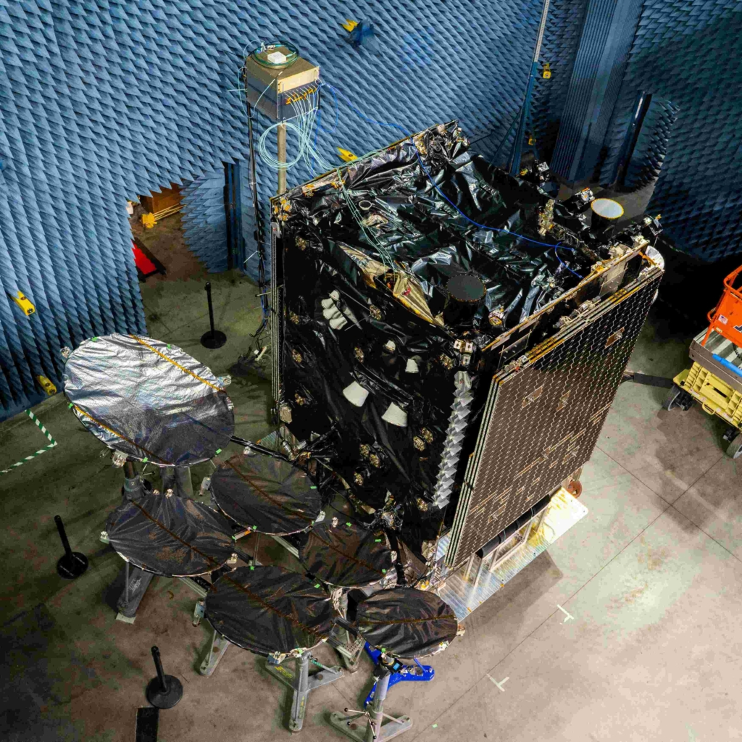
ASBM
Artic Satellite Broadband Mission
Norwegian communication satellites
  Full coverage of area above 65°N
  Operated by Space Norway
  15-year mission
  5 years nominal NORM operation
  Viasat communication payload
  On each orbit they cross the outer radiation belt
  NORM on one of the two satellites
Launch scheduled on July 15th, 2024, on a SpaceX Falcon 9 from Vandenberg SFB.
Credit: Northrop Grumman

Slide 15
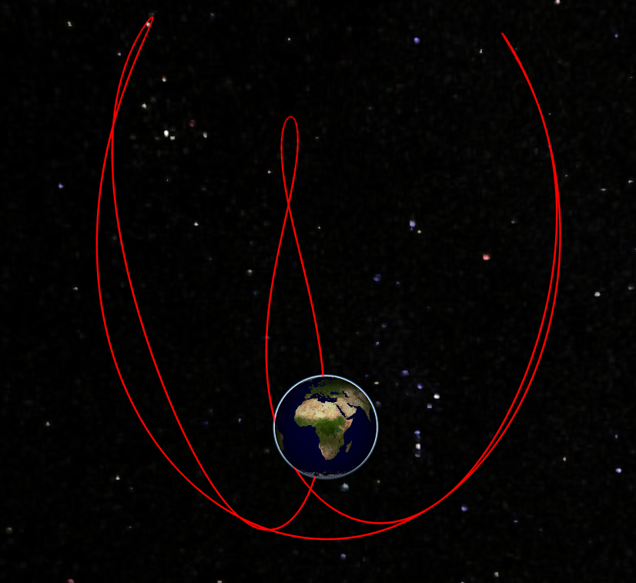
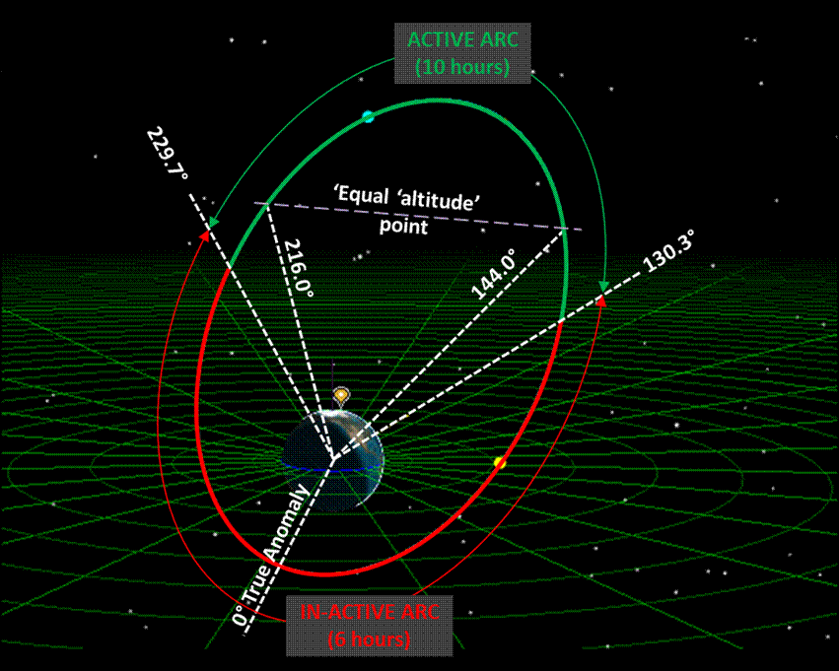
ASBM
Artic Satellite Broadband Mission
HEO: Three-Apogee Orbit, TAP
16h, 8746 km × 42878 km, 62.3°

Slide 16
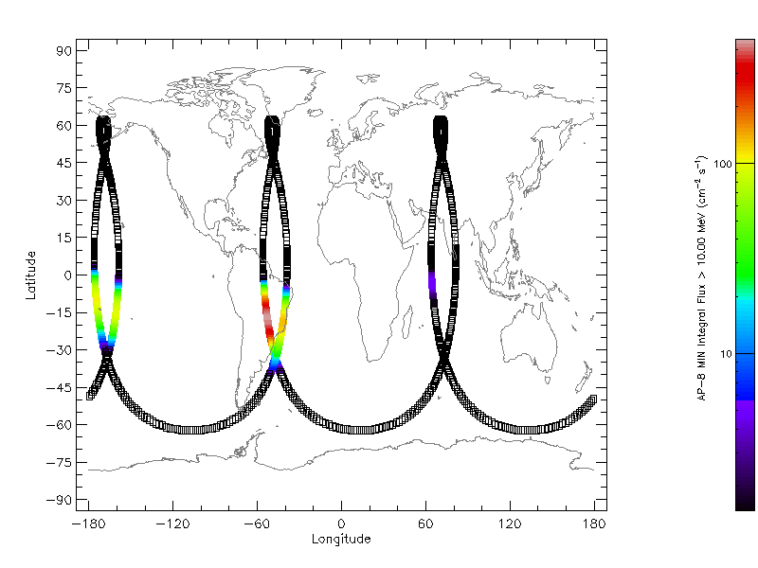
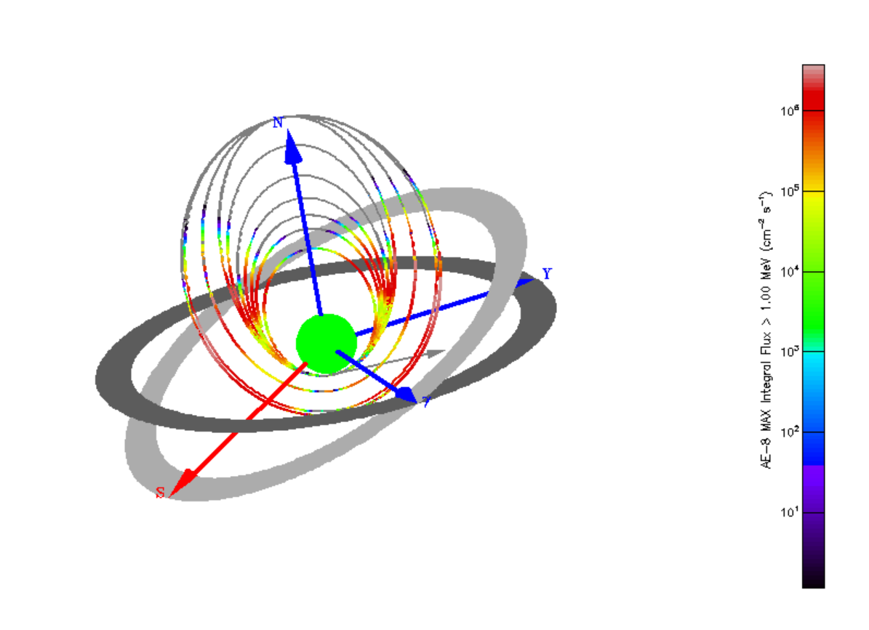
Radiation Environment
Protons > 10 MeV
Electrons > 1 MeV

Slide 17
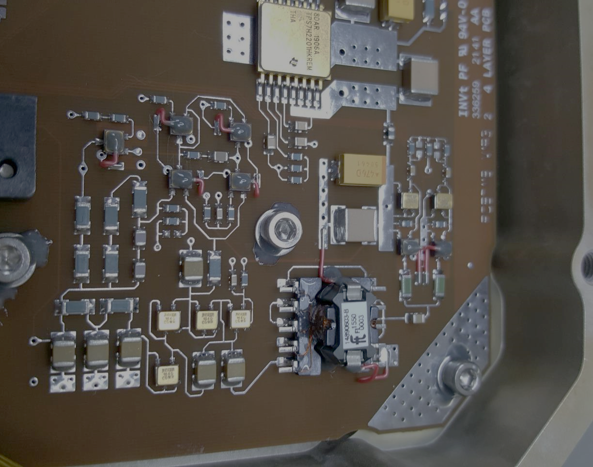
Project Timeline
Preliminary Design
Summer 2019 – January 2020
EM Design and Manufacturing
Feb. 2020 – Nov. 2020
Testing Dec. 2020.
CDR in Feb. 2021
What had happened?
  A few unanticipated problems
  COVID

Slide 18

June 2021
PCB Manufacturing
Feb 2022
FM Functional and
Calibration (“Beam-Test”)
Mechanics Manufacturing
PCB assembly EQM
EQM EMC Test
FM Thermal, Vibration, EMC/EMI,
Communication Test
One PCB rerun
Sept. 2021
EQM AIT
April 2022
Delivery
August 2022
EQM Functional and
Calibration (“Beam-Test”)
Dec 2021
EQM TVAC, Vibration Communication Testing
PCB assembly FM
QAR
Jan 2022
FM AIT
Sept. 2022

Slide 19
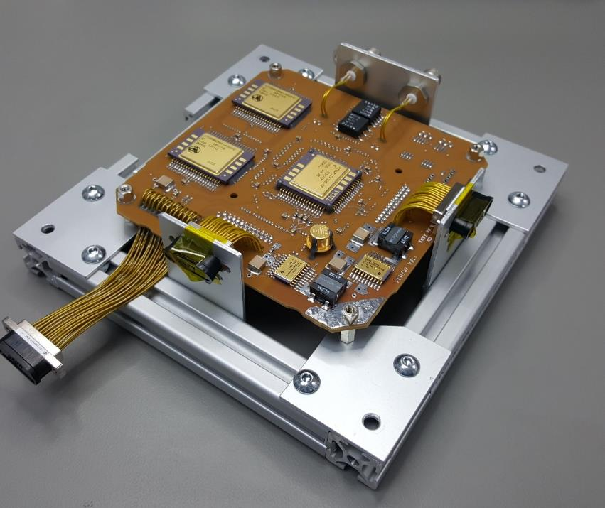
Manufacturing
PCBs manufactured by Invotec
PCB assembly done by Spur, UK
Mechanics manufactured in Norway by FFI

Slide 20
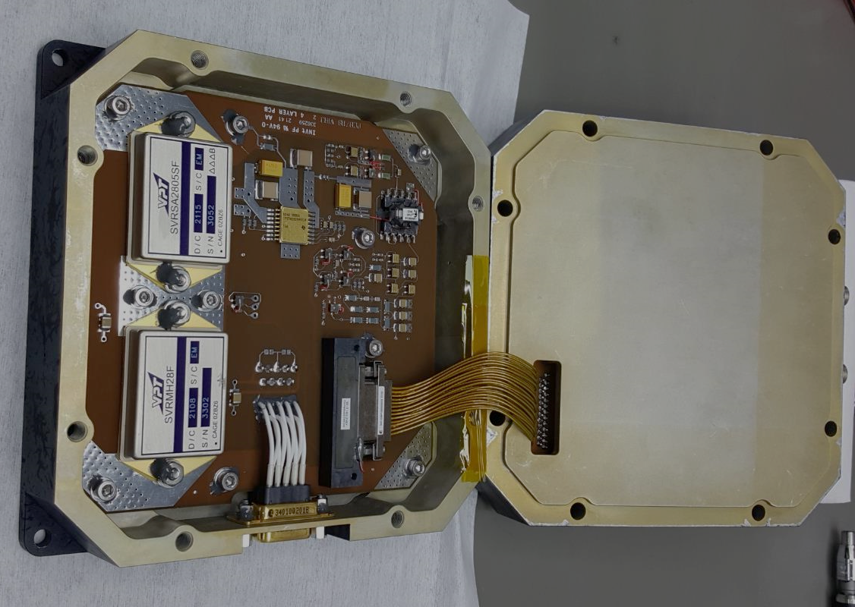
AIT

Slide 21
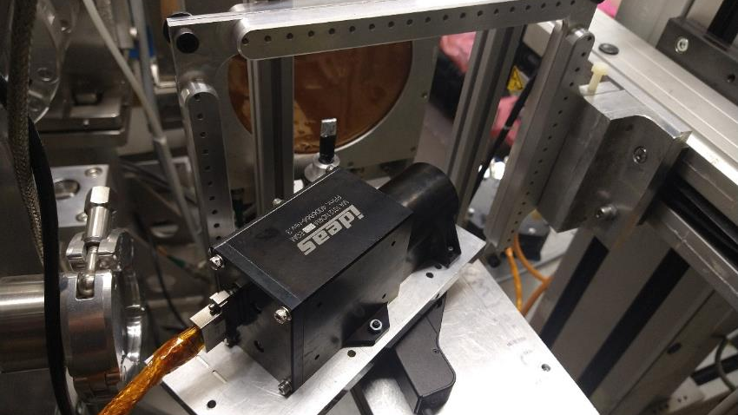
Calibration at PSI

Slide 22
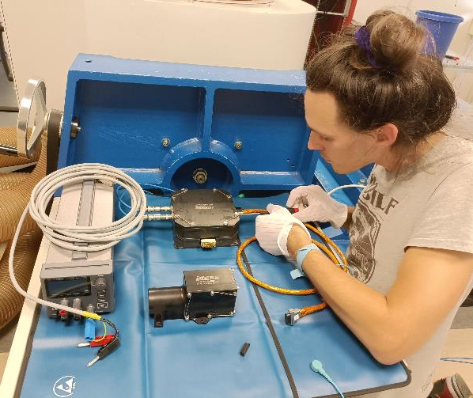
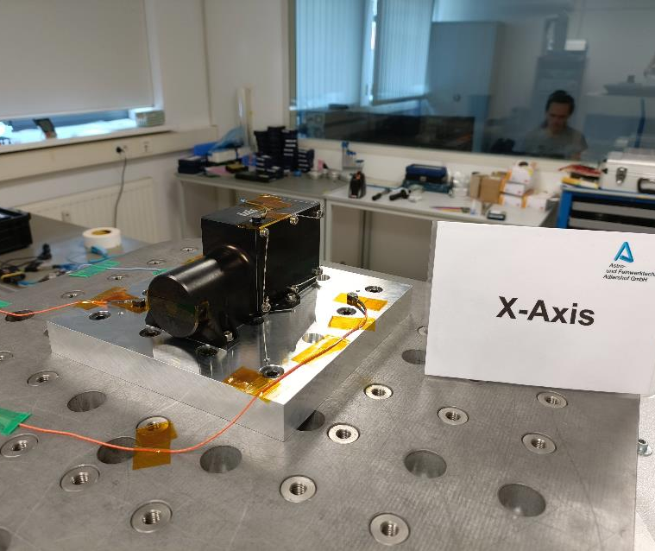
Vibration testing

Slide 23
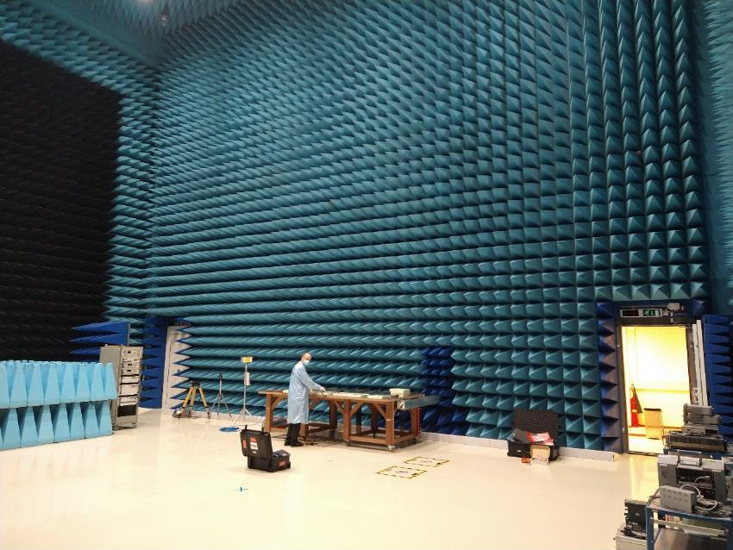
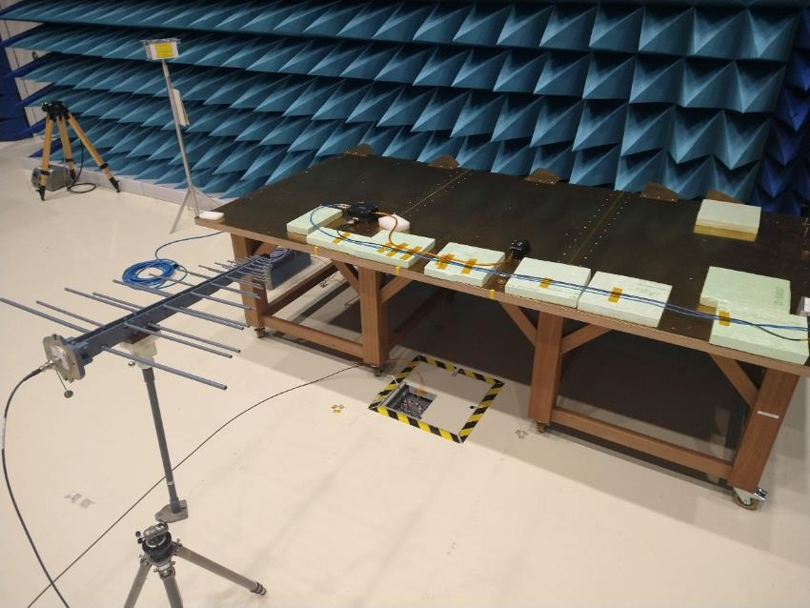
EMC Test @ESTEC

Slide 24
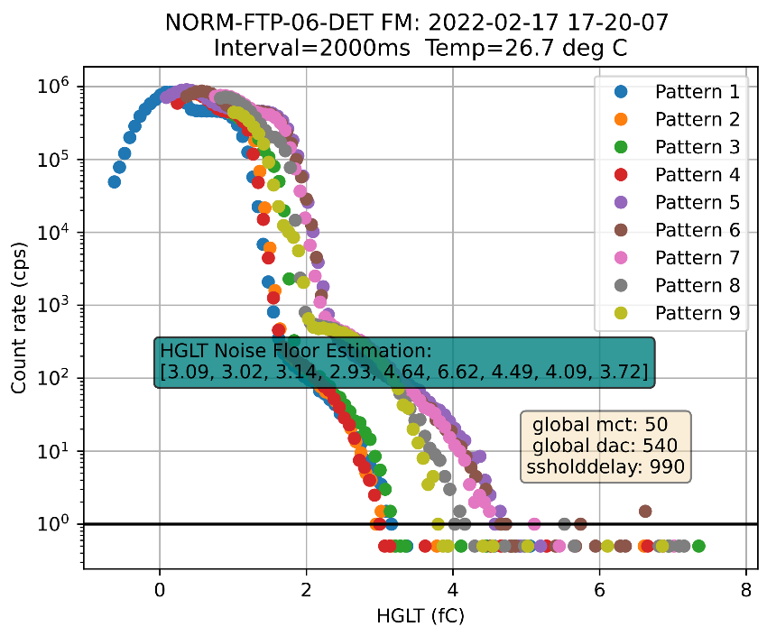
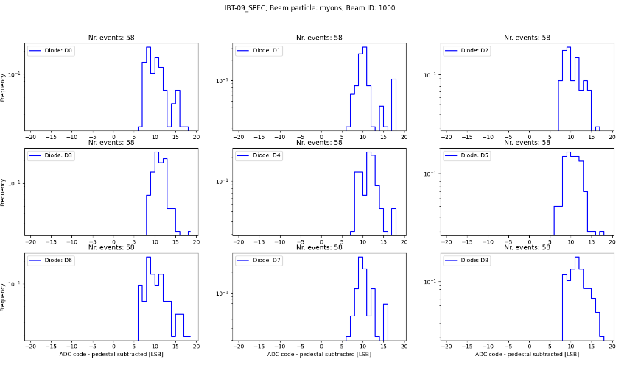
Test results: thresholds, muons

Slide 25
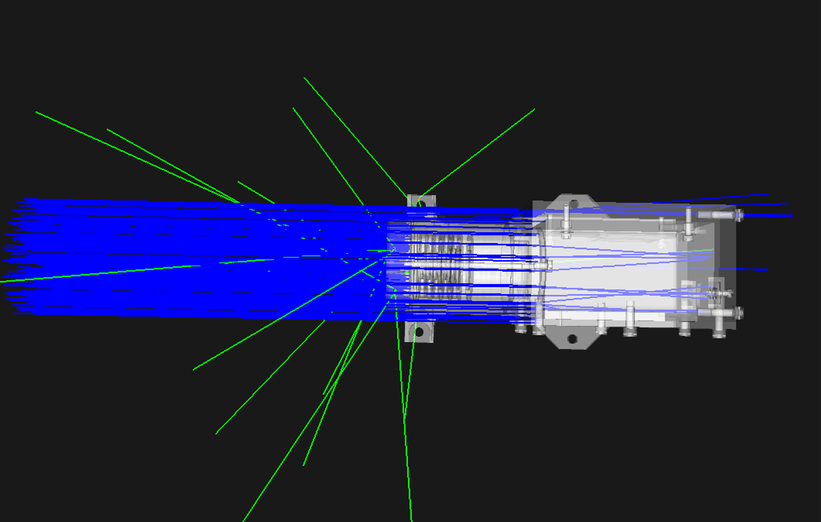
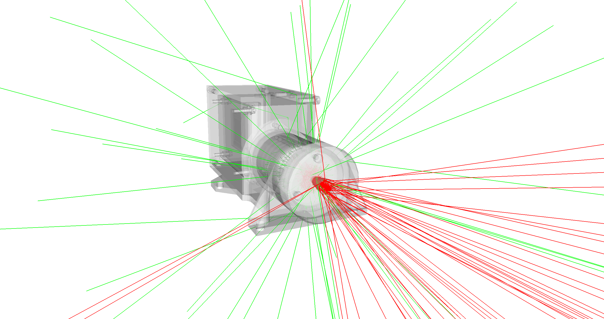
Simulation of the Test

Slide 26
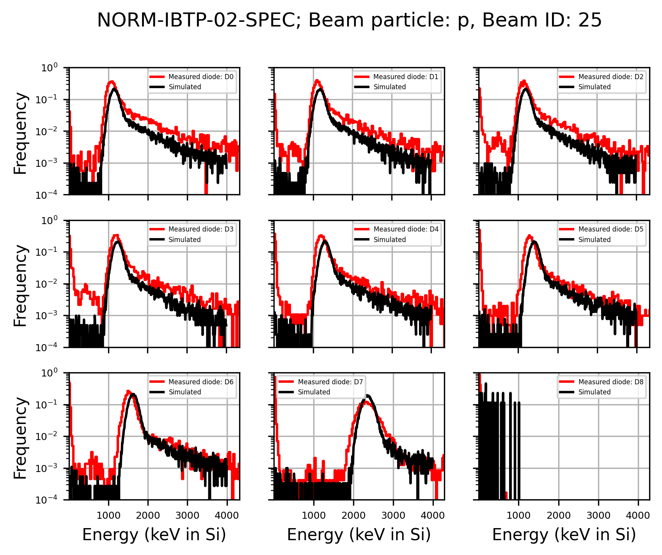
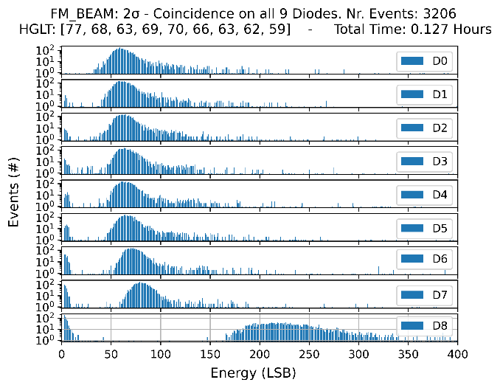
Test results (2)
51.2 MeV protons
Beam testing shows instrument is working as expected.

Slide 27
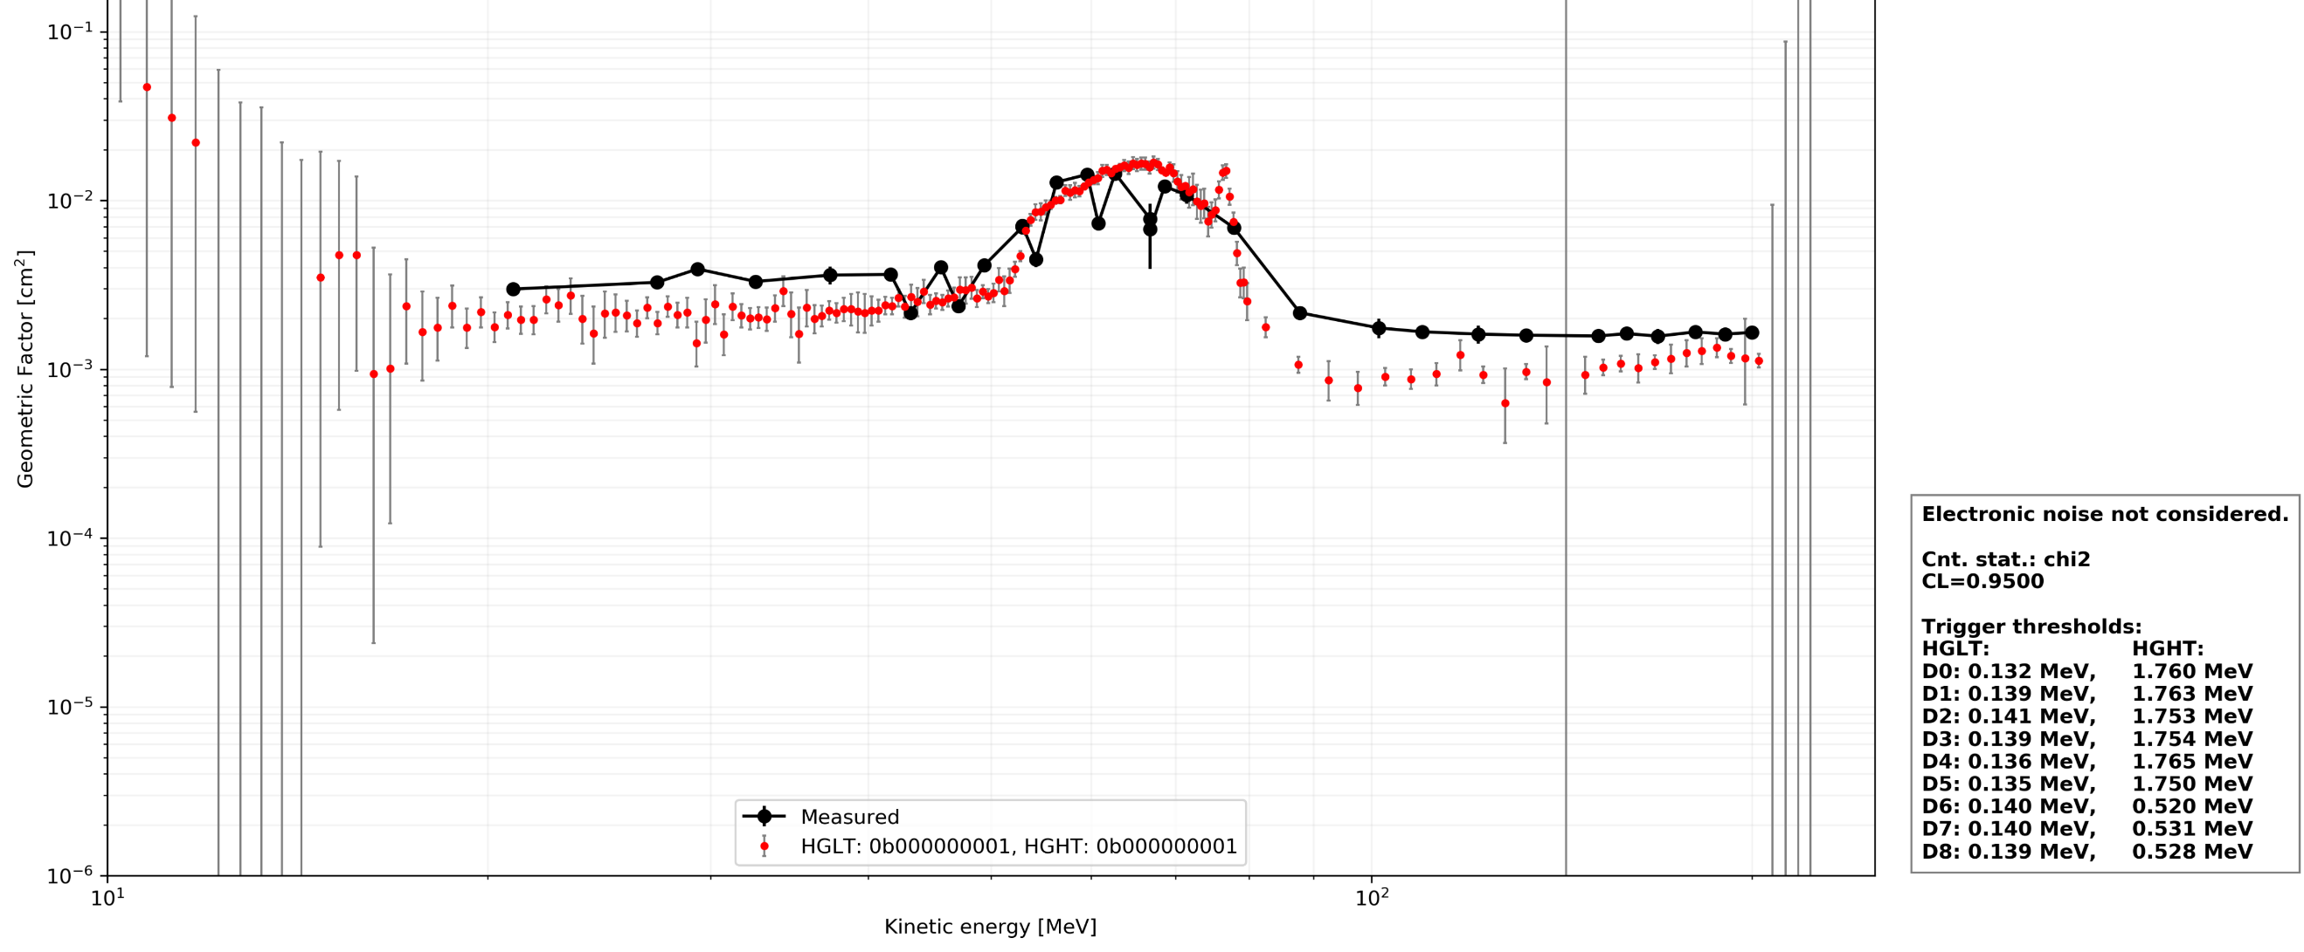
Test results (3)

Slide 28
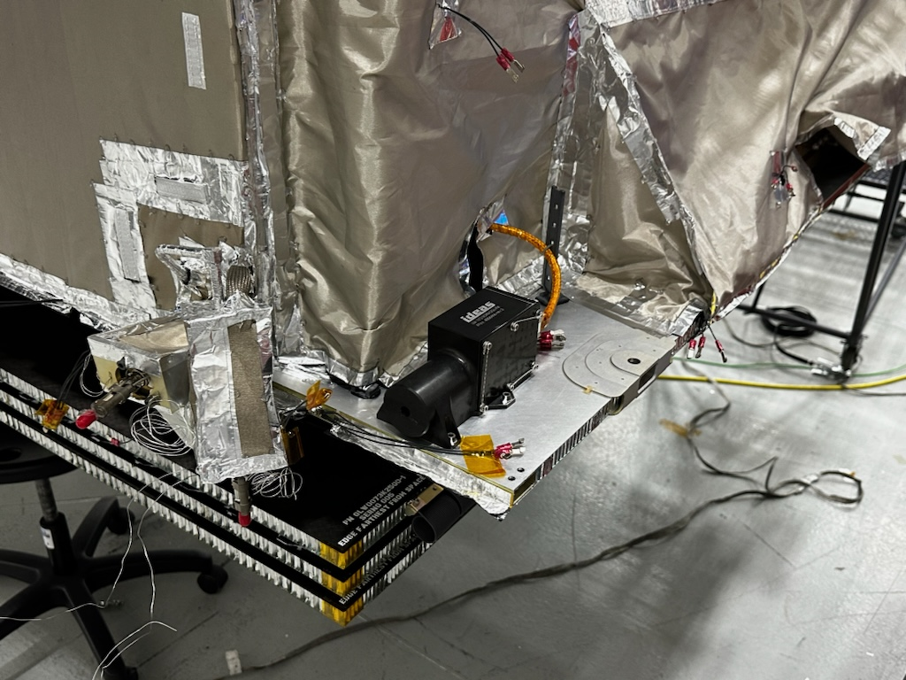
Results
Designed and manufactured the instrument
3 Models in < 3 years
During COVID
Preparation of final reports took longer
Launch of ASBM planned for July 15th
Usable in other missions as well
Detector stack is tunable if needed
(we are working on follow-on)
Photo: Northrop Grumman

Slide 29

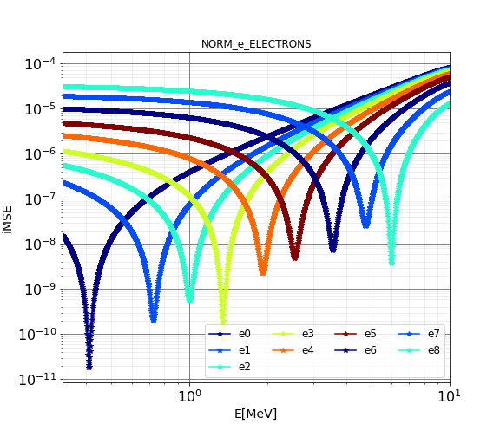
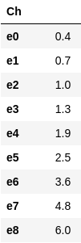
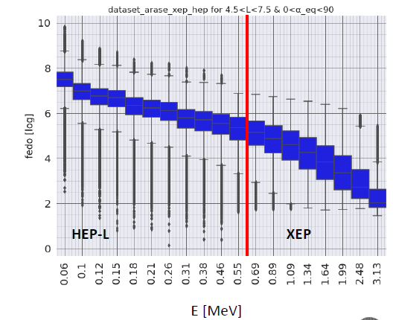
Flight on ASBM
Launch next month
Launch not part of the ESA contract
We set up a system to decode the telemetry and encode telecommands to the instrument.
With SPARC we developed software to provide Level 1 data
Data to be made available upon request
Example: Bow-tie analysis: integral electron fluxes (FEIO)

Slide 30
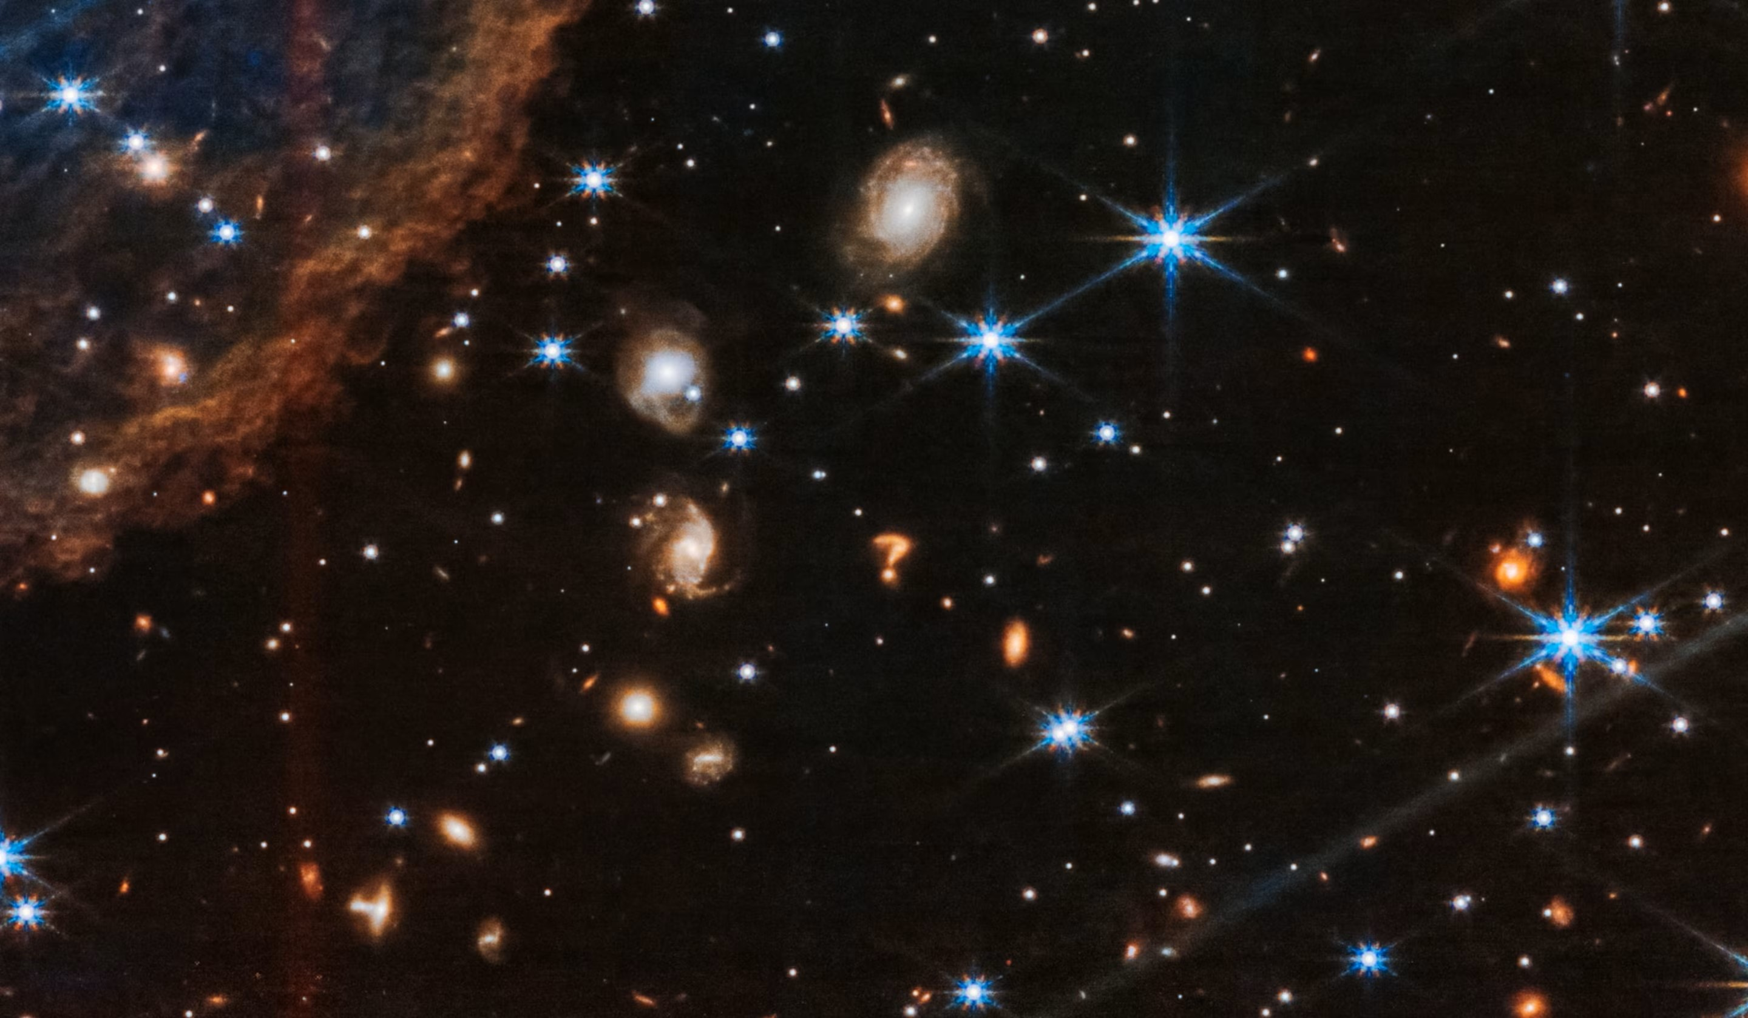
Any Questions
Image: JWST/NASA,ESA,JAXA

Slide 31


Thank You
Team behind NORM (alphabetical order):
Codin Gheorghe, Anja Kohfeldt, Gunnar Maehlum, Dirk Meier, Anders Olsen, Torbjørn Østmoe, Petter Øya, Christophe Plaissy, Timo Stein
Contact: sebastian.benoit@ideas.no

