Slide 1
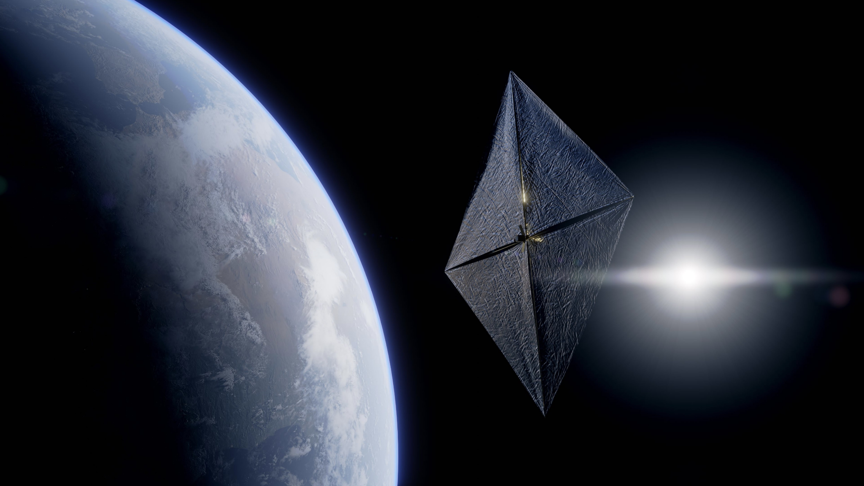
RELIABILITY AND SIMPLICITY FOR DEORBITING SPACECRAFT
CLEANSPACE DAYS 2024
ESTEC - 09/10/2024
Information on this presentation is not contractual and might not reflect the final product

Slide 2
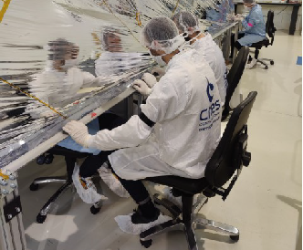
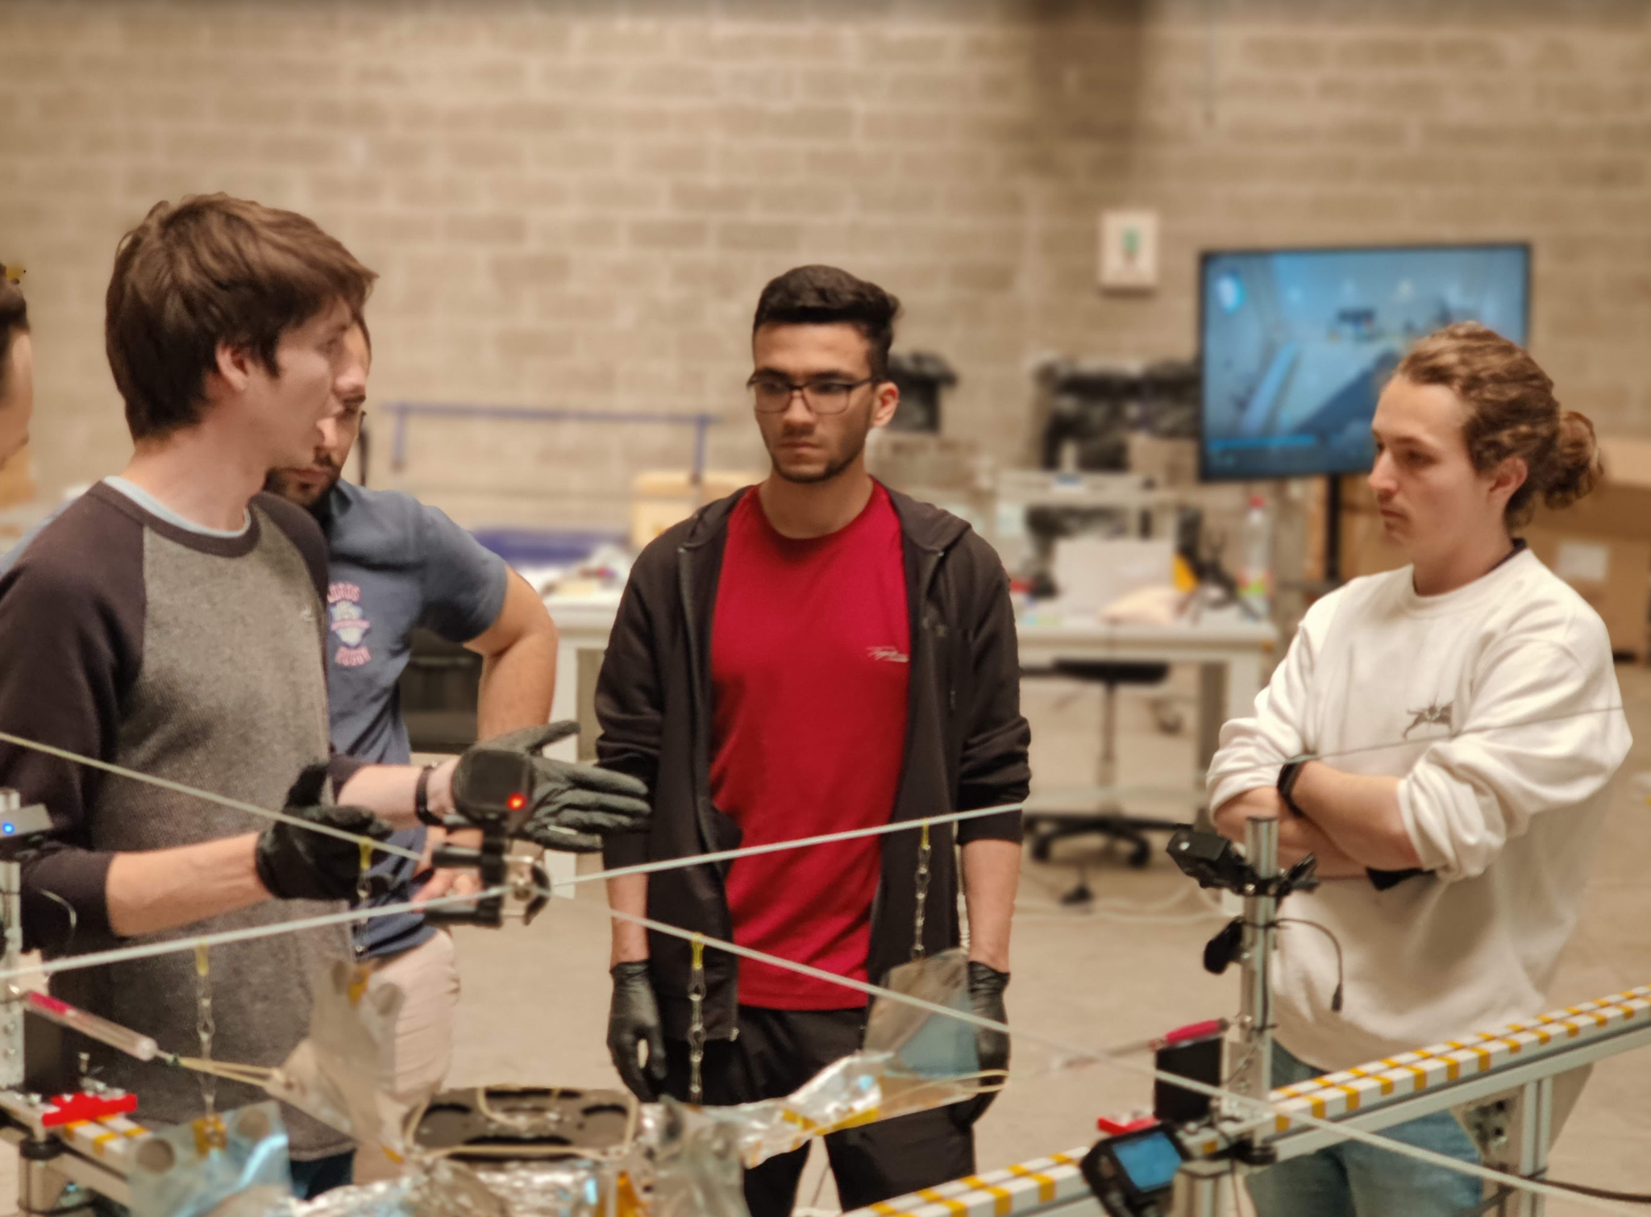
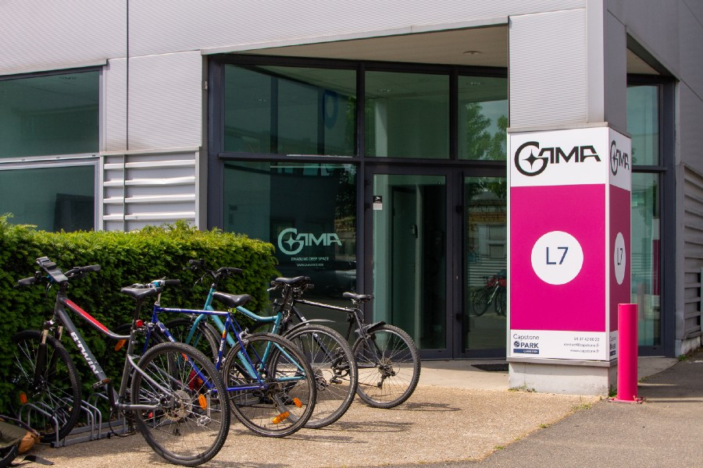
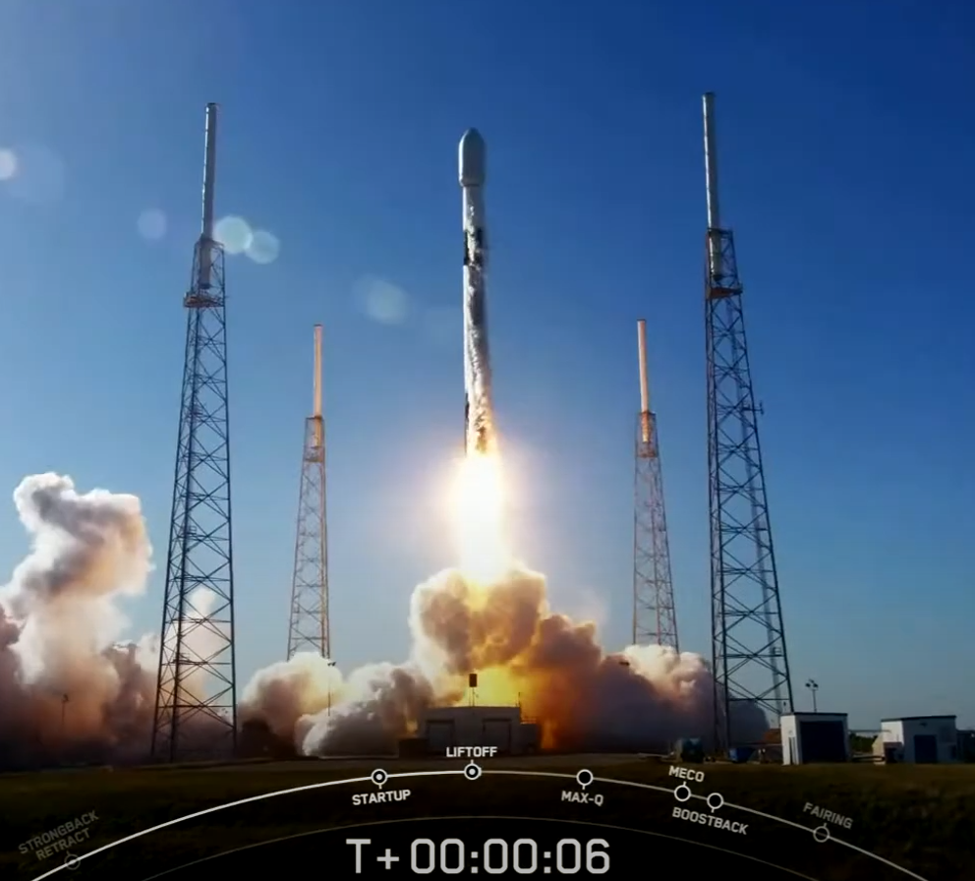
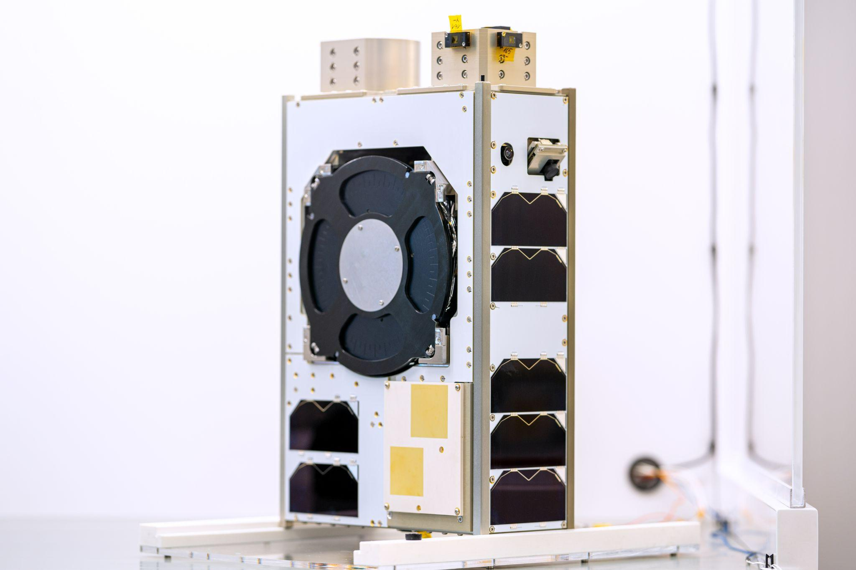
PRESENTATION
GAMA
Notes:
Partial Success

Slide 3
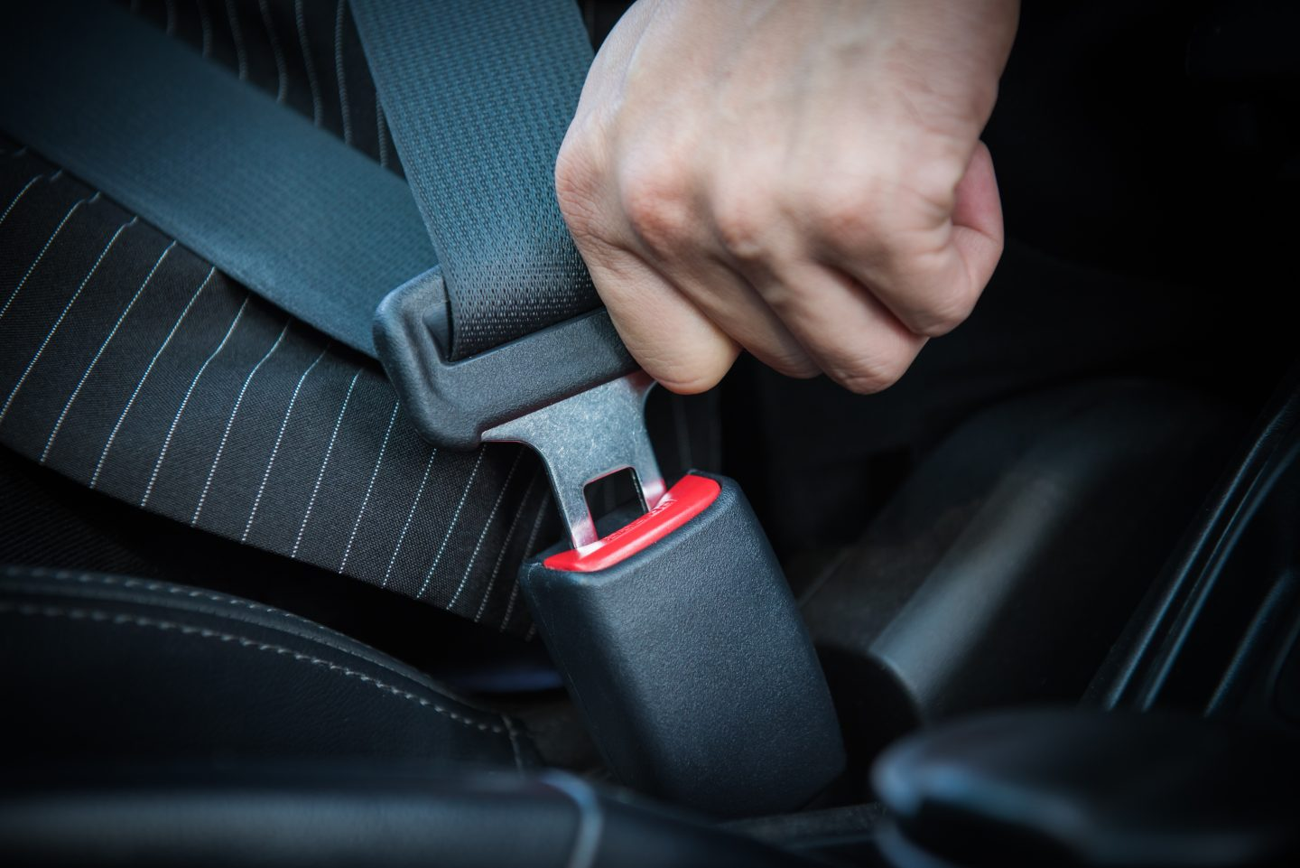
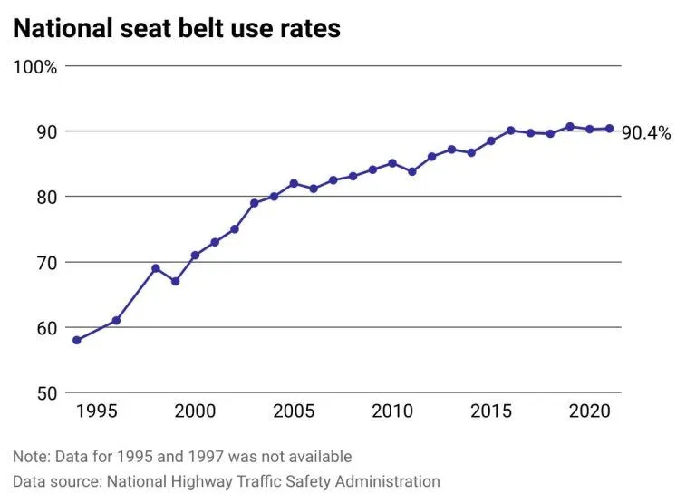
IMPACT OF REGULATIONS
THE SEAT BELT EXAMPLE (US)
Introduction of mains Seat Belt laws
1984, 65% of Americans were against mandatory seat belts as well as penalties for not wearing them [1]
[1] “POLL FINDS INCREASE in PUBLIC’S CONCERN over SAFETY in CARS.” Nytimes.com, The New York Times, 8 July 1984, www.nytimes.com/1984/07/08/us/poll-finds-increase-in-public-s-concern-over-safety-in-cars.html.

Slide 4
END-OF-LIFE REGULATIONS
AROUND THE WORLD
ESSB-ST-U-007 Issue 1 part 5.4.1.1; ODMSP part 4.2; LOS Article 41-12
Probability of successful disposal above 0,9 through to end of life
ESSB-ST-U-007 Issue 1 part 5.4.2.3; FCC 22-74A1
The orbit clearance time shall be less than 5 years
Figure 1: Excerpt from the Falcon 9’s rideshare user guide

Slide 5
SATELLITE RELIABILITY CHALLENGES
MANY SATELLITES FAIL
Launch year | Launched | Failed | Censored
1990-2009 | 441 | 228 | 213
2010-2019 | 425 | 56 | 369
Only 60% of Cubesats are successful
Figure 2: Categorization of small satellites based on launch year [2]
Figure 3: Rate of success/failure among the 672 analyzed CubeSats (left); classification of the failures per reason (center) and per lifetime (right) [3]
[2] A. Cervone et al., “The Path towards Increasing RAMS for Novel Complex Missions Based on CubeSat Technology,” CEAS Space Journal 16, no. 2 (March 2024): 203–24, https://doi.org/10.1007/s12567-023-00517-9.
[3] Raja Pandi Perumal et al., “Small Satellite Reliability: A Decade in Review,” n.d.

Slide 6
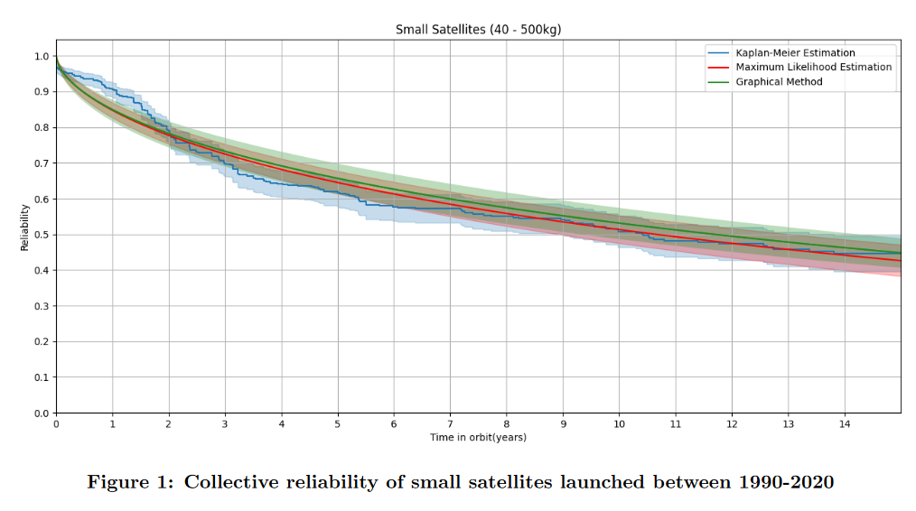
1 year
To deorbit using propulsion, all the spacecraft subsystems MUST still be functional
[3] Raja Pandi Perumal et al., “Small Satellite Reliability: A Decade in Review,” n.d.

Slide 7
COST-BENEFIT
TRADE-OFF
RELIABILITY REQUIREMENT
5-YEAR CLEARANCE REQUIREMENT
+ indirect costs for qualification of all subsystems required to deorbit + risk of not getting launch approval
+ risk of penalties
+ direct cost (more systems, more propellant, increased launch mass)
- Payload mass
+ indirect cost (increased complexity = more risks, more paperwork)

Slide 8
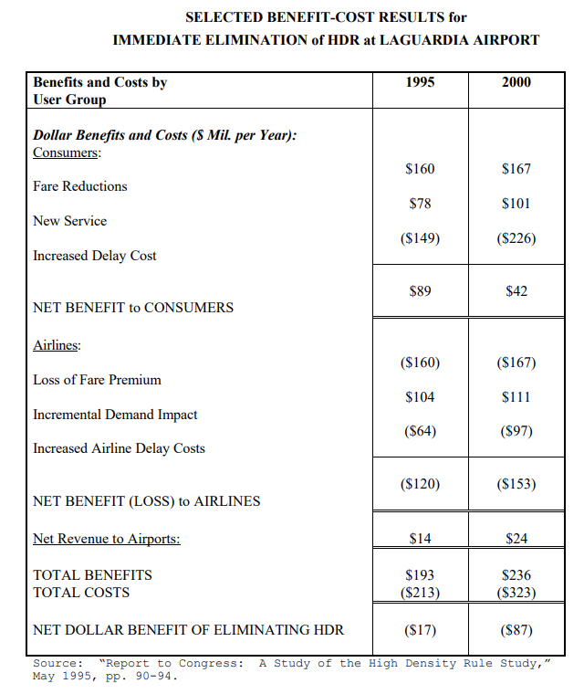
COST-BENEFIT
TRADE-OFF
But, with the right system, costs can be reduced
Benefits and Costs by User Group | No deorbiting device | Other deorbiting device | Dragsail
Satellite Operators
Purchase cost
Operation cost
Launch delay cost
Fines
Active deorbiting cost
Satellite Manufacturers
Design costs
Qualification costs
Delivery delay cost
Launchers
Launch authorization cost

Slide 9
THE COST OF
RELIABILITY
90% reliability = P(FAILUREEPS + ADCS + PROPULSION) < 10%
Reliability | Number of test samples without failure (CL 95%)
80% | 14
90% | 29
95% | 59
99% | 299
x2
x2
x5
Assuming a binomial distribution
cost of deorbiting device < cost of reliability
worth it

Slide 10
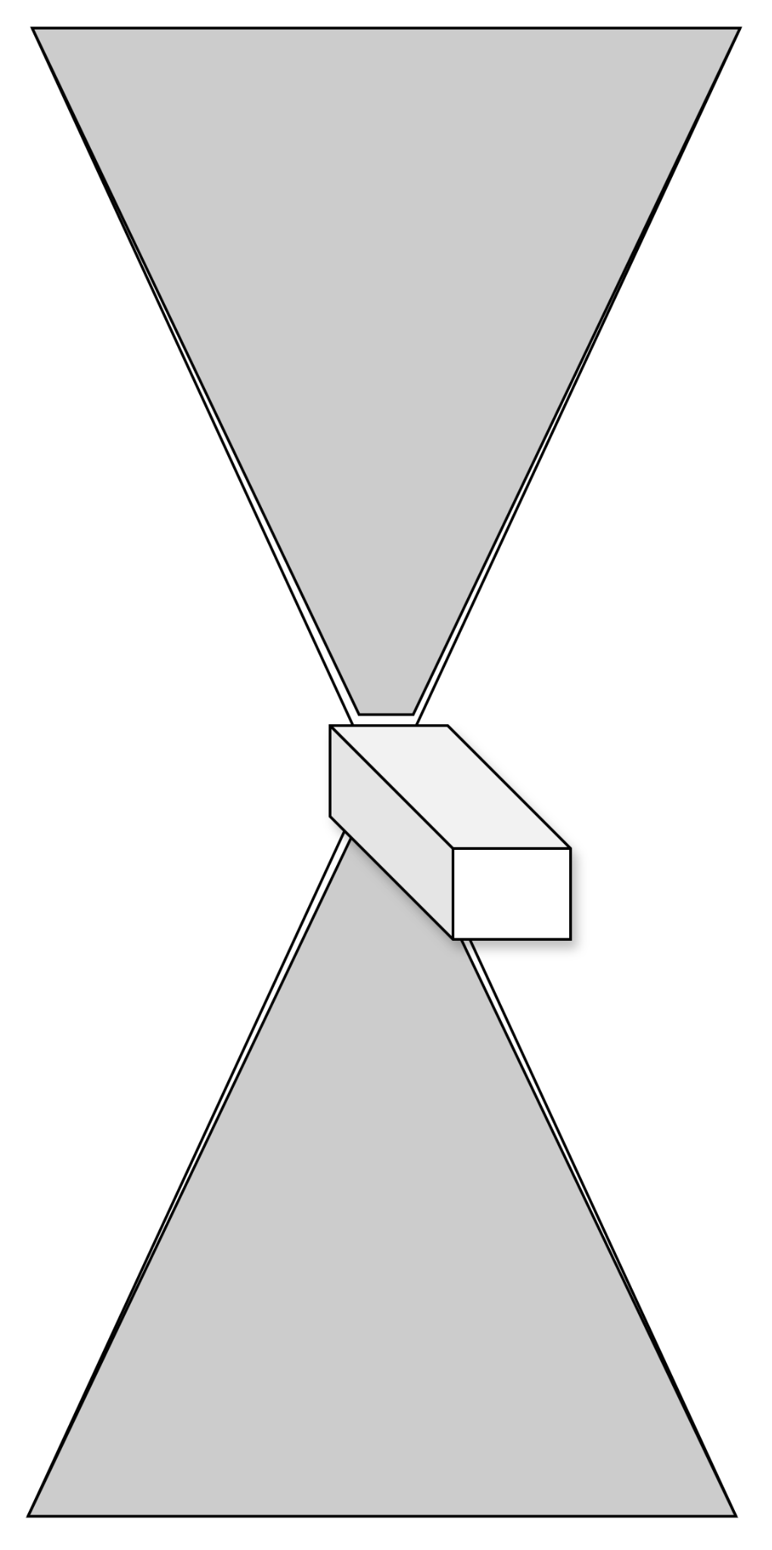
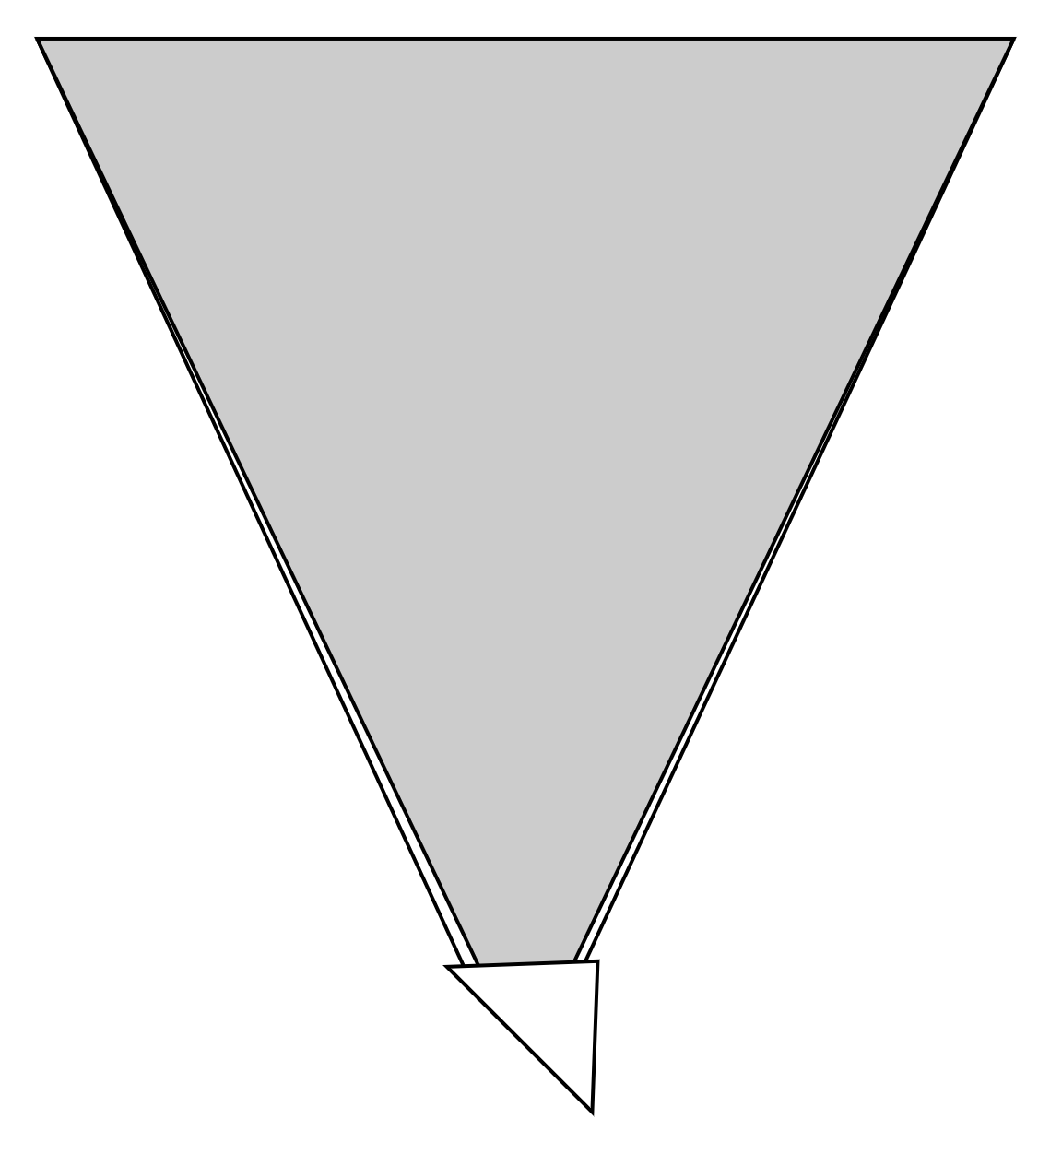
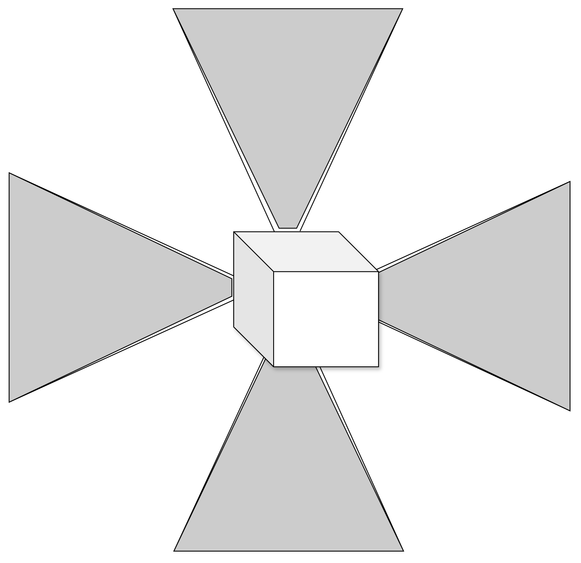
THE PRODUCT LINE
ASTROBRAKE
ASTROBRAKE-S
10-64m² Polyimide film
1.5m² Polyimide film
ASTROBRAKE-S2
Stored energy release mechanism
30-50kg
Metallic lightweight boom
ASTROBRAKE-S
Carbon-fiber lightweight boom
ASTROBRAKE-S
(deployed)
ASTROBRAKE-L
(deployed)
<30kg
>100kg
ASTROBRAKE-S4
50-100kg

Slide 11
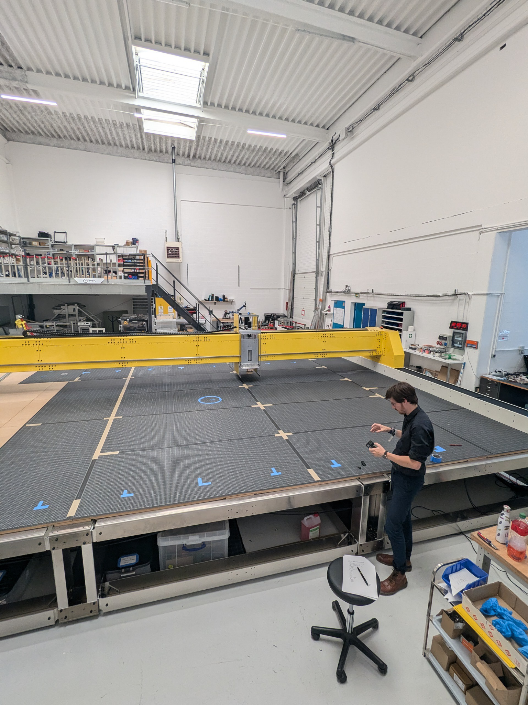
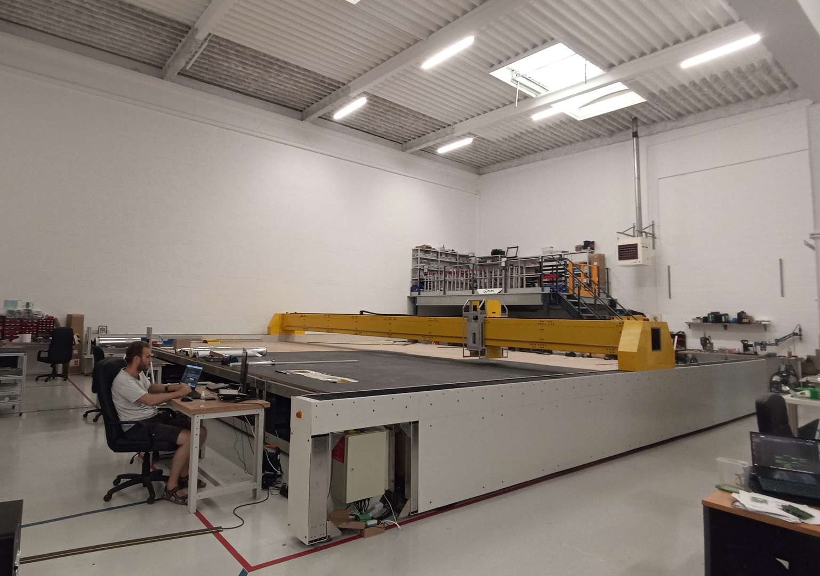
MAIVOS (Machine d’Assemblage et d’Intégration de VOile Solaire)
INDUSTRIALIZE AND STANDARDIZE
SPECIFICATIONS:
Max sail size: 64m²
Mass: 3.2T
Conception and assembly: homemade
Time to manufacture a 64m² sail: <4 days (with 2 operators)

Slide 12
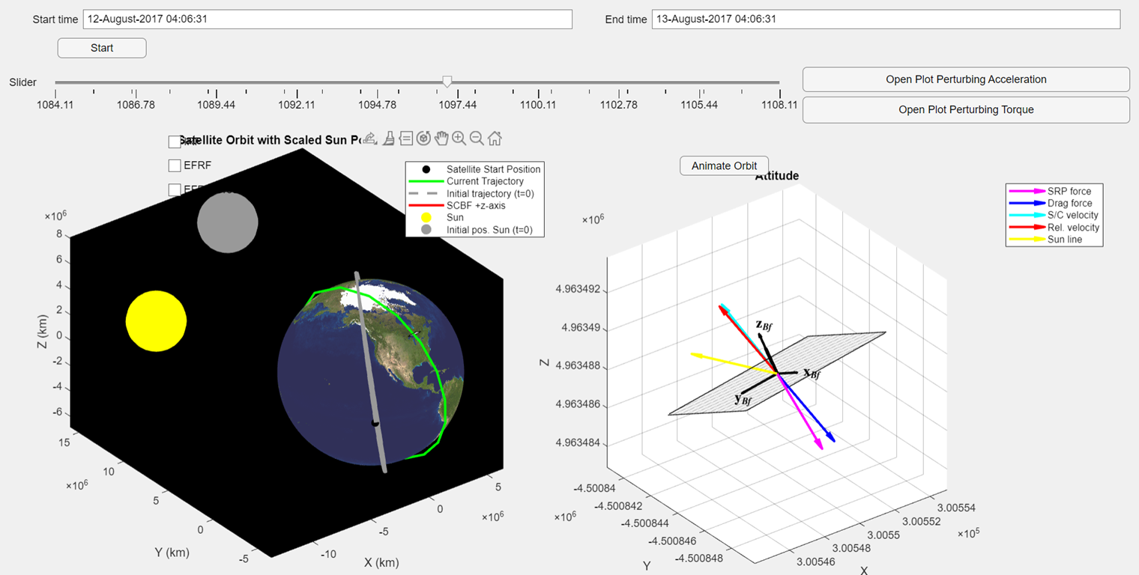
SEXTANT
SOFTWARE
Simulate Orbital decay with high precision to compute optimal sail size
Compute collision risks integrated throughout the deorbiting trajectory
Generate report for regulations

Slide 13
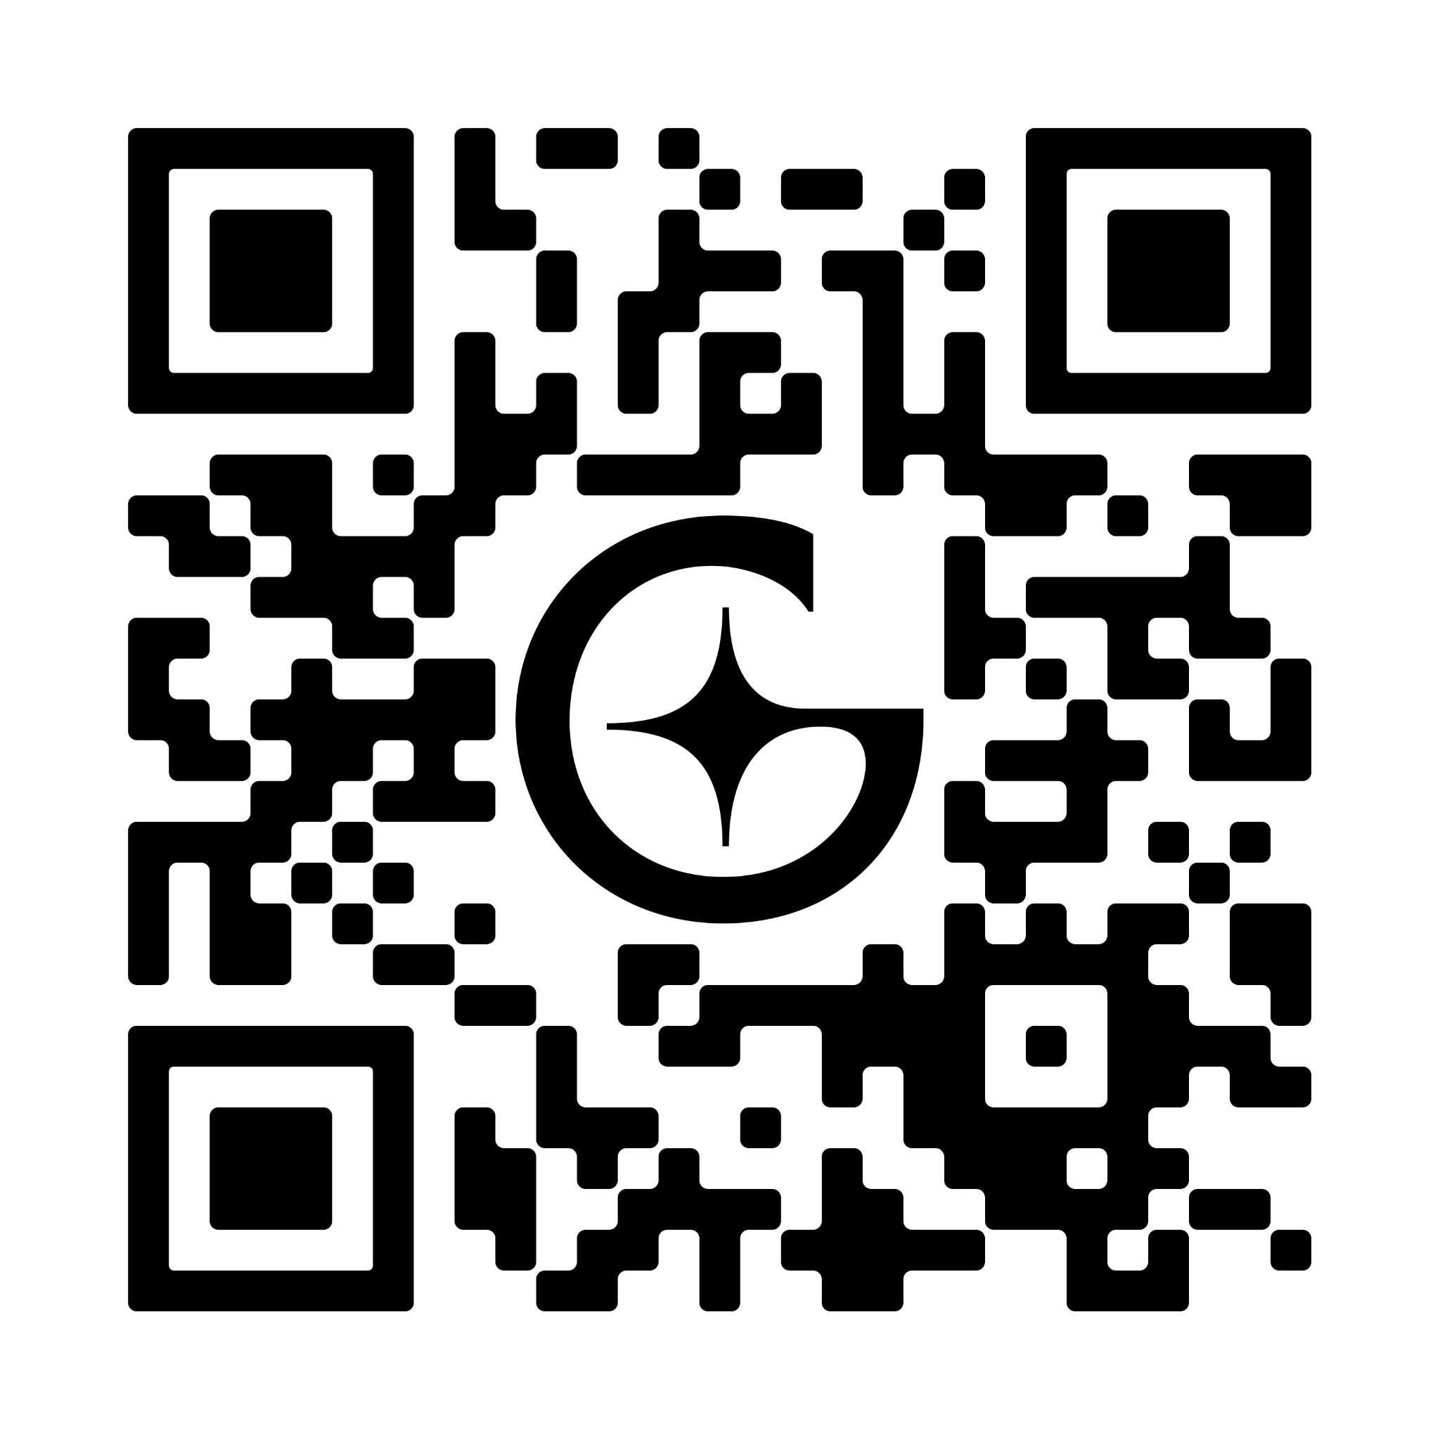
CONTACT US:
jordan@gamaspace.com

