Slide 1
Roadmap of DEBRISK V4 foreseen modeling and methodology improvements
J. Annaloro
S. Galera
A. Bellucci
G. Laur
Clean Space Industrial DAys
08/10/24

Slide 2

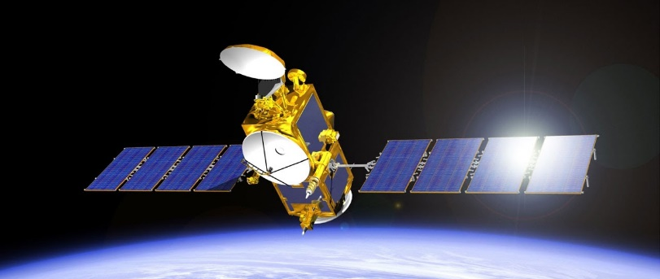
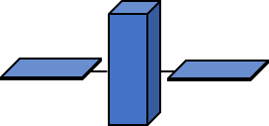
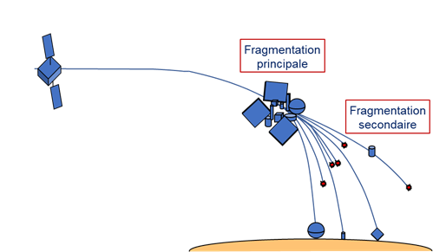
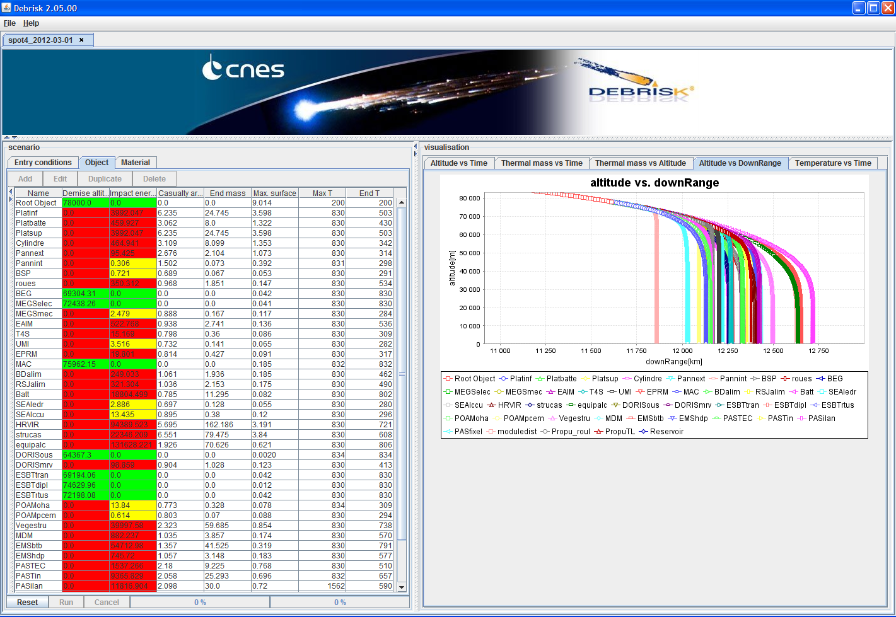
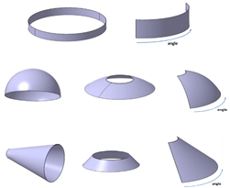
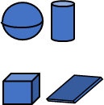

DEBRISK: The french object-oriented tool
Break-up
V2
V3
  The French Space Operation Act enforces the assessment of prospective risks in the context of a space mission
  Quantitative objective for the maximum allowable probability to have at least one victim: ${10}^{−4}$ for controlled reentries and uncontrolled reentries
DEBRISK: Access the survivability of debris after atmospheric re-entry
  Demise altitude or
  Casualty area, ground kinetic energy, final mass and impact location
  Requirements of DEBRISK
  Accurate results
  Fast computation (10 min max)
  Easy to use (2h training max)

Slide 3



Timeline of DEBRISK
DEBRISK V1/V2 :
  Upgraded version to be at the same level than the other codes
  In 2012, a version 2 has been released with a Best Practice Guide (GBP)
2008
2013
DEBRISK V3 :
  Improve the physical representativeness and the accuracy of the models,
  Provide additional geometrical shapes called "complex shapes" allowing for model reliable geometries of satellites and launchers fragments,
  Propose a more complete GBP (v3) to help the operators to establish the list of fragments.
2014
2022
DEBRISK V4 :
  Continue to improve the physical representativeness and the accuracy of the models
    Aerothermodynamics, attitude, brother relationship
  Continue to improve the GBP
    CFRP equipments modelling & Electronic cards
TR
GBP
Operators
2024
2028

Slide 4
DEBRISK V3
 | DEBRISK V2.7.1 | DEBRISK V3.5
Topology | 4 | 10
Trajectory | PATRIUS library (2.0) | PATRIUS library (4.5)
Atmosphere | US76 | US76, MSIS00
Spacecraft Break-up | Aerodynamics computation | Aerothermodynamics & Thermal computation
Aerothermo dynamics | Klett methodology | CFD/DSMC database
Low speed | Horner database | CNES in-house model
Oxidation | Cropp formula | CNES in-house model
Material database | Old database | New database
Thermal modelling | 0D | 0D & conduction heat transfer
Uncertainty | Ø | DEBRISK Uncertainty Qualification module
 | Methodology v3 improvements
Initial conditions and atmospheric model | More complete methodology
Break-up altitude | More suited to the satellites structures
Honeycomb sandwich panel (Aluminium & CFRP skins) | More complete methodology, based on experimental data
Other CFRP elements | More explicit methodology for other CFRP elements. Based on numerical computations
Electronic boxes | More explicit methodology. Based on numerical computations
Complex shapes | More accurate given the new shapes available
Material database | Updated. Harmonized and available within ESTIMATE
Minimum mass to be modelled | More complete
  DEBRISK v3 is available on the website ConnectByCNES (https://www.connectbycnes.fr/en/fsoa) (free download), by July 2023

Slide 5
DEBRISK v4: activities foreseen
Aerothermodynamics (2024-2026)
  Transitional regime: improvement of the bridging method for all the available shapes
  Continuum regime: continue to improve the CFD database
Attitude (2024)
  Either confirm or modify the attitude of all the available shapes
“Brother” relationship (2025-2026)
  ATD, thermal modelling, ablation & fragmentation
Improvement of the DEBRISK handbook relying on destructive experimental tests (2025-2026)
  COPV tank, CFRP optical support
  Electronic cards

Slide 6
Physical modeling improvements

Slide 7
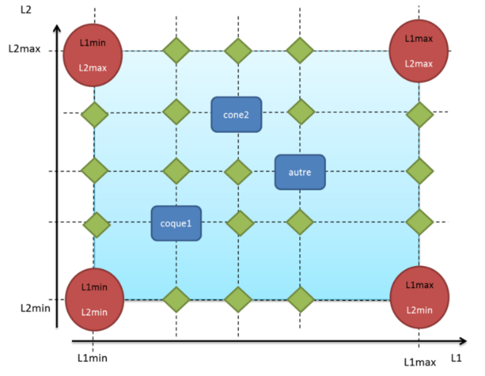
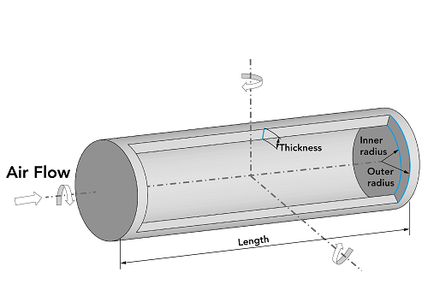
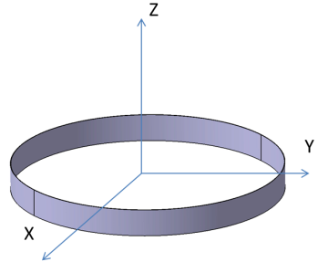
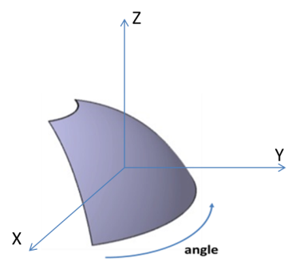
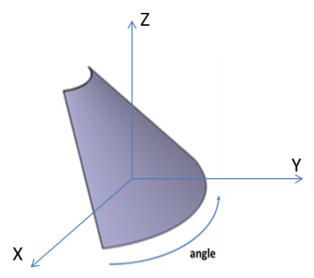
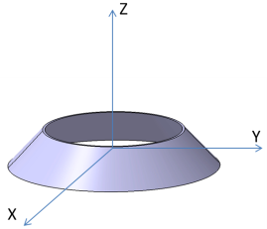
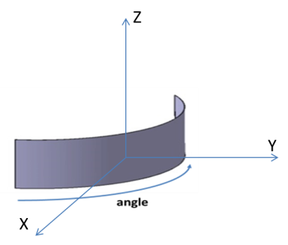
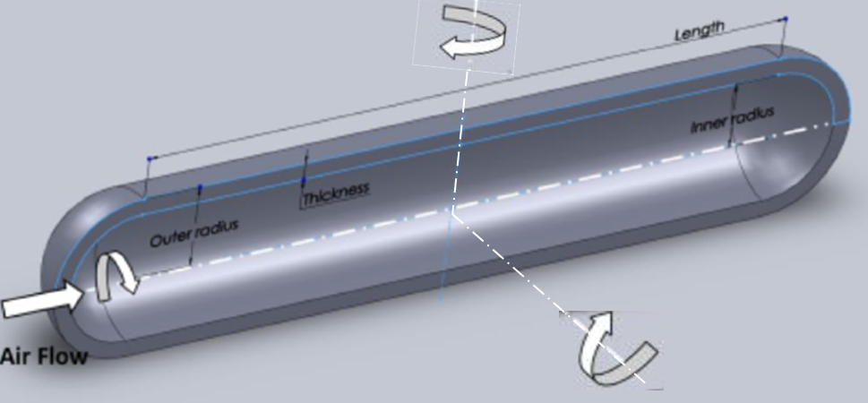
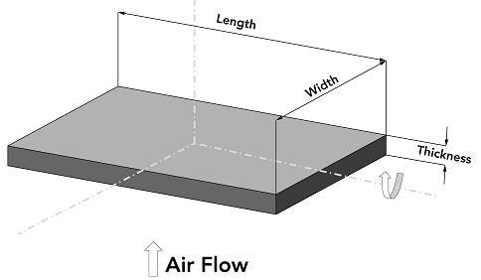
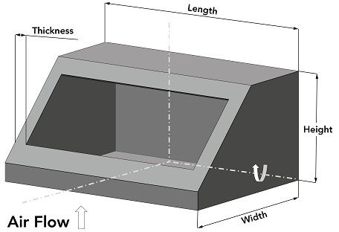
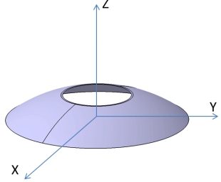
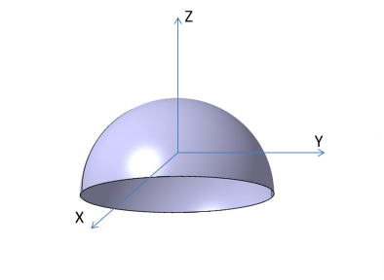
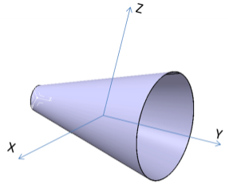
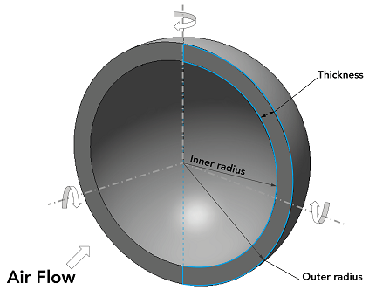
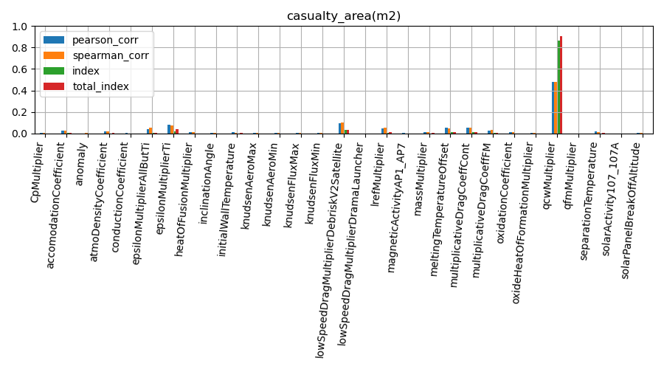

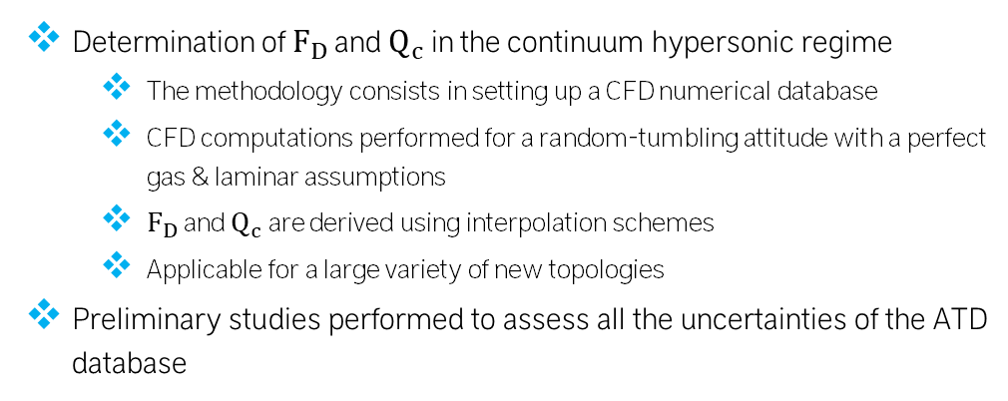
Aerothermodynamics: continuum regime
  Determination of $F_{D}$ and $Q_{c}$ in the continuum hypersonic regime
  The methodology consists in setting up a CFD numerical database
  CFD computations performed for a random-tumbling attitude with a perfect gas & laminar assumptions
  $F_{D}$ and $Q_{c}$ are derived using interpolation schemes
  Applicable for a large variety of new topologies
  Preliminary studies performed to assess all the uncertainties of the ATD database
Variation | Reference | Delta CD tumbling | Delta K tumbling
NE + fully (pseudo) catalytic | Perfect gas | +1% | +6%
Turbulent flow | Laminar flow | +5% | +20%
Non catalytic wall | Fully (pseudo) catalytic wall | - | Up to -40%
Mesh convergence | NA | < +/-1% | < +/-3%
Attitude discretization | NA | < +/-3% | < +/-4%
Invariance to inflow conditions | NA | < +/-4% | < +/-7%
Interpolation | NA | < +/- 10% | < +/- 40%

Slide 8
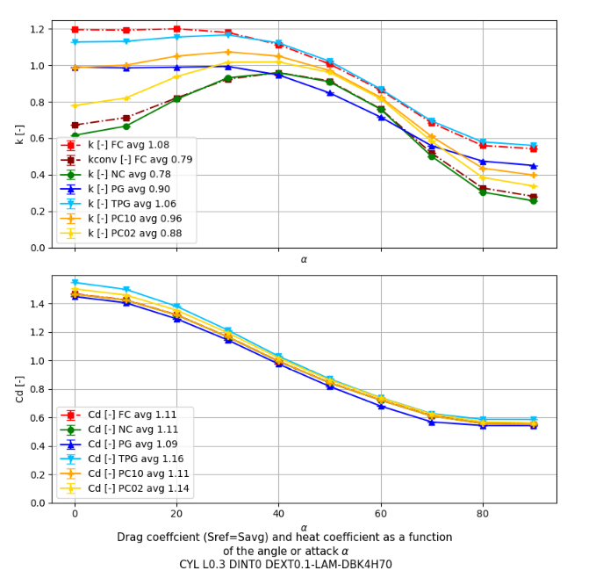
Aerothermodynamics: continuum regime
  Two important questions to address:
    Should we improve the accuracy of a CFD computation points by changing certain modeling assumptions? For instance,
      Switch between a laminar database versus a turbulent database?
      Give up a gas perfect database for a non-equilibrium/equilibrium database?
      Continue to assume an invariance of the Mach number?
    Interpolation: Should we focus on adding a few CFD points with very good precision, or many more points with less precision?

Slide 9
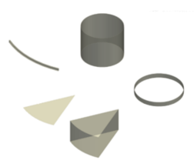
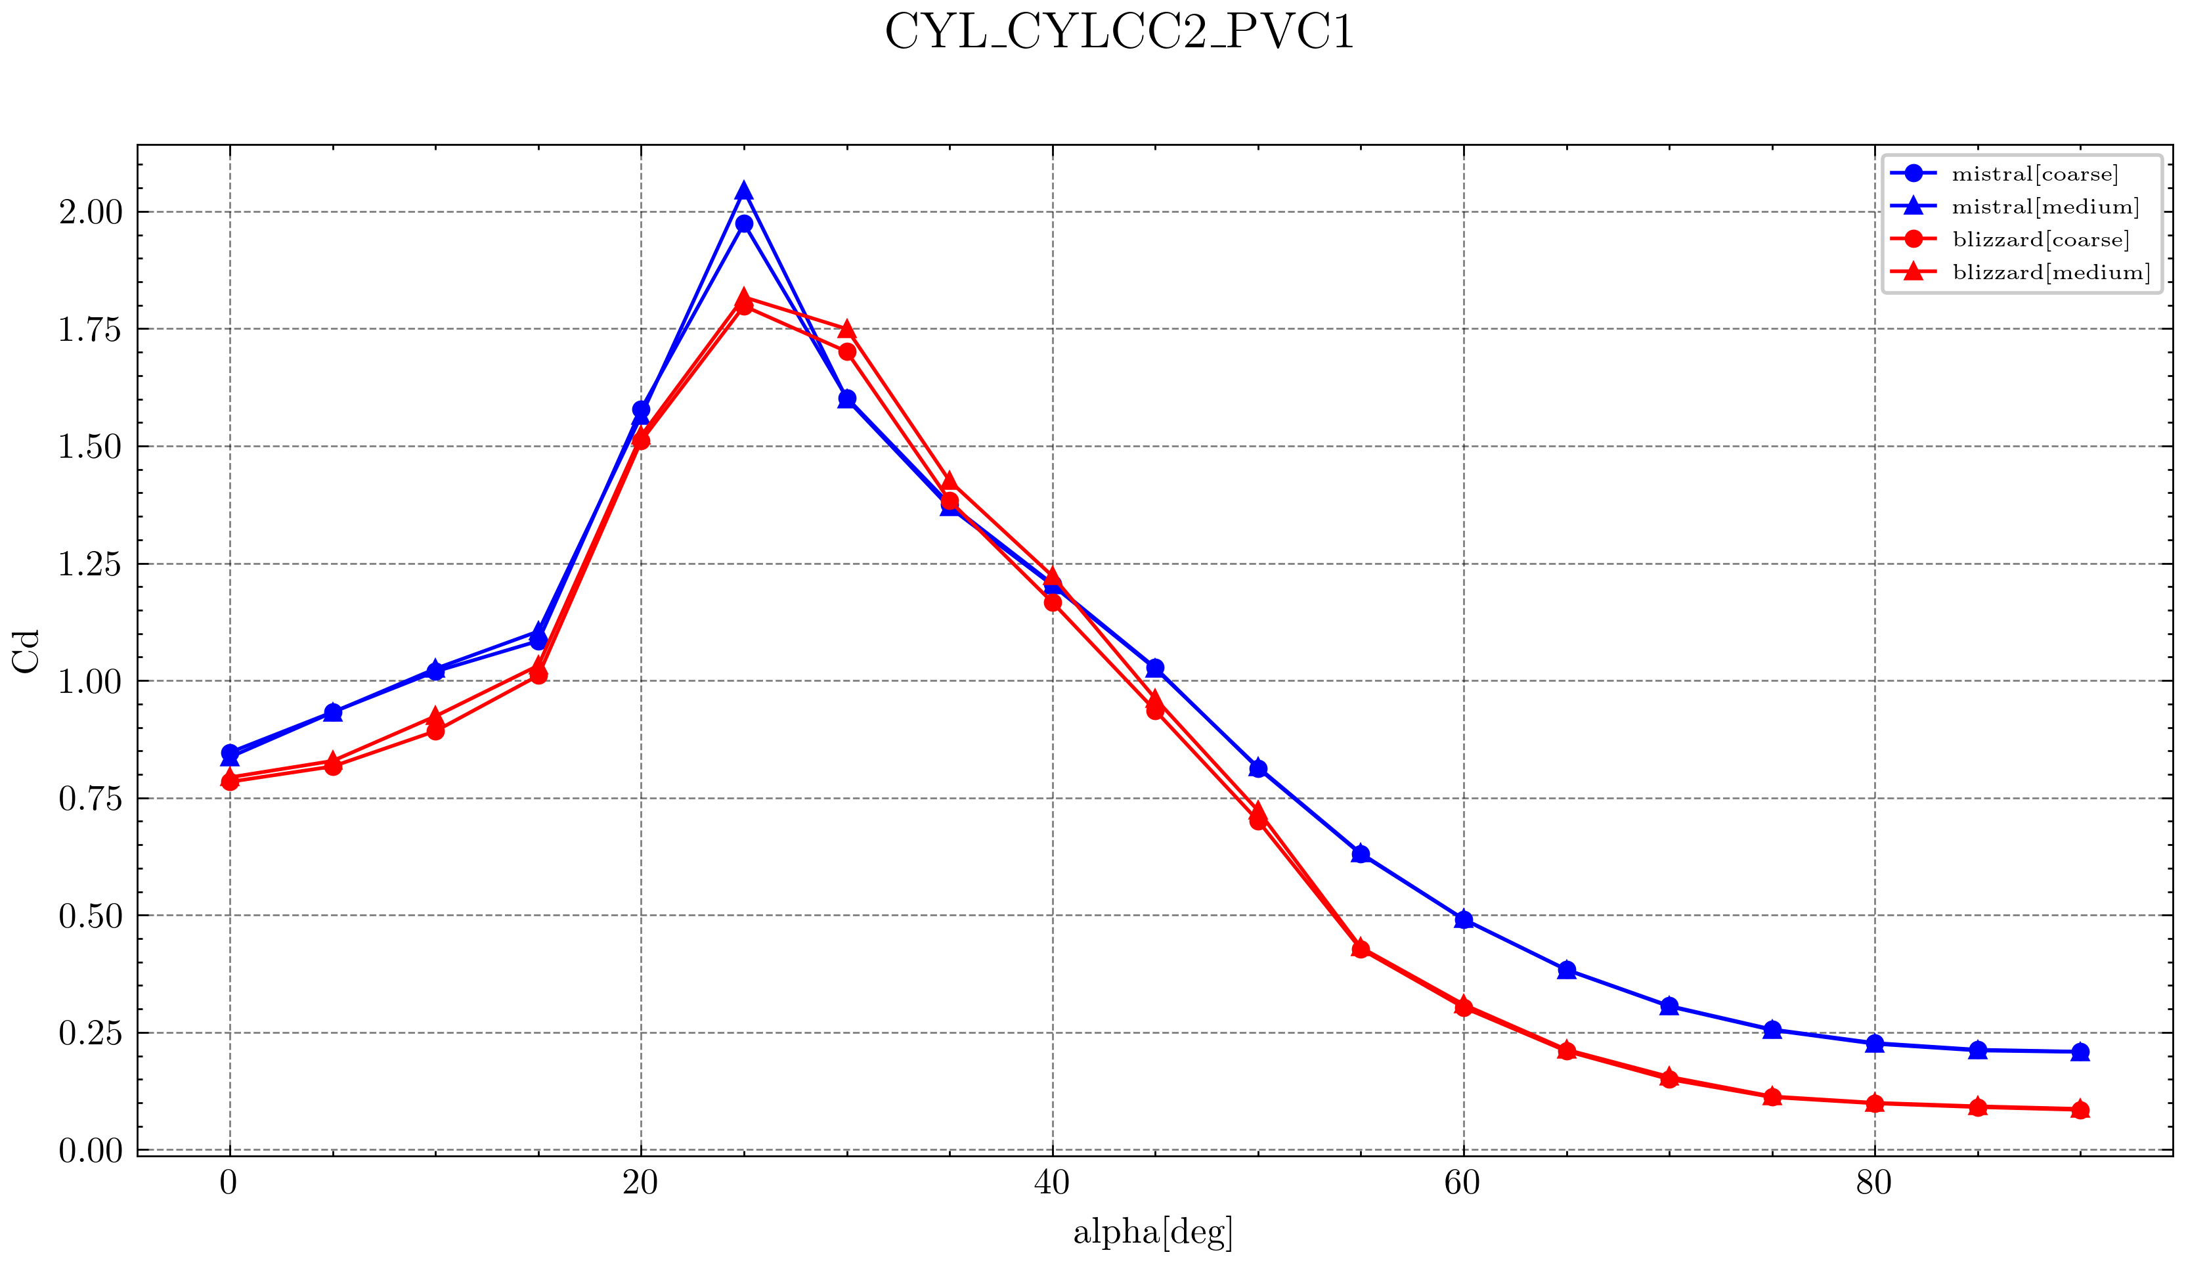


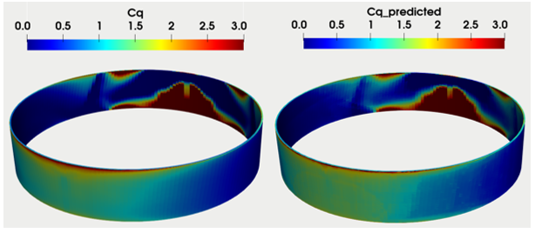
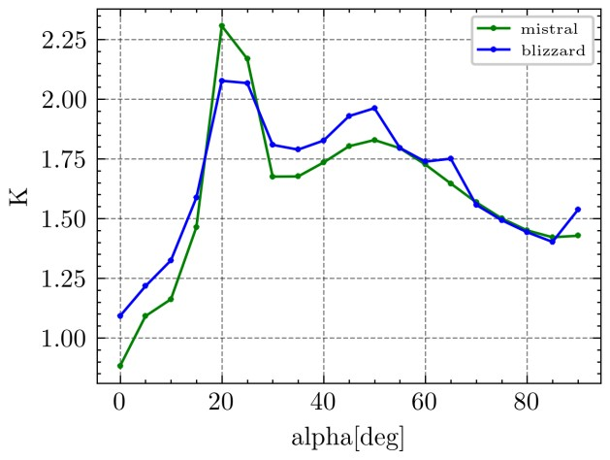
Aerothermodynamics: continuum regime
Machine learning
NS CFD
Database
(MISTRAL)
Euler CFD
MISTRAL
BLIZZARD +
ML
20°
Geometry | Mistral | Blizzard | %
CYLCC2 | 0.202 | 0.211 | 4
Geometry | Mistral | Blizzard | %
CYLCC2 | 1.631 | 1.692 | 4
Cd random tumbling
K random tumbling

Slide 10
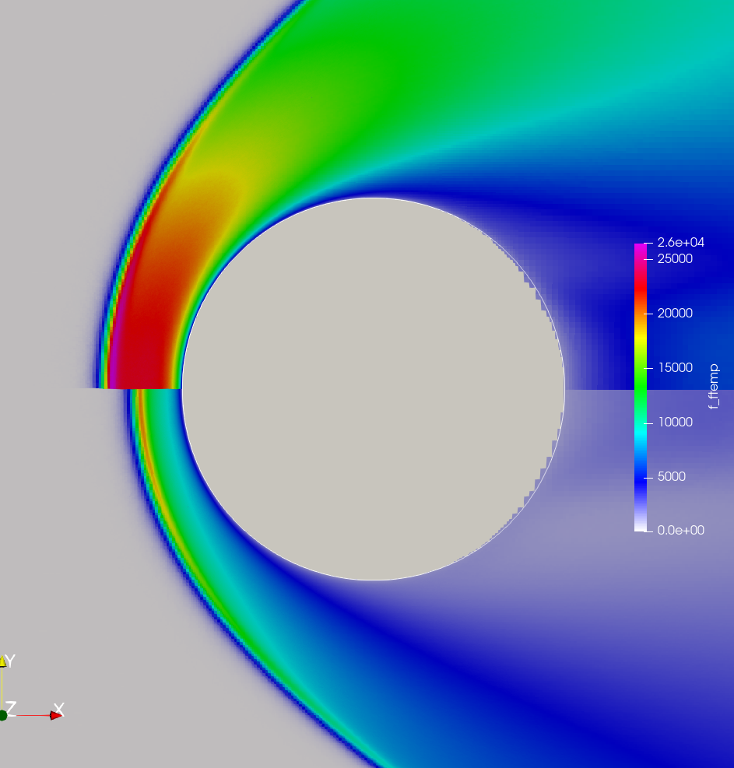
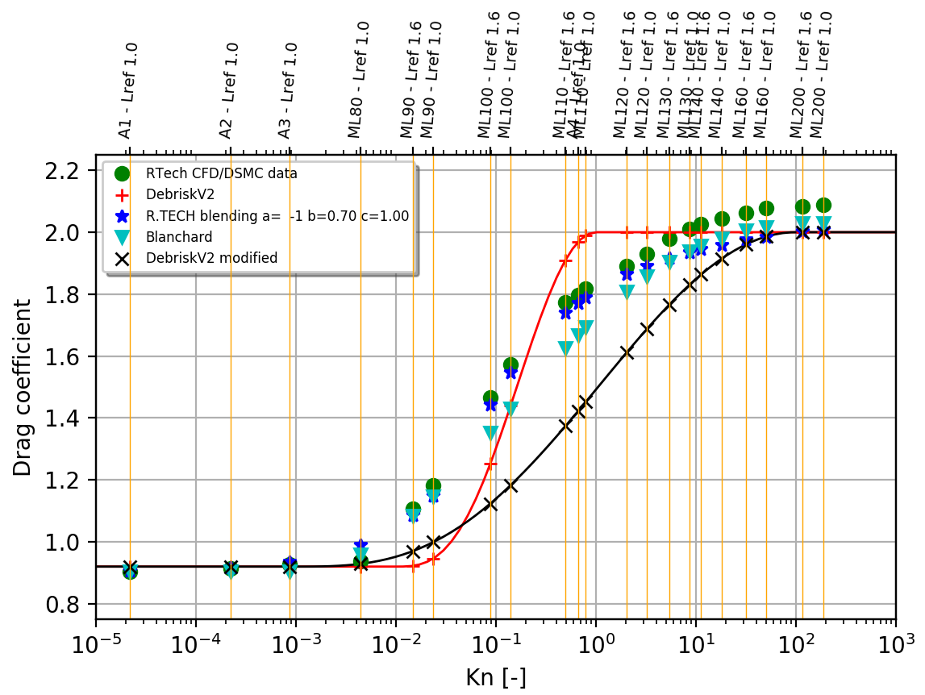
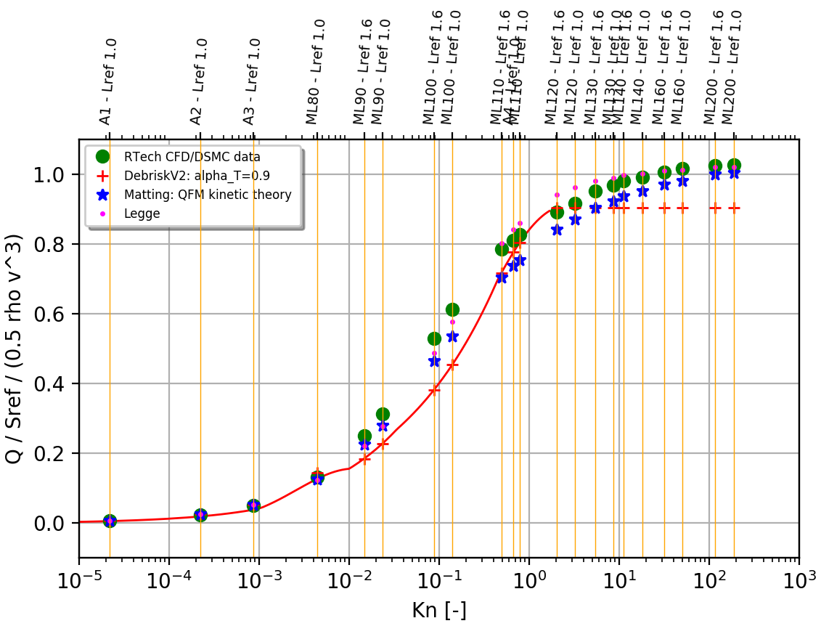
Aerothermodynamics: Transitionnal regime
  Bridging function currently implemented : Blanchard & Legge
  Blanchard & Legge bridging functions validated via a CFD/DSMC on spheres (only) by varying the Knudsen number
  Next activities : calibrate functions via CFD/DSMC computations for each topology
    From what Knudsen number a DSMC computation is getting too expensive?
    What is the influence of considering chemical reaction and which model to use?
    What is the influence of the catalicity?
    What is the influence of the wall boundary condition?
Kn = 0,004
No chemical reaction
Chemical reaction

Slide 11
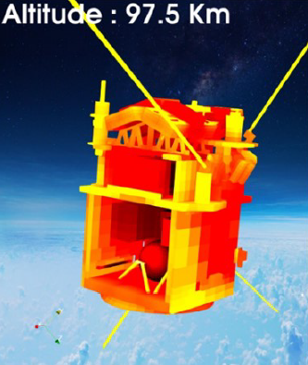

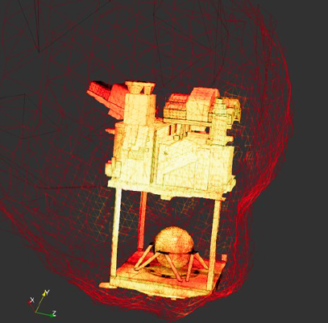
ATTITUDE
Random-tumbling attitude for all the shapes, except flat plates and boxes (end-over-end attitude) in the hypersonic regime
The EoE attitude is applied whatever the dimensions of the plates/boxes: need to consolidate this assumption
Generalizing the RT attitude in DEBRISK v4 is expected
Fast computations for all regimes
Calibrated damping coefficient
Database Generation
Topologies
CoG
Ballistic coefficients
Shape factors
Initial rotations
…………
Accurate computations
Damping directly computed
Time-consuming computations
Only for the continuum regime
~ 50 000 computations

Slide 12
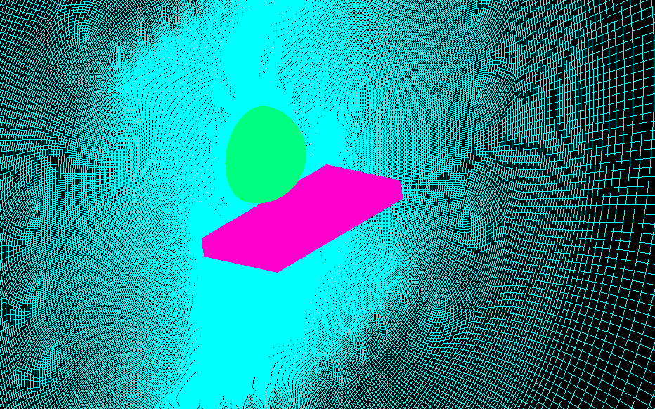
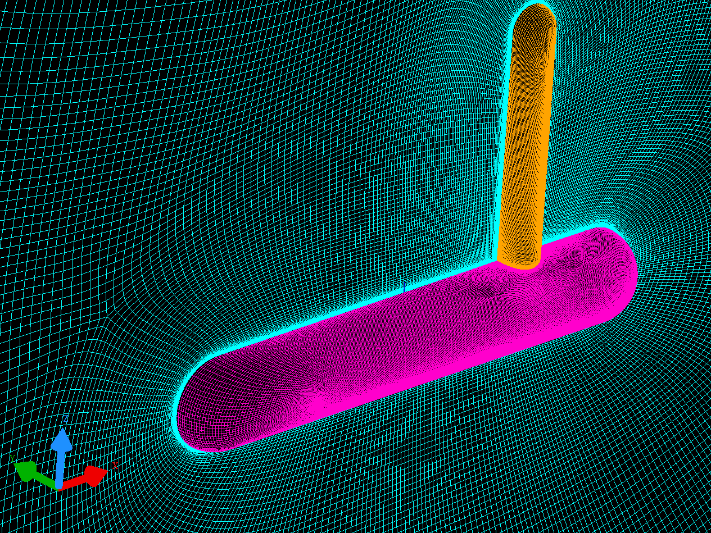



« Brother » relationship
$${Cd}^{ob1+2}S^{ob1+2}={Cd}_{single}^{ob1}S_{single}^{ob1}{VF}^{ob1}+{Cd}_{single}^{ob2}S_{single}^{ob2}{VF}^{ob2}$$
$$Q^{ob1}=Q_{single}^{ob1} {VF}^{ob1}$$
$$Q^{ob2}=Q_{single}^{ob2} {VF}^{ob2}$$
geo | VF_proj
box | 92%
sphere | 72%
cylL1D1 | 97%
cylL1D1 x0.25 | 55%
big cylhemi | 97%
small cylhemi | 86%
geo | Without VF_proj Discrepency (%) Q | With VF_proj Discrepency (%) Q
box | -9% | -16%
sphere | 0% | -28%
cylL1D1 | 4% | 1%
cylL1D1 x0.25 | 68% | -7%
big cylhemi | -26% | -27%
small cylhemi | -19% | -30%
geo | Without VF_proj Discrepency (%) Cd | With VF_proj Discrepency (%) Cd
Sphere+box | 11% | -3%
cylL1D1 x0.25+cylL1D1 | 7% | 2%
small cylhemi+big cylhemi | -13% | -17%
This methodology leads to high uncertainties on the thermal heat fluxes
The contribution of the VF correction is not obvious
Higher-fidelity solutions are being investigated, but necessarily more expensive, more time-consuming and perhaps more difficult to implement

Slide 13
Methodology improvements

Slide 14
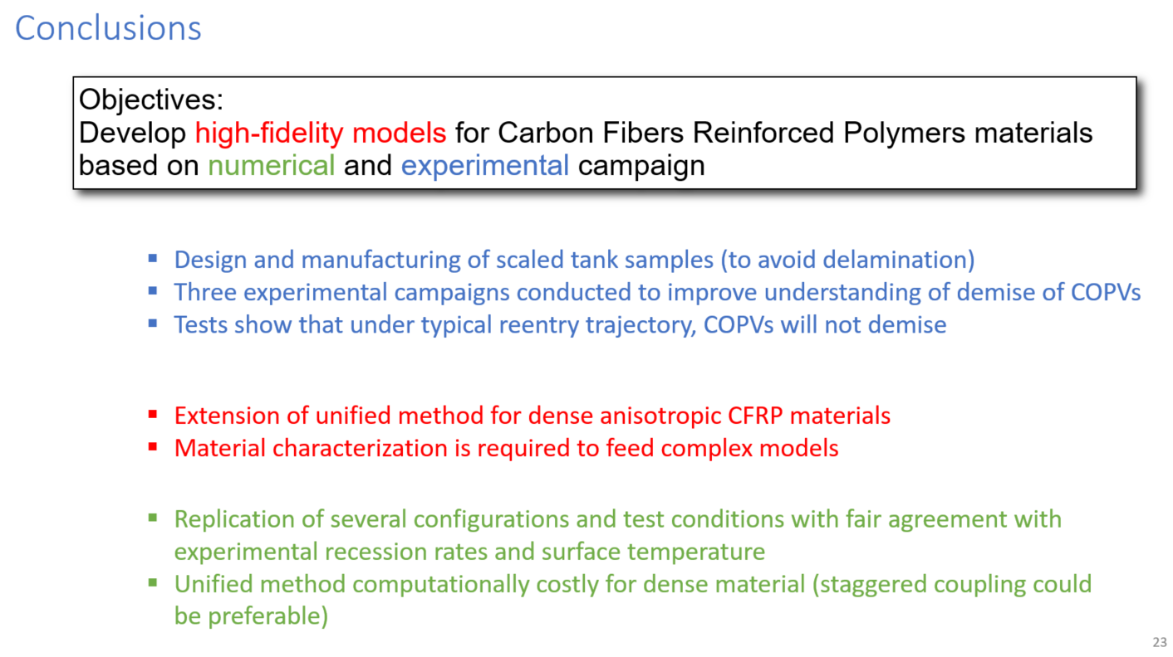
Equipment in CFRP: COPV and Optical support
COPV tank: the continuous filament winding represents an important protection against the ablation of the liner
Optical support: if thick, the amount of epoxy matrix to pyrolyze is much larger to allow an easy fiber delamination
Test-case on an EADS CFRP tank (8 layers) (the liner has been replaced by Aluminum), computed by PAMPERO
Thermal conduction through the thickness of the CFRP is not sufficient to degrade the aluminum liner
  GBP v3 recommends that these elements should be considered without degradation, throughout the trajectory.
  Must be confirmed by destructive tests in the frame of DEBRISK V4 !
Conclusions from P. Schrooyen et al. (ATD3)
 |  | 78 km | 100 km
Tank part | Initial mass | End mass | End mass
Fiber | 635 g | 594 g | 603 g
Resin | 347 g | 109 g | 77 g
Char | 0 g | 26 g | 32 g
Liner | 481 g | 481 g | 345 g

Slide 15
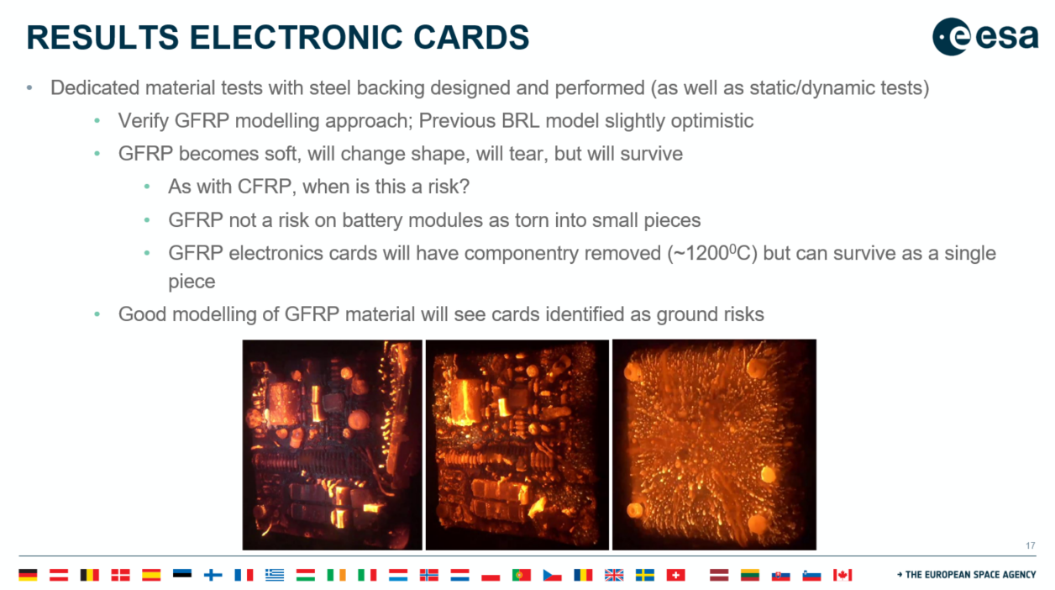
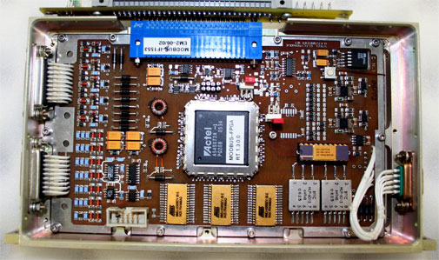
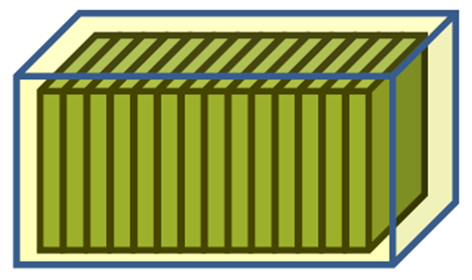
Electronic cards
Conclusions from Marco Papa (ATD3)
Mainly composed by epoxy resin (pyrolyse phenomena around 600K)
Composed by glass fiber (degradation around 1000 K)
DEBRISK computations show that the electronics cards completely demise for all the test-cases
Must be confirmed via the experimental tests in the frame of DEBRISK v4
The way in which electronic cards are modeled can be extremely critical to the total casualty area

Slide 16
Conclusion
See you in 4 years for DEBRISK version 4 !
Thank you for your attention ! Questions ?
Thanks to R.Tech for helping us for the slides !

