Slide 1
Institute of Space Systems
Airborne Observation of the Cluster-II Salsa Re-entry
S. Loehle, B. Jilete, F. Zander, C. Mueller, R. Ravichandran, B. Birch, G. Armstrong, J. Toth, T. Paulech, J. Silha, S. Lemmens, T. Lips, P. Kaerreng

Slide 2
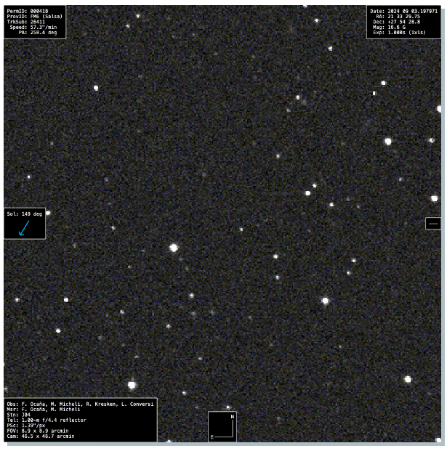
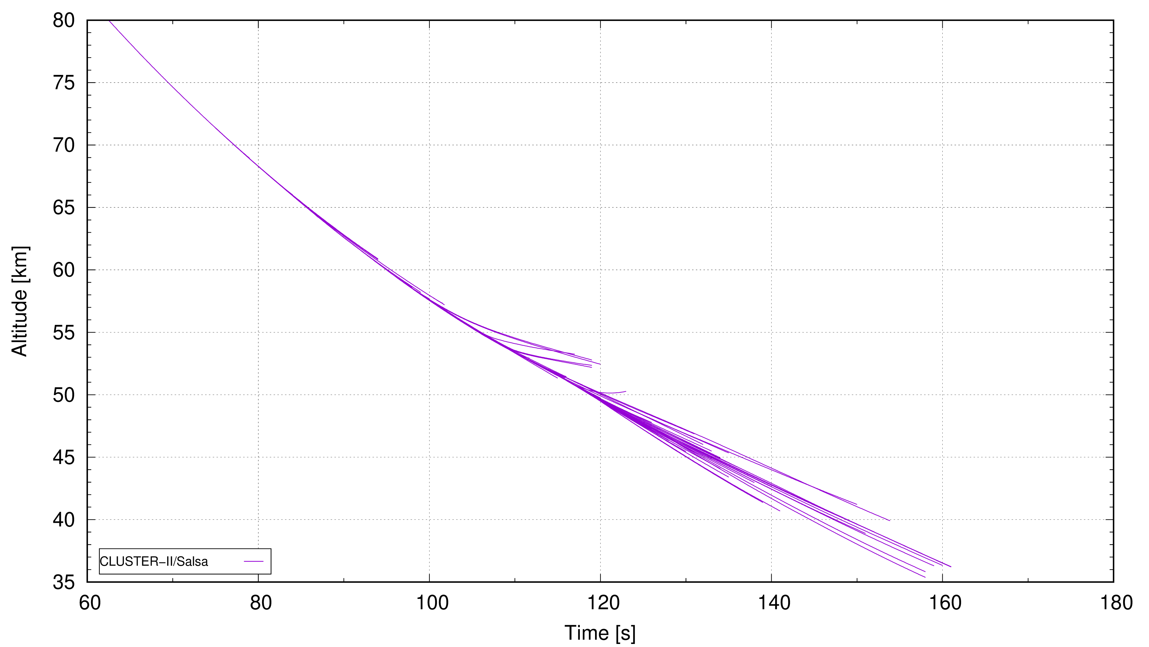
Science Question(s)
Cluster : - large satellite to be demised (2.9m wide, 1.3m high disk shape) - high entry velocity ~11.2km/s at -5.46° flight path angle
From Space to Ground:
Science Questions: Does it all happen the way it is predicted?
Does it fragment as predicted?
Does it fragment at the altitudes predicted?
What are the fragments? Temperatures?
2

Slide 3
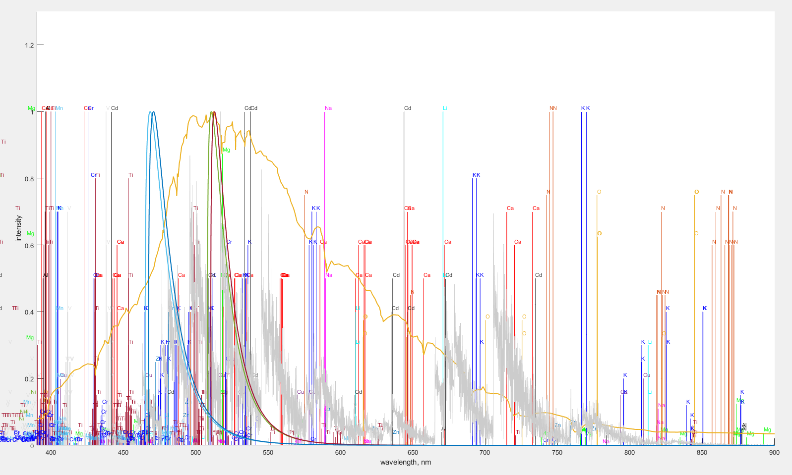
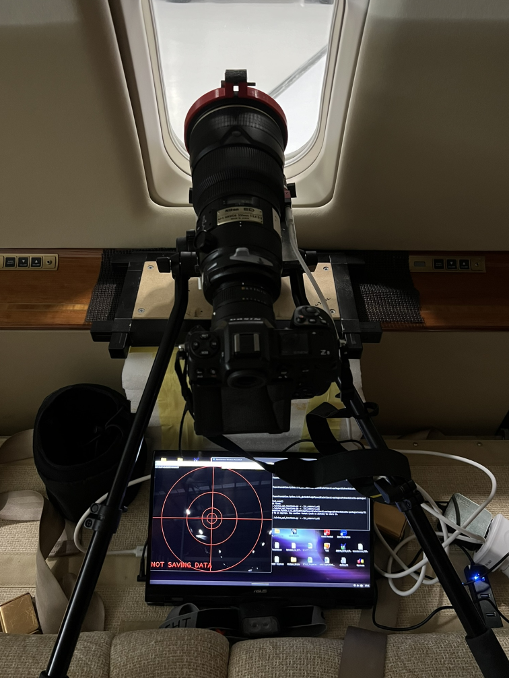
Spectroscopy in Bright Daylight - Spectral Markers
3

Slide 4
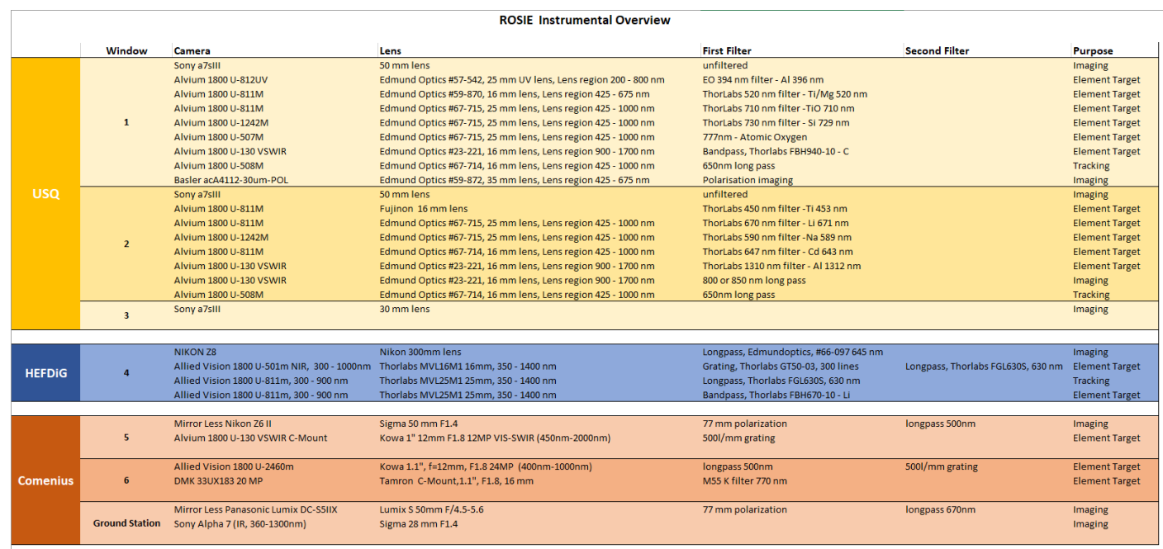
Spectroscopy in Bright Daylight - Spectral Markers
KREPE2 – Cygnus NG20
All cameras are time synchronized to one single gps signal
Stations 1-4 include attitude recording
Various IMUs are flow for attitude recording of the aircraft
4

Slide 5
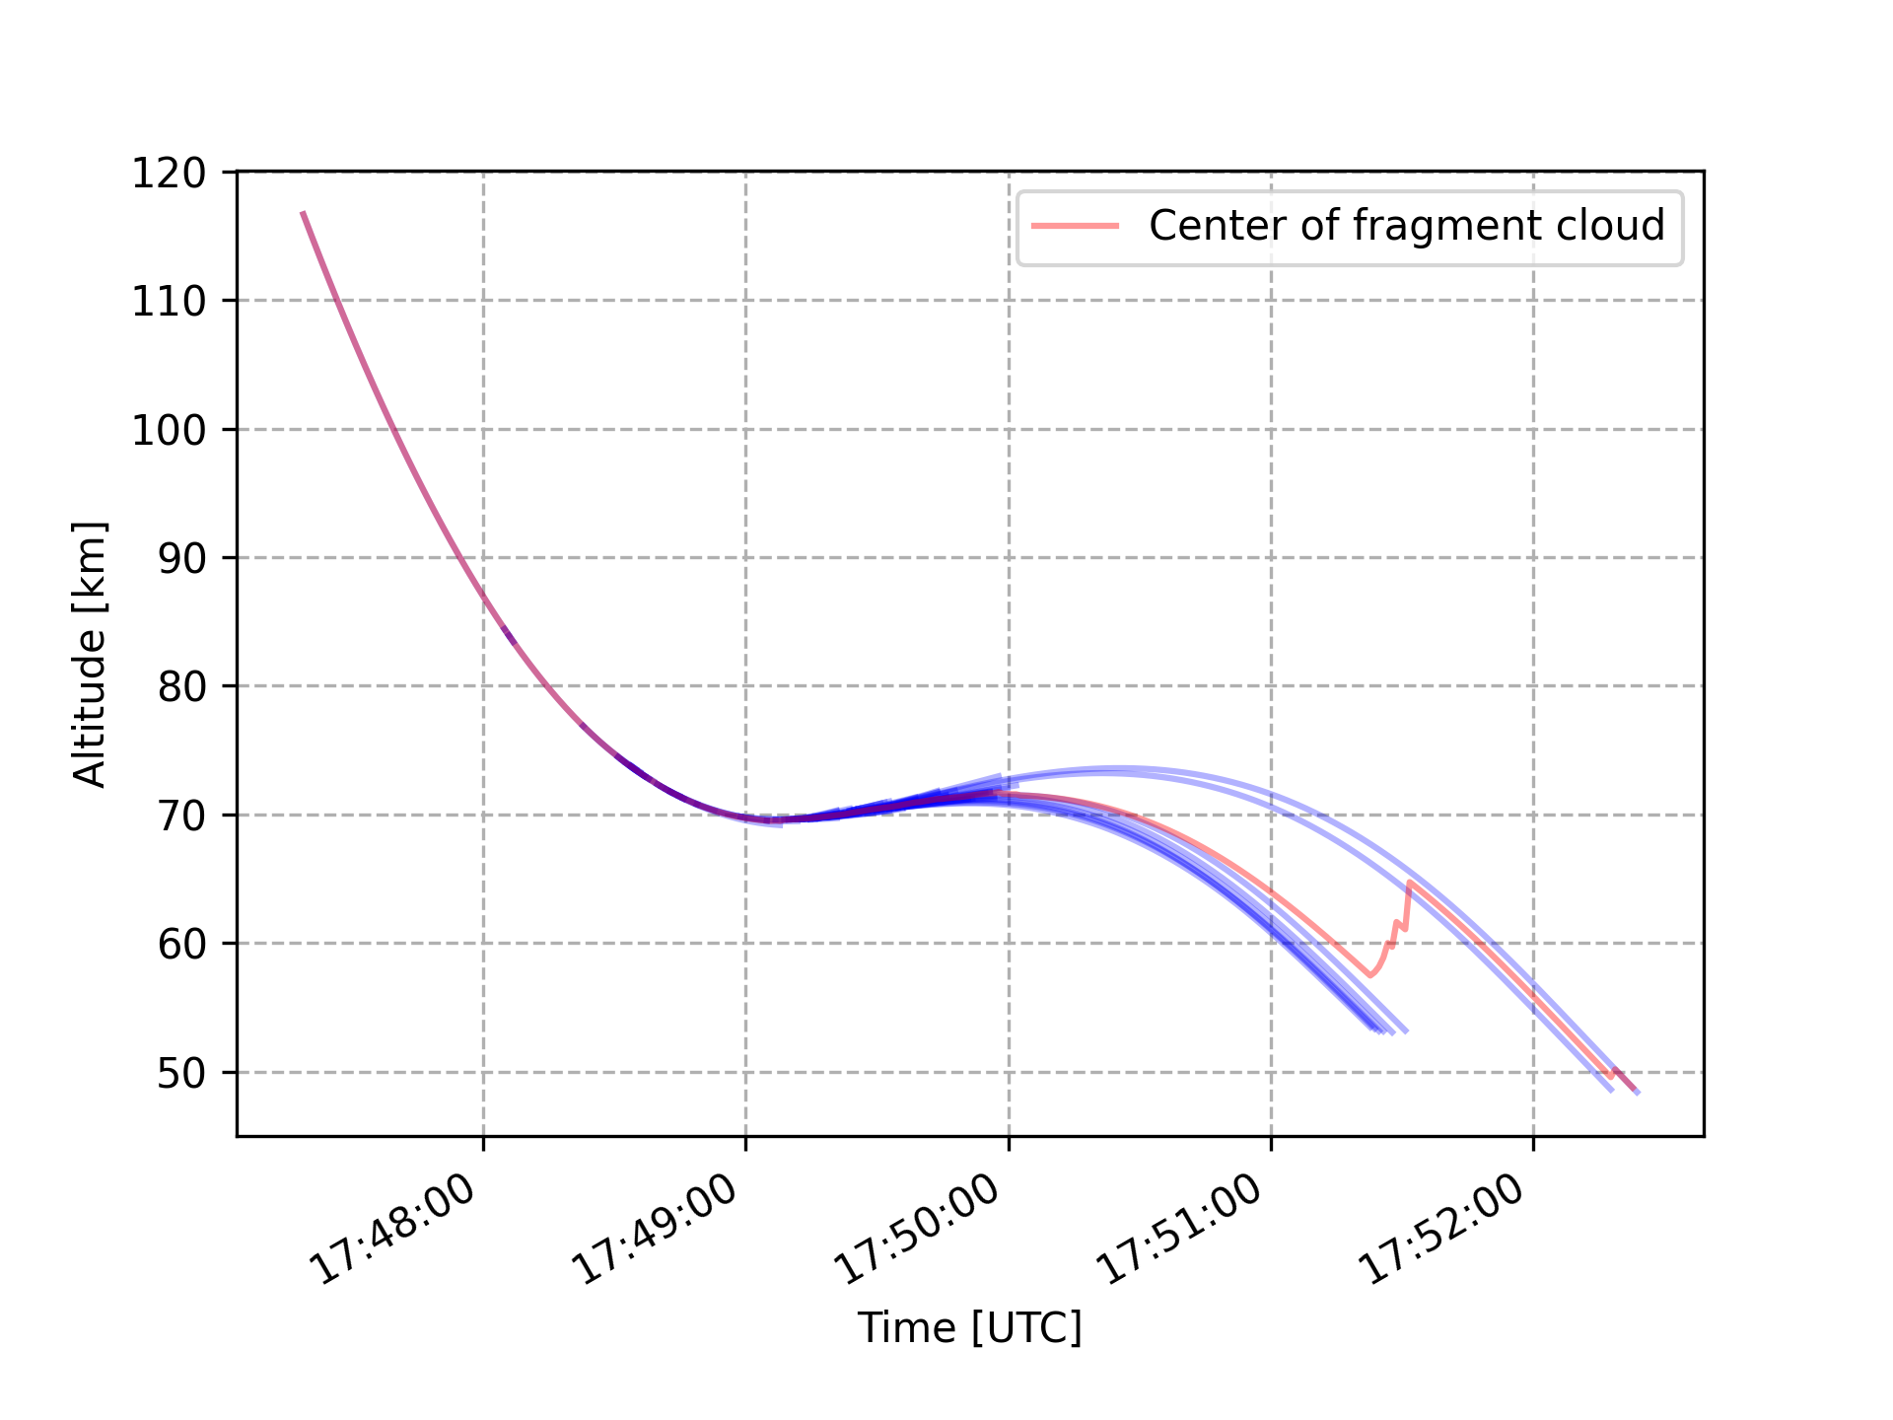
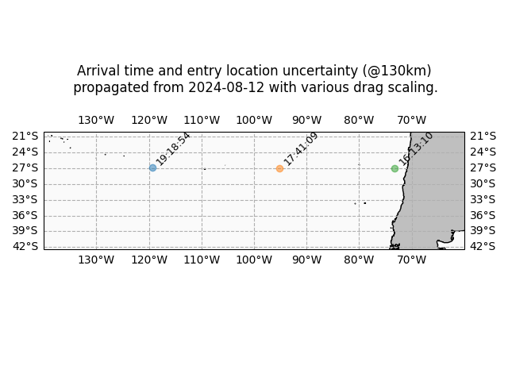
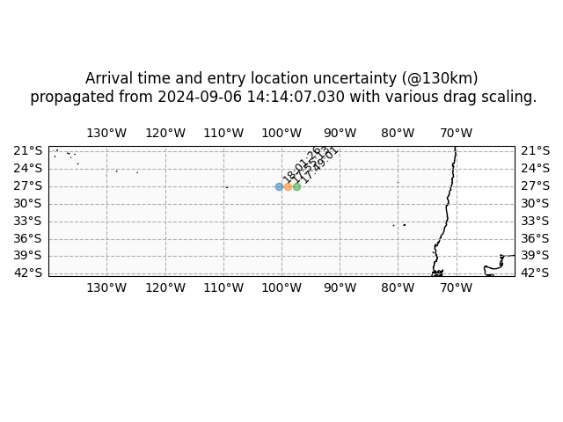
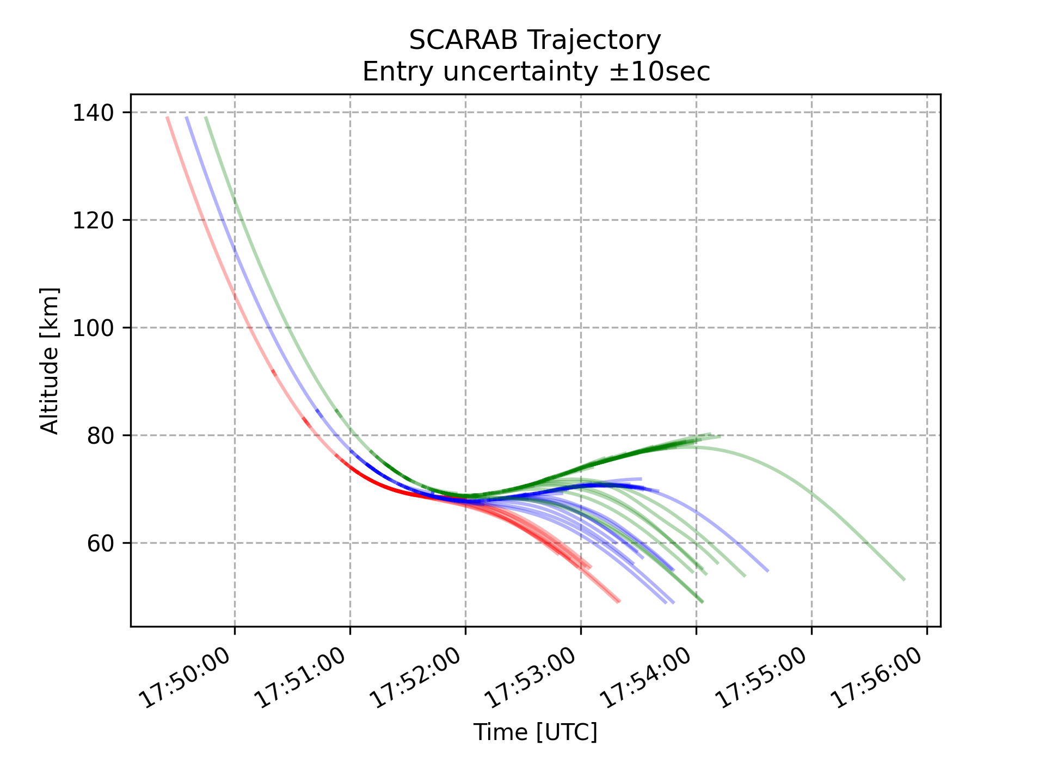
ESA - HTG Prediction
5

Slide 6
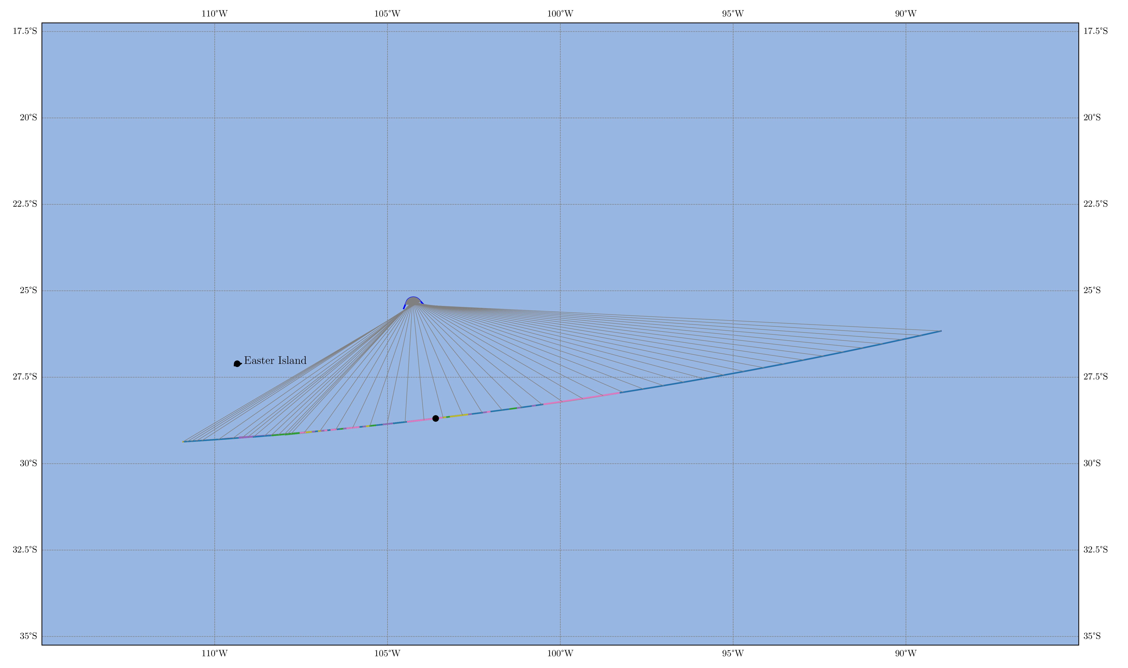
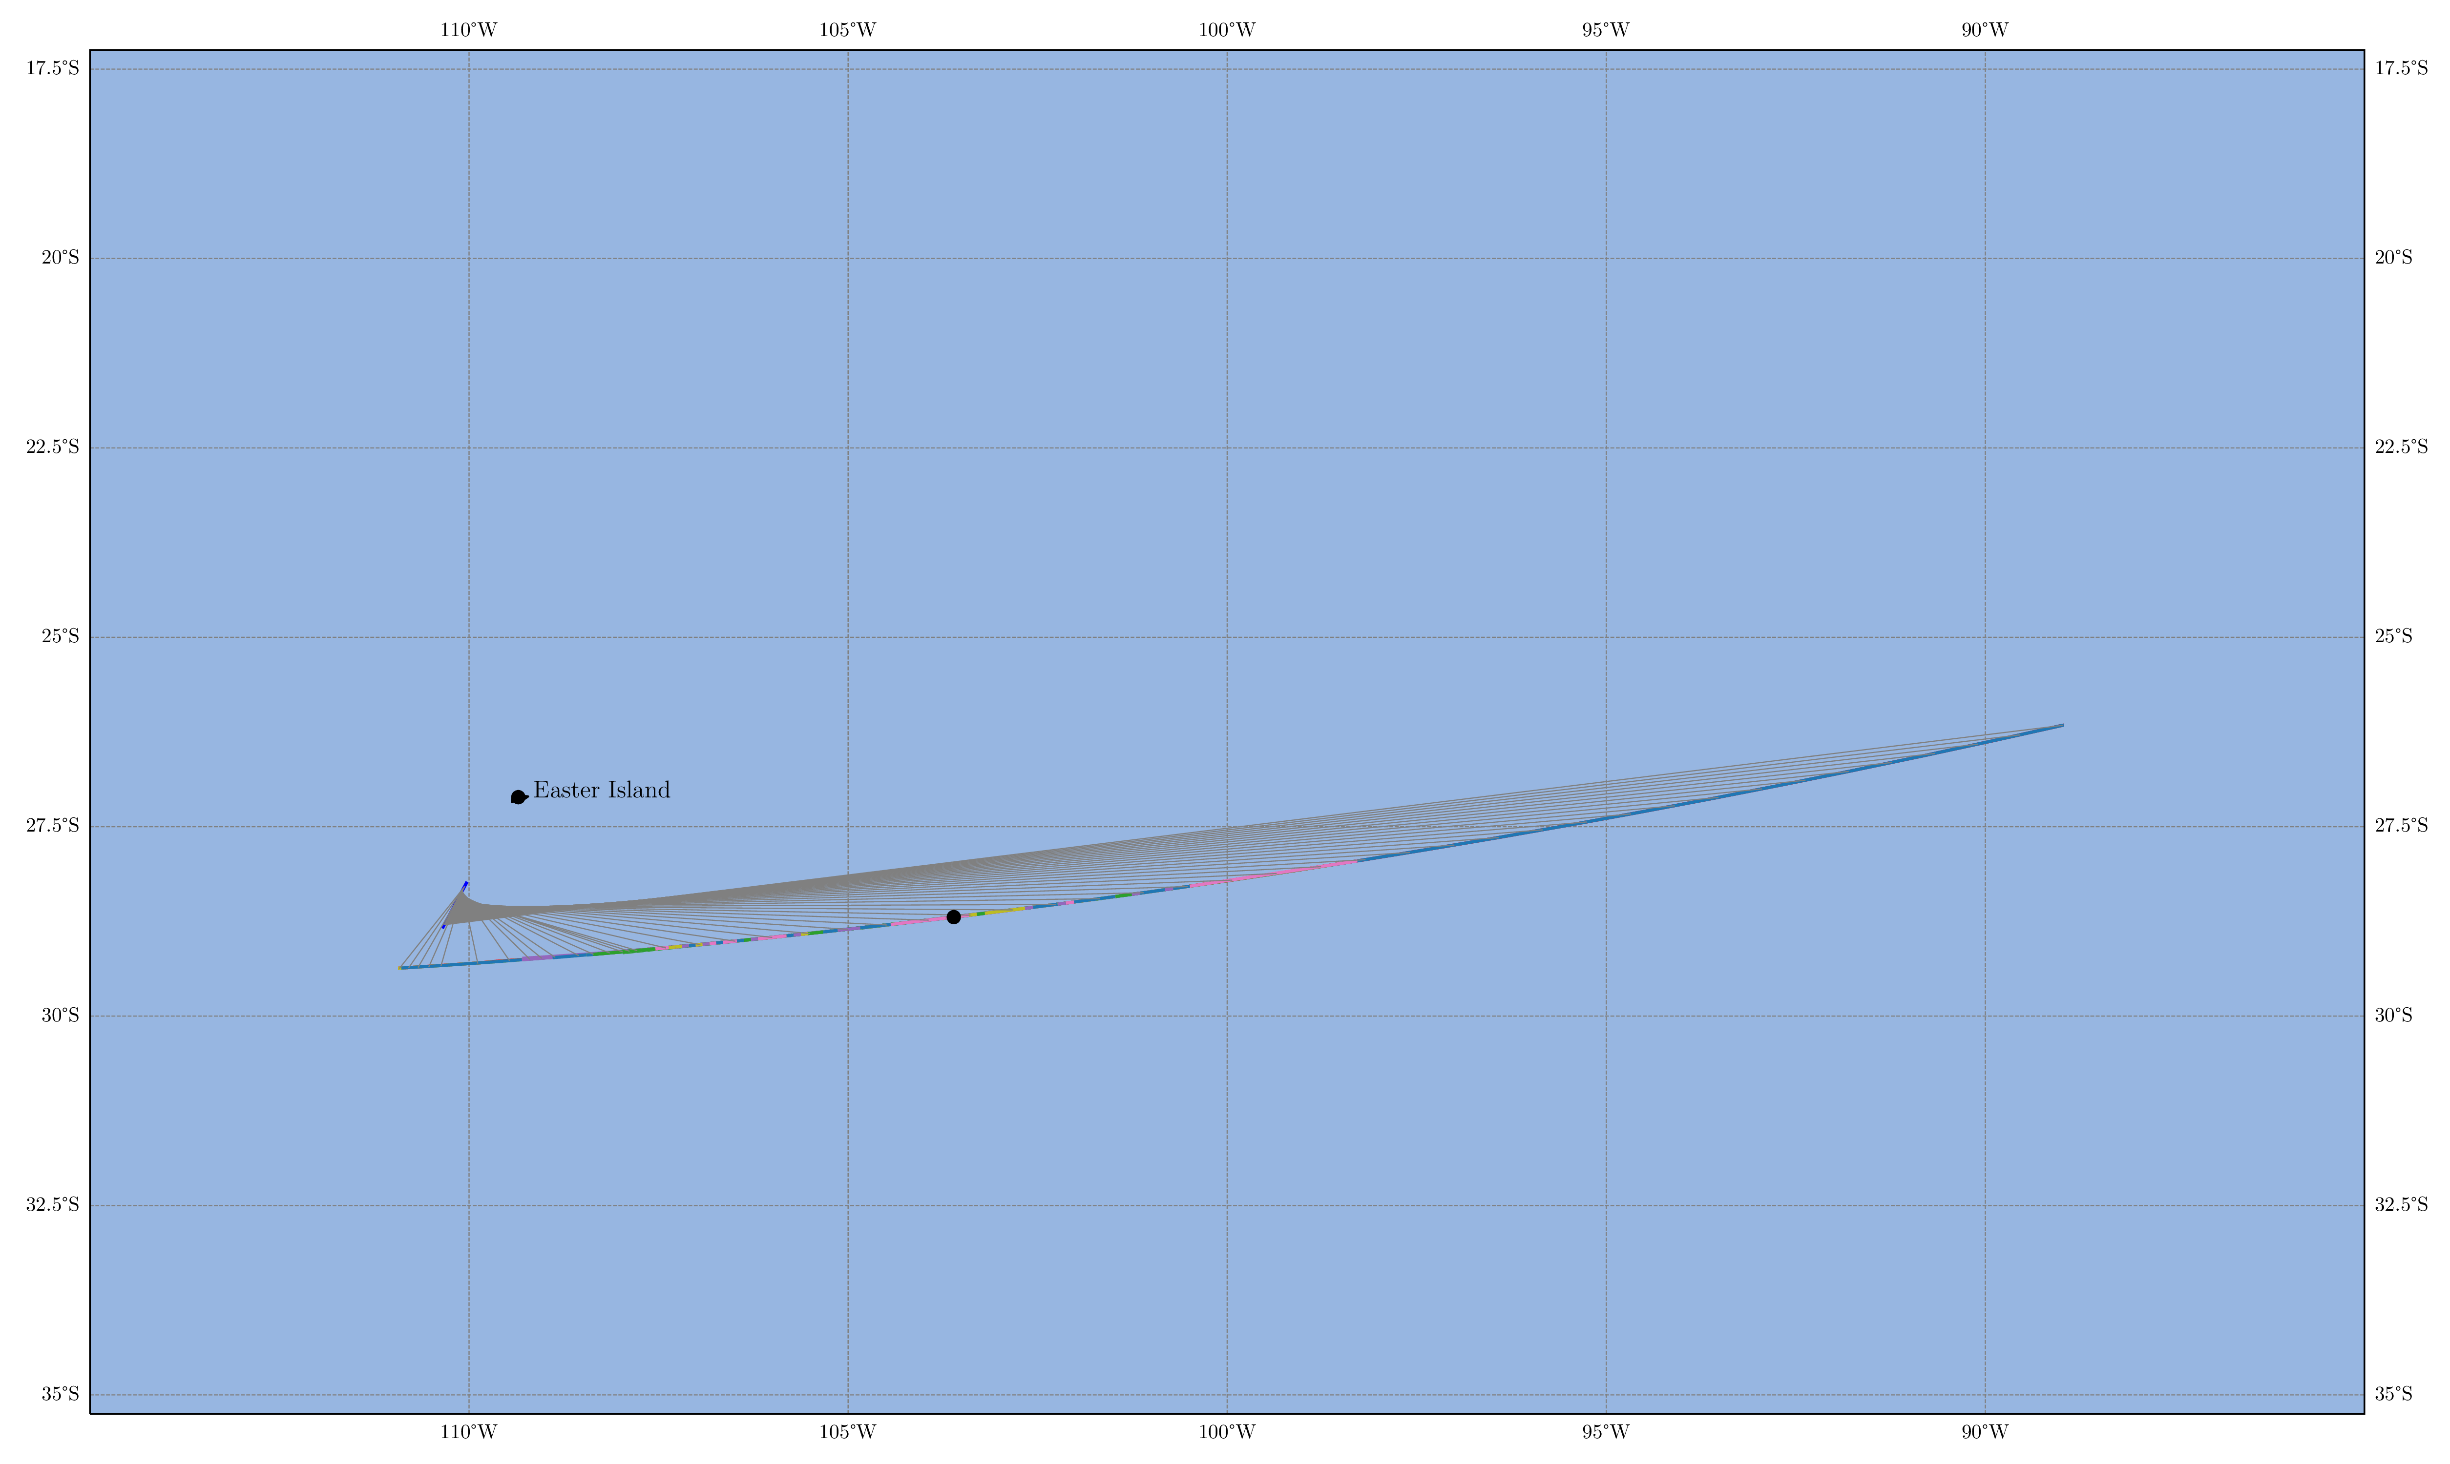
UniSQ Aircraft Flight Path
6

Slide 7
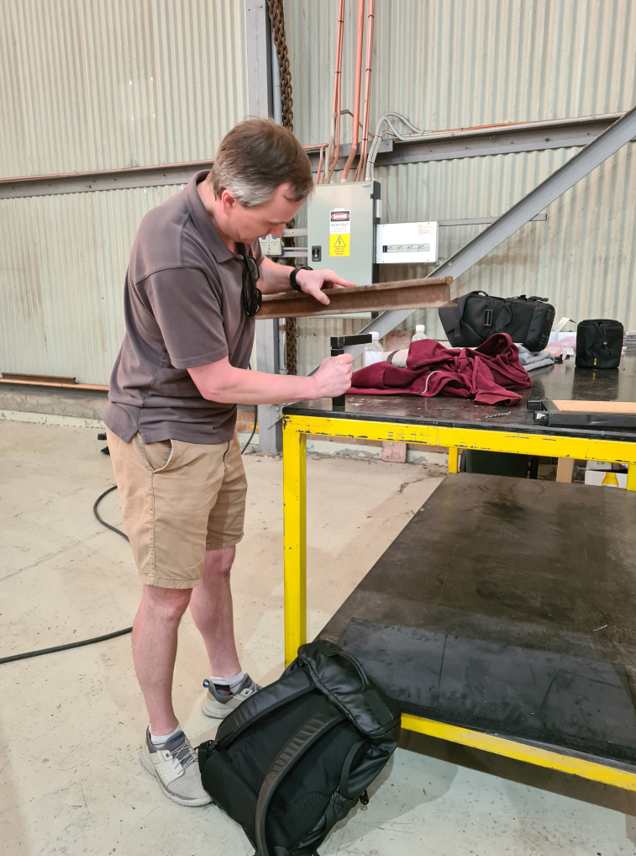
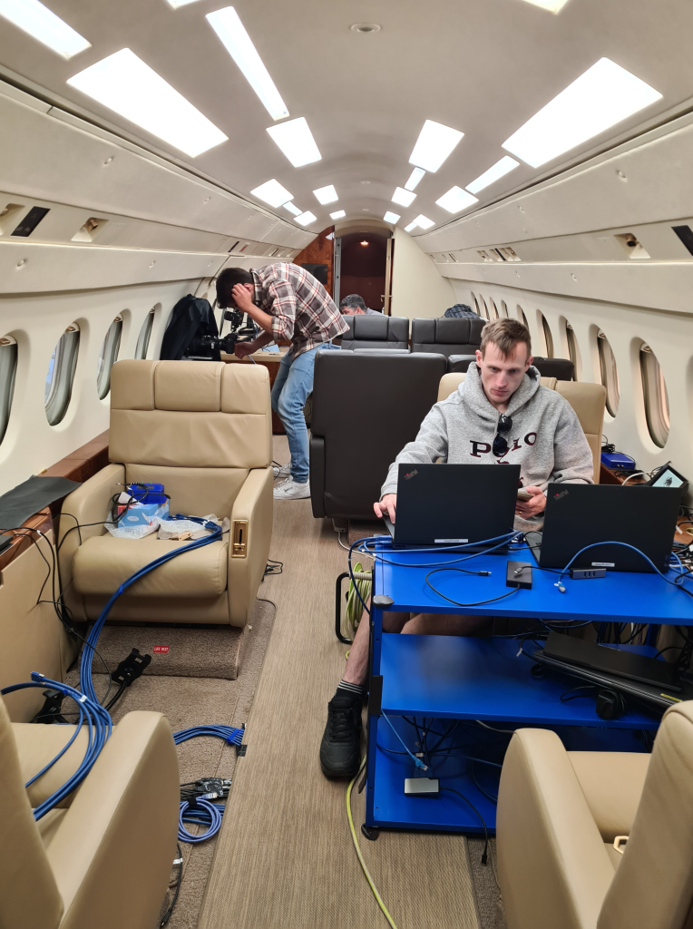
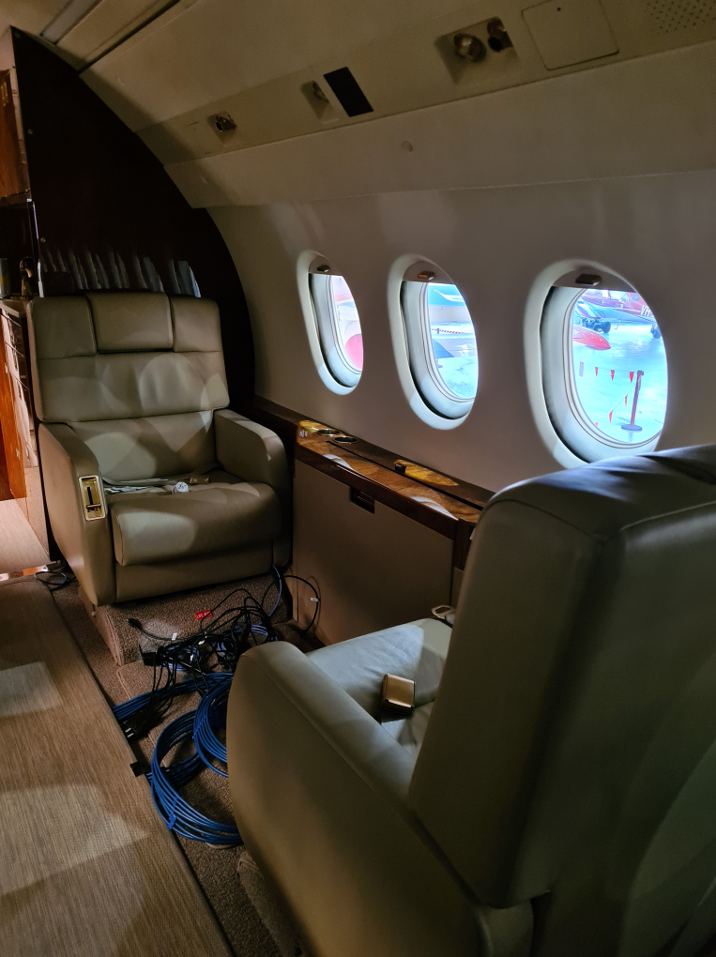
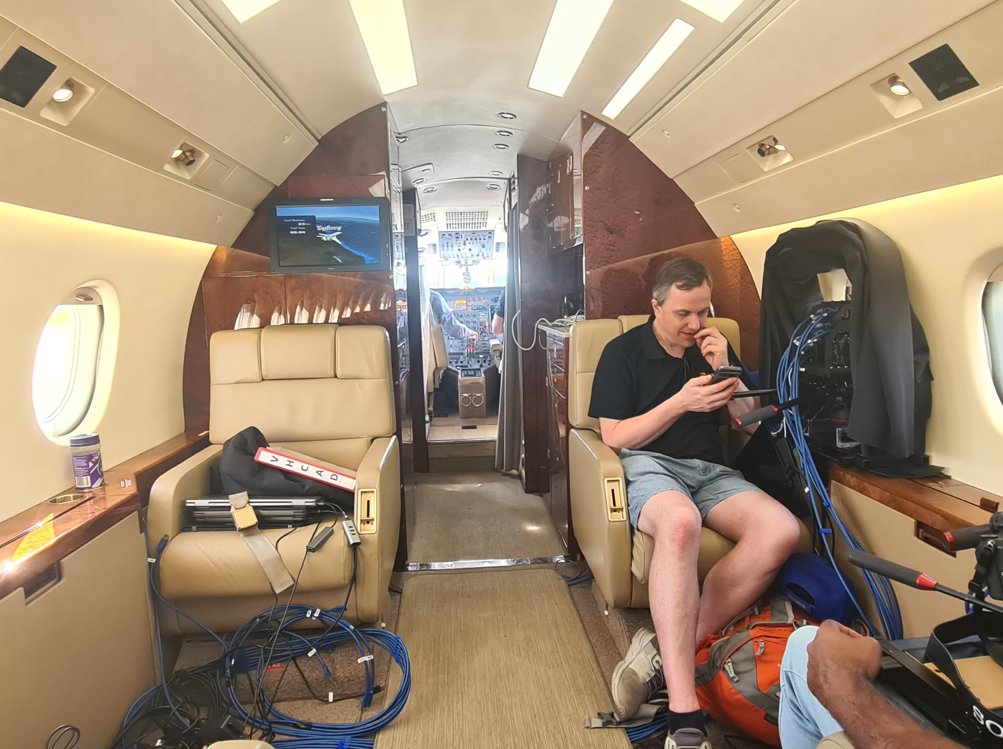
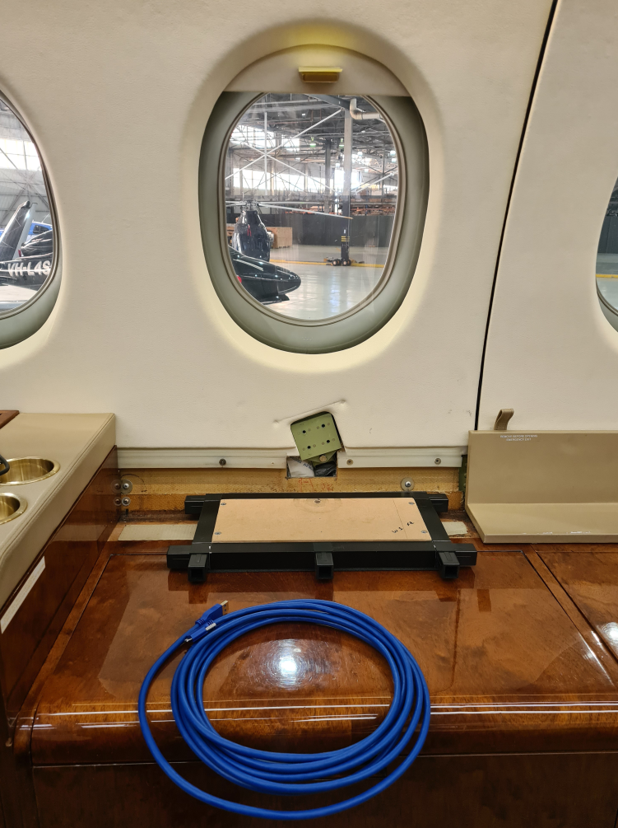
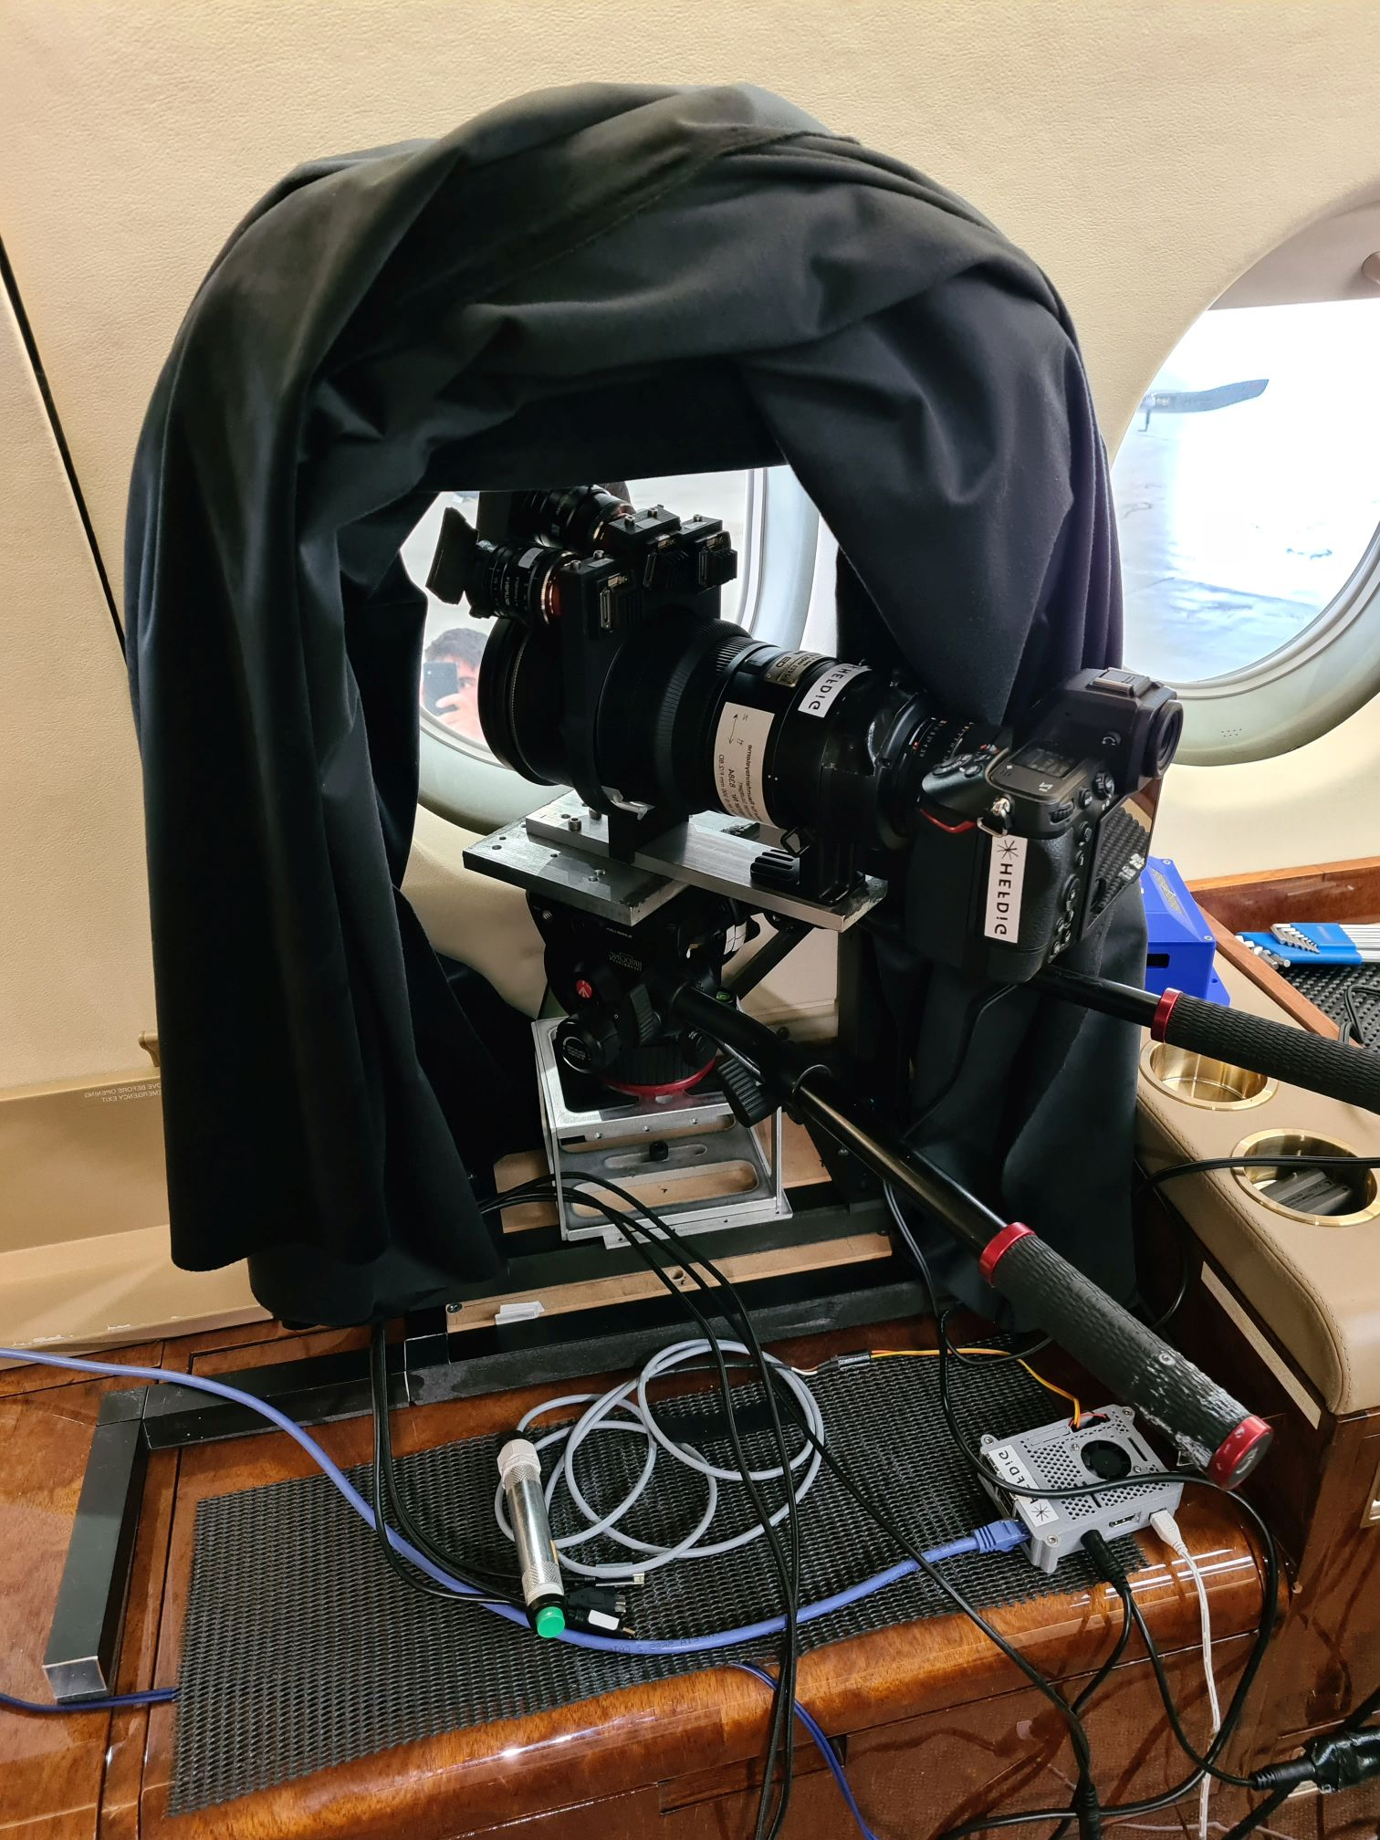
Airborne Observation Mission
Integration
7

Slide 8
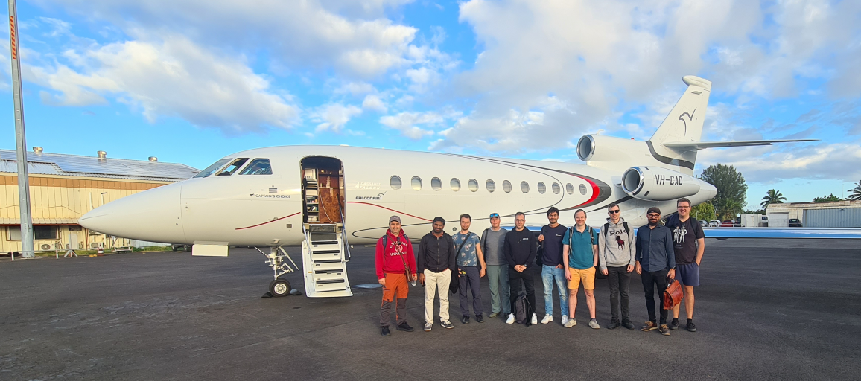
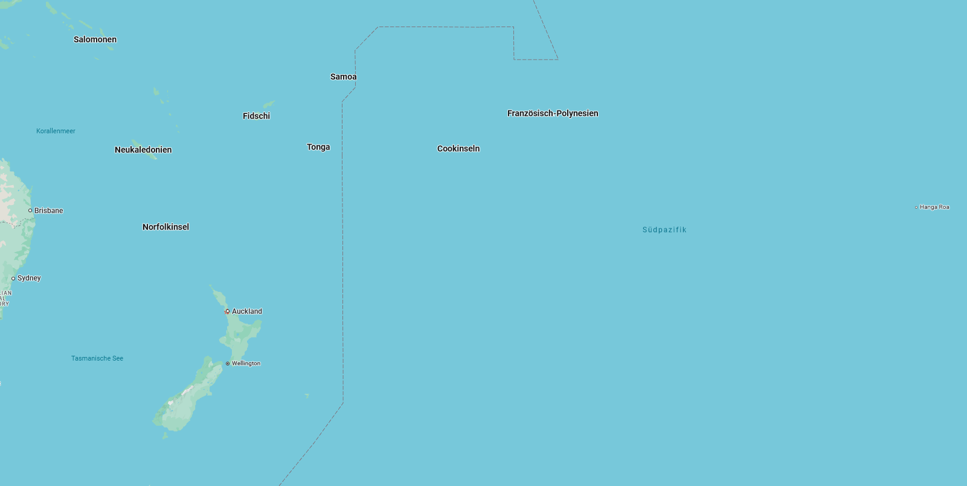
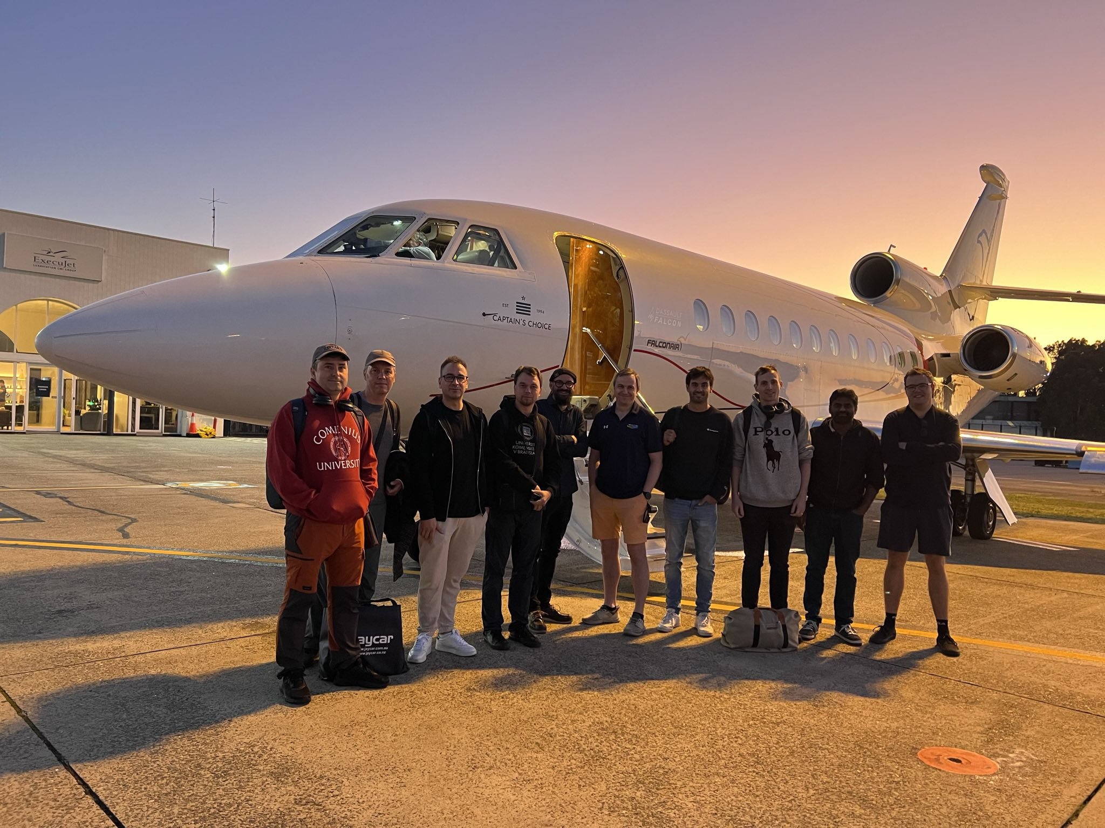
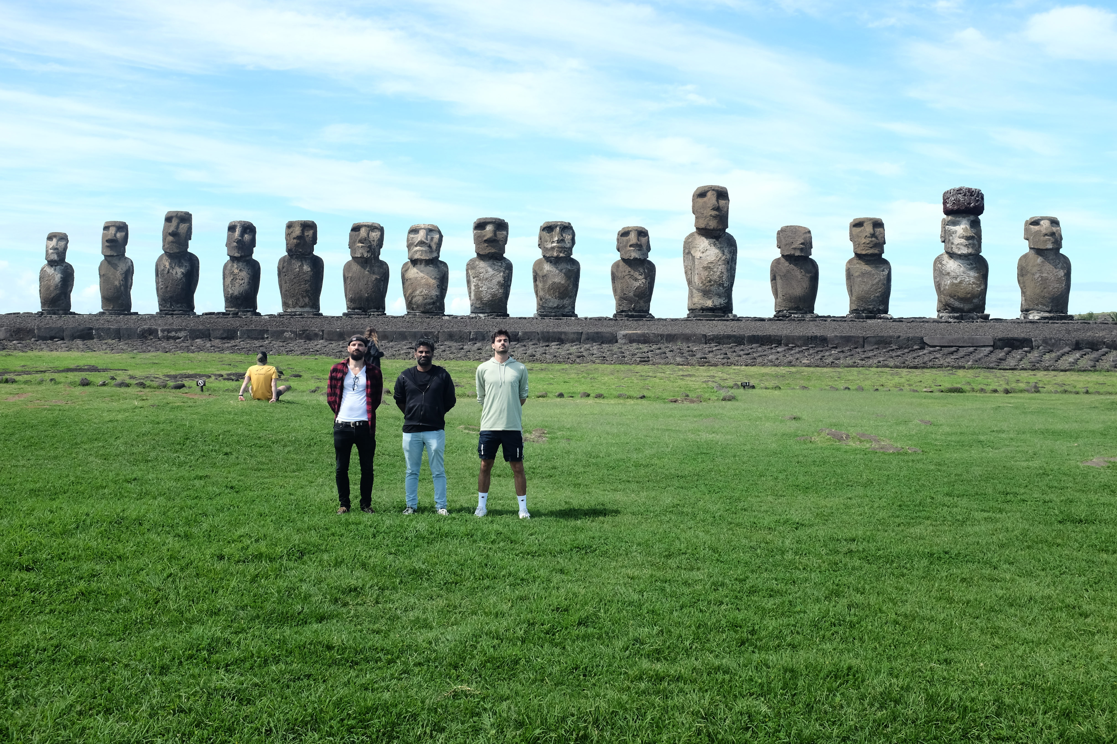
Airborne Observation Mission
Papeete
Sydney
8

Slide 9
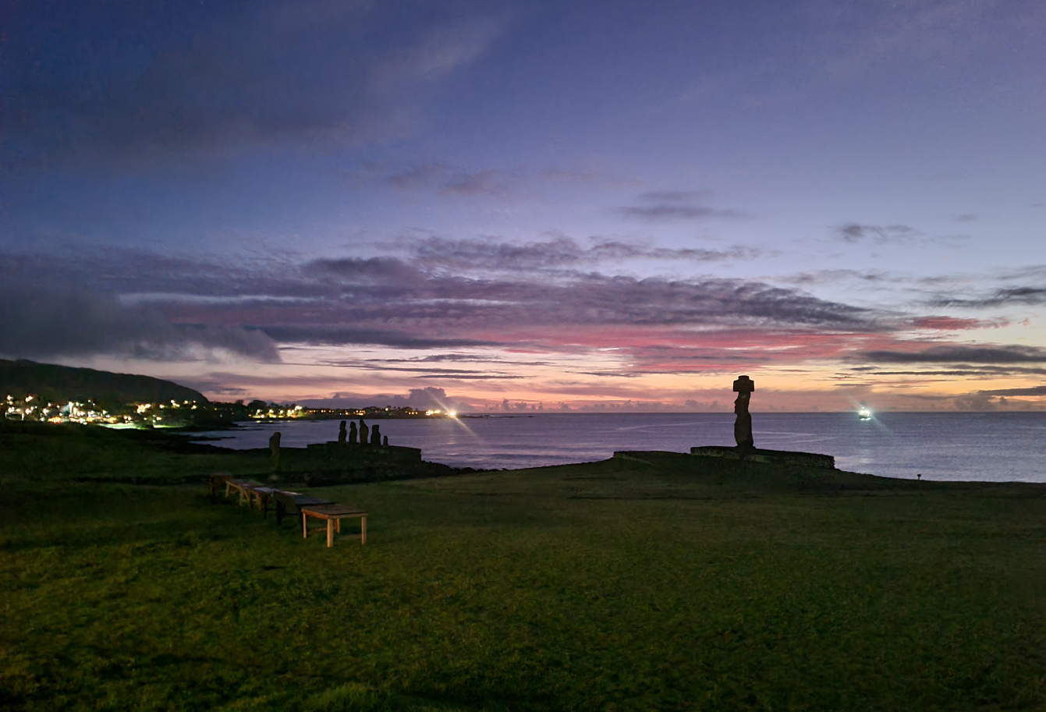
Latest information
9

Slide 10
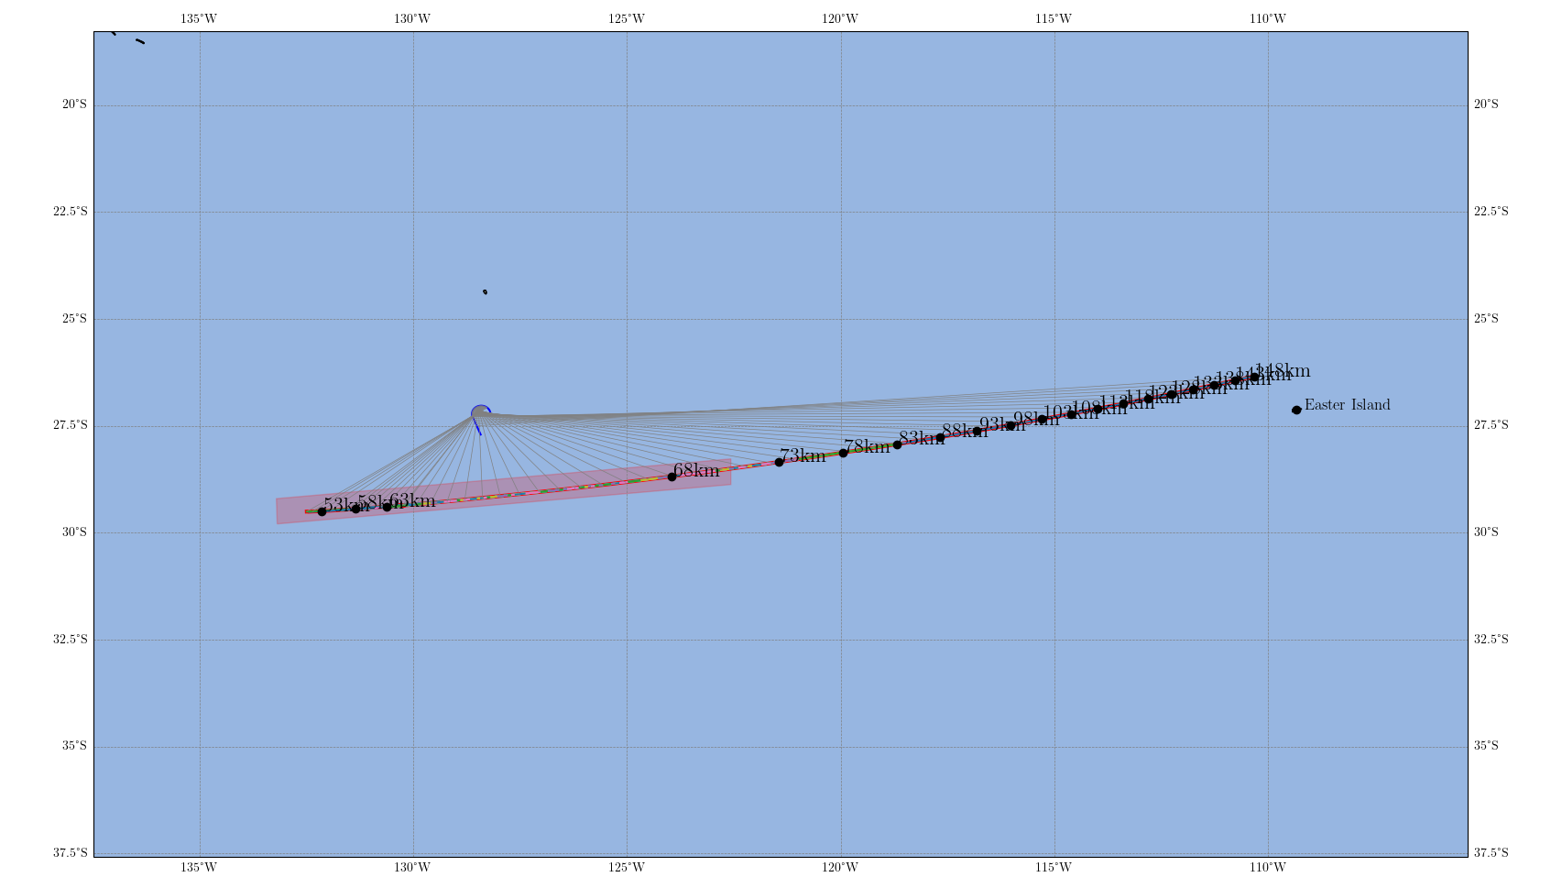
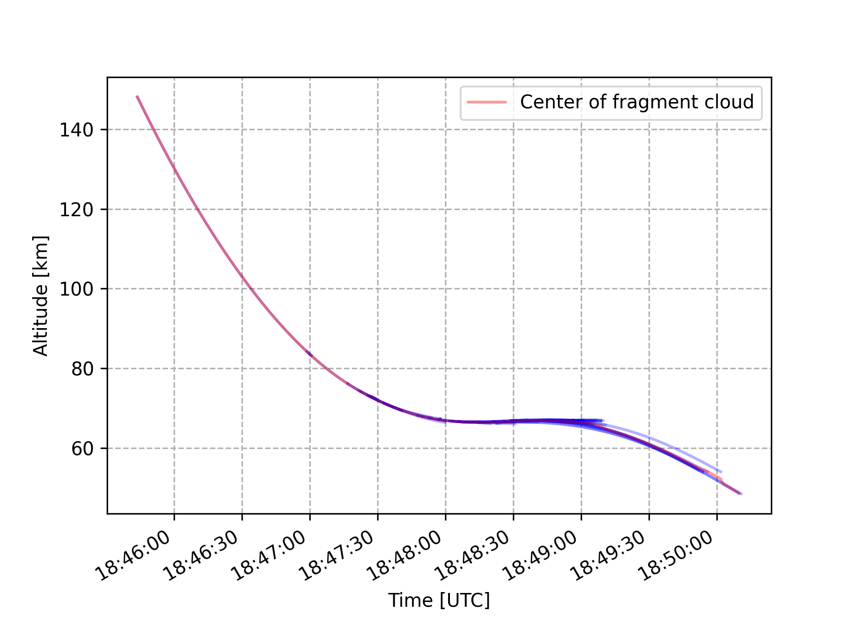
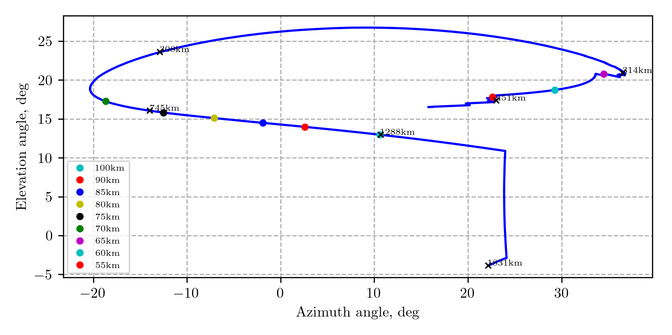
Final plan
10

Slide 11
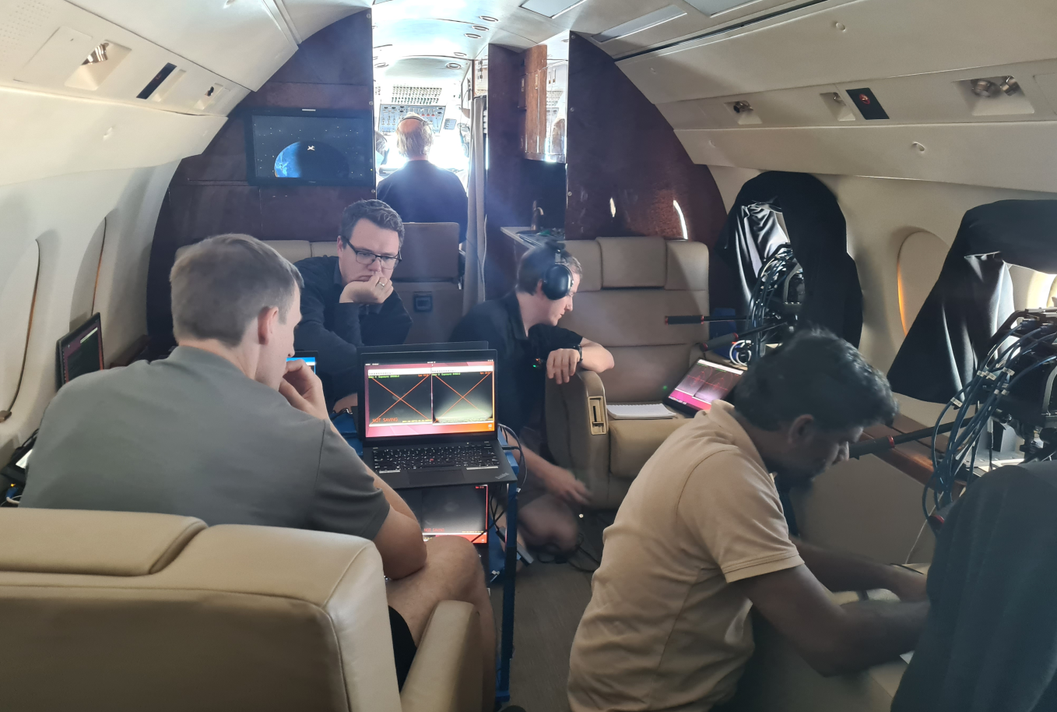
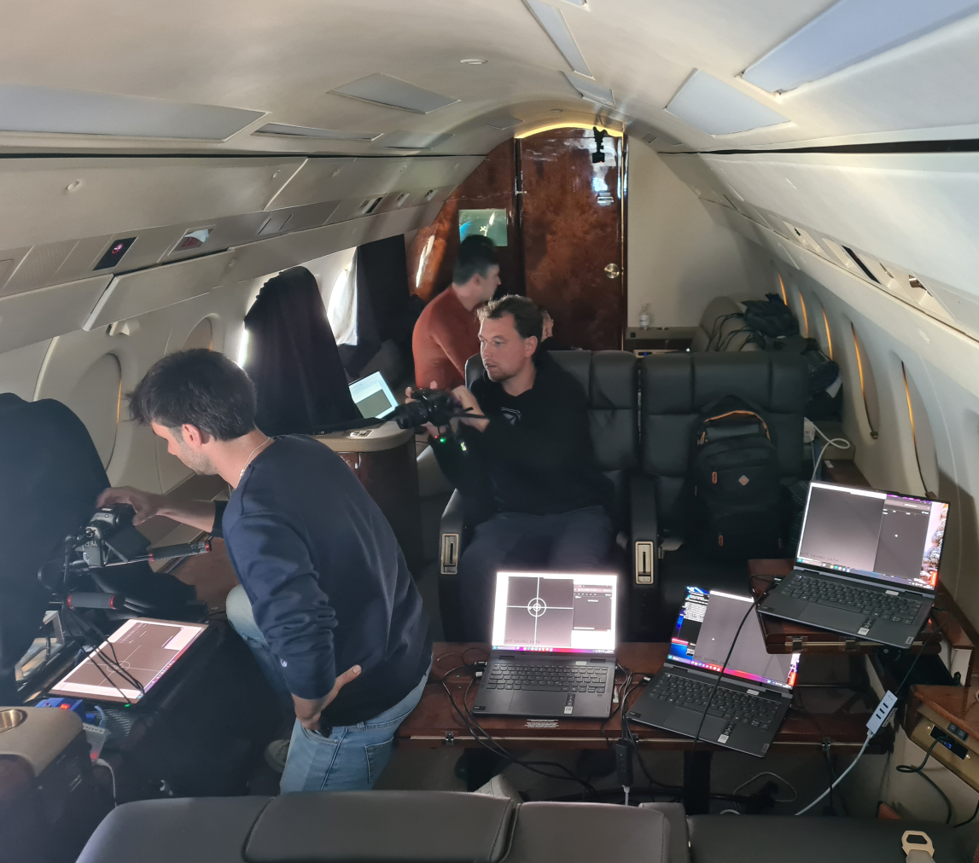
Mission Day!
11

Slide 12
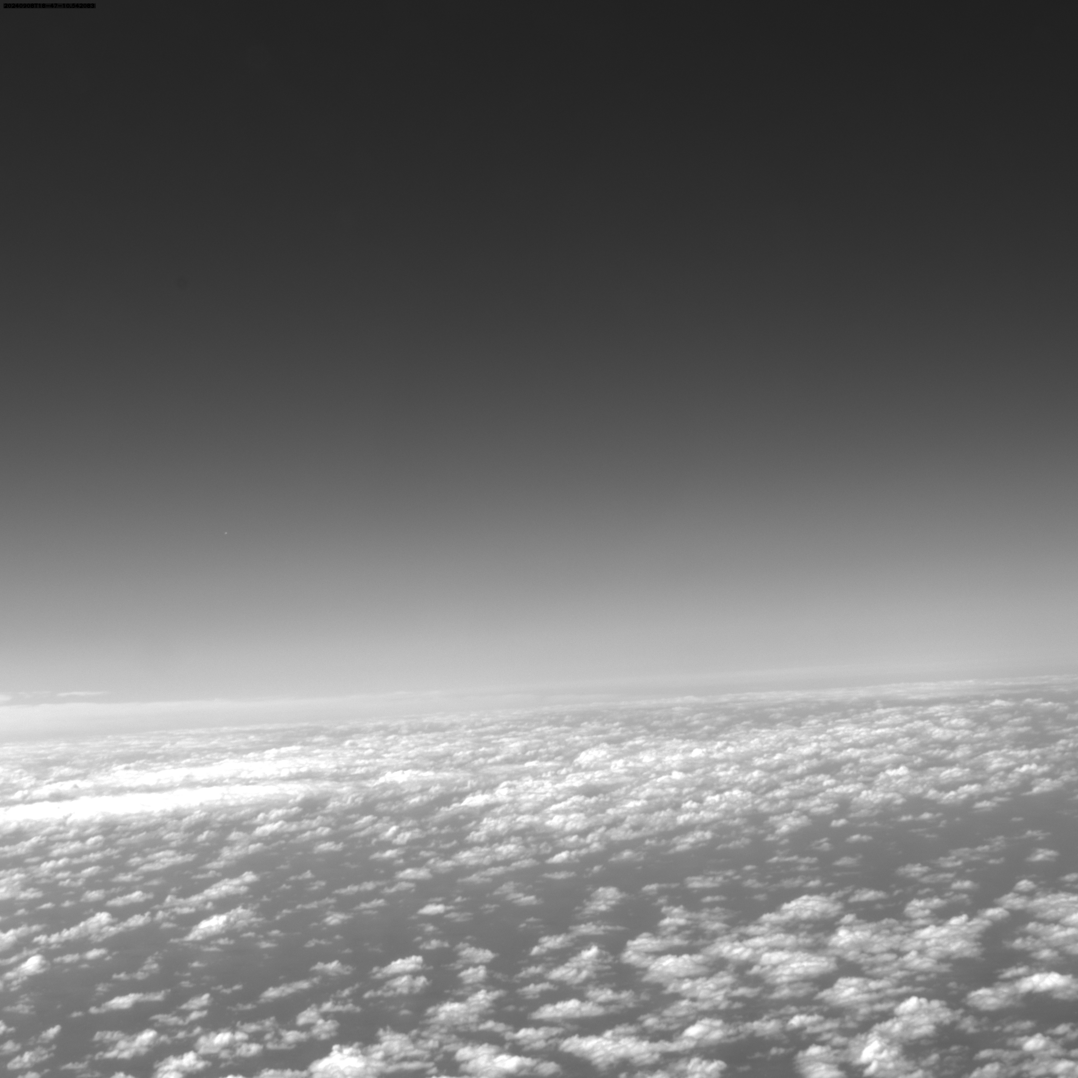
Oh. Wait. Where is it?
12

Slide 13
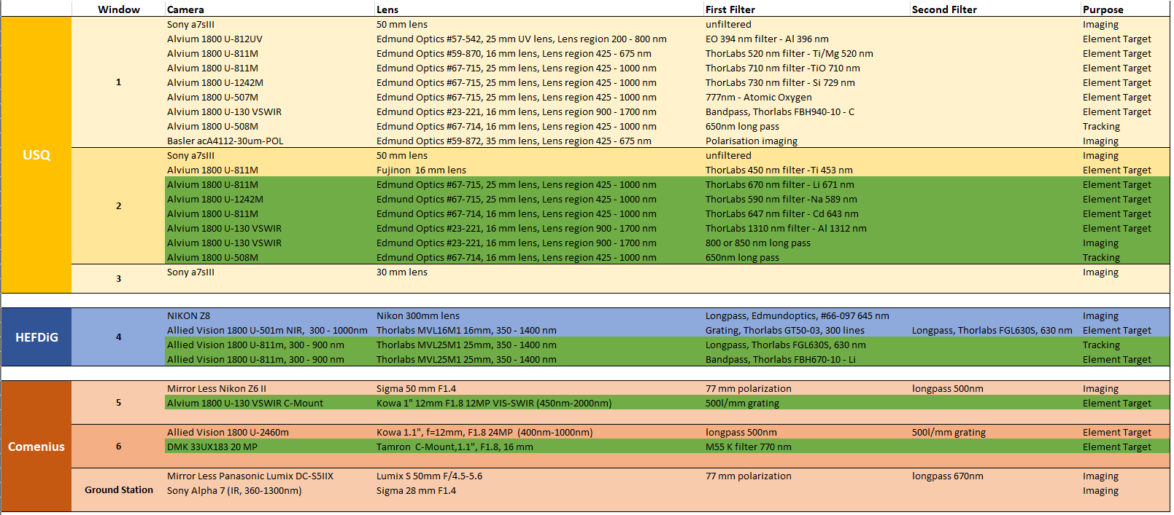
Mission Success
Preliminary first look result
Out of 26 lenses, 10 got data, elements are clearly detectable
13

Slide 14
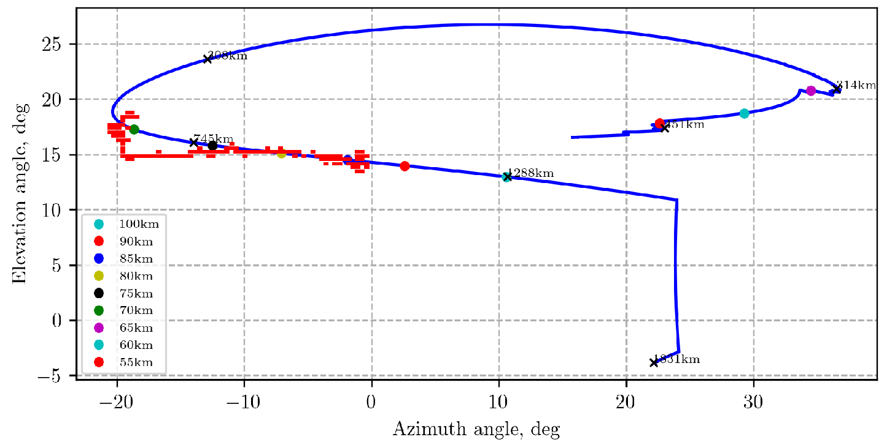
Ain‘t that wild?
14

Slide 15
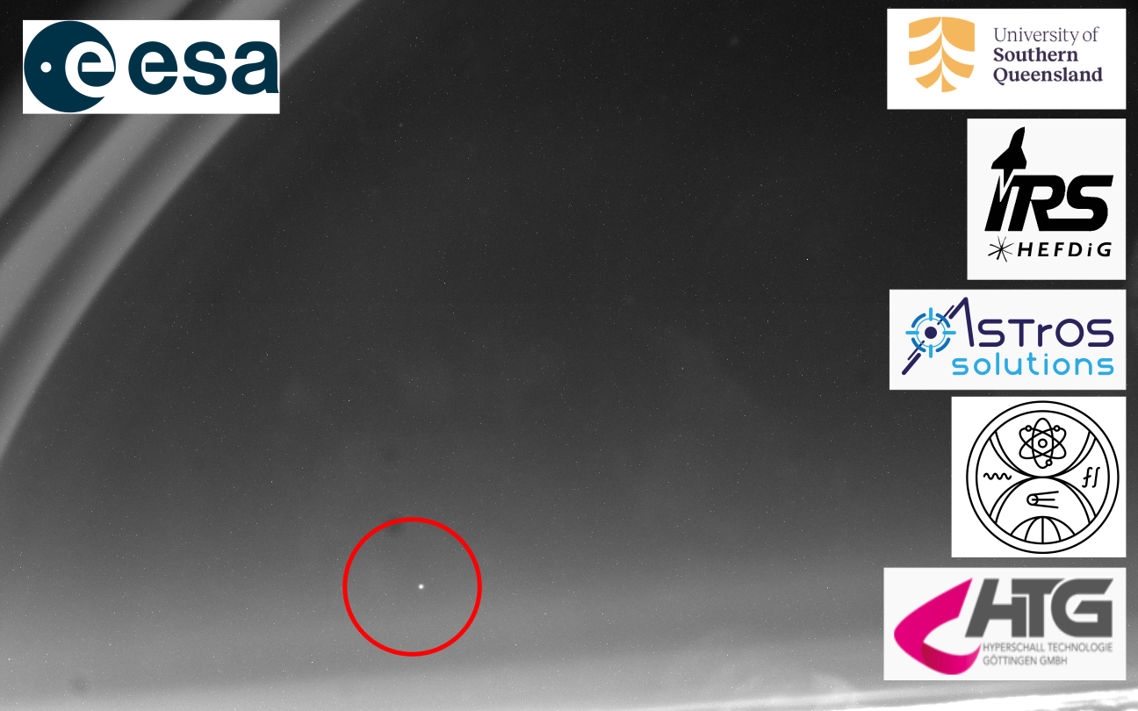
Ain‘t that wild?
15
University of Stuttgart

