Slide 1
Cluster-II-2 (Salsa): Atmospheric Re-entry
B. Jilete, S. Sanvido, M. Losacco, B. Bastida-Virgili, S. Lemmens
09/10/2024

Slide 2
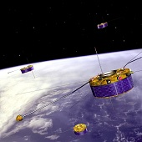
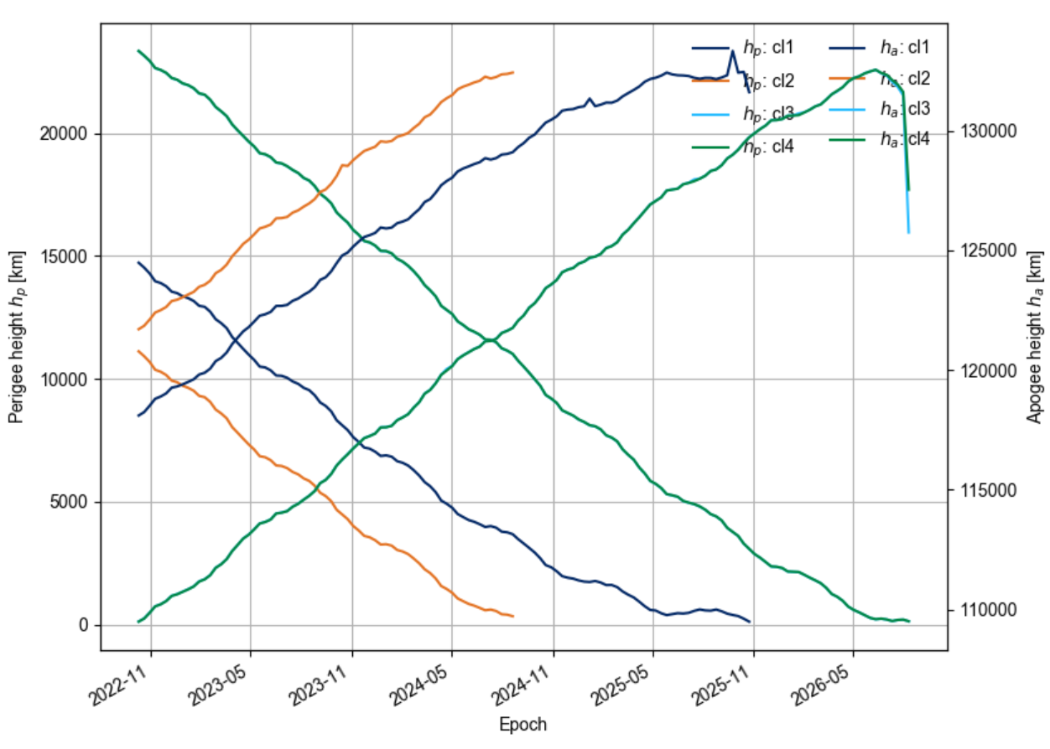
HEO missions: Cluster-II Mission
Launched successfully in 2000 – no regulation on re-entry at the time
ESA Zero Debris SDM requirements and charter (2023) - The casualty risk from re-entering objects should remain significatively lower than 1 in 10000, striving toward zero. A suitable aggregate risk threshold for constellations of satellites in the low Earth region should be identify.
Debris story started in 2013
Orbit of Rumba modified in 2014 to re-enter
Extended at least until end 2023.
Data from 2013
Data from
2021

Slide 3
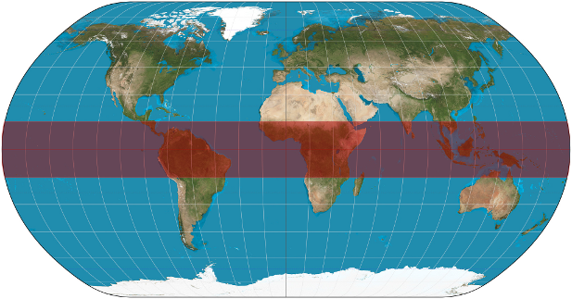
Challenges in the re-entry risk assessment
Circular (drag driven) Re-entry
Perigee & Apogee reduction driven by atmospheric drag.
Near 0 eccentricity when atmospheric capture occurs.
Analytical casualty risk approximation(s).
Location only limited by the orbit inclination.
Eccentric (third body driven) Re-entry
Orbital (perigee) change driven by perturbations due to Sun and Moon.
No circularisation of the eccentricity before atmospheric capture: high re-entry velocity.
Possible re-entry location in limited latitude band defined by the break-up.
No analytic casualty risk approximation.
Break-up fragments can escape into orbit.

Slide 4
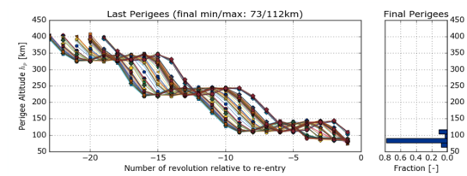
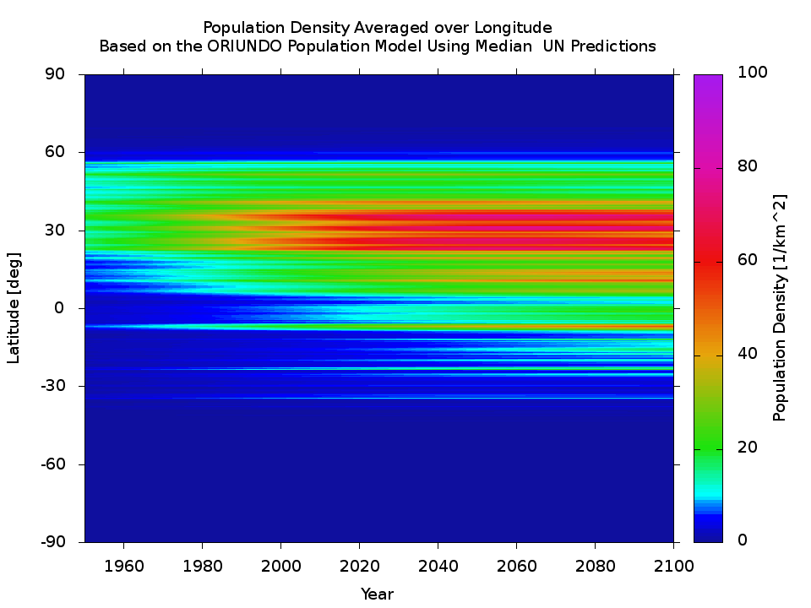
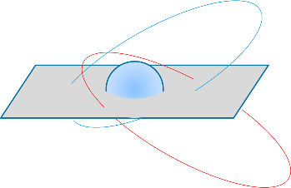
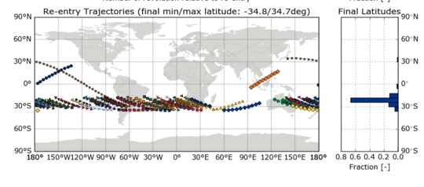
Third-body Driven Re-entries (1/2)
It is possible to target re-entry latitude by changing the geometry of the orbital evolution re-entry epoch
Example of circularisation
It is possible to target atmospheric interface point by fine tuning the orbital evolution at re-entry epoch
Behaviour still uncertain (circularisation, break-up) as the atmospheric state is unknown

Slide 5
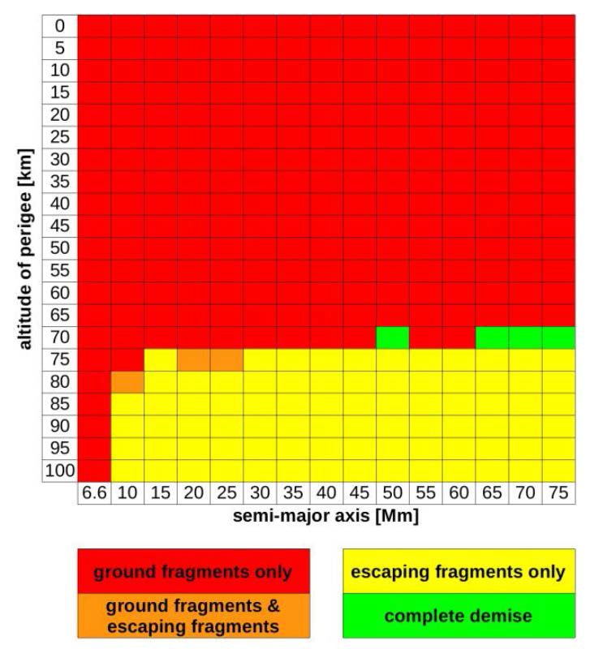
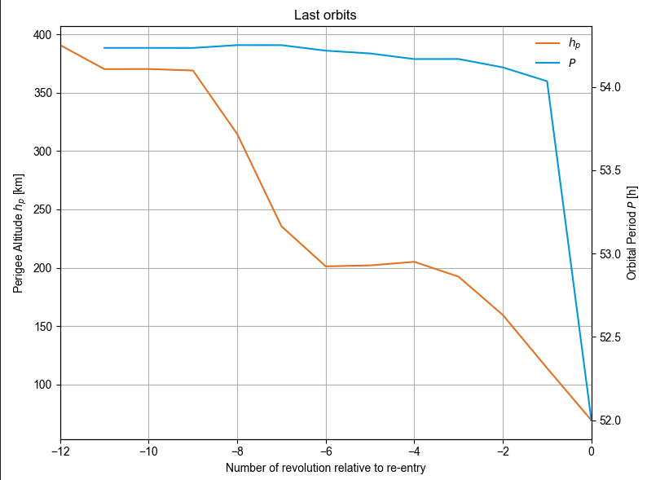
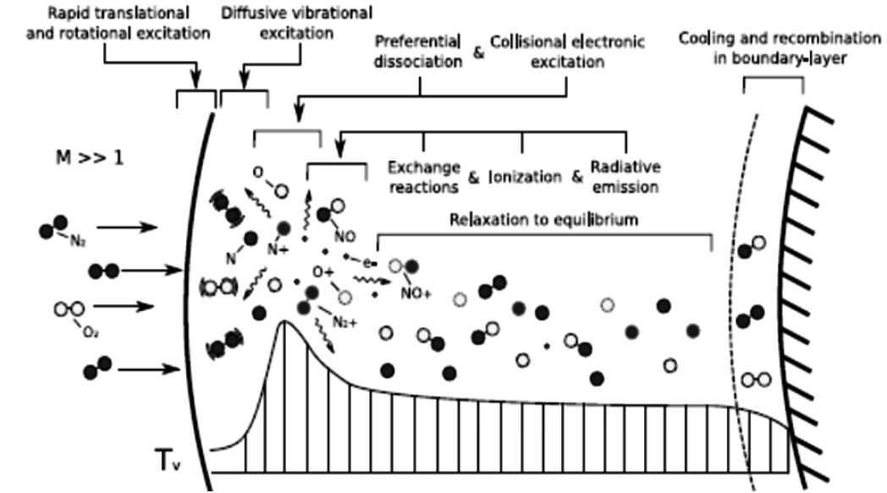
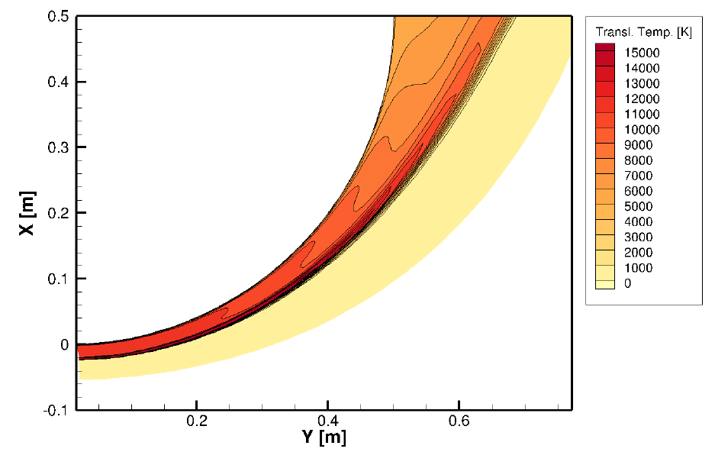
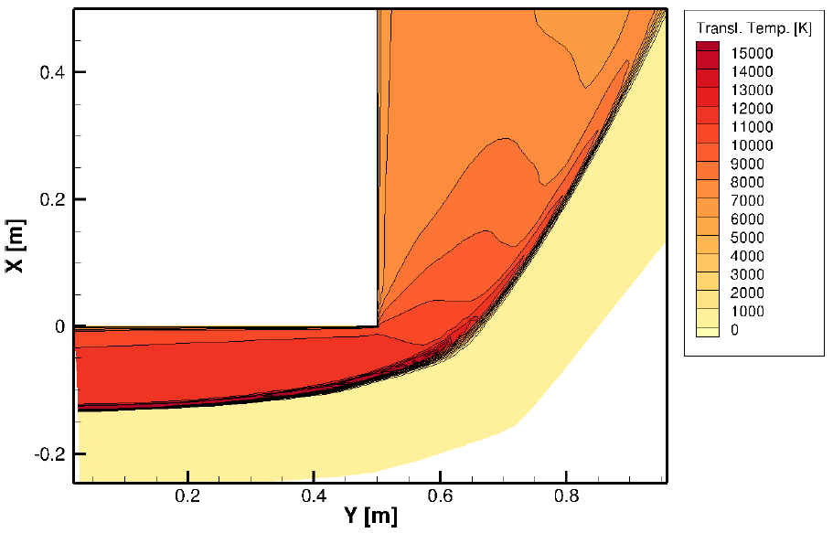
Third-body Driven Re-entries (2/2)
Notion of a well-behaved re-entry profile
Super-orbital re-entry (dominant heat transfer mechanism is the radiative heating)
Sensitivity to re-entry conditions
Theoretical Optimum
Super-orbital re-entry
Simplified model for radiative heating
Q_{R} ~ R^{-0.52}
Nose radii correlation available for few simple shape only
Desirable conditions

Slide 6
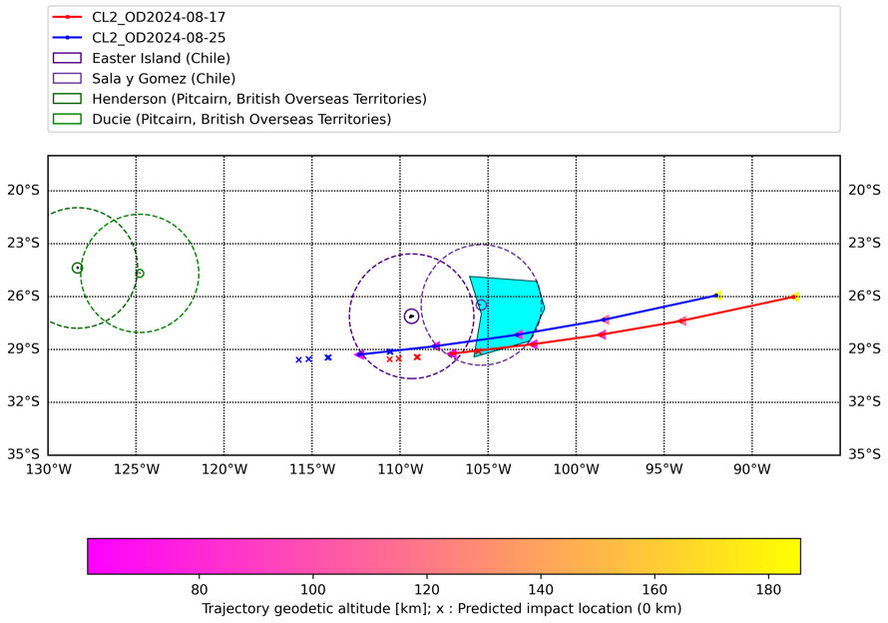
Disposal Plan for Cluster-II FM2 (Salsa) – 2nd Mano
Target: Penultimate perigee altitude lifted of ~1.5 km, and an estimated re-entry at 2024-09-08T17:51
Implementation: touch-up burn on 2024-08-22
After re-entry manoeuvre
Before re-entry manoeuvre

Slide 7
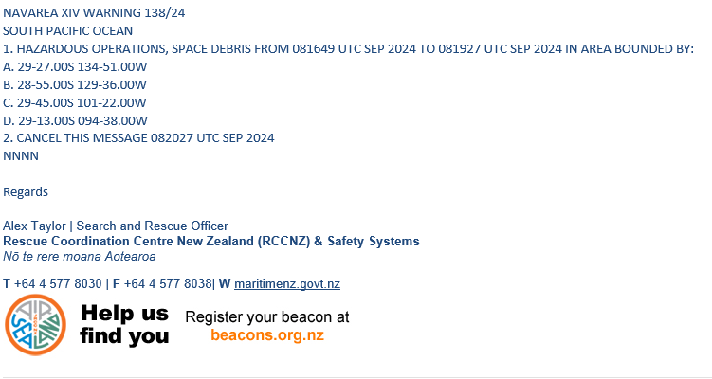
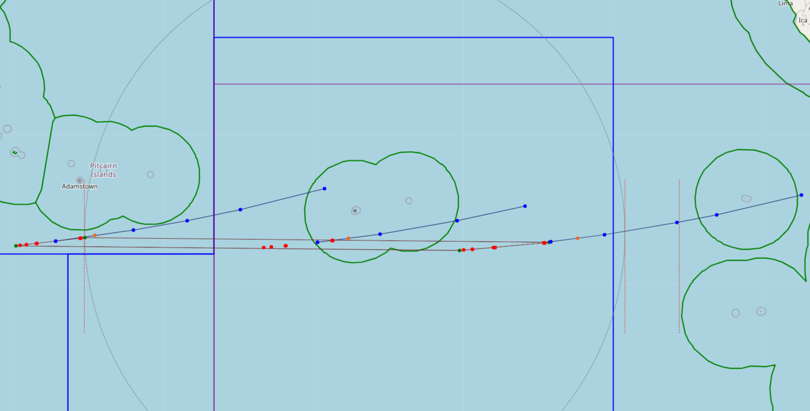
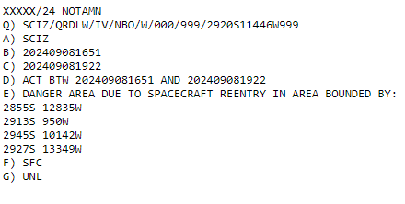
NAVAREA/NOTAM
Uncertainties assessment with +/- 50% for the drag coefficient

Slide 8
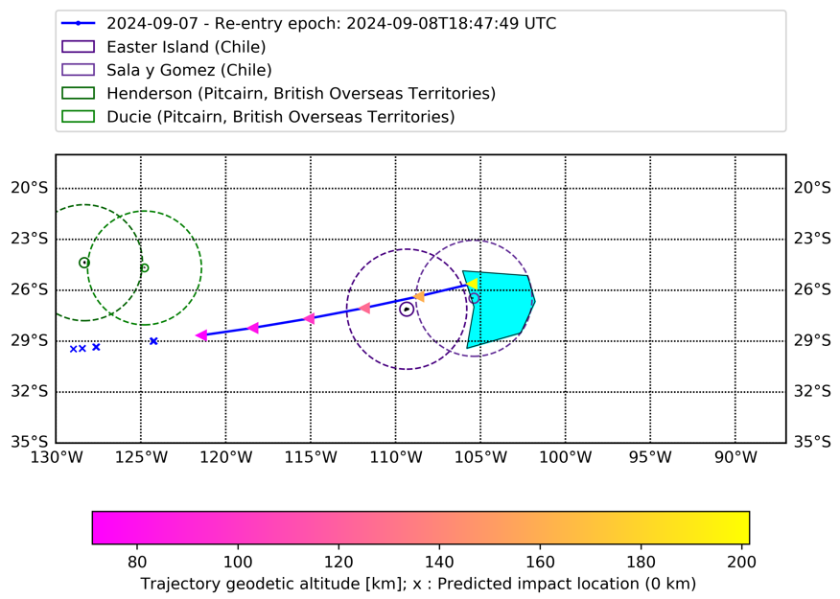
Cluster-II FM2 – Last predicted Re-entry Trajectory

Slide 9
Cluster-II FM2 – RE-ENTRY CAMPAIGN
Re-entry Campaign aiming to obtain orbital information from last revolutions before re-entry
During last revolutions TM might fail
Need of observations instead of predictions based on TLEs due to the high elliptical orbit

Slide 10
Conclusions
The Cluster-II Mission has provided profound insights into Earth's magnetosphere through detailed 3D mapping. Even in its last days, Salsa continued to enhance our understanding of space environments and to aid in, representing an incredible opportunity to refine re-entry predictions.
The disposal plan for Salsa involved several meticulously coordinated steps, starting from January through to re-entry. This plan, executed with remarkable precision, has successfully paved the way for an airborne campaign to gather critical re-entry data.
The lessons learned and data expected from the re-entry of Salsa will be instrumental in refining re-entry risk assessment models. These insights will be invaluable to ensure a safer and more representative approach, especially as we prepare for the re-entry of the other Cluster-II spacecraft.
6th International Space Debris Re-entry workshop 15th January 2025-> https://indico.esa.int/event/549

Slide 11
Thank you!

