Slide 1
ESA Space Debris Mitigation Requirements and compliance verification guidelines for the protection of dark and quiet skies
Beatriz Jilete and Jan Siminski
ESA Space Debris Office
10/10/2024

Slide 2
Space Debris Mitigation: History
1990s: First draft of Space Debris Mitigation Standards, Guidelines and handbooks issued by national and international organizations and space agencies
1993: Inter-Agency Debris Coordination Committee (IADC) established
2002: First “IADC Space Debris Mitigation Guidelines” published by IADC (updated in 2007)
2007: United Nations (UN) “Space Debris Mitigation Guidelines of the Committee on the Peaceful Uses of Outer Space – 22/12/2007” approved by 63 Member Nations
2010: First edition of the International Organization for Standardization (ISO) standard ISO 24113:2010 – Space Systems – Space Debris Mitigation Requirements published
2011-2019: Standards/guidelines updates
2023: ESA ”Zero Debris” approach -> ESSB-ST-U-007 ESA Space Debris Mitigation requirements baseline standard
2024: ESSB-HB-U-002 ESA Handbook (end of 2024)

Slide 3
Zero Debris: Technical Requirements
Applicable orbits
Guarantee successful disposal
Improve orbital clearance
Avoid in-orbit collisions
Avoid internal break-ups
No intentional release of space debris
Limit on-ground casualty risk
Guarantee dark and quiet skies
Assessment and mitigate impacts on ground astronomy

Slide 4
ESA SDM requirements and compliance assessment guidelines – dark and quiet skies
REQ - 5.6d | The developer and operator of a spacecraft or launch vehicle orbital element operating in near Earth orbit shall make available data on demand to support mitigation of impacts on astronomy, including brightness data, antenna diagrams, orbital profiles, and predicted and real-time orbital elements.
Review of design | Analysis/Test
SC GS review to ensure provision capabilities on accurate orbital and attitude data. CONOPS review to ensure capabilities: on precise orbital and attitude data provision on switch-off or point away over radio quiet zones GS capability on identification and reporting when SC passes over RQZ Surface material optical properties identification and collection Brightness map availability | Demonstrate attitude manoeuvrability Determine antenna diagram

Slide 5
ESA SDM requirements and compliance assessment guidelines – dark skies
REQ - 5.6a | The developer of a spacecraft or launch vehicle orbital element in near Earth orbit shall quantify the visual brightness of the design.
REQ - 5.6b | The developer and operator of a constellation in near Earth orbit shall propose and implement design and operational mitigation actions to reduce the visual brightness of the spacecraft.
Review of design | Analysis and material sample test
To identify systems and materials prone to specular reflections, strong scattering or can increase the brightness. | 1) Estimation of the brightness during early mission design phases (phases 0-B): Primitive shapes Assumed combination of diffuse/specular reflections Analytical expressions for Earth-pointing and Sun-pointing scenarios Rescale to operational altitude 2) For phases B-C: Estimation of the brightness with full 3D geometrical models Look-up table to sample different observation geometries -> statistics Quantification of flares and glints occurrence 3) From phase D: Update brightness estimate by measured BDRF material sample tests (system qualification campaign)
For Satellite Constellations -> aggregated effects into account

Slide 6
Mitigation measures – dark skies
Include a requirement on brightness characterisation Identify subcomponents that drive the overall system brightness Brightness model alongside SC design phases Update brightness map accounting for material degradation…by means of: Observations from ground Surveillance systems Astronomy community
Design SCs with reduced brightness Limit flares and strong reflections by operational mode Validate technological solutions that can reduce the brightness of the system

Slide 7
ESA SDM requirements and compliance assessment guidelines – quiet skies
REQ - 5.6c | The developer and operator of a spacecraft or launch vehicle orbital stage operating in near Earth orbit shall protect the Radio Astronomy Service, in compliance with the ITU Radio Regulations and in compliance with requirements from clause 4 to clause 9 of ECSS-E-ST-50-05.
Review of design | Analysis to
Avoid unwanted emissions falling into frequency bands of Radio Astronomy – section 5.5.1.2 ECSS-E-ST-50-05C-REV.2 | Assess interferences and procedures as per ITU-R RA.22.2259-1 to inform radio telescopes about SC passes Assess aggregated effect of spacecraft constellation

Slide 8
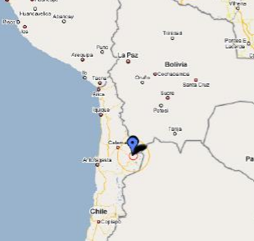
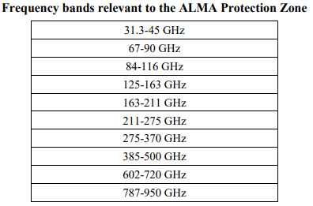
Mitigation measures – quiet skies
Early during design phases (B-C)
Special operational modes to include in CONOPS that could impact RQZ
Identify and limit undeliberate RF transmission/leakage
Report ITU-R RA.2259-1

Slide 9
Current status and next steps
In cosolidation phase within the ESA Space Debris Mitigation Working Group -> end of 2024
With annexes with showcase examples (https://indico.esa.int/event/541/):
Cubesat type mission
Box-wing type mission in GTO
Constellations of small satellites

Slide 10
Thanks for your attention

