Slide 1
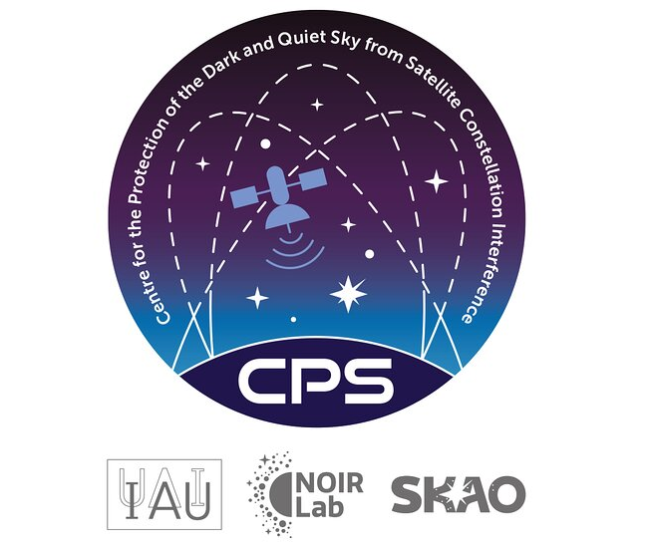
Towards a Quiet Sky for Radio Quiet Zones
Dr. Hao (Harry) Qiu
on behalf of IAU-CPS and SKAO Spectrum Management Team
Radio Spectrum Scientist, SKA Observatory
hao.qiu@skao.int

Slide 2
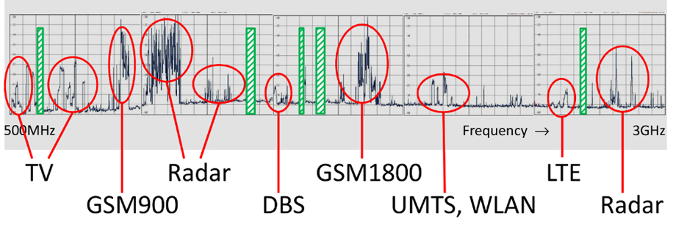
Radio Astronomy Protection
For modern society, the radio spectrum is a limited resource! Only 1.7% of the spectrum below 10 GHz is allocated to radio astronomy service (RAS)
Most were defined decades ago for our local universe, such as spectral lines emitted by atoms and molecules in our galaxy.

Slide 3
Radio Frequency Interference A Radio Astronomy perspective
Any radio signal that interferes with the observation of the target radio source.
RFI can be from both man-made and natural phenomena: lightning, meteors and solar flares!
Mobile phones, radio stations, aircraft, maritime signals…
Thermal signals at sub-mm frequencies!

Slide 4
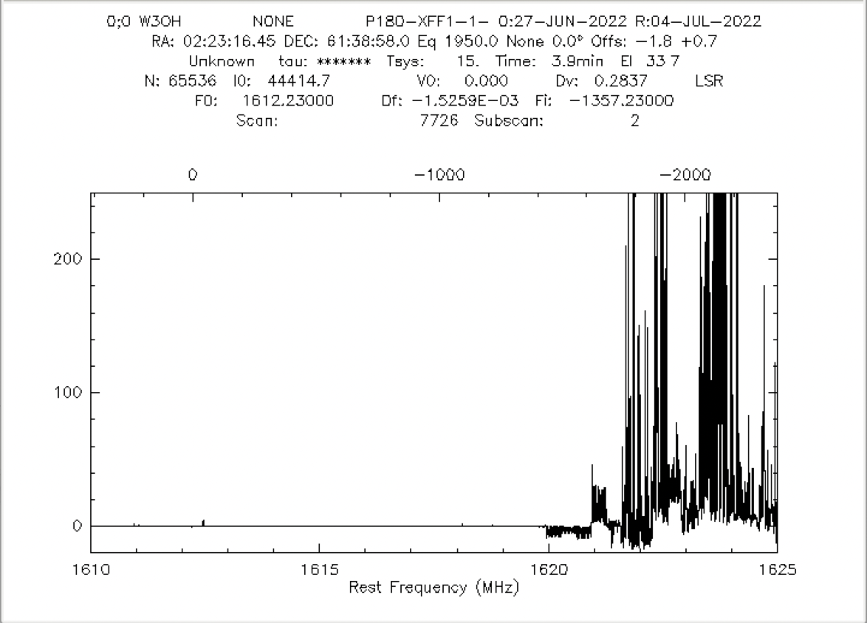
RFI in Radio Astronomy
Spectral Line observations with RFI from the Iridium Satellites
Credit: A. Kraus, MPIfR

Slide 5
RFI in radio Astronomy
Artefacts in Images
LOFAR
Credit: B. Gehlot (AARTFAC)
Credit: Emil Lenc

Slide 6
Meteor Scattering
MWA radio images of an 8 s duration, during which a meteor occurred. (Zhang et al. 2018)
Space debris depending on size and spread will create scattering/reflection screens at low frequencies (Tingay et al. 2013)

Slide 7
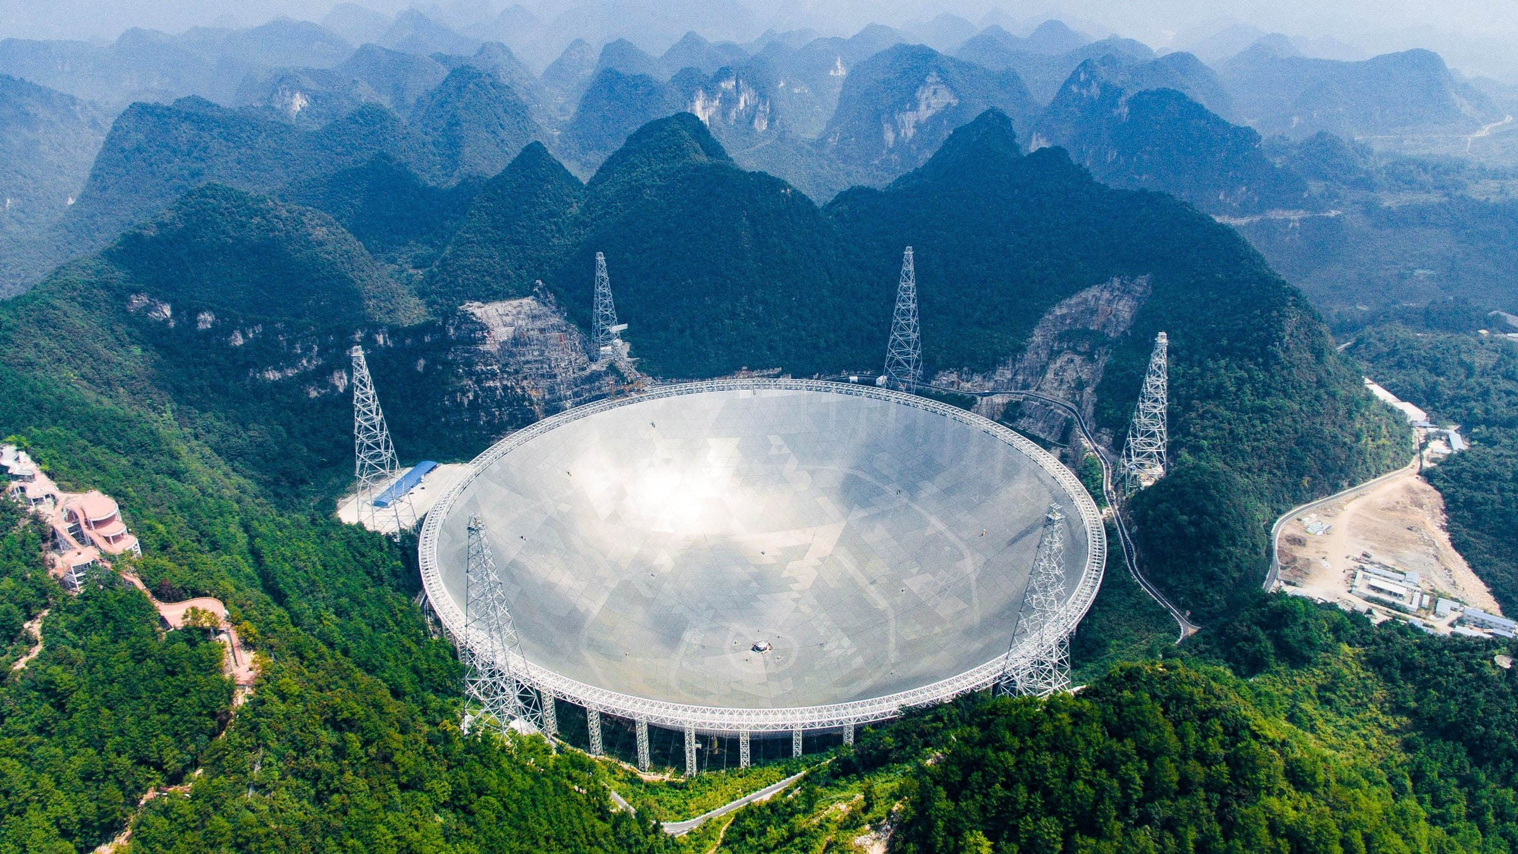
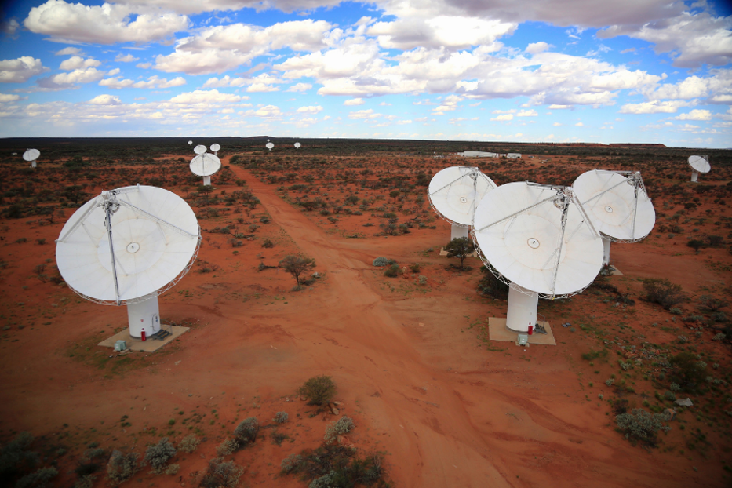
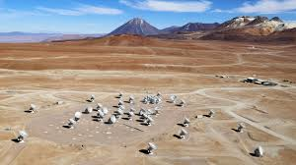
Radio Quiet Zones
ALMA telescope in the Atacama Desert, Chile. No transmitters within 30km
Arecibo Observatory in Puerto Rico. Restricted within 6-mile radius, also a no-fly zone.
FAST Observatory in Guizhou, China. No transmitters within 5km
Credit: NAOC, CSIRO, ESO

Slide 8
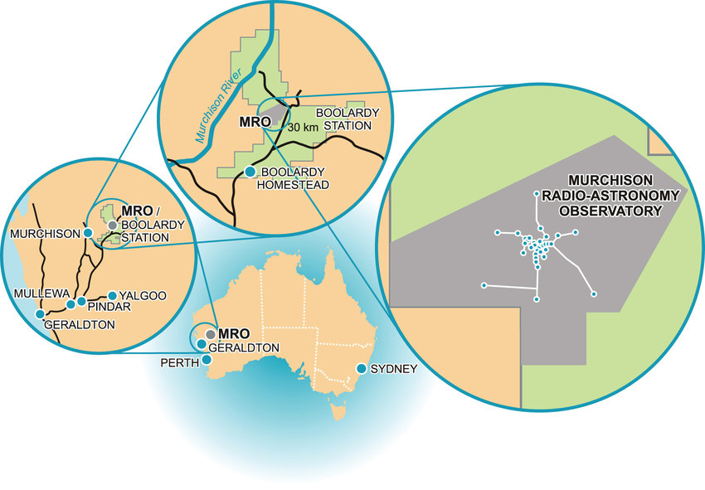
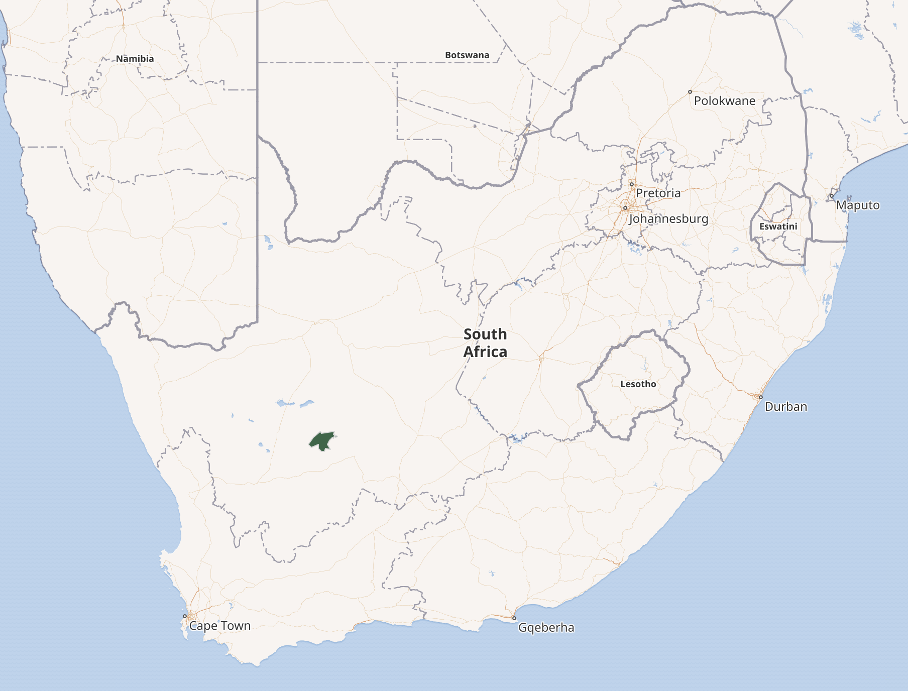
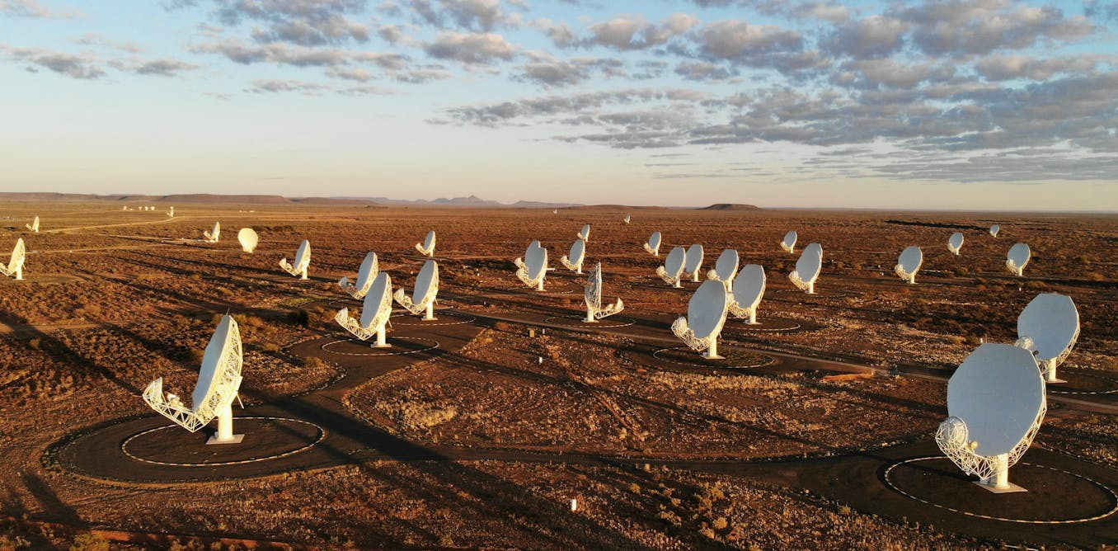
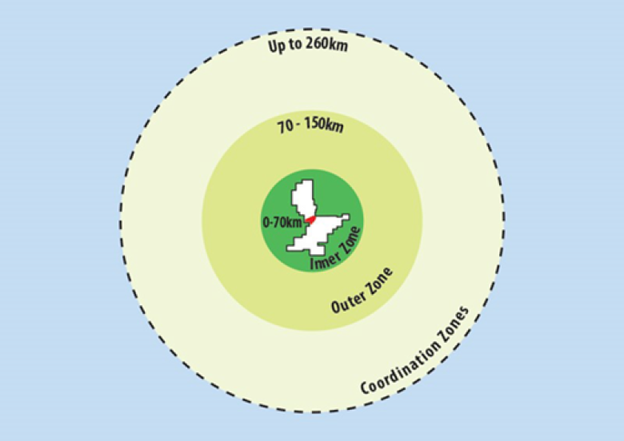
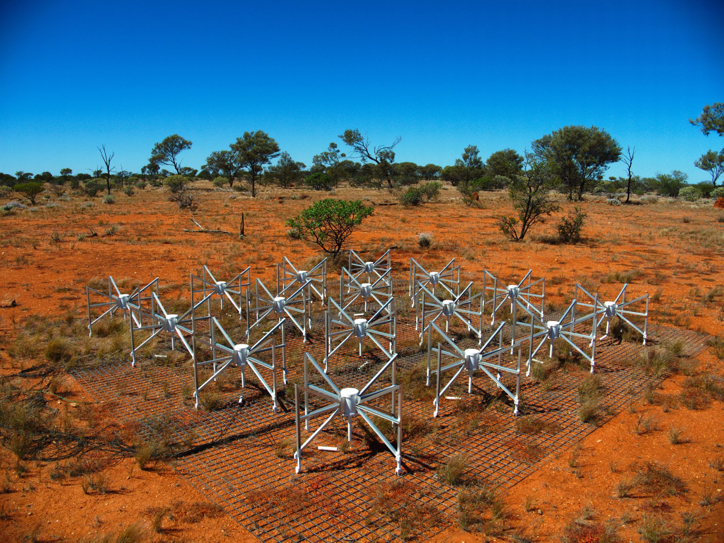
SKA Telescope Sites
Inyarrimanha Ilgari Bundara-Murchison Radio Observatory
Meerkat National Park

Slide 9
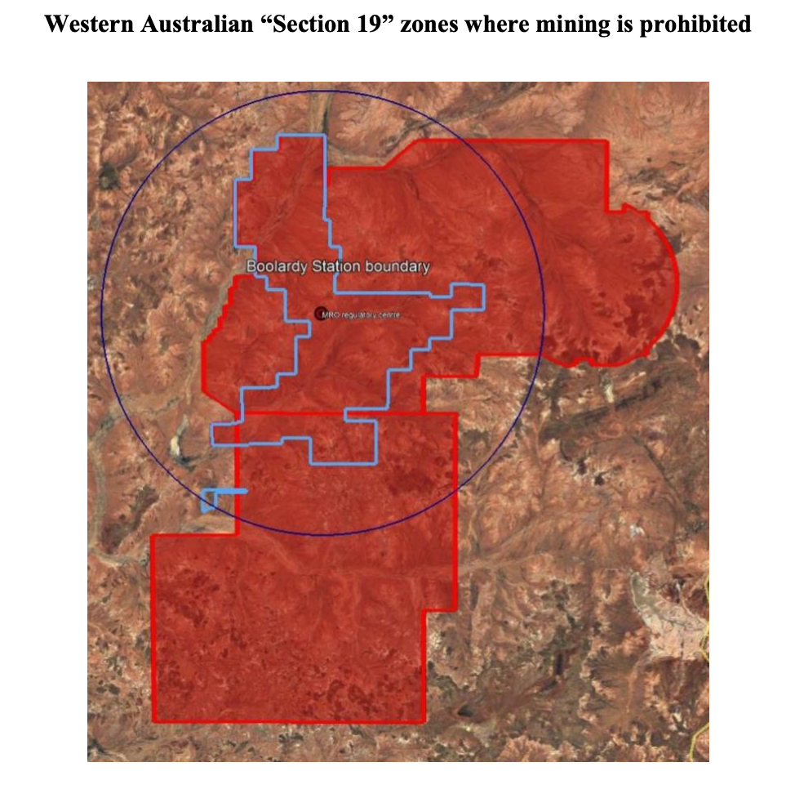
Radio Quiet Zones
Radio Quiet Zones are the established nationally as protected areas where large swaths of spectrum is reserved for radio astronomy.(See report: ITU-R RA.2259)
Regulated limits on electronic devices and active transmission within controlled radius
National License restrictions to spectrum users
Depends on regional legislation, limits to certain activities: e.g flights
Costs: local activities, rural development…

Slide 10
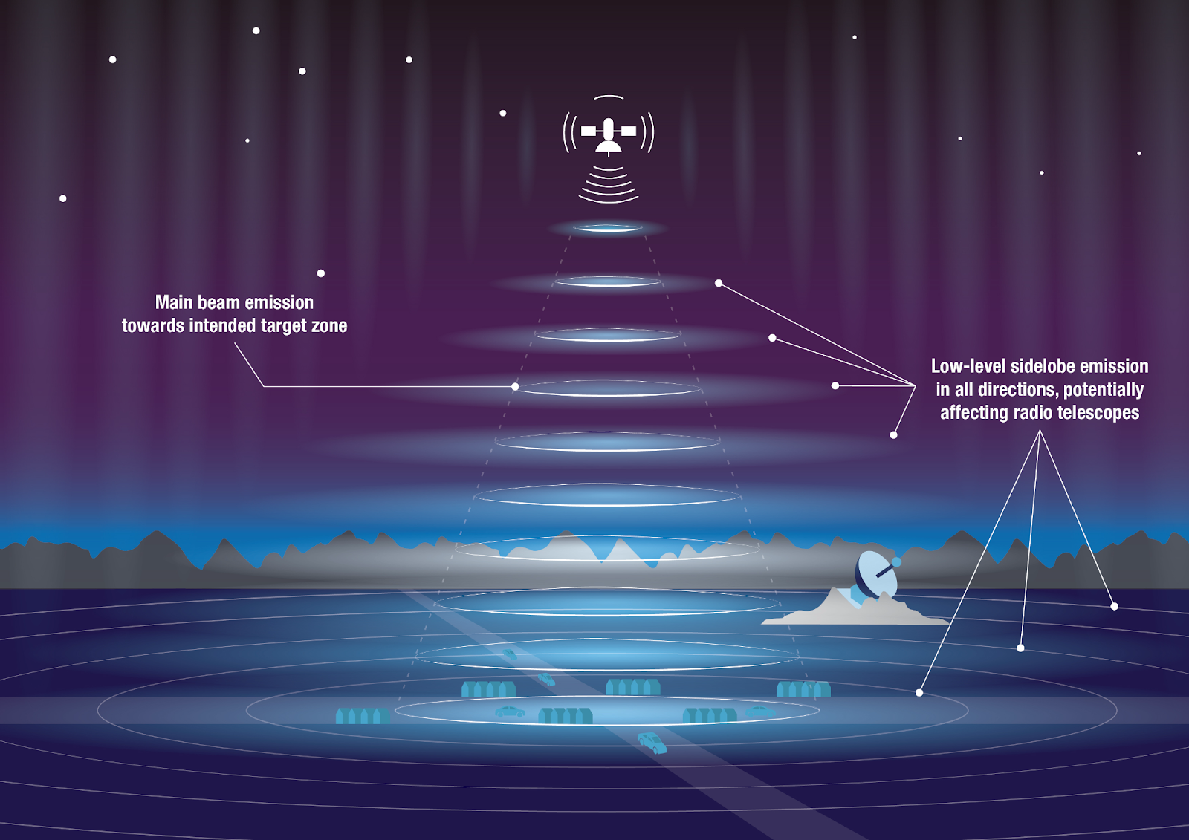
Satellite Interference

Slide 11
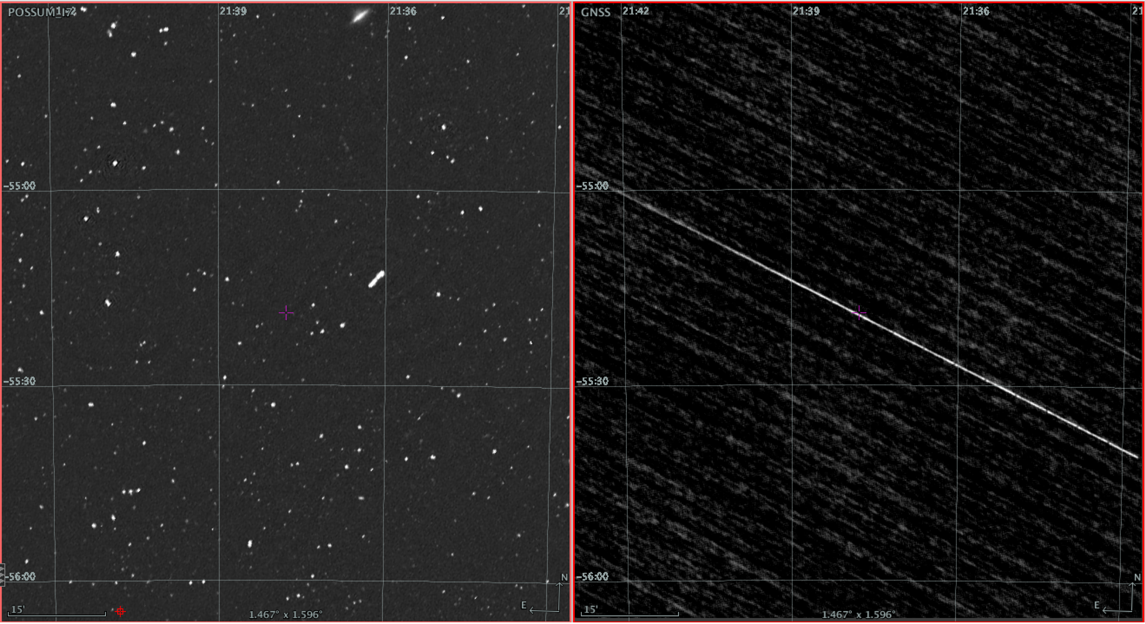
Radio Imaging
Strong direct beam to beam RFI will completely blind the radio interferometer visibilities
Credit: Emil Lenc

Slide 12
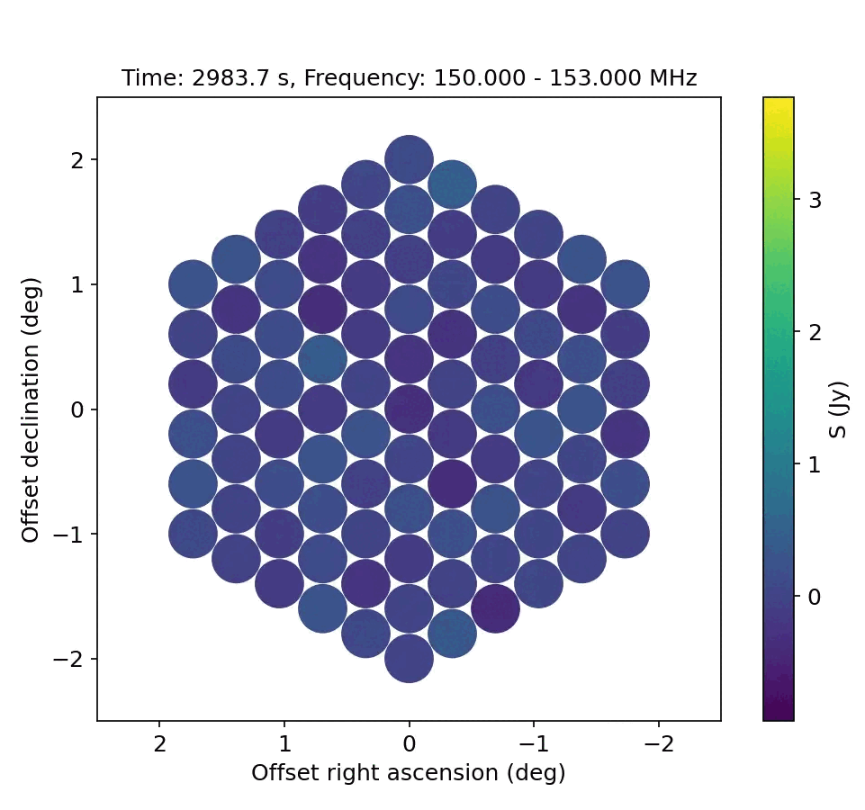
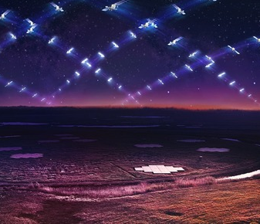
Unintended Emissions (UEMR)
Starlink’s allocated downlink transmission band is at 10.7-12.7 GHz
LOFAR Radio Telescope in Dwingeloo, Netherlands
Credit: Di Vruno et al. 2023
Credit:Danielle Futselaar

Slide 13
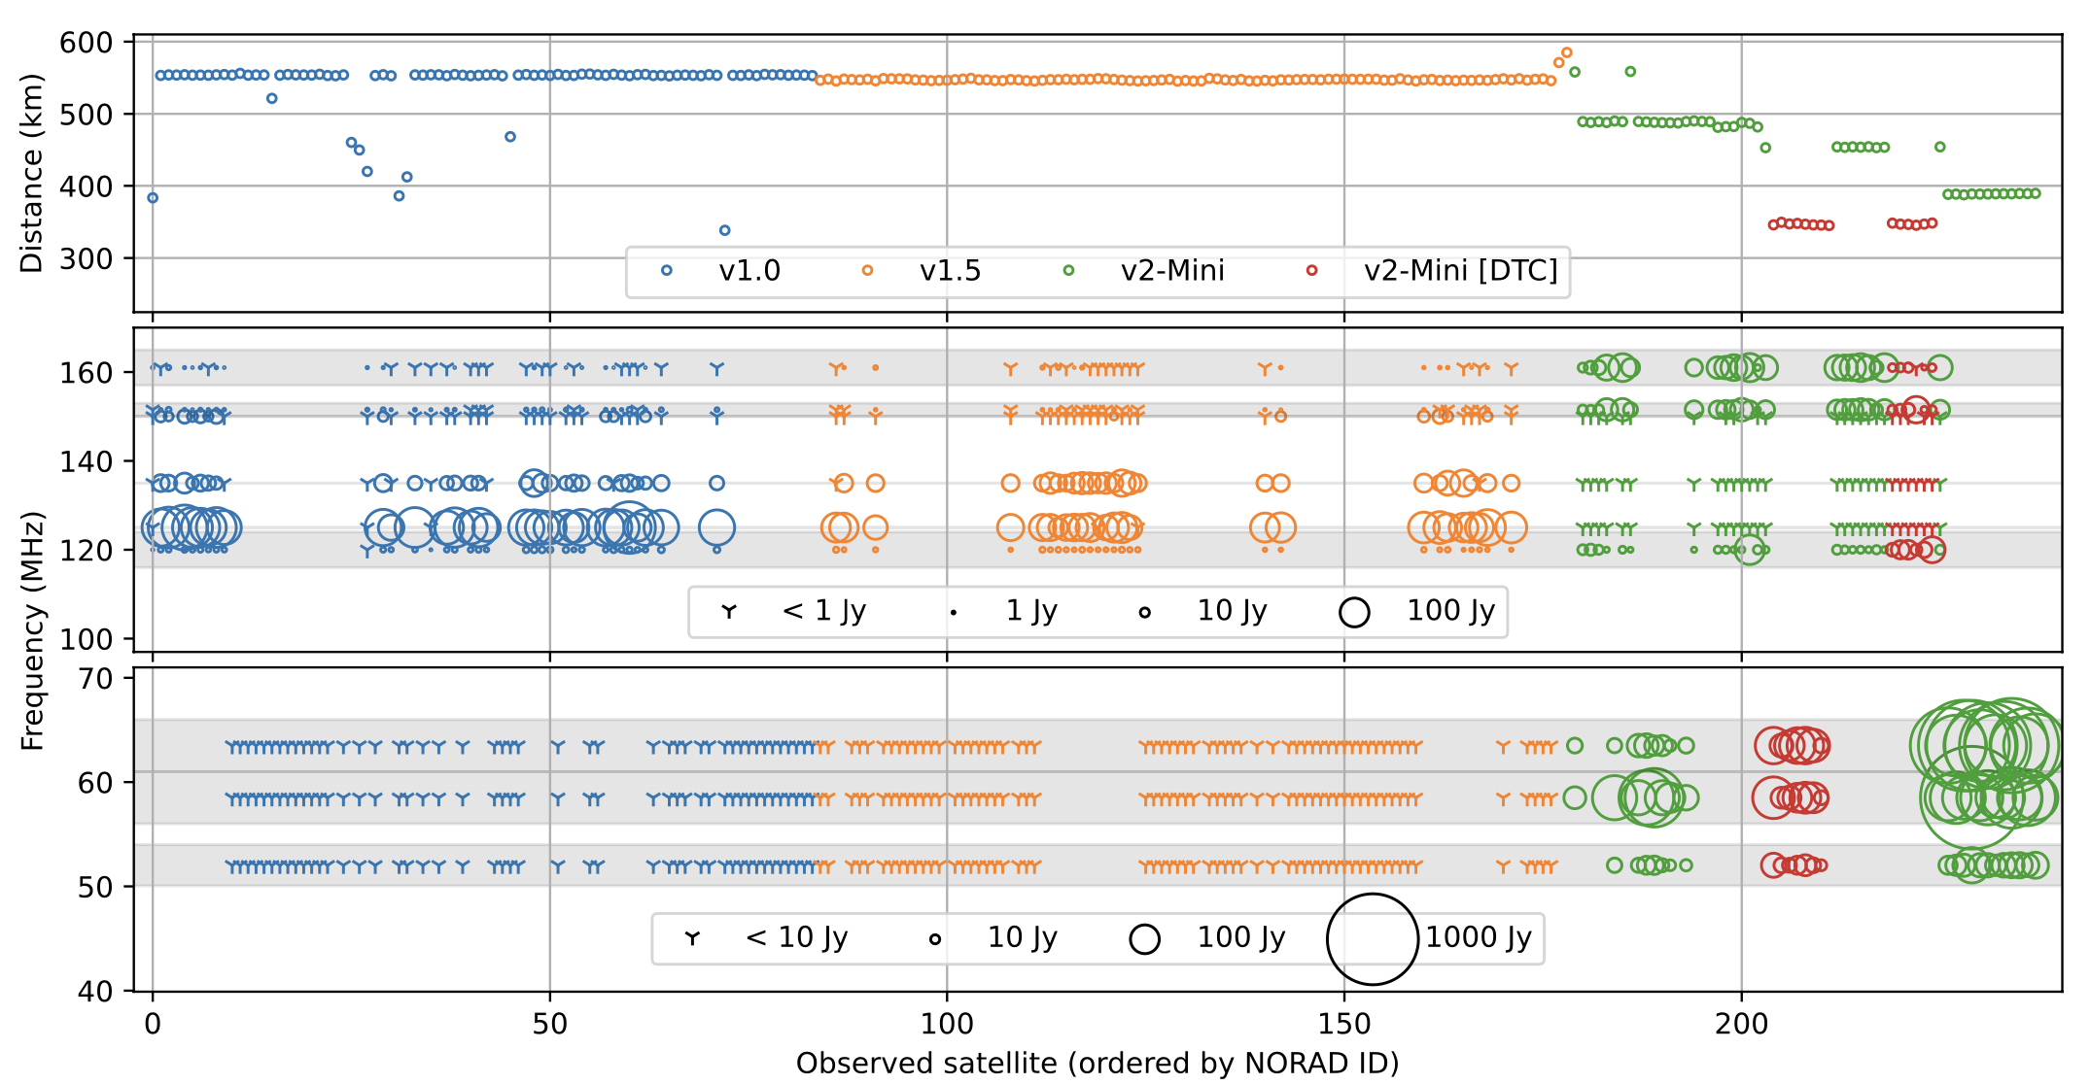
UEMR
Starlink MiniV2 have become significantly brighter
Further investigation together is needed to find out the cause and solution
Credit: Bassa et al. 2024

Slide 14
The current conflict
With new technology developed and larger instruments built, the receiver bandwidth has been increased by orders of magnitude
e.g., Parkes radio telescope 64MHz(pre-1997)→288 MHz(2001) → 3.5 GHz
Radio interferometers are likely to consist of smaller dishes with greater field of view increasing the chance of pass throughs.
Telescopes are just getting more sensitive!
Airborne/Spaceborne objects are increasing, but national authorities have limitations/boundaries on jurisdiction.

Slide 15
Technical Solutions Astronomer Perspective
Traditional RFI Mitigation in data processing
Increasing signal loss

Slide 16
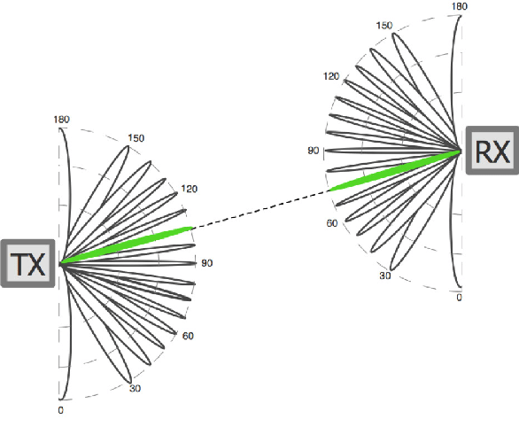
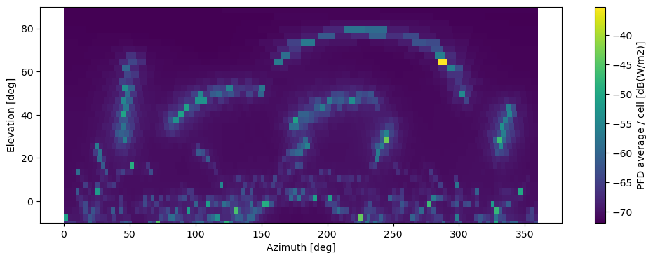
Technical Solutions Astronomer Perspective
RFI avoidance planning software at the SKA Observatory (SCEPTER) and IAU-CPS SatHub
Proof of concept for active transmissions from OneWeb and starlink
Simulation Example by SCEPTER, 100 second simulation using 500 starlink satellites TLEs and an empirical telescope elevation-gain model to predict the impact at the MeerKAT observatory, where the future SKA-Mid telescope will be operating.

Slide 17
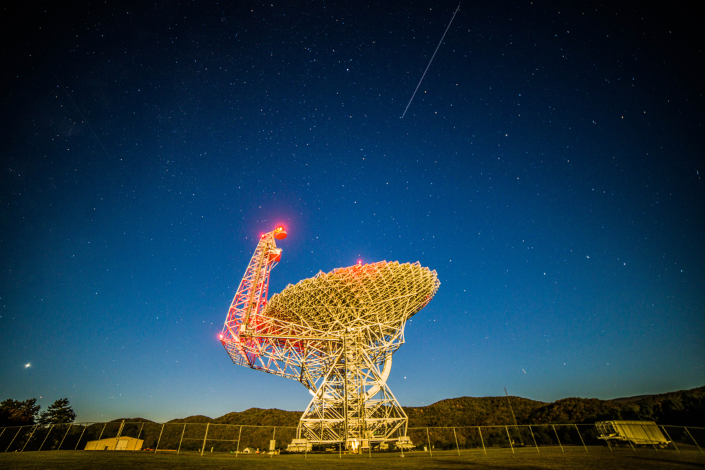
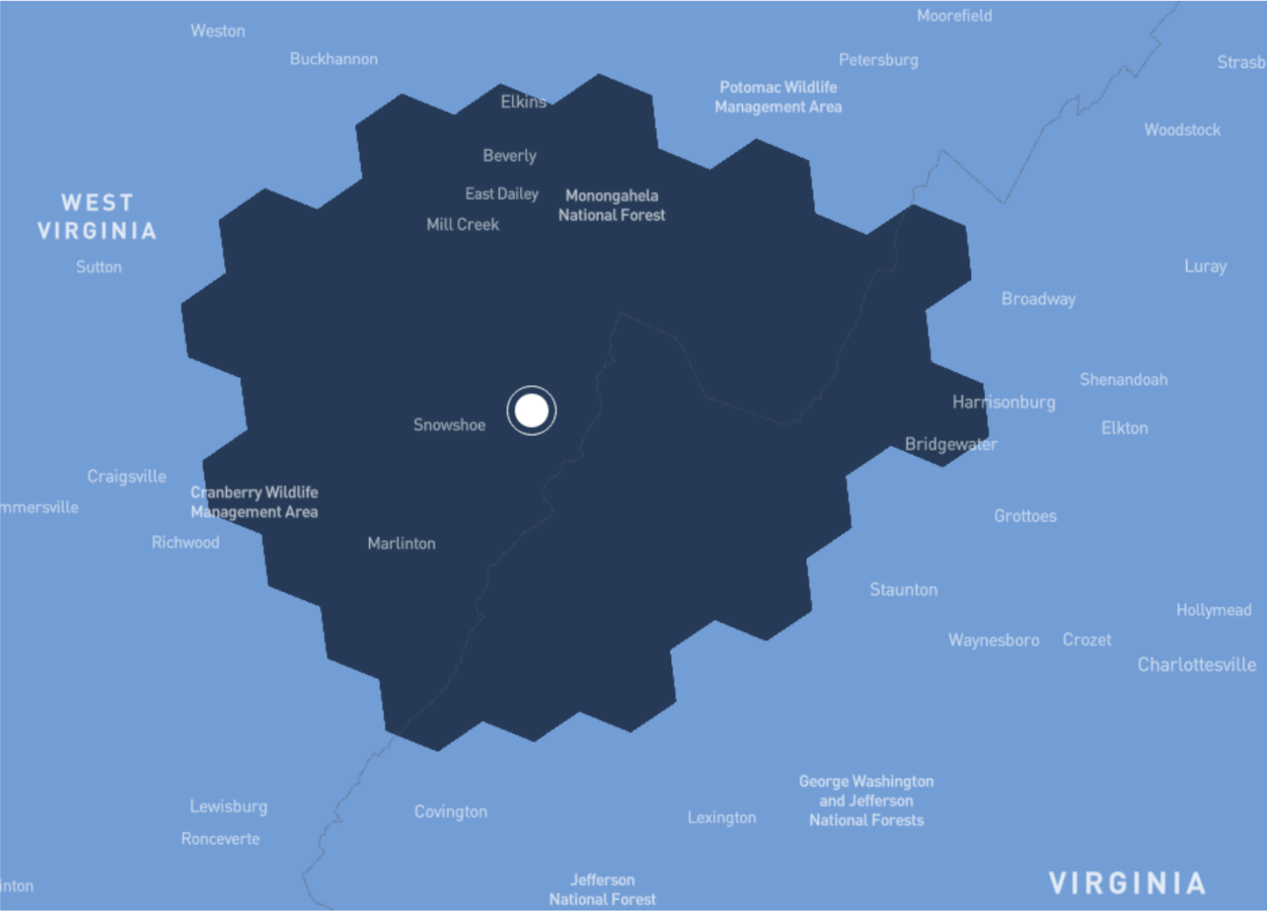
Technical Solutions Working together!
NRAO-Starlink Operation Coordination at Green Bank Observatory (Nhan et al. 2024) created beam avoidance zone, with significantly reduced RFI
Nhan et al. 2024

Slide 18
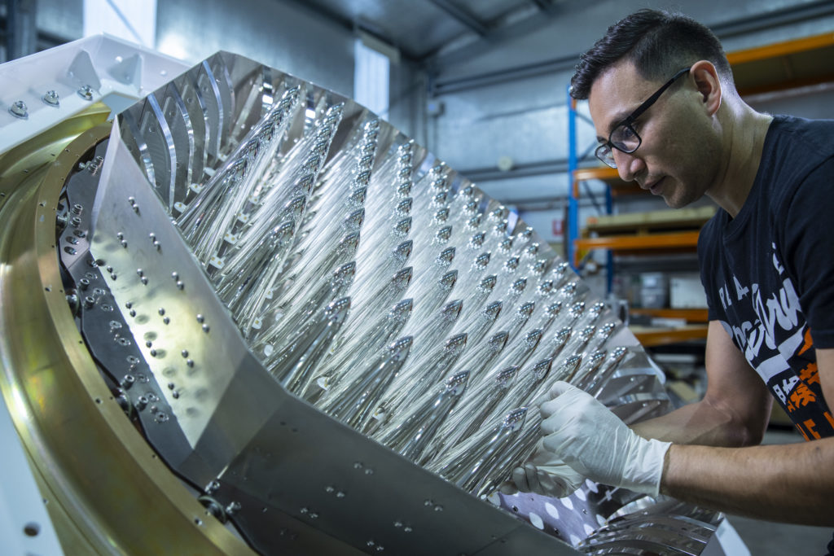
Technical Solutions Working together
Astronomy technology has benefitted and transferred to satellite tracking and orbit solutions
Phased Array Feed receivers developed from the Australian Radio Telescopes are providing high efficiency wide field satellite tracking
Low Frequency Arrays will be able to track scattering debris fields.
Credit: CSIRO

Slide 19
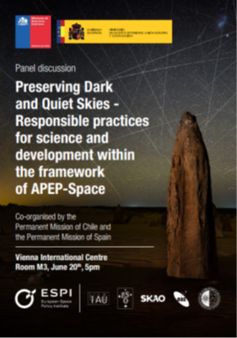
Policy and Regulations
UNCOPUOS
Dark and Quiet Skies agenda item established in the Scientific and Technical Subcommittee (STSC)
Group of Friends for the Dark and Quiet Skies for Science and Society
ITU
WRC-27
ITU-R Space Sustainability Forum (Sept 2024)
Notes:
As the UN COPUOS deals with all peaceful activities in Outer Space, the astronomical community has worked since 2019 alongside several member states to establish an agenda item on Dark and Quiet Skies. One could argue that the Quiet part belongs only in the ITU-R, and we all agree on that, but the argument has always been that two effects (reflection of sunlight and radio emission) coming from the same source should not be considered completely disconnected.
●
After several years of discussions in the scientific and technical subcommittee and in the main COPUOS an Agenda Item on Dark and Quiet Skies has been established for 5 years in the STSC, where delegations will be able to debate on the topic, with consideration of the remit of the ITU. We expect that the communication between ITU-R and COPUOS will increase connected to this topic.
●
Alongside the new agenda item, some member states and permanent observers of COPUOS have established a Group of Friends for the D&QS, which will informally work towards advancing the Agenda Item. This Group of Friends represents an opportunity for delegations to include technical experts in the discussion.

Slide 20
Policy and Regulations ITU WRC-27
Some of most important for radio astronomy WRC-27 topics:
Agenda Items (AI) 1.16: to address impacts on RAS bands and Radio Quiet Zones from satellite systems
1.18: bands above 76 GHz and satellites
1.15: use of radiocommunications in the cislunar space
Other activities:
Report on UEMR (ongoing at WP7D)
Resolution 219 (Bucharest 2022) and Resolution ITU-R 74: Sustainable use of spectrum and space orbits

Slide 21
Summary
Radio quiet zones is proven to be effective with ground-based facilities by working with the regional legislations
The increasing number of satellites challenges our current RFI mitigation strategies.
Regulation on spectrum use in space is needed to help create a radio quiet sky.
International policy support and closer industry collaboration is needed to overcome this problem together!

Slide 22
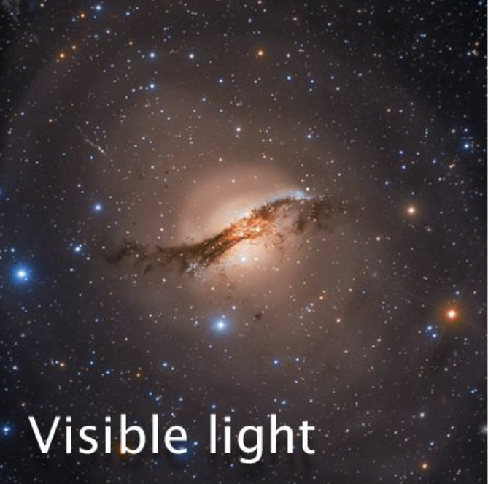
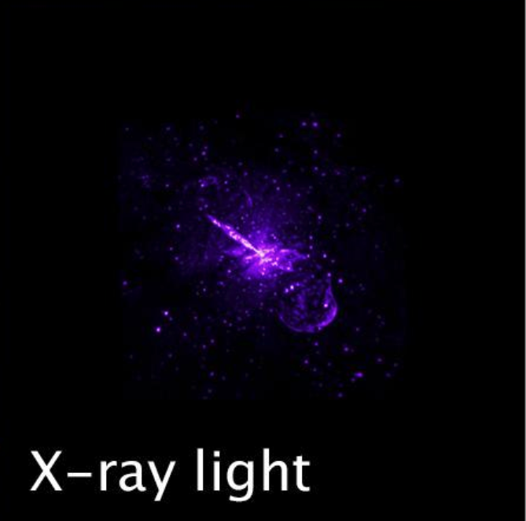
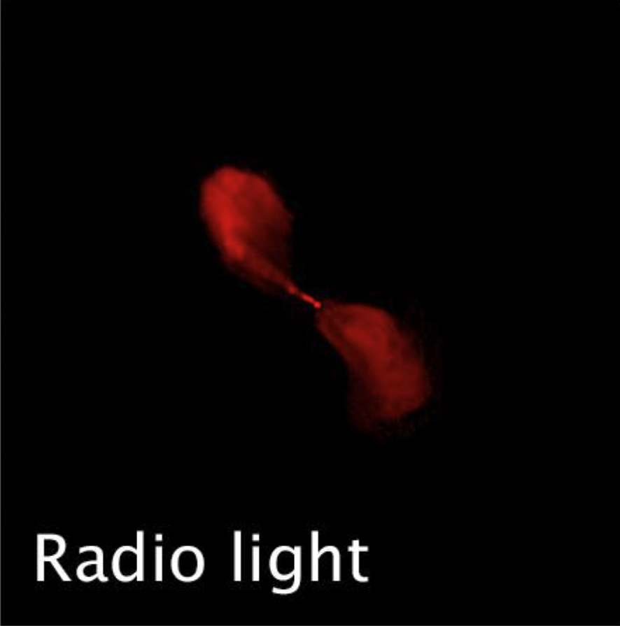
Astronomy is a Multiwavelength Science We need our radio telescopes!
Radio Jets from the supermassive black hole in Centaurus A
Credit: NASA/JWST

Slide 23
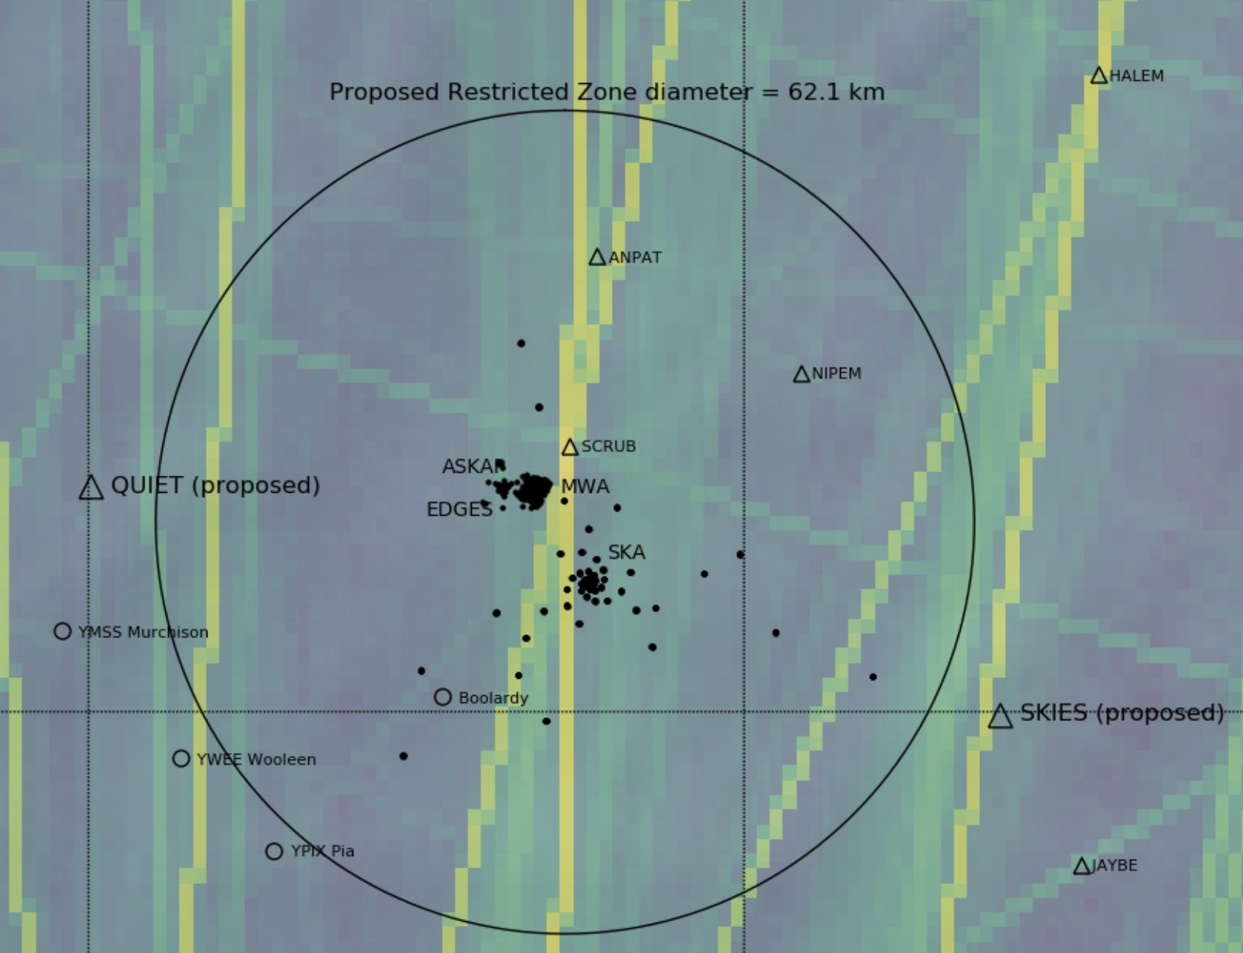
Technical Solutions Working together!
Murchison Radio Observatory Restricted Airspace Proposal
Flight Path Waypoints created outside of proposed zone to reduce RFI
Nhan et al. 2024

Slide 24
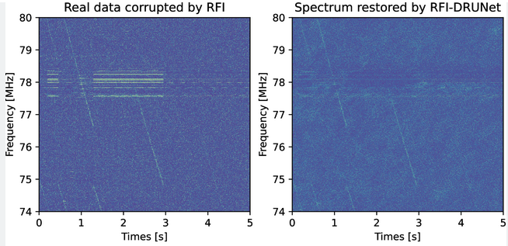
RFI in radio astronomy
Time domain observations of neutron stars with narrow band persistent RFI
Credit: Zhang et al. 2024

