Slide 1

Evolution of thermo-optical properties of solar panels or thermal control materials with lunar dust simulants contamination
S. Duzellier, JC. Mateo Velez, A. Beyler, S. Soonckindt
ONERA Toulouse
P.B. Hager
ESA-ESTEC

Slide 2
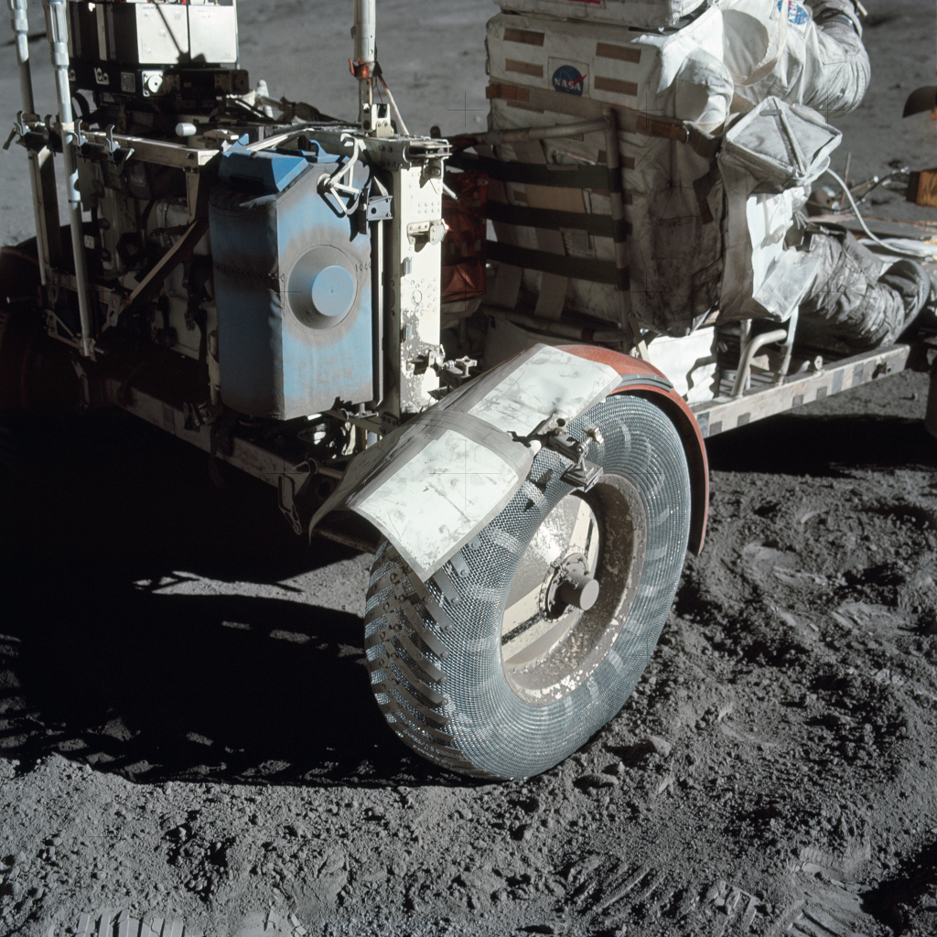
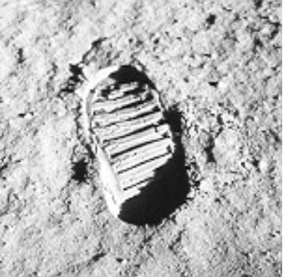
Context : Argonaut lander
The lunar surface imposes a challenging environment to space hardware, especially the lunar dust impacts the performance of functional surfaces and coatings.
The progressive dust accumulation induces degradation of power and thermal functions
Only very limited information is available about actual modification factors

Slide 3
Objective and description of the activity
to characterize the degradation of thermal and power functional coatings and surfaces due to lunar dust
performing a set of characterization tests with the purpose of linking the amount of dust coverage over time to degradation in performance
2 Lunar Dust Simulants (LDS):
LHS-1
LHS-1-25D
23 Material Samples:
OSRs, SSMs, Paints
Metallic & Polymers bases
MLI outer coatings
Solar Cell cover glasses
≠ % coverage levels:
5%, 15%, 30%, >60%
x µg/cm²
! LDS monolayer
Measurement of:
Infrared emissivity
Solar absorptivity
Transmissivity
Deposited mass
3 separate test campaigns (3 batches)
Data base of measurement results
Correlation of LDS coverage / deposited mass
Modification factors for TO properties

Slide 4
Outline
Materials samples selection
Lunar dust deposition rate and simulant selection (LHS-1, LHS-1-25A)
Experimental set-up & approach
Test results (LHS-1): trends
  Emissivity
  Solar absorptance
Impact on Thermal System
Summary

Slide 5
Materials Samples Selection
Structure
ONERA ID | Description
CFRP | composite for structure, M18/55
VESPEL | Vespel SP1 for structural parts
TIT35 | (Raw) Titanium T35 25 µm
AUCOAT | electroplated gold on aluminium
SURTEC | Surtec 650 with Al 6061 substrate, corrosion protection
OSRUVS | Optical Solar Reflector (silver/CMX 150µm) with or without coating (ITO or UVS) Radiator coating
OSRITO
OSR
SSMFEP | Second Surface Mirror (5 mils), Silver/FEP with or without coating (ITO) Flexible radiator material
SSMFEPITO
SG121 | White paintings Radiator coating for thermal and electrical control
PSBN
PCBE
AQ-PU1 | Black paintings Low outgassing coatings for thermal and electrical control
PNC
KAP | Polyimid insulation film, Kapton (200HN), 2 mils
VDAKAP | VDA on Kapton (1 mil)
KAPGE | Kapton with Germanium coating (1 mil)
STAKAP | Black kapton with Stamet coating, thermal control RF transparency
BETACLO | Betacloth with VDA on one side, woven silica fiber used for shielding and thermal control
NEXTEL | Nextel with VDA on one side (Woven fabric, MLI outer layer)
CVGARITO | coverglass with coating ITO/AR CMX 100µm
CVGAR | coverglass with coating AR CMG 100µm
CVG | coverglass un-coated CMX 100µm
Metallic
Radiator
Paintings
MLI
PVA mat.

Slide 6
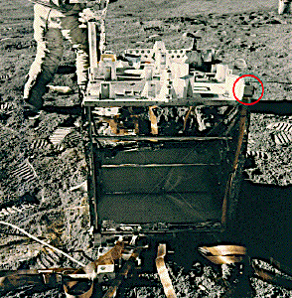
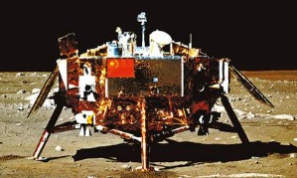
Dust deposition rates
Values/references from Argonaut Missions Environmental Specification
Data based on measurements from natural lunar dust
Data available in dust deposition rates
Chang’e-3 lander
Credit: CNSA
Location of the Apollo Dust Detector Experiment on the Apollo 14 ALSEP
Credit: NASA
Transport source | Measurements
Meteoroid impacts | 10 μg/cm²/year | Katzan, C.M. et al. (1991),
Electrostatic (Apollo Dust Detector Experiments) | 100 μg/cm²/year | Hollick, M., and O'Brien, B. J., (2013)
Human/Rover caused impact | < 40 μg/cm² | NASA-STD-1008
Annual deposition (Chang’e-3) | ~23.4 μg/cm²/year | Li, D., et al. (2019)
Nearby landing | 1 mg/cm² | Satkiewicz, F. G., et al. (1972)
Credit: F. Cipriani et al. / Argonaut Missions Environmental Specification
[NASA-STD-1008] & [Argonaut Spec] = few 10s µg/cm²/year

Slide 7
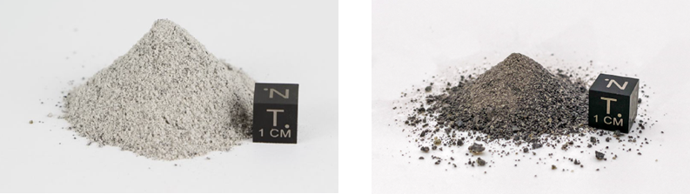
Lunar Dust Simulants Selection
(experts from the ESA Sample Analogue Curation Facility)
Importance of lunar simulant parameters
  0 – 50 micron particle size range : important
  Opaqueness (i.e. modal mineralogy) : important
  Abrasivity/Electrostaticity properties : not important
  Suitable particle size range and distribution : important
  Appropriate maturity : important
Careful selection of the LDS according to Argonaut lunar highland landing site
  No and/or minimal mare material
  Same primary with increased agglutinate (+/- relative η-phase iron-enrich.) to simulate ‘mature’ soil
  Lower limit of particle size range should be 0 microns.
  Upper-limit cut-off requires more research. Tentatively 90 µm is suggested.
LHS-1 from Space Ressource Technologies (Exolith)
LHS-1-25A Lunar Highlands 25% Agglutinated Simulant from Space Ressource Technologies (Exolith)
(75% LHS-1 Lunar Highlands Simulant and 25% Anorthosite Agglutinates, by weight)
Both with custom sieve < 100 µm

Slide 8
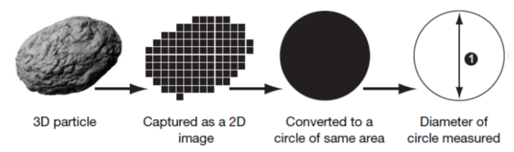
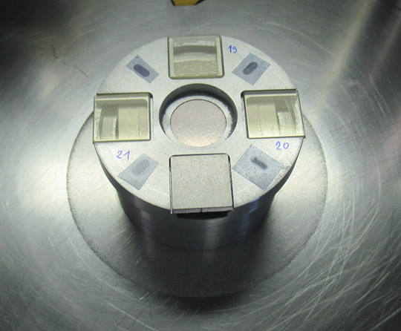
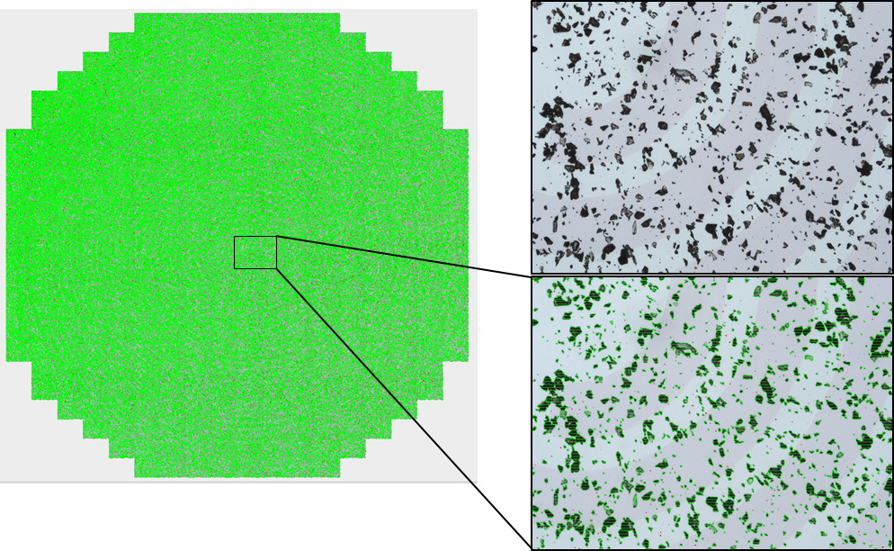
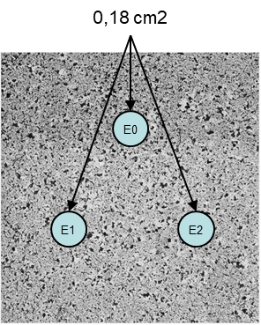
Experimental Set-up & approach
Dust Deposit (DROP)
combined effect of depressurized chamber and pulsed air inlet
Characterization
2D/3D reconstruction mapping
particle counting software
Dust percent area coverage (PAC) : %cov
%Cov ±15%
[NASA-STD-1008] & [Argonaut Spec] = few 10s µg/cm²/year, experiment 18 µg/cm².PAC
Measurement (ε, α, %T)
No direct contact of meas. head with dusty surface (E1->E3)
Mapping & meas. at 3 (same) positions on sample
Average data or per position
Solar absorptance [250-2500nm] ±1%
Emissivity [3-35µm] ±3%

Slide 9
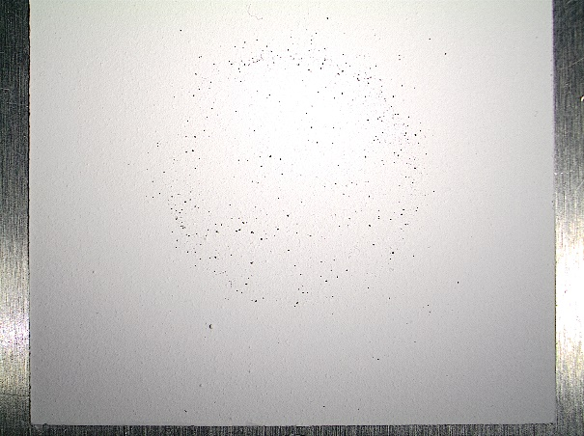
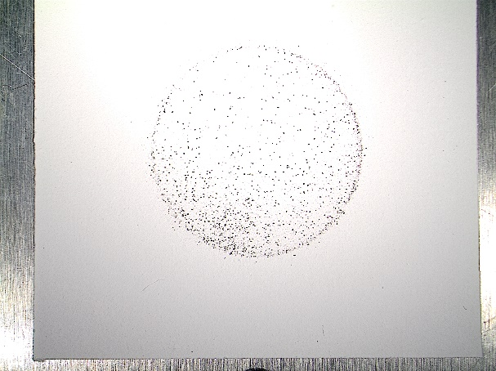
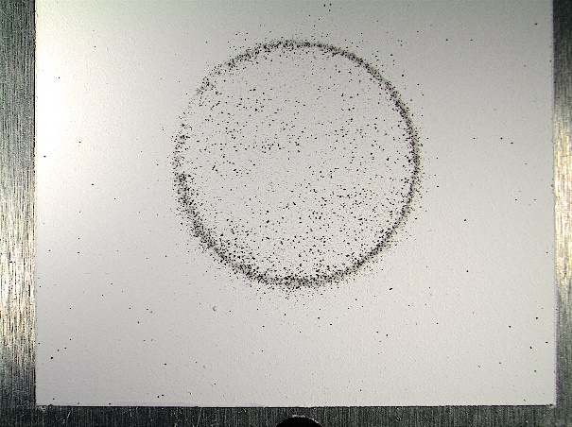
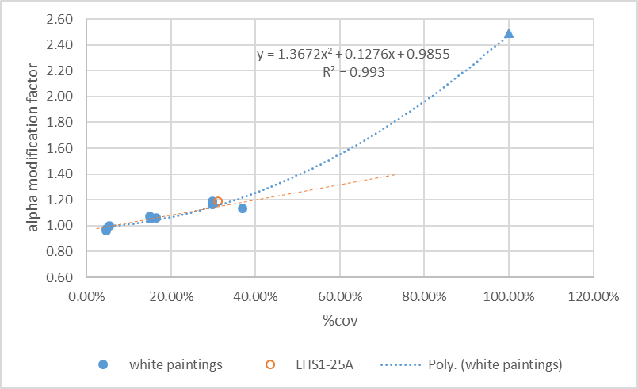
White paintings test results
SG121 5%
SG121 15%
SG121 30%
OSR 5% ~ 90 µg/cm²
OSR 15% ~ 270 µg/cm²
OSR 30% ~ 540 µg/cm²
Compacted LDS
Emissivity : Modification Factor close to 1
Solar absorptance :
« compacted » LDS data valid for the exp. data fitting? 2 different laws for low & high %cov?

Slide 10
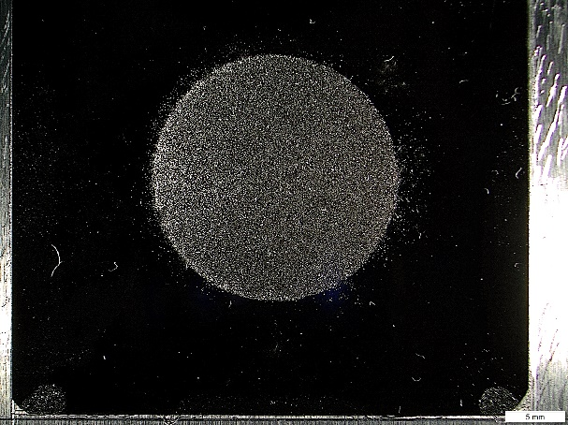
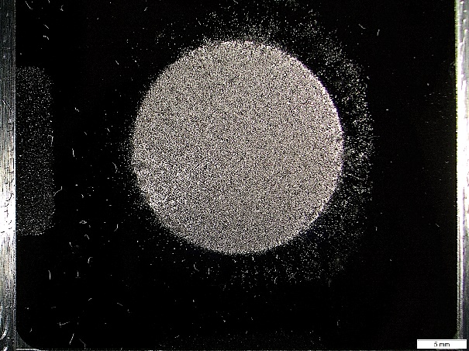
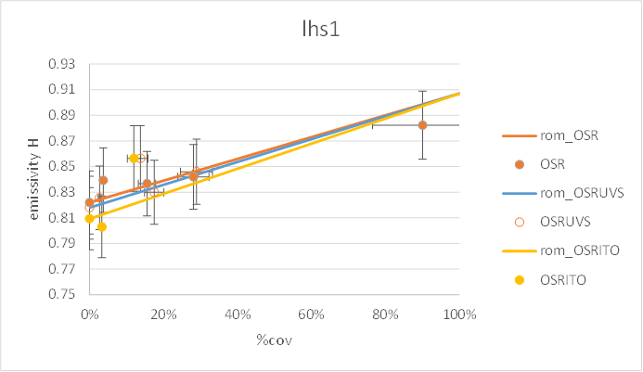
OSR test results
OSR 5% ~ 90 µg/cm²
OSR 15% ~ 270 µg/cm²
OSR 30% ~ 540 µg/cm²
Compacted LDS
Emissivity: Linear trends
Same response with different coatings (exp. law)
Similar response with both LDS

Slide 11
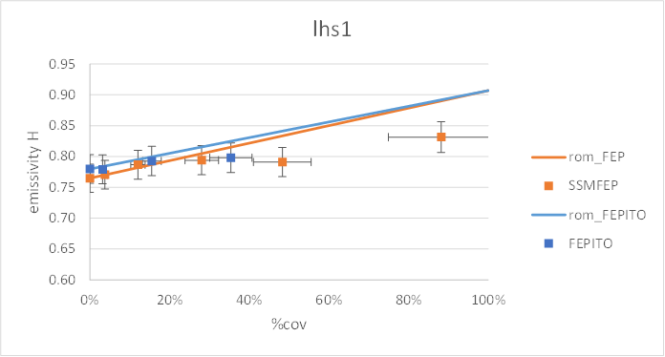
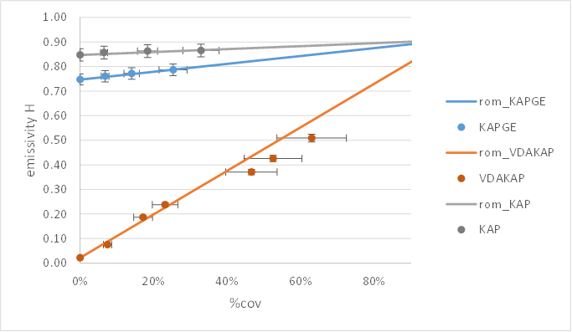
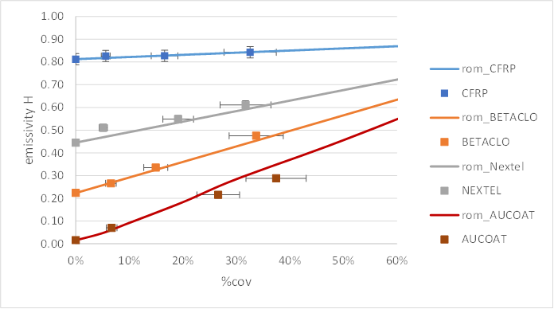
Emissivity results (misc. samples)
Linear trends : compliance with “rule of mixture model” [Gaier 2010]
ε_{LDS/SUB} = %cov*ε_{LDS} + (1-%cov)*ε_{SUB}
SSM
Sample init ε < LDS ε
KAPxx
Misc.

Slide 12
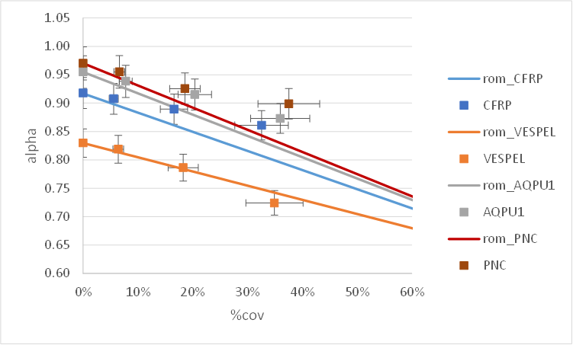
Solar absorptance results (misc. samples)
Sample init α > LDS α
Sample init α < LDS α
Deviation from “rule of mixture model” (larger for samples with MF >>1)

Slide 13
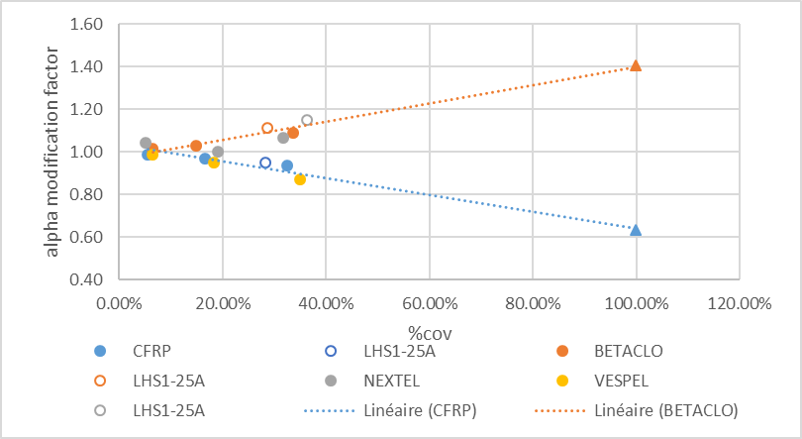
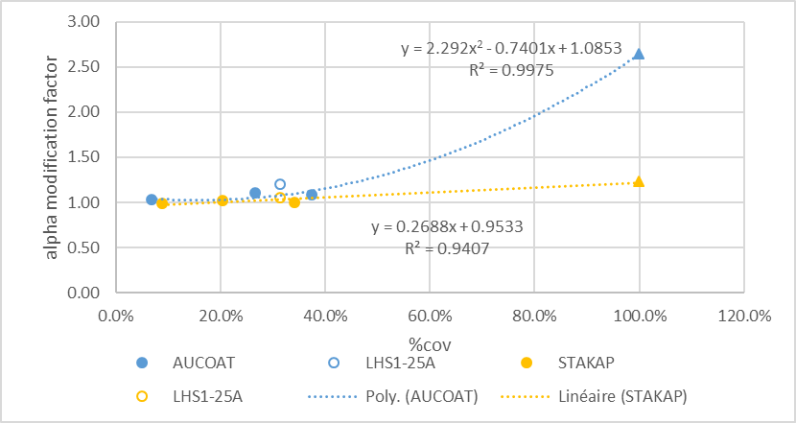
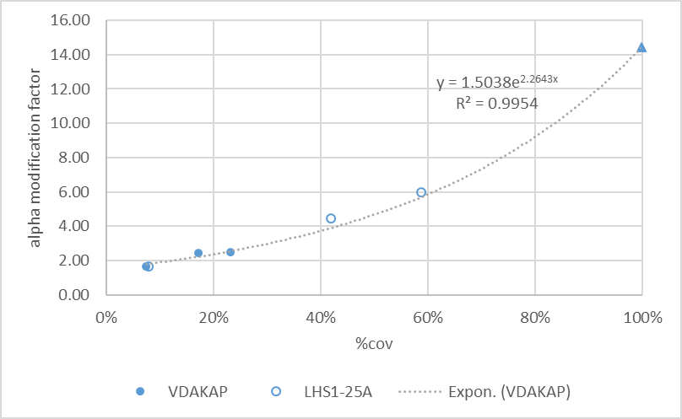
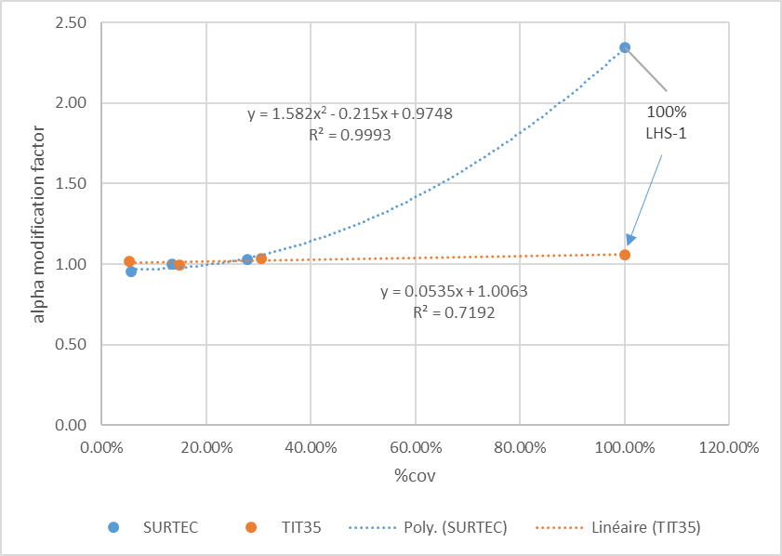
Solar absorptance results (misc. samples)
Example of Fitting laws

Slide 14
Fittings of data
sample # | α fitting law (LHS-1) | ε fitting law (LHS-1)
SSM FEPITO | Exponential incl. 100%LDS excl. 88-90% data (conservative) incl. LHS1-25A response | Linear ROM conservative
SSM FEP |  | Linear ROM conservative
OSRUVS | Exponential fits with 100% LHS-1 & LHS1-25A data | compliant with ROM
OSR
OSRITO
SURTEC | Polynomial compliant with ROM
SG121 | Polynomial (incl. 100%LDS and LHS1-25A data point)
PSBN
PCBE
KAP | Polynomial fits incl. LHS-1 data (does not apply with LHS1-25A)
KAPGE | Linear compliant with ROM (LHS-1 only)
VDAKAP | Exponential (incl. 100%LDS and LHS1-25A) ROM conservative
TIT35 | LInear compliant with ROM
CFRP | Linear
AUCOAT | Polynomial incl. 100% LDS and LHS1-25A
AQPU1 | Linear incl. 100% LDS
PNC
VESPEL | Linear compliant with ROM
BETACLO | Linear incl. 100% LDS
STAKAP | Linear incl. 100% LDS and LHS1-25A
Nextel | Linear incl. 100% LDS and LHS1-25A
Fitting laws can be defined for all samples types

Slide 15
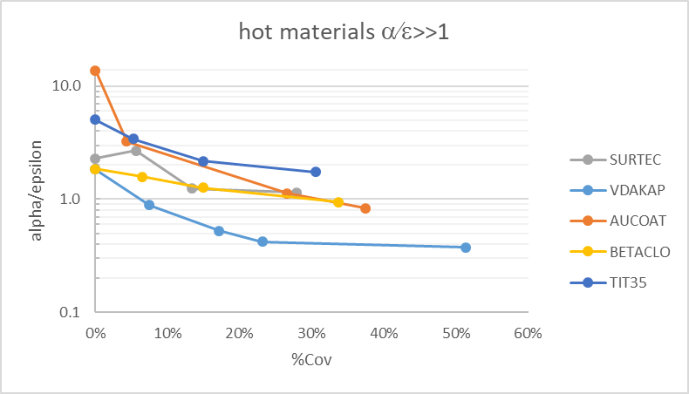
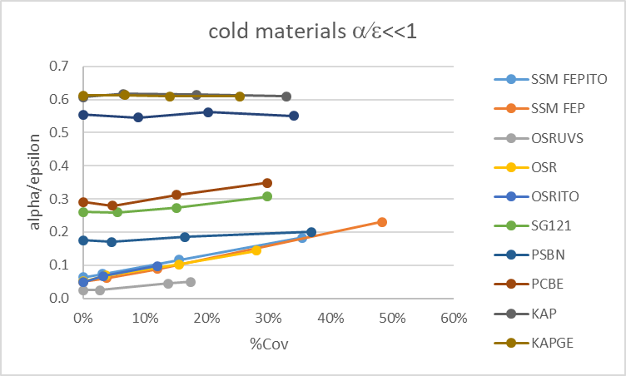
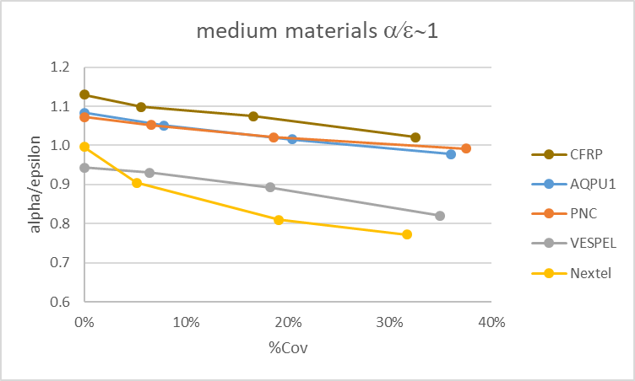
Impact on Thermal System

Slide 16

Summary
>120 deposits of LHS-1 and LHS1-25A lunar dust simulants on up to 23 different materials (“low” %cov, monolayer configuration)
Full set of LHS-1 results (LHS-1-25A limited number of comparison points)
LHS-1 results provide a clear insight on the effect of %coverage on thermo-optical response
  Emissivity: Linear Trends and Compliance with ROM for all sample types (except SSM - ROM slightly conservative).
  Solar absorptance: linear/polynomial/exponential fits depending on the sample type. ROM is conservative for most of the sample types.
LHS-1 and LHS-1-25A : similar results
Fitting laws can be provided for all samples (valid for LDS monolayer deposit, low %cov*)
LDS contamination impacts on all materials types however “HOT” materials response is the most affected (hot -> medium to cold)

Slide 17
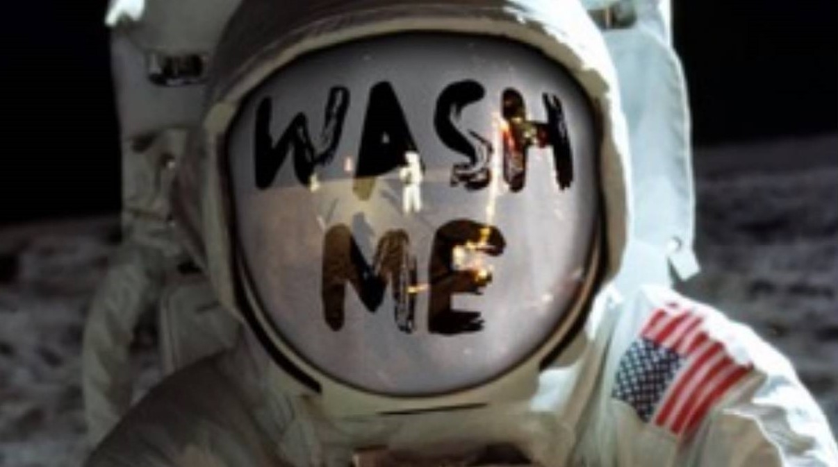
Thank you! Questions ?
Evolution of thermo-optical properties of solar panels or thermal control materials with lunar dust simulants contamination
S. Duzellier, JC. Mateo Velez, A. Beyler, S. Soonckindt : ONERA Toulouse
P.B. Hager : ESA-ESTEC

