Slide 1
GOES-19 MPS-HI Calibration: The Newest GOES Radiation Belt Instrument
May 20, 2025
IRENE Space Radiation Modelling
and Data Analysis Workshop 2025
Presenter: Athanasios Boudouridis (University of Colorado CIRES)
Contributors: Juan Rodriguez, Brian Kress, Kevin Hallock
(University of Colorado CIRES)
The CIRES team wish to thank NOAA/NCEI, the MPS-HI vendor Assurance Technology Corporation, the Space Weather Prediction Center, and the GOES-R Program

Slide 2
GOES-R Program
Satellites launched to date:
GOES-16 (R): launched 19 November 2016
On route to storage at 105ºW, arriving June 6, 2025
Was GOES-East (75.2ºW) from 18 December 2017 to April 7, 2025
GOES-17 (S): launched 01 March 2018
In storage (104.7ºW) since 14 March 2023, to relocate to 89.5ºW after GOES-16 arrival at 105ºW is confirmed successful
Was GOES-West (137.2ºW) from 12 February 2019 to 4 January 2023
GOES-18 (T): launched 01 March 2022
GOES-West (137ºW) since 4 January 2023
GOES-19 (U): launched 25 June 2024
Replaced GOES-16 as GOES-East on April 7, 2025 (75.2ºW)
Each GOES-R-series observatory carries a Space Environment In-Situ Suite (SEISS)
GOES-19 SEISS was turned on on 22 August 2024

Slide 3
Magnetospheric Particle Sensor – High Energy (MPS-HI)
MRD 3.3.6.1.3 Magnetospheric Electrons and Protons: Medium and High Energy
Primary purpose: measure radiation belt particle fluxes in the energy range responsible for internal charging
5 electron telescopes and 5 proton telescopes
30 deg full-width conical FOVs, centers separated by 35 deg
Each electron telescope:
10 differential channels, 50 keV – 4 MeV
2 integral channels, >2 MeV and >4 MeV (latter not part of L1b)
Each proton telescope:
11 differential channels
7 channels, 80 keV – 1 MeV (trapped)
4 channels, 1-12 MeV (solar protons)
Two dosimeters (250 and 100 mil Al)
Distinguish particles depositing < 1 MeV and >1 MeV
Credit: SEISS-TR-MH074-2 Rev C, Figure 3-1

Slide 4
ALERT: Electron 2 MeV Integral Flux Exceeded 1000 pfu
Space Weather Message Code: ALTEF3
Serial Number: 3381
Issue Time: 2023 Nov 07 1624 UTC
ALERT: Electron 2MeV Integral Flux exceeded 1000pfu
Threshold Reached: 2023 Nov 07 1600 UTC
Station: GOES16
Potential Impacts: Satellite systems may experience significant charging resulting in increased risk to satellite systems.
Space Weather Message Code: ALTEF3
Serial Number: 3386
Issue Time: 2023 Nov 12 0500 UTC
CONTINUED ALERT: Electron 2MeV Integral Flux exceeded 1000pfu
Continuation of Serial Number: 3385
Begin Time: 2023 Nov 07 1600 UTC
Yesterday Maximum 2MeV Flux: 4373 pfu
Space Weather Prediction Center (SWPC) alert at 1000 electrons/(cm² sr s) [pfu] was developed in consultation with the satellite industry
Based always on GOES-East observations
Fluxes systematically lower than at GOES-West by factor of 2.5 [Meredith et al., 2015]
First alert was issued on 18 May 1995
MeV electron fluxes have been very elevated starting in 2015
Primarily owing to the action of stream interaction regions (interface between solar wind of coronal hole and quiet sun origins) on the magnetosphere

Slide 5
Steps of Radiation Belt Electron and Proton Calibration
Initial Data Calibration
Dead time correction
Bowtie Analysis (electrons only)
Background removal for electron channels E9-E11
MPS-HI Telescope Cross-Comparison
Statistical comparison between telescopes observing the same pitch angles
Solar Energetic Particle Cross-Comparison
Comparison between MPS-HI and Solar and Galactic Proton Sensor (SGPS, also onboard GOES-R satellites) during an SEP event under high solar wind dynamic pressure
Cross-Satellite Comparison of Trapped Particles
Comparison between GOES-R satellites

Slide 6
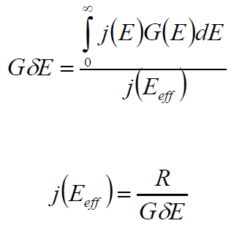
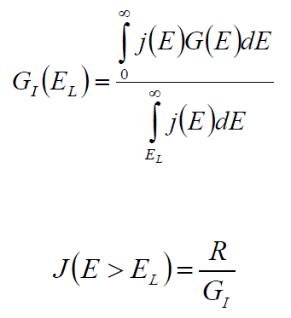
Inverse Model: Bowtie Method
Differential Channels
Integral Channel
Bowtie analysis, differential:
cm² sr keV
Bowtie analysis, integral: cm² sr
L1b processing (diagonalized)
L1b processing
Range in G due to natural variability at 5th and 95th percentiles
Effective energy found using non-linear minimization of (95%ile - 5%ile)
Boudouridis, A., Rodriguez, J. V., Kress, B. T., Dichter, B. K., & Onsager, T. G. (2020). Development of a bowtie inversion technique for real‐time processing of the GOES‐16/‐17 SEISS MPS‐HI electron channels. Space Weather, 18, e2019SW002403. https://doi.org/10.1029/2019SW002403

Slide 7
Backgrounds Trending: Methodology
GOES-19 MPS-HI E9-E11 Revised Background Removal
The baseline algorithm is inadequate to correct for the observed slowly-varying background due presumably to Galactic Cosmic Ray (GCR) protons. The background removal coefficients were corrected so as to better account for the GCR proton contamination. This involves a number of observations and assumptions (demonstrated for MPS-HI E11 (> 2 MeV) channel):
The first assumption is that the MPS-HI backgrounds are due to the GCRs.
Solar and Galactic Proton Sensor (SGPS) P11 channel is the best single measure of GCR fluxes. Use the $−$X sensor (looking east)
$M_{ELE}\left(i,E11\right)=N_{ELE}^{true}\left(i,E11\right)−C_{ELE}^{obc}\left(i,E11\right)=N_{ELE}^{true}\left(i,E11\right)−γ\left(i,E11\right)F_{{SGPS−X}_{P11}}$
The coefficient $γ$ is calculated separately for each telescope.
Assuming that SGPS-X P11 can track the GCR background well, we can average the SGPS-X P11 fluxes and the background fluxes in E11 due to the GCRs, yielding
$$γ\left(i,E11\right)={\overline{C_{ELE}^{obc}(i,E11)}}/{\overline{F_{{SGPS−X}_{P11}}}}=G_{P11}{\overline{C_{ELE}^{obc}(i,E11)}}/{\overline{C_{P11}}}$$

Slide 8
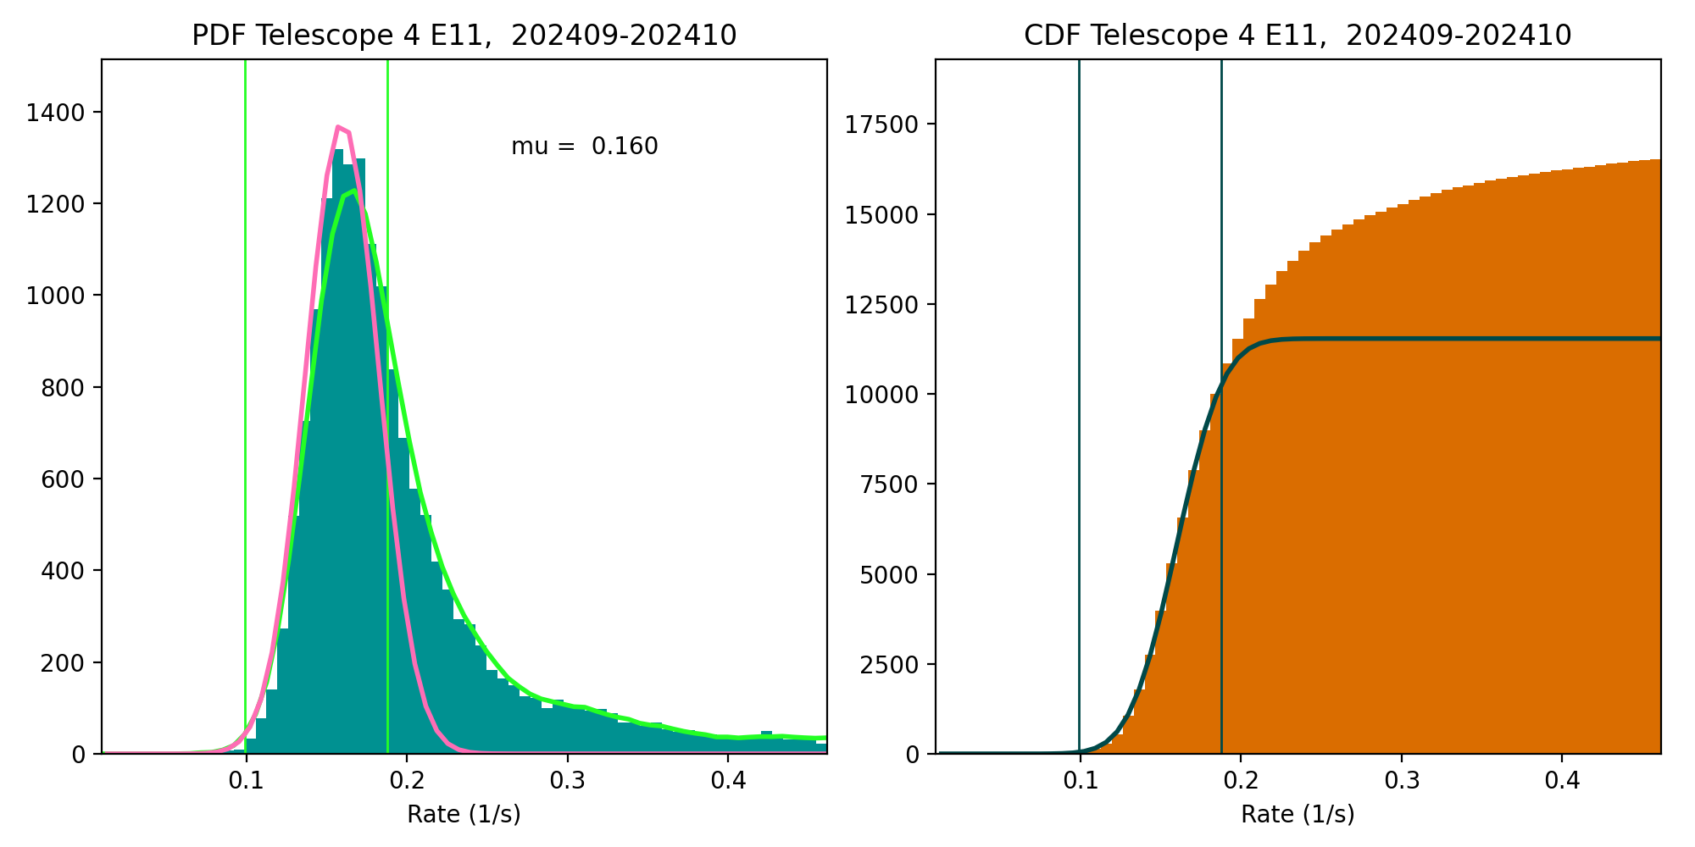
Backgrounds Trending: Methodology
Modeling the GCR background
Assume that the peak and the part of the PDF below the peak are dominated by the rates due to GCRs, model as Gaussians.
Gaussian PDF: $f\left(x\right)=a exp\left[−\frac{{(x−μ)}^{2}}{2σ^{2}}\right]$
Gaussian CDF: $F\left(x\right)=aσ\sqrt{\frac{π}{2}}\left[1+erf\left(\frac{x−μ}{σ\sqrt{2}}\right)\right]$
Conduct the analysis using 5-min averages for 09/01/2024-10/31/2024.
Fit the CDF that is varying smoothly, instead of PDF.
$\overline{C_{ELE}^{obc}(i,E11)}=μ_{E11}$ (fitted E11 mean).
Do the same for SGPS-X P11 counts, $\overline{C_{P11}}=μ_{P11}$
Repeat for E9, E10, E10A.
Estimate gammas.
Apply to the 1s L1b data.
GOES-19

Slide 9
Application of the revised background removal to GOES-19 MPS-HI E11 data
T3
GOES-19 channel E11 $(>2$ MeV)
T1
1000 electrons per (cm² sr s)
T4
SWPC alert level very close to uncorrected backgrounds
T2
T5
Corrected backgrounds more representative of the GCR spectrum
DOS

Slide 10
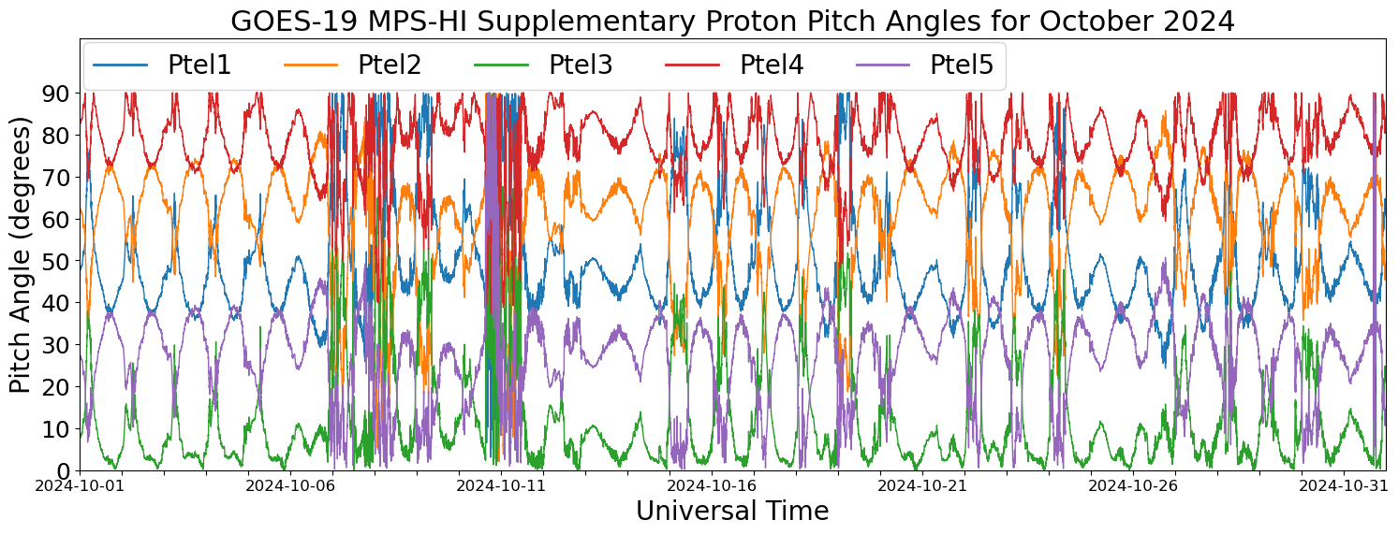
GOES-19 MPS-HI Telescope Cross-Comparison: Method
GOES-19
Protons
October 10 storm
Comparison of responses of MPS-HI telescopes when central pitch angle is the same
Under such conditions, telescopes should be measuring the same flux for the same effective energy
Use Nelder-Mead method to minimize the objective function: sum of squares of the following difference term
Use supplementary pitch angles (fold pitch angles > 90 degrees) to increase the number of matches
To reduce effect of statistical noise, use only matches where both fluxes correspond to at least 1000/100 counts/min
Because Scale Factors are only valid in a relative sense, they must be normalized to a reference telescope
$$R\left(m\right)=\frac{{SF}_{i}\left(m\right)J_{i}\left(m\right)−{SF}_{j}\left(m\right)J_{j}\left(m\right)}{{SF}_{i}\left(m\right)J_{i}\left(m\right)+{SF}_{j}\left(m\right)J_{j}\left(m\right)}$$
Rowland, W., and R. S. Weigel (2012), Intra-calibration of particle detectors on a three-axis stabilized geostationary platform, Space Weather, 10, S11002, doi:10.1029/2012SW000816.

Slide 11
GOES-19 MPS-HI Telescope Cross-Comparison: Results
Electron Scale Factors
September 1-October 31, 2024
Proton Scale Factors
September 1-October 31, 2024
Energy band | Count threshold | T1 | T2 | T3 | T4 | T5
E1 | 1000/min | 1.104 | 0.851 | 1.037 | 1.000 | 0.969
E2 | 1000/min | 1.069 | 0.882 | 1.018 | 1.000 | 1.122
E3 | 1000/min | 0.883 | 0.773 | 0.751 | 1.000 | 0.967
E4 | 1000/min | 0.996 | 0.877 | 1.022 | 1.000 | 0.977
E5 | 1000/min | 1.026 | 0.963 | 1.037 | 1.000 | 0.940
E6 | 1000/min | 1.082 | 0.823 | 0.988 | 1.000 | 1.175
E7 | 1000/min | 1.047 | 0.989 | 0.960 | 1.000 | 0.841
E8 | 100/min | 0.968 | 1.064 | 1.011 | 1.000 | 0.955
E9 | 100/min | 1.058 | 1.043 | 1.136 | 1.000 | 0.960
E10 | 100/min
E11 | 100/min | 0.957 | 0.603 | 1.157 | 1.000
Energy band | Count threshold | T1 | T2 | T3 | T4 | T5
P1 | 1000/min | 0.784 | 1.000 | 2.962 | 1.535 | 1.336
P2 | 1000/min | 1.121 | 1.000 | 1.788 | 1.701 | 1.838
P3 | 1000/min | 1.091 | 1.000 | 1.791 | 1.611 | 1.486
P4 | 1000/min | 1.189 | 1.000 | 1.850 | 1.937 | 1.678
P5 | 100/min | 1.239 | 1.000 | 1.968 | 1.909 | 1.835
P6 | 100/min | 0.992 | 1.000 | 1.502 | 1.865 | 1.791
P7 | 100/min | 1.011 | 1.000 | 1.877 | 1.974 | 1.991
Technique not applicable to solar proton channels P8-P11
Electron scale factors are mostly within the 25% requirement. No pitch angle matches for E10 and very few for E11, due to lack of high fluxes.
Proton scale factors are within the 25% requirement for PTel1, but quite high for PTels 3-5. Two distinct telescope families.
Blue: <10%, Green: 10-25%, Red: >25%
Pink: <100 PA matches
Orange: <1000 PA matches

Slide 12
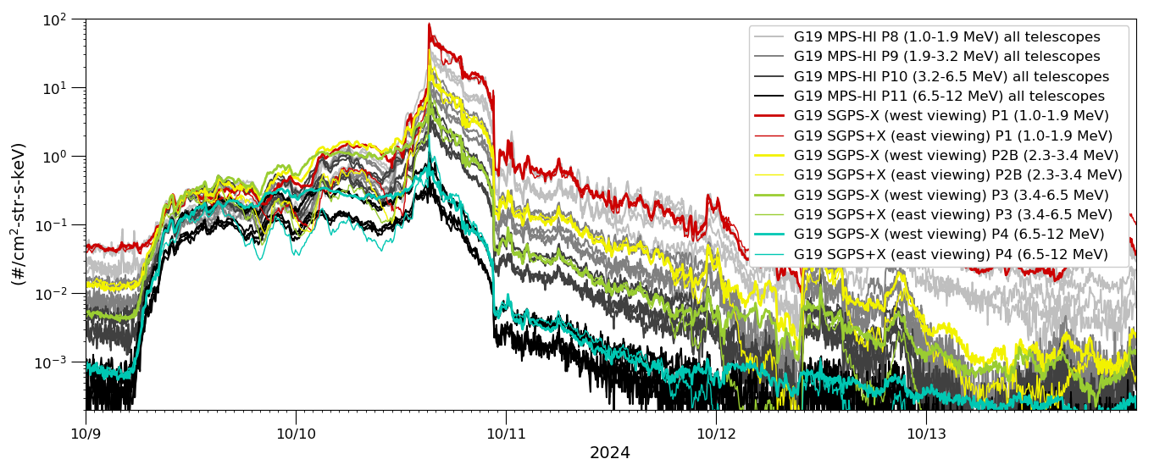
Solar Energetic Particle (SEP) Channels Cross-Comparison: G19 MPS-HI and SGPS Time series
L1b 5-minute avg. from 9-11 October 2024 Solar Particle Event and Geomagnetic storm period
Geomagnetic storm and high solar wind dynamic pressure
Fluxes from the GOES-19 MPS-HI Solar Energetic Particle (SEP) channels (P8-P11) are shown by the gray traces (all 5 proton telescopes), and SGPS P1-P4 channels with colored traces.
MPS-HI P8-P11 have energy bands similar to SGPS P1, P2B, P3 and P4.
In all four MPS-HI channels shown (P8-P11), two MPS-HI proton telescopes (PTels) are in close agreement with SGPS and three are reporting low.
The period indicated by the gray shaded region is used for the SEP channel cross comparisons.

Slide 13
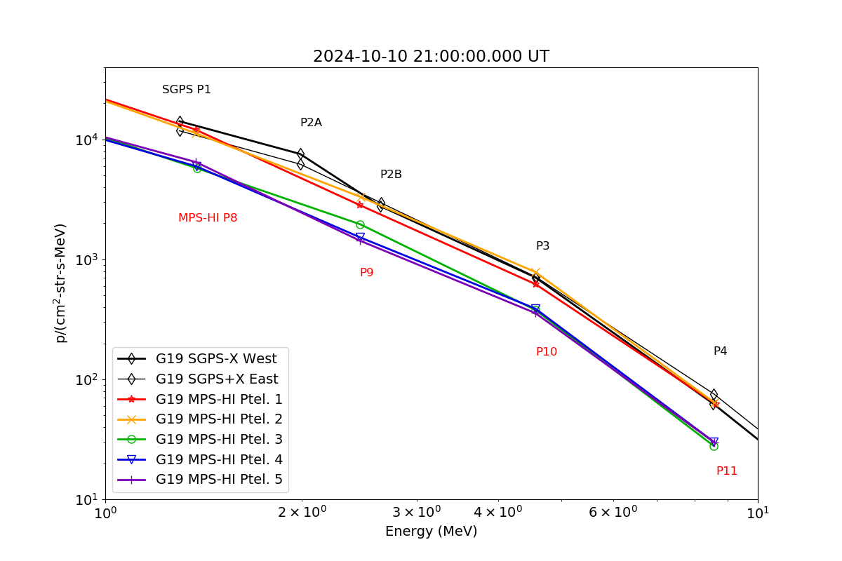
SEP Channels Cross-Comparison: Example Spectra
MPS-HI P8-P11 and SGPS P1-P4 5-minute averaged L1b spectra at 21 UT on 2024-10-10.
MPS-HI PTel-1 and -2 are in close agreement with SGPS. MPS-HI PTels 3-5 are reporting low.
The north-to-south order of MPS-HI proton telescopes is PTel-1, -4, -2, -5, -3.

Slide 14
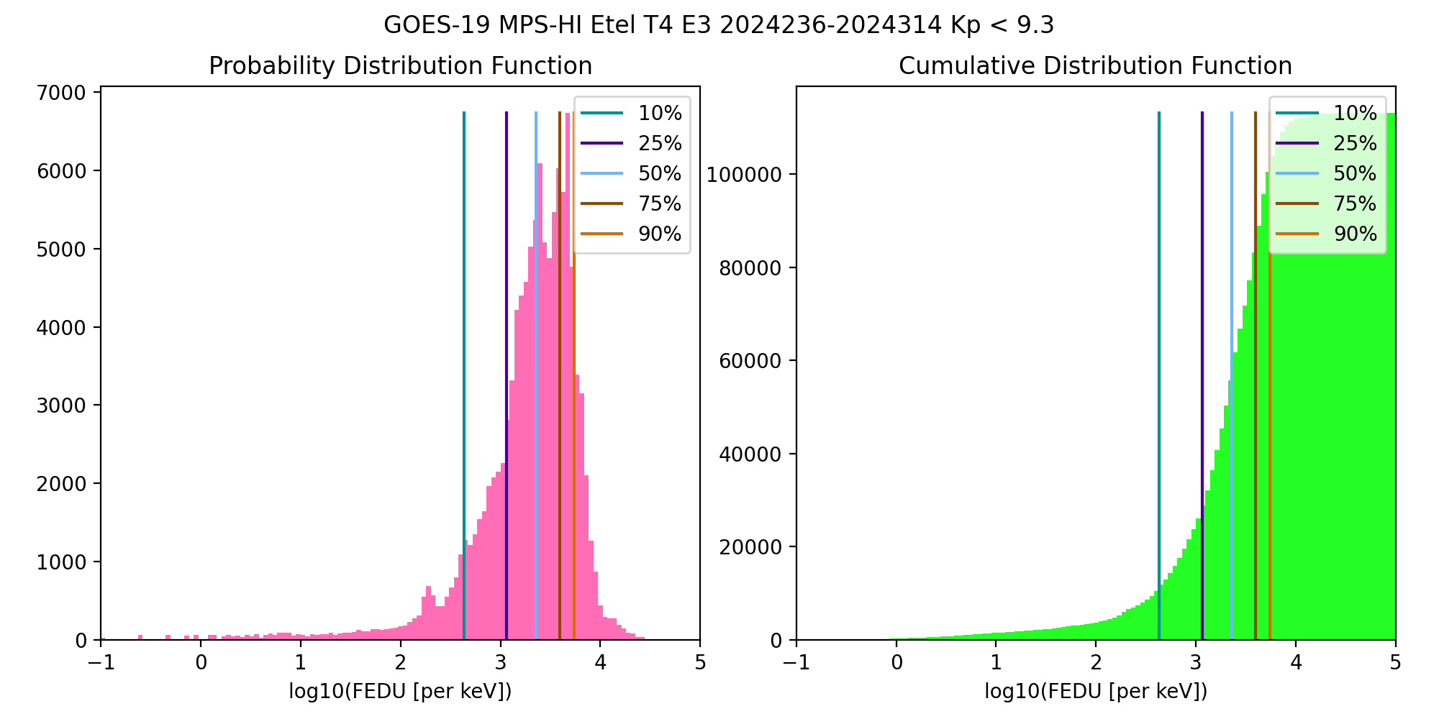
Cross-Satellite Comparison of Trapped Particles: Technique
Compare statistical differential flux spectra from GOES-16 and GOES-19, separated by ~1 hour in Magnetic Local Time (MLT):
GOES-16 (75.2W) to GOES-19 (89.5W), 08/23/2024-11/09/2024 (~2.5 months)
Calculate the particle distributions for all channels and telescopes
Compare flux percentile spectra for telescopes of the same orientation
0, ±35, ±70 deg from zenith (radially outward)
PDF: Number of fluxes in each flux bin
CDF: Number of fluxes up to a flux bin
Percentile fluxes: Flux at which number of fluxes < percentile
50% is the median of the distribution

Slide 15
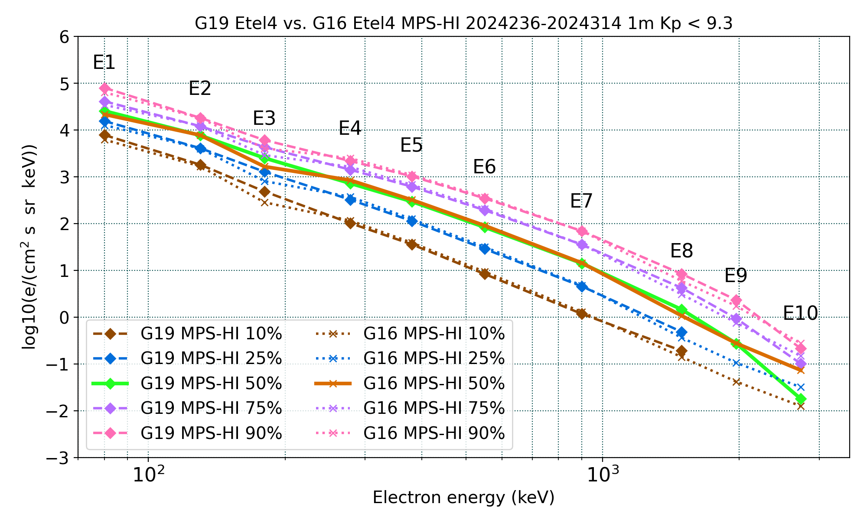
Cross-Satellite Comparison of Trapped Particles: Electron Results
GOES-19 vs GOES-16 Electrons , 08/23/2024-11/09/2024
GOES-16 E3 fluxes are appreciably lower
E9-E10 fluxes are affected by the applied background correction
Good agreement
in general
Missing or significantly lower fluxes are at residual background levels
Boudouridis, A., Rodriguez, J. V., Kress, B. T., Dichter, B. K., & Onsager, T. G. (2020). Development of a bowtie inversion technique for real‐time processing of the GOES‐16/‐17 SEISS MPS‐HI electron channels. Space Weather, 18, e2019SW002403. https://doi.org/10.1029/2019SW002403

Slide 16
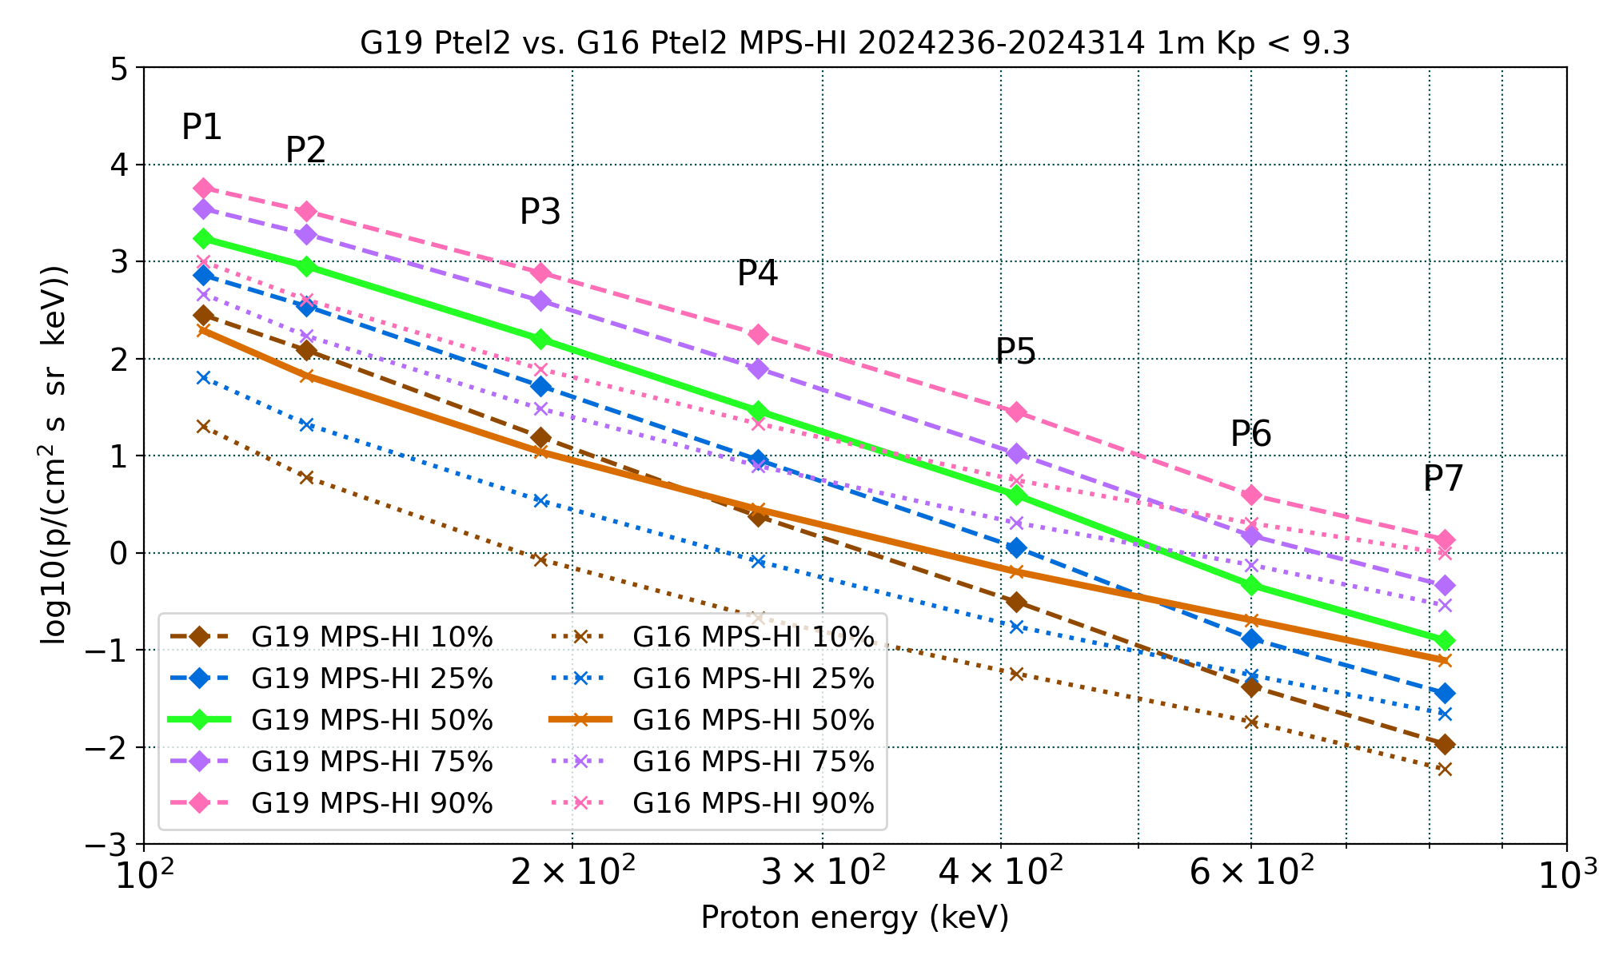
Cross-Satellite Comparison of Trapped Particles: Proton Results
GOES-19 vs GOES-16 Protons , 08/23/2024-11/09/2024
GOES-16 fluxes are significantly lower than GOES-19 in channels P1-P5 and all telescopes)
This observation has been documented extensively
A degradation of the proton detectors is actively being investigated
The proton spectrum is flattening for channels P6 and P7: effect of Solar Energetic Particle (SEP) events
Apply only to P1-P7

Slide 17
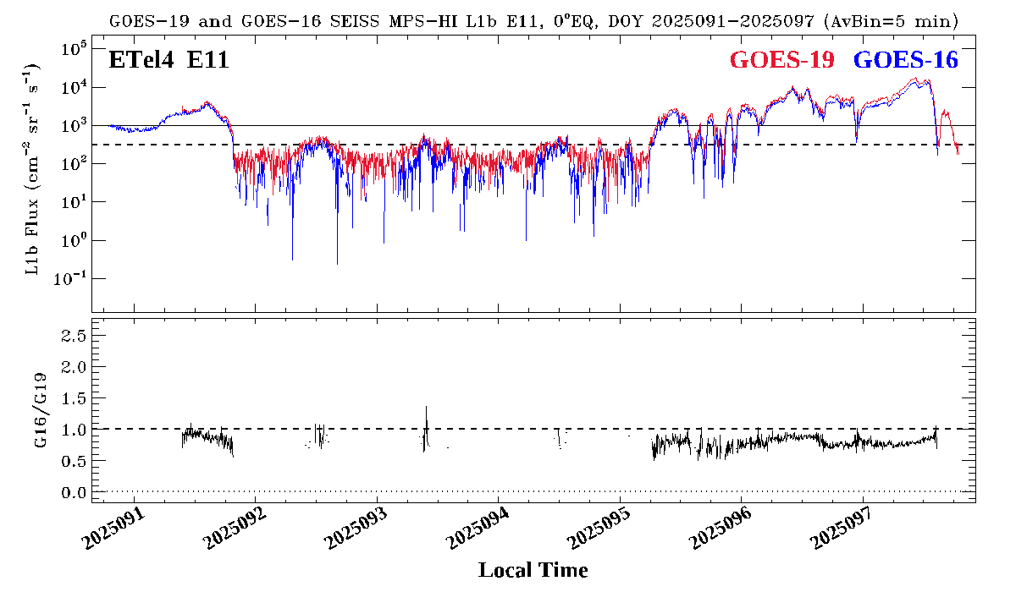
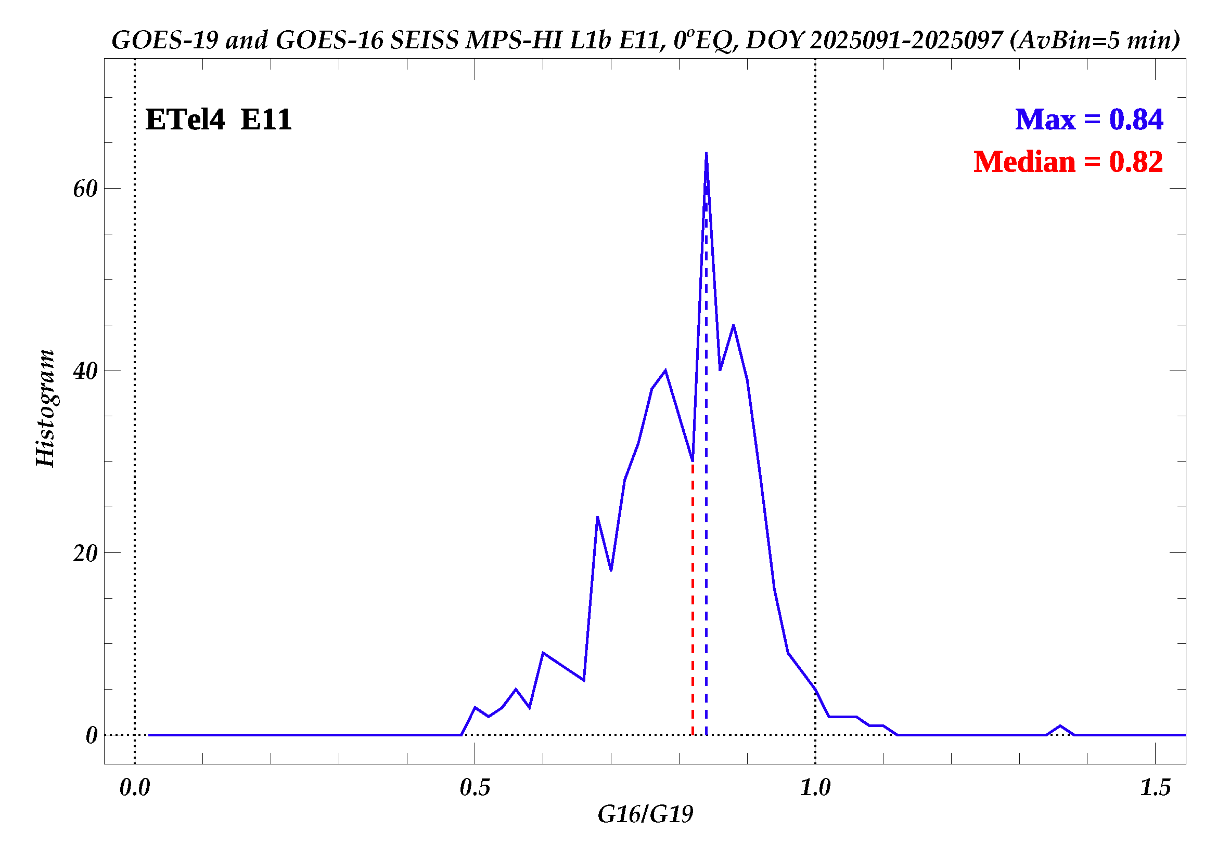
Cross-Satellite Comparison of Trapped Particles (E11): Technique and Results
Plot GOES-19 and GOES-16 MPS-HI channel E11 (> 2 MeV) Electron Telescope 4 (ETel4 ) 5-min averaged fluxes for April 1-7, 2025 (during colocation period, separated by 0.3º).
ETel4 is the central electron telescope looking along the equator.
Take the ratio GOES-16/GOES-19 of E11 ETel4 5-min average fluxes.
Make the histogram of the ratio GOES-16/-19 MPS-HI E11 ETel4 5-min average fluxes > 300 pfu.
The median of the GOES-16 to GOES-19 T4 >2 MeV flux ratio distribution is 0.82.
The G16/G19 flux ratios are below 1, but closer to 1 than the month of September 2024.

Slide 18
Concluding notes
Steps taken to ensure accurate flux determination
Dead time correction
Bowtie Analysis for accurate conversion from electron counts to fluxes
Background removal for channels E9-E11 for accurate GCR backgrounds specification and removal
Steps taken to ensure accurate calibration
Cross-telescope comparison: Statistical comparison between telescopes observing the same pitch angles
SEP Cross-Comparison: Comparison between MPS-HI and SGPS during an SEP event under high dynamic pressure
Cross-satellite: Comparison between GOES-R satellites

