Slide 1
ESA SREM measurements: Solar Energetic Particle events and Galactic Cosmic Rays
Sigiava Aminalragia-Giamini^{1,3}, Hugh Evans², Piers Jiggens², Daniel Matthiä⁴, Ingmar Sangberg¹, Constantinos Papadimitriou¹, Christos Katsavrias Ioannis^{1,3}, Ioannis A. Daglis^{3,5}
[1] SPARC, Greece
[2] ESA/ESTEC, The Netherlands
[3] National and Kapodistrian University of Athens, Greece
[4] German Aerospace Center (DLR), Germany
[5] Hellenic Space Center, Greece
1

Slide 2
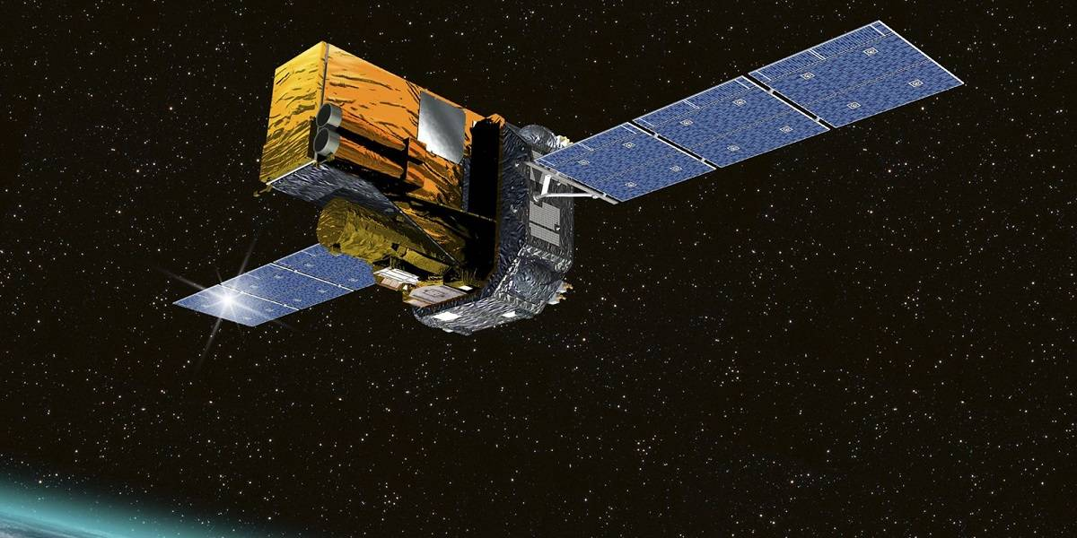
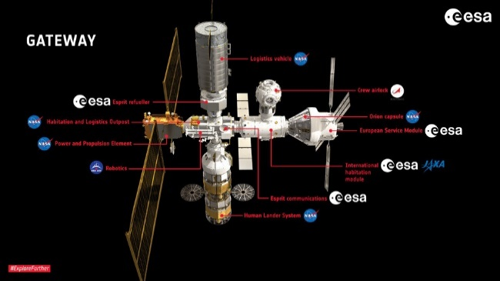
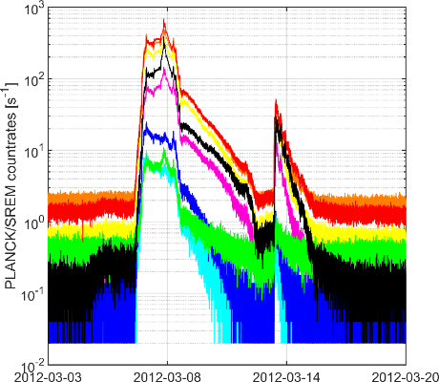
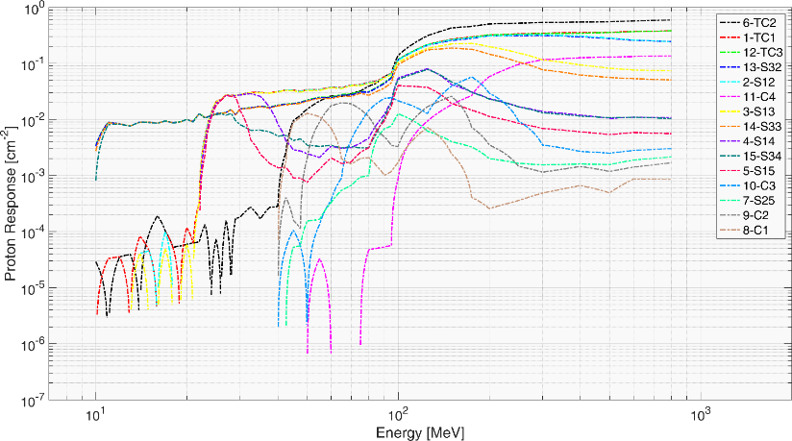
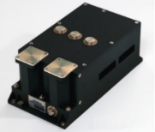
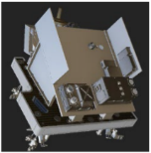
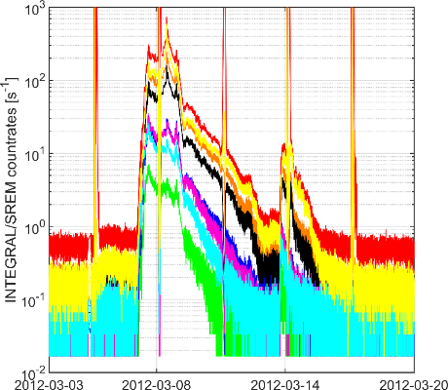
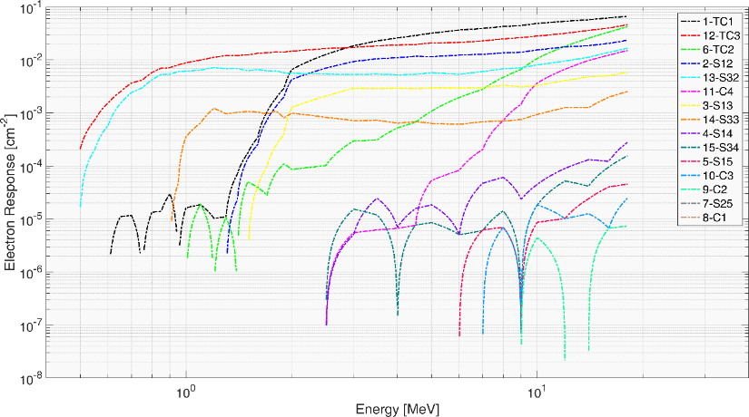
SREM missions and data
SREM units and data
GIOVE-B: MEO, 2008-2012
Planck/Herschel: Sun-Earth L2, 2009-2013
ROSETTA: Interplanetary space, 2004-2016
PROBA1: LEO, 2001-now
INTEGRAL: HEO, 2002 Oct - 2025 Feb + PSP until 2029
Lunar Gateway (ERSA): Lunar Halo orbit
Planck
INTEGRAL

Slide 3
SREM missions and data
New findings on SREM data
SREM measures GCRs well enough to resolve solar modulation HI contributions in SREM count-rates are non-negligible
SREM measures reliably SEP proton spectra into high energies ~1GeV
Derivation of solar electrons concurrently with protons during SEPs
Production of new SREM INTEGRAL and PLANCK SEP+GCR dataset

Slide 4
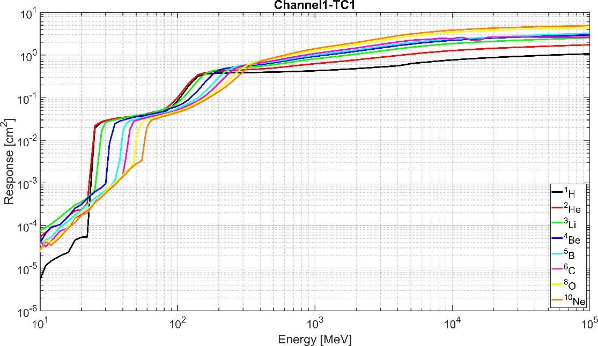
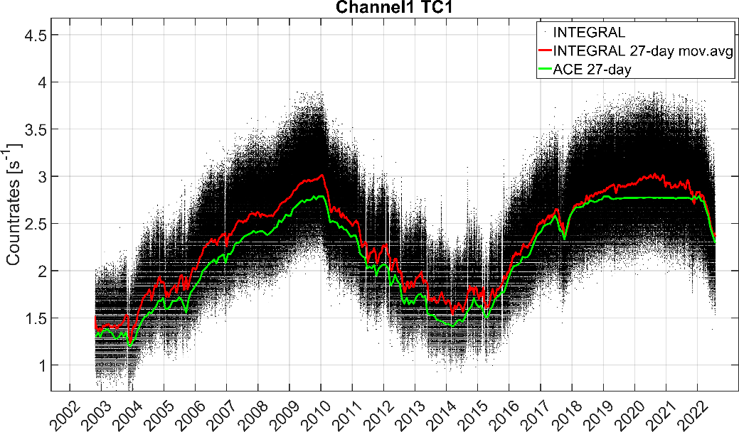
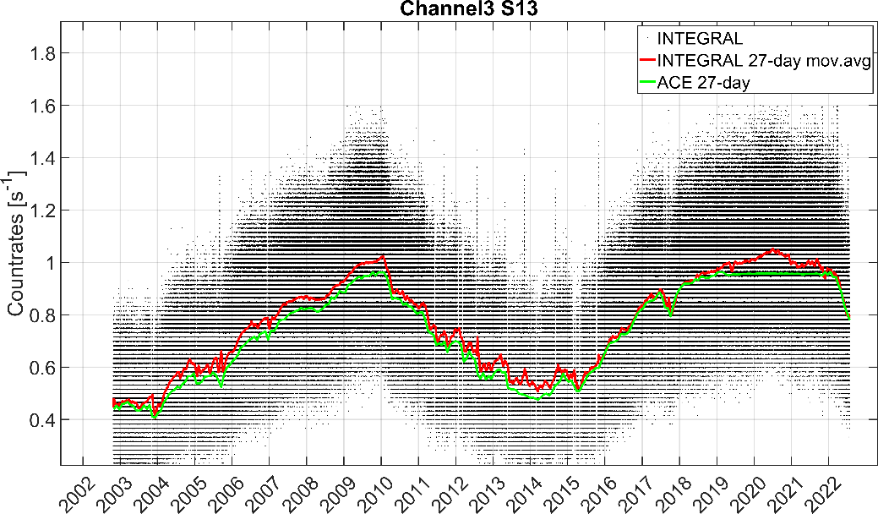
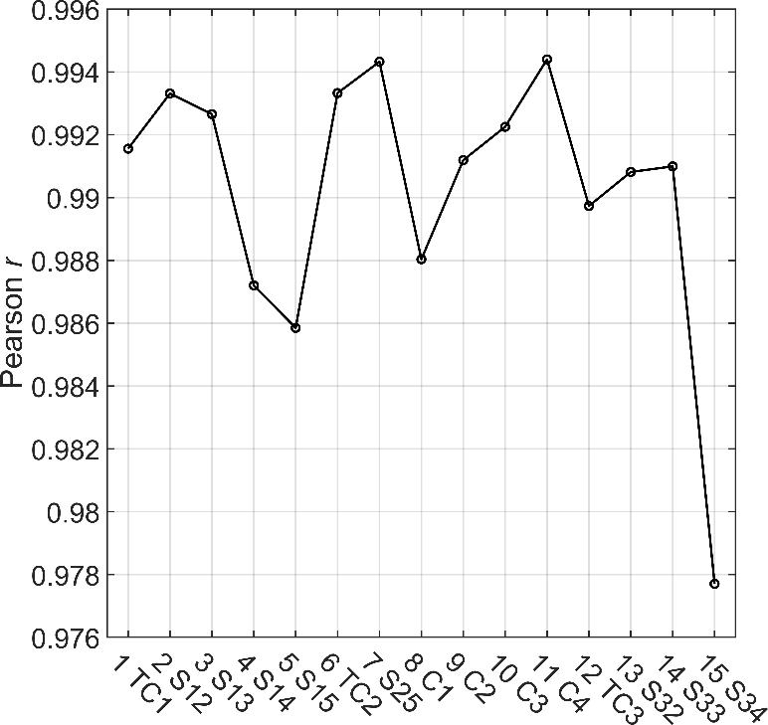
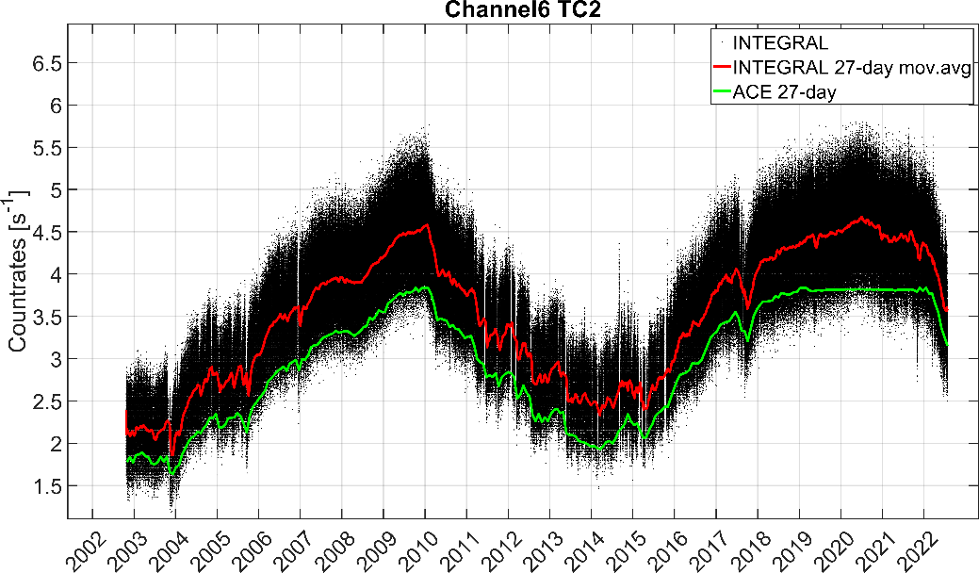
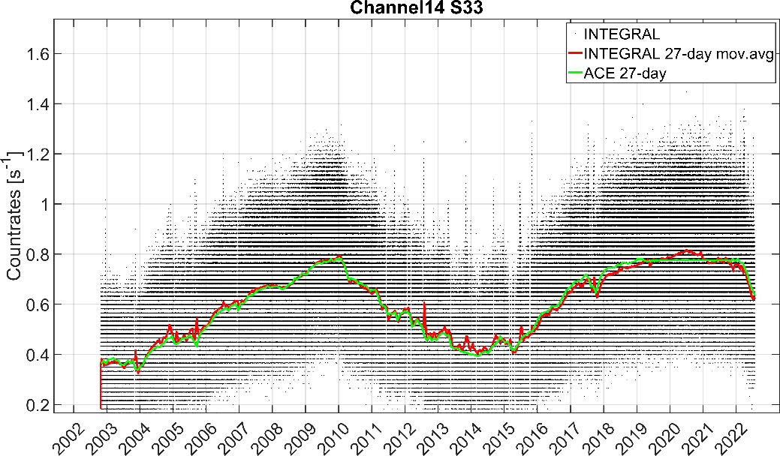
SREM GCRs
SREM measures GCRs
H and Z≥2 fluxes up to 100 GeV from DLR GCR model¹ driven from ACE/CRIS carbon fluxes [W parameter]
Counts from folded GCR fluxes are fully correlated with SREM countrates
Hugh Evans
Hendrick Neumann
mov.avg INTEGRAL – DLR(ACE)
¹Matthiä et al. 2013 A ready-to-use galactic cosmic ray model DOI: 10.1016/j.asr.2012.09.022

Slide 5
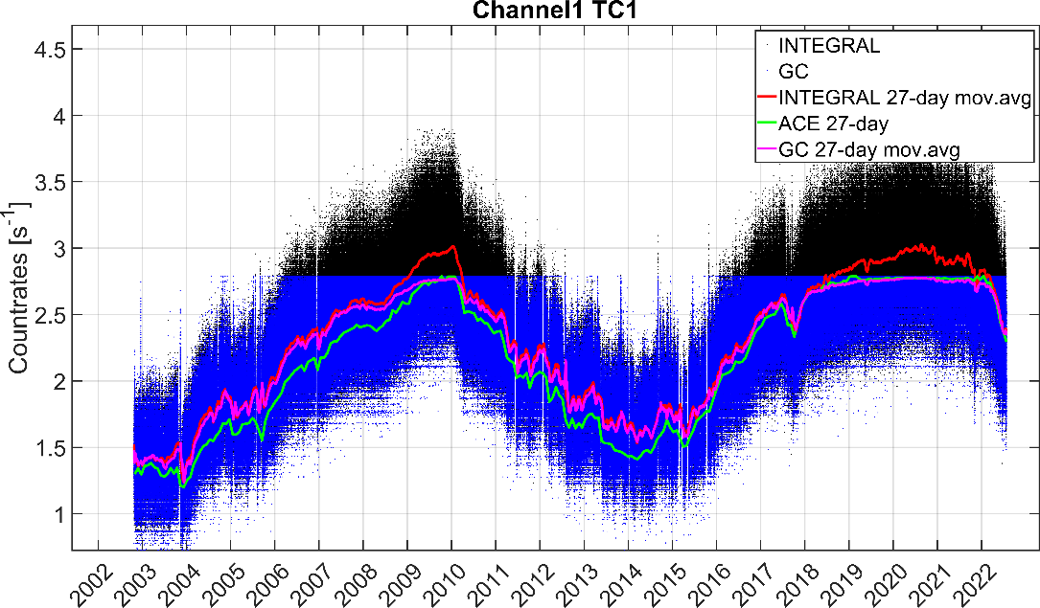
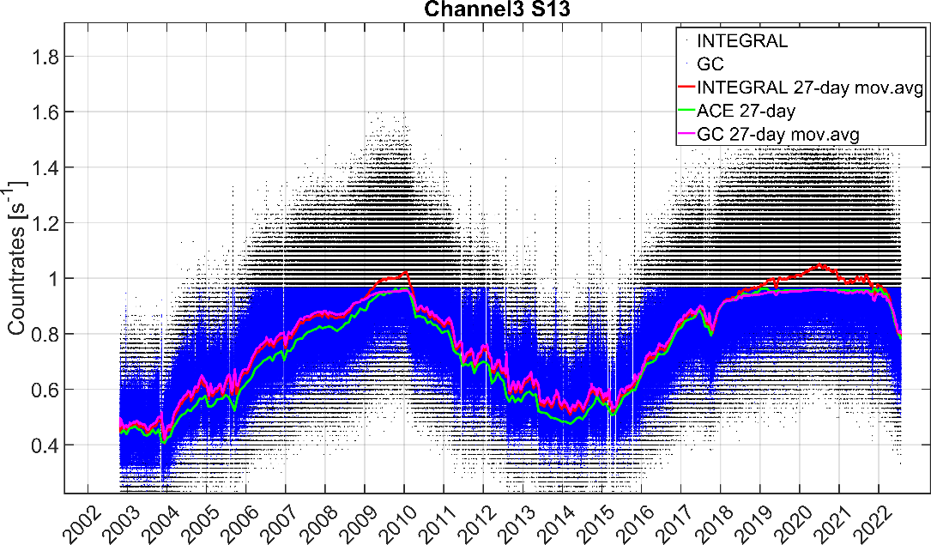
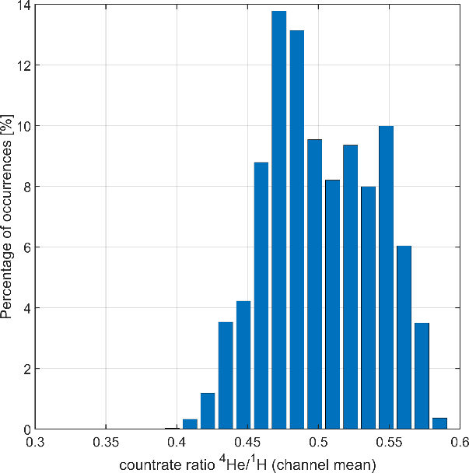
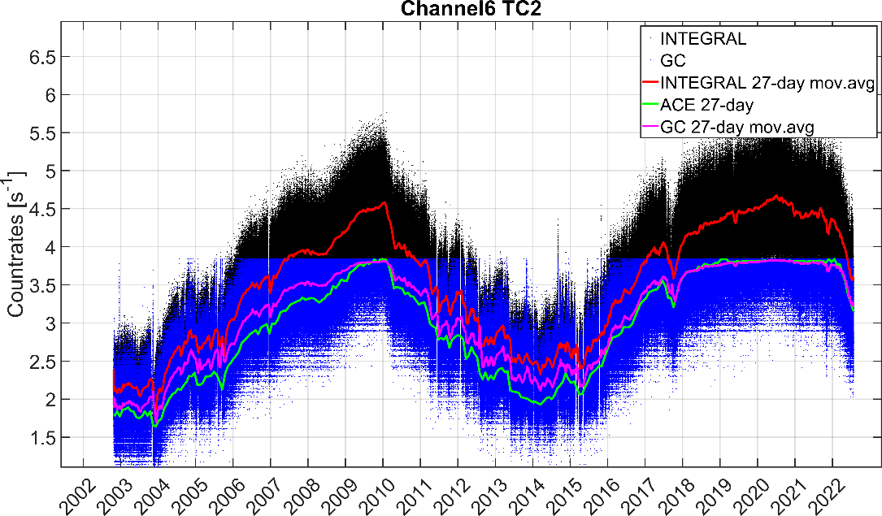
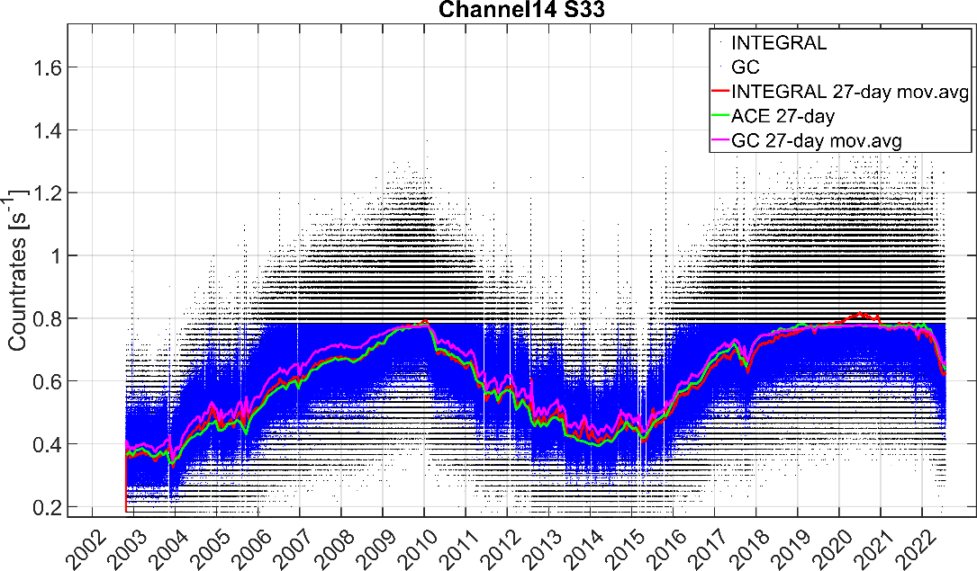
SREM GCRs
SREM reconstruction with SREM-derived GCR spectra
Good reconstruction at sol. active conditions
Partial reconstruction at sol. quiet conditions
~28%
RFs
E<100 MeV range
additional particles (ions/electrons)
~32%

Slide 6
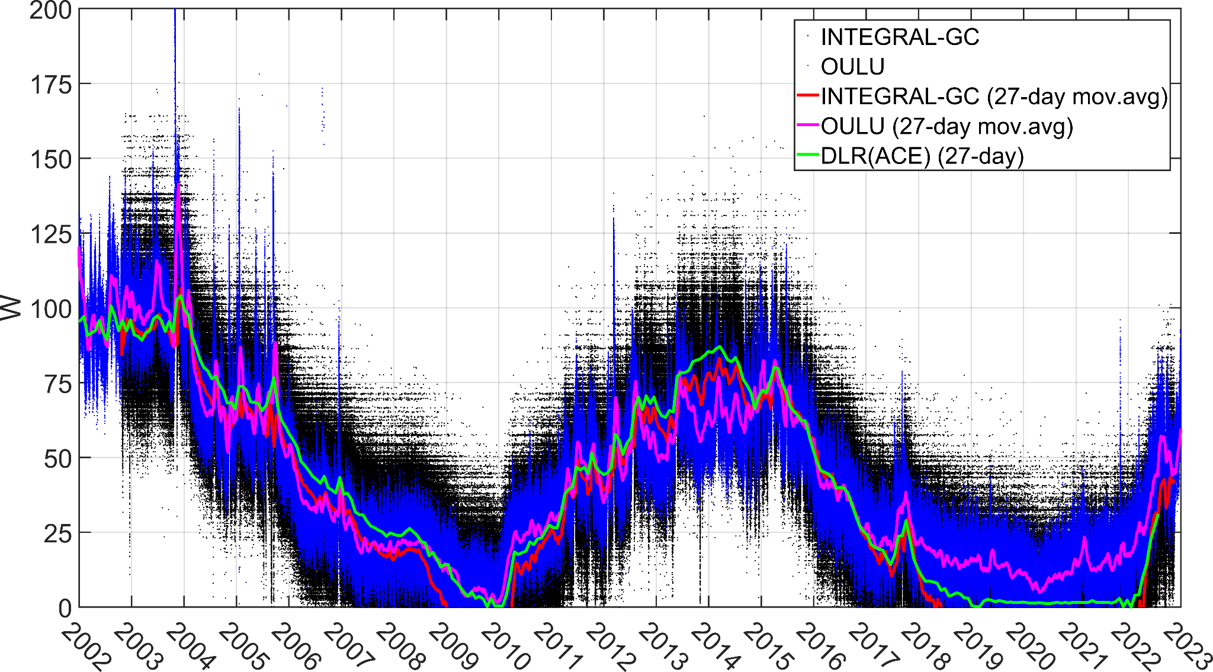
SREM GCRs
Estimation of W values from SREM measurements & flux derivation
Very good agreement with ACE
Solar modulation fully captured
INTEGRAL&PLANCK agree well

Slide 7
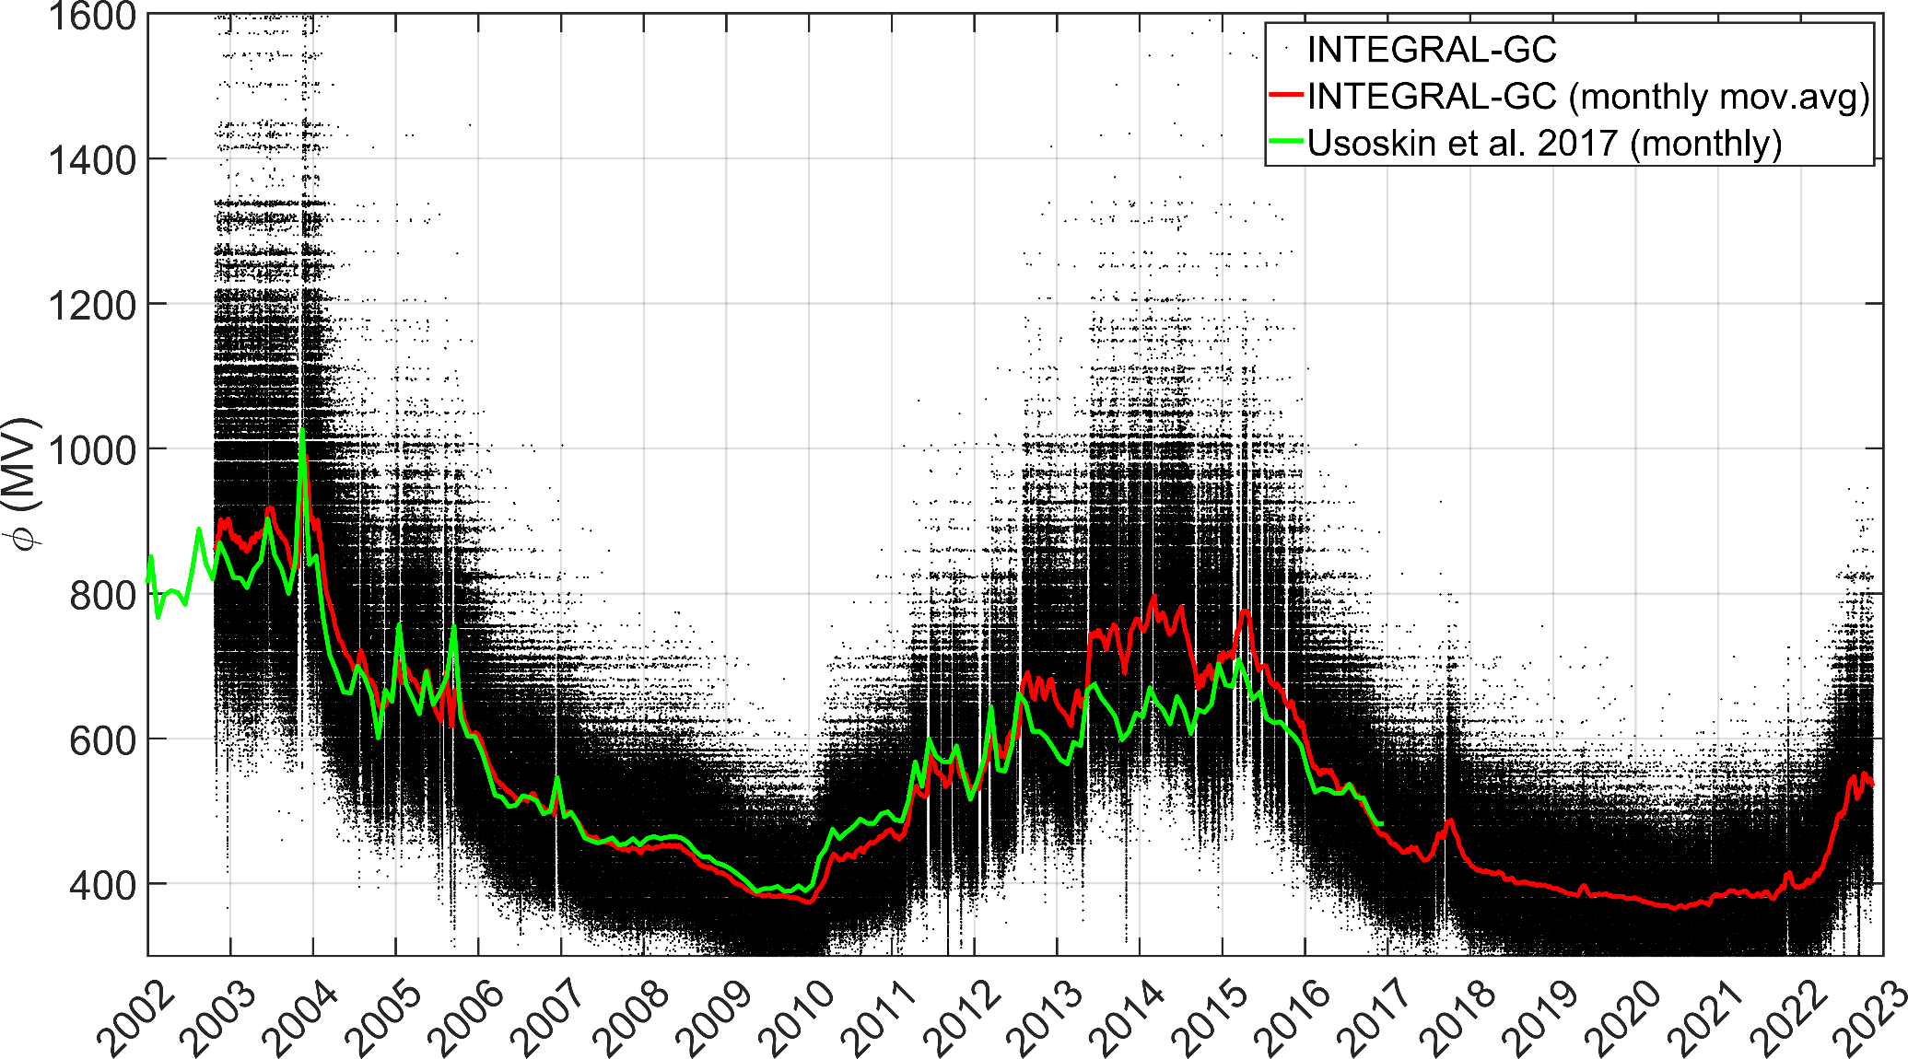
SREM GCRs
Estimation of φ solar modulation potential (Usoskin et al 2017¹ data)
Very good agreement with Usoskin et al. 2017
Solar modulation fully captured
¹Usoskin et al. Heliospheric modulation of cosmic rays during the neutron monitor era:
Calibration using PAMELA data for 2006-2010, 2017 DOI: 10.1002/2016JA023819

Slide 8
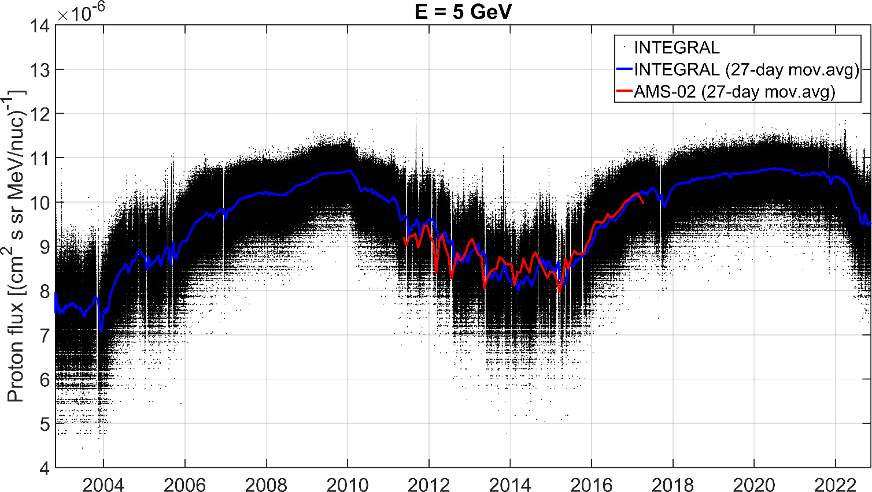
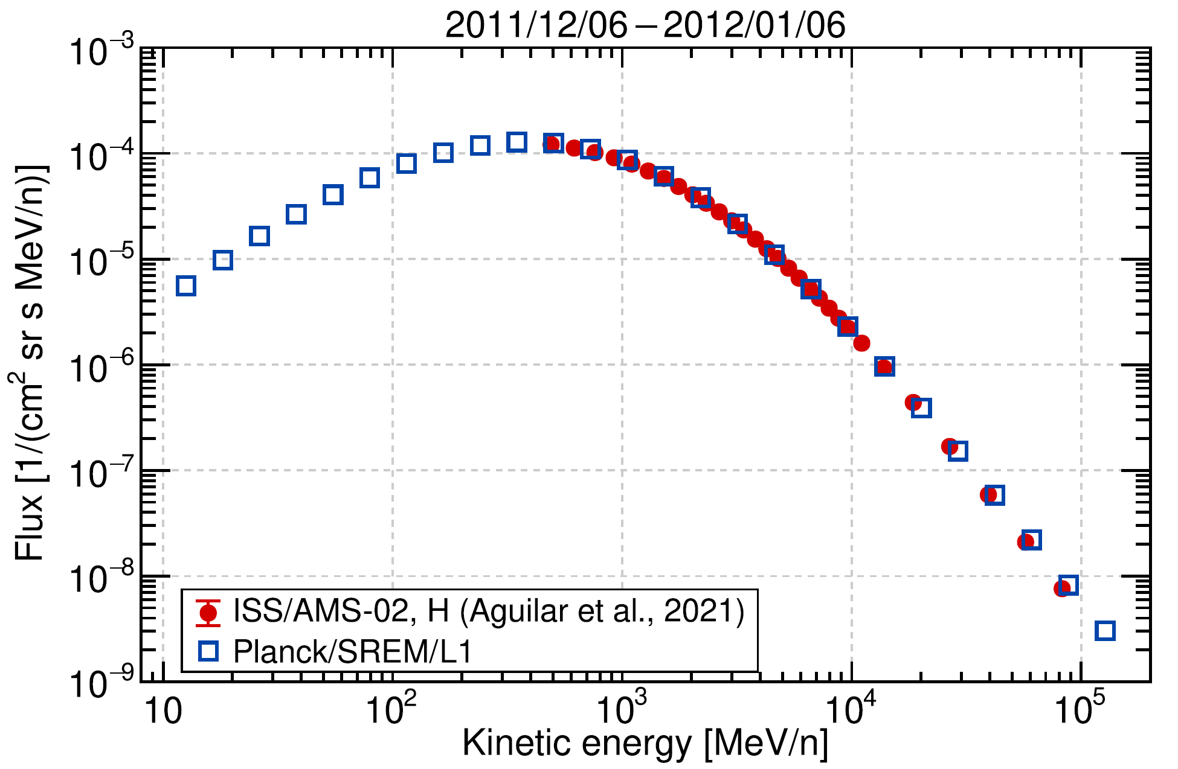
SREM GCRs
Flux comparisons (preliminary) with AMS-02 on board ISS
credit: Claudio Corti & Kathryn Whitman NASA/CCMC

Slide 9
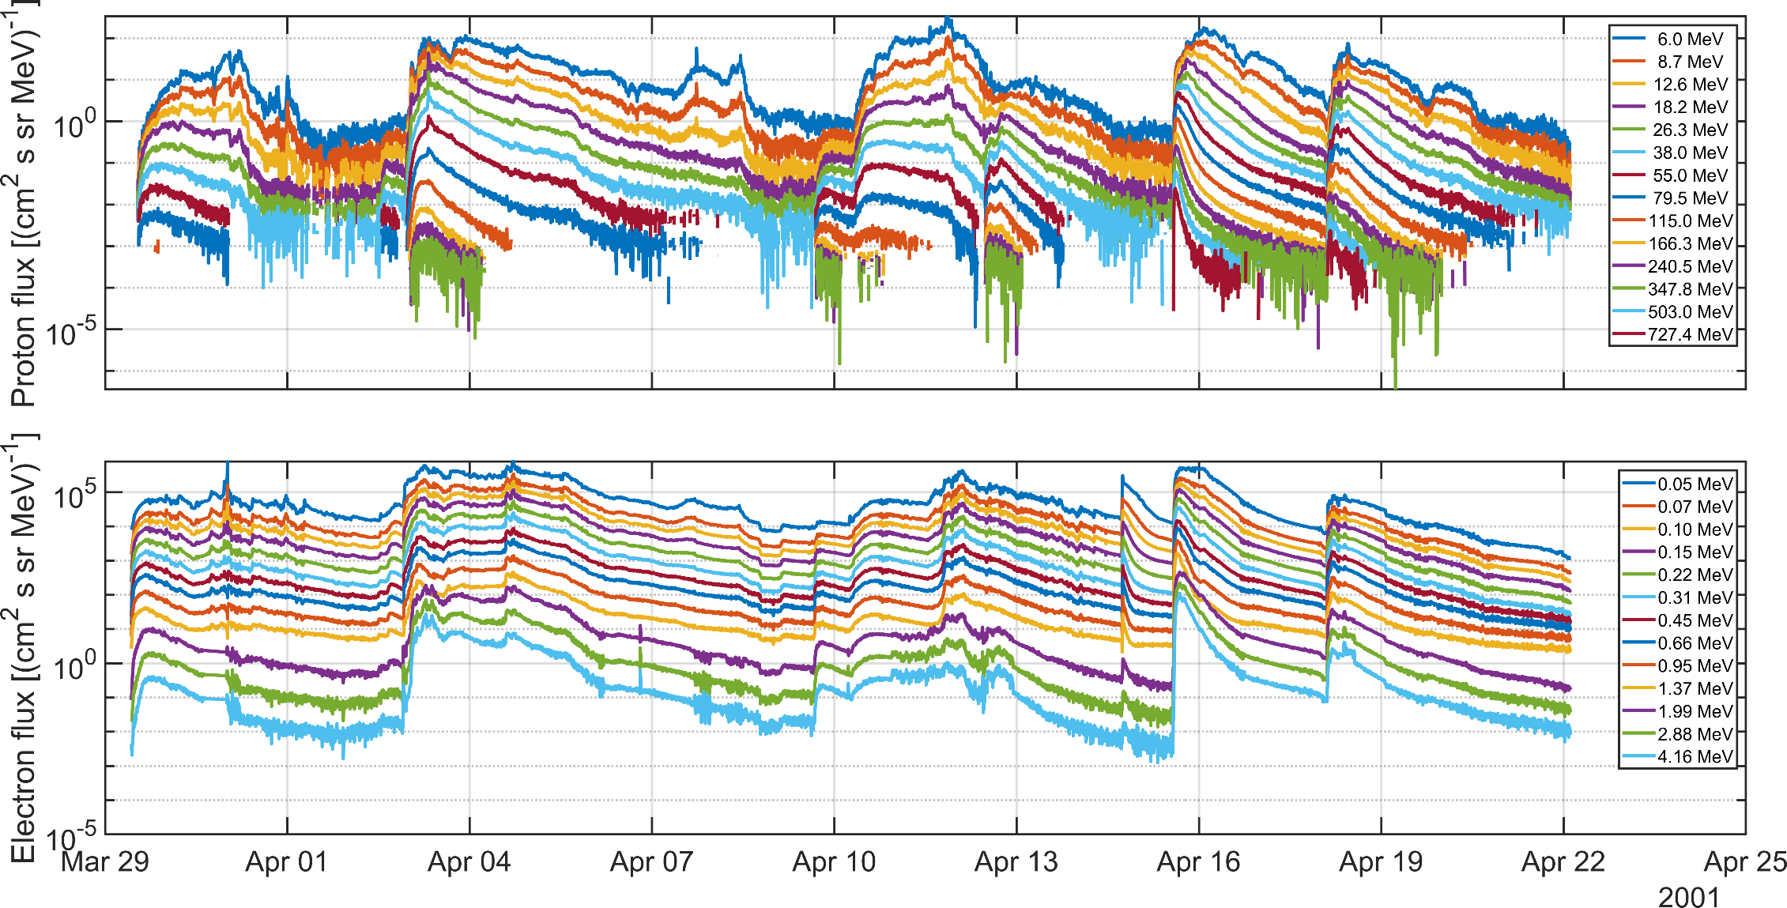
SREM SEPs
INTEGRAL/IREM has measured tens of SEP events in 2002-2022
Derive proton fluxes extending the energy of up to now available products
Take into account GCR spectra for fine-tuned high energy proton unfolding
Investigate simultaneous derivation of solar electrons
Protons: RDSv3.2
Electrons: FIRESPELL database
(cleaned\curated\calibrated IMP8&ACE&SOHO)

Slide 10
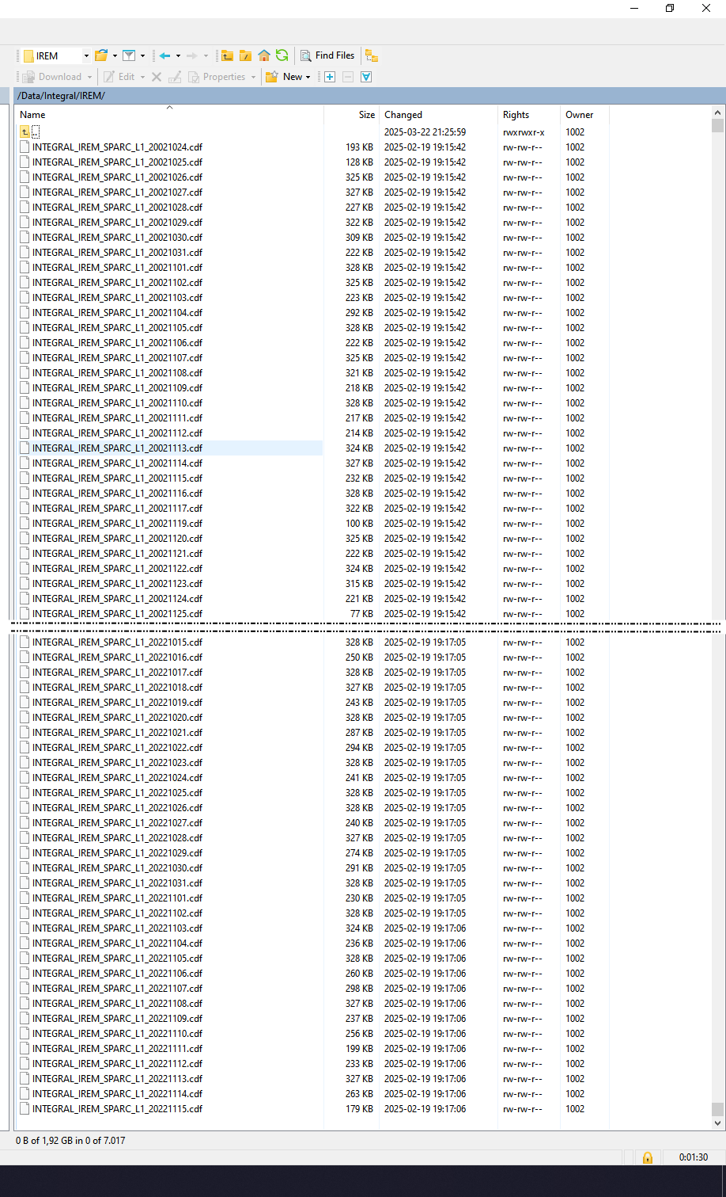
SREM SEPs
IREM/SREM time-series filtered/cleaned/despiked for during events of REL
Measurements unfolded with latest version of in-house developed methodology Gencorum¹
Timeseries joined with GCRs
Production of new datasets for INTEGRAL/IREM and PLANCK/SREM
Comparisons and validations with ESA RDS3.2
¹S. Aminalragia-Giamini et al. Artificial intelligence unfolding for space radiation monitor data 2018 JSWSC DOI: 10.1051/swsc/2018041

Slide 11
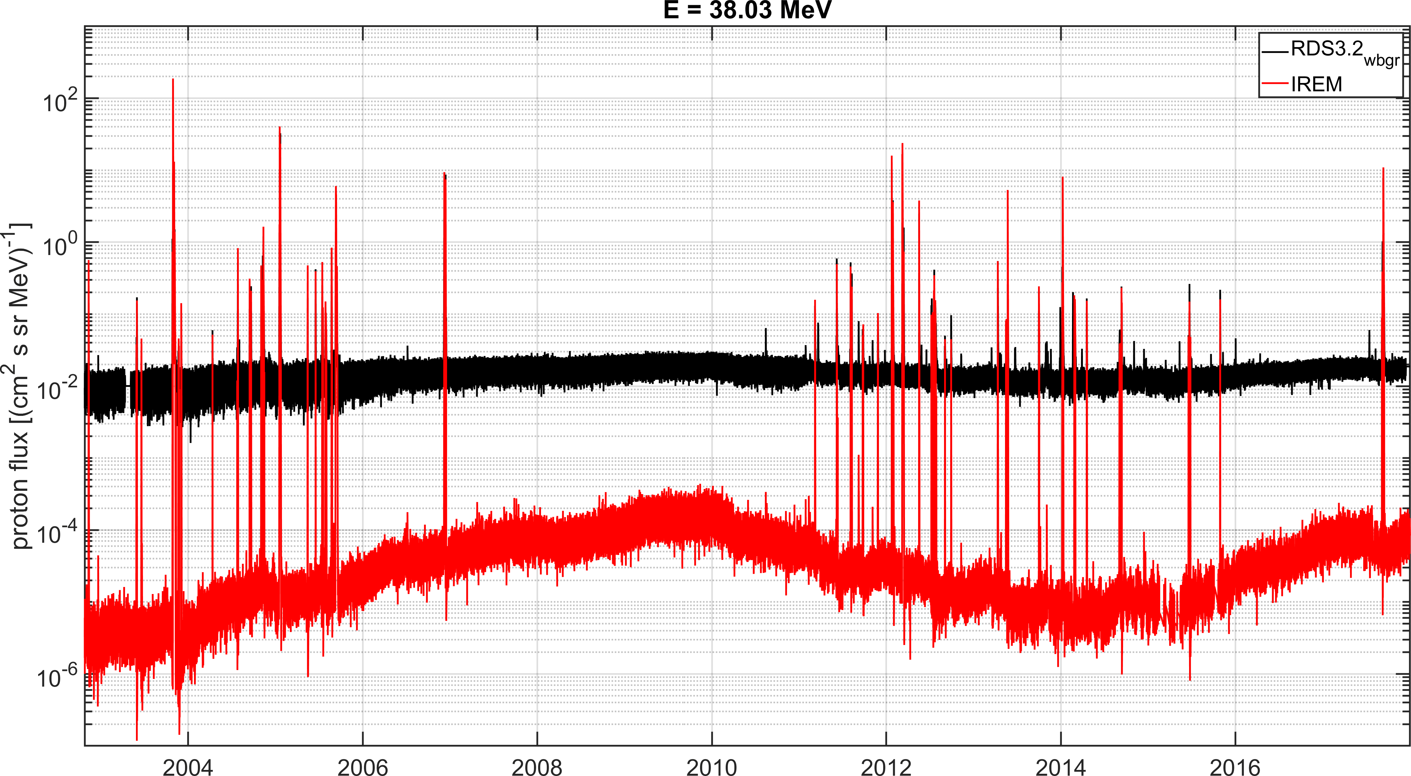
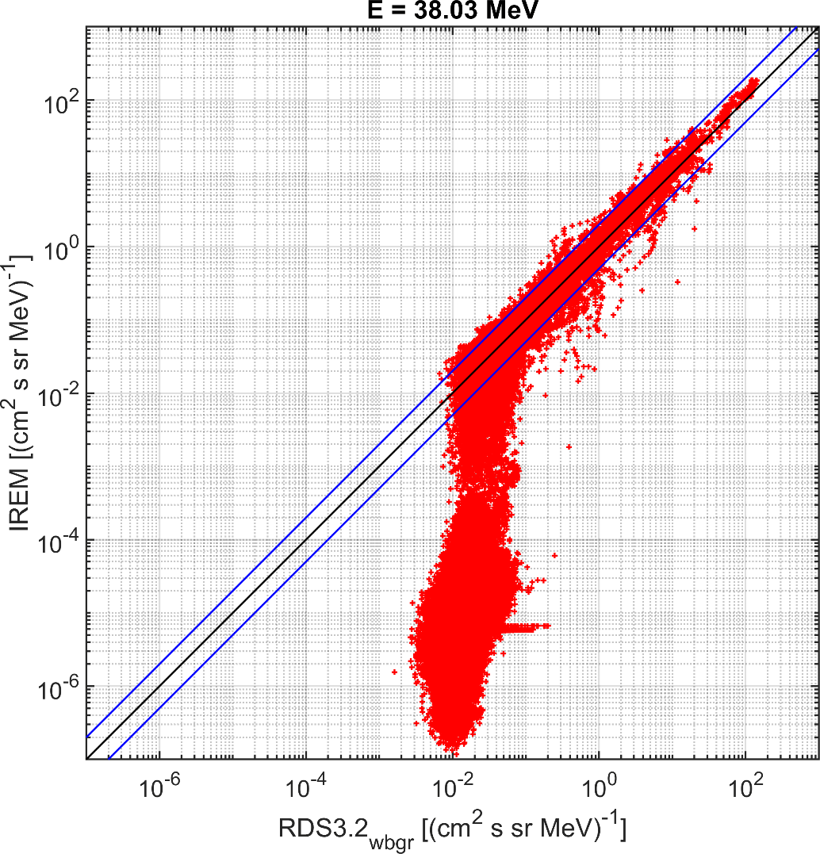
SREM SEPs
Comparisons and validations with ESA RDS3.2

Slide 12
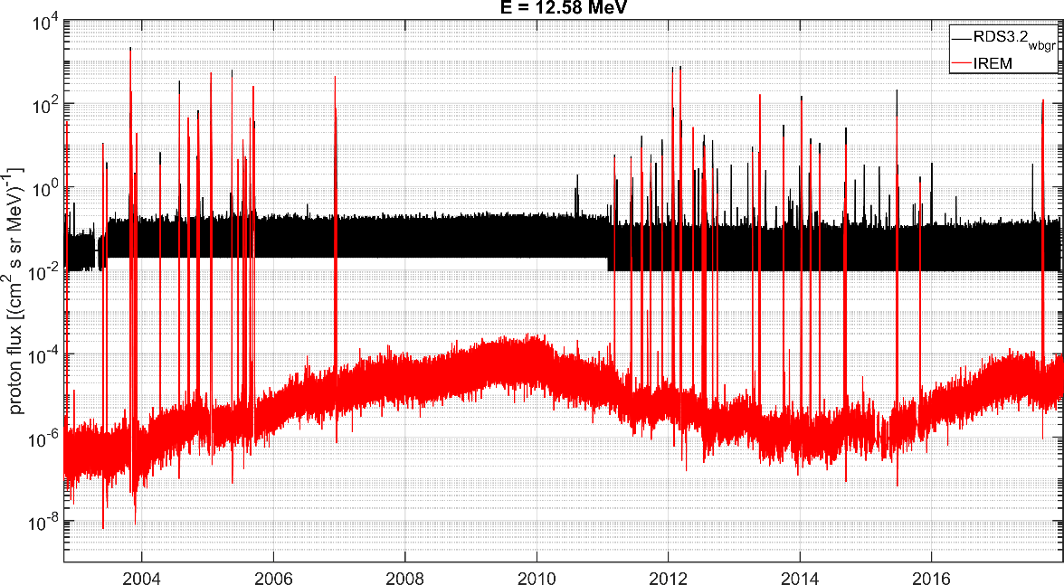
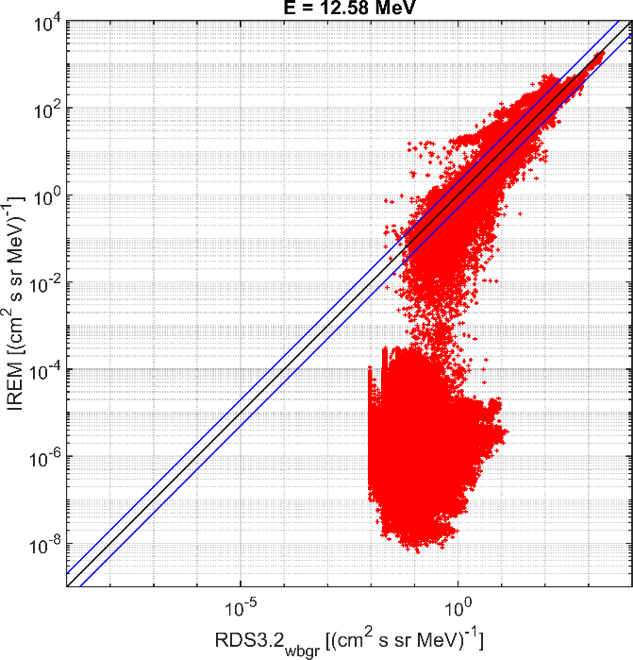
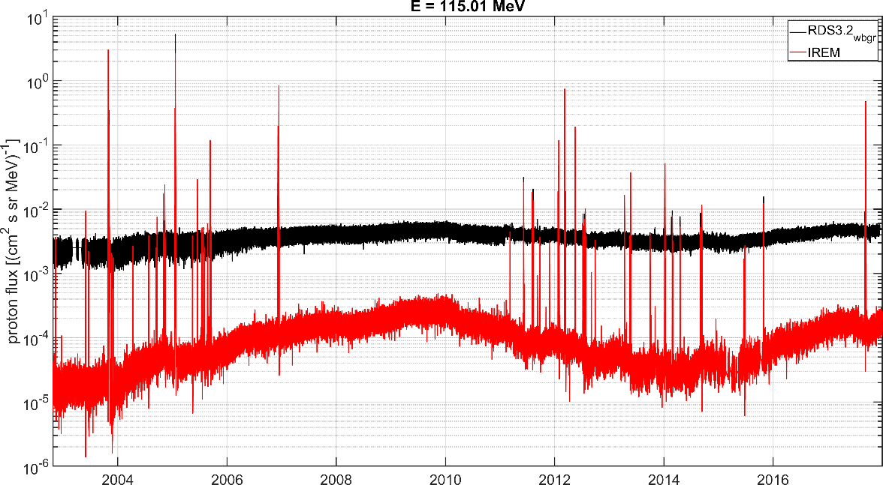
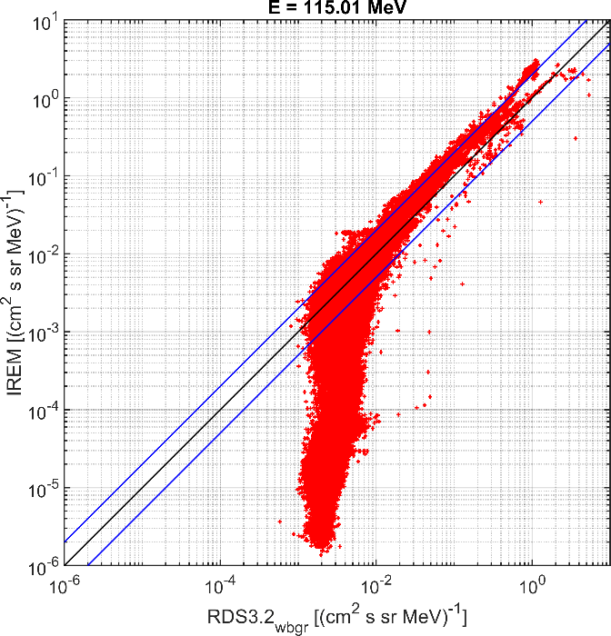
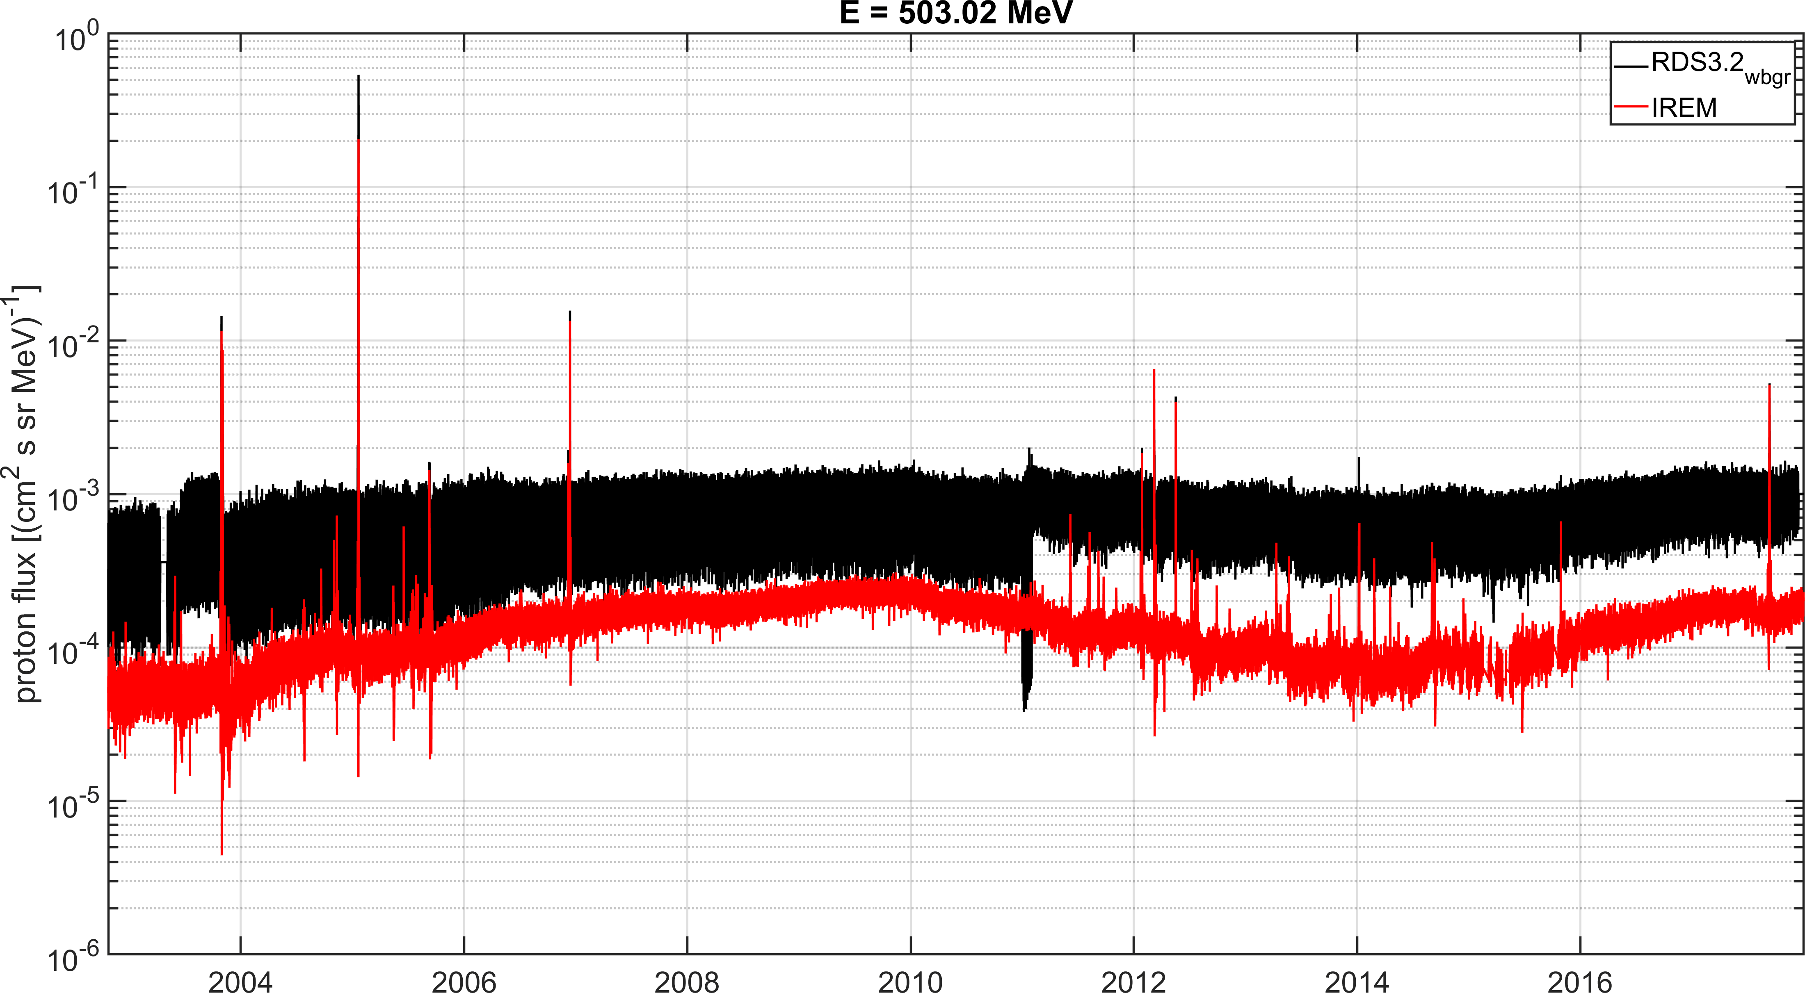
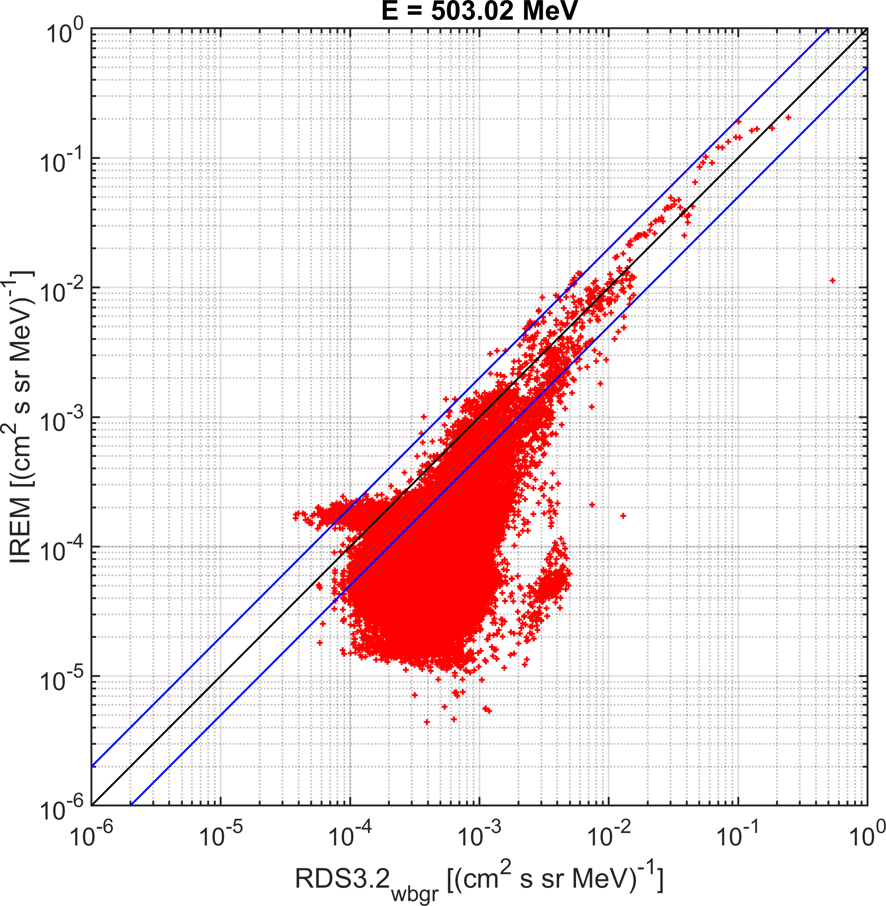
SREM SEPs

Slide 13
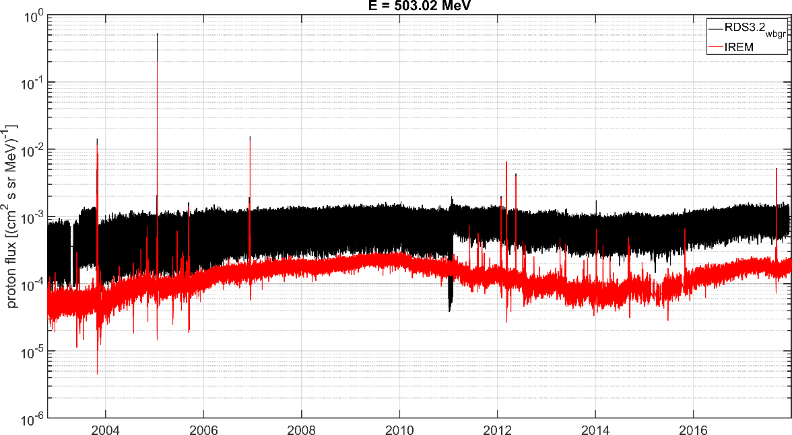
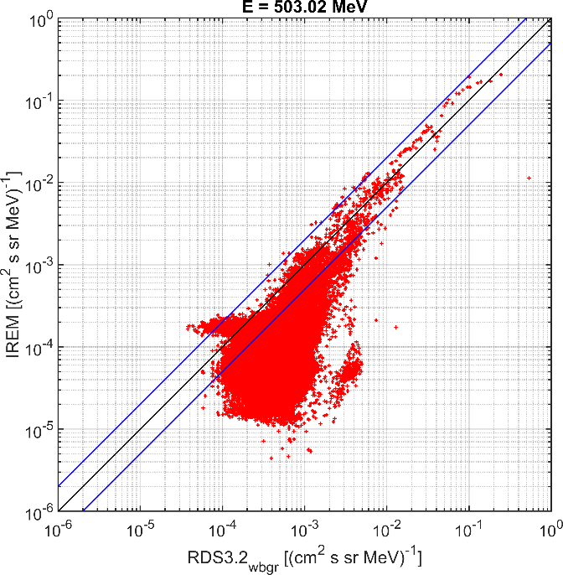
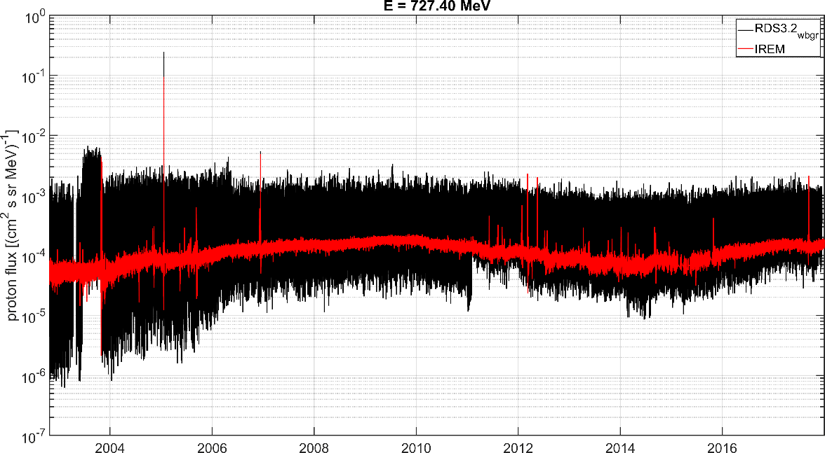
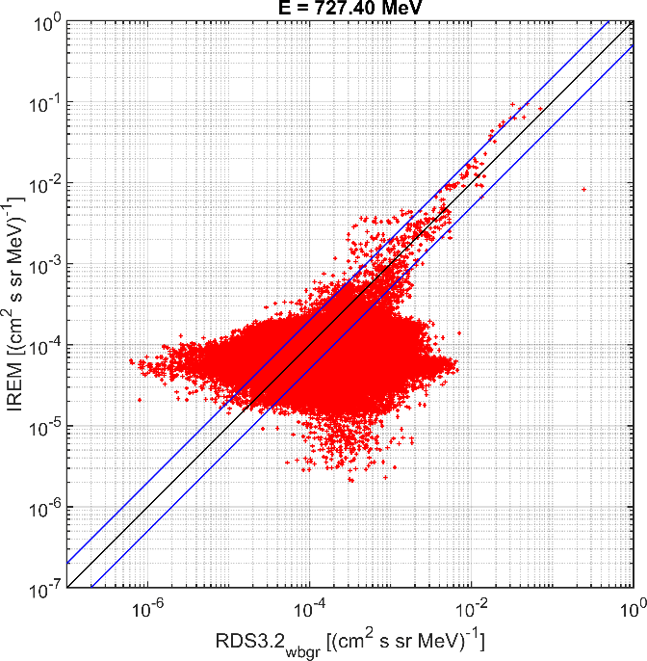
SREM SEPs

Slide 14
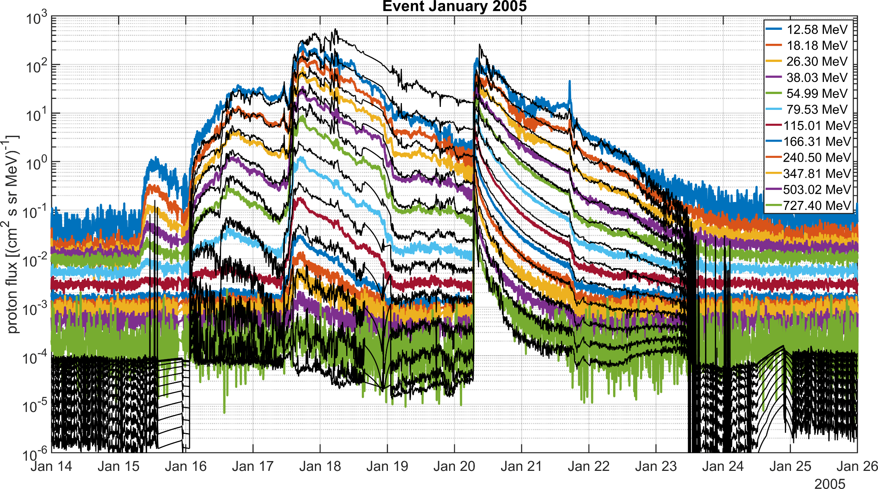
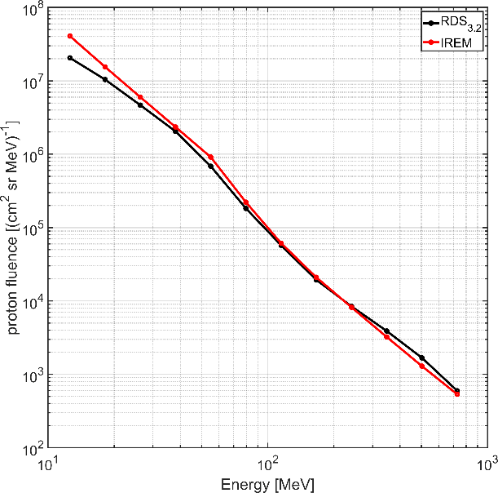
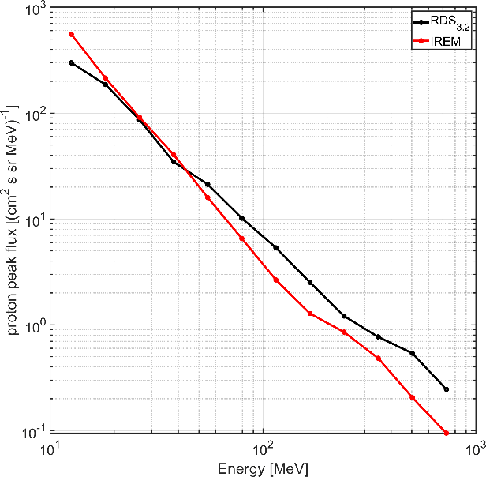
SREM SEPs

Slide 15
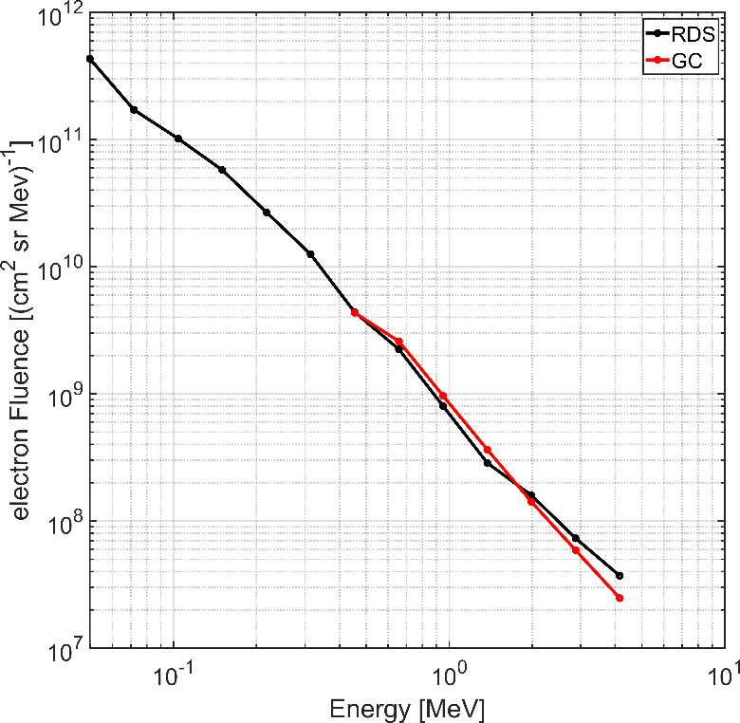
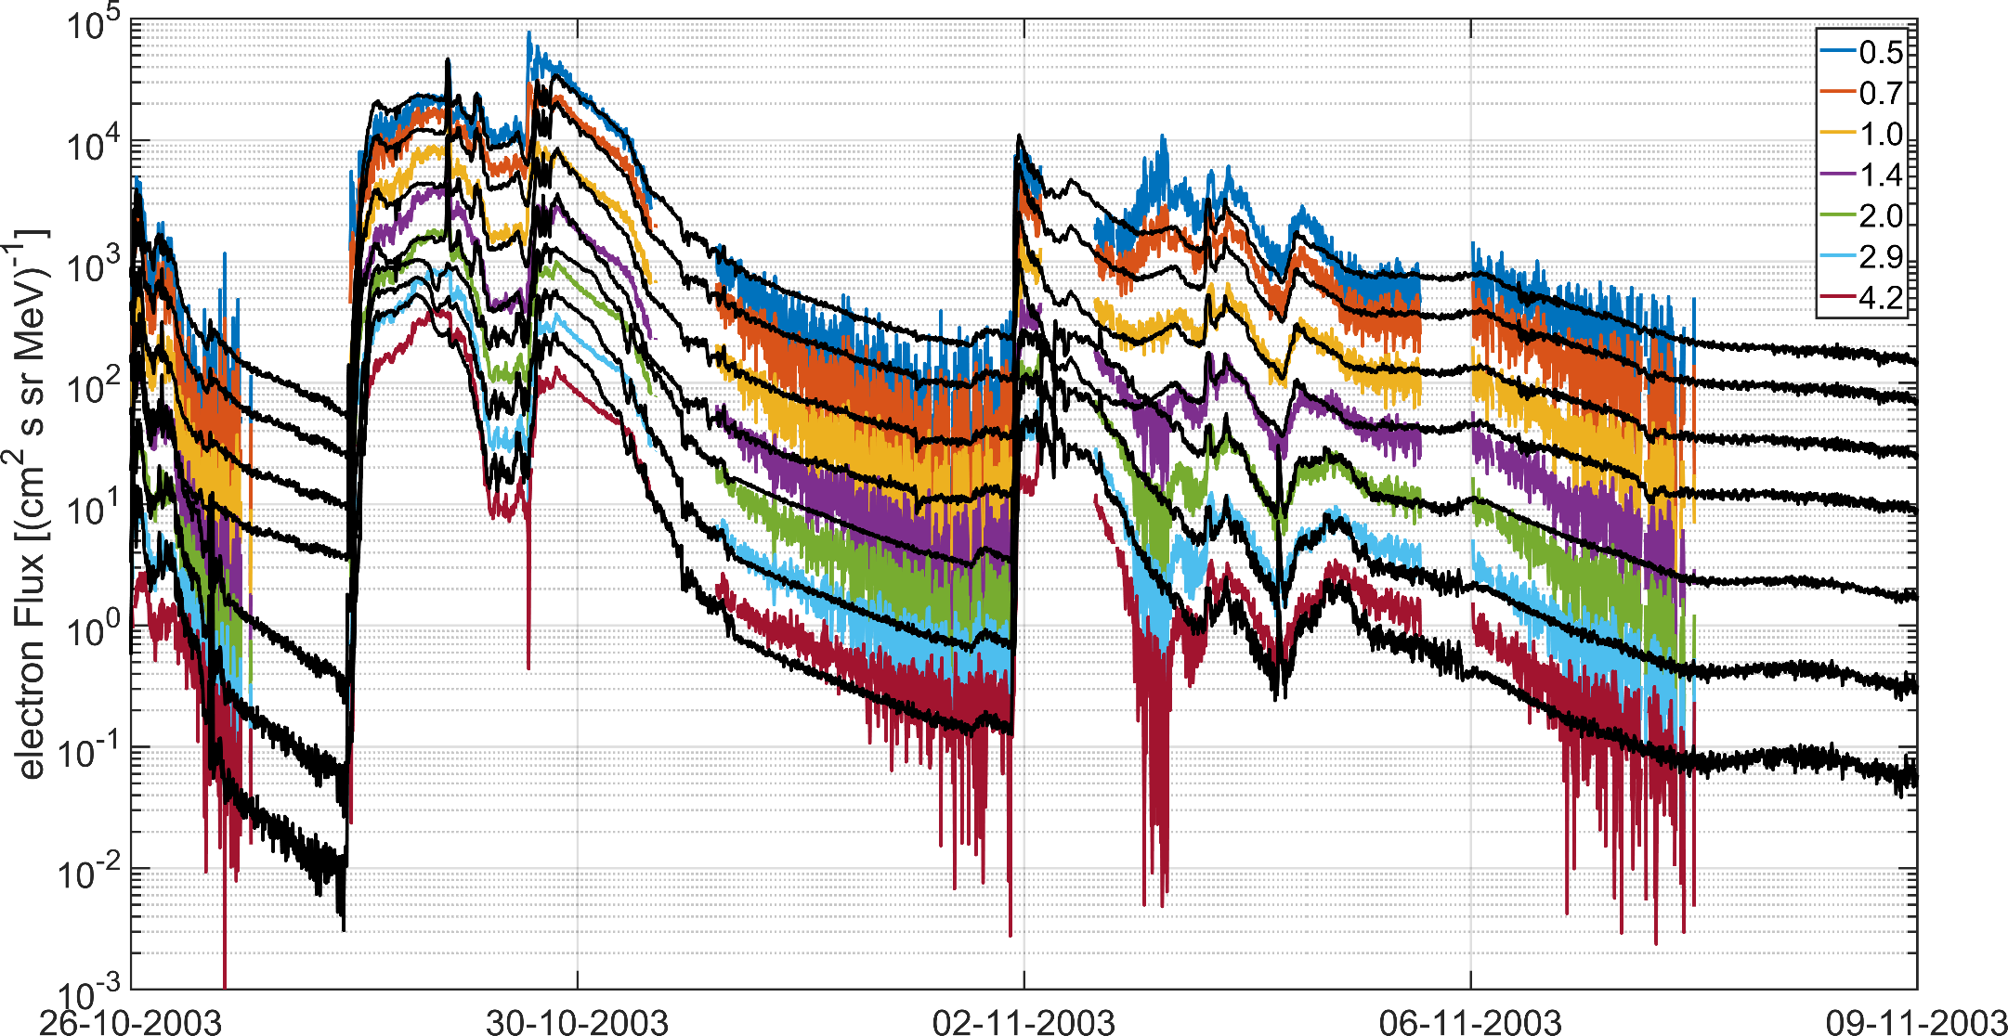
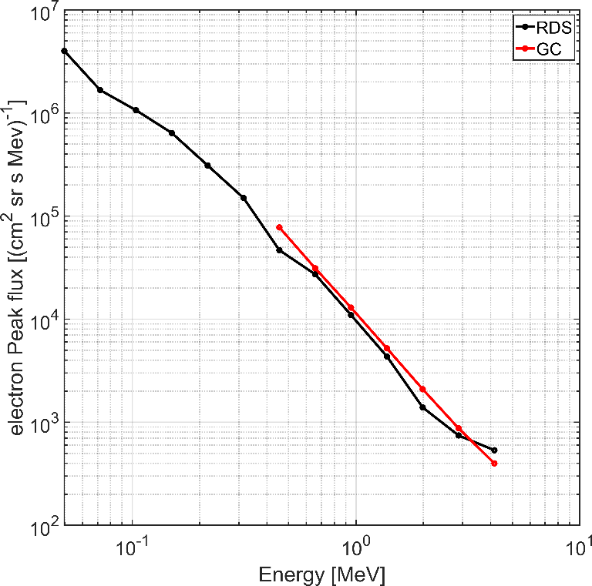
SREM SEPs
INTEGRAL electron fluxes comparison with FIRESPELL Reference Dataset 2003 October Halloween Event fluxes interpolated in time, energy

Slide 16
Key points & discussion
New SREM solar proton and GCR datasets produced – to be made publicly available soon HERSCHEL will follow, looking into ROSETTA – some interesting findings
Solar electrons will be included in future release of the datasets with also slightly extended SEP proton unfolding range
SREM GCR “background” is not background at all – our approach can be translated to other datasets Physical definition of background and improvement on counts-to-fluxes results e.g. RDSv4
IREM until 2029 and SREM unit in Lunar Gateway ERSA for many years – hopefully much more data to come
What happens in magnetotail crossings? Opportunity to study and challenge to distinguish electron enhancements (if any)
High energy RFs are not available for several high abundance elements, e.g. Fe High energy RFs are derived for generic SREM geometry

Slide 17
Back up slides

Slide 18
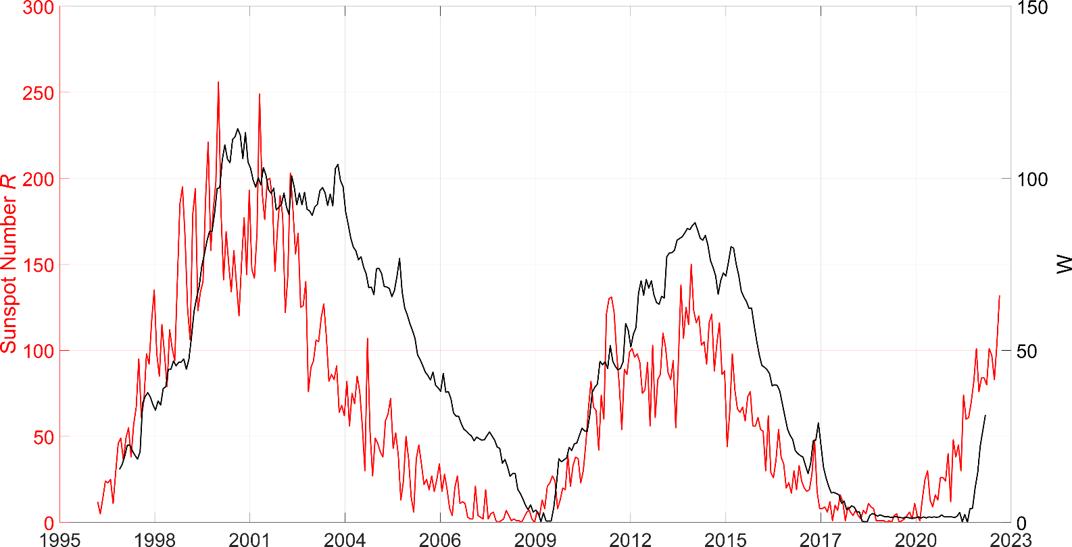
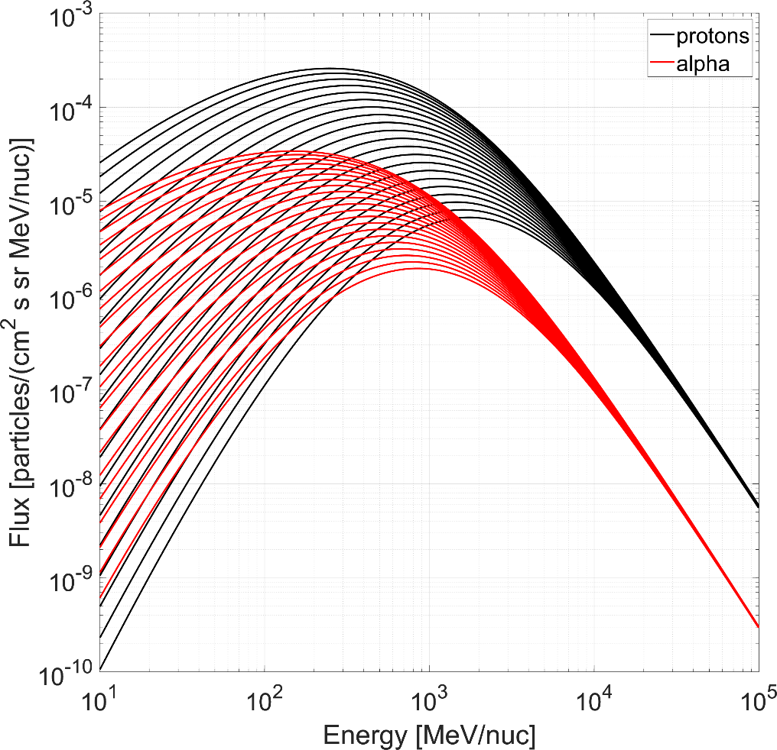
GCRs
Matthiä et al. 2013 A ready-to-use galactic cosmic ray model (DOI: 10.1016/j.asr.2012.09.022)
Adapted from the GCR-ISO 2004 model - validated with BON-10 GCR model
Fluxes for H, He, and Z>2
Single driving parameter W (based on Wolf number) from ACE-CRIS carbon fluxes (27-day) or Oulu NM counts (1-min)
W=0
higher W values
W=350

Slide 19
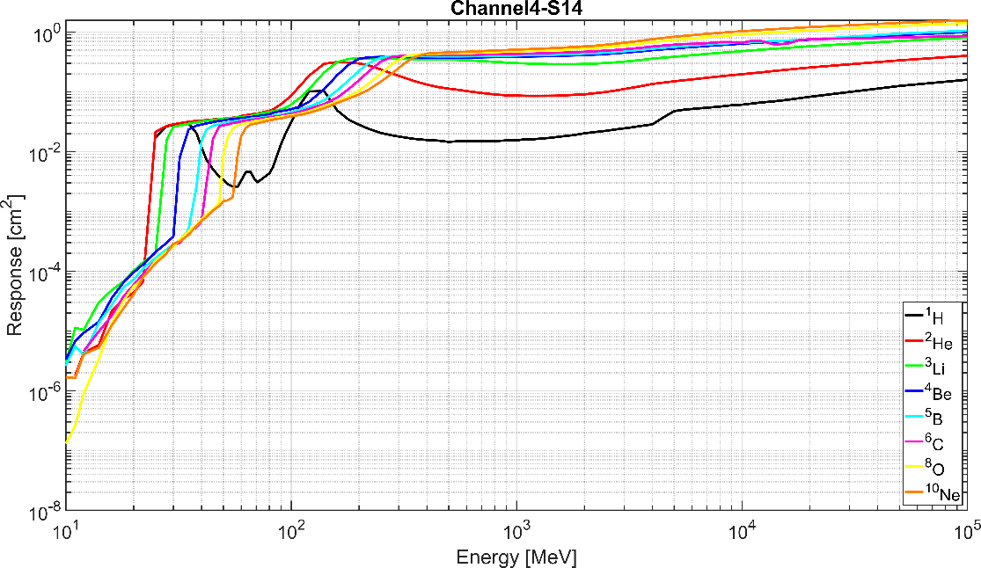
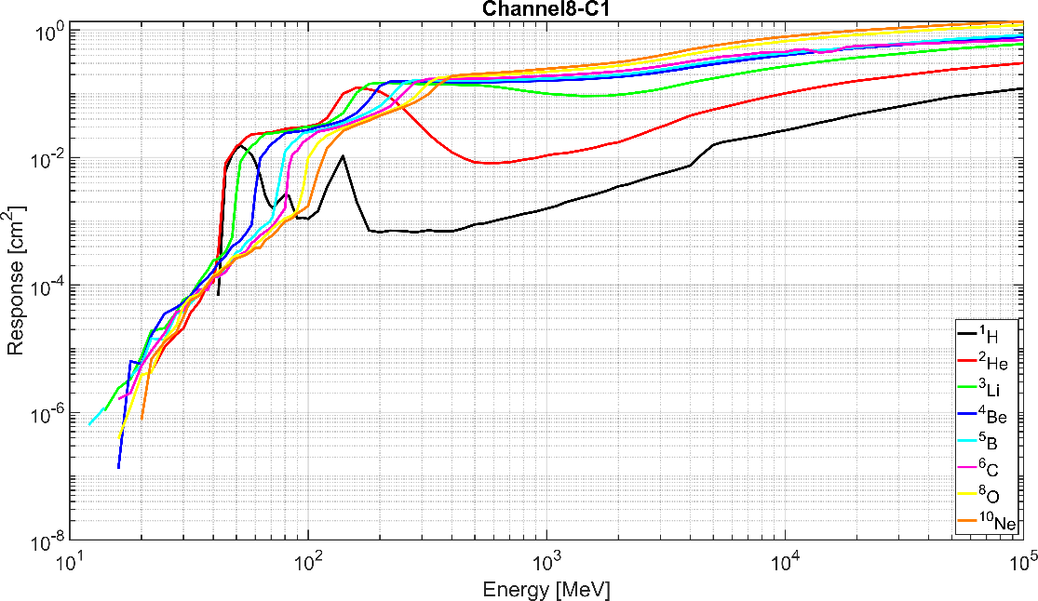
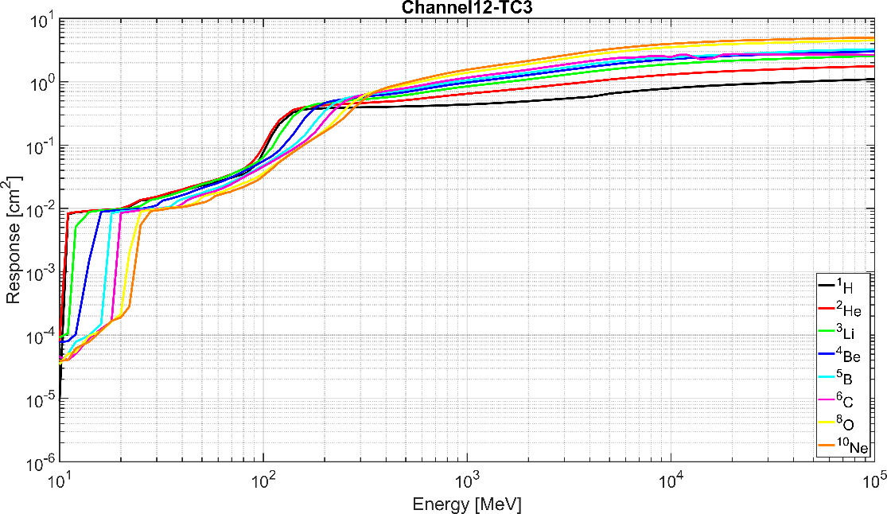
GCRs
SREM response functions extend at least to 100 GeV
Provided by ESA, produced by Hendrick Neumann (Uni. of Oldenburg)

