Slide 1

GREEN-NG, new version of GREEN, based on re-analysis databases
A. Sicard, N. Dahmen, A. Brunet

Slide 2
Plan
Objectives of the project
Reminders of the GREEN model
New approach
Preliminary results
What remains to be done
Conclusion

Slide 3
Objectives of the project
The goal is to develop a new version of the GREEN model : GREEN-NG.
GREEN-NG will be based on a re-analysis database derived from Salammbô + Data assimilation using the climate reanalysis approach.
GREEN-NG will be a mean model (yearly average) with a solar cycle dependency like GREEN
The objective is that GREEN-NG will not be a patchwork of several local models in order to avoid discontinuities at the interfaces of those models thanks to the spatial and temporal continuity of the reanalysis database distributions.
➔ Only GREEN-NG for electrons will be presented here

Slide 4
Reminders of the GREEN model
ONERA has developed many local models since many years (IGE-2006, MEO-V2, OZONE, Slot model, OPAL,…)
Those local models are considered more accurate than the reference global models AE8 and AP8
GREEN is a global model of electrons and protons in the Earth radiation belts. It is based on AE8 and AP8 by default and all the local models developed by ONERA when they are available. GREEN is a mean model and depends on the year of the solar cycle .
The main goal of GREEN was to meet the space industry’s needs for the design of their spacecraft

Slide 5
Reminders of the GREEN model
Synthesis of models contained in GREEN (electron)
Model | Energy range | Coordinate range | Magnetic field model | Solar cycle dependence
AE8 | 0.04 – 7 MeV | L=1.2 - 11 | Jensen & Cain | MIN MAX
SLOT model | 0.1 – 3 MeV | L*=2 - 4 | IGRF + O.P Quiet | YES
IGE-2006 | 0.001 - 5.2 MeV | L*~6.6 | IGRF + O.P Quiet | YES
OZONE | 0.3 – 10 MeV | L*> 4 | IGRF + O.P Quiet | YES
Low Energy | 0.2 keV – 30 keV | L > 3 | IGRF + O.P Quiet | NO
Models contained in GREEN (electron)
Energy and spatial coverage of each local model
Models are not valid for mission duration less than 1 year

Slide 6
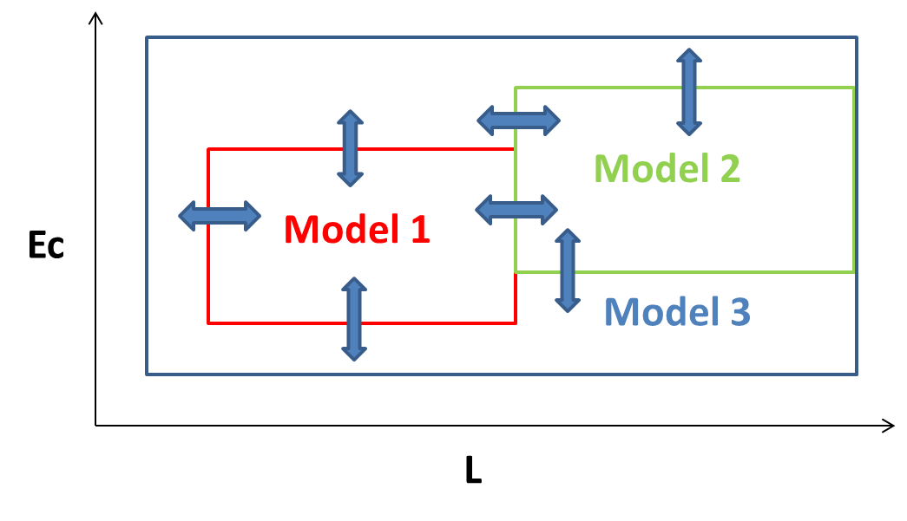
Reminders of the GREEN model
Synthesis of models contained in GREEN (electron)
Discontinuities at the interface of each sub-model
0
0.25
0.50
0.75
1
Ec
1
X
0.75
0.50
0.25
0
L
$$flux= \frac{{flux}_{grey}∗ {index}_{grey}+{flux}_{red}∗ {index}_{red}}{indexgrey+{index}_{red}}$$

Slide 7
Smoothing of discontinuities
Example of results of GREEN
Without smoothing of discontinuities
With smoothing of discontinuities

Slide 8





New approach for GREEN-NG
Re-analysis Database
State of the art physical description of Salammbô
Radiation diffusion | Boscher et al. 2018
W-P interactions | WAPI calculations
Frictions Collisions | using MSIS86
Dropouts | Herrera et al. 2016
Boundary conditions | POES data based BC
2000-2014 | HEO: HEO3/dsu MEO: NS33/bdd2, NS54/cxd2r GEO: LANL97A/sopa-esp, LANL02A/sopa-esp, GOES-12&13/maedpd
2014-2022 | HEO: RBSP-A/ect, RBSP-B/ect, ARASE/xep MEO: NS54/cxd2r, NS72/cxd2f GEO: GOES-15/maedpd & sem
Salammbô EnKF
New numerical solver
Mesh
Ensemble size
Computing time per year
Assimilated data
Retained physical description
34 x 25 x 34
100
12h
Solar cycle long simulation
Median and ensemble PSD values
Cycle 23
Cycle 24
Cycle 25
Low alt.
BC
22 years
Low altitude model
from ONERA at 1500km
2000
2022
Reanalysis database

Slide 9
New approach for GREEN-NG
Examples of fluxes providing by the re-analysis database (at equator)
500 keV 2014-2017
3 MeV 2000-2002
2 MeV 2002-2005
3 MeV 2014-2017
➔ For more details about the techniques for obtaining this kind of re-analysis database see the presentation from Nour Dahmen on Thursday morning

Slide 10
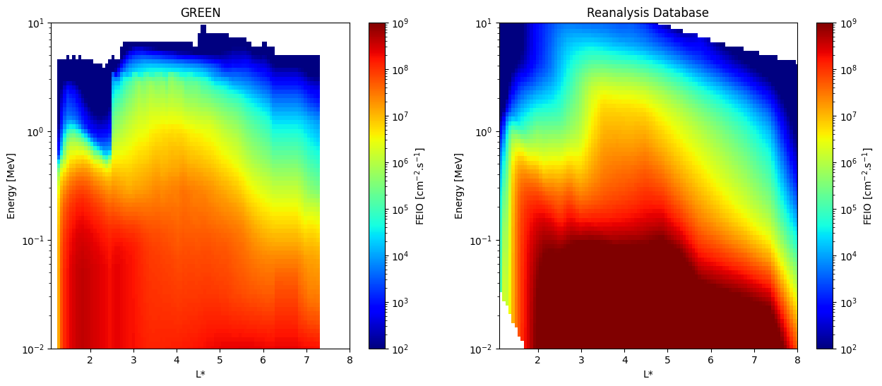
New approach for GREEN-NG
Use of the re-analysis database (PSD on a 4D grid (Ec, y, L, time))
Calculation of the yearly averaged omnidirectional fluxes (from 2000 to 2021)
Calculation of the omnidirectional fluxes for each year of the 11 years of the solar cycle (from year=-6 to year=4 with year=0 being the minimum of the solar cycle) ➔ for example fluxes for year=1 is the linear average of yearly fluxes from 2010 and 2020.
➔ Omnidirectional fluxes on a 4D Grid (Ec, y, L, year of the solar cycle)
Example of comparison between GREEN and the re-analysis database for year=-4 of the solar cycle (at equator)
Pros:
No patchwork of models
No need for smoothing
A physics based model
Cons:
The energy coverage where Salammbô is valid is between 0.3 and 2 MeV

Slide 11
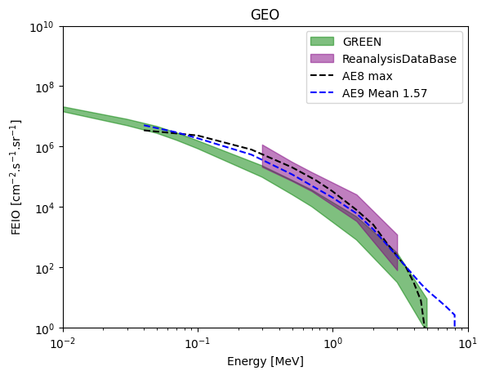
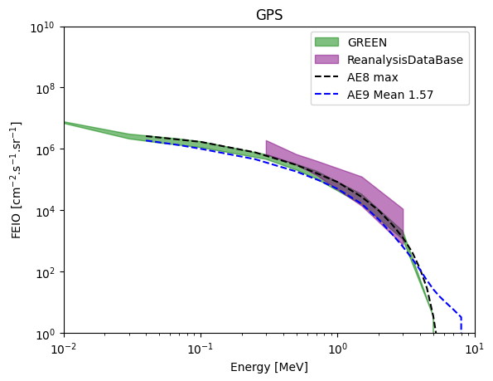
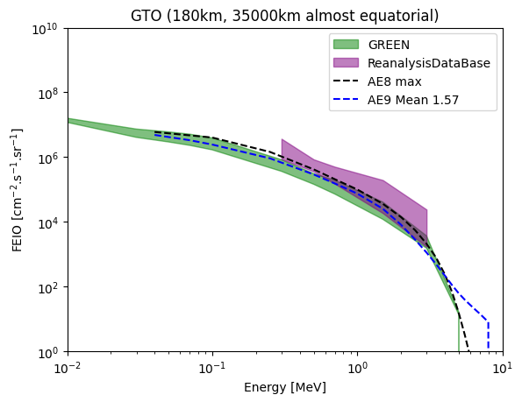
New approach for GREEN-NG
Mean Integral flux along orbits: comparison between reanalysis database (in the validity range of Salammbô) and GREEN, AE8 and AE9
Quite good agreement between the re-analysis database and other models
However, the idea of GREEN-NG is not to throw away the local models based on decades of measurements in which we have confidence (IGE-2006 or the Slot model for example)
Pending new versions of the reanalysis database, more refined and more accurate, correction factors can be applied to reproduce fluxes of these local models contained in GREEN.

Slide 12
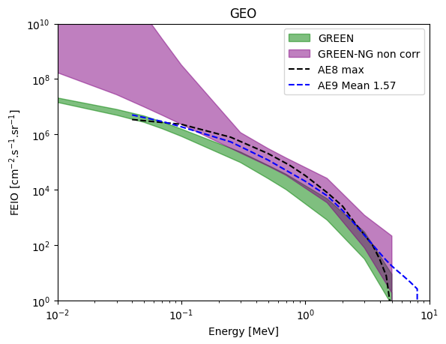
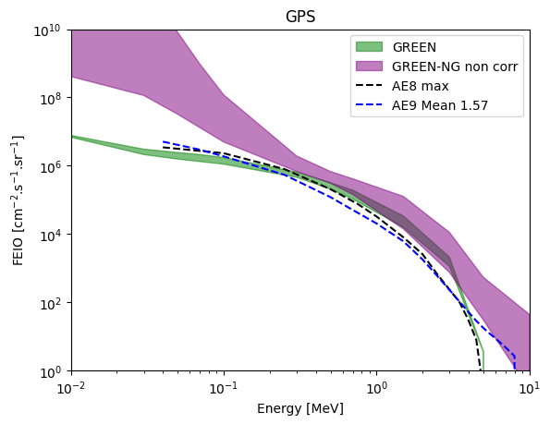
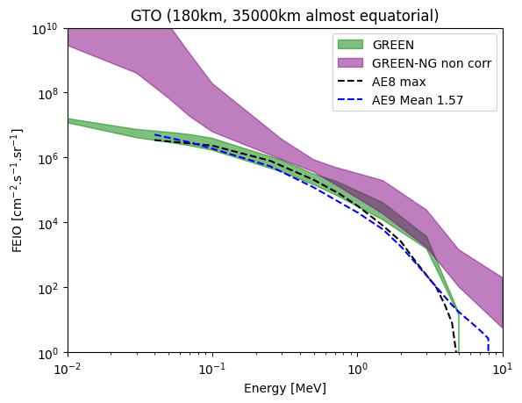
New approach for GREEN-NG
Mean Integral flux along orbits: comparison between reanalysis database and GREEN, AE8 and AE9
Moreover, GREEN provides fluxes from 1 keV to nearly 5 MeV
The reanalysis database is not good outside the energy range 0.3-2 MeV
Pending new versions of the reanalysis database, more refined and more accurate, correction factors have to be applied to reproduce fluxes of the local models for energies >2 MeV and <0.3 MeV.

Slide 13
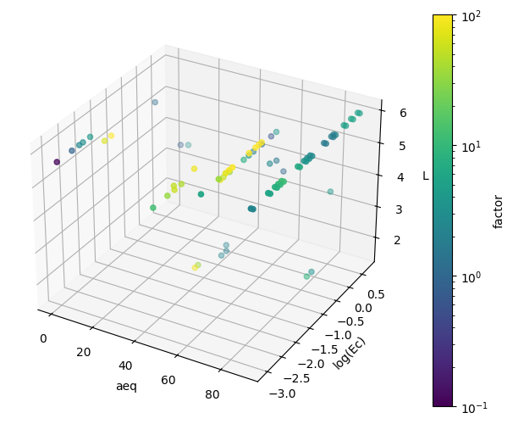
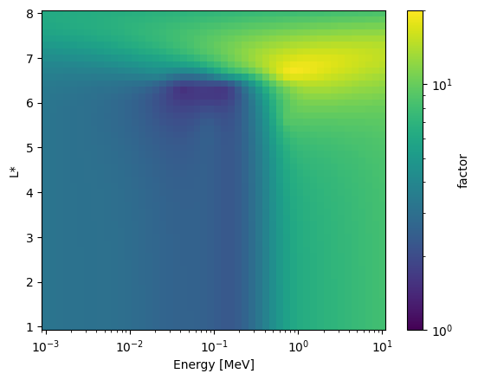
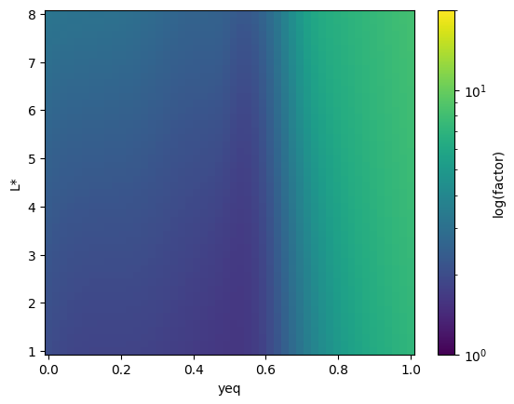
New approach for GREEN-NG
Correction of the re-analysis database (until a better version arrives….soon)
We decide to correct at some points this re-analysis database to obtain nearly the same fluxes that those provided by the local models on famous orbits like GEO, GTO and MEO.
For each of the three orbits (GEO, MEO, GTO) and each year of the solar cycle:
    mean differential spectrum is calculated with GREEN and with the re-analysis database
    ratio between both spectrum is calculated
    This ratio is applied on the re-analysis database at a given spatial location (y,L) where the fluence is the highest.
    Factor is interpolated in the full grid
Near equator
At 1 MeV

Slide 14
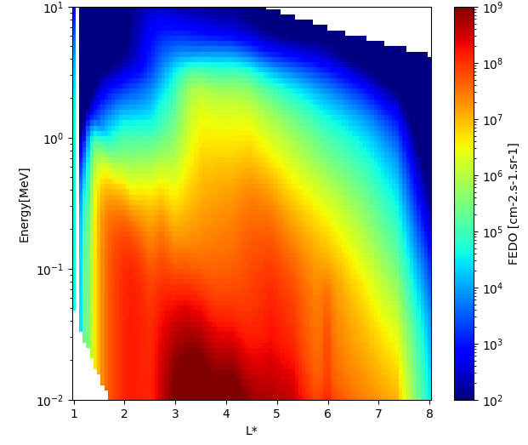
New approach for GREEN-NG
Comparison between GREEN, reanalysis database and corrected reanalysis database
➔ Example of year=-4 of the solar cycle (at equator)
Reanalysis database corrected

Slide 15
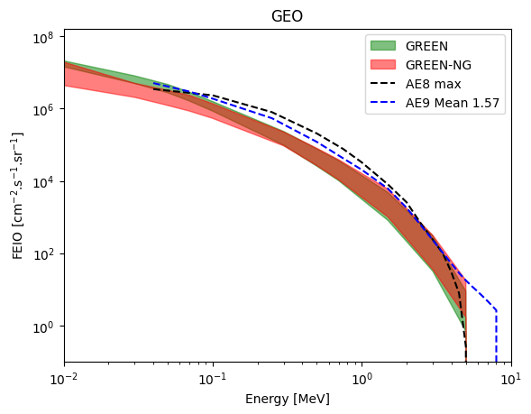
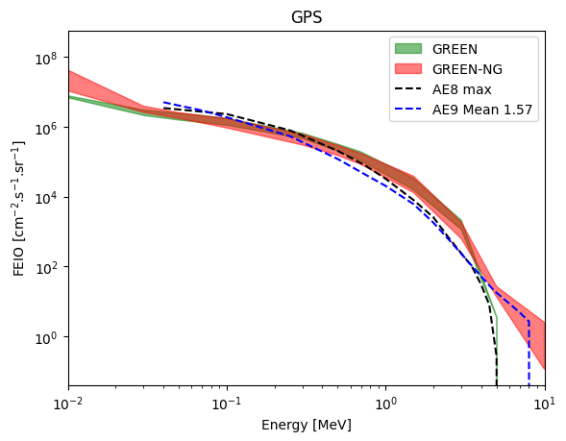
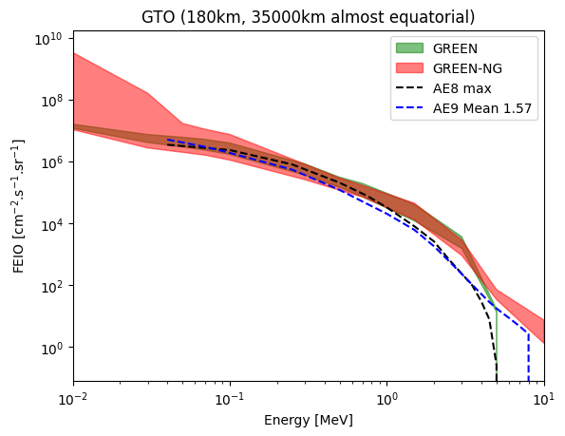
Preliminary results
Mean Integral flux along orbits: comparison between GREEN-NG (reanalysis database with correction) and GREEN, AE8 and AE9
➔ The envelope corresponds to the extent of the mean fluxes over the 11 years of the solar cycle (it does not represents the dynamics from one solar cycle to another)
15

Slide 16
Conclusion
Work still to be done:
Improve the re-analysis database (a new version will be used very soon, see Nour Dahmen) in order to remove in the end the correction factors
Develop a re-analysis database for protons
Improve the GREEN-NG tool so that it can be easily integrated into OMERE
Conclusion:
GREEN-NG is a mean global model valid for mission longer than one year
Like GREEN, GREEN-NG depends on the year of the solar cycle
GREEN-NG is based on the physical model Salammbô + data assimilation and is corrected to reproduce reference models as IGE-2006 in GEO.
➔ GREEN-NG's greatest advantage is that it is not a patchwork of models and therefore has no discontinuities
16

