Slide 1
Modeling the Internal Redistribution of Earth's Proton Belt by Interplanetary Shocks
Alexander Lozinski Atmospheric & Oceanic Sciences, UCLA
Tuesday 20th May 2025
with coauthors Adam C. Kellerman, Jacob Bortnik, Richard B. Horne, Ravindra T. Desai, Sarah A. Glauert

Slide 2
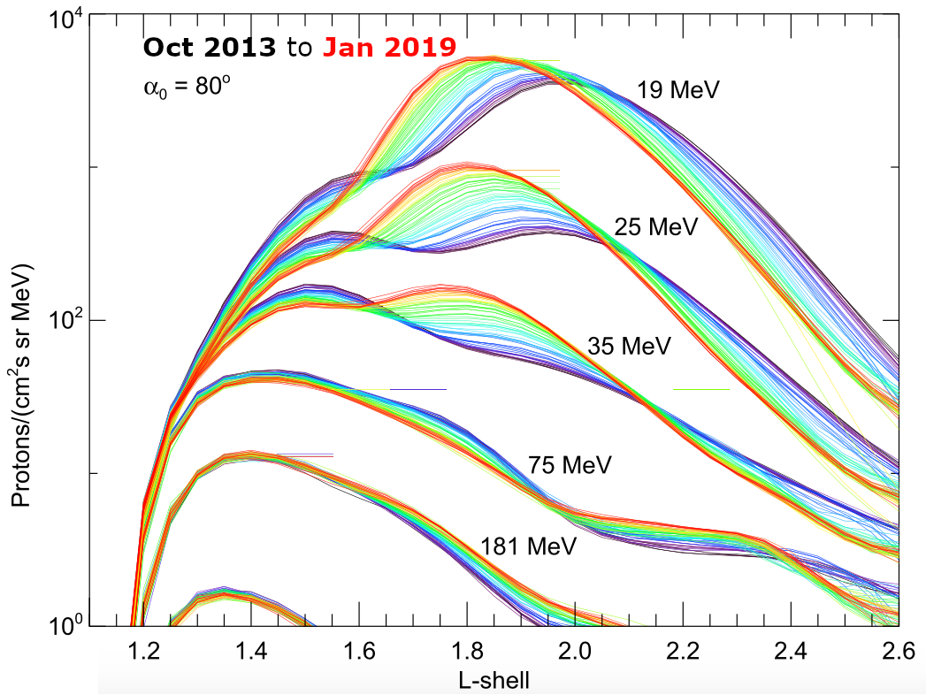
Trapped protons
Origins:
Cosmic Ray Albedo Neutron Decay (Singer, 1958)
The sun, via injection and trapping
from Selesnick & Albert 2019 (modified): proton intensity versus L, α₀ = 80°, ~5 years
Incoming GCR spectrum (H, He)
j_{n}
Notes:
Internal source of ≳30MeV protons at L≲1.3
Beta decay into proton
for consecutive color-coded monthly averages.

Slide 3
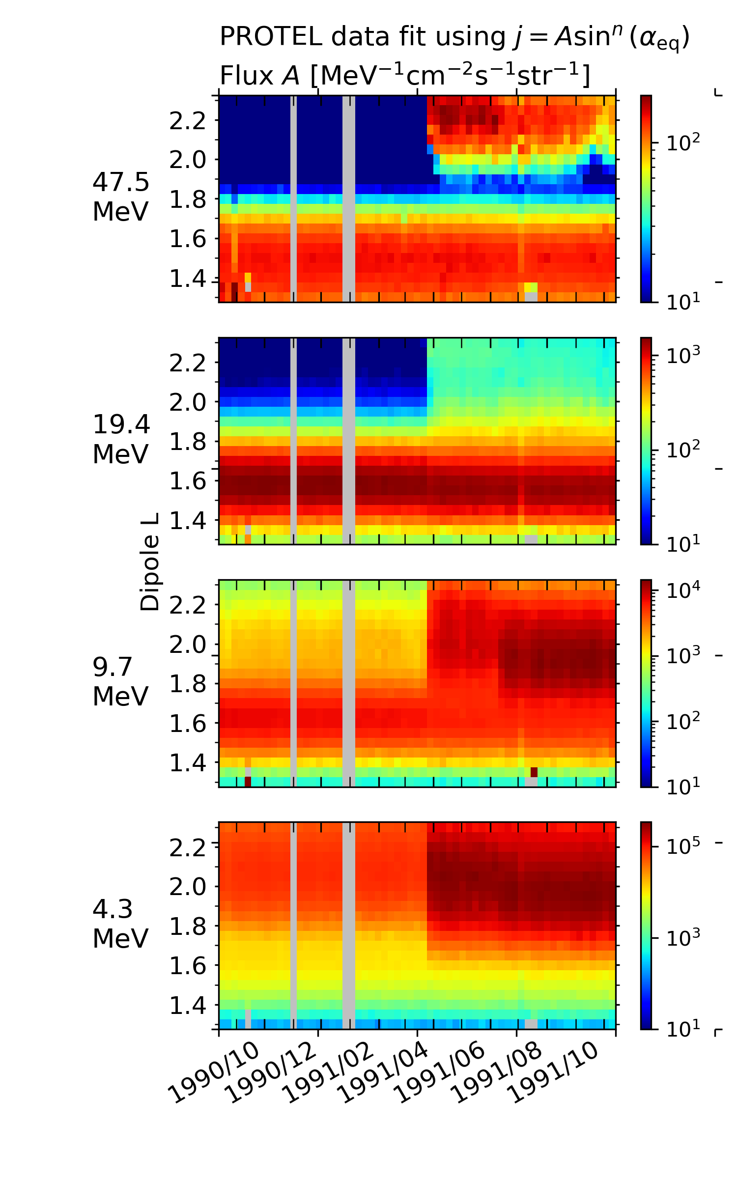
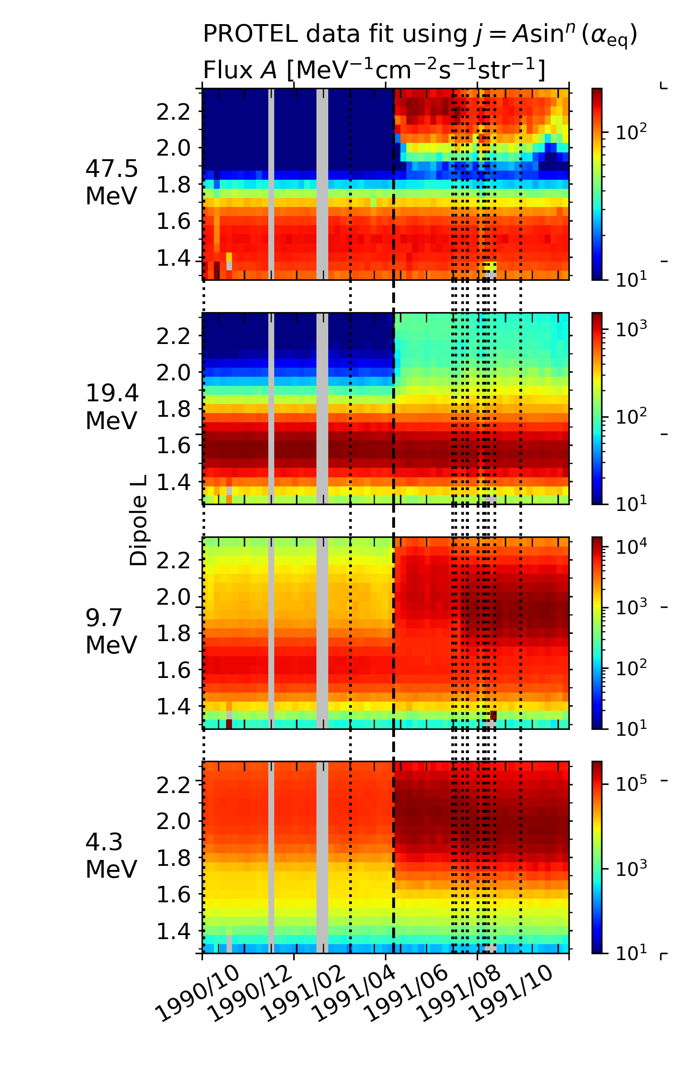
March 24, 1991 storm CRRES PROTEL measurements
interplanetary shock arrival at ∼03:40 UT
compression of the magnetosphere
accompanying flux of solar energetic particles (SEP)
At 50MeV, L~2.5: two orders of magnitude increase in flux, “second belt”
At 5MeV, L~2: one order of magnitude increase, not well studied
Notes:
Proton telescope aboard CRRES…
explain SEP

Slide 4
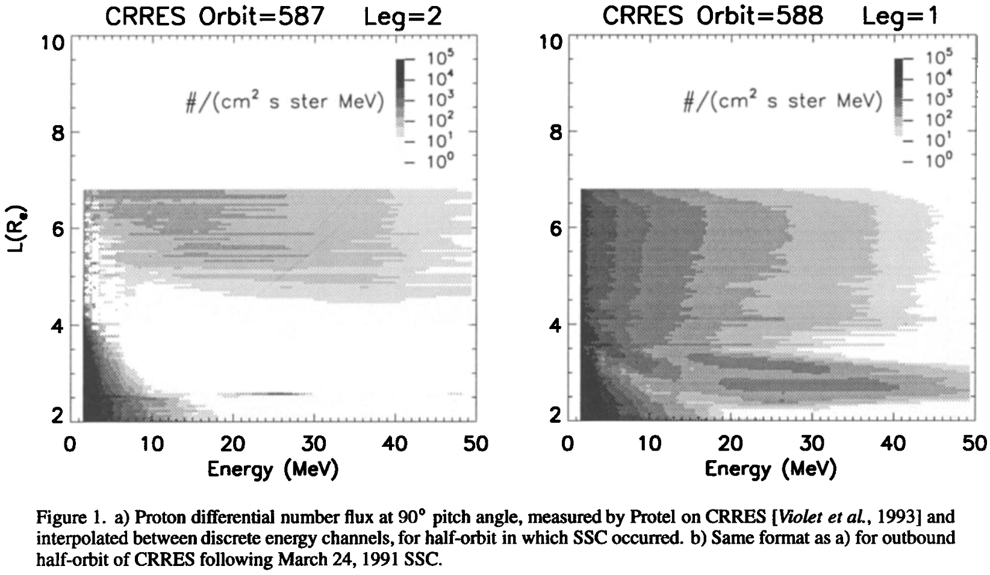
March 24, 1991 storm CRRES PROTEL measurements
proton source
inward transport to L~2.5
Notes:
CRRES measurements from the inbound and outbound half-orbit
On the left… on the right...
Solar proton source accessing the inner magnetosphere
Their inward transport to L~2.5, and we can see they remained trapped here

Slide 5
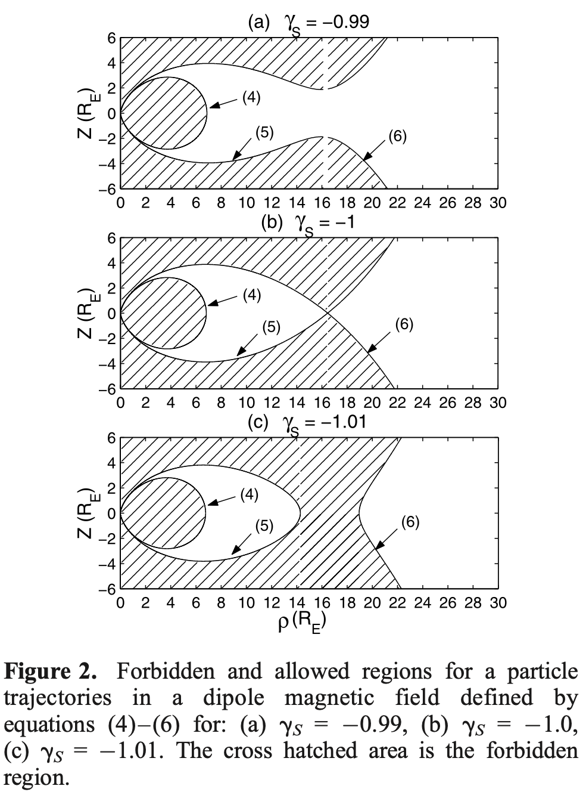
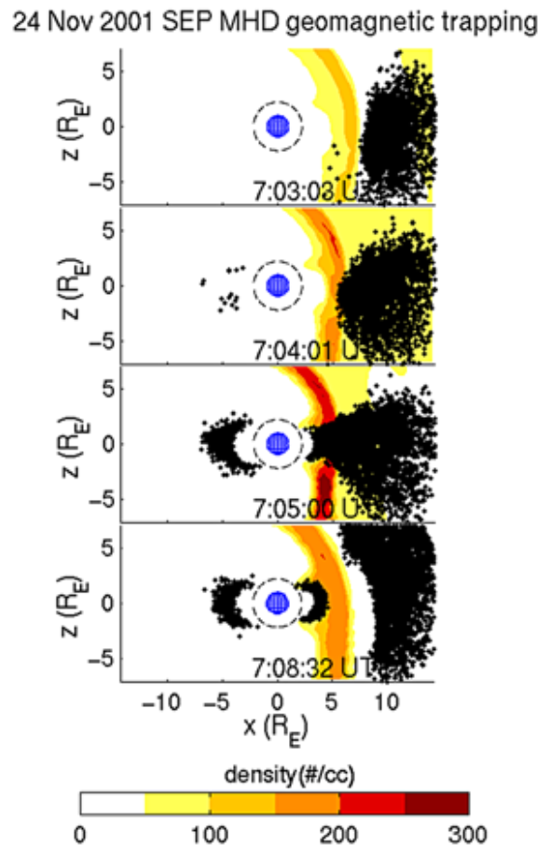
Geomagnetic cutoff
from Kress
et al., 2005:
Carl Störmer in 1903 demonstrated the existence of a region within the field where particles could be trapped, but showed that access was blocked for a particle approaching from infinity
Notes:
Explaining the proton source
Here we see 20MeV test protons accessing L~3

Slide 6
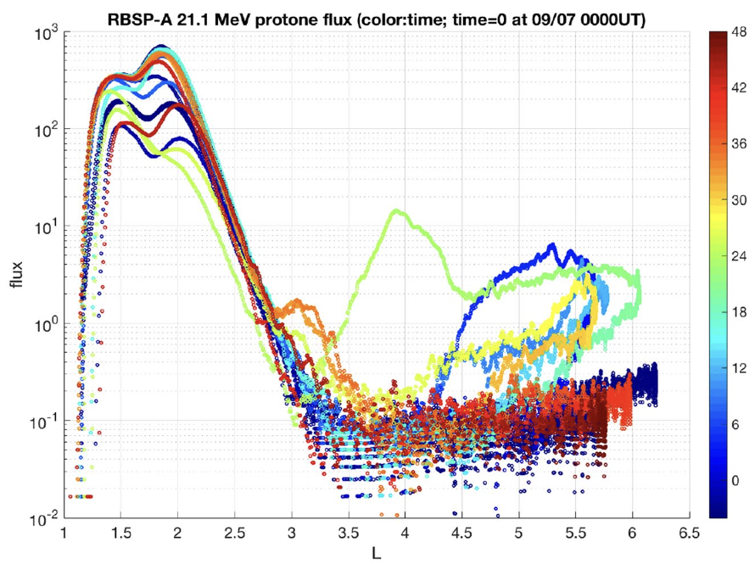
Li et al. (2021): Van Allen Probes measurements, 7-8 September 2017, show the trapping of 21.1MeV protons at L ∼ 3
Notes:
Explaining the proton source
Cutoff suppression is over a timescale of hours or less
The flux enhancement at GEO also lasted hours and that’s why particles were trapped at the end of cutoff suppression
We can see that this enhancement died out – FLCS
With cutoff suppression and a SEP source, we still cannot achieve transport to L~2.5

Slide 7
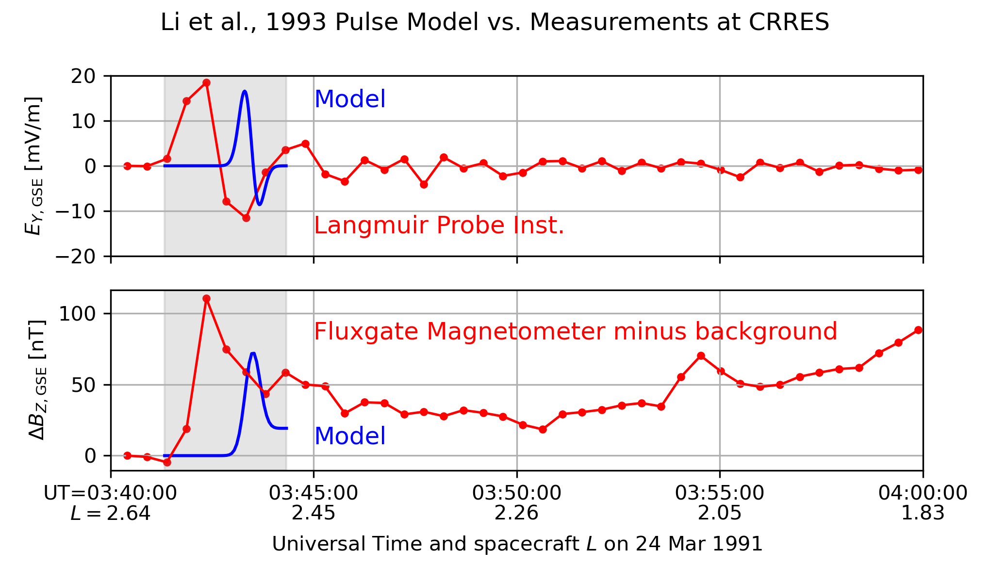
Li et al., 1993 empirical model
Y_{MAG}
X_{MAG} [RE]
Notes:
[CLICK]
The inward transport of solar protons seen during the March 1991 event was due to
the shock’s compression of the magnetosphere…
which induced an azimuthally-propogating electric field pulse…
that accelerated the solar protons inward
This is a model of the pulse given by Li et al., 1993 [explain figure…]
This model was developed using fitting parameters to match CRRES data
[CLICK]
Of the many free parameters in this model…
Good agreement with propagation speed Vd=2000km/s
Particles with a drift velocity in this range experienced resonant interaction with the pulse

Slide 8
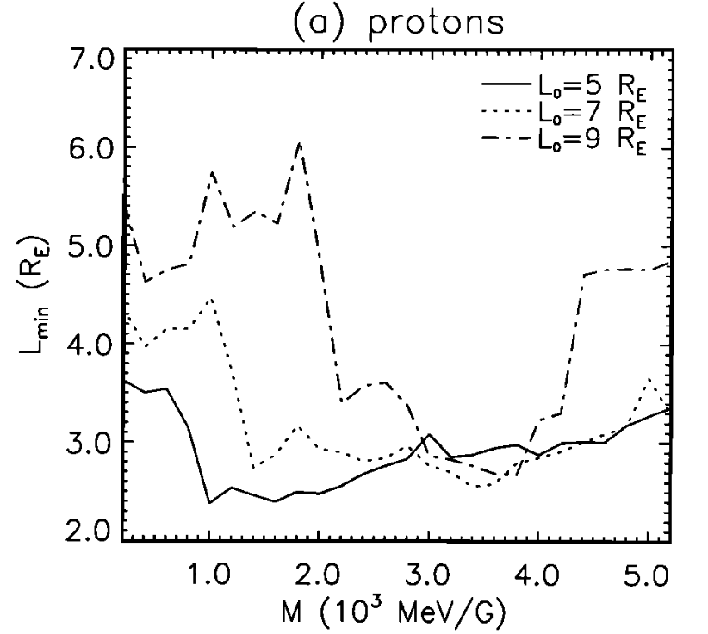
Drift resonance
Drift resonance of the SEP source at ~1000s MeV/G
M conserved
i.e. ring of M=1000MeV/G test particles at L₀=5RE (E ≈ 2.5MeV, v_{d} ≈ 1000 km/s) transported down to L ≈ 2.5
…but consider 5MeV at L ≈ 2: M ≈ 130 MeV/G L = 4: E ≈ 0.65 MeV, v_{d} ≈ 160 km/s L = 6: E ≈ 0.21 MeV, v_{d} ≈ 120 km/s etc.
Notes:
This interaction has been demonstrated in previous literature.
This figure from 1996 shows the inward limit of radial transport of test protons
For example: [read second bullet]
[CLICK] [CLICK] [CLICK]
…comparable to pulse prop. Speed
A key point is: since this interaction took place on the timescale of one drift orbit, the first invariant was conserved
However, consider the 5MeV enhancement we showed earlier
This corresponds to 130MeV/G

Slide 9
Reverse-time tracing of ~MeV test protons the domain of interest:
Notes:
To investigate further:
We used the Li et al. empirical pulse model to trace MeV test protons back in time through the March 1991 disturbance from our domain of interest to understand where this enhancement came from
Here are the coordinates we investigated…
We use the prime notation to indicate these are post-event quantities
Each unique combination is denoted x’a, and the full set of coordinates investigated is called P’
[prime]

Slide 10
Trajectory Redistribution In Phase Space
For each coordinate of interest…
Initialize test protons at regularly-spaced gyration, bounce & drift phases
Trace backwards in time through March 1991 event, then determine pre-event parameters:
Notes:
We performed particle tracing using a new code, TRIPS […], which is able to initialize test particles from a set of invariant coordinates and their respective phases.
1.)
TRIPS takes this coordinate x’a and generates combinations of gyration, bounce and drift phase, then converts these various combinations into a position-momentum state vector
2.)
TRIPS then evolved the test protons backwards in time through the March 1991 disturbance to find the pre-event coordinates of each particle.
In many cases, we found these particles had been transported from different adiabatic invariants x to x’
First I’ll show some results from this particle tracing, then I’ll show how these results can be used

Slide 11
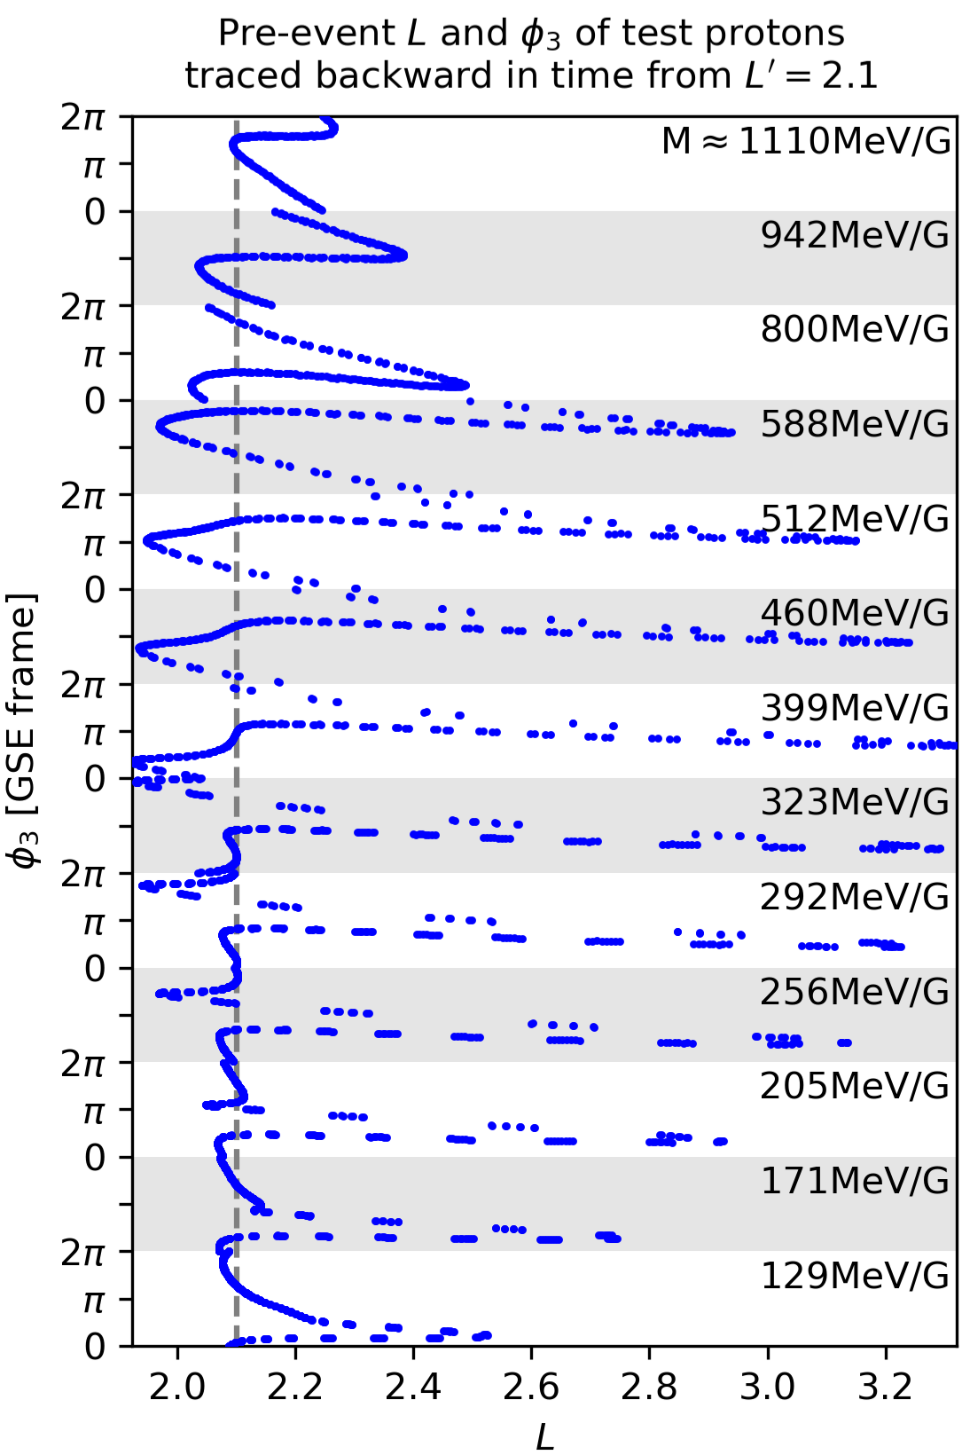
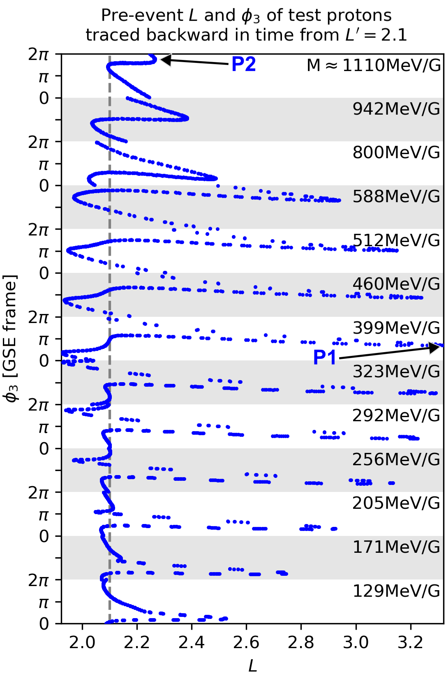
P1
Y_{MAG}
P1
X_{MAG}
Notes:
[check time, explain figure]
This figure shows the pre-event L and drift phase of a selection of test protons as blue dots.
[horizontal axis L, vertical axis phi3]
All these test protons were traced backwards from L=2.1 [grey dashed line]
This selection of test protons has been separated on the vertical axis into groups of different first invariant M.
[key points]
To show why this happened…
[CLICK]
…
Each dot is 3.7s apart
The shock-induced electric field pulse interacted resonantly with M ≈ 400 MeV/G radiation belt protons to transport them towards our region of interest

Slide 12
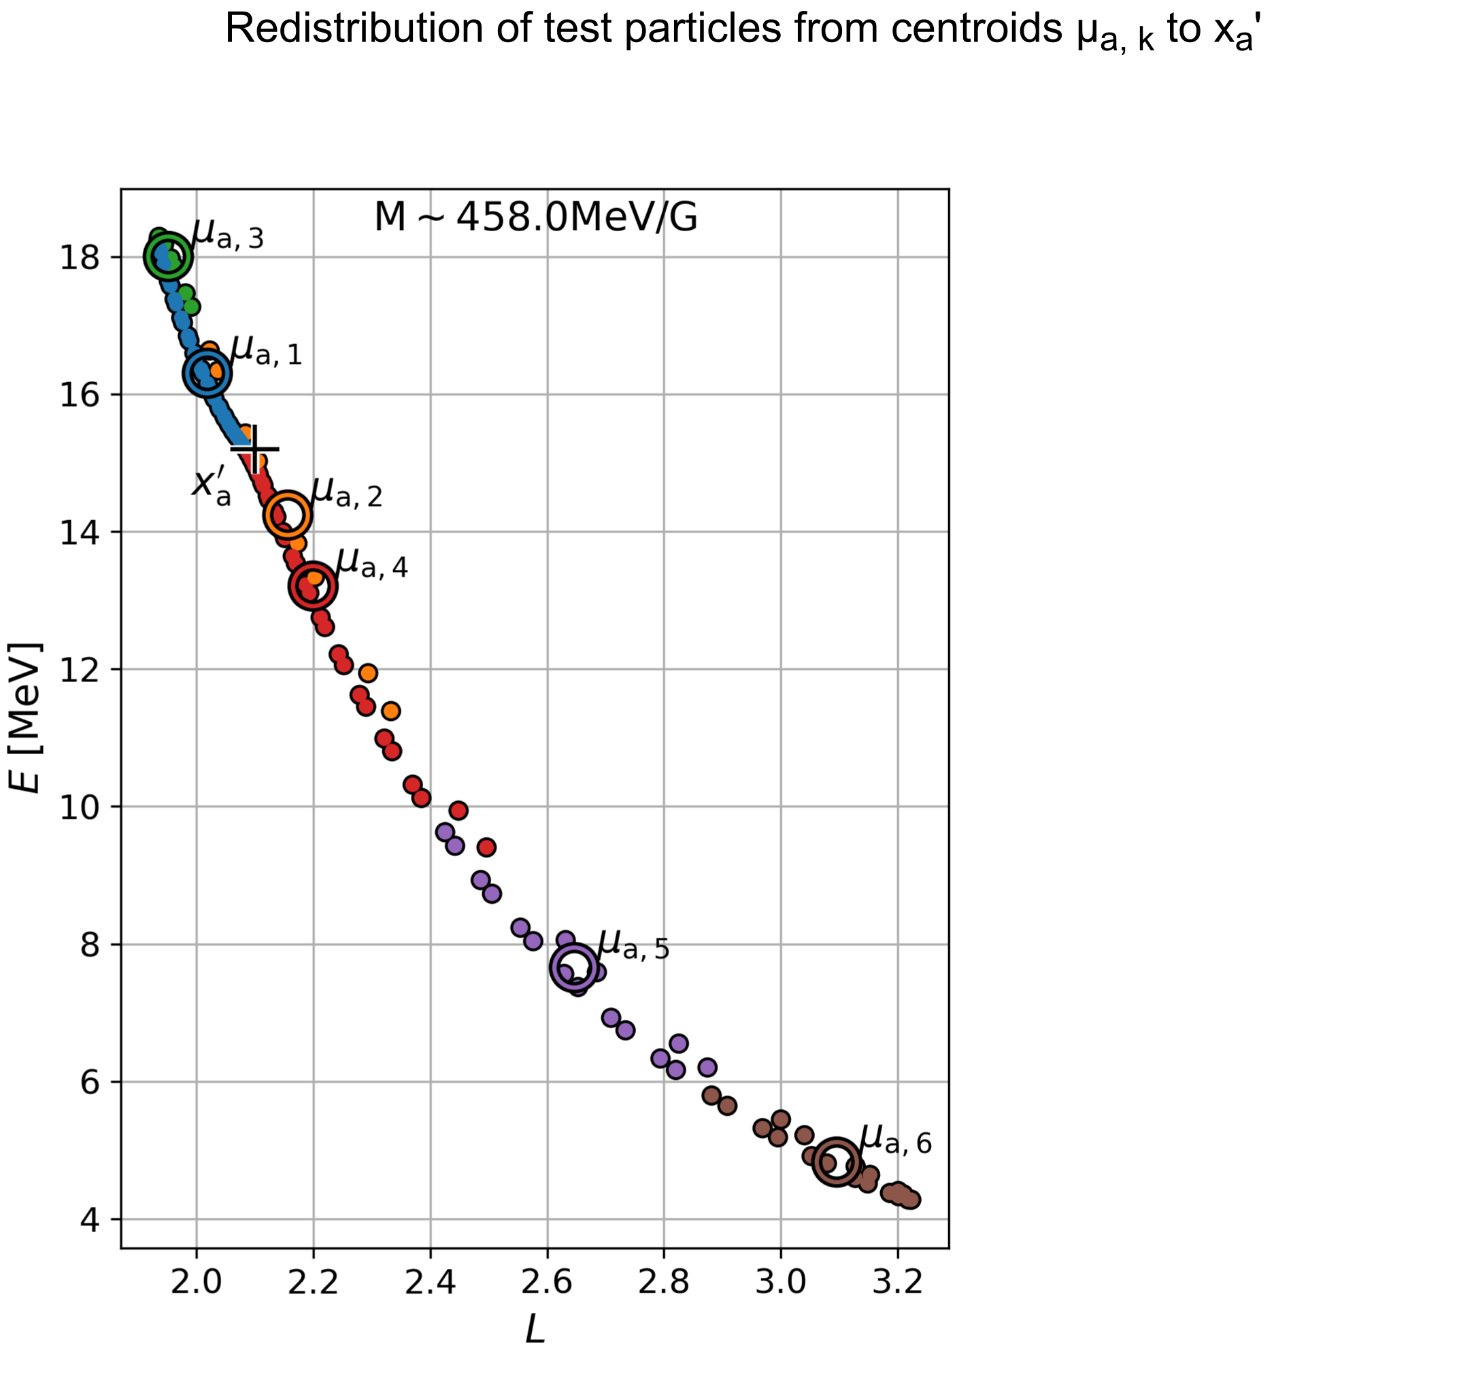
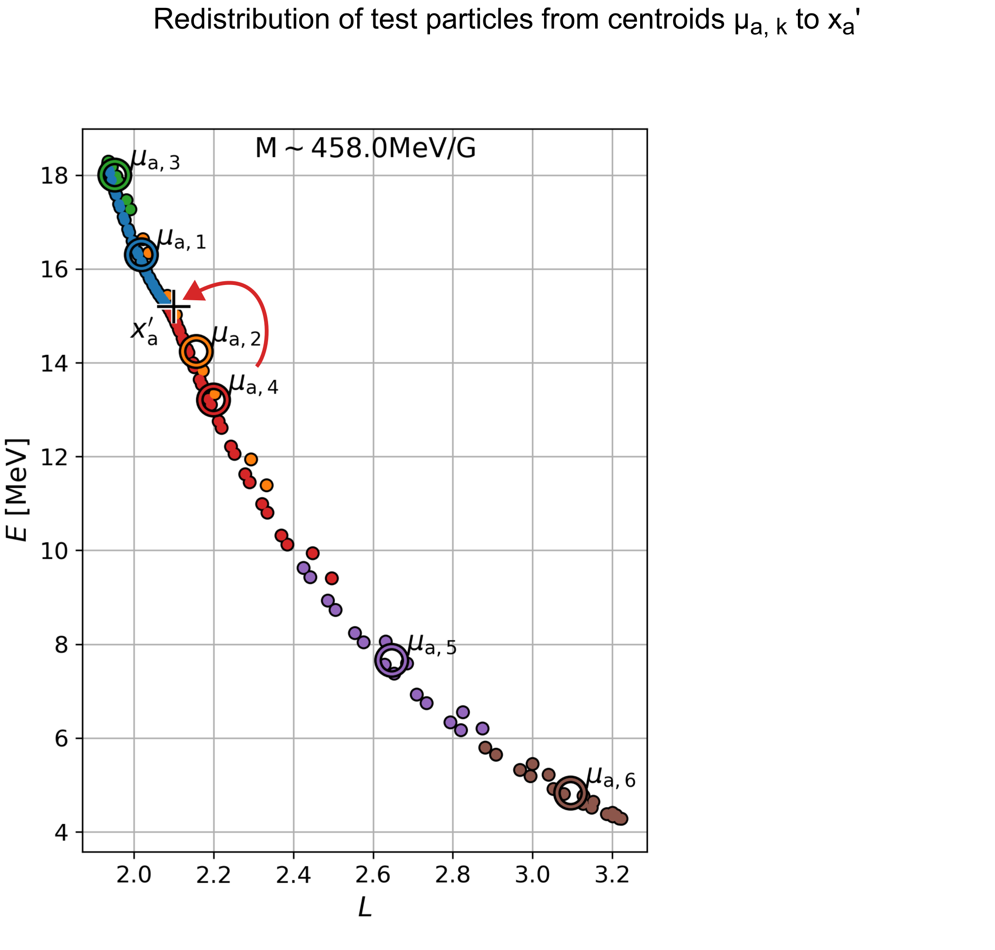
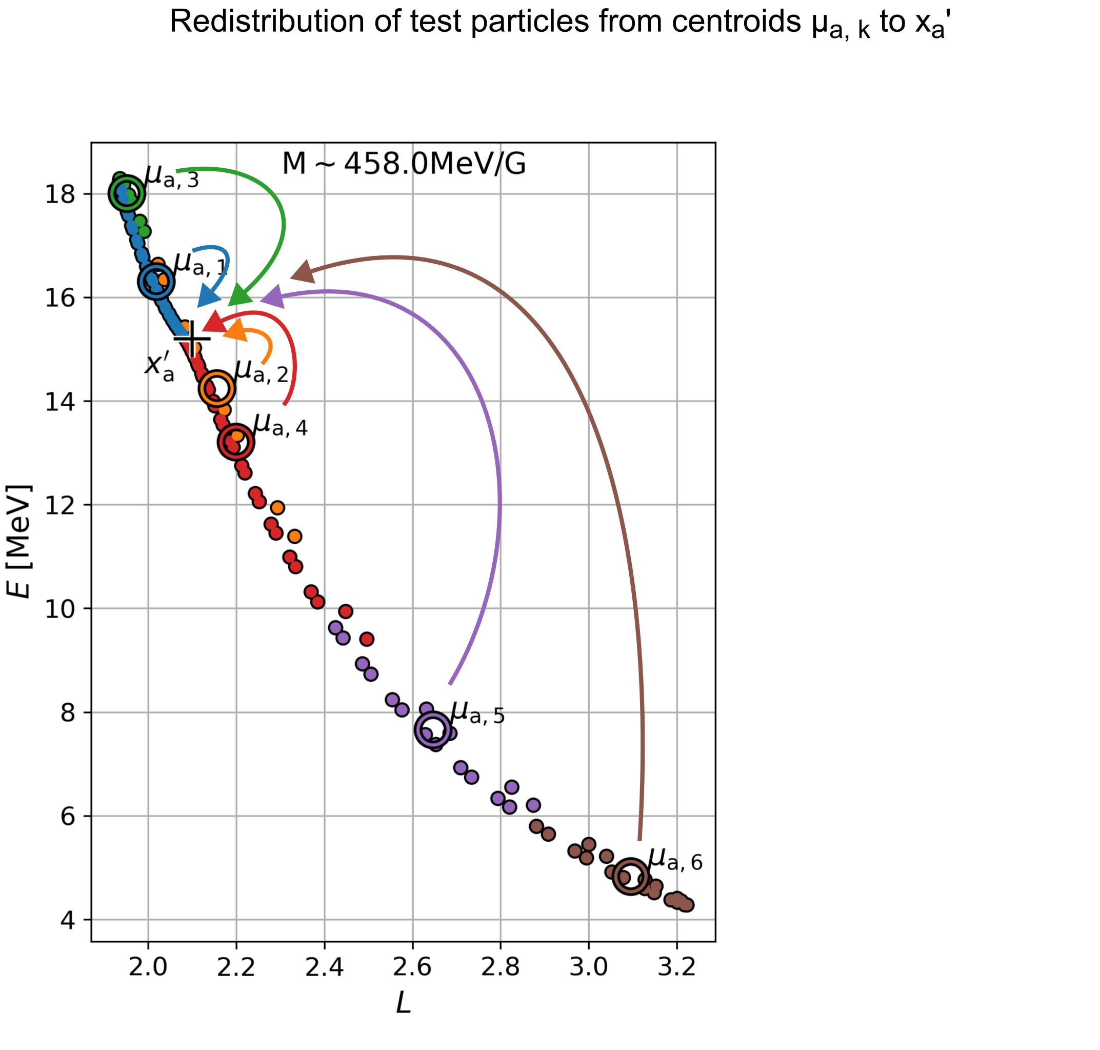
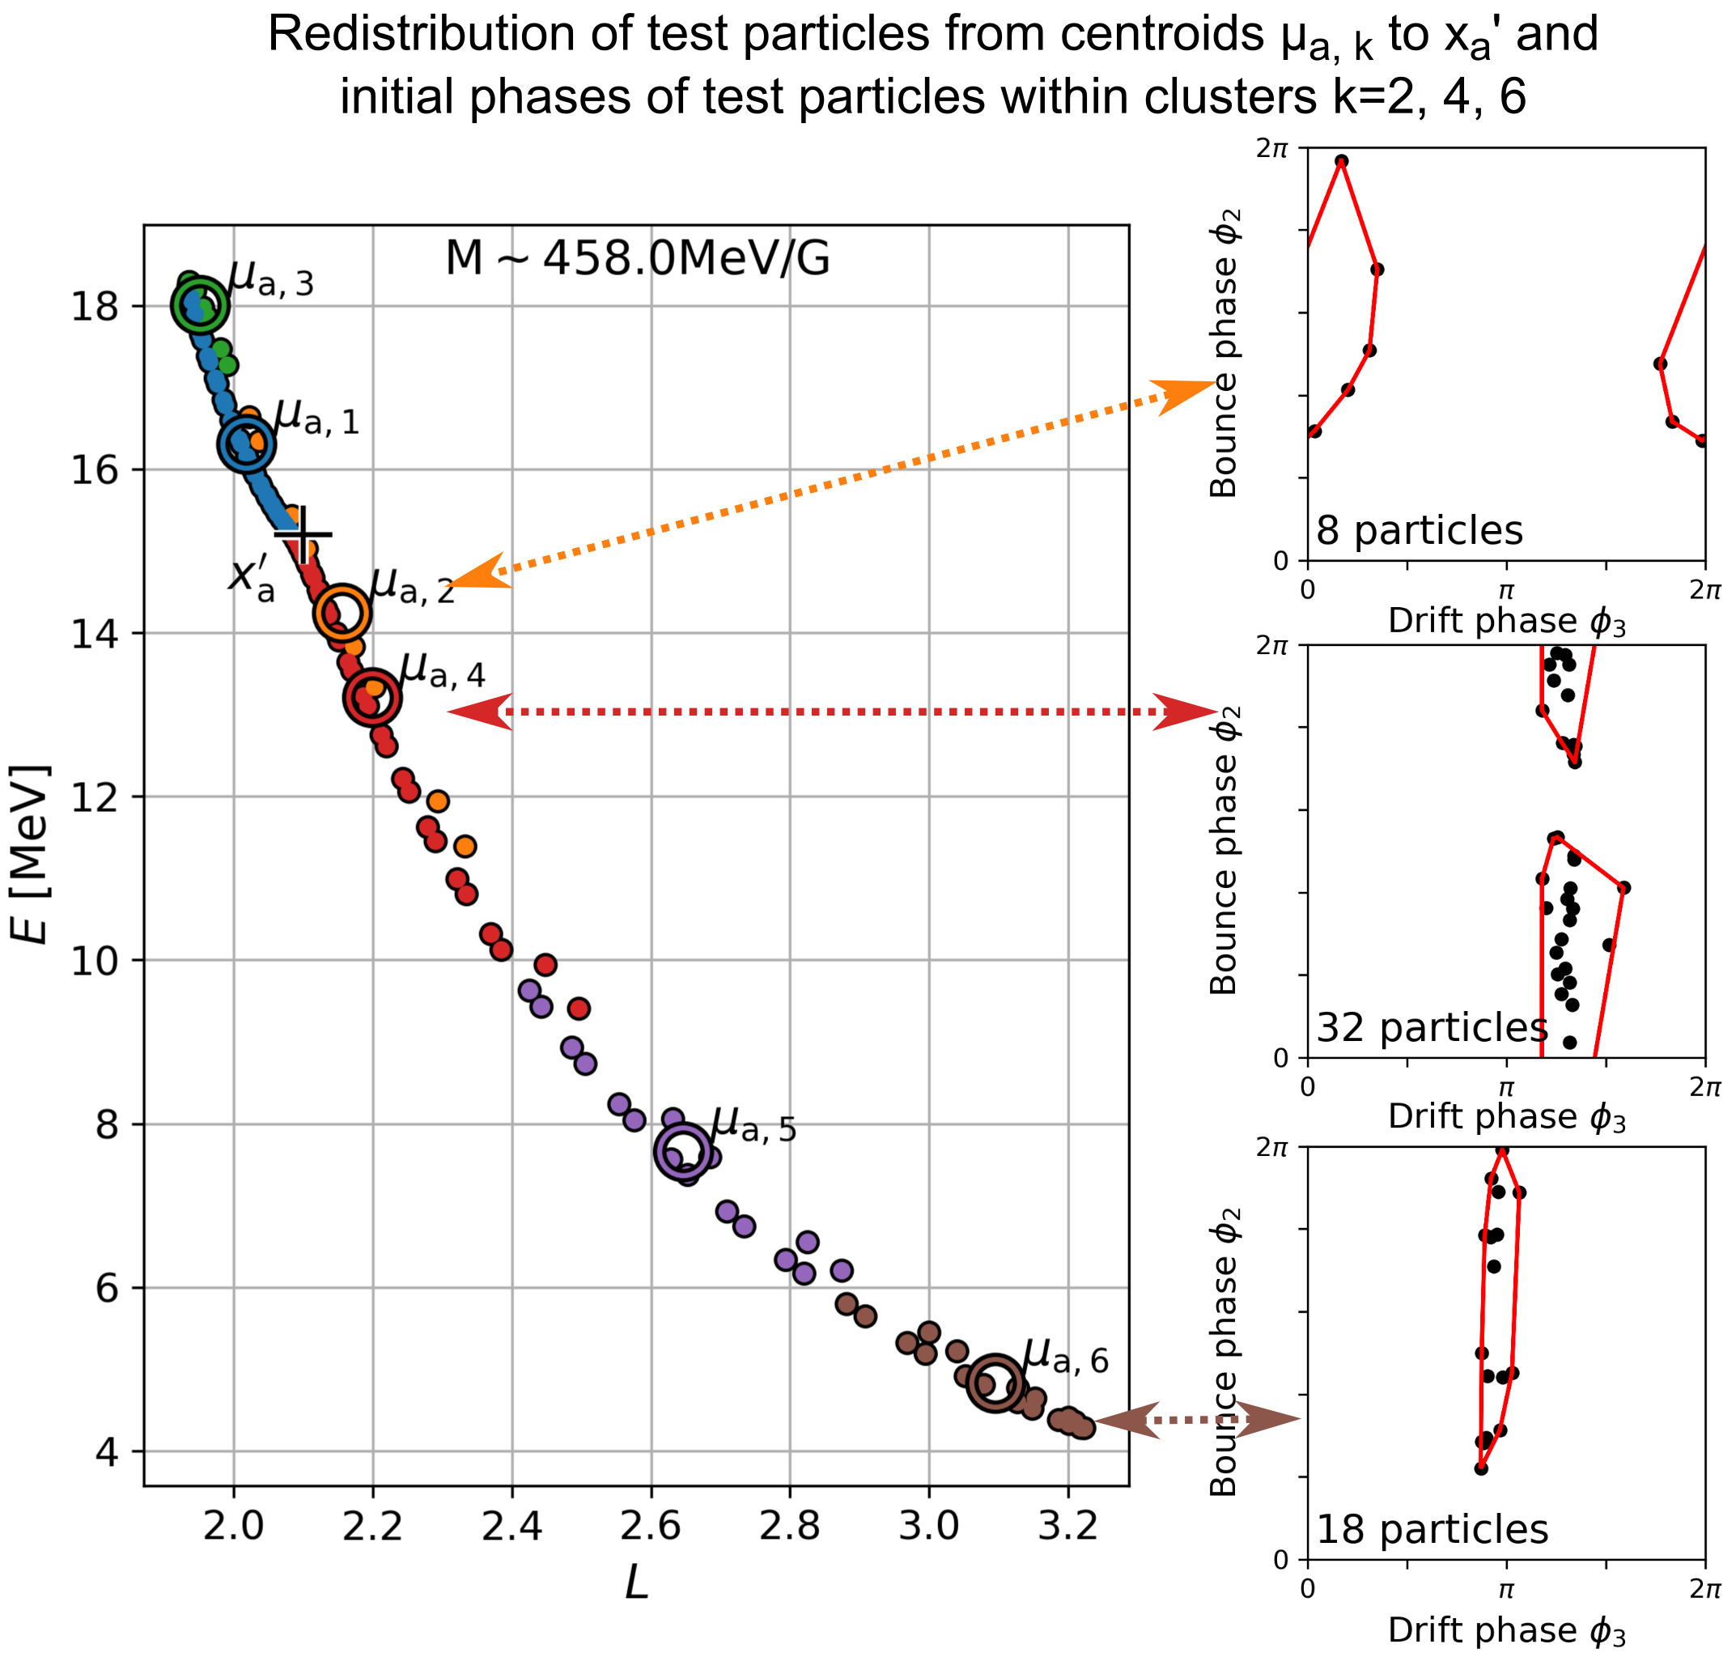
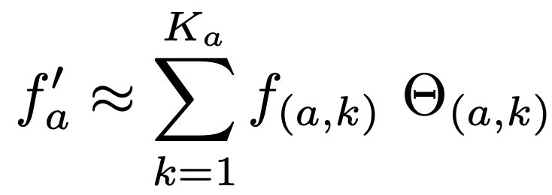
Predicting PSD
Test particles were organized into K clusters based on the pre-event parameters (1.4[L − 1], cosφ₃, sinφ₃)
Notes:
…
Let’s plot the phases of particles within each cluster
[CLICK]
Here are the phases within each cluster [explain subplots]
Focusing on this coordinate at L~3…
Imagine a ring of protons at L~3 [CLICK], these particles are from this phase of the drift orbit Our method makes the assumption that:

Slide 13
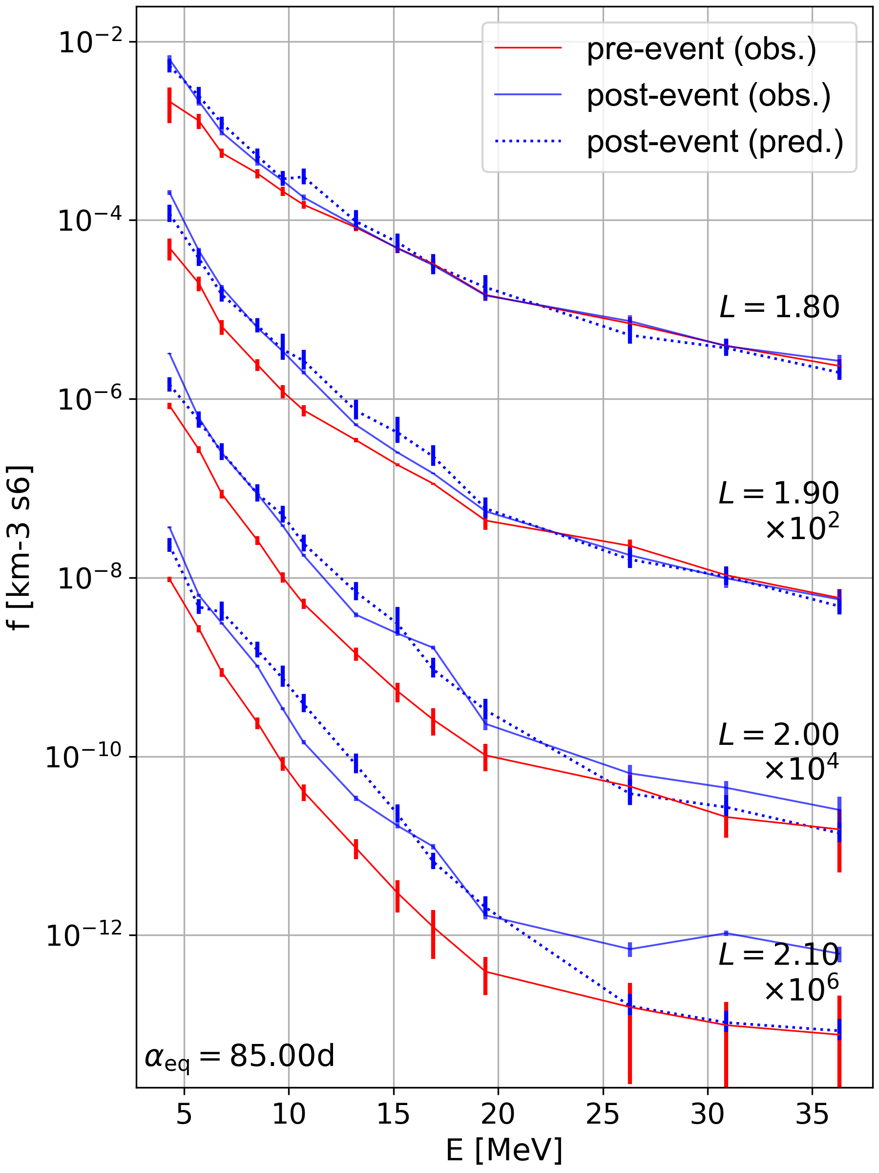
1-20MeV enhancement can be accounted for by internal redistribution
At >20MeV, there is a discrepancy, possibly because an external source of SEPs is required
Notes:
* or at this energy phase space density is not as accurate

Slide 14
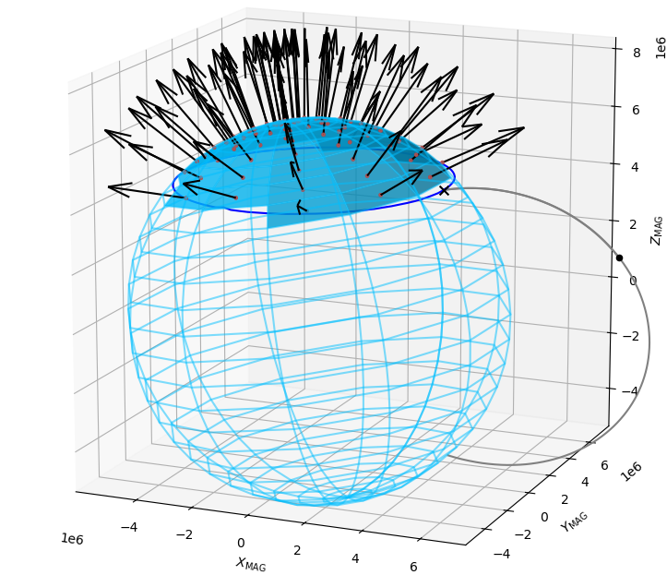
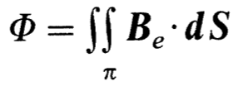
TRIPS – L* update in progress

Slide 15
Conclusions
The 24 March 1991 interplanetary shock produced an enhancement of 1-20MeV proton flux at L = 2 by up to one order of magnitude
The shock-induced electric field pulse interacted resonantly with M ≈ 400 MeV/G radiation belt protons to transport them towards this region
TRIPS enables a new method to predict changes in phase space density due to shock redistribution
Enhancements in 1-20MeV proton flux can occur at L≈2 due to large shocks with no associated SEP event

Slide 16
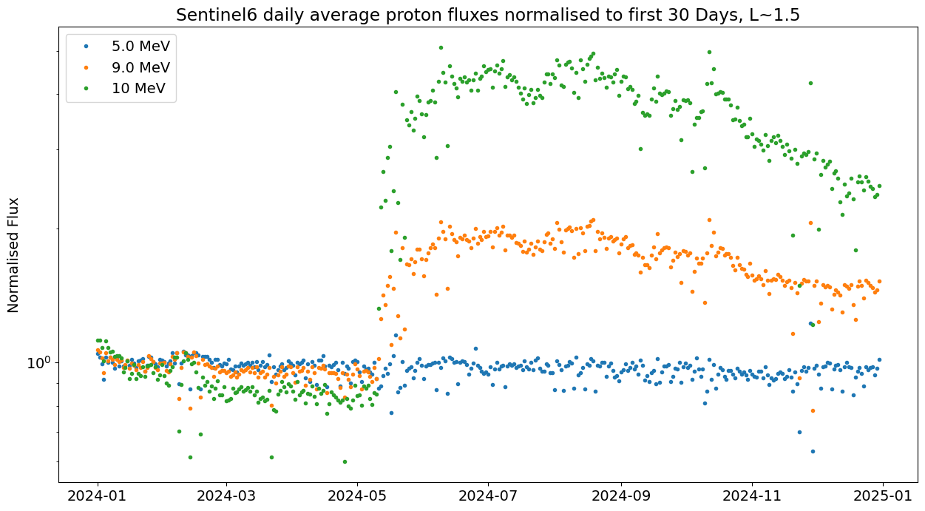
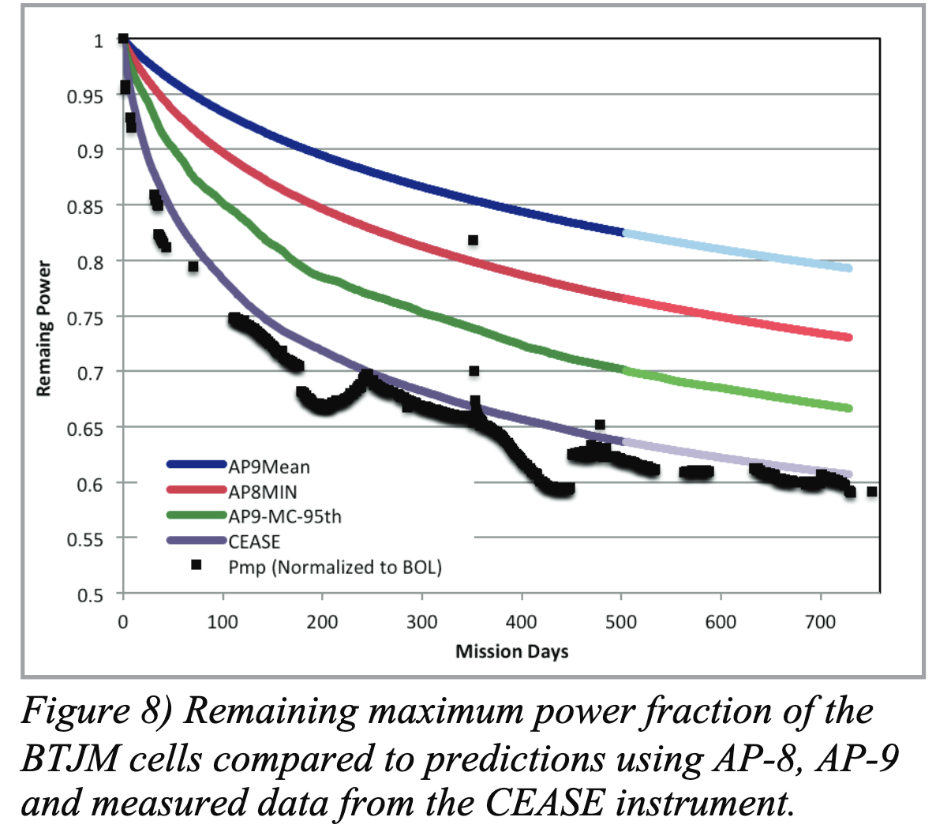
Prior observations of high MeV protons flux…
from Jenkins et al. (2014) Tacsat-4 Solar Cell Experiment: Two Years In Orbit
May superstorm, Sentinel-6 observations:
Notes:
However, you also see an enhancement at ~5MeV
We hypothesized that these enhancements are caused

Slide 17
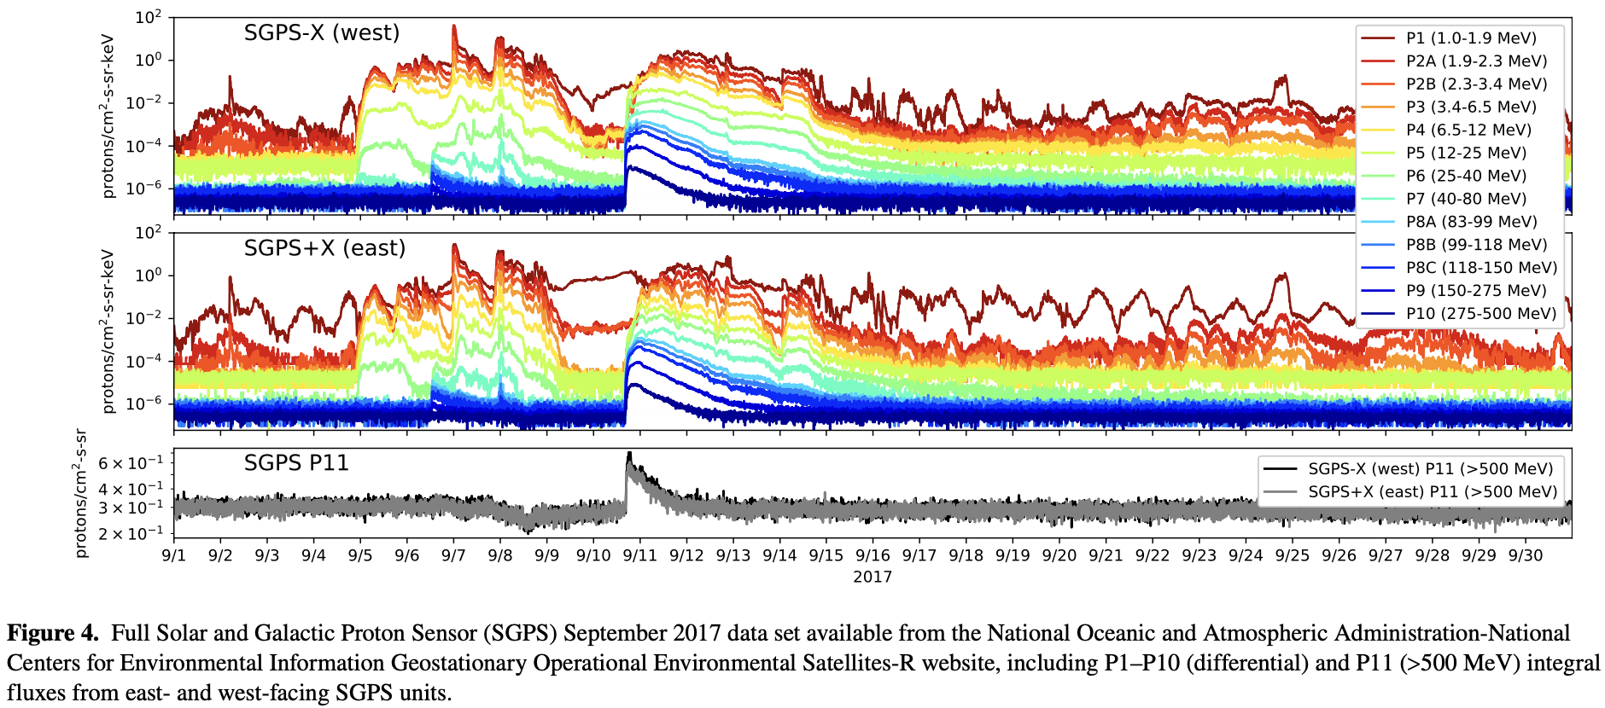
from Kress et al. (2021): Observations From NOAA's Newest Solar Proton Sensor
“
SEP
ESP
”
Notes:
Firstly… ESP events with a shock
Consider red: cutoff is suppressed
Consider blue: SEP events, but not cutoff suppression, therefore 1MeV particles cannot make it to the detector
Remember: E-W effect does not necessarily apply to untrapped particles, they are free to move throughout the magnetosphere

