Slide 1


Modeling for radiation belt electrons with nonlinear local scattering by lower-band whistler chorus mode waves
S. Saito¹, Y. Miyoshi², and S. Kurita³
¹National Institute of Information and Communications Technology
²ISEE, Nagoya University
³RISH, Kyoto University
10:50 – 11:10, 5/20
IRENE Space Radiation Modelling and Data Analysis Workshop 2025
5/20 – 5/22, Sykia, Corinthia, Greece

Slide 2
Background
Several processes are coupled each other in the actual radiation belt dynamics.
Type of spatial scale
Process
Action
Results
Inward diffusion/transport
Acc.
Radial diffusion/transport
Global
MPS
Outward diffusion/transport
Loss
Drift loss cone
Escape to interplanetary space
Loss
Local
Wave-particle interaction
Precipitation into the atmosphere
Loss
Local scattering
Loss
Acc.
An important issue:
Coupling of global and local processes (Cross-scale coupling in space and time)
Generally, the calculation of the WPI needs a large amount of calculation resources.
→ The key issue is to reduce the calculation cost of the WPI process.

Slide 3
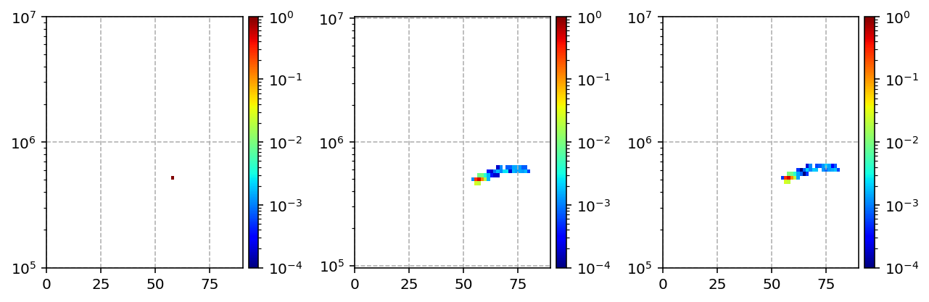



Nonlinear Local Scattering (NLS) model
We use probabilistic transfer tables to reduce the calculation cost for the scattering.
What is the probabilistic transfer table?
The transfer table can update an energy E and an equatorial pitch angle α_{eq} of an electron bouncing along a field line on L with the background density N through the scattering of the electron by a wave W.
Probabilistic transfer table
Scattering by a chorus wave interaction
(L, N, and W)
W: wave parameters (B_{w}, f, propagation latitudes, and etc.) )
$$p{\left(E^{′},α_{eq}^{′}\right)}_{E,α_{eq},L,N,W}$$
electron with E and α_{eq}
When the electron interacts with W, the energy and the equatorial pitch angle changes to different energy and equatorial pitch angle.
The changes of each W are probabilistic, we calculate the table p as the changes from monochromatic E and α_{eq}, by using test-particle simulations that solve equation of motion during the interaction.
Probabilistic distribution after the scattering: p
Set E and α_{eq}
Electrons are uniformly distributed along the field line.
Test-particle simulation (RBW)
with L, N, and W
[eV]
$$E^{′}$$
E [eV]
RBW simulation:
Saito, S., Y. Miyoshi, and K. Seki (2012), Relativistic electron microbursts associated with whistler chorus rising tone elements: GEMSIS-RBW simulations, J. Geophys. Res., 117, A10206, doi:10.1029/2012JA018020.
α_{eq} [deg.]
$$α_{eq}^{′}$$
[deg.]

Slide 4
Nonlinear Local Scattering (NLS) model
We define a chorus element model by reducing the number of free parameters.
Wave model parameters are fixed except wave amplitude.
Chorus element model
(Parallel propagating LBC chorus)
List of parameters for the probabilistic transfer table
0.4 f_{ce}
L grids (16 grids): 4 - 7
Energy grids (64 grids): 100 keV – 10 MeV in logscale.
Equatorial pitch angle grids (64 grids): 0 - 90 deg.
Dens values (8 points): 1, 3, 5, 7, 9, 11, 13, 15 /cc
Bw values (8 points): 10, 50, 100, 150, 200, 250, 300, 350 pT
B_{w} (Valiable)
0.1 f_{ce}
300 ms
sec.
Max Mlat.: 40 deg.
W: Wave parameters (B_{w}, f, Mlat. of propagation)
The total number of the probabilistic transfer tables: (16-1) x (64 - 1) x (64 - 1) x 8 x 8
= 3,810,240 table sets. (~4 Million tables)

Slide 5
Nonlinear Local Scattering (NLS) model
By referring the corresponding probabilistic transfer table, we can trace a trajectory of test-particle electrons in E-α_{eq} space on a L shell with N.
N^{th}
One of trajectories of an electron.
N^{th}
N^{th}
E [eV]
i^{th}
Each transfer to next step is probabilistic, the scattered electrons on the space show the distribution that corresponds to the interactions with the applied waves.
1st
2nd
0th interaction
α_{eq} [deg.]
The model can find the energy and pitch angle of test-particles after the scattering by referring the table set without calculating the equation of motion.
→ The calculation cost is relatively low, so the model can be coupled with the global model.

Slide 6
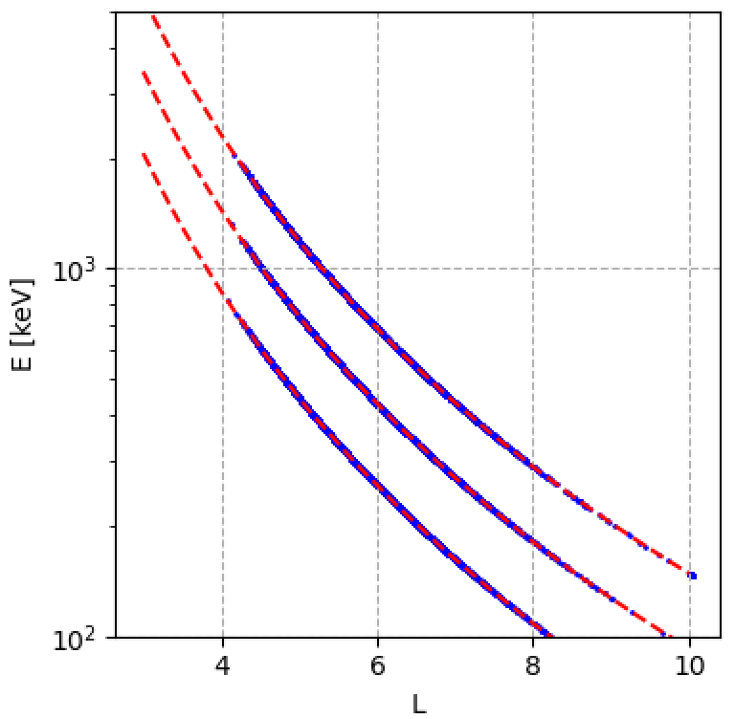
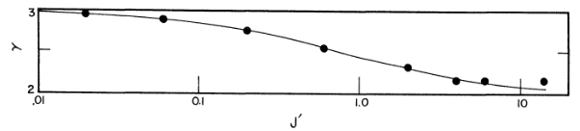

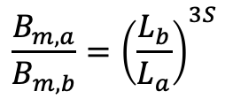

Quasilinear Radial Diffusion (QRD) Model
Calculate the radial diffusion satisfying the conservation of 1st and 2nd adiabatic invariants.
α_{eq} = 90 degree (t=0)
Monte Calrlo method for the radial diffusion
Dashed line：Theoretical curve of adiabatic motion
$$∆L= ±{\left(2D_{LL}∆t\right)}^{1/2}$$
Fujimoto, M., and A. Nishida (1990), Monte Carlo simulation of energization of jovian trapped electrons by recirculation, J. Geophys. Res., 95(A4), 3841–3853, doi:10.1029/JA095iA04p03841.
Blue: Result of test-particle simulation
If only L is changed, the invariants are not conserved (if p|| is not zero).
L=5.7 (t=0)
Adiabatic motion conserving the first and second adiabatic invariants in the dipole field
800 keV
$$\frac{B_{m,a}}{B_{m,b}}={\left(\frac{L_{b}}{L_{a}}\right)}^{3S}$$
500 keV
L_{i}: L at the field line i.
B_{m,i}: B at mirror points in the field line i.
300 keV
S is a function of only the second adiabatic invariant.
The equation defines the relation with the constant J.
Radial Diffusion
$$γ=3S$$
Edward W. HONES, Adiabatic Motions of Charged Particles in a Dipole Model of the Magnetosphere, Journal of geomagnetism and geoelectricity, 1966, Volume 18, Issue 2, Pages 133-140

Slide 7
Coupling Model: Rade3D (Radiation belt electrons model in 3D)
3D: L, E, α_{eq} + MLT
Two models (NLS and QRD models) are applied to each test particle.
NLS model: Nonlinear Local Scattering model (chorus element model)
QRD model: Quasilinear Radial Diffusion model (Ozeke model 2014)
Drift motion (Adiabatic)
Nonlinear Local Scattering (NLS) model
L
Local scattering
W
Local scattering
Radial Diffusion (Global process)
W
E → W → E’
α_{eq} → W → α’_{eq}
Quasilinear Radial Diffusion (QRD) model
L → L’
Dipole magnetic field model

Slide 8
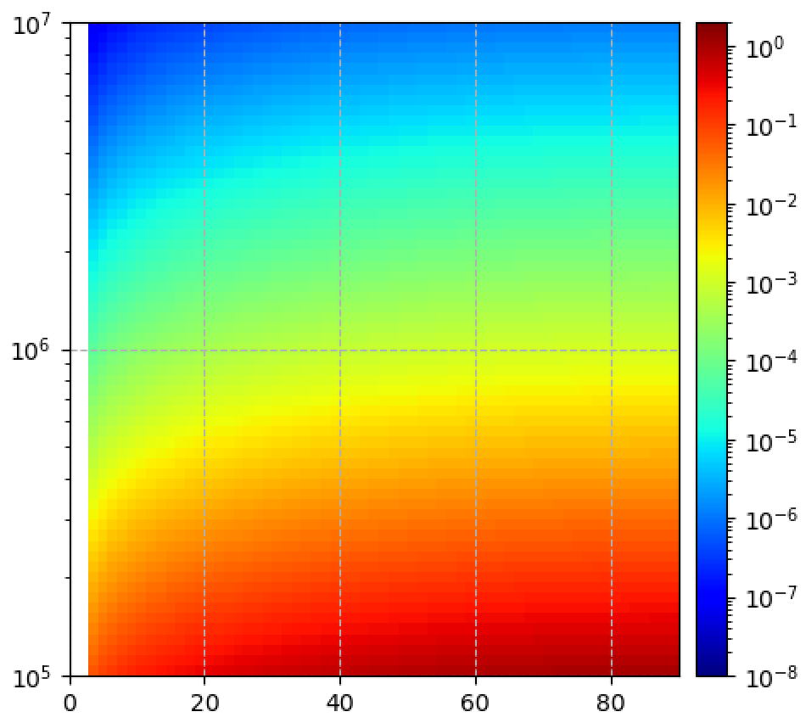
Rade3D simulation set up for test runs
Compare the flux enhancement of >2 MeV electrons by NLS x QRD and only-QRD.
Wave model:
Chorus element model (Parallel propagating LBC chorus)
0.4 f_{ce}
Max Mlat.: 40 deg.
Generated between L=5.6 and 5.8 in all local time.
The background density is 5/cc.
Keep to generate for 900s with the emission frequency 1 Hz.
B_{w} =150pT
0.1 f_{ce}
300 ms
sec.
Radial diffusion model:
Ozeke 2014 model with Kp=5.
Radial Diffusion
Initial flux distribution (∝E^{-p}sinα_{eq})
p=3
Ozeke, L. G., I. R. Mann, K. R. Murphy, I. Jonathan Rae, and D. K. Milling (2014), Analytic expressions for ULF wave radiation belt radial diffusion coefficients, J. Geophys. Res. Space Physics, 119, 1587–1605, doi:10.1002/2013JA019204.
Omnidirectional Flux (>2 MeV)
Energy [eV]
Normalized particle flux
We have checked if Rade3D model shows results that we expect.
pitch angle [deg.]
L = 5.6 – 5.8
L

Slide 9
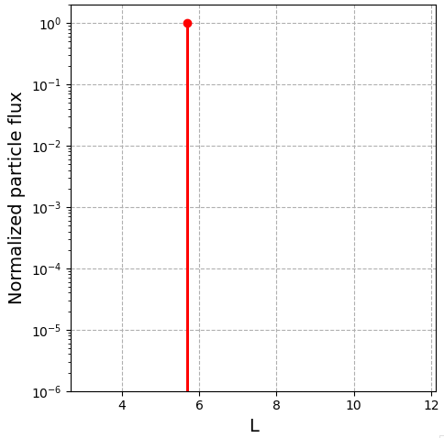
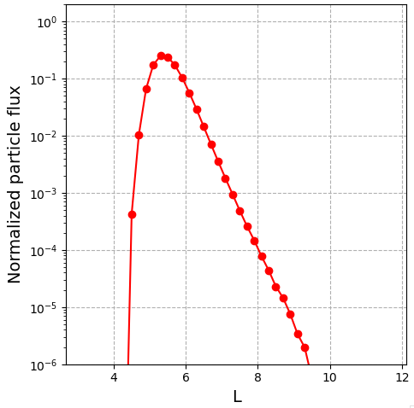
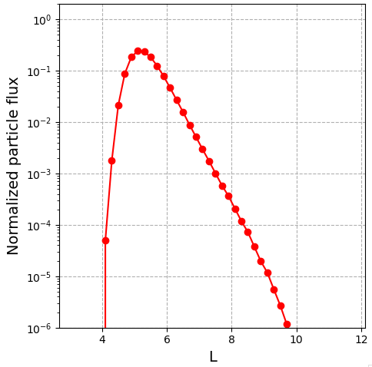

Rade3D simulation - Test Run Results - Radial diffusion
Temporal variation of omnidirectional flux in L with the quasilinear radial diffusion (Kp = 5)
t=0 [s]
t=3600 [s]
t=7200 [s]
>2 MeV
>2 MeV
>2 MeV
L=5.6 - 5.8
Ozeke, L. G., I. R. Mann, K. R. Murphy, I. Jonathan Rae, and D. K. Milling (2014), Analytic expressions for ULF wave radiation belt radial diffusion coefficients, J. Geophys. Res. Space Physics, 119, 1587–1605, doi:10.1002/2013JA019204.

Slide 10
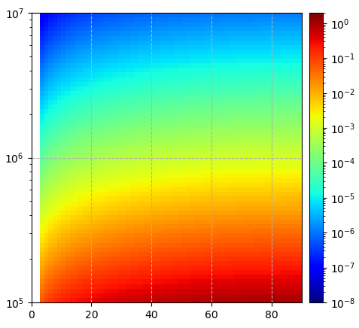
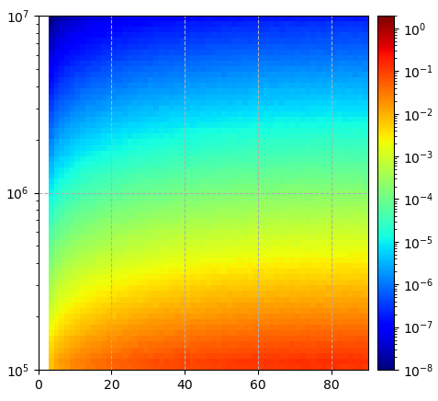
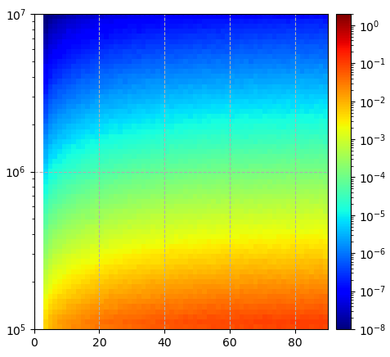
Rade3D simulation - Test Run Results - Radial diffusion
Temporal variation of the particle flux between L = 5.6 and 5.8 with the quasilinear radial diffusion (Kp = 5)
t=0 [s]
t=3600 [s]
t=7200 [s]
L=5.6 – 5.8
E [eV]
pitch angle [deg.]
pitch angle [deg.]
pitch angle [deg.]
The flux reduces in all pitch angle and energy, because the electrons move outer and inner L shells through the radial diffusion process.
The distribution except flux intensity is conserved because the radial diffusion does not change the energy and pitch angle on the same L shell.
The results are consistent with that we expect.

Slide 11
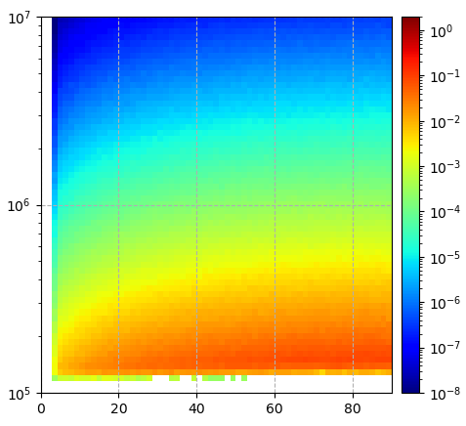
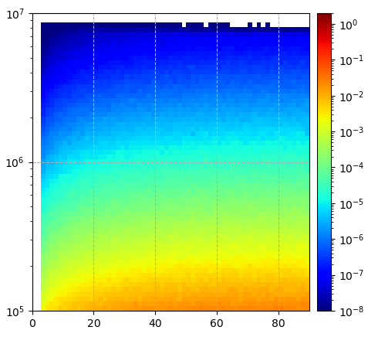
Rade3D simulation - Test Run Results - Radial diffusion
Inner L shell (L=5.0 - 5.2)
The adiabatic acceleration shifts the electrons into higher energies. (24% - 56% up: 100 keV → ~124 - 156 keV)
Outer L shell (L=6.2 – 6.4)
The adiabatic de-acceleration shifts the electrons into lower energies. (19% - 33% down: 10 MeV → ~6.7 - 8.1 MeV)
①
t=7200 [s]
Kp = 5
②
③
>2 MeV
The results are consistent with that we expect.
Adiabatic Acc.
Adiabatic de-Acc.
① L=5.0 – 5.2 (Inner L shell)
② L=5.6 – 5.8
③ L=6.2 – 6.4 (Outer L shell)
2 MeV
E [eV]
pitch angle [deg.]
pitch angle [deg.]
pitch angle [deg.]

Slide 12
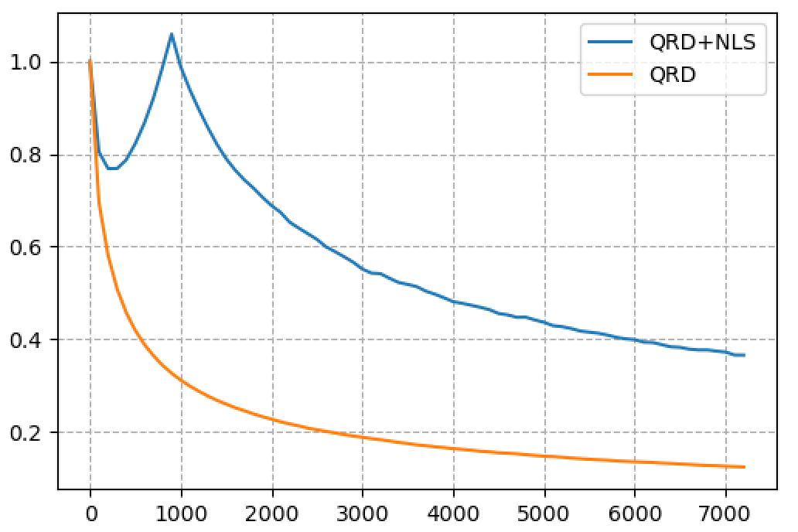
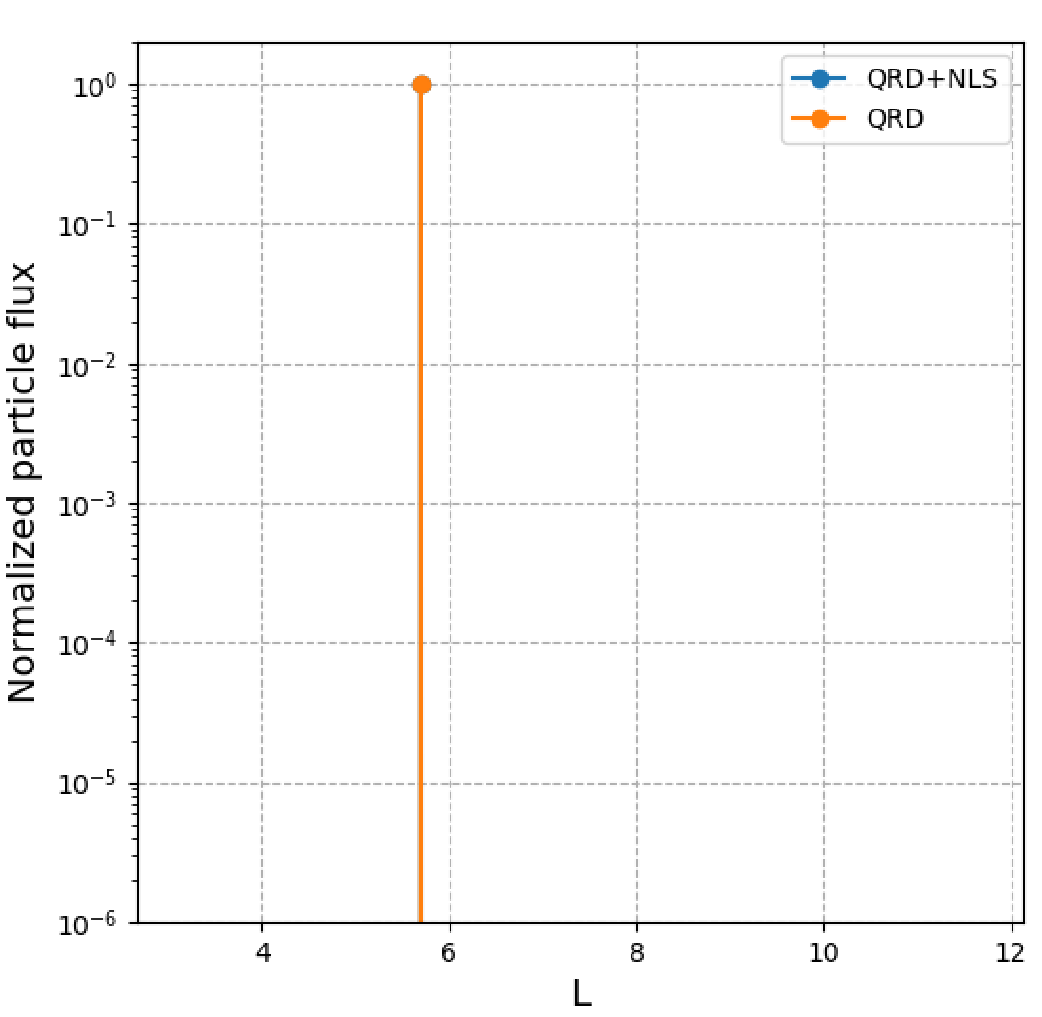
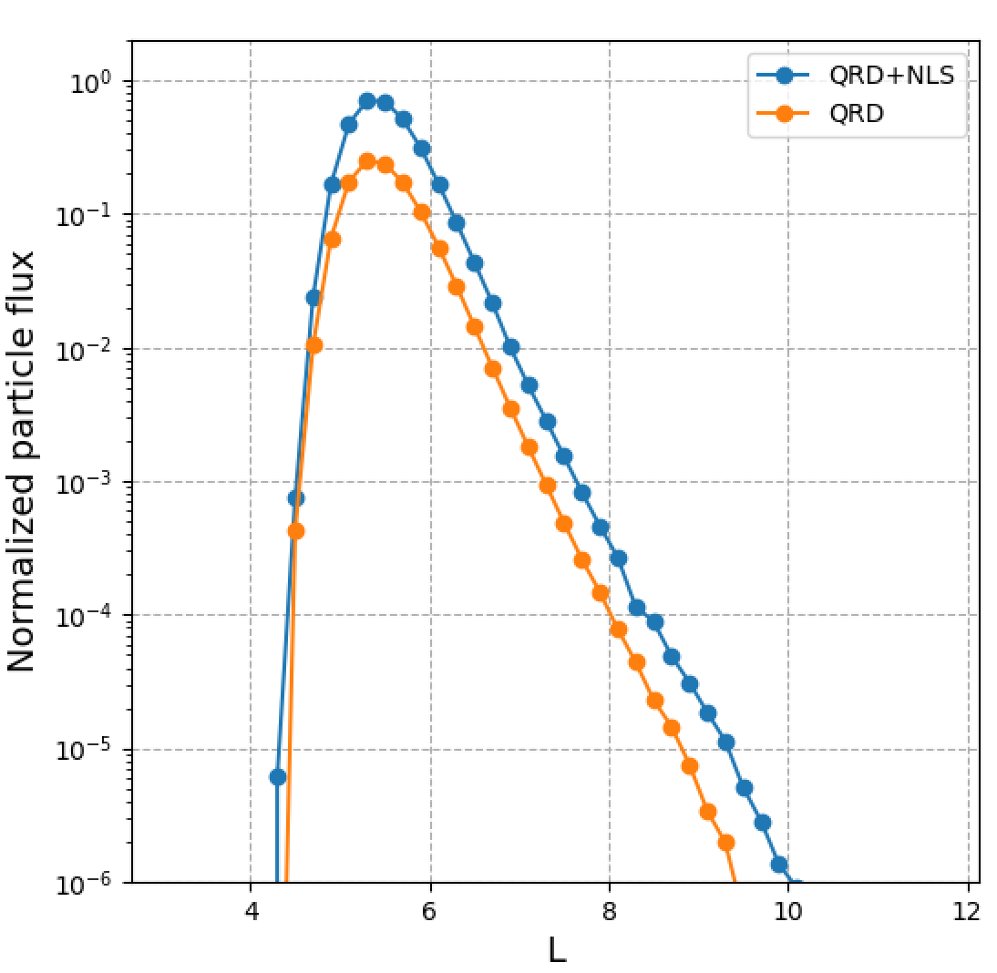
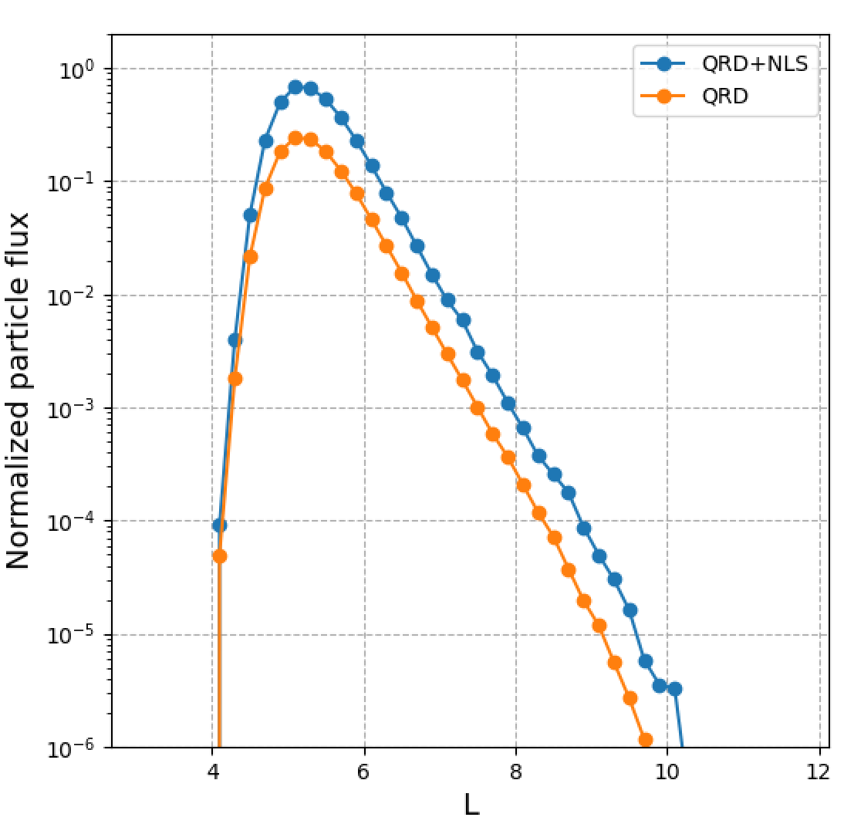
Rade3D simulation - Test Run Results – Quasilinear diffusion + Nonlinear scattering
We apply the both QLD and NLS to the Rade3D model.
QLD
Quasilinear radial diffusion reduces the flux in time at the initial L shell, because of the diffusion in L direction.
QLD + NLS
Nonlinear local scattering by whistler chorus elements increases the flux during the time when NLS model is applied.
After we stop applying the NLS model, the flux start to reduce by the quasilinear diffusion.
NLS model is applied for 15 min. on L shells of 5.6 - 5.8.
QRD+NLS
L=5.6 – 5.8
Normalized >2 MeV electron flux
QRD
NLS for 15 [min.] at L=5.6 – 5.8
time [s]
t=0 [s]
t=3600 [s]
t=7200 [s]

Slide 13

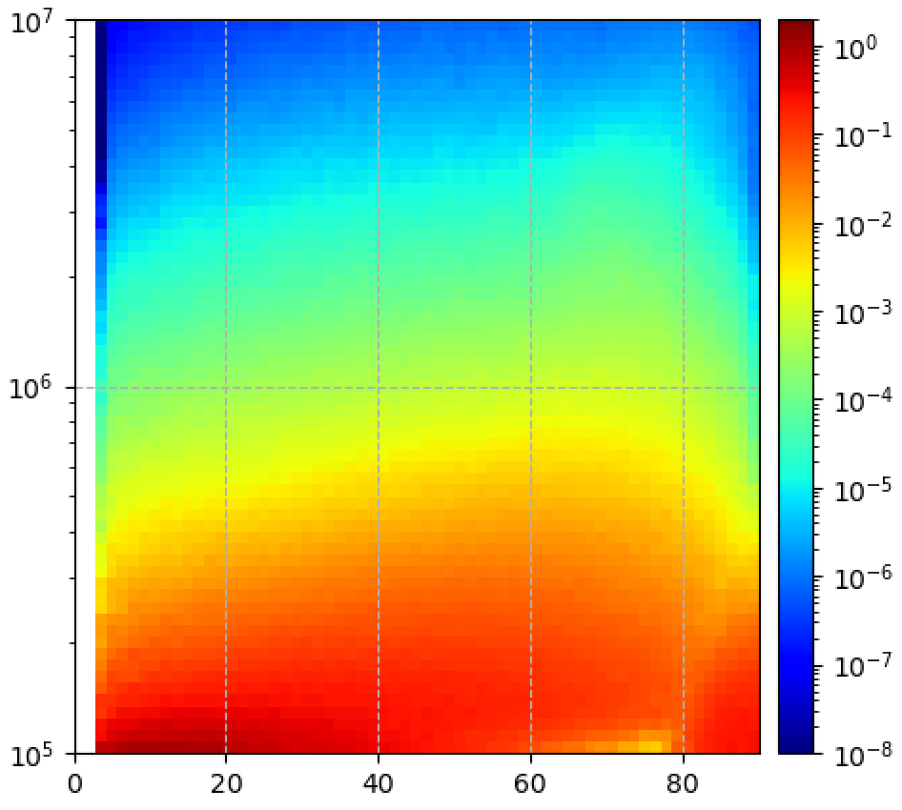
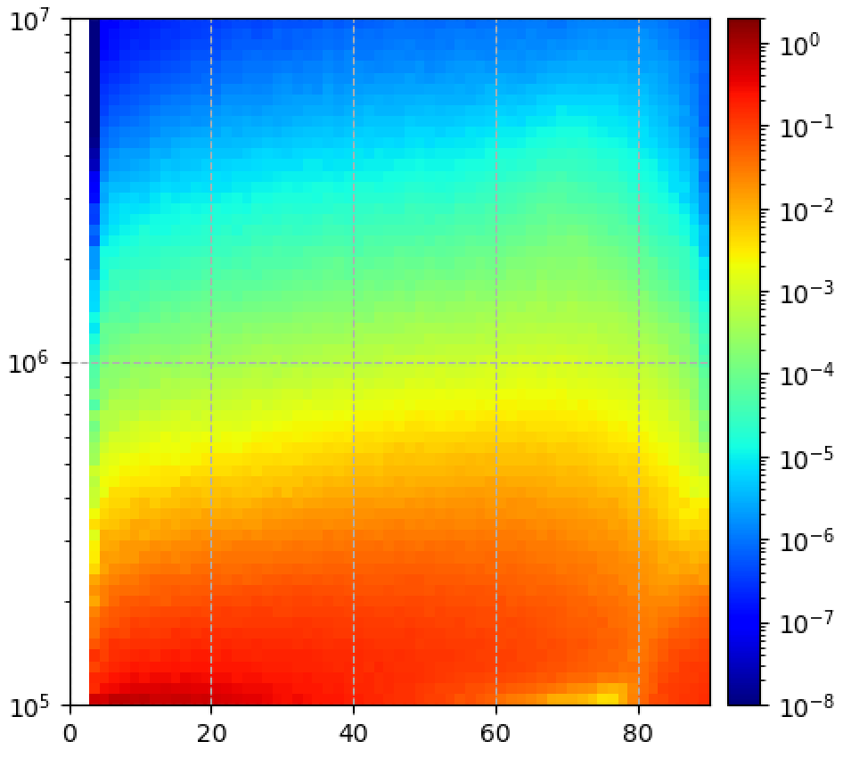
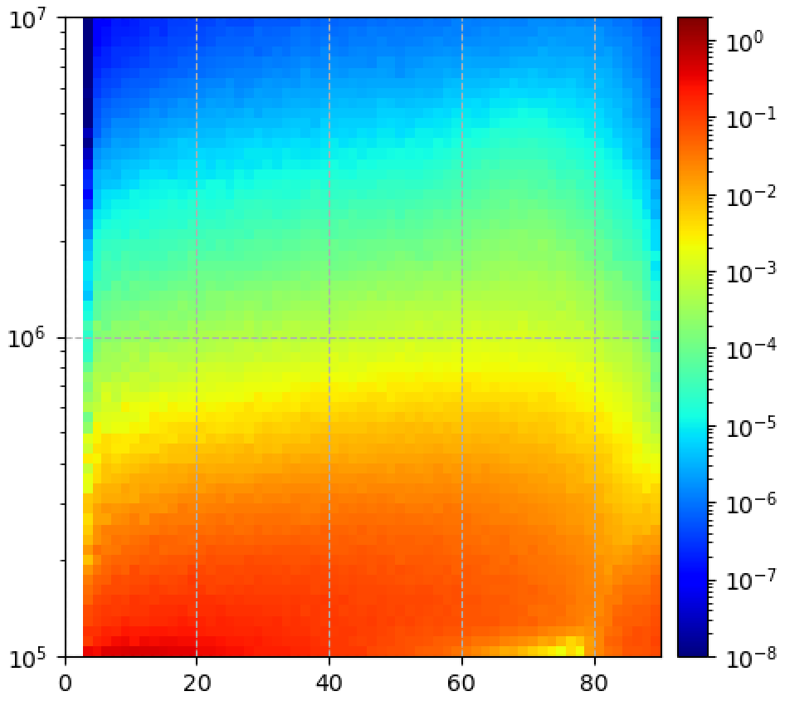
Rade3D simulation - Test Run Results – Quasilinear diffusion + Nonlinear scattering
Whistler chorus elements generated every 1 seconds accelerate electrons to higher energies and enhance the flux at energies greater than 2 MeV at pitch angles between 60 and 80 degree. → Butterfly distribution at relativistic energies.
Saito, S., & Miyoshi, Y. (2022). Butterflydistribution of relativistic electronsdriven by parallel propagating lowerband whistler chorus waves. GeophysicalResearch Letters, 49, e2022GL099605.
Radial diffusion reduces the flux while the local acceleration by whistler chorus mode waves increases the flux at relatively high pitch angle.
  → Competition between reduction and increase of the flux at relativistic energies.
L=5.6 – 5.8
t=0 [s]
t=200 [s]
t=400 [s]
t=600 [s]
2 MeV
E [eV]
Normalized flux
pitch angle [deg.]
pitch angle [deg.]
pitch angle [deg.]
pitch angle [deg.]

Slide 14
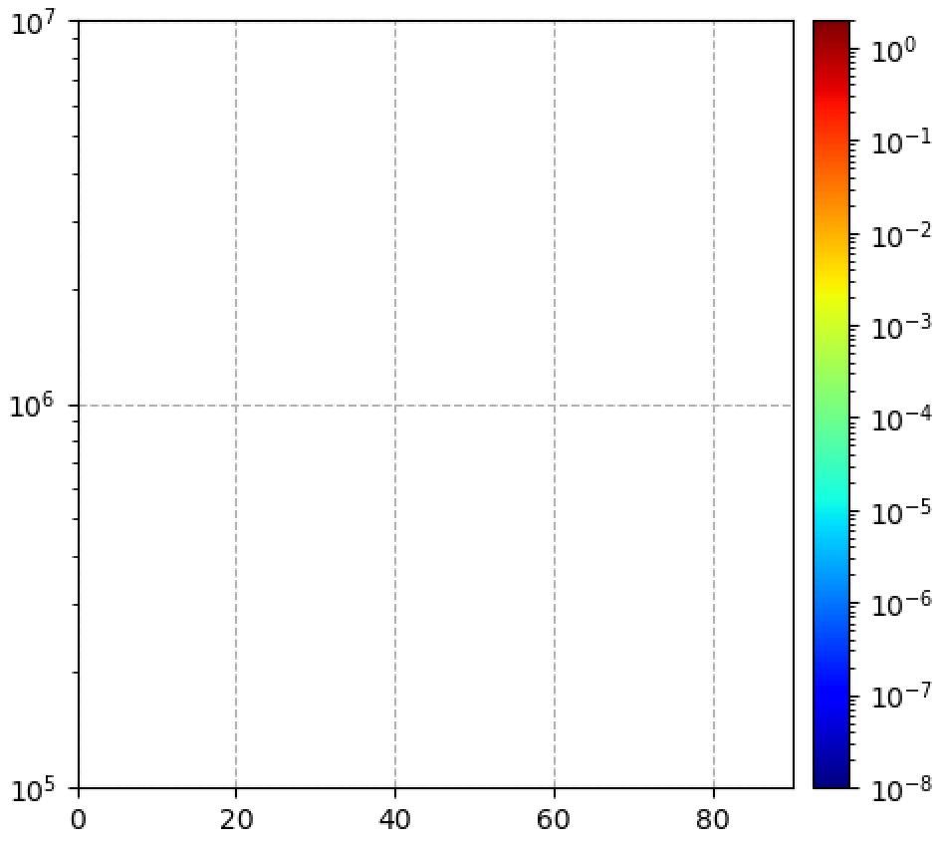
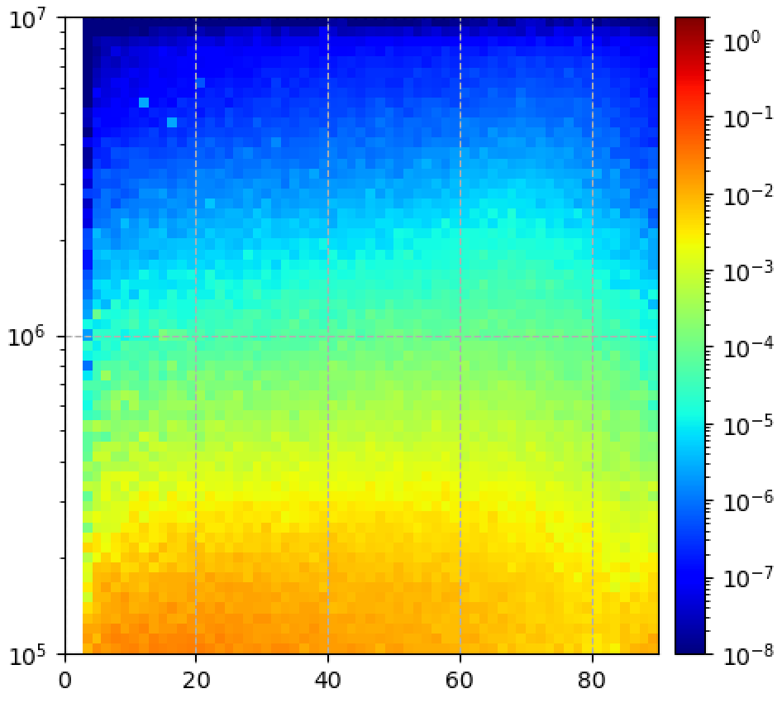
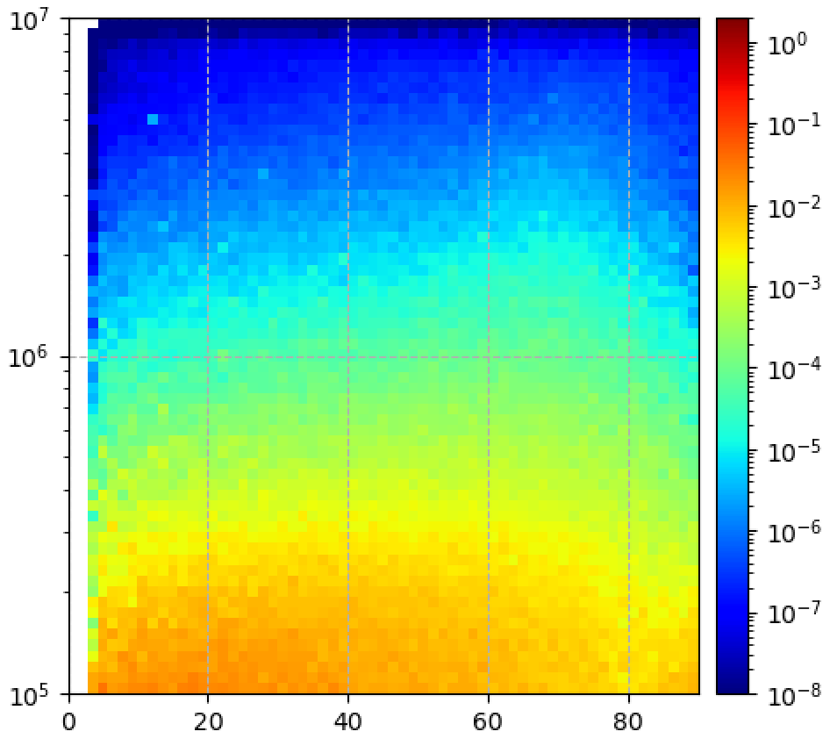
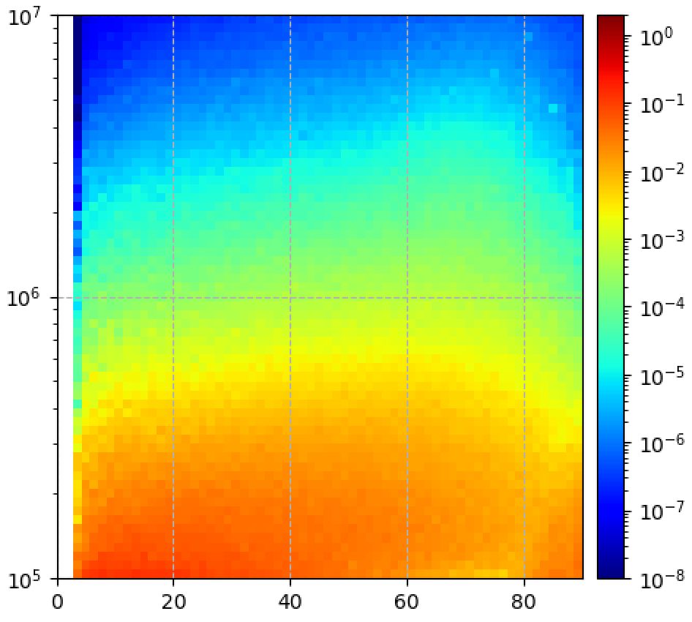
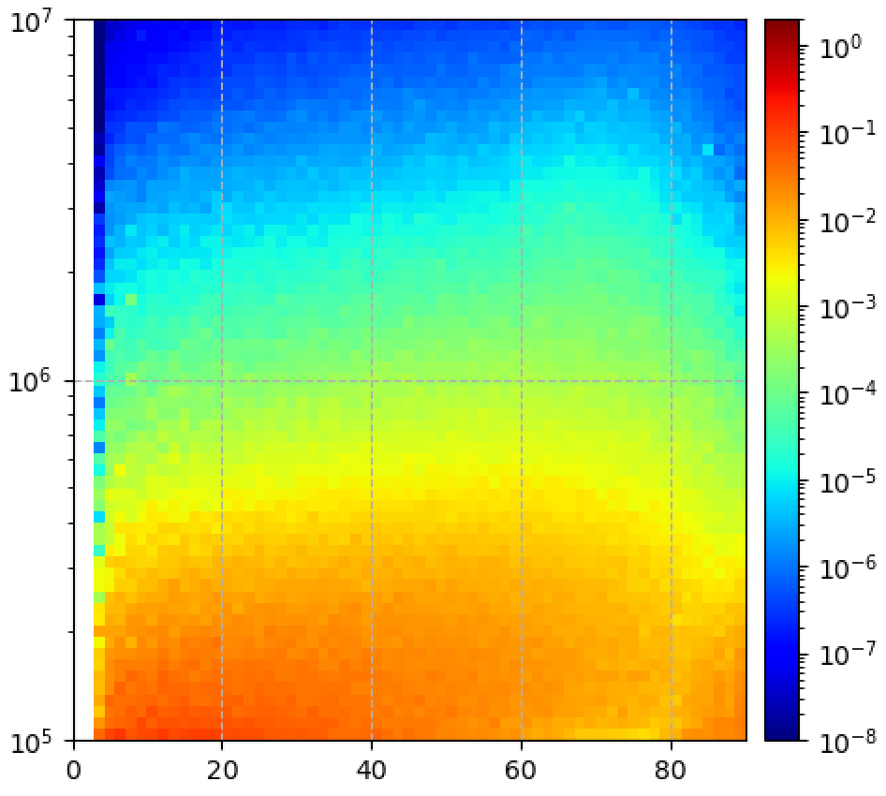
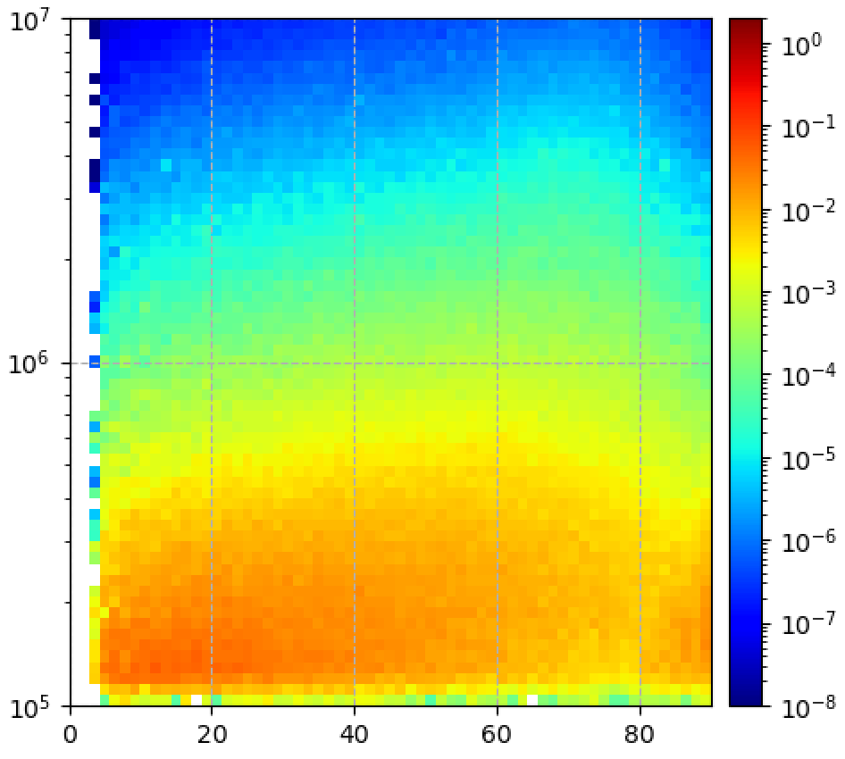
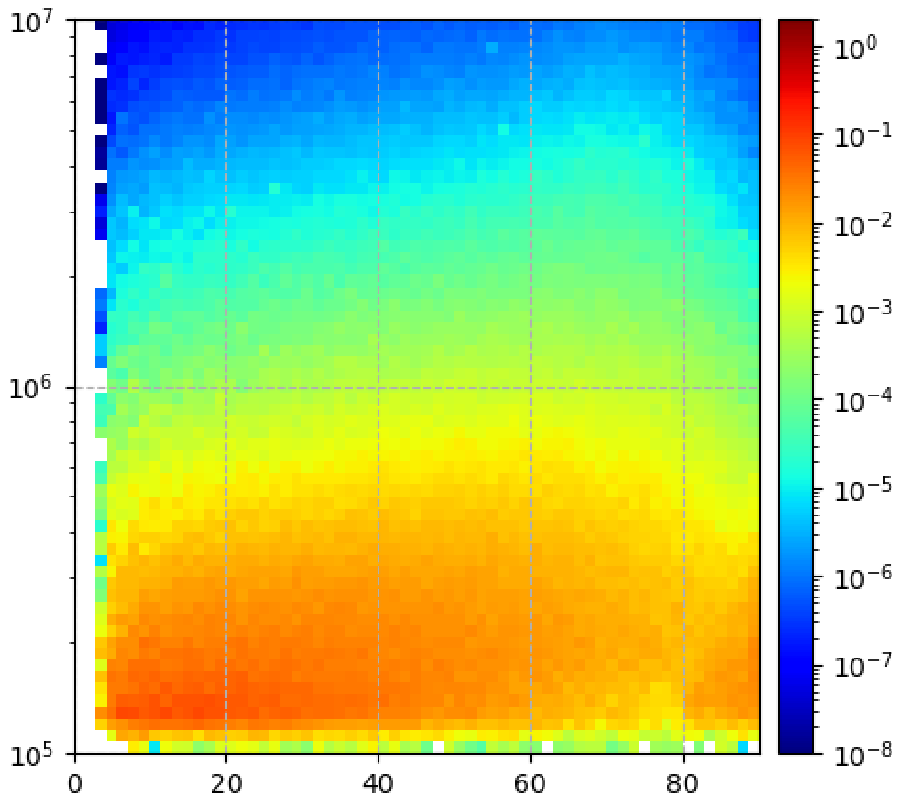
Rade3D simulation - Test Run Results – Quasilinear diffusion + Nonlinear scattering
Whistler chorus elements generate the butterfly distribution at relativistic energies on L shells between 5.6 and 5.8.
There is no chorus emission on inner and outer L shells, but the radial diffusion can transport the electrons into different L shells with keeping the characteristics of pitch angle distribution.
t=0 [s]
t=3600 [s]
t=7200 [s]
NLS model (ON/OFF)
L=6.2 – 6.4 (outer L shells)
E [eV]
OFF
L=5.6 – 5.8
E [eV]
ON
L=5.0 – 5.2 (Inner L shells)
E [eV]
OFF
pitch angle [deg.]
pitch angle [deg.]
pitch angle [deg.]

Slide 15
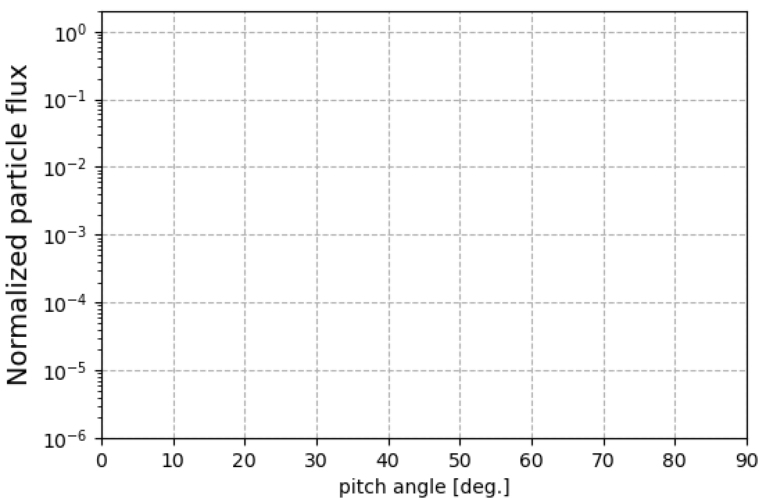
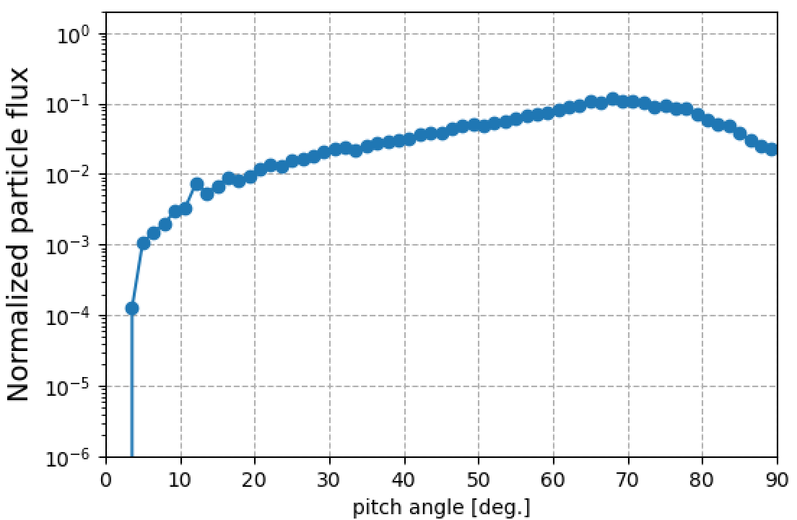

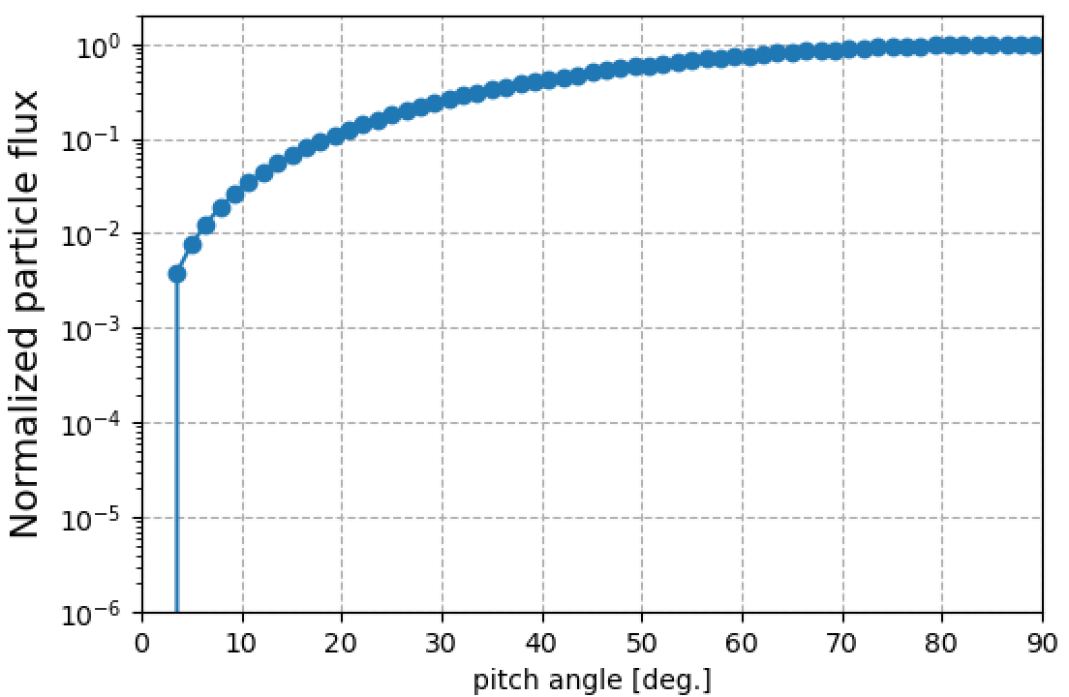
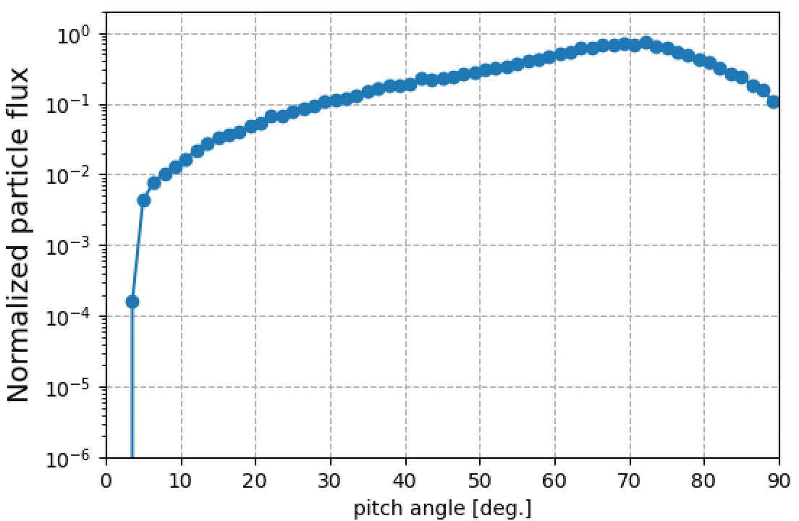
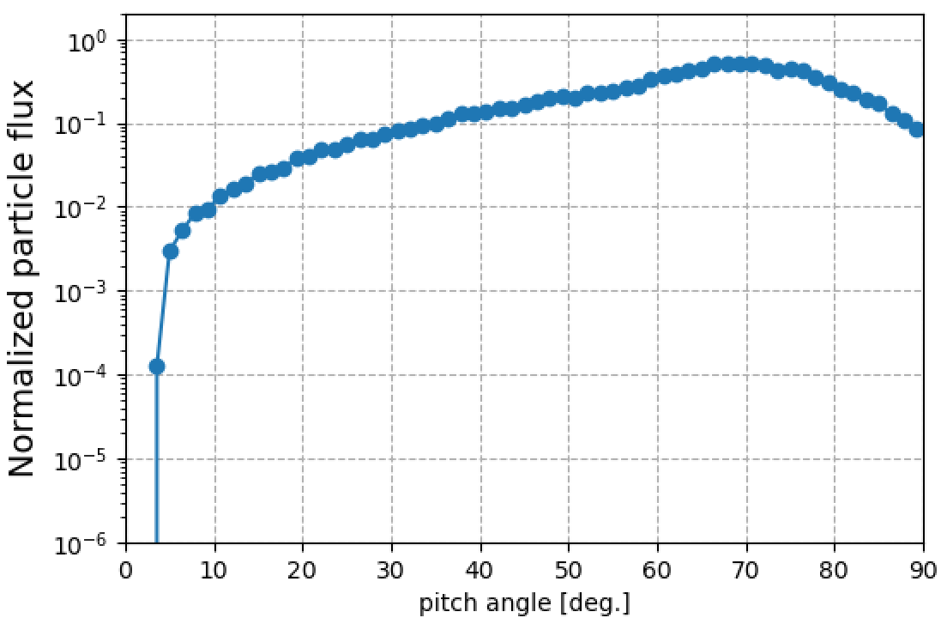
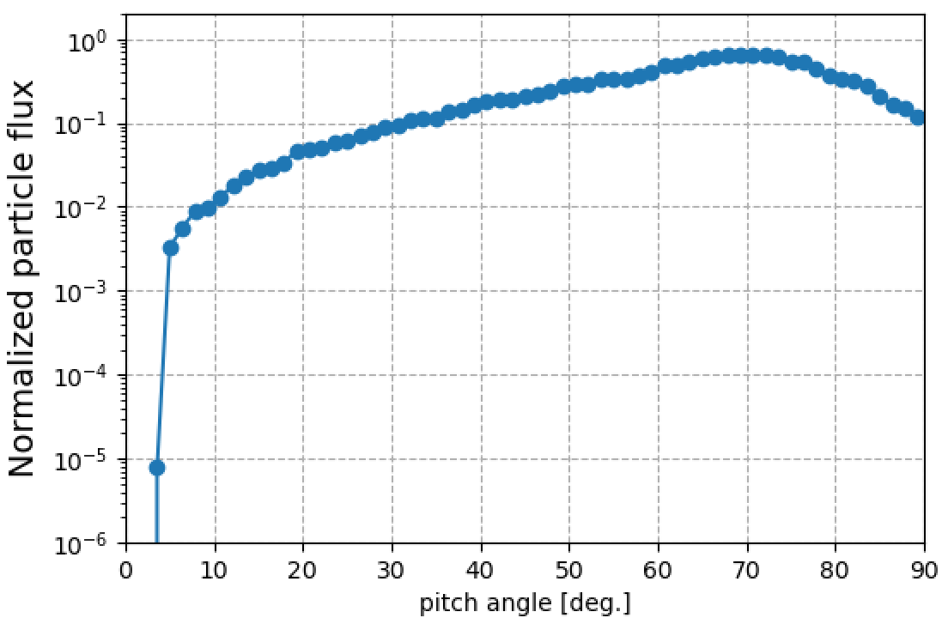
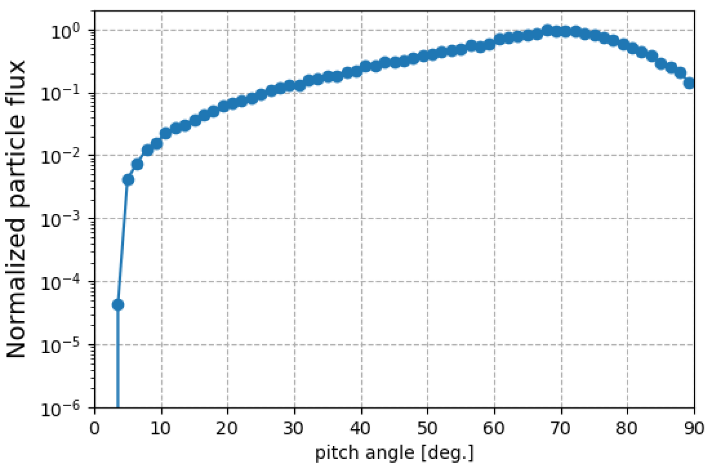
Rade3D simulation - Test Run Results – Quasilinear diffusion + Nonlinear scattering
Butterfly pitch angle distributions are seen in both outer and inner L shells at energies higher than 2 MeV.
The distribution appears on L shells where there is no wave-particle interactions.
The distribution might be transported from different L shells where the whistler chorus emissions occur.
>2 MeV
t=0 [s]
t=3600 [s]
t=7200 [s]
L=6.2 – 6.4
(Outer L shells)
L=5.6 – 5.8
L=5.0 – 5.2
(Inner L shells)

Slide 16
Summary
We developed the nonlinear local scattering model for whistler chorus mode waves.
The model also applies the quasilinear radial diffusion model to each test-particle.
The preliminary results show the flux variation that we expect.
Characteristics of the butterfly distribution can be transported into the inner and outer L shells.
Future works
  Define how to inject the particles at the low energy boundary.
  Apply an empirical model for temporal and spatial distribution of whistler chorus waves as a function of Kp.
  Apply an observed flux distributions as an initial condition and compare with the temporal variation of observed flux.
  Verification of the butterfly formation outside the wave generation region.
  Apply data observed by RMS which Himawari-10 is equipped with.
RMS: Radiation Monitors for Space weather, Himawari-10: Japan’s meteorological satellite on GEO.

