Slide 1
Space Environmental Effects Digital Laboratory (SEEDLab)
Kerry Lee, Paul O’Brien, Tim Guild, and Alex Boyd
Space Sciences Department
22 May 2025
Approved for public fer public release. OTR 2025-00728.

Slide 2
Outline
Space Environmental Effects Digital Laboratory (SEEDLab)
Overview
Current State
SEEDLab Description (Models and Modules, Framework, etc.)
Status - Updated Workflow
Status – General Workflow (Walk Through Workflow, Runtime, Data Visualization)
Example Outputs (Data Visualization of Inputs and Data Products)
Summary

Slide 3
Overview
Providing survivability specifications for the natural radiation environment and understanding the resulting effects on spacecraft components is needed for spacecraft design.
Different programs/agencies specify radiation requirements often based on the background and experience of their internal subject matter experts. This means that requirements often specify which models to use in verifying the design requirements.
It is often desirable to compare different environment model outputs for bounding the possible limits of the design environment or to do mission trade studies.
There are essentially four (4) kinds of models used to determine the final radiation effects
External natural environment models define GCR, ACR, SEP, Trapped, Atomic Oxygen, etc. spectra
Transport models consider spacecraft geometry, material, and the physics of particle interactions with matter
Effects models consider response of materials, electronics, etc. at a point of interest within the spacecraft geometry
Kernels, are precalculated transformations/tables to go from external environment spectra to a specific effect
Each of these kinds of models has had many different implementations over the decades of the space age with more being developed all the time
A spacecraft designer would like to use any available model to meet the needs of the program/agency that the spacecraft is being built for without having to learn all the nuances of each
SEEDLab will offer this ‘a la carte’ model selection capability

Slide 4
SEEDLab Space Environment Effect (SEE) Models
Proposed Changes to Perform Such Analysis in SEEDLab
Integrate CRÈME96 tool chain into a wrapper to run end-to-end on Dense Core cluster (maintain past capability)
Create a framework that permits adding newer SEE models, various radiation transport codes, precalculated kernels, and radiation effects models
Each Module is independent and will work with all the other modules (Pick any set to produce results)
Environment: Choose one of each model or omit any if desired [trapped, SEP, GCR, ACR, Atmosphere]
Transport: Choose which radiation transport tool to use based on task needs (speed/accuracy)
Kernels: Choose which kernels to use in order to speed up effects results or to compare with other methods
Effects: Choose which radiation effects models to use
Report: Summarize inputs and models used, gather data in one place (particle spectra, LET spectra, IC effects, single event effects) and results graphed for each mission/orbit and compare across multiple missions/orbits
Automated tool for providing all Natural Radiation Environment Results with Framework to add future models

Slide 5
Space Environment Effects (SEEs) Workflow
Current State of Natural Radiation Environment Analysis for a Mission/Orbit/Instrument
Run CRÈME96 tool chain (Vanderbilt Website or DOS Executables) for LET and SEEs for specific parts
Run IRENE for more modern/updated/accurate trapped and SEP spectra, and provide TID and DD
Run Internal Charging Kernel from IRENE electron worst case spectrum for IC effects
Run BON2020 for more modern/updated/accurate GCR environment
Run MSIS for atomic oxygen or other atmospheric/ionospheric particle densities
Gather environment spectra and input to desired radiation transport software with geometry and specify which end points to tally at which positions in the geometry
Gather results into a report caveating which result came from which model or set of models
Manual process with unique results gathering/reporting for each case

Slide 6
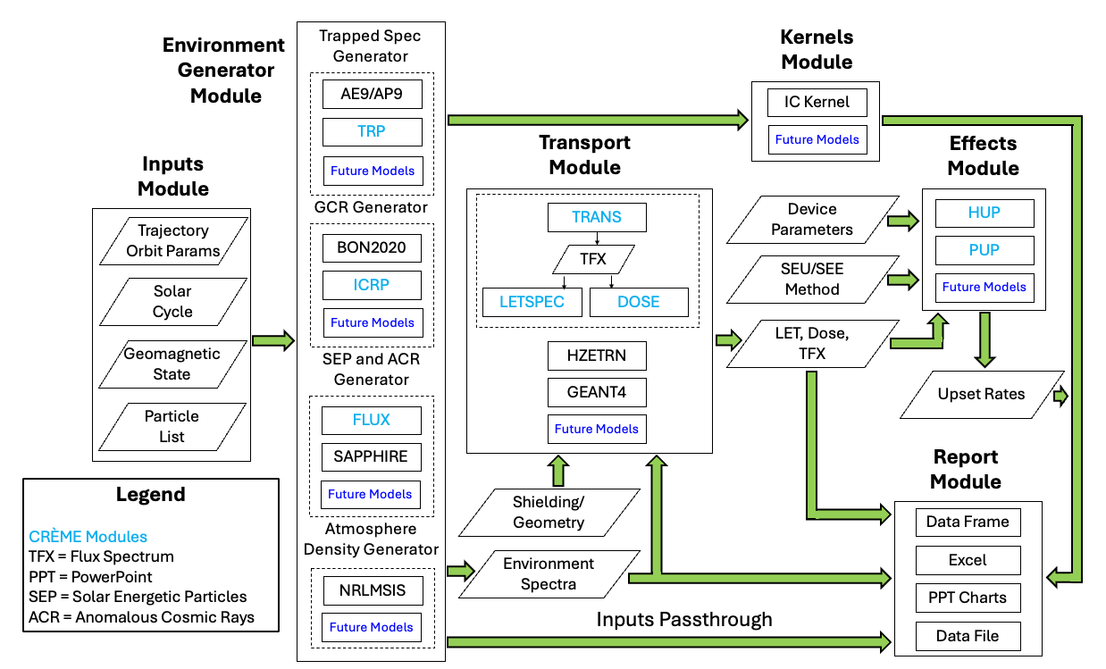
SEEDLab Models and Modules
Description

Slide 7
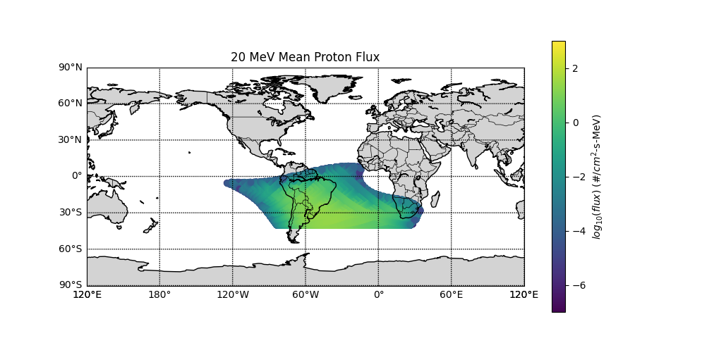
SEEDLab Framework
General Requirements for each model
Define an index file for managing all possible model outputs
Unique Set of Orbit Parameters (USOP) serves as unique identifier within index files
List of data products for each USOP

Slide 8
Status – Updated Workflow
Data Access and Archiving
For each USOP, the IRENE data products and path to each are listed
Input Files
Raw data flux output files
Intermediate aggregated data
Final probabilistic data products which combines plasma, trapped, solar, worst-case windows, and resulting dose
For each USOP, the CRÈME96 data outputs from each module are listed
For each data set the dependent modules and input parameters used to generate each are listed
Example: LET data at a given shield depth (LETSPEC module) is produced from a Transported Flux (TRANS module) which resulted from a flux spectrum (FLUX module) that could have required Trapped spectrum (TRP module) and geomagnetic transmission (GTRN module)
The full chain of inputs required to reproduce all the dependencies and final data product are indexed
Similar index files for each model will be added for quick assessment of existing data
For existing data from IRENE and CRÈME96 run outside of the SEEDLab workflow, an import function has been produced to walk through data folders and add those to their respective index files

Slide 9
Status – General Workflow
Walk Through Workflow
Setup: User selects…
USOP(s) or provides ephemeris and defines environmental conditions
start date, mission length, and time step for each USOP – defaults built in
models to use for generating radiation environment(s) and data products desired from each model
shielding geometry and which transport engine(s) to use, if any are required
kernels to run (bypasses the need for transport engines)
report and data output options – defaults exist for each model and data product
Runtime:
Search index files for existing data that closely matches user request.
User picks matches or continues with model run(s)
For matches picked, required data is read for desired report options
Models, transport, and kernels run in parallelized fashion across available computing resources
Reports are generated

Slide 10
Status – General Workflow
Runtime
IRENE
Jobs are split and submitted to distributed cluster resources
Optimized data post-processing making use of vectorization and multiprocessing capabilities
CRÈME96
Pre-run assessment of which modules need to be run
Creates a dependency tree where each module run is assigned a dependency count of the number of other module runs that rely on its results
The module runs with the highest dependency counts are prioritized, and those without dependencies needs are run in parallel.
Each process with a dependency waits for their respective dependents and runs in parallel upon all dependency completion
Optimization based on availability of computational resources

Slide 11
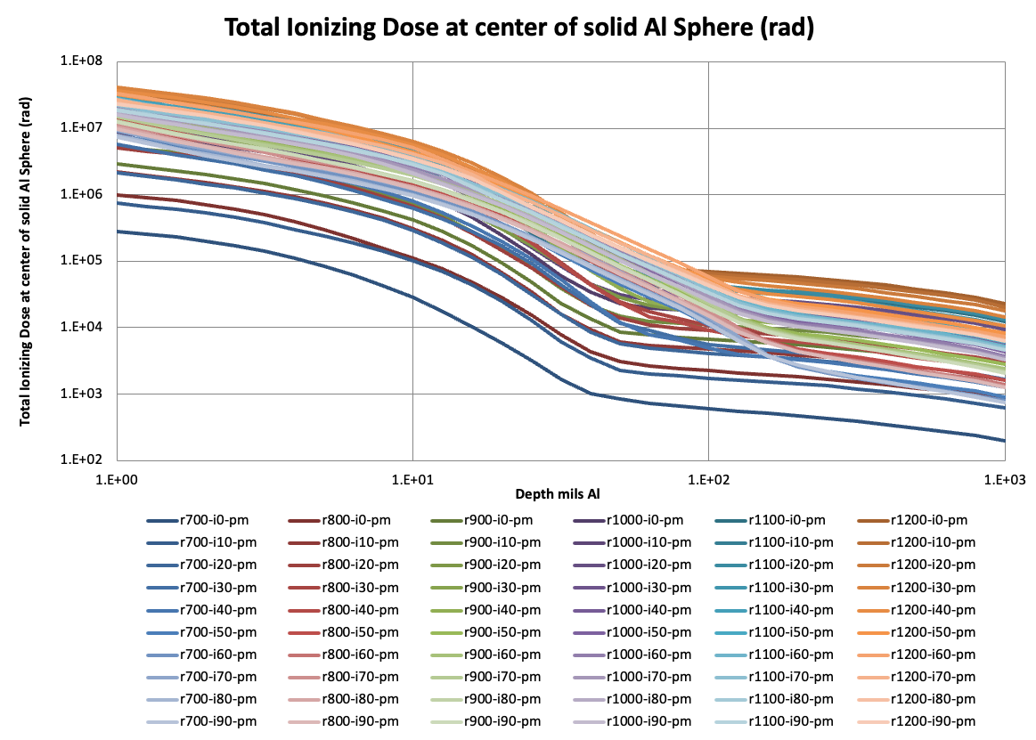
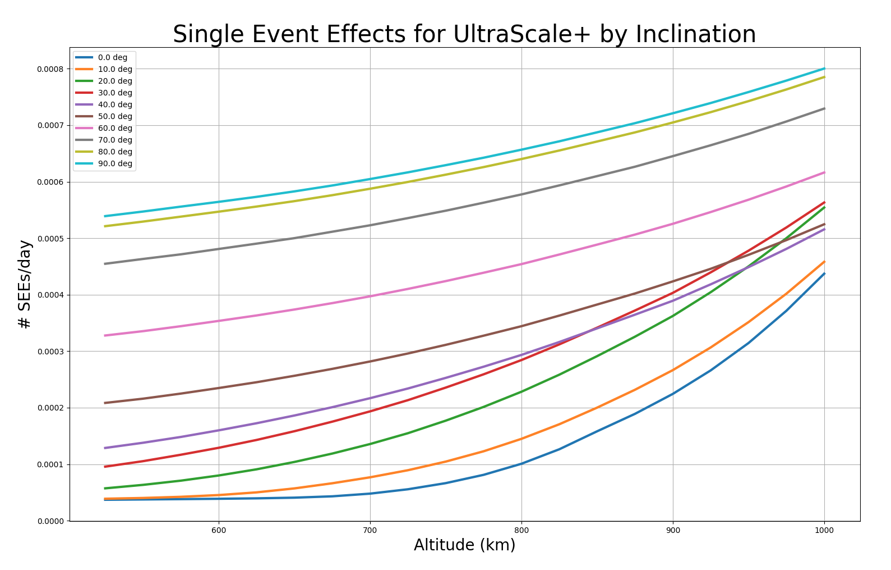
Status – General Workflow
Data Visualization
USOP mission trajectory
Environment Spectra and Transported Spectra - by component or combined
Point by point in 2D or 3D space – by energies and CLs
Energy vs Flux/Fluence – by mission length and CLs
Energy vs Flux/Fluence for multiple USOPs
Effects Data
Point by point in 2D or 3D space – by shield depths and CLs
TID/DDD/IC vs Depth – by mission length, CLs, shield geometry
LET spectra – by shield depth and particle range
SEE Rates – by shield depth
Component Single Event Effects by Inclination
Quick Visualization of Inputs and Data Products

Slide 12
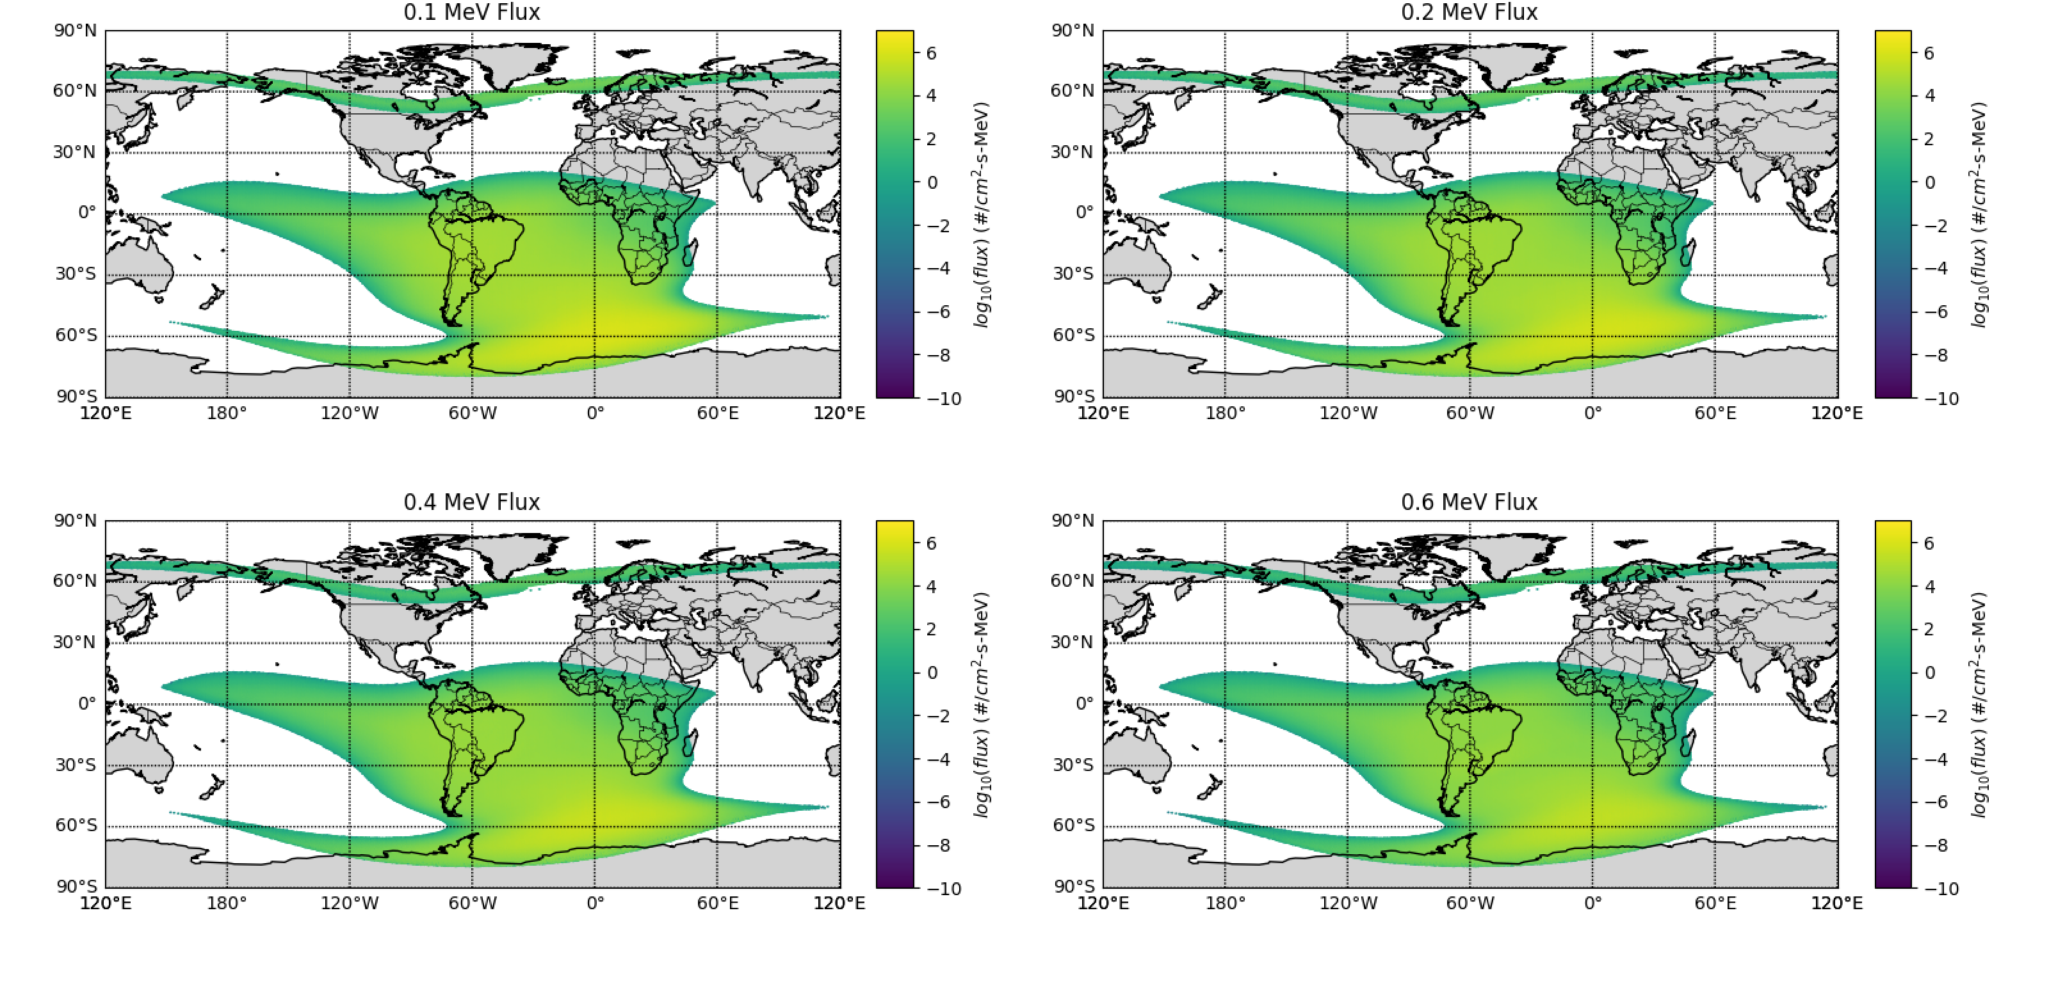
Differential Proton Flux at 95% Confidence
Data Visualization of Inputs and Data Products

Slide 13
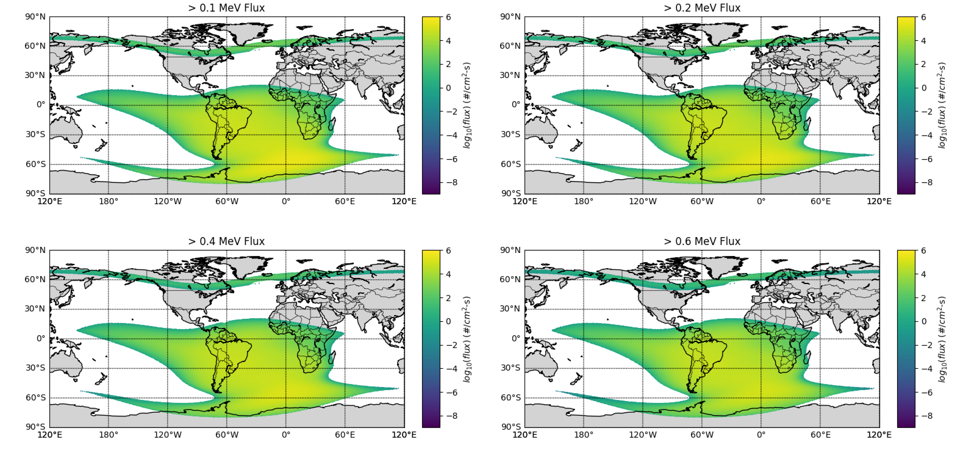
Integral Proton Flux at 95% Confidence
Data Visualization of Input and Data Products

Slide 14
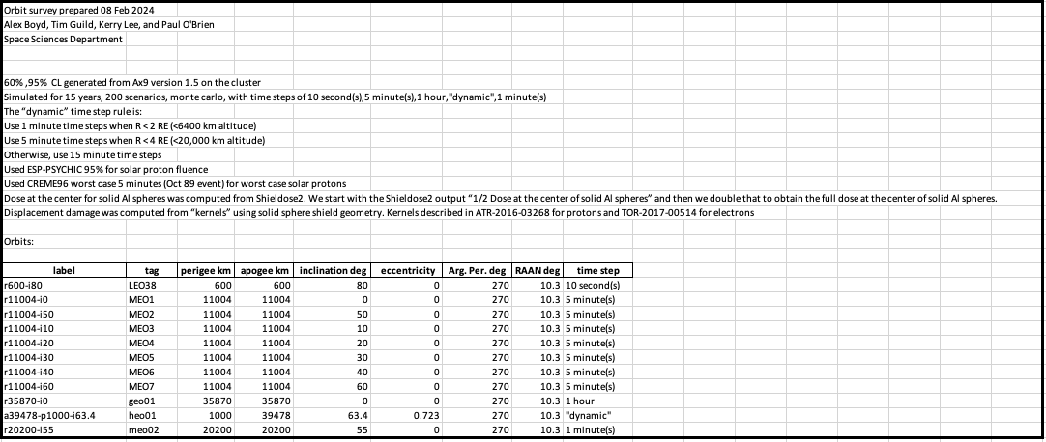
Status of SEEDLab Work
Reports
Example of Excel Cover Page listing all orbits included by their USOPs
Excel data sheet for a single orbit at a specified CL with data from IRENE and CRÈME96 models

Slide 15
Summary
SEEDLab is an effort to pull together many space radiation natural environment models into a single application that maintains the ability to reproduce historic analyses and built with a module design such that adding new models of the future will be a simple task
In addition to environment models SEEDLab will also allow the use of multiple existing methods to transport the natural environment through specified geometries to yield radiation spectra at any point within the geometry
The SEEDLab application will be able to quickly produce reports for generating requirement specifications for specific orbit applications as well as reports for doing orbital radiation trade studies

Slide 16
Thank you

