Slide 1
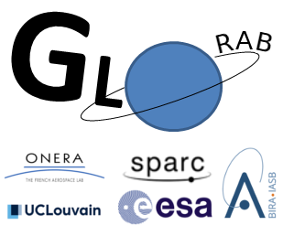
The GLORAB statistical model: Space and time correlation modelling for trapped radiations specification models
2025-05-20 IRENE Workshop, Sykia, Greece
A. Brunet¹, A. Sicard¹, N. Dahmen¹, C. Papadimitriou², H. Evans³
¹ ONERA/DPHY, Université de Toulouse, France
² Space Applications & Research Consultancy, Athens, Greece
³ ESA, ESTEC, Noordwijk, The Netherlands
Logo credit: N. Dahmen
This work received funding from the European space agency under ESA Contract 4000137689/22/NL/CRS.
Ce document est la propriété de l'ONERA. Il ne peut être communiqué à des tiers et/ou reproduit sans l'autorisation préalable écrite de l'ONERA, et son contenu ne peut être divulgué. This document and the information contained herein is proprietary information of ONERA and shall not be disclosed or reproduced without the prior authorization of ONERA.

Slide 2
Outline
Introduction
Statistical modelling of the fluxes
Application to environment specification
Conclusion

Slide 3
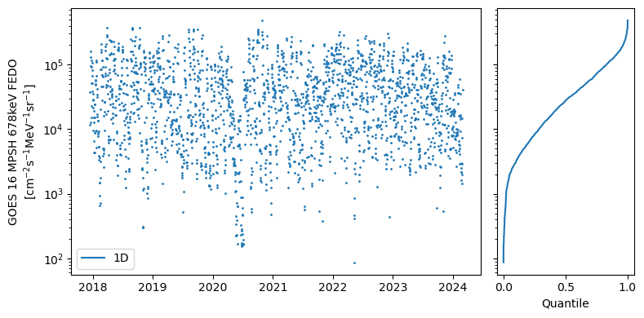
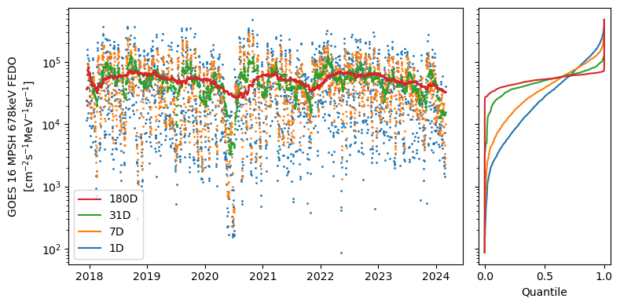
Motivation
Flux data
Cumulative distribution
Narrowing
of the distribution

Slide 4
Model objectives
Specification models: we want to compute the long-term distribution of the fluxes, given their variability due to space weather and space climate
Covariance between fluxes at different points has to be taken into account: they determine how fast the mean flux distribution reduces to the mean
Objectives:
Global radiation environment specification, which can produce
instantaneous flux levels along arbitrary spacecraft trajectories,
cumulative fluences during the mission
Applicable at all timescales: short to long-term mission profiles

Slide 5
Methodology overview
For a given trajectory, composed of $n$ points, we model the fluxes at all points by random variables $\left(X_{1}, X_{2}, …, X_{n}\right)$.
We suppose we know the distribution functions $F_{i}(x_{i})=Pr⁡[X_{i}≤x_{i}]$
Our goal: estimate the distribution of $\overline{X}=\sum_{i}{X_{i}.{dt}_{i}}$
The $X_{i}$ are not statistically independent in general.
Let’s introduce the normalized variables:
$$\left(U_{1},U_{2},…,U_{n}\right)=(F_{1}\left(X_{1}\right), F_{2}\left(X_{2}\right), …, F_{3}\left(X_{3}\right))$$
The $U_{i}$ variables have uniform distributions on [0,1]
Their joint distribution function $C\left(u_{1},…,u_{n}\right)=\operatorname{Pr}{[U_{1}≤u_{1},…,u_{n}≤U_{n}]}$ describes the dependence structure between the $F_{i}$ variables
Idea of the model: for a given list of trajectory points:
Estimate the marginals $F_{i}(x_{i})$ and the copula function $C\left(u_{1},…,u_{n}\right)$,
sample the distributions of $U_{i}$,
compute the corresponding samples $X_{i}=F_{i}^{−1}\left(U_{i}\right)$, and
compute the fluence distribution $\overline{X}$.

Slide 6
Data
Comparison of re-analysis database and RBSP data at ~1 MeV
Here we use re-analysis databases computed using the Salammbo-EnKF data assimilation code:
Complete radiation belt state description on a magnetic coordinate grid (Ec, L*, $y=sin⁡(α_{eq})$)
Omnidirectional, differential fluxes are considered
1h time resolution, approximately 10 years of data
For more details, see N. Dahmen presentation on Thursday

Slide 7
Outline
Introduction
Statistical modelling of the fluxes
Application to environment specification
Conclusion

Slide 8
Flux distributions
The statistical (marginal) distribution of the fluxes at each grid point (in L*, $α_{eq}$, Ec) was extracted from the re-analysis databases
Our distribution model uses the grid of 20 fixed values quantiles and interpolation to produce the marginal distribution at arbitrary points

Slide 9
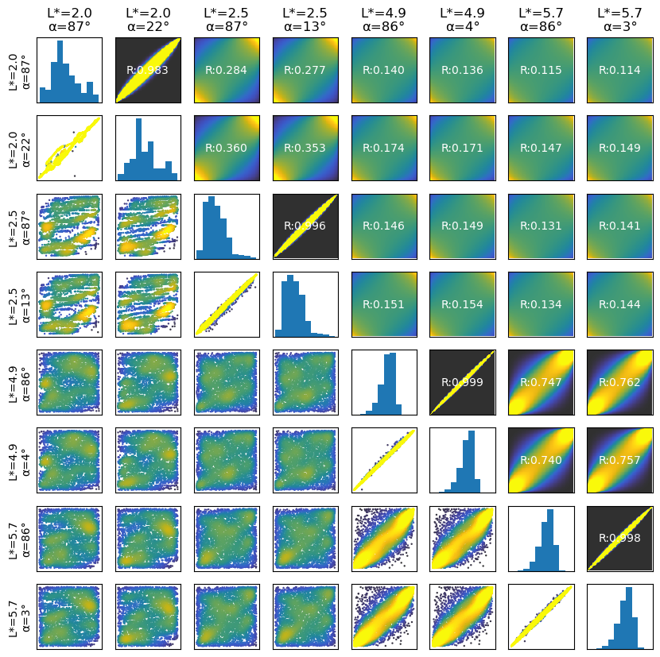
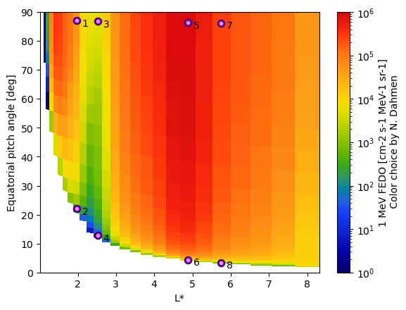
Covariance modelling
By normalizing the fluxes in the re-analysis database, we can study the dependence structure between them
The joint distributions of the normalized fluxes is very close to a gaussian copula:
Copula obtained from a multivariate gaussian distribution
Only depends on the correlation matrix $R_{ij}=\frac{Cov\left(U_{i},U_{j}\right)}{σ_{U_{i}}σ_{U_{j}}}$
To parametrize this copula, we only need to compute the correlation coefficient between the fluxes for each pair of trajectory points:
$R(P_{i}, P_{j}, Δt)$

Slide 10
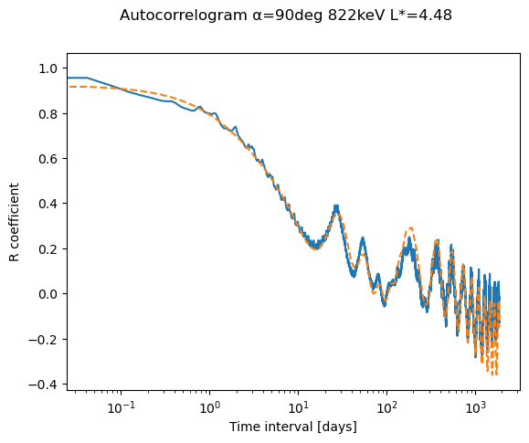
Temporal correlation modelling
Most complex dynamics in the correlations is the temporal dependency
Time correlograms show several components:
Storm response (short term to several months)
CIR effects : 27 days period, up to 6 months
Semi-Annual Variation: 6 month period
Solar-cycle dependency: 11 years period
Temporal model with 9 parameters can be fitted, works well for different energies and positions :
$$θ=\left(R_{0},τ_{storm},τ_{cir},a_{cir},Φ_{cir},a_{sav},Φ_{sav},a_{sc}, Φ_{sc}\right)$$

Slide 11
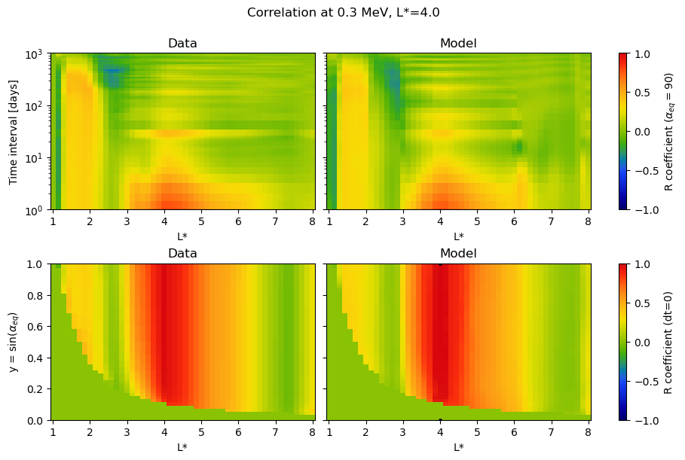
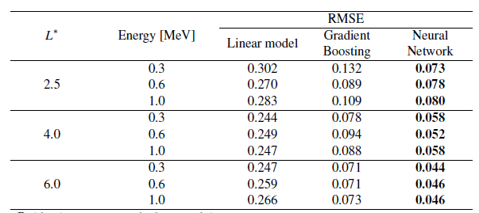
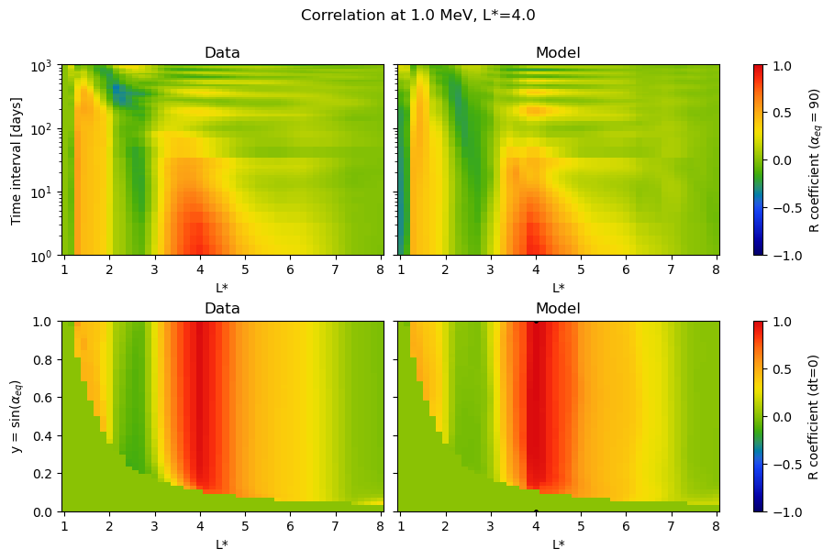
Resulting correlation model
A deep-learning model was trained to map from pairs of magnetic coordinates to the temporal model parameters
We obtained very good reconstruction of the correlation coefficient at the various timescales

Slide 12
Outline
Introduction
Statistical modelling of the fluxes
Application to environment specification
Conclusion

Slide 13
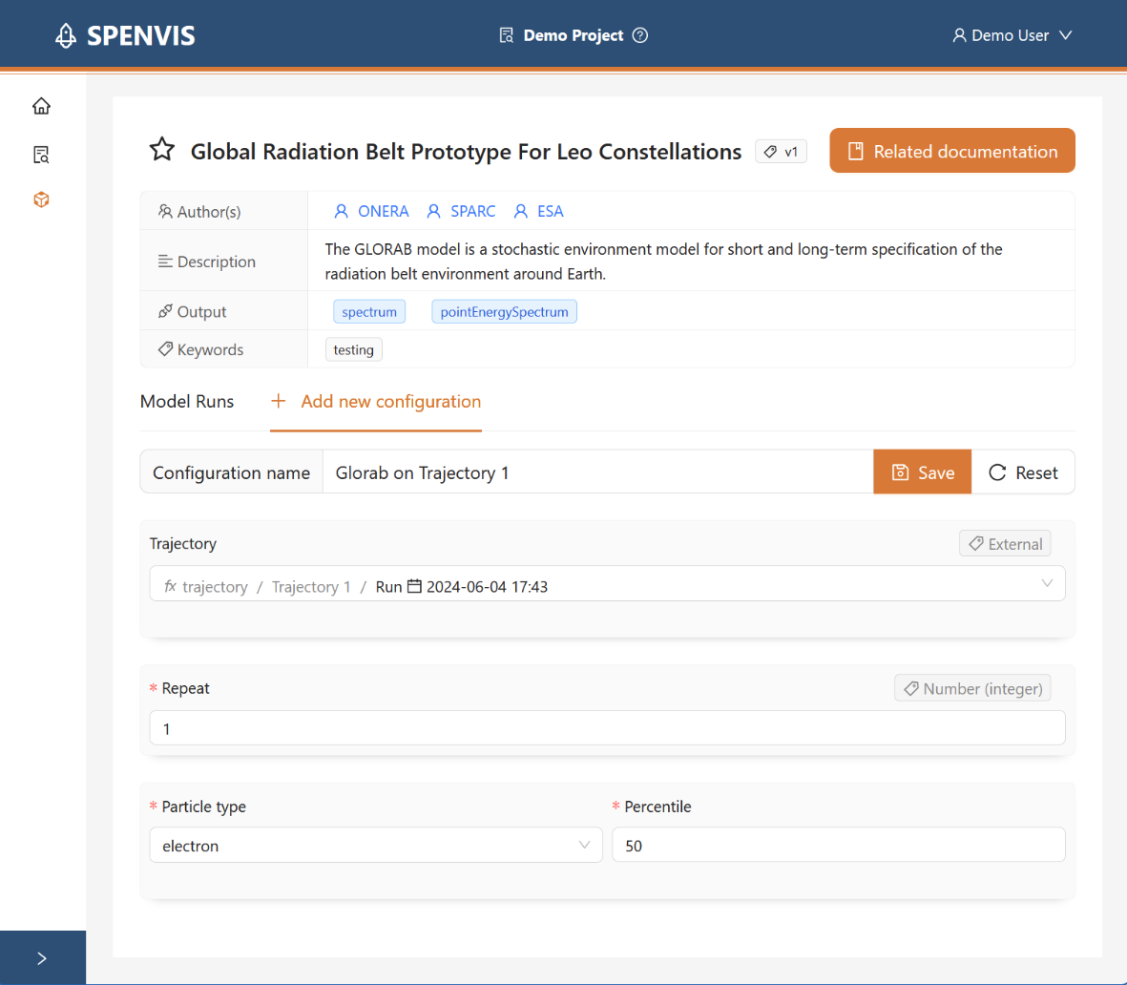
The GLORAB specification model prototype
The goal of the ESA GLORAB project is to develop two global radiation belt model prototypes (one for electrons, one for protons), dedicated to the LEO/MEO regions
Re-analysis databases were produced for both electrons and protons
The presented statistical method was applied, and a dedicated end-user tool was developed to fly satellites in the model
The model will be made publicly available by ESA on a future Spenvis release

Slide 14
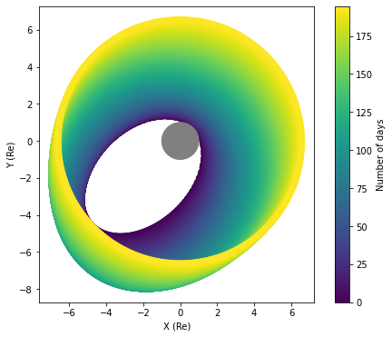
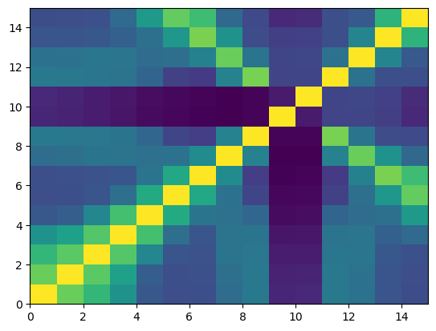
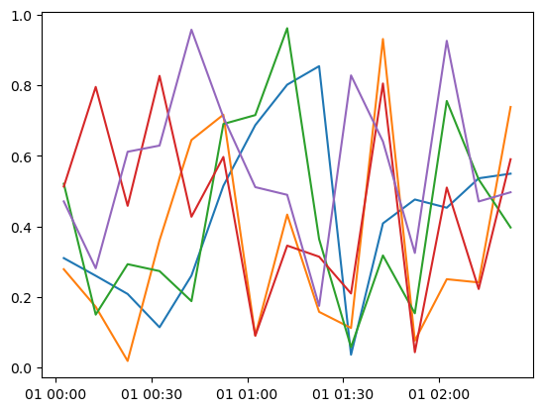
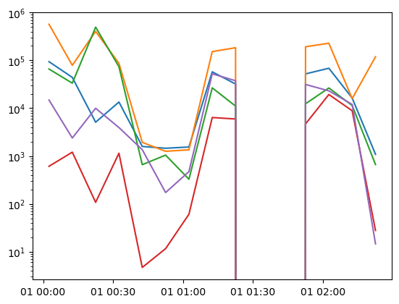
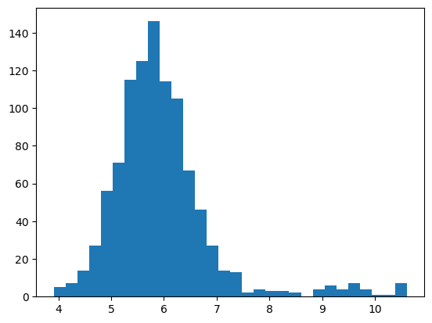
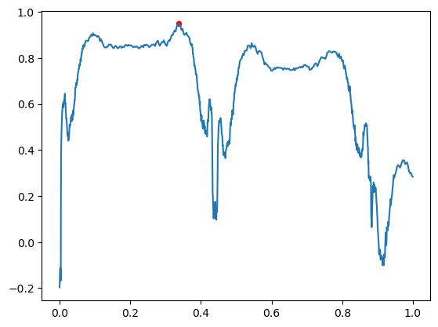
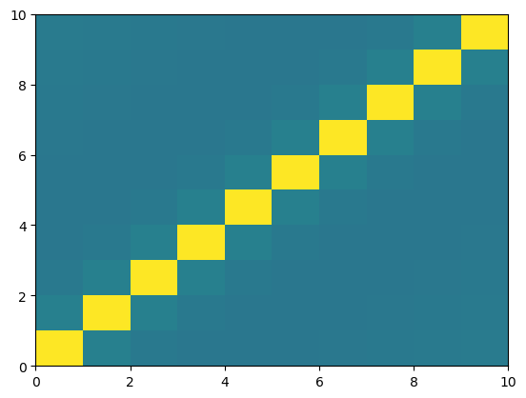
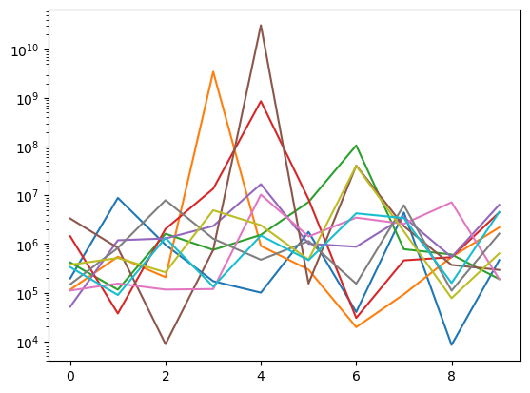
The GLORAB model overview
1st pass: Orbit flux model
Trajectory
Magnetic coordinates
Correlation matrix
Sampled trajectories
(Normalized fluxes)
Sampled trajectories
(Real fluxes)
Spatio-temporal
Correlation
Model
Monte-Carlo
Sampling
Application of
Local distributions
2nd pass (optional): Repeat orbit model
Temporal
Correlation
Model
Correlation
Sampling
Orbit mean flux
Distribution
Representative
point selection
Autocorrelation
Matrix
Sampled trajectories
(Mean flux per orbit)

Slide 15
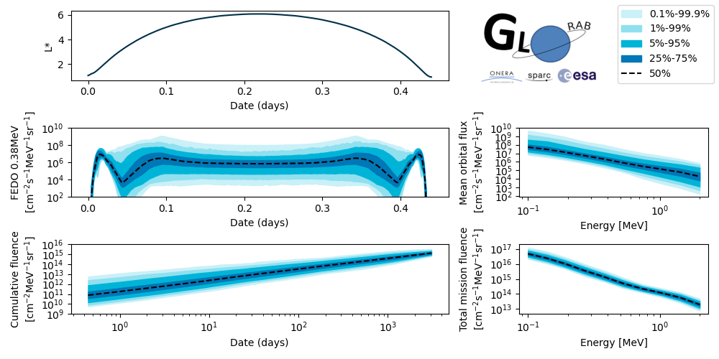
Products examples
The GLORAB model produces a very detailed statistical description of the environment:
Instantaneous flux distributions at each point of the orbit
Cumulative fluence distributions along the mission profile
It provides a much richer product than most specification models currently used

Slide 16
Results example
The GLORAB model provides a similar type of output as IRENE in Monte-Carlo mode
Much quicker computation time (especially for longer missions, seconds vs hours)
The evolution of the fluence variance along the mission is a direct consequence of the temporal covariance model

Slide 17
Outline
Introduction
Statistical modelling of the fluxes
Application to environment specification
Conclusion

Slide 18
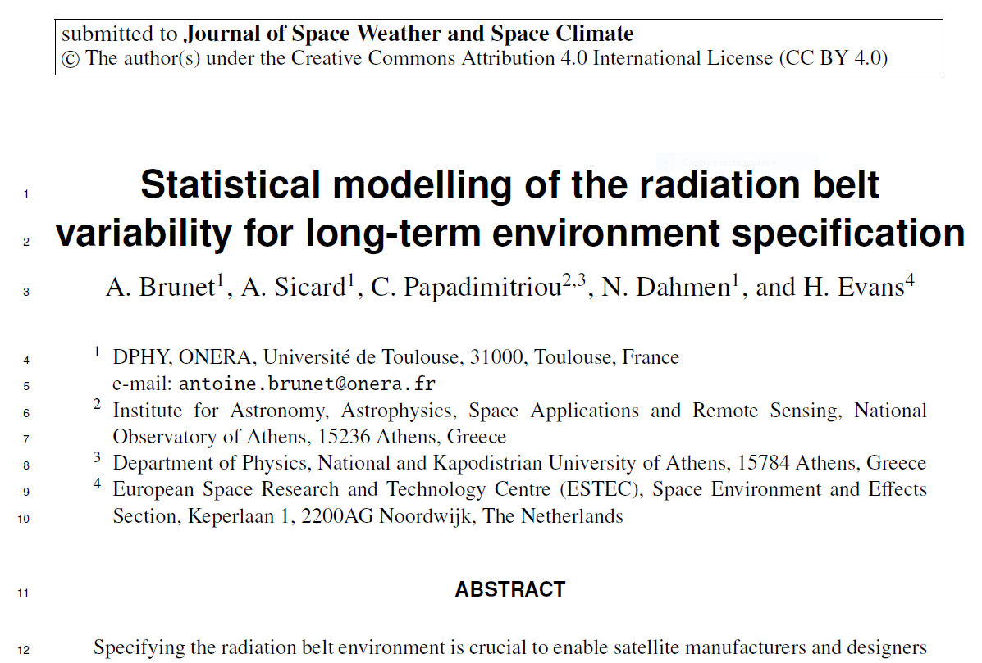
Conclusion
We have presented the statistical analysis performed to build the GLORAB prototype specification model:
Describes the statistical distribution of energetic particles fluxes
Captures spatial and temporal correlations of particle fluxes
Provides a rich output (instantaneous flux distributions and cumulative fluence distributions)
Accounts for the natural variability of the trapped radiation environment for all mission profiles
Easy to deploy:
Fast computation (seconds to minutes for complex missions)
Lightweight python package (20Mo including data)
Dependent on a high-quality reanalysis database
JSWSC article currently under review

Slide 19
Thank you
for your attention

