Slide 1


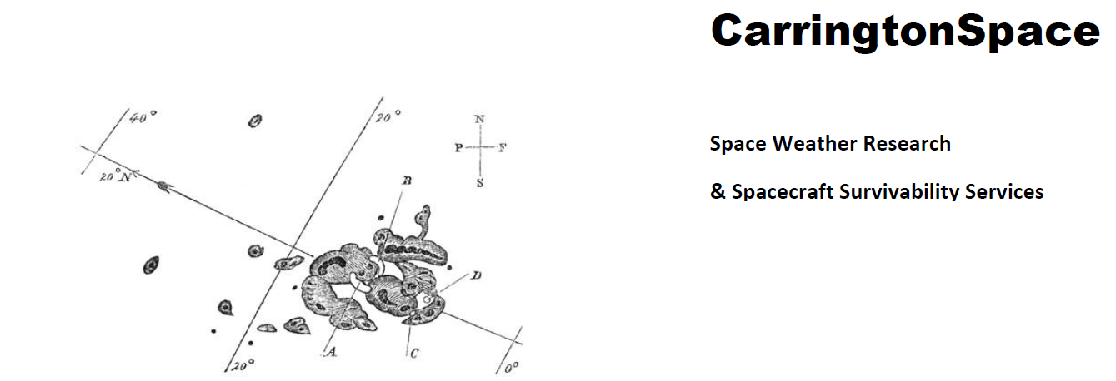






ReTiMo:
A CubeSat Mission with novel sensors for the Real Time Monitoring
of Radiation Effects on Spacecraft Electronics
Theodore Sarris (DUTH), George Kottaras (SA), Ingmar Sandberg (SPARC), Dave PITCHFORD (SES / Carrington Space), Paul O’Brien (Aerospace Corp.), Keith Ryden (SSC & USurrey), Wojtek Hajdas (PSI), Stelios Tourgaidis (DUTH), Thanasis Psomoulis (DUTH), Aggelos Papathanasiou (SA)
IRENE Workshop, Sykia, 22 May 2025
1
1

Slide 2
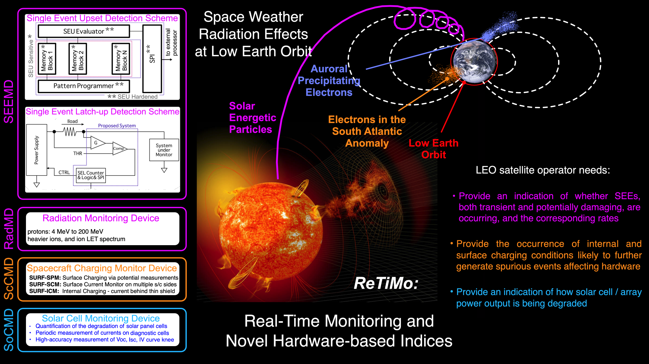
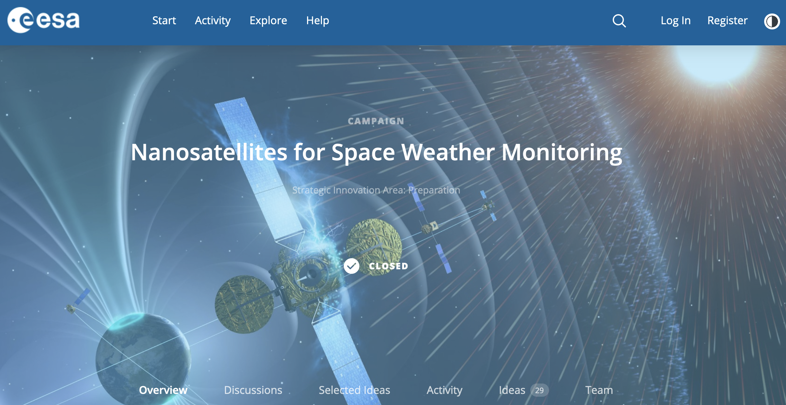
Mission Concept Overview
IRENE Workshop, Sykia, 22 May 2025
2

Slide 3
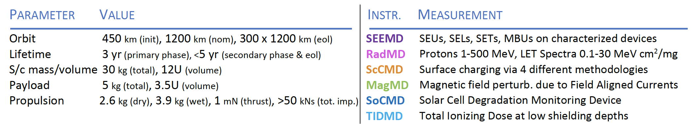
Mission Concept Overview
ReTiMo Mission Parameters and Payload – Full Instrument Suite (12U s/c)
IRENE Workshop, Sykia, 22 May 2025
3

Slide 4
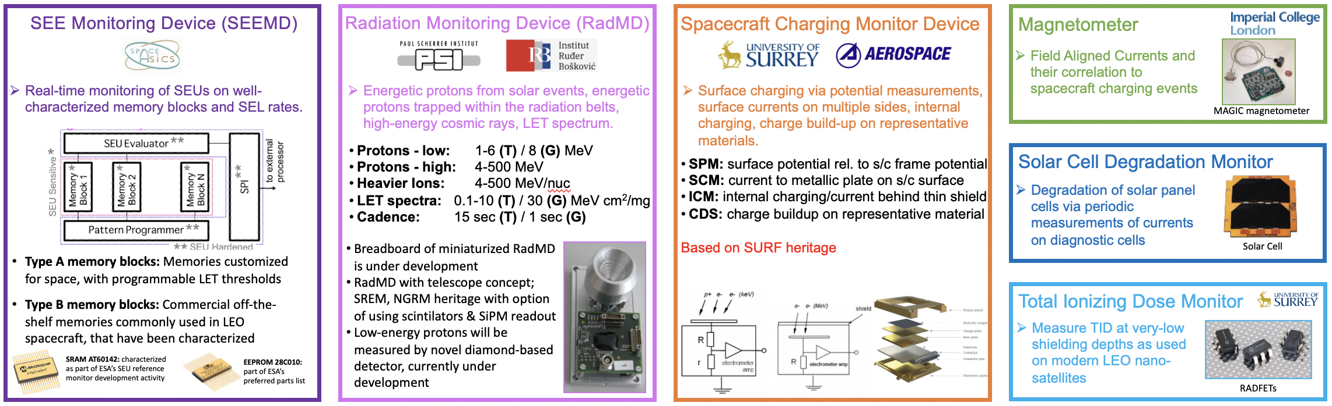
Mission Concept Overview
ReTiMo Mission Parameters and Payload – Full Instrument Suite (12U s/c)
IRENE Workshop, Sykia, 22 May 2025
4

Slide 5
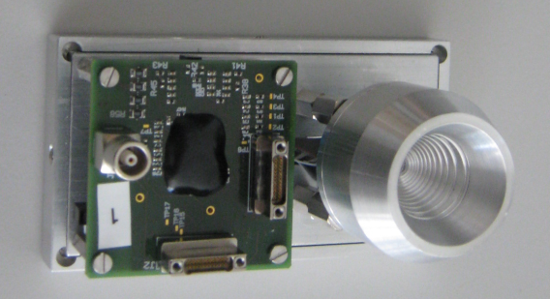
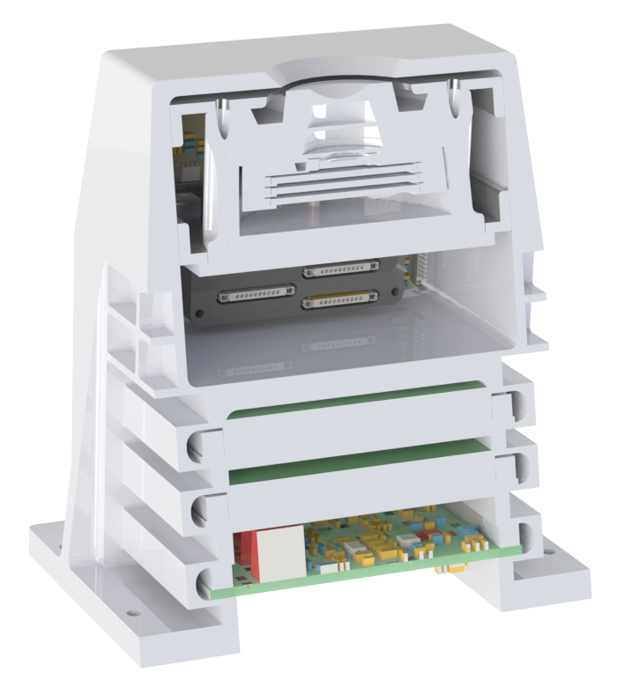
Mission Concept Overview
ReTiMo Mission Parameters and Payload – Full Instrument Suite (12U s/c)
Radiation Monitoring Device
Requirements:
Protons: 1-500 MeV (goal), 4-100 MeV (min)
Ions: 4-200 MeV/nuc
LET spectra: 0.1 - 30 MeV cm² mg⁻¹
Candidate 1:
PSI Mini Rad Monitor
Breadboard completed
Under development
Based on SREM and NGRM
Candidate 2:
CU/LASP REPTile-3
Under development for UAE Asteroid mission
Based on REPTile-2
IRENE Workshop, Sykia, 22 May 2025
5

Slide 6
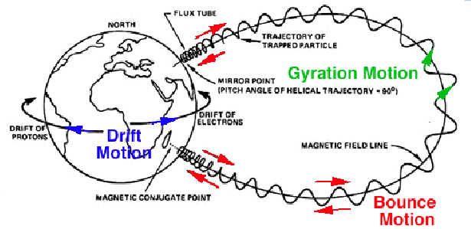
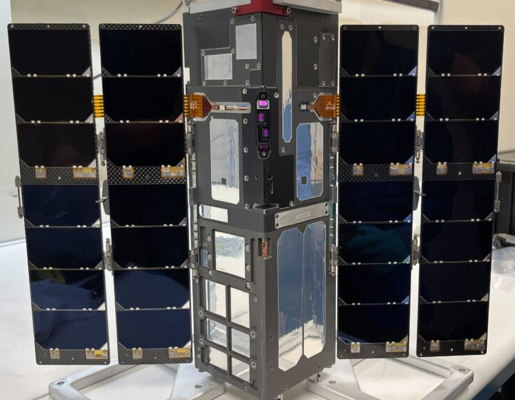
SEPs
Examples of Solar Energetic Particles measured by CIRBE/REPTile-2
(comparison with GOES measurements only on April 23, 2023)
CIRBE’s orbit
With the successes of REPTile
and REPTile-2, a unique opportunity surfaced: REPTile-3 onboard EMA
Cosmic Ray
Background

Slide 7
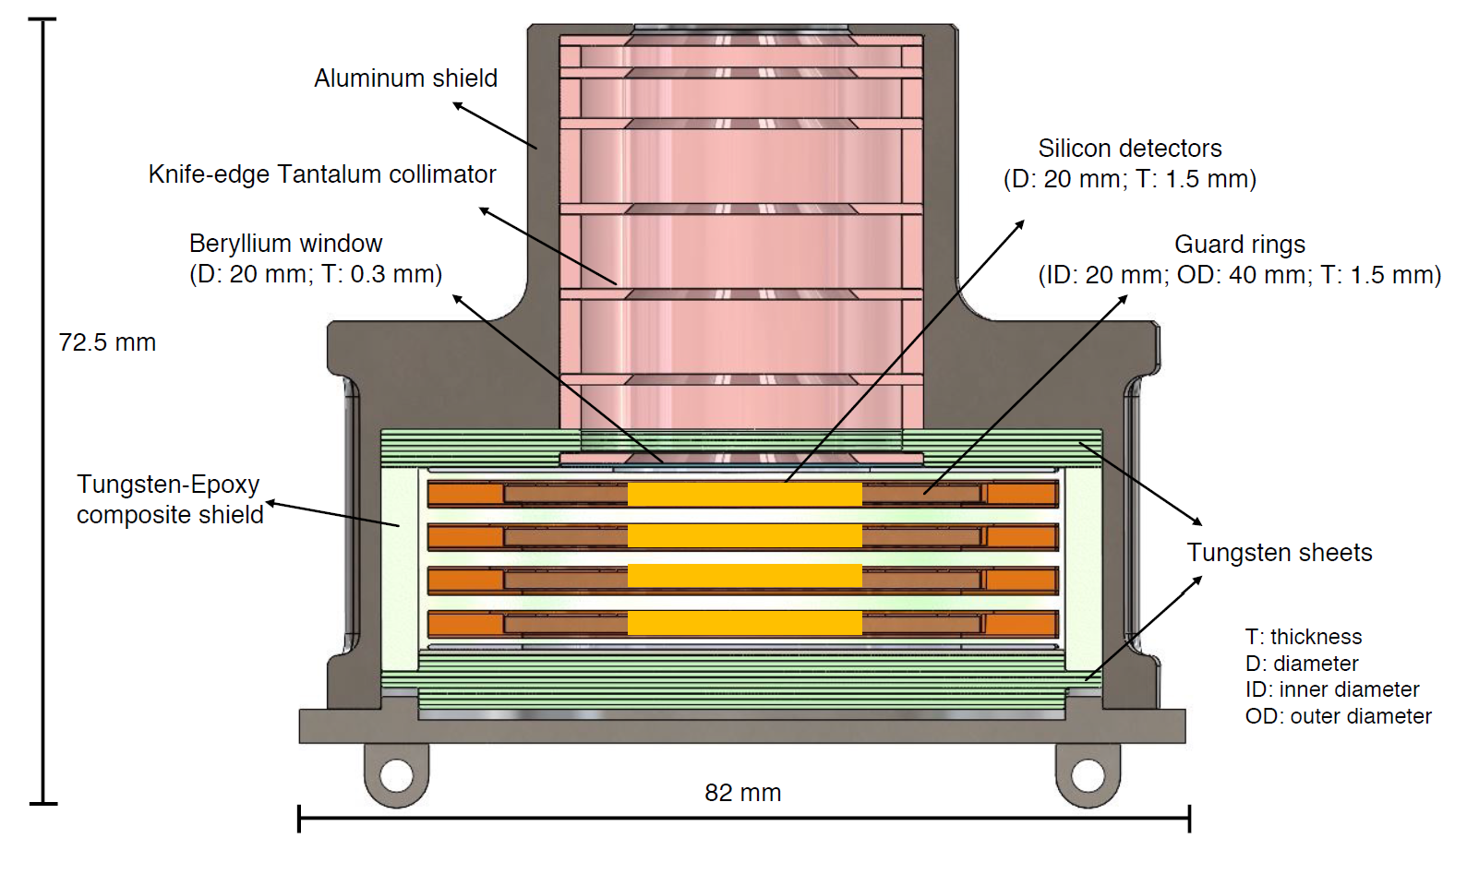
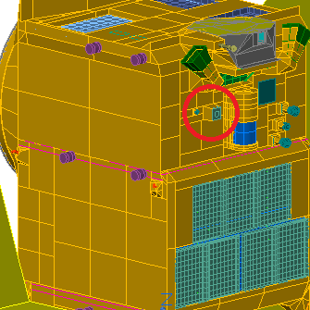
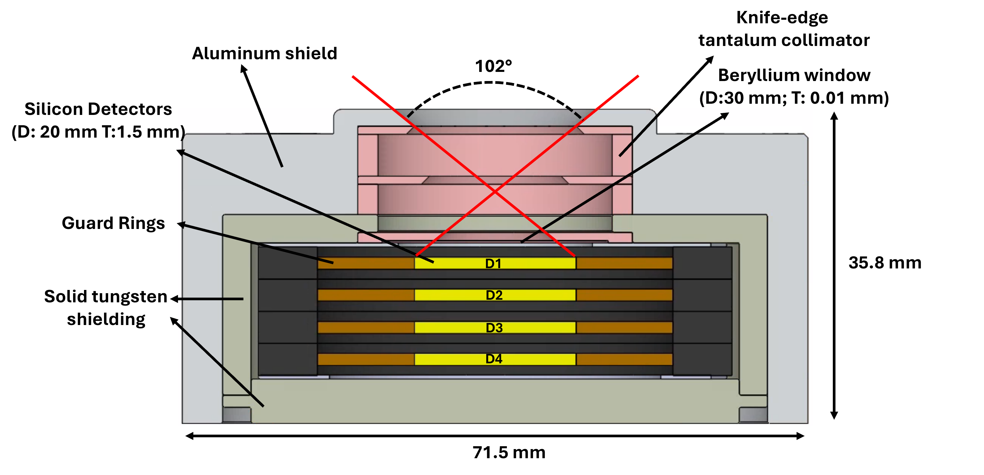
REPTile-3’s Design: building on the heritage of REPTile-2
REPTile-2
Focusing on solar energetic protons, helium, and electrons
Thinner Beryllium window to extend to lower energy particle measurements
Widening the field-of-view (FOV) to increase the statistics
Electrons: 0.1-5 MeV
Protons: 1.2-100 MeV
Helium (alpha): 18-200 MeV
(Khoo L. Y., X. Li et al., JGR, 2022)
REPTile-3
REPTile-3 on EMA
REPTile-3 (w/ electronics and structure)
(O’Brien D., X. Li et al., JGR, 2025)

Slide 8
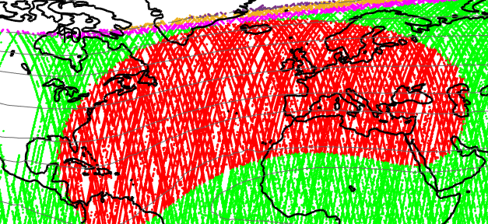
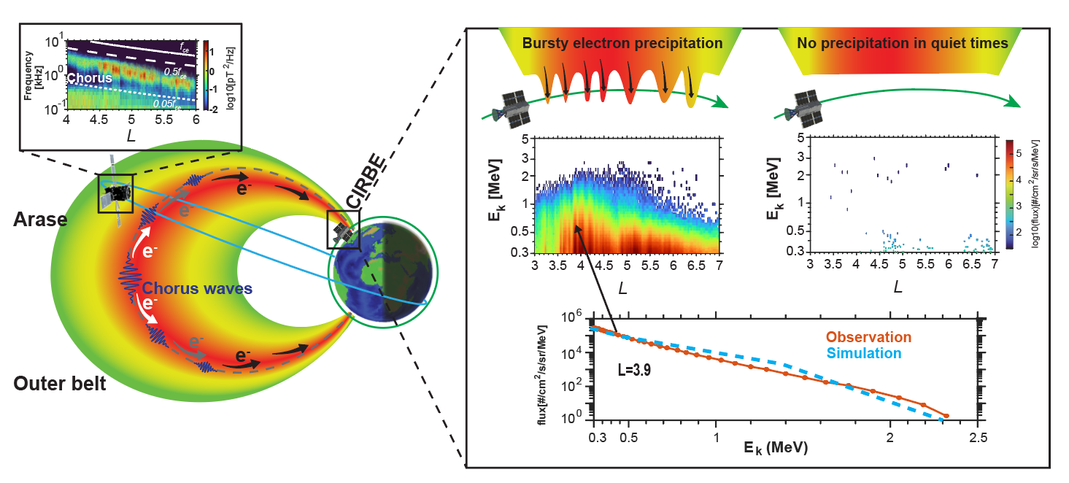
Bursty Precipitations of electrons with detailed spectrum, 0.3 - 2.5MeV, were captured by REPTile-2.
Chorus waves, measured by Arase at the same magnetic conjunction but at higher altitude
(Zheng Xiang, X. Li et al., 2025)
Notes:
Add a plots showing very little e- during the same pass (during a quiet time), ask Zheng to make this plot.

Slide 9
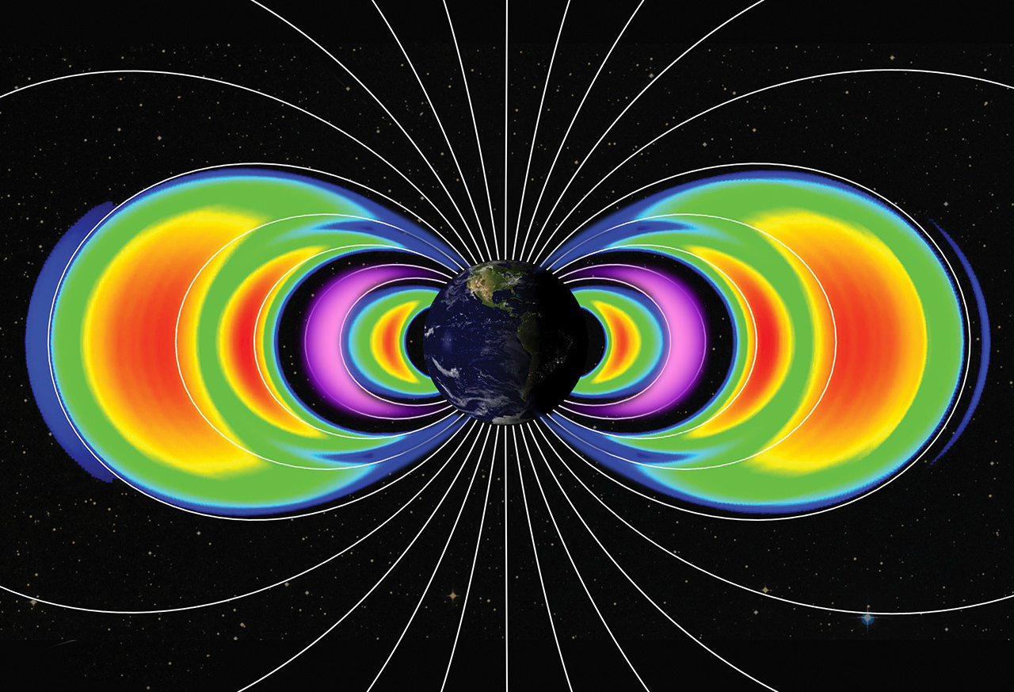
NASA Press Release on 6 February 2025 about the New Radiation Belts Identified by REPTile-2 on CIRBE After the Magnetic Super Storm of May 10-12, 2024
https://science.nasa.gov/science-research/heliophysics/nasa-cubesat-finds-new-radiation-belts-after-may-2024-solar-storm/
New Electron Belt
New Proton Belt

Slide 10
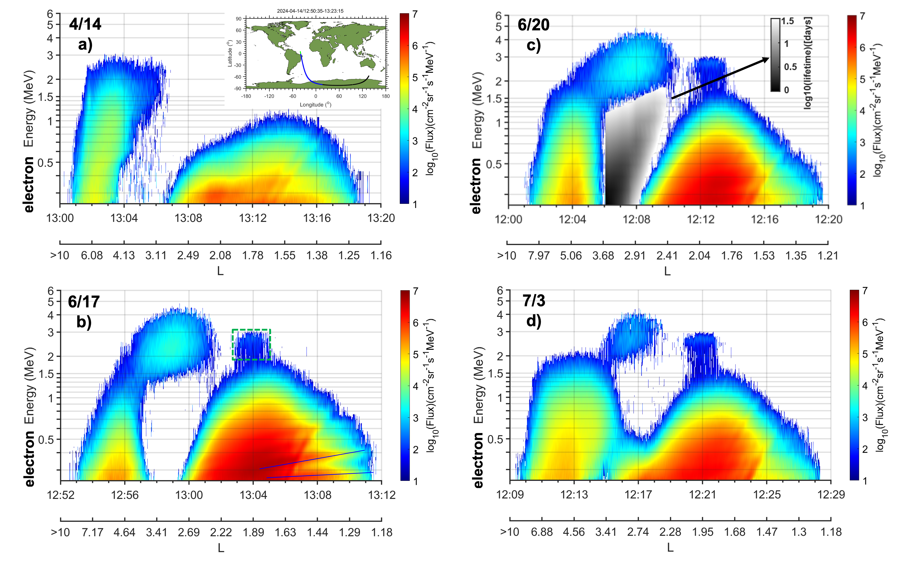
REPTile-2 e⁻ measurements above the SAA region before and after the Superstorm
*** high-energy resolution and clean measurements required to correctly identify the new belts ***
Calculated lifetime of electrons as a function of energy and L
New Electron Belt
Enhancements
in the inner belt
(Li et al., JGR, 2025)

Slide 11
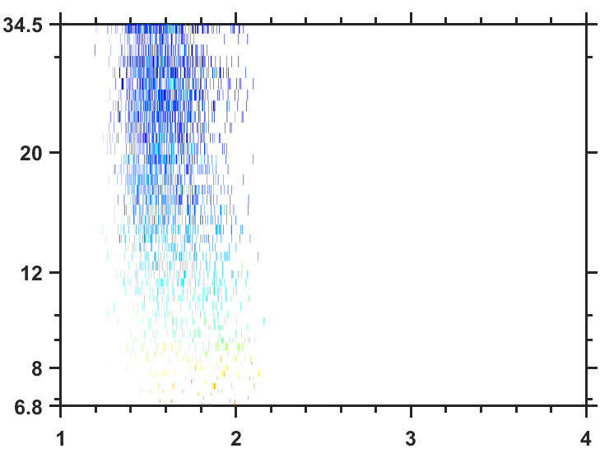
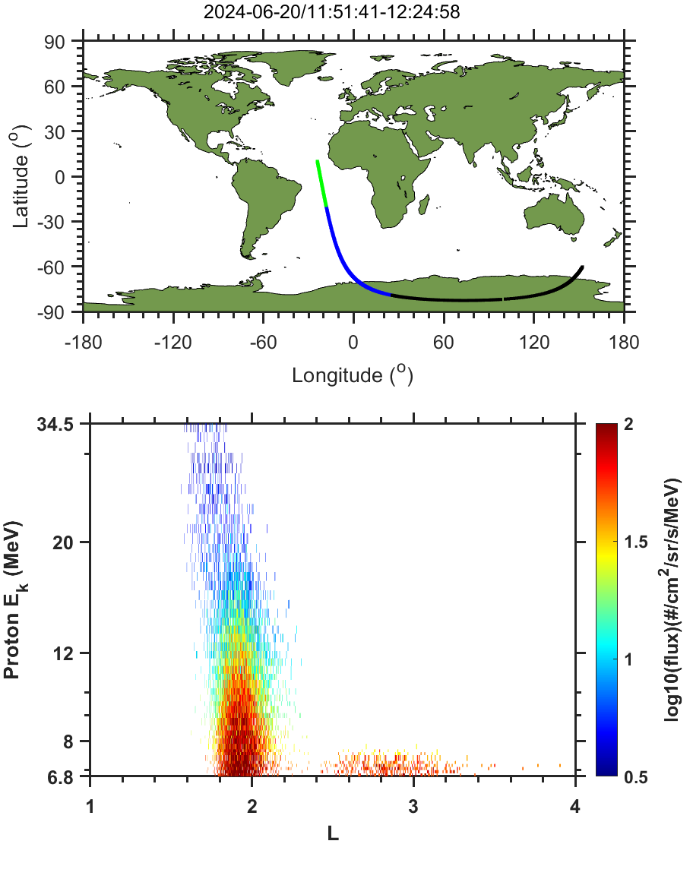
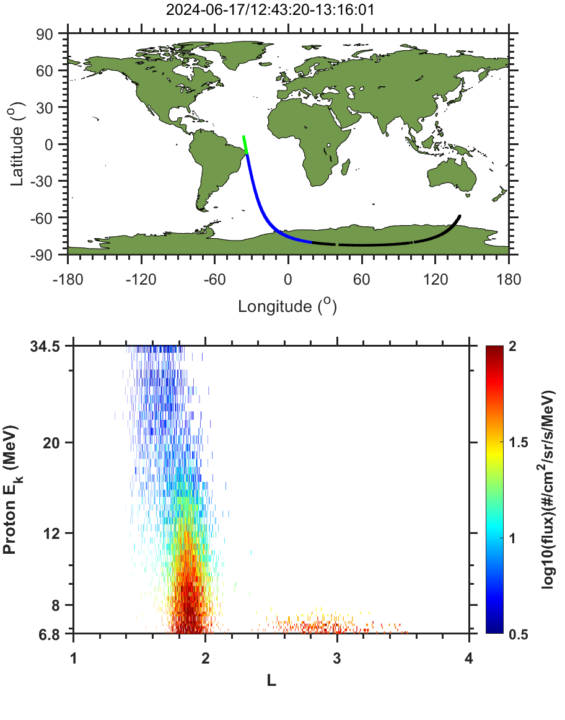
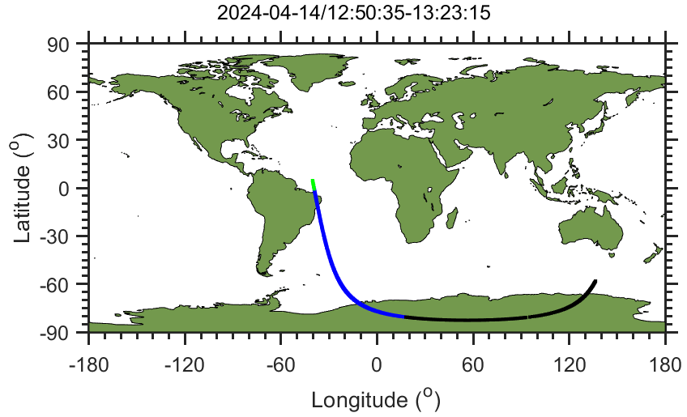
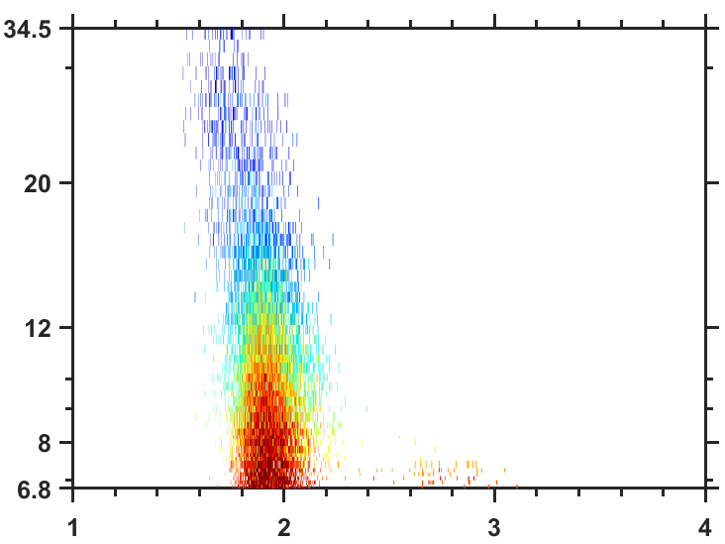
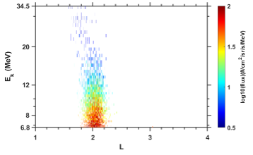
REPTile-2 p⁺ measurements above the SAA region before and after the Superstorm
4/14
a)
6/20
c)
6/17
b)
7/3
d)
New Proton Belt
8/13
9/20
CIRBE’s altitude
~300 km. The last bits of science data were received on 9/28. CIRBE re-entered on on 10/4
L
(Li et al., JGR, 2025)

Slide 12
Mission Concept Overview
ReTiMo Mission Parameters and Payload – Full Instrument Suite (12U s/c)
Radiation Monitoring Device
Requirements:
Protons: 1-500 MeV (goal), 4-100 MeV (min)
Ions: 4-200 MeV/nuc
LET spectra: 0.1 - 30 MeV cm² mg⁻¹
Candidate 1:
PSI Mini Rad Monitor
Breadboard completed
Under development
Based on SREM and NGRM
Candidate 2:
CU/LASP REPTile-3
Under development for UAE Asteroid mission
Based on REPTile-2
IRENE Workshop, Sykia, 22 May 2025
12

Slide 13
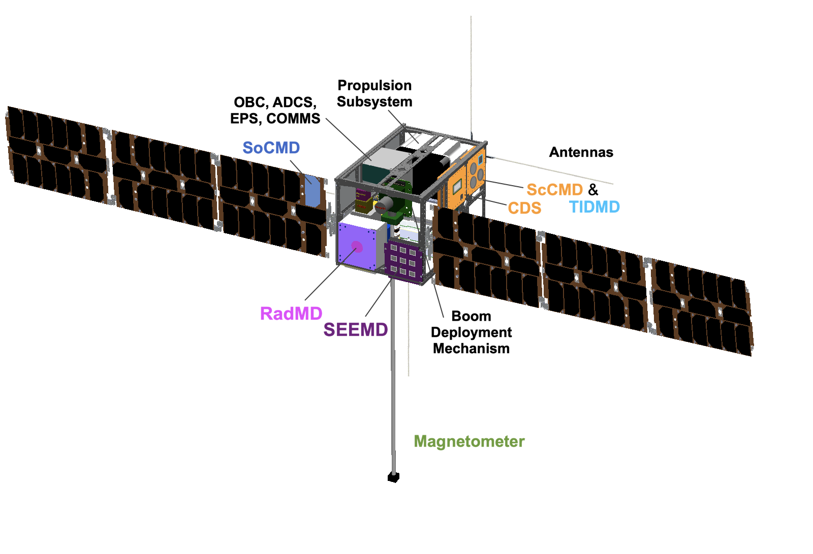
Mission Concept Overview
Overview of ReTiMo Satellite – Full Instrument Suite (12U s/c)
IRENE Workshop, Sykia, 22 May 2025
13

Slide 14
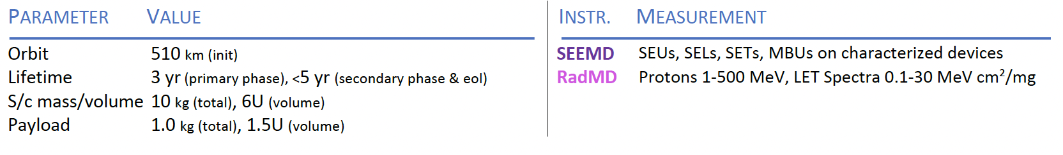
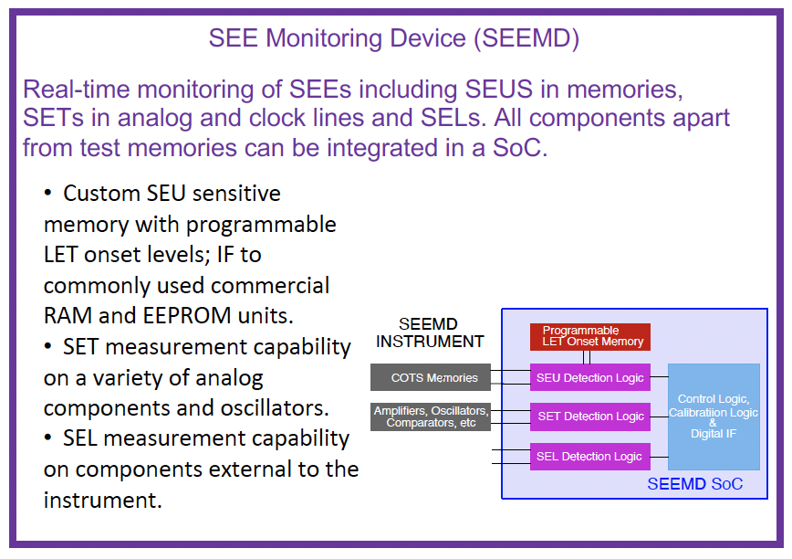
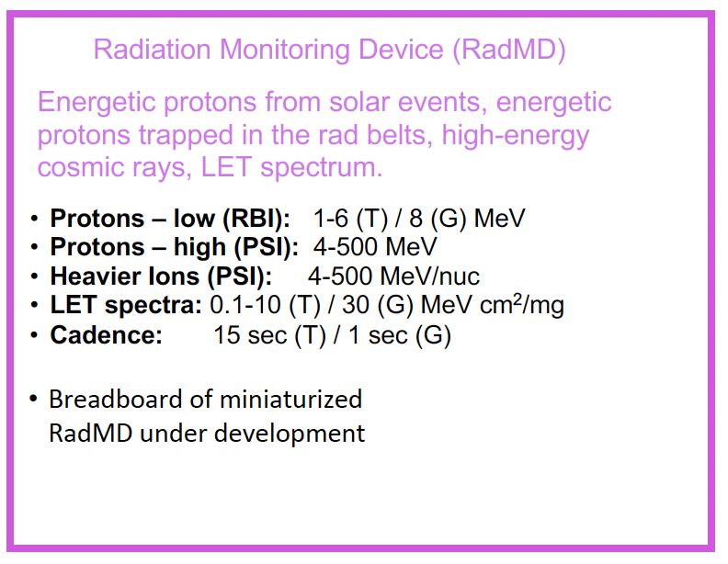
Mission Concept Overview
ReTiMo Mission Parameters and Payload – Reduced Instrument Suite (6U s/c)
IRENE Workshop, Sykia, 22 May 2025
14

Slide 15
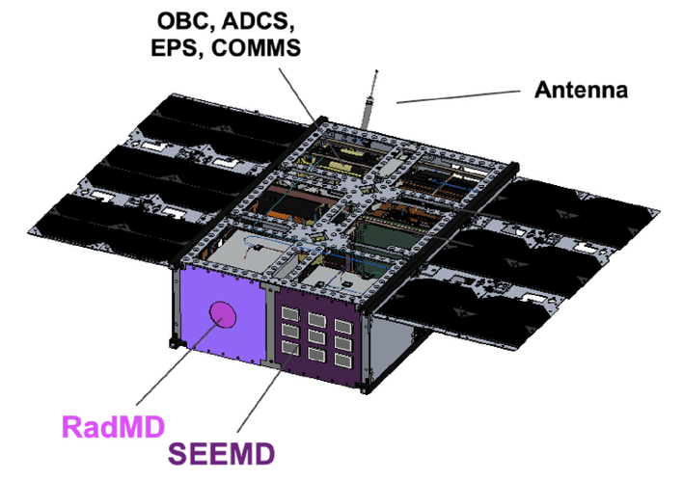
Mission Concept Overview
ReTiMo Mission Parameters and Payload – Reduced Instrument Suite (6U s/c)
IRENE Workshop, Sykia, 22 May 2025
15

Slide 16
Summary and Conclusions
ReTiMo data:
Real-time information of Space Weather effects at LEO
Novel hardware-based indices of errors that can be used by spacecraft operators
Unique co-spatial, co-temporal measurements of both Space Weather effects and their cause
ReTiMo Implementation:
ReTiMo is scalable and can be expanded to include more satellites for global coverage, as well as comprehensive measurements at MEO and GEO
A fully instrumented mission concept consists of a 12U, fully instrumented CubeSat with propulsion
A reduced mission concept consists of a 6U CubeSat, carrying the SEEMD and RadMD, without propulsion capability
IRENE Workshop, Sykia, 22 May 2025
16

Slide 17
-- The End --

Slide 18
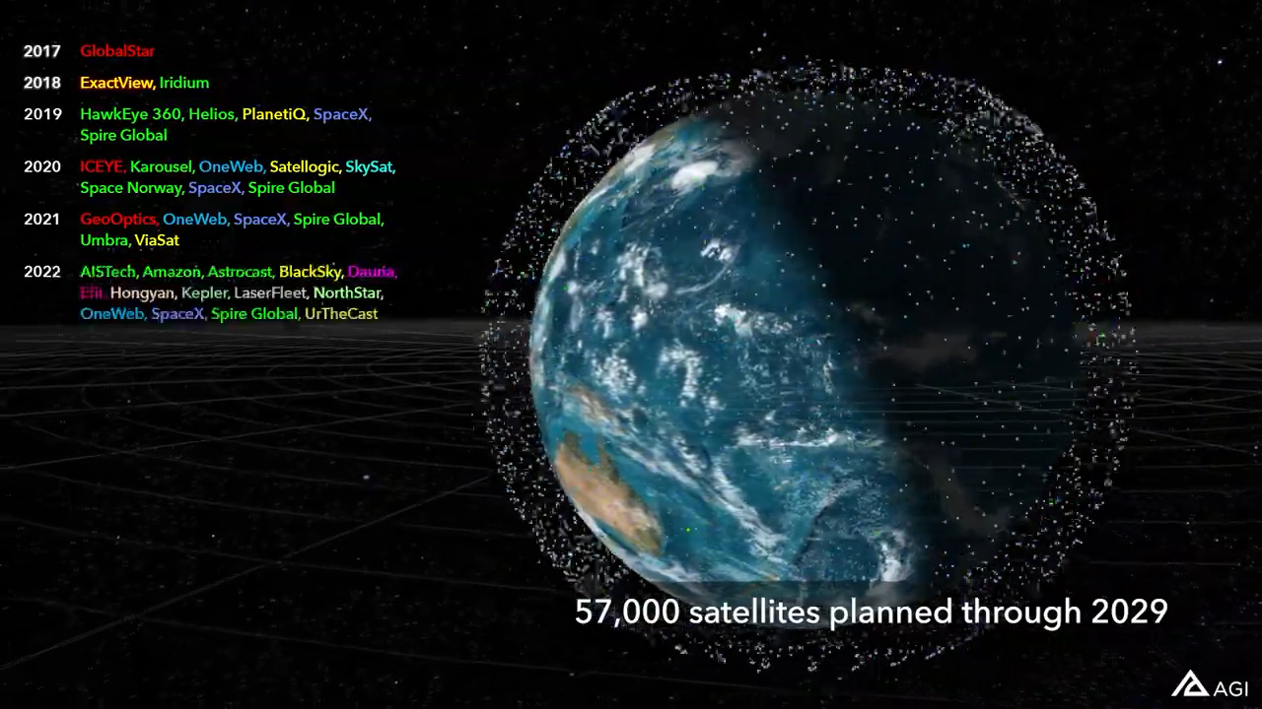
On the Need for monitoring Space Weather Radiation Effects at LEO
Pre- 2017: geostationary orbit (GEO) dominated the usage o space
NewSpace: services are shifted to mega-constellations at Low Earth Orbit (LEO)
However:
whereas at GEO there are multiple satellites providing real-time Space Weather measurements, LEO is much less systematically monitored than GEO
107,000
modern LEO spacecraft contain large and complex processors, FPGAs and ASICs that didn’t exist during the last solar cycle
LEO in the age of mega-constellations
LEO is much more dynamic and ever-changing compared to the well-structured environment at GEO.
IRENE Workshop, Sykia, 22 May 2025
18

Slide 19
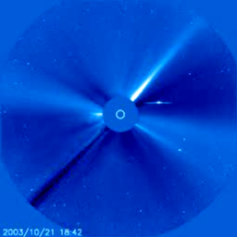
On the Need for monitoring Space Weather Radiation Effects at LEO
“Rogue” events:
Sep-2017 SPE: 210 pfu* at >10 MeV
Oct-2003 SPE: 29500 pfu at >10 MeV
Aug-1972 SPE: 86000 pfu at >10 MeV
Carrington event?
* Peak flux, in Proton Flux Units (pfu); 1 pfu = 1 pr cm⁻²sr⁻¹s⁻¹
The Sep 2017 Solar Proton Even produced an increase in Single Event Upset (SEU) rates in s/c
What would we see in terms of SEUs during an Oct-2003 type event, or, even worst, a 5-Aug-1972 type event?
Solar Proton Event of the storm of October 2003
At the same time, spacecraft charging is considered the cause of a number of LEO anomalies/failures
IRENE Workshop, Sykia, 22 May 2025
19

Slide 20
On the Need for monitoring Space Weather Radiation Effects at LEO
Responding to this need, ESA issued a Call for Ideas for a nano-satellite for real-time Space Weather Monitoring
A team lead by the Democritus University of Thrace proposed the ReTiMo mission concept, which was selected amongst 45 proposals, and was one of the studies that was funded for further maturity.
IRENE Workshop, Sykia, 22 May 2025
20

Slide 21
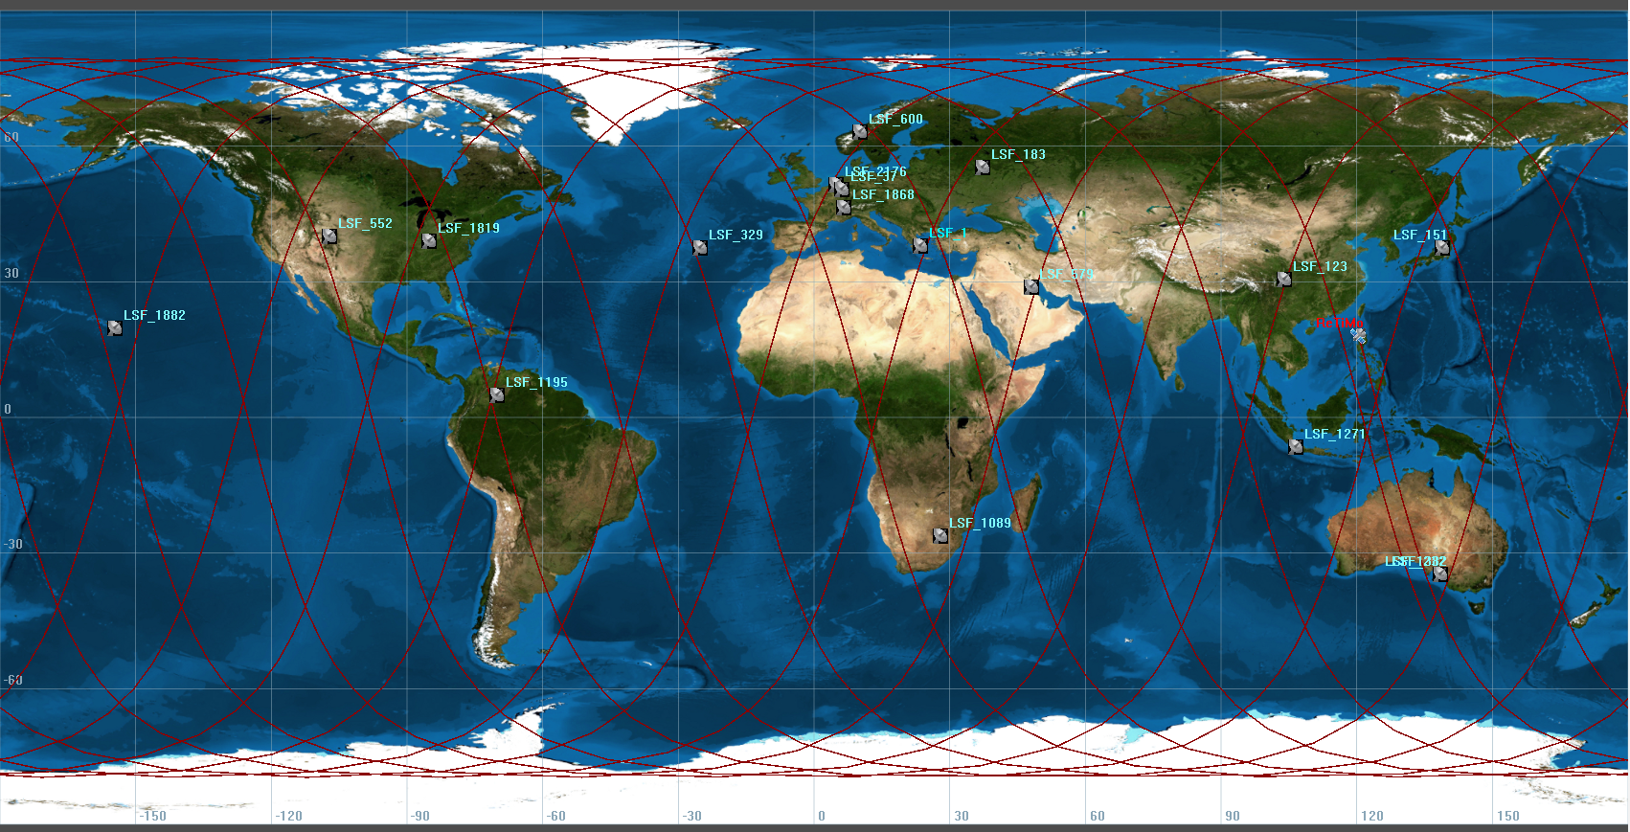
Mission Concept Overview
Ground Station Network
A network of Ground Stations will be used, to ensure the near-real-time monitoring of space weather effects at LEO
Libre Space Foundation’s contracted Ground Stations is baselined
IRENE Workshop, Sykia, 22 May 2025
21

Slide 22
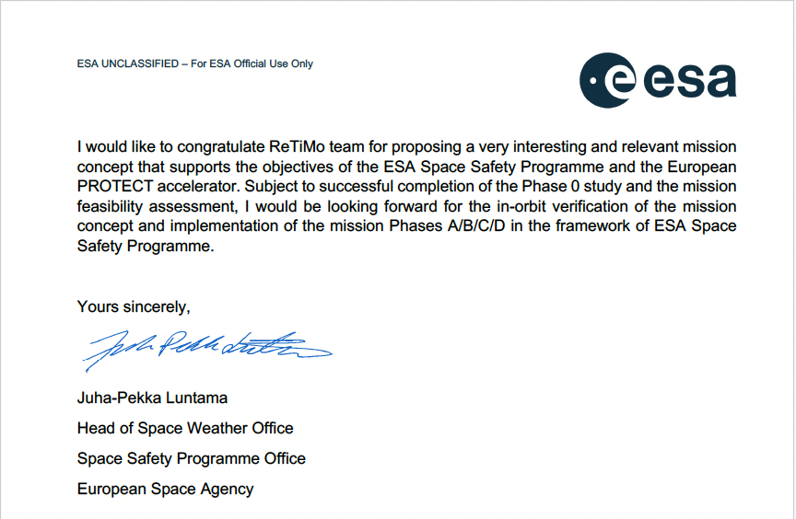
ReTiMo: Επιτήρηση Διαστημικού Καιρού από Ελληνικό νανο-δορυφόρο
International interest in ReTiMo measurements / Letters of Support:
ESA
Space Safety Programme
OneWeb
(now part of EutelSat Group)
Int'l Gov’t & Trade Engagement
NOAA, USA
National Oceanic & Atm. Admin.
Space Weather Prediction Center
BIRA
Royal Belgian Institute
for Space & Aeronomy
ROB
Royal Observatory of Belgium
IRENE Workshop, Sykia, 22 May 2025

Slide 23
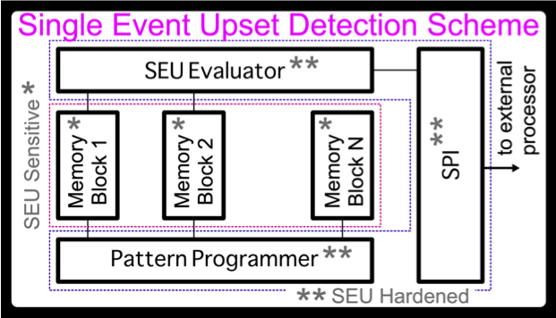
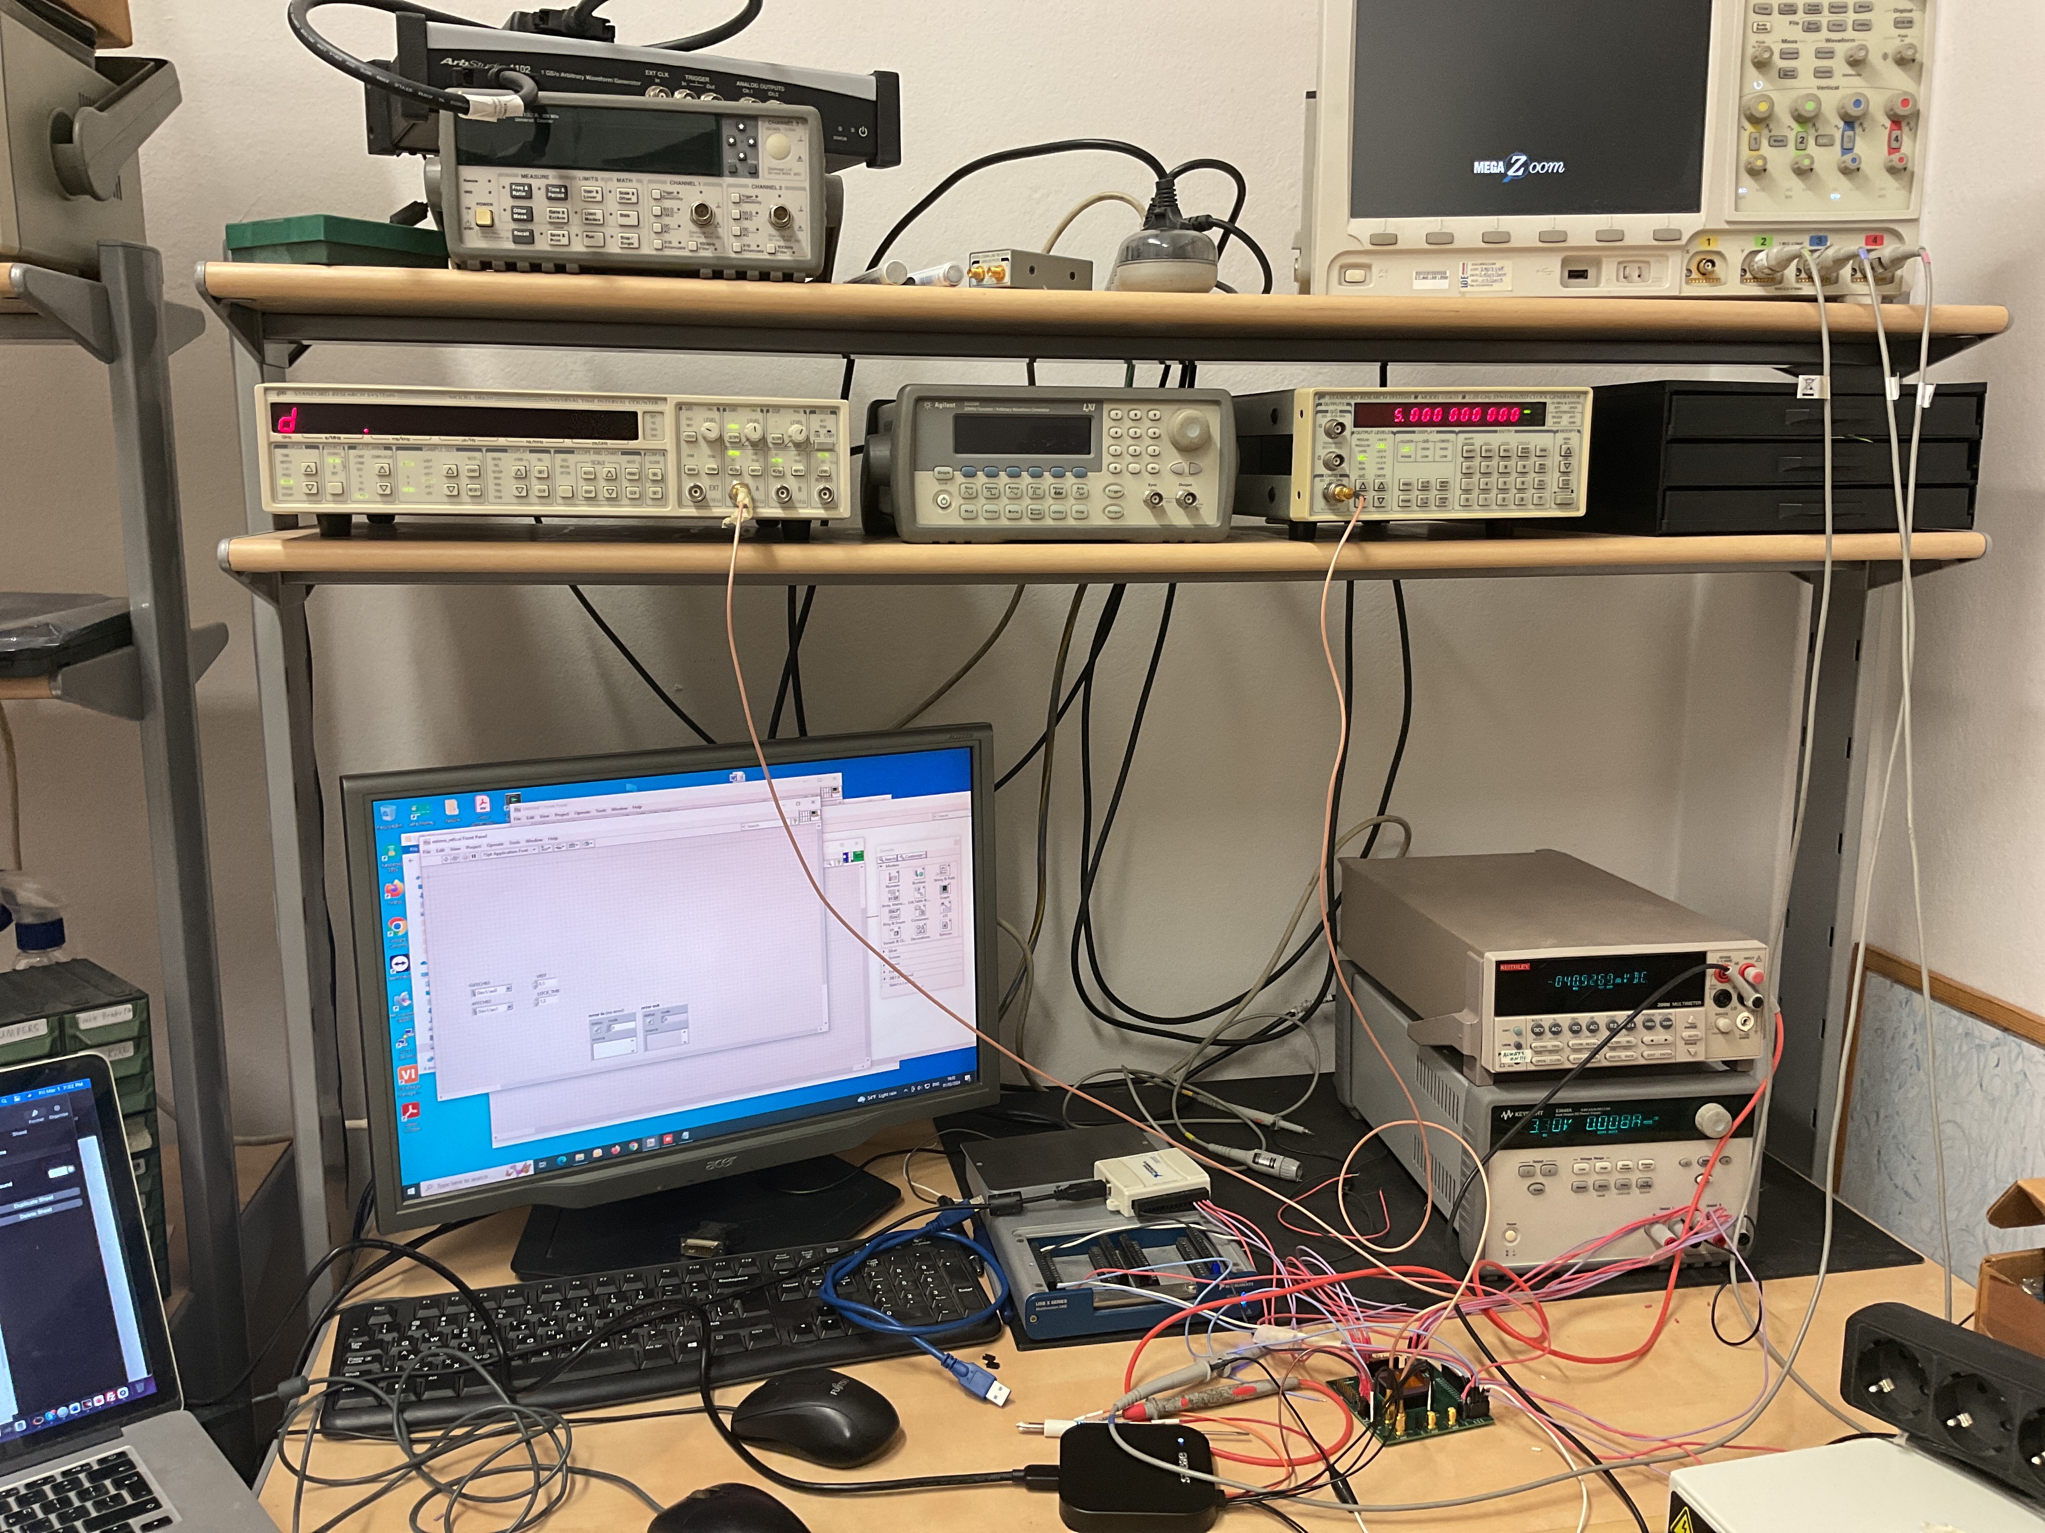

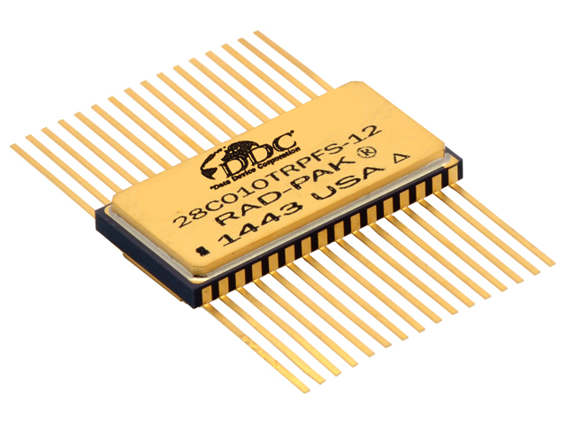
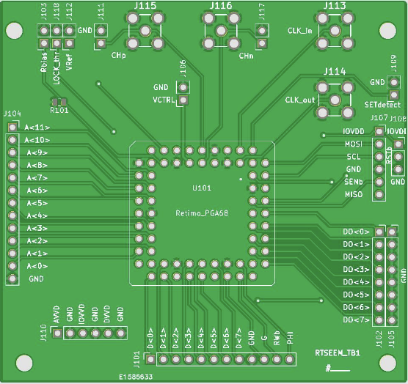
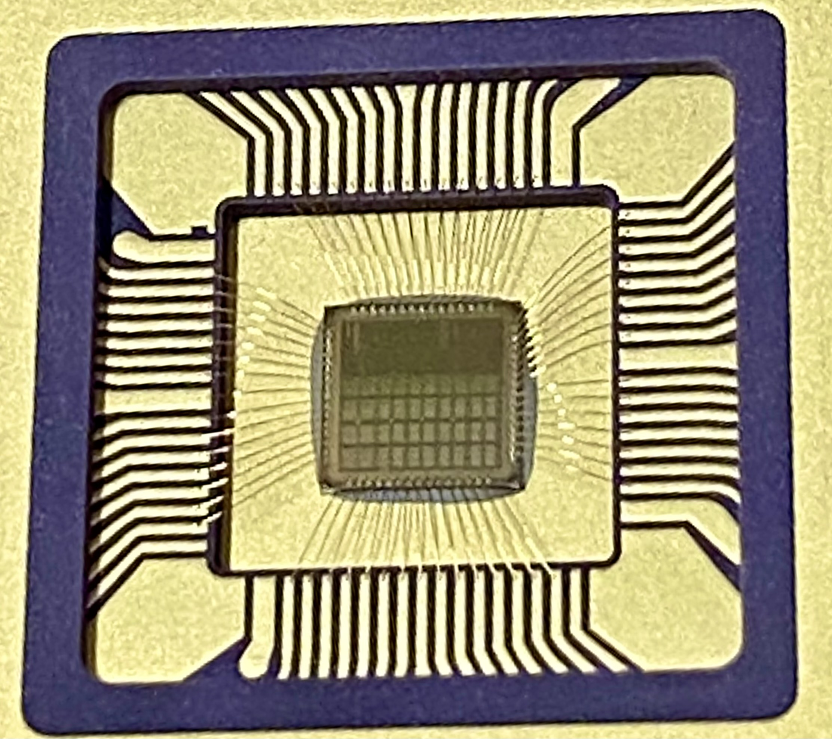
ReTiMo: Επιτήρηση Διαστημικού Καιρού από Ελληνικό νανο-δορυφόρο
Status of development - SEU Measurement Device Breadboard
1.
SRAM AT60142: characterized as part of ESA’s SEU reference monitor development activity
EEPROM 28C010: Approved by ESA for the “ESA preferred parts” list
IRENE Workshop, Sykia, 22 May 2025

