Slide 1
Recent Developments in the ESA Network of Models under the LeNoM Project
Zafar Iqbal⁽¹⁾, Pete Truscott⁽²⁾, Simon Clucas⁽⁵⁾, Sami Mezhoud⁽³⁾, Neophytos Messios⁽³⁾,
Stijn Calders⁽³⁾, Daniel Heynderickx⁽⁴⁾, and Ingmar Sandberg⁽¹⁾
(1) SPARC, (2) Kallisto Consultancy, (3) BIRA-IASB, (4) DH Consultancy, (5) ESA/ESTEC
IRENE Space Radiation Modelling and Data Analysis Workshop 2025, Sykia, Greece

Slide 2
Contents
What is NoM, how does it help the community …. And what does “NoM Taxonomy” mean
Modifications to NoM Taxonomy and treatment of physical units
NoM IRENE, biodose, and boundary-dose models
ESANoM
Summary

Slide 3
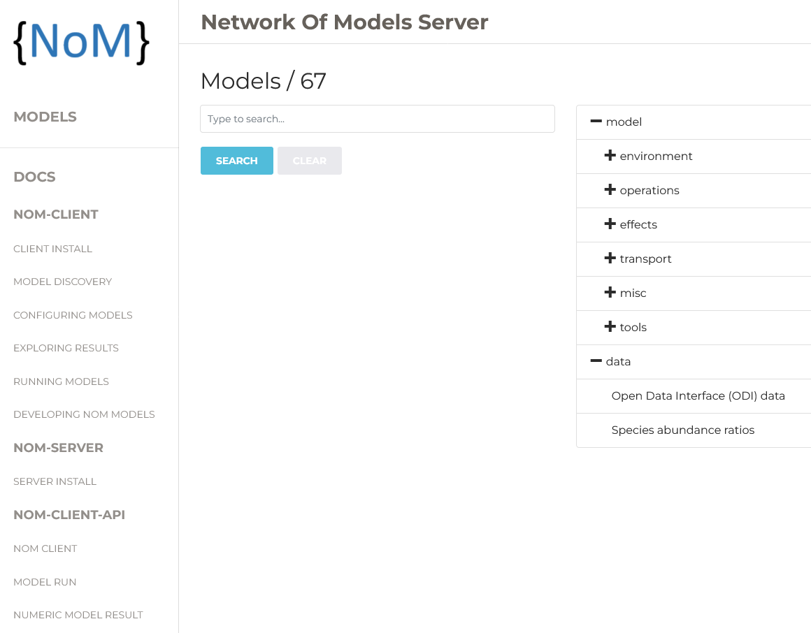
The Network of Models
The ESA Network of Models is a python-based client/server framework to host models and data in a very general, flexible way.
It packages models behind abstract interfaces to control how inputs are provided to models and how results are returned.
Models can be almost anything…
  Binaries with cmd. line inputs, input files, namelists …
  Python scripts, Docker containers
  Web/rest API calls to hosted models
  MySQL data driven data sources
  Many models from SPENVIS & ESPREM included
… and models can return/create almost anything:
  StdOut, CSV, HTML, text files, binary data, CDF etc.
http://nom.esa.int

Slide 4
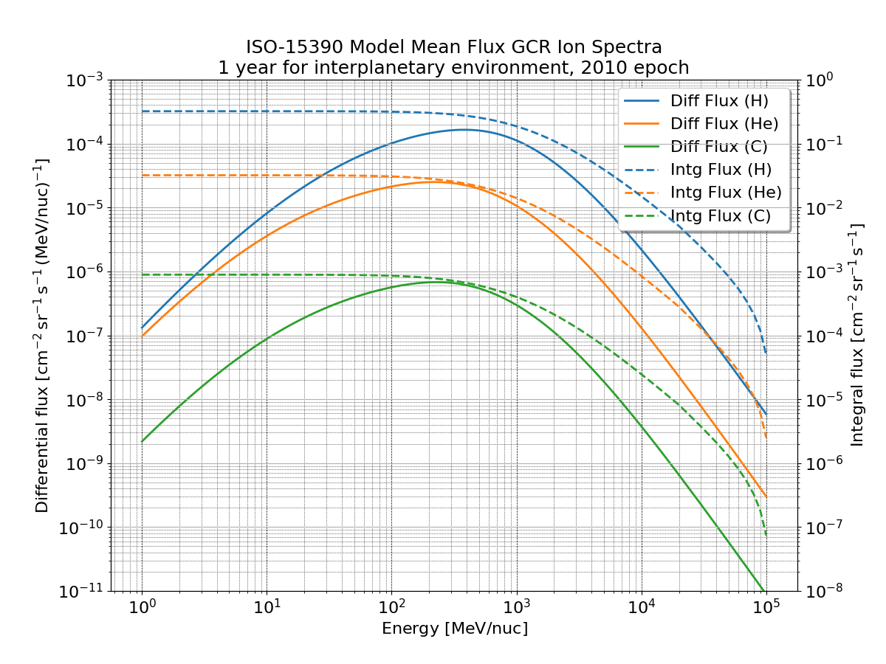
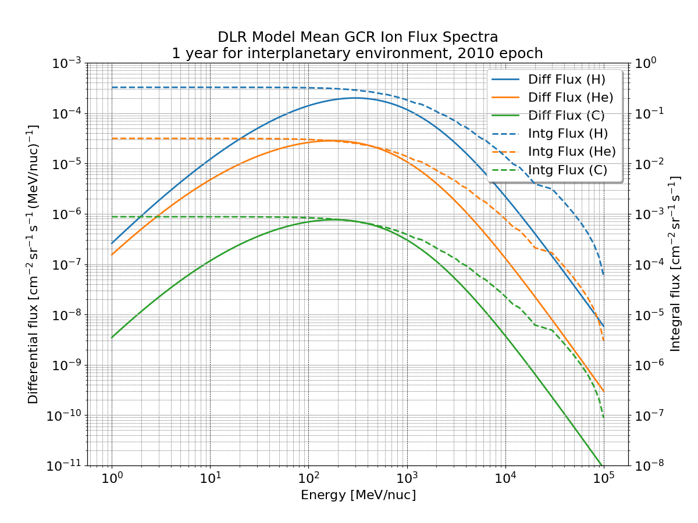
Example case for ISO-15390 GCR environment calculation
nom_client = NoMClient("MyProject",
client_configuration=conf,
default_server_id="local_server",
debug_output=False)
trajModel = nom_client.get_model("trajectory")
trajModel.set_params(naifCode = "EARTH",
orbitSpecificationCode = 205,
missionDuration = 365.25,
apogeeAltitude = 1200.0,
perigeeAltitude = 1200.0,
argumentOfPerigee = 0.0,
inclination = 51.6,
raan = 0.0,
epoch = "20210-01-01T00:00:00",
startDate = "20210-01-01T00:00:00",
duration = 1.0,
timeSteps = [60,240,3600],
trueAnomaly = 0.0,
missionStartDate = "2010-01-01T00:00:00",
missionStopDate = "2011-01-01T00:00:00")
trajRun = nom_client.run_model(trajModel)
GCRmodel = nom_client.get_model("iso_15390")
GCRmodel.set_params(lowestIonSpecies=1,
highestIonSpecies=28,
subModel=30,
solarActivity=0,
useGeomagneticShielding=0)
GCRmodel.set_external_input(external_input_name="trajectory",
external_input=trajRun)
GCRrun = nom_client.run_model(GCRmodel)
Or with GCRmodel=nom_client.get_model("dlr-gcr")

Slide 5
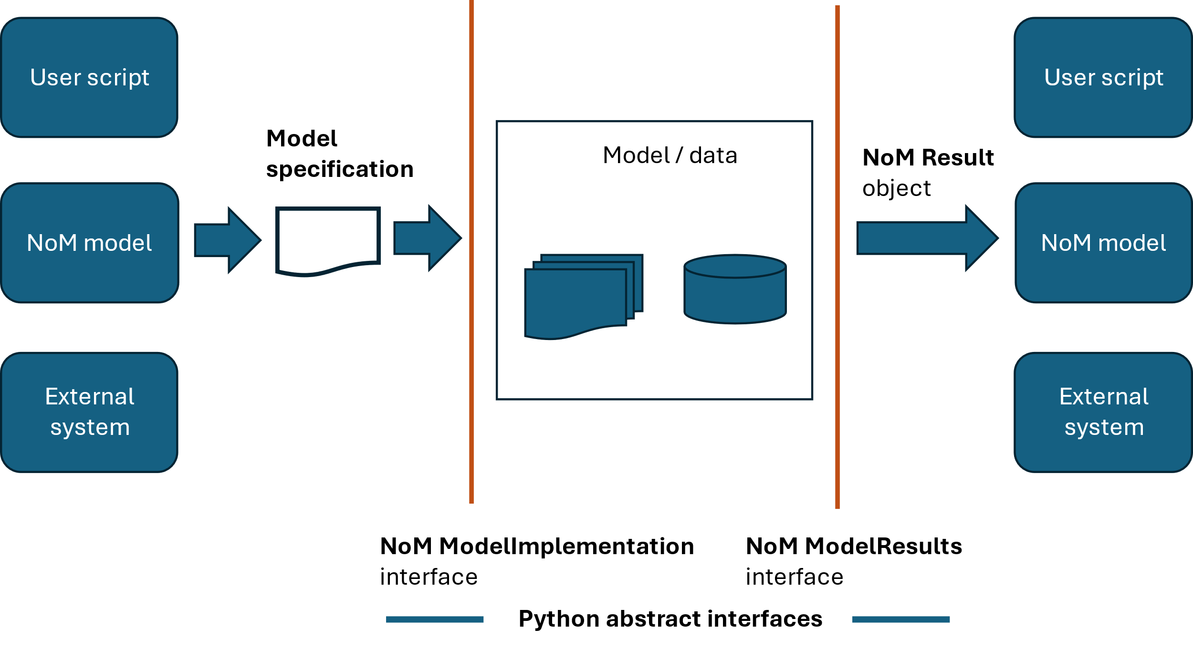
The Network of Models – Model Abstraction ➔Interoperability
NoM model packages describe everything about models using a single JSON model specification file
Inputs are converted to what the models expect prior to running
Model outputs are parsed/read and packaged into a consistent standard format that other NoM models can understand by use of a global taxonomy

Slide 6
The Network of Models - Taxonomy
The NoM taxonomy provides a common language dictionary to help models communicate their input requirements and outputs
Taxonomy is defined WRT several quantities
  Physical Quantities: dose; number flux
  Derived Quantities: ionising dose; energy differential flux
  Composite Quantities: ionising dose versus shield depth; differential flux versus energy
  Qualifiers: ionising dose in silicon; proton omnidirectional flux
The taxonomy is used for three main tasks:
  Top-level verification when supplying inputs to models
  Generating visual representations of model and workflows in HTML
  Provide a consistent way for models to inspect and use the results from other NoM models

Slide 7
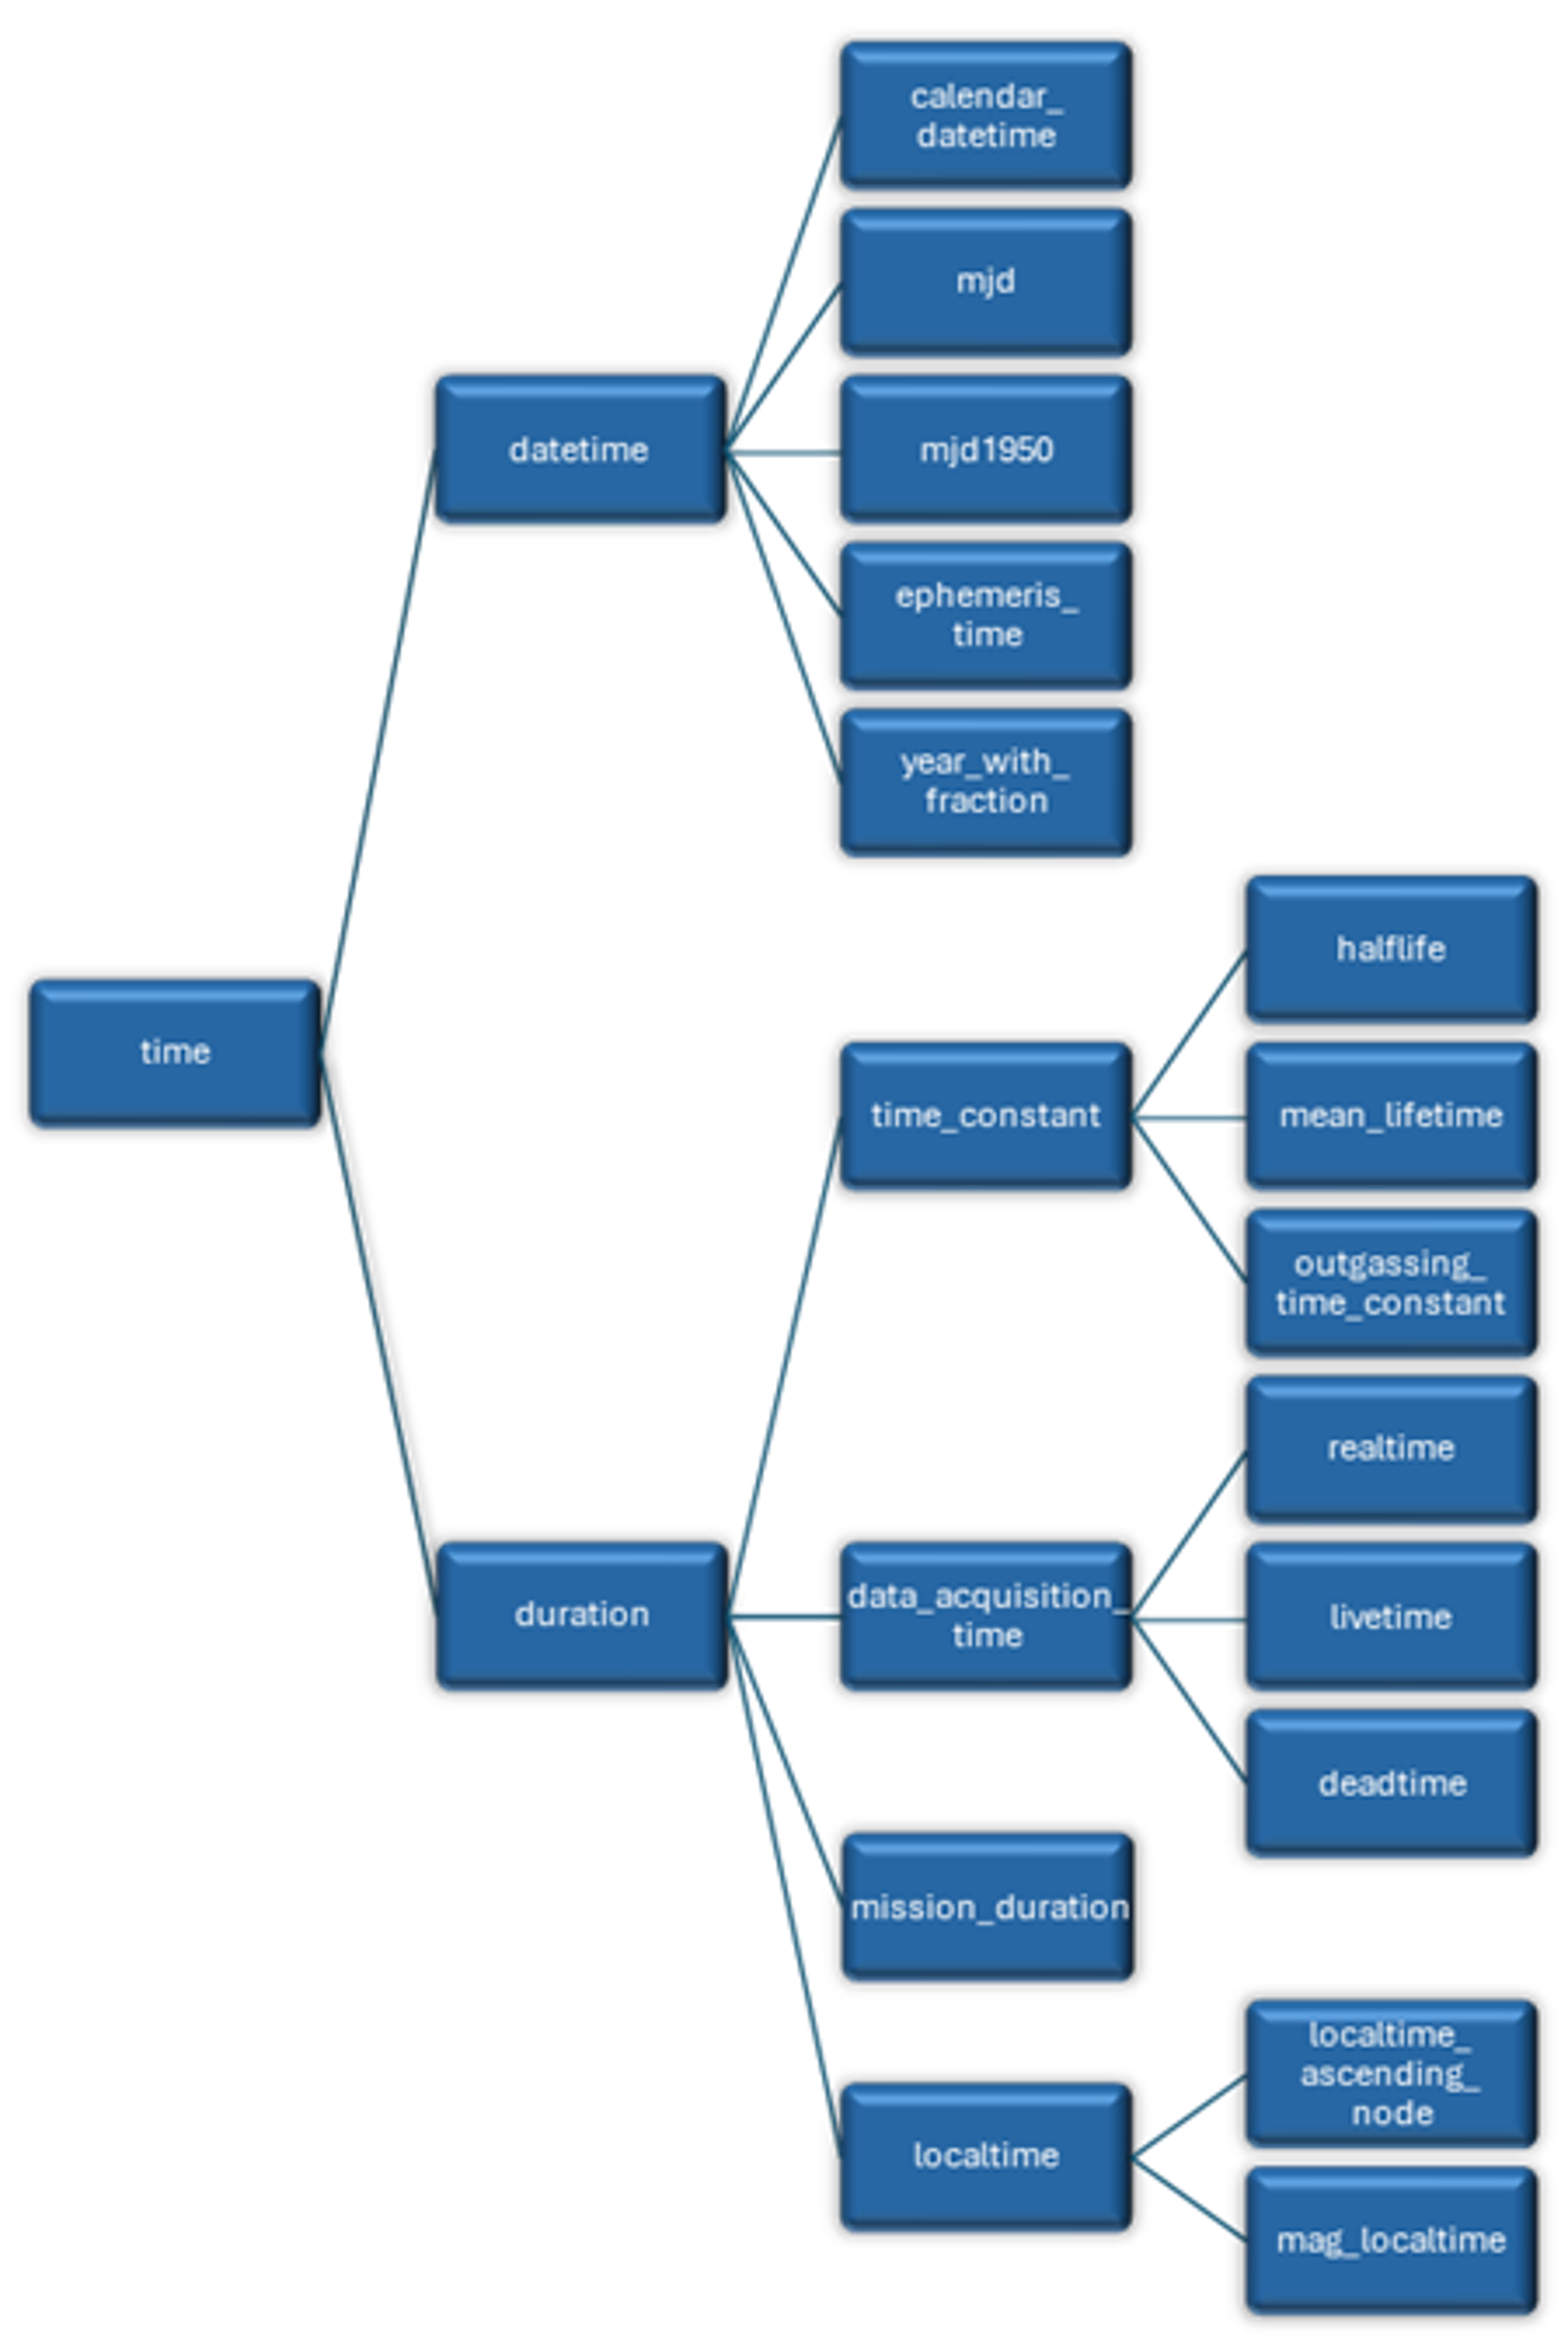
LeNoM Taxonomy Improvements
Extended physical quantities to cover ionizing radiation, debris & micrometeoroid, atmospheres & ionospheres, illumination, contamination
Taxonomy of physical quantities now strongly hierarchical – e.g., derived quantities of time (right)
  Allows quantities to be used better suited to a model
Polymorphic physical quantities can change depending on model conditions, e.g.:
  particle_shield_thickness can represent either length or mass-per-unit-area types
  directional_differential_fluence can be defined as derivatives WRT energy, energy-per-nucleon, rigidity, LET, etc.
Extended qualifiers to treat dose in different human tissue types and incident radiation directions

Slide 8
NoM System and User-Customizable Units
Previously, input and output quantities from NoM models were in units specific to the model
  SEP models may output differential fluences with units of area as cm² or m²
  User must repeatedly reference online manual for each model!!
System-wide definition of units in NoM (system_units.json file) with conversion interface←→model
User may override units definition through NoMClient, e.g.:
nom_client.set_units(plane_angle="rad",
orbital_distance="m",
orbital_velocity="m s^-1",
recursive=True)
Also, units may be specified when describing float parameter input as string with units
Datetimes may be passed as model parameters as strings, datetime.datetime or pandas.Datetime objects
Durations may be passed as floats, strings (including ISO 8601 “P” format), datetime.timedelta or pandas.Timedelta objects
All units parsed to confirm correct dimensions

Slide 9
Trajectory Definition with Units Included in Parameters
ureg = pint.UnitRegistry() // <--
DTstart = datetime.datetime.(year=2010,month=1,day=1) // <--
trajModel = nom_client.get_model("trajectory")
trajModel.set_params(naifCode = 399,
orbitSpecificationCode = 205,
missionDuration = ureg.Quantity(1.0,"years"), // <--
apogeeAltitude = " 647.9482 nautical_miles", // <--
perigeeAltitude = "3937008.0 feet", // <--
argumentOfPerigee = 0.0,
inclination = 51.6,
raan = 0.0,
epoch = DTstart, // <--
startDate = DTstart, // <--
stopDate = "2010-01-01 01:00:00",
duration = "P1DT", // <--
timeSteps = [60,240,3600],
trueAnomaly = 0.0,
missionStartDate = "1st January 2010 00:00", // <--
missionStopDate = "2011-01-01T00:00:00")
trajRun = nom_client.run_model(trajModel)

Slide 10
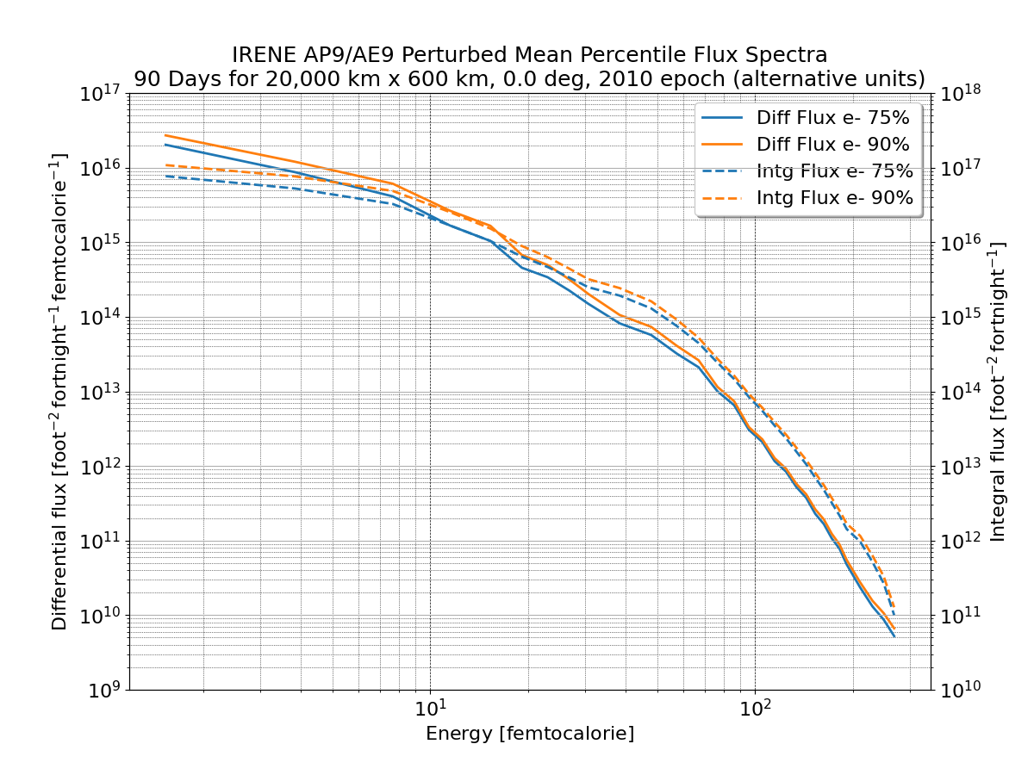
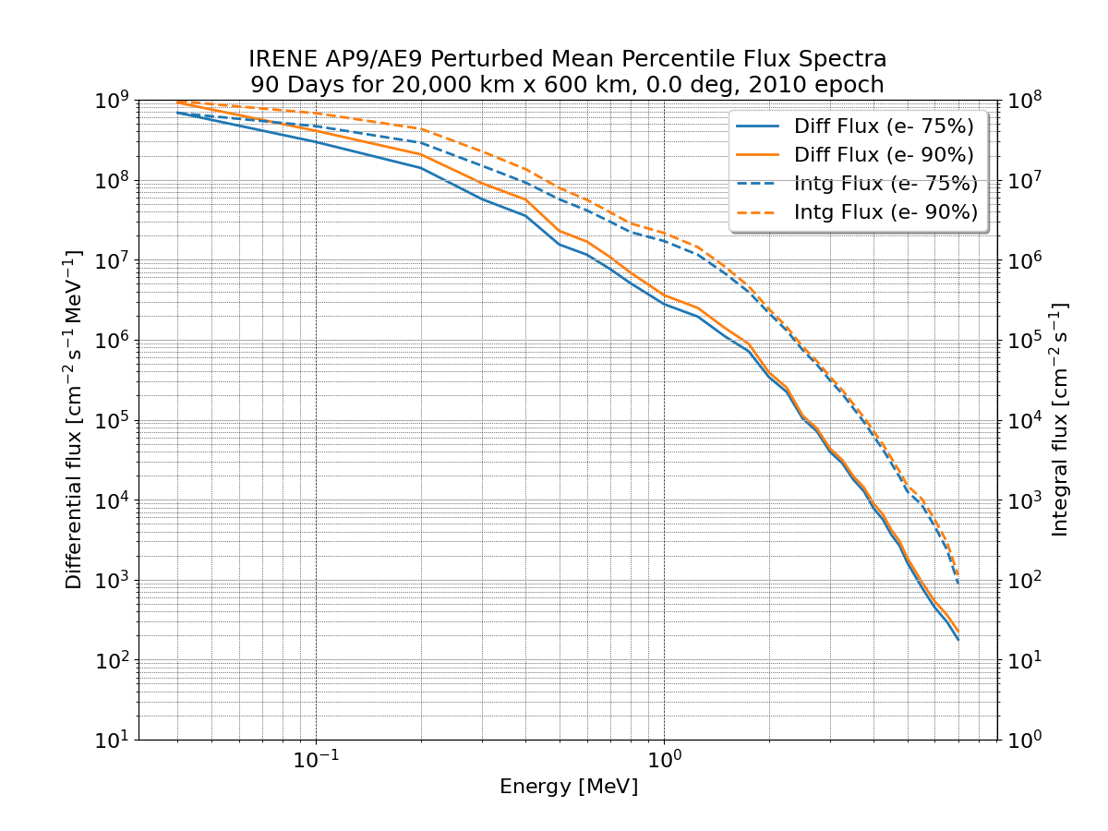
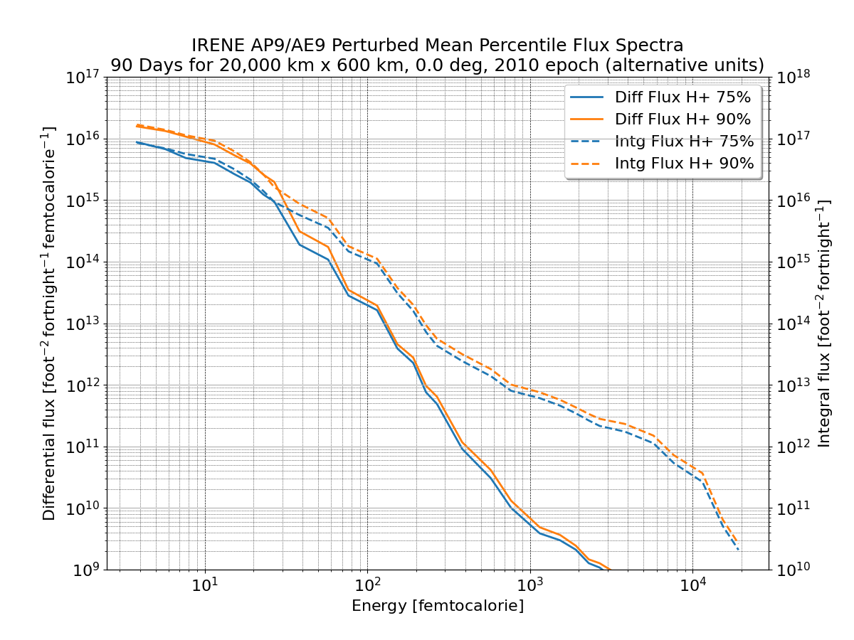
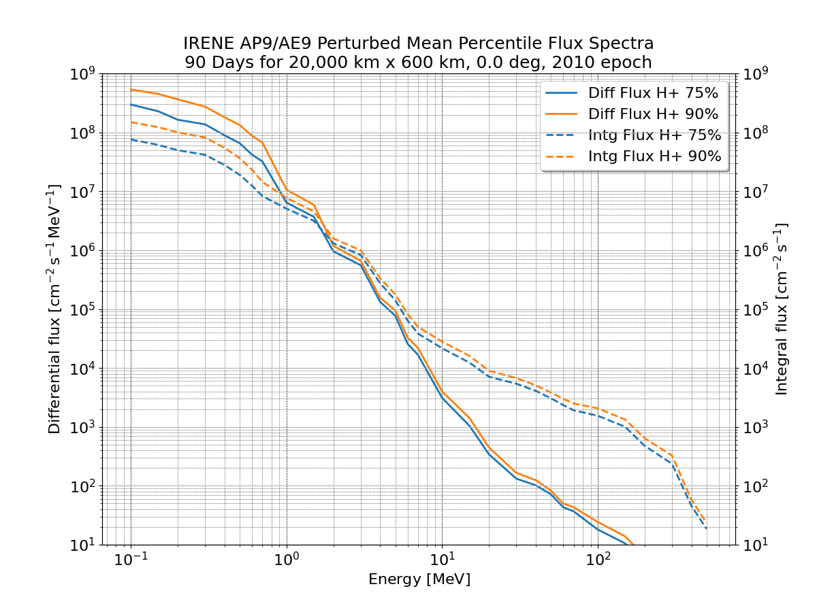
IRENE Version Update and MPI Operation
NoM version of IRENE updated to v1.58, and corresponding updates to NoM user interface
Model is run from new Docker build which now runs in multi-processor mode – faster!
biodose model introduced – convert particle fluence spectra to biological doses

Slide 11
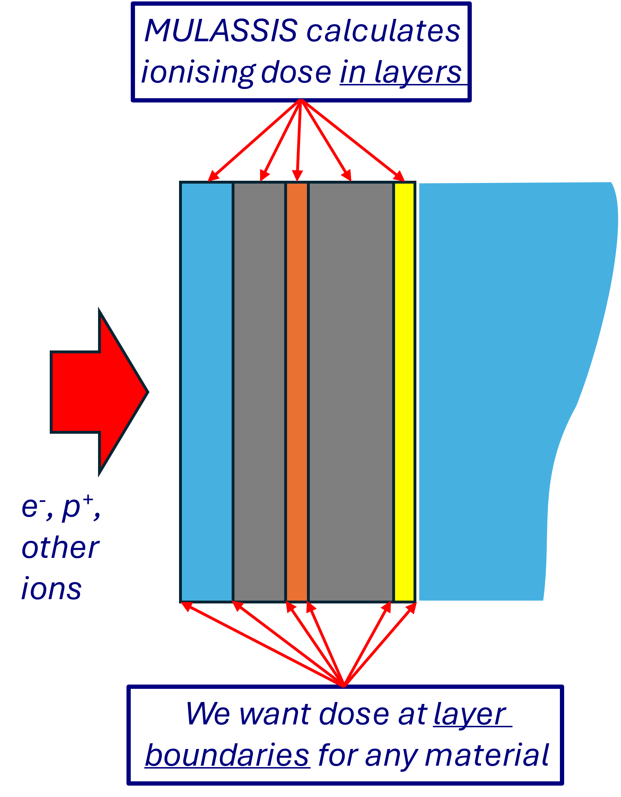

NoM boundary-dose Model
boundary-dose is a new NoM model to convert MULASSIS fluence results versus depth, r, to ionising dose at boundaries in geometry
  Uses stopping-powers model in NoM
  Propagation of Monte Carlo errors included in boundary dose
Neutron ionising dose estimated from
KERMA factors
Provided geometry is quasi-semi-infinite (r_{max}<T/5) solid sphere doses are calculated a la SHIELDOSE-2:
  MC uncertainties and errors assessed from
  finite spacing between layers also included

Slide 12
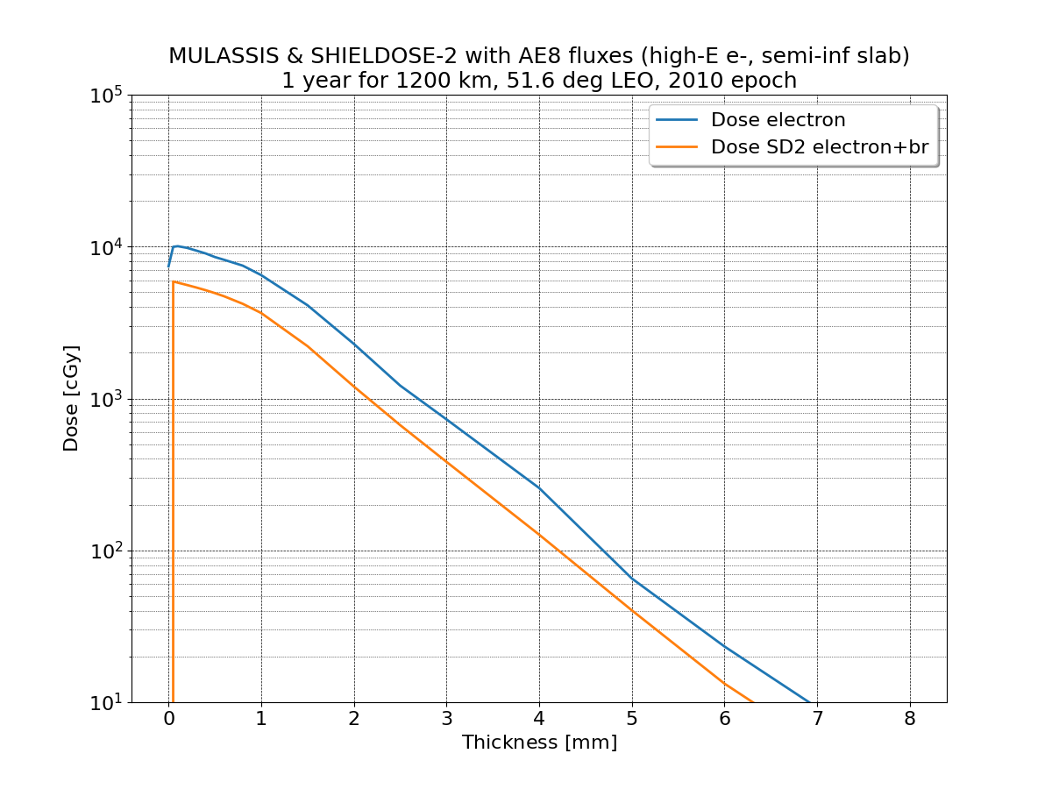
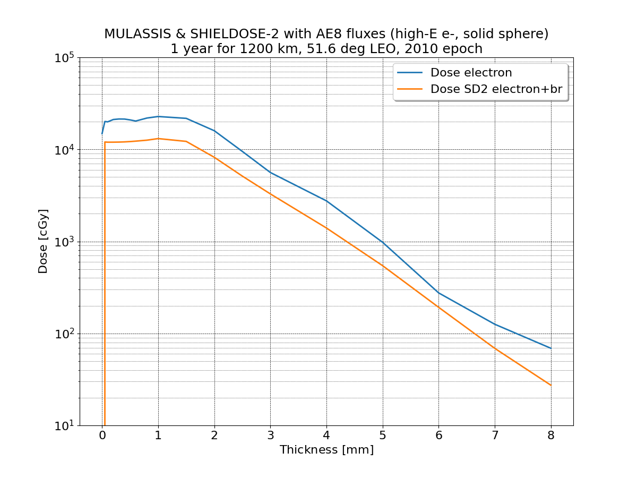
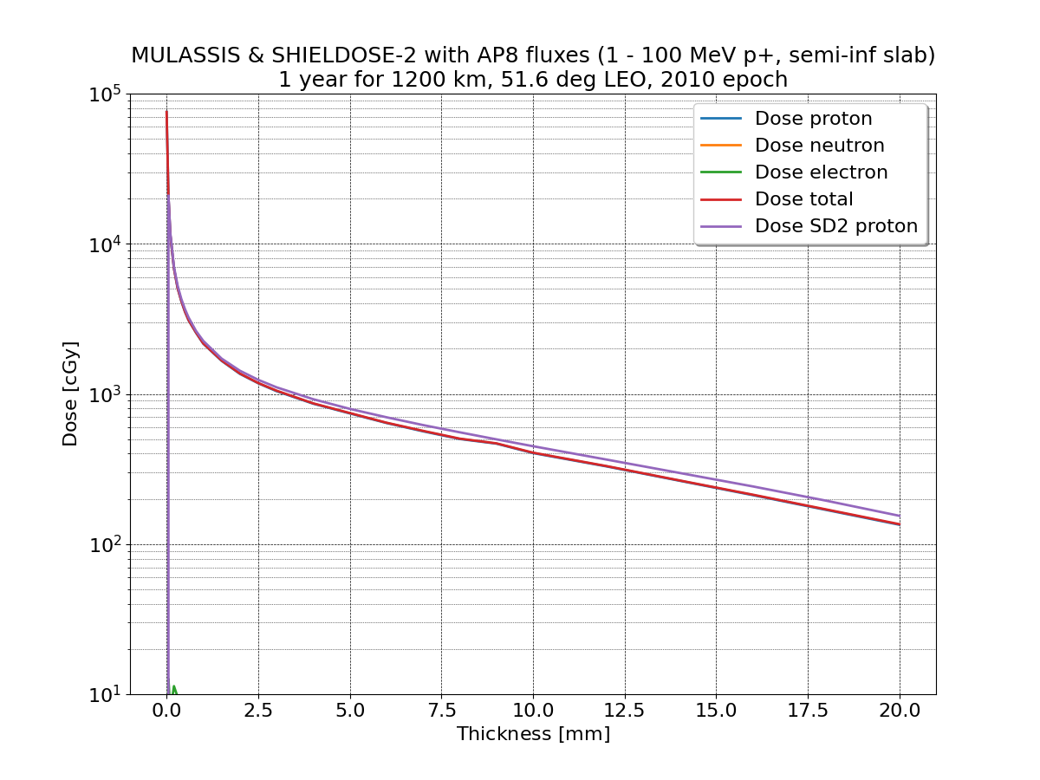
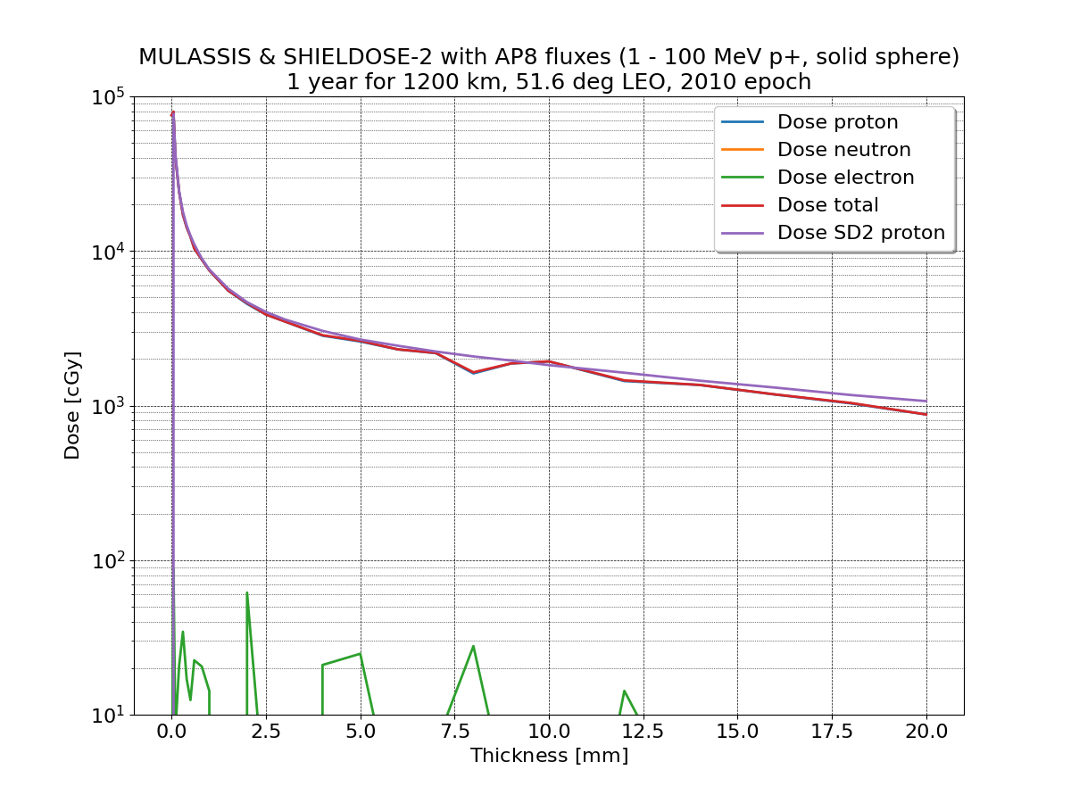
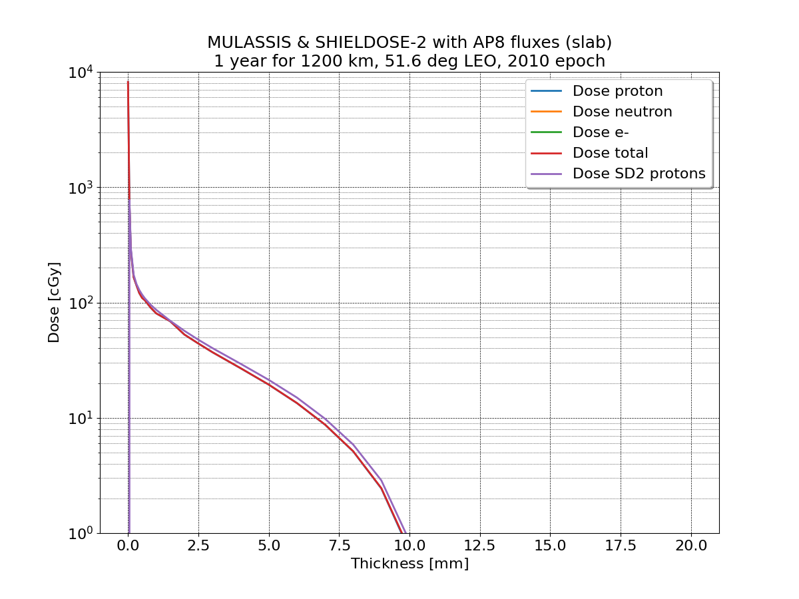
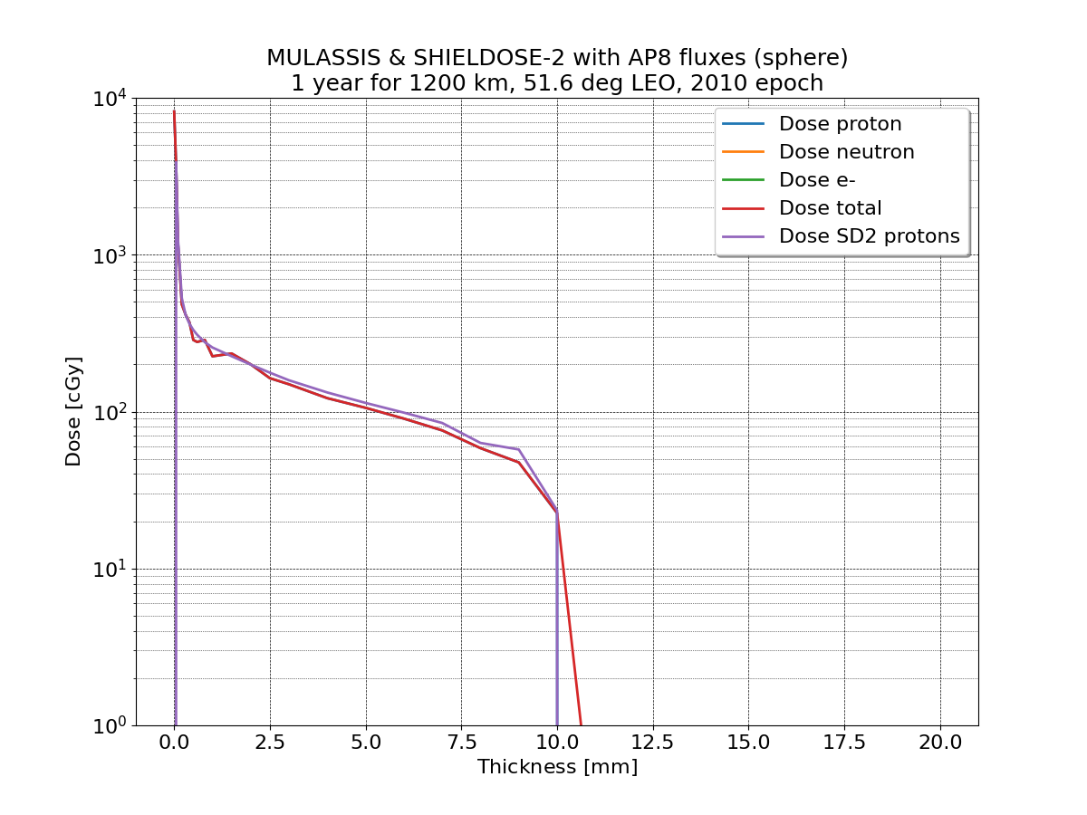
NoM boundary-dose Model Compared to SHIELDOSE-2 Results – Al Shields
>1 MeV electrons
1-100 MeV protons
1-50 MeV protons
Dose at boundaries in slab shield
Dose at centre of solids spheres

Slide 13
→ Presentation by Zafar Iqbal

Slide 14
Summary
NoM is a relatively new Python-based system of models developed by ESA
  Provides a framework to abstract the I/O interfaces of each model
  Good model interoperability of models, but with similar user-interfaces for each model
The NoM has recently been updated under LeNoM:
  Taxonomy has been improved and extended
  System-level, user-updateable units
  Improved interfaces to robustly treat different input types
  Updated and new models (IRENE v1.58, biodose, boundary-dose)
ESANoM connects scientists, models, and users

Slide 15
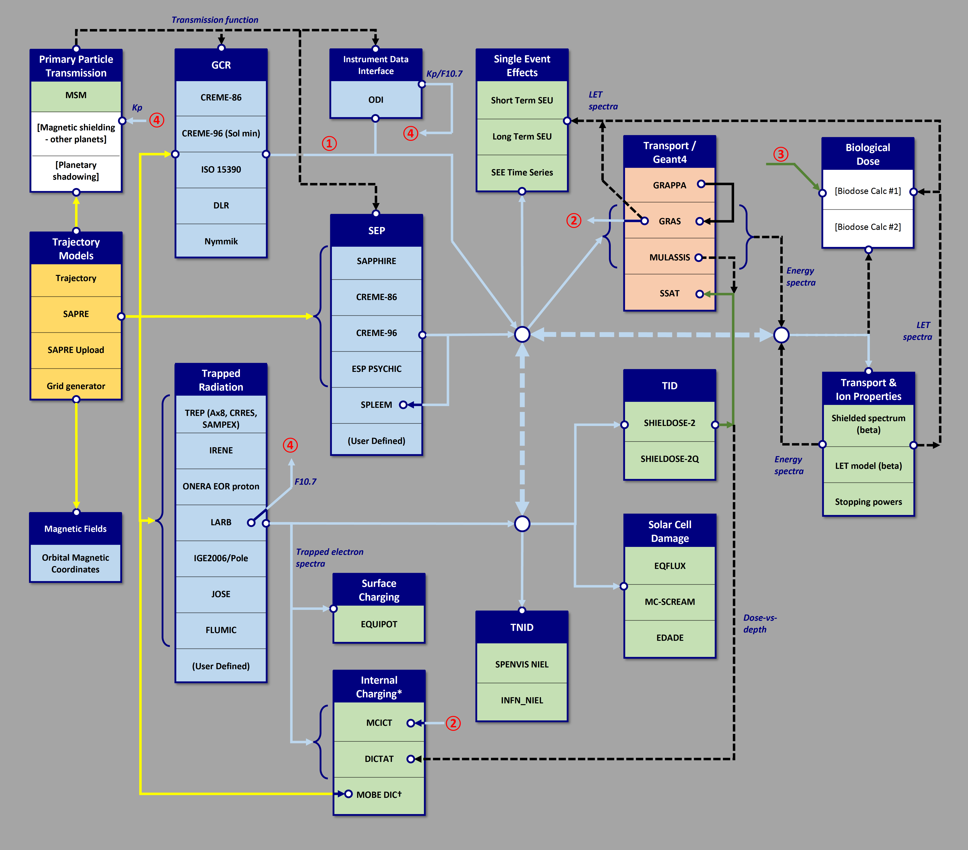
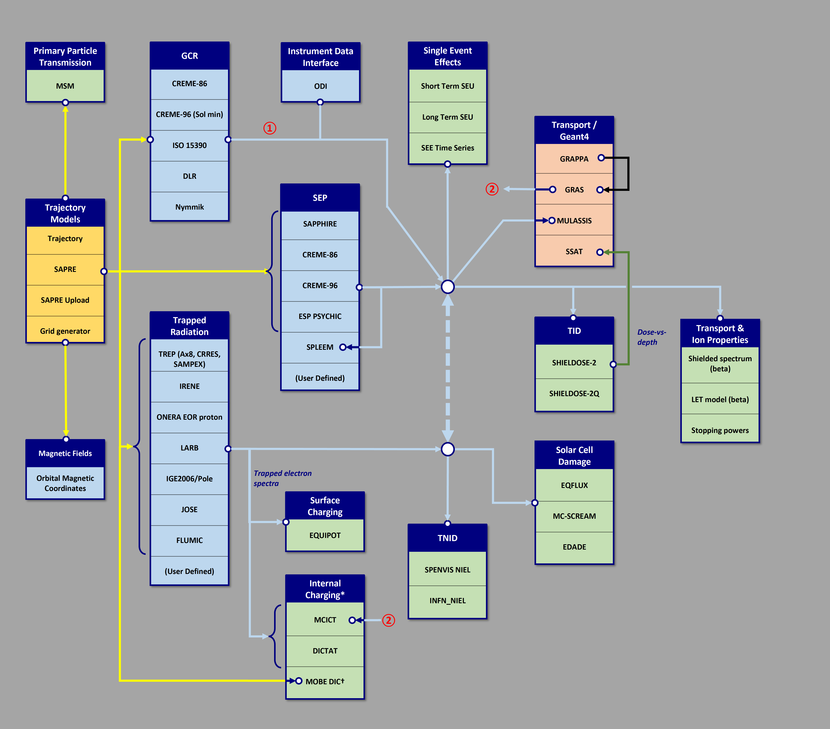
Review of NoM current and future radiation model interoperability

