Slide 1
ESA FPGA activities
To be presented at SEFUW’25, ESA/ESTEC
Lucana Santos Falcón & Alberto Urbón Aguado
TEC-EDM (ESA)
25/03/2025

Slide 2
Agenda
ESA IP Cores
  Motivation
  IP Cores availability
  Licensing
  Statistics
UDSM activities
HB for auto-coding of HDLs for Space Applications
FPGA Based Digital Simulation Acceleration Facility
IP Cores development standard: ECSS-E-ST-20-40C
Other ESA FPGA based activities
Q&A

Slide 3
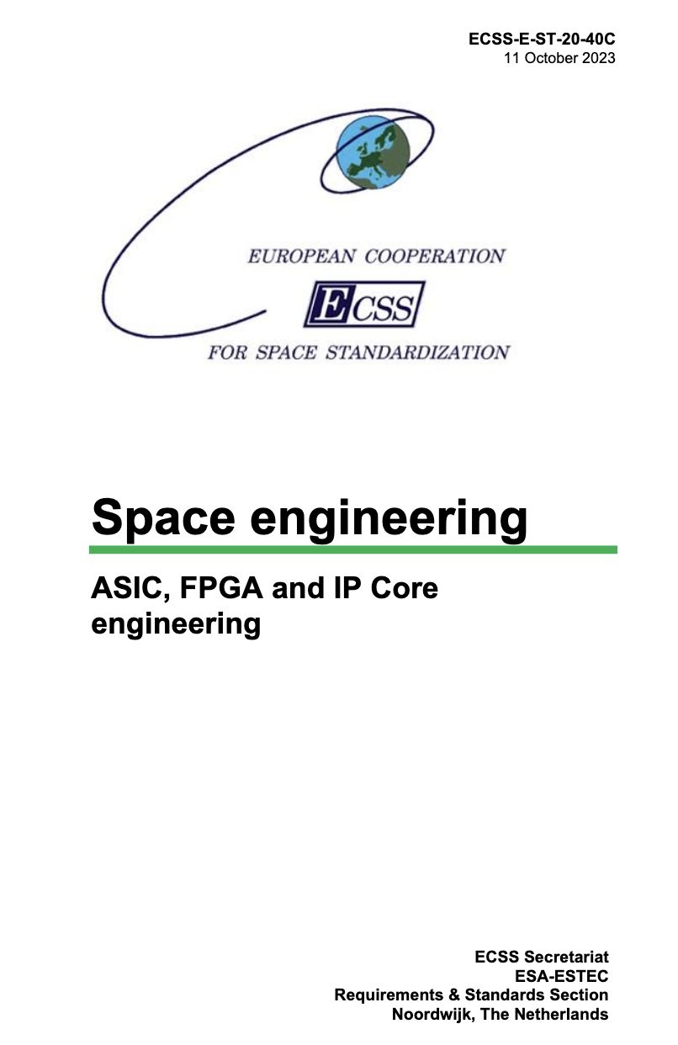
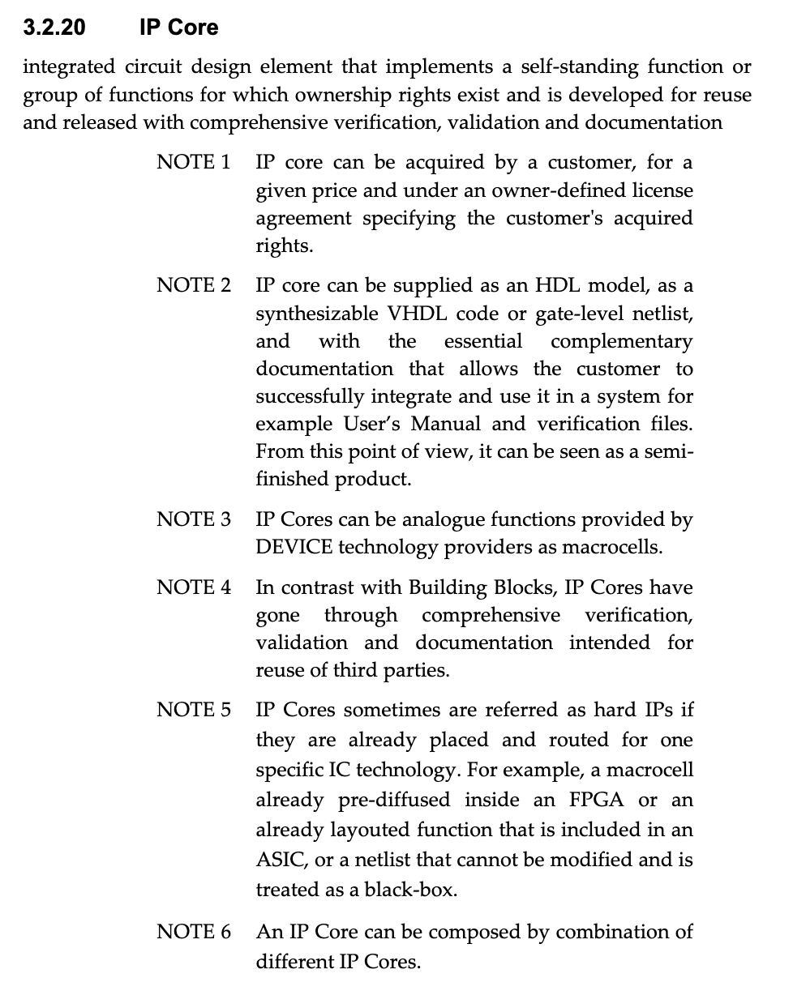
Why IP Cores?
Integrated circuit design element that implements a self-standing function or group of functions for which ownership rights exist and is developed for reuse and released with comprehensive verification, validation and documentation
Reusing IP Cores, as opposed to “from scratch” developments provides advantages and savings in costs:
  Guarantees compliance with standardised functions or communication protocols
  Further verification is not needed.
  Reduces overall risks.
  Reduces development times.
  Makes complex know-how accessible to smaller companies.

Slide 4

ESA IP Cores – History and Motivation
Since approximately 2002 ESA mantains a portfolio of IP Cores.
Origin:
  Internal development, hands on work.
  Part of an activity (a deliverable).
  Activity IS the IP Core development.
Why developing IP Cores for Space and not just reusing from the existing industrial market?
  Implementing functions that are typically seen in space projects: fault-tolerant processors (LEON2-FT), communication interfaces (Spacewire, Spacefibre, CAN), CCSDS time keeping, packet telemetry and telecommand…
  Meet needs in terms of robustness to space environment (SEE mitigation at RTL level); mapping to space-grade FPGAs.
  Ensuring fair accessibility for industry in Member States.
  Ensuring continuation of the distribution (main IP developers cease to exist; lack of economic interest to maintain the IP available…).
  Controlled development and quality: ECSS-E-ST-20-40C, ESA IP Cores technical guideline: https://amstel.estec.esa.int/tecedm/ipcores/ESA_IP_Core_tech_guide.pdf
Database
IP Cores
Design
Processor IP Core
SpW Interface IP Core
CANIP Core
Other custom logic

Slide 5
ESA IP Cores availability
The IP Cores are advertised on the ESA website managed by TEC-EDM:
http://www.esa.int/Our_Activities/Space_Engineering_Technology/Microelectronics/ESA_HDL_IP_Cores_Portfolio_Overview
AHBR – AHB to AHB bus bridge. | PDEC – Packet Telecommand Decoder as per CCSDS standard with a Cmd Pulse Distribution Mod (CPDM) and a Cmd Pulse Distribution Selector (CSEL). AHB compatible.
AUIP – AES based TC authentication with key management. | PTCD – synthesizable VHDL Packet TC Decoder of the MA28140 chip from GEC-Plessey Semic.
CAN – HurriCANe implements the CAN controller Core. | PTME – Packet TM Encoder as CSSDS with Virtual Channels, RS and Convolutional Encoders
CCIPC - implements a large subset of the CANopen services as defined in the CAN in Automation (CiA) Standard. | RT53EUR – Classic 1553 Remote Terminal core.
CUC-CTM - CCSDS Unsegmented Code (CUC) & CCSDS Time Manager (CTM). | SHyLoC - synthesizable cores implementing lossless data compression algorithms as defined in CCSDS 123.0-B-1 and CCSDS 121.0-B-2.
EDAC – encoders/decoders for SEC/DED in 4b:64b data words. | SpW-AMBA, SpWb, SpW-RMAP-Astrium & SpW-RMAP-Dundee – x2 SpW Codec implementations and x2 RMAP extensions for memory access.
FTADDR – fault tolerant AHB(internal) & DFI(PHY) based memory controller for DDR2/DDR3 SDRAM mems. | SpW-TDP - the aim of the Time Distribution Protocol (TDP) is to synchronize time across a SpW network.
IP1533 - MIL-STD-1553B protocol for the three different working modes: Bus Controller, Remote Terminal, and Bus Monitor. | SpFi - synthesizable VHDL implementation for single-lane SpFi port.
IPMON – IP Monitoring, AHB based sniffer with multiple capabilities. | SCCC - medium data rate Turbo Encoder soft IP.. Compliant with CCSDS 131.2-B-1 standard.
LEON2FT – hardened version of the LEON2 CPU, with SIMD and FPU extensions.
26 IP Cores
2 Under validation
5 Under development
6 discontinued
Coming soon:
GNSS receiver (AGGA4), multi-spectral near-lossless image compression, video compression, RISC-V microcontroller, SCCC receiver, NAND flash controller, JESD204C/D…

Slide 6


ESA IP Cores licensing
A License Agreement the scope and conditions of use, as well as limits ESA responsibility.
ESA IP Cores licenses are free, however a handling fee is charged per license (5000 per IP cores and application case).
The fee is meant to cover the administration expenses of the service: technical maintenance, documentation, dissemination of information, processing requests, licenses …
How to obtain an ESA IP Core
Check our website for detailed information on the offered IP Cores.
http://www.esa.int/Our_Activities/Space_Engineering_Technology/Microelectronics/ESA_HDL_IP_Cores_Portfolio_Overview
Once the desired IP Cores are identified, fill the online request form: http://ipcores.estec.esa.int/
The License Agreement is then prepared, signed internally by ESA and sent by e-mail to the licensee. An example of the License Agreement can be found here:
http://www.esa.int/Our_Activities/Space_Engineering_Technology/Microelectronics/Licensing
The licensee signs the License Agreement and sends it back to ESA.
Once the signed agreement is received, the IP Core is sent to the licensee.

Slide 7
Is it open source?
Open source (https://opensource.org/osd) | ESA Licensing conditions (*)
Free re-distribution. | Sub-licensing is forbidden. Final products can be commercialised without restrictions.
Source code is distributed. | Source code is distributed but cannot be re-distributed.
Allows modifications and derived work and re-distribution. | It is allowed but cannot be re-distributed. We expect users to share modifications with ESA.
Applies world-wide. | Only for Member States.
The license must not restrict anyone from making use of the program in a specific field of endeavour. | For peaceful applications only. For some IP cores the license must be linked to an ESA contract.
Distribution of license (upon re-distribution) | No. A new license is always required.
License must not be specific to a product. | No. License is for a single application case.
License must be technology-neutral. | Yes.
Does not contaminate surrounding code/IP (i.e. does not oblige to make everything open source). | Yes, IP conditions apply only to the subject IP and not to any other code around or instantiating it.
No support, no warranties. | No support, no warranties.
(*) Applies to the majority of ESA IP Cores, some exceptional cases have restrictions or source code cannot be distributed.
(*) Applies to the majority of ESA IP Cores, some exceptional cases have restrictions or source code cannot be distributed.
No warranties implied (provided “as is”), but if there is a known problem we share the information with all licensees
No support is offered but we do our best to help.

Slide 8
Some statistics
765 IP Core requests since 2002.

Slide 9
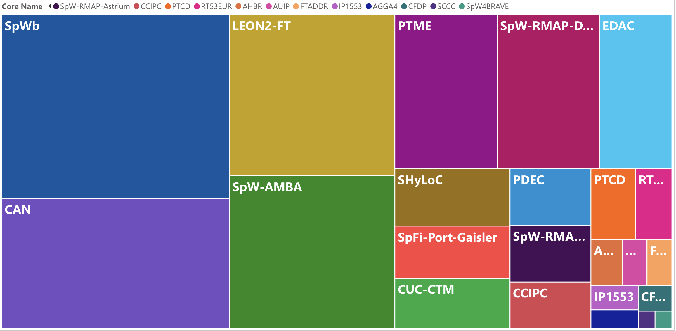
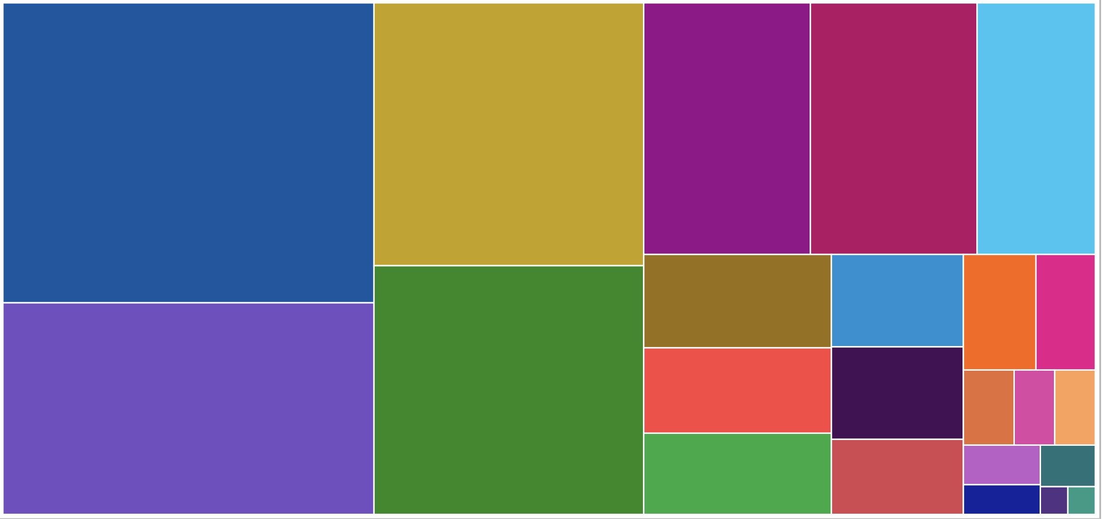
Some statistics
765 IP Core requests since 2002.

Slide 10
Developing IP Cores for ESA catalogue
ESA IP Cores for developers
Is it interesting? ESA will offer the IP for a very low handling fee, possibly attracting users to license from ESA rather than from the supplier when the two options exist. But there are still many advantages: ESA pays for the development → brings know-how to the company. ESA ensures quality of the delivered code. ESA advertises the IP Core in the portfolio. IP rights stay with the supplier. Supplier is free to distribute. Users might license the IP (cheap) from ESA; but come back to the developers to request for additional support/integration efforts.
ESA IP Cores for users
Redundant space functions accessible for a small handling fee. IPs are documented, verified and validated → but that does not guarantee a project will not request extra effort to be put in proving it works well. No warranties or support offered from ESA → it is advisable compare ESA IP Cores with options that are available in the market. Sometimes, developers offer a more complete service. It’s not necessary to acquire know-how on some functions → but sometimes it’s in the interest of the company.

Slide 11



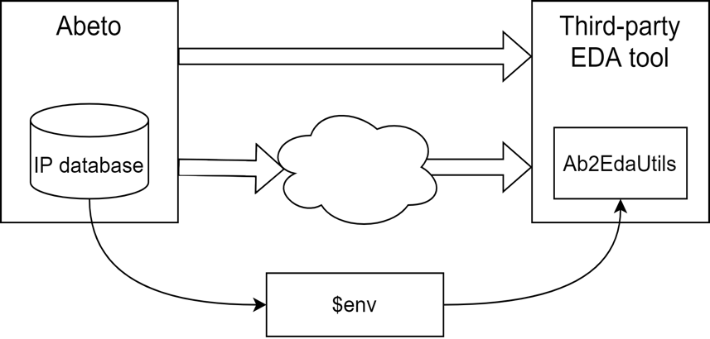
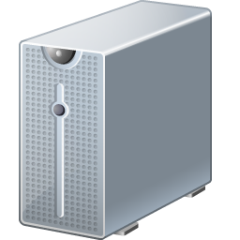










ESA IP Cores continuous improvement
New IP Developments
Investigation on reported issues.
Mapping to latest FPGA technologies → CI/CD flow enabled in our laboratories.
Failed builds, feedback loop
EDA flow automation for IP Cores
check out
Includes FPGAs representative of space projects.
check out
check out
updates
check out
DRAIN
release
Hosting code for IP Cores and internal developments.
Version control.
CI/CD features
Computing server hosting and running EDA tools
Users
Cl001 laboratory
FPGA validation bench

Slide 12
2. Ultra Deep Sub-Micron activities (UDSM)
Development in the scope of the EEE Space Component Sovereignty for Europe (ESA’s ARTES and GSTP = optional)
Collaborative approach among: ESA & EC & EDA & CNES
Trying to cope with the needs of the next generation of EU space ICs
Targeting advanced nodes, 7nm by TSMC for the mid-long term
UDSM 0 - ARTES AT 5C.443 Assessment for On-Board Digital Processors Assessment of 7nm technology and libraries Kick-Off January 2024, 1st test vehicle taped-out on 4Q24
UDSM 1 – GTE3-101ED Foundation Library and Platform Technology Kicked-Off November 2024 with Frontgrade Gaisler as prime | Main Objective: Next Gen GPP Develop next generation European space General Purpose Processor, based on open-source RISC-V and exploiting N7 FinFET Develop a mature SW tool ecosystem to exploit multi-core parallel processing | Target IPs Foundation library Die to die interface HSSL DDR PCIe Ethernet SpF controller RISC-V Chiplet Router FPGA chiplet
UDSM 2 – GTE3-102ED Interface and SiP Technology ITT in Preparation | Main Objective: Next Gen EU Components (e.g. FPGAs…) Increase portfolio of European Components Develop next generation Components in N7 FinFET

Slide 13
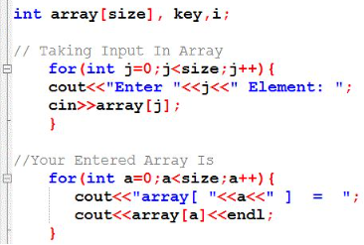
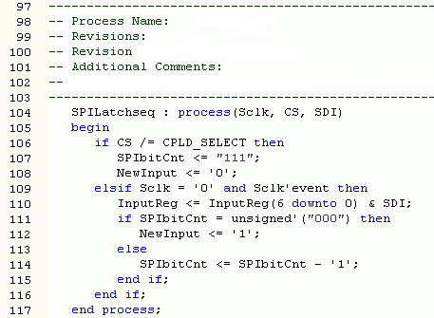
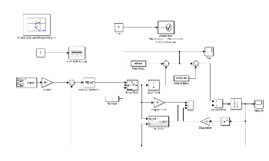
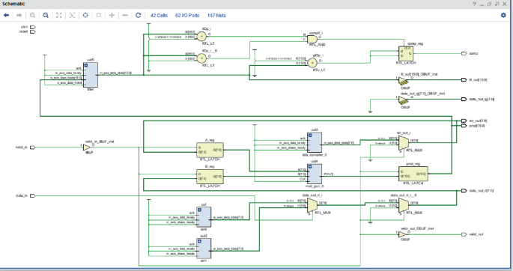
3. HB for auto-coding of HDLs for Space Applications
With the incoming trend of modelling digital electronics at higher levels, auto-coding (HLS) HDLs, ESA has pushed to gather a group of experts and produce a set of guidelines on the topic
Shape of a SAVOIR Handbook and captured by the WG
Scope of reliable VHDL auto-code generation for Space Segment FPGAs
Guidelines at three levels: Essential, Strongly Recommended, Recommended
Generic part + Annex on Matlab/SL HDL Coder
HL design flows including roles, phases and models
V&V strategies
Traceability towards ECSS-E-ST-20-40C
Radiation Mitigation techniques in high level models
Optimizations
Reuse
VCS and CI
Traditional Input Level
High Level
RTL HDL
High Level Synthesis
Synthesis
…
Auto-coding
Expected timeline:
KO
PM
PM
PM
CO
Preparation
Sprint 1: capture + review
Sprint 9: capture + review
Final review & wrap up
. . .
Nov’24
Jan’25
Feb’25
Nov’25
Jan’26

Slide 14
4. Overview of R&D ESA TEC-EDM FPGA related activities
IP Developments
JESD204B/C
O3K & HPE Rx coding schemes
Multi-spectral near-lossless image compression
Efficient Video compression (H264)
AGGA4 GNSS receiver
Project Support
Number of FPGAs per project
Methodology
Open-source FPGA toolchain for the EU NG-Ultra
Lowering the adoption barriers of Formal Verification
UVVM extension
Others
FPG-AI extension
Mitigation techniques evaluation of advanced COTS FPGAs (KU060)
Partners
Ingeniars, YosysHQ, Uni. Sevilla, IUMA, PoliTo, Uni. Pisa, EmLogic, Daiteq…
Notes:
-Develop a JESD204B/C IP Core targeting NG-Ultra from NanoXplore.
-Coding schemes for optical links following CSSDS standard
-Continuation of ShyLoc
-To consolidate video requirements for ESA missions, to perform a performance vs. complexity analysis + development + V&V
-Enhancement of nextpnr
-Formal Verif Methodology
-UVVM
-AI soft cores architecture??
-Mitigation techniques for KU060

Slide 15
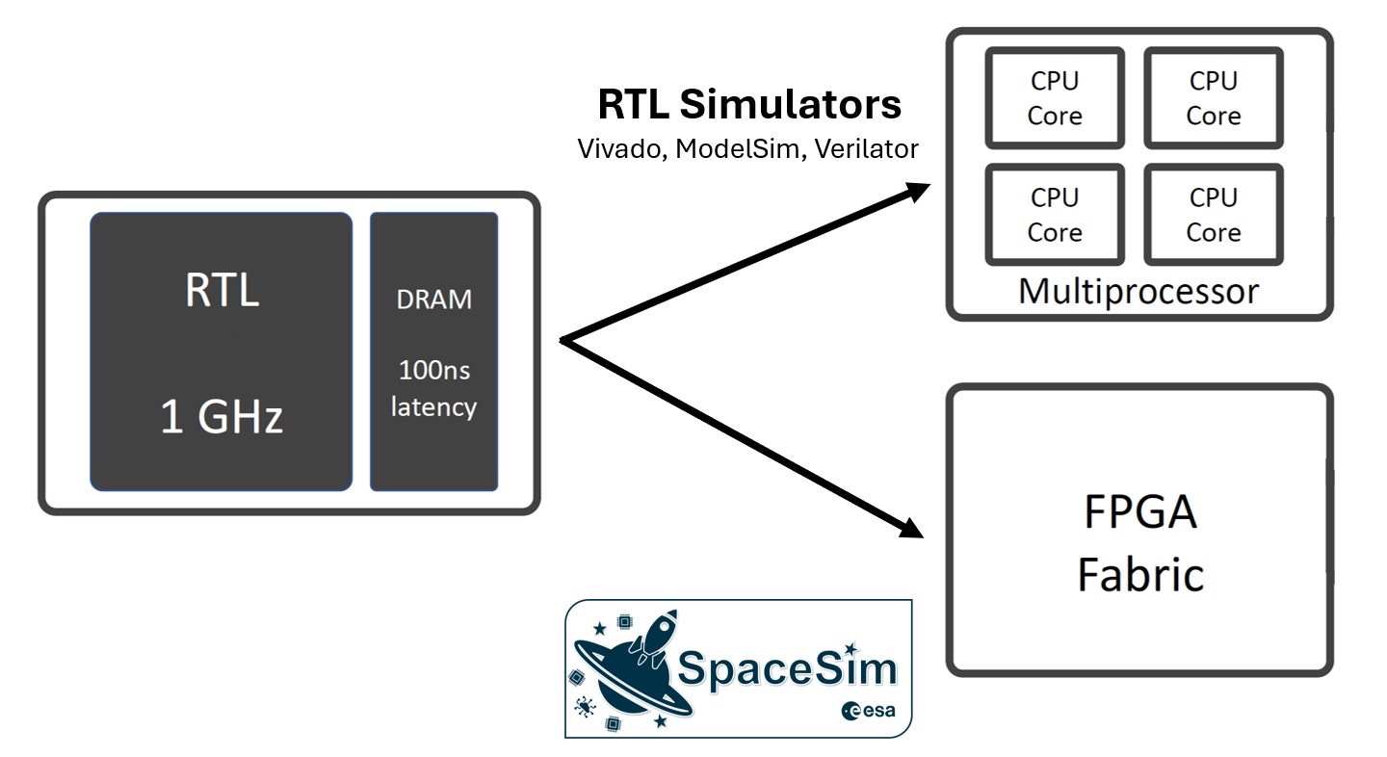
5. FPGA Based Digital Simulation Acceleration Facility
Functionality implementation on SoCs is becoming more sophisticated with heterogeneous complex computing units.
  E.g., CPU, GPU, VPU, e-FPGAs, systolic arrays (TPU-like), parallel vector engines (NVDIA-like), neuromorphic engines.
Current problem:
  Simulate individual computing units and leave the issues of scale to the post-silicon measurement.
Consequence:
  Lack architectural optimization & precise performance evaluation.
Need: Cycle-exact microarchitectural simulation platform to simulate heterogeneous complex SoC.
Proposed solution: FPGA-accelerated Hardware Simulator:
  FireSim: open-source simulation platform for cycle-accurate, full-system benchmarking
  AMD Alveo U250 FPGA accelerating cards
Final goal: Give access to industry/ESA partners to be able to simulate complex SoCs
Notes:
x4 AMD Alveo boards planned
can simulate up to 5 million equivalent gates

Slide 16
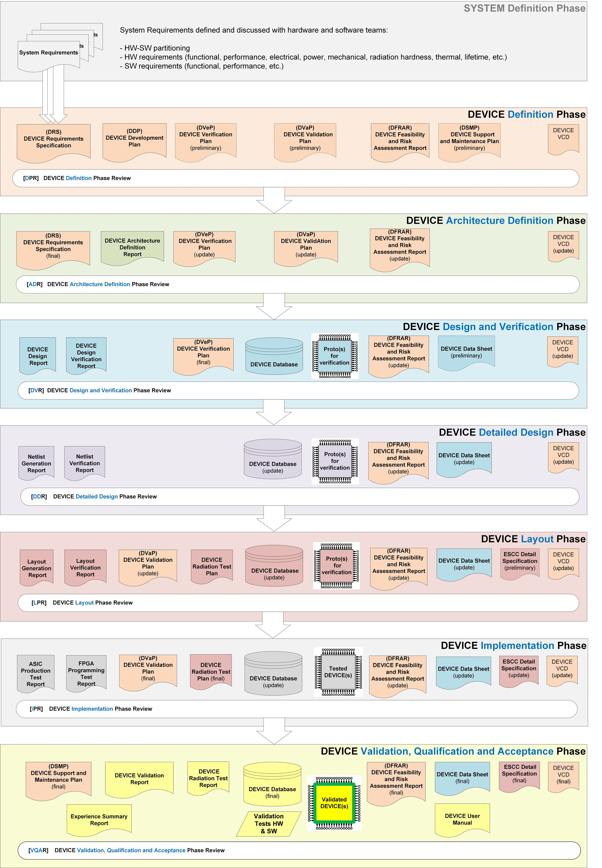

6. Methodology: ECSS-E-ST-20-40C
- ECSS: EU Cooperation Space Standardization
- Requirements applicable to EU space activities, from management to HW development
- Produced by space agencies and industry
-Generic framework that contains accepted definitions, dev. flow and stages, milestones and deliverables… to be tailored in each case
- Scope: D-ASIC, A-ASIC, FPGA and IP Cores
- Criticality levels envisaged → pre-tailoring:
  A = Catastrophic
  B = Loss of mission
  C = Major effects
  D = Minor effects
- No predefined alignment in time between device and system development milestones where the device will be used!
- Qualification of the device shall be carried out prior to qualification of the system where it will be used!
ESA - Microelectronics Development Methodology

Slide 17
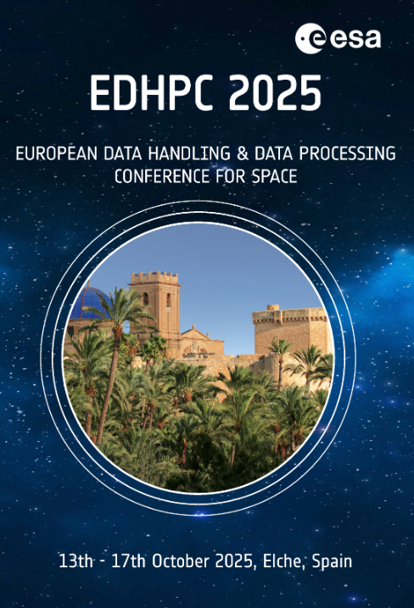









7. Q&A
London, 7th October 2025

Slide 18
Contact
ESA Microelectronics Section
microelectronics@esa.int

