Slide 1



A GRADE ABOVE
SEFUW – 2025
CertusPro-NX-RT FPGA Radiation & Qualification Update
Brian Baranski
Product Manager – uC, uP, FPGA, Ethernet

Slide 2


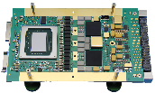



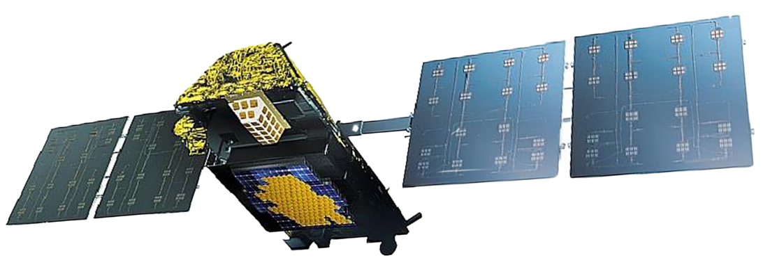

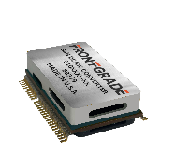

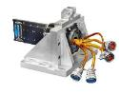









Payload & Bus Solutions Provider
Avionics & Mission Processing
Antenna Products
Processors, ASICs, IP cores,
Rad-Hard ICs, memory, interconnects
AESAs, pointing mechanism controllers, position sensors, gimbals
Antennas
Motion Control
RF
Motion Control
Waveguide, filters, rotary joints, SSPA, LNA, Switches
Power
Actuators, DC motors,
electronic controls
Power management & conversion, battery electronics

Slide 3
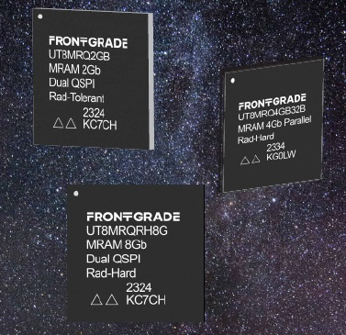

1, 2, 4 & 8Gb MRAM
Frontgrade.com/MRAM
128Mb Density QSPI available in 2025
Summary
Class A/B/C screening & qualification (NASA PEM-INST-001)
1, 2, 4 & 8Gb densities
Parallel PBGA 15mm x 17mm
DQSPI PBGA 20mm x 20mm
DQSPI 100MHz SDR – Parallel 45 ns read/write
Unlimited Read Cycles / 10¹⁶ Write Cycles
+2.50V to 3.60V VCC
-40°C to +125°C
1mm ball pitch
100 krad(Si), SEL Immune ≤ 83MeV-cm²/mg @2.7V, 125C
Non-ITAR
Applications
Certus/CertusPro-NX-RT | Avant | Versal | HPSC | Data Storage | Config Memory

Slide 4
4Gb Parallel MRAM Radiation Summary
Frontgrade.com/MRAM
SEL Immune:
44 LET; Tested at 3.6V, 105 & 125C (4 parts statically tested, 1 part dynamically tested)
62 LET; Tested at 3.0V, 105 & 125C (4 parts statically tested, 1 part dynamically tested)
83 LET; Tested at 2.7V, 105 & 125C (4 parts statically tested, 1 part dynamically tested)
SEFI/SEU Immune:
83 LET; Tested at 2.5V, Room Temp
Dynamic testing (Write/Read/Compare loop)
RH QSPI MRAM SEE report in Q2 2025
Summary Radiation Report available for download at Parallel MRAM webpage (UT8MRQ4G32B)

Slide 5
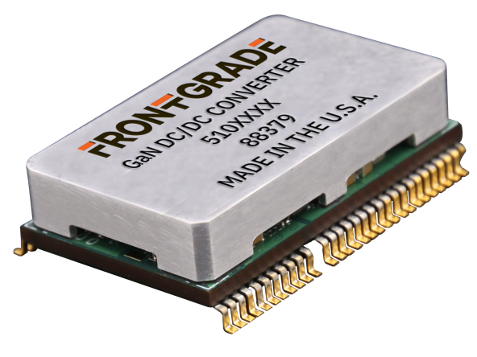
GaN Single Stage DC - DC Converter
Frontgrade.com/GaN
Summary
Space Industry's most efficient GaN-based
DC-DC converter
20-38 VDC input, 0.8-12 VDC output
93% efficiency, 50W power output
Scalable with parallel connections delivering up to 100W
61-lead, small volume: 63.5L x 38.1W x 17.0H mm
Integrated protection: overvoltage, undervoltage, overcurrent, and short circuit.
MIL-STD-883 Tested
TID 50 Krad (Si), SEL ≤ 60 MeV-cm²/mg
Lead Times
Prototypes/EM – 18 weeks
Flight – 20 weeks
Integrate FG’s EMI filter
for complete, space-
qualified GaN solution.
Applications
Space Systems | Commercial and Military Avionics| LEO Satellites | Mobile & Ground
Notes:
From: Space Industry's most efficient single-stage GaN-based isolated DC-DC converter To:
From: 62-lead module with encapsulated PCB, metallic heatsink, and plastic base To: 62-lead, small volume 2.51L x 1.51W x 0.67H inches
Removed – PCB enclosure details, Flight time (16 Weeks LT)
18,20

Slide 6
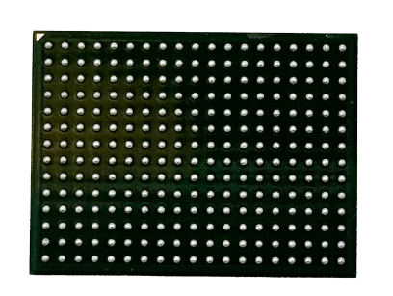
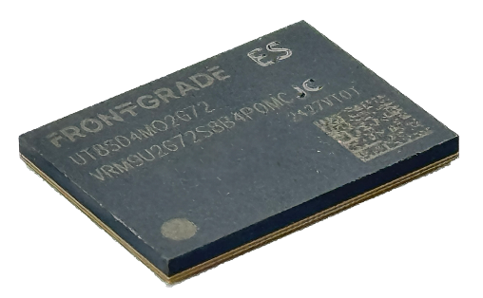
18GB DDR4
Frontgrade.com/DDR4
Summary
Space Industry’s Highest Density DRAM
16GB + 2GB ECC
Organized as 2G x 72
266 PBGA, 15mm x 20mm
1mm pitch SnPb
-55°C to 125°C
2,400 MT/s
Class B/C/D Missions
Individual reset signals to each die – SEFI mitigation w/o power cycle
MTTF of >45,000yrs GEO (Adams 90%, 100 mil Al)
Summary SEE report available at Frontgrade.com/DDR4
Non-ITAR
Availability
Prototypes/EQM/Class D – Now
Class B Flight Units – Aug 2025
Applications
Avant | Polar Fire | LX2160 | Versal | HPSC | GR765 | Data Processing

Slide 7
18GB DDR4 Radiation Summary
Frontgrade.com/DDR4
MTTF (Conservative)
LEO: 1.5 million years
MEO: 55.8 thousand years
GEO: 45.6 thousand years
SEL:
Tested at 1.26V and 85/105°C up to 82 LET
4 parts tested to total fluence of 5e7 with no latch up at 37 LET and 105°C
1st latch up observed at 38 LET
  Some runs between 38 and 82 did not have a latch up
Destructive latch up observed at 67 LET
Weibull curve of data through 82 LET for both 85°C and 105°C
  Very low cross section
Category | LEO(ISS) | MEO | GEO | Units
HCE | 1.16E-05 | 8.43E-05 | 8.79E-05 | events/die/day
SEL @105C | 1.95E-10 | 5.45E-09 | 6.67E-09 | events/die/day
SEL @85C | 1.04E-10 | 2.91E-09 | 3.56E-09 | events/die/day
dyn SEFI | 6.52E-05 | 5.64E-04 | 6.70E-04 | events/die/day
SBE SEU | 8.93E-12 | 7.85E-11 | 9.07E-11 | bits/dev/day
MBE SEU | 4.68E-18 | 8.89E-17 | 9.54E-17 | bits/dev/day
LOW SEL DEVICE CROSS-SECTION UP TO 82 LET -> LOW EVENT RATE

Slide 8


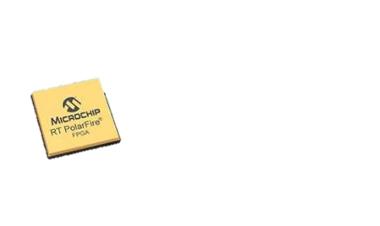
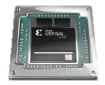



When small FPGAs & Microcontrollers are not enough
…and large FPGAs are overkill
Performance
Large FPGAs
& Processors
AMD KU060
Microchip RTG4
Small FPGAs
& Microcontrollers
FPGAs for Distributed
Space Processing
Microchip RT Polarfire
AMD
Versal
Vorago
VA41630
Microsemi RT ProASIC3
Microchip
RTAX
SWaP-C
Frontgrade, the leading electronics space products provider, and
Lattice, the low power programmable leader,
are solving the space industry’s need for efficient FPGAs together.
Notes:
Designers of space systems have options at the high end including many well known FPGA vendors, as well as the low end with Microcontroller or smaller FPGA’s, but Frontgrade saw a need for another option serving the middle ground. When the small options don’t provide enough performance or flexibility and the large options are too power hungry and consume too large of a footprint, Frontgrade is bringing new options to market.

Slide 9


Frontgrade & Lattice
Why our partnership matters
Leading dedicated space electronics provider
30+ years of Space flight heritage
Flight-proven, space-grade
PEM-INST-001, QML-Q & QML-V screened devices
Low power programmable device leader
20 years of automotive domain expertise
Industry-leading performance & reliability
Our proven space heritage and the latest commercially developed FPGA technology will advance next-gen capabilities in support of government, civil, and commercial Space missions.

Slide 10
Certus™-NX-RT & CertusPro™-NX-RT​
Filling Performance / SWaP-C Gap for Distributed Satellite Processing
TRAITS | Certus-NX-RT UT24C407 | CertusPro-NX-RT UT24CP1008
Logic Cells | 39K | 96K
LUT4/Flip Flop | 32.3k | 79.9k
Embedded Memory | 2.5Mb | 7.3Mb
Supply Voltage (V) | 1.0 Core, 1.8V Aux | 1.0 Core, 1.8V Aux
Max. Image Size (w/ max. LRAM & EBR) | 8.807Mb | 22.333Mb
I/O Voltage (V) | 1.0 – 3.3 | 1.0 – 3.3
PLL | 3 | 4
Primary I/O | LVDS, SGMII, PCIe, GbE | LVDS, SGMII, PCIe, 10GbE, SRIO
SERDES | 4 Lanes – PCIe only | 8 Lanes – Flexible PCS
Supported Memory | DDR2/3L, LPDDR2/3 x8, x16 | DDR2/3L, LPDDR2/3/4 x8, x16, x32, x64
Security | Bit stream encryption (AES-256) & authentication (ECDSA) | Bit stream encryption (AES-256) & authentication (ECDSA)
ADC | 2x 1 MSPS, 12-bit SAR | 2x 1 MSPS, 12-bit SAR
Typical Power (mW) | 100 | 600
Size (mm) | 14 x 14, 0.8 pitch | 19 x 19, 0.8 pitch
Temp. (°C) | -40 to 125 | -40 to 125
Packaging | Plastic package, SnPb balling (x256) | Plastic package, SnPb balling (x484)
TID (kRad (Si)) | 100 | 100
SEL Immune (MeV-cm²/mg) | ≤80 | ≤80
Both parts are Non-ITAR

Slide 11




FD-SOI & Architectural Improvements for Rad Tolerance
Effect of Ionizing Particles
Traditional FPGA on Bulk
FPGA in 28nm FD-SOI
GATE
+ –
– +
Radiation strike ionizes Si atoms, forming cylindrical track of electron hole pairs
– +
+ –
GATE
SOURCE
+ –
– +
DRAIN
– +
+ –
+ –
– +
– +
+ –
+ –
– +
– +
+ –
+ –
– +
– +
+ –
+ –
– +
– +
+ –
SOURCE
DRAIN
– +
+ –
+ –
– +
ULTRA-THIN BURIED OXIDE
Critical transistor channel area (orange)
for soft errors (several ɥm thick)
Silicon film transistor channel (~100 Å)
GATE
SOURCE
+
DRAIN
Funnel-shaped charge collection occurs
–
+
–
+
Critical area significantly reduced, minimizing charge collection
Built-in SEDC (fabric SRAM scrubber) and ECC (EBR & large RAM) for added mitigation
Greatly improved soft error rate (SER)
+
+
–
+
–
+
–
+
+
–
+
–
+
–
+
+
+
+
–
+
+
+
–
+
– +
+
– +
+ –
+
+
+
+
GATE
–
–
Charge collects into current pulse, state of charge inverts
SOURCE
–
+ –
+
DRAIN
–
+ –
– +
–
– +
–
+ –
+ –
– +
+
– +
+
–
–
– +
–
– +
–
–
+
–
–
+ –
–
–
+ –
+
+
–
+
+ –
– +
–
+
+ –
+
+ –
+
+
+
+
– +
+
+
– +
–
+
+
–
+
+
+ –
–
+
–
– +
–
+
–
+
+
– +
+
– +
+
+ –
+
+
+
+
+
+

Slide 12
A Closer Look at CertusPro™-NX-RT – UT24CP1008
Optimized For Embedded Edge AI Processing
Low Power FPGA Fabric
Power efficient performance
Built on FD-SOI technology
Industry-leading reliability
100k logic cells
Optimized For Edge Processing
DSP, LRAM & EBR
7.3 Mb on-chip memory
LPDDR4, DDR3 (1066 Mbps)
2x ADC
305 total I/O (167 at 3.3V)
4ms I/O configuration
30 ms device configuration
Fast Programmable I/O with LPDDR4 Support
100k Logic Cells
Embedded Memory
DSP Blocks
High Bandwidth Interfaces
8 SERDES lanes up to
6.25 Gbps
Flexible multi-protocol PCS
Supports 10GE, PCIe Gen 2, SpaceFibre & more
6.25G SERDES
Bitstream Encryption
and Authentication
Small Form Factor
19 x 19 mm package
Notes:
This is a simplified block diagram of the CertusPro, highlighting the higher speed more flexible SerDes.
There are 156 SysDSP blocks, clock-data recovery circuitry for SGMII gigabit ethernet, 305 I/O 167 of which support 3.3V range. I/O configures in as little as 4 ms, and full-device in under 30 ms

Slide 13

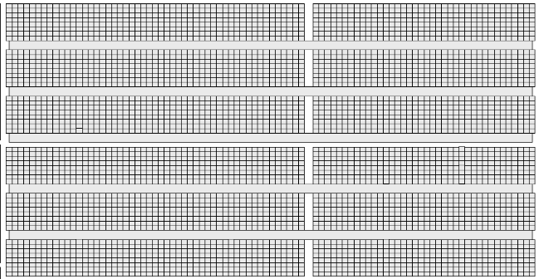
Soft Error Detection & Correction
Certus™-NX-RT & CertusPro™-NX-RT
Built-In Error Detection & Correction on all Embedded Memory Bits
Dedicated hard logic to detect soft errors
Frame-by-frame SED check
Single & multi-bit error detection
Frame-level, single bit error correction
Programmable SED clock with wider clock frequency option
Soft error injection (SEI) tool available in Radiant
2 levels of SED check
  Level 1: Frame level
  Level 2: Bitstream level
CRC at the end of bitstream
Correction using ECC for single bit error
Multi-bit error detection only
Report out error location of error frame
Report out bit location inside the error frame
1 0 1 1 0 1 1 1 0 0 0 1 0 0 1 1 0 1 0 1
Single bit error detection / correction
SED/C
Multi bit error detection
1 0 1 1 0 1 1 1 0 0 0 1 0 0 1 1 0 1 0 1
Frame by Frame – SED Check
Frame by Frame – SED Check
Frame by Frame – SED Check
Frame by Frame – SED Check
SED/C
Hard IP
CRC (End of Bitstream)

Slide 14
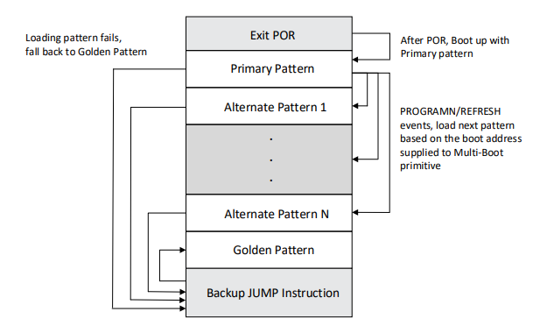
Multi-Boot Options for
True In-Flight Reconfigurability
Various configuration boot modes are supported to minimize risk of in-flight reconfigurability and the flexibility of running different patters at different times.
Supports booting of up to
6 different patterns

Slide 15

Security
Certus™-NX-RT & CertusPro™-NX-RT
Built-in bitstream encryption & authentication for system integrity
Bitstream security
ECDSA256 authentication
AES256 encryption
Radiant support enabled by default
User mode security features
  Access CRE functions thru fabric (using CRE IP)
  Radiant support enabled upon request (under license control)
  Unlimited reprogramming cycles
Certus™-NX-RT and CertusPro™-NX-RT
Cryptographic Engine (CRE)
Programmable I/O
Unique ID
Fabric
(Flexible User Security Algorithm + Flexible I/O Protocol)
True Random Number Generator
SHA256 Service
AES128/ AES256 Encrypt / Decrypt
Configuration Engine
SPI NVM

Slide 16
Radiation Tests & Facilities
Heavy Ion SEE (HiSEE) testing performed at Texas A&M Cyclotron and Lawrence Berkeley National Laboratory Cyclotron facilities.
Heavy Ion testing performed at target LETs from 0.2 - 83 MeV-cm²/mg
SEL immunity validated at 83 MeV-cm²/mg at 125°C
Proton SEE (PSEE) testing performed at Northwestern Medicine Proton Facility and James M. Slater MD Proton Treatment & Research Center.
Proton testing performed at target proton energies of 50MeV, 100MeV, and 200MeV
Total Ionizing Dose (TID) testing performed at Frontgrade Technologies’ Cobalt-60 chamber with Advantest V93000 tester

Slide 17
Test Campaign Overview
Frontgrade mapped a variety of designs into CertusPro-NX-RT FPGA.
Evaluated their susceptibility to single events (single event upsets (SEUs) and single event failures (SEFs) via beam exposure.
Functionality tested:
Configuration RAM
ADC (2x 12 bit ADC’s tested with static and 1Mhz sine wave)
SerDes (Tested in 8B10B external loopback)
PLL (Loss of lock and clock output monitoring)
Shift registers (Multiple chains with different clock rates and sources)
  SRAM (Large RAM block (LRAM) and embedded RAM (EBR) with and without embedded ECC)
  DSP (DSP blocks configured as FIR filters)
  GPIO (General purpose I/O, LVCMOS 3.3V, 1.8V output monitoring)
  SEDC (Configuration RAM scrubbing and error detection)

Slide 18
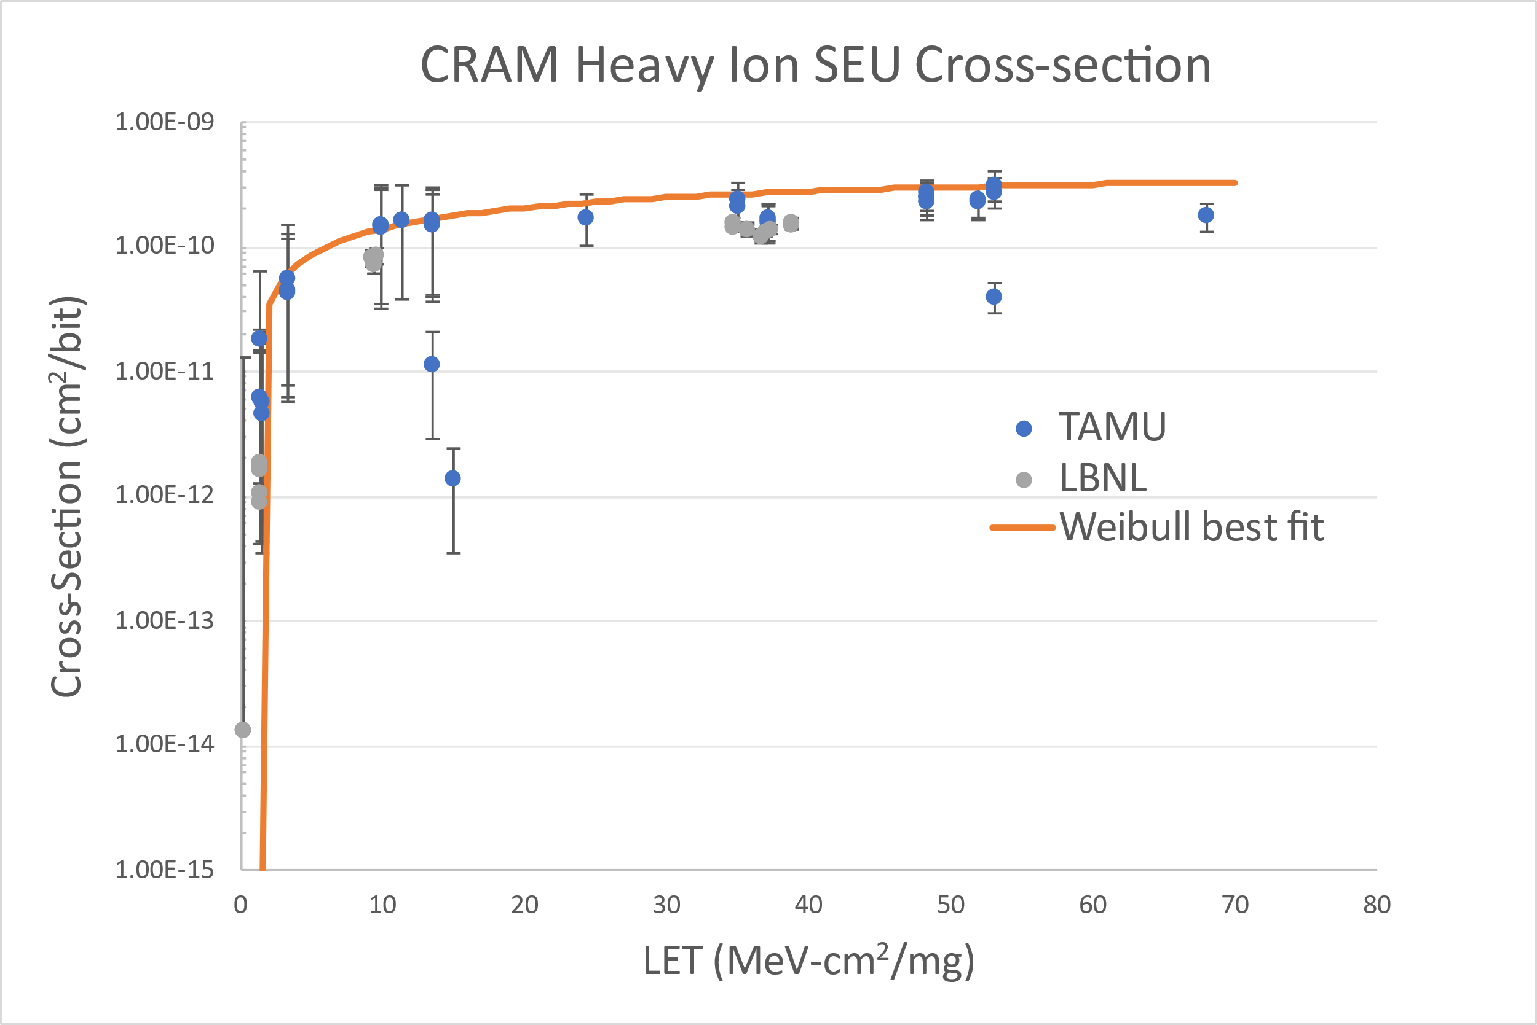
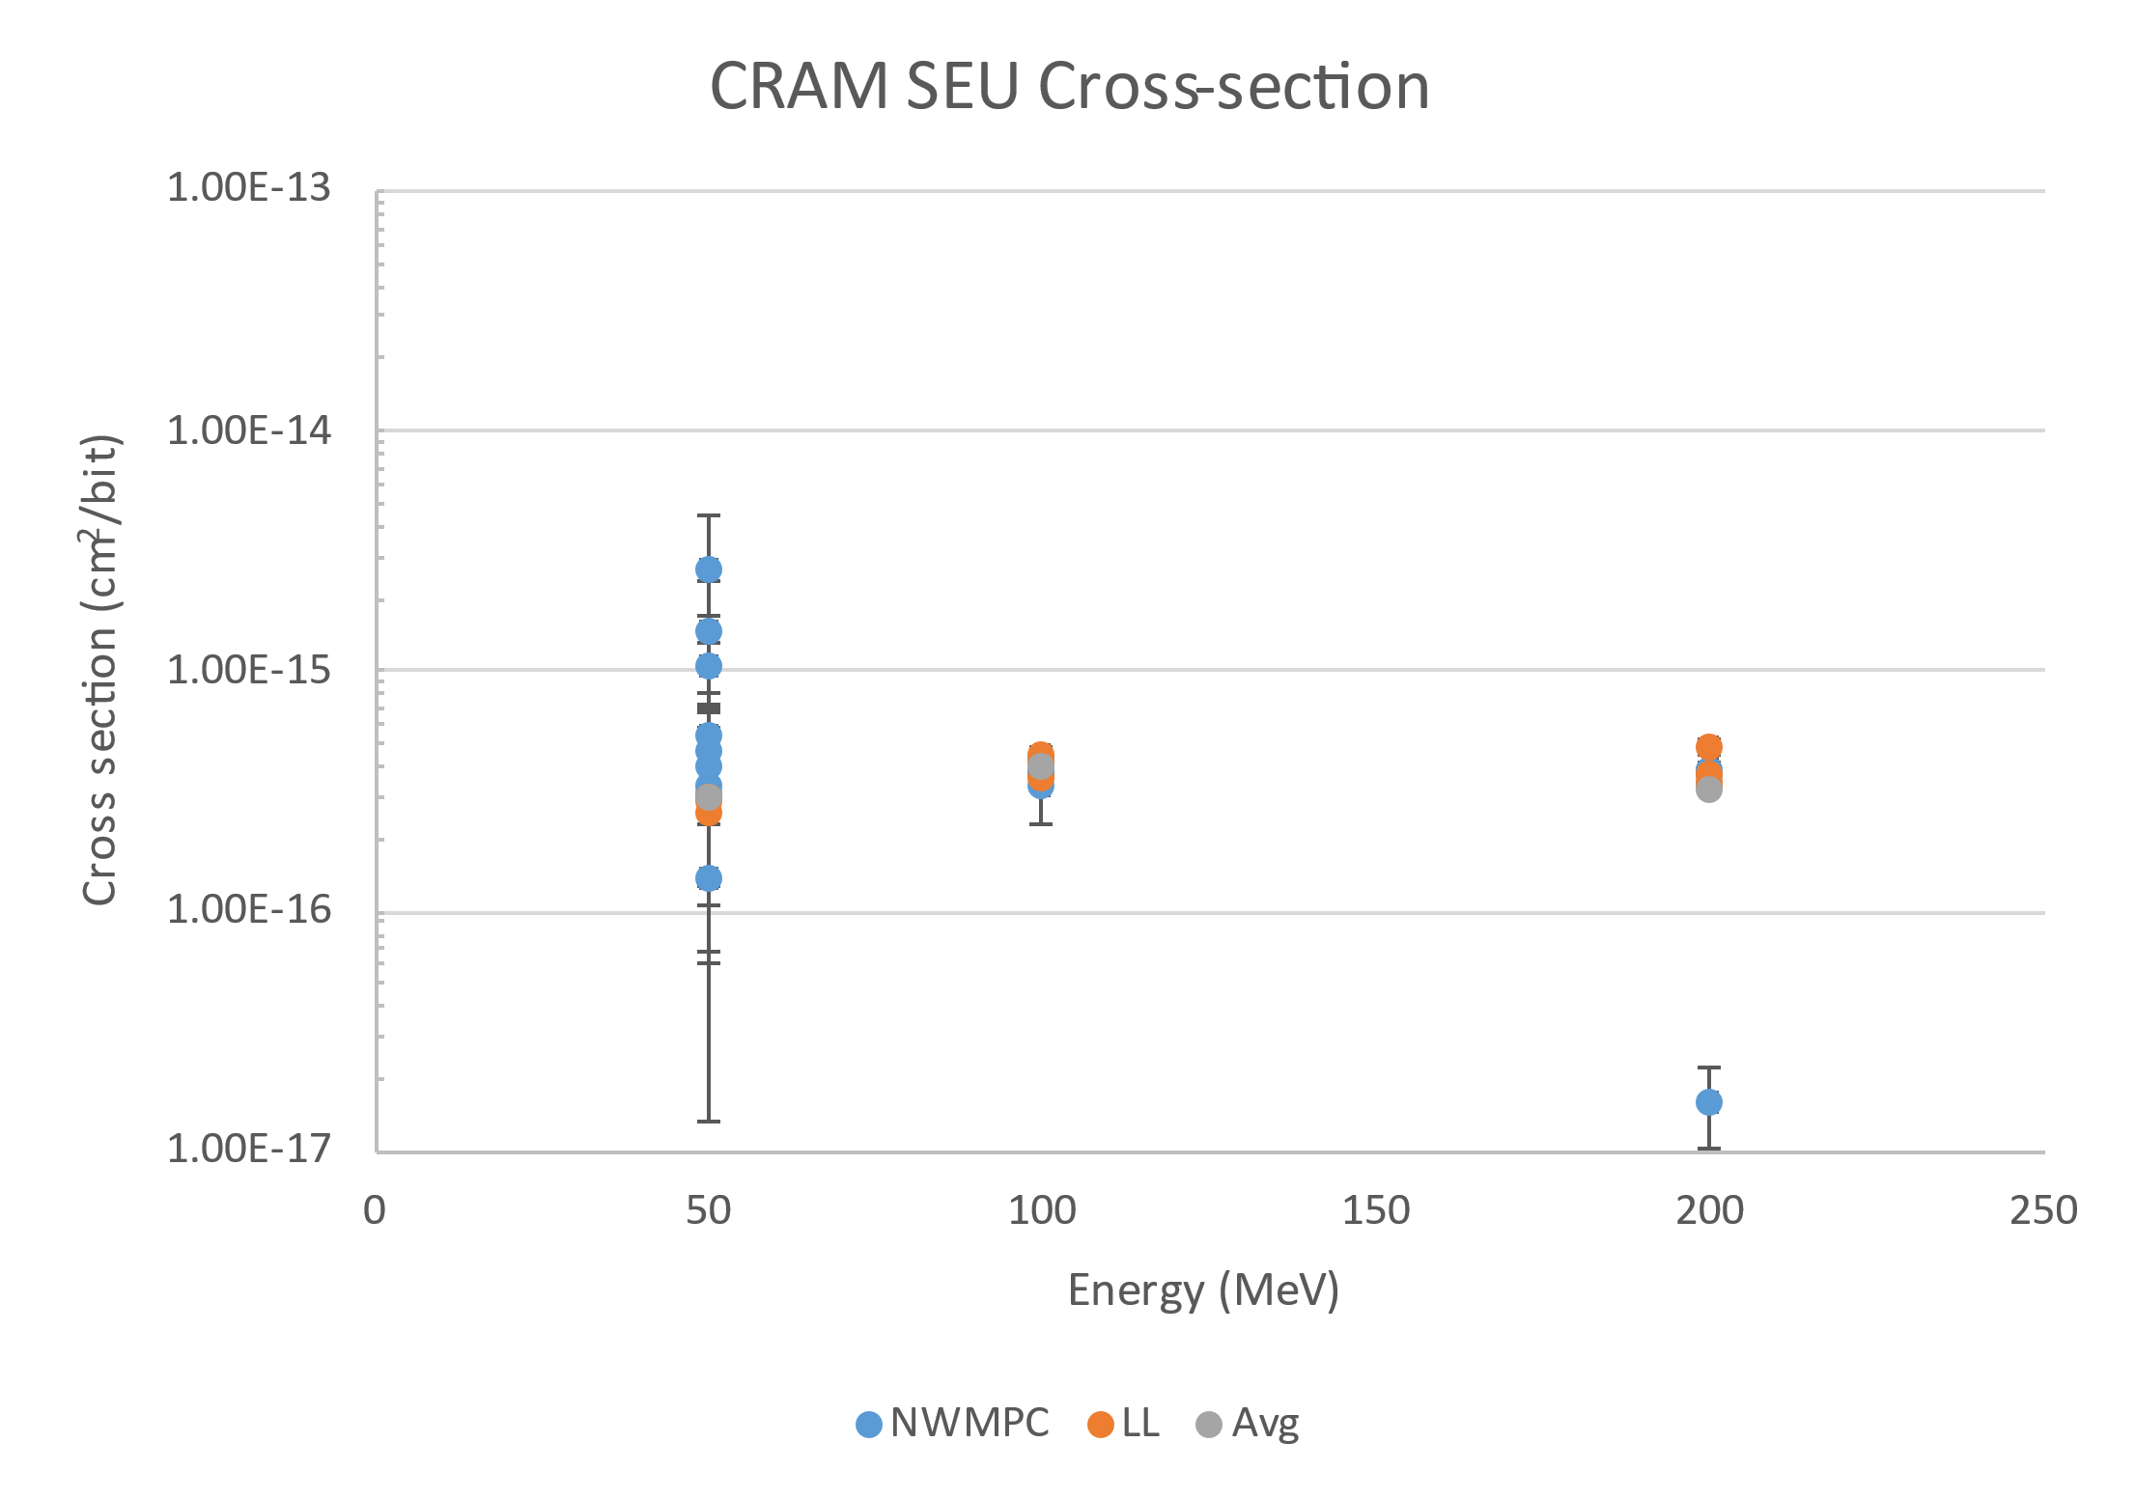
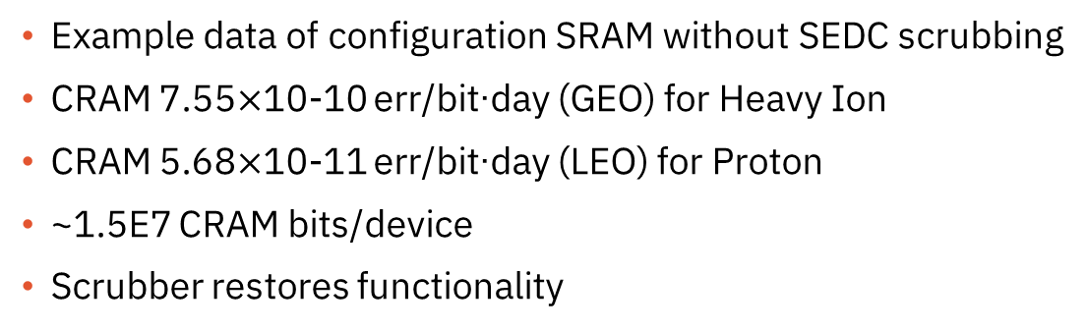
CRAM Heavy Ion & Proton
Example data of configuration SRAM without SEDC scrubbing
CRAM 7.55$×$10-10 err/bit∙day (GEO) for Heavy Ion
CRAM 5.68$×$10-11 err/bit∙day (LEO) for Proton
~1.5E7 CRAM bits/device
Scrubber restores functionality

Slide 19
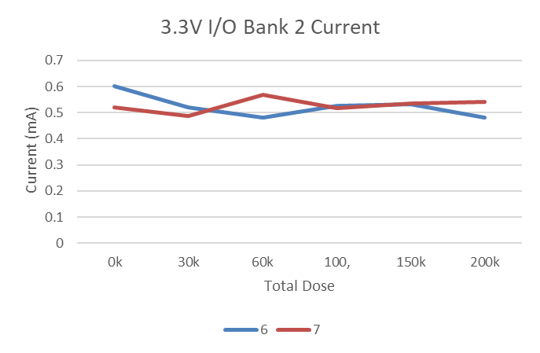
Total Ionizing Dose
5 parts tested to 100krad(Si); 2 additional parts step stressed to 200krad(Si). See full report for details.
All 5 parts passed functional and parametric testing. Currents stayed well behaved.
2-step stress parts pass functional testing to 200krad(Si) but failed some parametric testing at 150krad(Si).
 |  | Total Dose rad(Si)
 |  | 0k | 30k | 60k | 100, | 150k | 200k
Unit number | 0 | N/A | N/A | N/A | Pass all | N/A | N/A
 | 1 | N/A | N/A | N/A | Pass all | N/A | N/A
 | 2 | N/A | N/A | N/A | Pass all | N/A | N/A
 | 3 | N/A | N/A | N/A | Pass all | N/A | N/A
 | 4 | N/A | N/A | N/A | Pass all | N/A | N/A
 | 5 | N/A | N/A | N/A | Pass all | N/A | N/A
 | 6 | Pass all | Pass all | Pass all | Pass all | Pass all | Pass func Fail Vil/Vih
 | 7 | Pass all | Pass all | Pass all | Pass all | Pass func Fail Vil/Vih | Pass func Fail Vil/Vih

Slide 20

Engaging With Frontgrade
What We Deliver
Space Flight Assurance
Single wafer lot traceability from AEC-Q100 qualified material
Packaging for flight: SnPb balling
Radiation lot acceptance testing
Radiation reports
NASA out-gassing compliance
Design-in & Technical Support from Program Start to Finish
  Fault-tolerant IP
  Easy access to engineering support
Comprehensive HW & Design SW Ecosystem
Long-Term Assured Supply
Multiple Flight Grades to Meet Differing Mission Requirements – Space PEM QD, L2, L1

Slide 21
Frontgrade Space PEM QD to ECSS-Q-60-13C Grade 3
Frontgrade begins with single wafer lots of AEC-Q100 qualified material and performs additional screening and evaluation steps to ensure space-grade readiness.
ECSS-Q-ST-60-13C Class 3 | Category | Test type | Frontgrade Space PEM QD
X | Evaluation | Radiation evaluation | Complete Heavy Ion, Proton, TID data available
X | Evaluation | Construction Analysis | DPA/Construction analysis and Outgassing testing complete
X | LAT | RVT | Single wafer lots, RLAT performed on every wafer lot
X | LAT | Construction Analysis | DPA/Construction Analysis performed on each lot
 | Screening | Temp Cycling | Frontgrade performs on each part
 | Screening | CSAM | Frontgrade performs on each part
 | Screening | External Visual | Frontgrade performs on each part

Slide 22
Frontgrade Space PEM L1 vs ECSS-Q-60-13C
Grade 1
ECSS-Q-ST-60-13C Class 1 | Category | Test type | Frontgrade Space PEM L1 *
X | Evaluation | Radiation evaluation | Complete Heavy Ion, Proton, TID data available
X | Evaluation | Construction Analysis | DPA/Construction analysis & Outgassing testing complete
X | Evaluation | Life Test 2000h | Tested >2000h of life test data
X | Screening | Complete screening | Screening performed on each part (detailed next slide)
X | LAT | RVT | Single wafer lots, RLAT performed on every wafer lot
X | LAT | Construction Analysis | Perform DPA/Construction Analysis on each lot
X | LAT | Life test 1000h | Perform 1500h HTOL on each lot
 | Evaluation | HTSL | Perform 1000h HTSL
 | LAT | BHAST | Perform 264h BHAST on each lot
 | LAT | Temp Cycling | Perform 500 Temp Cycles on each lot
*Some optimizations performed if multiple lots are procured in short time period

Slide 23
Frontgrade Space PEM L1 vs ECSS-Q-60-13C Grade 1
ECSS-Q-ST-60-13C Class 1 | Category | Test type | Frontgrade Space PEM L1
X | Screening | X-rays | X
X | Screening | Serialization | X
X | Screening | Temperature cycling | X
 | Screening | CSAM | X
X | Screening | Initial electrical test | X
X | Screening | Dynamic Burn-in | X
 | Screening | Interim electrical test | X
 | Screening | Static Burn-in | X
X | Screening | Final electrical test | X
X | Screening | PDA | X
X | Screening | External visual inspection | X

Slide 24
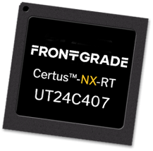
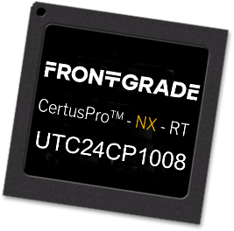
CertusTM-NX-RT and CertusProTM-NX-RT FPGAs
Frontgrade.com/FPGA
Frontgrade Technologies on X:
“We’re excited to announce in collaboration with @latticesemi
that the technology behind our Certus-NX-RT FPGA
has achieved
@NASA’s highest TRL 9.
It’s now proven and ready
for deployment in the
LEO Space environment.”
Availability
Prototypes/EM – Now
Class C/D Flight Units – Today
Availability
Prototypes/EM – Now
Class C/D Flight Units – Today
Class A/B Flight Units – Aug. ‘25

Slide 25
Questions?
Brian.Baranski@frontgrade.com

