Slide 1
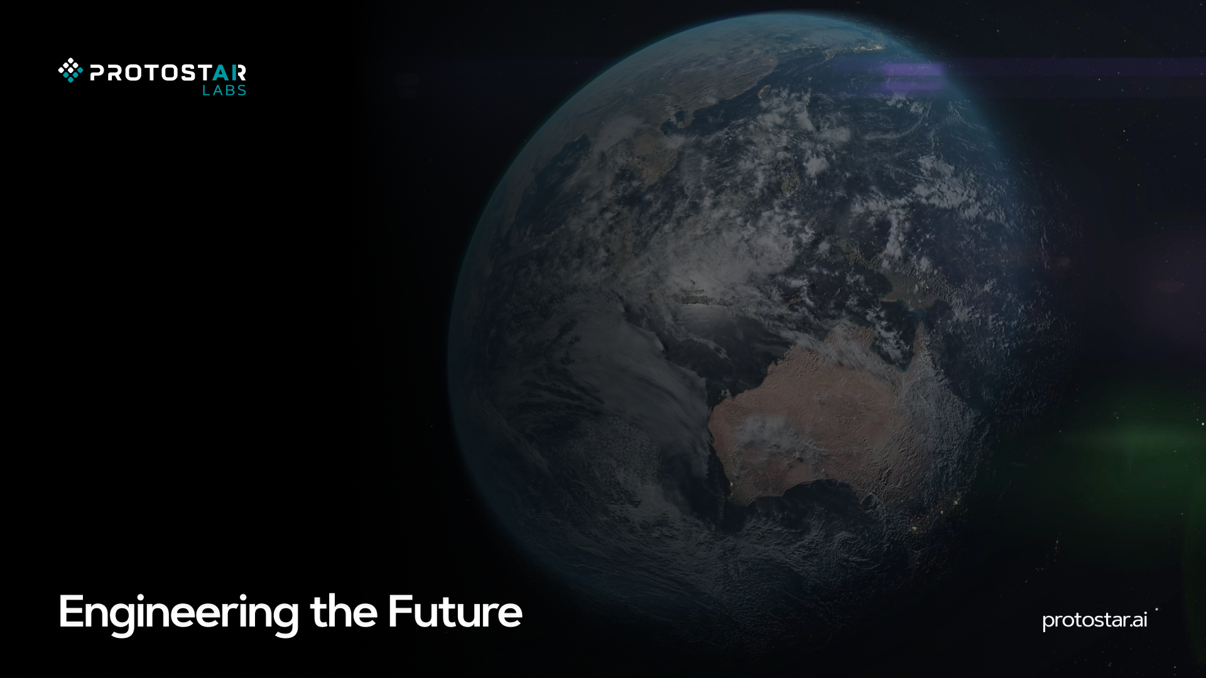
ProtoSDK: Low-code development platform for deployment of neural networks to FPGA devices
Authors: Filip Novoselnik, Davorin Miličević, Marko Mamić, Filip Gembec, Ivica Skokić

Slide 2
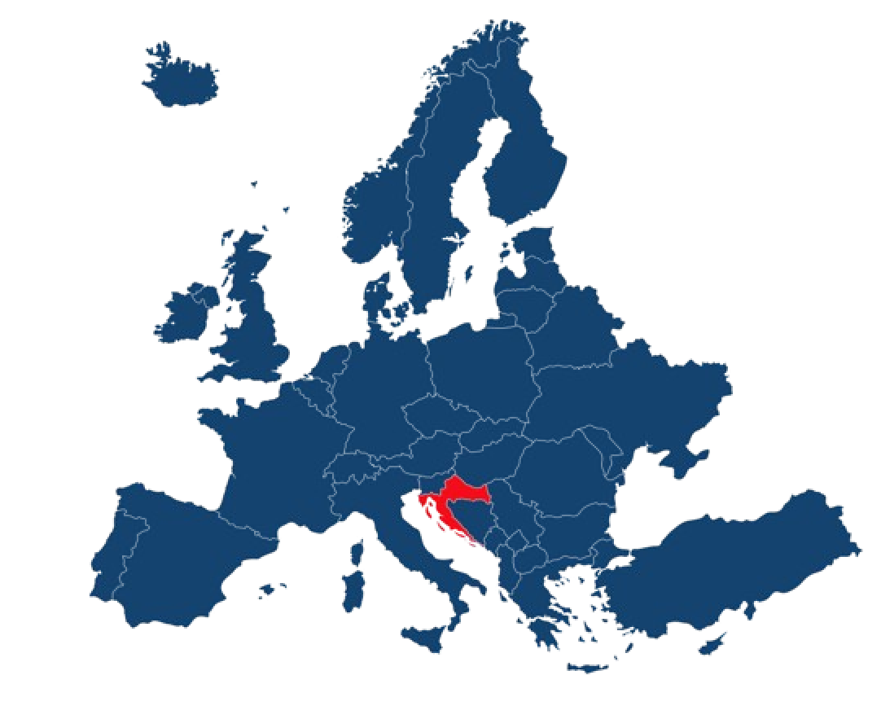
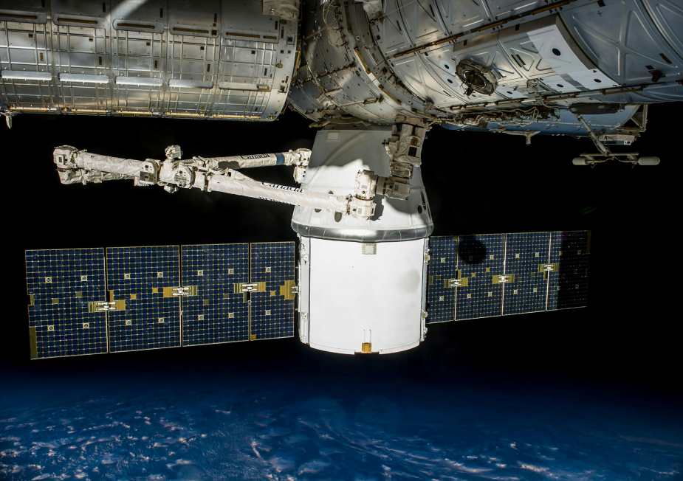
About Us
Croatian R&D company based in Osijek, Croatia
We develop and deliver innovative AI-powered technologies for industrial and space applications
Interdisciplinary team of engineers, scientists and problem-solvers
Our vision is to pioneer Croatian technology in space
2019
Founded
20
Team Members
50+
Projects

Slide 3
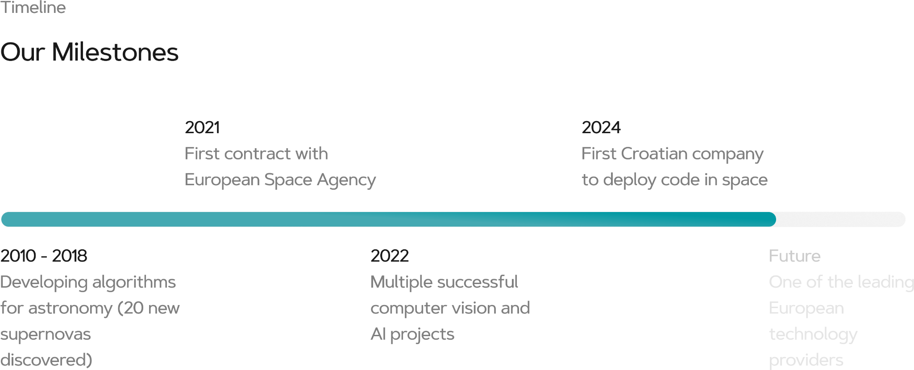
Our Milestones

Slide 4
Trusted By

Slide 5
Why use FPGAs?
Mitigate bottlenecks
Satellites generate vast amounts of data, but limited downlink bandwidth makes it difficult to transmit everything back to Earth. On-board AI processing helps reduce the data load by selecting the most valuable information.
Real-time decision making
With integrated AI, FPGAs can perform real-time data processing and autonomous mission scheduling. This ensures that satellites can adapt quickly to environmental changes and operational needs.
Lower operational costs
By processing and prioritizing data on board, the need for expensive data transmission is reduced, resulting in significant savings in downlink bandwidth and overall mission expenses.
Intelligent payload switching and anomaly detection
Activate specific payloads based on the detected environment and monitor for satellite anomalies, enhancing mission reliability, flexibility and longevity.
Flexibly system integration
The solution is designed to integrate with existing satellite systems, delivering enhanced processing capabilities without disrupting current operations.

Slide 6
ProtoSDK

Slide 7
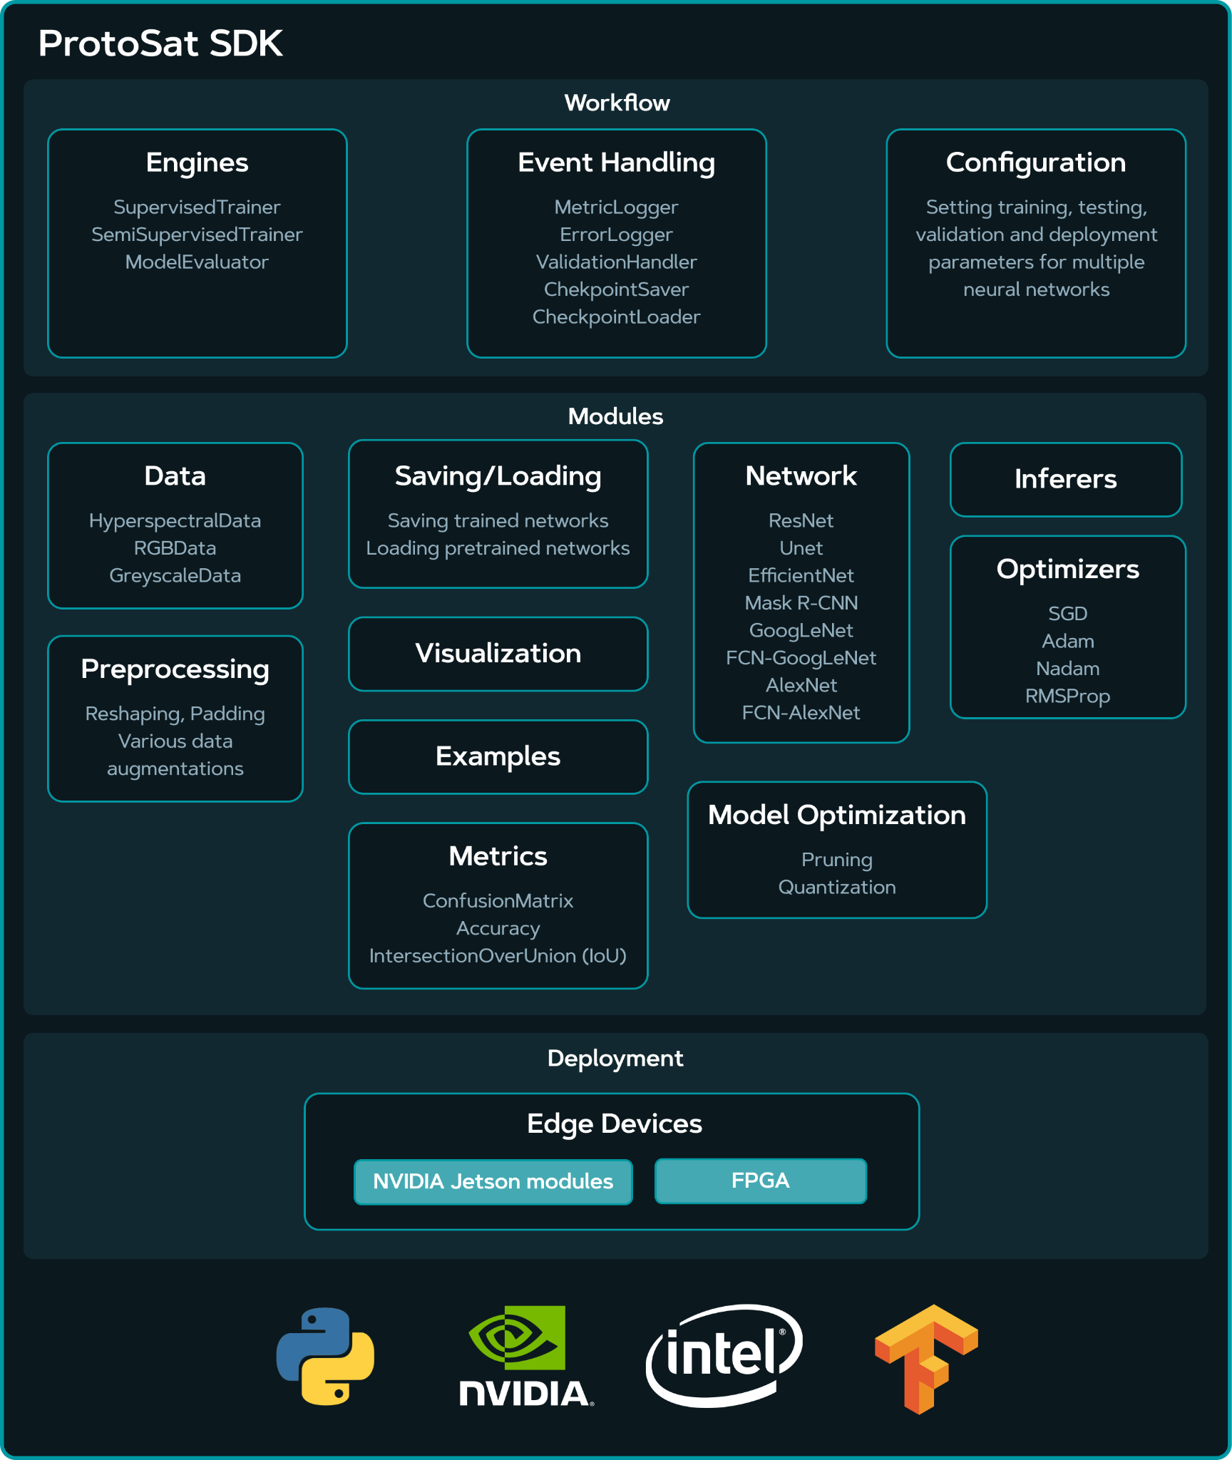
ProtoSDK - First phase
TRL: 3-5
Work done
Creation of custom training pipeline with supported model architectures which included configuration files for easier training setup. This enables low-code configuration of training parameters and easier prototyping. Custom deployment pipeline enables porting such models to embedded systems such as NVIDIA Jetson and FPGAs
Achievements
Successfully developed an end-to-end pipeline that lowers the knowledge needed in ML domain for successful training of supported model architectures and lowered the knowledge needed to successfully port those models onto supported embedded systems. Real world testing was carried out with a drone carrying an NVIDIA Jetson with an equipped camera
Conclusion
Lowering the domain knowledge needed for specific task creates a wider audience that can utilize our product. Since the vast majority of satellites already include various FPGA design into their platform, a pipeline that can utilize automated training and deployment of ML models could significantly increase the available use cases on-board satellites.

Slide 8
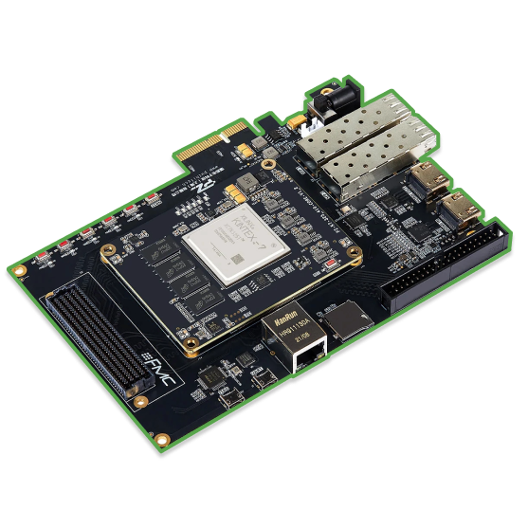
ProtoSDK - Second phase
TRL: 4-6/7
Accelerate data processing and minimize power consumption on embedded systems by utilizing FPGAs
Product description
ProtoSDK is a product that enables users to deploy AI models to FPGAs by utilizing a streamlined pipeline from model quantization to inference on FPGAs. The pipeline offers a no-code configuration of selected AI models and automatic deployment to selected FPGA boards.
Model training
Creation of use-case specific models from supported architectures
Quantization
Optimization of model weights to lower memory footprint
Model training
Optimized model
ProtoSDK was successfully tested on ESA OPS-SAT satellite in space!
Deployment
Compilation
Transfering the model from standard format to FPGA-compatible format
FPGA blueprint model

Slide 9
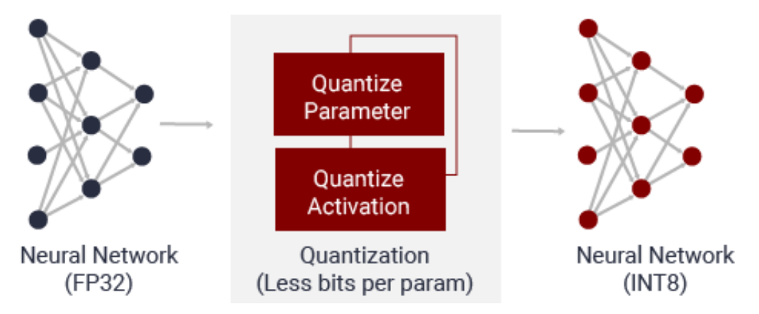
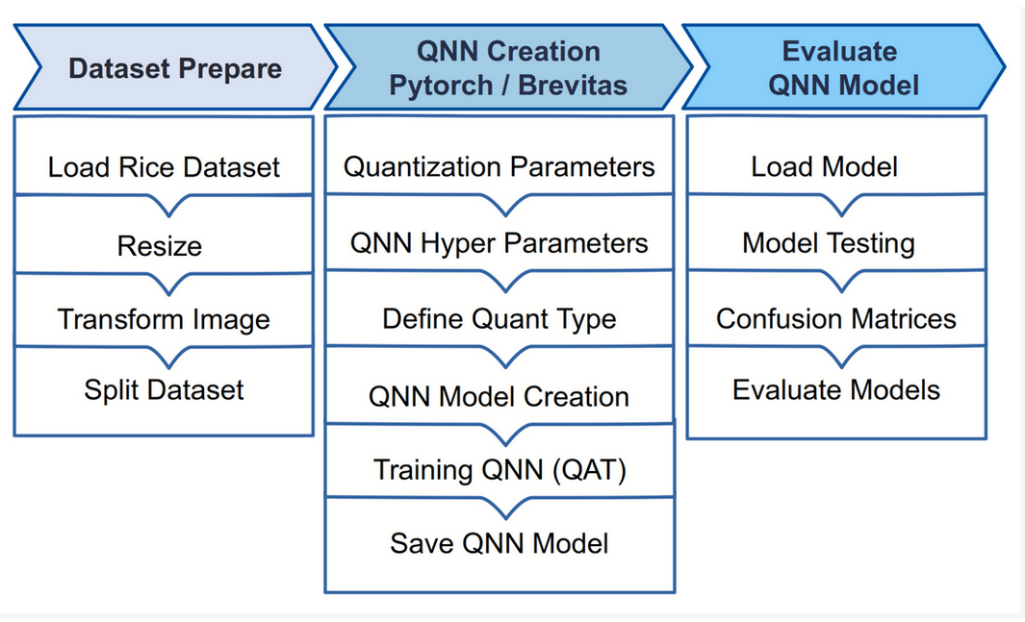
Quantization - Brevitas
QAT (Quantization-aware training)
Implementation of neural network layers based on their quantized counterparts from Brevitas (+ natively supported PyTorch layers)
Enables per layer configuration of quantization depth
Export to QONNX (Quantized ONNX)
FINN adaptation - models exported to QONNX can be further used in FINN to streamline the model
Netron compatibility - allows for inspection of the network structure

Slide 10
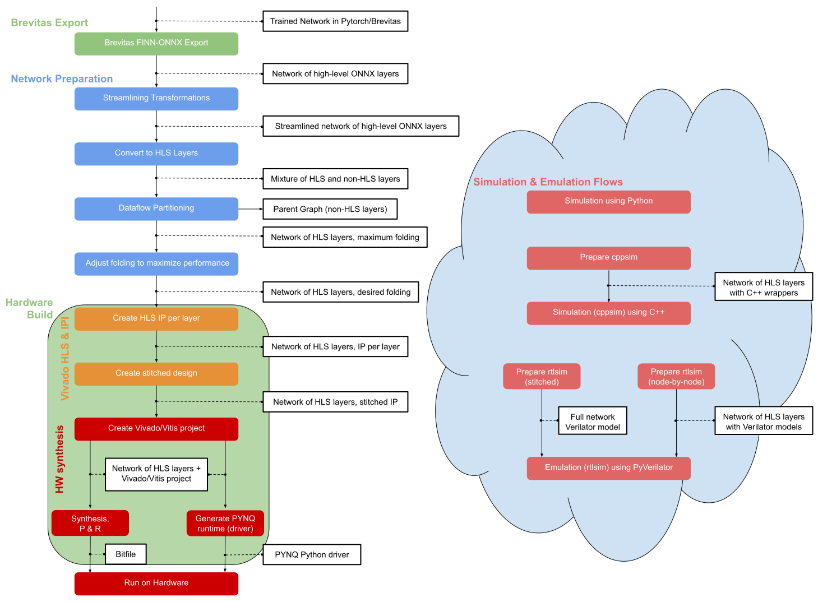
Compilation - FINN
Streamlining
Convolution lowering (IM2Col)
Value thresholding
Emitting multiplication and addition
HLS conversion and parallelization
ConvolutionInput Generator
MVAU (Matrix-Vector Activation Unit)
MaxPoolStreamingBatch Layer
Folding for parallel operations
Defining PE (Processing elements) and SIMD (Single Instruction, Multiple Data)
Bitstream generation
PYNQ-compatible FPGAs
Export models directly to PYNQ-compatible bitstream
Other Xilinx FPGAs
Manual bitstream configuration is needed and custom stitching of IP cores

Slide 11
Compilation - FINN
AI + Industrial IoT + Software
Model translation:
Models quantized with Brevitas are translated into high-performance hardware designs in C++ with the help of FINN.
Streamline, Conversion to HLS, Dataflow Partitioning, Folding
Tools utilized:
Use of Xilinx Vivado for synthesis, placement and routing, bitstream generation.
Vitis for software-defined FPGA programming.
Advanced solutions that bring more eﬀiciency, increase productivity and cut costs.

Slide 12
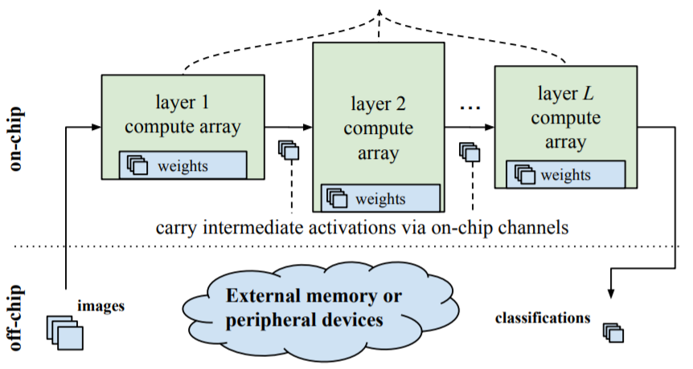
Compilation - FINN
AI + Industrial IoT + Software
For each layer HLS conversion was made to generate IP core
Hardware Synthesis done by:

Slide 13
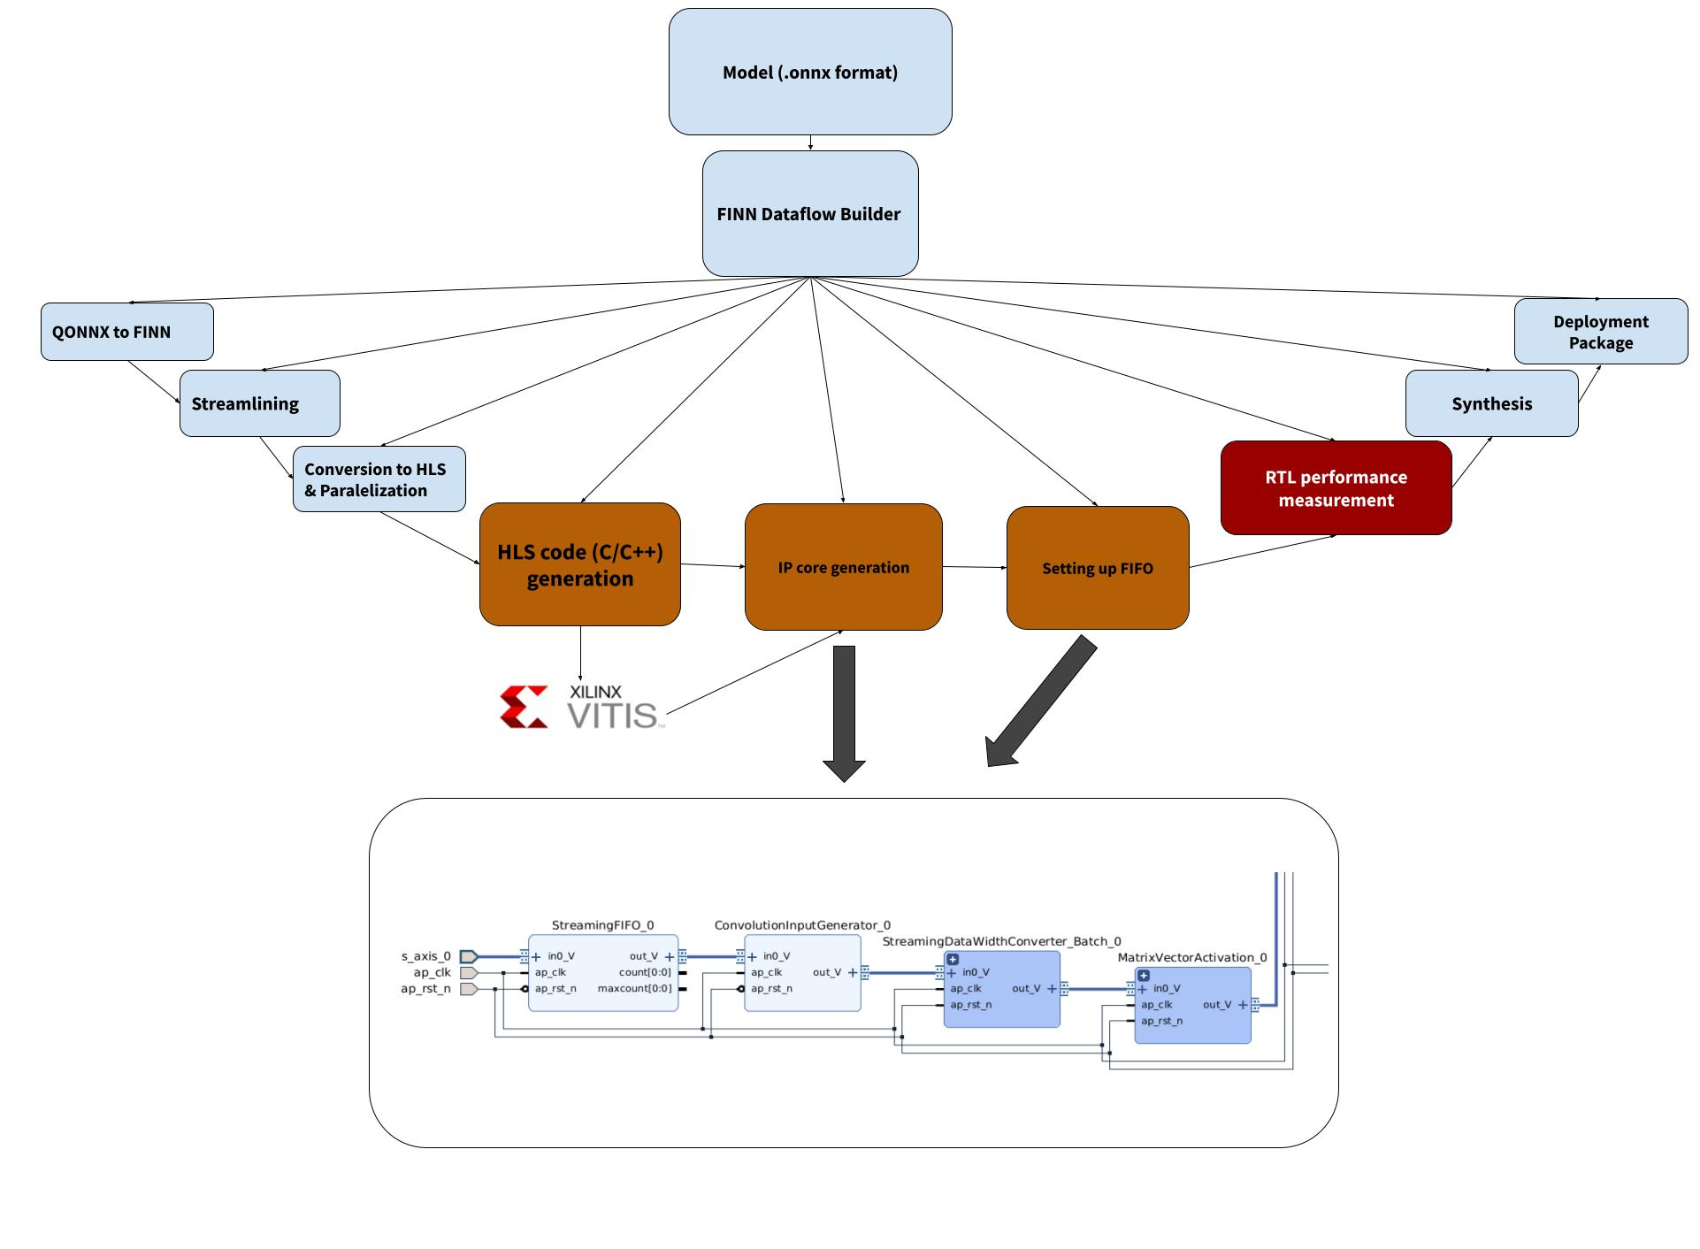
IP cores with FINN
AI + Industrial IoT + Software
IP cores: Reusable design components, often for a specific function like signal processing or an algorithm.
IP creation in FINN: FINN generates IP cores to run parts of the deep learning model.
Process: Steps include HLS code generation, IP core generation, stitching IP cores together, and bitfile creation.

Slide 14
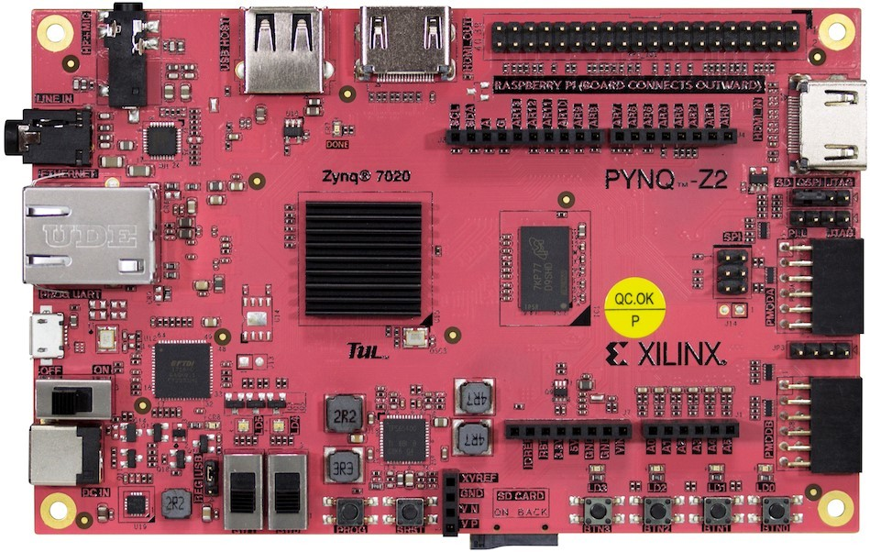
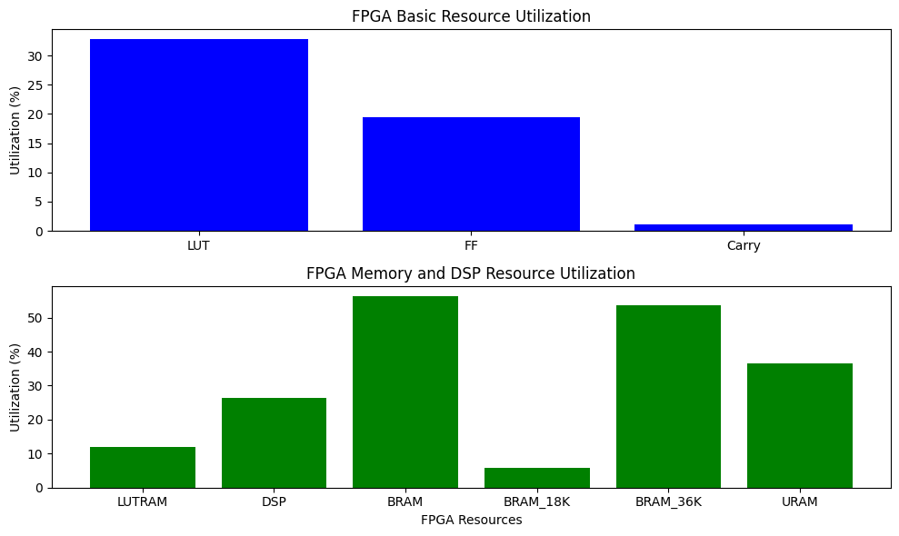
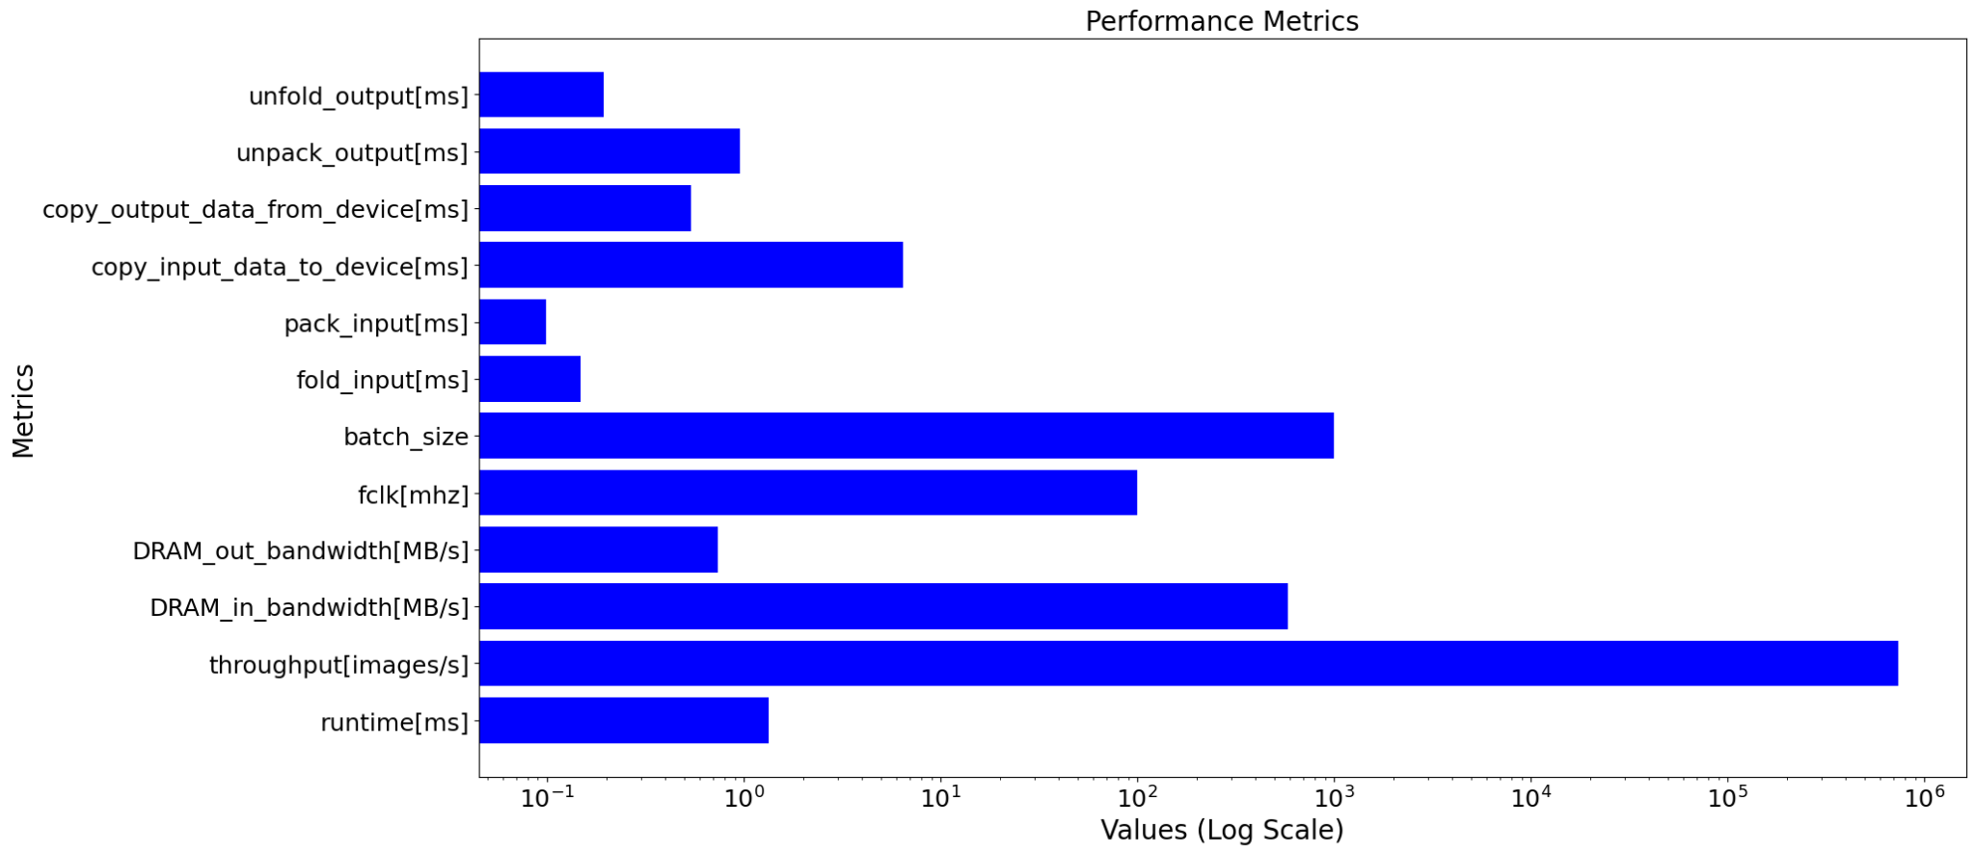
FPGA performance metrics
High throughput with hundreds of images processed per second
Real-time metrics like inference time, throughput, DRAM bandwidth, clock frequency, and batch size can be analyzed in the notebook
Precise measurements allow for optimizing the model's effectiveness and efficiency

Slide 15
Supported FPGAs and use cases
Bitstream generation
If the boards from the listed table are targeted, the pipeline can create the complete bitstream that can the be uploaded to the target FPGA. This also covers the needed driver that enables us to start the inference with just a few lines of code
IP Core synthesis
If the boards are from other Xilinx families, we can only generate the IP cores which then need to be manually stitched onto an pre-existing FPGA design with manual creation of the needed driver
Supported FPGAs
Ultrascale
Ultrascale+
ZYNQ 7000 series
Supported use cases
Land classification | Object detection
Segmentation | Super-resolution

Slide 16
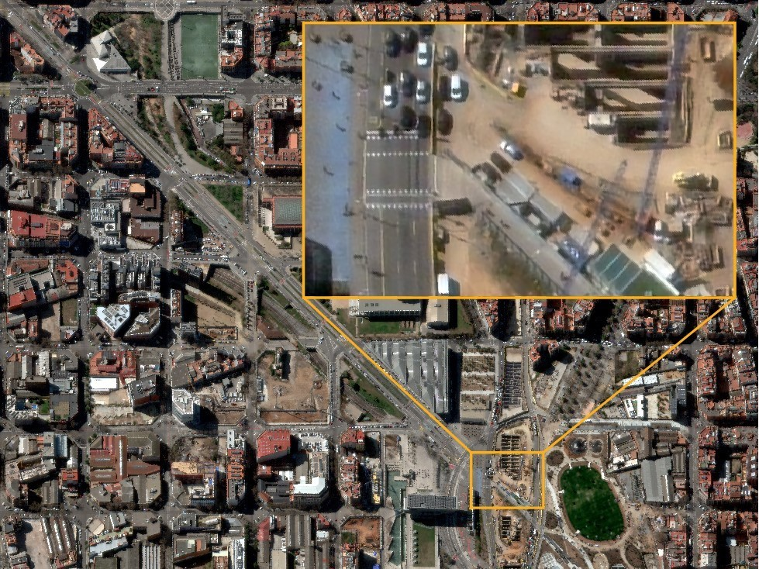
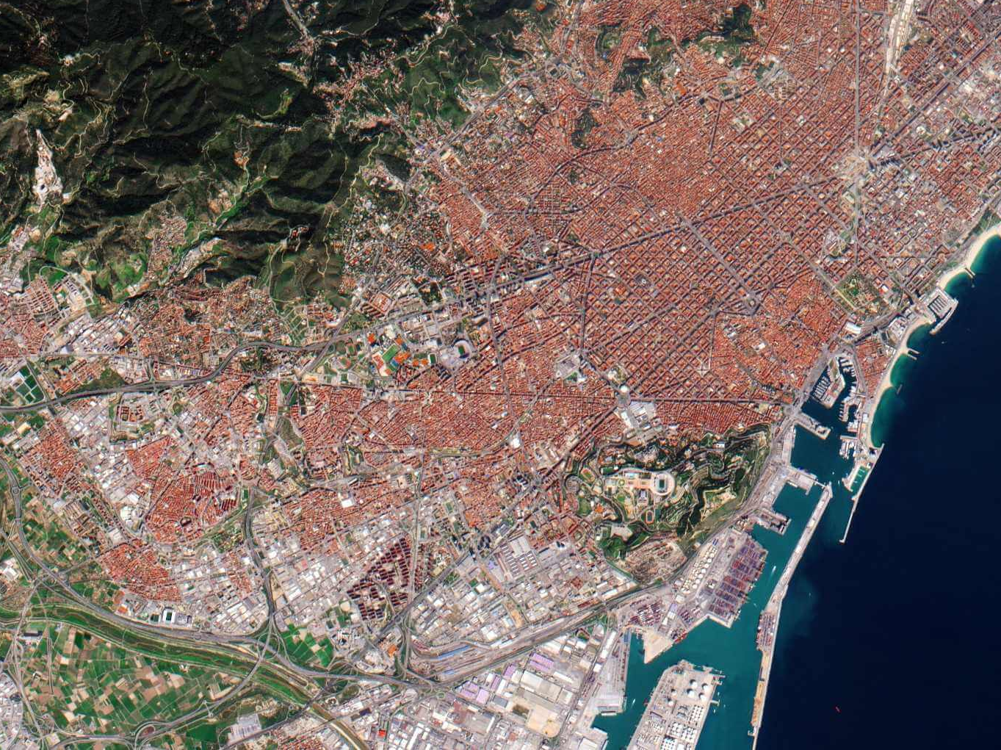
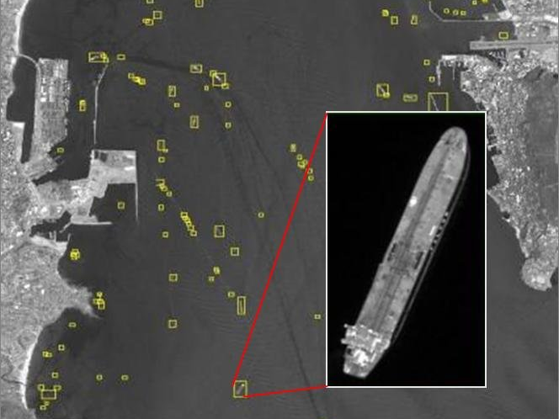
Example use cases
Cloud segmentation
Super-resolution
Land classification
Object detection

Slide 17
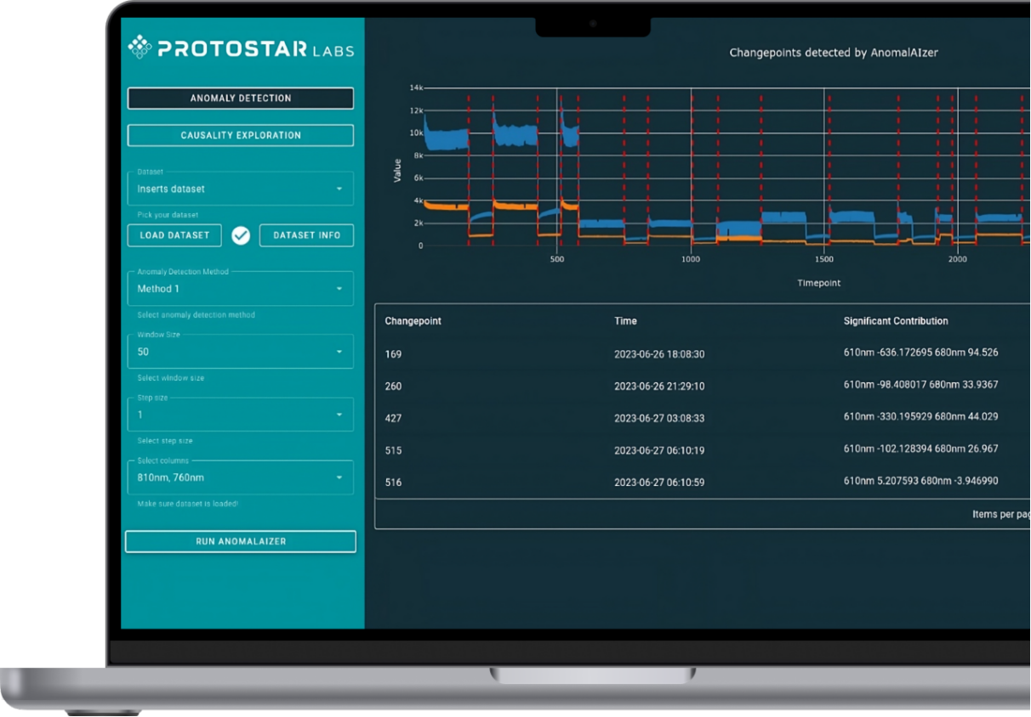
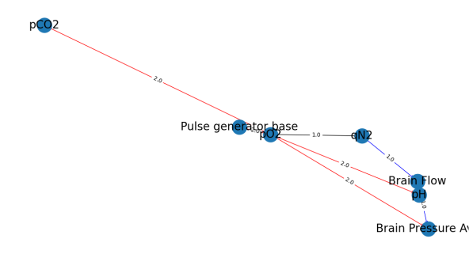
Anomaly detection
Development of proprietary anomaly detection algorithms for industry
Univariate or multivariate
Real-time
Time-series data
Causality exploration
Tested in BioTech industry

Slide 18
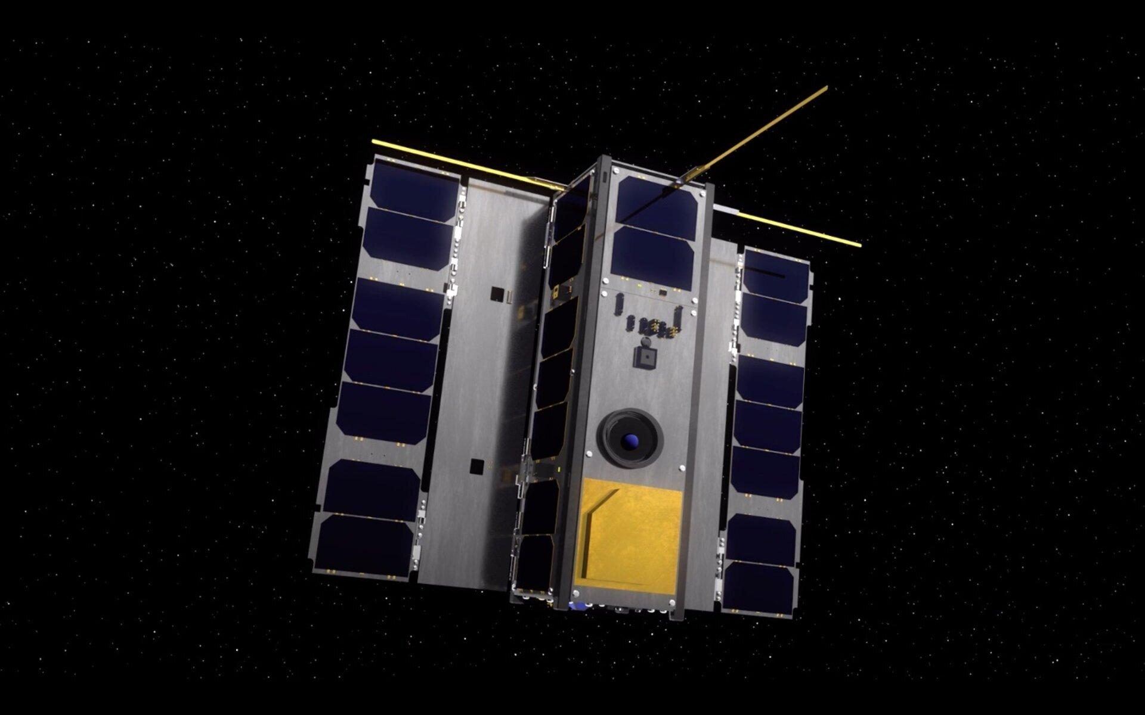
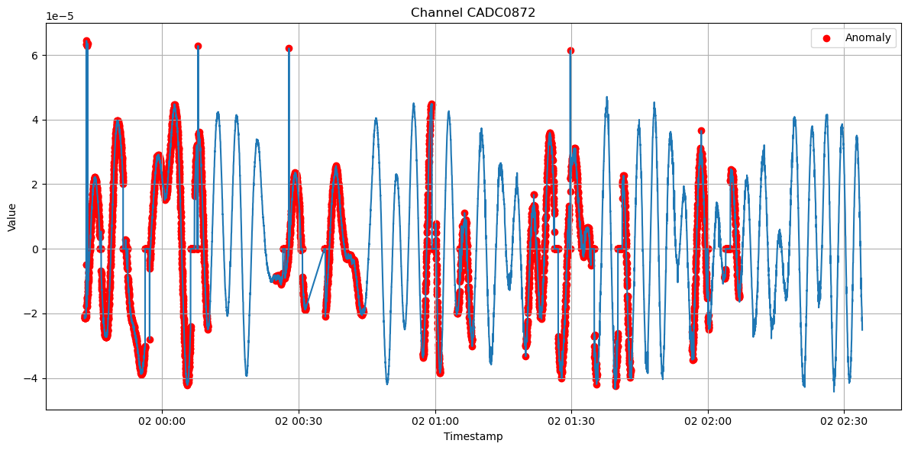
OPS-SAT Anomaly Detection
Goal
Implement and deploy anomaly detection algorithms for spacecraft on-board data analysis.
Solution
We ported our anomaly detection solution to the FPGA environment by utilizing modules and submodules of ProtoSDK for developing custom IP cores that leveraged FPGA parallel processing while optimizing for resource constraints. We mapped the device tree for access from the on-board Linux OS and developed complementary C code to ensure system integration, robustness, and reliability.
Results
algorithm successfully deployed on satellite on-board FPGA
results successfully downlinked back to Earth via Darmstadt ground station

Slide 19
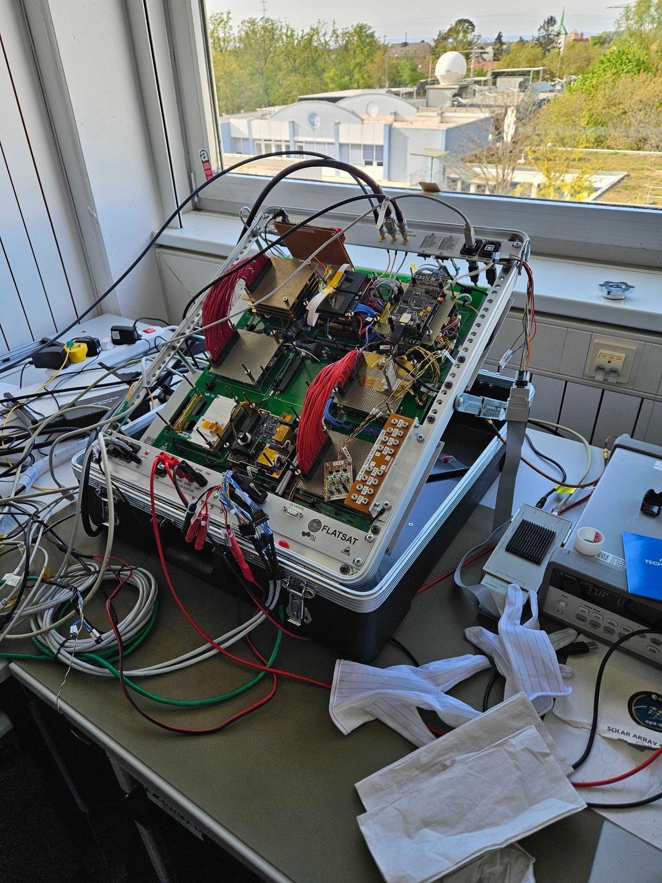
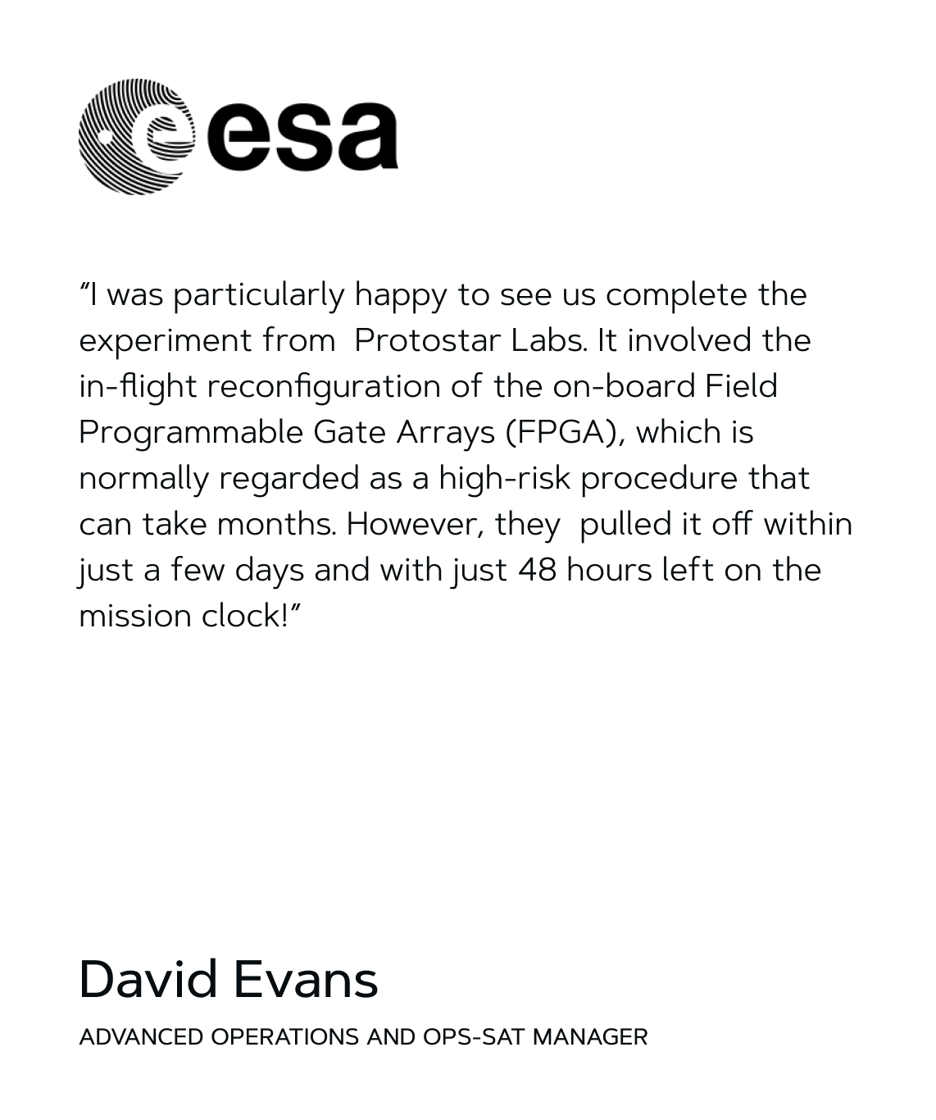
OPS-SAT Experiment - Timeline
In the nick of time
Development started on 2nd of January
March 14, 2024 - Protostar team was notified that the satellite was losing altitude faster than before, with the following weeks creating even more problems for OPS-SAT team
March 26, 2024 - David Evans (OPS-SAT) notified the Protostar team that they could lose attitude control earlier than expected, resulting in loss of S-band communication which in turn would make it impossible to finish the experiment
March 27, 2024 - Race against time begins
April 10, 2024 - Protostar team visits ESOC and works with the OPS-SAT team to resolve issues encountered
April 24, 2024 - First prototype of the experiment ran successfully on dev kit
April 30, 2024 - Started work on porting the project to SEPP (FPGA module that was on OPS-SAT)
May 15, 2024 - First run on EM-FPGA
May 16, 2024 - EM testing completed successfully
May 18, 2024 - Final adjustments to code requested
May 19, 2024 - OPS-SAT team successfully uplinked the experiment onboard satellite and scheduled the run for next morning
Results were downlinked in a morning pass on 20 May 2024 via ESOC1 S-Band station in Darmstadt
Exact time of the downlink -> 06:17:02 on 20-05-2024
OPS-SAT deorbited during the night between 22 - 23 May 2024 over Australia

Slide 20
Catch as at future events!

Slide 21
Thank you for your attention!
Protostar Labs d.o.o.
www.protostar.ai
Belišće/Osijek, Croatia
hello@protostar.ai
Follow us:

