Slide 1


COTS FPGA technology for On-Board Switching
Dawid Linowski, Szymon Kałużyński, Tomasz Rybak (presenter)
6th SEFUW, Space FPGA Users Workshop
ESA/ESTEC
27th March 2025

Slide 2


Agenda
Introduction and objectives
Achronix FPGA technology
Ethernet layer 2 switch design
Tests in hardware
AMD Versal NoC
Summary
arobs.pl

Slide 3

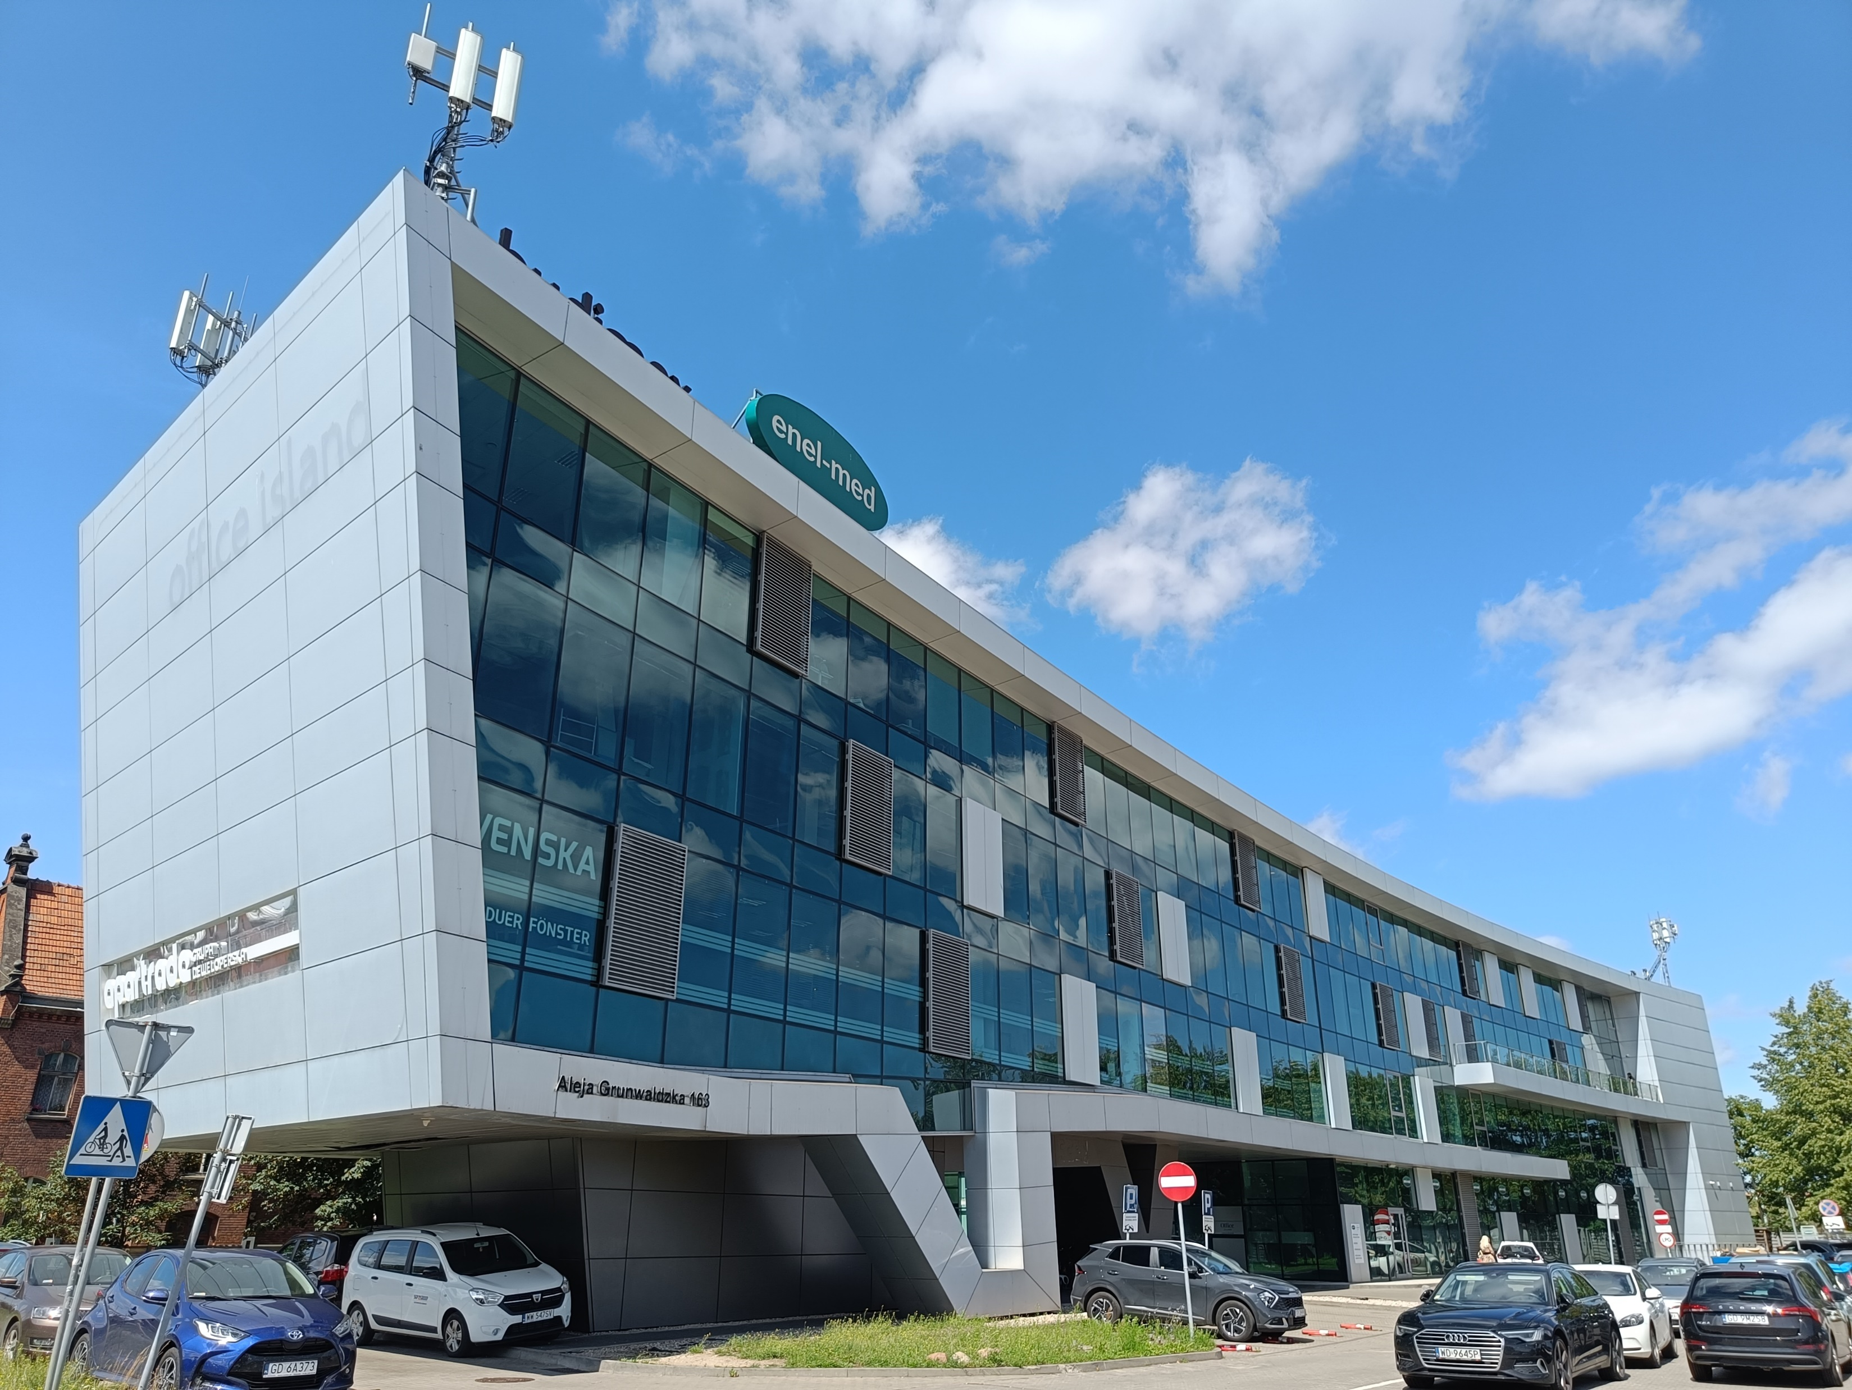



AROBS Polska – space electronics, FPGA & software
Established in:
2016
Number of employees:
20
=
Elektronika i oprogramowanie
na potrzeby branży kosmicznej
Headquarters:
Gdańsk, Poland
Office Island in Gdansk – AROBS Polska headquarters
arobs.pl

Slide 4
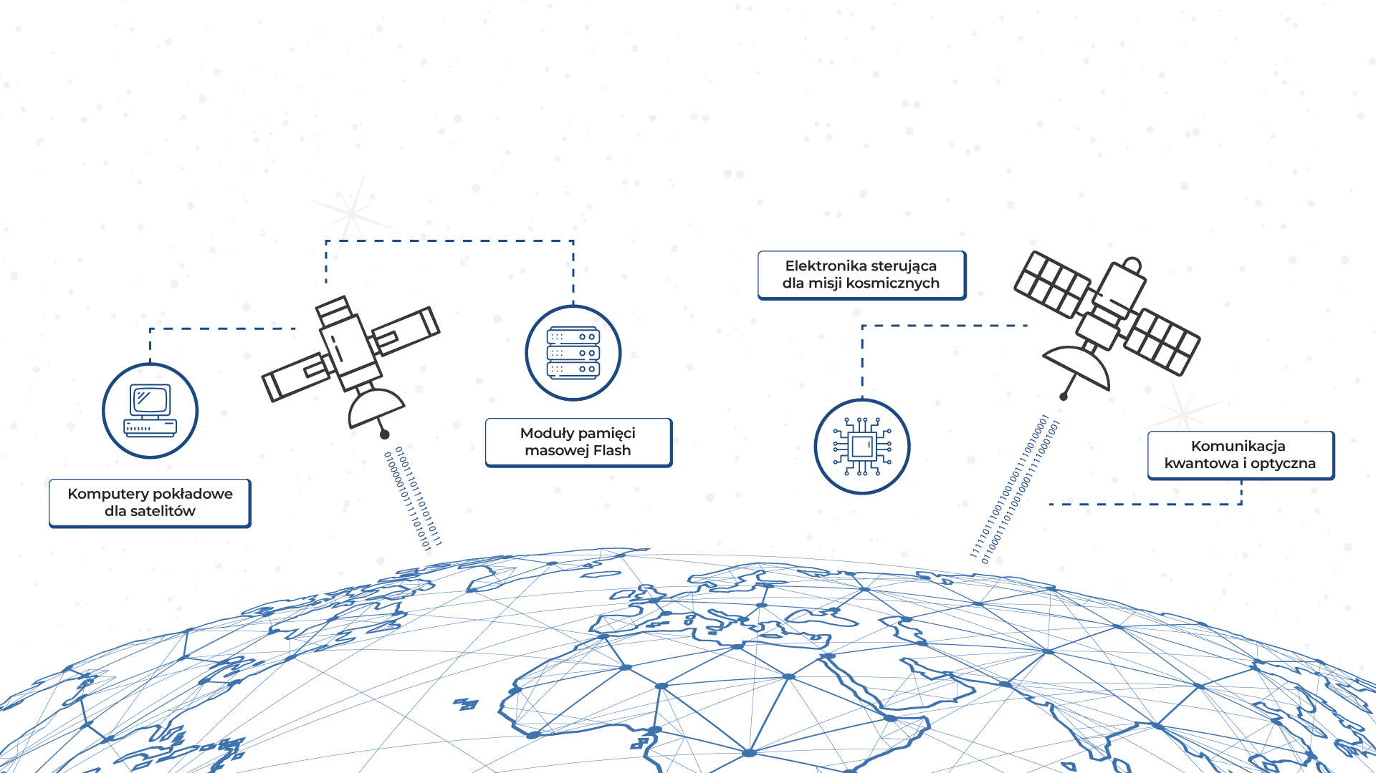
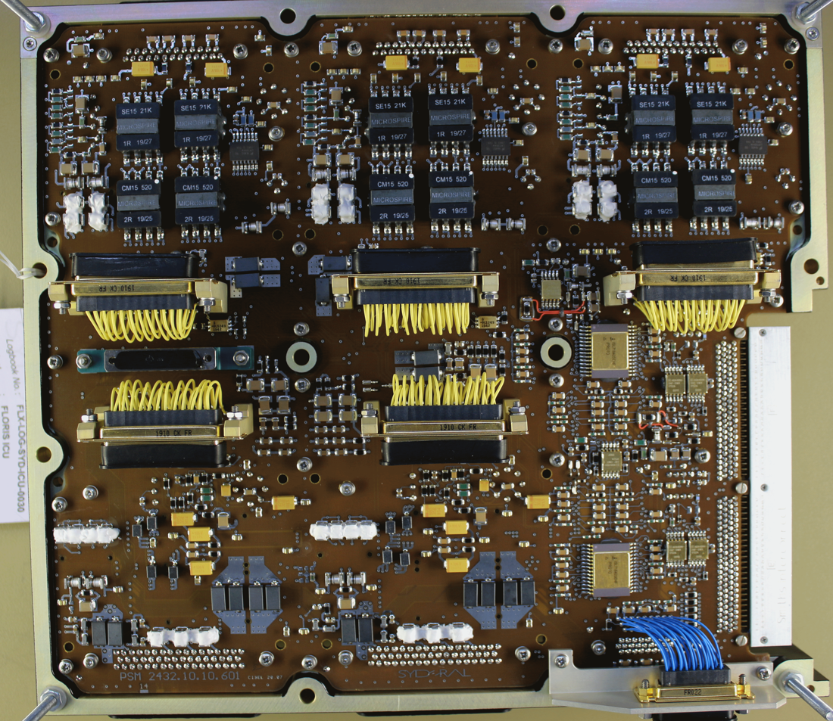
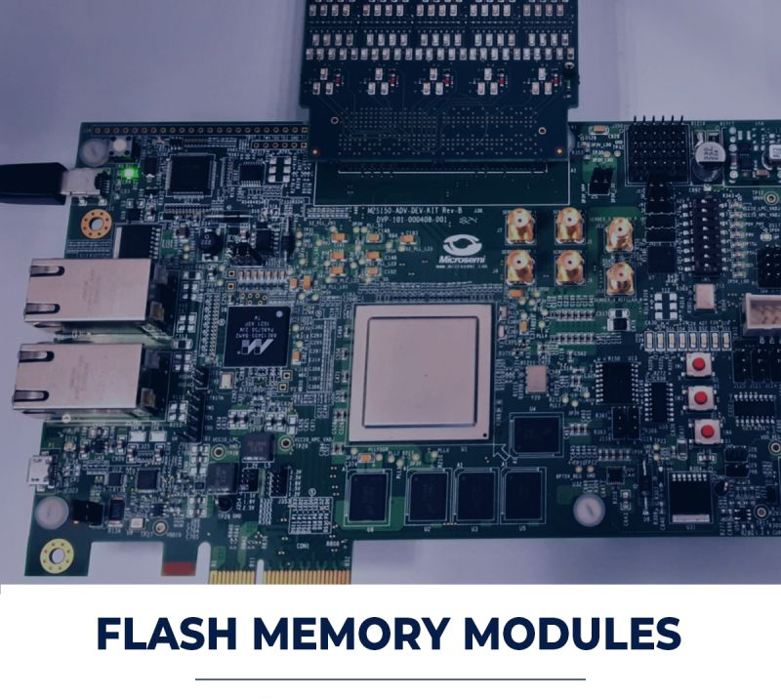
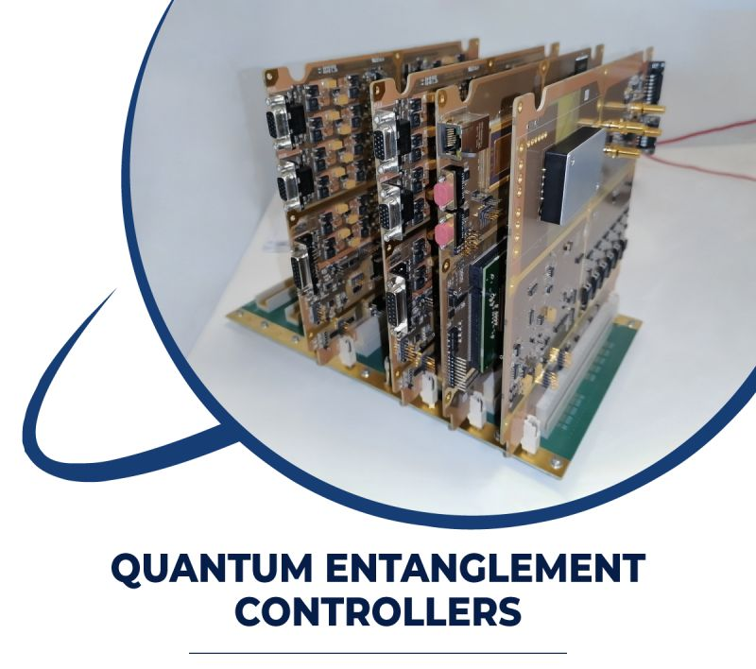

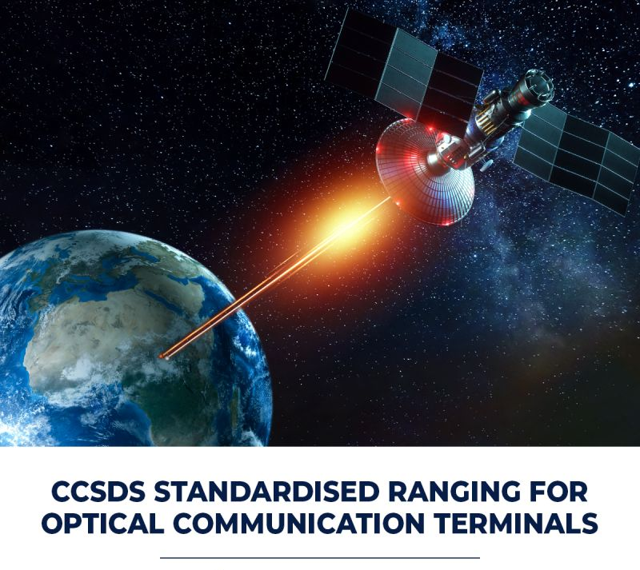
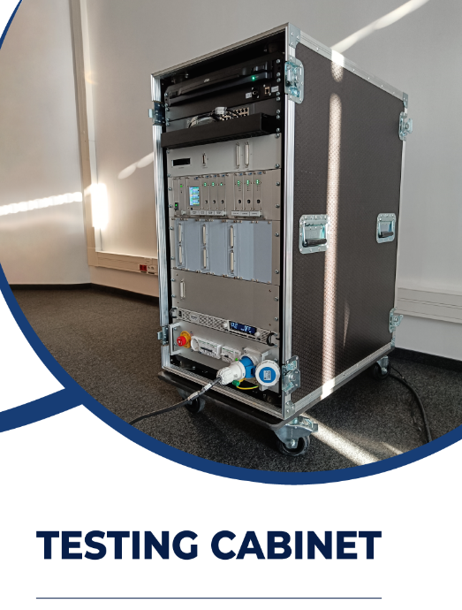
Areas of expertise
Control electronics for mechanisms and instruments
Flash Memory
Modules
Quantum and optical communication
Payload computers, data processing units
Electrical Ground Support Equipment
arobs.pl

Slide 5


Project’s objectives
COTS FPGA technology for On-Board Switching
Developed under ESA contract No. 4000138940/22/NL/AF, in the scope of ScyLight Strategic Programme Line within ARTES 4.0
Project in the frame of ESA High thRoughput Optical Network project (HydRON)
Target TRL-4
Project duration: 05.09.2022 – ongoing (closing Final Review).
Goals:
Technology assessment of Achronix FPGA-based solution for Ethernet layer 2 switch
Data rate up to 100 Gbps per single channel (simulation and HW validation).
Transferring achieved solution to AMD/Xilinx Versal technology (just simulation).
Comparison of simulation performances for both technologies.
arobs.pl

Slide 6
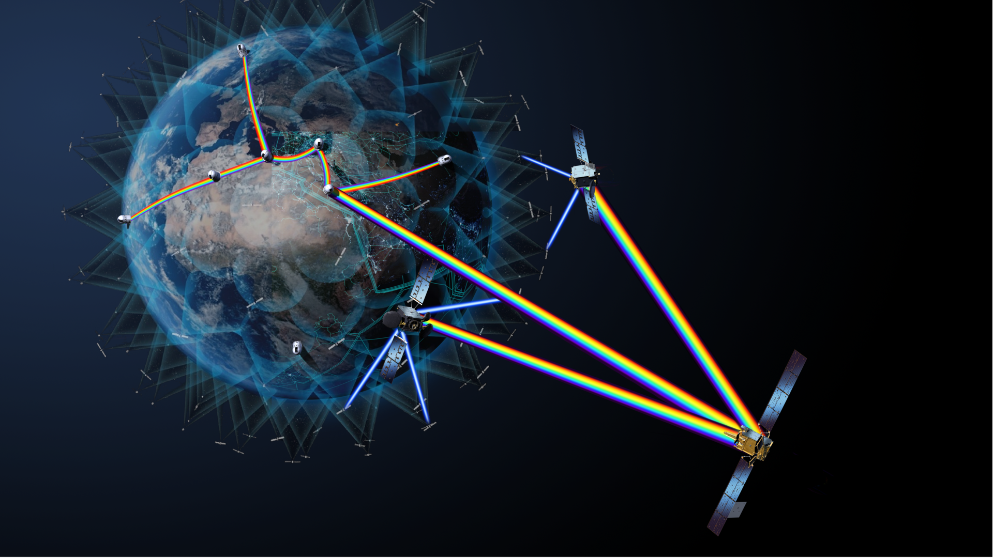
Why such a project?
HydRON:
Part of ScyLight programme, which focuses on optical communications, photonics and quantum communication.
Aims to demonstrate the world’s first (all) optical multi-orbit transport network at Terabit/sec capacity in space
Extends terrestial fibre-based networks into space -> „Fibre in the sky”.
Currently used Rad-Hard By Design (RHBD) FPGA devices do not allow to implement the performance required by this programme -> potential COTS solutions shall be investigated.
arobs.pl

Slide 7


Technology assessment
AMD Versal FPGA:
  built in TSMC 7 nm FinFET process technology
  promising radiation test results -> similar behaviour expected from other FPGAs based on the same process.
Achronix Speedster7t family:
  based on the same technology process
  incorporating Network-on-Chip (NoC) for high data rate connections inside the fabric
  mainly used in data centres for high throughput, Ethernet switch-based solutions up to 400 Gbps per port.
arobs.pl

Slide 8
Agenda
Introduction and objectives
Achronix FPGA technology
Ethernet layer 2 switch design
Tests in hardware
AMD Versal NoC
Summary
arobs.pl

Slide 9

Achronix FPGA
Speedster7t AC7t1500 family:
692K 6-input LUTs (1,522K 4-input LUT equivalents)
1.382M flip-flops
2-dimensional NoC capable of > 20 Tbps
32 high-speed SerDes transceivers, each up to 112 Gbps (PAM4) and 56 Gbps (NRZ).
Two hard-IP Ethernet MACs, with support up to 400 Gbps (each using 8 of 32 SerDes).
Integrated DDR4/5 and GDDR6 controllers.
Integrated PCIe Gen5 controller (uses remaining 16 SerDes).
arobs.pl

Slide 10
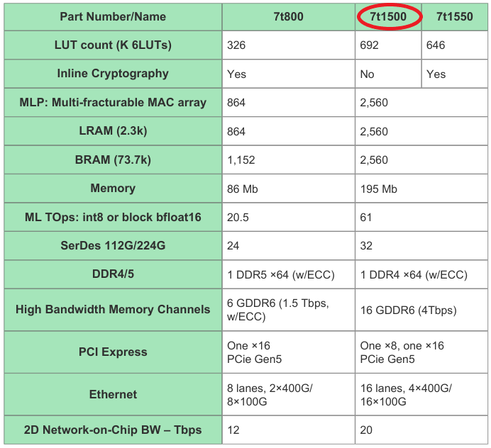
Speedster7t FPGA family
arobs.pl

Slide 11
Achronix NoC overview
Extremely high-speed connection between:
  fabric logic and interfaces around the periphery (GDDR6, DDR4/5, Ethernet, PCIe)
  fabric logic within FPGA itself.
Cross-sectional bidirectional bandwidth of 20 Tbps.
Running with the main clock of 2 GHz.
Consists of two main parts:
  Peripheral ring around the fabric with all the IP interfaces.
  The rows and columns that run over the top of the FPGA fabric.
Wide (256-bit), high-speed buses without using the fabric routing resources!
arobs.pl

Slide 12
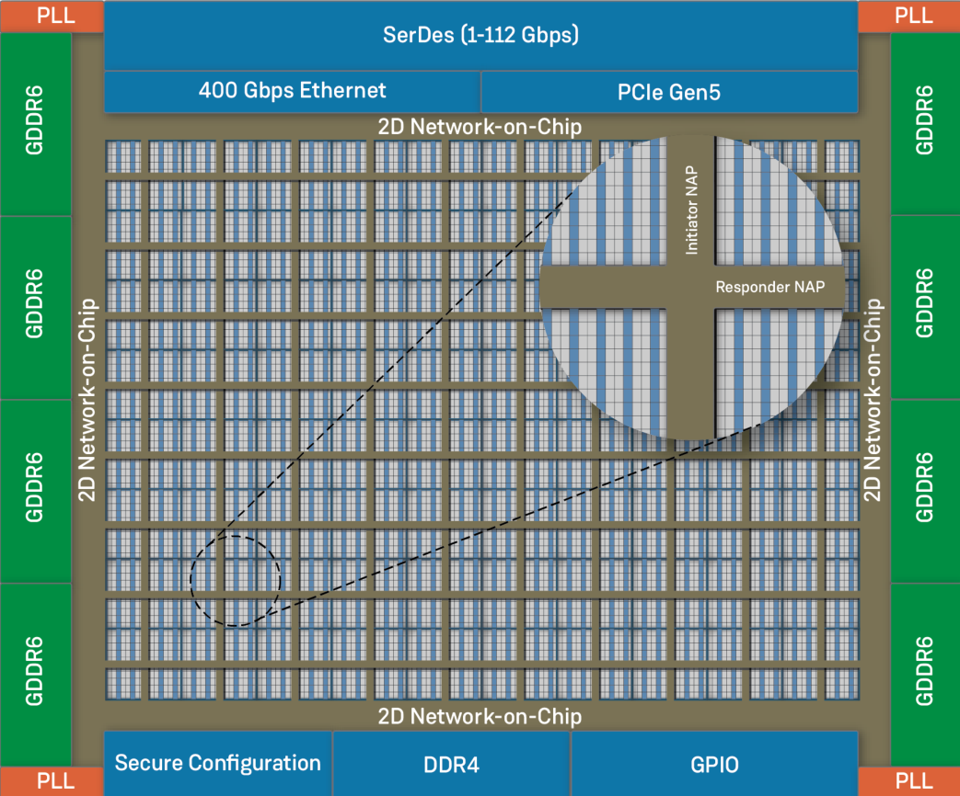
Achronix NoC overview
arobs.pl

Slide 13
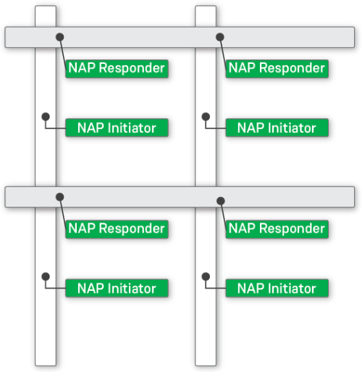
Accessing the Achronix NoC - NAP
NoC Access Points (NAPs) instantiated in user logic to connect to the rows and columns of the 2D NoC.
NAP types:
  AXI Responder NAP – allows connection to a row of the NoC
  AXI Initiator NAP – allows connection to a column of the NoC
  Horizontal NAP – allows connection along one row of the NoC
  Vertical NAP – allows data streaming along one column of the NoC
  Ethernet NAP – allows data streaming of Eternet packets along NoC columns.
NAP handles required Clock Domain Crossing.
arobs.pl

Slide 14
Achronix NoC limitations
Connection to NAP follows AXI4 standard, but bursts are limited to 16 transfers.
Both Ethernet modules are connected only to certain NoC columns (two columns per Ethernet module).
No direct connection between rows or columns - ring usage necessary.
NoC performance results directly from the main NoC clock frequency. 2 GHz is used only in the highest speed grade (C1).
NoC transactions on the same column or row are point to point - no broadcast option.
Multiple NAPs along a single column or row in the FPGA can potentially create a traffic congestion. Expected traffic patterns in the design should be evaluated beforehand and NAP locations selected to spread the transaction traffic across several rows or columns when possible.
arobs.pl

Slide 15
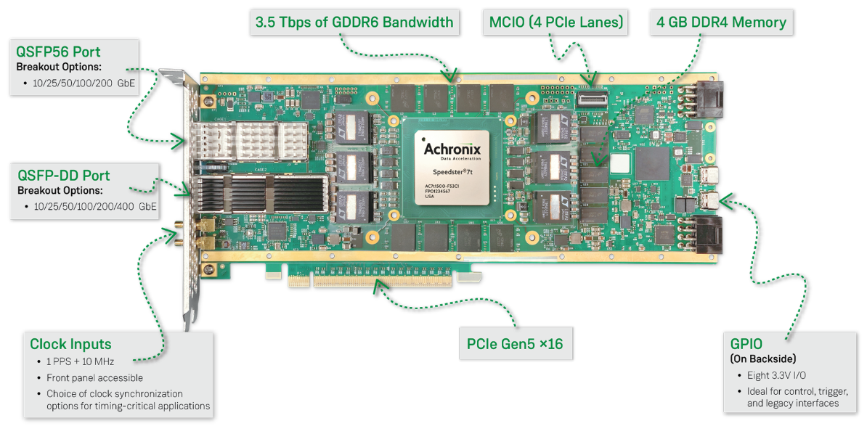
Achronix Evaluation Board
BittWare VectorPath® S7t-VG6 accelerator card
arobs.pl

Slide 16
Agenda
Introduction and objectives
Achronix FPGA technology
Ethernet layer 2 switch design
Tests in hardware
AMD Versal NoC
Summary
arobs.pl

Slide 17
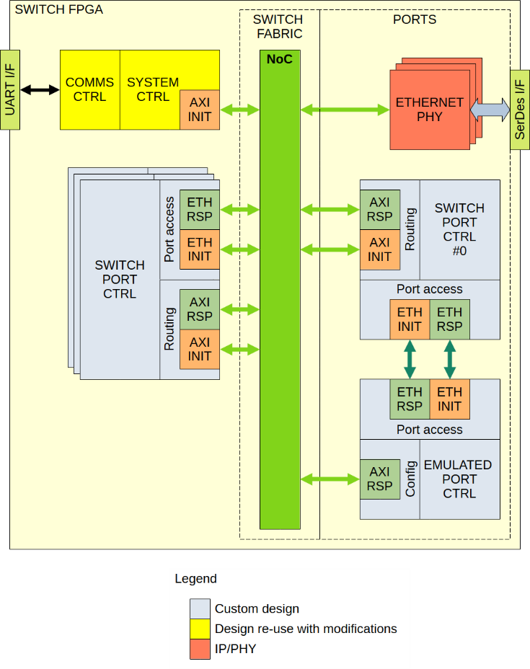
Ethernet layer 2 switch - architecture
Composed of:
COMMS CTRL – responsible for communication between the PC and Achronix FPGA
SYSTEM CTRL – manages system control and status operations
SWITCH PORT CTRL – realizes Ethernet packet switching between Ethernet ports through NoC.
EMULATED PORT CTRL – Ethernet subsystem emulation; also Ethernet packet generation and checking.
arobs.pl

Slide 18
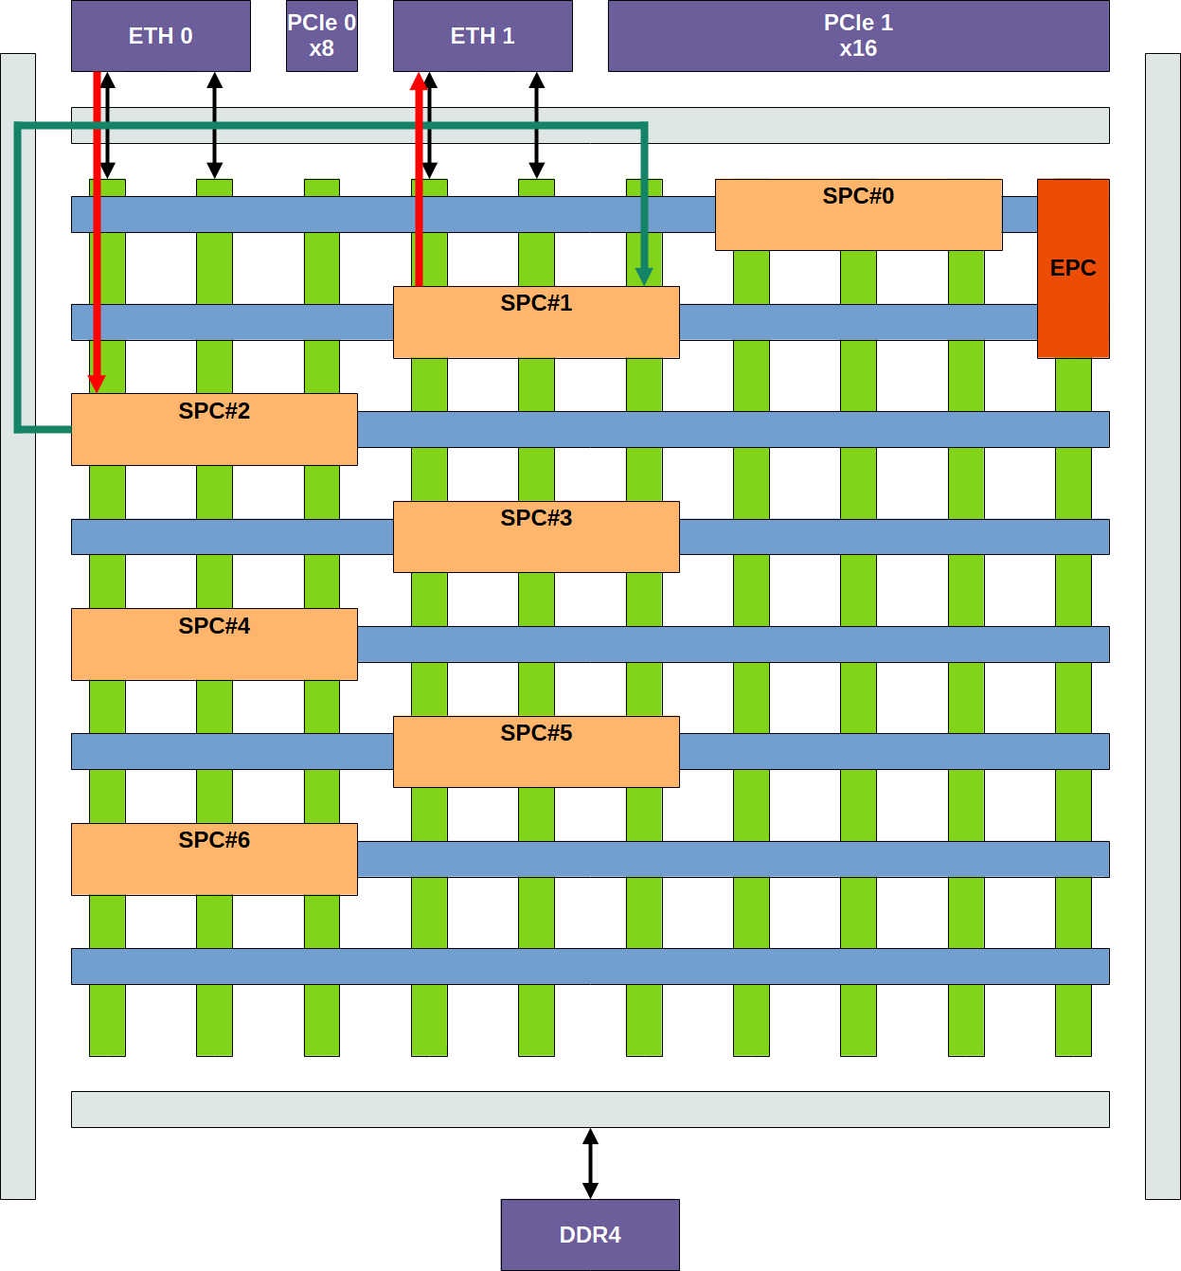
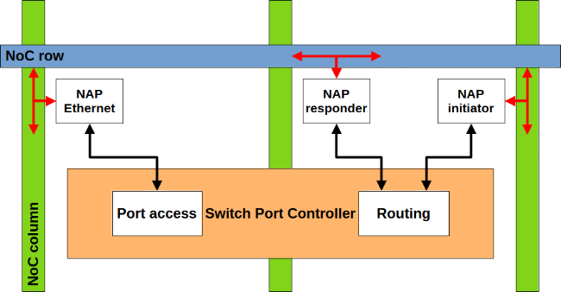
Ethernet layer 2 switch - SWITCH PORT CTRL
No direct connection between two columns connected to two different Ethernet submodules – SWITCH PORT CTRL (SPC).
Each SPC has two NoC interfaces:
  for communication with Ethernet submodule (packets RX/TX)
  for Ethernet packet routing to / from another SPC.
arobs.pl

Slide 19
Ethernet layer 2 switch - SWITCH PORT CTRL
SPC instances spread out in fabric to minimize congestion to the NoC ring.
Final SPC placement:
arobs.pl

Slide 20
Ethernet layer 2 switch – challenges and limitations
The BittWare evaluation board allows for only 56 Gbps PAM4 (28 Gbps NRZ) per transceiver lane.
For a 100 Gbps Ethernet port the timing closure on AXI and Ethernet related clocks could not be reached within the project’s schedule.
Issues with Ethernet submodule BFM (number of Ethernet ports).
Final Ethernet ports configuration in Achronix Evaluation Kit is 3x 50GAUI-2 connected to the QSFP:
Connector | Ethernet subsystem | Number of ports | Data rate [Gbps] (per port) | SerDes lanes (per port) | SerDes rate [Gbps] (per lane)
QSFP56 | ETH_1 | 1 | 50 | 2 | 25
QSFP-DD | ETH_0 | 2 | 50 | 2 | 25
arobs.pl

Slide 21
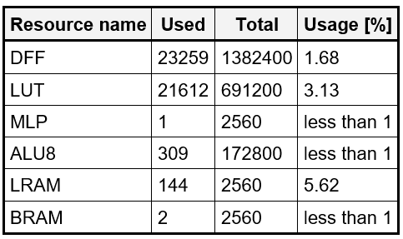
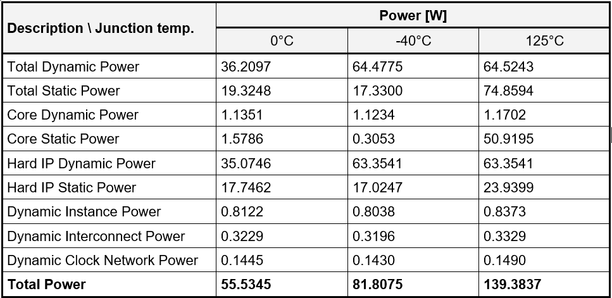

Synthesis / Place&Route results
FPGA resources
FPGA power report
FPGA timing report
arobs.pl

Slide 22
Agenda
Introduction and objectives
Achronix FPGA technology
Ethernet layer 2 switch design
Tests in hardware
AMD Versal NoC
Summary
arobs.pl

Slide 23
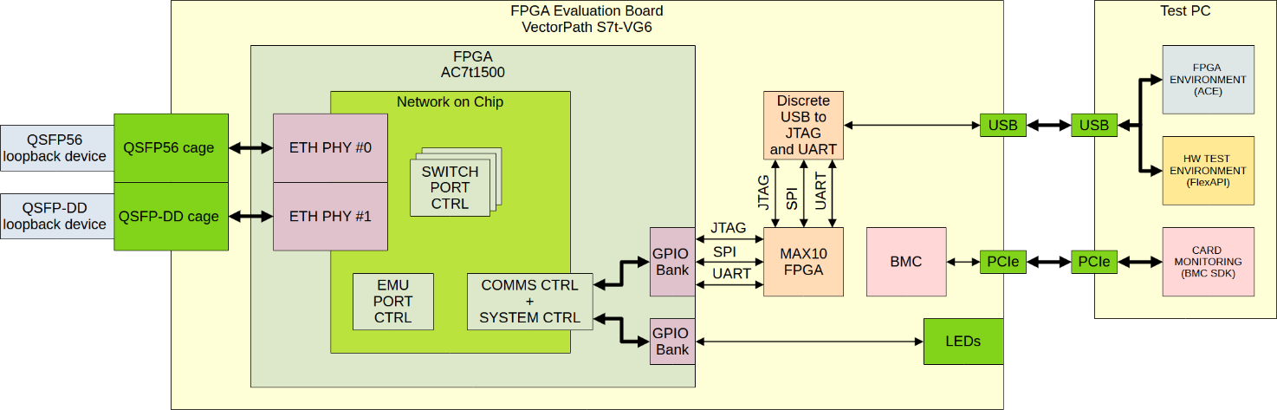
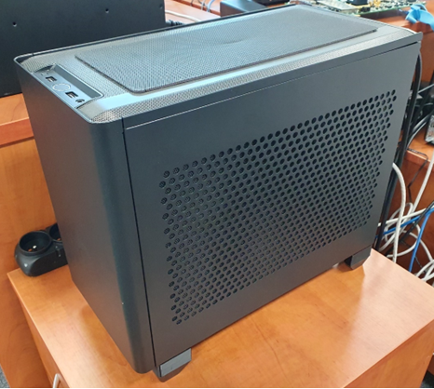
Test setup
The entire Test Setup:
The Achronix Breadboard (BB):
  The BittWare VectorPath S7t-VG6 accelerator card with the Achronix AC7t1500 FPGA chip.
  The QSFP56 and QSFP-DD loopback devices.
  USB port connection to the Test PC, for MODBUS RTU communication via UART.
  PCIe port connection to the Test PC, which provides card monitoring.
The Test PC.
arobs.pl

Slide 24
Test results
Test:
Four test cases ran, each using three different paths via all three available Ethernet ports.
Results:
No functional errors observed
50 Gbps throughput per port.
Description | Throughput [Gbps]
 | Seq. #1 | Seq. #2 | Seq. #3
Test case 1 – 2048 packets, 256 bytes each | 47.645 | 47.645 | 47.515
Test case 2 – 4096 packets, 1522 bytes each | 48.555 | 48.555 | 48.555
Test case 3 – 50 packets, 9000 bytes each | 49.855 | 49.79 | 49.855
Test case 4 – 32,767 packets, 9000 bytes each | 49.855 | 49.92 | 49.855
arobs.pl

Slide 25
Agenda
Introduction and objectives
Achronix FPGA technology
Ethernet layer 2 switch design
Tests in hardware
AMD Versal NoC
Summary
arobs.pl

Slide 26
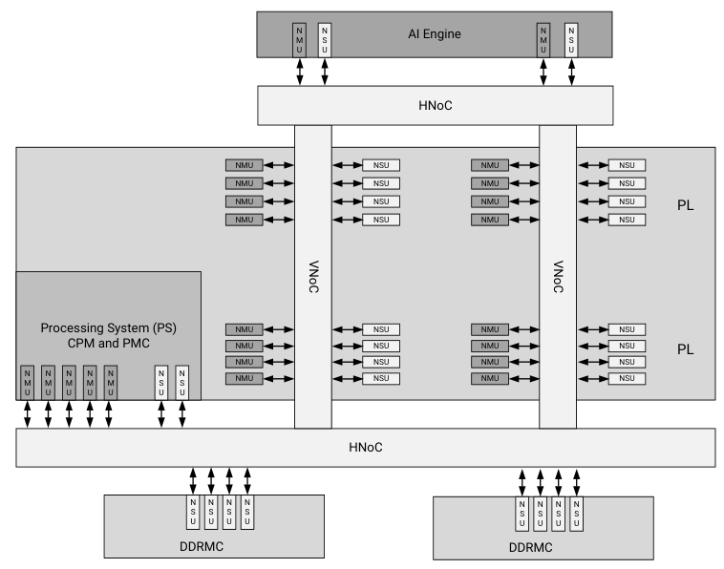
AMD Versal NoC – overview
Features:
VNoC – to connect logic in the fabric
HNoC – to connect the AI Engine Processing System, memory controllers and others
NMU – to connect master to the NoC via AXI4
NSU – to connect slave to the NoC via AXI4
No direct connection between Ethernet MAC and NoC
No ring (as in Achronix) – different VNoCs connected with HNoC
NoC clock – max. 1080 MHz.
arobs.pl

Slide 27
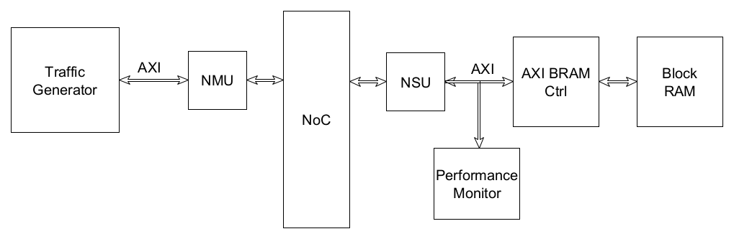
AMD Versal NoC – project approach
Initial goal: to transfer Ethernet switch solution from project with Achronix FPGA but...
no Ethernet MAC connection to NoC
no mixed language support in Vivado simulation when using NoC (all Verilog design necessary).
Thus, simple project to measure performance in simulation just with AXI transactions (no Ethernet packets):
arobs.pl

Slide 28
AMD Versal NoC – performance
Performance results with 210 MHz AXI clock:
Description | Throughput [Gbps]
Test case 1 – 2048 bursts, 256 bytes each | 42.0033
Test case 2 – 4096 bursts, 1536 bytes each | 40.5117
Test case 3 – 50 bursts, 4096 bytes each | 42.0097
Test case 4 – 71,998 packets, 4096 bytes each | 41.9992
Not performed:
synthesis and layout
timing analysis.
arobs.pl

Slide 29
Agenda
Introduction and objectives
Achronix FPGA technology
Ethernet layer 2 switch design
Tests in hardware
AMD Versal NoC
Summary
arobs.pl

Slide 30
Summary
For Achronix FPGA:
100 Gbps target bandwidth per port and transceiver lane not reached.
50 Gbps bandwidth per port achieved for 3 Ethernet ports in 50GAUI-2 mode.
NoC feature tested in Ethernet layer 2 switch design.
There are no limitations on port routability.
Ethernet layer 2 switch solution verified in hardware:
  no functional errors detected during transmissions
  all Ethernet ports operated with maximum configured data rate in both directions.
For AMD Versal FPGA:
Switch solution transfer unsuccessful due to differences in Ethernet MAC connection to NoC and issues with NoC simulation in Vivado.
Verified NoC performance in simulation of a simple project. Lower value (42 Gbps) needs further investigation.
arobs.pl

Slide 31

Thank you for your attention!
Tomasz Rybak
e-mail: tomasz.rybak@arobs.pl es)

