Slide 1
Common Framework for Hardware Root-of-Trust
Timo Lilja, Kimmo Järvinen, Atte Tommiska, Petri Jehkonen
SEFUW March 2025 ESTEC

Slide 2
Agenda
0. Agenda
Short Company Intro
Creating Trust in Computing Platforms
Hardware Root-of-Trust Overview
FSM based HW-ROT implementation
Future HW-ROT
Closing words

Slide 3
Xiphera Ltd.
1. Short Company Intro
Finnish company founded in 2017
Secure and optimised cryptographic IP cores for SoCs and FPGAs
Hardware-based security solutions with proven cryptographic algorithms
Modern and comprehensive solution portfolio
Entire product line designed fully in-house
Committed roadmap to evolving cryptographic standards
Notes:
Technical version

Slide 4
Creating Trust in Computing Platforms
2. Creating Trust in Computing Platforms
NV-MEMORY
IC
Ext-CPU
DRAM
Power
Clock
RF, Eth, etc
Sensors,
Other…
Computing Platform
Fig 1: Generic Computing Platform
Notes:
The block diagram displays typical computing platform, which consists of:
Non-volatile memory
An IC performing power-up sequence
Other components which are used on the operation of a platform

Slide 5
Creating Trust in Computing Platforms
2. Creating Trust in Computing Platforms
External NV-memory Programming Interface
NV-MEMORY
Boot image
BIN
IC
Ext-CPU
DRAM
Power
Clock
RF, Eth, etc
Sensors,
Other…
Boot Loading Operation
Rest of platform components
Computing Platform
Fig 2: Generic Computing Platform elements
Notes:
Non-volatile memory holds typically boot-image of system processor and also typically critical configuration parameters for the physical an logical components on the computing platform.
The power-up process may include several boot-loading stages as systems such as SoC or multi-chip computing platforms are relatively common
When we look at typical platform block diagram, it is obvious that the non-volatile memory can be programmed either via external physical programming connector or via CPU or FPGA interface.
When we start CREATING trust in Computing platform, it is mandatory that the FPGA or CPU provide secure operating environment.

Slide 6
Creating Trust in Computing Platforms
2. Creating Trust in Computing Platforms
External NV-memory Programming Interface
NV-MEMORY
Boot image
BIN
Trusted
IC
Ext-CPU
DRAM
Power
Clock
RF, Eth, etc
Sensors,
Other…
Boot Loading Operation
TRUST
validation
Rest of platform components
Computing Platform
Fig 3: Trust in Generic Computing Platform
Notes:
Therefore, the first step on CREATING TRUST IN COMPUTING PLATFORM is to:
- Guarantee that non-volatile memory content is not tampered with and holds only content the platform is supposed to contain
- At the end of the presentation we show one approach how to protect boot-image and capitalize the agility of FPGA to protect complete system

Slide 7
Hardware Root-of-Trust
3. Hardware Root-of-Trust Overview
Trust is as good as its foundation(s)
Agility to cope with changing requirements
Immutability with system level as basis of trust (trust anchors)
Hardware Root-of-Trust is the trust anchor of HW and SW platform

Slide 8
Towards Common HW-ROT Framework
3. Hardware Root-of-Trust Overview
Digital trust benefits from HW-ROT in the computing platform itself
Current HW-ROT solutions include TPM, DICE, OpenTitan and Caliptra:
Discrete component (TPM)
Wide range of services for SoC
Often based on CPU code
Established reliable providers
Typical services:
Offer true random numbers TRNG (+PRNG)
Generate cryptographic keys
Generate and verify digital signatures
Encrypt and decrypt information
Perform key exchange operations
Store and use ephemeral and long-term keys
Offer different access levels for services and information: root and user
Firmware Upgrade Security
Device identity functionality
Measured and Secure boot
Attestation Capability

Slide 9
But what if:
3. Hardware Root-of-Trust Overview
Designed SoC is resource-limited equipment? (No CPU in HW-ROT)
Modifications to HW-ROT are required? (This is shown to be difficult)
High assurance is required from the trust system?
Open Source reviews + massive amount of dependencies
Crypto agility is needed due long lifetime of platforms?
PQC first phase is now, it is not the last Crypto-algorithm change

Slide 10
FSM based HW-ROT framework
4. FSM Based HW-ROT implementation
State machine (FSM) based architecture suitable for FPGA and ASIC
Enables majority of HW-ROT services
Reduced Complexity
Simplifies verification
Enhanced Security
Minimal attack surface due to fewer parametrizable elements
Predictable Behaviour
Deterministic state transitions support reliability and easier testing
Lower Power Consumption
FSM implementations draw less power, beneficial for constrained satellite environments

Slide 11
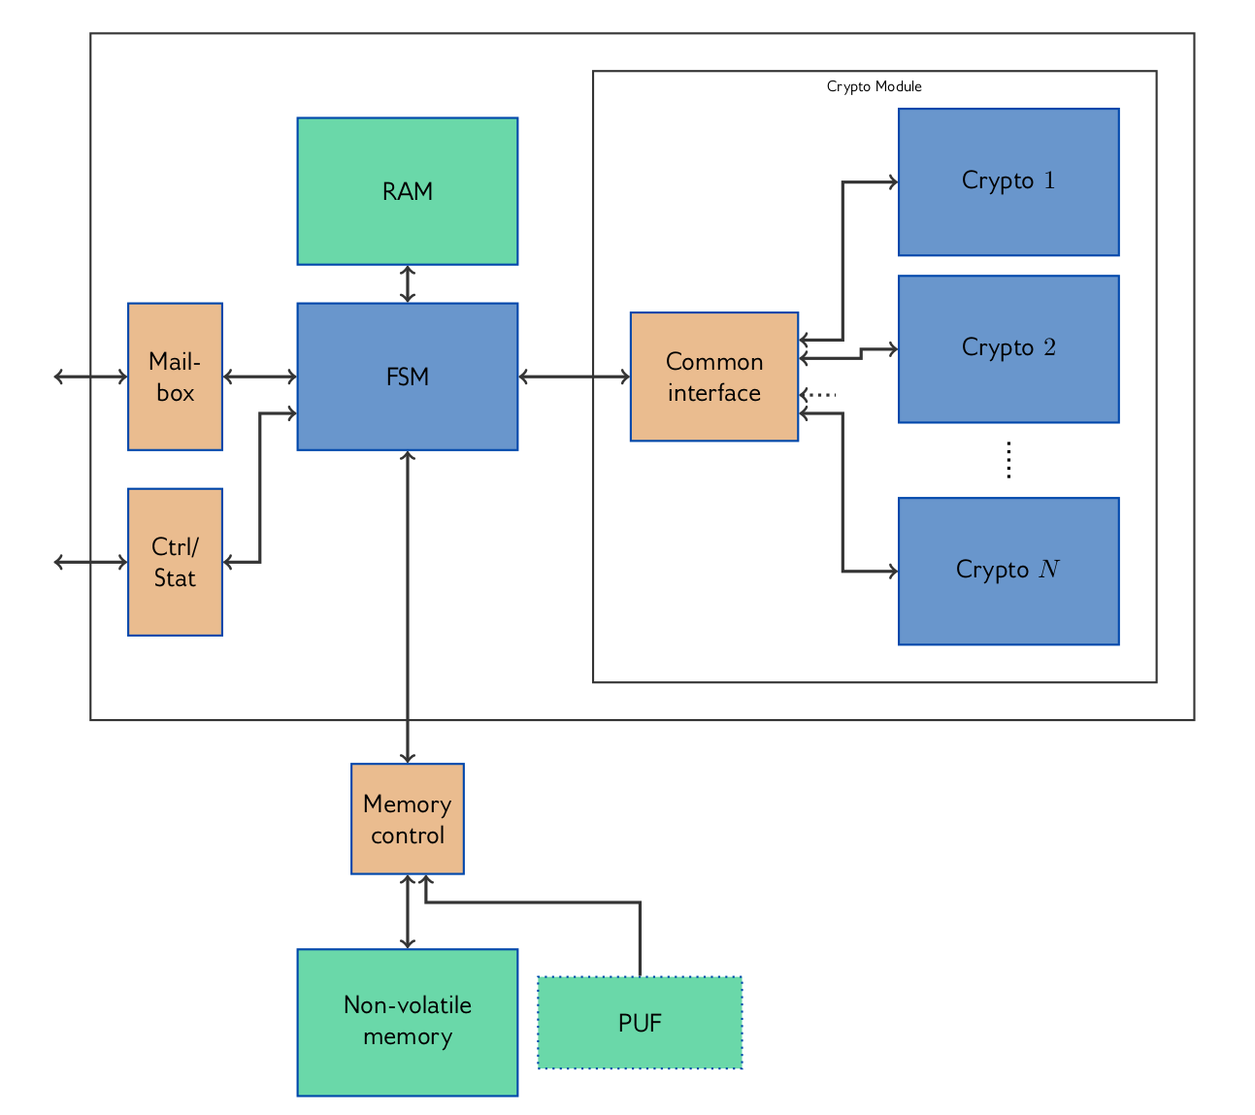
FSM based HW-ROT implementation
4. FSM Based HW-ROT implementation
Physically isolated area
Finite State Machine (FSM)
Encrypted mailbox interface
Offers essential HW-ROT functions
Low latency and fast response time
Lower power consumption
Deterministic execution
Small footprint in FPGA/ASIC design
Easier to validate and verify
Enables High Assurance Certification
Fig 4: System Architecture

Slide 12
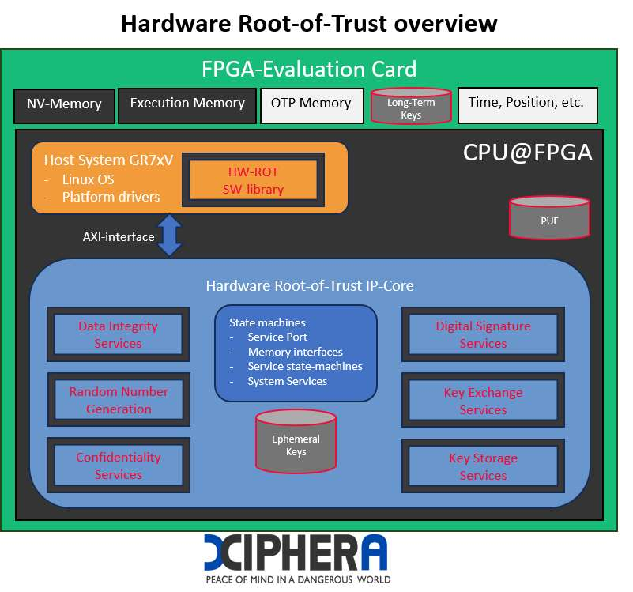
FSM based HW-ROT in practise
4. FSM Based HW-ROT implementation
Active work going on with ESA project 4000145191/24/NL/KK/adu
FSM based HW-ROT functional proof of concept (PoC) benefitting FrontGrade Gaisler GR7xV subsystem
Fig 5: Functional Prototype

Slide 13
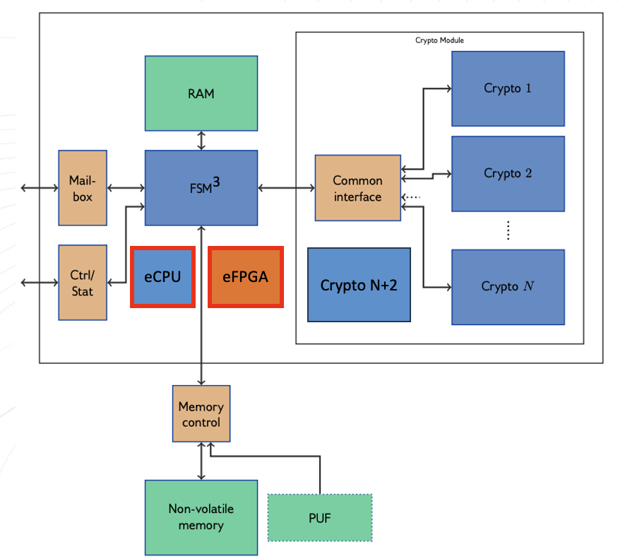
Extending FSM HW-ROT
5. Future HW-ROT
Improved FSM core
Added cryptographic algorithms
eFPGA domain for proprietary/ SECRET algorithms
eCPU for complex parsing of non-secrets and additional services
Is there need for a discrete component?
Your opinion is appreciated!
Fig 6: Extended HW-ROT concept

Slide 14
Sept 10, 2024: “Quantum-resilient Authenticated Boot for space-grade semiconductor architectures”
6. Closing Words
Trust in the digital hardware components and system configurations in space and satellite infrastructures
Development project partially financed by the European Space Agency, as part of its General Support Technology Program
Integration into Frontgrade Gaisler’s space-grade GR765 processor
Notes:
Sept 10, 2024: Xiphera announces a project for developing quantum-resilient Authenticated Boot and Hardware Root of Trust solutions for space-grade semiconductor architectures.
Solutions ensure trust in the digital hardware components and system configurations in space and satellite infrastructures. Xiphera’s implementations are based on hybrid cryptography – a combination of traditional and Post-Quantum Cryptography (PQC) – thus ensuring the security of the system throughout its life cycle.
The development project is partially financed by the European Space Agency, as part of its General Support Technology Program (GSTP). The solutions have been designed in close co-operation with Frontgrade Gaisler, a leading Swedish developer of space-grade electronics. Authenticated Boot is planned to be integrated into Frontgrade Gaisler’s space-grade GR765 processor.
The Authenticated Boot and Hardware Root of Trust technologies are productised for general availability in Xiphera’s nQrux® family of Hardware Trust Engines – highly optimised and customisable security solutions for FPGAs and ASICs. The first released product is nQrux® Secure Boot, available immediately for semiconductor and equipment vendors in space technology and other industrial and critical infrastructure sectors.

Slide 15
Crypto Module
MACsec
IPsec
CCE
Key storage
ML-DSA
Secure Boot
TLS 1.3
Key exchange
ML-KEM
xQlave®
PQC
nQrux®
Hardware Trust Engines
Security Protocols
Key Management
Key genera-tion
HW RoT
AES-GCM
RSA
AES-CTR
Symmetric Encryption
Random Number Generation
Hash Functions
Asymmetric Cryptography
ECC Accelera-tor
Versatile AES
AES-XTS
Ascon
SHA-3
NIST Curves
ChaCha20-Poly1305
PRNG
SHA-2 / HMAC & HKDF
Curve25519
TRNG

Slide 16
Thank you! Any questions?

Slide 17
Crypto Module
MACsec
ML-DSA
Secure Boot
CCE
IPsec
xQlave®
PQC
nQrux®
Hardware Trust Engines
Security Protocols
ML-KEM
TLS 1.3
AES-GCM
RSA
AES-CTR
HW RoT
Symmetric Encryption
Asymmetric Cryptography
ECC Accelera-tor
Versatile AES
Random Number Generation
Hash Functions
AES-XTS
NIST Curves
ChaCha20-Poly1305
Ascon
Curve25519
SHA-3
TRNG
PRNG
SHA-2 / HMAC & HKDF

