Slide 1
A NEW HYPERSPECTRAL COMPRESSION IP CORE FOR SPACE MISSIONS BASED ON CCSDS-123.0-B-2 STANDARD
Antonio J. Sánchez, Samuel Torres-Fau, Lucana Santos, Roberto Sarmiento
26th March 2025

Slide 2
Index
Introduction
Project overview
Compression IP Core Proposal:
  Overview
  Configuration
  Encoder
IP Verification
Synthesis results
Conclusions
  Interfaces
  Predictor

Slide 3
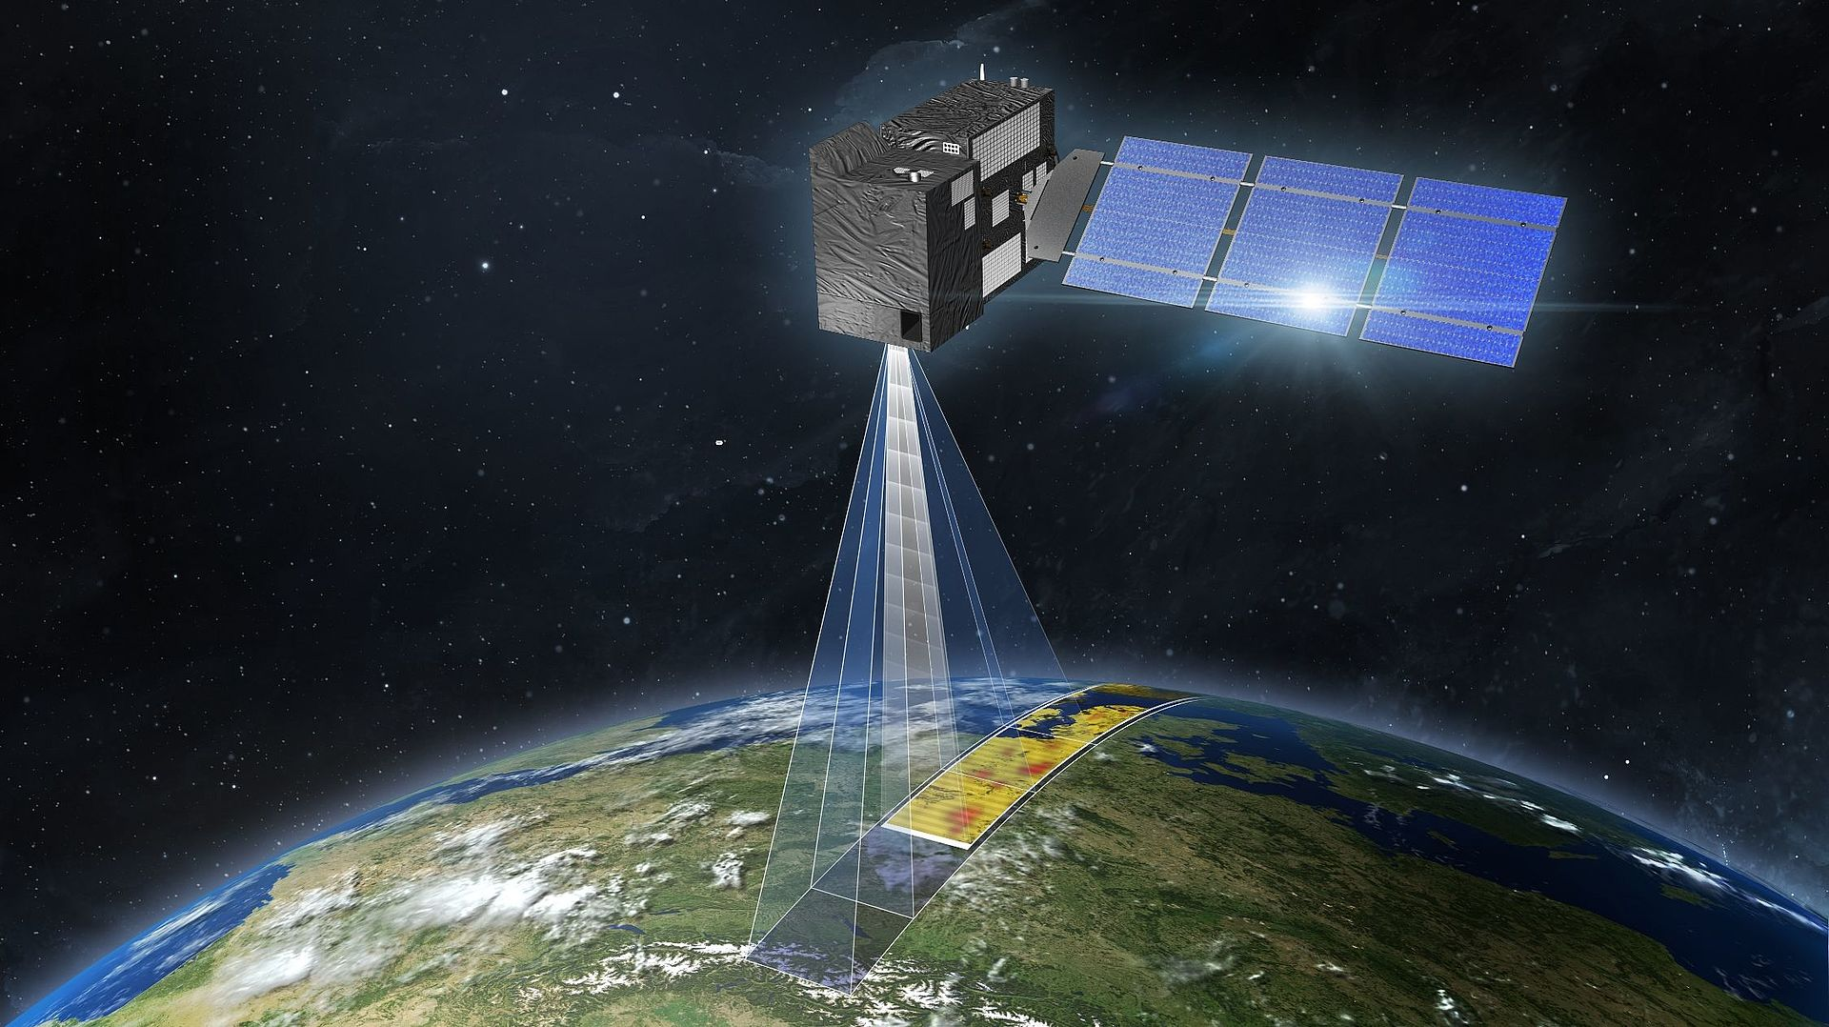
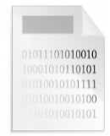

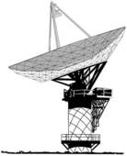

Introduction
Acquired data
1) On-board storage
On-board compression
2) Downlink
Earth observation mission
Compressed data
Data compression on-board becomes a necessity. Active research field.
SHyLoC IP cores:
  HW implementations of CCSDS 121.0.B-3 and 123.0.B-1 standards.
  Belong to the ESA IP repository for space missions.
  Lossless compression.
Increasing sensor resolution → shift to lossy compression:
  Higher compression rates by introducing controlled losses.
  New compression standard: CCSDS 123.0-B-2 → more computational complexity
Notes:
-Moreover, the limited downlink bandwidth with ground in comparison with the data size is an additional bottleneck.
-Lossless → the image can be fully recovered after decompression
-Lossy → the resulting image is not identical to the original one

Slide 4




Project overview
Lossless/lossy multispectral & hyperspectral compression IP core
ESA Contract No. 4000136723/22/NL/CRS
Consortium:
  IUMA/ULPGC. Prime Contractor.
  Thales Alenia Space in Spain.
  DSCAL. Greece.
  UAB. Spain.
Objectives:
  Implement the CCSDS 123.0-B-2 compression standard as a reusable VHDL IP core.
    Fully compliant: support all standard features.
    Provide high-performance (1 sample/clock cycle) for a subset of IP configurations
  Perform an architectural trade-off analysis to take early design decisions.
  IP core verification, validation and documentation.

Slide 5
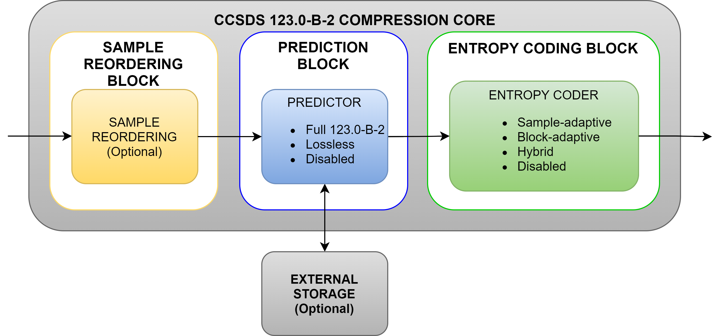
Compression IP Core Proposal: Overview
IP core compliant with the CCSDS 123.0-B-2 standard.
  Predictor and encoder blocks can operate jointly or separately.
  Predictor: full or lossless only.
  Entropy coding block: one choice per implementation.
IP core supports BSQ, BIL and BIP orders:
  Implement a BIL/BSQ architecture (hybrid).
  BIP to BIL reordering for BIP order.
      Data dependencies limit predictor performance for BIP.
      BIL/BSQ performs better.
      BIP to BIL conversion has reduced overhead.
  Several predictor configurations.
      Implies different throughput profiles.
  All stages are configured through a single dedicated AMBA configuration port.
*
*
Block diagram of the compression IP core
*Predictor and entropy coder blocks should not be disabled at the same time. At least one of both should be present in any given implementation.

Slide 6
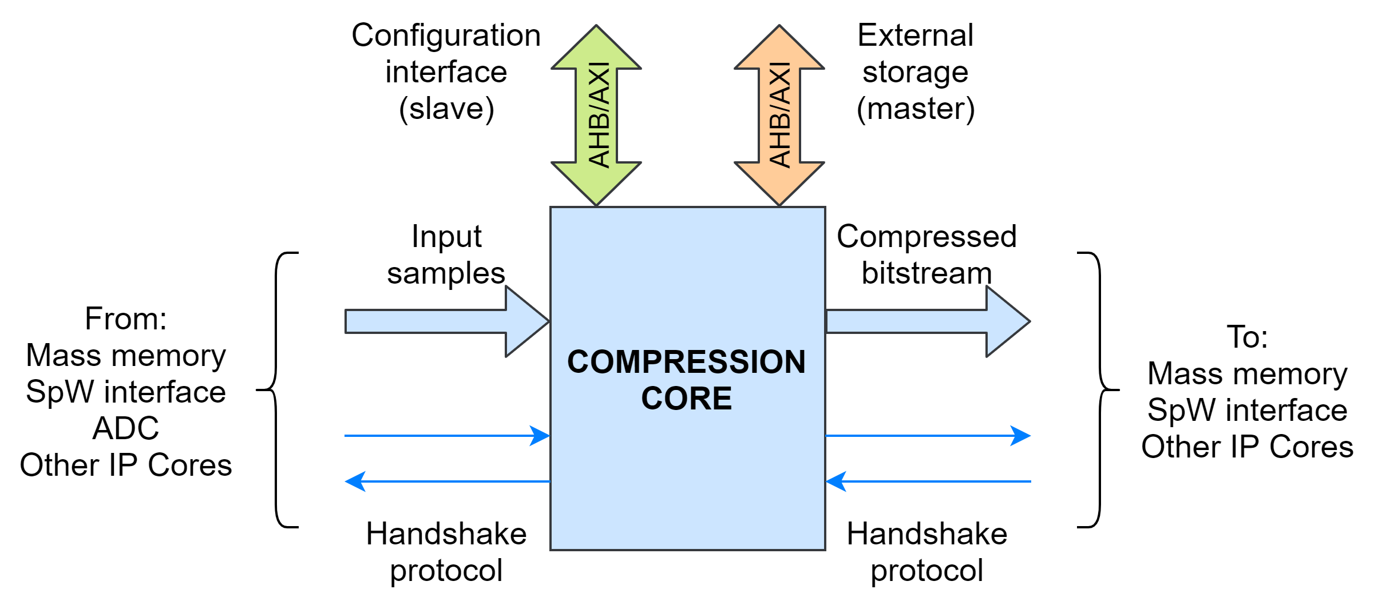
Compression IP Core Proposal: Interfaces
Input samples (data input)
Generic data interface of configurable width with simple handshake protocol.
Configuration interface (AMBA slave).
To receive configuration options from an external controller when runtime configuration is enabled.
External memory Interface (AMBA master).
The IP core will provide the possibility of allocating certain memory elements into an external memory.
Compressed bitstream (data output).
Generic data interface of configurable width with simple handshake protocol.
AHB or AXI4Lite
AHB or AXI4 full

Slide 7
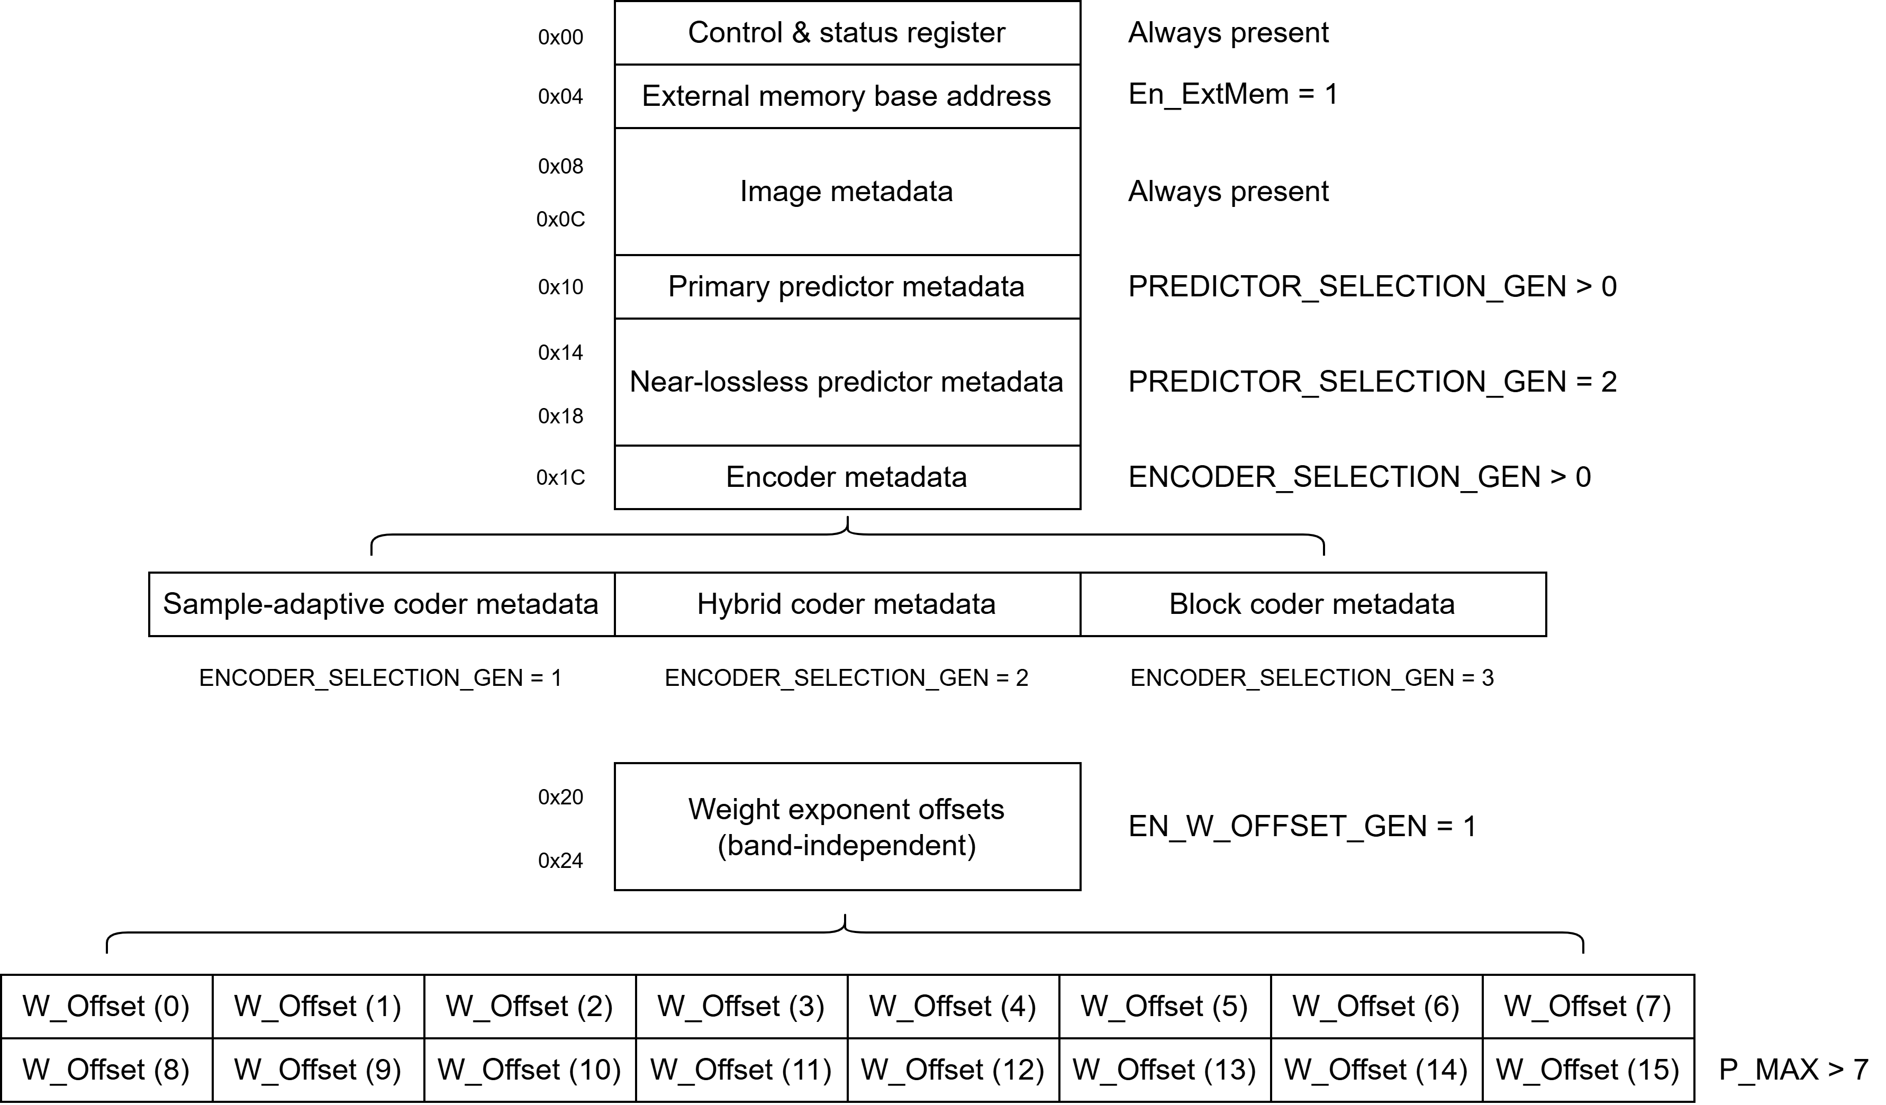
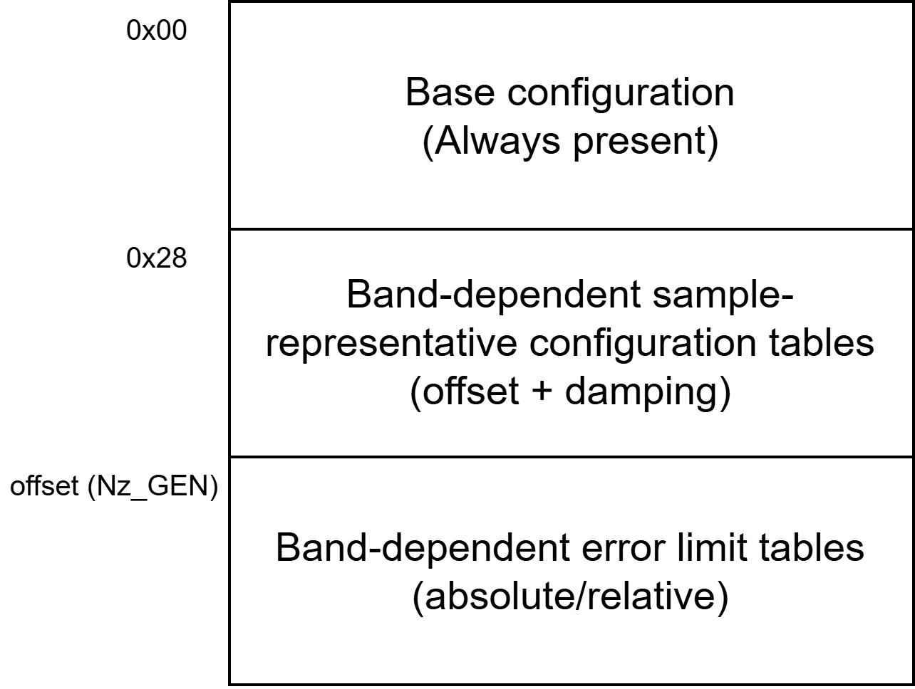

Compression IP Core Proposal: Configuration
2 configuration layers:
Compile-time (IP implementation)
Runtime (for each compression run)
Runtime configuration memory space:
$$offset\left({Nz}_{GEN}\right)=0x28+4∙\left\lceil Nz_{GEN}/4\right\rceil$$

Slide 8
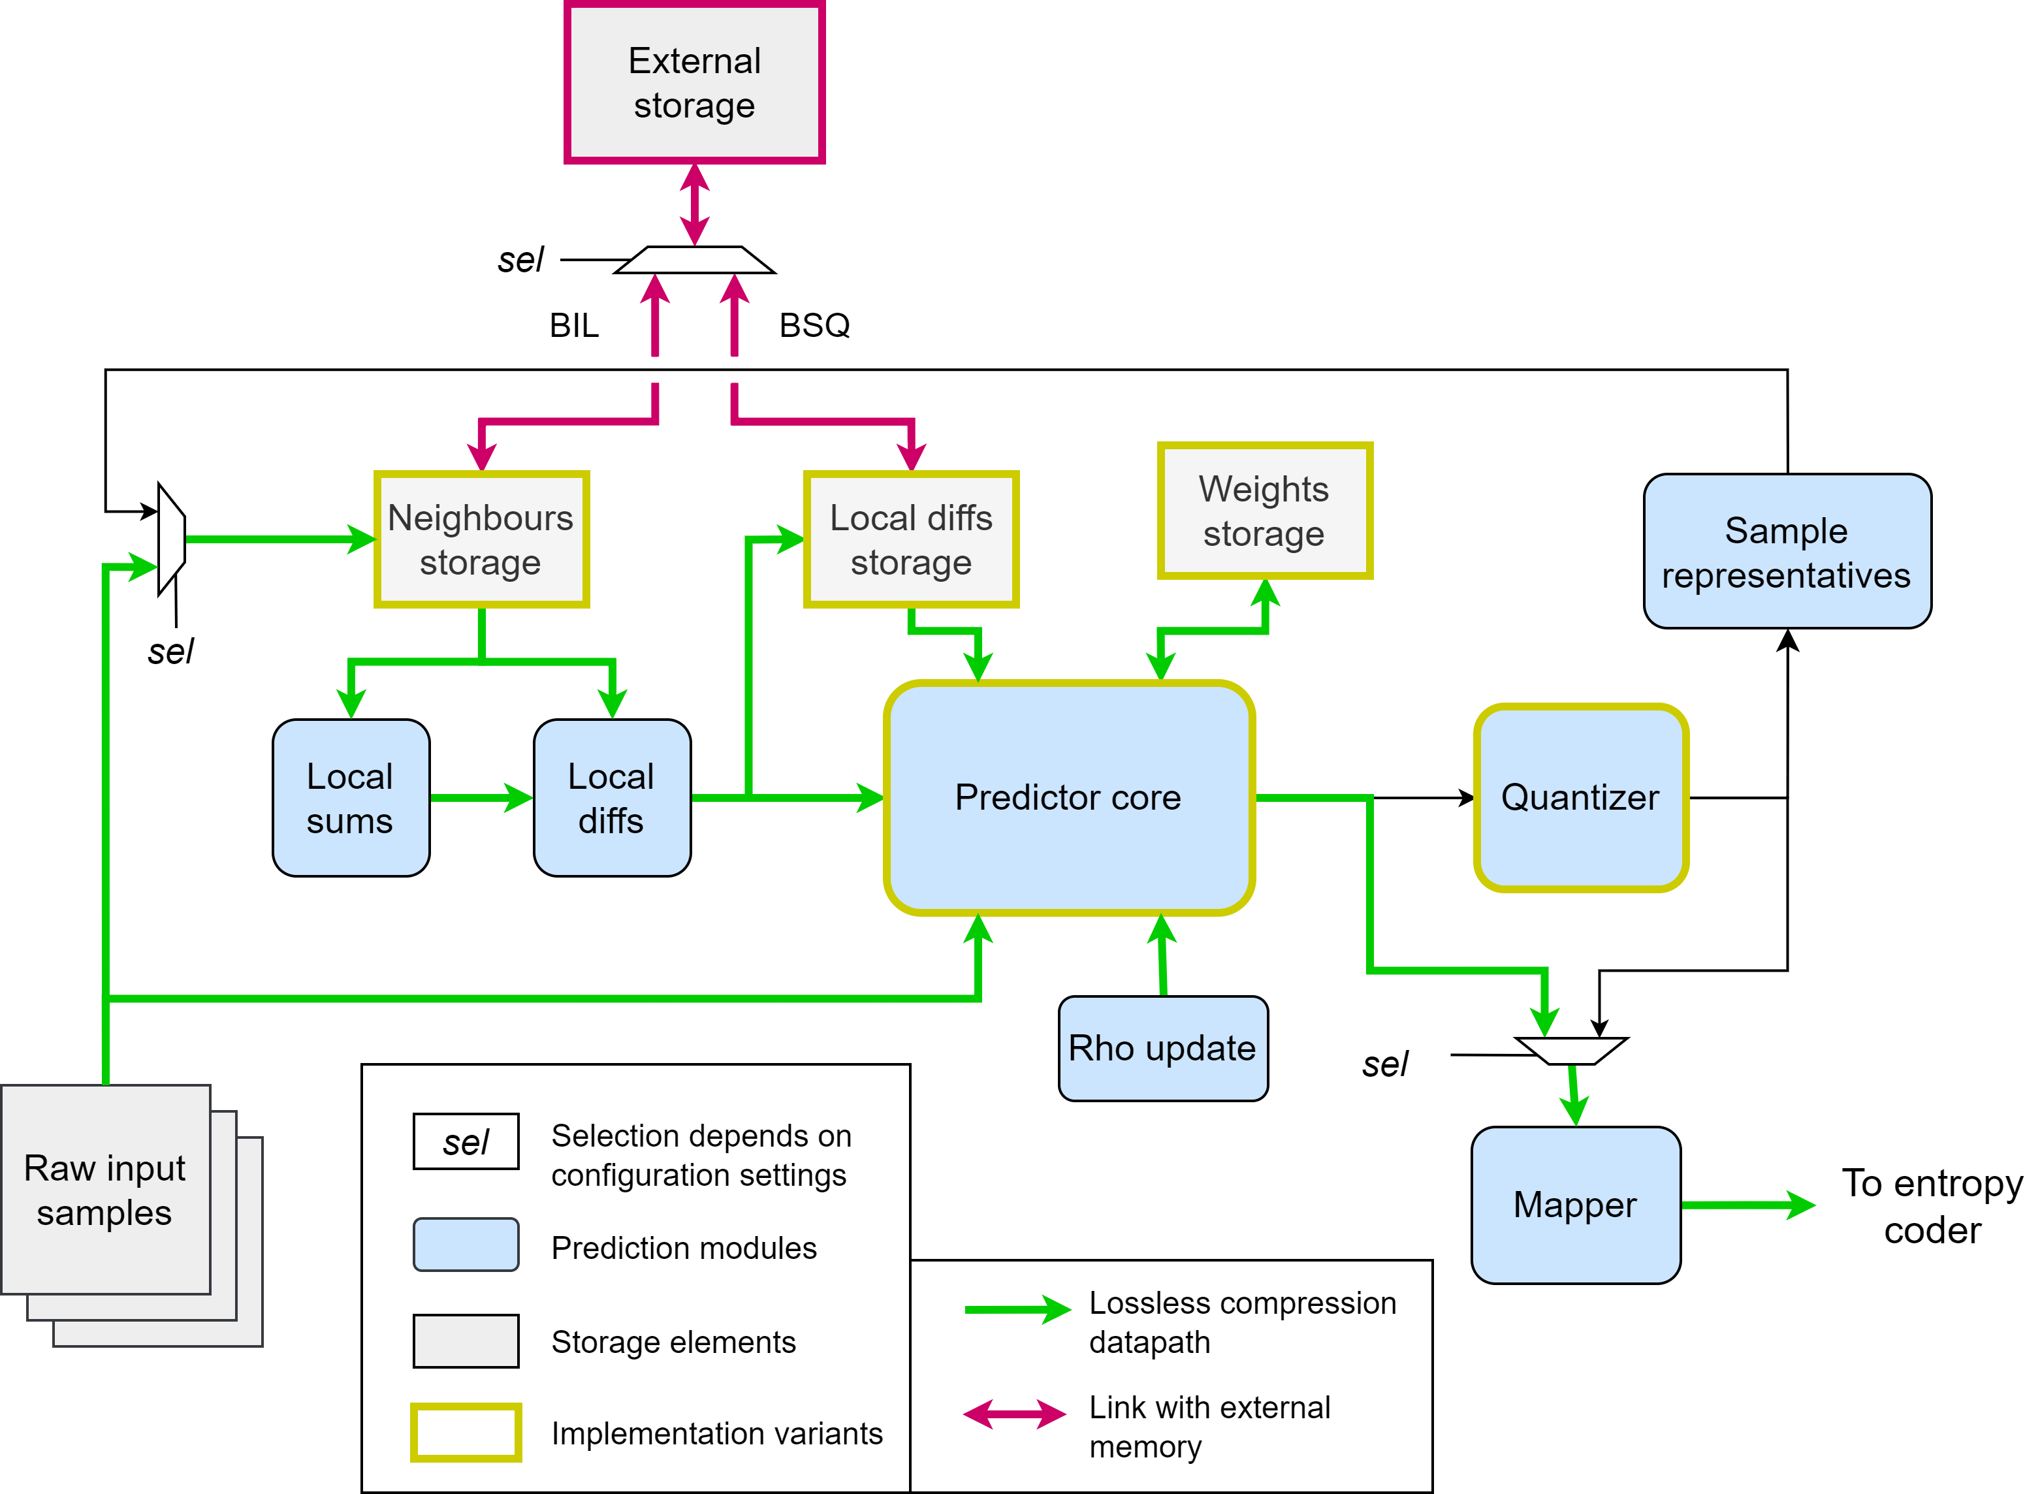
Compression IP Core Proposal: Predictor
Common structure to all IP configurations.
Adaptive control based on configuration.
External memory allocation depends on processing order:
BIL: Neighbours storage.
BSQ: Local differences storage.
Implementation variants:
Localdiffs storage
Weights storage (used only in BIL).
Neighbours storage.
Predictor core (dot product + predictor + weights update).
Quantizer. Iterative integer division with configurable division step.

Slide 9
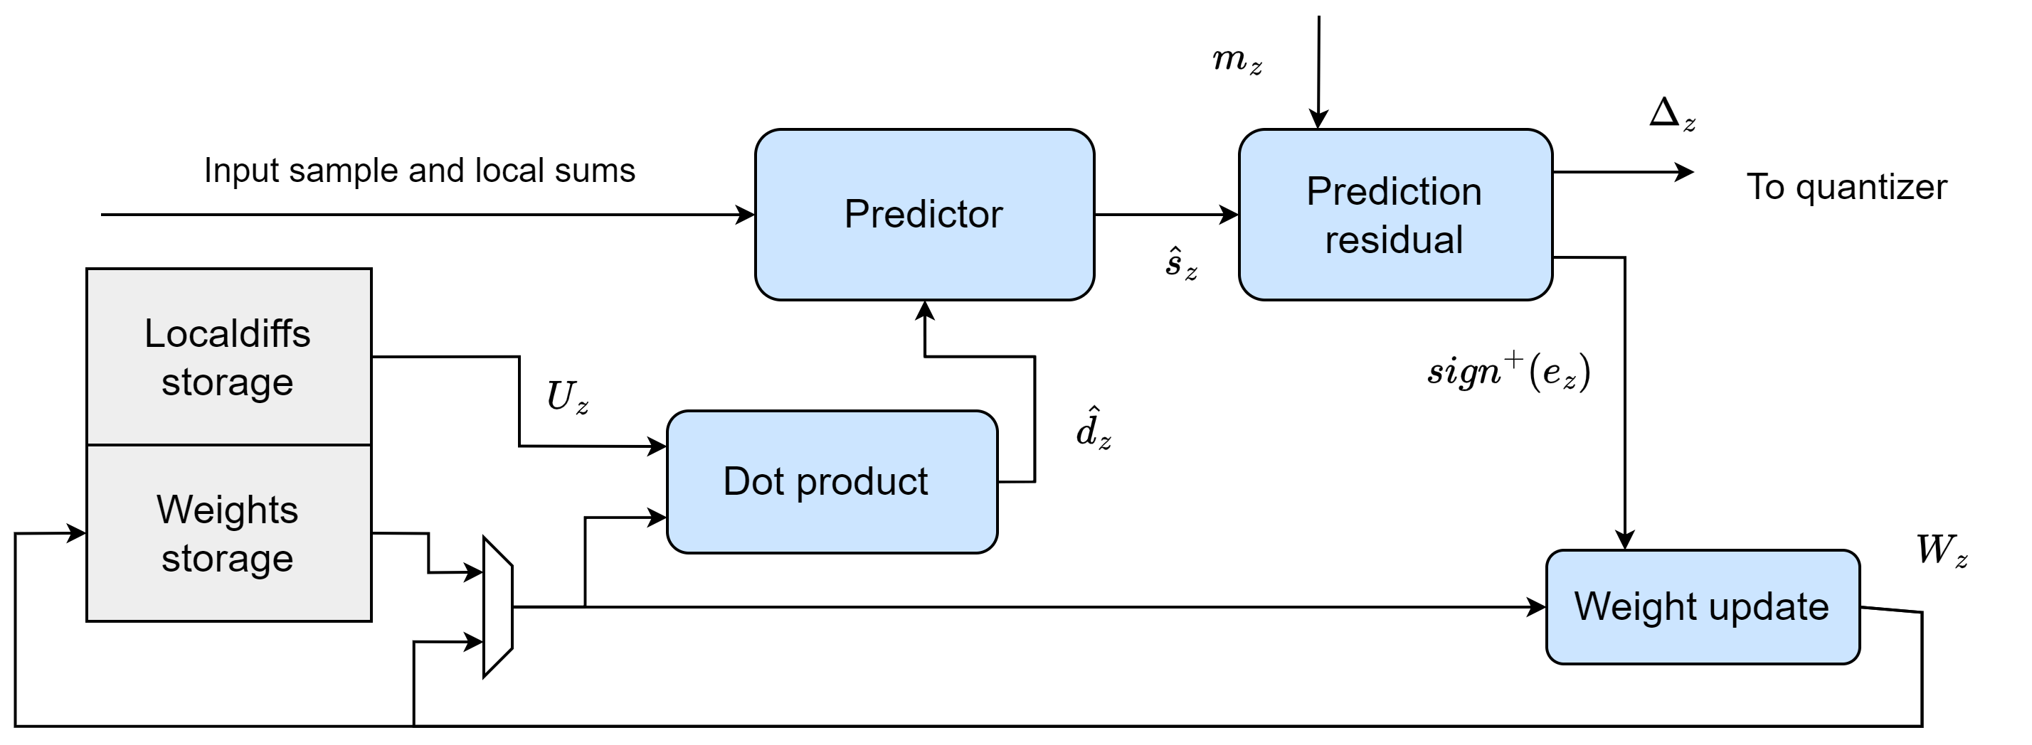
Compression IP Core Proposal: Predictor
Predictor core: weights update feedback loop
Critical component in design.
Weights update uses an alternative formula but equivalent to the standard.
2 versions of prediction computation, based on register size (R):
  Standard-compliant
  Simplified (if R does not overflow)
2 architectures: base + high performance

Slide 10
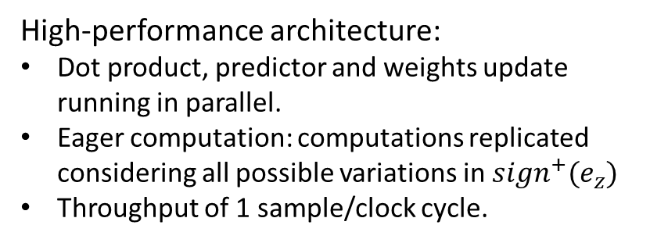
Compression IP Core Proposal: Predictor
Base architecture:
Pipelined datapath.
Adaptive control. Trigger of next sample depends on data dependencies.
Variable throughput.
Additional cycle latency if relative errors are used.
High-performance architecture:
Dot product, predictor and weights update running in parallel.
Eager computation: computations replicated considering all possible variations in ${sign}^{+}(e_{z})$
Throughput of 1 sample/clock cycle.

Slide 11
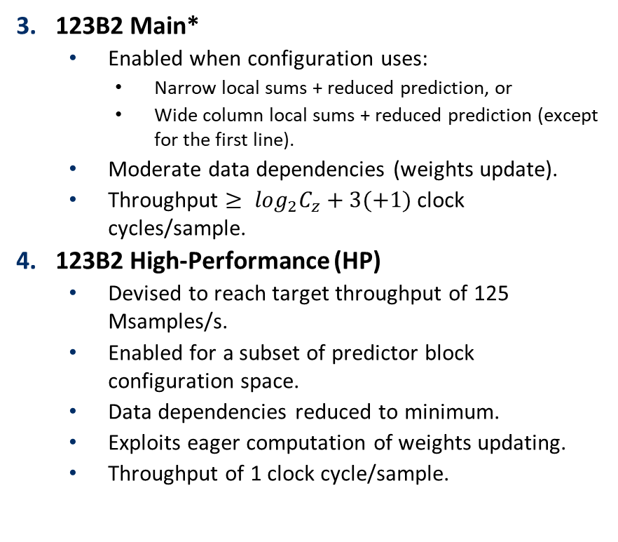
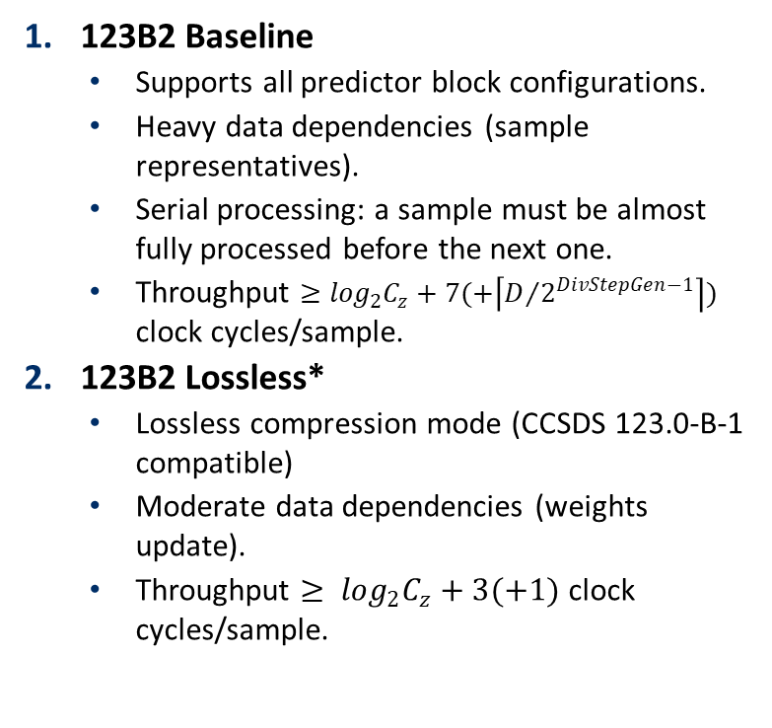
Predictor operation modes
123B2 Baseline
  Supports all predictor block configurations.
  Heavy data dependencies (sample representatives).
  Serial processing: a sample must be almost fully processed before the next one.
  Throughput $≥\log_{2}C_{z}+7(+\left\lceil D/{2^{DivStepGen−1}}\right\rceil )$ clock cycles/sample.
123B2 Lossless*
  Lossless compression mode (CCSDS 123.0-B-1 compatible)
  Moderate data dependencies (weights update).
  Throughput $≥ \log_{2}C_{z}+3(+1)$ clock cycles/sample.
123B2 Main*
  Enabled when configuration uses:
    Narrow local sums + reduced prediction, or
    Wide column local sums + reduced prediction (except for the first line).
  Moderate data dependencies (weights update).
  Throughput $≥ \log_{2}C_{z}+3(+1)$ clock cycles/sample.
123B2 High-Performance (HP)
  Devised to reach target throughput of 125 Msamples/s.
  Enabled for a subset of predictor block configuration space.
  Data dependencies reduced to minimum.
  Exploits eager computation of weights updating.
  Throughput of 1 clock cycle/sample.
*: Lossless and Main modes share the same scheduling.

Slide 12
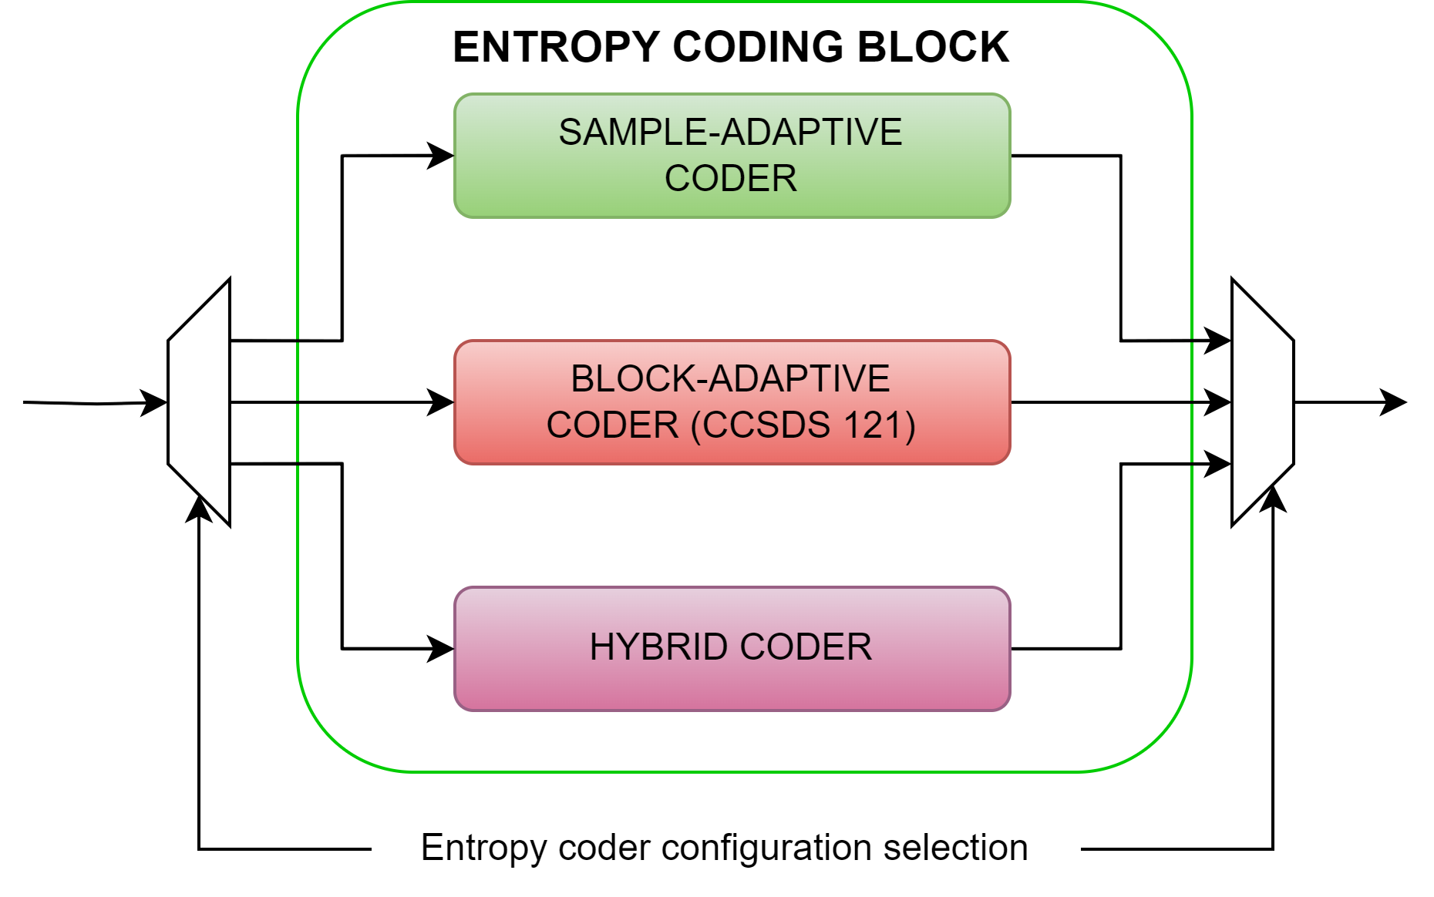
Compression IP Core Proposal: Encoder
Entropy coder block. 3 options:
Block-adaptive encoder. Inherited from SHyLoC 121 IP.
Sample-adaptive encoder. Inherited from SHyLoC 123 IP.
Hybrid encoder. New incorporation.
Entropy coder selected at implementation.
Purposes:
Receives compression header (image + predictor metadata) and pre-processed samples.
Attaches encoder metadata to header.
Encodes input samples.
Packages output bitstream.
Pipelined. Performance: 1 sample/clock cycle.

Slide 13


Compression IP Core Proposal: Encoder
Block- and Sample-adaptive encoders:
Based on Golomb/Rice codes.
Encoding granularity: by blocks vs. individual samples.
Theoretical compression limit: 1 bpp.
Block-adaptive encoder
${[δ}_{1}$, $δ_{2}$, $δ_{3}$, $⋯$, $δ_{J}]$, ${[δ}_{J+1}$, $δ_{J+2}$, $⋯$, $δ_{2J}],⋯$
Sample-adaptive encoder
$δ_{1}$ , $δ_{2}$, $δ_{3}$, $⋯$, $δ_{J}$, $δ_{J+1}$, $δ_{J+2}$, $⋯$, $δ_{2J},⋯$
J = 8, 16, 24, or 32

Slide 14
Compression IP Core Proposal: Encoder
Block- and Sample-adaptive encoders:
Based on Golomb/Rice codes.
Encoding granularity: by blocks vs. individual samples.
Theoretical compression limit: 1 bpp.
Block-adaptive encoder
${[δ}_{1}$, $δ_{2}$, $δ_{3}$, $⋯$, $δ_{J}]$, ${[δ}_{J+1}$, $δ_{J+2}$, $⋯$, $δ_{2J}],⋯$
Sample-adaptive encoder
$δ_{1}$ , $δ_{2}$, $δ_{3}$, $⋯$, $δ_{J}$, $δ_{J+1}$, $δ_{J+2}$, $⋯$, $δ_{2J},⋯$
Encoding
Counter
Code selection
k
J = 8, 16, 24, or 32
Σ

Slide 15
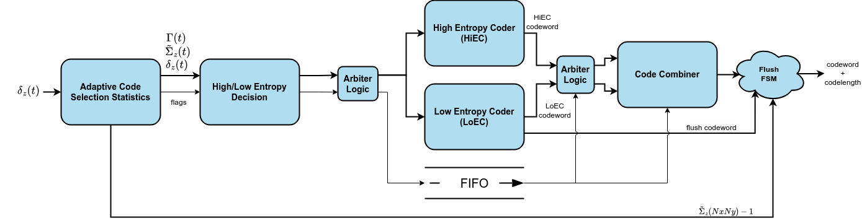
Compression IP Core Proposal: Encoder
Hybrid encoder:
2 compression modes:
  High entropy (~Sample-adaptive encoder)
  Low entropy (Any-to-one dictionary-based encoding)
Compression performance < 1 bpp for low entropy data.
Decoded in reverse: requires compression tail (final status of encoder)

Slide 16
IP verification
Block-level verification (testcase-driven):
Sample-reordering block.
Prediction block.
AXI4 interface.
Hybrid encoder.
Sample- and block-adaptive encoders verified in previous IP developments (SHyLoC)
System-level verification:
Testcase-driven (61 tests). Prove project requirements and assess code coverage (> 99%).
Fuzz testing (~10⁶ tests). Corner cases detection.
Tools used:
Self-checking testbenches developed for the IP core.
CCSDS 123.0-B-2 reference software: CNES + in-house implementation

Slide 17
Synthesis results: IP configurations
Parameter | Base | High-perf. | Lossless | WExp. Offsets
Predictor Selection | full | full | lossless | lossless
Prediction Mode | full + reduced | reduced only | reduced only | reduced only
Local Sums Mode | wide + narrow | narrow only | narrow only | narrow only
Max. Weight resolution (Ω) | 13 | 19 | 10 | 19
Register Size Range (R) | [40,48] | 48 | [32,51] | 48
W. Update scaling exp. Range (ν_{min}/ν_{max}) | [-3,1] | [-1,3] | [-3,0] | [-1,3]
W. Update scaling exp. Max. Interval (t_{inc}) | 11 | 6 | 7 | 6
Weight exponent offsets | Disabled | Disabled | Disabled | Enabled
Quantization Fidelity Method | abs + rel | absolute only | lossless | abs + rel
Max. Error Limit bitdepth (D_{A}/D_{R}) | 8 | 10 | 1 | 8
Max. Sample Representatives resolution (θ) | 2 | 4 | 0 | 4
Encoder Selection | Hybrid | Hybrid | Sample | Hybrid
Max. Rescaling Counter Size (γ*) | 4 | 6 | 6 | 4

Slide 18
Synthesis results
Common configuration
Configuration port enabled (AHB)
Image dimensions: 680 x 512 x 256 samples (AVIRIS sensor)
BIL processing order
Preliminary synthesis
SW: Synopsys Synplify Premier S-2021.09
Target technology: Xilinx UltraScale XCKU060
Configuration | Base | High-perf. | Lossless | WExp. Offsets
LUTs | 14524 (~4%) | 17866 (~5%) | 4760 (~1%) | 9208 (~2%)
FFs | 6689 (~1%) | 7759 (~1%) | 2431 (<1%) | 3909 (<1%)
BRAMs | 140 (~13%) | 138 (~13%) | 134 (~12%) | 137 (~13%)
DSPs | 23 (<1%) | 55 (~2%) | 4 (<1%) | 9 (<1%)
Clock frequency (MHz) | 132.6 | 125.3 | 160.8 | 134.5

Slide 19
Synthesis results
Common configuration
Configuration port enabled (AHB)
Image dimensions: 680 x 512 x 256 samples (AVIRIS sensor)
BIL processing order
Preliminary synthesis
SW: Synopsys Synplify Premier S-2021.09
Target technology: MicroChip Polarfire MPF500T
Configuration | Base | High-perf. | Lossless | WExp. Offsets
LUTs | 22655 (~5%) | 33200 (~7%) | 7876 (~2%) | 15909 (~3%)
Sequential Cells | 7073 (~1%) | 11231 (~2%) | 2991 (<1%) | 4267 (<1%)
uSRAM (64x12) | 87 (~2%) | 58 (~1%) | 34 (<1%) | 56 (~1%)
LSRAM (20 Kb) | 269 (~18%) | 265 (~17%) | 264 (~17%) | 264 (~17%)
DSPs | 47 (~3%) | 82 (~5%) | 6 (<1%) | 34 (~2%)
Clock frequency (MHz) | 66.2 | 51.9 | 89.8 | 60.1

Slide 20
Conclusions
New compression IP core:
Fully compliant with CCSDS 123.0-B-2 compression standard.
All-purpose compression solution.
Technology agnostic.
Highly configurable.
Predictor block providing lossless to near-lossless compression.
  Flexible architecture and control.
  Throughput of 1 sample/clock cycle for a subset of the configuration space.
3 entropy coder options: Block-adaptive, sample-adaptive, hybrid.
BIL and BSQ natively supported. BIP→BIL conversion.
Will join the ESA IP cores portfolio for space missions

Slide 21
A NEW HYPERSPECTRAL COMPRESSION IP CORE FOR SPACE MISSIONS BASED ON CCSDS-123.0-B-2 STANDARD
Antonio J. Sánchez, Samuel Torres-Fau, Lucana Santos, Roberto Sarmiento
26th March 2025

