Slide 1



  SEFUW: 6th SpacE FPGA Users Workshop
Fast SEU Detection and Recovery in FPGA-Based AI Accelerators
Eleonora Vacca, Giorgio Cora, Corrado De Sio, Luca Sterpone
Politecnico di Torino, Italy

Slide 2

AI in Space - A Cool but Overlooked Challenge
AI is rapidly being integrated into space applications, bringing enhanced autonomy and decision-making capabilities.
⚠️ But What About Reliability?
  Reliability concerns in AI for space are often overlooked.
  The focus remains on performance, while traditional approaches like TMR (Triple Modular Redundancy) persist without exploring new methodologies.
🛰️ The Rise of RISC-V and Accelerators
  AI accelerators are increasingly coupled with RISC-V cores.
  The scientific community is rapidly adopting new ISA extensions and core implementations
🤔 The Missing Piece: Reliability in Heterogeneous Computing
  The focus on performance is critical, but we must rethink traditional methods and develop novel reliability-driven approaches for AI in space.
E. Vacca
SEFUW: SpacE FPGA Users Workshop
2

Slide 3
Proposed Approach
What do we want?
  Fast error detection in AI Inference
  Fast system recovery
  Minimal area overhead
  Minimal execution overhead
How?
E. Vacca
SEFUW: SpacE FPGA Users Workshop
3

Slide 4
Proposed Approach
What do we want?
  Fast error detection in AI Inference
  Fast system recovery
  Minimal area overhead
  Minimal execution overhead
How?
  A runtime self-test SEU-induced error detection mechanism on the AI accelerator
E. Vacca
SEFUW: SpacE FPGA Users Workshop
4

Slide 5
Proposed Approach
Goals:
  Fast error detection in AI Inference
  Fast system recovery
  Minimal area overhead
  Minimal execution overhead
How?
  A runtime self-test SEU-induced error detection mechanism on the AI accelerator
  Dynamic partial reconfiguration to enable a fast and efficient error correction mechanism
E. Vacca
SEFUW: SpacE FPGA Users Workshop
5

Slide 6
Proposed Approach
Goals:
  Fast error detection in AI Inference
  Fast system recovery
  Minimal area overhead
  Minimal execution overhead
How?
  A runtime self-test SEU-induced error detection mechanism on the AI accelerator
  Dynamic partial reconfiguration to enable a fast and efficient error correction mechanism
  A RISCV core monitoring the system
The RePAIR (Reconfigurable Platform for AI Resilience within RISC-V Ecosystem ) platform
E. Vacca
SEFUW: SpacE FPGA Users Workshop
6

Slide 7
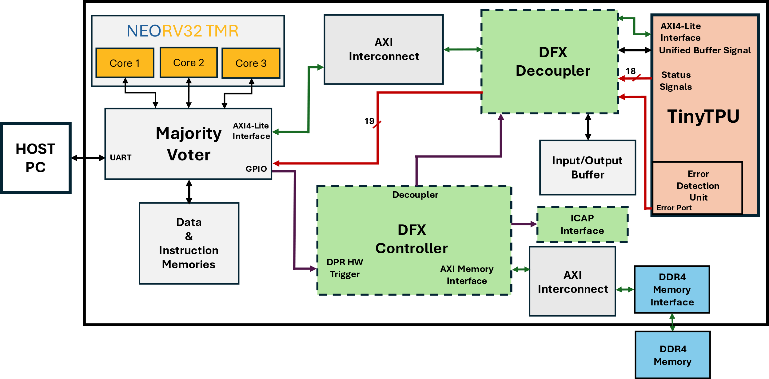
RePAIR
E. Vacca
SEFUW: SpacE FPGA Users Workshop
7

Slide 8
RePAIR – The RISC-V core
NEORV32:
Tiny, Highly reconfigurable, and modular 32-bit VHDL-based architecture implementing RV32I ISA.
AXI4-LITE Interface for communication with the TPU and DDR memory.
UART Communication with the Host
GPIO Interfaces for Error Detection and Partial Reconfiguration management.
TMR for Improved Reliability.
E. Vacca
SEFUW: SpacE FPGA Users Workshop
8

Slide 9
RePAIR – The AI Accelerator
TinyTPU:
Configurable Systolic Array size, from 6x6 to 14x14 MAC units.
Custom 80-bits CISC ISA.
Designed for DNN execution.
Support for ReLU and Sigmoid activation.
Custom ISA Extension to Support Error Detection capabilities.
Minimal hardware and execution time overhead.
E. Vacca
SEFUW: SpacE FPGA Users Workshop
9

Slide 10
Systolic Arrays
2D Array of Processing Elements
Fixed Interconnection path between PEs for fast data exchange and processing
Neural Networks on SA are implemented as GEMM operations
E. Vacca
SEFUW: SpacE FPGA Users Workshop
10

Slide 11
Systolic Arrays – SOTA Fault Detection
Algorithm Based Fault Tolerance
  computing checksums on the matrices processed
  high area overhead
    (2N + 1) adder for a SA N x N
Scan chain methods
  Exploit the functional path between PEs to propagate test patterns
  Requires modification on MAC units
  Efficient in detection and diagnosis
  Not feasible for runtime execution during application workload
E. Vacca
SEFUW: SpacE FPGA Users Workshop
11

Slide 12
Proposed Fault Detection
Developing a novel runtime methodology for fault detection in Systolic Arrays named RunSAFER
The method combines SCAN and ABFT with:
  Minimal hardware overhead
  Reduced intrusiveness on the application workload
  Fault detection during inference execution
  Detection and diagnosis of critical computational units of the Datapath:
    Systolic Array core
    Accumulators
E. Vacca et al., "RunSAFER: A Novel Runtime Fault Detection Approach for Systolic Array Accelerators," 2023 IEEE 41st International Conference on Computer Design (ICCD), Washington, DC, USA, 2023
E. Vacca
SEFUW: SpacE FPGA Users Workshop
12

Slide 13
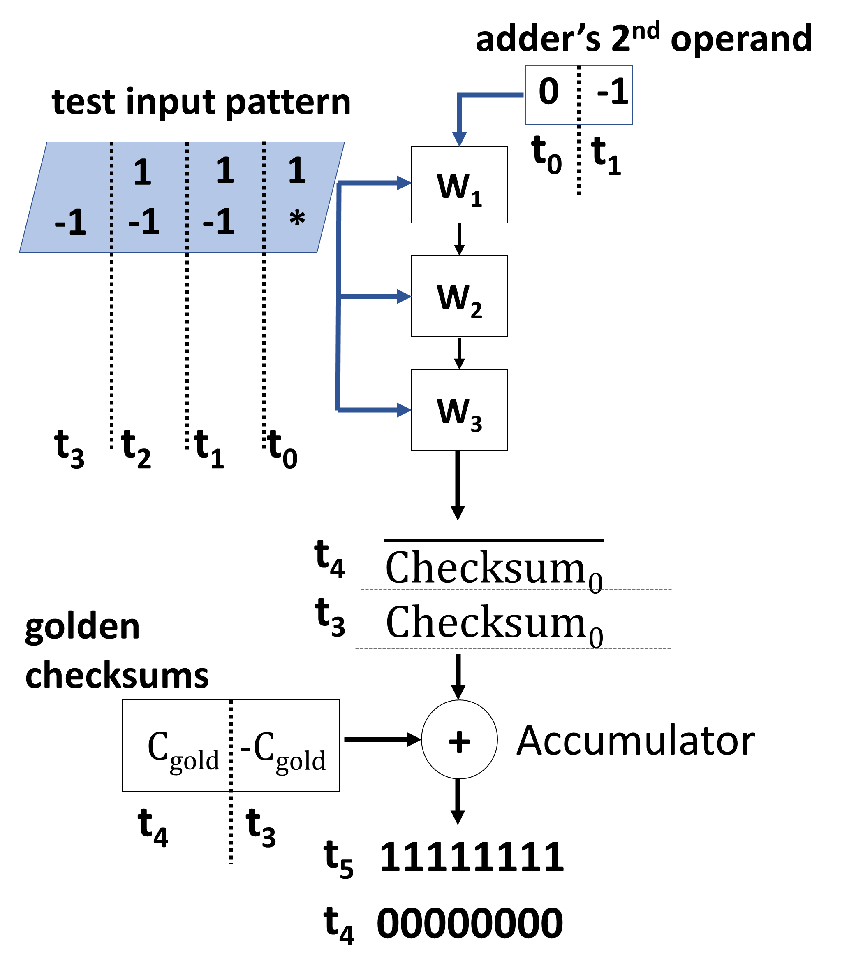
Proposed Fault Detection
The detection method consists of the following phase:
  Exploit systolic core resources to compute checksums on the current workload data.
  Checksums’ values are computed in such a way that complemented values flow through all the Datapath resources
    Allowing for SEU-induced interconnection fault
  Diagnosis unit (XOR and OR gates) evaluates the checksums produced to detect faults
E. Vacca
SEFUW: SpacE FPGA Users Workshop
13

Slide 14
Proposed Fault Detection - Implementation
The fault detection method has been integrated in the ISA of open-source TPU core
The matmul instruction has been augmented to support the self-testing mode (tmatmul)
Each tmatmul induces a penalty of 3 clock cycle
  Due to additional processing of test vectors appended to the main computation
Datapath modifications have been implemented to introduce no hardware overhead for the golden checksum computation
  Use of the available Accumulators through the implementation of asymmetric SIMD
E. Vacca
SEFUW: SpacE FPGA Users Workshop
14

Slide 15
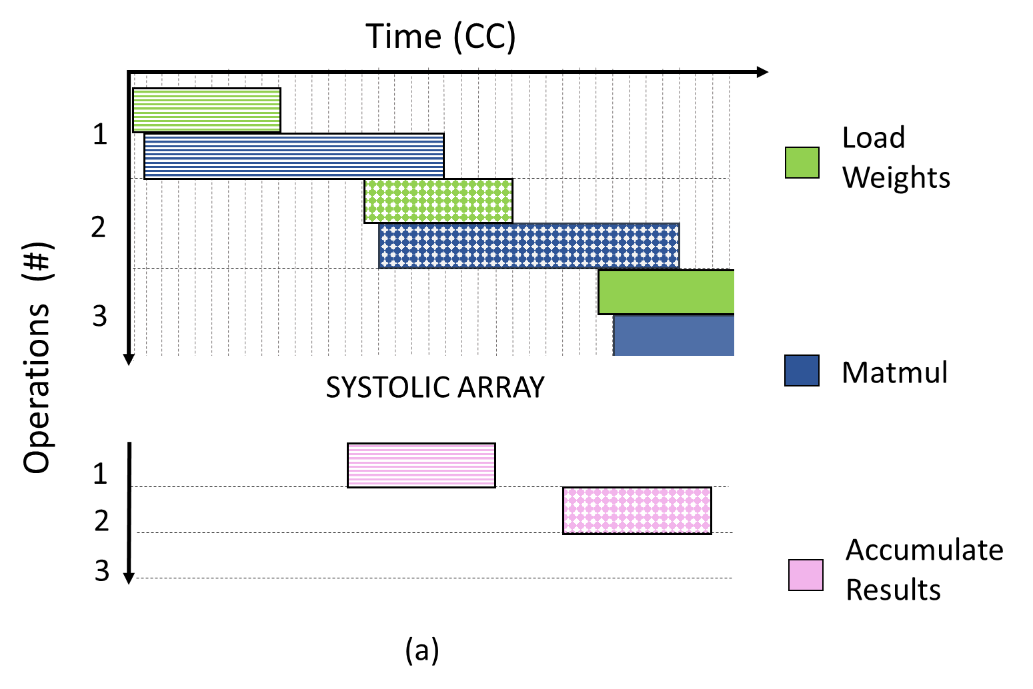
Original Pipeline
Every matrix multiplication operation starts with a load weights instruction, followed by a matmul instruction.
Once the results are generated, they are sequentially processed by the Accumulators, vector by vector. Meanwhile, a new set of load weights and matmul instructions can be sent to the Systolic core.
E. Vacca
SEFUW: SpacE FPGA Users Workshop
15

Slide 16
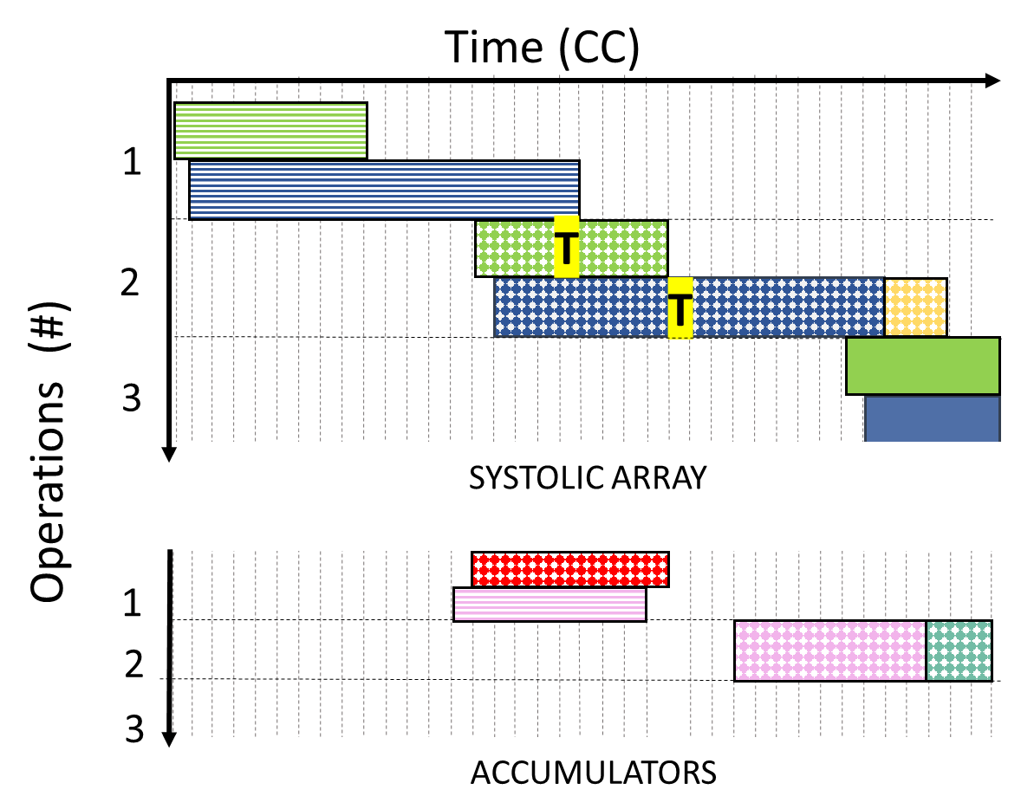
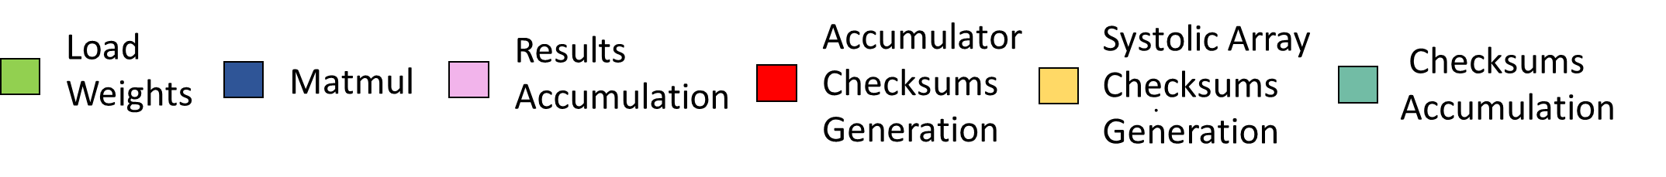
Modified Pipeline
E. Vacca
SEFUW: SpacE FPGA Users Workshop
16

Slide 17
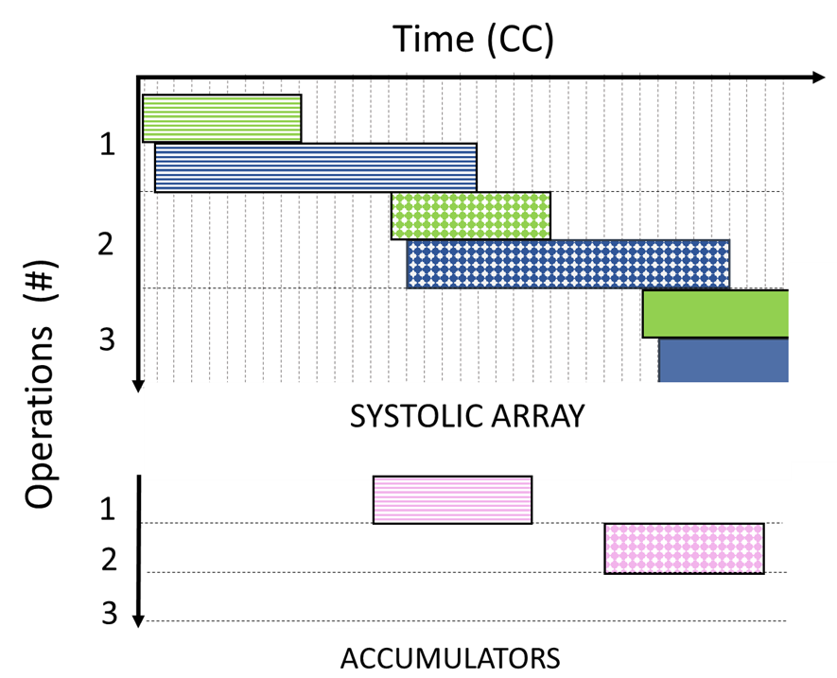
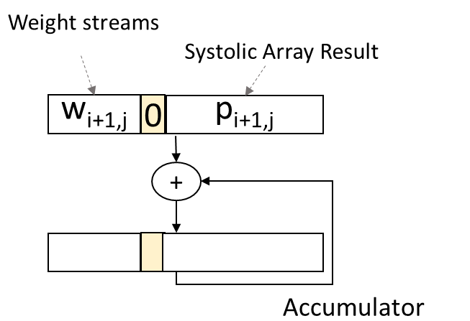
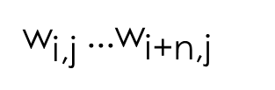
Modified Pipeline
E. Vacca
SEFUW: SpacE FPGA Users Workshop
17

Slide 18
Partial Reconfiguration Support
Partial Reconfiguration:
TPU raises an error signal mapped to RISCV GPIO.
RISCV triggers the DFX Controller to perform DPR
Recovery time in the range of tens of milliseconds, based on the TPU Size.
Allows for execution resumption from the last correct state, saved in memory.
Ensure minimal system downtime.
E. Vacca
SEFUW: SpacE FPGA Users Workshop
18

Slide 19
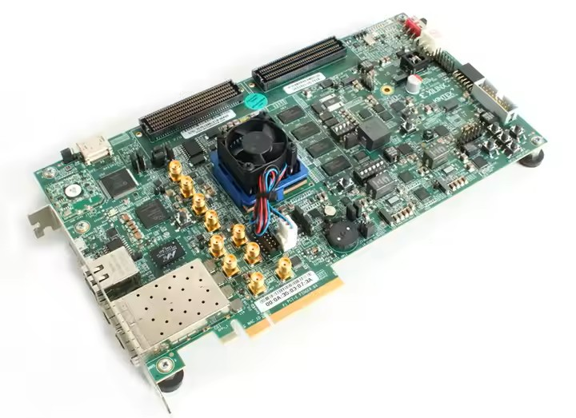
Hardware and Software Setup
Benchmarks CNNs:
CIFAR-10
MNIST
Platform Modules | LUTs | FFs | BRAMs | DSPs
TinyTPU | 4,294 | 7,211 | 181 | 210
TMR NEORV32 | 3,219 | 3,180 | 3 | 0
DPR Logic | 1,185 | 989 | 0 | 0
Glue Logic Resources | 13,874 | 17,670 | 95.5 | 3
Total [%] | 9.31% | 5.99% | 46.58% | 11.09%
KCU105 Development Board
E. Vacca
SEFUW: SpacE FPGA Users Workshop
19

Slide 20
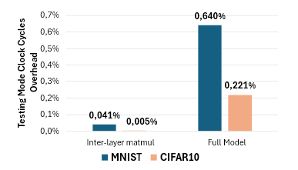
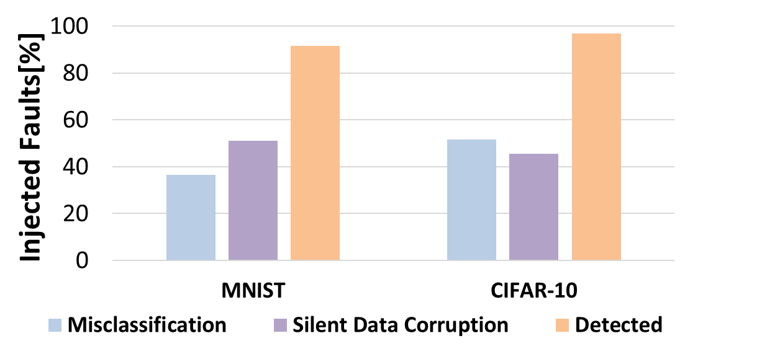
Experimental Results: Error Detection Mechanism Performances
5,000 SEU emulated through Fault Injection in CRAM, selectively targeting SA resources
  For each fault both benchmarks are executed ( to evaluate data masking effects)
The detection mechanism provided 94% of detection
  Detecting also faults masked by rounding and activation functions
The overall time overhead is limited to a maximum of 0,.64% clock cycles more in the worst-case scenario.
  The resources overhead 0.31%.
Fault injection Results
Error Detection Execution Time Overhead
E. Vacca
SEFUW: SpacE FPGA Users Workshop
20

Slide 21
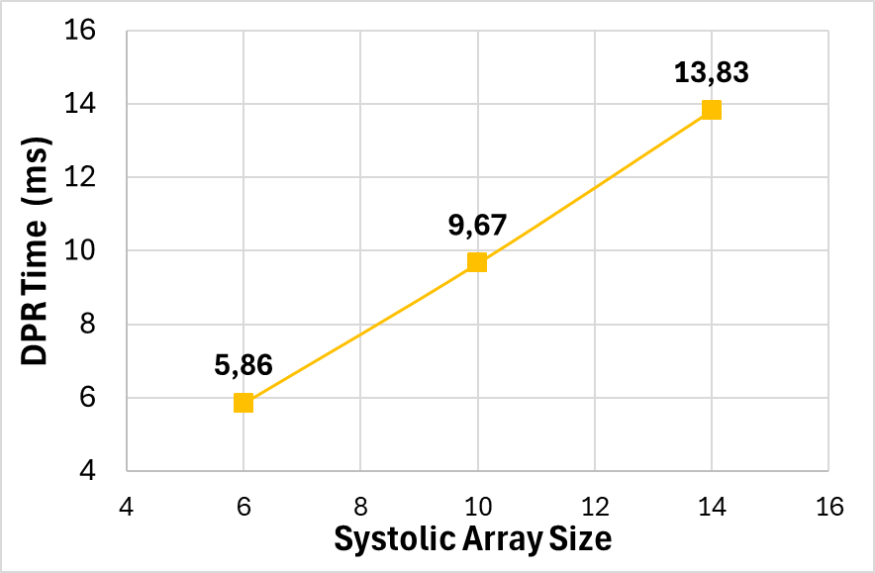
Experimental Results: Recovery Time Overhead
The DPR time scales linearly with the size of the PEs grid, from less than 6ms in the smallest case to around 14ms for the largest SA size.
tinyTPU DPR Time
E. Vacca
SEFUW: SpacE FPGA Users Workshop
21

Slide 22
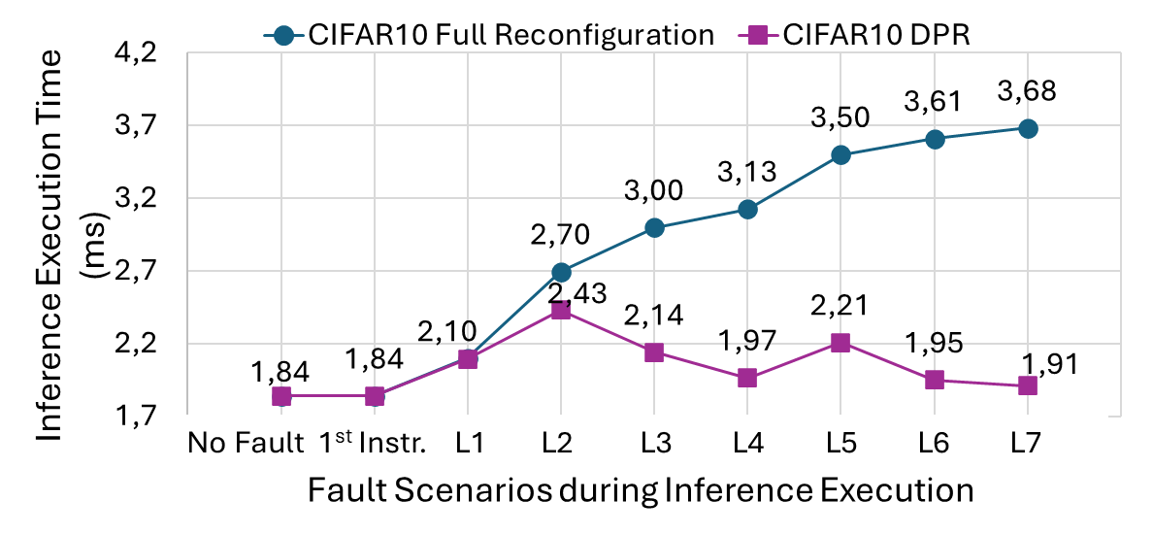
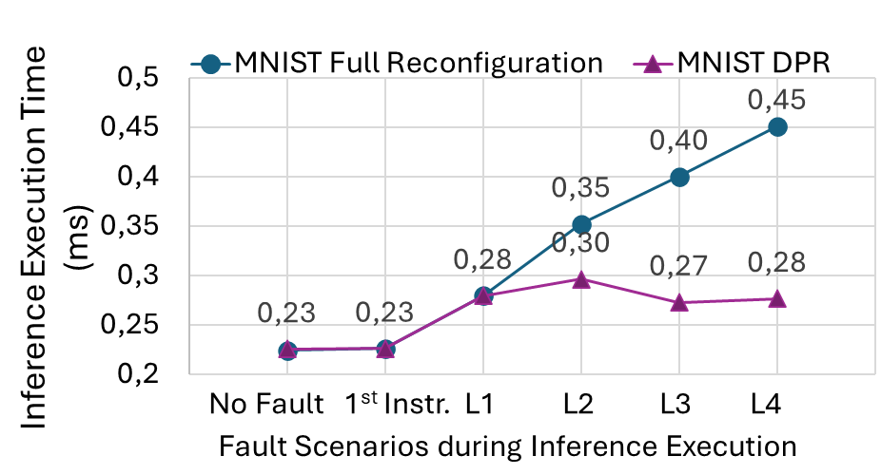
Experimental Results: Recovery Time Overhead
The overall inference execution time is reduced in the DPR case, allowing operation recover from last correctly executed operation.
tinyTPU DPR Time
E. Vacca
SEFUW: SpacE FPGA Users Workshop
22

Slide 23
Conclusions
A reliable platform for DNN execution in a safety-critical environment has been proposed.
Error detection capabilities have been implemented into a Systolic Array.
The Accelerator has been paired with the NEORV32 and Partial Reconfiguration to ensure error recovery and reduced system downtime.
A fault injection campaign took place to validate the effectiveness of the proposed error detection mechanism.
A detailed analysis of the efficiency of the proposed platform has been carried out.
E. Vacca
SEFUW: SpacE FPGA Users Workshop
23

Slide 24

Thank you for your attention!
Eleonora Vacca
Politecnico di Torino, Italy
Email: eleonora.vacca@polito.it
Link: http://asaclab.polito.it/
LinkedIn:
E. Vacca
24

