Slide 1

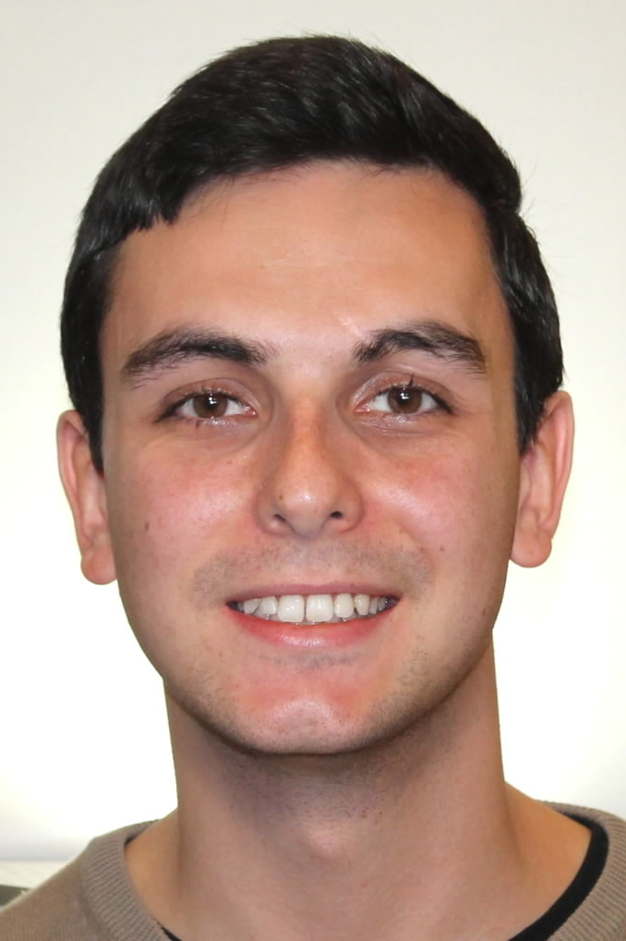
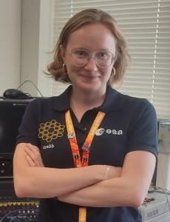
A Parameterizable CGRA-based Engine for Machine Learning Acceleration On-board Satellites
L. Zulberti, M. Monopoli, G. Mystkowska, S. Moranti, P. Nannipieri, L. Fanucci
6th SEFUW: SpacE FPGA Users Workshop
Matteo Monopoli
matteo.monopoli@phd.unipi.it
PhD Student
University of Pisa
Dept. Information Eng.
Gabriela Mystkowska
gabriela.mystkowska@phd.unipi.it
PhD Student
University of Pisa
Dept. Information Eng.

Slide 2
Parameterizable CGRA-based Engine for On-board ML
Outline
Background
  Motivation
  Hardware for AI Onboard
State-of-the-Art
CGRA-based HW Accelerator
  ESA OSIP Context
  CGR-AI Engine
  Ongoing Work
Std. Cell Synthesis & FPGA Prototype
Conclusion
SEFUW 2025
Matteo Monopoli and Gabriela Mystkowska

Slide 3
Parameterizable CGRA-based Engine for On-board ML
Outline
Background
  Motivation
  Hardware for AI Onboard
State-of-the-Art
CGRA-based HW Accelerator
  ESA OSIP Context
  CGR-AI Engine
  Ongoing Work
Std. Cell Synthesis & FPGA Prototype
Conclusion
SEFUW 2025
Matteo Monopoli and Gabriela Mystkowska

Slide 4
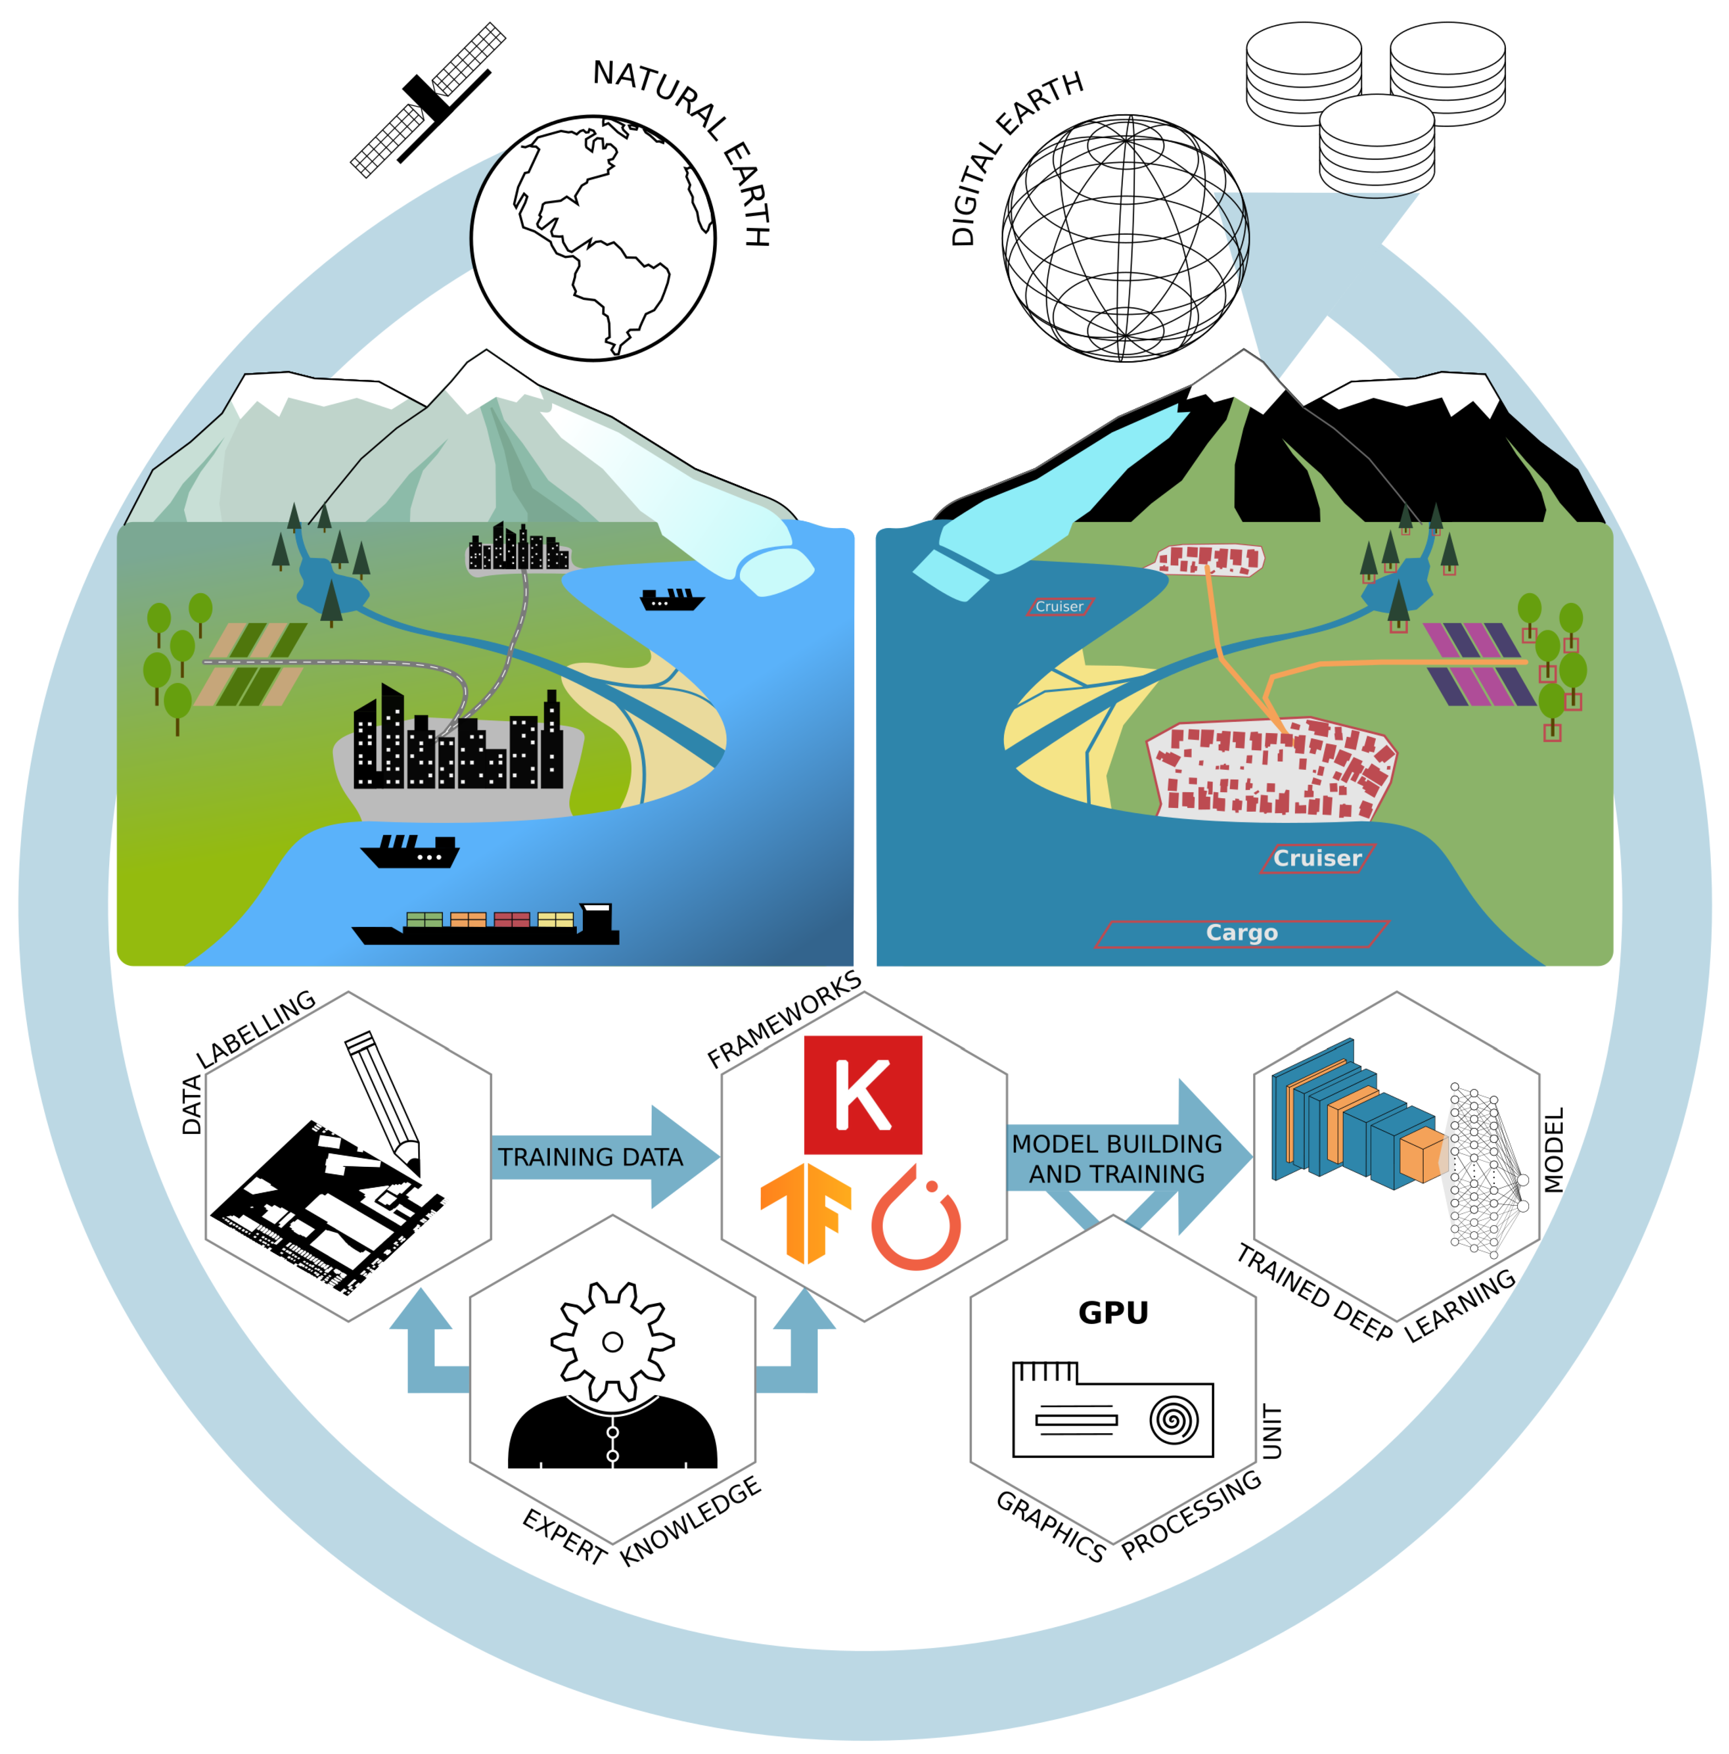
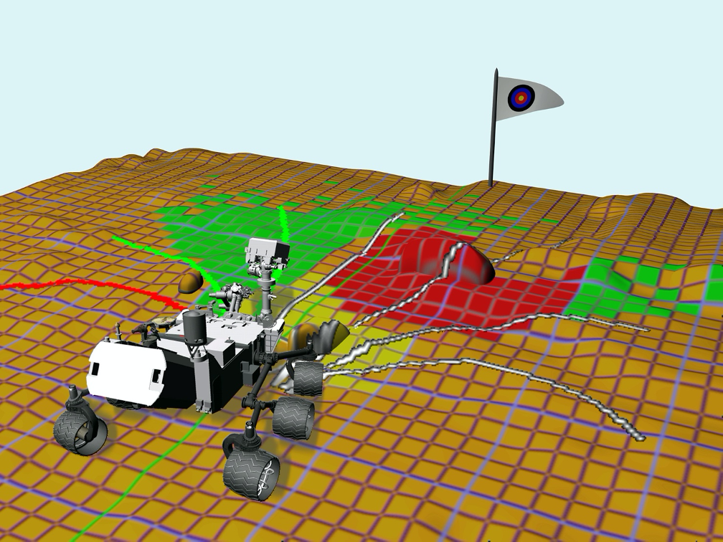
Parameterizable CGRA-based Engine for On-board ML
Background – Motivation
AI Applications in orbit:
Remote Sensing
  Object detection
  Weather forecast
  Earth observation
Autonomous spacecrafts
  Vehicle docking
  Probes
  Landers, rovers
  Deep space missions
  Fault detection and isolation, recovery
Data privacy increase
  Downlink requirements reduction
SEFUW 2025
Matteo Monopoli and Gabriela Mystkowska

Slide 5

Parameterizable CGRA-based Engine for On-board ML
Background – Hardware for AI Acceleration On-board
High Computational Efficiency
  Inference
  Real-time processing in resource-constrained environments
  Tailored for parallel processing, and NN operations
Energy efficient
Compact and Integrated Design:
  Small form factors
Customizability and Flexibility:
  Reconfigurable to meet specific AI requirements
  Adaptable to evolving AI models and algorithms without requiring new hardware
Reliability
  Must be able to withstand exposure to radiation
  Protection against Single Event Effects (SEEs) through radiation-hardening or fault mitigation
SEFUW 2025
Matteo Monopoli and Gabriela Mystkowska

Slide 6
Parameterizable CGRA-based Engine for On-board ML
Outline
Background
  Motivation
  Hardware for AI Onboard
State-of-the-Art
CGRA-based HW Accelerator
  ESA OSIP Context
  CGR-AI Engine
  Ongoing Work
Std. Cell Synthesis & FPGA Prototype
Conclusion
SEFUW 2025
Matteo Monopoli and Gabriela Mystkowska

Slide 7
Parameterizable CGRA-based Engine for On-board ML
State-of-the-Art
Architecture | Chip | Pros | Cons
GPU | NVIDIA Xavier, NVIDIA Jetson Orion, AMD Ryzen | COTS, High performance (up to 300 TOPS and 5 TOPS/W ) | Not rad-hard, only short missions, only LEO
VPU | Intel Myriad X
TPU | Google Coral
FPGA | Xilinx Zynq UltraScale+, Microchip PolarFire | Flight heritage, Rad-hard, Flexible, Reprogrammable | General purpose, Relatively high energy consumption and low performance
CPU | Gaisler GR740
Spatial Architecture | Xilinx Versal | Rad-tolerant, High performance (up to 430 TOPS) | Low interpretability (“black box”) Low predictability in time critical tasks, Relatively high power consumption (35W)
Systolic Array | HPDP | High flexibility High reconfigurability Low power consumption | Relatively old technology (STM 65 nm), Proprietary tools
NOT RAD-HARD
RAD-HARD
SEFUW 2025
Matteo Monopoli and Gabriela Mystkowska

Slide 8
Parameterizable CGRA-based Engine for On-board ML
SotA – Technology Available over the Years
TSMC 10nm vs TSMC 16nm
2x logic density
~15% faster speed
~35% less power consumption
SEFUW 2025
Matteo Monopoli and Gabriela Mystkowska

Slide 9
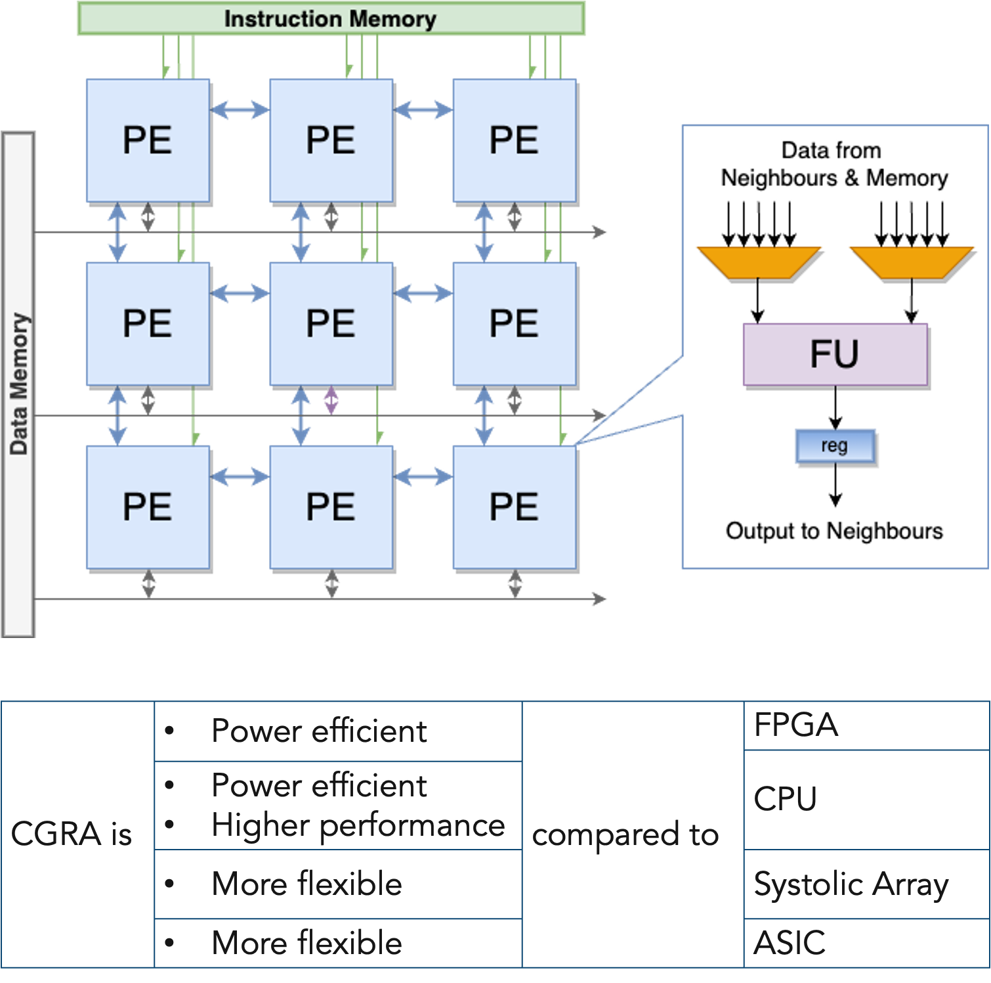
Parameterizable CGRA-based Engine for On-board ML
SotA – Resource Optimised CGRA Hardware Accelerator
2D array of PE interconnected through NoC
Speeding up compute-intensive inner loops
  Digital signal processing
  AI/ML workloads
Heterogeneous computing, high parallelism
Highly predictable (timing model)
Highly parametrized architecture
  Optimised resource utilisation
  Scalable and flexible
Low reconfiguration time
SEFUW 2025
Matteo Monopoli and Gabriela Mystkowska

Slide 10
Parameterizable CGRA-based Engine for On-board ML
Outline
Background
  Motivation
  Hardware for AI Onboard
State-of-the-Art
CGRA-based HW Accelerator
  ESA OSIP Context
  CGR-AI Engine
  Ongoing Work
Std. Cell Synthesis & FPGA Prototype
Conclusion
SEFUW 2025
Matteo Monopoli and Gabriela Mystkowska

Slide 11
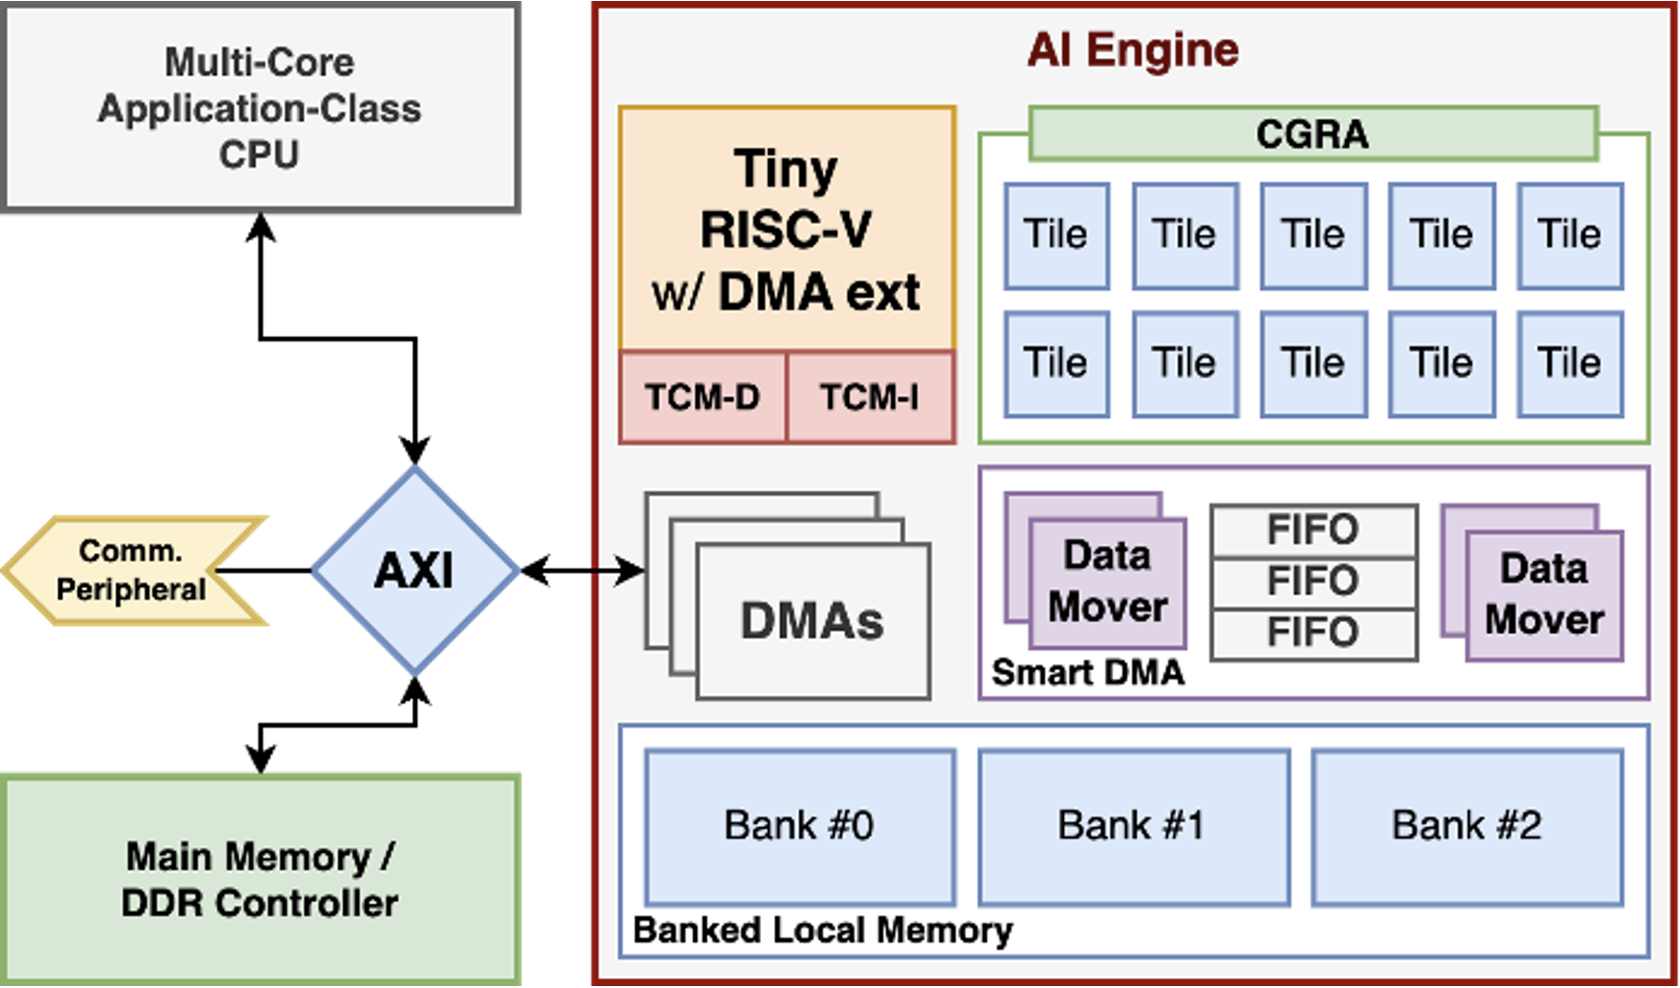


Parameterizable CGRA-based Engine for On-board ML
UniPi – CGR-AI Engine
CGRA-based accelerator for AI on-edge applications
  Time-constrained applications (e.g., autonomous operations)
  High-reliability applications
Technology:
  RHBD DARE65T std. cell
  TSMC40LP std. cell
  7 nm radiation-hardened (in progress)
Heritage of:
  Three ongoing ESA supported projects
  OPERAND project supported by Italian Ministry of Education and Research
OSIP I-2021-03237 Innovative Coarse-Grained Reconfigurable Array Platform for Computing Artificial Intelligence On-Board
OSIP I-2022-04765 Risc-V Based SoC Featuring A Soft-GPU Hardware Accelerator for Artificial Intelligence On-Board
OSIP I-2023-09415 UDSM AI-engine For Reliable, Energy-efficient Next-generation Satellites
SEFUW 2025
Matteo Monopoli and Gabriela Mystkowska

Slide 12
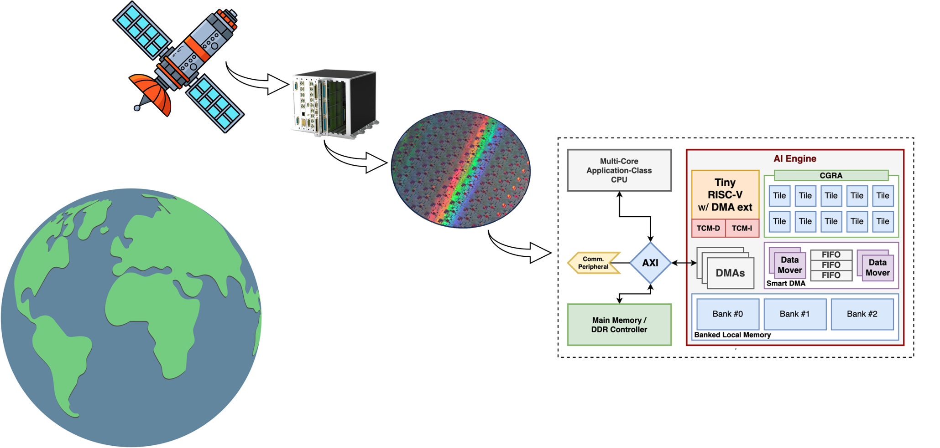
Parameterizable CGRA-based Engine for On-board ML
ESA OSIP - UDSM AI-Engine for Next-Gen. Satellites
AI Engine IP
  CGRA core
  Simplified programming environment
    CGRA configurations
    Scheduling firmware
What we have
  CGRA core
  Software-controllable SmartDMAs
  Tiny RISC-V with DMA extension for data management
What we need to carry out
  Reliability analysis
  SoC integration in UDSM 7nm
  Programming environment
  Benchmarking with multiple CNNs
SEFUW 2025
Matteo Monopoli and Gabriela Mystkowska

Slide 13
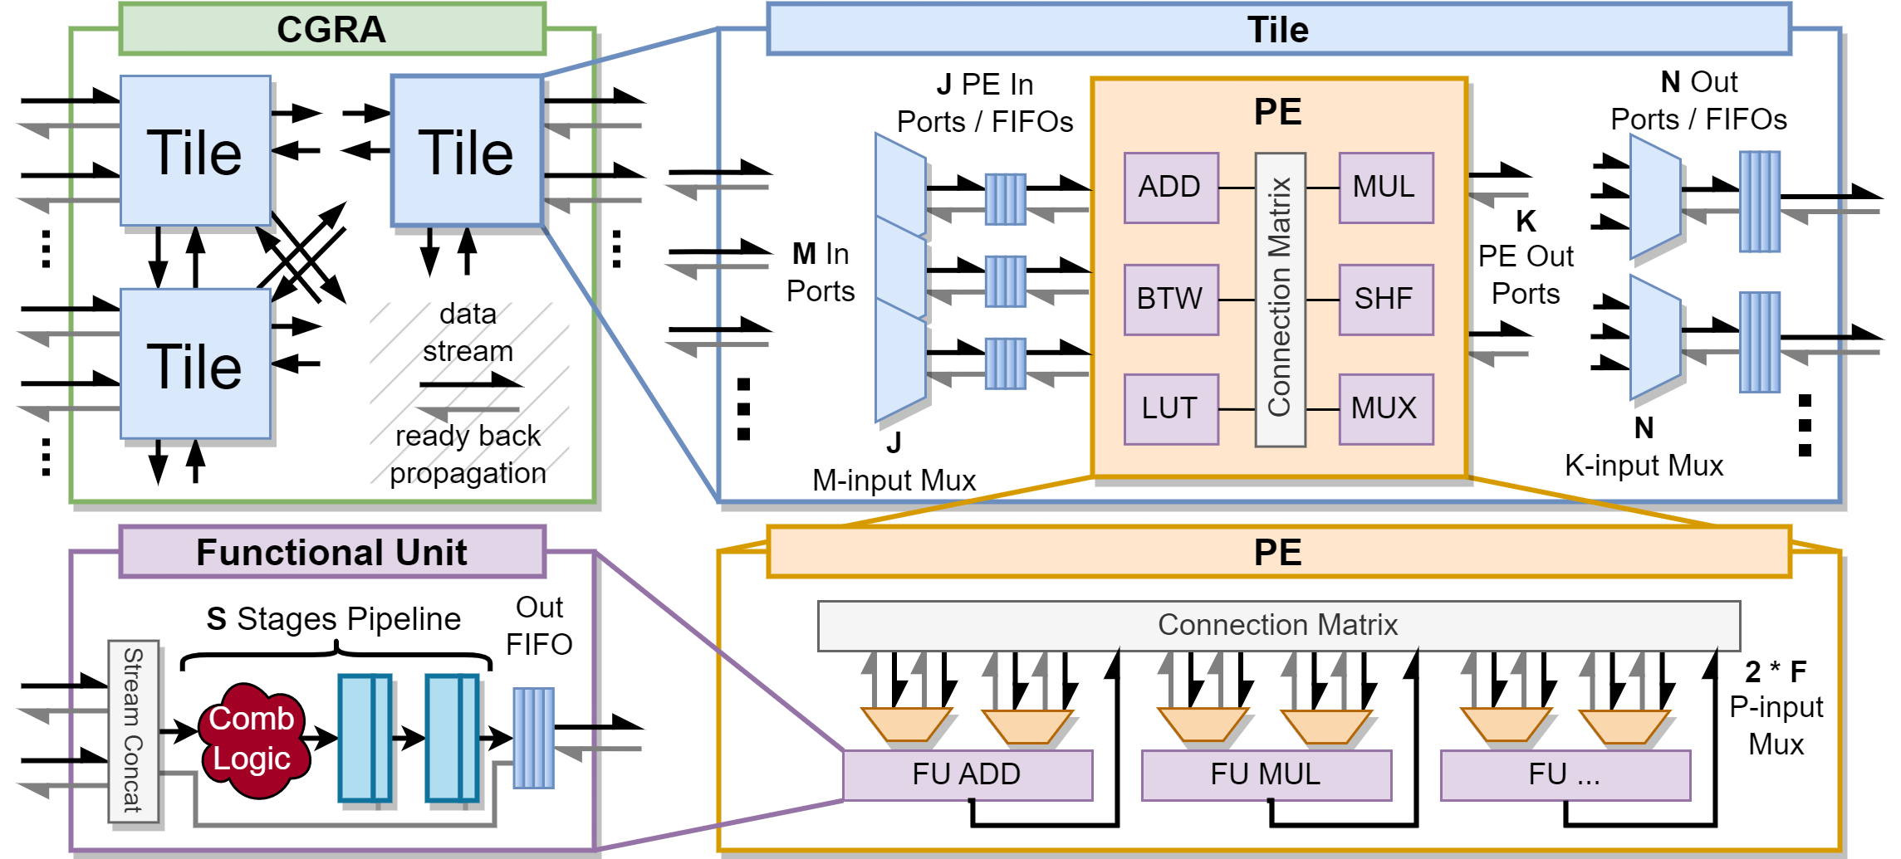
Parameterizable CGRA-based Engine for On-board ML
HW Development – CGRA Architecture
Four hierarchy levels:
  Functional Units: ADD, MUL, SHF, BTW, LUT, MUX
  Processing Elements
  Tiles
  CGRA
High parametrization and scalability
  Number of rows and columns
  Implemented FUs and connection matrix
  FIFOs depth and pipeline stages
Design optimized for ML execution
  MACC operations
  Non-linear activation functions
L. Zulberti, M. Monopoli, P. Nannipieri and L. Fanucci, “Architectural Implications for Inference of Graph Neural Networks on CGRA-based Accelerators”, doi: 10.1109/PRIME55000.2022.9816810.
L. Zulberti, M. Monopoli, P. Nannipieri, L. Fanucci and S. Moranti, “Highly Parameterised CGRA Architecture for Design Space Exploration of Machine Learning Applications Onboard Satellites”, doi: 10.23919/EDHPC59100.2023.10396632.
L. Zulberti, M. Monopoli, P. Nannipieri, S. Moranti, G. Thys and L. Fanucci, “Efficient Coarse-Grained Reconfigurable Array architecture for machine learning applications in space using DARE65T library platform”, doi: 10.1016/j.micpro.2025.105142
SEFUW 2025
Matteo Monopoli and Gabriela Mystkowska

Slide 14

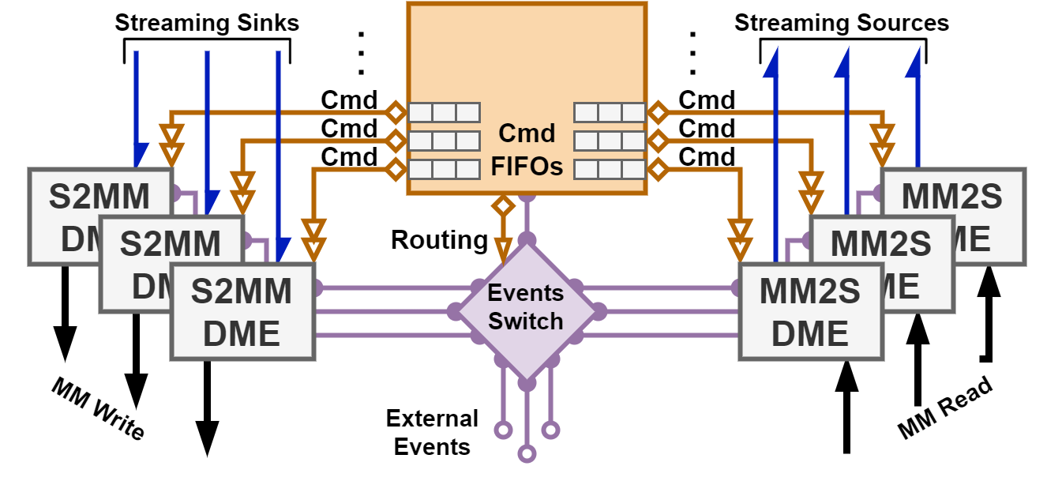
Parameterizable CGRA-based Engine for On-board ML
HW Development – SmartDMA Architecture
RISC-V CPU
  NeoRV32 CPU
  Xdma custom extension
Data Mover Engines
  Support for 2D/3D data movement
  Unaligned access
Event Switch
  Configurable DME dependencies
  Data is loaded to the CGRA after transfer to local memory is finished
Nolting, S., & All the Awesome Contributors. (2024). The NEORV32 RISC-V Processor (v1.10.2). Zenodo. doi: 10.5281/zenodo.13127811.
L. Zulberti, A. Monorchio, M. Monopoli, G. Mystkowska, P. Nannipieri and L. Fanucci, “SmartDMA: Adaptable Memory Access Controller for CGRA-based Processing Systems”, doi: 10.1109/DSD64264.2024.00048.
SEFUW 2025
Matteo Monopoli and Gabriela Mystkowska

Slide 15
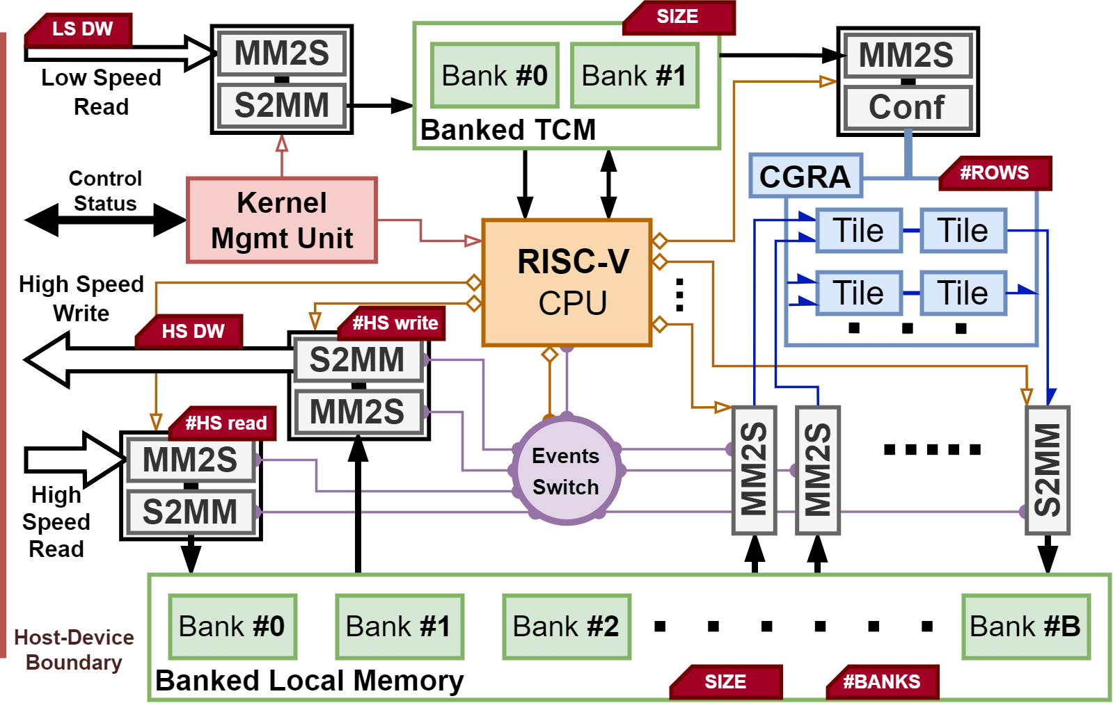
Parameterizable CGRA-based Engine for On-board ML
HW Development – CGR-AI Engine
Scalable and parametrizable architecture:
  CGRA size (rows, columns)
  Size of banked local memories (for data and firmware)
  Number of reading and writing DMEs
External host loads firmware and kernel parameters
RISC-V loads CGRA configuration from banked TCM
RISC-V executes only data movement operations to instruct DMEs
Event Switch module synchronizes high-speed DMEs communicating with the host with CGRA low-speed DMEs
SEFUW 2025
Matteo Monopoli and Gabriela Mystkowska

Slide 16
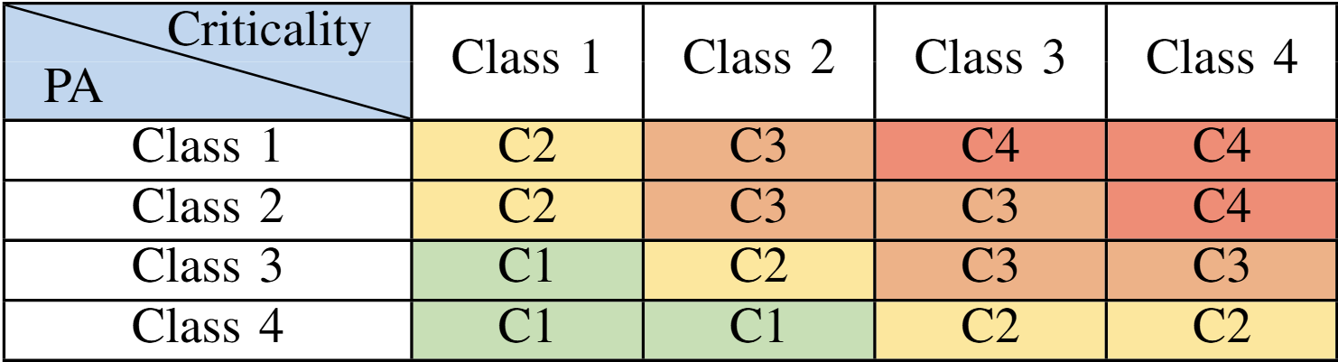
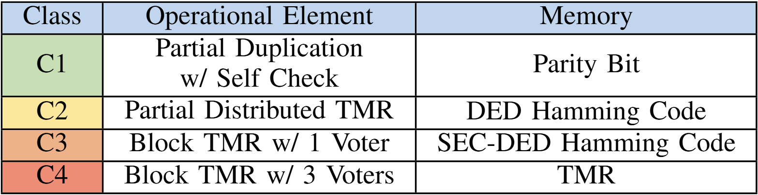
Parameterizable CGRA-based Engine for On-board ML
Ongoing Work – Reliability Enhancement Approach
Strict reliability requirements for space applications, especially when implementing on non-radiation-hardened technology
Limited area and power consumption budget
Evaluation of possible fault detection and mitigation strategies (TMR, EDAC)
  Trade-offs between PPA metrics and robustness
  Different level of granularity to consider (from register level to engine level)
Tabular-based classification approach already developed by University of Pisa as result of OSIP activity
M. Monopoli, M. Biondi, P. Nannipieri, S. Moranti, C. Bernardeschi and L. Fanucci, “Enhancing a Soft GPU IP Reliability Against SEUs in Space: Modelling Approach and Criticality Analysis on a Radiation-Tolerant FPGA”, doi: 10.36227/techrxiv.173273657.76155928/v1
SEFUW 2025
Matteo Monopoli and Gabriela Mystkowska

Slide 17
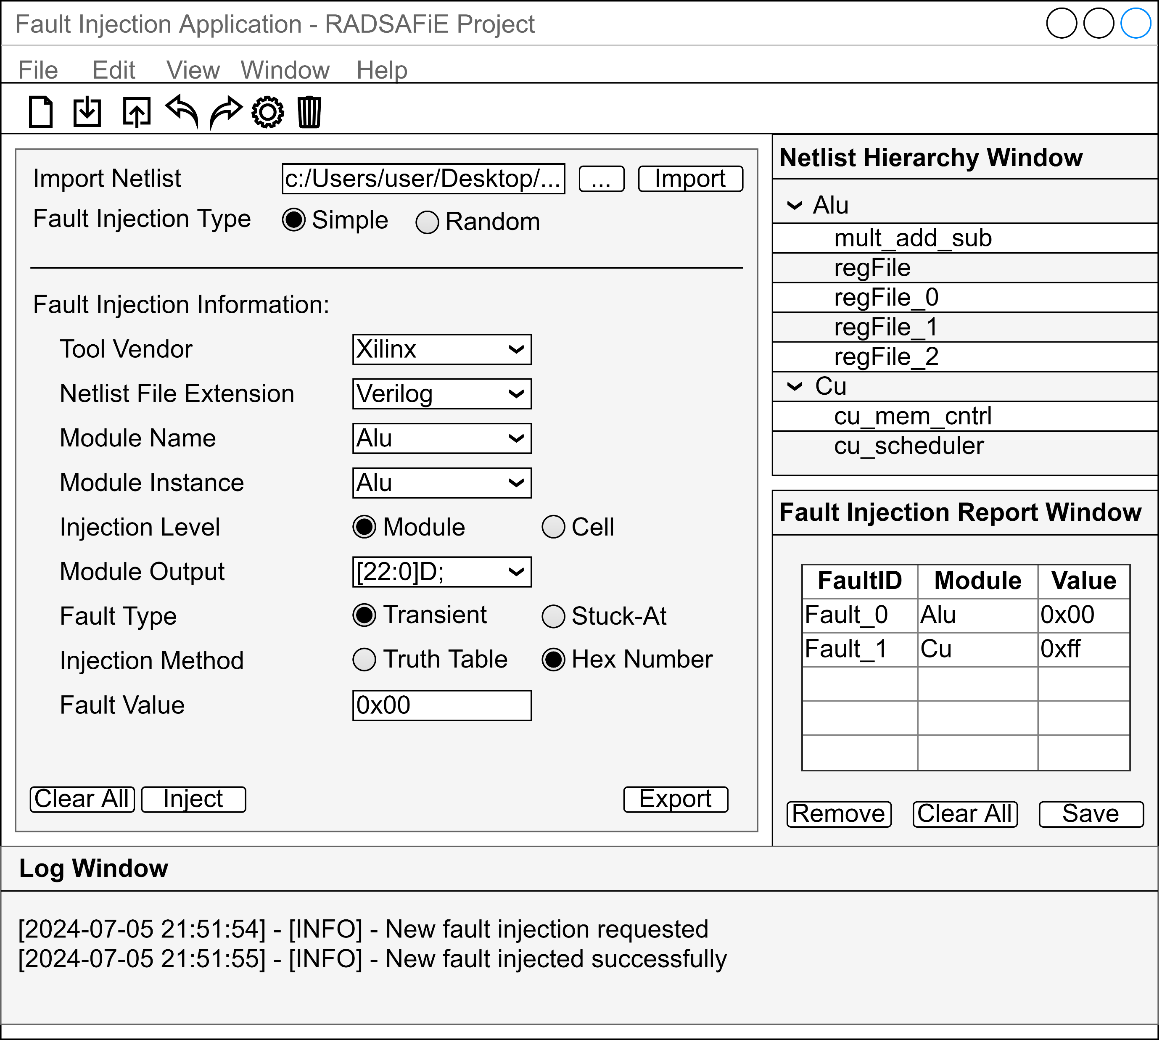
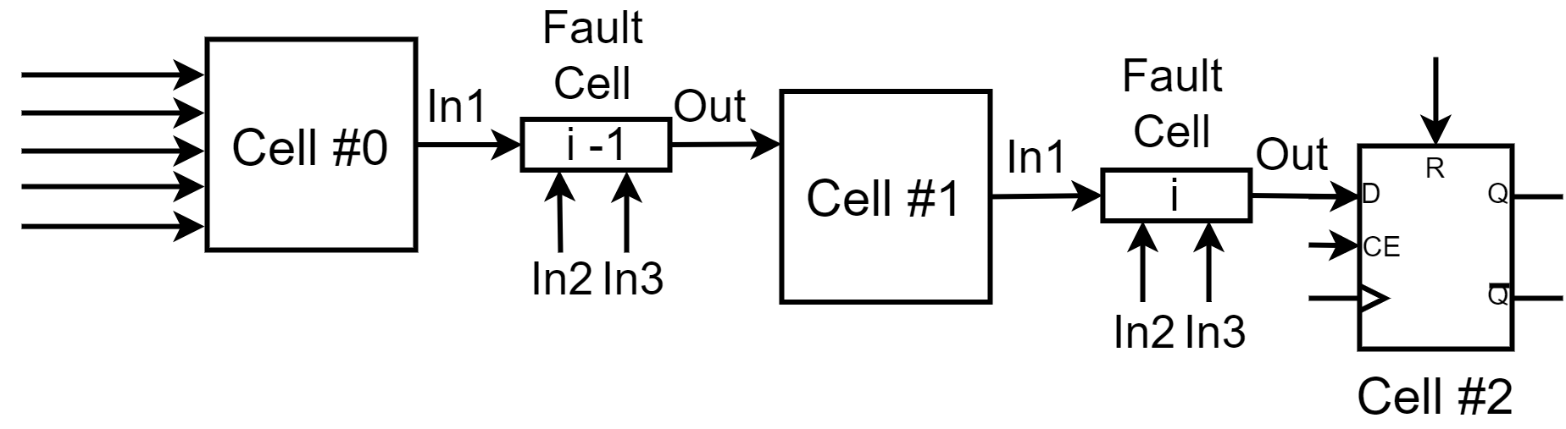
Parameterizable CGRA-based Engine for On-board ML
Ongoing Work – Reliability Validation Approach
Use of GUI fault injection application developed internally
Netlist-based approach to emulate different types of fault on the FPGA implemented netlist
  Stuck-at
  Transient
Addition of LUT-based fault injection cells
Integration in a SystemVerilog simulation environment
M. Monopoli, M. Biondi, P. Nannipieri, S. Moranti and L. Fanucci, “RADSAFiE: A Netlist-Level Fault Injection User Interface Application for FPGA-Based Digital Systems”, doi: 10.1109/ACCESS.2025.3539932
SEFUW 2025
Matteo Monopoli and Gabriela Mystkowska

Slide 18
Parameterizable CGRA-based Engine for On-board ML
Outline
Background
  Motivation
  Hardware for AI Onboard
State-of-the-Art
CGRA-based HW Accelerator
  ESA OSIP Context
  CGR-AI Engine
  Ongoing work
Std. Cell Synthesis & FPGA Prototype
Conclusion
SEFUW 2025
Matteo Monopoli and Gabriela Mystkowska

Slide 19
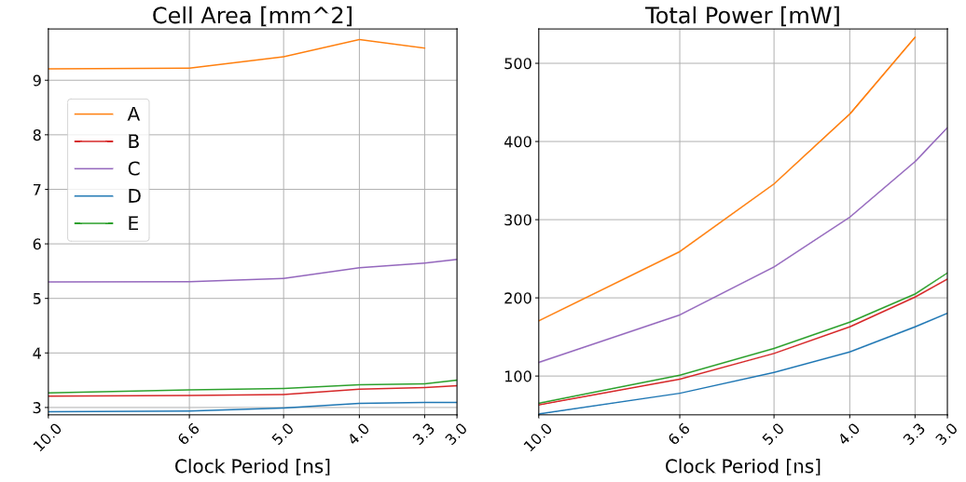
Parameterizable CGRA-based Engine for On-board ML
CGR-AI on DARE65T RHBD Library Platform
Optimized for std. cell implementation
Synthesized on the 65nm RHBD DARE library platform
Performed DSE activity with different:
  Data width
  CGRA rows
  Local memory size
  High-speed ports
Tested against classic CNN kernels (e.g., conv2D, ReLU)
Collected area and power consumption data across increasing clock frequencies
  Great scalability
  Less than 0.5 W @ 300 MHz on average
Config | Element Size | Vector Size | Rows | Memory (kB) | HS Ports
A | 8-bit | 32-bit | 8 | 512 | 2R/2W
B | 8-bit | 64-bit | 3 | 64 | 1R/1W
C | 8-bit | 64-bit | 6 | 256 | 2R/2W
D | 8-bit | 128-bit | 1 | 64 | 1R/1W
E | 16-bit | 64-bit | 3 | 64 | 1R/1W
SEFUW 2025
Matteo Monopoli and Gabriela Mystkowska

Slide 20
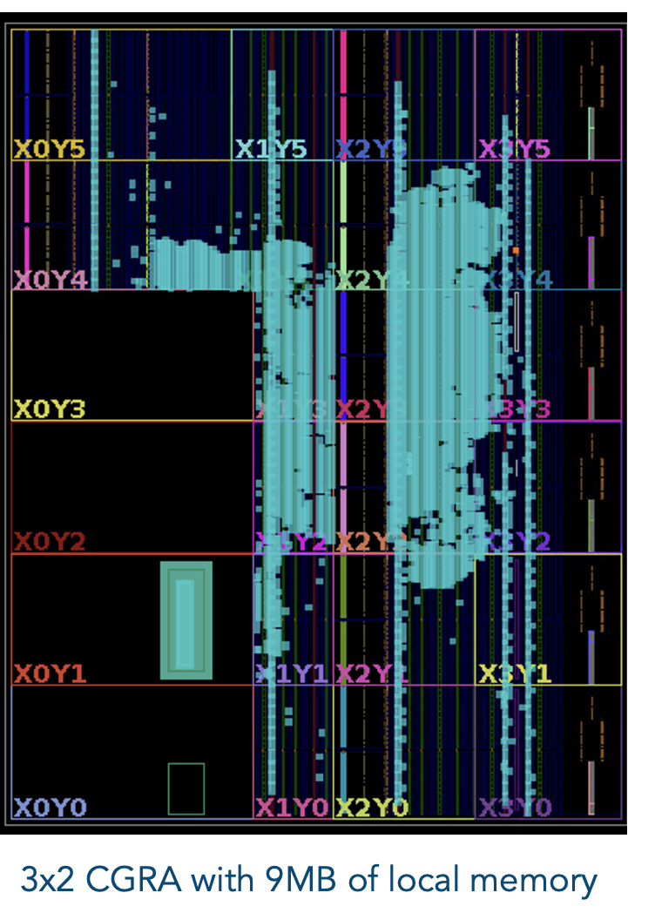
Parameterizable CGRA-based Engine for On-board ML
CGR-AI on Xilinx Zynq Ultrascale+ MPSoC
System functionality confirmed in simulation
FPGA overlay as intermediate milestone to demonstrate the readiness of the system
Scale up directly based on the numbers obtained through std. cell synthesis
Xilinx Zynq Ultrascale+ ZCU104 MPSoC
  PS ARM core as external host
  600 MHz maximum operating frequency for the CGR-AI Engine
  Contained resource utilization and power consumption, can still be optimized for FPGA implementation
IP approach used for ease of portability
SEFUW 2025
Matteo Monopoli and Gabriela Mystkowska

Slide 21
Parameterizable CGRA-based Engine for On-board ML
Outline
Background
  Motivation
  Hardware for AI Onboard
State-of-the-Art
CGRA-based HW Accelerator
  ESA OSIP Context
  CGR-AI Engine
  Ongoing work
Std. Cell Synthesis & FPGA Prototype
Conclusion
SEFUW 2025
Matteo Monopoli and Gabriela Mystkowska

Slide 22






A Parameterizable CGRA-based Engine for
Machine Learning Acceleration On-board Satellites
Matteo Monopoli and Gabriela Mystkowska
matteo.monopoli@phd.unipi.it, gabriela.mystkowska@phd.unipi.it
CGRA-core for calculation acceleration
  Heterogeneous computing
  Scalable and flexible
  Low reconfiguration time
Developed systematic approach to increase reliability and fault injection application to validate results
CGR-AI Engine synthesized on DARE65T RHBD
FPGA overlay as intermediate milestone to demonstrate the readiness of the system
This study received funding from the European Union - Next-GenerationEU - National Recovery and Resilience Plan (NRRP) – MISSION 4 COMPONENT 2, INVESTMENT N. 1.1, CALL PRIN 2022 PNRR D.D. 1409 14-09-2022 – (OPERAND - a recOnfigurable Platform & framEwork foR Ai infereNce on the eDge) CUP N.I53D23006070001, from the Italian Ministry of Education and Research (MUR) within the framework of the FoReLab project (Departments of Excellence), from the European Space Agency (ESA) within the framework of the Open Space Innovation Platform (OSIP) co-funded research under the ESA contract n. 4000144254 and from the Space It Up project funded by the Italian Space Agency (ASI) and the Ministry of University and Research (MUR) under contract n. 2024-5-E.0 - CUP n. I53D24000060005.

