Slide 1
ResNet50-based testbench development for the SEE evaluation of the AMD Versal SoC AIEngines
S. Achaq^{1,2}, V. Pouget², L. Artola¹, J. Boch²
1, ONERA, Toulouse, France. 2, IES, Univ. Montpellier, CNRS, Montpellier, France.

Slide 2
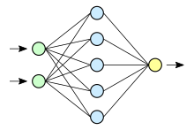
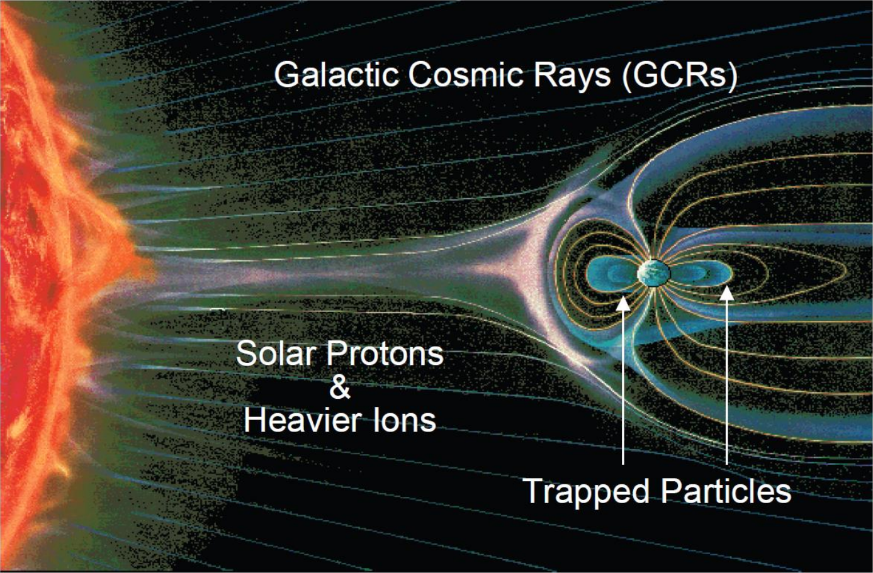
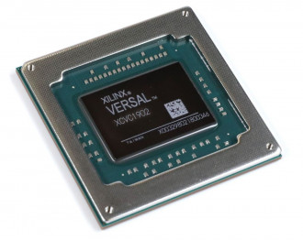
Context & motivation
Technological context
Space Radiation Environment
The rapid rise of embedded artificial intelligence (AI) systems
Artificial Neural Networks (ANNs)
New generation of System-on-Chips (SoCs) for edge-AI
AMD-Xilinx Versal: Programmable SoC including AI-accelerator cores
7nm FinFET technology
Radiation-induced Single event effects
(SEE)
SEU, MCU, SEFI
Reliability ?
Evolution of embedded systems computation capabilities
Autonomous decision, on-board data processing…
Are AI based embedded systems reliable in space radiation environments ?

Slide 3
Context & motivation
SEE test of an embedded-AI application on the AMD-Xilinx Versal AICore series 7nm FinFET SoC:
ResNet50 convolutional Neural network (CNN) as a case study
Laser testing of adaptive intelligence engines (AIEs)
Investigate the sensitivity of AIE resources running a CNN
Study the impact of SEE in a CNN hardware accelerator

Slide 4
Outline
Target device
AIEngine resources
ResNet50 CNN
Principles
Implementation in Versal
Test challenges
Test methodology
Summary

Slide 5
Target device
Versal AI-Core System-on-Chip
7nm FinFET technology
Complex monolithic SoC, embedding:
Multiple processing cores (PS)
Configurable FPGA-like logic (PL)
Network-on-Chip (NoC)
AI dedicated engines: array of 400 cores, each with local dedicated memory
GMIO interface to NoC/DDR
AMD Xilinx Versal AICore SoC
Scalar Engines
Application processing unit (APU)
Dual-core
Arm Cortex-A72
Real-Time Processing unit (RPU)
Dual-Core
Arm
Cortex-R5F
Programmable logic
(PL)
AI Engines
Platform management Controller (PMC)
Programmable Network on Chip (NoC)
Notes:
Nm processThe device under cores suited for intensive computations

Slide 6
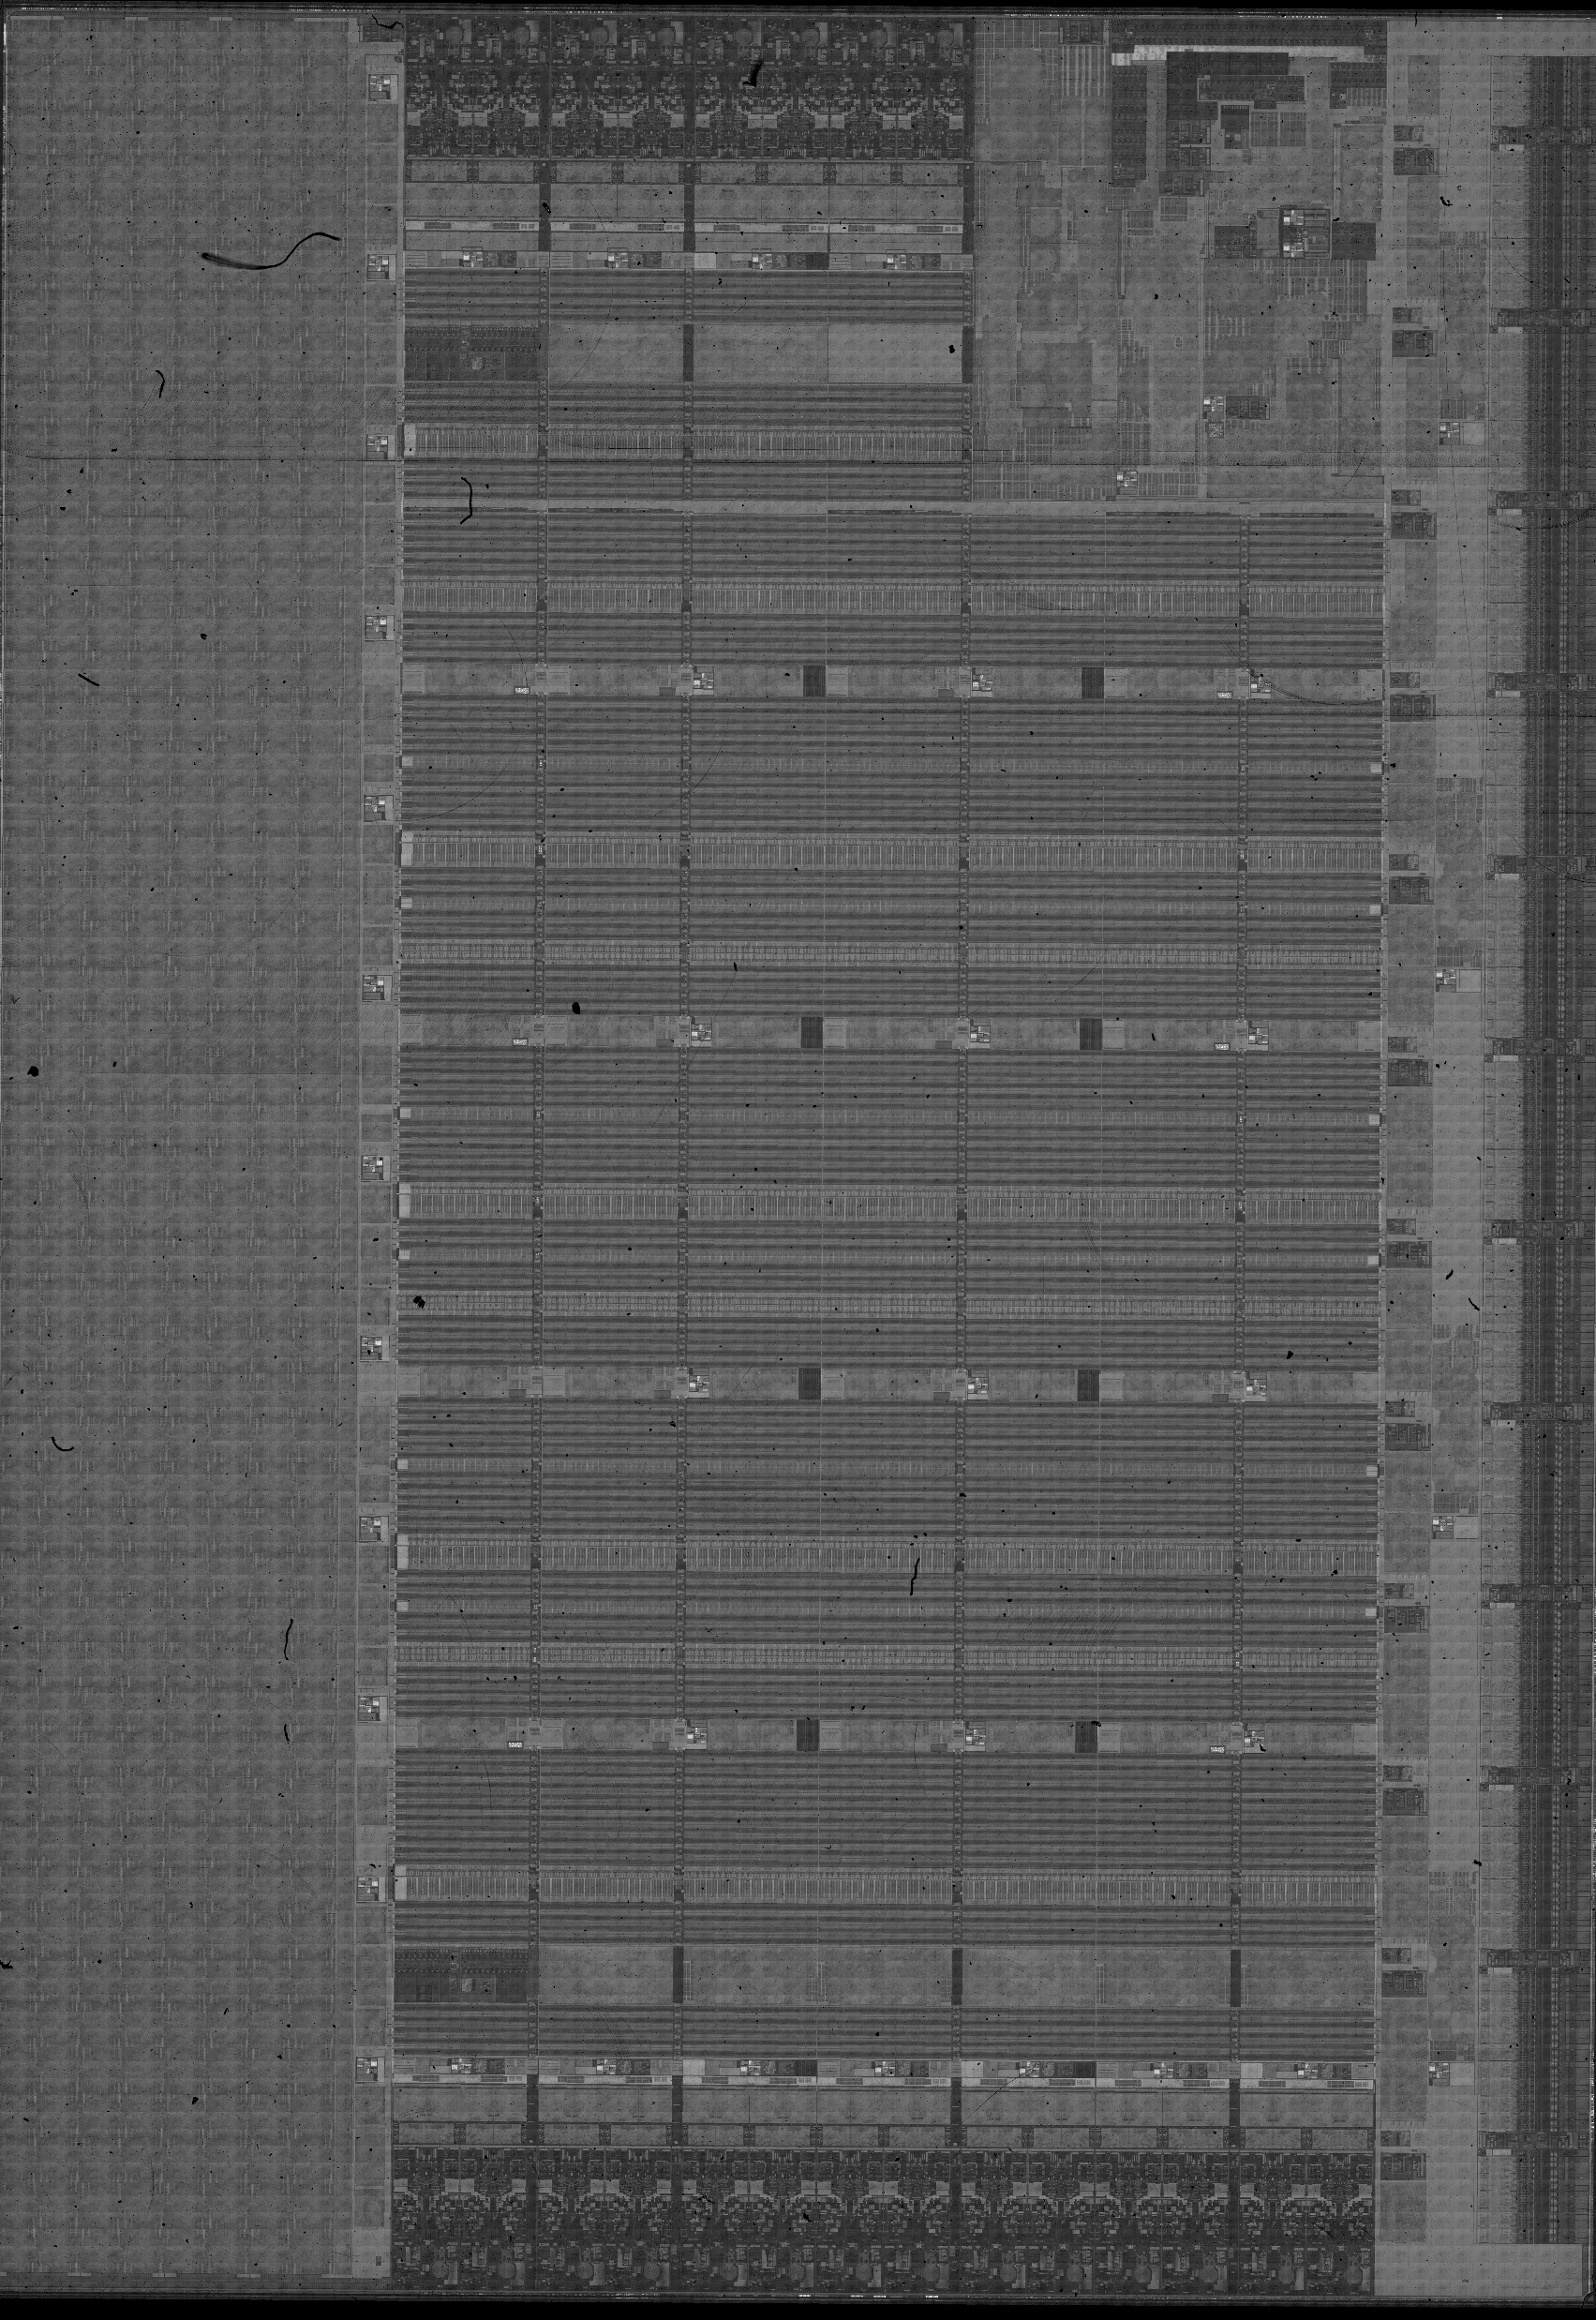
Target device
Versal AI-Core System-on-Chip
7nm FinFET technology
Complex monolithic SoC, embedding:
Multiple processing cores (PS)
Configurable FPGA-like logic (PL)
Network-on-Chip (NoC)
AI dedicated engines: array of 400 cores, each with local dedicated memory
GMIO interface to NoC/DDR
25.4mm
PL
AIEngines
17.7mm
PS

Slide 7
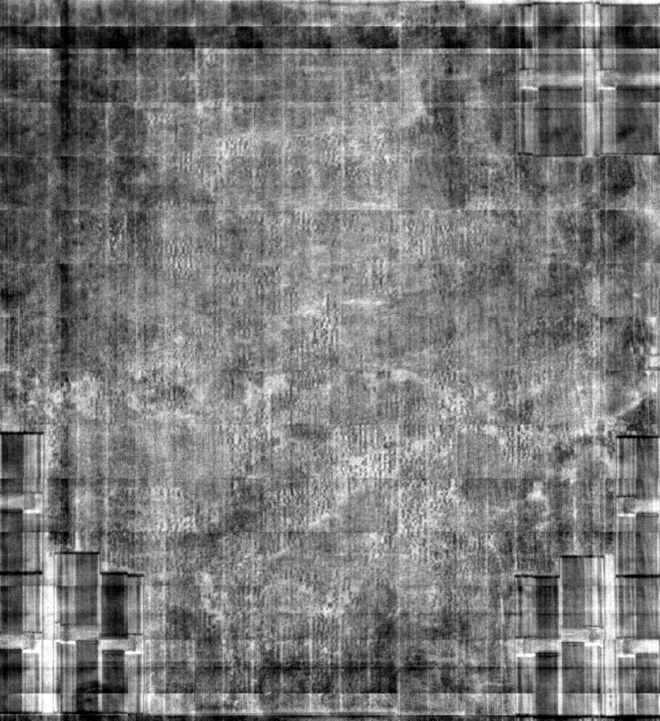
Target device
Versal AI-Core System-on-Chip
7nm FinFET technology
Complex monolithic SoC, embedding:
Multiple processing cores (PS)
Configurable FPGA-like logic (PL)
Network-on-Chip (NoC)
AI dedicated engines: array of 400 cores, each with local dedicated memory
GMIO interface to NoC/DDR
Ultra-RAM
PL
AIEngines
AI Engine tile
PS

Slide 8
AIEngine resources
Hardware architecture of an AIEngine
Memory blocks in the manufacturer tool
North
AI Engine Tile
Memory interface
Instruction memory
AXI4 interconnects
Memory Bank 0 - 8KB
Memory Bank 2 - 8KB
Memory Bank 1 - 8KB
Memory Bank 3 - 8KB
Memory module
AI Engine core
VLIW processor
Instruction memory - 16KB
West
8 Memory banks
4KB
4KB
4KB
4KB
4KB
4KB
4KB
4KB
Scalar unit
East
Vector unit
DMA
Program Memory
16KB
Bank 3
Control
DMA
502μm
Switch
Bank 1
South
AI Engine Tile:
AI Engine core
VLIW processor
16 KB program memory
Integrated data memory
32 KB local memory
8 memory banks
Interfaces
Memory interface
AXI4 stream interface
Bank 0 (ECC)
Bank 2
465μm

Slide 9
ResNet50 CNN - Principles
Each stage contains between 1 and 6 residual blocks.
Residual block input
Key features of ResNet50 Convolution Neural Network (CNN):
Designed to efficiently train very deep models using residual connections
Strong performance in image classification tasks
Based on convolution operations
Architecture overview:
Consists of 4 stages
Each stage contains between 3 and 6 residual blocks
Each residual block consists of convolutions and a skip connection
8.78 10⁶ 2D-convolution operations
CONV
Batch_norm
Batch_norm
RELU
CONV
Batch_norm
CONV
Batch_norm
RELU
Batch_norm
Residual block
CONV
Batch_norm
RELU
Residual connections
RELU
Residual block output
Stage 1
Stage 2
Stage 3
Stage 4

Slide 10
Embedded ResNet50 - Implementation in Versal
Our objectives:
Testability, observability and AIE workload modularity
Not performance!
Design choices
Bare-metal code running on PS
Using float32 data
Weights : 80 MB
Mostly software-based bench
No use of PL (no proprietary IP)
Acceleration of the most computation intensive operations
ResNet50 convolutions layers and additions delegated to AIEngines
Data segmentation and parallelizing of operations in an AIEngine graph with multiple identical branches
Embedded ResNet50 application
PS
Running ResNet50
Delegating Conv operations to AIEs
AIEs
Conv + add operations

Slide 11
Embedded ResNet50 - Implementation in Versal
AIEs hardware configuration:
Custom AIE graph architecture
One branch of the AIE Graph
Data dispatch AIEs
Conv AIEs
Addition AIEs
22 AIEs used
Data flow
D
D
A
A
GMIO OUT
GMIO IN
D
A
1
C
2
1
2
4
4
8

Slide 12
Embedded ResNet50 - Implementation in Versal
Customizable AIEs occupancy
Up to 16 branches can be implemented, using 352 AIEs out of the 400 available
GMIO IN
D
A
GMIO OUT
GMIO IN
D
A
GMIO OUT
GMIO IN
D
A
GMIO OUT
GMIO IN
D
A
GMIO OUT
GMIO IN
D
A
GMIO OUT
GMIO IN
D
A
GMIO OUT
GMIO IN
D
A
GMIO OUT
GMIO IN
D
A
GMIO OUT
GMIO IN
D
A
GMIO OUT
GMIO IN
D
A
GMIO OUT
GMIO IN
D
A
GMIO OUT
GMIO IN
D
A
GMIO OUT
GMIO IN
D
A
GMIO OUT
GMIO IN
D
A
GMIO OUT
GMIO IN
D
A
GMIO OUT

Slide 13
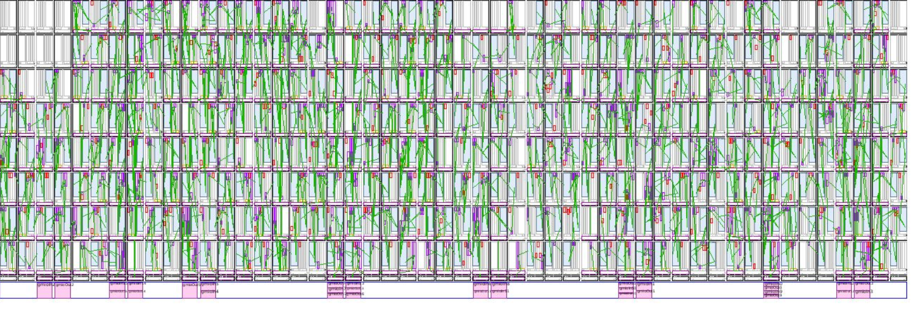
Embedded ResNet50 - Implementation in Versal
Customizable AIEs occupancy
Up to 16 branches can be implemented, using 352 AIEs out of the 400 available

Slide 14
Embedded ResNet50 - Implementation in Versal
AIEs software configuration
Each used AIE executes a C++ kernel
Dispatch kernel
Dispatch input data including header of parameters needed by conv+add operations
Convolution kernel
Read convolution loop parameters from the header
Calculate convolutions on data
Addition kernels
Calculate post-convolution additions
D
C
A

Slide 15
Embedded ResNet50 - Software application overview
ResNet50 application
Network construction
Weights & bias loading
Input images loading
Convolution layer operations
Delegation to AIEs
AIE graph execution
x N data segments
Input data transfer
Output data transfer
x N layers
Executed by one of the PS APU cores
Batch normalization
Activation functions
Pooling functions
Fully connected layer calculations
CLASSIFICATION RESULT

Slide 16
Embedded ResNet50 - Software bench overview
Test bench:
Self test approach
ResNet50 application is executed
Outputs gold data is generated during the first execution
Saved to the SD card
Outputs are verified at:
Layer level
Classification results level
bench
ResNet50 application
First test iteration?
Yes
Outputs gold data generation
No
X N test iterations
Intermediary outputs verification
Send error reports
Classification outputs verification
Send error reports

Slide 17
Embedded ResNet50 - Software bench overview
The main test-loop is executed by one of the CortexA72 cores In the PS APU
One CortexR5 core is in charge of reporting AIE errors
The other CortexR5 core collects the error reports generated by the XilSEM
All status and error reports are transmitted to the test computer by a TCP/IP stack running on one of the CortexA72 cores.
The AIE graph is executed by AIEngines array
A python script to:
Initialize the DUT configuration through JTAG
Log DUT reports
Detect high current events, freezes and communication losses
VCK190 Development board
AMD Xilinx Versal AI Core
PS
AI Engines
CortexA72-0
Ethernet communications
AIE graph
CortexA72-1
ResNet50 application
PL
CortexR5-0
XilSEM reports
DUT test script (python)
DUT config
CortexR5-1
Data logging
AIE reports
Watchdogs
Power supply current
SysMon
Communication flow

Slide 18
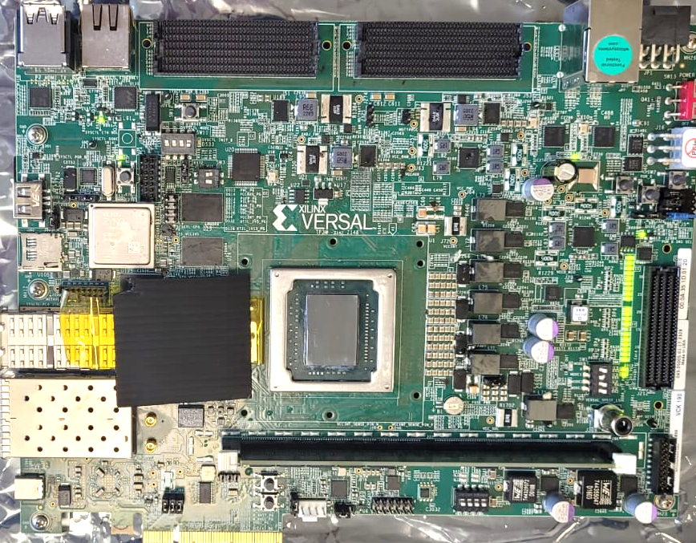
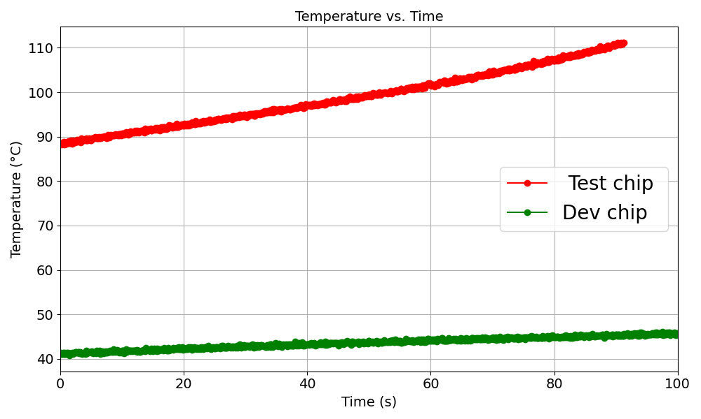
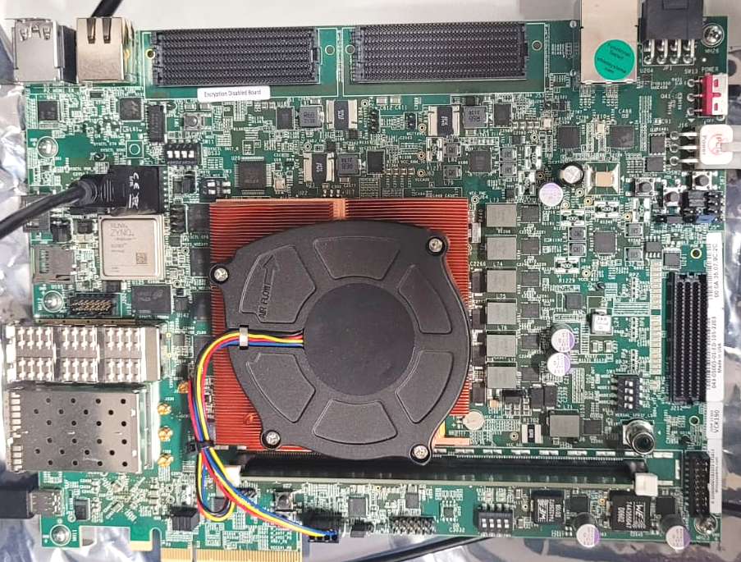
Embedded ResNet50 – Test challenges
Test Board
Sample backside preparation:
Heatsink removed
Substrate backside polished
Substrate thickness: 690 µm
Dissipation of DUT self-heating during test operations using:
A constant air flow at ambient T°
Thermal runaway
Dev Board

Slide 19
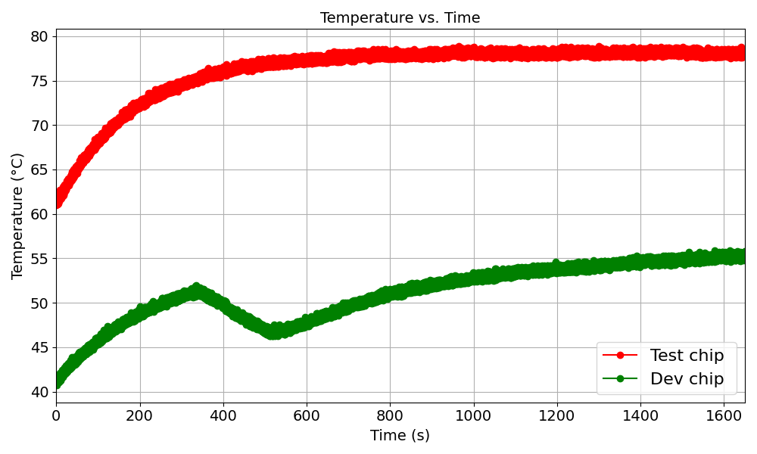
Embedded ResNet50 – Test challenges
Implemented Solution:
Custom heatsink adapted for AIEs laser test
Opening on AIEs
Temperature stabilized at 80 °C
No thermal runaway during test
Test board with custom heatsink

Slide 20
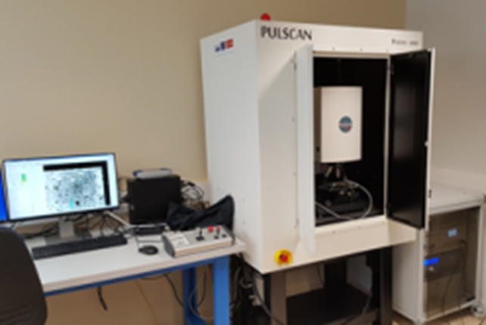
Embedded ResNet50 – Test methodology
Laser tests performed at IES
Single-Photon Absorption (SPA)
Through the substrate backside
The implemented graph consists of 176 AIEs
8 branches
Laser parameters:
wavelength: 1064nm (SPA)
pulse duration: 30ps
spot size (φ 1/e²): 1.1µm
Test script (python)
DUT test
Events reporting & scan control
PULSWORKS (laser scanning software)
Events mapping
Scan execution
Board Power Supply
VCK190 Development board
AMD Xilinx Versal AI Core
Device under test

Slide 21
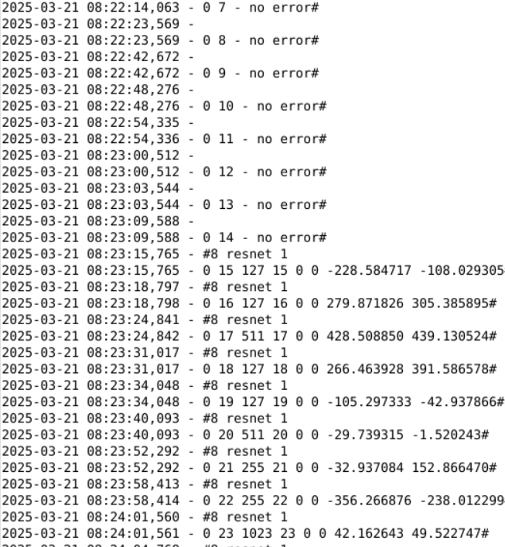
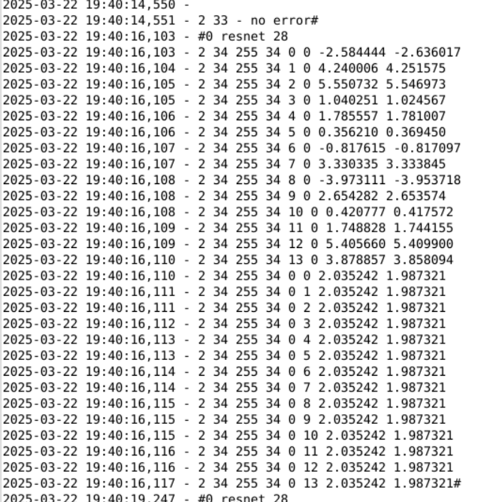
Embedded ResNet50 – First logs
Logs examples:
Intermediary errors logs
Classification errors logs

Slide 22
Summary
Versal implementation methodology of a SEE test-oriented embedded ResNet50 application is detailed
ResNet50 application integration in a ResNet50 test bench is presented
Delegation of operations to AIEs
Bench modularity
Laser tests in progress:
Testbench validated experimentally for laser testing
First convolution and classification errors observed
More results to be submitted to RADECS

