Slide 1

WELCOME TO 6th SEFUW – SpacE FPGAs Users Workshop
David Merodio Codinachs, David Dangla, Filomena Decuzzi
Silvia Moranti, Lucana Santos,, Alberto Urbon
ESA ESTEC – 25th, 26th and 27th March 2025

Slide 2
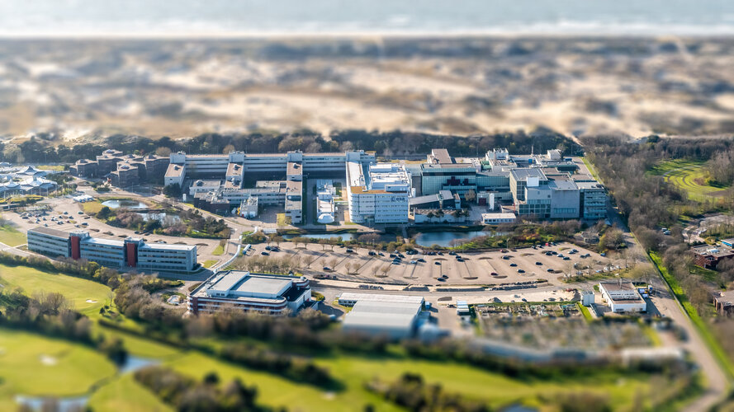
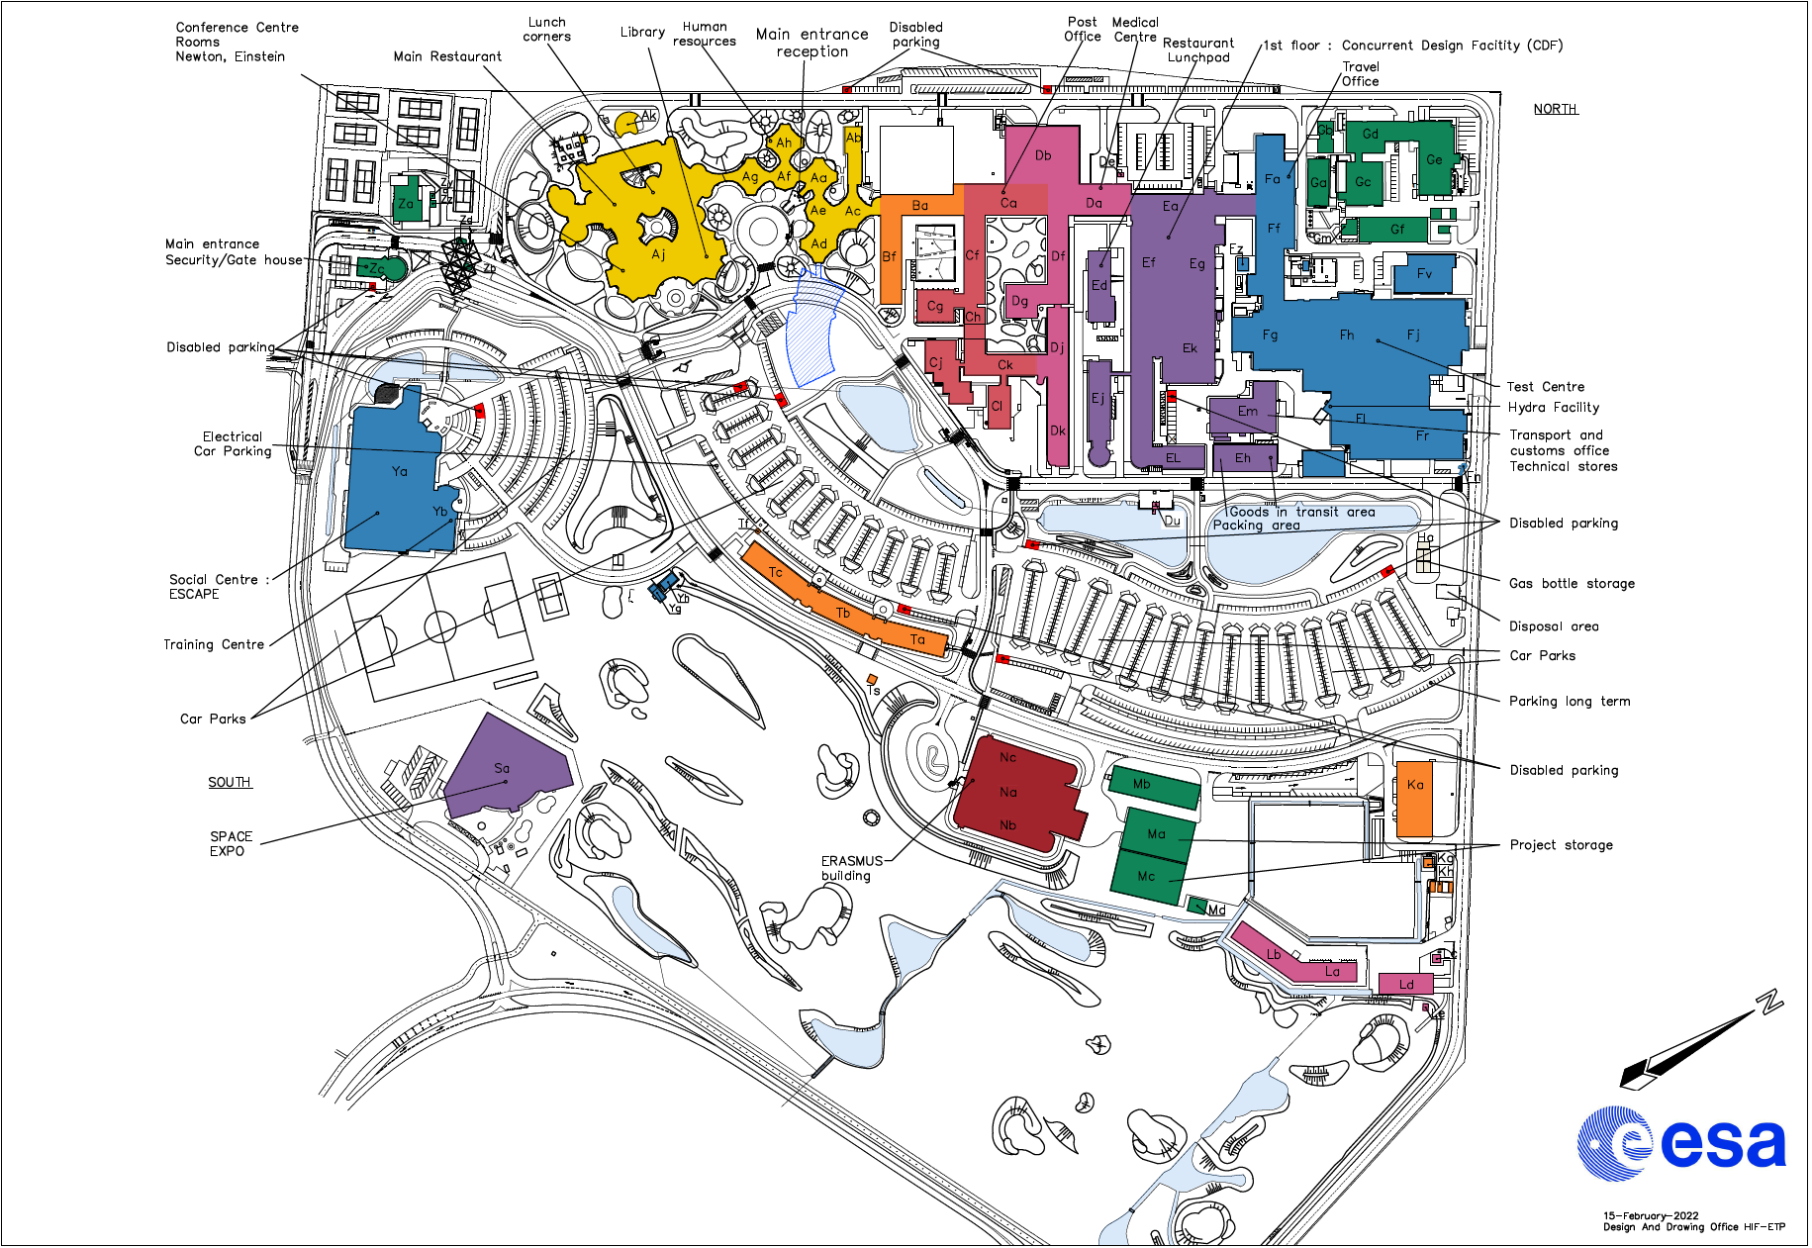
WELCOME TO ESTEC
Winter Garden

Slide 3

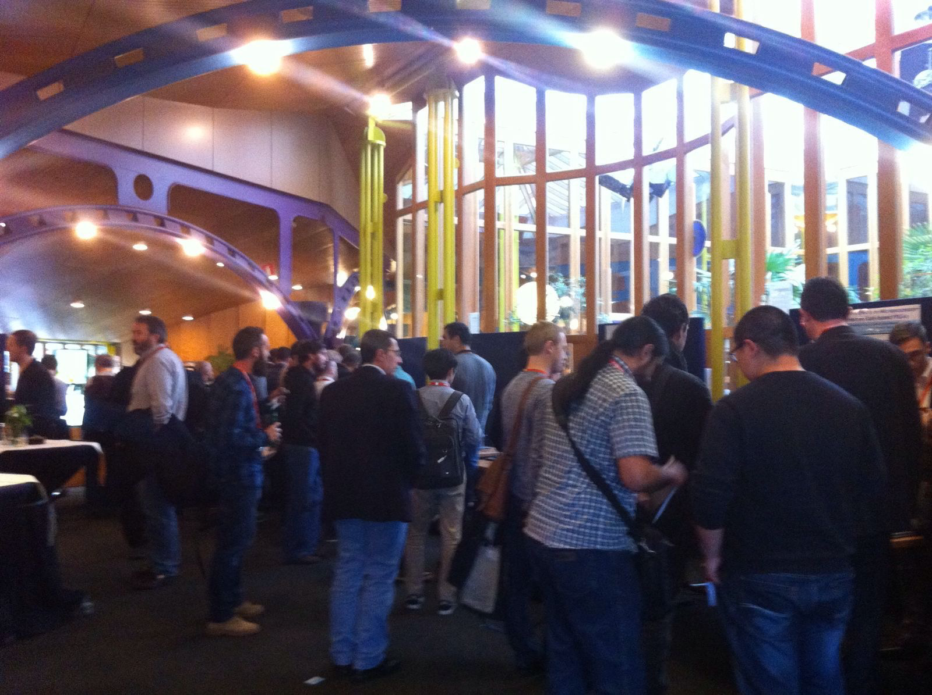

SEFUW Objective
Exchange of highly valuable information and experience among FPGA users, researchers, Tool vendors and FPGA vendors

Slide 4
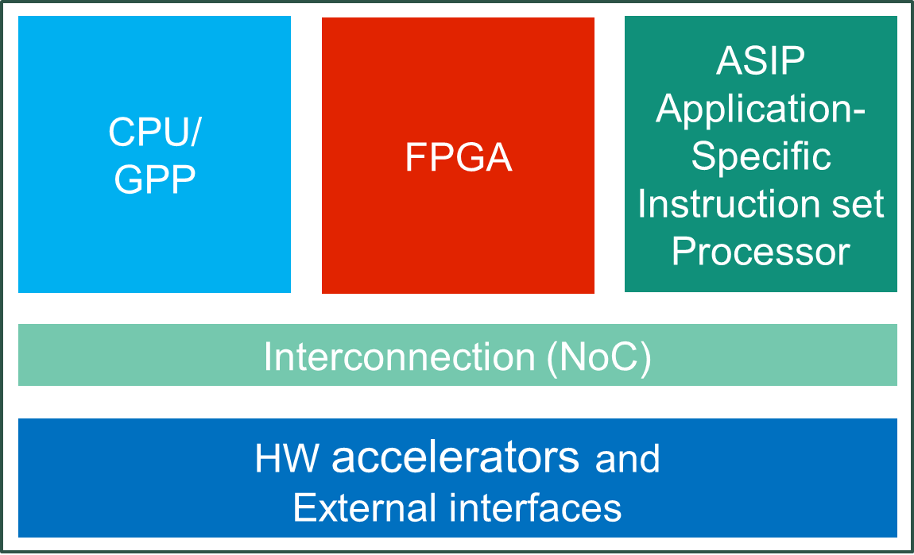




FPGAs evolution
FPGAs Architectures
 | First | Second | Third | Fourth | Fifth | Sixth
New arch. Element
Logic and
interconnect
Hard Macros:
- Internal mem.
Hard Macros:
- Arithmetic (DSP)
- HSSL
MPSoC:
- Hard macro
Processor System
(uP or Multicore)
MPSoC RF:
- Hard macro
RF ADC/DAC
Adaptive Compute Accelerator Platforms
FPGAs large range of sizes and performances
Some challenges:
Low / Mid / High
Performance
Low / Mid / High
Size
Radiation performance and
design mitigation techniques
Design methodologies (HLS, etc..)
…

Slide 5
SEFUW topics
FPGA Vendors
Tools Vendors
Design Flow
Fault Tolerant Methodologies and tools
Reconfiguration
FPGAs: High Performance
Industrial experiences
Artificial Intelligence / Machine Learning
High Level Synthesis and Model Based Design
Poster session

Slide 6
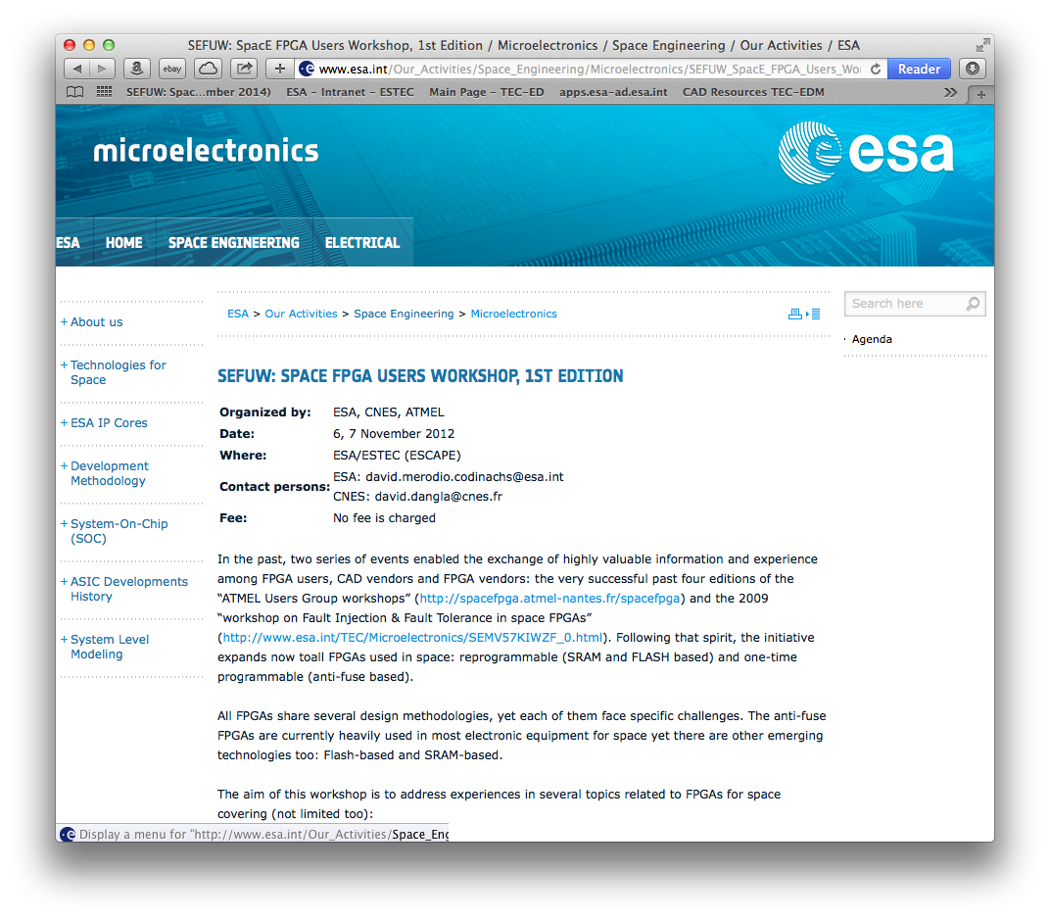
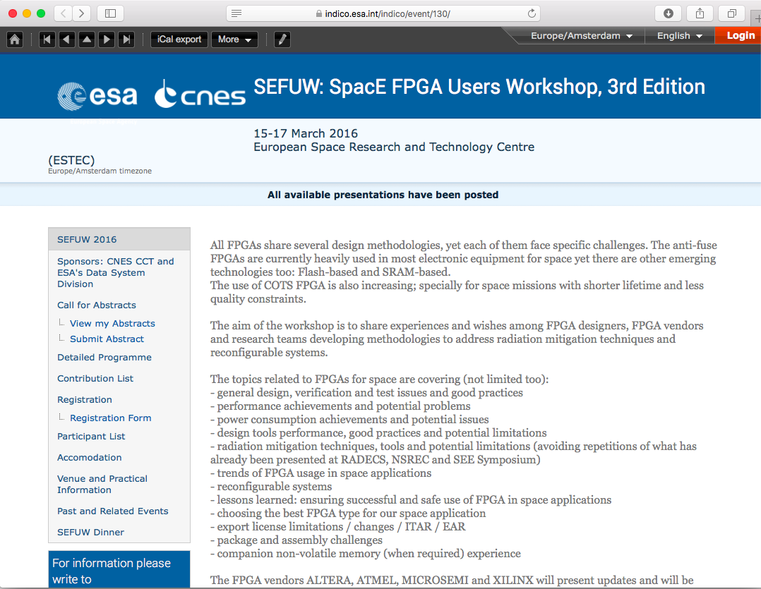
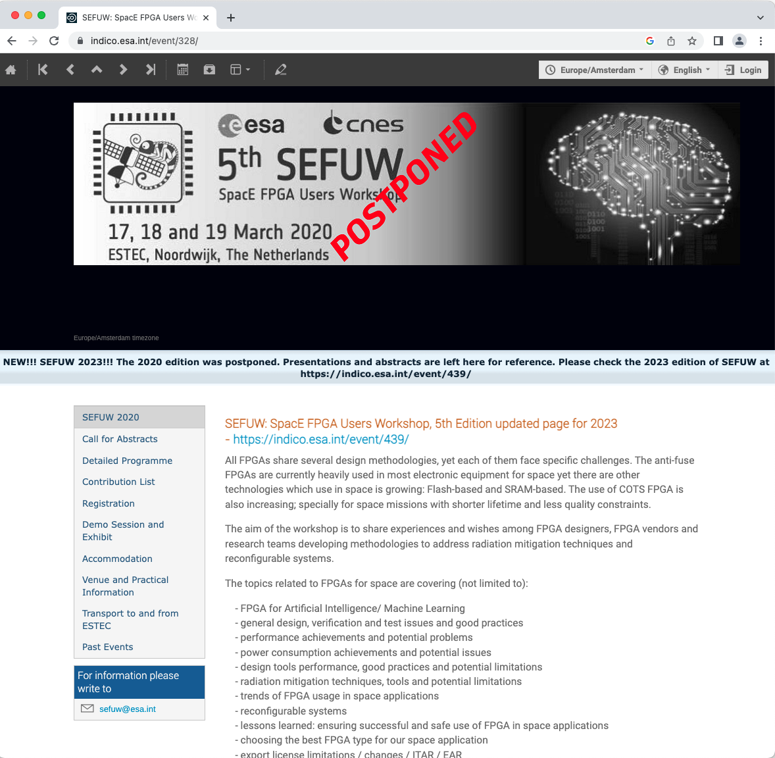
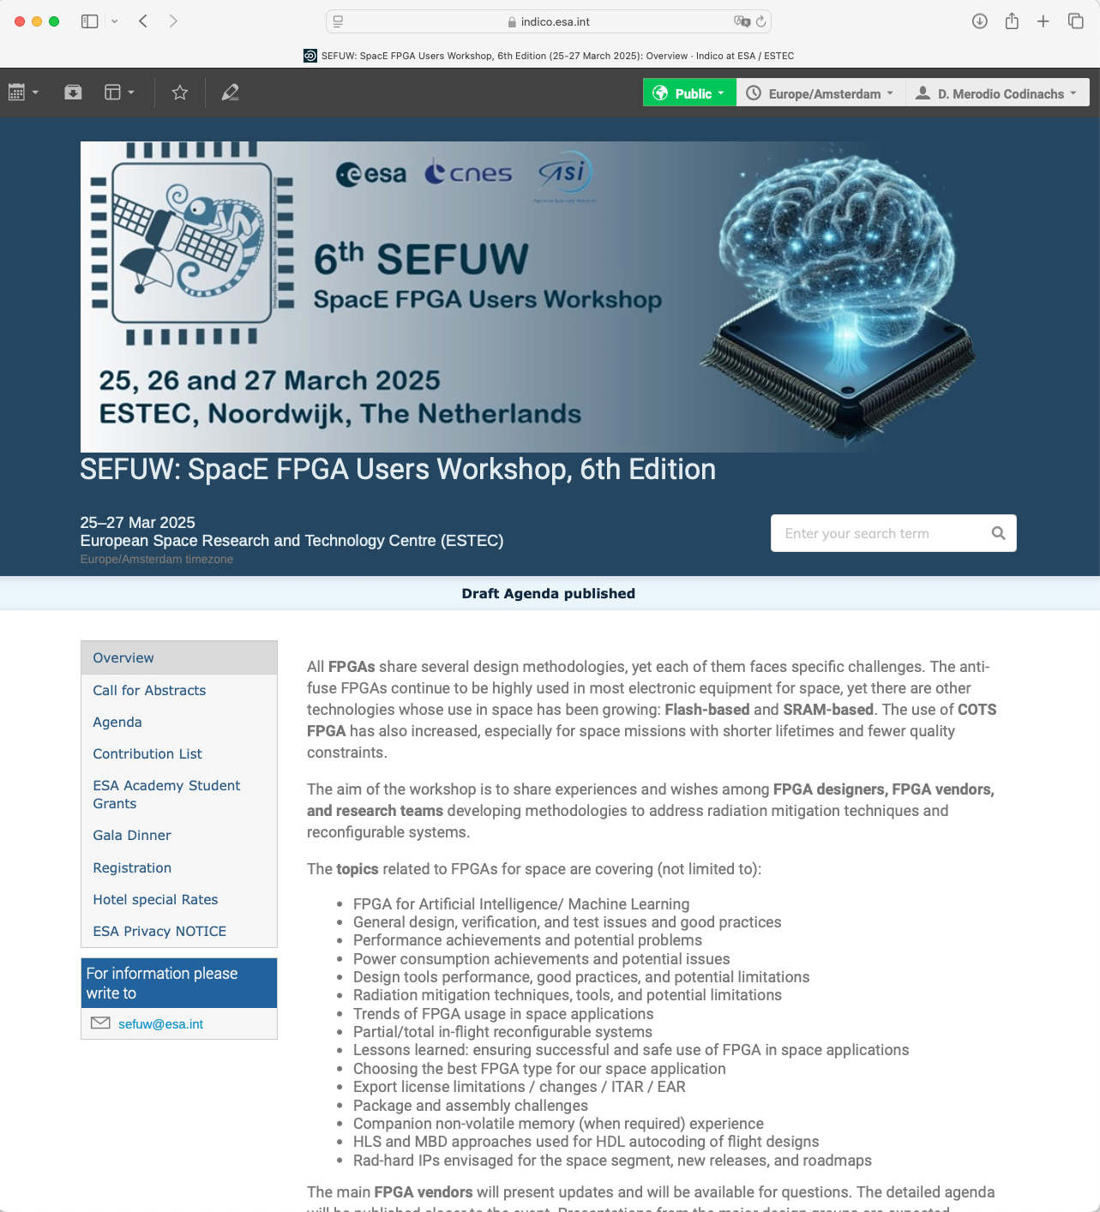
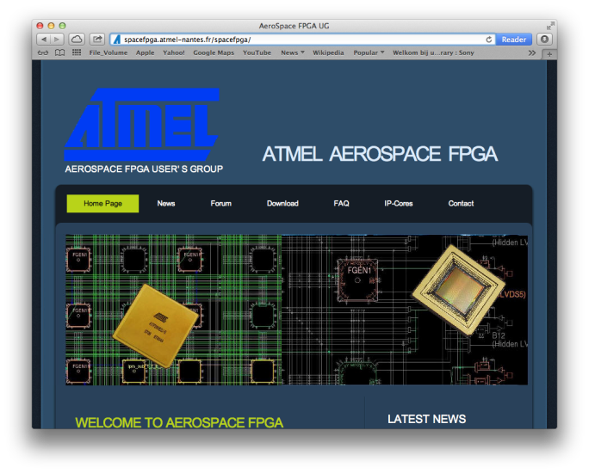
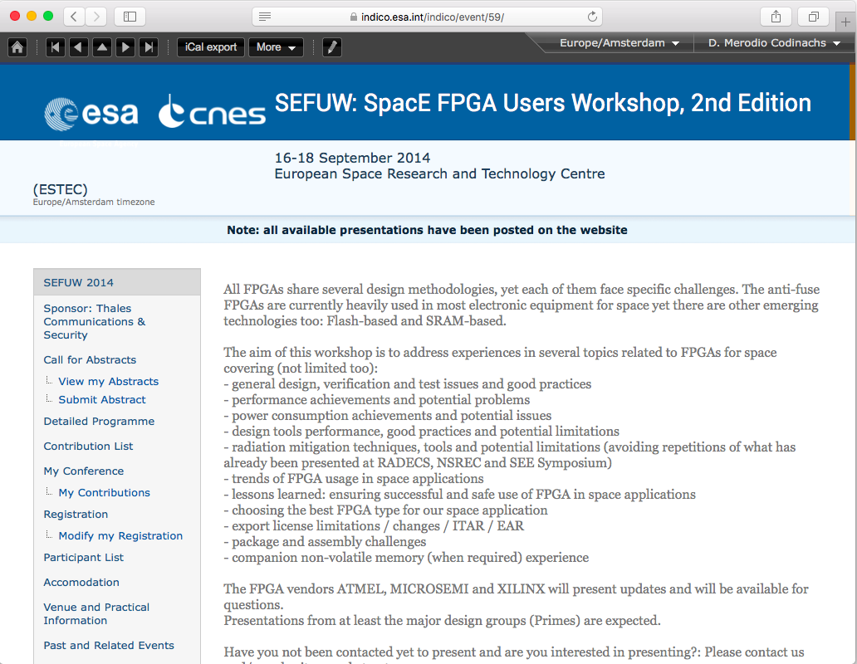
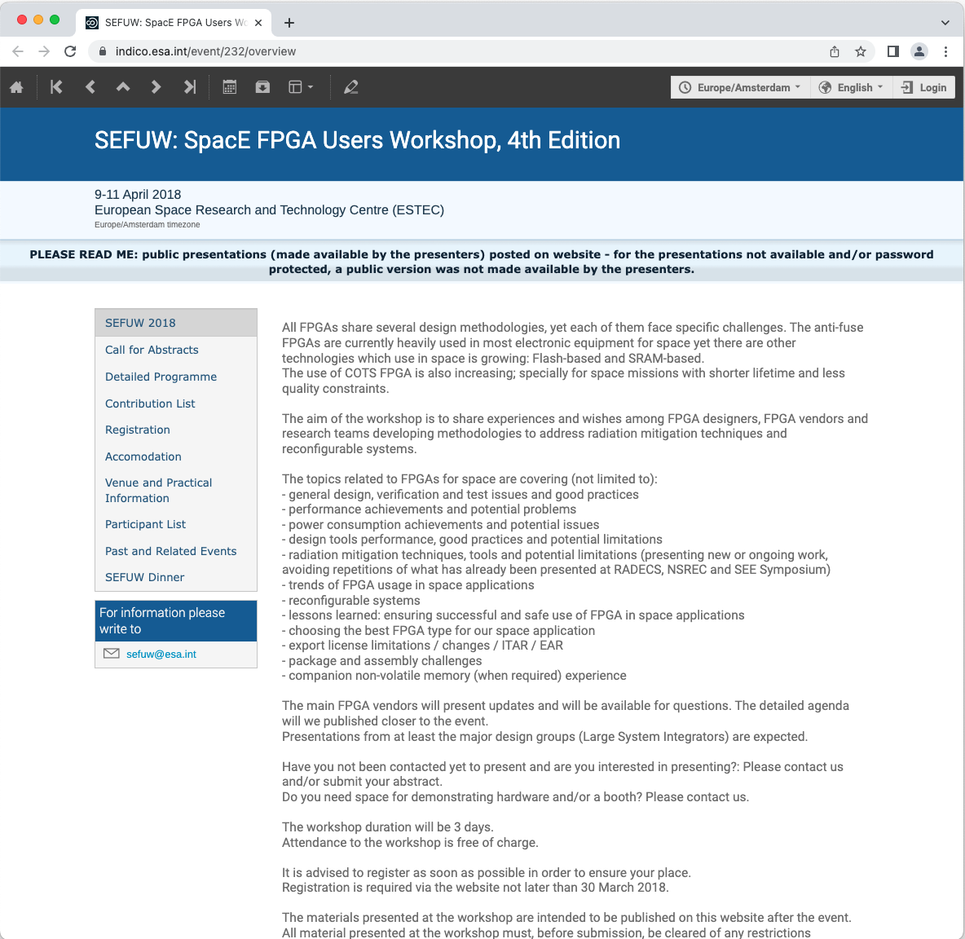
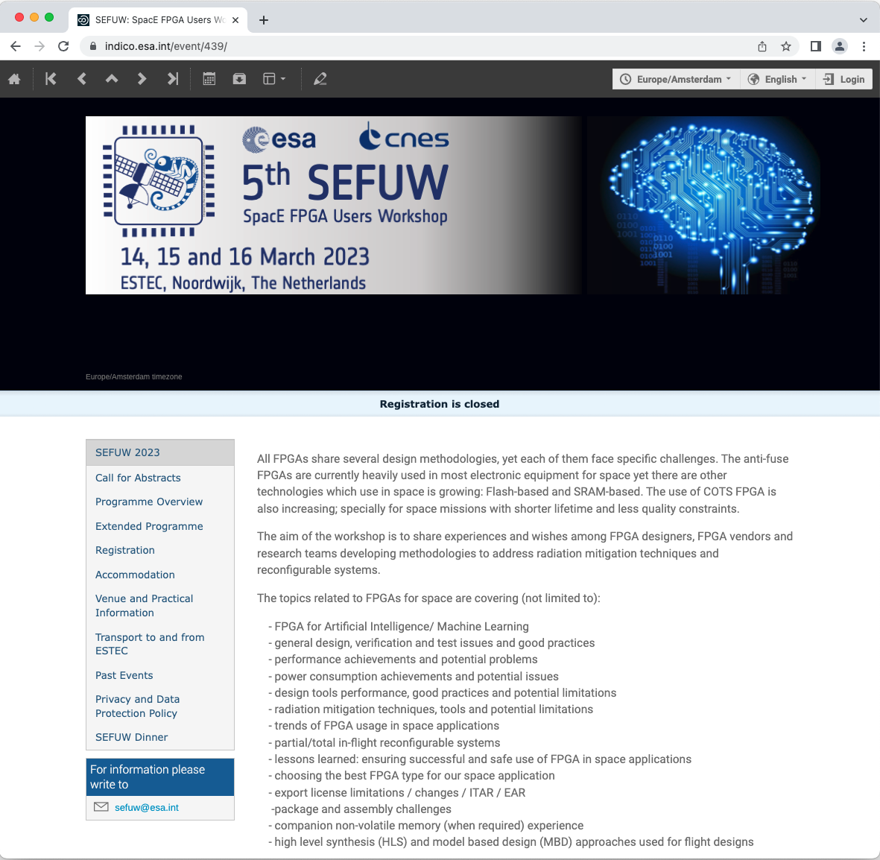
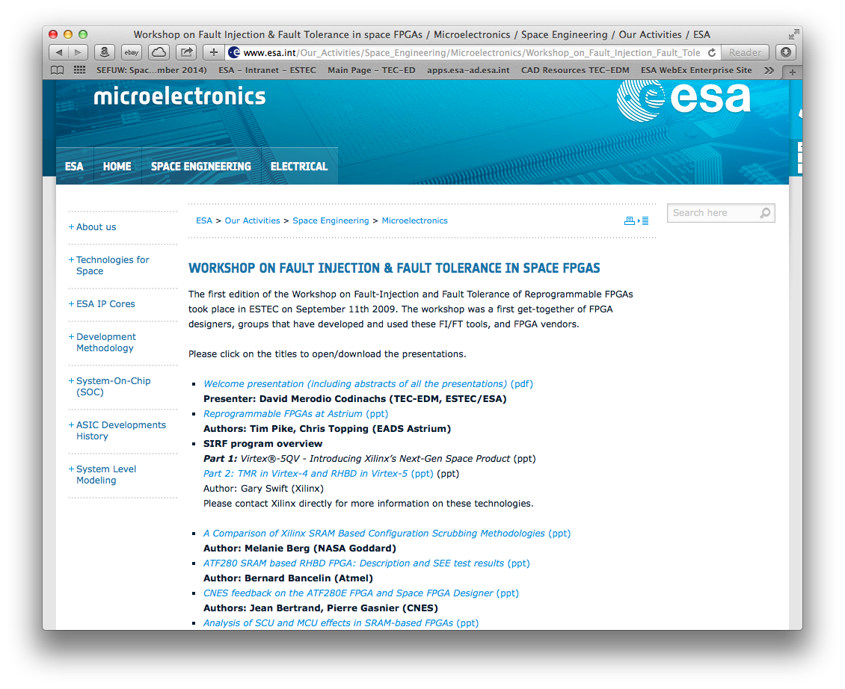
SEFUW 2023, where we come from
Oct. 2012
Sep. 2014
May 2016
Mar. 2018
Mar. 2020
Mar. 2023
Mar. 2025
Precursors
ATMEL Aerospace FPGA working group:
Workshops and website
Workshop on Fault Injection & Fault Tolerance in space FPGAs (2009)

Slide 7
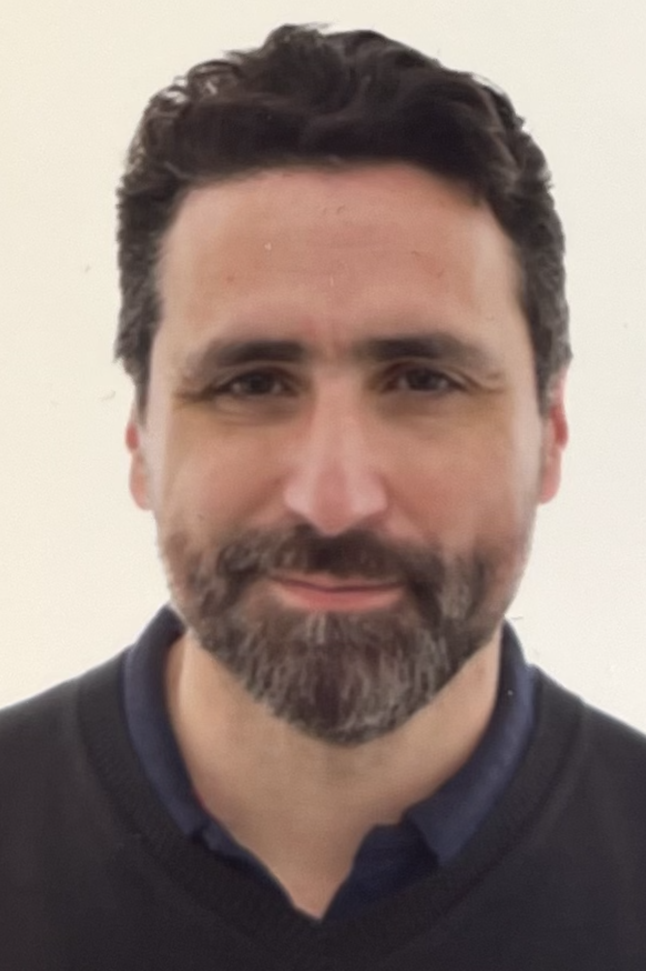
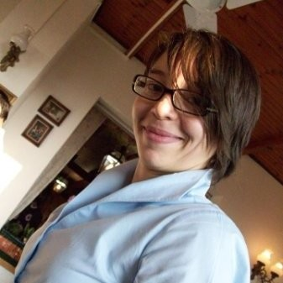
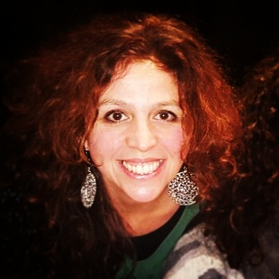
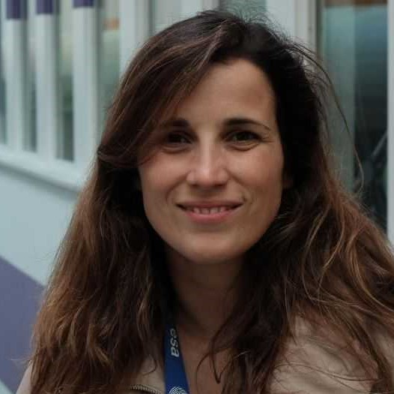
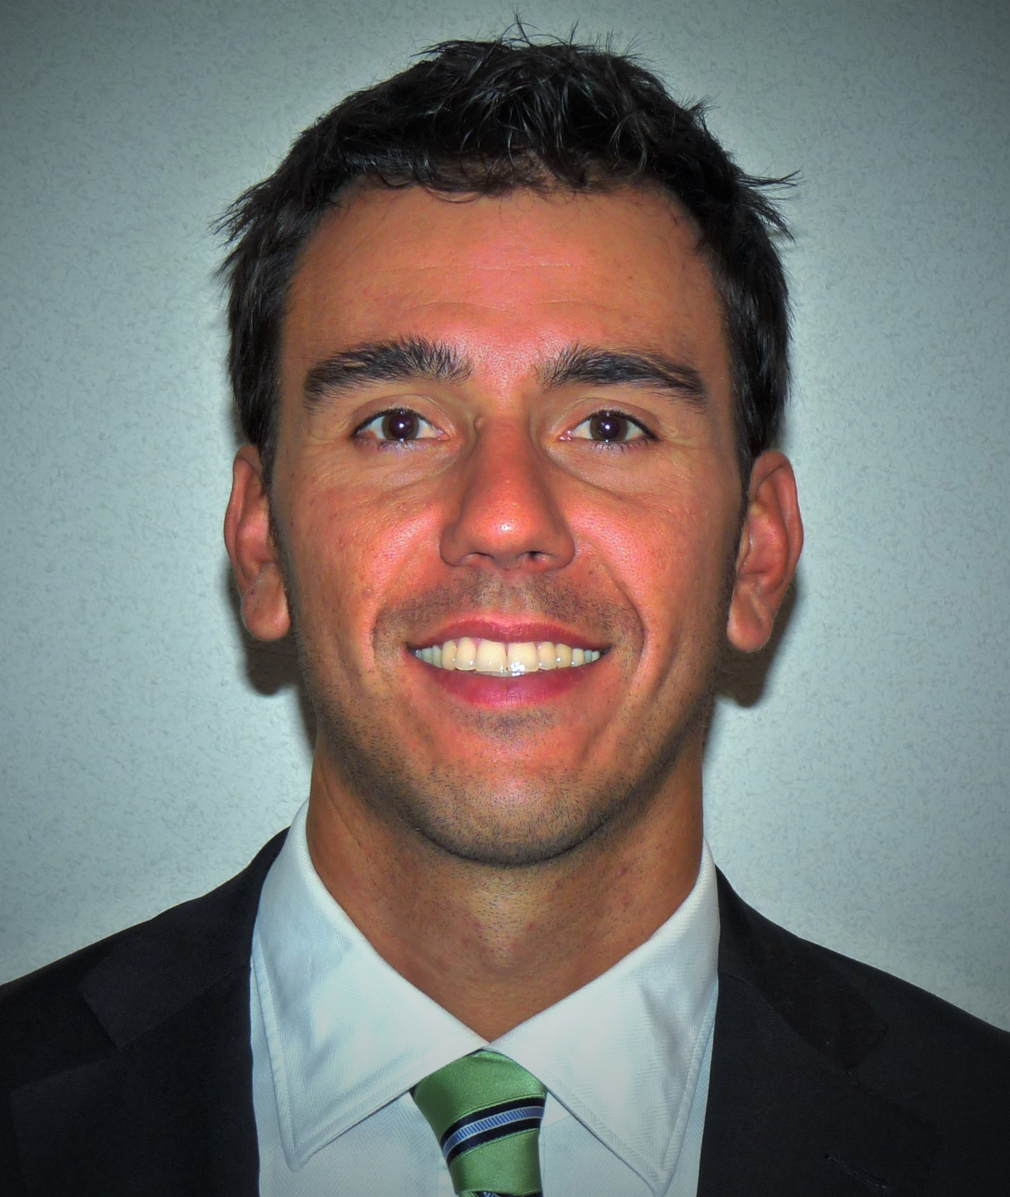
SEFUW’25 Local OrganisationTeam
David Merodio | Filomena Decuzzi | Silvia Moranti | Lucana Santos | Alberto Urbon
Questions?
Please don´t hesitate to contact us!

Slide 8
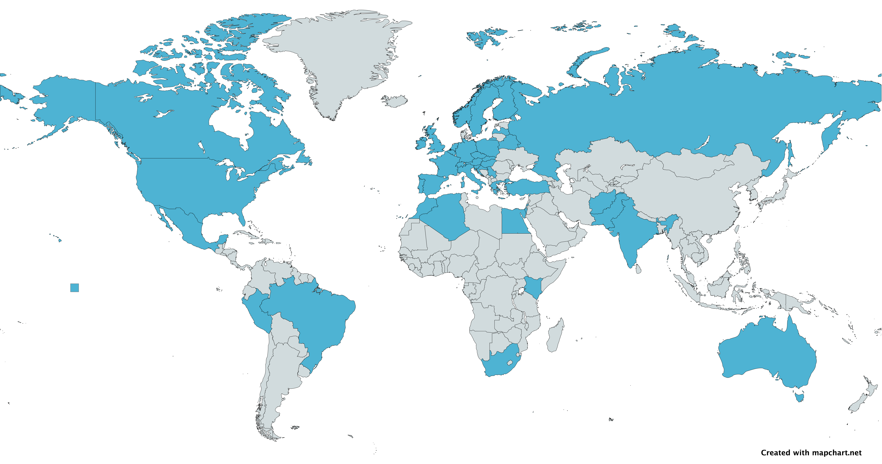
SEFUW participants nationality map

Slide 9



Sponsors 2025
Booth at Conference center entrance area
Platinum sponsors
Gold sponsors
Students grants
Paolo Ritirato
Tommaso Bocchi
Silvia Romero Azpitarte

Slide 10
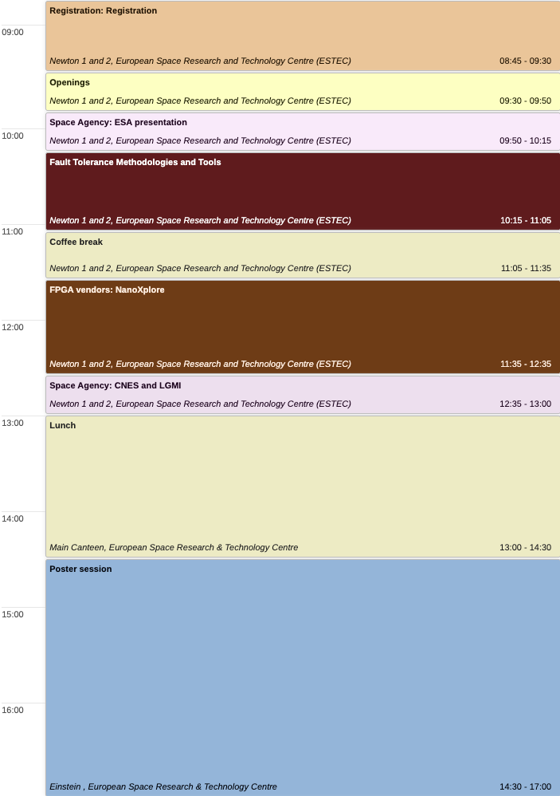
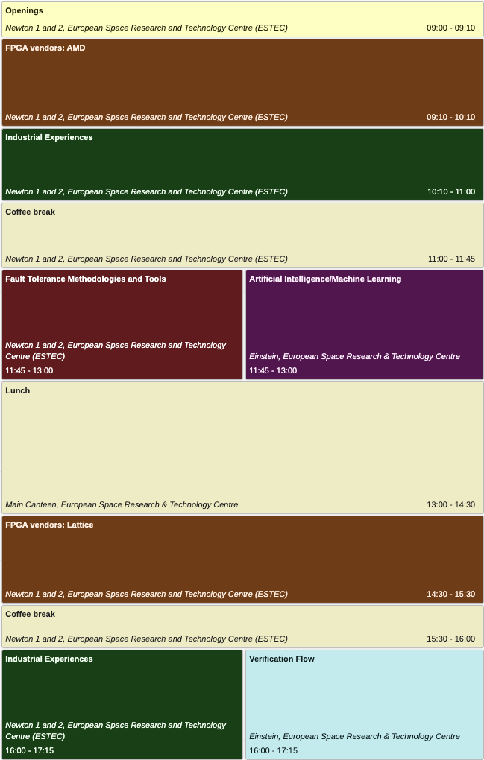
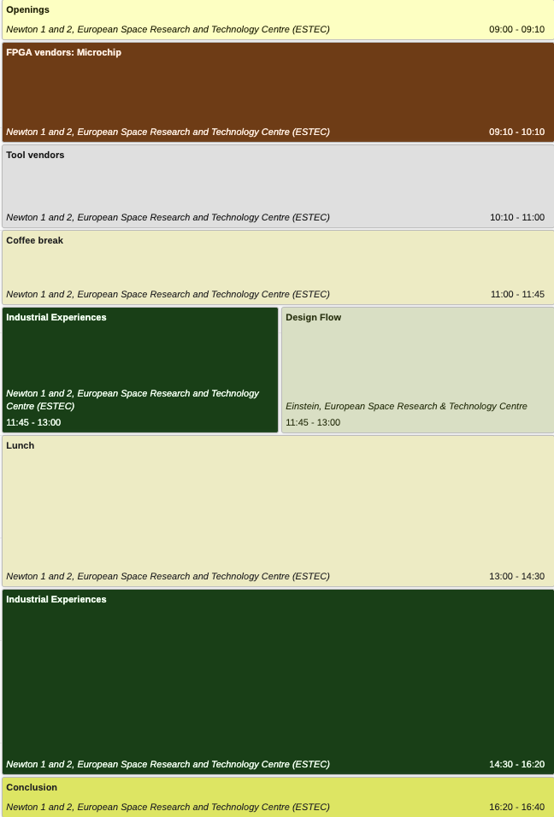
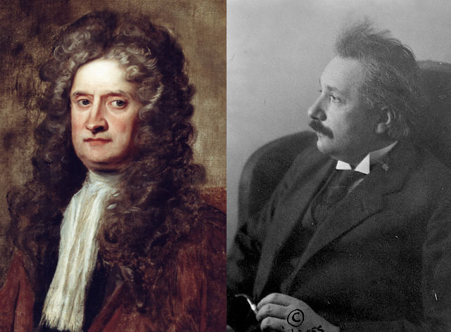


Agenda overview
Day 1
Day 2
Day 3
17:00 Welcome Reception
19:00 Gala Dinner

Slide 11
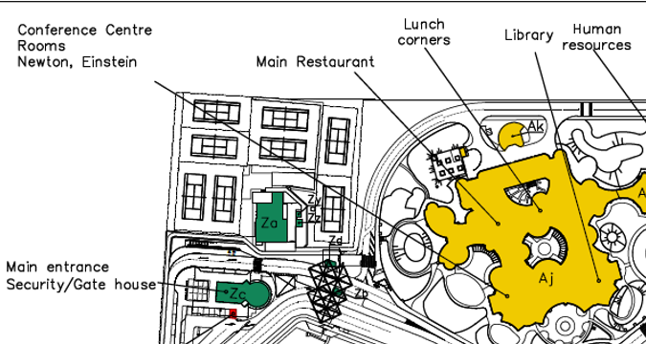


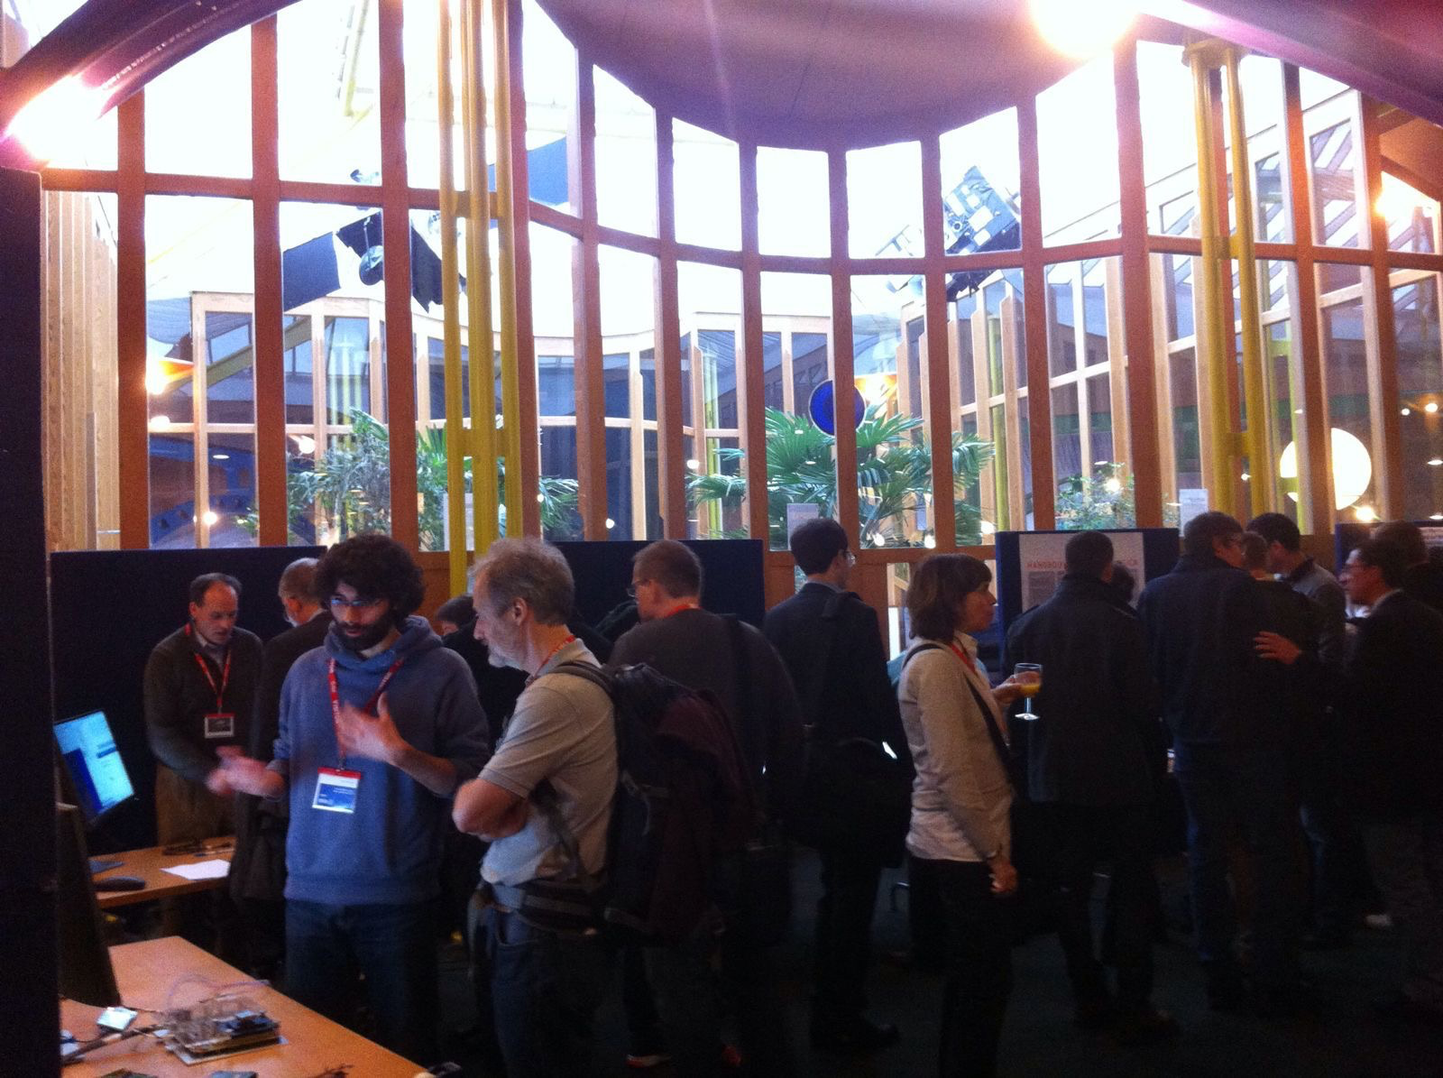
Agenda overview – Welcome Reception
Today after poster session
Wintergarden South
Demo session / Exhibit
All Sponsors
Winter Garden
Curtesy bus at 20:00 to Noordwijk

Slide 12

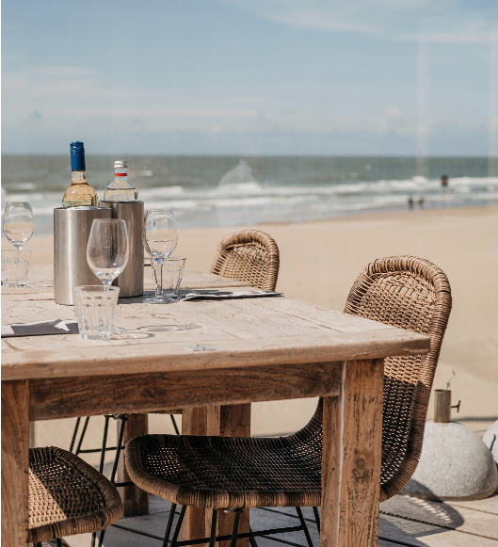
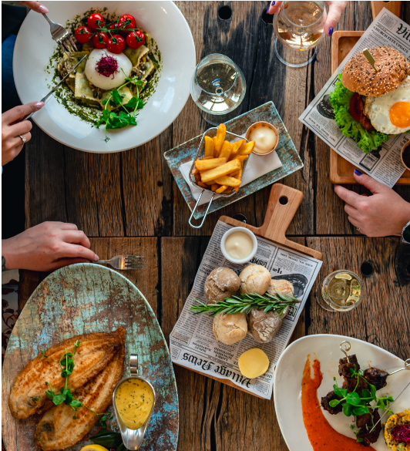
Agenda overview – Gala dinner
Wednesday 26th
19:00 - 23:00
A courtesy bus will be available
from ESTEC to the restaurant at 18:30
from the restaurant to Leiden central at 22:30
Noordwijk

Slide 13
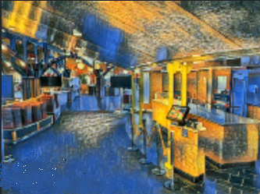
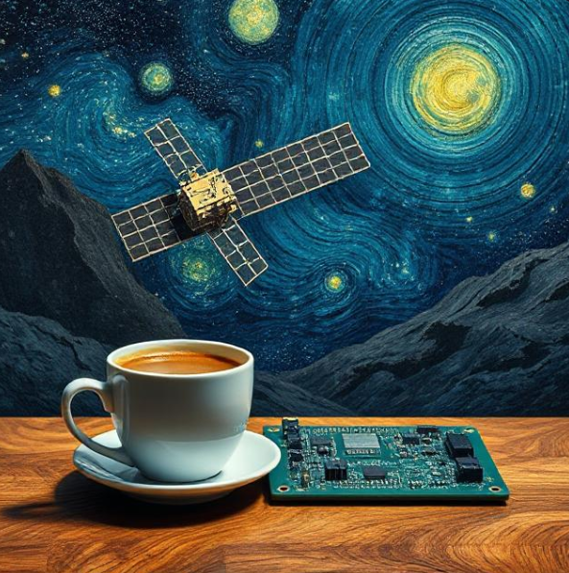

Usefull information
Network Luncheon at 13:00 the ESTEC Main Canteen
Coffee breaks at Conference rooms entrance where our Sponsor booths are
WIFI access: You receive your credentials at the SEFUW Registration Desk

Slide 14


Presenters and posters information
Oral talks
Posters
Place your posters on Tuesday morning
Contact SEFUW local organisers in case of any doubt
Be prepared to skip content if you're running out of time.
Make sure your presentation is available to the organizers
Your presentation will be available on the Indico SEFUW website after the event
Stick to your designated time to ensure every speaker has a chance to present and the audience can ask questions.
The posters sessions are on Tuesday afternoon
Do not remove the poster on Tuesday afternoon, you can take it on Thursday
Best student presentation and best student poster awards

Slide 15
Some statistics - Attendees
Affiliations 107
  83 Industries
  7 Institutions
  4 Agencies
  13 Universities
Attendees 280
  206 from Industry
  17 from Institution
  29 from Agency
  18 from University

Slide 16
Some statistics - Submissions
Number of submissions 74
Presentations 35
Posters 20
Acceptance rate 78.57%

Slide 17
Improved Event Features – Insights from the 2023 Survey
Extended Networking Opportunities:
  Longer coffee breaks for better interaction.
  First day: Welcome drink for relaxed networking.
  Second day: Time allocated for networking before departing for the gala dinner.
  Third day: Earlier end time, allowing for more flexible departures.
Dedicated Poster Session
Parallel sessions
Morning Coffee Provided by Sponsors
Convenient Transports Provided by Sponsors
Prime Location:
    Near the restaurant for easy access to meals.
    Near the coffee corner for convenience.

Slide 18
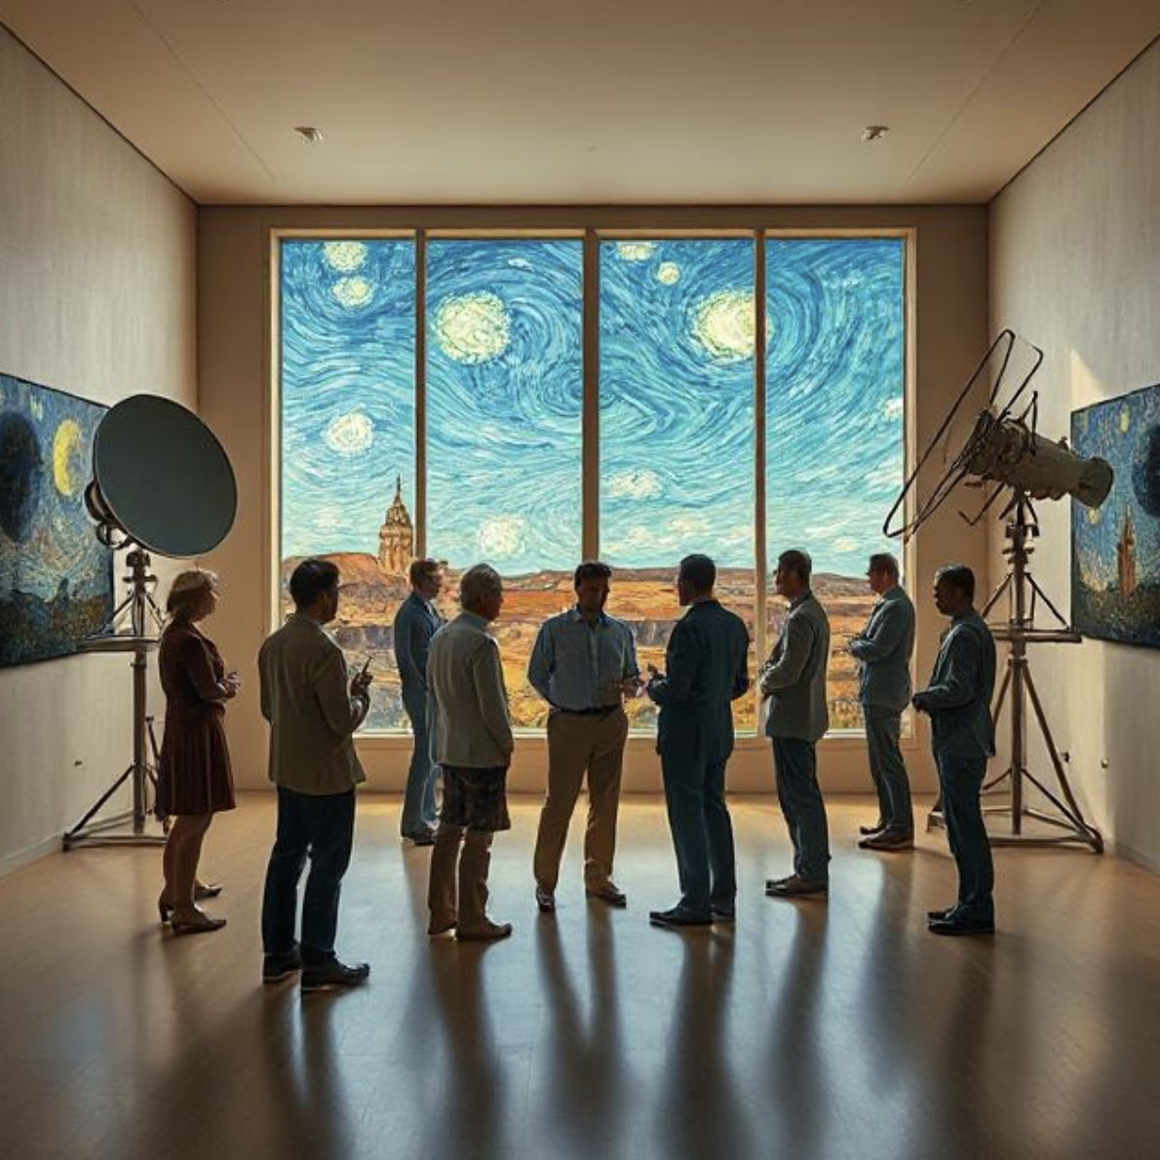
Maximizing Interactions
Engage Actively
Network
Explore Exhibits
Take Advantage of Breaks
Follow Us on Social Media
Share your experience using #SEFUW25 and stay connected.
Notes:
Encouraging interactions among attendees is vital for a successful workshop. Engaging with your peers can lead to valuable insights and collaborations. Make the most of the discussions, ask questions, and take advantage of networking opportunities during breaks to foster meaningful connections.

Slide 19










7. Q&A
London, 7th October 2025

