Slide 1
Experimental investigations of impact processes on the metal asteroid 16 Psyche
Danielle Vosper
EGT in Simulant Research and Development
Vulcan Analogue Sample Facility
Directorate of Human and Robotic Exploration
04/06/2025
Notes:
So intro, context, psyche, approach and aim, methods, expectations

Slide 2
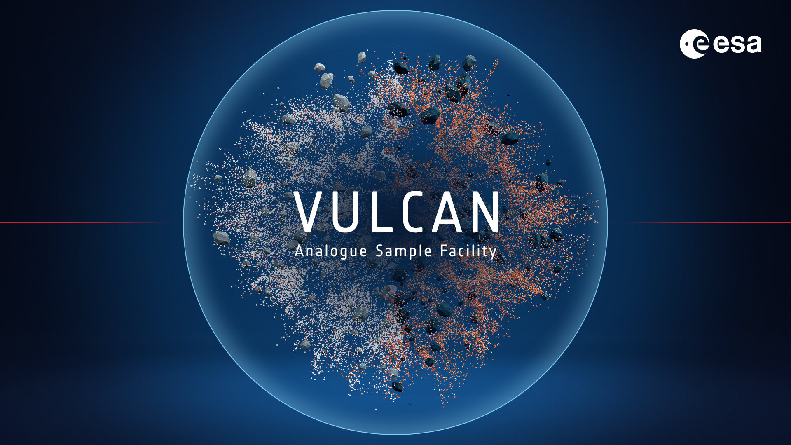
Introduction
ESA Graduate Trainee since October 2024
Based in the Vulcan Analogue Sample Facility at ECSAT
Background: Geoscience and astrobiology
EGT Focus: Simulant research and development
Notes:
ESA Graduate Trainee based in ECSAT, ESA’s UK site, working in the Vulcan Analogue Sample Facility for the last 8 months

Slide 3
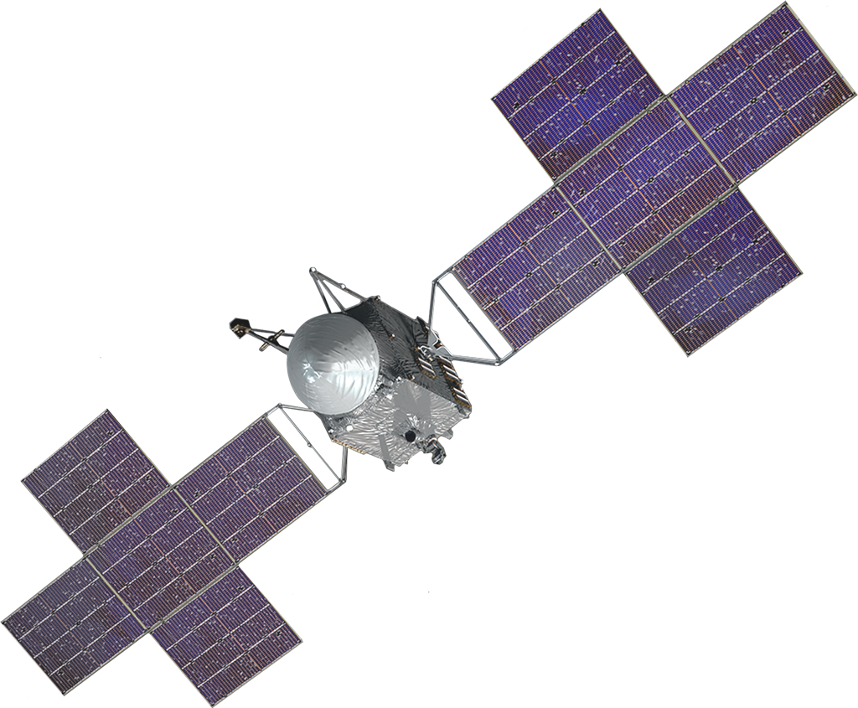
ISRU and Asteroid Mining
NASA’s Psyche Mission
Heightened
interest and investment across private and commercial sectors
NASA (2021)
Notes:
As you will hear more about later from Chris, ISRU is one of the areas of interest and development for the Vulcan facility….
Supporting European industry etc
What materials can you mine from asteroids – water, metals
ISRU (one of Vulcan lab’s areas of interest)
Asteroid mining – issues with gauging the feasibility when there are so many unknowns about the asteroid materials, behaviours and surfaces.- different kinds of mining but metal is targeted here
European: Global: some companies and the NASA mission
SMT – Netherlands
AMC – London

Slide 4
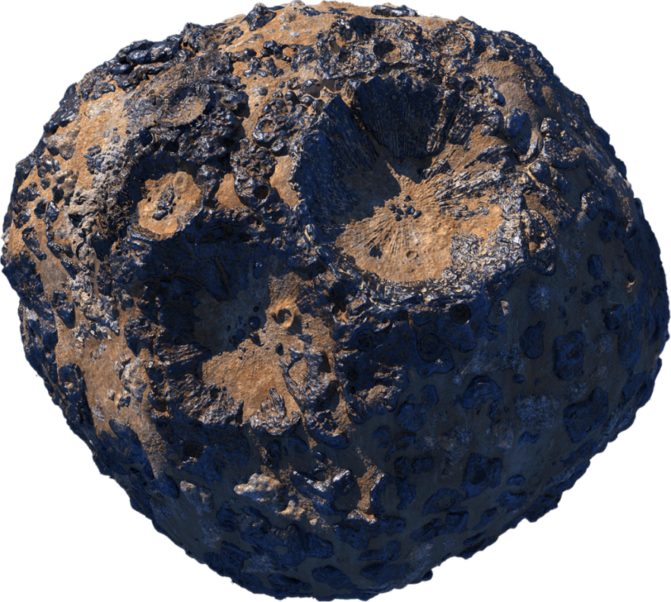
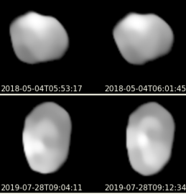
16 Psyche
The facts:
Size: 280km x 232km → largest known M class asteroid
Composition: 30-60% iron and nickel, remainer silicate rock
Origin: potential core of an early planetesimal
As a result:
A primary candidate for asteroid mining!
Illustration (NASA, 2021)
Very Large Telescope images
(Ferraris et al., 2020)
Notes:
Largest known metal asteroid etc: water and metal possible to mine
Joke about its worth…
Background – Psyche itself
Psyche Mission – heightened level of interest with this mission / demonstrated by the mission
Media sensation joke about the amount of money its worth

Slide 5
16 Psyche
The unknowns:
Is there a surface regolith and what would its composition be?
How are 16 Psyche and other metal asteroids affected by micrometeorite impacts?
How much does the broader composition vary from the surface?
Why do we care?
To derisk and enable ISRU/asteroid mining in the future, we need to understand:
The surface properties: composition, structure
The surface behaviours: response to space weathering i.e., shatter/flow
Notes:
Surface conditions and behaviours
Nature and composition of the regolith (loose, fractured material vs crust through impact melting)
High resolution spectral information to detail composition, chemistry etc (due from NASA mission)
Impact and space weathering processes on metal asteroids
Origin of Psyche – is it an early planetesimal?
’This research, conducted at ESA’s Vulcan Analogue Sample Facility, aims to better understand the impact processes on 16 Psyche and their influence on the presence (or lack thereof) of a surface regolith

Slide 6
Aim and Approach
Aims:
To better understand the impact processes on 16 Psyche and their influence on the presence (or lack thereof) of a surface regolith.
To create a chemically, spectrally and physically representative simulant of the surface of Psyche.
How to determine these unknowns?
→ Hypervelocity impact experiments on to meteorite surfaces
Notes:
Essentially – we want to know if the material will shatter or flow//

Slide 7
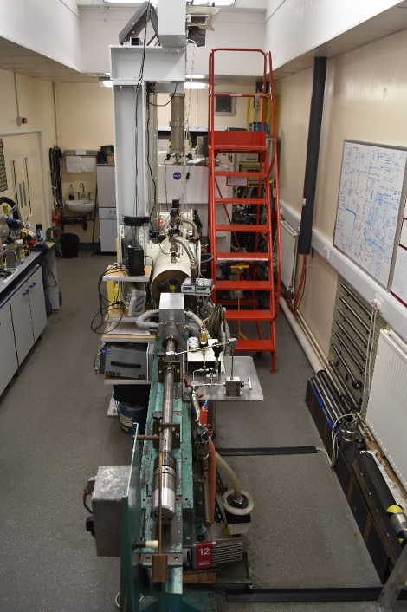
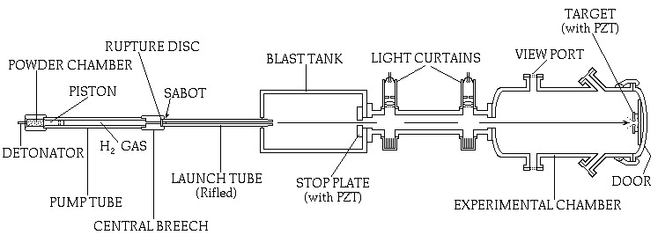
Materials and Methodology
The Light Gas Gun – University of Kent:
Facilitator: Dr Penny Wozniakiewicz
University of Kent (2024)
Notes:
Explain how it works and then that
Speed etc

Slide 8
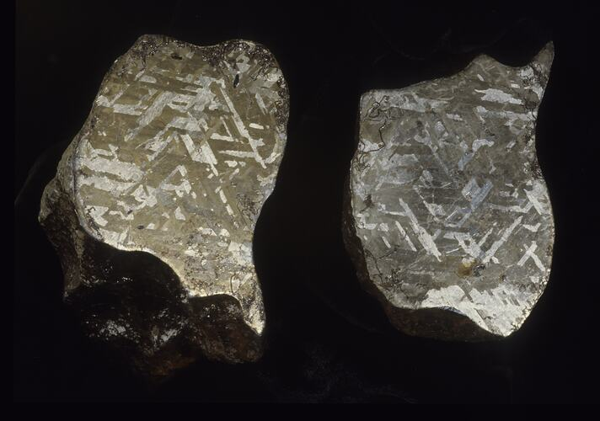
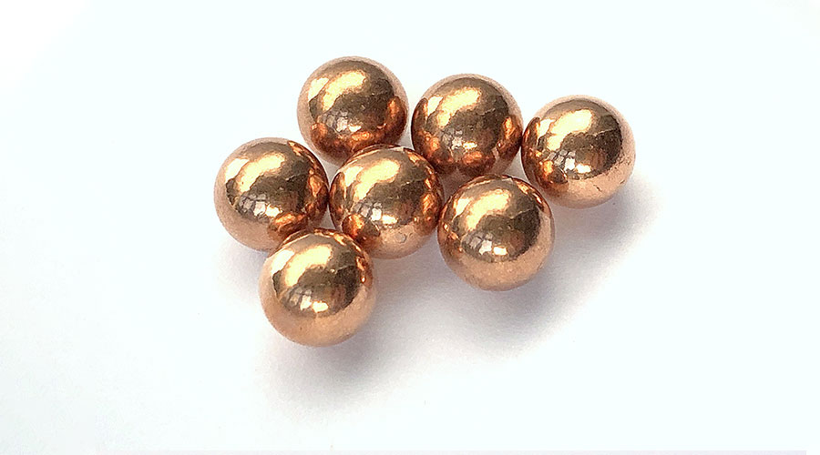
Materials and Methodology
Projectiles: Ball bearings
2-4mm diameter
Composition: Copper
For maximum cratering effect
To be visually and chemically distinct
Impact surface: Meteorite
Dimensions: ~10cm x 5cm
Composition: Iron and nickel rich, clear crystal structure (Widmanstätten patterns)
Gibeon: denied loan
Henbury: in pursuit…
Redhill Precision (2025)
Smith (2017)
Notes:
This is the part where we sadly have to be a little theoretical – I would love to be able to tell you this as if we already have the materials but we do not…
Hyper velocity impact experiments will be conducted using the two-stage gas gun at the University of Kent. Small copper projectiles (~2mm) will be fired at a metal meteorite to determine if the large metal crystals present will shatter and be comminuted, thus contributing to a metal rich surface regolith, or if they will instead melt, therefore not significantly contributing to a surface regolith. In doing so, we aim to predict the composition and physical structure of 16 Psyche’s surface material.
We will be performing hypervelocity impact experiments using a 2-stage light gas gun at the University of Kent. Small copper projectiles (~2mm) will be fired at one or more metal meteorites at a rate between 2-8km⁻¹, to determine whether comminution of the large metal crystals occurs (thereby producing a metal-rich regolith), or whether the crystals melt but remain coherent, thereby not significantly contributing to the production of regolith on the surfaces of such asteroids. Copper has been chosen as the impactor material to facilitate material separation/identification post-impact, and better understand the amount of material from both the bolide and target that contributes to regolith production.

Slide 9
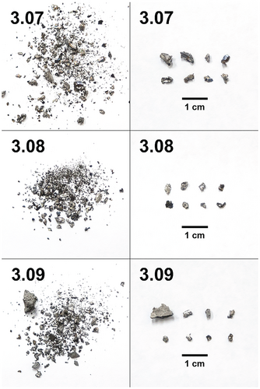
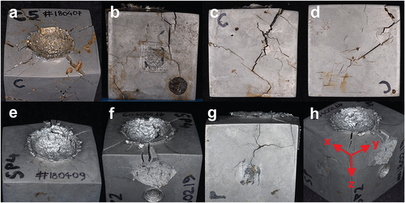
Analysis
Materials to analyse
1. Impacted meteorite surface Cross section crater analysis / CT crater scanning Characterisation: SEM, FTIR | 2. Ejected material / loose regolith produced Grain size analysis: Visisize Characterisation: SEM, FTIR…
Example: impacted metal ingots (Marchi et al., 2019) | Example: Metallic fragments (Marchi et al., 2019)
(Marchi et al., 2019)
(Marchi et al., 2019)

Slide 10
Expectations
Hypotheses:
Upon impact a crater will be produced, the crystals will shatter and produce a loose regolith like material.
This regolith will be metal rich as a result.
There will be positive implications for future asteroid mining due to the ease of metal extraction from regolith compared to impact-melt crusts.

Slide 11
Next steps…
Short term (<4 months) | Medium term (18 months) | Long term (2+ years)
Finalise materials Initial rounds of experiments take place Analysis of post-impact materials | Scale up – rerun tests with different materials, repeated impacts Design a simulant recipe based on results | Support current and future ISRU/asteroid mining needs, activities and uses within Europe
Notes:
This initial round of experiments will take place in the summer – still finalising materials
We hope we can scale this up – and run further experiments with different meteorites (ones harder to source once we have proven the concept) and with multiple impacts on the same surface etc…

Slide 12
Thank you for listening!
danielle.vosper@esa.int

