Slide 1
Ultra-Fast, Low-Overhead SpaceFibre Communication for System-on-Chips
Dave Gibson, Andrew MacLennan, Stuart Mills, Steve Parkes, Albert Ferrer Florit and Alberto Gonzalez Villafranca
STAR-Dundee
European Data Handling & Data Processing Conference 2025

Slide 2
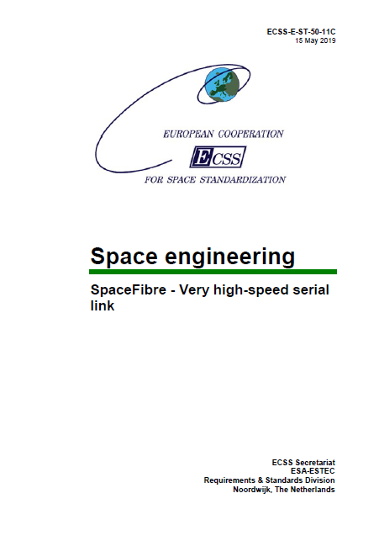
SpaceFibre
Very high-performance:
6.25 Gbit/s per lane and higher depending on the SerDes
Multi-lane capability:
For example, a quad-lane link at 6.25 Gbit/s per lane gives 25 Gbit/s
Maximum of 16 lanes
Graceful degradation on lane failure
Asymmetric traffic supported with unidirectional lanes

Slide 3
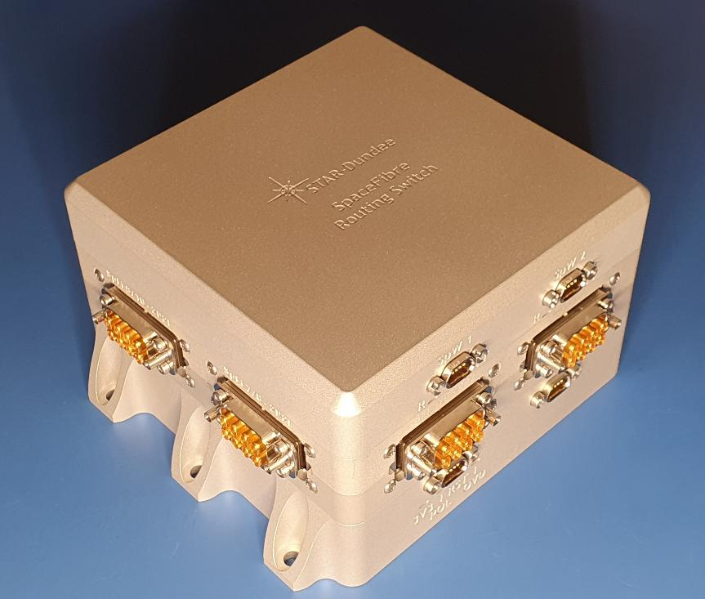
SpaceFibre
Runs over electrical or optical cables:
Few m electrical
100 m fibre optic
Low-latency broadcast messages:
Time-distribution
Synchronisation
Event signalling
Error notification
STAR-Tiger 10-Port SpaceFibre Routing Switch
100 Gbit/s bi-sectional bandwidth

Slide 4
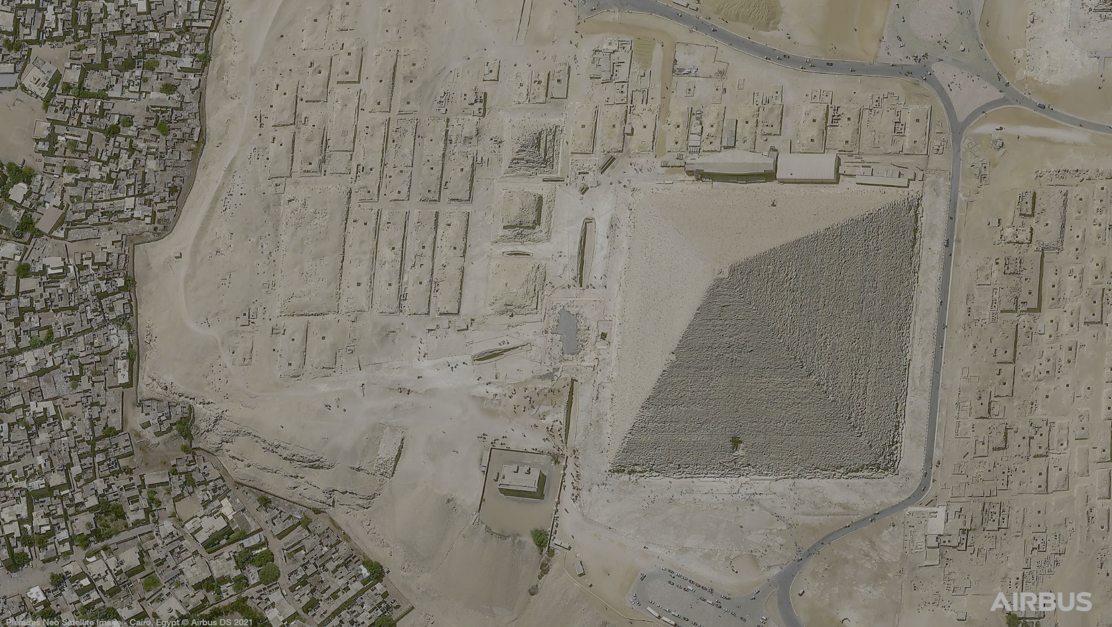
SpaceFibre
Novel quality-of-service:
Up to 32 virtual channels
Bandwidth reservation, priority and scheduling
Virtual networks:
Constructed with virtual channels
Acting as independent networks over a single physical network
Inbuilt fault detection, isolation and recovery:
At the link level enabling rapid error recovery
Babbling node / virtual channel protection
Graceful degradation of multi-lane links
Image from Airbus Pléiades Neo 3 transferred using SpaceFibre

Slide 5
SpaceFibre
Small footprint:
Taking a few percent of a recent radiation-tolerant FPGA
Straight forward to integrate with existing SpaceWire equipment
Flying on at least 6 operational satellites
Being designed into around 60 others
Image from Airbus Pléiades Neo 3 transferred using SpaceFibre

Slide 6
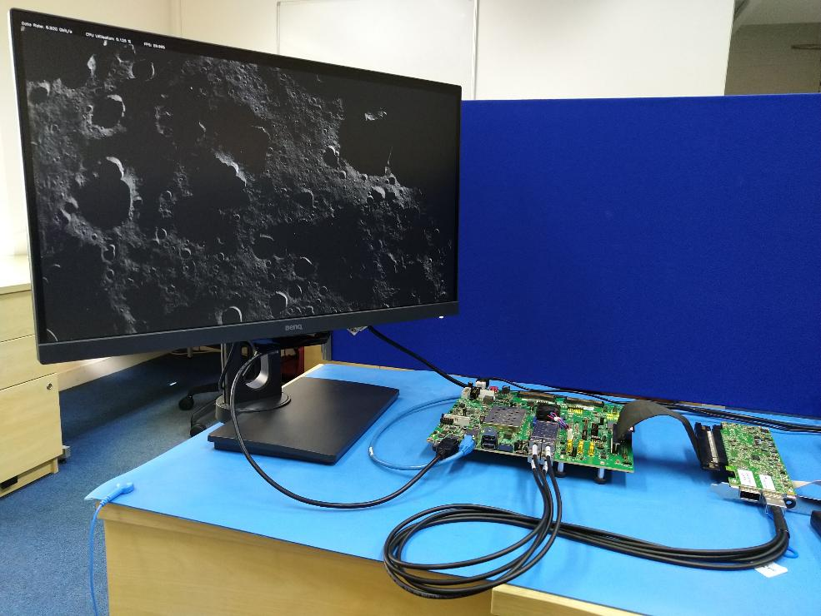
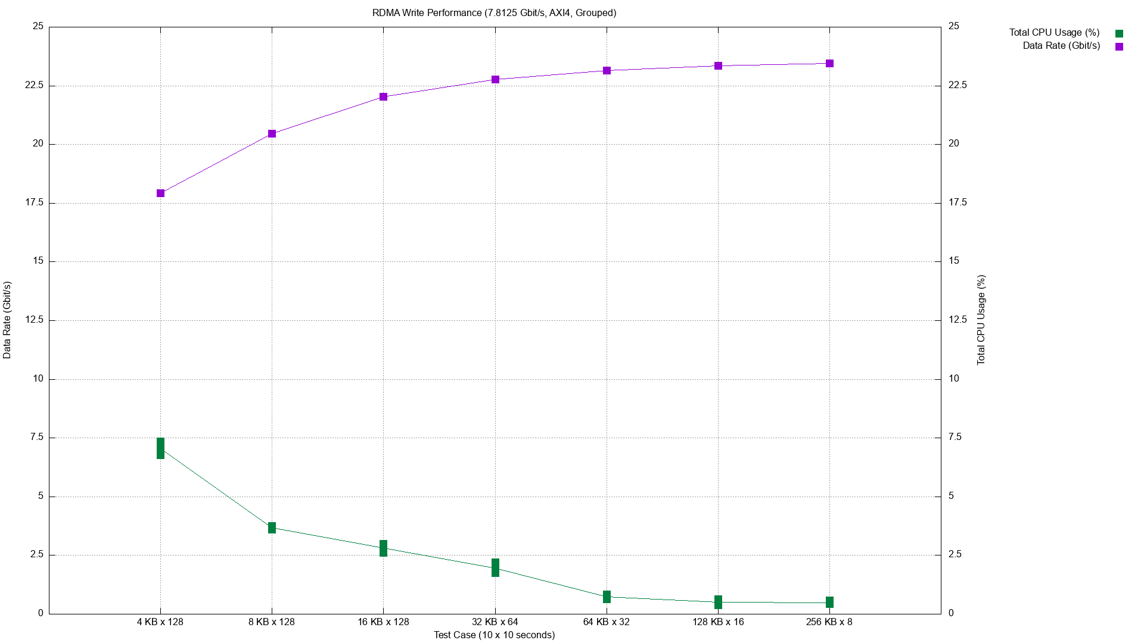
RDMA Over SpaceFibre
Remote Direct Memory Access (RDMA) Over SpaceFibre:
Demonstration running on AMD Zynq UltraScale+ SoC and PetaLinux
Over 20 Gbit/s with < 1% CPU
25 Gbit/s
Data Rate
10 %
CPU Utilisation
0 Gbit/s
0 %

Slide 7
RDMA Over SpaceFibre Demo
Graphics System
RDMA Target
Application
DisplayPort Interface
Image 0
DisplayPort Monitor
Graphics Demo (PetaLinux)
Image 1
Frame Buffers
Image 2
FB 0 / MR 0
Image 3
FB 1 / MR 1
RDMA Initiator
Image 4
RDMA Controller
Image 5
SpaceFibre Interface
…
Image 581

Slide 8
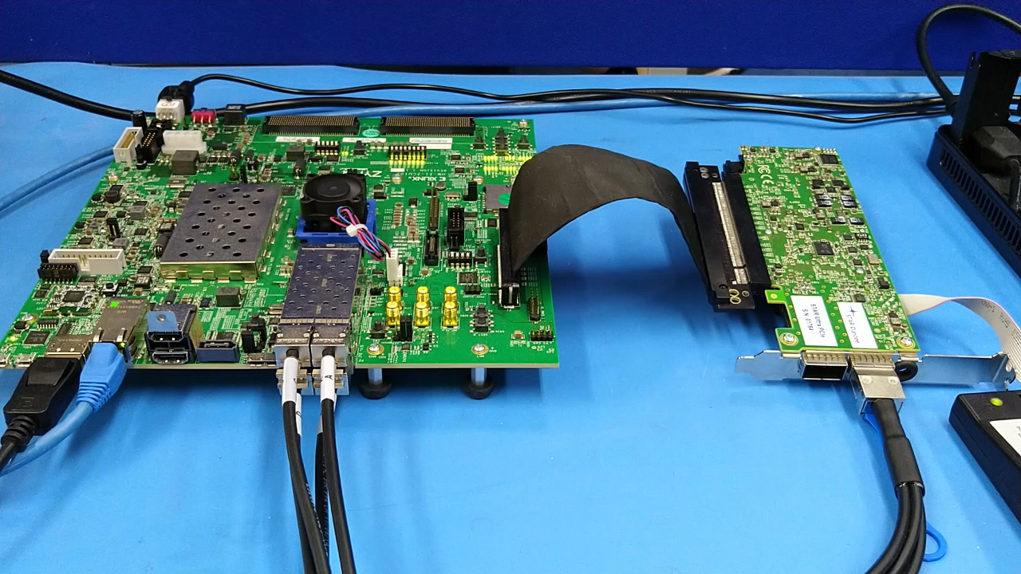

Slide 9
SpaceWire and SpaceFibre Processor Endpoint
Uses similar techniques to RDMA Over SpaceFibre:
Hardware-acceleration
Minimal CPU overhead
Simple and rapid integration for software-based systems
Supports any packet format
User-Space
STAR-Core APIs
Kernel-Space
Data Transfer
STAR-Core Drivers (Platform and PCIe)
SoC PL / FPGA
Processor Endpoint IP
SpaceWire Port
SpaceWire Port
SpaceFibre VC
SpaceFibre VC
SpaceFibre VC

Slide 10
SpaceWire and SpaceFibre Processor Endpoint
Support for SoCs:
Linux platform driver and PS-to-PL interface
Support for FPGAs:
Linux PCIe driver and PCIe interface
User-Space
STAR-Core APIs
Kernel-Space
Data Transfer
STAR-Core Drivers (Platform and PCIe)
SoC PL / FPGA
Processor Endpoint IP
SpaceWire Port
SpaceWire Port
SpaceFibre VC
SpaceFibre VC
SpaceFibre VC

Slide 11
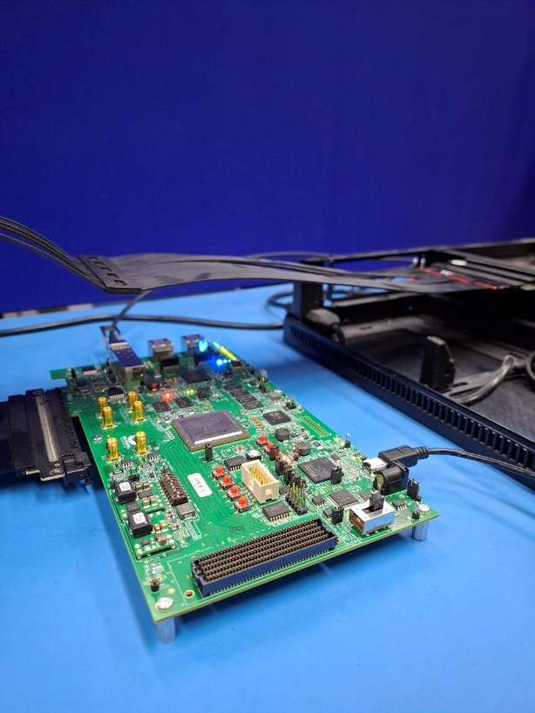

SpaceWire and SpaceFibre Processor Endpoint
Example of PCIe-based endpoint:
Processor Endpoint in standalone FPGA (Microchip PolarFire MPF300)
Connected to software in external processor using PCIe driver (Intel i5-9600 CPU)
SFP+ connected to SpaceFibre network
PolarFire (MPF300 Eval Kit)
SpaceFibre Processor Endpoint
1 x SpFi (1L, 6.25 Gbit/s)
SFP+
PCIe
Intel i5-9600 CPU
Linux Mint

Slide 12
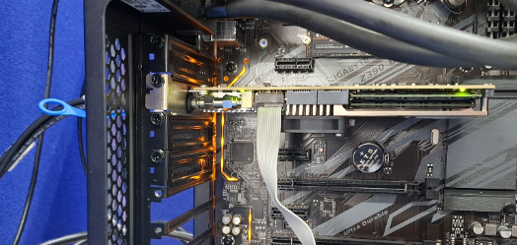
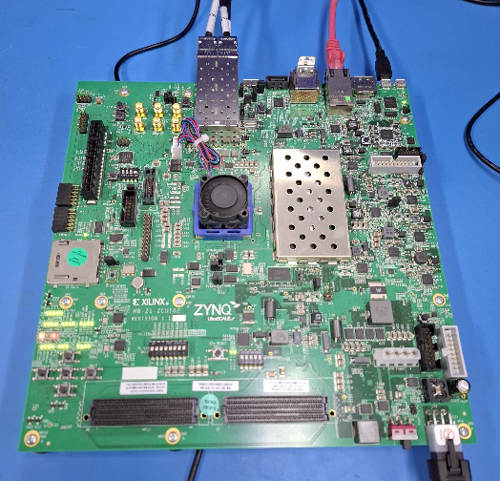
SpaceWire and SpaceFibre Processor Endpoint
Example of SoC-based endpoint:
Processor Endpoint in SoC PL (AMD Zynq UltraScale+ ZCU102)
Connected to software in SoC PS using platform driver (ARM Cortex-A53 CPU)
4xSFP+ connected to SpaceFibre network
Test PC
Zynq UltraScale+ MPSoC (ZCU102)
STAR-Ultra PCIe
PL
PS
SpaceFibre Processor Endpoint
1 x SpFi (4L, 7.5 Gbit/s)
ARM Cortex-A53 CPU
(PetaLinux 2022.1)
QSFP+
4xSFP+

Slide 13
Performance Testing (Setup)
Processor endpoint:
AMD ZCU102
ARM Cortex-A53 CPU
PetaLinux 2022.1
Test PC:
STAR-Ultra PCIe
Intel i9-9900 CPU
Windows 11 Pro
SpaceFibre:
4 x 7.5 Gbit/s lanes
30 Gbit/s link

Slide 14
Performance Testing (Procedures)
Send performance tests:
Send packets from Processor Endpoint (ZCU102)
Receive packets on STAR-Ultra PCIe
Receive performance tests:
Send packets from STAR-Ultra PCIe
Receive packets on Processor Endpoint (ZCU102)
Packet sizes from 1 KB to 256 KB
Perform 10 iterations of 10 seconds for each size
Measure data rate and CPU utilisation

Slide 15
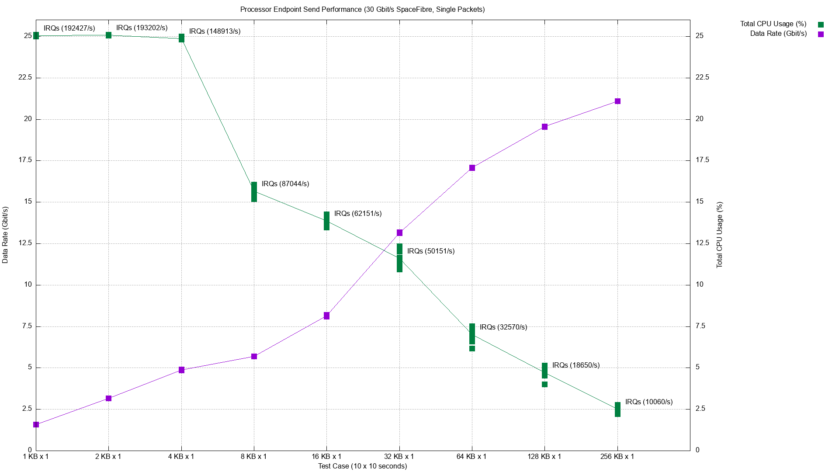
Send Performance (Single Packets)

Slide 16
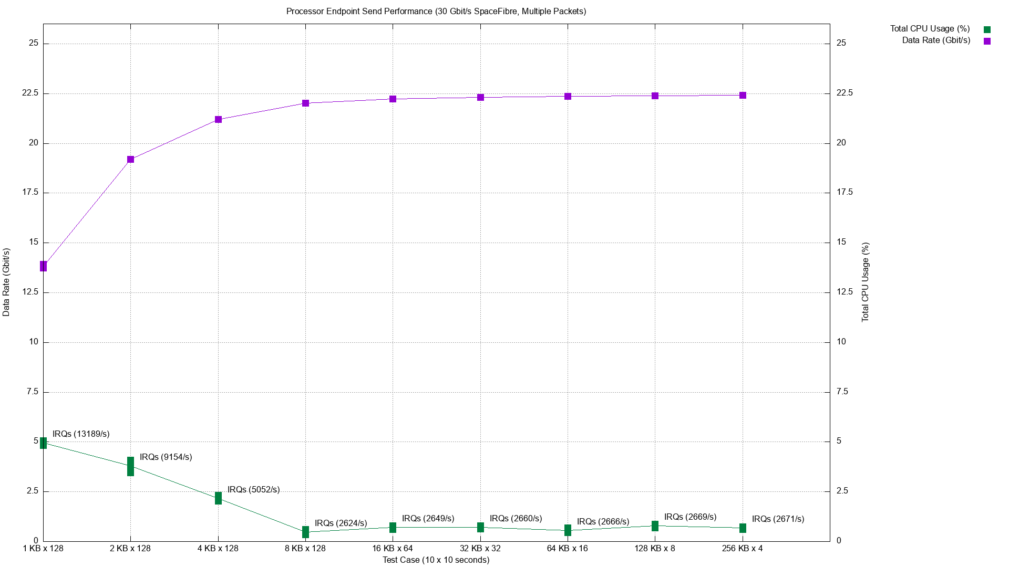
Send Performance (Grouped Packets)

Slide 17
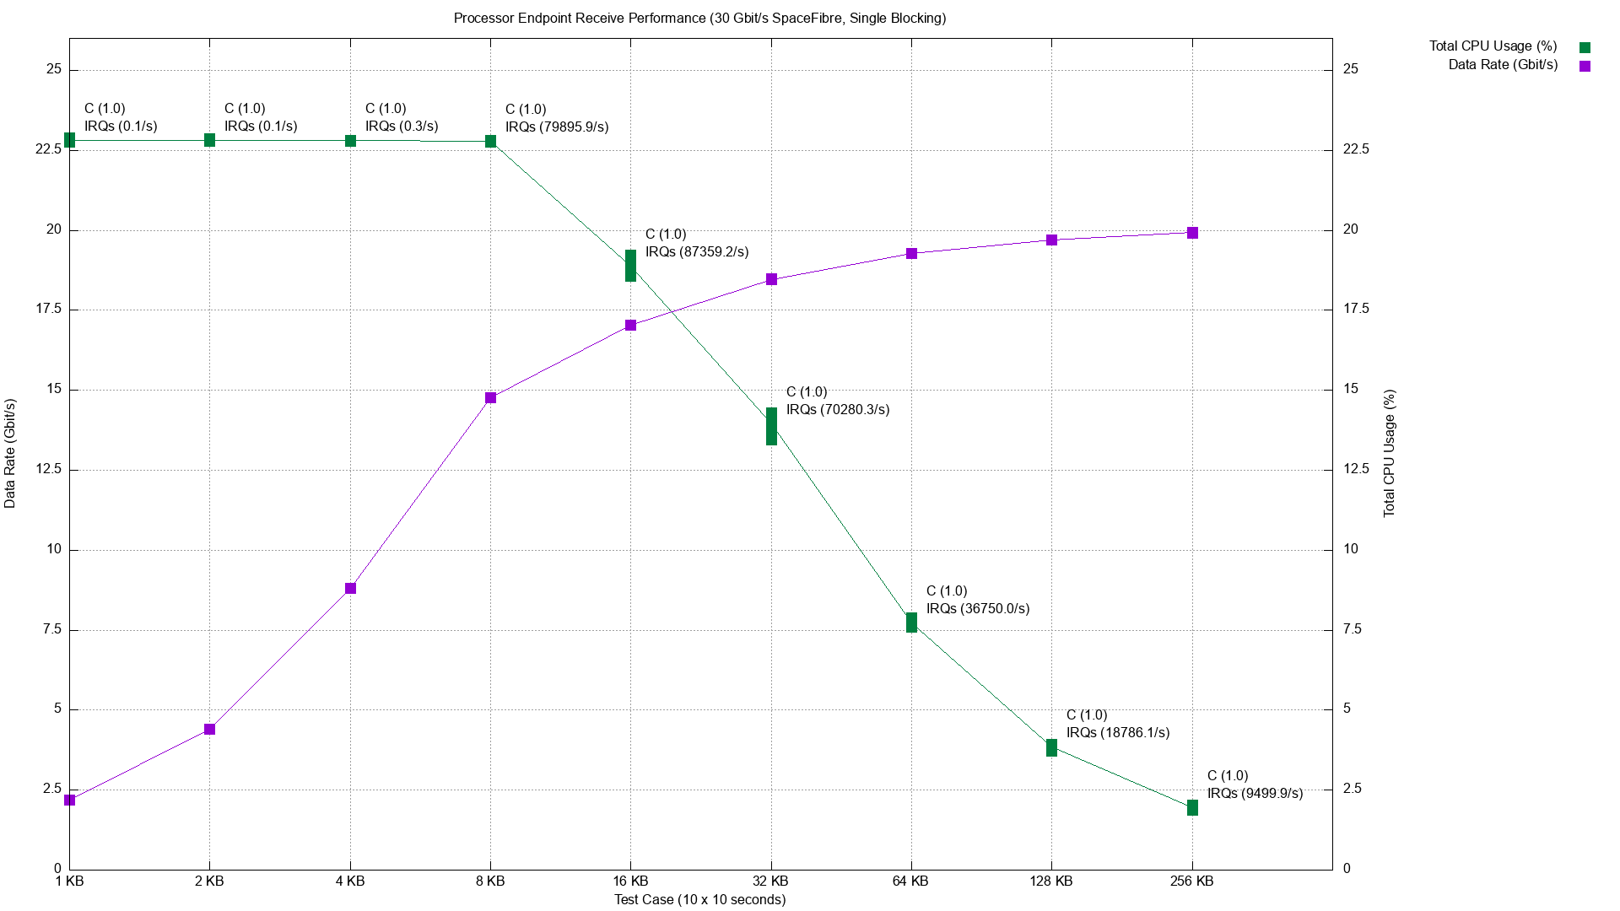
Receive Performance (Single Packets)

Slide 18
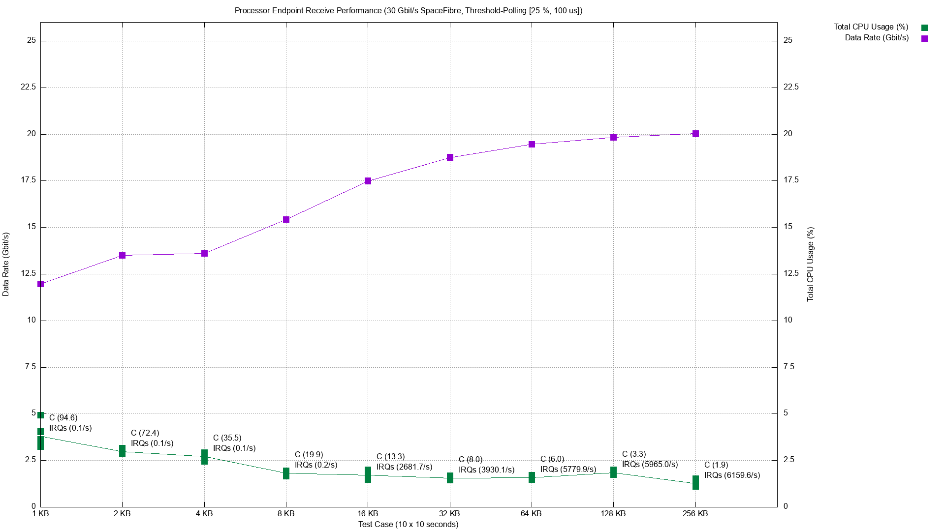
Receive Performance (Grouped Packets)

Slide 19
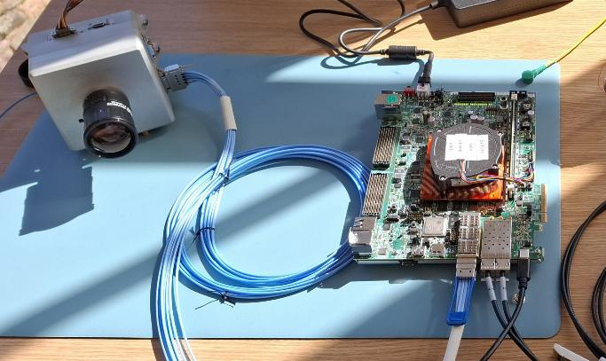
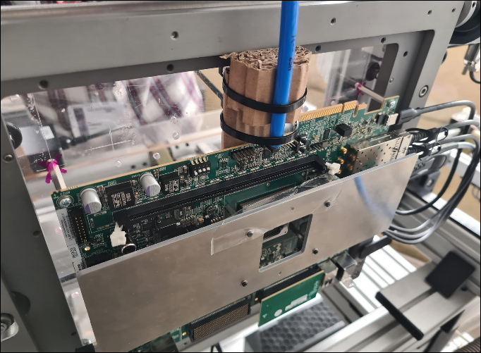
Future Testing
Performance testing of SpaceFibre Processor Endpoint on AMD Versal SoC to support 100 Gbit/s+ SpaceFibre
A. Gonzalez Villafranca, A. Ferrer Florit, M. Farras Casas and S. Parkes,
“SpaceFibre IP Cores for Fast Adoption of Next-Gen FPGA Communication Architectures”,
IEEE Aerospace Conference, Big Sky, USA, March 2025

Slide 20
Thank you for your attention Any questions?
https://www.star-dundee.com/

