Slide 1


100 Gbps SpaceFibre on Space-Qualified FPGAs Albert Ferrer, Alberto Gonzalez, Marti Farras Steve Parkes STAR-Barcelona SL STAR-Dundee Ltd
EDHPC 2025
STAR-Dundee © - EDHPC 2025

Slide 2
Next-generation missions with complex payloads demand much higher data rates.
Motivation
Current SpaceFibre links, using 8b/10b encoding, reach practical limits around 10 Gbit/s per lane
Some next-generation missions demand even higher onboard data rates
Modern FPGAs like Versal offer up to 25 Gbit/s per lane (112 Gbit/s commercial), enabling faster links
Objective is to upgrade SpaceFibre encoding to support >6.25 Gbps lane with minimum changes to the standard
Existing implementations can be easily adapted to operate at both legacy and enhanced speeds
Scrambling-based schemes (e.g. 64b/66b) reduce encoding overhead and improve spectral balance
SpFi Link
<10 Gbps
>10 Gbps
8b10b
Encoding
New
Encoding
STAR-Dundee © - EDHPC 2025

Slide 3
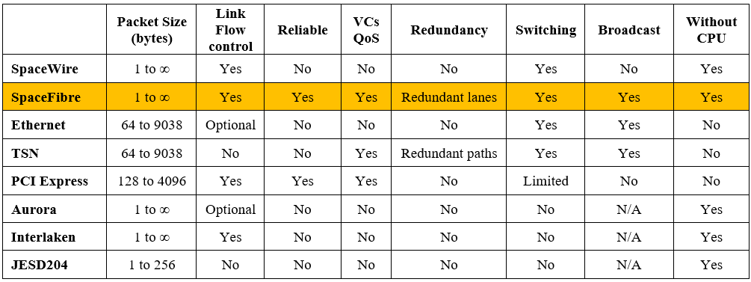
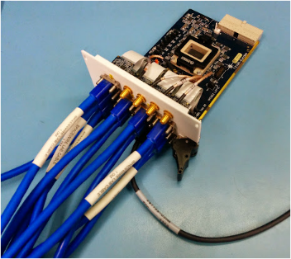
Next-generation missions with complex payloads demand much higher data rates.
Why SpaceFibre?
High performance
Runs without SW intervention
Virtual channels handle multiple data flows
Any packet size / No segmentation required
High reliability
Reliable link with link-level flow control
Link-layer error recovery in 2us
Multi-lane redundancy
Graceful BW degradation on lane failure
Hot and warm redundant lane
Quality of service
Bandwidth reservation, priority and scheduling
Designed for Space Applications
SW compatible with SpaceWire
Multi-lane with unidirectional lanes
Efficient implementation on radiation tolerant FPGAs
OSI Data Link Layer protocols
9xSpW
1xSpFi
STAR-Dundee © - EDHPC 2025

Slide 4
Line Encoding
Use of scrambling-based encoding schemes
Bit streams are statistically DC balanced
Uniform spectral properties facilitate adaptive equalization at higher rates
64b/66b encoding was selected among other options (e.g. 128b/130b, 256b/257b)
Encoding overhead reduction from 20% down to 3.125%
Low latency with a small 66-bit block size
Explicit 2-bit header
Faster block alignment than using periodic alignment patterns
Guaranteed bit transition every 66 bits (run length)
Native transceiver support in radiation tolerant FPGAs
Data Block
Control Block
0 1
D₀ D₁D₂ D₃D₄ D₅D₆ D₇
1 0
D₀ D₁D₂ D₃D₄ D₅D₆ D₇
scrambled
scrambled
STAR-Dundee © - EDHPC 2025

Slide 5
Error Detection
8b/10b encoding detects all single-bit errors and a subset of multi-bit errors
64b/66b provides no built-in error detection capability
Additional integrity check is required
A 32-bit CRC is added to each 32-bit SpFi control word covering previous data words since the preceding CRC.
32-bit SpFi words
64-bit blocks
Control Word
Control Word
32-bit CRC
Data Word
Data Word
Data Word
Data Word
CRC coverage
Data Word
Data Word
Data Word
Control Word
32-bit CRC
Data Word
Control Word

Slide 6
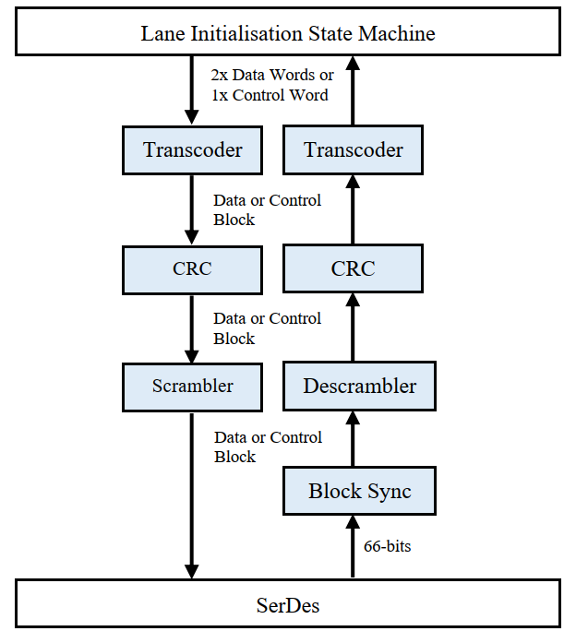
Block Diagram

Slide 7


SpaceFibre Words
K-Flags
Data Bytes
SpFi words have four characters
Can be Data or Control characters
Control characters have the 8b/10b K-flag set
SpFi control words
First character is a Control character
SpFi data words
Have control characters (EEP, EEP, FILL) at the end of a packet
The end of a packet can start at any of the four characters
C
D
D
D
D
D
D
D
D
D
D
E
D
D
E
F
D
E
F
F
E
F
F
F

Slide 8




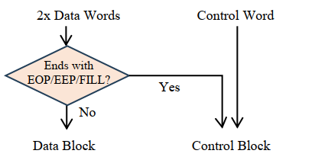
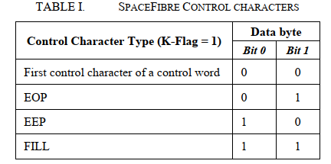
Transcoder TX
Data Word
Data Word
Control Word
End of Packet ?
Control Block with
Control Word and CRC
No
Data Block
Control Block with Data Words
First byte describe the type of packet ending (EOP/EEP/FILL)

Slide 9



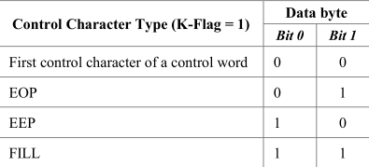


Transcoder RX
Control block
Data Block
First two bits indicates if is a control word or a data word with end of packet
Data Word
Data Word
Data Word
Data Word
Control Word

Slide 10
CRC Block
32-bit CRC field appended to each control block that contains a SpFi control word
CRC-32 polynomial defined in IEEE 802.3
CRC-32 detects
All one-bit, two-bit, and three-bit errors
All burst up to 32 bits in length
Any pair of burst errors up to eight bits each
CRC does not cover the 2-bit sync header
Invalid control blocks have random invalid CRC
Invalid data blocks will be detected in the CRC of the next control word

Slide 11
Block Sync
The block synchronizer detects where the header is located in the incoming 66-bit stream
Two consecutive bits are checked
Header bits can only be “01” or “10”.
Scrambled bits can be “01” or “10” or “11” or “00”
If “11” or “00” is found, check next bit position
After 64 consecutive “01” or “10”, block lock is considered correct
Check two consecutive bits here
Shift until lock found
scrambled
scrambled
scrambled

Slide 12
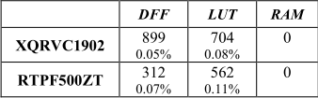
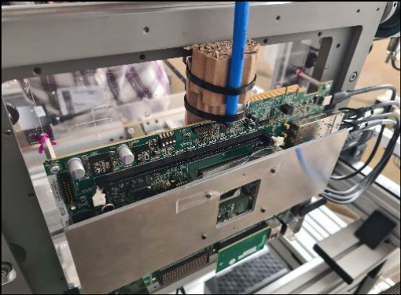
Hardware Validation
Implementation in radiation-tolerant Versal and PolarFire
Resource usage of the new encoding blocks at maximum transceiver lane rates
Heavy-ion radiation testing of 4-lane 100 Gbps links with VCK190 Evaluation Kit

Slide 13
Conclusions
SpaceFibre updated to 64b/66b to achieve higher data rates (e.g. 100G)
Limited modifications to the standard enables backwards compatibility
Transcoding block maps SpaceFibre 8b/10b codes into 64b/66b blocks
With minimal logic and power overhead
Validation in HW with radiation testing on Versal
SpaceFibre advantages
No limit on packet length -> No segmentation required
Reliable link -> mitigates high BER and SEEs
Can work without software -> Simpler, more robust
QoS with multiple Virtual Channels -> Simple decoupling of data flows
Link flow control -> Transmit reacts to dynamic receiver behaviour
Future work focus on forward error correction (FEC) for >25 Gbps per lane

