Slide 1


Effective, Robust TCP/IP over SpaceFibre Albert Ferrer, Marti Farras Steve Parkes STAR-Barcelona SL STAR-Dundee Ltd
EDHPC 2025
STAR-Dundee © - EDHPC 2025

Slide 2
Overview

Slide 3
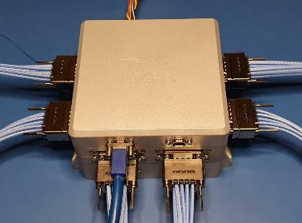

Next-generation missions with complex payloads demand much higher data rates.
Motivation
SpaceFibre designed for space applications
Reliable
Link layer error recovery
Multilane redundancy
Flexible
Arbitrary lane rate, packet format and size
Virtual Networks with QoS decouple different data flows
Works without software
Implemented in multiple radiation-tolerant FPGAs
Leverage commercial HW and SW in space applications
Use COTS processors with Ethernet interfaces
Use standard OS network stack and related applications (e.g. FTP)
STAR-Dundee © - EDHPC 2025

Slide 4
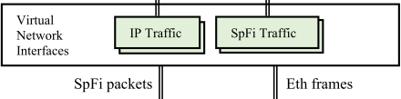
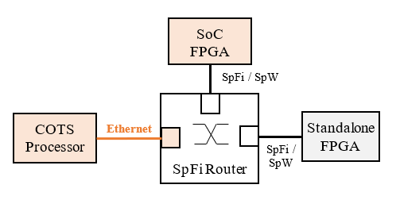
Next-generation missions with complex payloads demand much higher data rates.
Proposed Solution
Use COTS SW and HW with the development of:
Virtual Network Interface that handles:
IP traffic (e.g. TCP/UDP)
Carried by Ethernet Frames
SpFi native traffic (e.g. RMAP)
Using UDP sockets
SpaceFibre Router with Ethernet ports
Bridges SpaceFibre and Ethernet at link layer
Simpler, no IP layer processing required
Support raw Ethernet frames and TCP/IP
STAR-Dundee © - EDHPC 2025

Slide 5
SpaceFibre Router with Ethernet ports

Slide 6
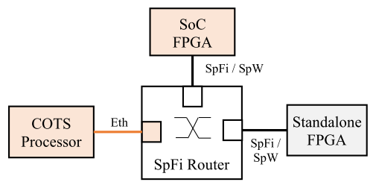
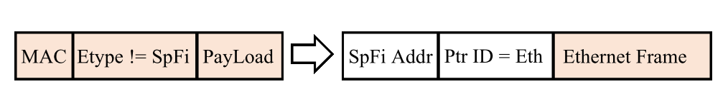
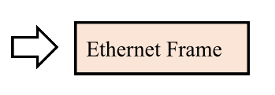
Next-generation missions with complex payloads demand much higher data rates.
IP Traffic: COTS Processor to SoC FPGA
The Ethernet frames from the COTS processor are encapsulated into SpFi packets by the Ethernet port of the SpFi Router
At the destination, the virtual network interface of the SoC FPGA decapsulates them into Ethernet frames, which are then processed by the standard OS network stack
STAR-Dundee © - EDHPC 2025

Slide 7
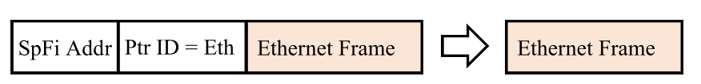
Next-generation missions with complex payloads demand much higher data rates.
IP Traffic: SoC Processor to COTS FPGA
The network interface of the SoC FPGA sends SpaceFibre packets containing Ethernet frames
The SpFi packets are routed to the Ethernet port, which decapsulates the Ethernet frames, so they can be forwarded to the COTS Processor
STAR-Dundee © - EDHPC 2025

Slide 8
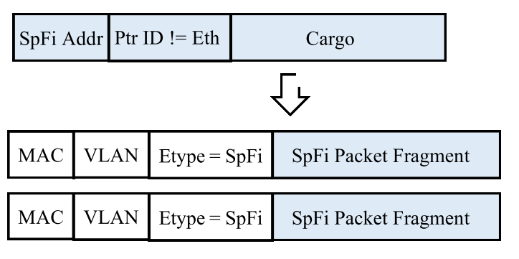

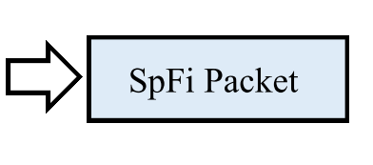
Next-generation missions with complex payloads demand much higher data rates.
SpaceFibre Traffic: COTS Processor to Standalone FPGA
The virtual network interface of the COTS Processor encapsulates the SpFi packets into Ethernet frames
The Ethernet Frames are then decapsulated by the Ethernet port and routed to the destination FPGA
STAR-Dundee © - EDHPC 2025

Slide 9
Next-generation missions with complex payloads demand much higher data rates.
SpaceFibre Traffic: Standalone FPGA to COTS Processor
The SpaceFibre packets arrive at the Ethernet port, which encapsulates them into Ethernet frames
The network interface of the COTS processor obtains the application data, e.g., RMAP read reply, from the encapsulated SpFi packets
STAR-Dundee © - EDHPC 2025

Slide 10
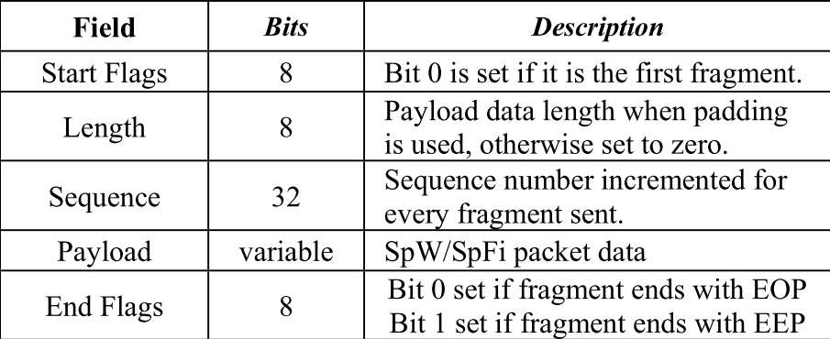
Next-generation missions with complex payloads demand much higher data rates.
SpaceFibre Packet Fragment within Ethernet Frame
“Start Flags” and “Sequence” fields detect if an Ethernet frame was lost
Provides data integrity by truncating an outgoing SpFi packet with an EEP
“Length” field used only when there is Ethernet frame padding
When payload length being smaller than the minimum (48 bytes)
STAR-Dundee © - EDHPC 2025

Slide 11
Next-generation missions with complex payloads demand much higher data rates.
MAC Address Translation
Direct mapping between a MAC address byte to the SpFi address byte
If MAC values can not be configured, then a look up table is necessary
MAC Format: 02:00:XX:XX:LA
02: unicast traffic and locally administered MAC
00: Ethernet port identifier
XX: Don’t care
LA: SpaceFibre Logical Address
A MAC address is assigned to each Ethernet port of the SpFi Router
Sets the source MAC address of Ethernet frames created to encapsulate SpFi packets
STAR-Dundee © - EDHPC 2025

Slide 12
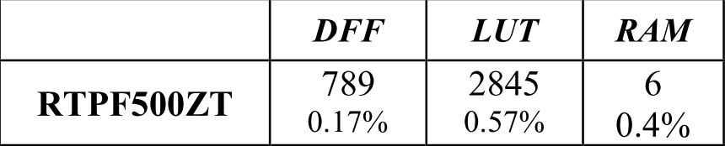
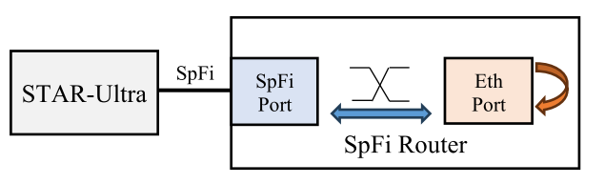
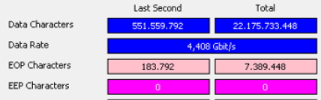
Next-generation missions with complex payloads demand much higher data rates.
Implementation Results
Ethernet port bridging logic implemented on a radiation-tolerant PolarFire FPGA (RTPF500ZT) without including an Ethernet MAC IP
Performance test on a SpFi Router implemented in a Versal
The Ethernet MAC IP was replaced with a loopback logic
STAR-Ultra is sending at 5 Gbps:
SpFi packets with 3 KB of raw data
SpFi packets carrying Ethernet frames
STAR-Dundee © - EDHPC 2025

Slide 13
Virtual Network Interfaces

Slide 14
Next-generation missions with complex payloads demand much higher data rates.
Virtual Network Interface
Allows user applications to exchange both IP-based traffic and native SpaceFibre packets through standard TCP/UDP sockets
When an application opens a TCP or UDP socket, the OS stack generates the corresponding IP packets and forwards them to the appropriate virtual interface, depending on the source and destination IP address of the socket configuration
Each virtual interface is configured with an IP address (or subnet) and a maximum transmission unit (MTU)
The MTU defines the maximum packet size supported by the interface
OS network stack handles fragmentation
Received packets from SpFi or Ethernet are decapsulated, reconstructed as IP packets, and injected back into the OS stack
STAR-Dundee © - EDHPC 2025

Slide 15
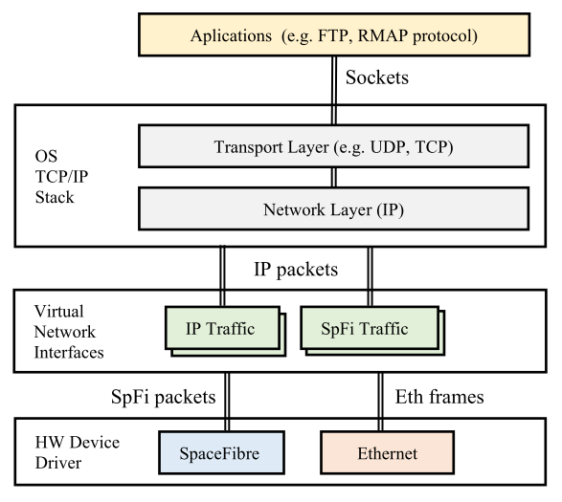
Next-generation missions with complex payloads demand much higher data rates.
Unified Network Stack
IP traffic and SpFi traffic have different IP subnets and associated network interfaces
IP traffic is always encapsulated in an Ethernet frame
SpFi Traffic applications use the UDP protocol
QoS: each SpFi Virtual Channel or Ethernet PCP can be assigned to a different Virtual Network Interface
A network interface use a particular HW Device Driver (SpFi or Ethernet)
STAR-Dundee © - EDHPC 2025

Slide 16
Evaluation

Slide 17
Next-generation missions with complex payloads demand much higher data rates.
Hardware and Software Setup
Flexible HW setup
SpFi Router implemented in a Versal
SW-based endpoints are Linux PCs with SpFi and Ethernet interfaces
Router Configuration port used to test RMAP commands
PC with SpFi STAR-Ultra
PC with Ethernet
Router config port
Versal
Virtual network interfaces are implemented as TUN interfaces
TUN kernel driver exposes IP packets from the network stack through R/W file descriptors
The functionality is implemented in a user-space process using these file descriptors
STAR-Dundee © - EDHPC 2025

Slide 18
Next-generation missions with complex payloads demand much higher data rates.
IP Adress Translation
Direct translation is used between IP, MAC and SpFi logical addresses
Simple and easy to use
<VN> is the SpFi virtual network number (similar to Ethernet VLAN)
<LA> is the SpFi destination logical address
IP traffic: 10.100.<VN>.<LA>
SpFi traffic: 10.100.<VN+128>.<LA>
Each SpFi or Ethernet endpoint is assigned a unique SpFi LA
Common identifier across all network layers (SpFi, MAC, IP)
STAR-Dundee © - EDHPC 2025

Slide 19
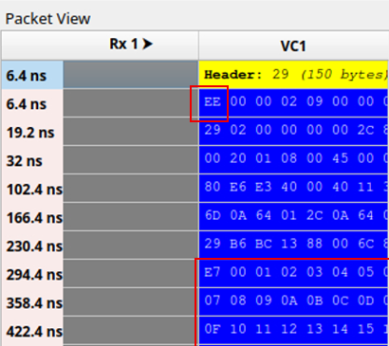
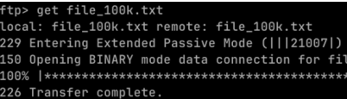
Next-generation missions with complex payloads demand much higher data rates.
Example Results: IP Traffic over SpFi/Ethernet
IP packet received from a SpFi link
SpFi protocol ID is 0xEE (Ethernet Frame)
IP payload after Ethernet and IP headers (0x00, 0x01, 0x2…)
File transfer with FTP between two endpoints, across a network with both SpFi and Ethernet links
STAR-Dundee © - EDHPC 2025

Slide 20
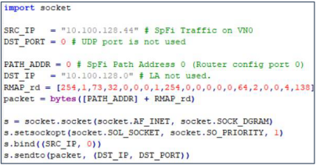
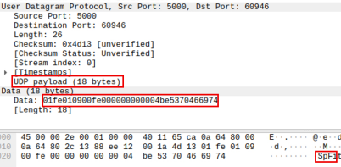
Next-generation missions with complex payloads demand much higher data rates.
Example Results: SpFi Traffic over SpFi/Ethernet
Python script sends RMAP read command with a UDP socket
RMAP reply received over Ethernet as seen by Wireshark software
STAR-Dundee © - EDHPC 2025

Slide 21
Next-generation missions with complex payloads demand much higher data rates.
Conclusions
COTS Processors with Ethernet links are easily integrated into a SpaceFibre network
HW-based bridge logic integrated in the SpaceFibre Router
TCP/IP and related commercial SW can use SpaceFibre links
Solution is based on:
SpaceFibre Router upgraded with Ethernet ports
Virtual Network Interfaces handles both IP and native SpFi traffic
Get the best of both worlds
Commercial technology can leverage SpaceFibre capabilities for Space Applications
Reliable link and lane redundancy handles radiation events
Flexible packet length and format avoids segmentation and header parsing
Link level flow control allows transmitter to react to dynamic receiver without loss
Virtual Networks with QoS make system integration simpler
Broadcast messages natively support redundant topologies
STAR-Dundee © - EDHPC 2025

Slide 22
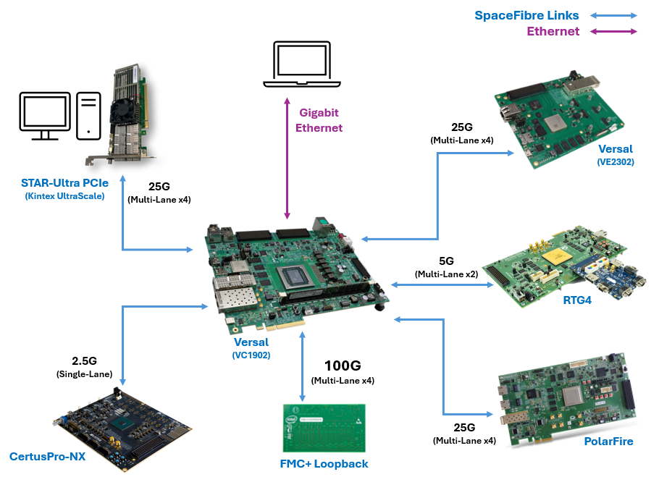
Next-generation missions with complex payloads demand much higher data rates.
Visit our booth
and see our demo!
STAR-Dundee © - EDHPC 2025

