Slide 1
Development and Reliability assesment of High Data Rate cPCI Serial Space Connectors
Dr. Léo Farhat
Mr. Joaquín Jiménez
EEE passive component experts
Components’ section TEC-EDC
14/10/2025

Slide 2
Background & Rationale
Specification & Challenges
On-going Activities
Conclusion

Slide 3
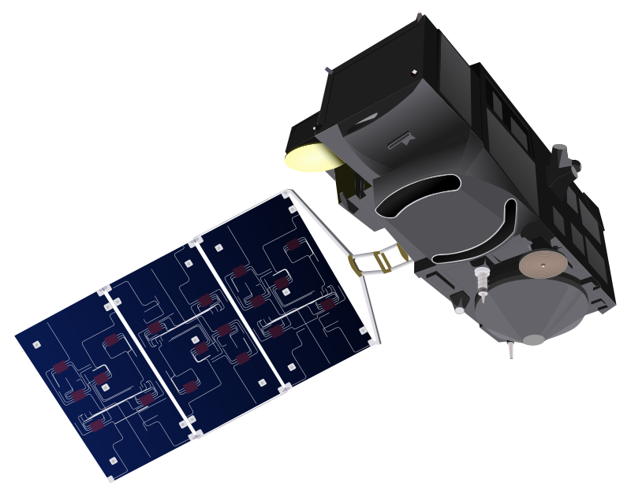
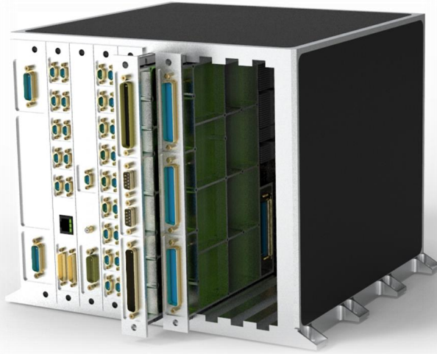
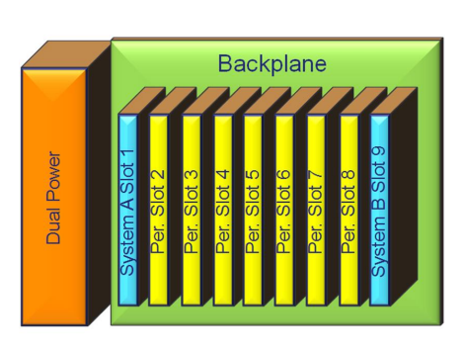
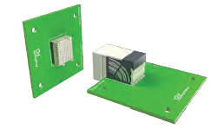

Background and rationale
ADHA Modules
cPCI Serial Space Architecture
cPCI SS
Connectors
<<< CO$T
The cPCI Serial Space (SS) was selected as the standard for ADHA workshop January 2020.
cPCI SS allows for flexibility, modularity, interoperability and relatively price reduction compared to the level of performances.

Slide 4
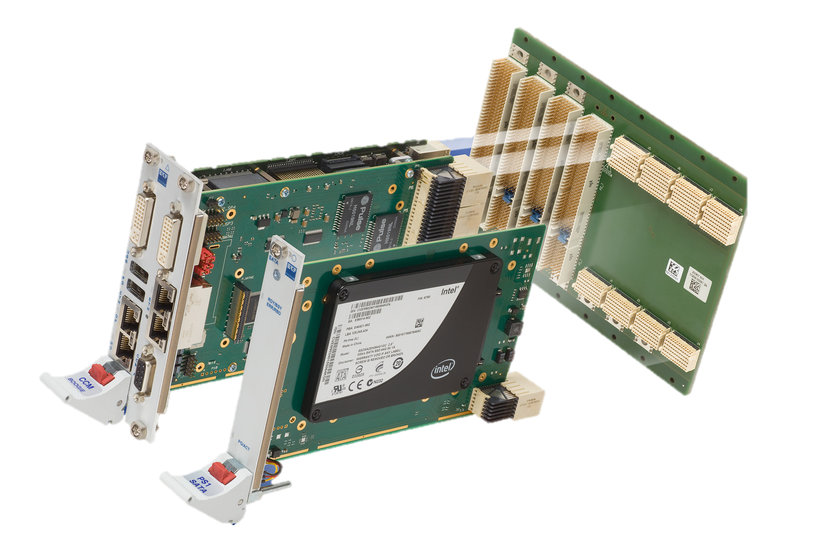
Background and rationale
Daughterboard Connectors
Backplane
Motherboard
Backplane Connectors
Printed Cicuit Boards (PCB)
Daughterboard
Daughterboard

Slide 5
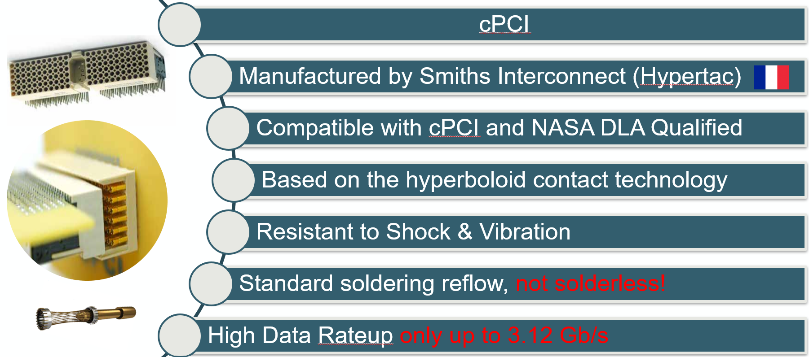
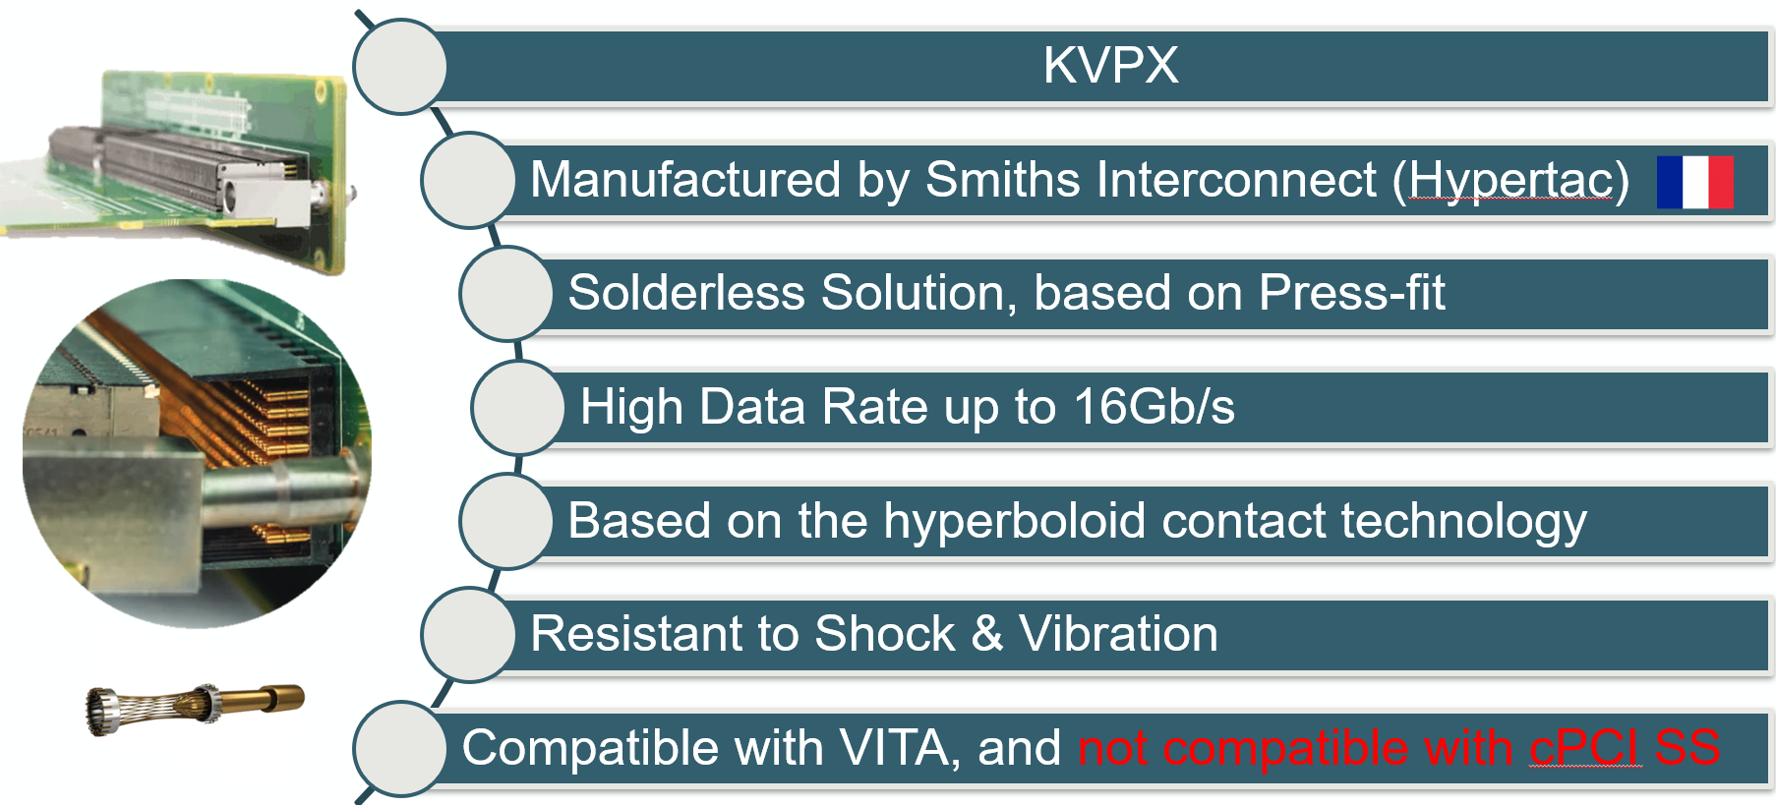
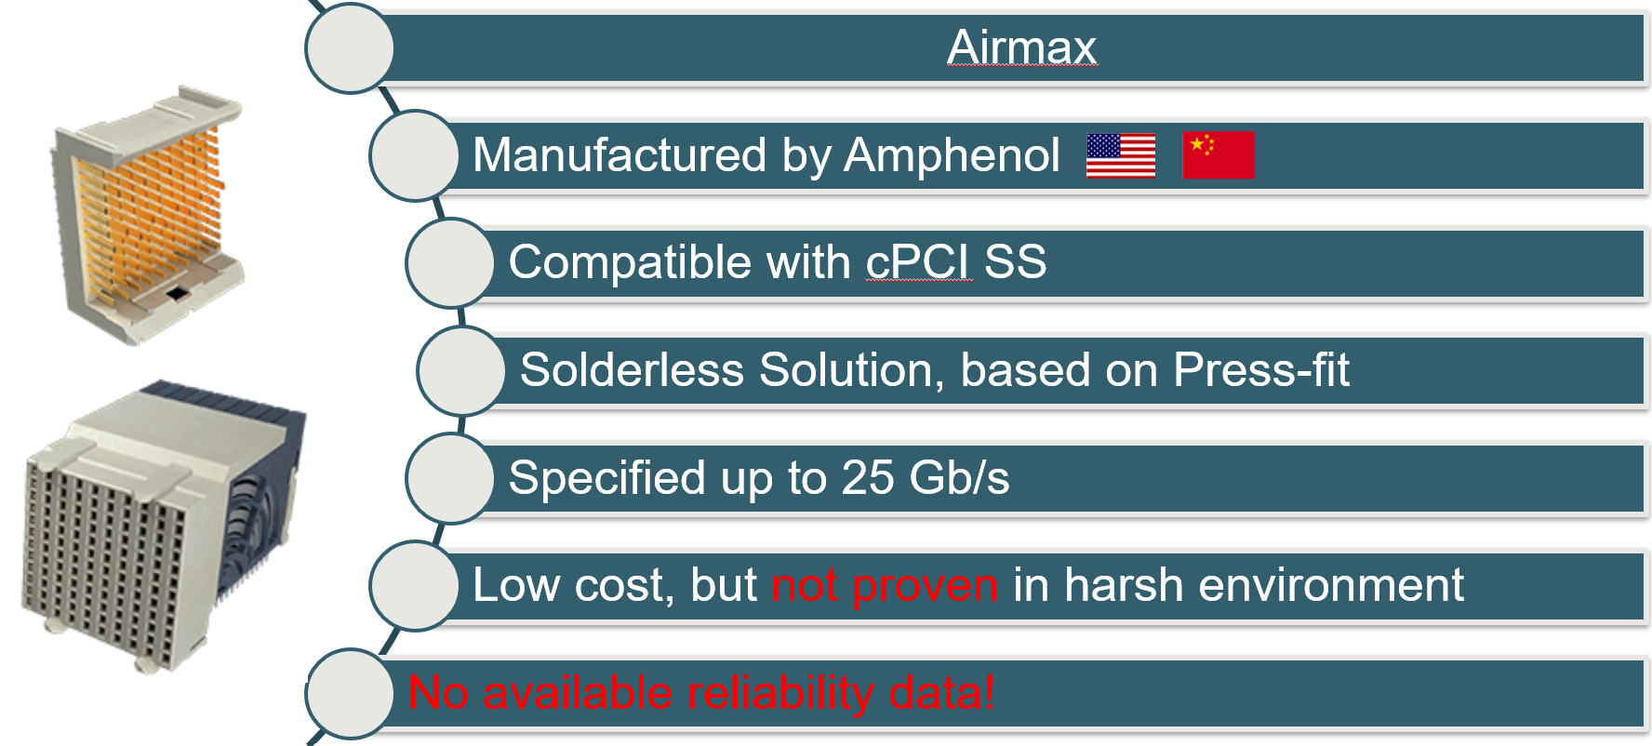
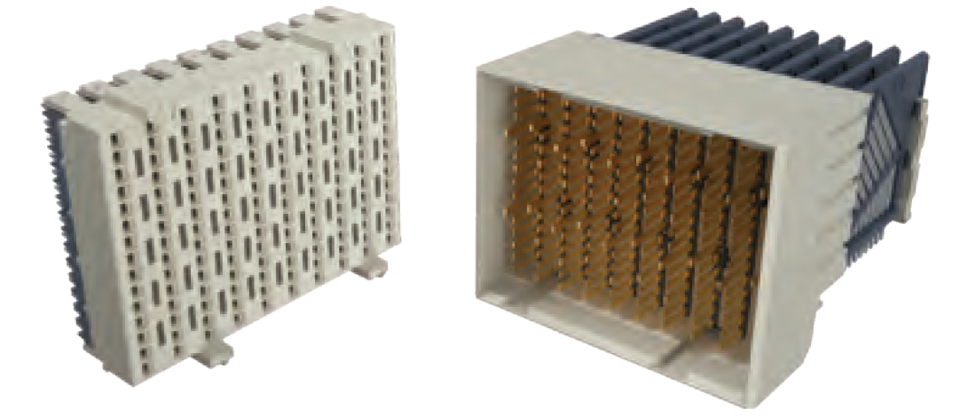
Background and rationale
Currently, there is no High Data Rate connectors, compatible with cPCI SS, for space applications!
The current available space solutions are not compatible with cPCI SS (speed rate, layout, etc.).

Slide 6
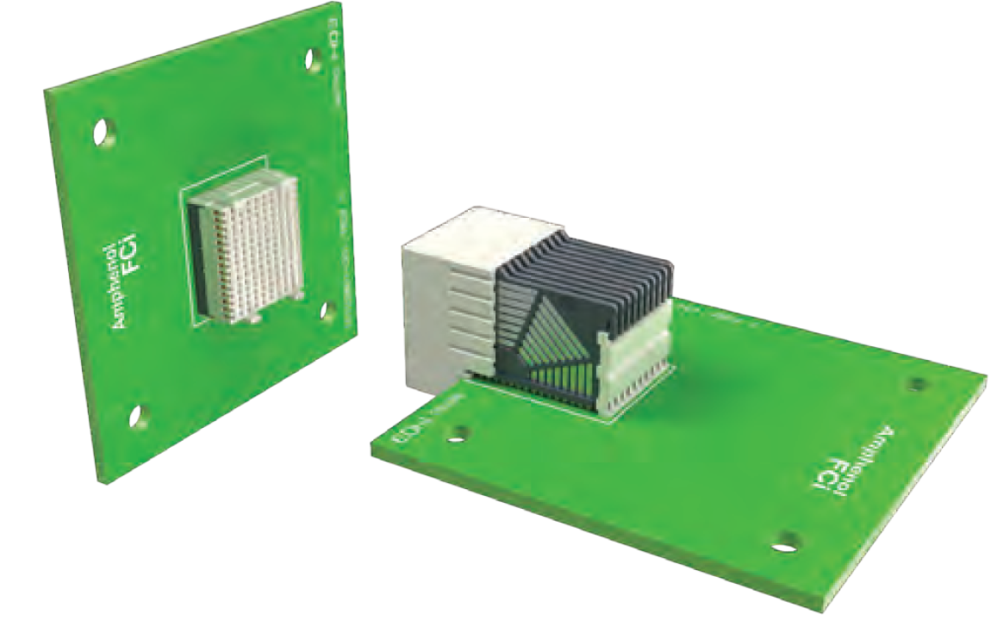
Background and rationale
The only solution compatible with cPCI SS (and with high data rate) is a commercial solution, manufactured by Amphenol (manufactured in China) with no proper evaluation data!
Need to Develop and Qualify a Space-grade High Data Rate (25 Gb/s) Connectors compatible with cPCI SS for space applications

Slide 7
Background & Rationale
Specification & Challenges
On-going Activities
Conclusion

Slide 8
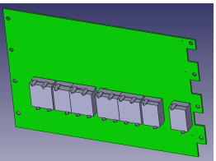
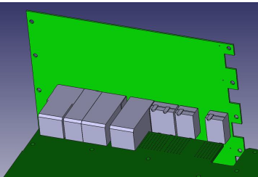
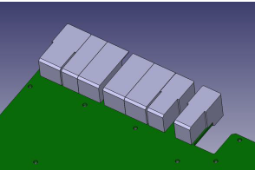



Specifications & Challenges
Main Challenges w.r.t. ADHA Specification:
High Speed up to 25 Gb/s
Solderless solutions (i.e. Press-fit)
Operating Temperature: -55°C to 125°C
No impedance change or discontinuity of 1ns or longer duration during mechanical and thermal tests
Current rating per contact: 2A

Slide 9
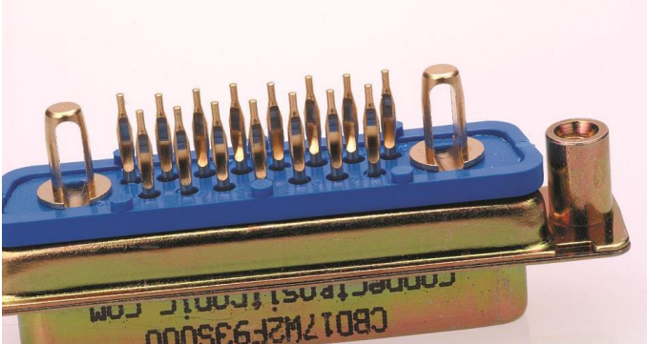
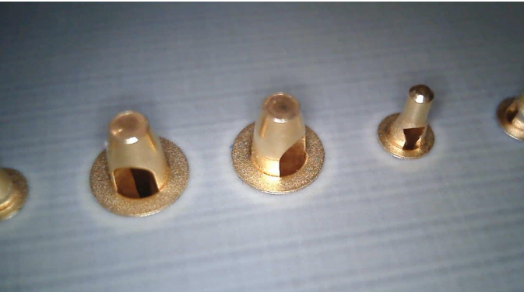
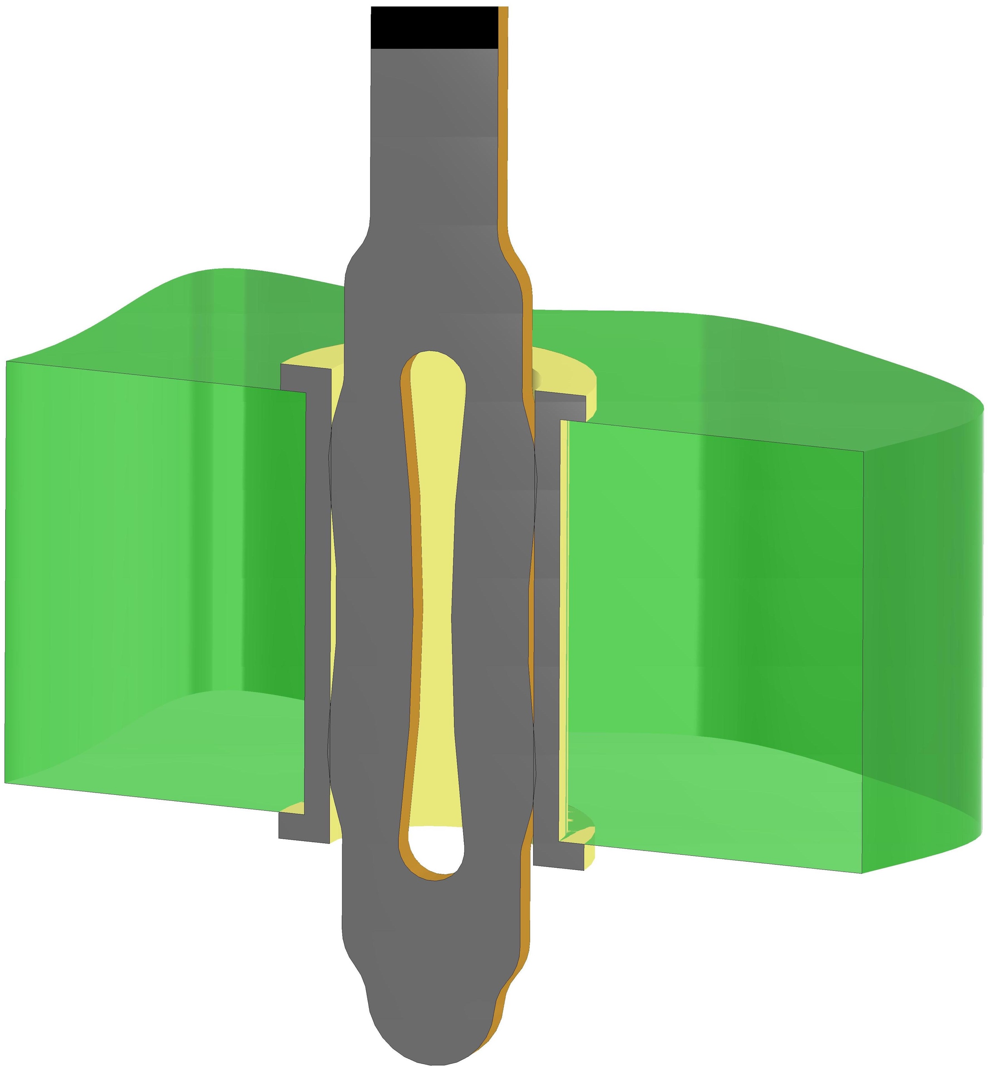
Specification & Challenges
Known reliability issues related to the press-fit technologies:
Impedance discontinuities during mechanical tests
Low data press-fit connectors (Positronic) are being ESCC qualified for discontinuities smaller than 10 us during mechanical tests.
ADHA High data rate requires 1ns of discontinuity during mechanical test.
No clamping mechanism (or additional screws) to hold the mated pair together.
All the mechanical stress goes through the press-fit terminations.
This leads to intermittent loss of connectivity during vibration or shock!

Slide 10
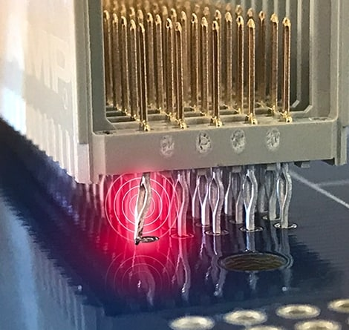
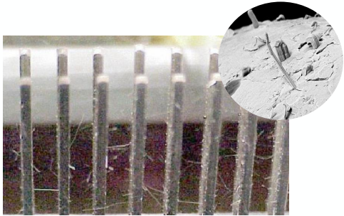
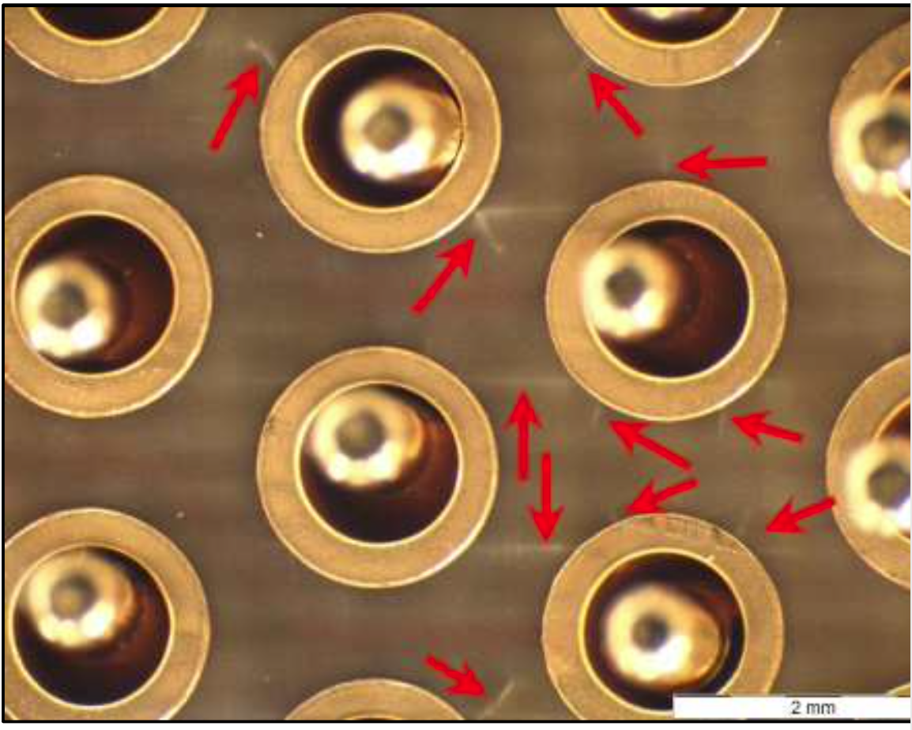
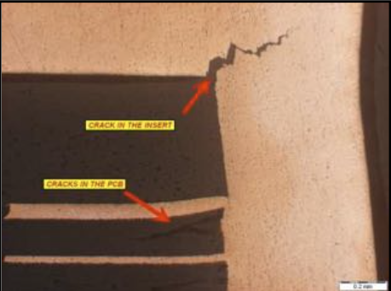
Specification & Challenges
Known reliability issues related to the press-fit technologies:
PCB Damage due to the fretting of the plating materials (corrosion wear) or cracks in PCB and pins materials, due to the relative movement of the press-fit pins inside the PCB.
Growth of dendrites tin whiskers on pins with pure tin are also considered as delayed failures!
This leads to an increase in contact resistance, thus a drastic decrease of the data rate!

Slide 11
Background & Rationale
Specification & Challenges
On-going Activities
Conclusion

Slide 12
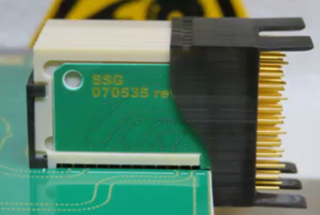
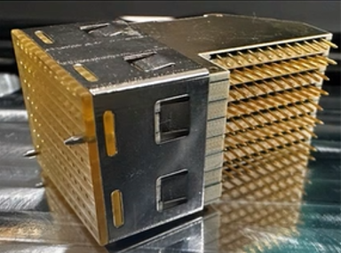


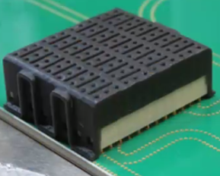

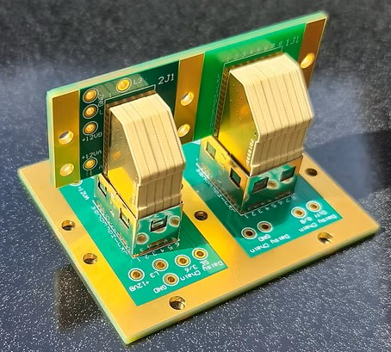


ON-GOING ESA R&D ACTIVITIES
TDE: Procurement and Reliability Assessment of High Data Rate Press-Fit cPCI SS connectors: AIRMAX (Amphenol) and HYPERBITS (Performance Interconnect) (ALTER TECHNOLOGY SPAIN)
ARTES: Board to Board Interconnections for High Data Rate applications (AXON’ cable)
TDE:High Density Modular Electrical Interconnections for High Data Rate Applications (Performance Interconnect & ALTER TECHNOLOGY FRANCE)

Slide 13
Background & Rationale
Specification & Challenges
On-going Activities (I)
TDE: Procurement and Reliability Assessment of High Data Rate Press-Fit cPCI SS connectors: AIRMAX (Amphenol) and HYPERBITS (Performance Interconnect) (ALTER TECHNOLOGY SPAIN)
Conclusion

Slide 14
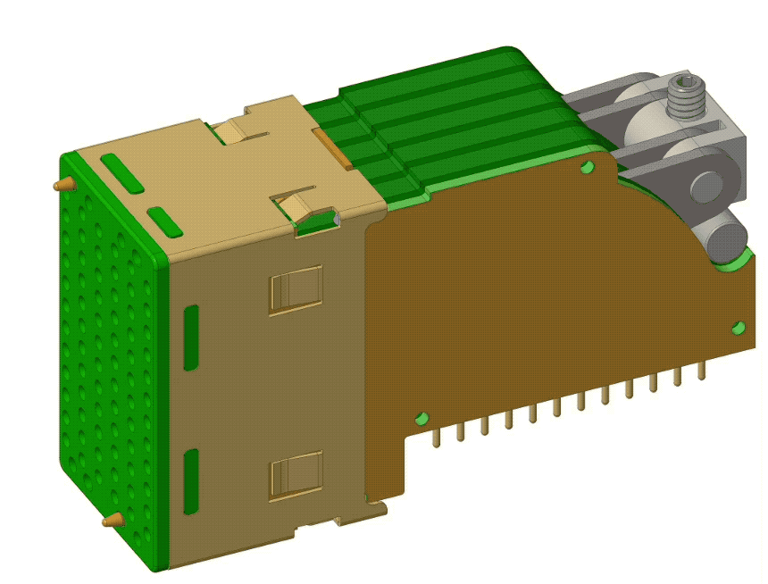
Procurement and Reliability Assessment of High Data Rate Press-Fit cPCI SS connectors
Contractor: ALTER TECHNOLOGY (Spain) |  |  |  |  | ESA Budget | 80 k€ +20k€
Funding | TDE | Initial TRL: 2 | Target TRL: 4 |  | TO: Léo Farhat Joaquín Jiménez
Start of activity: June 2022 |  | End of Activity: March 2026
Background and justification: The current large increase of data traffic is causing the space sector to push for the development of communication standards that allow for higher data rates. ESA has recently funded a study on Advanced Data Handling Architecture (ADHA) in order to establish a versatile, compact, modular and scalable Data Handling System architecture using standardised building blocks. Unfortunately, there is currently no space grade High Data Rate (HDR) connectors compatible with cPCI SS. The only existing solution is a commercial connector, manufactured by Amphenol (USA), with no reliability assessment data.
Objective(s): The aim of this activity is double: 1 -to procure and assess the reliability of existing high data rate press-fit connectors compatible with cPCI SS: the commercial AirMax VS® cPCI-s manufactured by Amphenol (USA). 2- to support the development and assess the reliability of the HyperBits™ S-FECT (Performance Interconnect, FR)
Achievement and status: AirMax VS® cPCI-s samples procured. Assembly of Hyperbits gen1: assembled solutions Q2 2023 Test plan has been defined: DC electrical parameters under mechanical and thermal cycles with electrical continuity monitoring, mating & de-mating, life test (s-parameters, high and low temperature), construction analysis, outgassing. Final design and validation of test PCBs for mechanical testing and s-parameters testing. DC electrical parameters tested, outgassing performed, mechanical tests on-going (sine vibration).
Benefits: The advantages offered by solderless technology makes this the perfect baseline to develop High Data Rate connectors.
Next steps: S-parameters measurements |  |  |  | Thermal cycles, mating & de-mating, life test Final Report expected in March 2026.

Slide 15
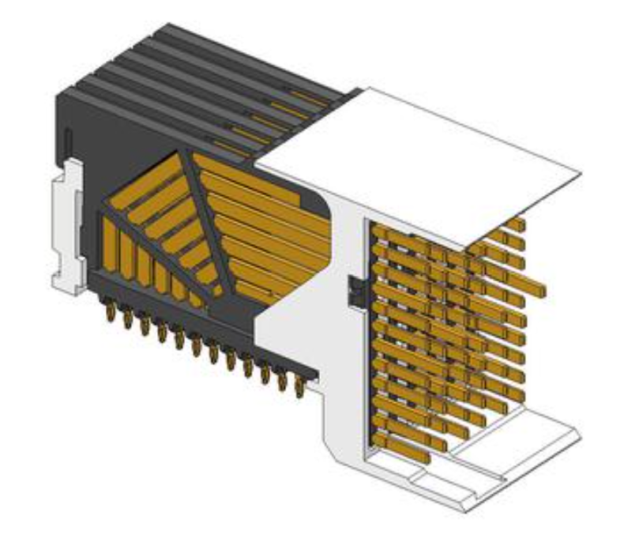
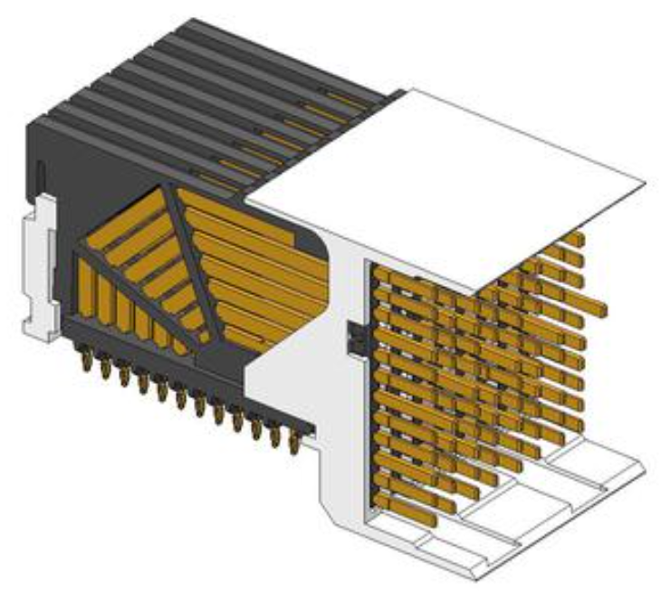
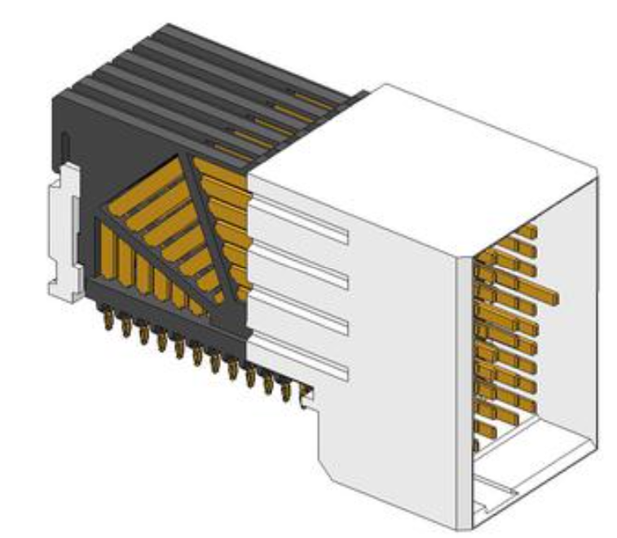
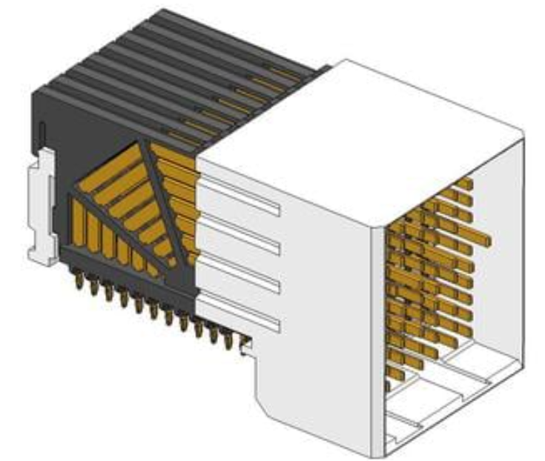
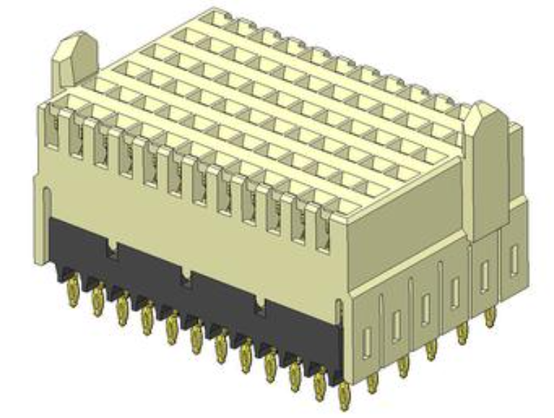
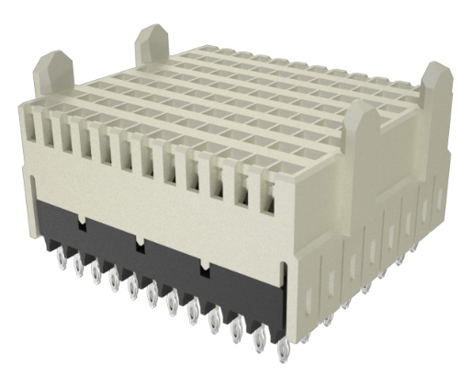
Airmax (Amphenol): Assembly & Reliability Tests (Procurement)
10 samples HDR press-fit AirMax VS® cPCI-s 10052824-101LF Daughterboard 72-position, 6 column, 2 Walls, Right Angle |  | 10 samples HDR press-fit AirMax VS® cPCI-s 10052837-101LF Daughterboard 96-position, 8 column, 2 Walls, Right Angle Header
10 samples HDR press-fit AirMax VS® cPCI-s 10052825-101LF Daughterboard 72-position,6 column, 4 Walls, Right Angle |  | 10 samples of HDR press-fit AirMax VS® cPCI-s 10052838-101LF Daughterboard 96-position, 8 column, 4 walls, Right Angle
15 samples HDR press-fit AirMax VS® cPCI-s 10052829-101LF Backplane 72-position, 6 column, Vertical Receptacle |  | 15 samples HDR press-fit AirMax VS® cPCI-s 10052842-101LF Backplane, 96-position, 8 column, Vertical Receptacle

Slide 16
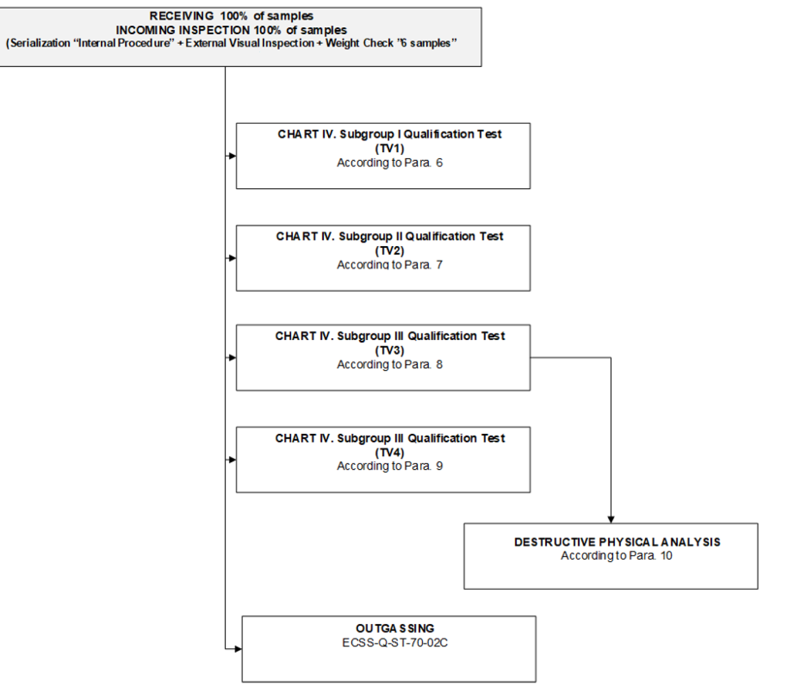
Airmax (Amphenol): Assembly & Reliability Tests: Test plan (I)
SUBGROUP I - TV1
DC Electrical measurements
  Contact resistance at 10mA
  Contact resistance at 2A
  Voltage proof 500V_{rms}
  Insulation resistance 500V_{DC}
Sine vibration
Random vibration
Mechanical Shock
20 cycles thermal shock

Slide 17
Airmax (Amphenol): Assembly & Reliability Tests: Test plan (II)
SUBGROUP II – TV2
Mating and de-mating
DC Electrical measurements

Slide 18
Airmax (Amphenol): Assembly & Reliability Tests: Test plan (III)
SUBGROUP III – TV3
RF measurements
(at 25°C, -55°C, +125°C):
  Insertion loss
  Near-end cross talk
  Far-end cross talk
  Differential impedance
Life test until 500h
until 1000h
until 2000h

Slide 19
Airmax (Amphenol): Assembly & Reliability Tests: Test plan (IV)
SUBGROUP IV – TV4
DC Electrical measurements
RF measurement (+125°C)
5 cycles overload test
(1,5xrated current)

Slide 20
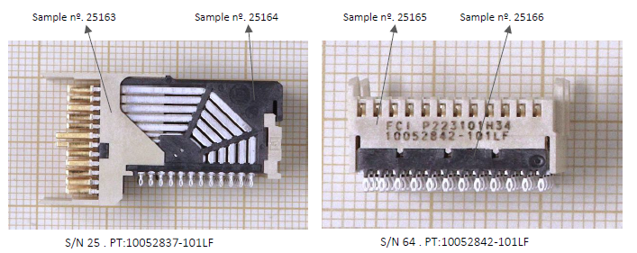
Airmax (Amphenol): Assembly & Reliability Tests: Test results (I)
1. Outgassing ECSS-Q-ST-70-02C
Samples | Description | TML (%) | RML (%) | CVCM (%)
25163 | White plastic housing - Header | 0,069 | 0,053 | 0,001
25164 | Black plastic housing - Header | 0,074 | 0,058 | 0,003
25165 | White plastic housing - Receptacle | 0,072 | 0,047 | 0,001
25166 | Black plastic housing - Receptacle | 0,052 | 0,041 | 0,002
The samples tested are compliant with general limits of acceptance for material selection according to ECSS-Q-ST-70-02C: RML < 1,00% , CVCM < 0,10%.
10052837-101LF
10052842-101LF

Slide 21
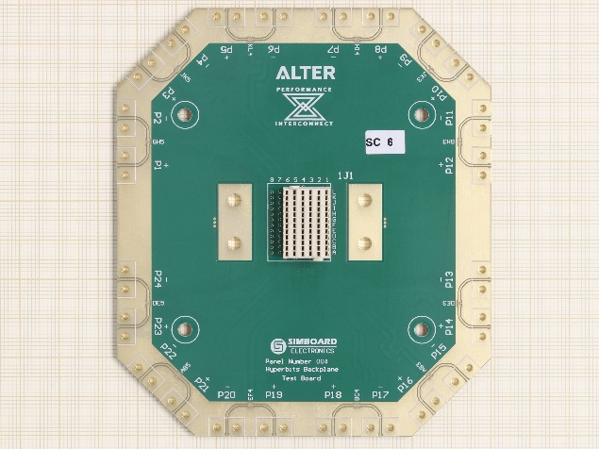
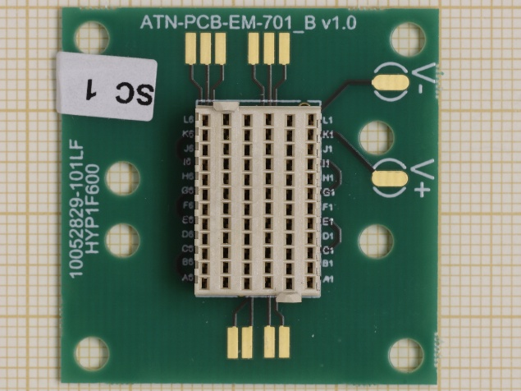
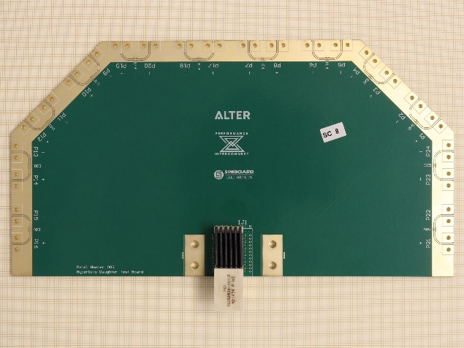
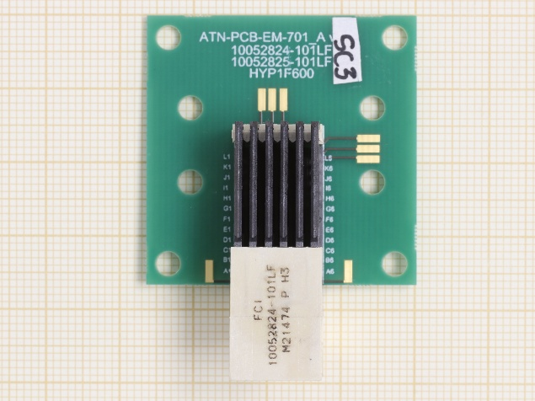
Airmax (Amphenol): Assembly & Reliability Tests: Test results (II)
RF characterisation PCB, Mechanical characterisation PCB, Airmax connectors insertion
Connector SN | Connector-PCB SN | Type of connector | Nº of Pins | PCB
54 | A | 10052829-101LF Receptacle. | 72 | RF PCB (Back plane)
4 | B | 10052824-101LF Header. | 72 | RF PCB (Daughter)
53 | C | 10052829-101LF Receptacle. | 72 | Vibration PCB 10052829-101LF
34 | D | 10052824-101LF Header. | 72 | Vibration PCB 10052824-101LF & 10052825-101LF
66 | E | 10052842-101LF Receptacle. | 96 | Vibration PCB10052842-101LF
36 | F | 10052838-101LF Header. | 96 | Vibration PCB 10052837-101LF & 10052838-101LF
61 | G | 10052842-101LF Receptacle. | 96 | RF PCB (Back plane)
24 | H | 10052838-101LF Header. | 96 | RF PCB (Daughter)
SN A
RF
SN C
VIB
SN B
RF
SN D
VIB
Successful insertion of 8 Airmax connectors:
Four inserted in PCBs for vibration characterisation
(SN C,D,E,F)
Four inserted in PCBs for RF characterisation
(SN A,B,G,H)

Slide 22
Airmax (Amphenol): Assembly & Reliability Tests: Test results (III)
3. DC electrical measurements at room temperature: continuity verification, contact resistance, voltage proof, insulation resistance
Samples to be submitted to mechanical testing
Connector SN | Connector-PCB SN | Type of connector | Nº of Pins | PCB
53 | C | 10052829-101LF Receptacle. | 72 | Vibration PCB 10052829-101LF
34 | D | 10052824-101LF Header. | 72 | Vibration PCB 10052824-101LF & 10052825-101LF
66 | E | 10052842-101LF Receptacle. | 96 | Vibration PCB10052842-101LF
36 | F | 10052838-101LF Header. | 96 | Vibration PCB 10052837-101LF & 10052838-101LF
SN C: 10052829-101LF Receptacle
SN E: 10052842-101LF Receptacle
SN D: 10052824-101LF Header
SN F: 10052838-101LF Header
DC Electrical measurements test results:
Nº | TEST |  | CONDITIONS | LIMITS |  | UNIT | PASS | FAIL
 |  |  |  | MIN | MAX
1 | Contact Resistance | RCL | Imeas = 10mA | -- | 35 | mΩ | 4 | 0
2 | Contact Resistance | RCR | Imeas = 2A | -- | 20 | mΩ | 4 | 0
3 | Voltage Proof | IL | Vmeas = 500Vrms, t = 5s (Note 3) | Note 3 |  | -- | 4 | 0
4 | Insultaon Resistance | Ri | Vmeas = 500VDC, t = 60s (Note 4) | 1000 | -- | MΩ | 4 | 0
Electrical measurements performed in 4 mated connector pairs (C mated with D / E mated with F)
Continuity verification: Successful results.
Contact resistance, voltage proof, insulation resistance: Successful results.
No anomalies were detected.
Note 3: No evidence of breakdown, flashover or excessive leakage current >0.5mA.

Slide 23
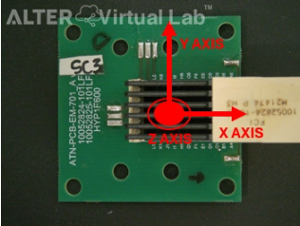
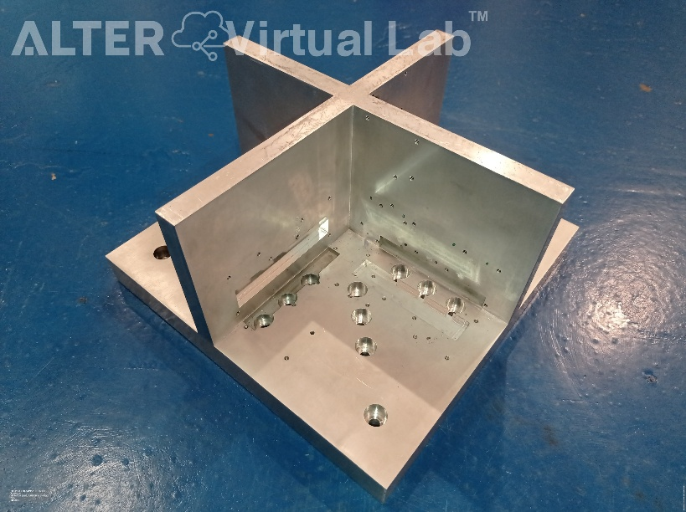
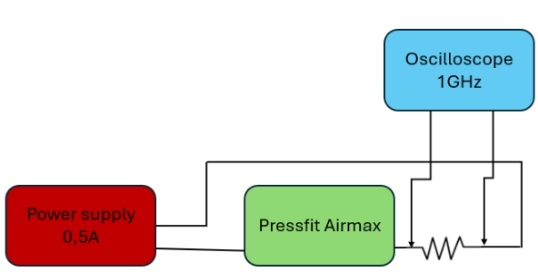
Airmax (Amphenol): Assembly & Reliability Tests: Test results (IV)
4. Sine vibration test: Axis definition, vibration tool & measurement conditions
EUT set up & Measurement conditions
Detection of 1 ns or longer duration discontinuity.
Constant DC signal maintained through the contacts under test and + External resistor with magnitude significantly higher than the contacts resistance of the device under test.
Singal monitored with a digital scope with a minimum bandwidth of 1.0 GHz
Threshold level and time period configured to be triggered if limits are exceeded.
Axis definition & vibration tool
(a)
(b)
(a) Axis identification (SN D) and (b) vibration tool.
Voltage | Frequency | Number of wires
10 V | DC | 2

Slide 24
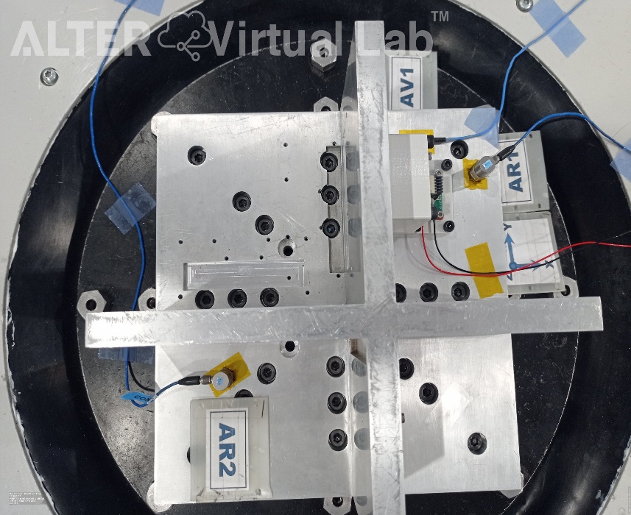
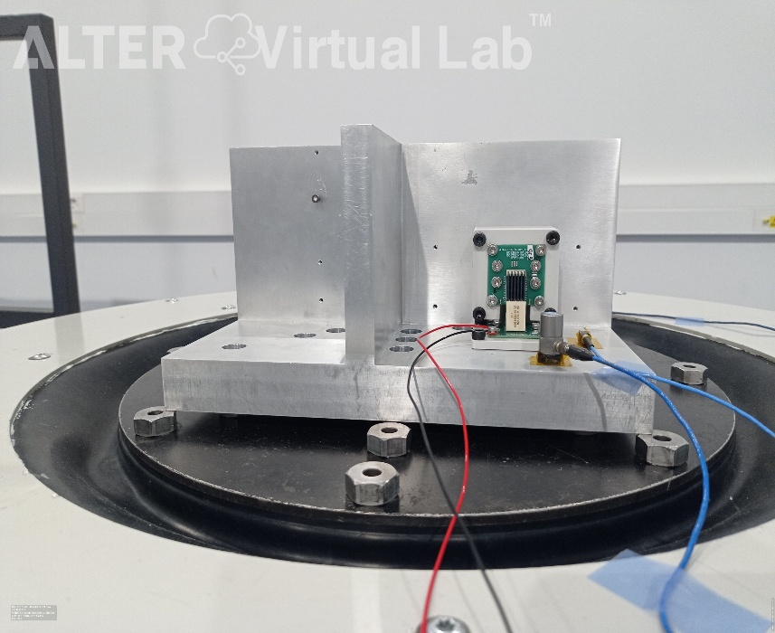
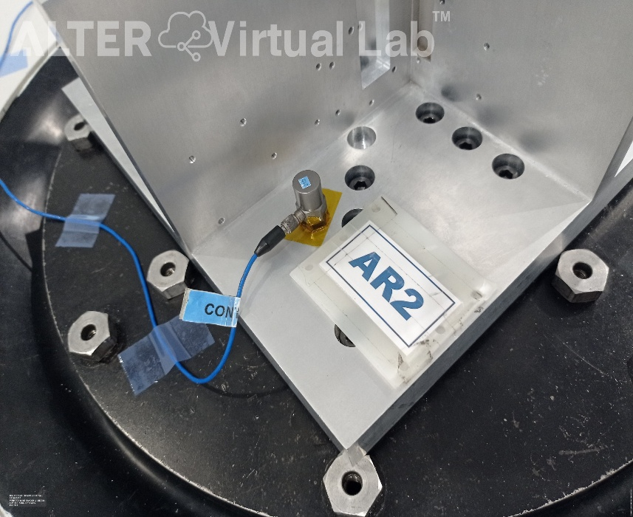
Airmax (Amphenol): Assembly & Reliability Tests: Test results (V)
4. Sine vibration test: Set up
Set up

Slide 25
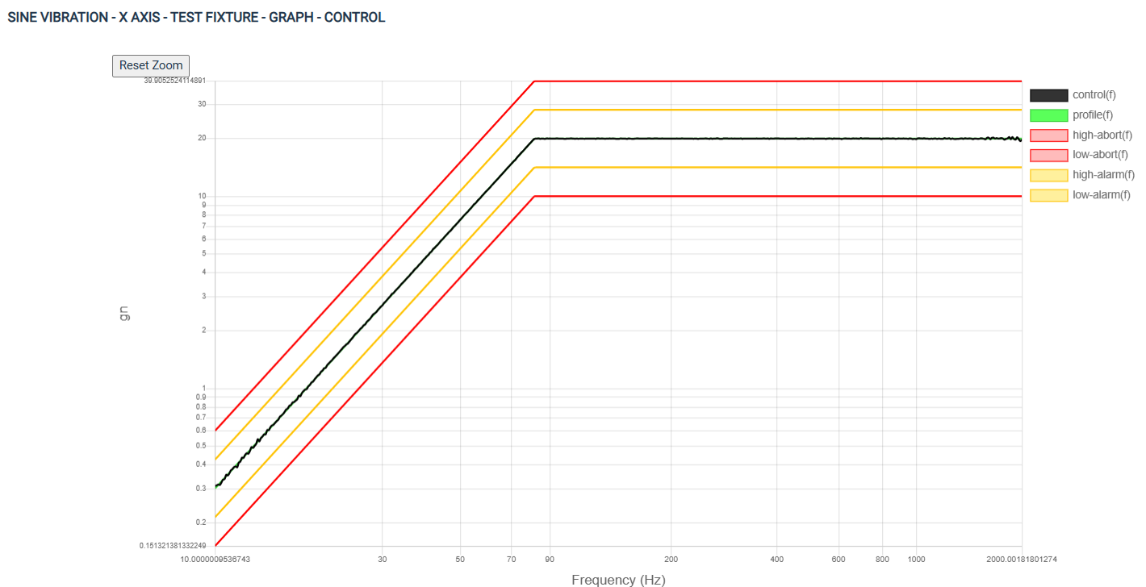
Airmax (Amphenol): Assembly & Reliability Tests: Test results (VI)
4. Sine vibration test: Vibration conditions check (empty tooling)
Vibration conditions check (empty tooling)

Slide 26
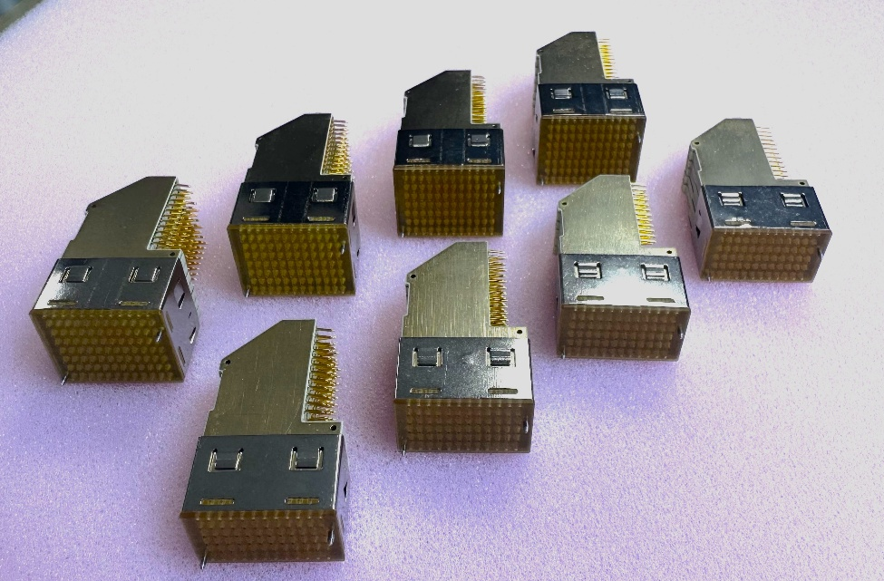
Airmax (Amphenol): Assembly & Reliability Tests: Next steps
Next steps:
  S-parameters measurements and life test
  Finish mechanical testing (random vibration, mechanical shock)
  Perform thermal shock testing
  Mating & de-mating (endurance) test flow
Hyperbits (Performance Interconnect)
AIRMAX VS (Amphenol)

Slide 27
Background & Rationale
Specification & Challenges
On-going Activities (II)
ARTES: Board to Board Interconnections for High Data Rate applications (AXON’ cable)
Conclusion

Slide 28
Board to Board Interconnections for High Data Rate applications
Contractor: AXON’ CABLE (FR) |  |  |  |  | ESA Budget | 250 k€ + 275k€
Funding | TDE | Initial TRL: 2 | Target TRL: 4 |  | TO: Léo Farhat - Joaquín Jiménez
Start of activity: August 2023 |  | End of Activity: 12 2026
Background and justification: To fulfil future Telecommunication payload mission needs, satellite manufacturers are fabricating digital and high power processing equipment with high speed signal performance, high speed and complex digital processing technologies. These are based on digital printed circuit boards (PCB) and new high density and high data interconnection technologies. Solderless solutions based on press fit connectors, spring probes or S-FECT (Slide-Fit Electrical Contact Termination) technology, are being developed in order to validate reliability issues, especially the signal continuity during mechanical tests. These solutions are not designed for high data rate applications yet. This justifies the need for next-generation interconnect solutions capable to withstand space environment for high data rates.
Objective(s): To develop interconnection solutions based on innovative solderless technologies, that need to withstand future requirements in terms of High Data Rate (HDR), up to 56Gbps.
Achievement and status: Kick-off Aug 2023 Literature review and user survey: identify customers’ needs and confirm the performance levels to be specified in the technical specification. Critical assessment of existing connectors. Consolidated preference for connector design: HDR and power with few Mbit/s. Patent survey. Technical specification based on survey results updated. Back-up procurement to guarantee EM models manufactured. PDR Dec 2024, 3D printed prototyping with two different materials and two variants: shielded and unshielded.
Benefits: Availability of European connector for HDR for space applications.
Next steps Production of samples for mechanical tests |  |  |  | Reliability tests to be started (Evaluation Test Plan): test sequence on contacts, test set-up definition, tool-machining

Slide 29
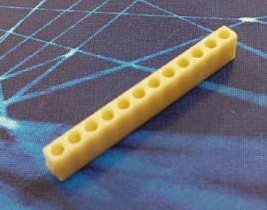
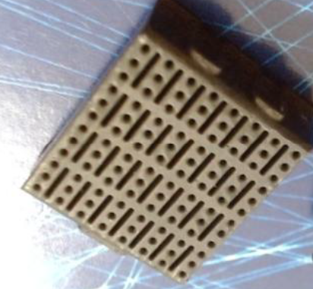
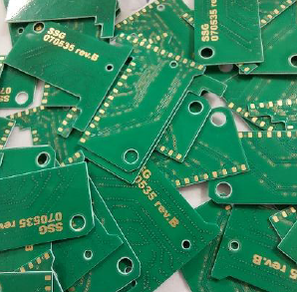
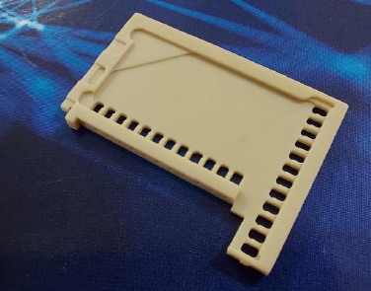
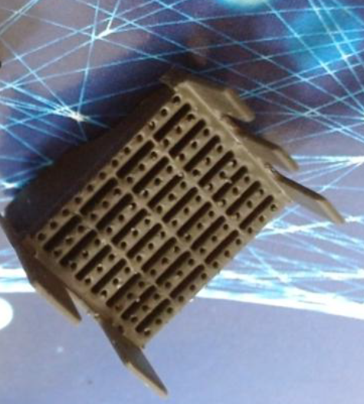




AXON’ CABLE: CONNECTOR MANUFACTURING (I)
Backplane connector
Daughter board connector
Machined frame
3D printed housing
PCBs
Machined frame
3D printed housing
Machined pin
contacts
Metal sheet
press-fit

Slide 30




AXON’ CABLE: CONNECTOR MANUFACTURING (II)
Daugther board connector
Back-plane connector
Closed pressfit

Slide 31


AXON’ CABLE: CONNECTOR MANUFACTURING (III)
Insertion tool manufactured by AXON (manual press)
No damage on frames or PCB

Slide 32

AXON’: CONNECTOR PROTOTYPE ELECTRICAL CHARACTERISATION (I)
Two types of connectors characterised:
  Unshielded connector
  Shielded connector daughter board (to try improve crosstalk,
  decrease impedance)
Two types of test results:
  Connector and PCB
  Connector contribution only (“de-embedded”)
DC tests: line resistance, insulation, voltage proof
RF tests:
    high data rate
    insertion loss
    near-end cross talk
    far-end, cross-talk
    differential impedance

Slide 33



AXON’: CONNECTOR PROTOTYPE ELECTRICAL CHARACTERISATION (II)
Test PCBs:
Lines J1, K1, K2, and L2 are longest lines on PCB connector.
Lines A1, B1, B2 and C2 are the shortest lines on PCB connector.

Slide 34



AXON’: ELECTRICAL CHARACTERISATION (III) DC LINE RESISTANCE
-B2 & C2 close to 52mΩ and A1 & B1 close to 63mΩ: Δ= 21%
-J1 & K1 close to 108mΩ and K2 & L2 close to 120 mΩ: Δ= 11%
-B1, B2 & B3 close to 63mΩ and A1 close to 66mΩ: Δ= 5%
-J1 & K1 close to 107mΩ and K2 & L2 close to 140m Ω : Δ= 31%
Variability on DC-resistance probably caused by irregular thickness of the line PCB layers

Slide 35



AXON’: ELECTRICAL CHARACTERISATION (IV) VOLTAGE PROOF, INSULATION
unshielded connector
shielded connector
Tests results are successful

Slide 36



AXON’: RF PARAMETERS (I) DATA RATE
Connector&PCB contribution (“embedded”)
Connector contribution only (“de-embedded”)
NOK
NOK
All configurations at 12.5 Gb/s pass the test
For configurations at 25 Gb/s the signal fails
12.5, 25 and 32Gb/s pass the test
Similar results for shielded or unshielded variants

Slide 37


AXON’: RF PARAMETERS (II) INSERTION LOSS
Connector&PCB contribution
Connector contribution only (“de-embedded”)
For each configuration, the insertion
losses:
2 dB for 3.125 GHz
5 dB for 6.25 GHz
8 dB for 12.5 GHz
For each configuration, the insertion
losses:
0.7 dB for 3.125 GHz
2 dB for 6.25 GHz
3 dB for 12.5 GHz
Similar results for shielded or unshielded variants
Only for 3.125GHz results are PASS

Slide 38




AXON’: RF PARAMETERS (III) NEAR/FAR END X-TALK
PASS
PASS
Near-end unshieldeded
Near-end shieldeded
PEAK
NOK
PEAKS
NOK
Far-end unshieldeded
Far-end shieldeded
Similar results for shielded or unshielded variants

Slide 39


AXON’: RF PARAMETERS (V) DIFFERENTIAL IMPEDANCE
Localisation of the impedances on the connector
NOK
Similar results for shielded or unshielded variants

Slide 40



AXON’: RF PARAMETERS (VI) SUMMARY
Data rate: PASS
Insertion loss: PASS only at 3.125GHz
Near-end cross-talk: PASS
Far-end cross-talk: PASS unshielded variant
Differential impedence: NOK

Slide 41

AXON’: RF PARAMETERS (VIII) COMPARISON WITH AIRMAX VS

Slide 42


AXON’: RF PARAMETERS (VII) COMPARISON WITH AIRMAX VS

Slide 43
AXON’: RF PARAMETERS (VII) CONCLUSIONS / NEXT STEPS
CONCLUSIONS
Digital transmission is ensured with margin a bit more over 25Gb/s with a NRZ baseband signal.
The non-conformances concern mainly the insertion losses above 3.125GHz
Differential impedance not compliant. Internal PCB to be improved.
Shield between the frames => light impedance improvement but not big changes. In some cases, as far end signal crosstalk, results are worse with shield.
NEXT STEPS:
Improvements: Molded parts with same material, improve internal PCBs, pin surface treatment
TRR estimated for June 2026.
Evaluation test plan
Production of samples for mechanical testing
Test set-up definition
Performance of tests

Slide 44
Background & Rationale
Specification & Challenges
On-going Activities (III)
TDE:High Density Modular Electrical Interconnections for High Data Rate Applications (Performance Interconnect & ALTER TECHNOLOGY FRANCE)
Conclusion

Slide 45
Development of High Density Modular Electrical Interconnections for High Data Rate Applications
Contractor: ALTER TECHNOLOGY (FR), PERFORMANCE INTERCONNECT (FR) |  |  |  | ESA Budget | 500 k€
Funding | ARTES AT | Initial TRL: 3 | Target TRL: 6 | TO: Léo Farhat Joaquín Jiménez
Start of activity: 12 2023 |  | End of Activity: 07 2026
Background and justification: Urgent need to develop backplane high data rate interconnections compatible with compact PCI Serial Space (cPCI SS) standard. This is capable of routing data between processing modules of on-board computers. Backplane connectors are critical components to enable high speed interconnections. Currently, there are no European solutions able to reach 25 Gbit/s to 50 Gbit/s. Engineering models of modular backplane high density connectors compatible with cPCI serial space standards will be designed, manufactured and tested for use in high data rate space applications. Additionally, the focus of the activity will be to achieve at least 25 Gbit/s data rate.
Objective(s): The objective of this activity is to design, develop and test engineering models of modular backplane high density connectors for high data rate space applications, compatible with cPCI serial space standard. - enabling routing of more than 120 channels - achieve an interface bit rate of at least 25 Gbit/s, with a goal of 56Gb/s for long-term missions.
Achievement and status: ITT was issued in Q3 2022. No support from delegation. ITT re-issued to get support from National Delegation. Contract signed with ALTER (FR) and Performance Interconnect (FR) on 12/12/2023. Kick-off held in January 2024, finalized technical specification. Version 2 of the connectors created (Gen2HYP) to have EM models available:prototypes manufactured and characterisation done.
Benefits: European provider of interconnections for High Data Rate applications for space applications.
Next steps: CDR+MRR Nov 2025 Reliability tests: electrical validation (high frequency measurements), mechanical validation (vibration, shock), thermal cycles.

Slide 46

HYPERBITS: S-FECT
S-FECT:
SLIDE-FIT
ELECTRICAL
CONTACT
TERMINATION

Slide 47



HYPERBITS: S-FECT
<Higher
normal
Force
>Lower
resistance
NO SOLDERING
NO PRESS-FIT
Based on S-FECT Technology
Contacts slide and operate in elastic deformation

Slide 48

External
Pressure
Element
Technology
Already
qualified to
Mil - 39029
GSFC-311
ESCC-3401
S-FECT
Technology
Similar
mechanism
of operation BUT…
< Higher
normal
Force
and
> Lower
resistance
Connects
directly to PCB

Slide 49


HYPERBITS: ADVANTAGES (I)
Press-fit versus S-FECT
S-FECT™
Technology
1-part connector system
reduced cost
simple installation
NO Deformation of contacts +
NO Damage to PCB =
Reusable PCB +
Reusable Connector

Slide 50


Press-fit versus S-FECT
S-FECT™
Technology
1-part connector system
reduced cost
simple installation
HYPERBITS™
R1 = R2 ≤ 5mΩ

Slide 51




HYPERBITS Gen 2.0: CONNECTOR MANUFACTURING
A- Pin soldered on wafer
B- PCB Connector Assembly
C- Slide Shield Assembly
Hyperbits Gen 2.0

Slide 52



TEST PCBs
V1: on test boards for RF measurements (Backplane and Daughter Card), tracks and insulation were not respected
RF impedance not respected –
V2: new RF boards were manufactured; Tracks and isolation are now respected.
RF boards V1
RF boards V2

Slide 53



Slide 54

HYPERBITS: CONNECTOR ASSEMBLY
Repairability:
PCB reusable
Connector reusable
Blindmating:
Directly into the backplane
Zero specialty tools
Zero jet effect
Zero deformation
Zero loose particles
Zero inspection

Slide 55



CHARACTERISATION HYPERBITS GEN 2.0 (I)
Design FMEA and Process FMEA to define critical parameters for reliability testing (Electrical, Mechanical, Temperature, Insertions etc.)
Internal Alter Technology and Performance Interconnect prototypes assembly 5x parts + 5x parts
Mechanical validation 5x 2x parts
  External Visual Inspection
  PCB Insertion
  External Visual Inspection
  Contact resistance (RCL – PCB to PCB)
  Daisy-chain measurements.
  Sine Vibration (no random vibration)
    Sweep frequency: 10 – 2000 -10Hz
    Cycle Period: 30 minutes
    Amplitude: 1,5mm / 20g whichever is less.
    Axis per Cycle: 3 mutual perpendicular direction
    contact disturbance detection (1µs)
  External Visual Inspection to check any crack or Failure
  Daisy-chain measurements
  Mechanical Shock
    Shape of Shock: Half Sine
    Acceleration: 50 g
    Pulse duration: 11 ms
    Nº of Shock per test: 3
    Axis per Test: 3 (mutual perpendicular direction)
    contact disturbance detection (1µs)
  External Visual Inspection
  Daisy-chain measurements
  Contact resistance (RCL - PCB to PCB)
  5x Thermal Shock
    -55 ºC (+0, -10) ≥10 min
    125 ºC (+15, -0) ≥10 min
  External Visual Inspection
  Daisy-chain measurements
  Contact resistance (RCL - PCB to PCB)
  Insulation Resistance – 500Vdc
  Voltage Proof Withstanding voltage 750 Vrms
Electrical validation 5x parts
  External Visual Inspection
  PCB Insertion
  External Visual Inspection
  High Frequency measurements
June 24
30 connecteurs - 8 range
Pass No-Pass status
Pass – Go to WP4
No-pass – Explore PCB design, BOM sub parts, material, connector mounting process. Start again prototypes assembly prior to ESA qual.

Slide 56


CHARACTERISATION HYPERBITS GEN 2.0 (II)
Shocks and Vibrations environment
Shocks and Vibrations X position example
Contact disturbance detection system
Results : No contact disturbance detected during Shocks and vibrations sequence

Slide 57
CHARACTERISATION HYPERBITS GEN 2.0 (III)
Rdaisy-Chain 8-Rows = 1.66 Ohm all along testing (including 2 x 1.5 m cable)
Rdaisy-Chain 6-Rows (only 2 rows) = 0.41 Ohm all along testing (including 2 x 1.5 m cable)
RCL PCB to PCB before and after Vib and shocks [mOhm]
RCL PCB to PCB after TC [mOhm]
 | 1 | 2 | 3 | 4 | 5 | 6 | 7 | 8
A | 25 | 19 | 25 | 17 | 25 | 19 | 24 | 16
B | 27 | 28 | 26 | 25 | 28 | 26 | 26 | 25
C | 20 | 28 | 24 | 27 | 22 | 27 | 18 | 26
D | 30 | 23 | 28 | 25 | 29 | 22 | 28 | 18
E | 31 | 29 | 31 | 32 | 32 | 32 | 28 | 28
F | 21 | 30 | 24 | 33 | 20 | 31 | 18 | 28
G | 33 | 20 | 33 | 22 | 30 | 22 | 31 | 18
H | 30 | 35 | 32 | 36 | 34 | 32 | 32 | 28
I | 17 | 37 | 21 | 37 | 20 | 34 | 18 | 30
J | 31 | 20 | 33 | 19 | 34 | 20 | 32 | 19
K | 33 | 37 | 33 | 36 | 35 | 38 | 32 | 31
L | 16 | 37 | 18 | 45 | 17 | 37 | 16 | 31
 | 1 | 2 | 3 | 4 | 5 | 6
A | 26 | 19 | 25 | 11 | 25 | 19
B | 14 | 11 | 12 | 12 | 12 | 11
C | 16 | 25 | 11 | 28 | 19 | 26
D | 15 | 18 | 11 | 21 | 20 | 19
E | 15 | 29 | 11 | 30 | 21 | 21
F | 13 | 12 | 11 | 35 | 17 | 21
G | 17 | 20 | 11 | 67 | 22 | 19
H | 16 | 31 | 11 | 28 | 22 | 22
I | 15 | 33 | 12 | 28 | 17 | 23
J | 15 | 16 | 11 | 27 | 33 | 26
K | 17 | 11 | 12 | 14 | 13 | 13
L | 22 | 33 | 19 | 15 | 17 | 42
 | 1 | 2 | 3 | 4 | 5 | 6 | 7 | 8
A | 25 | 17 | 24 | 17 | 23 | 17 | 22 | 17
B | 25 | 25 | 24 | 24 | 28 | 24 | 22 | 30
C | 17 | 25 | 21 | 27 | 20 | 25 | 15 | 34
D | 28 | 23 | 25 | 25 | 28 | 17 | 25 | 16
E | 27 | 29 | 27 | 30 | 29 | 24 | 25 | 30
F | 20 | 29 | 17 | 27 | 17 | 27 | 16 | 31
G | 33 | 19 | 27 | 17 | 28 | 20 | 26 | 19
H | 32 | 29 | 28 | 31 | 30 | 27 | 30 | 27
I | 18 | 21 | 17 | 33 | 18 | 29 | 16 | 29
J | 33 | 18 | 30 | 17 | 30 | 18 | 29 | 17
K | 33 | 32 | 31 | 33 | 31 | 33 | 29 | 30
L | 16 | 35 | 17 | 33 | 15 | 27 | 15 | 31
 | 1 | 2 | 3 | 4 | 5 | 6
A | 24 | 15 | 23 | 9 | 23 | 17
B | 8 | 9 | 9 | 10 | 10 | 10
C | 11 | 23 | 9 | 27 | 17 | 25
D | 11 | 15 | 9 | 19 | 18 | 18
E | 11 | 24 | 10 | 21 | 19 | 19
F | 10 | 9 | 9 | 21 | 16 | 20
G | 11 | 15 | 9 | 21 | 21 | 18
H | 10 | 28 | 9 | 23 | 20 | 21
I | 11 | 28 | 9 | 24 | 17 | 23
J | 11 | 16 | 9 | 22 | 31 | 23
K | 8 | 9 | 9 | 10 | 10 | 11
L | 15 | 31 | 16 | 10 | 17 | 38
Very good contact
resistance values compared
to competitors.
No significant drift
observed all along test
sequence

Slide 58


NEXT STEPS: RELIABILITY ASSESSMENT TEST FLOW (TBD)
Test specification
ESCC 3401 inputs
ESCC 3408 inputs
June 24
TO BE DISCUSSED DURING MRR
Climatic sequence

Slide 59
Background & Rationale
Specification & Challenges
On-going Activities
Conclusion

Slide 60
CONCLUSIONS
TDE: Procurement and Reliability Assessment of High Data Rate Press-Fit cPCI SS connectors, ALTER TECHNOLOGY SPAIN:
  Existing commercial solution Airmax, Amphenol (China).
  New and innovative solution Hyperbits, Performance Interconnect (France).
ARTES: Board to Board Interconnections for High Data Rate applications (AXON’ cable)
  Prototypes manufactured, electrical characterisation done
  EMs to be manufactured by June 2026, mechanical tests to be performed
TDE:High Density Modular Electrical Interconnections for High Data Rate Applications (Performance Interconnect & ALTER TECHNOLOGY FRANCE)
  Prototypes manufactured, electrical characterisation and mechanical testing done
  Full reliability assessment to be defined and performed.
Many Lessons learned already identified in the three activities: related to assembly process, manufacturing steps, test PCB, etc.

Slide 61



Space Passive Component Days (SPCD)
First announcement: SAVE THE DATE!
www.spcd.space

