Slide 1
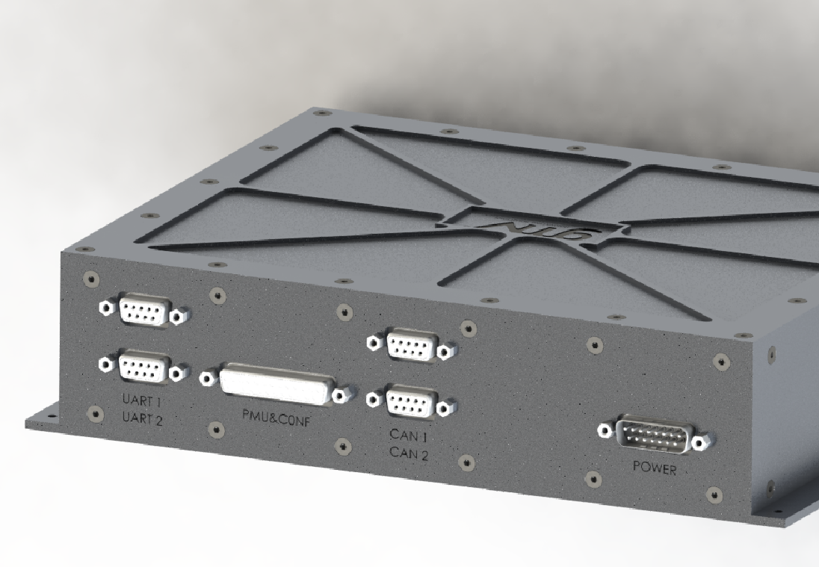
LEOSG: : RFSoC Based Navigation Payload Signal Generator Demonstrator for a Future LEO-PNT System
David González Arjona dgarjona@gmv.com
Giovanni Brajato gbrajato@gmv.com
Rubén Domingo Torrijos rdomingo@gmv.com
David Sanz Villalón david.sanz.villalon@gmv.com
Arturo Pérez García arturo.perez.garcia@gmv.com
Umberto Vargas umberto.vargas@gmv.com
Maria Manzano Jurado mmanzano@gmv.com
Max Ghiglione max.ghiglione@esa.int

Slide 2
Contents
Introduction
Background
Roadmap
Innovation aspects
Environmental assessment
Conclusions and future work
© 2025 GMV Property – All rights reserved
Page 2

Slide 3
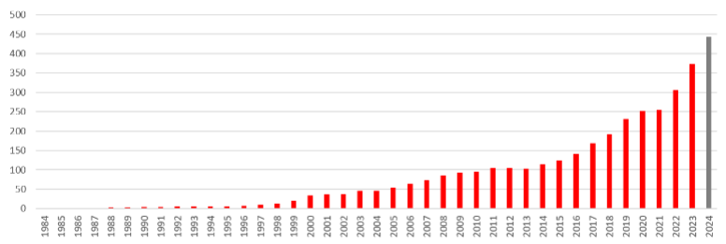
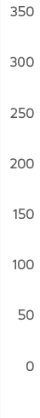


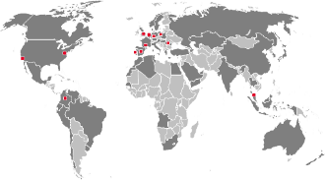











GMV: A global technology group
~450 M€
worldwide revenue 2024
  Multinational technology group.
  Private capital
  Engineering, development and integration of systems, software, hardware, specialized products and services
  +3,500 employees
  Founded
  in
  1984
  Headquarters in Spain (Madrid).
  Subsidiaries in 12 countries
  (ops in 70+)
  Roots tied to the Space and Defence industry
  Aeronautics, Space, Defense & Security, Cybersecurity, Intelligent Transport Systems, Healthcare, Banking & finances, and ICT industries
  Space
  Aeronautics
  Defense &
  Security
  Telecommunication
  Cybersecurity
  Intelligent Transport
  Systems
  Healthcare
  Public Sector and Corporate ICT
  Banking & Finances

Slide 4




GMV Space Technological Leadership
  #1 Worldwide Satellite Control Center provider to commercial telecom operators.
  Primary SST technology and Operation Centers
  Space Segment GNC technology leader
  On-board Autonomy On-board SW
  Space Equipment
  Test Facilities
  Prime role in European GNSS Systems and its safety critical systems (EGNOS and Galileo)
  Leading European Space Robotics technology, growing
  Microelectronics,
  HW Avionics and
  Technology Transfer
  Excellence in Flight Dynamics, Mission Analysis,
  E2E Simulators,
  EO Data Processing and downstream geospatial services

Slide 5

Introduction
© 2025 GMV Property – All rights reserved
Page 5

Slide 6
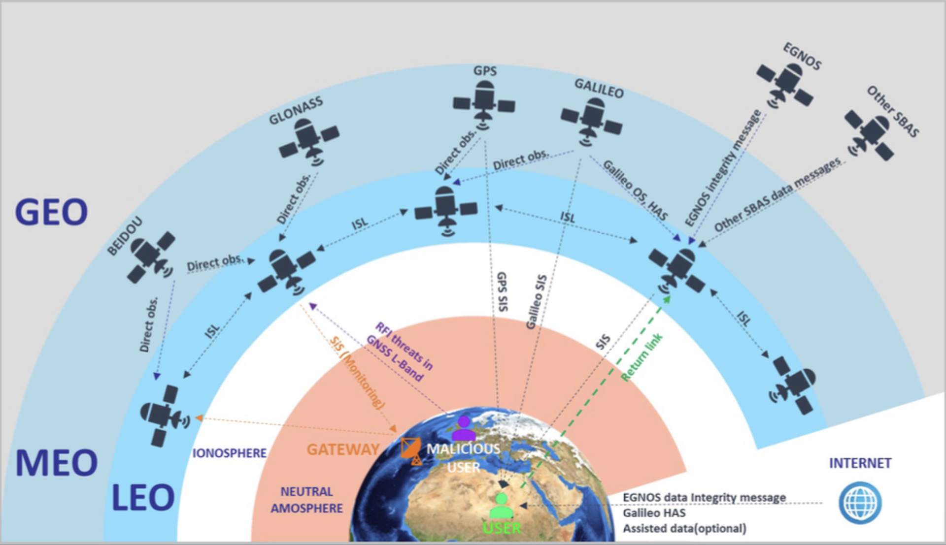

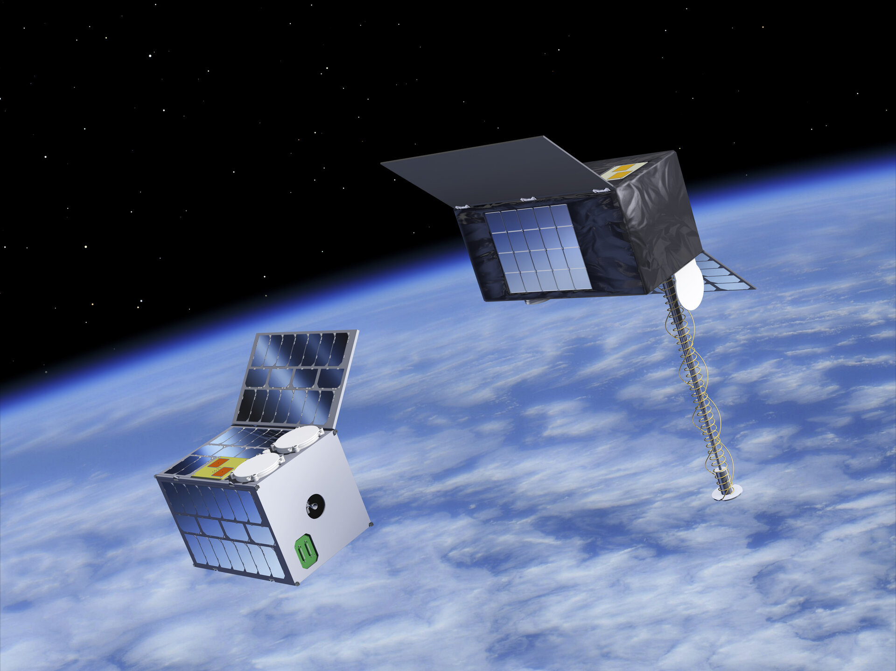
LEO-PNT constellations​
  Low Latency
    Reduced signal travel time compared to MEO/GEO systems.
  Higher Bandwidth
    Supports more data-intensive applications.
  Stronger Signal Power
    Improved link budget and robustness.
  Reduced Noise
    Better signal-to-noise ratio for navigation.
  Improved Accuracy
    Enhanced positioning performance for PNT services

Slide 7
Traditional SDR vs RFSoC Architecture​
Traditional navigation uses SDRs and analog circuits, while RFSoC integrates digital and analog components in one chip.​
Traditional SDR Approach | RFSoC-Based Architecture
Separate FPGA/SoC + external DAC/ADC modules | Integrated DACs/ADCs on the same silicon as FPGA and CPU
Requires additional analog circuits (mixers, PLLs) | Direct RF output up to 6 GHz (no external upconversion)
Higher size, weight, and power (SWaP) | Lower SWaP and footprint
Increased design complexity and latency | Real-time signal parameter reconfiguration, reduced latency and interface overhead
Limited real-time reconfigurability | Real-time signal parameter reconfiguration

Slide 8
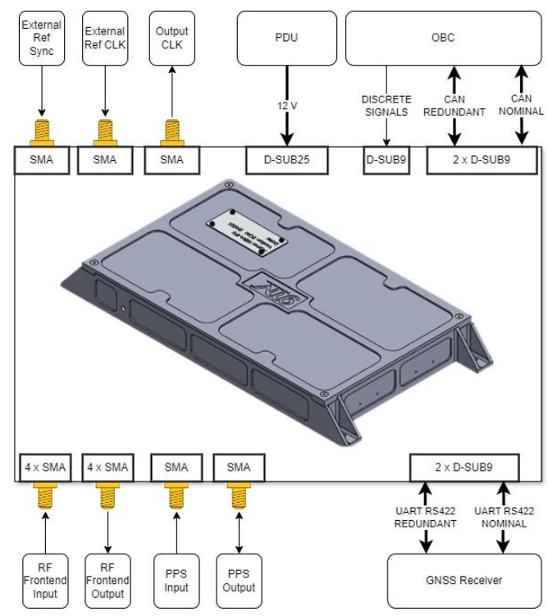
LEOSG EM Signal Generator​
High-performance RF signal generator for LEO-PNT navigation payload signal generation.
  Core Platform:
    Xilinx Zynq UltraScale+ RFSoC (ZU48DR)
  Key Features:
    Integrated DACs/ADCs for direct RF output up to 6 GHz.
    Real-time reconfigurability for emerging signals and modulations.
    On-board monitoring and error mitigation mechanisms.
  Architecture Highlights:
    Processing System (ARM cores) for control and telemetry.
    Programmable Logic with Versatile Signal Generator (VSG) IP
    Embedded RF data converters and high-stability clock subsystem.
  Flexibility:
    Supports L-band, S-band, and configurable for UHF.
  TRL Goal:
    From EM (TRL6) toward EQM/FM (TRL8).

Slide 9
Background
© 2025 GMV Property – All rights reserved
Page 9

Slide 10
Overview of SING Project​
  Purpose:
    Demonstrate a single-chip GNSS signal generator for E1, E5, and E6 bands.
  Platform:
    Xilinx ZCU208 board with Zynq UltraScale+ RFSoC (ZU48DR).
  Key Features:
    High flexibility for future signals and modulation schemes.
    Optimized for power consumption in navigation payloads.
  Capabilities:
    Generation of up to 128-QAM signals and GNSS-specific signals at baseband and RF.
  Identified Limitations:
    Limited real-time reconfigurability.
    Degraded SNR due to hardware constraints.
    Suboptimal FPGA resource allocation → higher power consumption.

Slide 11
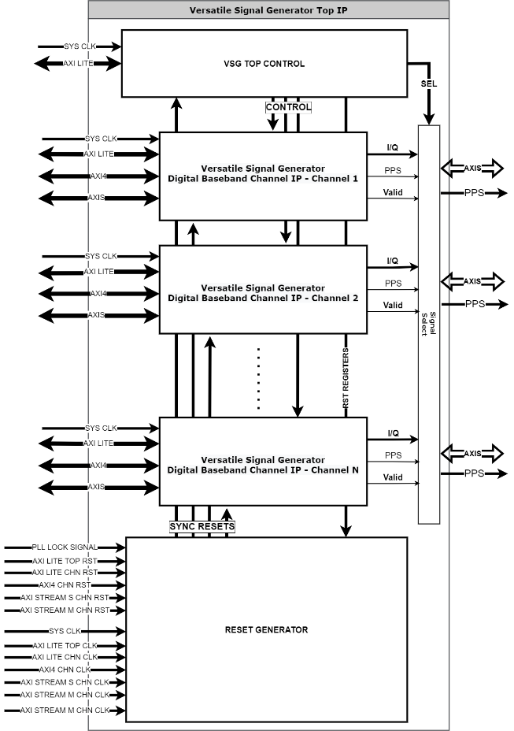
Overview of VSG IP in SING
    VSG top IP vendor agnostic design
    Parametrizable design by generics to adapt to application and device requirement
    Support for different clock domains for each channel/interface
    Scalability from 1 to N VSG digital baseband channels
    Easy control of the N channels through a single AXI interface
    Vectorized inputs and outputs to automatically generate interfaces

Slide 12
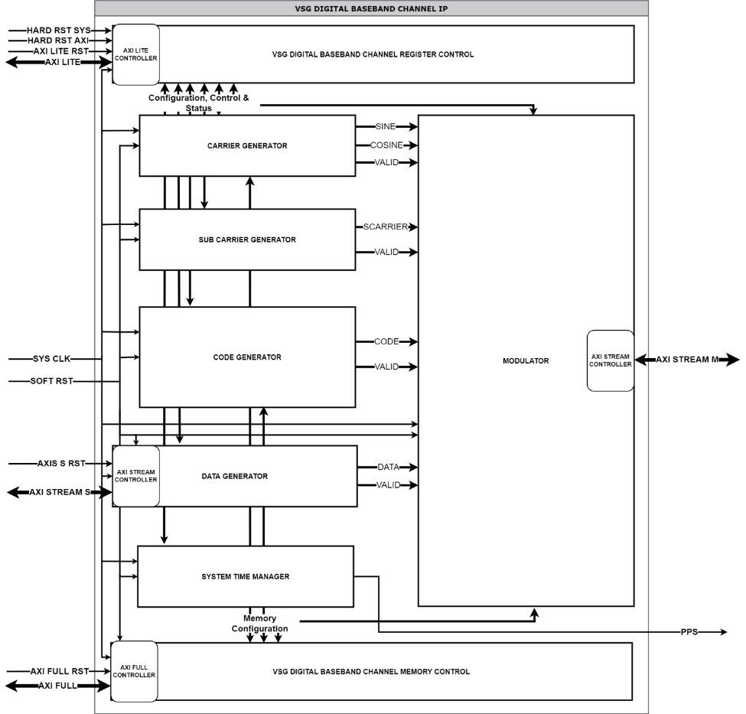
Overview of VSG IP in SING
    Fully configurable VSG Digital baseband channel through AXI Interfaces
    AXI Lite for register configuration, AXI4 for internal memory transaction, AXI Stream for Navigation data input and Modulated output to RF chain
    Programmable Carrier (NCO, LUT values and gain)
    Programmable Sub Carrier (NCO, size and period)
    Programmable Code generator
    7 (by default) simultaneous code bits for 128QAM modulation support
    XOR combination of Primary LFSR, Secondary LFSR, Primary LUT and Secondary LUT
    Configurable code NCO, Primary and secondary Periods, initial Periods, Polynomials, seeds and initial seeds
    Code independent enables
    Pilot XOR Data independent configuration
    Programable Navigation Data Generator (NCO and periods
    Programmable Modulator (Number of modulation bits, configurable Pilot&Code combination, configurable subcarrier modulation bits, Configurable LUT symbol map)

Slide 13
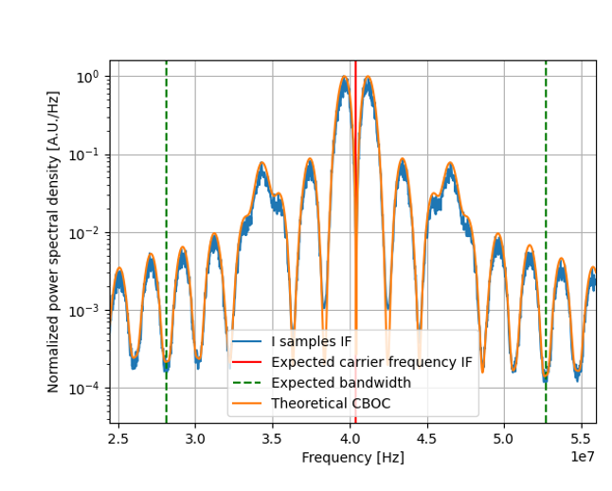
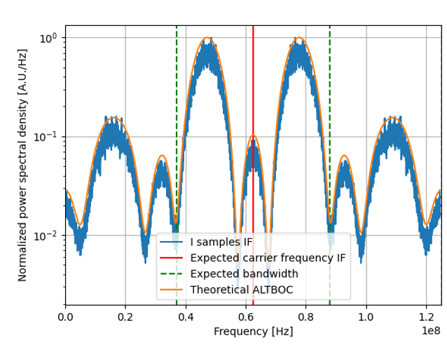
Achieved results with SING​
Galileo E1 baseband spectrum
Galileo E5 baseband spectrum

Slide 14
Roadmap
© 2025 GMV Property – All rights reserved
Page 14

Slide 15
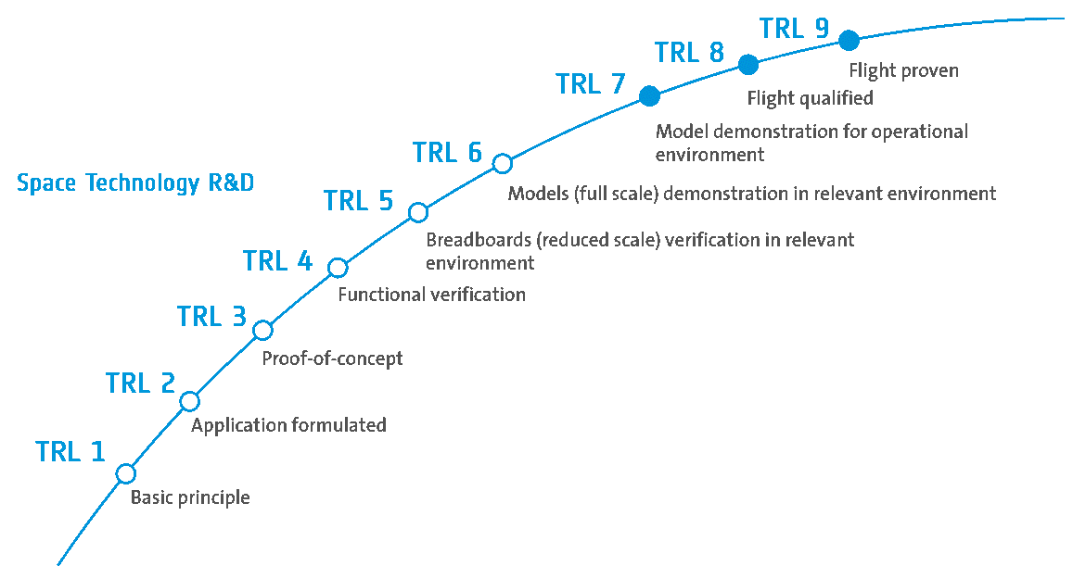
Roadmap​
  Project Development Stages​
    The LEOSG project progresses from the initial EBB model to the Engineering Model and future qualified models.​
  Technology Readiness Levels​
    The roadmap follows ESA’s TRL framework, advancing from TRL4 toTRL6 and aiming for TRL8 for space qualification.​
  Technical Refinements​
    Key developments include consolidating RFSoC knowledge, refining hardware design, and optimizing GNSS Signal Generator IP.​
  Mission Qualification Goals​
    Strategic steps ensure LEOSG meets requirements for LEO-PNT space mission deployment and qualification.

Slide 16
Innovation aspects
© 2025 GMV Property – All rights reserved
Page 16

Slide 17
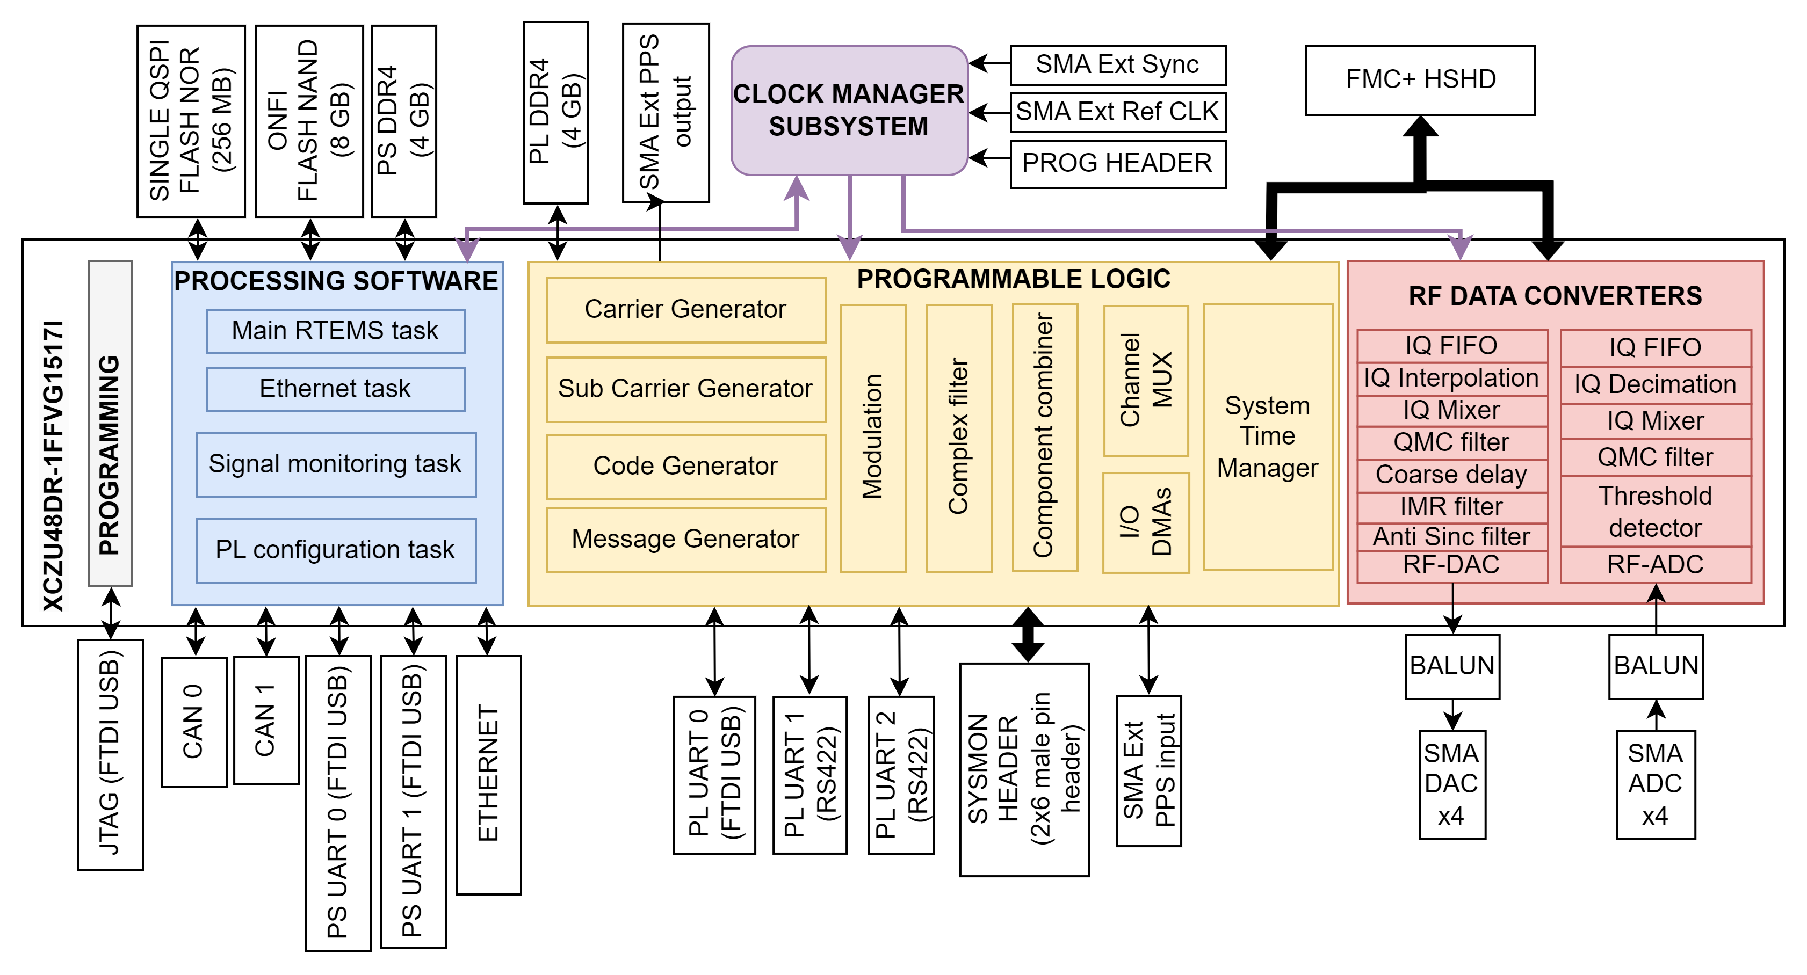
LEOSG architecture

Slide 18
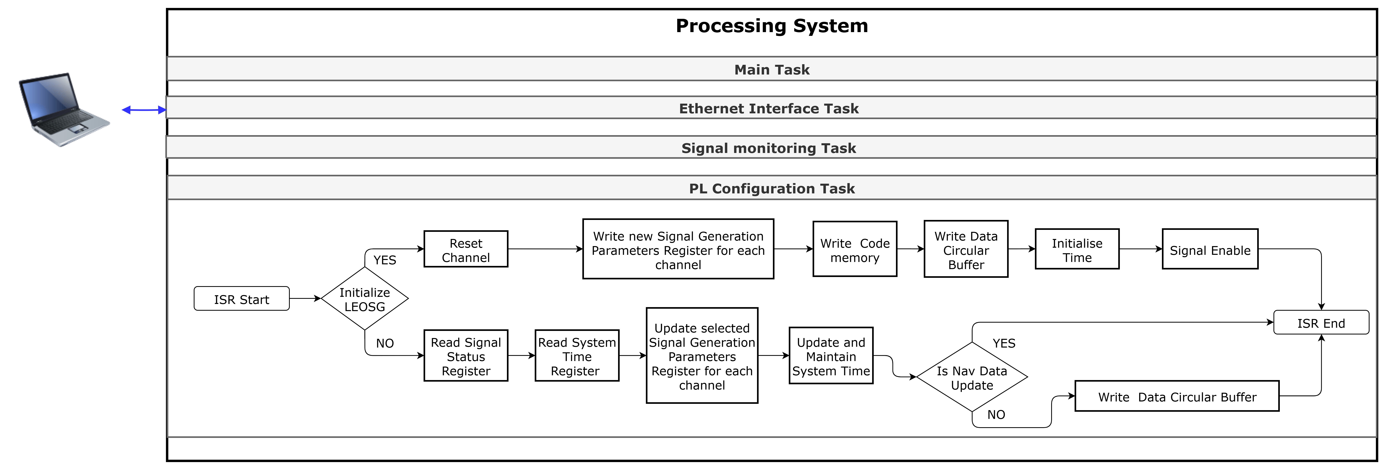

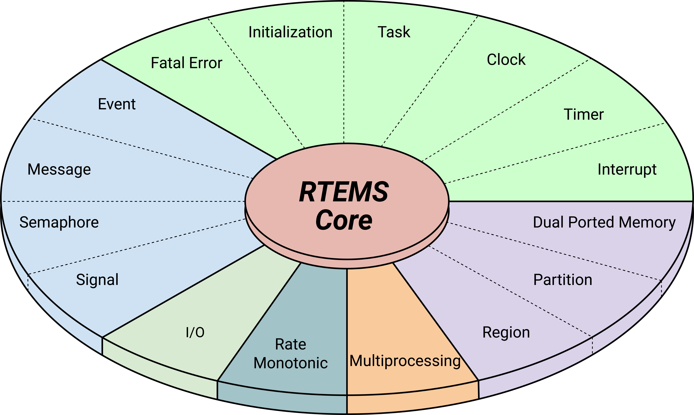
Processing software
  Role of PS Software
    TM/TC Communication with the OBC (CAN -> CSP -> PUS)
    Real-time operational control of signal generation.
    Low-latency, high-throughput communication with PL (same RFSoC device).
  RTEMS-Based Implementation
    Thread-safe design for precise timing and safe HW access.
    Xilinx RF data converter, clock management, and drivers ported to RTEMS.
  Runtime Flexibility
    Allows dynamic modification of complex IP configurations.
  Key Features
    Initialization of LUTs for carriers, codes, and modulation symbols.
    Control register configuration with transparent memory management.
    Signal and system monitoring for quality assessment.
    Configuration memory, PS and IPs integrity
    Mutual exclusion for hardware access (thread safety).
    Periodic navigation data delivery.

Slide 19
Programmable logic
  Architecture Basis:
    Built on Versatile Signal Generation (VSG) IP (GMV VHDL-based).
    Integrated with XCZU48DR RFSoC RF data converters.
  Origin & Validation
    Developed under SING project, validated on Xilinx ZCU208 board.
  Primary Objective
    Generate LEO-PNT GNSS signals in L-band and S-band.
    Flexible configuration → supports UHF band (per LEO-PNT SIS ICD).
  VSG updates form SING:
    Carrier Generator: Digital sine/cosine carriers, NCO with FHSS support.
    Channel organization (each channel is composed on 3 baseband component generators + component combiner)
    System Time Manager (STM): STU + 1PPS generator for synchronization.
    Component Combiner: Summation of signal components.
    Channel Multiplexer: Routes IQ streams to DACs.
    Complex modulation on I and Q
    Channel Baseband complex Filter: Band-pass filtering & distortion pre-compensation.
    DMA Modules: IQ sample injection/retrieval for testing & monitoring.
    AXI interface optimization (the entire design uses 1 AXI + 1 AXI Lite + N AXI Stream {one per channel})

Slide 20
Clock manager subsystem
  Precise reference input clock
    10 MHz OCXO: Holdover ±1.5 µ sec over 8 hours, PhaseNoise10kHz [dBc/Hz] -154 dBc/H
  External reference clock
    Possibility to switch between OCXO and external reference clock input
  Dedicated Clock Input per Tile
    Each RF-ADC or RF-DAC tile has its own clock input.
  No Additional Clock Buffer Required
    Current-Mode Logic (CML) clock input buffer already integrated in tile architecture.
  Clock Input Usage
    Can serve as sampling clock or PLL reference for the tile.
  CML Clock Characteristics
    On-die differential termination of 100 Ω.
  On-Chip Clock Distribution
    Enables forwarding of clock signals between adjacent tiles within converter groups.
  Clock Source Options
    Forwarded clock can be external reference or PL-generated.

Slide 21

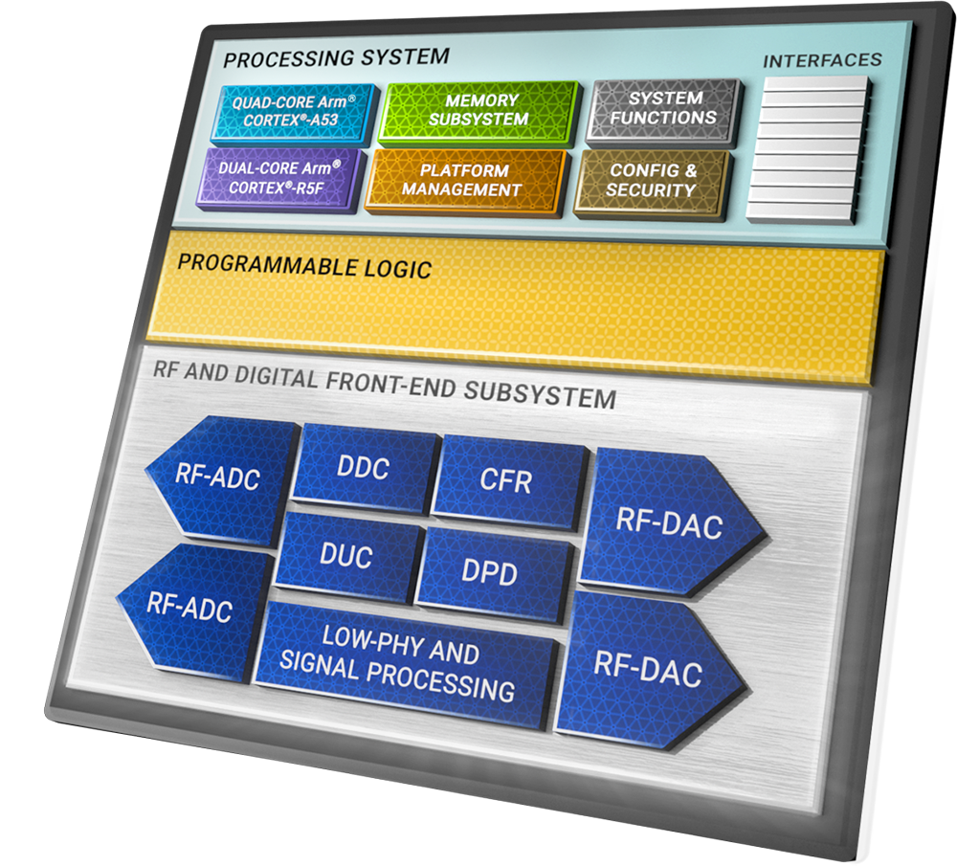
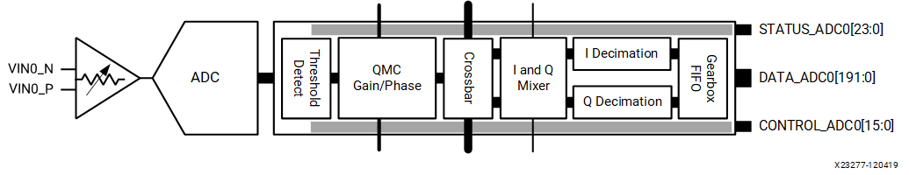
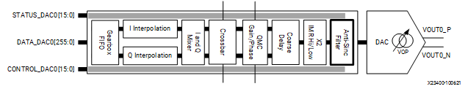
RF-Data converters
LEOSG integrates high-speed DACs and ADCs within the same silicon die, reducing complexity, latency, and power use.

Slide 22
Proposed EQM optimizations
© 2025 GMV Property – All rights reserved
Page 22

Slide 23
EQM modifications
  Hardware and VHDL design optimizations that can decrease size, weight and Power consumption up to 60%
    Fit the hardware design to LEOPNT requirements reducing processing capabilities
    Remove the DDR4 of the PL and reduce the performance of the DDR4 of the PS
    Remove Debug interfaces as PS/PL UARTS and ethernet
    Replace OBC CAN communication interface by SpaceWire
    Currently in progress optimizations in AXI infrastructure and configuration registers will significantly decrease the logic resources and the power consumption of the RFSoC
  Replace COTS component by Low power Space Qualified counterparts
  Applies ECSS-Q-ST-70C in manufacturing and assembly processes

Slide 24
Environmental assessment
© 2025 GMV Property – All rights reserved
Page 24

Slide 25
Environmental Assessment
  Suitability for Space Missions​
    RFSoC devices are evaluated for use in LEO space missions with low radiation tolerance and short duration.​
  Digital and Analog Component Analysis​
    Radiation tests show promising digital component results, with further analysis required for the analog RF chain.​
  Fault Mitigation Strategies​
    Ongoing campaigns focus on fault mitigation to ensure reliability of RFSoC devices in harsh space environments.

Slide 26
Conclusions and future work
© 2025 GMV Property – All rights reserved
Page 26

Slide 27
Conclusions & Future Work​
  Project Feasibility Demonstrated​
    LEOSG proves RFSoC technology is effective for navigation payload signal generation in LEO-PNT systems.​
  Engineering Model Features​
    Incorporates real-time reconfigurability, adaptive modulation, and low SWaP for space mission viability.​
  Future Work and Testing​
    Focus on RF characterization, radiation testing, multi-channel support, and frequency band expansion.​
  Advancing Towards Flight Models​
    Aims to achieve TRL8 flight models for resilient navigation payloads in next-generation LEO constellations.​

Slide 28

gmv.com
Thank you
© 2025 GMV Property – All rights reserved

