Slide 1


Advanced Data Handling Architecture (ADHA)
– EDHPC2025 ADHA Sessions Wrap-up
“Working towards a European solution for standardized Data Handling Systems"
David Steenari, david.steenari@esa.int
Kostas Marinis, kostas.marinis@esa.int
Data Handling Section ESA/ESTEC | TEC EDD
EDHPC 2025 ADHA Session A5 2025-10-15

Slide 2
ADHA Sessions held at EDHPC2025
Day | Time | Session(s) Title | Contents
Monday | 14:00 – 16:00 | Tutorial: ADHA 101 | Introduction to ADHA
Tuesday | 09:00 – 10:20 | Session A1 – ADHA Plenary | ADHA roadmaps (ESA, LSIs) and round-table
 | 10:50 – 12:30 | Session A2 – ADHA Architectures and Equipment | Paper presentations
 | 14:00 – 15:30 | Session A3 – ADHA Equipment | Paper presentations
 | 16:10 – 17:30 | Session A4 – ADHA Equipment | Paper presentations
Wednesday | 09:00 – 10:00 | Session A5 – ADHA Building Blocks and Future Activities | Paper presentations
 | 14:00 – 16:00 | Poster session
Don’t miss the poster session today (e.g. ADHA EGSE poster!)

Slide 3
Summary of EDHPC2025 ADHA sessions
In total >25 presentations (+few posters) related to ADHA during EDHPC2025!
→ Compared to >10 at EDHPC2023
→ The ADHA eco-system is growing!
Presentations covering topics including:
ESA R&D roadmap for ADHA
ADHA system studies – next phases
ADHA data-handling architectures
ADHA hardware developments
Both 6U and 3U
Building blocks methods and technologies for ADHA
Backplane connector, thermal control, routing, MBSE, etc.

Slide 4
EDHPC2025 ADHA sessions: key milestones/achievements
Key milestones/achievements for ADHA at EDHPC2025
Updates for ADHA iss1rev1 datapack introduced (during tutorial)
ADHA-IWG (Industrial Working Group) announced
ADHA-3 Phase-1 system study kicked off – and presented to community
ESA R&D roadmap for ADHA presented (including GSTPe1 compendium
Update on backplane connector qualification (first versions tested!)
>10x presentations on ADHA module developments!

Slide 5
Summary of EDHPC2025 ADHA sessions – important take aways (ADHA#3 System Studies)
ADHA#3 system study will cover many open topics identified by both industry and ESA:
Module Functional Specifications for key data handling functions not yet covered (RTU, ICU and many more) will come:
Very important for hardware developers already developing these functions
Many new functions to be defined, 1st iteration through ADHA system studies – then later presented to the ADHA-IWG
If you have a key interest to provide early feedback – don’t hesitate to contact ESA

Slide 6
Summary of EDHPC2025 ADHA sessions – important take aways (ADHA#3 System Studies)
ADHA#3 system study will cover many open topics identified by both industry and ESA (continued):
3U-ADHA specifications
Key for 3U-ADHA suppliers to have specifications as soon as possible (e.g. MICD)
COTS interfaces proposed by some companies – must be further discussed

Slide 7
Summary of EDHPC2025 ADHA sessions – important take aways (ADHA#3 System Studies)
ADHA#3 system study will cover many open topics identified by both industry and ESA (continued):
Thermal control
Different solutions under consideration
Wedgelock identified by several parties as a bottleneck – needs to be further discussed in the ADHA-IWG

Slide 8
ADHA-3 Phase-1 Tasks
Task # | Task | Common or single consortia | ADS/DSI/BG consortium | TAS/OHB consortium
1 | ADHA-3U Specifications | Common | X | X
1a) | Class Gamma missions analysis and DHS requirements | Lead by TAS consortium |  | X
1b) | Update of specifications for 3U | Common | X | X
2 | Payload Module/Unit Specifications | Common | X | X
2a) / 2b) | Payload mission analysis | Lead by ADS consortium | X
2c) | Payload module specifications | Common | X | X
3 | Additional ADHA Module Specifications | Common | X | X
4 | ADHA Data and Software Interfaces | TAS |  | X
5 | EDS Format and MBSE Architecture | ADS | X
6 | Structural/Thermal Study | ADS | X
7 | ADHA EGSE Architecture | TAS |  | X
8 | End-to-End Use Case Analysis | Common | X | X
9 | Industrial Roadmaps | Separate | X | X
10 | ADHA Verification approach | ADS | X
11 | ADHA-U1 DHS Use-Case Analysis and FDIR | TAS |  | X

Slide 9
Summary of EDHPC2025 ADHA sessions – important take aways (ADHA Roundtable)
From the ADHA round table, discussions on several topics:
Possible procurement flows for ADHA equipment to mission RFI/RFP campaigns:
Different options considered
Both nominal unit-level procurements (where ADHA is not required, but is proposed by a unit supplier, who takes responsibility for the ingratiation)
Also option for unit integrator to issue RFI/RFP for ADHA modules – either at DHS level (e.g. for platform OBC, MM functions), or by instrument prime

Slide 10
Summary of EDHPC2025 ADHA sessions – important take aways (ADHA Roundtable)
From the ADHA round table, discussions on several topics (continued):
Important that ADHA-IWG (Industrial Working Group) is starting
Several industry partners expressing interest to be more actively involved in the standard
ADHA-IWG will be a forum for such feedback
First (remote) meeting to be organised within 2025
Call for agenda points for discussion at first meeting – please send your proposed agenda points to david.steenari@esa.int
Few points already requested by industry:
Wedge-lock mechanical/thermal interface improvements
3U-ADHA COTS interface utilisation for NewSpace equipment
…others to be added

Slide 11
Coming steps – Upcoming ADHA R&D activities
ESA R&D roadmap for ADHA presented at EDHPC2025
Also presented in Q3-2025 to national delegations to GSTP
Many thanks to ADHA stakeholders who’ve participated in bilateral meetings with ESA during 2025 to provide feedback!
Next steps: GSTP Element 1 compendium – dedicated section of 7x ADHA activities
Campaign currently on-going on OSIP, deadline 31st October – please go there and express your interest!
For questions on specific GSTPe1 ADHA activities – please contact david.steenari@esa.int and kostas.marinis@esa.int
Next steps: TDE activities related to ADHA
TDE plan to be approved at IPC in November – once approved, ESA can share more information with industry on planned future activities related to ADHA
Several proposed TDE activities related to ADHA currently under evaluation

Slide 12
ADHA EM/EQM Modules – Development Status
Goal: To have dual-sourcing for each of the key modules – for each of the mission class targets.
Two mission criticality class targets:
Class Alpha & Beta (Institutional EO & Science Missions) - mainly ADHA-6U
Class Gamma & Delta (Constellations & Commercial Mid- and Small-Sat Missions) - mainly ADHA-3U
Other functions under proposal: SDR, Security, Payload FEE, Ethernet, EGSE, etc.
Class Alpha & Beta – ADHA-6U
Class Gamma & Delta – ADHA-3U
Legend:
Power (TBD)
Power (TBD)
Power ADS-FR [TDE]
Power (TBD)
Running
Under proc.
OBC TAS-I [TDE]
OBC (TBD)
Not funded
OBC EvoLeo [GSTP]
OBC (TBD)
Mass-Memory DSI [TDE]
Mass-Memory (TBD)
Mass-Memory (TBD)
Mass-Memory (TBD)
RIU CRISA [GSTP]
RIU BGF [GSTP]
RIU (TBD)
RIU (TBD)
GNSS ITT [TDE]
GNSS (TBD)
GNSS (TBD)
GNSS (TBD)
ICU CRISA [InCubed]
ICU (TBD)
ICU EIDEL [TDE]
ICU (TBD)
DPU OHB [GSTP]
DPU GMV [TDE]
DPU KP Labs [GSTP]
DPU [TBA]

Slide 13

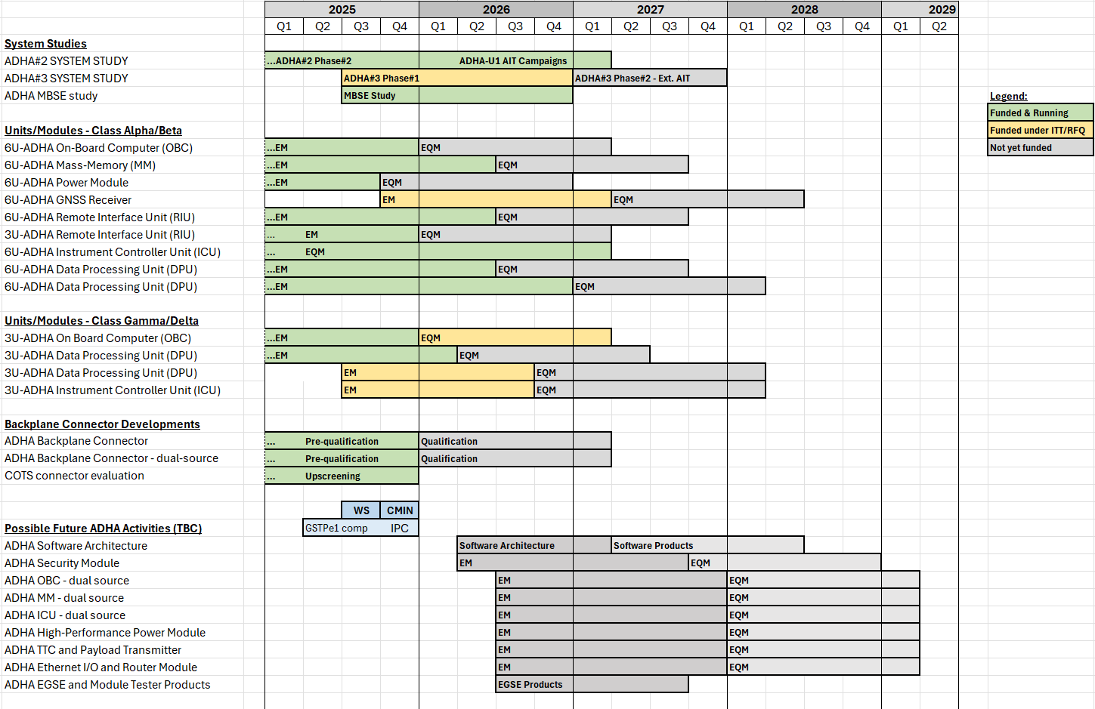











ADHA Activities Roadmap Overview – Current activities
1. Extended AIT campaign
CCN to ADHA system study contracts, under GSTP
Open to ADHA equipment suppliers
2. EQM developments & hardware qualification
Proc. policy: DN
Same suppliers as EMs
Estimated total budget 15-20MEUR 2025-2027
3. Future TDE/GSTP activities (TBC)
Proc. policy: ITTs (open competition)
Activities TBC (pending internal ESA evaluation)

Slide 14
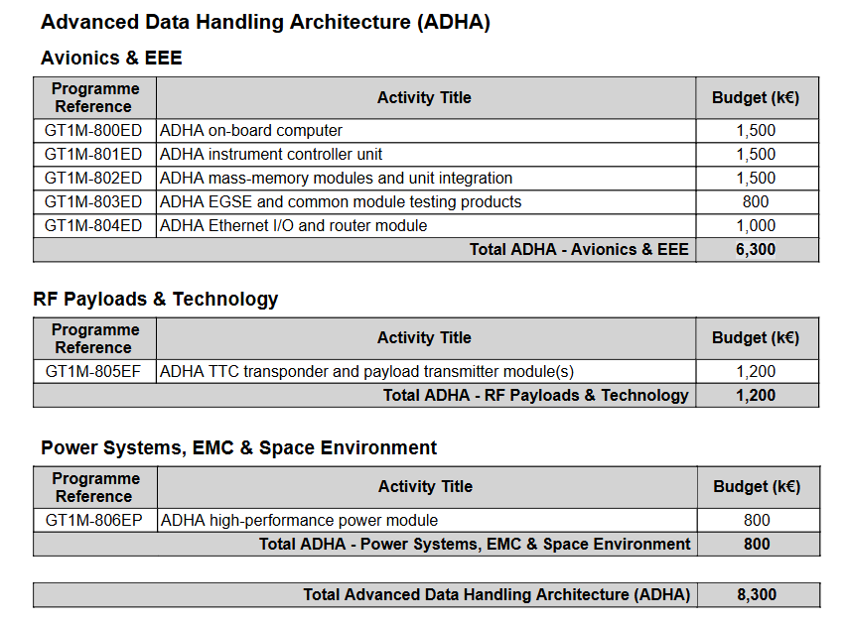
ADHA Future Activities – GSTP Element 1 Compendium
Dual-source and additional EM activities:
Either: open ITTs through GSTPe1 (compendium)
…or industry-initiated through optional programme(s)
Estimated required budget (2026-2027): ca 8.3 MEUR
Parallel activities are desirable for dual sourcing of functions
GSTP Element 1 Compendium includes both:
2nd source activities (OBC, Mass-Memory, Instrument Controller)
…and new functions under standardisation (e.g. TTC module and payload transmitter module)

Slide 15
ADHA Future Activities – GSTP Element 1 Compendium
Complementary hardware development activities:
Note: not specified whether activities should target 6U or 3U, Class Alpha/Beta or Class Gamma
Will be up to industry to propose (feedback welcome!)
ADHA OBC – using next-gen micro-electronics components for higher performance (dual-source)
ADHA MM – complete ADHA MM, with unit integration and SW (dual-source, or 1st 3U)
ADHA ICU – ICU controller + I/O module (and unit integration) (dual-source or 1st 3U)
ADHA Payload Power module – targeting highly dissipative units (500-1000W)
ADHA TT&C transponder and Payload transmitter module(s) – SDR-based radio modules
ADHA Ethernet router module – To provide external Ethernet connectivity to ADHA units – for future-proofing
ADHA EGSE and automated module tester – to allow fast testing of module (for future serialisation) and to lower cost in EGSE for ADHA module suppliers

Slide 16
Advanced Data Handling Architecture (ADHA) @ EDHPC2025
Presenters, co-chairs, participants: Thank you all for a great set of ADHA sessions at EDHPC2025!
“Working towards a European solution for standardized Data Handling Systems"
David Steenari, david.steenari@esa.int
Kostas Marinis, kostas.marinis@esa.int
Data Handling Section ESA/ESTEC | TEC EDD

