Slide 1
An Overview of the Foreseen MBSE Approach for ADHA Units and Modules: Methodologies and Applications
Authors:
Alper Akarsu, Stephan Jahnke, Jon Caudepon (OHB System AG, DE)
Eleonora Marioitti (ESA, NL)
Dovydas Bieliauskas, Tilo Wiklund, Simonas Draukšas (Sensmetry, LI/SE)
Michael Jetzschmann (DLR, DE)
ESA Funded Activity: AO/1-12744/25/NL/VR/my

Slide 2
Motivation: ADHA Initiative
Modular Avionics Ecosystem: ADHA defines a standardized, modular, interoperable avionics framework to replace custom designs. This enables multiple suppliers to provide plug-and-play electronics, shortening development cycles and reducing cost.
Program Roadmap: ESA’s ADHA-1 study (2019–20) established the concept and adopted the CPCI-Serial-Space 6U standard. ADHA-2 (2022–26) is building 6U Engineering Models (EMs) housing core modules for Low Earth Orbit payload data handling, aligning with high-performance EO requirements.
Next-Gen Processing: Driven by New Space demands, ADHA fosters re-use of next-gen microelectronics. Its unified architecture aims to blend the speed/cost benefits of modular design with spaceflight reliability.

Slide 3
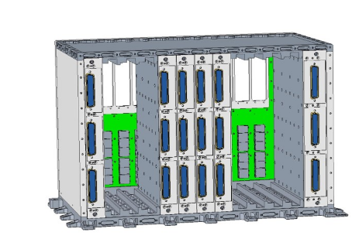
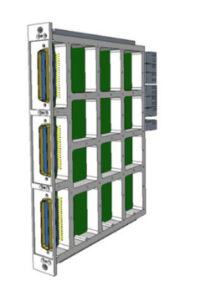
ADHA Architecture & Core Modules
6U Unit Design: The ADHA-6U unit is based on CPCI-Serial-Space backplane with space-grade enhancements. The backplane adds redundant +12V/+28V/+5V power lines and relocates control signals (Reset, PSON, PPS) to dedicated areas for high reliability.
Module Slots: Each 6U unit hosts up to 13 module slots (including redundancy), allowing interchangeable boards. Standard mechanical/electrical form factors (shared with Advanced Power Architecture) ensure cross-compatibility.
Core Modules (ADHA-2): Three core modules are under development:
On-Board Computer (AOBCM): Central controller managing C&C and health monitoring, leveraging advanced FPGA technology for high performance and fault tolerance.
Mass Memory (A3M): Scalable solid-state memory with one Master and multiple Extension Modules, supporting up to 104 Tbit and interfacing via SpaceFibre/SpaceWire.
Power Module (APwRM): Provides regulated power to all modules through two redundant power chains (21–37 V input). Designed to the APA standard to simplify module power interfaces.
Supplier Ecosystem: Each module is developed by a different industry partner, but uses common ADHA interfaces so units from one integrator can mix modules from various suppliers.
ADHA-6U Unit design
ADHA generic 6U module

Slide 4
Need for MBSE in ADHA
Complexity & Collaboration: Modular, multi-vendor avionics require a coherent systems engineering approach. MBSE ensures consistency across suppliers and life-cycle traceability of requirements, interfaces, and functions.
Digital Continuity: A single MBSE model serves as the “single source of truth,” enabling digital continuity from early design to flight model. This reduces manual documentation effort and errors.
Automated Artifacts: ADHA’s MBSE framework targets automatic generation of key artifacts (Interface Control Documents, electronic datasheets, budgets, diagrams). This improves quality and saves months of manual editing.
Reuse & Efficiency: Consistent modelling promotes reuse of module and unit design patterns. It also shifts the community toward model-centric engineering, aligning with ESA’s goal of efficient, interoperable design processes.

Slide 5
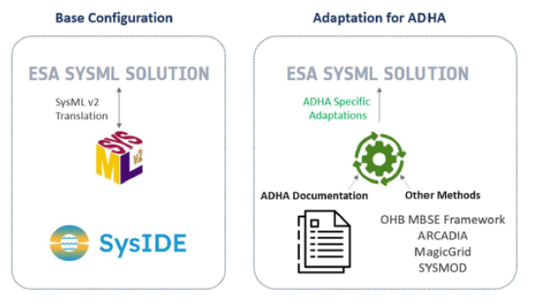
Proposed ADHA MBSE Framework
Processes
MBSE Language
MBSE Method
MBSE Tool
Baseline + Extensions: We start with the ESA SysML method (process and profiles), SysML v2 language, and SysIDE tools as the baseline. We then extend them to capture ADHA’s modular avionics specifics.
MBSE Framework

Slide 6
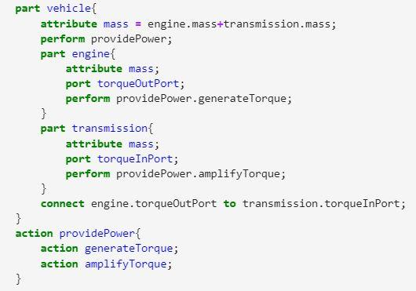
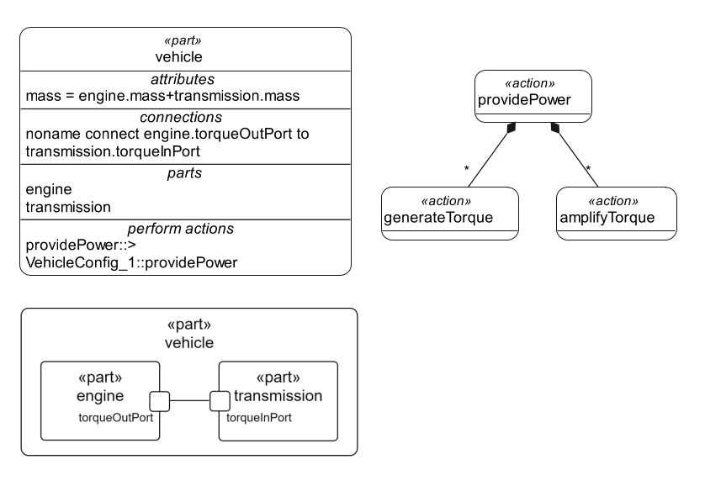
ESA SysML Solution & SysML v2
ESA SysML Solution: It is open, aligned with ECSS standards, and tailored to space-domain engineering. It provides a common SysML profile and methodology adopted by major ESA projects.
SysML v2 Language: SysML v2 offers formal semantics and a textual syntax and graphical views, eliminating UML port ambiguities and making requirements first-class model elements, supports tool independent interoperability.
SysML v2 textual and graphical syntax. Source and Credits: Object Management Group (OMG)

Slide 7
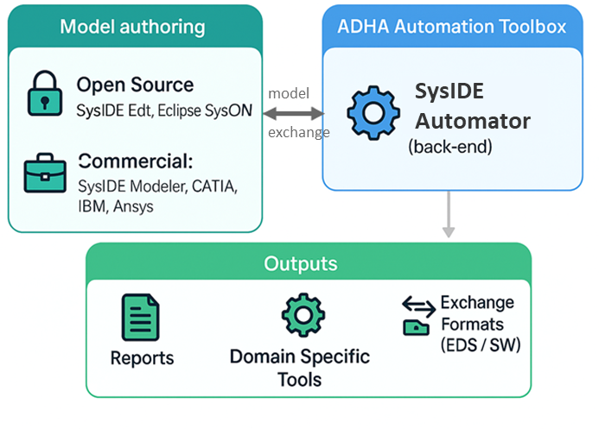
MBSE Toolchain & Automation
Model Authoring:
Architecture Supports any SysML v2 compliant editor → tool independence
Models are stored in plain .sysml text, allowing version control and collaboration.
For MBSE4ADHA project: SysIDE Editor/Modeler (VSCode plugin or GUI Modeler).
ADHA Automation Toolbox:
SysIDE Automator (Python): Provides a programmable interface to the model.
ADHA-specific scripts handle tasks like importing Electronic Data Sheets, computing power/mass/data budgets, and generating documentations (e.g. Interface Control Documents) from the model.
Integration: The toolchain supports exporting model views (diagrams, blocks) and integrating with other (domain specific) tools, e.g. to support simulation or specialized tasks.

Slide 8
Key Use Cases & Benefits
Automated Documentation: Generate unit-level deliverables automatically. This eliminates tedious manual efforts and ensures consistency across documents.
Requirements and Interface Validation: Build bidirectional traceability. The MBSE model links requirements to design elements. Scripts can automatically check interface consistency and completeness, flagging mismatches early.
Collaboration & Continuity: The model acts as a single source of truth across suppliers. Module providers can deliver standardized model components to the unit integrator. All stakeholders reference the same database, ensuring digital continuity from design through verification. This DevOps-like approach enforces modelling best practices and avoids vendor lock-in.
Simulation-Driven Design: Because SysML v2 integrates behavior (blocks + flows), the ADHA model can feed simulations. Early concept-of-operations modeling can predict workload and validate architectural tradeoffs.
RAMS Analysis: Reliability and safety analyses can be tied to the model. Engineers can attach failure modes to blocks and ports, automatically propagate them, and build fault trees or FMEA diagrams. This keeps RAMS data synchronized with the design.

Slide 9
Key Use Cases (Implementation Details)
Extract
Data sheet and specification exchange: Allow for the exchange / import & export of standardized formats (i.e. Electronic Data Sheets or compatible SysML v2 models) + redaction of IPR relevant data
Support Simulation and behavioural model execution: Model serves as central database for parametric simulation in-/outputs towards Domain Specific Tools. Functional validation through execution of behaviour (i.e. State Machines for Operational Modes)
Support interface management: Derive TMTC / observable data, create signal-to-pin allocations and support IO budgets, check interface compatibilities
Unit configuration and sizing: Configure Unit from Module models and generate bottom-up calculations to check agains limites & requirements
CAD integration: create links between MBSE model elements and CAD parts to ensure tracing and derive main characteristics (e.g. size, mass, volume, CoG / MoI)
Software generation: Generate code skeletons from the model in selected programming languages (i.e. low level drivers, hardware description)

Slide 10
Summary of Expected Benefits
Efficiency & Consistency: Automated artifact generation and model-checks cut manual engineering effort and errors. The MBSE model ensures all documents (ICDs, diagrams, budgets) are consistent with each other and with requirements.
Improved Communication: A shared model improves cross-team understanding. For example, auto-generated ICDs ensure everyone agrees on interfaces, saving “months of document editing”. Systems engineers can query the model for up-to-date stats (mass, power, etc.).
Reuse & Standardization: Common ADHA model libraries allow reuse of proven module architectures across missions. Templates and validation rules promote best practices and speed up future designs.
Digital Continuity: This framework embodies ESA’s vision of moving from document-centric to model-centric engineering. Full traceability and data handover in the model form the backbone of a digital thread across the supply chain.
Reduced Time & Risk: Ultimately, adopting this MBSE approach should reduce ADHA unit development time and risk, multiplying the benefits of the hardware standardization initiative.

Slide 11
THANK YOU
ANY QUESTIONS?
Feel free to contact us also after the conference: Stephan.Jahnke@ohb.de
Jon.Caudepon@ohb.de
Eleonora.Mariotti@esa.int

