Slide 1





EDHPC2025 paper presentation:
Modular and Scalable Electrical Architectures for Satellite On-Board Data Handling and Processing
– using ADHA (Advanced Data Handling Architecture)
David Steenari¹, Julian Bozler², Dario Pascucci³, Jon Caudepon⁴, Felix Siegle¹, Kostas Marinis¹
^{1:} ESA ESTEC, ^{2:} Airbus GmbH, ^{3:} Thales Alenia Space Italia, ^{4:} OHB Systems AG
David Steenari, david.steenari@esa.int
Kostas Marinis, kostas.marinis@esa.int
Data Handling Section ESA/ESTEC | TEC EDD
EDHPC 2025 ADHA Session A1
2025-10-14

Slide 2
Presentation Scope and Overview
ADHA has already provided standardisation of some DHS functions (OBC, MM, etc).
An expansion of DHS functions to be standardised under ADHA is currently planned.
This paper presentation aims to provide possible examples of end-to-end data-handling / avionics architectures for representative mission profiles based on ADHA units, and module functions currently considered for standardisation under the ADHA-3 system study activity.
More details are included in the provided technical paper.
Presentation sections:
Standardised ADHA data-handling functions
Example unit architecture configurations
End-to-end data-handling system / avionics architectures based on ADHA units

Slide 3
1. ADHA standardised DHS functions

Slide 4
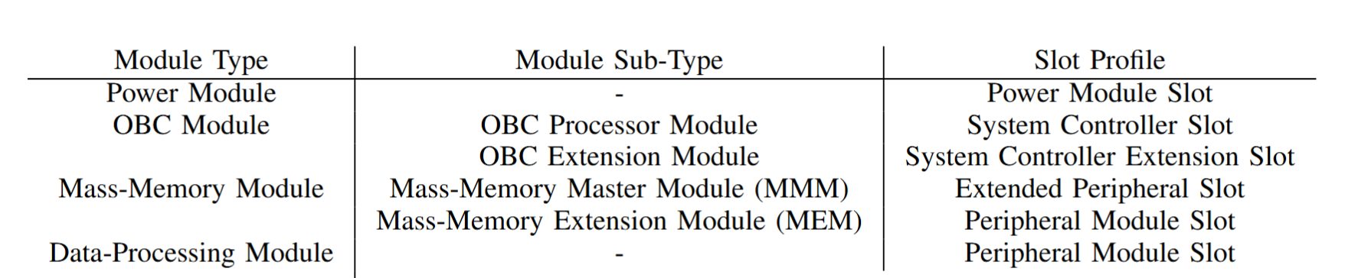
ADHA standardised DHS functions – current
ADHA standardises DHS functions as Module Functional
Requirements Specifications.
The currently standardised module functions include:
Power Module – provides backplane power buses
OBC Module – complete SAVOIR-compliant OBC
  Possible to split over several modules – up to supplier!
Mass-memory – complete (payload) mass-memory
  Reference architecture split between MM master module and MM extension (storage) module)
DPM (Data Processing Module) – for high-end (payload) data processing
  Can also be provided as for co-processor, off-loading a payload ICU or platform OBC for processing tasks

Slide 5
ADHA standard DHS functions under consideration – platform
Module type | Profile Type | Short description | HW roadmap
RTU Controller Module | System Controller Slot | Provides control function for free-standing RTU unit, or for offloading OBC | Under dev.
RTU Generic I/O Module | Peripheral Slot | Generic I/O for thermistors, heaters, HPCs, etc. (similar to ICU Generic I/O module) | Under dev.
RTU AOCS I/O Module | Peripheral Slot | For interfacing AOCS sub-system (MAG, MTQ, RW, sun-sensor, etc.) | Under dev.
RTU Propulsion I/O Module | Peripheral Slot | For interfacing the propulsion sub-system | Under dev.
GNSS Receiver Module (GNSSRxM) | Peripheral Slot | GNSS (Galileo, GPS, etc) receiver | TDE ITT
TTC Transponder Module | Peripheral Slot | TTC transponder / radio (SDR) | GSTP Compen.
Payload Transmitter Module | Peripheral Slot | Payload transmitter / radio (SDR) | GSSTP Compen.
Security Module | Peripheral Slot | Additional security functions (authentication, encryption, etc) | TBA

Slide 6
ADHA standard DHS functions under consideration – payload
Module type | Profile Type | Short description | HW roadmap
ICU Controller Module | System Controller Slot | Provides control of instrument/payload, instrument applications SW (IASW), interface to platform, | GSTP Compen.
ICU Generic I/O Module | Peripheral Slot | Generic I/O for thermistors, heaters, HPCs, etc. (similar to RTU Generic I/O module) | GSTP Compen.
Payload Power Module | Power Slot | High-end power module for highly dissipative units (500-1000W) | GSTP Compen.
Payload Power Distribution Module | Peripheral Slot | For distributing power to external payload units (e.g. sensor front-end, etc) | Future
Optical FEE I/O module | Peripheral Slot | For interfacing with optical sensors / FEEs, both analogue and digital output sensors | Future
RF Digital Backend module | Peripheral Slot | Provides digital backend for RF payloads, including ADCs/DACs, buffering, processing and synchronisation | Future

Slide 7
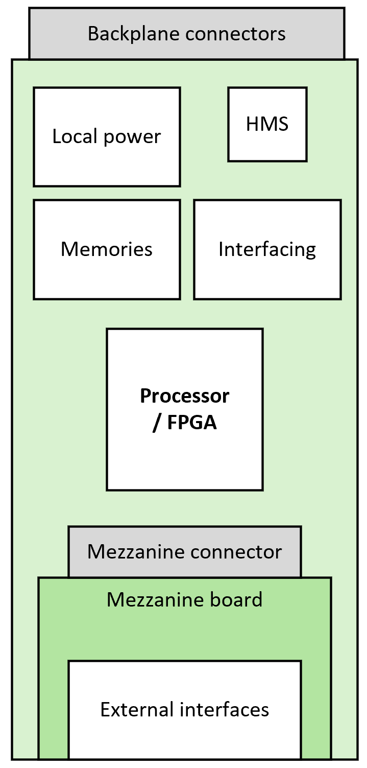
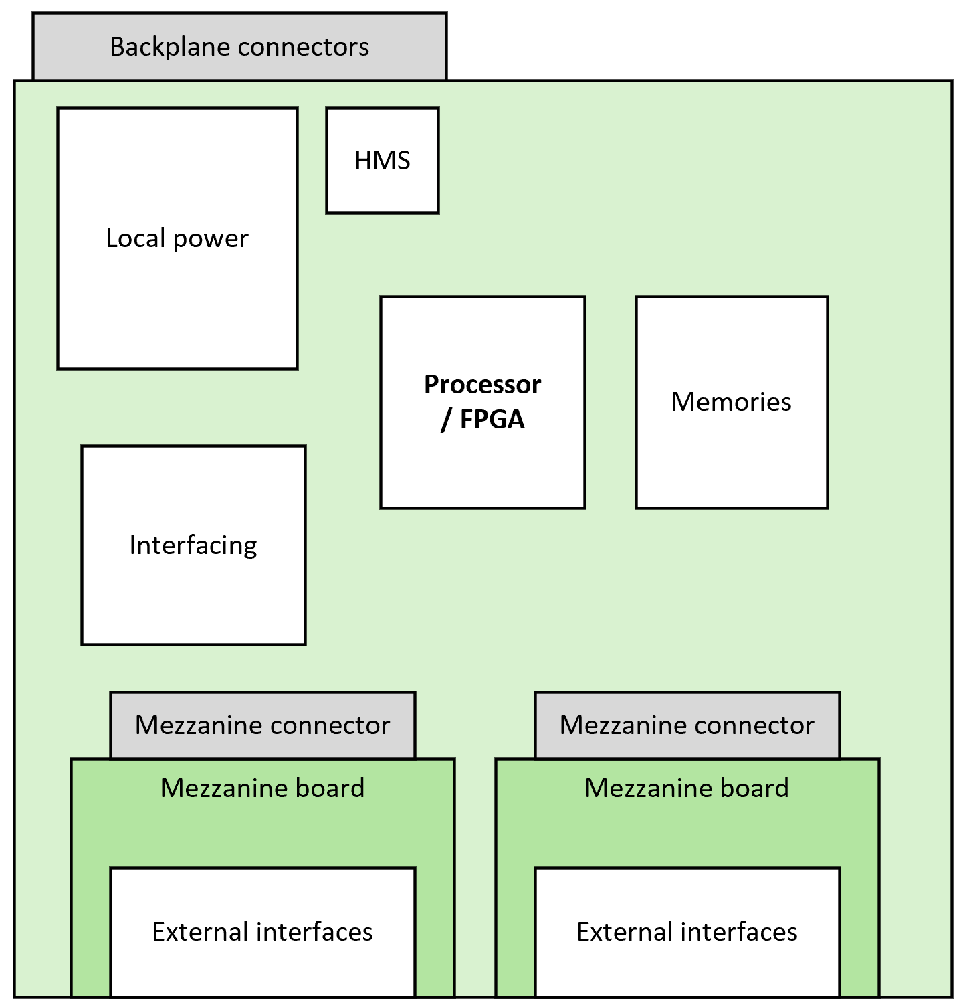
Flexibility in ADHA module design – mezzanines
Note that it is possible to support multiple different ADHA DHS functions
with a single hardware design!
Due to the standardised backplane interfaces, the same core hardware configuration can be kept – while adapting for specific DHS functions by:
Changing the SW and FPGA design
Adopting the front-panel interfaces
To make updating the front-panel interfaces more affordable – ESA plans to develop and qualify very-high performance (10-25Gbit/s/lane) mezzanine connectors, with high-pin count (>100 pins), for board-to-board configurations
This allows to change the front-panel interfaces, without impacting the TRL of the core module design (including processor/FPGA, power, backplane interfaces)
3U 6U
Example ADHA modules with mezzanine boards

Slide 8
2. Example ADHA unit configurations

Slide 9
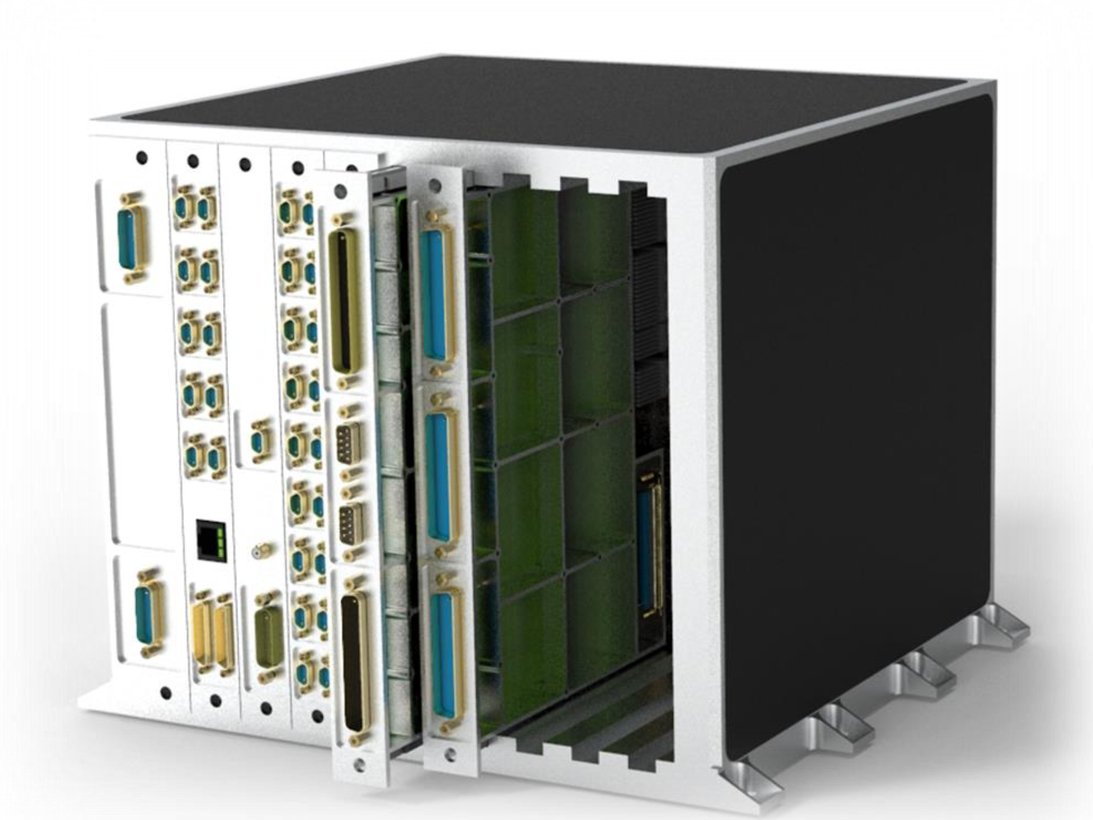
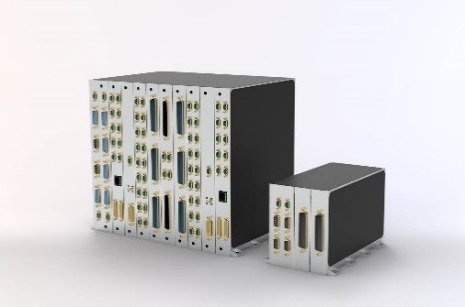
Example ADHA Unit Configurations
In the following slides, we will go through some possible example configurations of ADHA units – based on the standardised module functions described in the previous section.
…including the ones that are considered for future standardisation.
Examples:
Central Data Handling Unit (CDHU) – for institutional EO mission
Fully integrated platform DHS – for integrated platforms
Payload Data Handling Unit (PDHU)
Instrument Controller Unit (ICU)
Data Processing Unit (DHU)
Integrated instrument electronics

Slide 10
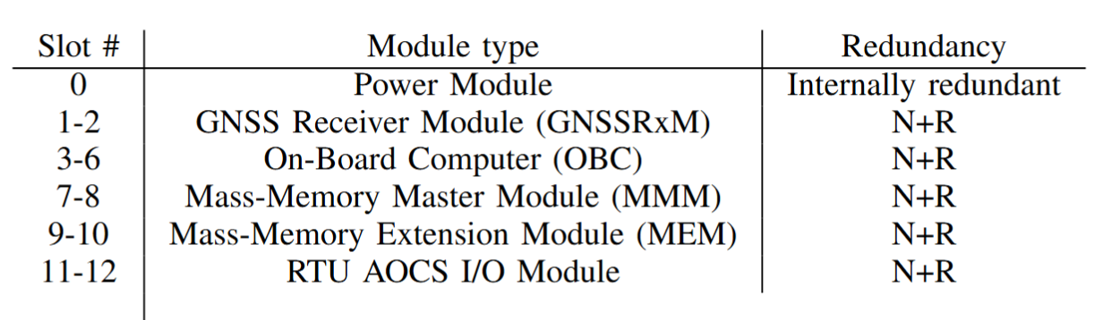
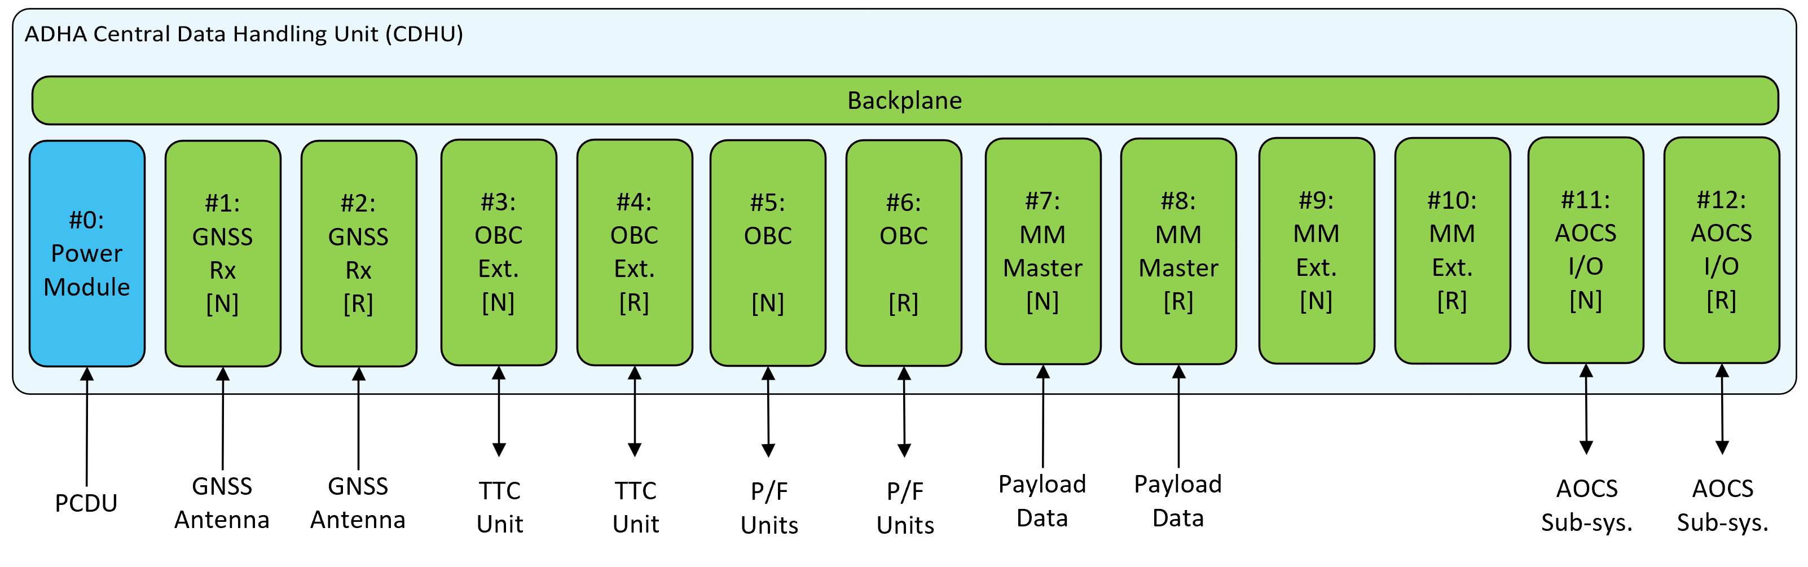
ADHA unit configuration example 1)
12-slot 6U-ADHA Central Data Handling Unit (CDHU)
The following CDHU (Central Data Handling Unit) integrates both platform and payload data handling in a single unit:
Full platform OBC
GNSS Receiver
I/O Modules for AOCS
Full payload Mass-Memory
Note: excepts additional external (u)RTU for propulsion sub-system, and thermistor acquisition – if necessary.
Options:
AOCS I/O can be replaced with e.g. additional MM
…or removed for a smaller 10-slot unit.
Possible optimisation:
N+R GNSSRxM in a single slot (#1) with 2x FCGs
…would allow a possibility to add a transponder (also 2xFCGs) in the open slot (#2)

Slide 11
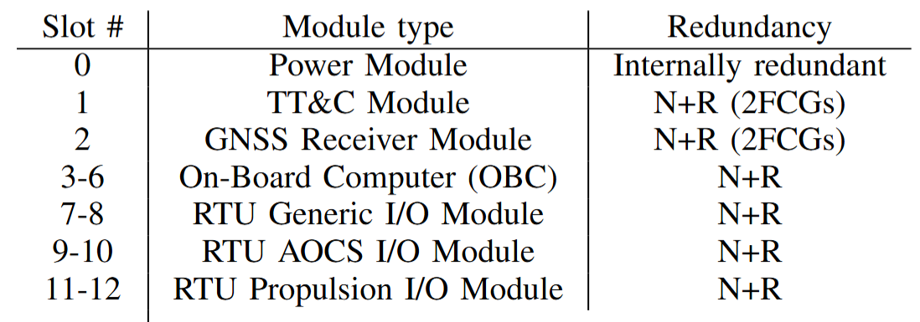
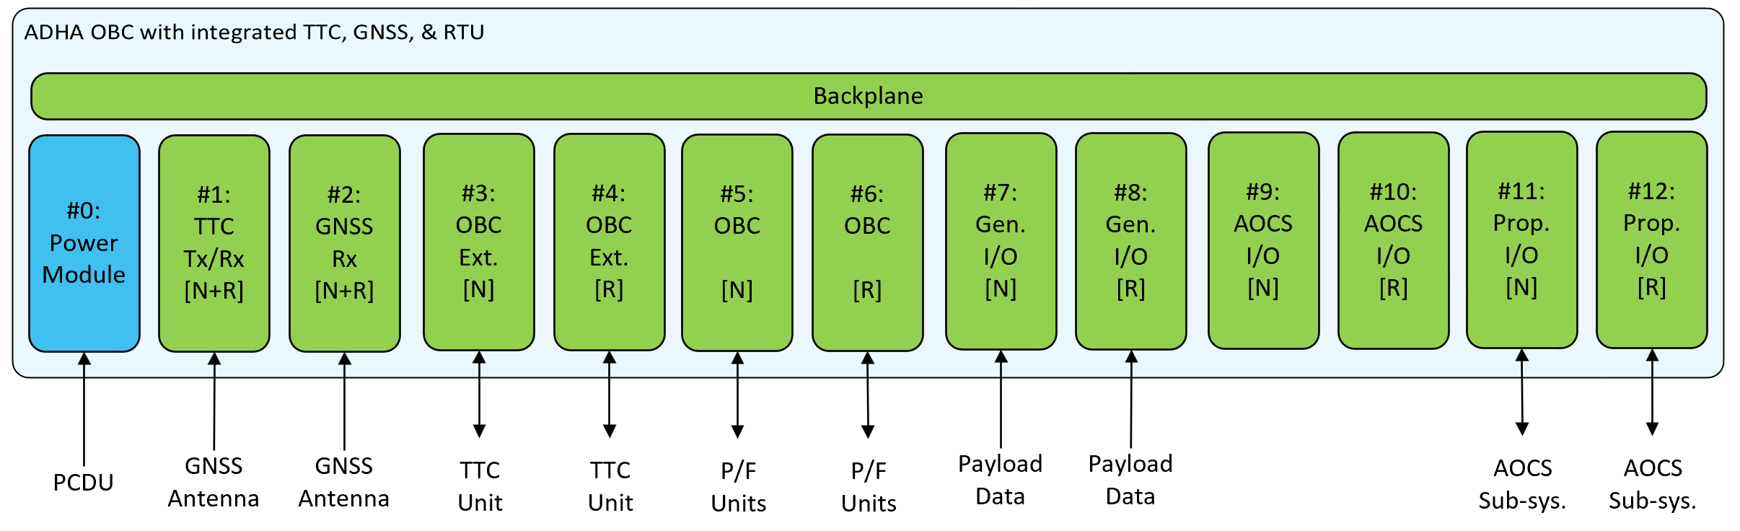
ADHA unit configuration example 2)
Complete platform DHS
Targets a fully integrated platform functions is a single unit – suited for more integrated spacecraft configurations, that do not need to place RTU functions close to AOCS and propulsion sub-systems for harness management.
Note: expects payload data to be handled by external unit (e.g. PDHU)
Integrates:
OBC
TT&C Transponder
GNSS Receiver
RTU functionality – generic I/O, AOCS I/O and propulsion sub-system I/O
Utilises 2xFCGs in slots #1-#2 for TT&C transponder and GNSS Receiver.

Slide 12
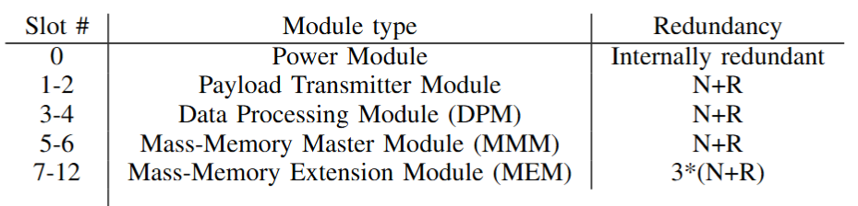
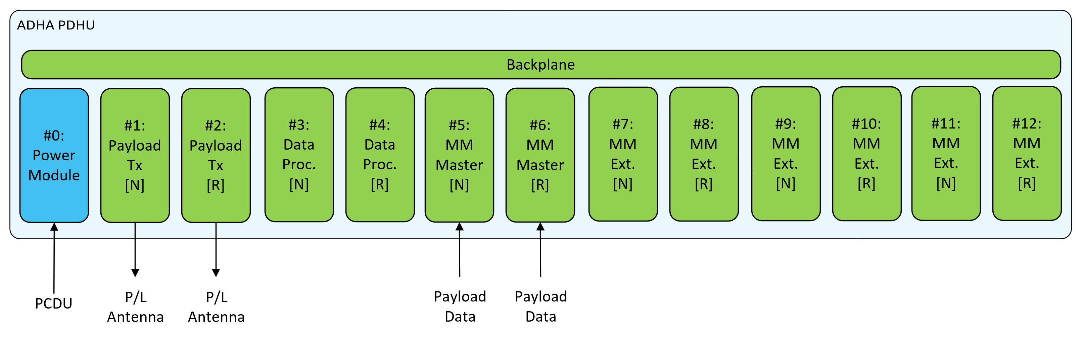
ADHA unit configuration example 3)
Stand-alone Payload Data Handling Unit (PDHU)
This example PDHU (Payload Data Handling Unit) targets the complete management of payload data
Integrates:
MM master controller and memory slices
Data processing module
Payload transmitter radio
The number of MEM slices and/or DPMs can be adapted for the specific mission need.
Redundancy concept can also be adapted for the reliability: both N and R master-modules, have access to all (six) MEM slices – in principle all can be activated at the same time.
Possible optimisation: data processing can be provided by the MM master module.

Slide 13
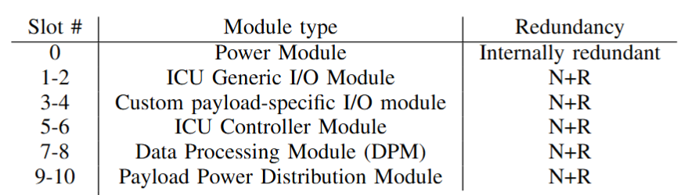
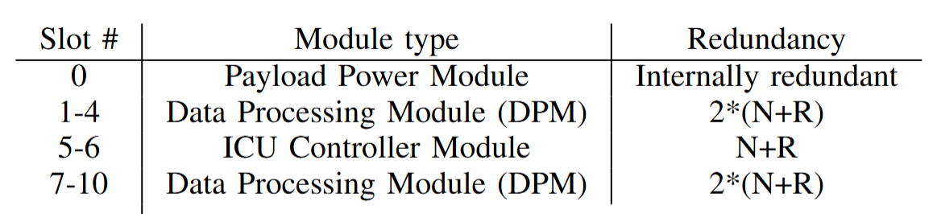
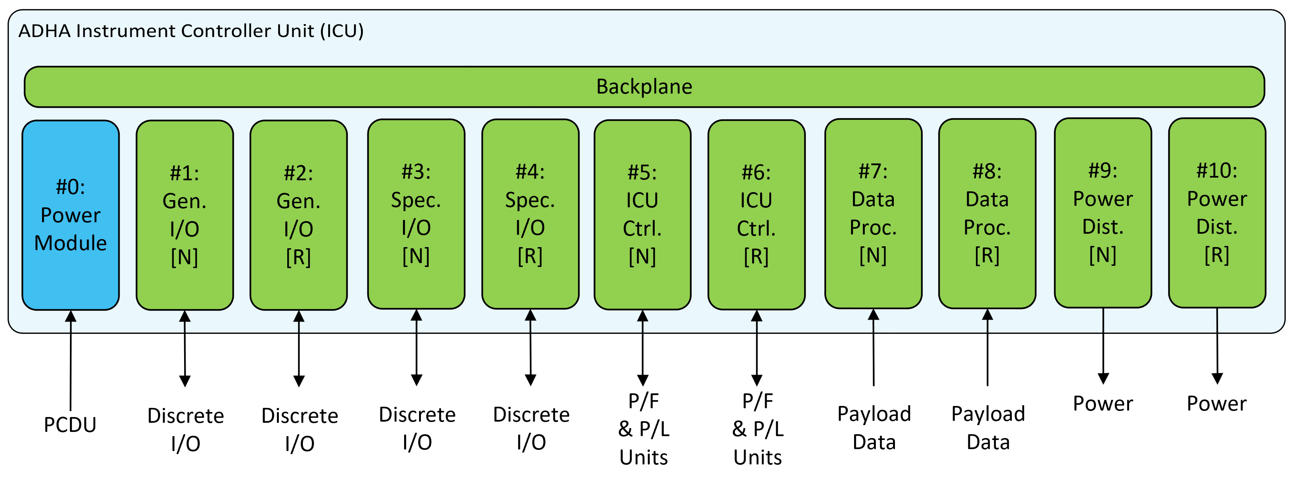
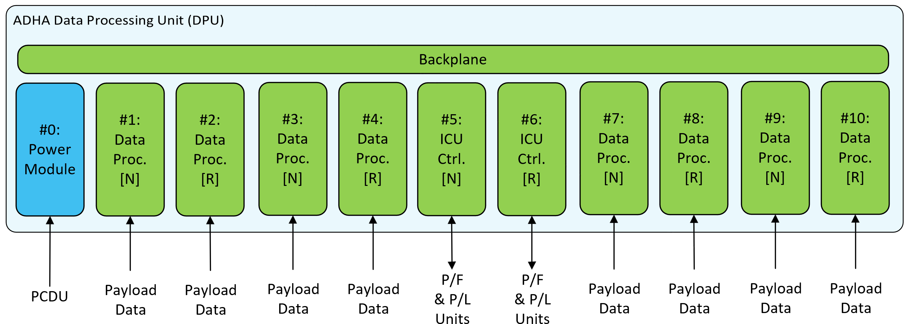
ADHA unit configuration examples 4) and 5)
Instrument Controller Unit (ICU) – and dedicated high-performance DPU
Instrument Controller Unit (ICU) includes:
ICU control, generic and specific I/O functions (motor control, heaters, thermistors etc), power distribution for external payload units, and payload data processing.
Data Processing Unit (DPU)
For a very high-throughput payload (e.g. multi-sensor or SAR radar)
Integrates multiple DPMs (data processing modules) – scalable between 1-10 per unit (here shown with 8x).

Slide 14
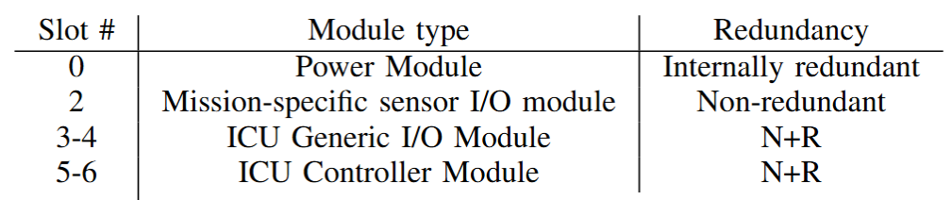
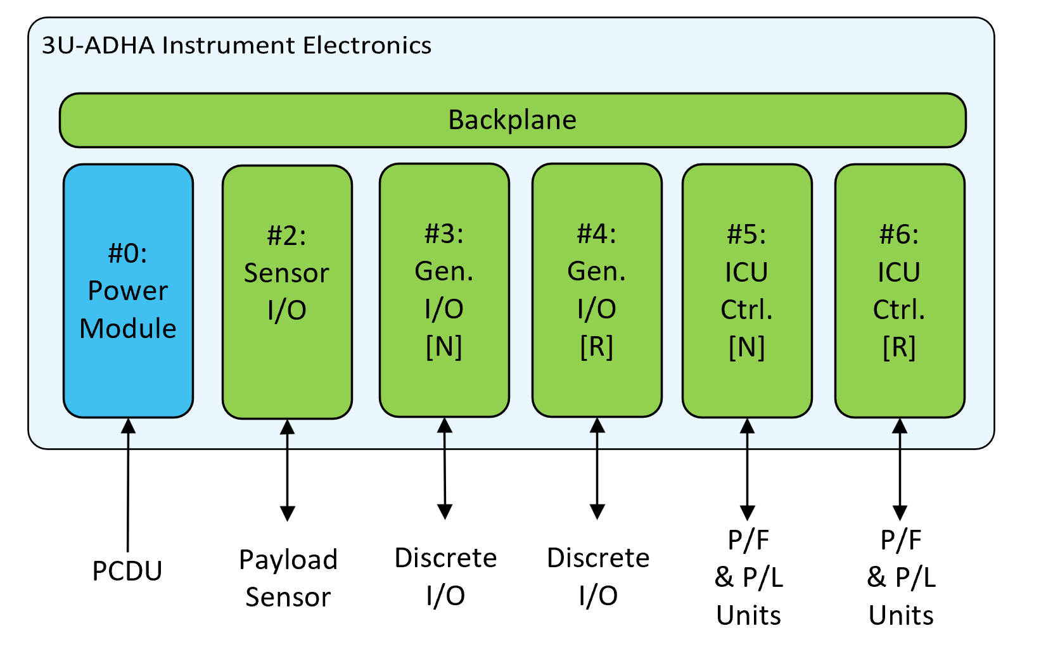
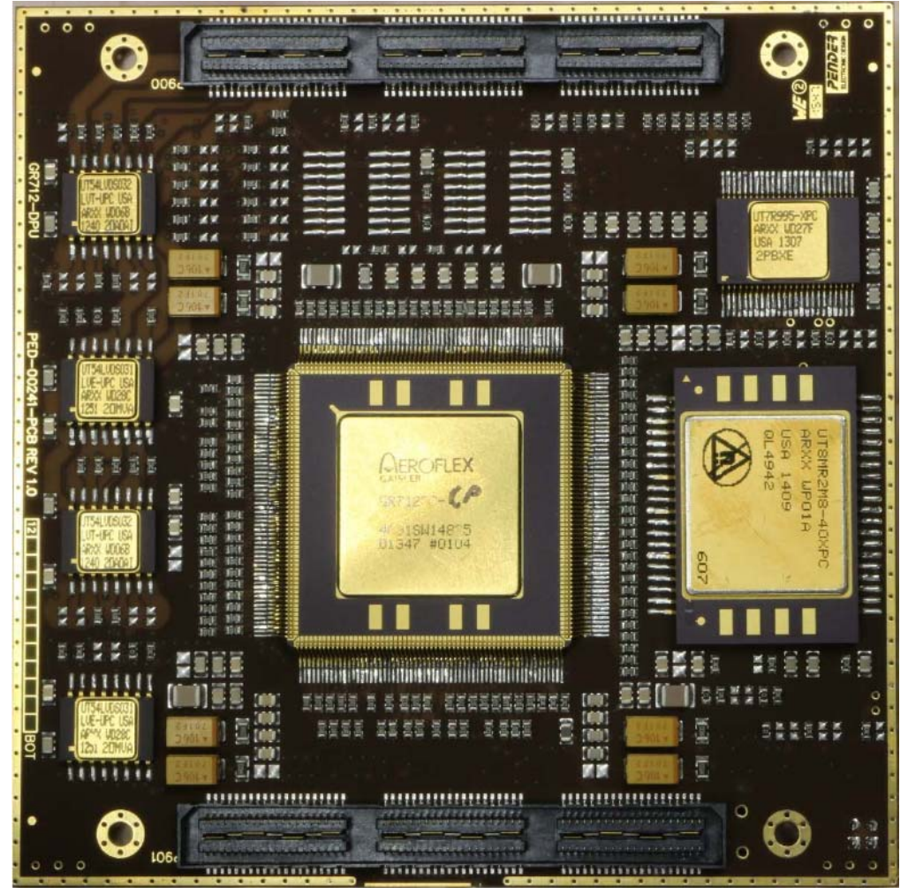
ADHA unit configuration example 6)
3U-ADHA integrated instrument electronics
A unit targeting a full instrument electronics for a less complex instrument.
Integrates:
ICU/DPU module for IASW, control and simpler processing
Generic I/O for instrument discrete functions (e.g. payload mechanism)
Specific (non-redundant) sensor I/O
Targets primarily science instruments
developed by research institutes
for ESA Science missions, as CFIs.
Note: similar concept for a reference
payload DPU reference design
was e.g. used on the ESA JUICE mission.
JUICE payload DPU reference design
Image source: Frontgrade Gaisler AB

Slide 15
3. End-to-end data-handling / avionics architectures based on ADHA units and modules

Slide 16
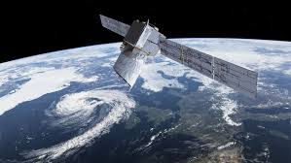
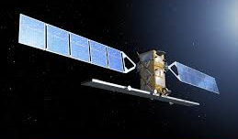
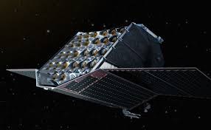
End-to-end data-handling / avionics architectures based on ADHA units and modules
In the following slides, we now present some example end-to-end data handling / avionics architectures based on the ADHA units and modules presented in the previous sections.
Examples:
Institutional EO mission
Mission with very high-rate remote-sensing payload
Multi-instrument science mission
Large-scale space telescope

Slide 17
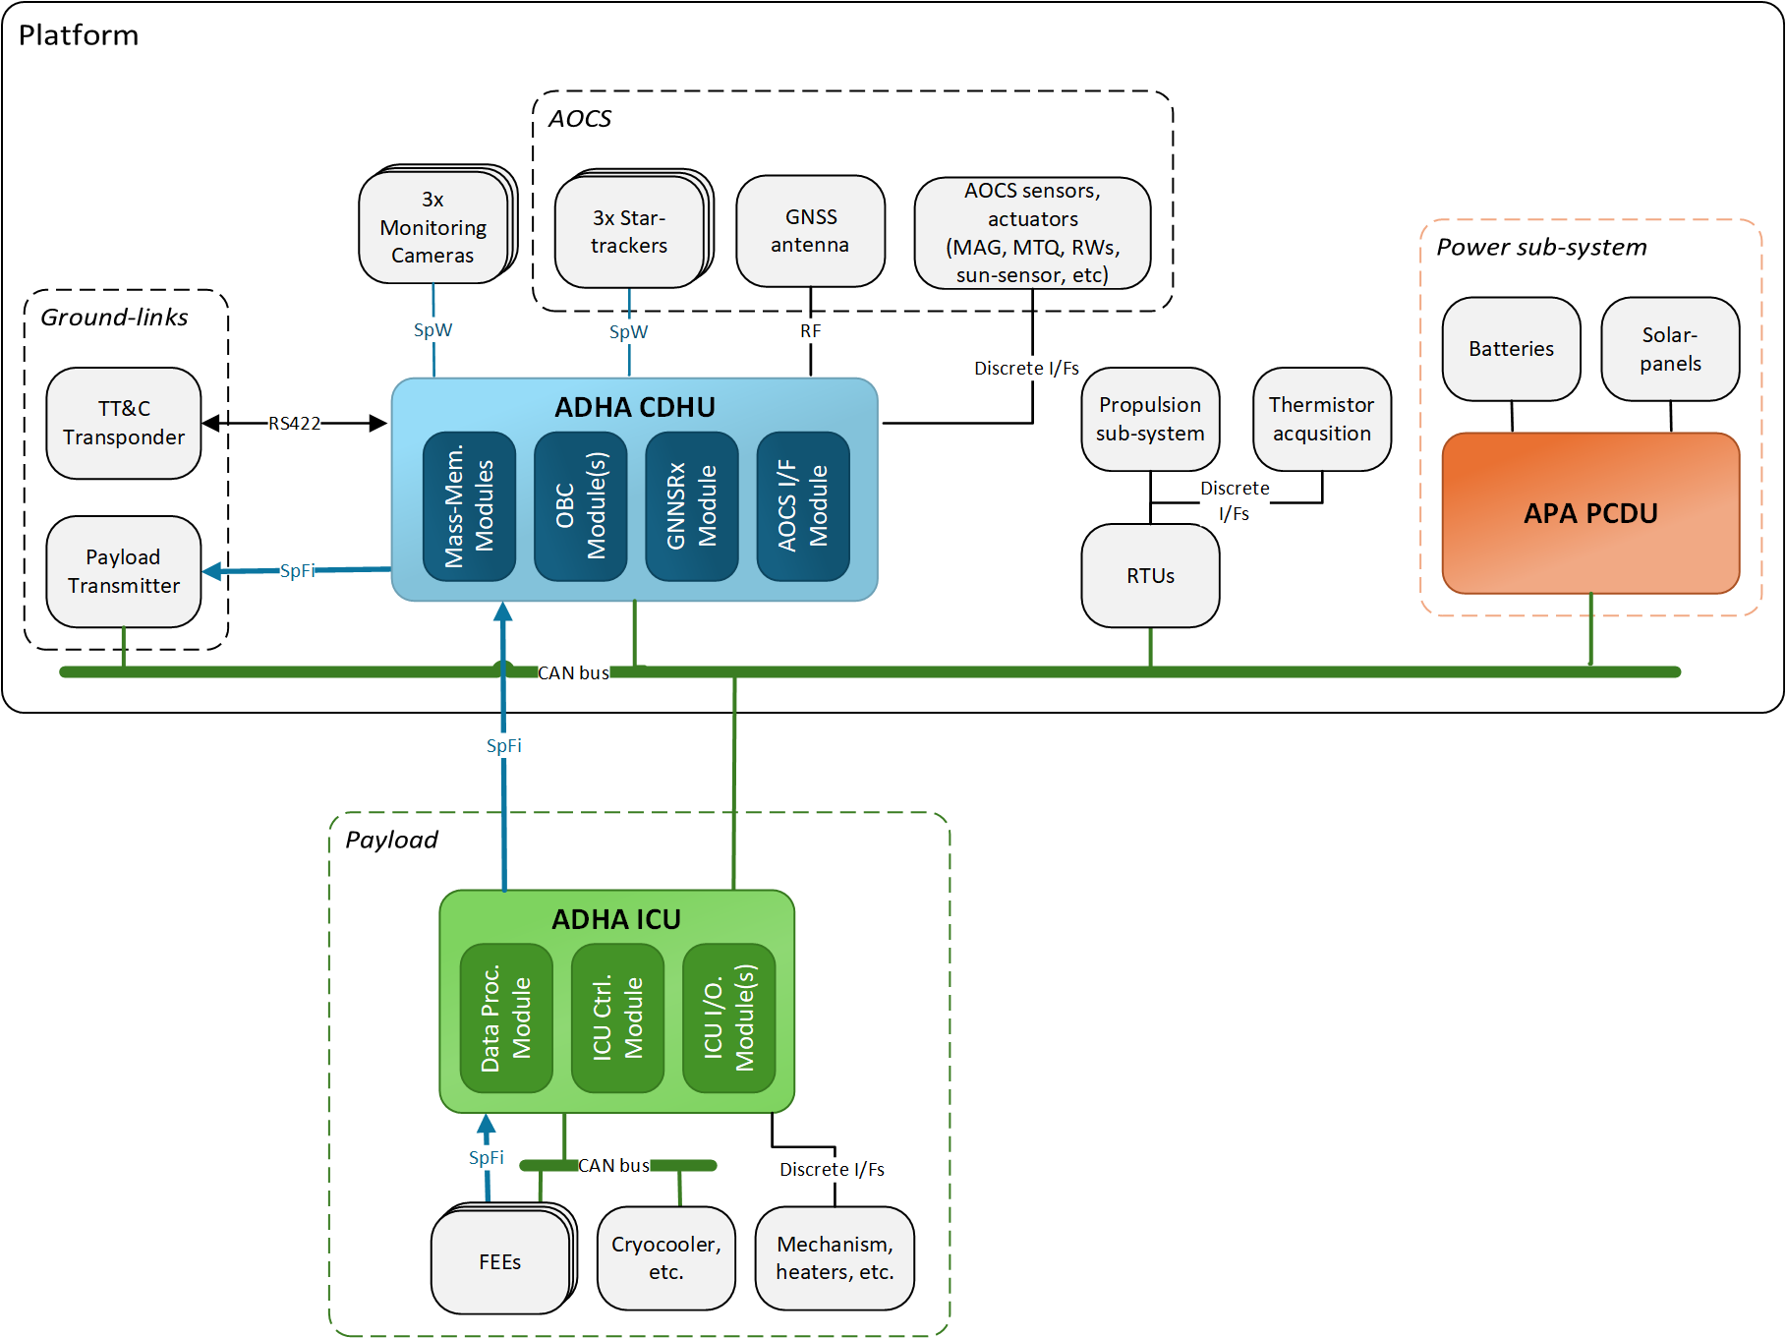
ADHA-based avionics / data-handling architectures 1)
Institutional EO mission
Use-case description:
Institutional EO mission with complex instrument, with medium data throughput
Platform:
ADHA CDHU – for platform and payload data handling
APA PCDU – for power conditioning and distribution
Additional RTU(s) for propulsion etc
External TTC transponder and payload transmitter
Payload:
ADHA ICU – for instrument control, I/O and data processing
Additional FEEs, cryocooler, mechanism etc

Slide 18
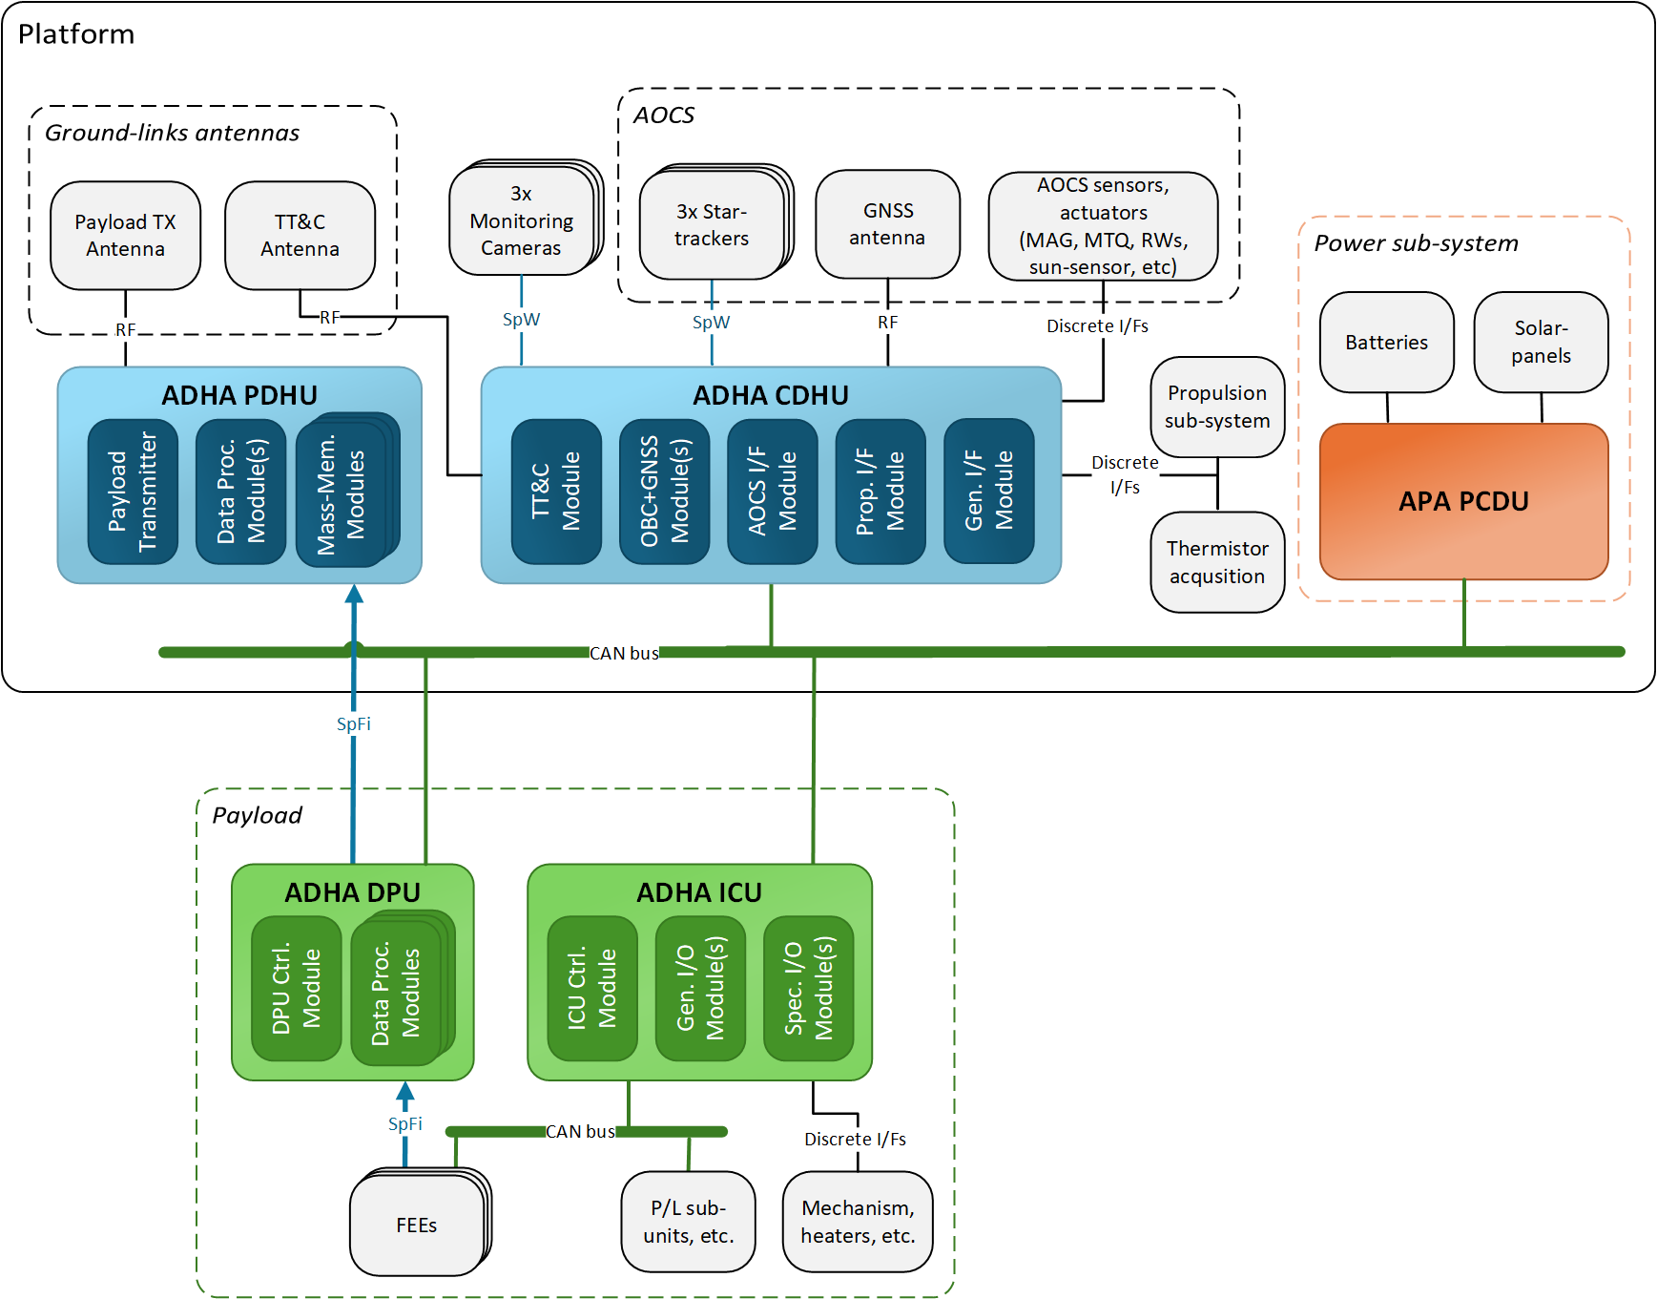
ADHA-based avionics / data-handling architectures 2)
Mission with very high-rate remote-sensing payload
Use-case description:
A very high-rate remote-sensing payload (multi-sensor hyperspectral instrument, or SAR radar)
Platform:
ADHA CDHU – for complete platform data handling (incl. GNSS, TTC, RTU)
ADHA PDHU – for complete payload data handling (incl. payload transmitter)
APA PCDU
Payload:
ADHA ICU – for instrument control
ADHA DPU – for payload data processing and synchronisation
Additional front-end/sensor units, and mechanisms

Slide 19
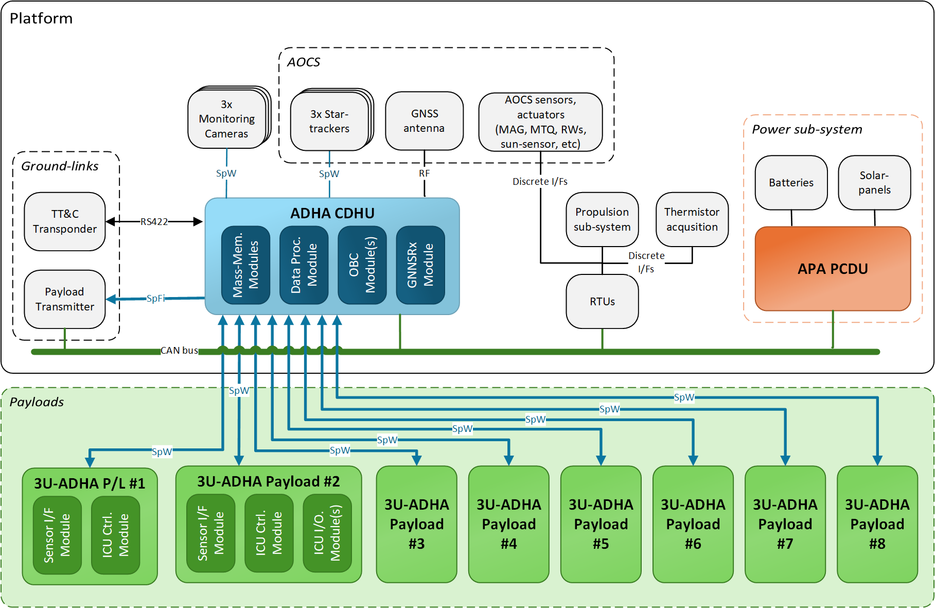
ADHA-based avionics / data-handling architectures 2)
Multi-instrument science mission
Use-case description:
Large-scale ESA deep-space science mission, with multiple CFI instruments from research institutes (e.g. JUICE, SolarOrbiter, BepiColombo, etc.)
Platform:
ADHA CDHU for platform + payload data handling
APA PCDU
Additional RTUs, TTC transponder, payload transmitter
Payload:
8x 3U-ADHA based payloads
All based on reference design

Slide 20
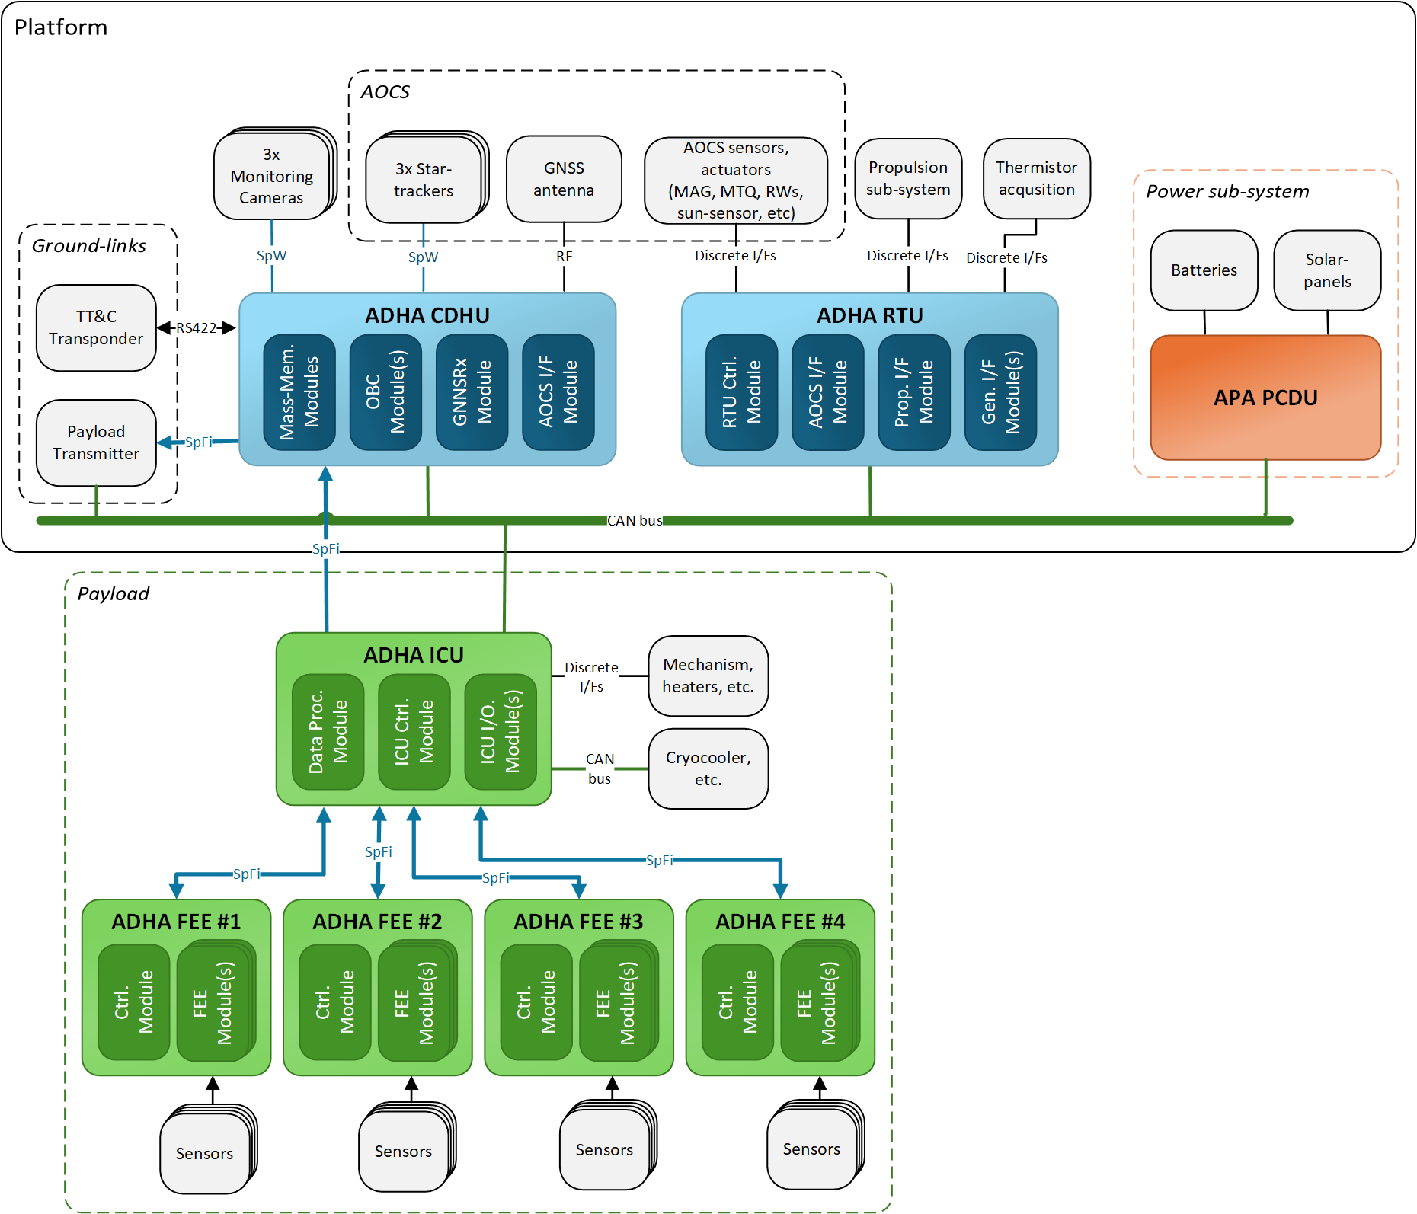
ADHA-based avionics / data-handling architectures 4)
Large-scale deep-space telescope
Use-case description:
Large scale ESA deep-space telescope (e.g. Plato, Euclid, etc.)
Platform:
ADHA CDHU – for platform and payload data handling
ADHA RTU – for AOCS, propulsion, discrete I/O
APA PCDU
Payload:
ADHA ICU – for instrument control and data processing
4x ADHA FEEs – for readout of multiple sensors per FEE, and data pre-processing

Slide 21
Summary and conclusions
We’ve shown the new planned DHS functions that are planned to be standardised as
ADHA Functional Module Specifications.
Many already under development as hardware – see next presentations within this session!
The new planned DHS specifications allows to derive different ADHA unit configurations.
We’ve shown examples of different CDHU, RTU, PDHU, ICU, DPU, FEE configurations across both platform and payload DHS functions.
We’ve shown different DHS / avionics architectures based on the ADHA units and modules.
Across different mission complexities and types (EO, Science, etc)
This shows that ADHA is flexible to enable different DHS / avionics configurations – pending on the preferences and designs of different satellite primes, and for different
Units can be configured with different functions - or split over multiple units – to meet needs of different mission profiles, across domains (EO, Science, Exploration, etc.)

Slide 22
Advanced Data Handling Architecture (ADHA):
Project Status, Background and Roadmap
“Working towards a European solution for standardized Data Handling Systems"
David Steenari, david.steenari@esa.int
Kostas Marinis, kostas.marinis@esa.int
Data Handling Section ESA/ESTEC | TEC EDD

Slide 23
EDHPC2025 paper presentation:
Modular and Scalable Electrical Architectures for Satellite On-Board Data Handling and Processing
– using ADHA (Advanced Data Handling Architecture)
David Steenari¹, Julian Bozler², Dario Pascucci³, Jon Caudepon⁴, Felix Siegle¹, Kostas Marinis¹
^{1:} ESA ESTEC, ^{2:} Airbus GmbH, ^{3:} Thales Alenia Space Italia, ^{4:} OHB Systems AG
Contact:
David Steenari, david.steenari@esa.int
Data Handling Section ESA/ESTEC | TEC EDD
EDHPC 2025 ADHA Session A1
2025-10-14

