Slide 1

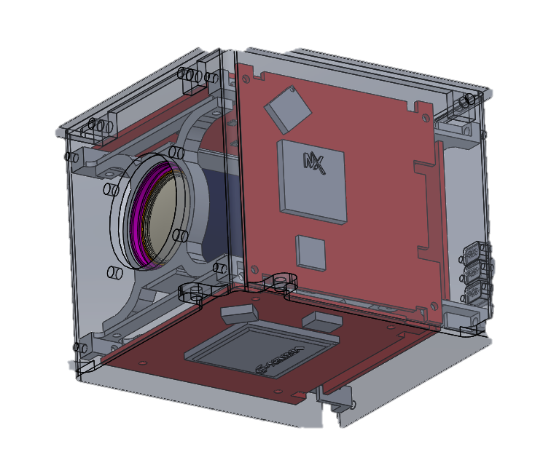
ADHA Co-processor for AI
EDHPC 2025, ESTEC (The Netherlands)- dgarjona@gmv.com
D. Gonzalez-Arjona

