Slide 1

Advanced Data Handling Architecture (ADHA)
– Development Status & Roadmap
“Working towards a European solution for standardized Data Handling Systems"
David Steenari, david.steenari@esa.int
Kostas Marinis, kostas.marinis@esa.int
Data Handling Section ESA/ESTEC | TEC EDD
EDHPC 2025 ADHA Session A1 2025-10-14

Slide 2
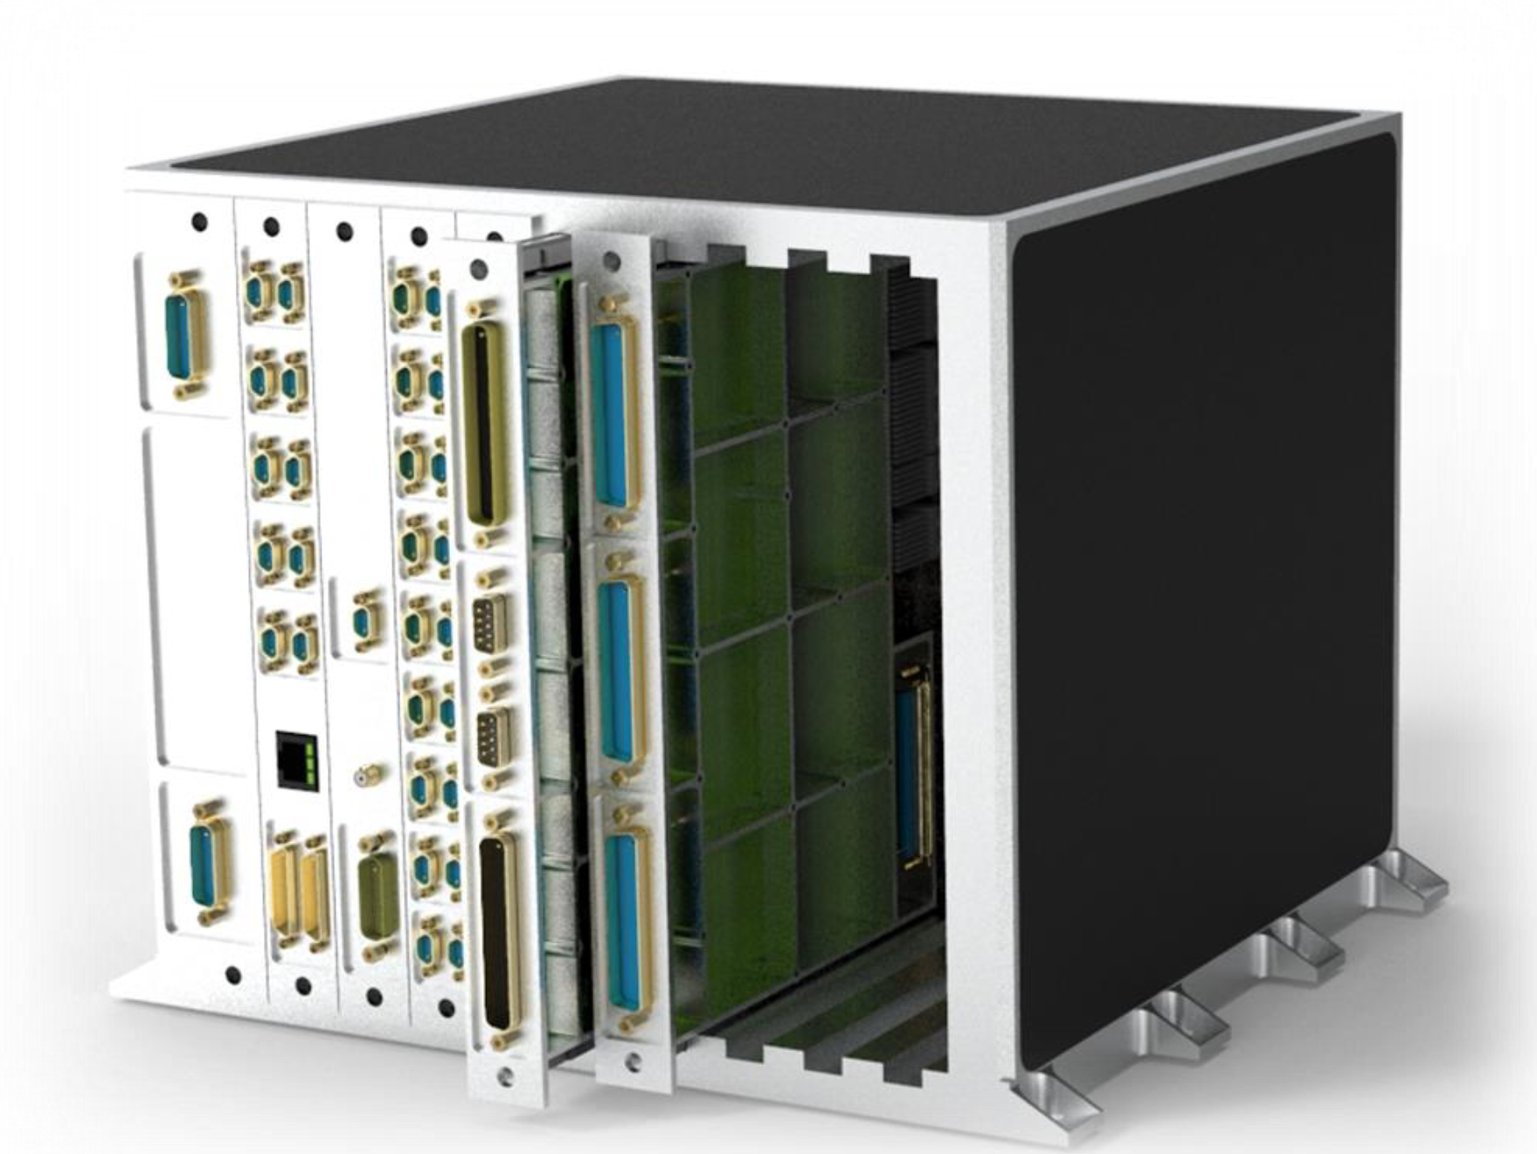
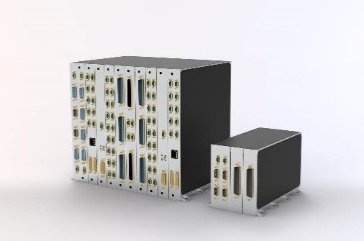
ADHA & APA: Executive Summary
The Advanced Data Handling Architecture (ADHA) and Advanced Power Architecture (APA) initiatives specify an end-to-end architecture for data-handling and power sub-systems, based on European standardized and inter-operable electronics modules and units, of common electrical and mechanical form-factors and interfaces.
This level of modularity, interoperability and standardization enables the streamlined and accelerated development, testing, integration and qualification of new configurable data handling units.
The ADHA program was initiated in 2019, in a partnership between ESA and key industry partners (SMEs, LSIs) across ESA Member States.
The Advanced Power Architecture (APA) initiative addresses the same objectives, for the Electrical Power Subsystem (EPS)
Substantial commonalities and synergies between the ADHA and APA programs.
The aim of the ADHA and APA R&D programs is to deliver a new generation of standardized data-handling and power equipment at TRL6 by 2027, ready for use by institutional and commercial missions and constellations.

Slide 3





ADHA R&D Programme Organisation
The ADHA Programme is divided into three types of activities:
System-level studies (ADHA-1, -2, and -3)
Define the requirements specification for ADHA elements
Perform 1st ADHA unit-level AIT campaigns
Parallel contracts, led by: ADS (DE) and TAS (IT) as primes
ADHA Unit and Module hardware development contracts
Funded through ESA TDE, Preparation, GSTP, InCubed programs
many initiated by industry!
In total, 20+ development activities on-going
ADHA Building Block activities
(e.g. backplane connector development and qualification)
ADHA System Studies (ADHA-1, -2, -3)
ADHA Building Blocks
ADHA Modules & Units
In ESA, ADHA is led by the Data Handling section (TEC-EDD), in close collaboration with other technical domains in ESA D/TEC:
Power, Microelectronics, Flight Software, Radiation Hardness Assurance, Components, Structures, Thermal, GNC/AOCS, Software Systems
These close collaborations are a real testament to the interdisciplinary nature of ADHA.

Slide 4
ADHA development programme – and ecosystem
The ADHA program has grown to an ecosystem of industrial partners, developing avionics and data handling equipment
based on a standardized set of electrical and mechanical specifications.
Indicative statistics:
22+ MEuros of capital raised so far by ESA funding programs (as per Q3 2025) –
Funded by Future EO, Preparation, TDE, GSTP, InCubed
17 industrial partners involved in the ADHA ecosystem, from 13 different countries,
Including companies’ own capital investments
25 activities ongoing, for ADHA module, unit and equipment developments (plus 10+ new activities planned)
In the ADHA ecosystem, we are shaping the future of modular and interoperable avionics, by:
Fostering cooperation, within industry, and with ESA
Increasing competitiveness
Leveraging synergies, between agency and industry, and between technical domains
…to advance European leadership and innovation.
ADHA is more than a standard…
It is a foundation for flexibility, scalability, and European autonomy and sovereignty in space avionics systems.

Slide 5
Evolution of OBDH / DHS Equipment
In the last years, the requirements for on-board data handling equipment have evolved:
Increase in data-rate/performance requirements
More data at faster rate to process and store on-board
More power / thermal dissipation needed
Increase in the number of missions to serve with a single product
→ More demanding schedules, and less time for generic product developments
Higher level of on-board autonomy (e.g. for constellations)
→ More advanced on-board functions required
At the same time the technology is evolving:
More advanced high-performance microelectronics and sensors available for space
Higher acceptance to use COTS components
Very-high speed payload transmitters and optical transceivers have been demonstrated
Higher demands &
requirements
Higher performance technology

Slide 6
ADHA Objectives
ADHA aims to:
Meet the evolving performance requirements of OBDH / DHS equipment – of the next generation of applications – by utilising the latest technologies (e.g. European UDSM technology)
Increase European competitiveness, serialisation and non-dependence – and reduce Non-Recurring Engineering (NRE) in Data Handling Systems
ADHA has the following objectives:
Deliver a new generation of On-Board Data Handling equipment at TRL6 by 2027
Ensure dual- or multi-sourcing of key On-Board Data Handling Equipment by 2028
…to be available for institutional and commercial missions. …both large-scale missions (ADHA-6U), mid- and small-sats / constellations (ADHA-3U).

Slide 7
ADHA Technical Perimeter & Scope
The ADHA program defines the following elements:
An end-to-end data handling architecture
To ensure interoperability between data handling units
A standard backplane electrical interconnect between modules
Based on the cPCI-Serial-Space standard
To allow interoperability of modules from different suppliers within the same unit
Standard mechanical form factor and interfaces
For uniformity across the OBDH subsystem, more efficient qualification, assembly and integration
Compatibility between any ADHA-compliant modules, for faster unit integration and configuration
A standard procurement and PA (Product Assurance) approach
To allow clear requirements based on expectations in different mission classes
All ADHA specifications have been agreed between the ADHA consortia members, including the three LSIs (ADS, TAS and OHB), ensuring that data handling equipment suppliers / SMEs have a consistent set of requirements.

Slide 8
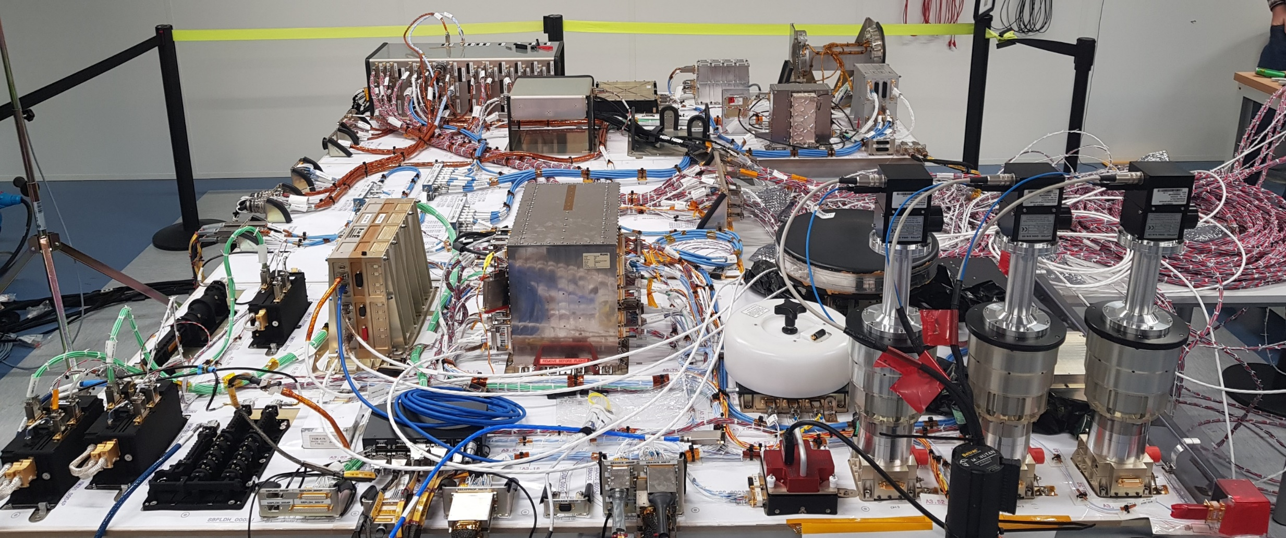
Example DHS Flat-Sat (before ADHA/APA)
Power Conditioning and Distribution
GNSS Receiver
On-Board Computer & Software
Payload Processing Units
Remote Terminal Unit
Communication buses
Reaction Wheels
Mass Memory
Star Trackers
Magnetorquer
Coarse Sun Sensor
TT&C
MetOp-SG EFM @ Airbus DS Toulouse

Slide 9
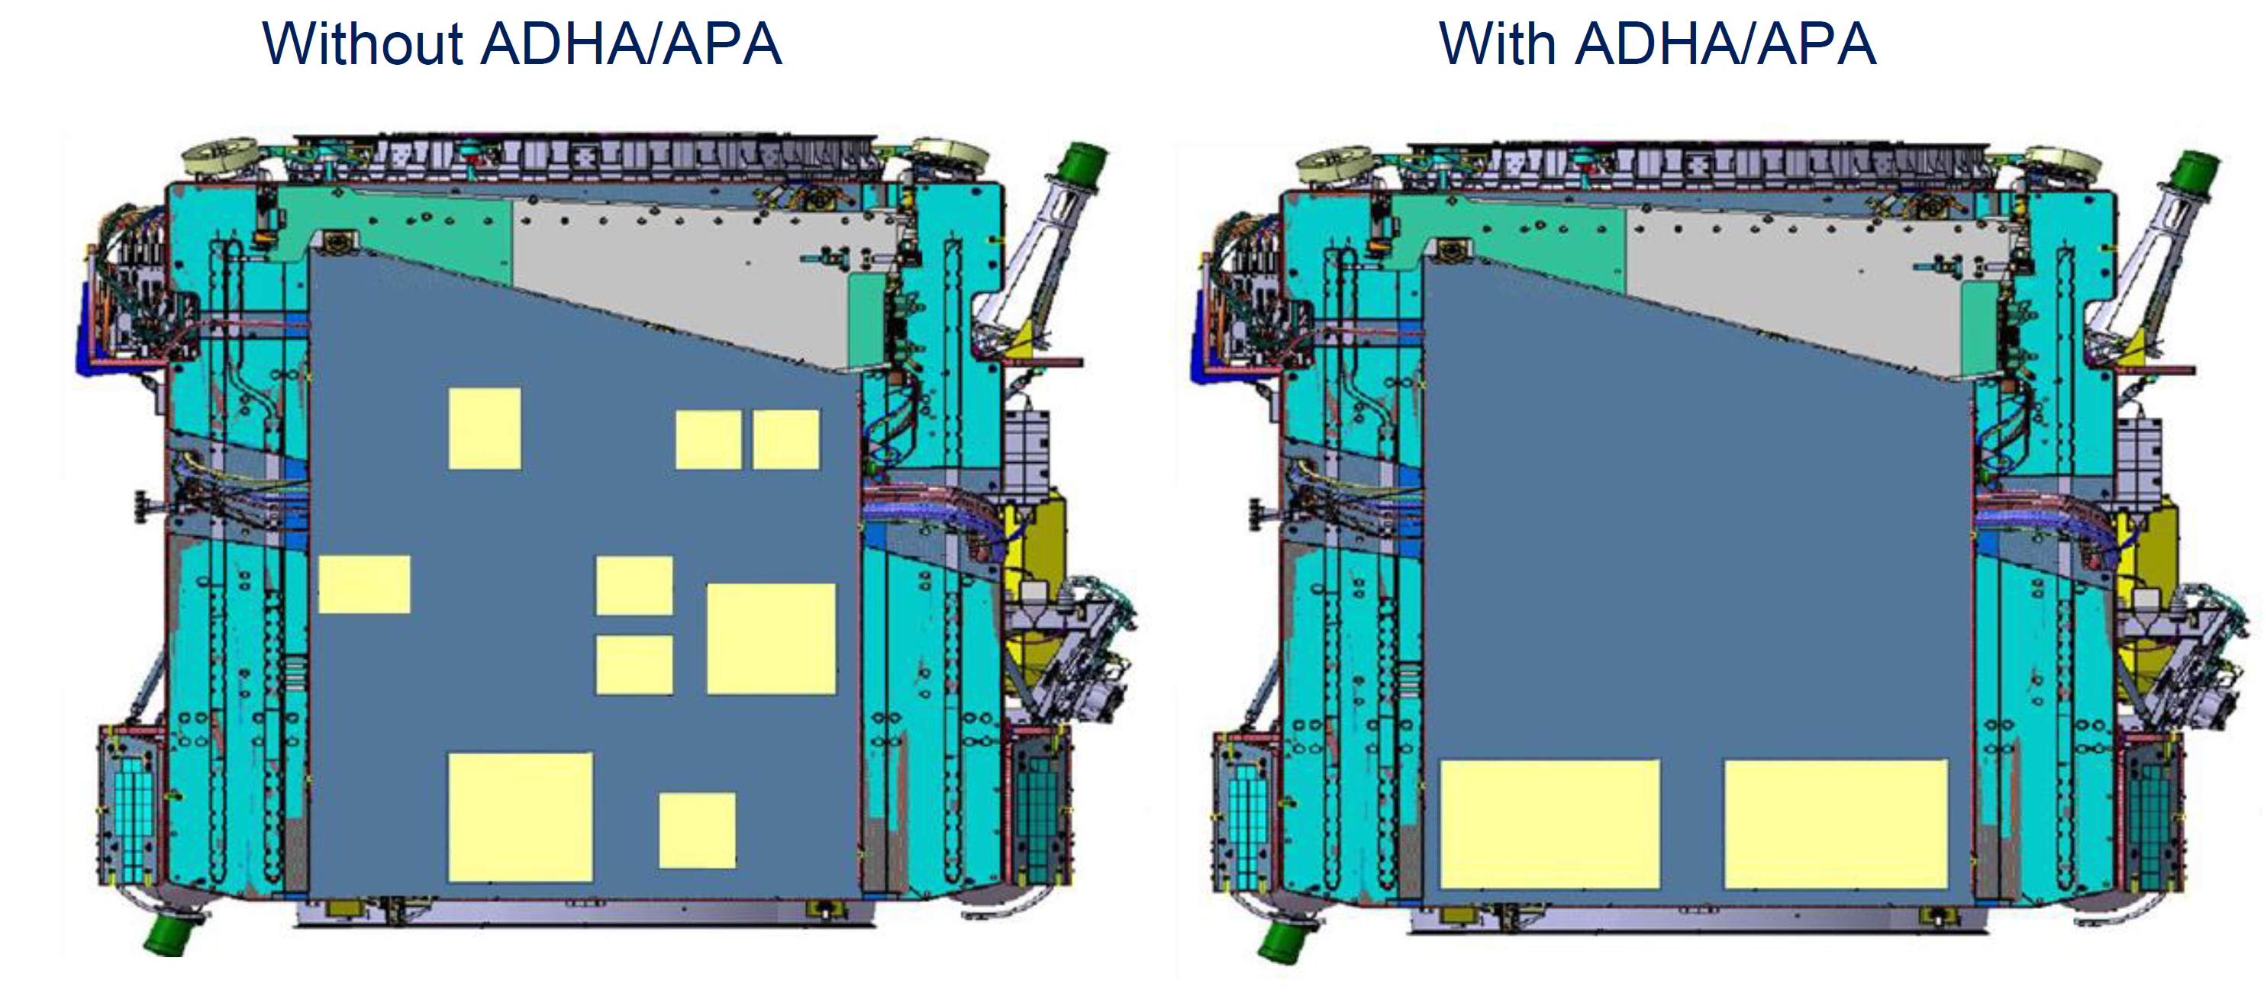
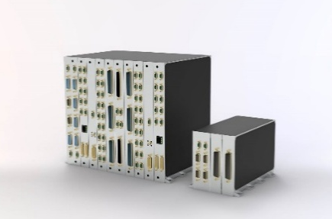
ADHA: Benefits at System Level
Interoperability at module level allows integration of multiple functions in same unit
Overall reduction in harness mass – and fewer electronics boxes per mission
Uniformity across platform (and payload) units dimensions facilitates placement and harness optimisation within the S/C
Use of recurring equipment products lowers project risk
Allows schedule optimisation and early testing of mission critical functions
Scalability and modularity provide flexibility in unit configuration and allows expansion of functions
Allows adoption for specific mission needs, reducing expensive and risky NRE – i.e. less chance of an equipment development being on the critical path of the mission schedule
Flexibility in implementation of georeturn requirements
Allows dual- and multi-source of same equipment (important for constellations)
Image source: Airbus, DASIA2024
Supplier #1
Supplier #2

Slide 10
ADHA: Benefits for Equipment Suppliers (incl. SMEs)
Standardisation of interfaces, functions and verification approach
Promotes reuse of products across different flight projects/customers
Iterative upgrades of products and use of the latest technology
Modularity allows upgrading of specific functions (e.g. as new microelectronics becomes available) – without losing TRL level of other functions, allowing European companies to stay competitive to increasing data handling requirements to increasing data handling and performance requirements
Interoperability at unit level allows integration of 3rd party products
Allows expansion of product portfolio beyond in-house products
Lower entry threshold into programmes with geo-return constraints
All of these benefits contribute to promote less risky and costly NRE per mission
Freeing up supplier’s engineering resources to focus on recurring products
Standardisation
Reduce risk
Modularity
Reduce NRE/cost
Scalability
Iterative products
Interoperability

Slide 11
Advanced Data Handling Architecture (ADHA): Architecture Overview
The ADHA architecture consists of the following elements:
The standardised ADHA Backplane
ADHA Modules – with standardised functions
ADHA Units
Note: ADHA comes in two sizes: 6U and 3U (Eurocard sizes)
6U: 220x233mm, 3U: 220x100mm
We show an example using 6U in the next slides

Slide 12
Advanced Data Handling Architecture (ADHA): Architecture Overview: ADHA Module (6U)
ADHA Module
Standardised ADHA Backplane Connector* and
Interfaces *Based on commercial cPCI-S-S standard
Standardised
External Interfaces
(per module function)
Additional
External Interfaces
ADHA Modules follow
Specification per Function (e.g. ADHA OBC, ADHA mass-memory, etc.)

Slide 13
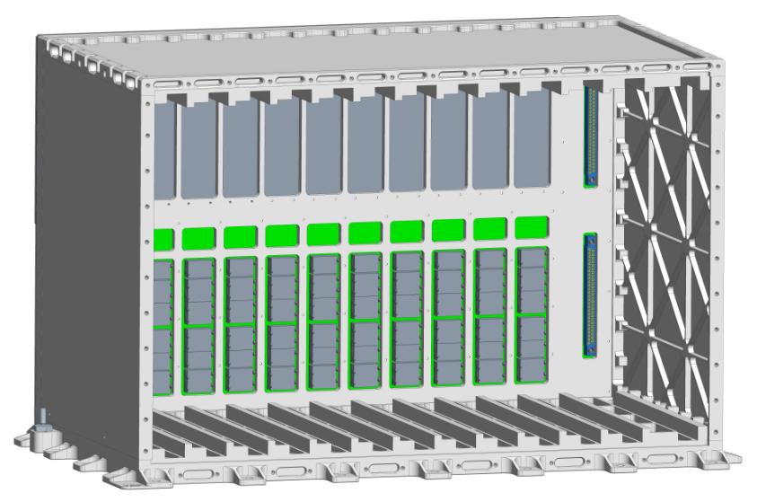
Advanced Data Handling Architecture (ADHA): Architecture Overview: ADHA Unit (6U)
ADHA Unit Enclosure
Custom connector area
Standard ADHA Backplane
Up to 12 standard module slots

Slide 14



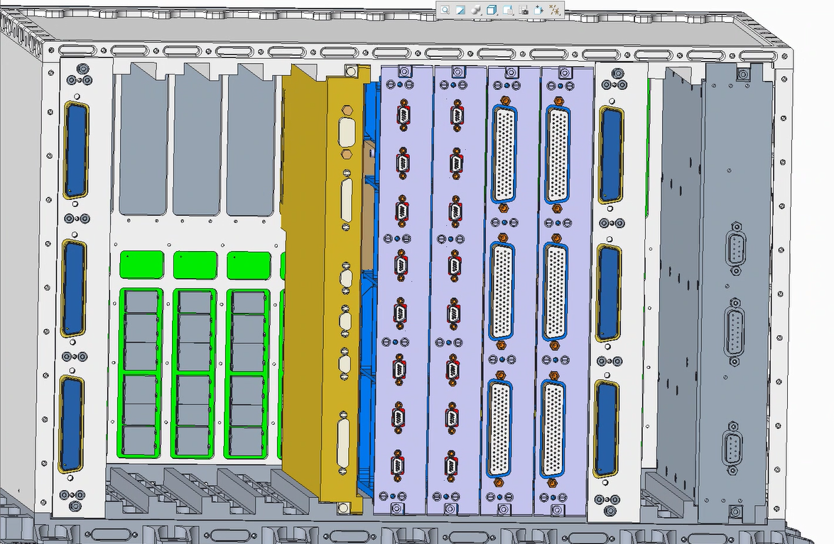

Advanced Data Handling Architecture (ADHA): Architecture Overview: Example 6U-ADHA Unit
ADHA Enclosure
& Backplane from
(Beyond Gravity )
ADHA On-Board Computer (Thales Alenia Space )
ADHA Power Module
(Airbus DS )
ADHA Instrument Controller (Airbus CRISA )
ADHA Reference Modules (Beyond Gravity )

Slide 15

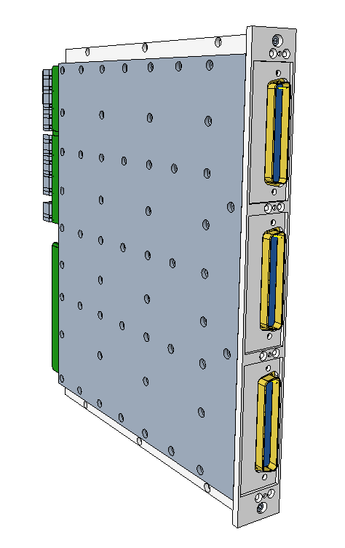


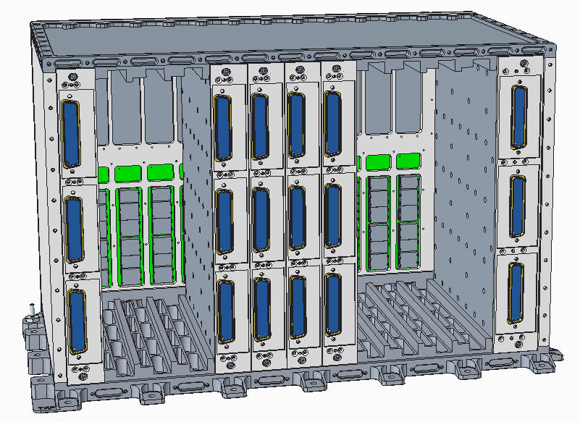



PHASES
OF THE ADHA DEVELOPMENT PROGRAM
1 Technical and Procurement Requirements Spec.
2 Engineering Model (EM) Modules Development
3 Engineering Model (EM)
Unit Integration / Testing
4 ADHA Unit Qualification
5 IOD & Flight Opportunities
TRL4
TRL5
TRL6
TRL7-9
We’re here
2026
2027

Slide 16


ADHA R&D Programme Organisation
The ADHA R&D Programme is divided into three types of activities:
System-level studies (ADHA-1, -2, and -3)
Define the requirements specification for ADHA elements
Perform 1st ADHA unit-level AIT campaigns
Parallel contracts: ADS (DE) and TAS (IT) primes
ADHA Unit and Module hardware development contracts
Core modules: OBC, MM, Power and GNSS funded through TDE
Others funded through GSTP, Incubed, etc - many initiated by industry! In total, ca 20 development activities on-going
ADHA Building Block activities
(e.g. backplane connector development and qualification)
ADHA System Studies (ADHA-1, -2, -3)
ADHA Building Blocks
ADHA Modules & Units

Slide 17
The On-Board Data Handling System (DHS/OBDH) – Scope of ADHA System Studies
In green: within the scope of the ADHA-2 System Study
In yellow: within the scope of the ADHA-3 System Study
In addition ADHA-3 covers:
Standardisation of software and protocols
Standardisation of EGSE and module testers
PA tailoring for Class Gamma/Delta
…and other topics
In blue: within the scope of the APA Study
Instrument Frontend(s)
Payload DHS
Batteries, solar-panels, etc
Instrument Frontend(s)
Instrument Frontend(s) (FEE)
Other payload functions
Other payload functions
Other payload functions
PCDU
(APA)
Instrument Controller Unit (ICU)
Data Processing Unit (DPU)
Platform DHS
Remote Interface Unit (RIU)
On-Board Computer (OBC)
Mass Memory (MM)
Payload Transmitter
GNSS Receiver
TT&C Transponder

Slide 18
ADHA-3 Phase-1 Tasks
Task # | Task | Common or single consortia | ADS/DSI/BG consortium | TAS/OHB consortium
1 | ADHA-3U Specifications | Common | X | X
1a) | Class Gamma missions analysis and DHS requirements | Lead by TAS consortium |  | X
1b) | Update of specifications for 3U | Common | X | X
2 | Payload Module/Unit Specifications | Common | X | X
2a) / 2b) | Payload mission analysis | Lead by ADS consortium | X
2c) | Payload module specifications | Common | X | X
3 | Additional ADHA Module Specifications | Common | X | X
4 | ADHA Data and Software Interfaces | TAS |  | X
5 | EDS Format and MBSE Architecture | ADS | X
6 | Structural/Thermal Study | ADS | X
7 | ADHA EGSE Architecture | TAS |  | X
8 | End-to-End Use Case Analysis | Common | X | X
9 | Industrial Roadmaps | Separate | X | X
10 | ADHA Verification approach | ADS | X
11 | ADHA-U1 DHS Use-Case Analysis and FDIR | TAS |  | X

Slide 19
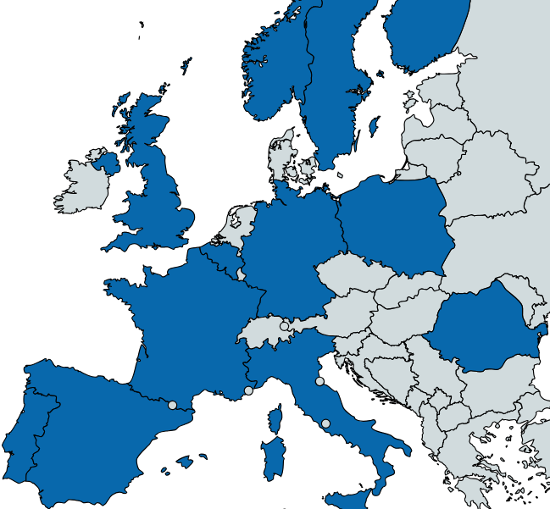


















ADHA: Current Contracts, Industry and Budgets
The overall ADHA development ESA activities are divided over:
…18 companies and groups
…in 14 European countries
…for a total ESA budget of ca 22MEUR from multiple ESA funding programs (FutureEO, Discovery/Preparation, TDE, GSTP, InCubed, ARTES)

Slide 20
ADHA Industrial Working Group (ADHA-IWG)
An ADHA Industrial Working Group (ADHA-IWG) has been initiated
The ADHA-IWG will be responsible for the future maintenance and updates to the standard.
The ADHA standardisation effort was funded by ESA, and performed by European Industry – and the ADHA standard will be led by industry
Very positive early response from European Industry
More than 30 entities from 15 different European countries have agreed to participate
In particular SMEs see the benefit, and savings in effort by adopting the standard
The ADHA-IWG is open to entities in ESA Member States, and will also invite participation from technical experts in national space agencies and technology providers.

Slide 21




























ADHA Industrial Working Group (ADHA-IWG) – Members

Slide 22
The ADHA Industrial Supply Chain
Technology, EEE, Microelectronics providers
ADHA Module Suppliers
ADHA Unit Integrator and Supplier
Mission Primes, LSIs, Mid- and Small-Sat Providers
Technology, EEE, Microelectronics providers
Technology, EEE, Microelectronics providers
Technology, EEE, Microelectronics providers
Technology, EEE, Microelectronics providers
Technology, Component, EEE/Microelectronics providers
ADHA Module Suppliers
ADHA Unit Integrator and Suppliers
Mission Primes, LSIs, Mid- and Small-Sat Providers
Technology, Component, and EEE/microelectronics providers benefit from the standardisation provided in ADHA
allowing to promote products towards the ADHA eco-system
Example: backplane/connector suppliers
ADHA Module Suppliers benefit from the standardisation and common functional/interface definitions
allowing to promote modules within the ADHA eco-system, to end-users or ADHA unit integrators
Example: mass-memory module suppliers
ADHA Unit Suppliers benefit from the standardisation and reuse of standard modules
allowing to promote module/scalable ADHA units towards mission primes
Example: payload data handling unit provider
Note: unit supplier can also be a module supplier
Mission primes benefit from the standardisation – reduces the specification work per mission
allowing to procure standard functions from multiple sources
Note: spacecraft bus provider can also be ADHA unit supplier/integrator

Slide 23
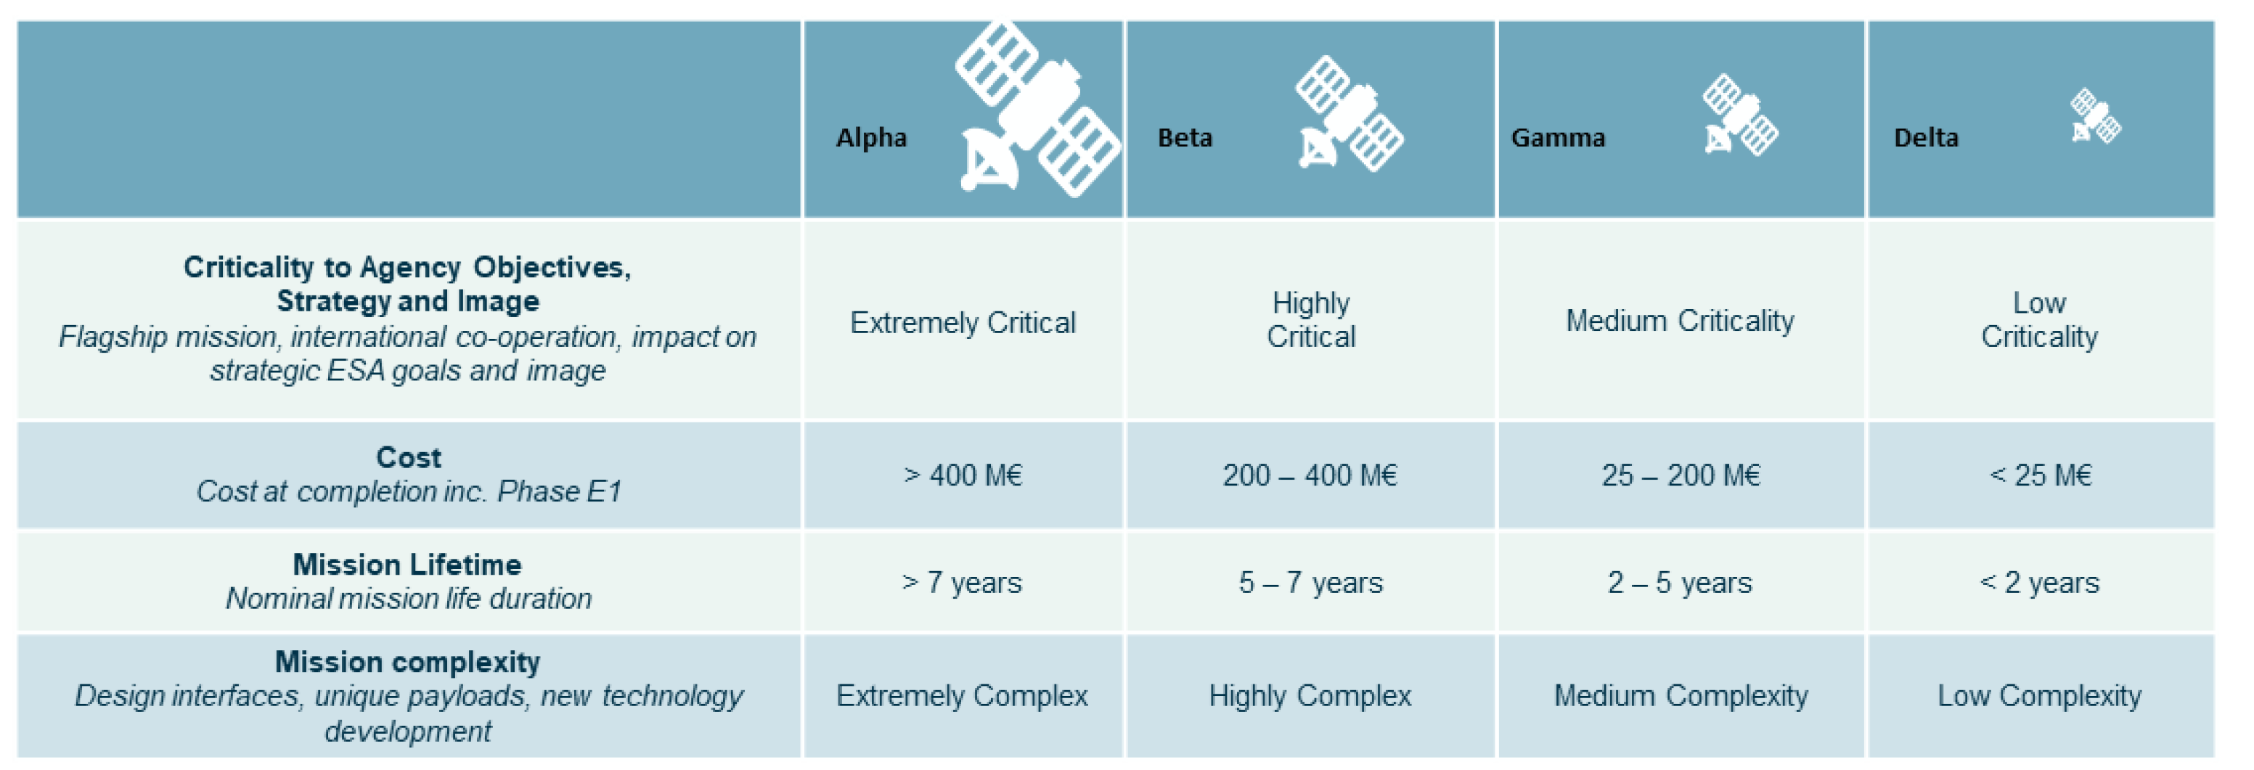

ADHA/APA and ESA Mission Classes (From ESA/IPC(2024)219)
6U-ADHA
3U-ADHA

Slide 24
ADHA EM/EQM Modules – Development Status
Goal: To have dual-sourcing for each of the key modules – for each of the mission class targets.
Two mission criticality class targets:
Class Alpha & Beta (Institutional EO & Science Missions) - mainly ADHA-6U
Class Gamma & Delta (Constellations & Commercial Mid- and Small-Sat Missions) - mainly ADHA-3U
Other functions under proposal: SDR, Security, Payload FEE, Ethernet, EGSE, etc.
Class Alpha & Beta – ADHA-6U
Class Gamma & Delta – ADHA-3U
Legend:
Power (TBD)
Power (TBD)
Power ADS-FR [TDE]
Power (TBD)
Running
Under proc.
OBC TAS-I [TDE]
OBC (TBD)
Not funded
OBC EvoLeo [GSTP]
OBC (TBD)
Mass-Memory DSI [TDE]
Mass-Memory (TBD)
Mass-Memory (TBD)
Mass-Memory (TBD)
RIU CRISA [GSTP]
RIU BGF [GSTP]
RIU (TBD)
RIU (TBD)
GNSS ITT [TDE]
GNSS (TBD)
GNSS (TBD)
GNSS (TBD)
ICU CRISA [InCubed]
ICU (TBD)
ICU EIDEL [TDE]
ICU (TBD)
DPU OHB [GSTP]
DPU GMV [TDE]
DPU KP Labs [GSTP]
DPU [TBA]

Slide 25
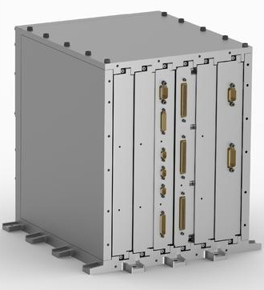
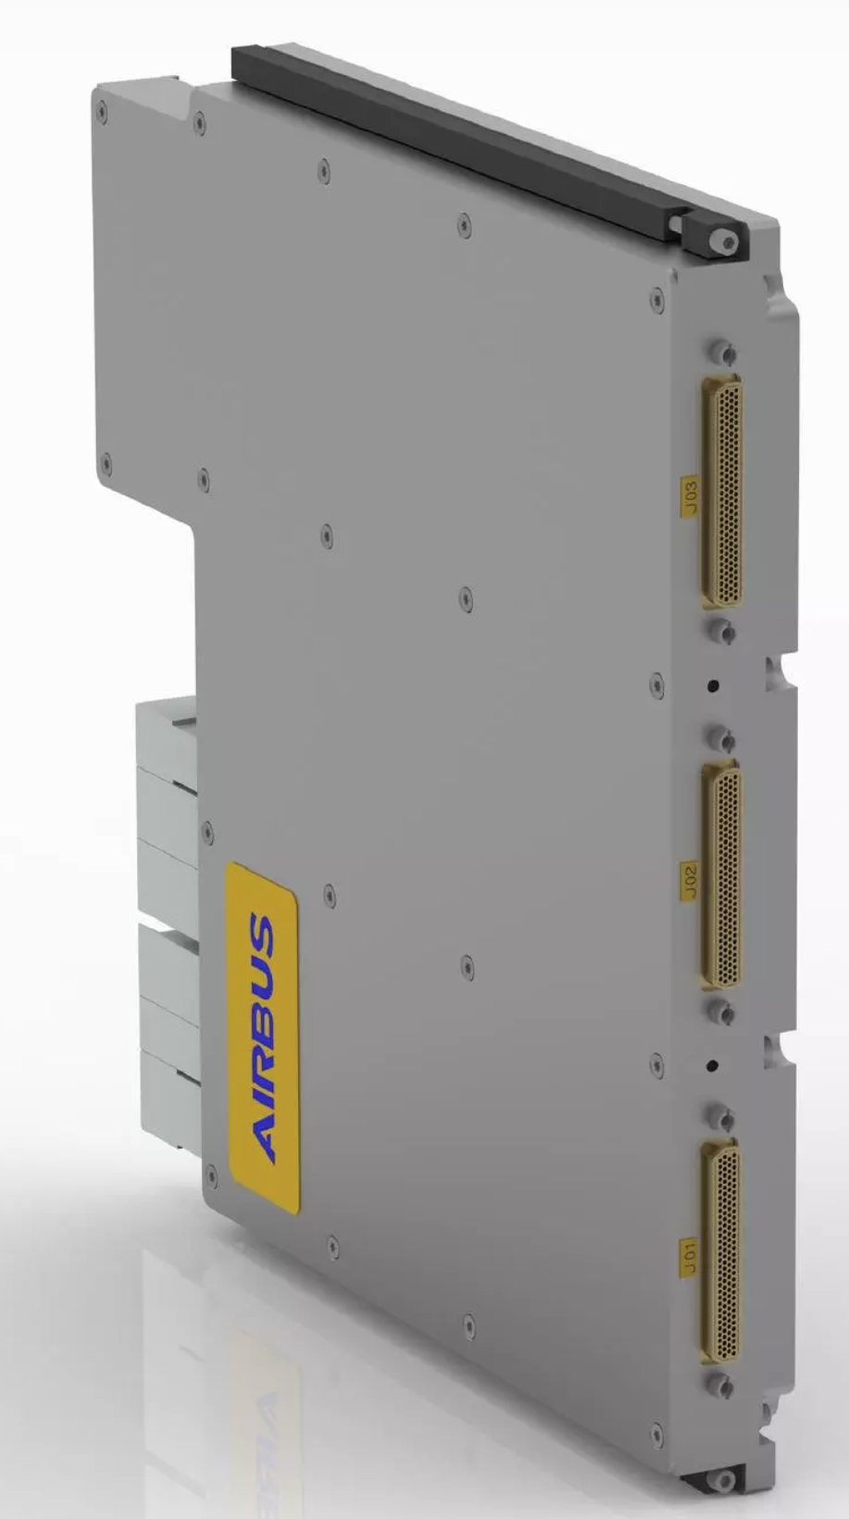
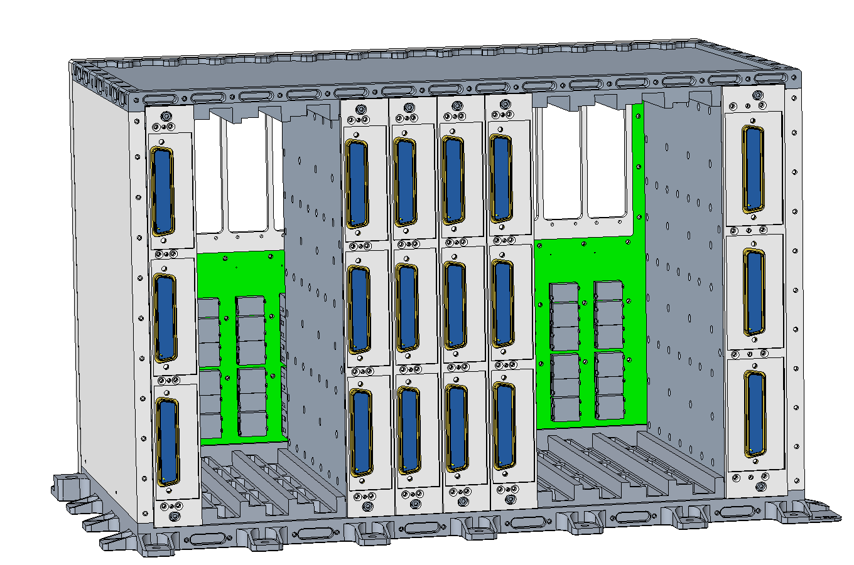
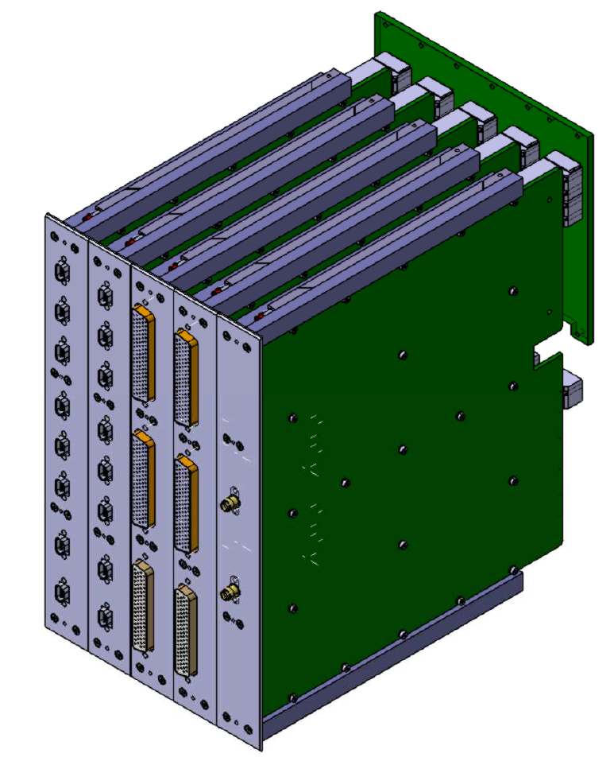
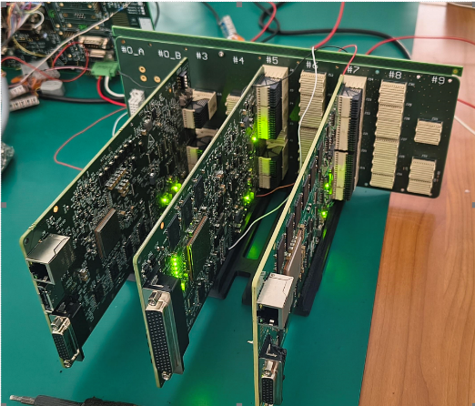
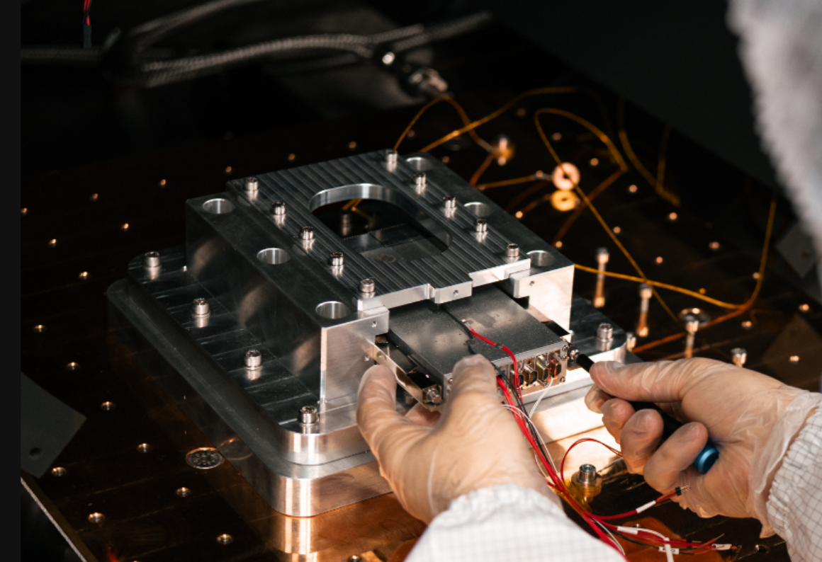
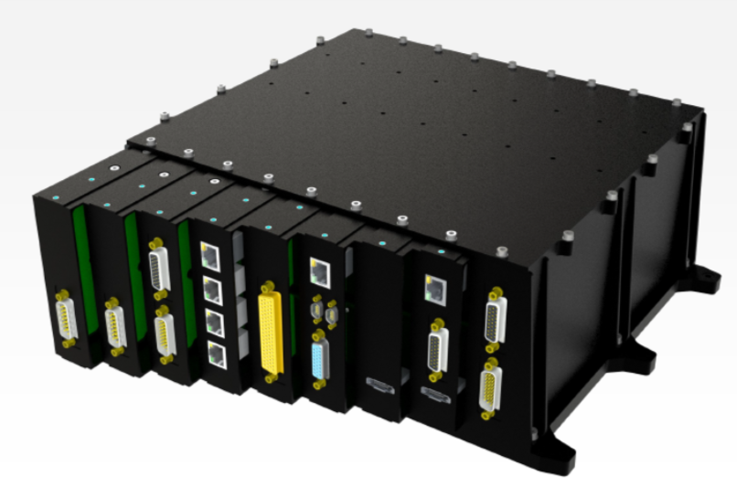
Examples of ADHA modules/units under development
ADHA 6U Payload Control Module (PCM), Airbus CRISA
ADHA 6U RIU module, Airbus CRISA
ADHA Backplane Connector, Axon
ADHA 6U Unit, Beyond Gravity
ADHA 6U OBC, Thales Alenia Space
ADHA 6U Instrument Control Unit (ICU)
ADS CRISA
ADHA Backplane Connector, Alter / Performance Interconnect
ADHA 3U bread-board, EVOLEO
ADHA 3U avionics suite, EVOLEO
Lion DPU, KP Labs

Slide 26

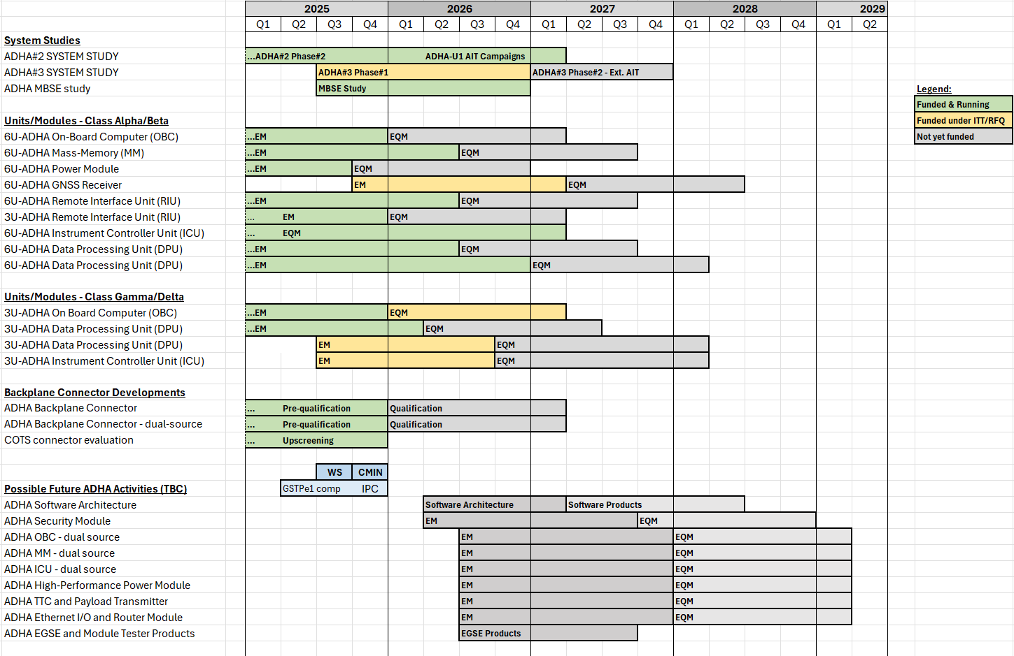







ADHA Activities Roadmap Overview – Current activities
1. System-level study activities
2. Class Alpha/Beta hardware developments
3. Class Gamma hardware developments
4. Key building blocks
5. Future activities (dual-sources)

Slide 27
ADHA Activities Roadmap Overview – Current activities
1. Extended AIT campaign
CCN to ADHA system study contracts, under GSTP
Open to ADHA equipment suppliers
2. EQM developments & hardware qualification
Proc. policy: DN
Same suppliers as EMs
Estimated total budget 15-20MEUR 2025-2027
3. Future TDE/GSTP activities (TBC)
Proc. policy: ITTs (open competition)
Activities TBC (pending internal ESA evaluation)

Slide 28
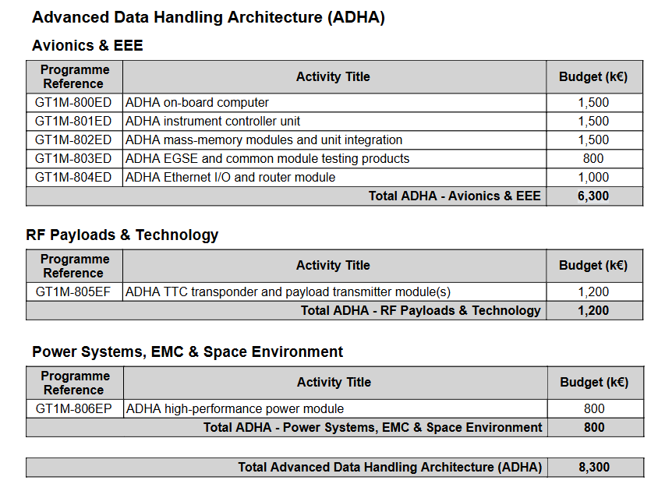
ADHA Future Activities – GSTP Element 1 Compendium
Dual-source and additional EM activities:
Either: open ITTs through GSTPe1 (compendium)
…or industry-initiated through optional programme(s)
Estimated required budget (2026-2027): ca 8.3 MEUR
Parallel activities are desirable for dual sourcing of functions
GSTP Element 1 Compendium includes both:
2nd source activities (OBC, Mass-Memory, Instrument Controller)
…and new functions under standardisation (e.g. TTC module and payload transmitter module)

Slide 29






ADHA Status & Roadmap Summary
The growing ADHA ecosystem, and increasing number of industrial partners interested in developing ADHA -compliant equipment creates new opportunities
Requirements of different mission criticality classes can be addressed via different ADHA unit formats and configurations (6U/3U, etc).
Expanding the target applications beyond EO will further enhance the business opportunities: Science, Exploration, Navigation, etc.
ESA has clearly and actively demonstrated the support in the ADHA program
Significant and continuing investments in ADHA program by ESA programs
Future EO, Discovery/Preparation, TDE, GSTP, InCubed
22 MEuros in total, as per Q3 2025

Slide 30
Advanced Data Handling Architecture (ADHA):
Project Status, Background and Roadmap
“Working towards a European solution for standardized Data Handling Systems"
David Steenari, david.steenari@esa.int
Kostas Marinis, kostas.marinis@esa.int
Data Handling Section ESA/ESTEC | TEC EDD

