Slide 1
ADHA and the Needs for the Earth Observation Ecosystem
ADHA session to EDHPC Conference
Josep.Rosello@esa.int
EO Technology Coordination, EOP-FMT
EO Future Missions and Architecture Department, EOP-F
Elx, ES, 13 October 2025

Slide 2
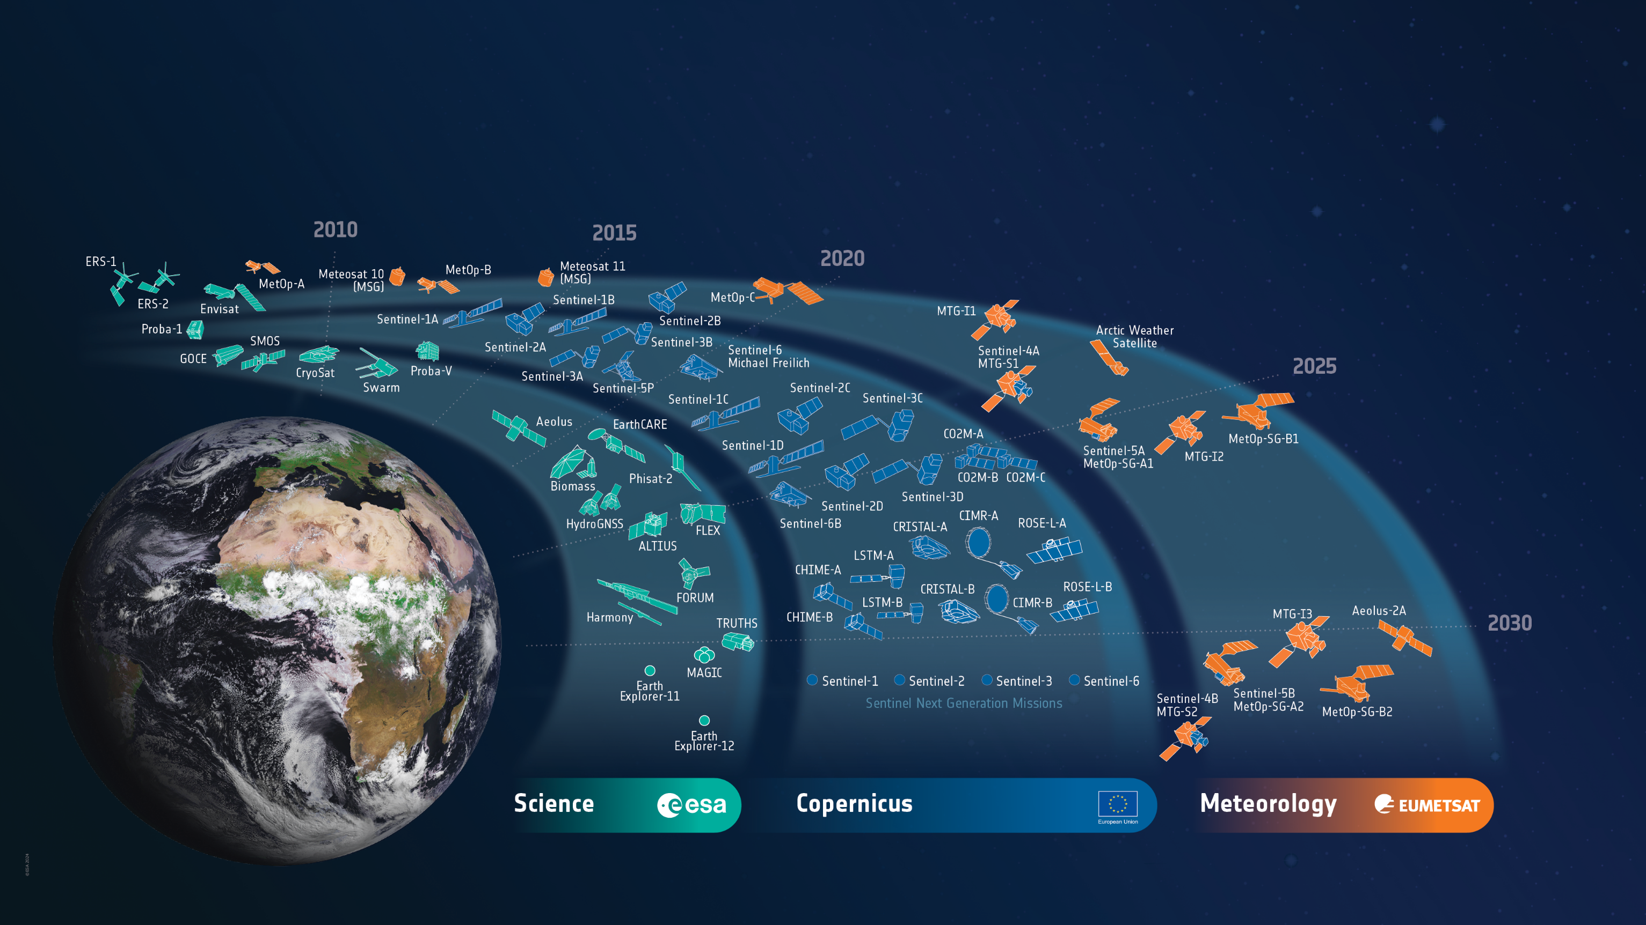
ESA’s Earth Observation Missions
Satellites: Heritage 08 / Operational 16 / Developing 40 / Preparing 22 / Total 86
Ph. B2/C/D
Ph. 0/A/B1
1991
Tango
NanoMagSat
World-class EO Sys
to address scientific & societal challenges
2
Notes:
HERITAGE MISSIONS
7 Missions/8 Satellites:
Earth Explorers+ (5M/6S)
1 GOCE
1 Aeolus
2 ERS (ERS-1/2)
1 Envisat
1 Proba-1
Earth Watch (1M/1S)
1 Proba-V
Sentinels (1M/1S)
1 Sentinel-1 (S1-B)
Met Missions (2M/8S) (EUMETSAT managed so not counted in total)
7 Meteosat (#1-7)
1 Meteosat SG (#8)
OPERATIONAL MISSIONS
10 Missions (16 satellites):
Earth Explorers+ (5M/7S)
1 SMOS
1 CryoSat
3 Swarm
1 EarthCARE
1 PhiSat-2
Earth Watch (0M/0S)
0
Sentinels (5M/9S)
2 Sentinel-1 (S-1A/1C)
3 Sentinel-2 (S-2A/2B/2C)
2 Sentinel-3 (S-3A/3B)
1 Sentinel-5P
1 Sentinel-6 (S-6A)
Met Missions (4M/8S) (EUMETSAT managed so not counted in total)
3 Meteosat SG (#9-11)
1 Arctic Weather Satellite
1 Meteosat TG (MTG-I1)
3 MetOp (A/B/C)
MISSIONS IN DEVELOPMENT
23 Missions (40 satellites):
Earth Explorers+ (5M/6S)
1 Biomass
1 Flex
1 Forum
1 Harmony
2 Scout-2 (HydroGNSS)
Earth Watch (2M/2S)
1 TRUTHS
1 ALTIUS
Sentinels (12M/24S)
1 Sentinel-1 (S-1D)
1 Sentinel-2 (S-2D)
2 Sentinel-3 (S-3C/3D)
2 Sentinel-4 (S-4A/4B)
3 Sentinel-5 (S-5A/5B/5C)
2 Sentinel-6 (S-6B/C)
2 CO2M (A/B/C)
2 CRISTAL (A/B)
2 CIMR (A/B)
2 LST (A/B)
2 CHIME (A/B)
2 ROSE-L (A/B)
Met Missions (4M/8S)
1 Aeolus-2
3 Meteosat TG-I (MTG-I2/3/4)
2 Meteosat TG-S (MTG-S1/2)
2 MetOp SG (A1/B1)
MISSIONS IN PREPARATION
9 Missions (22 satellites):
Earth Explorers (3M/11S)
2 EE11
4 EE12
3 Scout-3 (NanoMagSat)
2 Scout-4 (TANGO)
MoO (1M/2S)
2 NGGM
Sentinels (5M/9S)
2 Sentinel-1 NG
(S-1NG A/B)
2 Sentinel-2 NG
(S-2NG A/B)
2 Sentinel-3 NG OPT
(S-3NGO A/B)
2 Sentinel-3 NG TOPO
(S-3NGT A/B)
1 Sentinel-6 NG
(S-6NG A)
Met Missions (0M/0S)
0

Slide 3
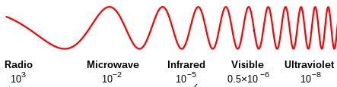




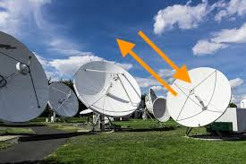
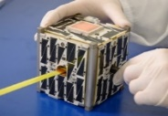
EO EO Technology vision – part of ESA’s Technology Strategy
Higher performance / cost ratio
New Measurements/ EO instruments (enabler)
Higher spatial, temporal, radiometric, spectral resolution
Full spectrum –
Disruptive: e.g. “Quantum Sensing”
Lower recurring development cost / faster adoption
Platform Standardisation & multi source suppliers
Spin-in techno: e.g. COTS
Lifetime & flexibility (FPGAs)
Digitalisation (e.g. MBSE, others)
CleanSpace (e.g. demisable, EoL disposal)
Big Data & Analytics (AI enabler) & Data continuity
Miniaturisation and constellations
More autonomous platform & operations & synchronisation
Distributed Ground Segment
Not limited to LEO: also HEO & GEO orbits relevant for EO
Largest
part
10s
MHz
UltraViolet
Generic
e.g. via BA, GSTP
AI for EO
constellations
smallSats

Slide 4
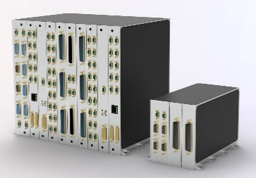
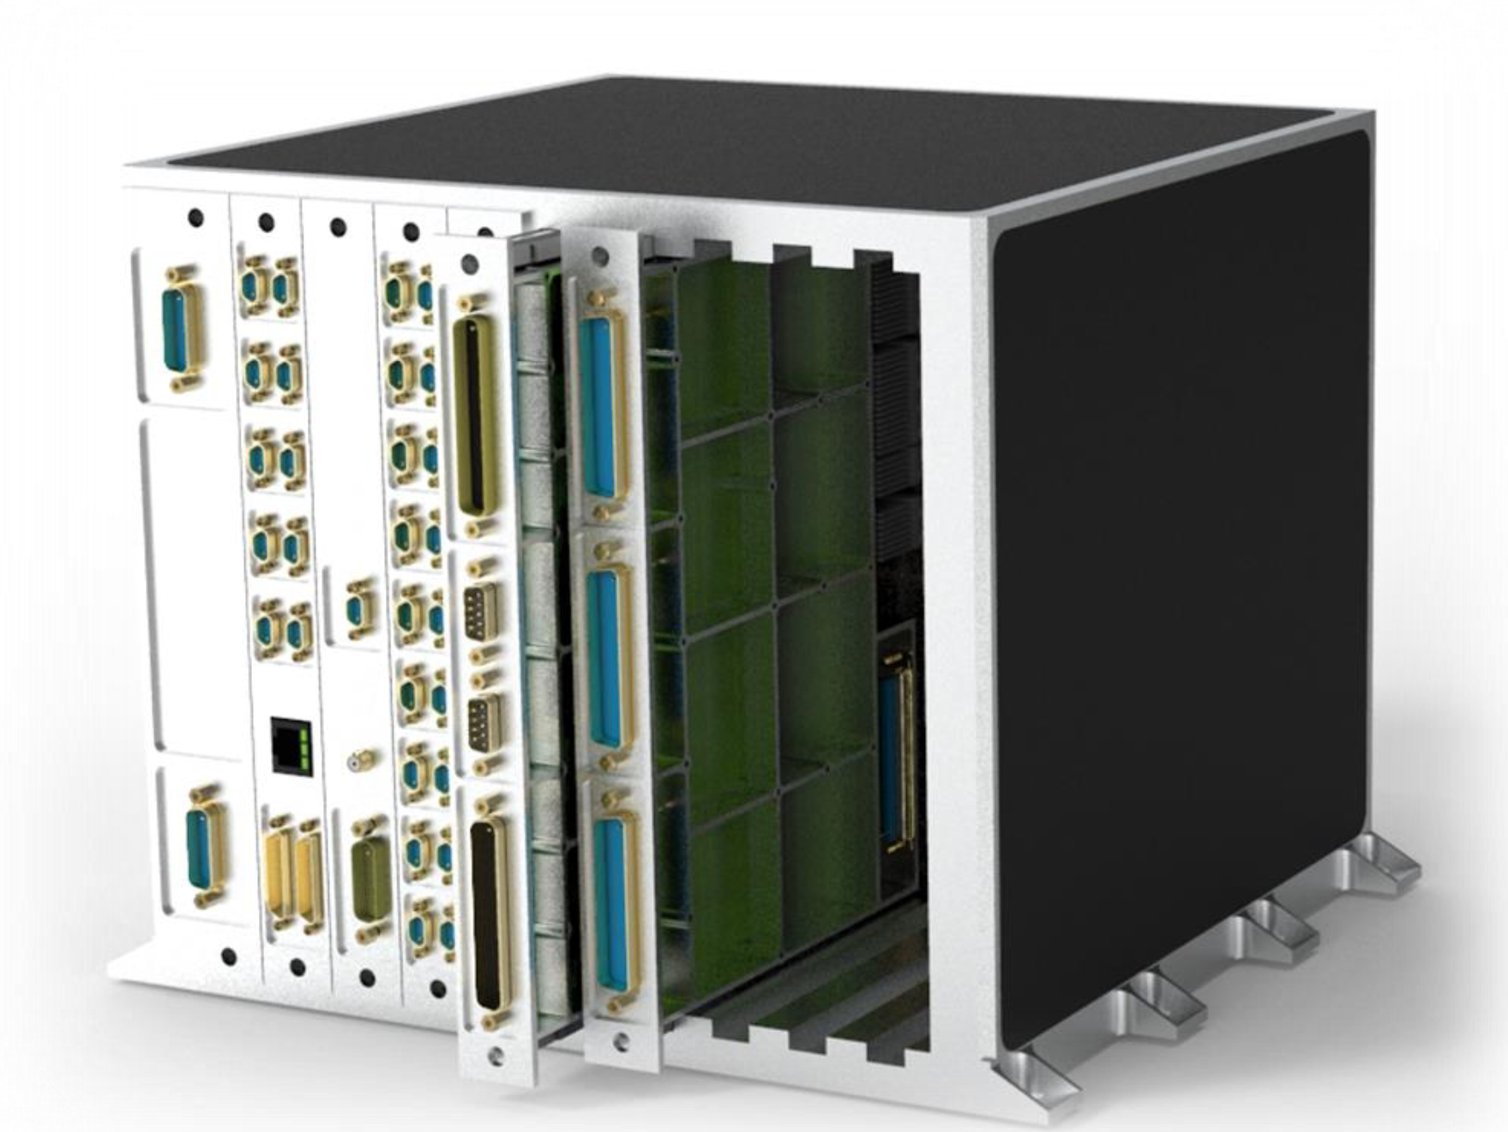
ADHA System Studies – with FutureEO funding
ADHA-1
ADHA-2 (ongoing)
ADHA-3
start in Q4 2025
ADHA Payload Req. Spec. to be defined (power + thermal challenges)
ADHA 3U Req. Spec. defined & completed
ADHA SW + EGSE Sys. Architecture Def.
Extended 6U/3U AIT campaigns (Unit Integration and testing)
Extension of concepts beyond EO: to SCI, Telecom, Exploration
ADHA Req. Specs
ADHA Req. Specs
ADHA Req. Specs
ADHA Req. Specs Issue#1 Published (2023) – mainly 6U
3x Core 6U-ADHA platform modules
2x 6U-ADHA Unit developments
6U-ADHA platform modules to be integrated in ADHA 6U Units
ADHA 6U modules: Interoperability testing in 2 separate LSI test setups
cPCI-S-S
Formulation of initial concepts
Industry agrees to use
the cPCI-S-S Interconnect Standard
2019-2020
2021-2026
2025-2027
Notes:
ADHA-3 is not aligned with what we said to the IPC :
Extend ADHA Std not covered before: e.g. SW, EGSE, new module Spec.
• Extending ADHA Std to common EO optical + RF instrument ICU + PDHU functions.
• Δεταιλεδ Σpecs (electrical, mechanical/structural and thermal) for 3U ADHA module and units (miniaturised terminals and Small sats).
• Extension of ADHA concepts beyond EO: science, telecom and exploration.

Slide 5
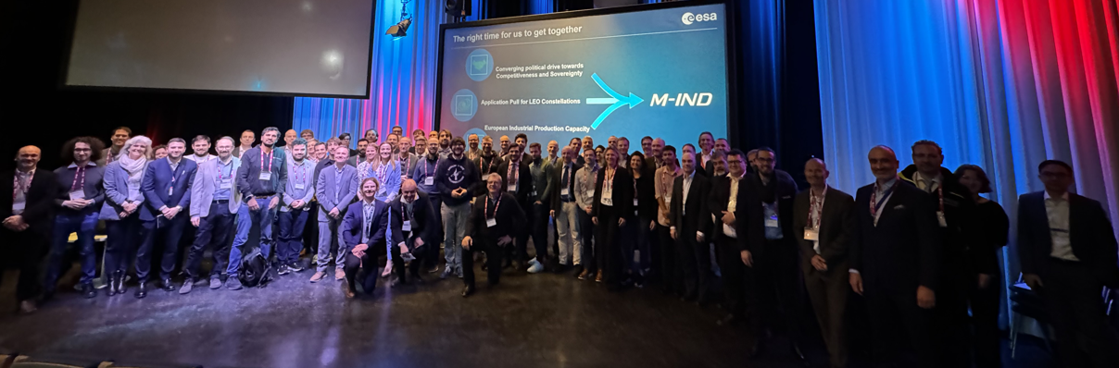
M-IND: Industry-driven recommendations
- 35+ integrators involved in the M-IND initiative
Survey on platform &
Workshop @ ESTEC 20th March 2025
5 major M-IND recommendations
(M-IND Report in June-2025)
Industrialisation (MRL; support transition highly customised low volume to serial production)
Industrial Policy
Reduction and communalisation of interfaces
Priority platform subsystems (for competitive, modular and sovereign supply to integrators)
Constellation deployment and operations
Partially in GSTP Compendium + Roadmaps under preparation together with Programme Directorates

Slide 6
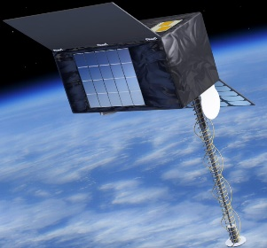
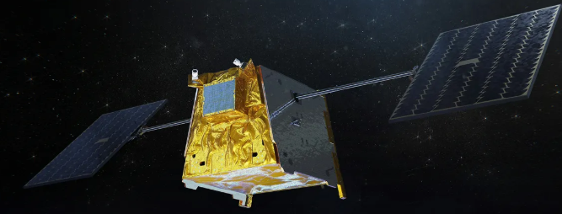
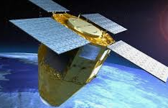
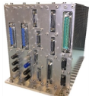
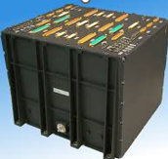
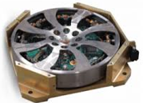

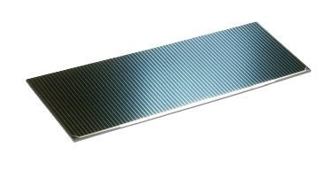
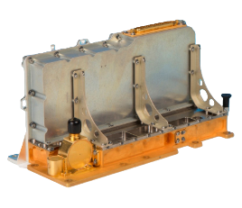
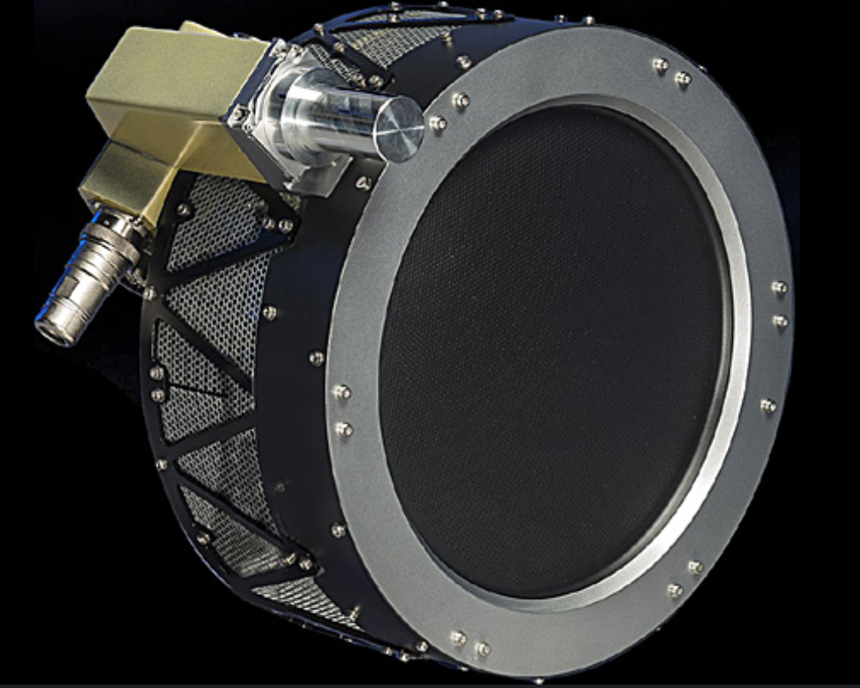
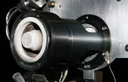
M-IND Implementation: multi-program
Funded by TDE & GSTP,
led by TEC
Not all
cross points
apply to all
IRIS²
LEO Platform Products
ERS
LEO Platform Products
LEO PNT
Platform Products
ADHA
Data Handling (ISL compatible)
AOCS
(Reaction Wheels, Gyros)
Power
(Solar Gen & cells)
APA
Wide Band Gap
(Power & RF)
EEE
Funded & led by Application Directorates
Propulsion

Slide 7
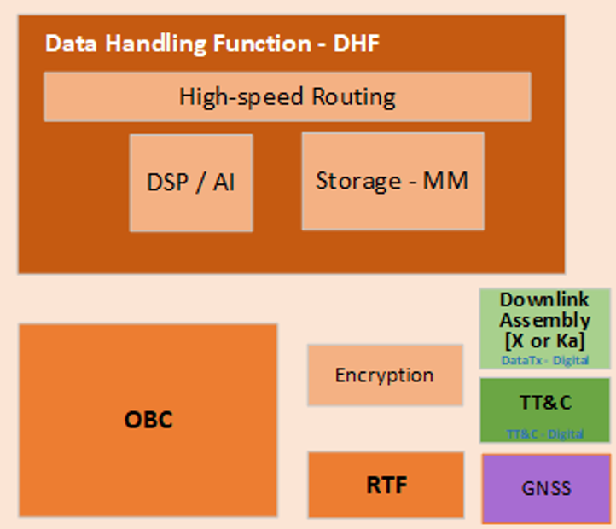
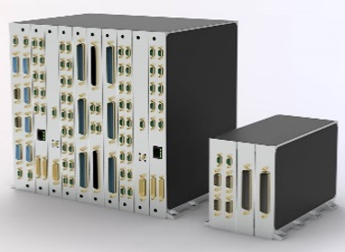
ADHA – APA (in mid-size sat context)
Highly vertical integration (industrial + technical miniaturisation )
More digital & High Power consumption → thermal dissipation
M-IND Reduced & Common Interfaces:
KO end-Oct.2025 with SpinIn + 3 LSIs
Survey Dec Q4-2025 → for all (Integrators + Suppliers) in Europe
mini-Workshop (End-Jan. 2026, TBC)
Ethernet, SpFi, SpW, CAN
28V, 70V, …
other
Comms (on-board + direct-to-ground + ISL)
Low rate (kb/s)
High rate (Gb/s)
New functions: security, routing
EO Instruments
- Very High-Res
- also Lower-res
Eurocard sizes:
6U: 220x233mm,
3U: 220x100mm
Centralised vs decentralised
High integration
Modularity
SW aspects (AOCS)
PCDU
Primary Voltage
Secondary Volt.

Slide 8

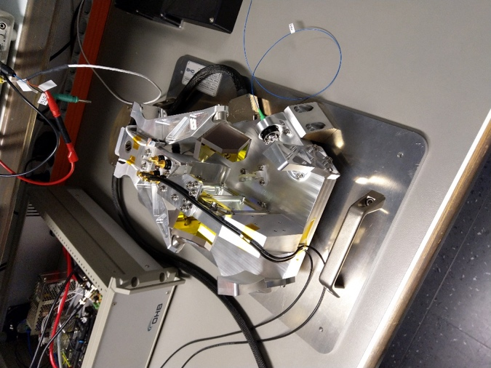

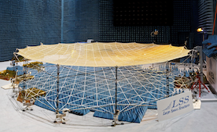

FutureEO Programme - Pillar-1
Many missions & Technologies
Mission Definition & Feasibility (Ph.0/A)
Earth Explorer-13 : 4 mission concepts in Ph.0 ; ≤ 2 in Ph.A ; Implem. after CM31
Earth Explorer-12 : 2 mission concepts in Ph.A ; Implem. after CM28
Scout-3rd cycle: ≤ 4 mission concepts in Consolidation Phase; ≤ 2 for Implem. after CM28
Stepping Stones ≤ 4 mission concepts in Definition Phase
Sent-6 NG : Phase A/B1 (additional freq. for RA + MWR) ; for Implem. after CM28
Meteosat 4th Gen. Phase 0
Missions of Opportunity Phase 0
Phi-Sat-3 Up to Ph.E1
At end of Ph.B1 (ISRR)
Target TRL 5 Instruments
TRL 6 Equipment
SRL 5
Pillar 1
(3 interlinked areas)
Technology Maturation
Instrument maturation
as part of Ph.0/A
support to Commended EE-13, future Meteo Missions
new low TRL concepts, miniaturisation
Other Preparatory : e.g. architectural / system studies
In synergies with DPTD / GSTP for EO
Standard Platform + Communications
Frequency Management
Science & Applications (with EOP-S)
BoostFutureEO in
Step-1: EO Science Strategy = update of Living Planet Challenges
Step-2: New EO Mission Ideas (NEOMI)
Step-3/4: as part of Phase 0/A
End-to-End Simulation :
as part of Ph. 0/A
also enable new EO concepts (low SRL)
Campaigns (in-situ, airborne)

Slide 9
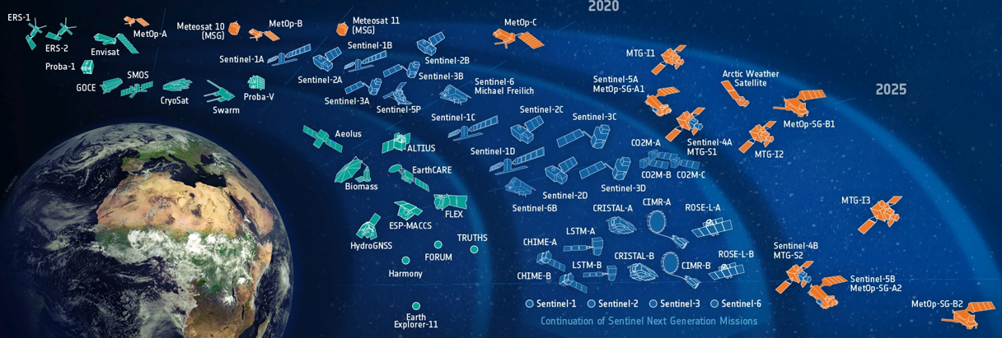




ADHA / APA / M-IND strategic for EO
EOP Technology needs (incl. European independence)
New + higher performance (EO instruments – also for the digital ADHA part)
Higher efficiency (incl. platform / instruments )
Driven by Large Satellites (institutional),
but growing needs for mid-size Sats (Scouts, constellations) → M-IND
FutureEO – Pillar 1
Mission Definition
Technology + Science/Apps
FutureEO Programme
Unique synergizer to build the whole range of ESA EO missions
EO technology needs grows
More about EO Technology:
Josep.Rosello@esa.int

