Slide 1
ADHA-3 – Expansion of a modular standard
Airbus Defence and Space
Julian Bozler
October 2025
EDHPC 2025, Elche
© Copyright Airbus Defence and Space GmbH 2025
Notes:
TEST

Slide 2
Motivation to use ADHA
Airbus Amber
GeoReturn
More flexibility for Geo-Return
:

Slide 3
Motivation to use ADHA
Airbus Amber
GeoReturn
More flexibility for Geo-Return
Smaller Developments
Reduced development risk
ADHA developments are easier to finance
Higher degree of specialization possible
Higher development efficiency
Reduced development effort
:
Notes:
Modules instead of Units

Slide 4
Motivation to use ADHA
Airbus Amber
GeoReturn
More flexibility for Geo-Return
Smaller Developments
Reduced development risk
ADHA developments are easier to finance
Higher degree of specialisation possible
Higher development efficiency
Reduced development effort
:
Reduction of
non-recurring cost
Reduction of
development time

Slide 5
Motivation to use ADHA
Airbus Amber
GeoReturn
More flexibility for Geo-Return
Smaller Developments
Commercialisation
Lower entry barriers for SMEs and
commercial suppliers
Increasing the re-use
Reduced development risk
Increase of competition
ADHA developments are easier to finance
Higher degree of specialization possible
Higher development efficiency
Reduced development effort
:
Reduction of
non-recurring cost
Reduction of
development time
Notes:
Example from Sener

Slide 6
Motivation to use ADHA
Airbus Amber
GeoReturn
More flexibility for Geo-Return
Smaller Developments
Commercialisation
Lower entry barriers for SMEs and
commercial suppliers
Increasing the re-use
Reduced development risk
Increase of competition
ADHA developments are easier to finance
Higher degree of specialization possible
Higher development efficiency
Reduced development effort
:
Reduction of
non-recurring cost
Reduction of
development time
Avoidance of
non-recurring cost
Reduction of
recurring cost
Notes:
Less REC by batch-effects

Slide 7
Motivation to use ADHA
Airbus Amber
GeoReturn
More flexibility for Geo-Return
Smaller Developments
Commercialisation
Lower entry barriers for SMEs and
commercial suppliers
Industrialisation:
Supplier know the agreed specification before the development (at least for many products)
Supplier knows that his product is possible to integrate
Increasing the re-use
Reduced development risk
Increase of competition
ADHA developments are easier to finance
Higher degree of specialization possible
Higher development efficiency
Reduced development effort
Agency / LSI knows that developments can be integrated thanks to standardization
Reduction of
non-recurring cost
Reduction of
development time
Avoidance of
non-recurring cost
Reduction of
recurring cost
Notes:
Payload of Opportunity
This shall be understood.

Slide 8
Expansion of the standard: ADHA-3
Airbus Amber
Expansion of the standard: ADHA-3

Slide 9

Expansion of the standard: EDS and MBSE
Airbus Amber
EDS-template is today available for ADHA-unit and -modules:
    EDS covers electrical modes, mode transitions, power consumption, power dissipation, connectors, connector allocation, register, TM/TC, calibrations, mass, frequency plan, …

Slide 10

Expansion of the standard: EDS and MBSE
Airbus Amber
EDS in ADHA-3:
    Take inputs from SAVOIR EDS working group
    Align with “TDE T701-806ED: MBSE applied to ADHA products activity”
    If possible, align with “MBSE for interface management” (ESA AO/1-12903)
                Alignment between agency, LSI, unit integrator and module developers
                Simplification and condensation to the essentials
    Generate a consolidated EDS for the ADHA-U1 Unit
Notes:
Next slide: thermal

Slide 11
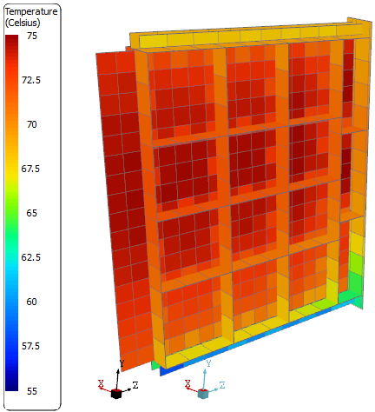
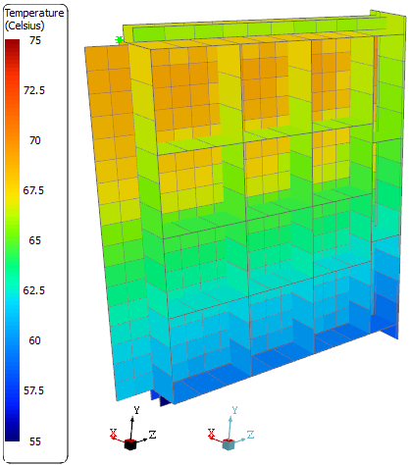
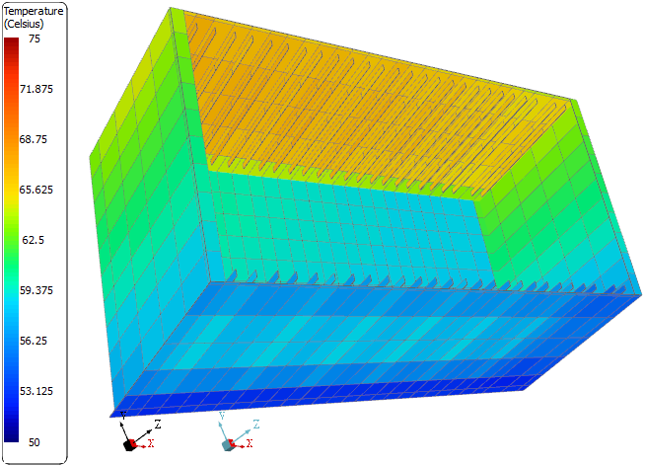
Expansion of the standard: Thermal and Structural Study
Airbus Amber
Thermal Analysis – Results
System/Peripheral Module Design and Parameters:
    ~30W Power on each of the standard module to reach maximum temperature
    ~42W Power on every second standard module to reach maximum temperature
    Sufficient for most classical applications / module designs.
    But modern processing chips like VERSAL or GPU generate a dissipation of >100W…

Slide 12
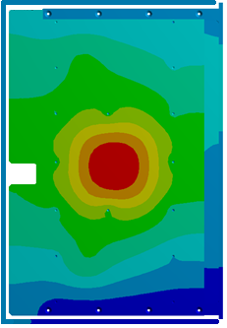
Expansion of the standard: Thermal and Structural Study
Airbus Amber
Simplified thermal network, from chip to radiator:
R_{T1}: Chip to PCB
R_{T1}
Notes:
- RT1: Chip to PCB incl. junction t
- Several possibilities depending on the mounting and case technology. Thermal path could be just by pins, could be in addition by thermal filler between case and PCB, could be cooled over the topo case

Slide 13
Expansion of the standard: Thermal and Structural Study
Airbus Amber
Simplified thermal network, from chip to radiator:
R_{T1}: Chip to PCB
    R_{T2}: Within the PCB
R_{T2}
R_{T1}
R_{T2}
Notes:
several thermal paths to the frame through the PCB

Slide 14
Expansion of the standard: Thermal and Structural Study
Airbus Amber
R_{T3}
Simplified thermal network, from chip to radiator:
R_{T1}: Chip to PCB
    R_{T2}: Within the PCB
    R_{T3}: PCB to module frame
R_{T2}
R_{T1}
R_{T2}
R_{T3}

Slide 15
Expansion of the standard: Thermal and Structural Study
Airbus Amber
R_{T3}
Simplified thermal network, from chip to radiator:
R_{T1}: Chip to PCB
    R_{T2}: Within the PCB
    R_{T3}: PCB to module frame
    R_{T4}: Frame to Wedge Lock
R_{T4}
R_{T2}
R_{T1}
R_{T2}
R_{T4}
R_{T3}
Notes:
screwed

Slide 16
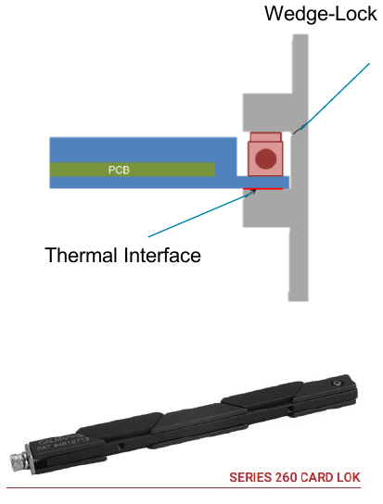
Expansion of the standard: Thermal and Structural Study
Airbus Amber
R_{T5}
R_{T3}
Simplified thermal network, from chip to radiator:
R_{T1}: Chip to PCB
    R_{T2}: Within the PCB
    R_{T3}: PCB to module frame
    R_{T4}: Frame to Wedge Lock
    R_{T5}: Wedge Lock to Housing
R_{T4}
R_{T2}
R_{T1}
R_{T2}
R_{T5}
R_{T4}
R_{T3}
Notes:
Significant delta T through the wedge lock
Performance Interconnect & Evoleo

Slide 17
Expansion of the standard: Thermal and Structural Study
Airbus Amber
R_{T5}
R_{T3}
Simplified thermal network, from chip to radiator:
R_{T1}: Chip to PCB
    R_{T2}: Within the PCB
    R_{T3}: PCB to module frame
    R_{T4}: Frame to Wedge Lock
    R_{T5}: Wedge Lock to Housing
    R_{T6}: Housing to Baseplate
R_{T4}
R_{T2}
R_{T1}
R_{T6}
R_{T2}
R_{T5}
R_{T4}
R_{T3}
R_{T6}
Notes:
geometric transfer of the heat within the same material

Slide 18
Expansion of the standard: Thermal and Structural Study
Airbus Amber
R_{T5}
R_{T3}
Simplified thermal network, from chip to radiator:
R_{T1}: Chip to PCB
    R_{T2}: Within the PCB
    R_{T3}: PCB to module frame
    R_{T4}: Frame to Wedge Lock
    R_{T5}: Wedge Lock to Housing
    R_{T6}: Housing to Baseplate
    R_{T7}: Baseplate to Panel
R_{T4}
R_{T2}
R_{T1}
R_{T6}
R_{T2}
R_{T5}
R_{T4}
R_{T3}
R_{T7}
R_{T6}

Slide 19
Expansion of the standard: Thermal and Structural Study
Airbus Amber
R_{T5}
R_{T3}
Simplified thermal network, from chip to radiator:
R_{T1}: Chip to PCB (incl. junction to case)
    R_{T2}: Within the PCB
    R_{T3}: PCB to module frame
    R_{T4}: Frame to Wedge Lock
    R_{T5}: Wedge Lock to Housing
    R_{T6}: Housing to Baseplate
    R_{T7}: Baseplate to Panel
    Additional items on thermal path:
    Flexible thermal link / thermal strap
    Heat Pipe
    Thermal doubler
    Heat buffer material
R_{T4}
R_{T2}
R_{T1}
R_{T6}
R_{T2}
R_{T5}
R_{T4}
R_{T3}
R_{T7}
R_{T6}
Notes:
- each thermal resistance -> analysis, test and optimisation
- For active cooling: a standardized active cooling shall allow developers, integrators and LSIs the reuse.

Slide 20
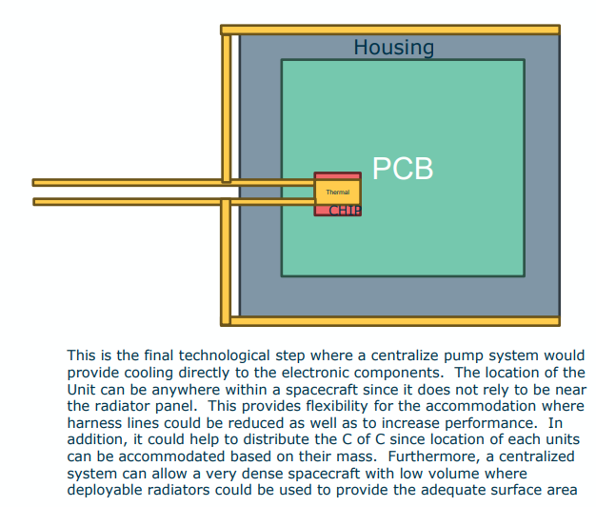
Expansion of the standard: Thermal and Structural Study
Airbus Amber
R_{T5}
R_{T3}
R_{T4}
R_{T2}
R_{T1}
R_{T6}
R_{T2}
R_{T5}
R_{T4}
R_{T3}
R_{T7}
R_{T6}
    Source: Stéphane Lapensée, EDHPC 2025, 13.10.2025

Slide 21
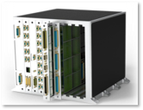
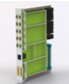
Expansion of the standard: Verification and Qualification Approach
Airbus Amber
The challenges in ADHA today:
    The defined generic qualification is not fully optimized.
    Module developer and unit integrator are not necessarily the same entity.
Notes:
defined in the SoW
Example: how to ensure compatibility between modules, e.g. MassMemory and GNNS receiver? (Emiliano Artina)

Slide 22
Expansion of the standard: Verification and Qualification Approach
Airbus Amber
The challenges in ADHA today:
    The defined generic qualification is not fully optimized.
    Module developer and unit integrator are not necessarily the same entity.
Goals in ADHA-3:
    Avoid double testing on module and unit level.
    Update of the generic test, verification and qualification approach.

Slide 23
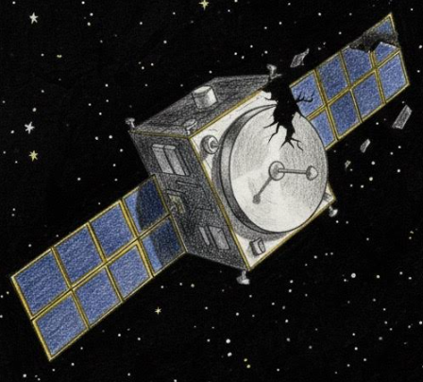
Expansion of the standard: Verification and Qualification Approach
Airbus Amber
The challenges in ADHA today:
    The defined generic qualification is not fully optimized.
    Module developer and unit integrator are not necessarily the same entity.
    The generic qualification might be not sufficient for an application.
Goals in ADHA-3:
    Avoid double testing on module and unit level.
    Update of the generic test, verification and qualification approach.
Notes:
Qualification might be accepted for the first application but is rejected for the second application.
-> because of different qual-levels

Slide 24
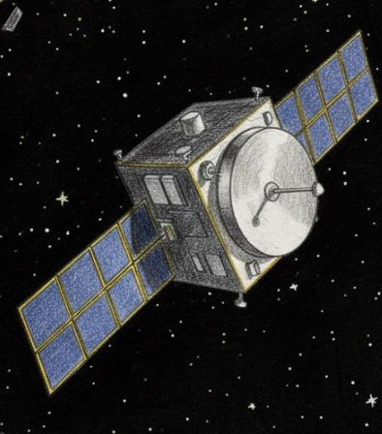
Expansion of the standard: Verification and Qualification Approach
Airbus Amber
The challenges in ADHA today:
    The defined generic qualification is not fully optimized.
    Module developer and unit integrator are not necessarily the same entity.
    The generic qualification might be not sufficient for an application.
Goals in ADHA-3:
    Avoid double testing on module and unit level.
    Update of the generic test, verification and qualification approach.
    Definition of a suitable approach for delta qualification.

Slide 25

Expansion of the standard: Verification and Qualification Approach
Airbus Amber
The challenges in ADHA today:
    The defined generic qualification is not fully optimized.
    Module developer and unit integrator are not necessarily the same entity.
    The generic qualification might be not sufficient for an application.
    No generic agreement yet on the qualification from PA/QA.
Goals in ADHA-3:
    Avoid double testing on module and unit level.
    Update of the generic test, verification and qualification approach.
    Definition of a suitable approach for delta qualification.
Notes:
different customer PA/QA
risk and cost by missing generic agreement

Slide 26

Expansion of the standard: Verification and Qualification Approach
Airbus Amber
The challenges in ADHA today:
    The defined generic qualification is not fully optimized.
    Module developer and unit integrator are not necessarily the same entity.
    The generic qualification might be not sufficient for an application.
    No generic agreement yet on the qualification from PA/QA.
Goals in ADHA-3:
    Avoid double testing on module and unit level.
    Update of the generic test, verification and qualification approach.
    Definition of a suitable approach for delta qualification.
    Get a generic agreement on the qualification from all parties.
Notes:
Generic agreement are important for a standard
Other agreements: use of high density connectors or using several SpW within on D-Sub connector.

Slide 27
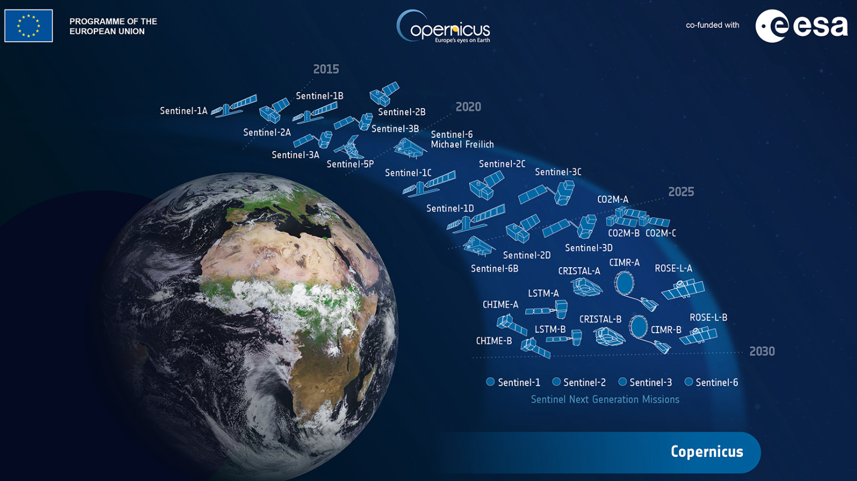
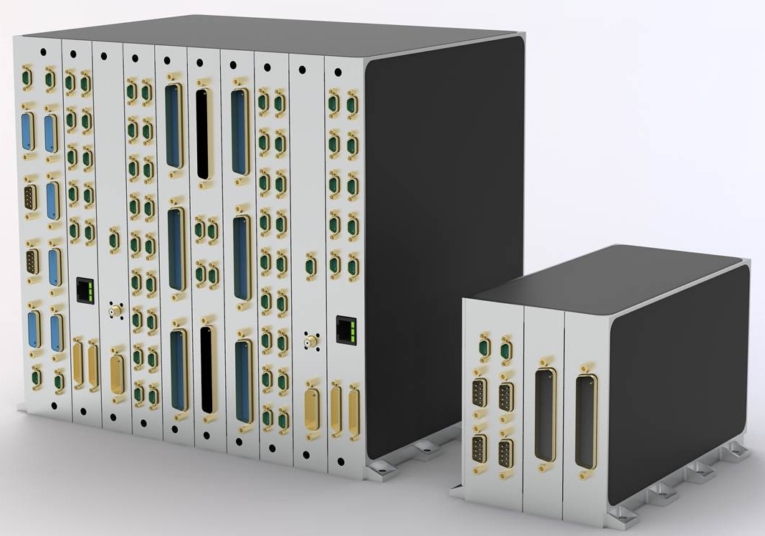

Expansion of the standard: Specifications
Airbus Amber
Notes:
Requirements from Copernicus: Cristal, LSTM, CIMR, CO2M; ROSE-L, Chime.

Slide 28
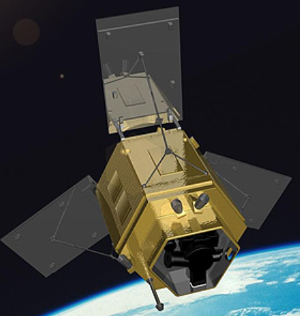
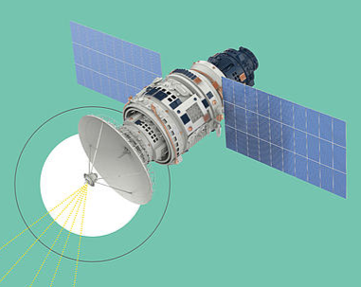
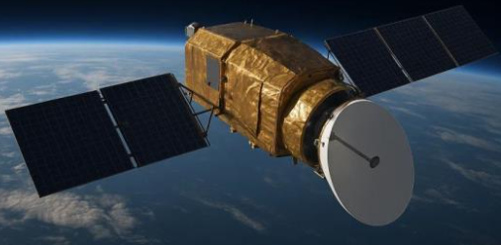
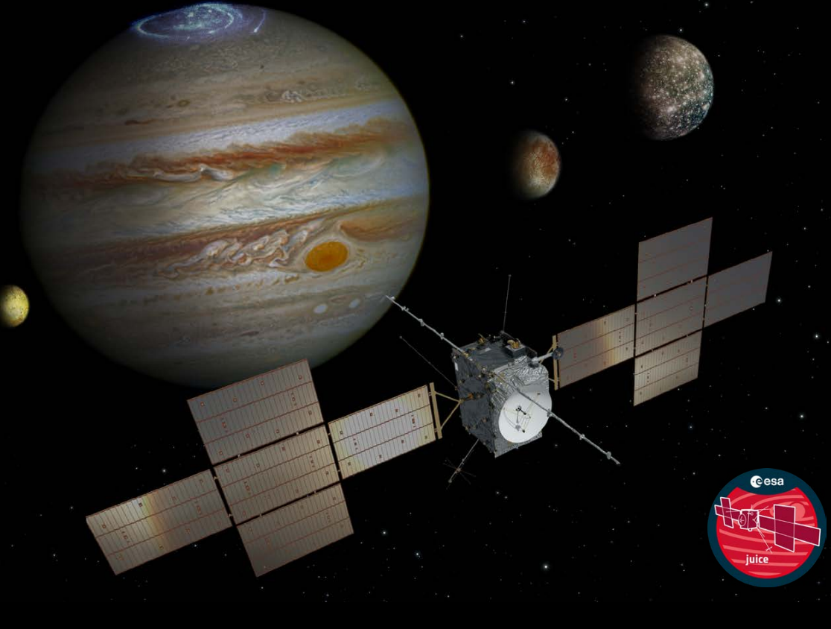
Expansion of the standard: Specifications
Airbus Amber
Notes:
Class beta and gamma mainly in 3U: EE CAIRT, Wivern, Forum
This includes tailoring of PA/QA.

Slide 29
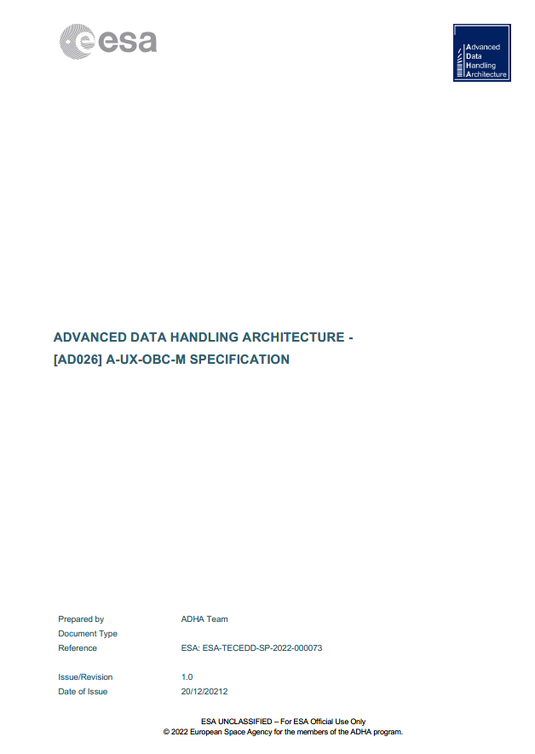
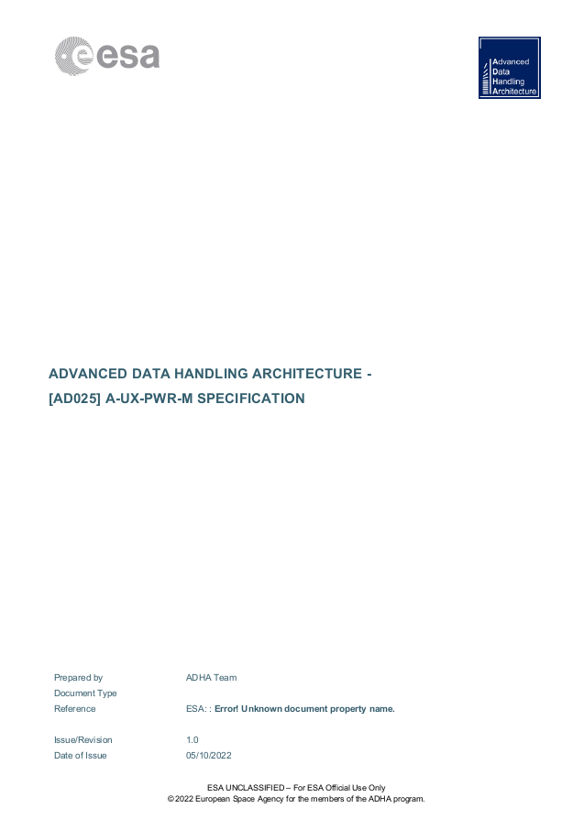
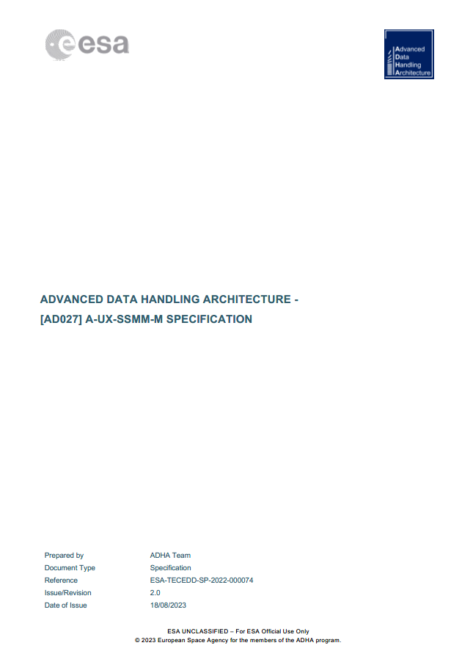
Expansion of the standard: Specifications
Airbus Amber
    Existing ADHA Module Specs
    from ADHA-2
Notes:
Today OBC, SSMM, Power Module.

Slide 30
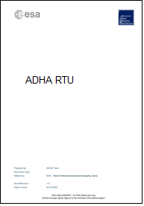
Expansion of the standard: Specifications
Airbus Amber
    Existing ADHA Module Specs
    from ADHA-2
    Additional ADHA PF Module Specs
Notes:
ADHA RTU I/O Module specification
ADHA RTU AOCS-IF Module specification
ADHA RTU Controller Module specification
ADHA RTU Propulsion Module specification
ADHA TTC/Payload Transponder (SDR) Module(s) specification
ADHA GNSS Module specification
ADHA Security Module specification

Slide 31
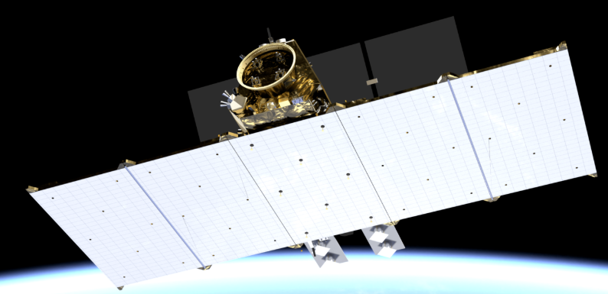
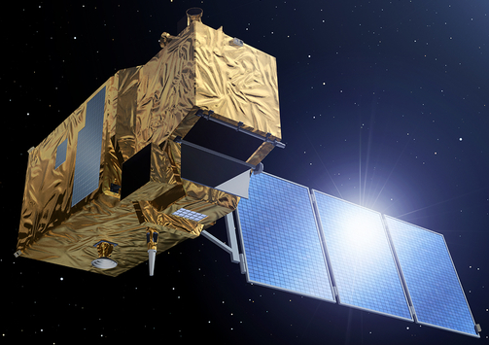
Expansion of the standard: Specifications
Airbus Amber
    Existing ADHA Module Specs
    from ADHA-2
    Additional ADHA PF Module Specs
    Analysis of different payload-architectures

Slide 32
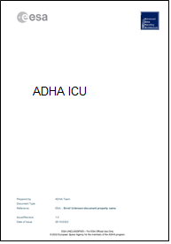
Expansion of the standard: Specifications
Airbus Amber
    Existing ADHA Module Specs
    from ADHA-2
    Additional ADHA PF Module Specs
    Analysis of different payload-architectures
    Additional ADHA PL
    Module Specs
Notes:
ICU Processor Module Specification
Payload ICU I/O modules
Payload Power Distribution Module Specification
Dedicated Payload Power Module
Co-Processing Module
Optical Front-End Electronics (FEE) modules
Digital BackEnd for RF instruments

Slide 33
Expansion of the standard: Specifications
Airbus Amber
    Existing ADHA Module Specs
    from ADHA-2
    Additional ADHA PF Module Specs
    Analysis of different payload-architectures
    In total:
    17 ADHA Module Specs
    Additional ADHA PL
    Module Specs
Notes:
Supplier knows that the spec is agreed by ESA and all LSIs -> supllier knows that his product fit for everybody

Slide 34
Thank you

