Slide 1
ADHA System Study Expansion: Missions, Data/SW Interfaces, ADHA-3U, EGSE
Dario Pascucci (TAS)
EDHPC – October 14th 2025

Slide 2
introduction
The ADHA-3 Change Notice has the purpose of extending some further aspects of the ADHA standardization that were not covered by the initial contracts, e.g.:
Identification and assessment of use cases from real missions, covering different application domains (extending from Earth Observation to Science, Telecom and Planetary Exploration)
Unit level study to extend the ADHA design and specification (electrical, mechanical/structural and thermal) to cover more dissipative modules (higher power consumption), as well as more compact design (3U format) especially for miniaturised terminals and smaller spacecrafts (Gamma-class missions)
New ADHA module specifications (EO optical and RF instrument/payload, processing board, …)
Data Handling and Software architecture and interfaces
Modular EGSE architecture, to be used both at Unit and Module level

Slide 3


summary
TAS Consortium Task
ADS Consortium Task
Common Task
Separate Task
ADHA-3 CN System Study Expansion:
Task-1: ADHA-3U Specifications
Task-2: Payload Modules/Unit Specifications
Task-3: Additional Modules Specifications
Task-4: Data/SW Interfaces
Task-5: Electronic Data Sheet (EDS) Format
Task-6: Thermal and Mechanical studies and prototyping
Task-7: EGSE Architecture
Task-8: Missions use-case analysis
Task-9: Industrial Roadmaps
Task-10: ADHA Verification and Validation approach
Task-11: ADHA-U1 DHS Use-Case Analysis and FDIR

Slide 4
Adha-3 cn TASKS SEQUENCING AND REVIEW MILESTONES
Time frame:
End 2026/Beg. 2027

Slide 5
Task-8: End-to-End missions Use Case Analysis
Perform end-to-end use-case analysis of representative EO mission(s) plus representative case from other domains to study the implications of implementing the complete system based on ADHA concepts;
For the selected missions, map system architectures to ADHA (and APA) units (logical functions to physical entities), with different ADHA unit module configurations
Derive reference end-to-end architecture of mission DHS based on ADHA (and APA) units – and inter-unit interfaces (taking also into account SAVOIR specs)
Analyse the impacts of the utilisation of ADHA – both technical and programmatic aspects: (procurements, specifications, AIT, and qualification)
Study of ADHA-U1 flight-configuration use case:
derive a DHS description showing the ADHA unit external interconnections (e.g. Star-trackers, payload ICU, PCDU, etc);
perform a Data Handling FDIR Analysis of the ADHA-U1 (including possible failure modes on the internal buses/networks), to derive a lessons learned for possible improvements of the ADHA specification and modules design.

Slide 6
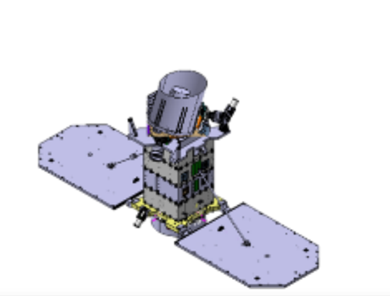
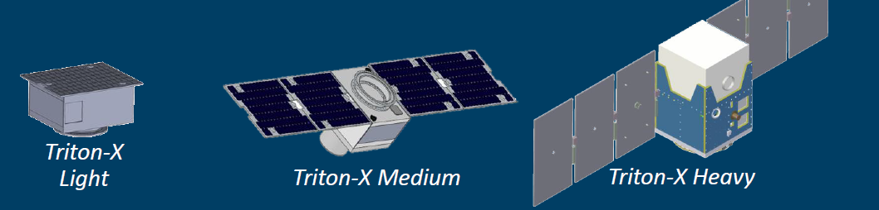
Task-1: ADHA-3U Specifications (1/2)
Establish detailed electrical, mechanical, and thermal specifications for 3U-ADHA units and modules
including tailoring of PA/QA requirements for Class Beta, Gamma and Delta missions,
but with focus on Class Gamma (equivalent to current Class III) missions
Starting point are the system requirements for small-sat (Class III) missions:
OASIS – for TAS tasks and
INNOSat/Triton Platforms – for OHB tasks
INNOSAT
GMS-T, Arctic Weather Satellite
Up to 1kW
TRITON microsatellite Platform family covering:
3 main classes: Light (40kg), Medium (75kg) and Heavy (150-250kg).
Designed around the modular and configurable Integrated Avionics Unit (IAU)
OASIS
Italian National Optical/Scientific Mission
542 Km –inclination orbit 98 deg
225 Kg – 500 W

Slide 7
Task-1: ADHA-3U Specifications (2/2)
Task starts with a mission analysis of the selected reference mission to:
identify the applicable system and DHS requirements for ADHA 3U System for Class Beta, Gamma and Delta missions.
investigation on ADHA 3U unit layout, to improve the external connectors availability.
The second part of the task includes:
the preparation of all 3U / Class Gamma and Delta specific documents (“new documents”) and
the introduction of 3U / Class Gamma and Delta specific sections in existing documents (“updated documents”)

Slide 8
Task-4: Data handling and Software Interfaces (1/3)
Identification and characterization of Data Handling interfaces (services, protocols and data formats) between:
modules on the backplane, e.g.:
System Controller (OBC PM) to/from MM Controller
System Controller (OBC PM / ICU / RTU) to/from peripheral modules (e.g. platform / payload I/O modules) (including GNSS module)
MM Controller and MM Extension modules and processing modules
ADHA (and APA) units (e.g. OBC to ICU or RTU).
Definition of standard data exchange protocols and services at unit and module level:
At data link layer (e.g. CAN/SpW packets)
At application layer (e.g. ADHA PUS Tailoring)
trade-off to select the preferred protocols (e.g. RMAP, CCSDS, PUS…).

Slide 9
Task-4: Data handling and Software Interfaces (2/3)
Definition and prototyping of SW interoperability framework:
Analyse the software components within the end-to-end DHS system (taking into account also SAVOIR/OSRA/OSRA-P specs), identifying the use cases for SW “plugins” interoperability framework. Outstanding use cases are:
SSMM module delegating its SW processing to remote processing module;
Star Tracker optical heads delegating their SW processing to remote processing module;
GNSS electronics delegating its SW processing to remote processing module;

Slide 10
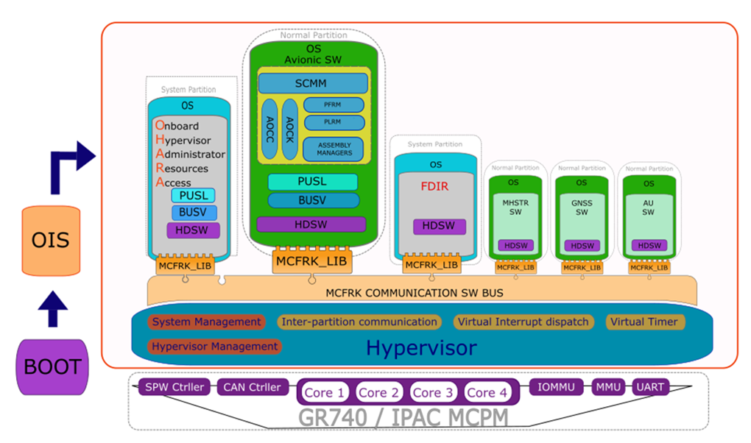
Task-4: Data handling and Software Interfaces (3/3)
Derive an ADHA interoperability framework for implementing effective exchange of SW plugins between ADHA modules, through standardized SW/SW interfaces and protocols. This shall cover both static (data interfaces) and dynamic (tasking) aspects.
Implementation of a SW prototype to prove the SW plugin integration concept, based on state of the art SW mechanisms:
Execution platform virtualization thanks to hypervisor;
Time/Space partitioning (TSP);
Applications containerization and orchestration framework.

Slide 11
Task-7: ADHA EGSE Architecture (1/2)
Definition of a modular ADHA EGSE architecture, for 6U and 3U units, to support both platform and payload elements. The activity is twofold:
Definition of Unit Level ADHA EGSE architecture;
Definition of Module Level ADHA EGSE architecture and prototype implementation.

Slide 12
Task-7: ADHA EGSE Architecture (2/3)
ADHA Module EGSE architecture and prototype implementation:
Analyze test rack needs for module level testing:
Target modules: OBC, RTU, MM, ICU, PDHU,…
Define and specify standard module test facility (test rack)
Host (at least) 1 ADHA module
Provide power, control signals and data bus to the module under test / representative backplane signals
Support testing of various ADHA format modules
Specify needed test means (complementary to Unit-level EGSE) + automation principle
Produce signal access extender (cf. figure)

