Slide 1
ADHA-3 Expansion:
unlocking the full potential
EUROPEAN DATA HANDLING AND DATA PROCESSING CONFERENCE FOR SPACE
13-17.10.2025, ELCHE, SPAIN

Slide 2

1
ADHA-3 STRATEGIC RELEVANCE & GOALS
2
SPECIFIC CONTRIBUTIONS FROM OHB
3
OHB ADHA DEVELOPMENT & ADOPTION PLANS
4
OUTLOOK INTO ADHA ROADMAP: KEY OPPORTUNITIES & CHALLENGES
5
CONCLUSIONS
HO-1463-SYS_03 // EUROPEAN DATA HANDLING AND DATA PROCESSING CONFERENCE FOR SPACE / 13-17.10.2025, ELCHE, SPAIN

Slide 3
STRATEGIC RELEVANCE & MOTIVATIONS
1

Slide 4
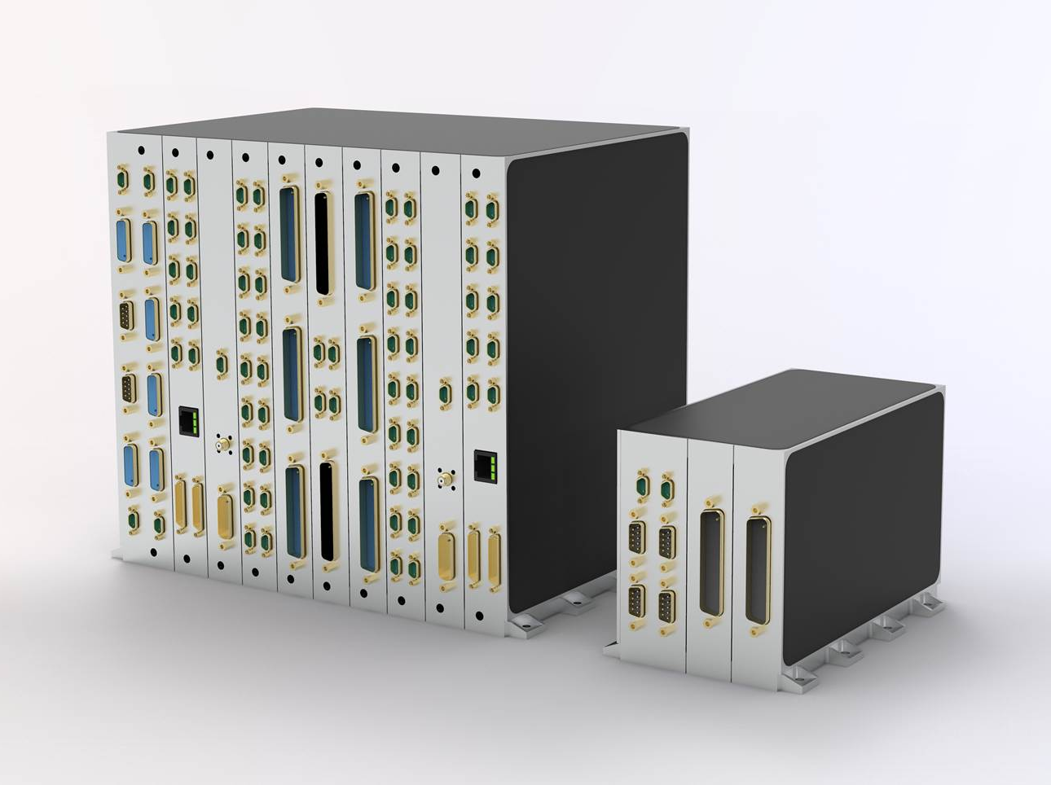
ADHA-3 Expansion: unlocking the full potential
STRATEGIC RELEVANCE & MOTIVATIONS
ADHA considered an enabler to:
Increase reusability and minimize NRE
Enhance competitiveness & facilitate dual-source procurement
Upgrade & expand functions without penalizing TRL
Foster collaboration and facilitate contributions of functionalities/boards by SMEs
HO-1463-SYS_03 // EUROPEAN DATA HANDLING AND DATA PROCESSING CONFERENCE FOR SPACE / 13-17.10.2025, ELCHE, SPAIN

Slide 5
ADHA-3 Expansion: unlocking the full potential
STRATEGIC RELEVANCE & MOTIVATIONS
To unlock the full potential of ADHA, it is essential to address following areas of standardization & industrialization:
ADHA System SW architecture and module interactions
Definition of Common ADHA EGSE & Test approach
Perimeter Expansion beyond Classical Platform Data handling
Competitiveness of ADHA products & Industrialization
HO-1463-SYS_03 // EUROPEAN DATA HANDLING AND DATA PROCESSING CONFERENCE FOR SPACE / 13-17.10.2025, ELCHE, SPAIN

Slide 6
ADHA-3 Expansion: unlocking the full potential
STRATEGIC RELEVANCE & MOTIVATIONS
ADHA-3 CN System Study Expansion:
Task-4: Data/SW Interfaces
Task-5: Electronic Data Sheet (EDS) Format
Task-10: ADHA Verification and Validation approach
Task-7: EGSE Architecture
Task-2: Payload Use Case & Modules/Unit Specifications
Task-3: Additional Modules Specifications
Task-1: ADHA-3U Specifications
Task-6: Thermal and Mechanical studies and prototyping
Task-8: Missions E2E use-case analysis
Task-9: Industrial Roadmaps
To unlock the full potential of ADHA:
ADHA System SW architecture and module interactions
Definition of Common ADHA EGSE & Test approach
Perimeter Expansion beyond Classical Platform Data handling to:
New functions & modules:
TTC Transponders and SDRs
GNSS, Security…
Payload Co-Processor & ICUs
RTU modules…
New applications in Commercial & Class Gamma/Delta Missions
Competitiveness of ADHA products & Industrialization
HO-1463-SYS_03 // EUROPEAN DATA HANDLING AND DATA PROCESSING CONFERENCE FOR SPACE / 13-17.10.2025, ELCHE, SPAIN

Slide 7
SPECIFIC CONTRIBUTIONS FROM OHB TO ADHA-3
2

Slide 8
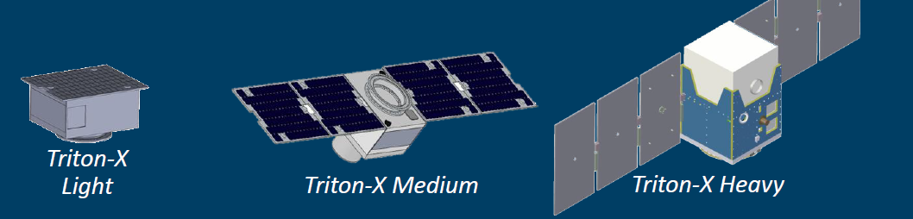


ADHA-3 Expansion: unlocking the full potential
OHB SPECIFIC CONTRIBUTIONS TO adha-3 activities
Task-1: ADHA-3U Specifications:
Establish detailed electrical, mechanical, and thermal specifications for 3U-ADHA units and modules
Focus on Class Gamma (equivalent to current Class III) missions
Tailoring of PA/QA requirements & ENV Specifications
System requirements and architectures from following OHB small-sat (Class III & IV) Reference Platforms will be analyzed:
InnoSat & Triton Platforms
Task-2: payload specifications
EO payload applications, including the study of Optical and RF payload data handling for current and future EO missions
High-Power/Payload Power Module Specifications
INNOSAT
GMS-T, Arctic Weather Satellite
Up to 1kW
TRITON microsatellite Platform family covering:
3 main classes: Light (40kg), Medium (75kg) and Heavy (150-250kg).
Designed around the modular and configurable Integrated Avionics Unit (IAU)
HO-1463-SYS_03 // EUROPEAN DATA HANDLING AND DATA PROCESSING CONFERENCE FOR SPACE / 13-17.10.2025, ELCHE, SPAIN

Slide 9
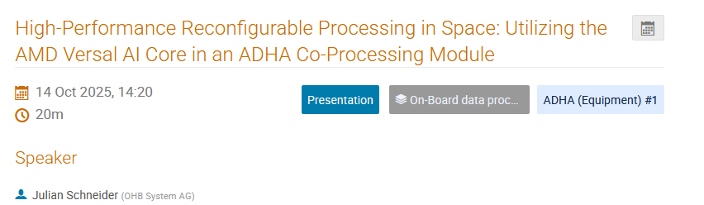
ADHA-3 Expansion: unlocking the full potential
OHB SPECIFIC CONTRIBUTIONS TO adha-3 activities
Task-3: Additional module specifications:
ADHA TTC/Payload Transponder (SDR) Module Specs
Co-Processing Module (CPM) Specs
OHB currently developing ADHA HIPERPRO Co-Processor
Task-8: End-to-End missions Use Case Analysis:
End-to-end use-case analysis of representative EO mission(s) to study the implications of implementing the complete ADHA-based architecture
Task-4: Data handling and Software Interfaces:
Enabling provision, procurement & easy integration not only on HW, but also drivers & software: Interchangeable SW components
2 layers of software envisaged by OHB:
Communication Middleware: Standardized interaction-pattern for communication
Services: Time provisioning; DataStorage provisioning; Ground communication; Logging…
Task-7: ADHA EGSE Architecture:
EGSE Use Case definition
ADHA EGSE Requirements Specification
HO-1463-SYS_03 // EUROPEAN DATA HANDLING AND DATA PROCESSING CONFERENCE FOR SPACE / 13-17.10.2025, ELCHE, SPAIN

Slide 10
OHB ADHA DEVELOPMENT & ADOPTION PLANS
3

Slide 11
ADHA-3 Expansion: unlocking the full potential
OHB ADHA DEVELOPMENT & ADOPTION PLANS
Q2
Q3
Q4
Q1 2026
Q2
Q3
Q4
Q1 2027
Q2
Q3
Q4
Q1 2028
Q2
Q3
Q4
Q1 2029
Q2
Q3
Q4
Q1 2030
Project Adoption
EE11
S3NG-O
B2CD
S6NG
B2CD
EE12
ADHA Phase 3
ADHA MBSE Infrastructure
ADHA Integration Capabilities & PoC
ADHA Rack & Test Bench
GSTP
OHB ADHA SW Architecture
PoC & Industrial Landscape
ADHA-3
HIPERPRO ADHA Co-Processor
ADHA Instrument Product Roadmaps
PL DHS Landscape
HO-1463-SYS_03 // EUROPEAN DATA HANDLING AND DATA PROCESSING CONFERENCE FOR SPACE / 13-17.10.2025, ELCHE, SPAIN

Slide 12
OUTLOOK INTO ADHA ROADMAP: KEY OPPORTUNITIES & challenges
4

Slide 13

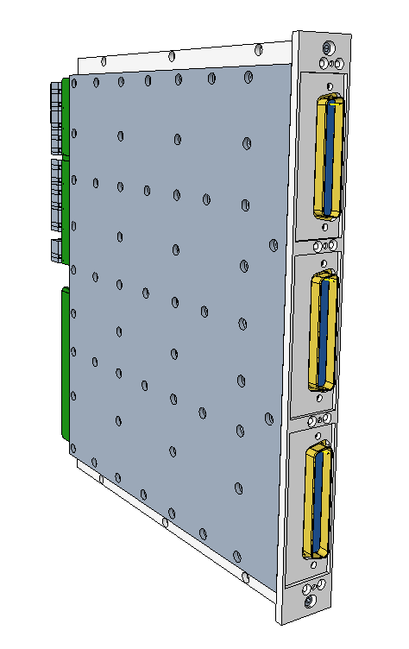
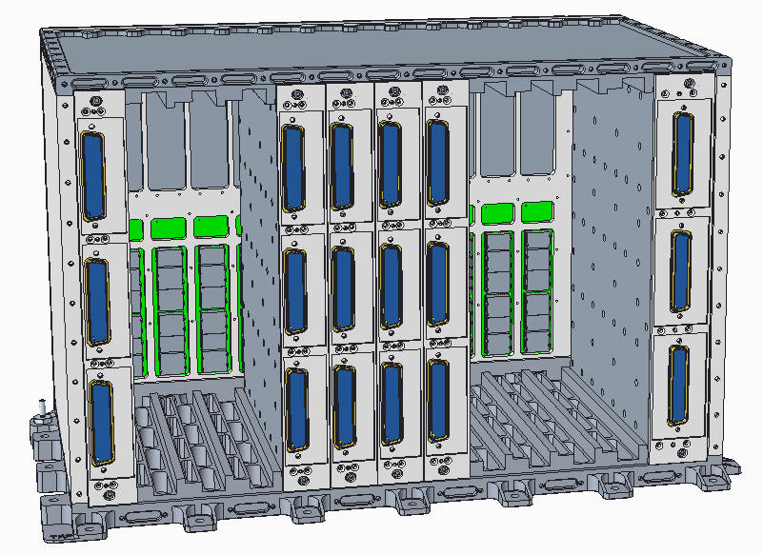



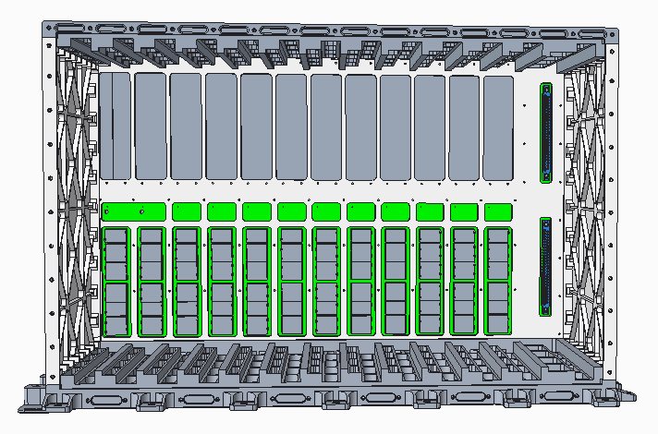




ADHA-3 Expansion: unlocking the full potential
OUTLOOK INTO ADHA ROADMAP: KEY OPPORTUNITIES & challenges
ADHA SRR
ADHA Module Developments
ADHA EM Units AIT
ADHA 1st Mission Adoption
ADHA PDR
4 ADHA EM Units
Development
6 Qualification of Modules, SW & Units
8 LL / Products Improvements
ADHA-2
ADHA-3
ADHA Industrial Lanscape Dev.
Nov
2021
Oct 2025
2027
Dec 2029
HO-1463-SYS_03 // EUROPEAN DATA HANDLING AND DATA PROCESSING CONFERENCE FOR SPACE / 13-17.10.2025, ELCHE, SPAIN

Slide 14
ADHA-3 Expansion: unlocking the full potential
OUTLOOK INTO ADHA ROADMAP: KEY OPPORTUNITIES & challenges
Qualification of Modules & Units
Development of ADHA Landscape
ADHA Industrial Landscape development phase, focused in the qualification of ADHA products and development of a competitive ADHA Landscape considered Key for the success of ADHA.
This phase needs to encompass several efforts to secure such a competitive industrial landscape:
Development of multiple sources for each ADHA module types.
Development of ADHA integrator capabilities (HW & SW).
Qualification of ADHA Units (HW & SW).
A Competitive ADHA Ecosystem is necessary to realistically consider an ADHA based broad RFP campaign in the frame of e.g. SxNG/EE11.
ADHA Modules
ADHA EQM Development & Qualification
ADHA Integrator Capabilities & Testbenches
ADHA Unit Qualifications
2026
ADHA Industrial Landscape Dev.
2029
HO-1463-SYS_03 // EUROPEAN DATA HANDLING AND DATA PROCESSING CONFERENCE FOR SPACE / 13-17.10.2025, ELCHE, SPAIN

Slide 15

ADHA-3 Expansion: unlocking the full potential
OUTLOOK INTO ADHA ROADMAP: KEY OPPORTUNITIES & challenges
Besides ADHA Ecosystem developments, Efforts should be initiated to prepare for project adoption, e.g.
Connect efforts in ADHA-3 (Task-8: Missions E2E use-case analysis) with planned trades and studies in the frame of SxNG & EE AB1 Studies.
Class Alpha/Beta missions: e.g. S6NG; S3NG-O, EE-11 & 12 0AB1 Studies: for PF & Payload elements.
Class Gamma/Delta & Constellations: Potential adoption in LEO-PNT; ERS… needs to be orchestrated with M-IND initiative and related application directorates (NAV, EO, TELECOM…)

Slide 16
Conclusions
5

Slide 17
ADHA-3 Expansion: unlocking the full potential
CONCLUSIONS
ADHA has reached a high maturity and consolidation of main DHS building blocks
The development of a competitive ADHA Industrial landscape is underway
ADHA-3 will broaden ADHA’s perimeter to exploit its full potential
ADHA-3 will address E2E System use case optimization, SW architecture & EGSE definitions
ADHA-3 outcomes need to be demonstrated in a PoC Implementation.
ADHA community and Project directorates need to get prepared for the first adoption of ADHA Products
HO-1463-SYS_03 // EUROPEAN DATA HANDLING AND DATA PROCESSING CONFERENCE FOR SPACE / 13-17.10.2025, ELCHE, SPAIN

Slide 18
OHB SE Manfred-Fuchs-Platz 2-4
28359 Bremen
Germany
Phone: +49 421 2020 9660 Fax: +49 421 2020 700 Email: jon.caudepon@ohb.de Web: www.ohb.de

